Slide 1
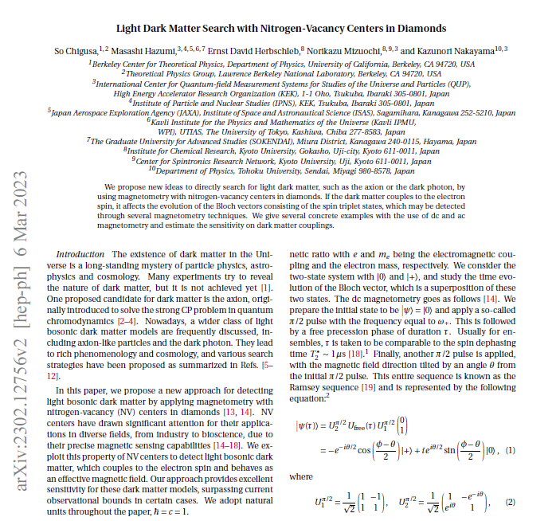
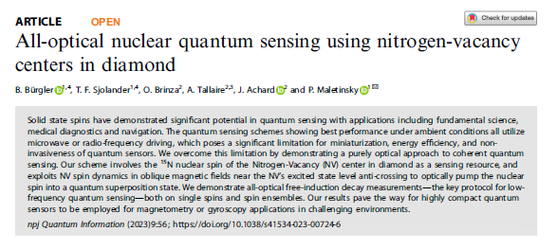
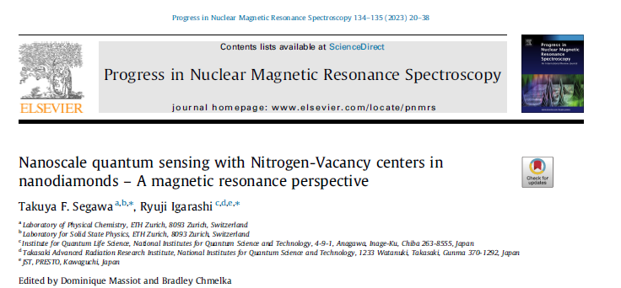

Slide 2
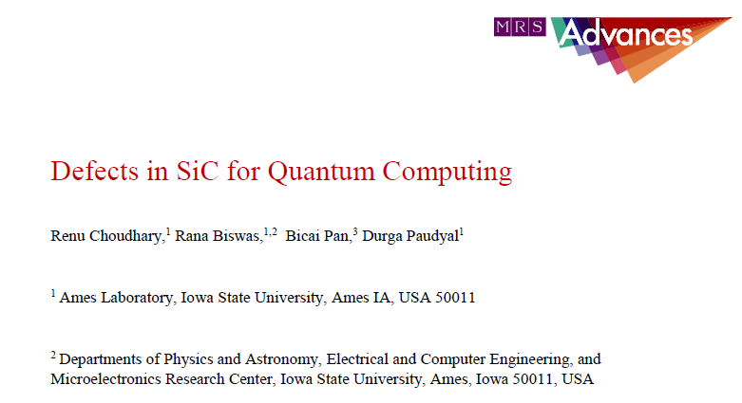
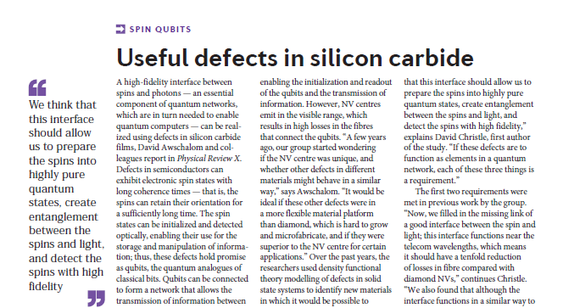
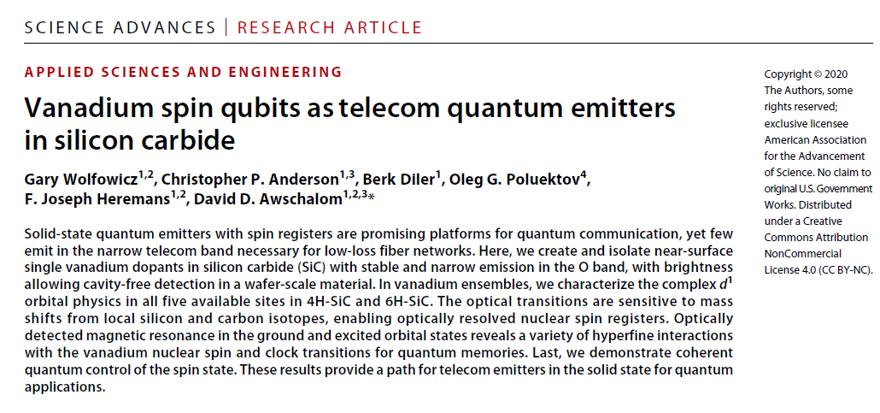
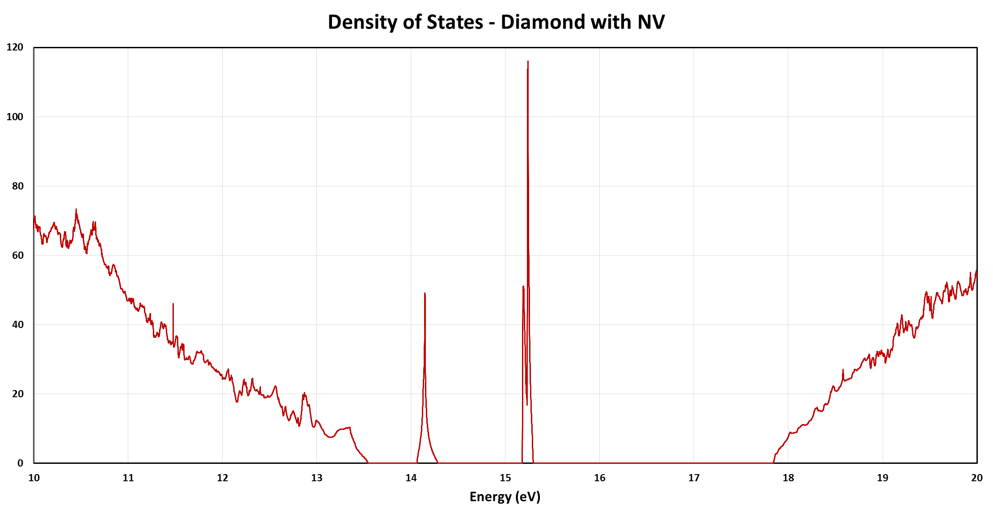
Virtual atoms in semiconductors
Understanding behaviours of defects in wide bandgap semiconductors for using as virtual atoms.
Deterministic implantation and defect electro-optical handling

Slide 3
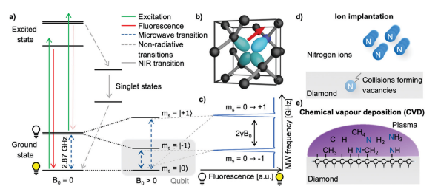
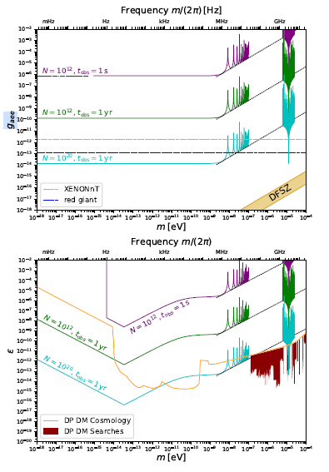
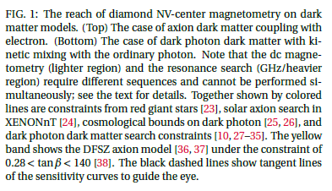
NV-spin state can be initialized optically by laser
NV-spin state can be coherently manipulated with resonant microwave (MW) fields
NV-spin state can be read out optically by its spin-state-dependent fluorescence, enabling optically detected magnetic resonance experiments.
The system enables the realization of a fully functional qubit which interacts with its environment and results in an optically readable signal.

Slide 4
Deterministic implantation
FIB COLUMN
LIQUID METAL ALLOY ION SOURCE
Si⁺⁺; Au⁺⁺; Au⁺
Ge⁺ or Ge⁺⁺
ION ENERGY (ACC. VOLTAGE: 2 -35 kV):
2 -35 keV for SINGLE CHARGED ions;
4 –70 keV for DOUBLE CHARGED ions.
LMAIS ION BEAM INTENSITY:
Si⁺⁺: min. 1.5 pA; max. 475 pA
Ge⁺: min. 1.3 pA; max. …
Ge: min. 1.9 pA; max. 420 pA
Au⁺: min. 4.1 pA; max. 2,000 pA
Au⁺⁺: min. 1.7 pA; max. 420 pA
PATTERN GENERATOR: 20 bit/ 50 MHz
MINIMUM DWELL TIME: 20 ns
MINIMUM STEP SIZE: 0.2 nm on 200 µm WF
LASER INTERFEROMETER TABLE
EXCELLENT STITCHING AND BLIND NAVIGATION
SMALL SAMPLES preferred
TILT 0-90°ON 1.5x1.5 cm2
A NANOFABRICATION MACHINE

Slide 5

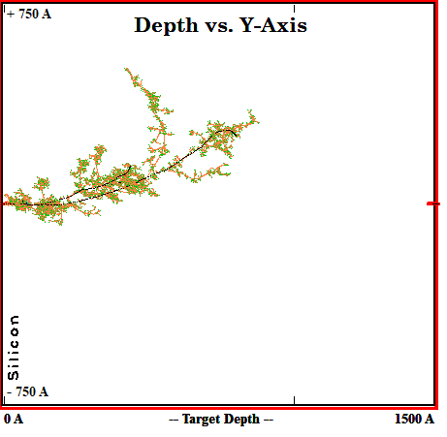
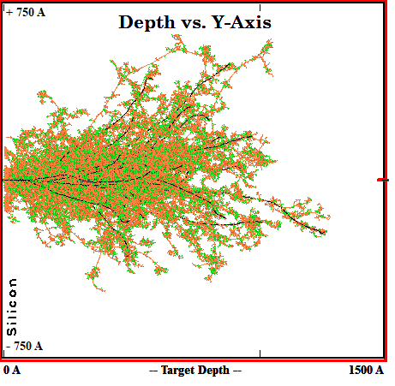
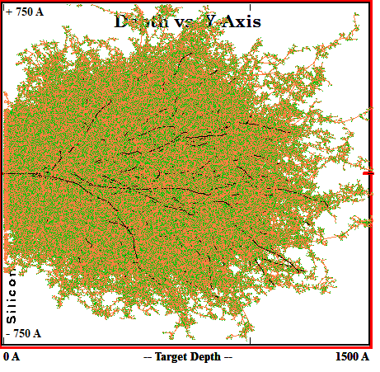
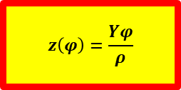
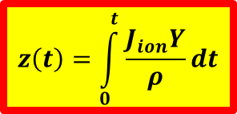
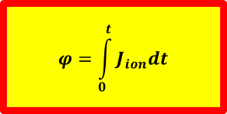
Ion Dose makes the difference for applications: sputtering yield and milled depth
70 keV Ge⁺ on Si - collision cascade (SRIM simulations)
Si SURFACE
ION INDUCED (NANO-) STRUCTURES:
  ripples, hillocks, terraces…
  nanovoid
  self-assembly
ION DOSE
$$φ=\int_{0}^{t}{J_{ion}dt}$$
$$z\left(t\right)=\int_{0}^{t}{\frac{J_{ion}Y}{ρ}dt}$$
$$z\left(φ\right)=\frac{Yφ}{ρ}$$
ρ = Atomic Density,
Y = Ion Species, Energy and Angle
MILLED DEPTH
INCREASING ION DOSE
SINGLE ION IMPLANTATION;
single vacancy-complexes.
ION IMPLANTATION:
  composition change
  defect creation
  amorphization
ION MILLING:
  sputtering
  patterning.
1-100 ions per spot
1E13-1E16 ions/ cm²
6E15 - … ions/ cm²

Slide 6
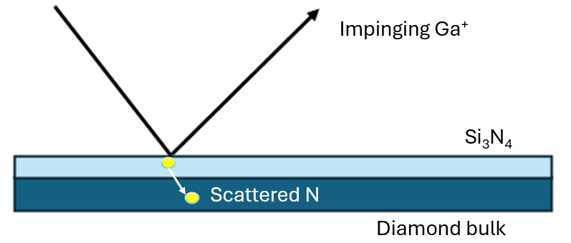
Deterministic implantation: scattering implantation
Confocal fluorescence scans of a SiC surface impl. with Si⁺⁺
100 ions/spot
400 ions/spot

Slide 7
Lithography defined implantation
Particle beam

Slide 8
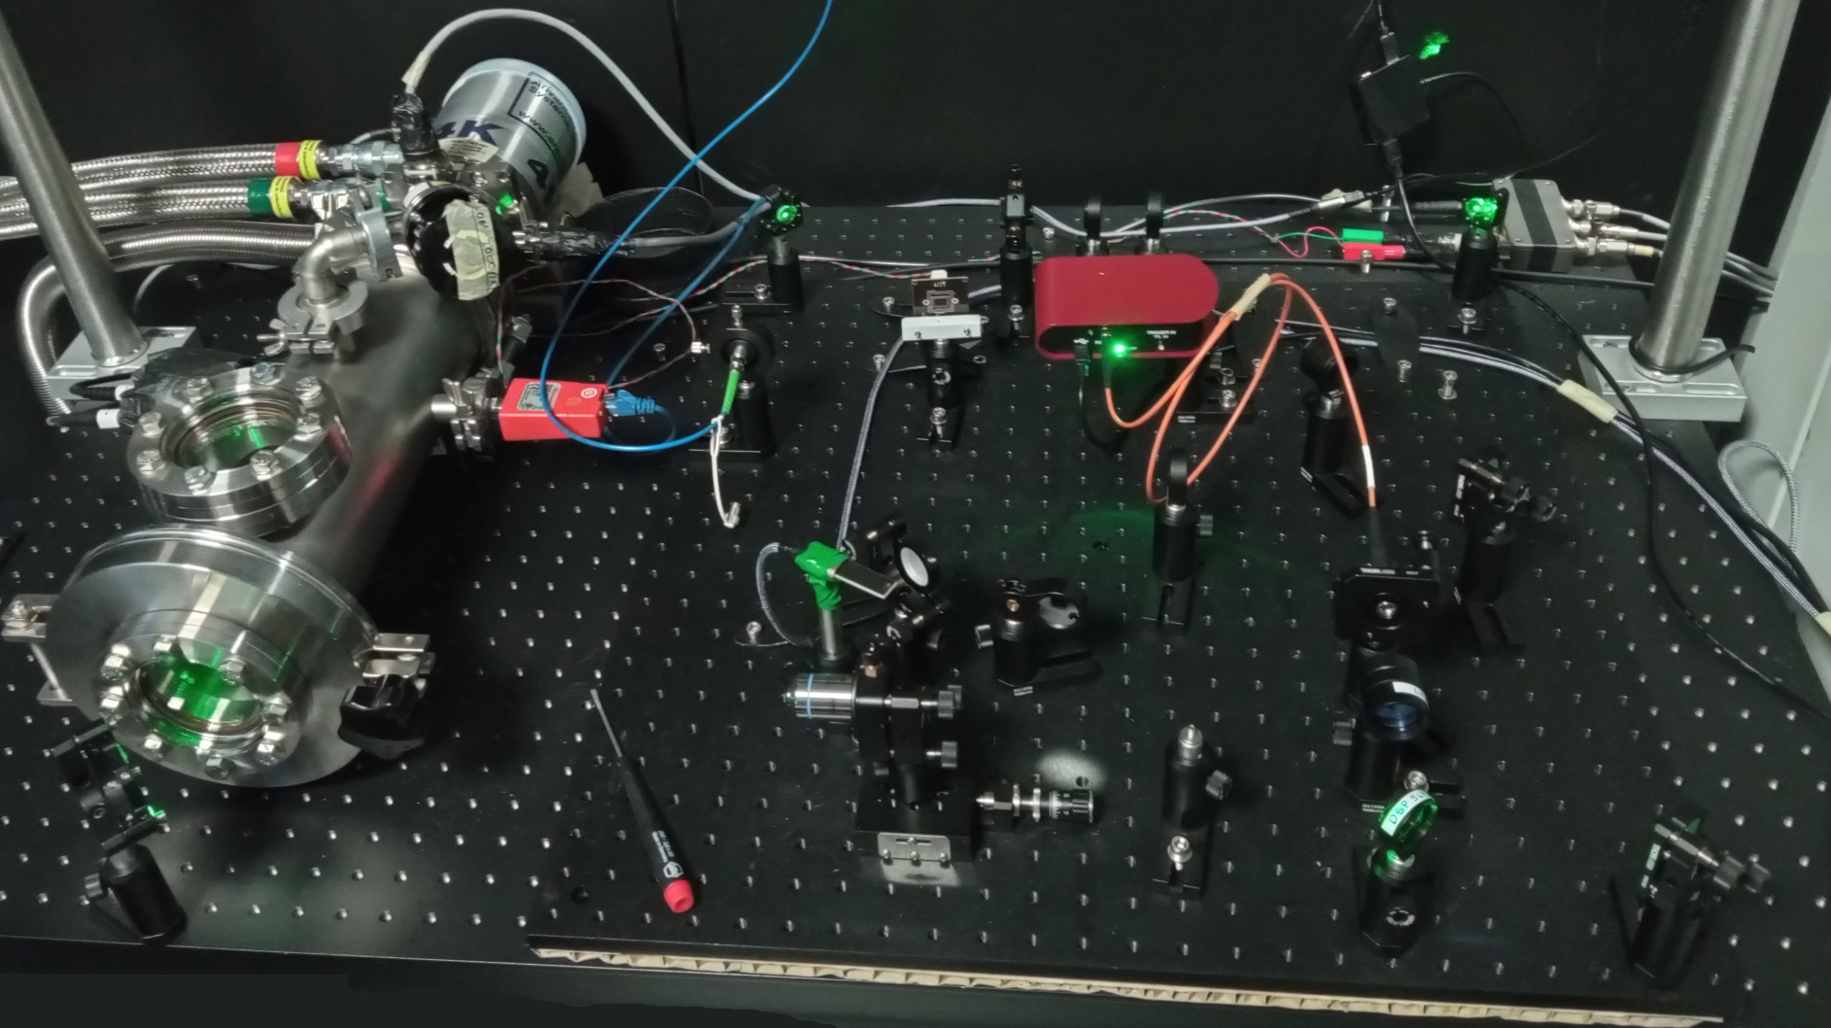
Optical cryo-setup
We successfully built a confocal microscopy system for the detection of the PL from both NV⁻ and SiV

