Slide 1
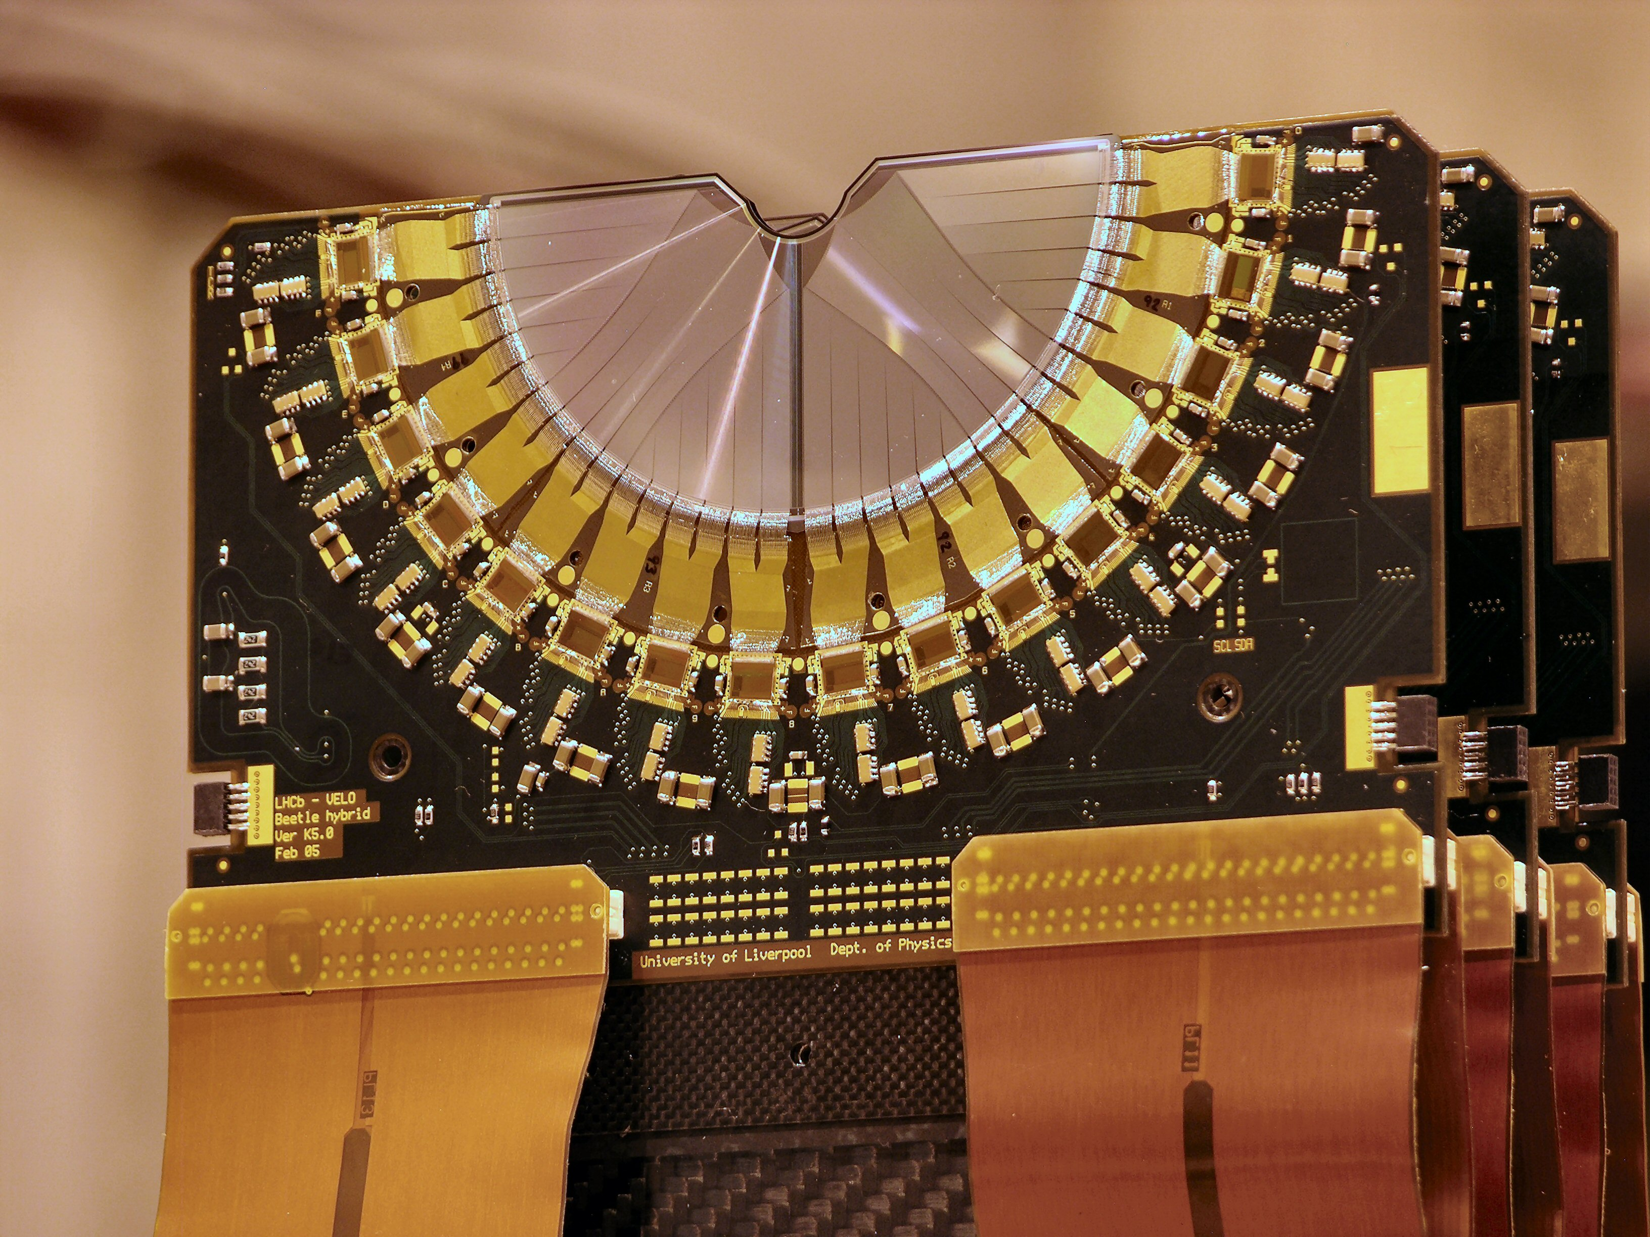
The Beauty of LHCb
Original VELO modules
Dr Paras Naik
Notes:
Hi

Slide 2
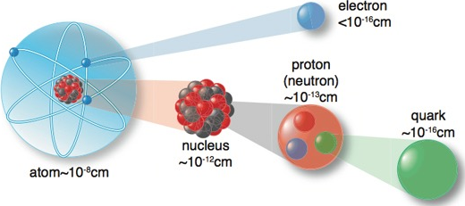
Matter
Matter occupies space and has rest mass
Common example: The atom
Common types of matter
quarks [up and down quarks that make up nuclei]
leptons
charged [electrons]
neutral [neutrinos, which interact very weakly]

Slide 3
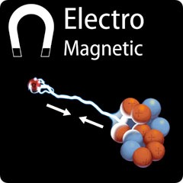
Forces
Interactions between particles of matter take place through the exchange of force carriers (gauge bosons)
Known Fundamental Forces (and force carrier)
Electromagnetic (photon)
Strong Nuclear (gluon)
Weak Nuclear (W, Z)
Gravity (?)
Some of these are massless (photon, gluon), but the W and Z are very massive compared to most quarks and leptons.
Notes:
gauge bosons should be massless due to symmetry constraints

Slide 4
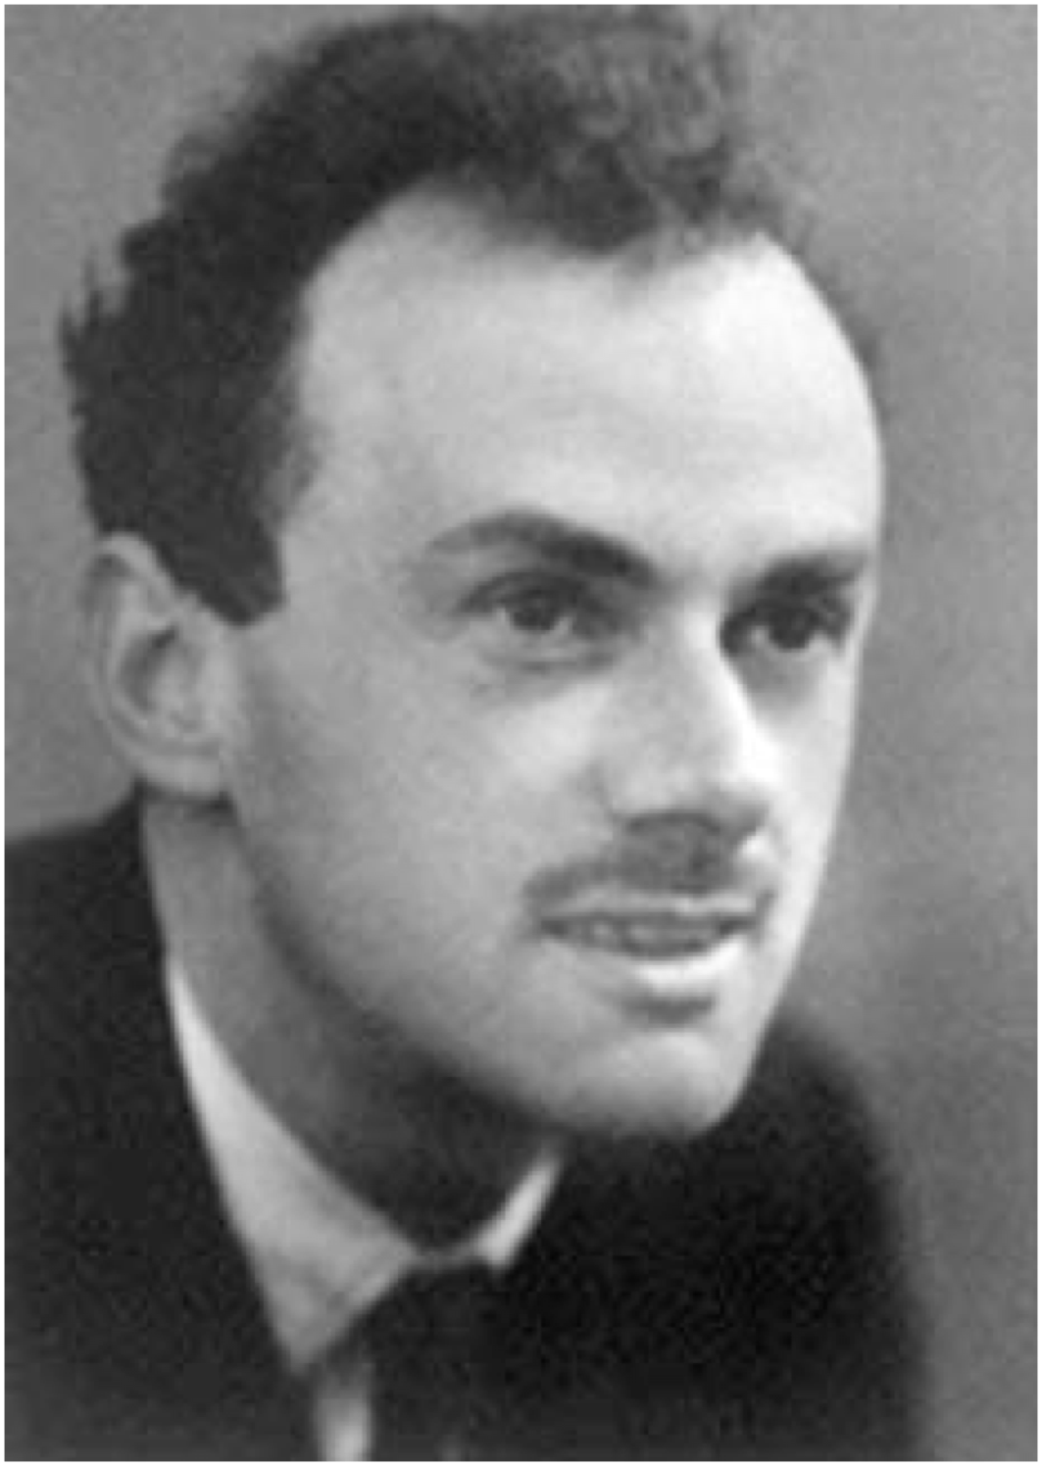
Dirac’s Discovery
Paul Dirac (1902 - 1984)
Born and educated in the UK
“It is more important to have beauty in one’s equations than to have them fit experiment”
What does it mean?
Specifies the motion of matter particles
Predicts that particles have spin
Predicts the existence of antimatter

Slide 5
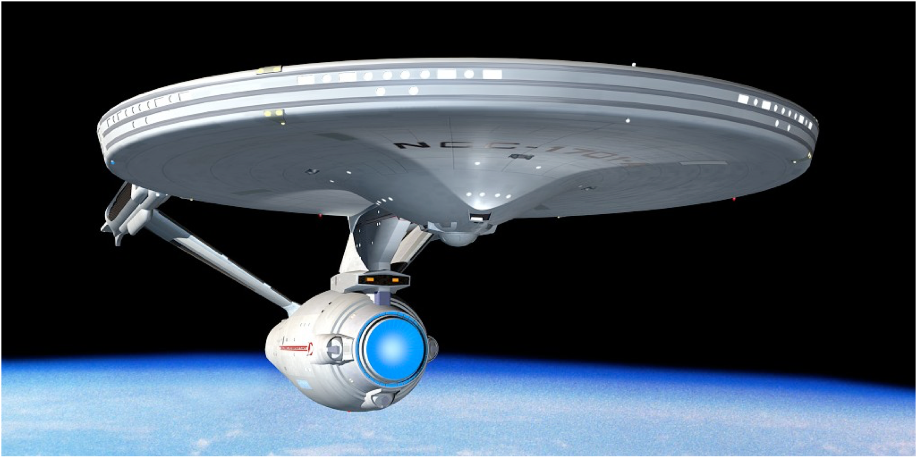
Antimatter?

Slide 6
Antimatter?

Slide 7
Twins
Matter and antimatter behave differently (“CP Violation”)
Is this why our Universe is mostly matter?
Notes:
identical cats, non-identical cats

Slide 8
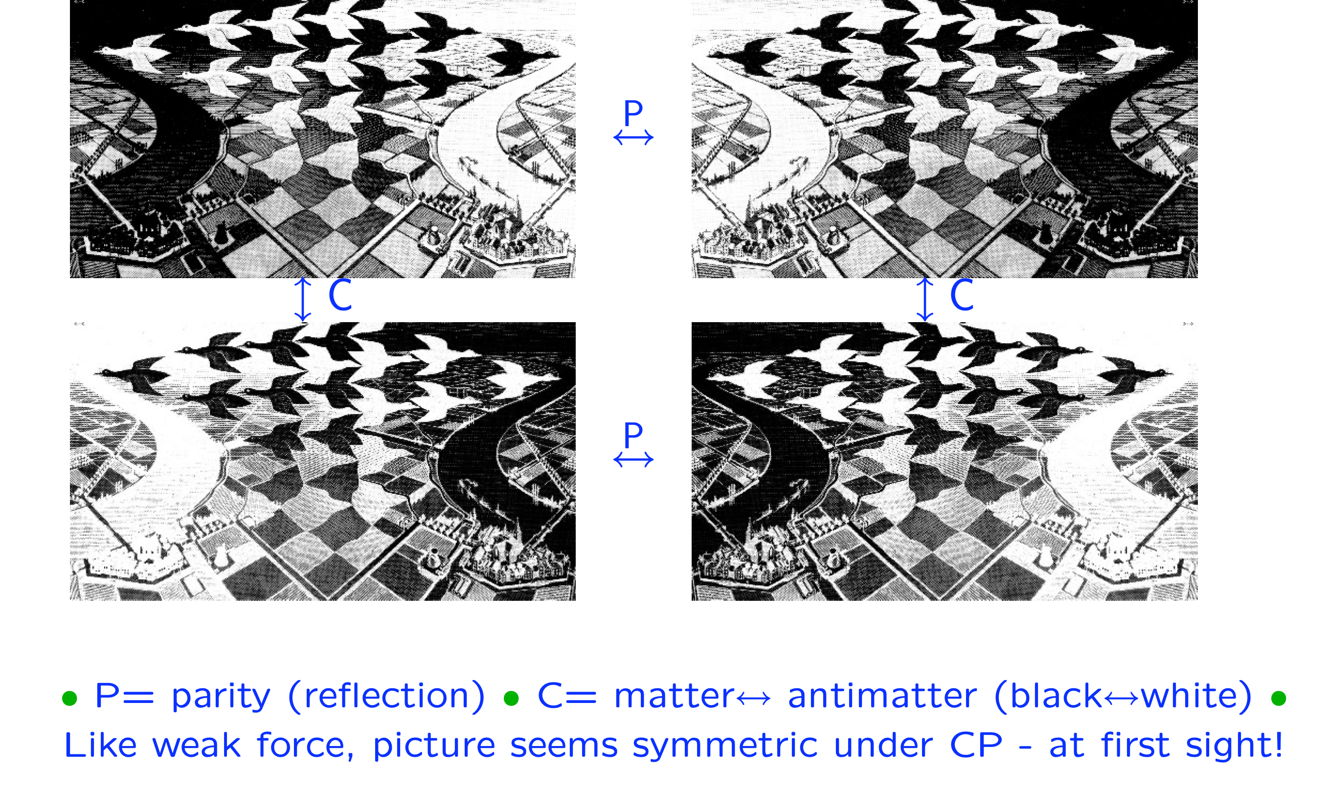
CP Violation
P = parity (reflection)
C = matter ⟺ antimatter (black ⟺ white)
Picture seems symmetric under CP, at first sight...

Slide 9
The Nobel Prize in Physics 2008
Rewarded two discoveries concerning symmetry violation

Slide 10
The Nobel Prize in Physics 2008
Rewarded two discoveries concerning symmetry violation
The discovery of CP violation led to the prediction of new quarks
beauty
discovered 1977
top
discovered 1994

Slide 11
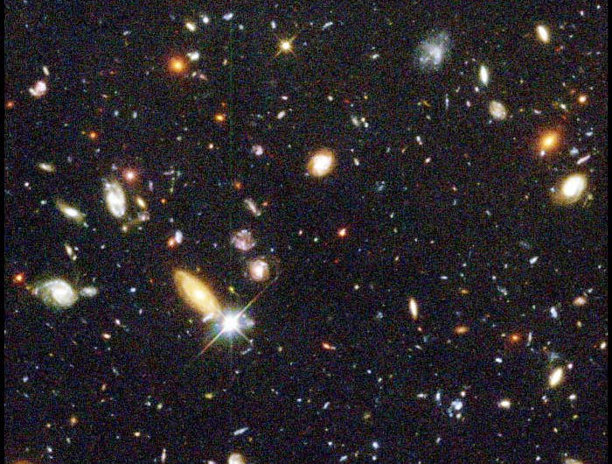
Our Universe
Notes:
one 24-millionth of the whole sky

Slide 12
Universe without CP violation
Fortunately for us, the Universe is not symmetrical.

Slide 13
Universe with the amount of CP violation we know about
Understanding symmetry, or the lack of it, is an ongoing task.

Slide 14
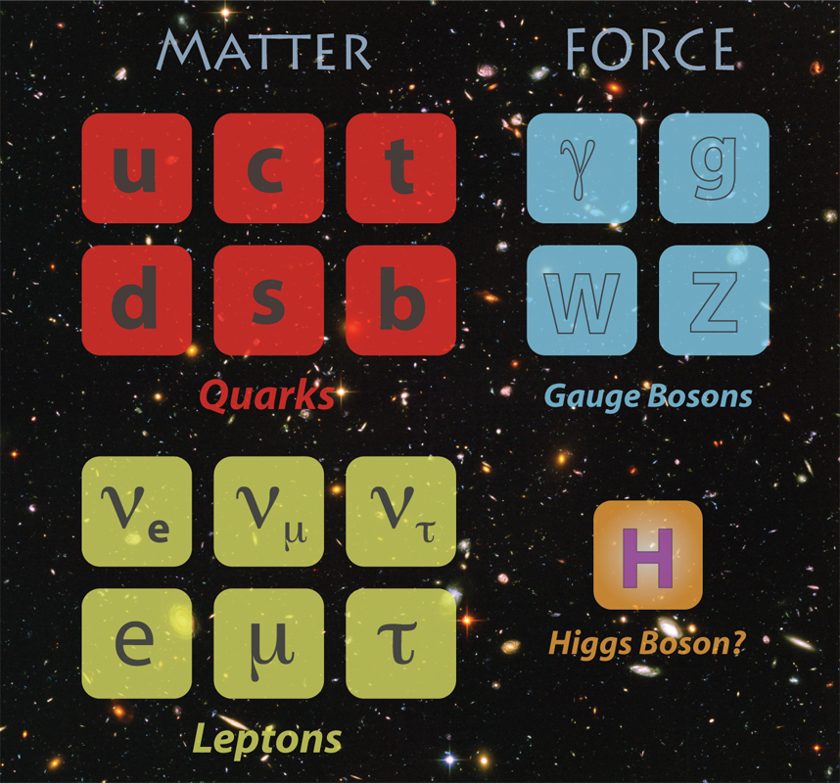
The Standard Model
Notes:
? as Higgs was theorized to solve the W and Z mass problem
Higgs boson not a (vector) gauge boson
anim to “generation”

Slide 15
Finding New Physics

Slide 16
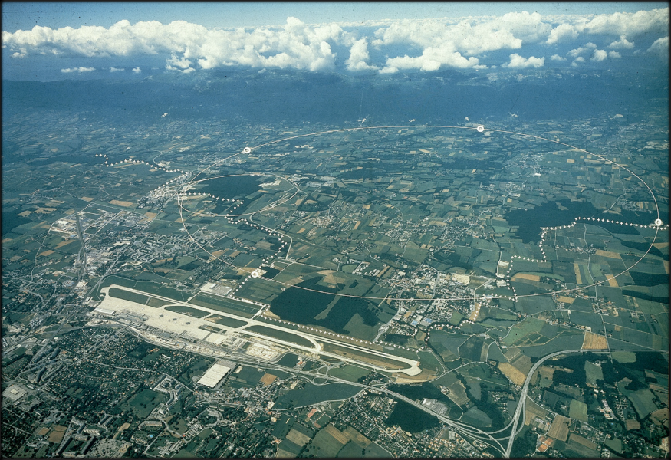
Large Hadron Collider (LHC) at CERN

Slide 17
CERN
Notes:
Long piece of rubber tubing, zoom in looks like more D than 1, use for string theory
27 km around
100s of countries 1000s of scientists, engineers, programmers, fire fighters, administrators, etc…

Slide 18
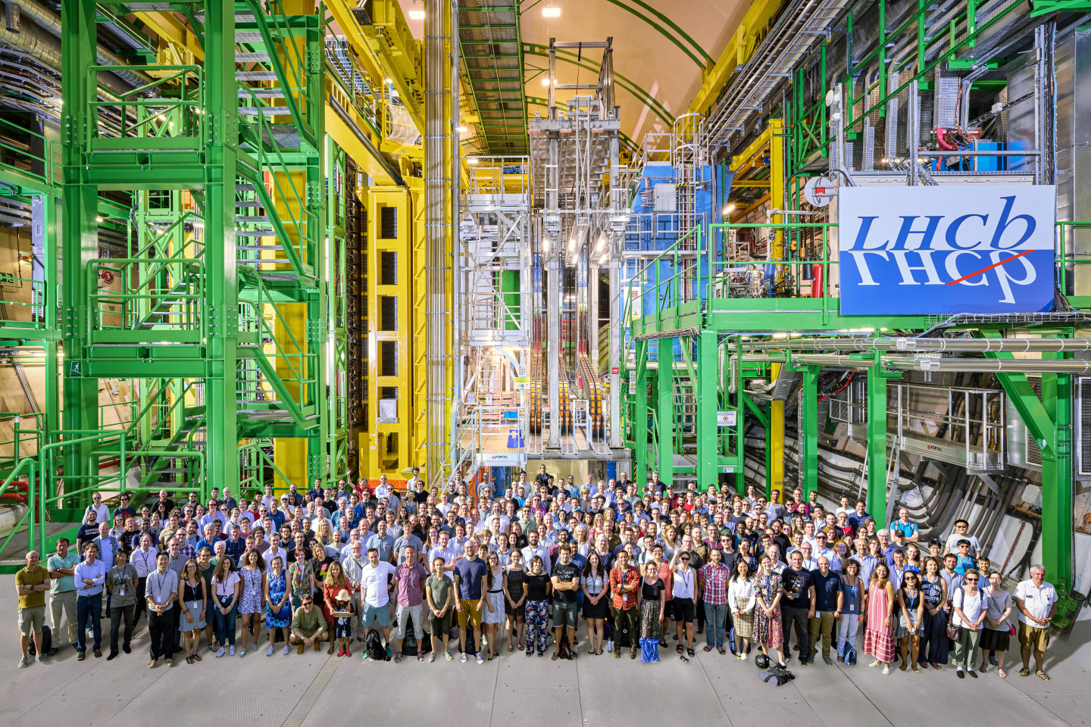
LHCb Collaboration
1725 members from 98 institutes in 24 countries

Slide 19
LHCb Collaboration
Me
1725 members from 98 institutes in 24 countries

Slide 20
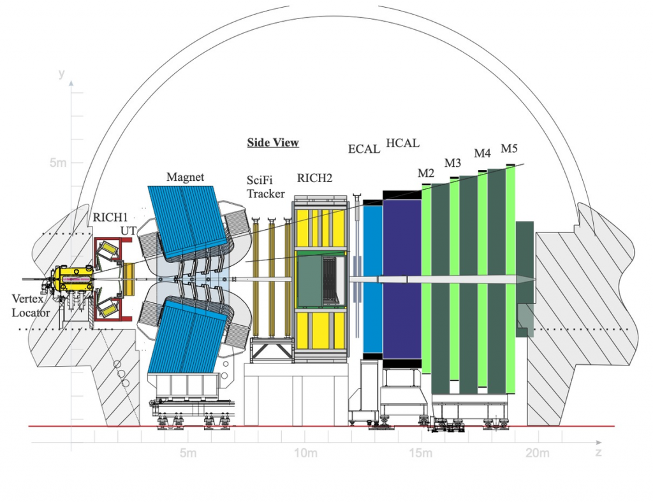
LHCb Detector

Slide 21
LHCb Detector

Slide 22
Capturing quarks
Beauty (and Charm) quarks are produced in forward directions
b
b
b
p
_
_
p
_
b
b
b

Slide 23
LHCb!
Beauty (and Charm) quarks are produced in forward directions We built our detector to focus on finding these events
b
b
b
p
_
_
p
_
b
b
b

Slide 24
LHCb!
Optimised for quark flavour physics, especially the precision study of beauty quark and charm quark decays.
100,000 b anti-b pairs per second at the LHCb interaction point. (and 20 times as much charm!)
We study hadrons (mesons and baryons)
Vast quantities of all b-hadron (B⁰, Bs, ...) and c-hadron (D⁰,Ds, ...) species

Slide 25
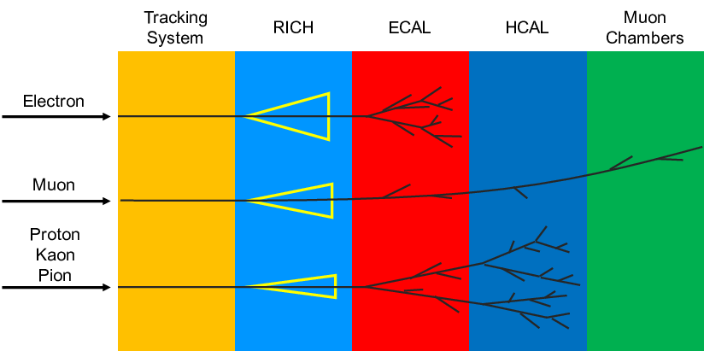
Putting it all together
Heavy quark hadrons do not live very long, decaying to other, relatively stable, particles.
momentum & position
velocity
energy
momentum & position
Calorimeters
+ Magnet
+ Magnet
Particle ID

Slide 26
Vertex Locator (VELO)
We need extremely precise detectors to observe the particles.
Particularly at the collision point!
(VELO)

Slide 27
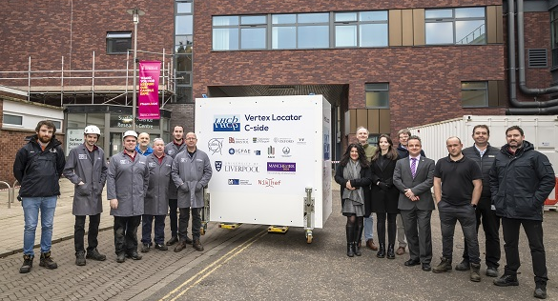
Built in Liverpool!
The 41-million-pixel Vertex Locator (VELO) was assembled right here at the University of Liverpool!
New VELO modules (McCoy Wynne)

Slide 28
Inside the VELO
First 2 minutes of YouTube Video from Marco Kraan (Nikhef)

Slide 29
Inside the VELO!
One proton-proton collision
A neutral particle containing a b-quark travels along the dotted path
It then decays (in a millionth of a millionth of a second!) via the weak force into another particle containing a c-quark and one other particle
The c-quark containing particle travels further and decays into three charged particles

Slide 30
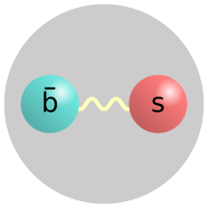
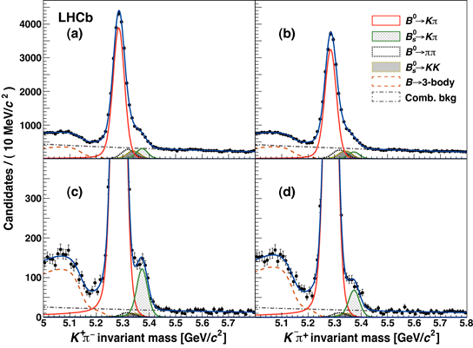
This Matters
Improved measurement of CP violation in “B⁰” mesons
First Observation of direct CP violation in “Bs” mesons
d
B⁰
anti-B⁰
Bs
anti-Bs
Phys. Rev. Lett. 110 (2013) 221601
Notes:
identical cats, non-identical cats

Slide 31
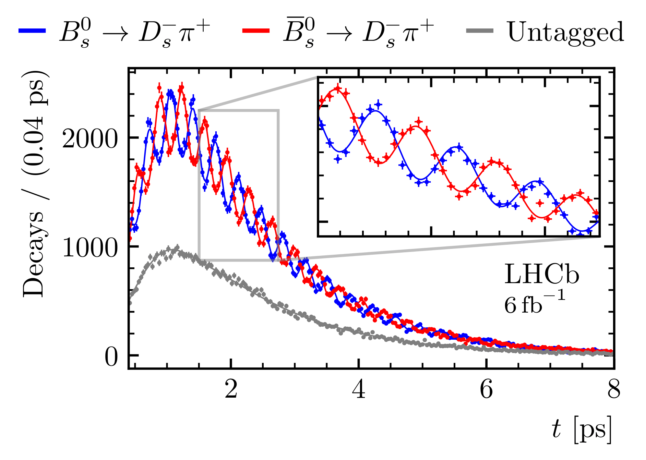
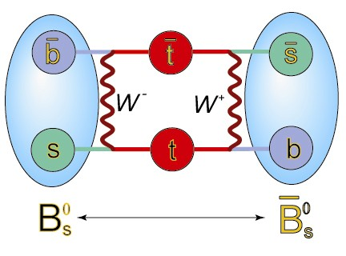
Oscillations!
Decay time distribution of a neutral beauty-strange meson for many thousands of decays
Matter and anti-matter can oscillate into each other trillions of times per second! LHCb precisely measures how fast this oscillation occurs
Nature Phys. 18 (2022) 1, 1-5

Slide 32
A new Liverpool measurement!
JHEP 12 (2024) 026
Measuring this precisely is essential for testing the Standard Model and searching for new physics.

Slide 33
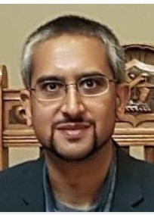
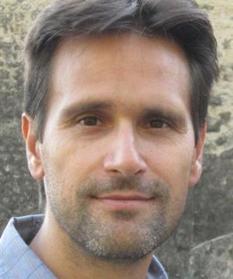
The Friendly Faces of LHCb Liverpool
Dave
Paras
(at CERN)
Juan
Ho Sang
Involved Today
Ned
Students!
We are an active group, leading the field...
We’ve built/invented detectors, techniques, and tools used to collect/analyse LHCb data.
Perhaps you can join us in 2030?

Slide 34
Want to know more?
Videoconference with LHCb @ CERN this afternoon!
Search the web for “Liverpool Particle Physics” or seek: https://www.liverpool.ac.uk/physics/research/particle-physics/ and click on links and the video for more information!
Meet LHCb: https://lhcb-outreach.web.cern.ch/
http://scaleofuniverse.com/
Notes:
ATLAS,LHCb sites... CERN hangout

Slide 35
The End

