Slide 1
Introduction to the LHCb Masterclass exercise
David Hutchcroft

Slide 2
Introduction
Here I will
Briefly motivate why these exercises are interesting
Explain what the LHCb detector is
Explain the data format
Give you some starting point for performing the exercises

Slide 3
What will you be measuring today?
D⁰ meson
Charm quark
Up
antiquark
The object of this exercise is for you to measure the lifetime of a certain kind of particle found in nature: The $D^{0}$ meson

Slide 4
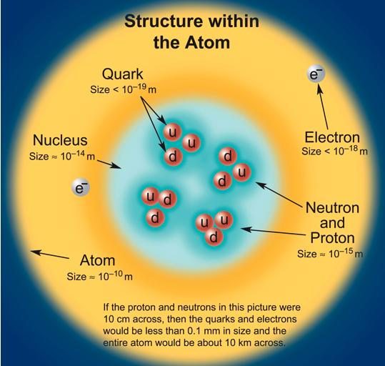
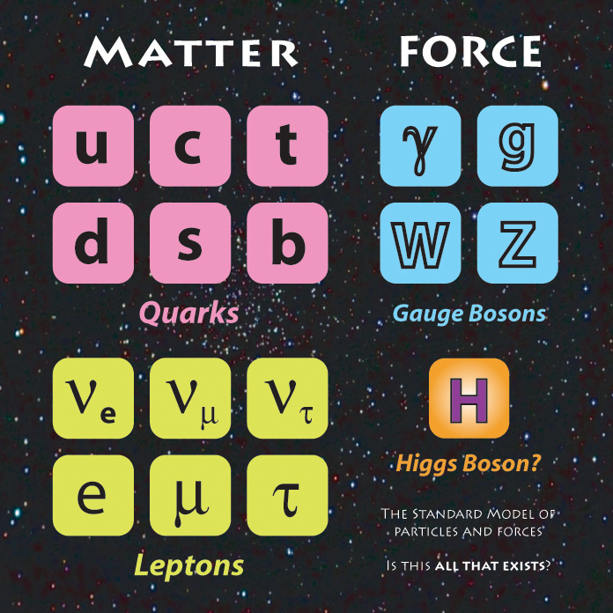
What kind of particles are there?
There are a small number of fundamental particles.
Quarks cluster into very small pairs or triplets

Slide 5
What do quarks form?
Meson
Baryon
quark
antiquark
quark
quark
quark
Two different kinds of combinations : quark-antiquark, or three (anti)quarks.
Antiparticles have opposite charges to the corresponding particles, otherwise they are supposed to interact in the same way. Most particles have a corresponding antiparticle (but sometimes a particle is its own antiparticle).

Slide 6
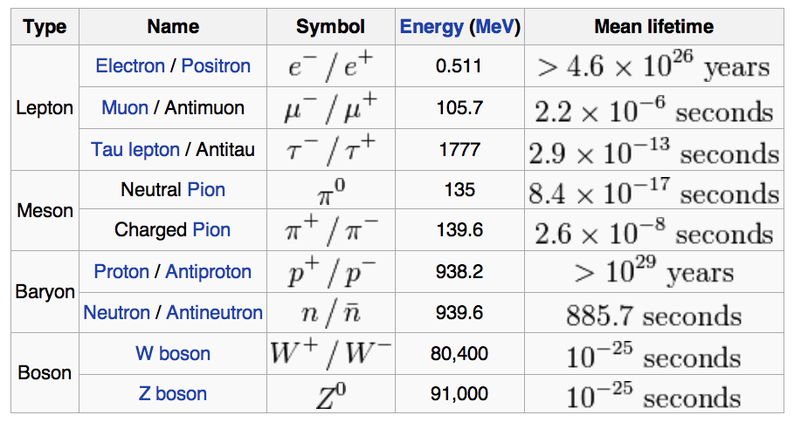
What are some typical particle lifetimes?
“Intermediate” decay lifetimes can be seen in particle detectors
Wikipedia: Almost all knowledge is here (some is even true)

Slide 7
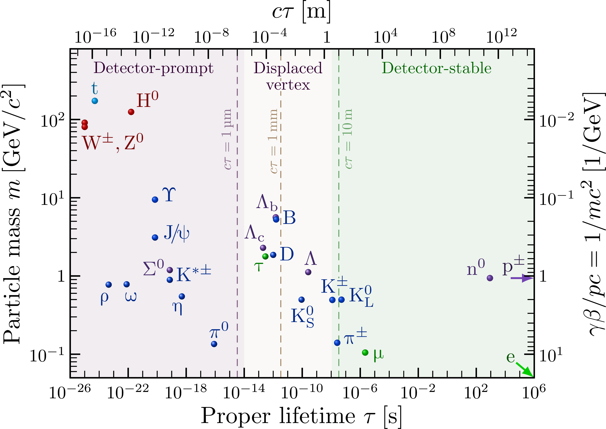
What can we detect?

Slide 8
How do we measure a short lifetime?
As an example, consider a particle which lives 10⁻¹² seconds
How far will it travel, on average, if it travels at the speed of light?
$c=3⋅10^{8}$ m/s
It travels $3⋅10^{−4}$m, or 0.3 mm
This is not very long! Luckily, the calculation is wrong; we forgot special relativity, which tells us that the particle lives longer because of time dilation
$$t^{′}=\frac{t}{\sqrt{1−\frac{v^{2}}{c^{2}}}}$$
Typically, an LHC particle with a lifetime of 10⁻¹² seconds will fly 1 cm... that is long enough that we can measure it!

Slide 9
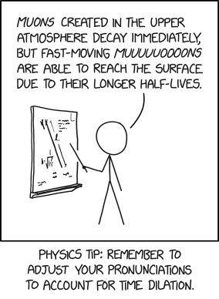
Cosmic rays
If you hold your hand out flat about 25 muons go through it every second
You can see the effects in our cloud chamber in the CTL atrium, the electrons knocked loose by the muons leave trails of droplets.
Update: I’ve been banned from the physics department for the way I pronounce “Doppler effect.”
https://xkcd.com/3043

Slide 10
So why is the D⁰ special?
D⁰ meson
Charm quark
Up
antiquark

Slide 11
So why is the D⁰ special?
anti-D⁰ meson
Charm antiquark
Up
quark

Slide 12
So why is the D⁰ special?
D⁰ meson
Charm quark
Up
antiquark

Slide 13
It oscillates!
anti-D⁰ meson
Charm antiquark
Up
quark
The D⁰ is a neutral particle : it can oscillate between matter and antimatter before decaying!

Slide 14
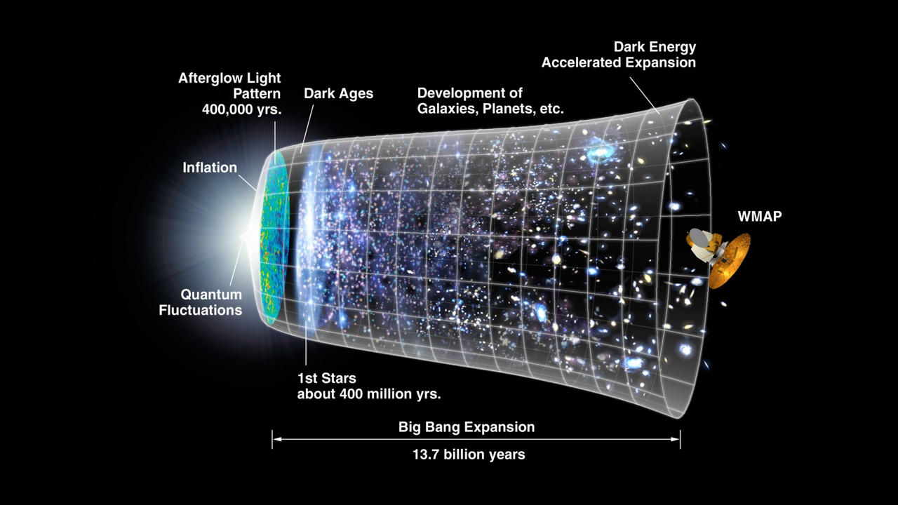
Why does antimatter matter?
14

Slide 15
Why does antimatter matter?
Equal amount of matter and antimatter created
Today: almost no antimatter in the universe
15

Slide 16
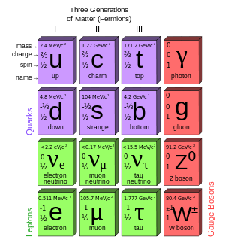
Why the D⁰ and not another particle?
Neutral mesons can oscillate between matter and anti-matter as they propagate
Classic example is the $B_{d}$ meson : measurement of $B_{d}$ oscillations was an early indication of the top quark mass
Oscillations are interesting because they are sensitive to new particles appearing virtually inside the box diagram, which can be very much heavier than directly produced particles
LHCb’s measurement of $D^{0}↔\overline{D^{0}}$, first direct measurement of oscillations in flight https://arxiv.org/pdf/1211.1230 Talk Measurement of D0 to anti-D0 mixing and CP violation in D0 to Kpi decays

Slide 17
The object of the exercise
The purpose of this exercise is to
Give you a look at the data coming out of the LHC
Teach you about selecting particles in the LHC data
Teach you about fitting functions to the data in order to measure the signal properties
Teach you about uncertainties in measurements

Slide 18
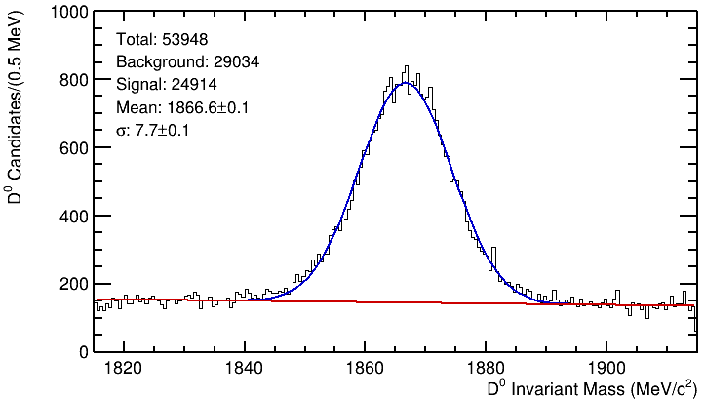
Data for exercise
Use the D⁰→Kπ events from 2012 data taking, starting mass distribution above.

Slide 19
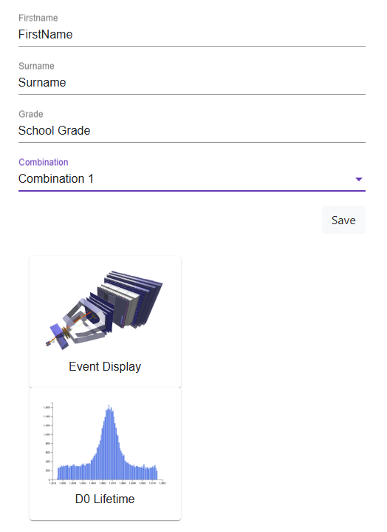
Sign in to the masterclass
Put your details here
There are 32 sets of D⁰ to measure, you will each only do a couple of these
When the form is complete you can pick one of the options

Slide 20
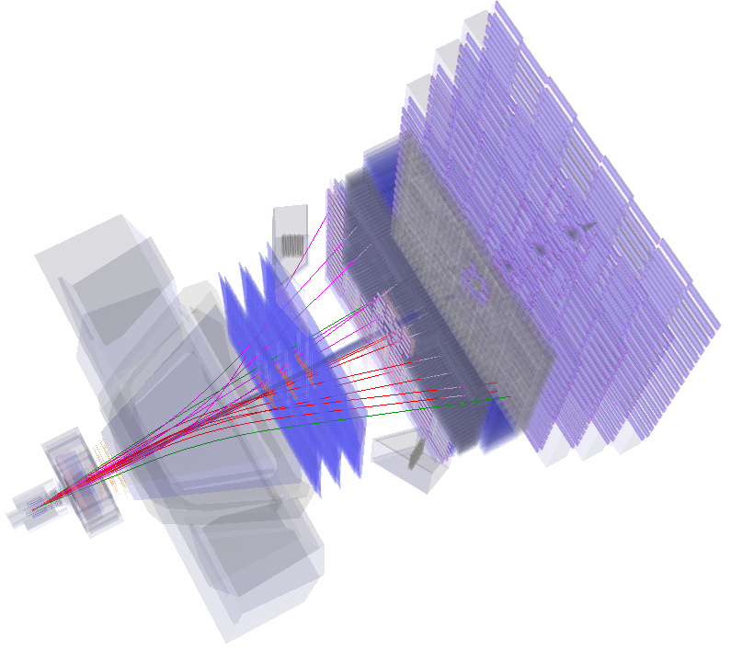
Event display
Because LHCb is a forward spectrometer with a dipole magnet, it is hard to do visual exercises looking at the full detector. We will zoom in around the interaction region for you to find displaced vertices.

Slide 21
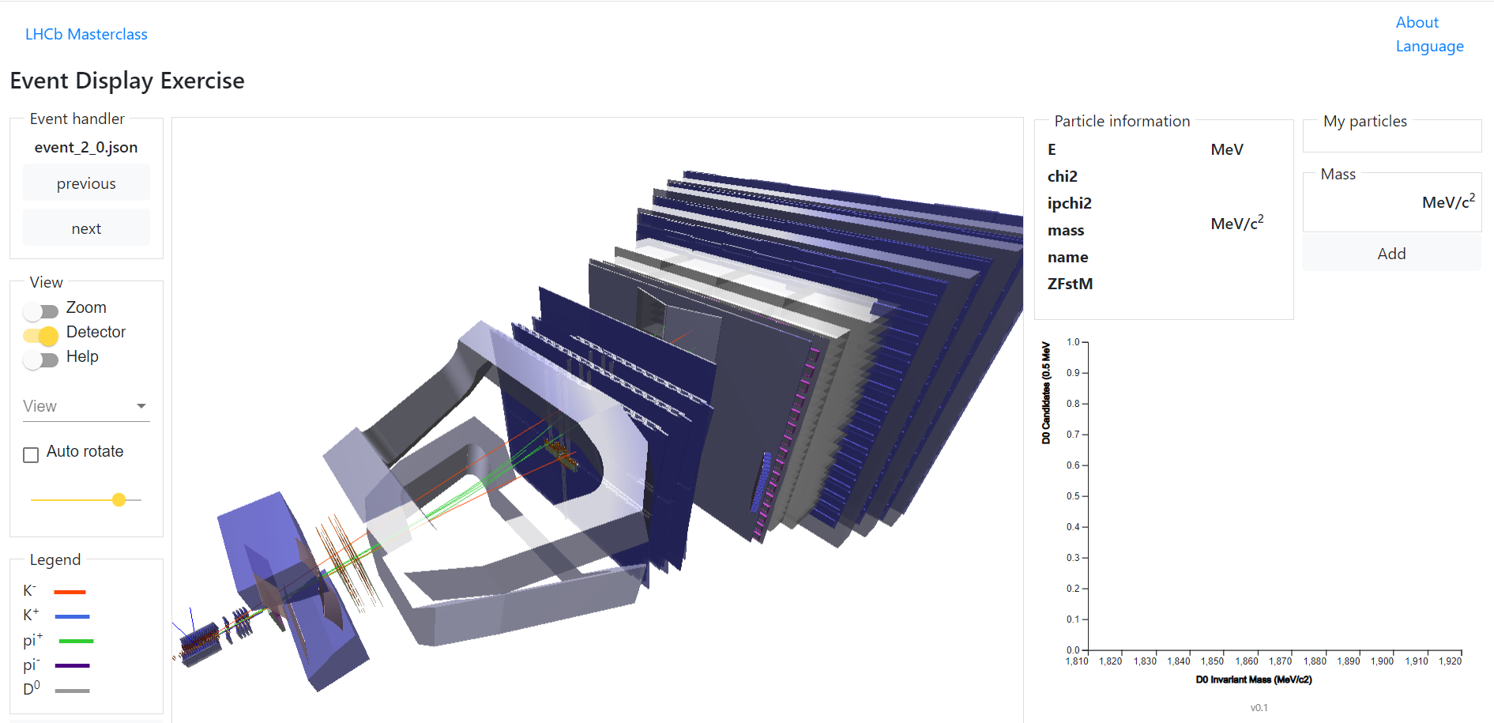
The visual analysis framework
Use zoom option

Slide 22
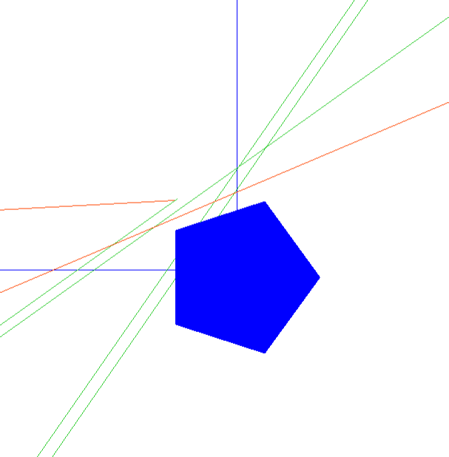
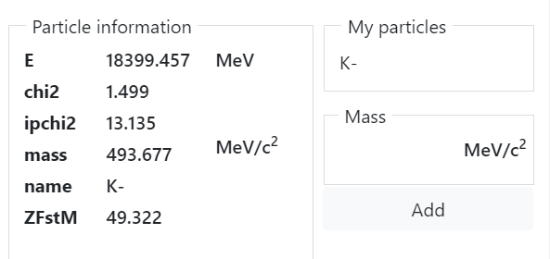
Pick a pion and kaon, starting not from the beam line
When selected, shown in “My particles”
Kaon selected here, also click pion then “Add”

Slide 23
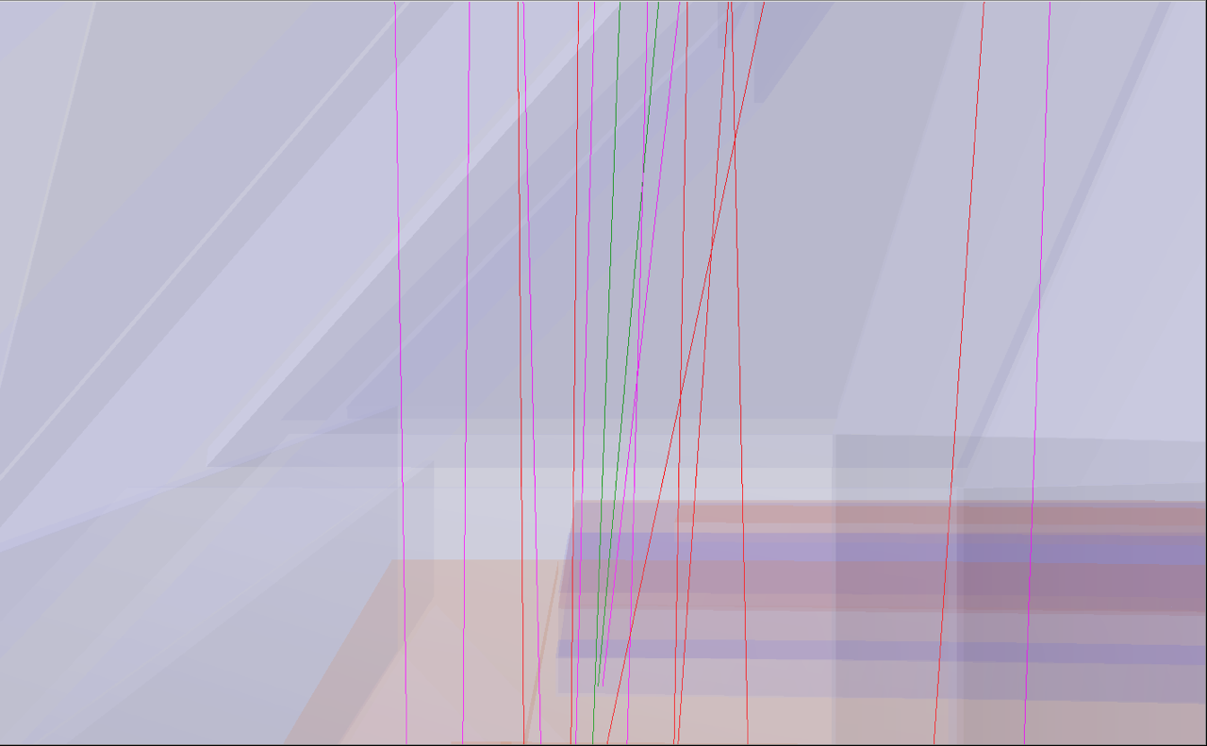
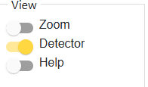
A “harder” event
Note you can turn off the detector display and just show the tracks

Slide 24
Sign in to the masterclass
The second part is to choose the D0 lifetime fitting option

Slide 25
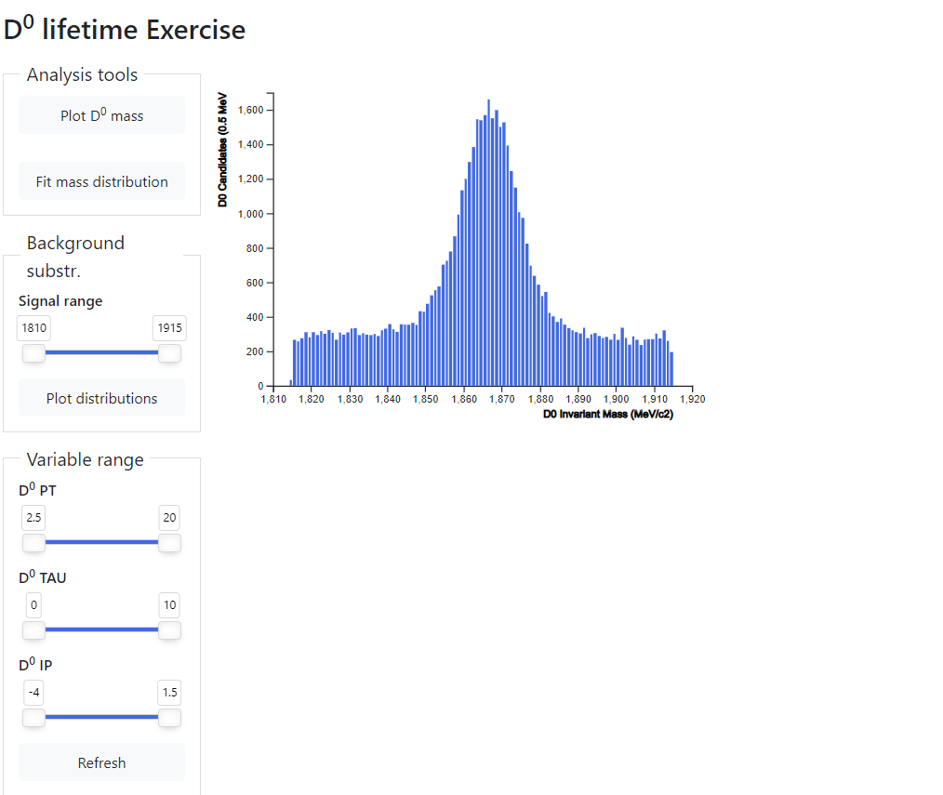
Fitting the lifetime
Once you finish looking for the events, you will get a bigger collection of data to use to measure the lifetime.
Select a range to fit then fit
Adjust selection to select true events (blue) verse background (red)

Slide 26
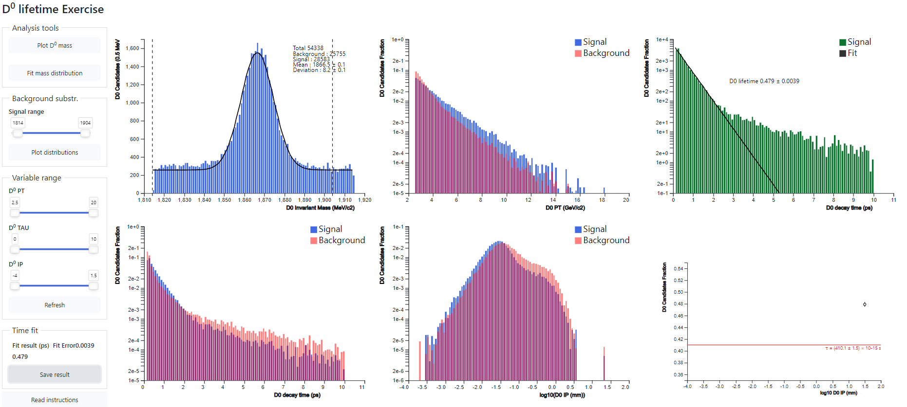
Plotting the distributions
History of your value is here
Use save results button so see if you have improved with your changes

