Slide 1
Measuring the cross section of $ν_{e}$at TeV energies using the FASER electronic detector
Sinead Eley
Supervisors
Prof. Carl Gwilliam & Prof Monica D’Onofrio (w/ Dr. John Anders)

Slide 2
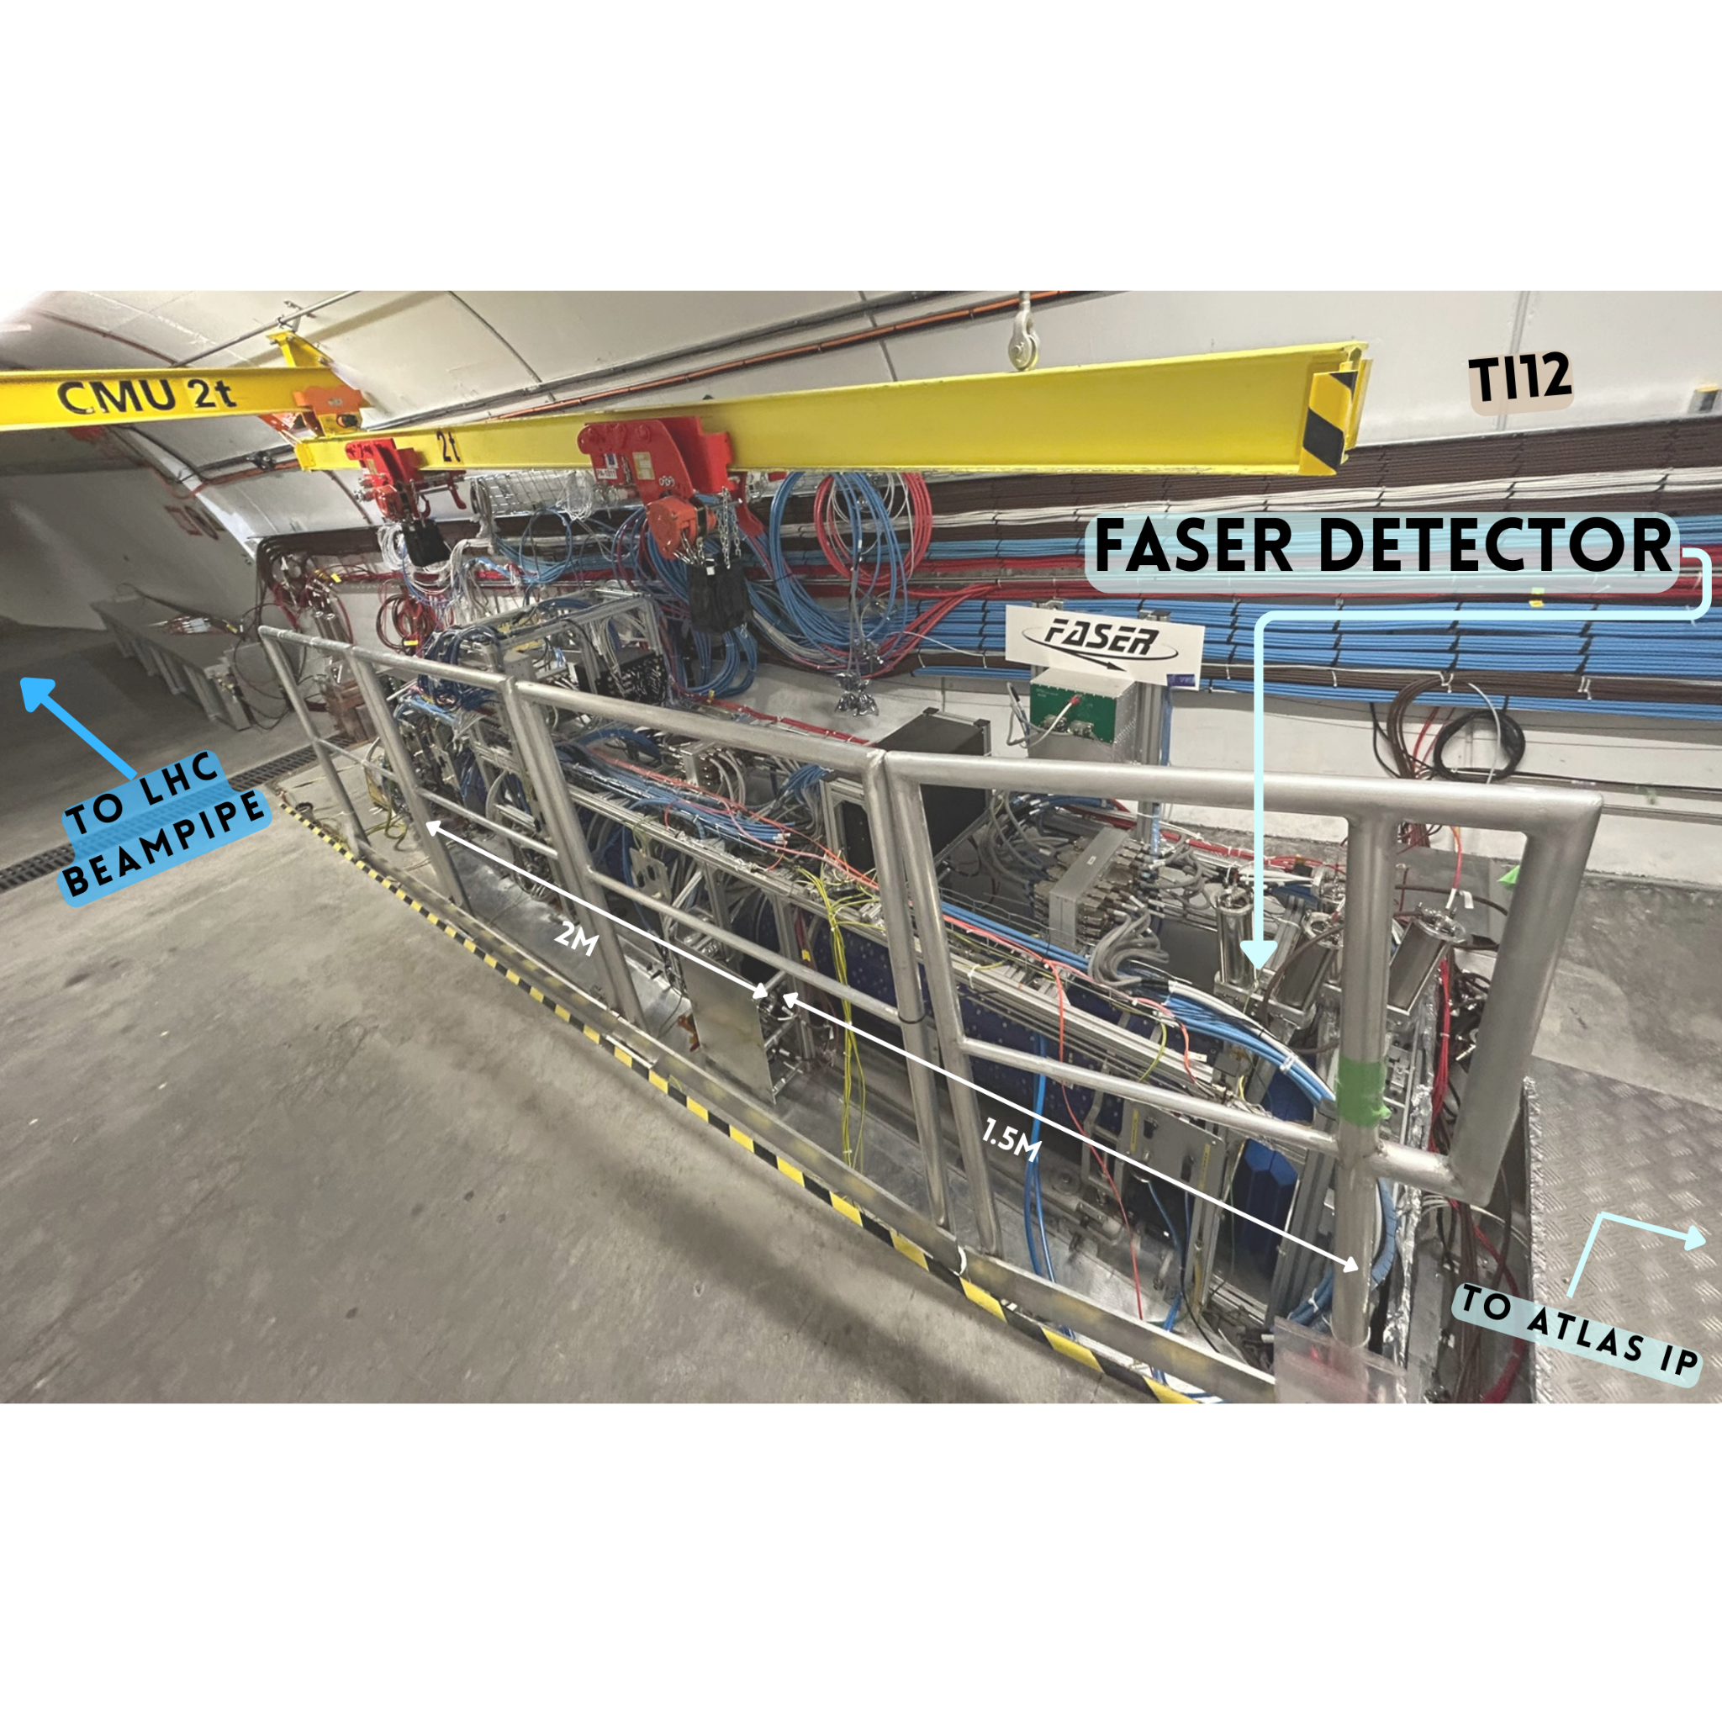
FASER (ForwArd Search ExpeRiment)
Neutrinos and light feebly-interacting particle (FIPs) produced at ATLAS interaction point (IP1)
Highly boosted and long–lived
Both predicted to decay in the far-forward region along line-of sight (LOS)
FASER in old service tunnel at LHC in far-forward region
On the LOS - 480m downstream from IP1
Two complementary programs:
Studying collider neutrino properties
Searching for light FIPs, such as:
E.g. Dark Photons (A' Paper)
Axion-like Particles (ALPs) (ALPs Paper)

Slide 3
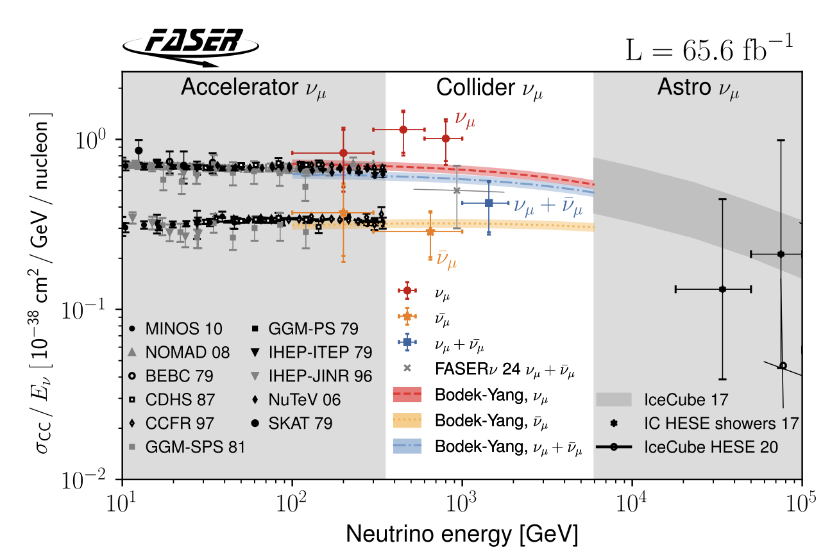
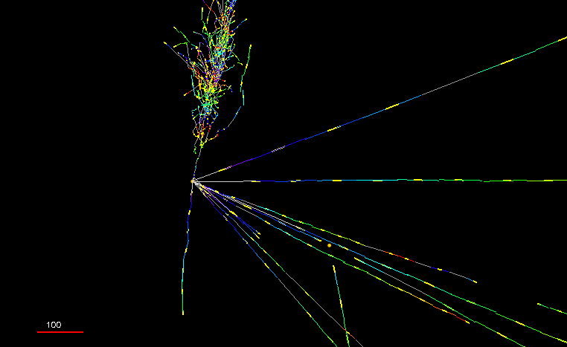
Neutrinos @ FASER
Studying properties of collider neutrinos at TeV energy scales
Electronic detector used to complement the work of FASER$ν$
Bridges the energy gap between accelerator and astro neutrinos
Probe neutrino interactions in a region where neutrino cross sections are currently largely unconstrained
FASER was the first experiment to directly detect collider neutrinos!! (FASER $ν$ Observation Paper)
$ν_{τ}$ predicted to be produced in the neutrino energy range probed at FASER
Hope to observe this, alongside studying electron and muon neutrino flavours
Pika-Nu Event (2023)

Slide 4
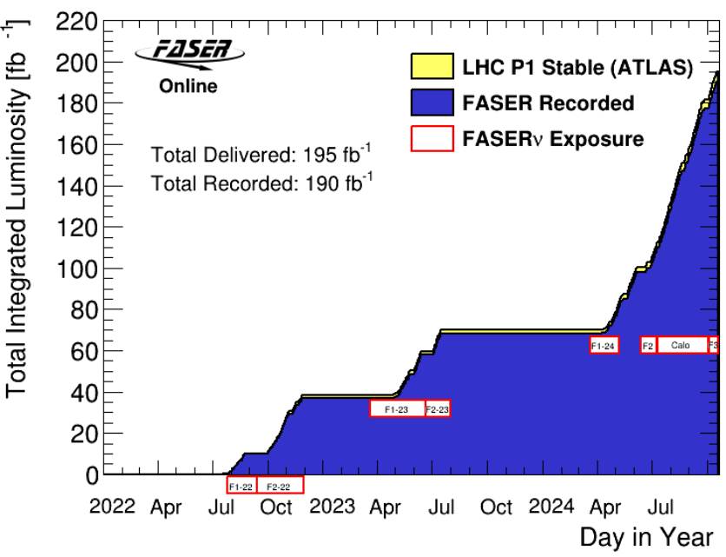
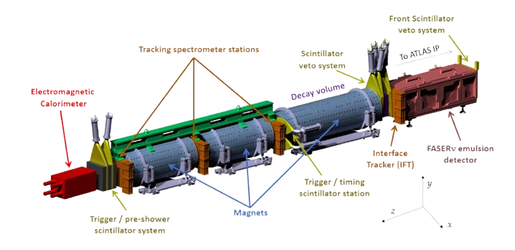
FASER Detector
OPERATIONS
Small detector – on the line of sight of the ATLAS IP
7m in length
20cm aperture
NEW
Began taking data at start of LHC Run 3 (2022)
Successfully collected ~ 190$\text{f}{\text{b}}^{\text{−1}}$
>97% of delivered luminosity
All detector components working well
Successful operations during lifetime
Operations take place remotely with only:
Monitoring Shifter
Run Manager
….. And experts on hand
New For 2025
MuonID
Regularly undertaking Run Manager Shifts
New For 2025

Slide 5
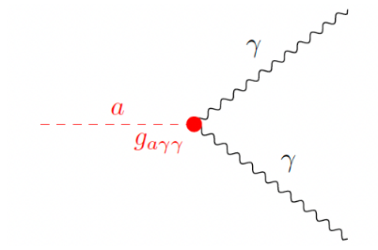
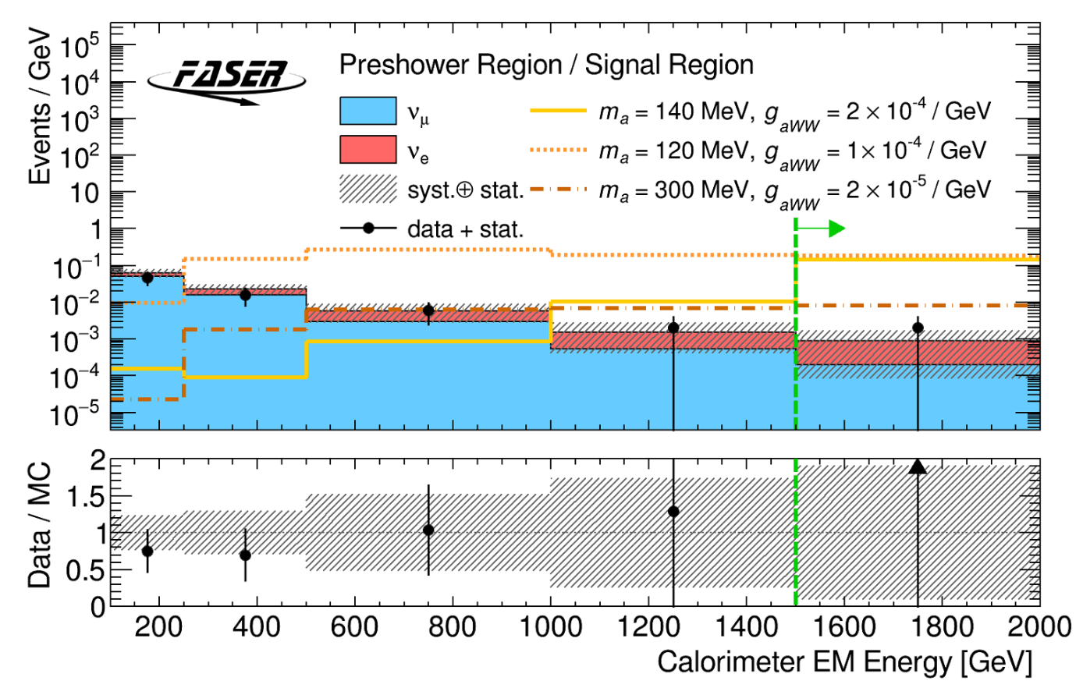
ALPs Search $→$ ALPtrino Analysis
Search for Axion Like Particles (ALPs) conducted by FASER last year
Led by Liverpool Group:
Analysis contact - Lottie (Now @ ETH) | Paper Editor – Monica
Main background from neutrinos
New analysis will turn the background from ALPs analysis into a measurement
Makes use of a similar approach and framework
Aim :- Measure the cross section of the electron neutrino using the electronic components of the FASER detector
i.e. An electronic electron neutrino analysis (dubbed ALPtrino analysis)
Similar hypothesis to electronic muon neutrino analysis in 24’(CONF Note)
Utilise the entire dataset currently available (2022-24) ~ 190$\text{f}{\text{b}}^{\text{−1}}$of data
ALP-Photon

Slide 6
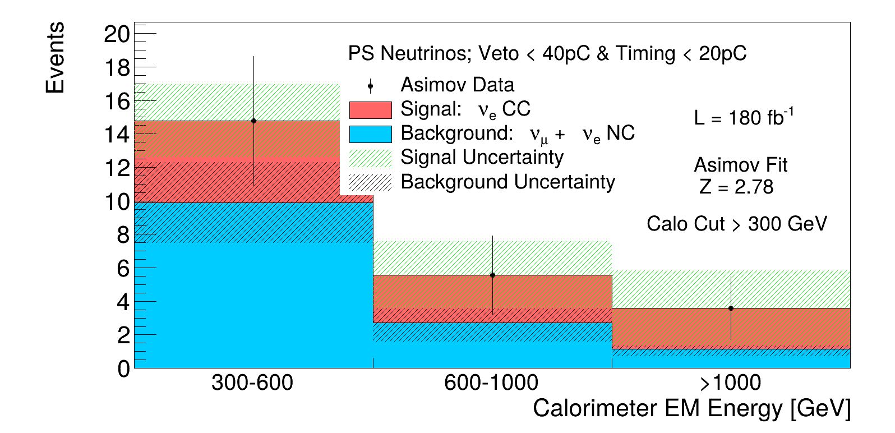
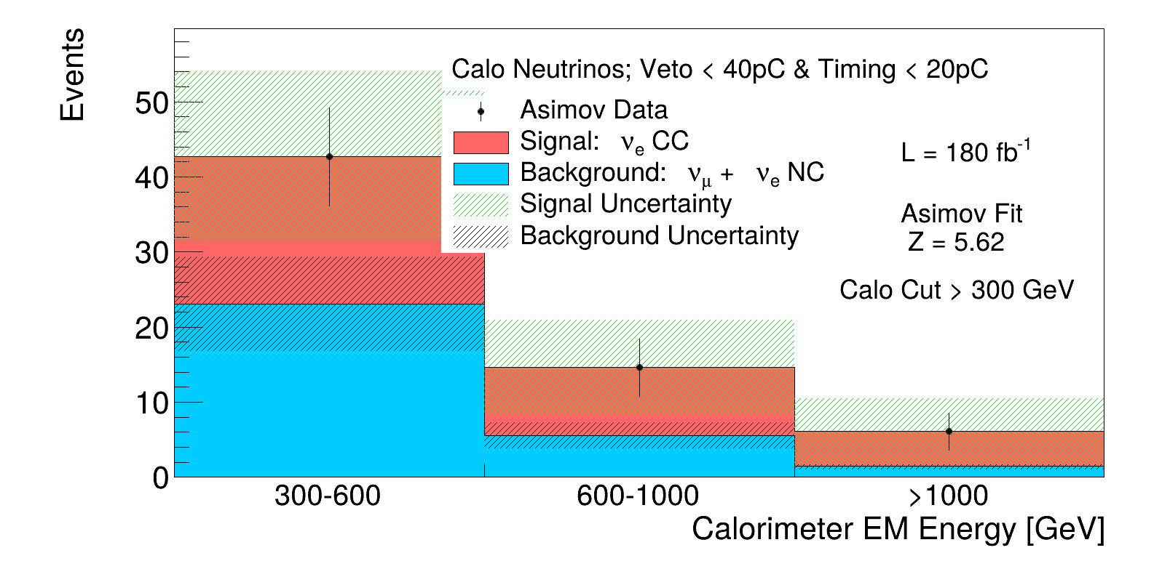
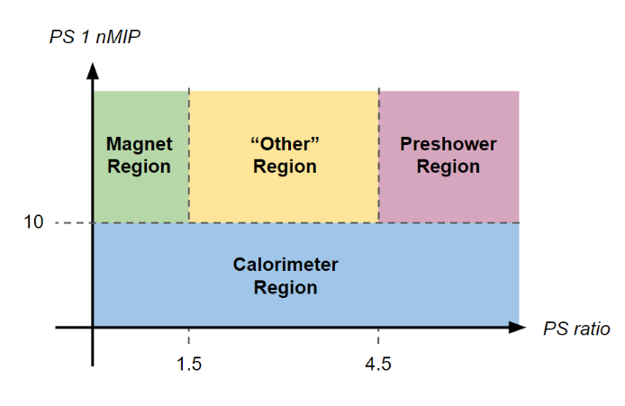
ALPtrino (Electronic Electron Neutrino Analysis)
MC studies (no background included) estimate a significance of ~6.3σ.
Use neutrino regions defined in the ALPs analysis:
Split the signal region into orthogonal sub-regions.
Isolate where neutrino interactions occur in the detector.
Unfold to a measurement as a function of true neutrino energy ($E_{ν}$).
Accurate significance requires considering backgrounds from data:
Muon neutrinos ($ν_{μ}$) form a major background—use results from the electronic${ ν}_{μ}$ analysis to constrain this.
Include all potential background sources:
Anticipate increased muon background in 2024 due to high rates observed after LHC optics changes.
Number of MIPs in preshower station 1
Ratio of MIPs in PS 2nd preshower station compared to 1st

Slide 7
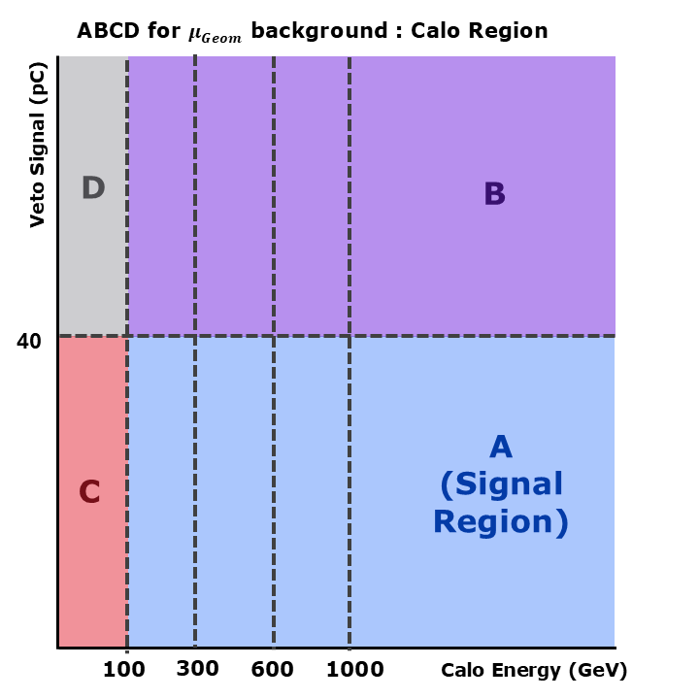
ALPtrino Backgrounds
FASER in low background environment:
Still need to account for background from:
Muon decay to neutral hadrons
Non-collision backgrounds
Scintillator inefficiencies
Large-angle muons
Not all muons that enter FASER necessarily pass through all vetos scintillators
Some could enter at large angle
Utilise a data-driven method
Use two uncorrelated variables, the background can be estimated using:
$A_{i}\left[Pred.\right]=\left(B_{i}^{Data}−B_{i}^{ν_{MC}}\right)∗\frac{C^{Data}−C^{ν_{MC}}}{D^{Data}−D^{ν_{MC}}}∗f$
$f$ – factor to correct for use of inverted cuts
Region to expect $μ_{Large Angle}$

Slide 8
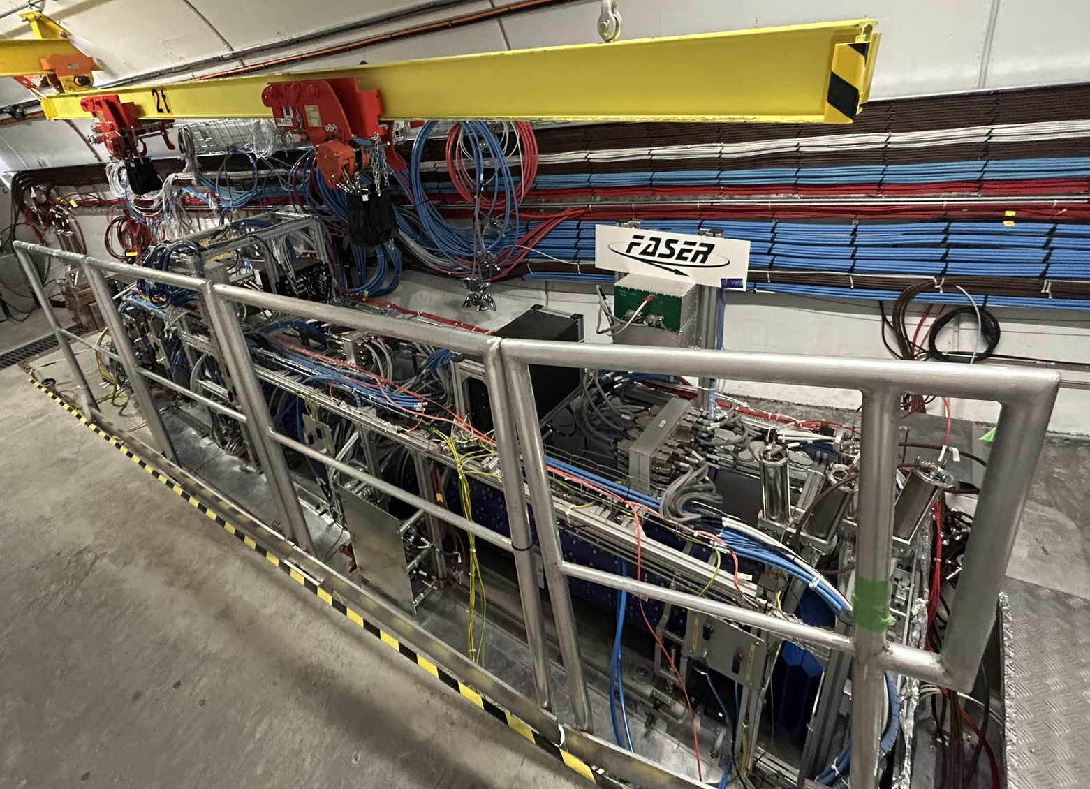
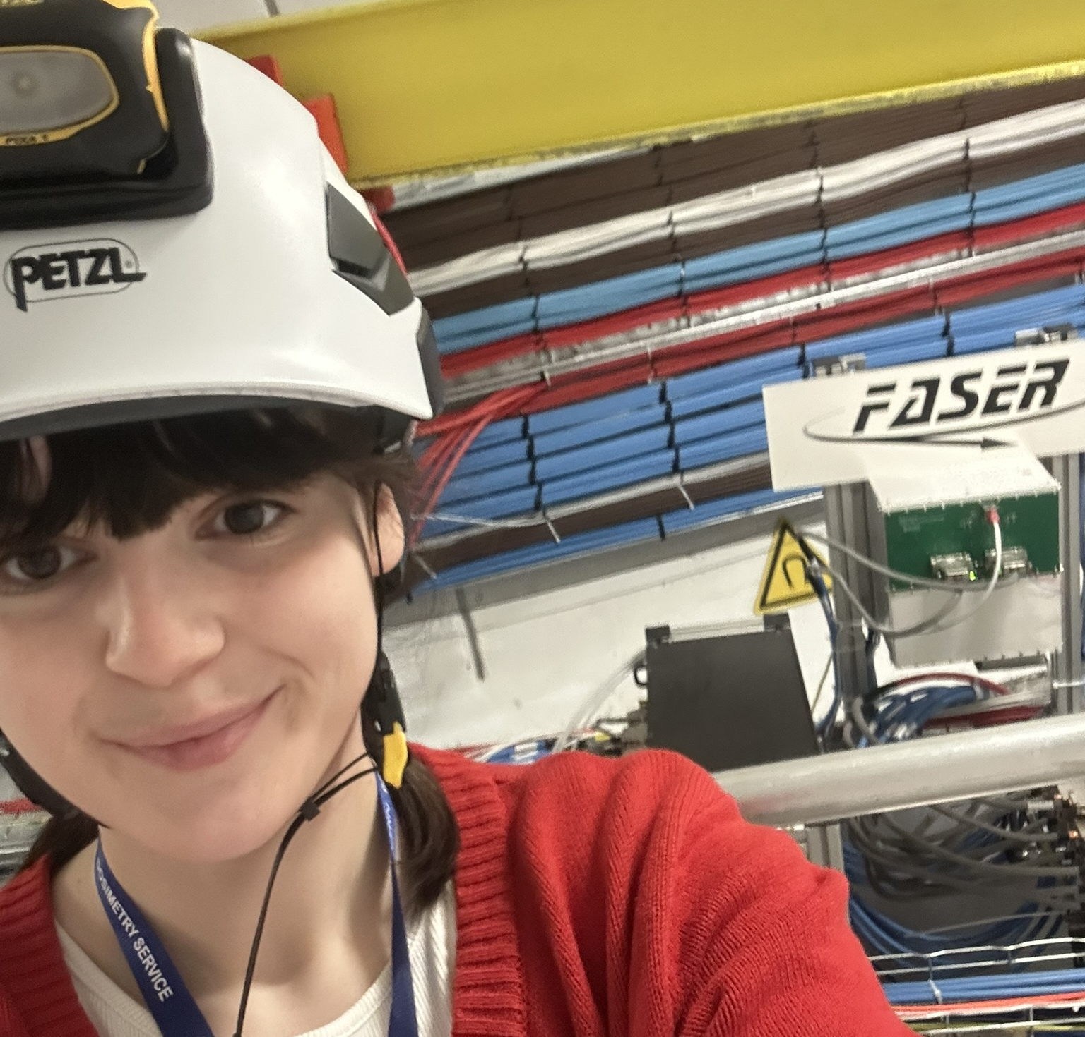
Next Steps
Work on ALPtrino analysis is well underway
Aiming for results around the end of the year
Will be the 1st measurement of the electron neutrino cross section using the electronic detector
This will begin to fill in the energy gap for electron neutrinos
Leads the way to observe and study tau neutrinos in the future
FASER continues to prepare for data taking in 2025
Contributed to this preparation by doing run manager shifts during 1st stable beam of the year
Will continue to do run manager shifts – both in Geneva and remotely
During the remainder of the PhD :
Will be based in Liverpool (LTA ends this autumn)
Undertake 6-month data science placement in industry
Thanks for listening ☺
Visit to FASER
(March 2025)

