Slide 1
ATLAS Experiment
Carl Gwilliam
(obo the Liverpool ATLAS group)
22nd May 2025
HEP Annual Meeting

Slide 2
Liverpool ATLAS Group
7 Academics
Andy, Carl (TL since 01/25), Jan (DTL) , Monica, Nikos, Uta, Sergey (low FTE)
2 Physics Analysis PDRAs
Jordy Degens + John Anders (who returned in October)
Goodbye to Cristiano (CERN fellow) and Joe (DESY PDRA)
9 PhD students (+2 incoming)
Y1: Shirsendu, Stephen
Y2: Mehul
Y3: Bhupesh, Josh, Rob
Y4/5: Conor, Rebecca, Samuel (viva next week)
Graduated: Dr. Ting
(PDRA at York, CA)
Along with upgrade staff (see Helen’s talk)
SCT + Analysis Software
SM Precision + rare processes
Tau reco. and ID
W mass, W/Z p_{T}, low/high-mass DY, ttZ, single top, rare tau decays
Lumi Measur-ement
b/c –jet tagging
Higgs physics
New physics searches
SM Higgs, Di-Higgs, BSM Higgs
SUSY, Dark Matter, Dark Sector, LLPs, LQs, ALPs, …
Ubiquitous use of Machine Learning across almost all areas

Slide 3
Liverpool ATLAS Group
Work on wide variety of areas
Operations, performance, physics
Excellent feedback from CG
Leadership across the board
ATLAS published 127 papers in 2024
Significant Liverpool input to 11 papers
SCT + Analysis Software
SM Precision + rare processes
Tau reco. and ID
W mass, W/Z p_{T}, low/high-mass DY, ttZ, single top, rare tau decays
(Deputy) Publications Coordinator | Jan
(Deputy) ATLAS UK Spokesperson | Monica
CB chair advisor group member | Monica
SCT offline coordinator | John
Analysis release coordinator | Andy
Computing Resource Mgmt Board chair | Carl
Luminosity Z-counting contact | Uta
Tau Reco + ID convener (~30) | Jordy
Strong SUSY convener (~100) | John
ATLAS LHC Higgs group coordinator for extended Higgs sector + NMSSM | Nikos
Lumi Measur-ement
b/c –jet tagging
Higgs physics
New physics searches
SM Higgs, Di-Higgs, BSM Higgs
SUSY, Dark Matter, Dark Sector, LLPs, LQs, ALPs, …
Ubiquitous use of Machine Learning across almost all areas

Slide 5
Operations and Performance
SCT + Analysis Software
SM Precision + rare processes
Tau reco. and ID
W mass, W/Z p_{T}, low/high-mass DY, ttZ, single top, rare tau decays
Lumi Measur-ement
b/c –jet tagging
Higgs physics
New physics searches
SM Higgs, Di-Higgs, BSM Higgs
SUSY, Dark Matter, Dark Sector, LLPs, LQs, ALPs, …

Slide 6
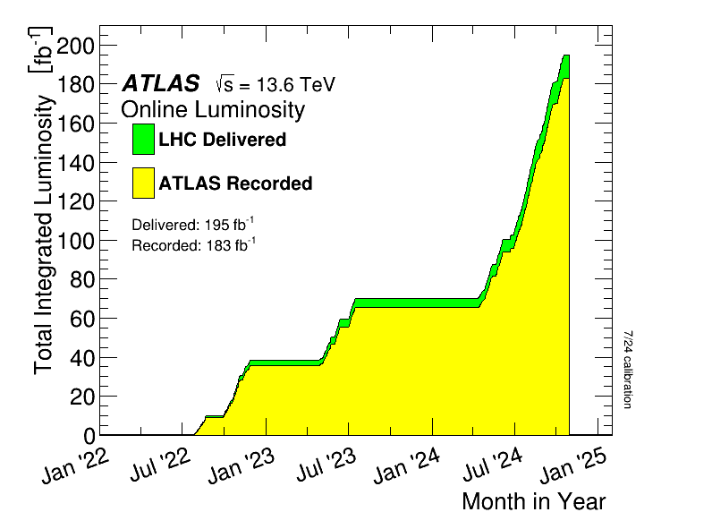
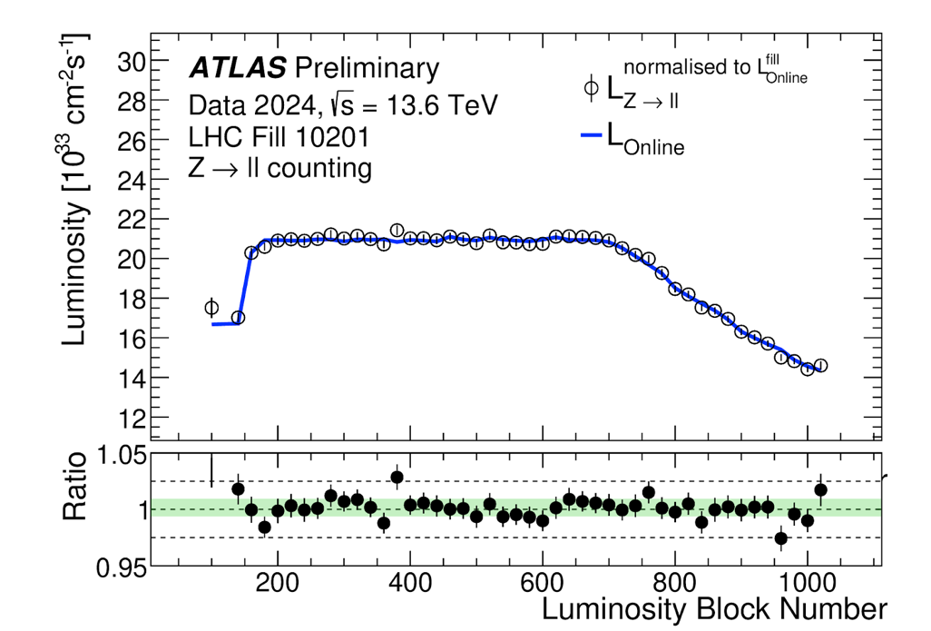
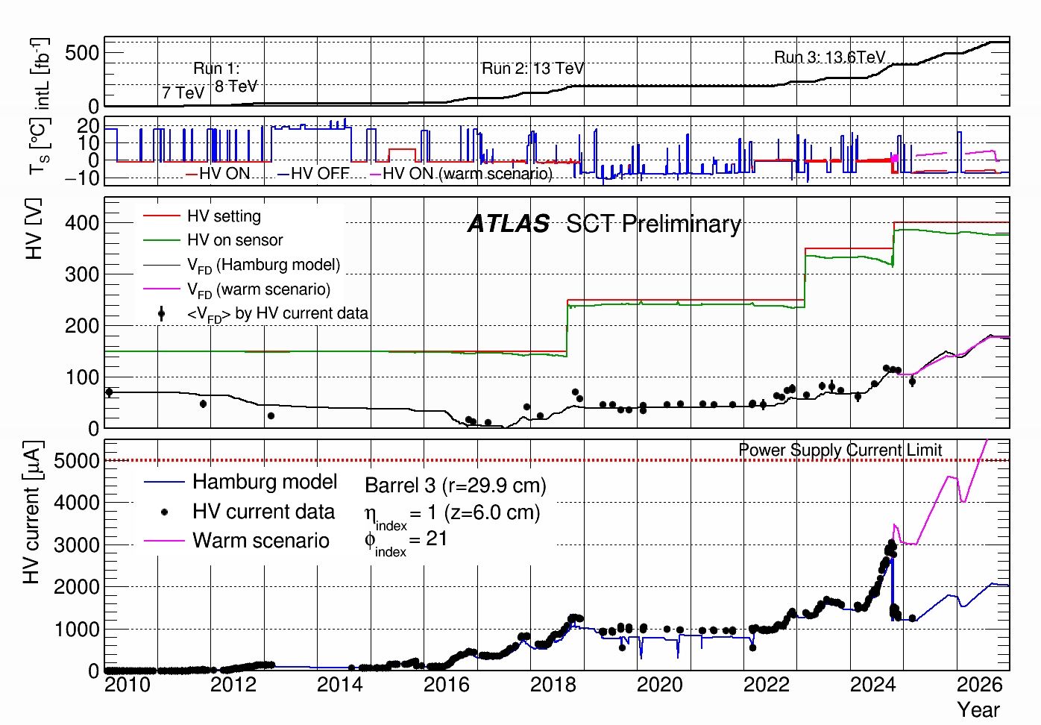
Status and Operations
LUMI-2025-01
ATLAS well into successful run-3 data-taking → 183 fb⁻¹
Expect total run-2+run-3 yield of 460 fb⁻¹ by summer 2026
Followed by LS3 for HL-LHC upgrade (see Helen’s talk)
Uta, Jan, Josh, Samuel contribute to precision lumi measurement
Using Liv-pioneered Z-counting method for rapid results
Public preliminary results for 2024 + run on 2025 as data arrives
John coordinates the SCT offline activities
Crucial to keeping SCT operating with high efficiency
Leading final run-3 performance paper
(see Josh’s talk for more details)
5° T reduction
Many people performing control room (ID, run control) and remote (DQ, analysis, computing) shifts

Slide 7
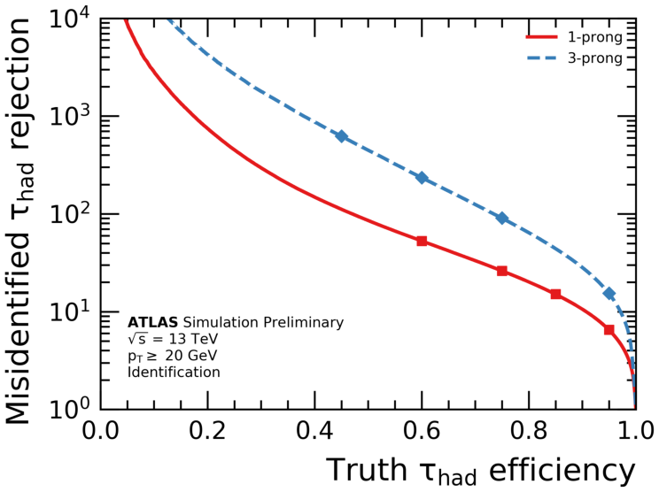
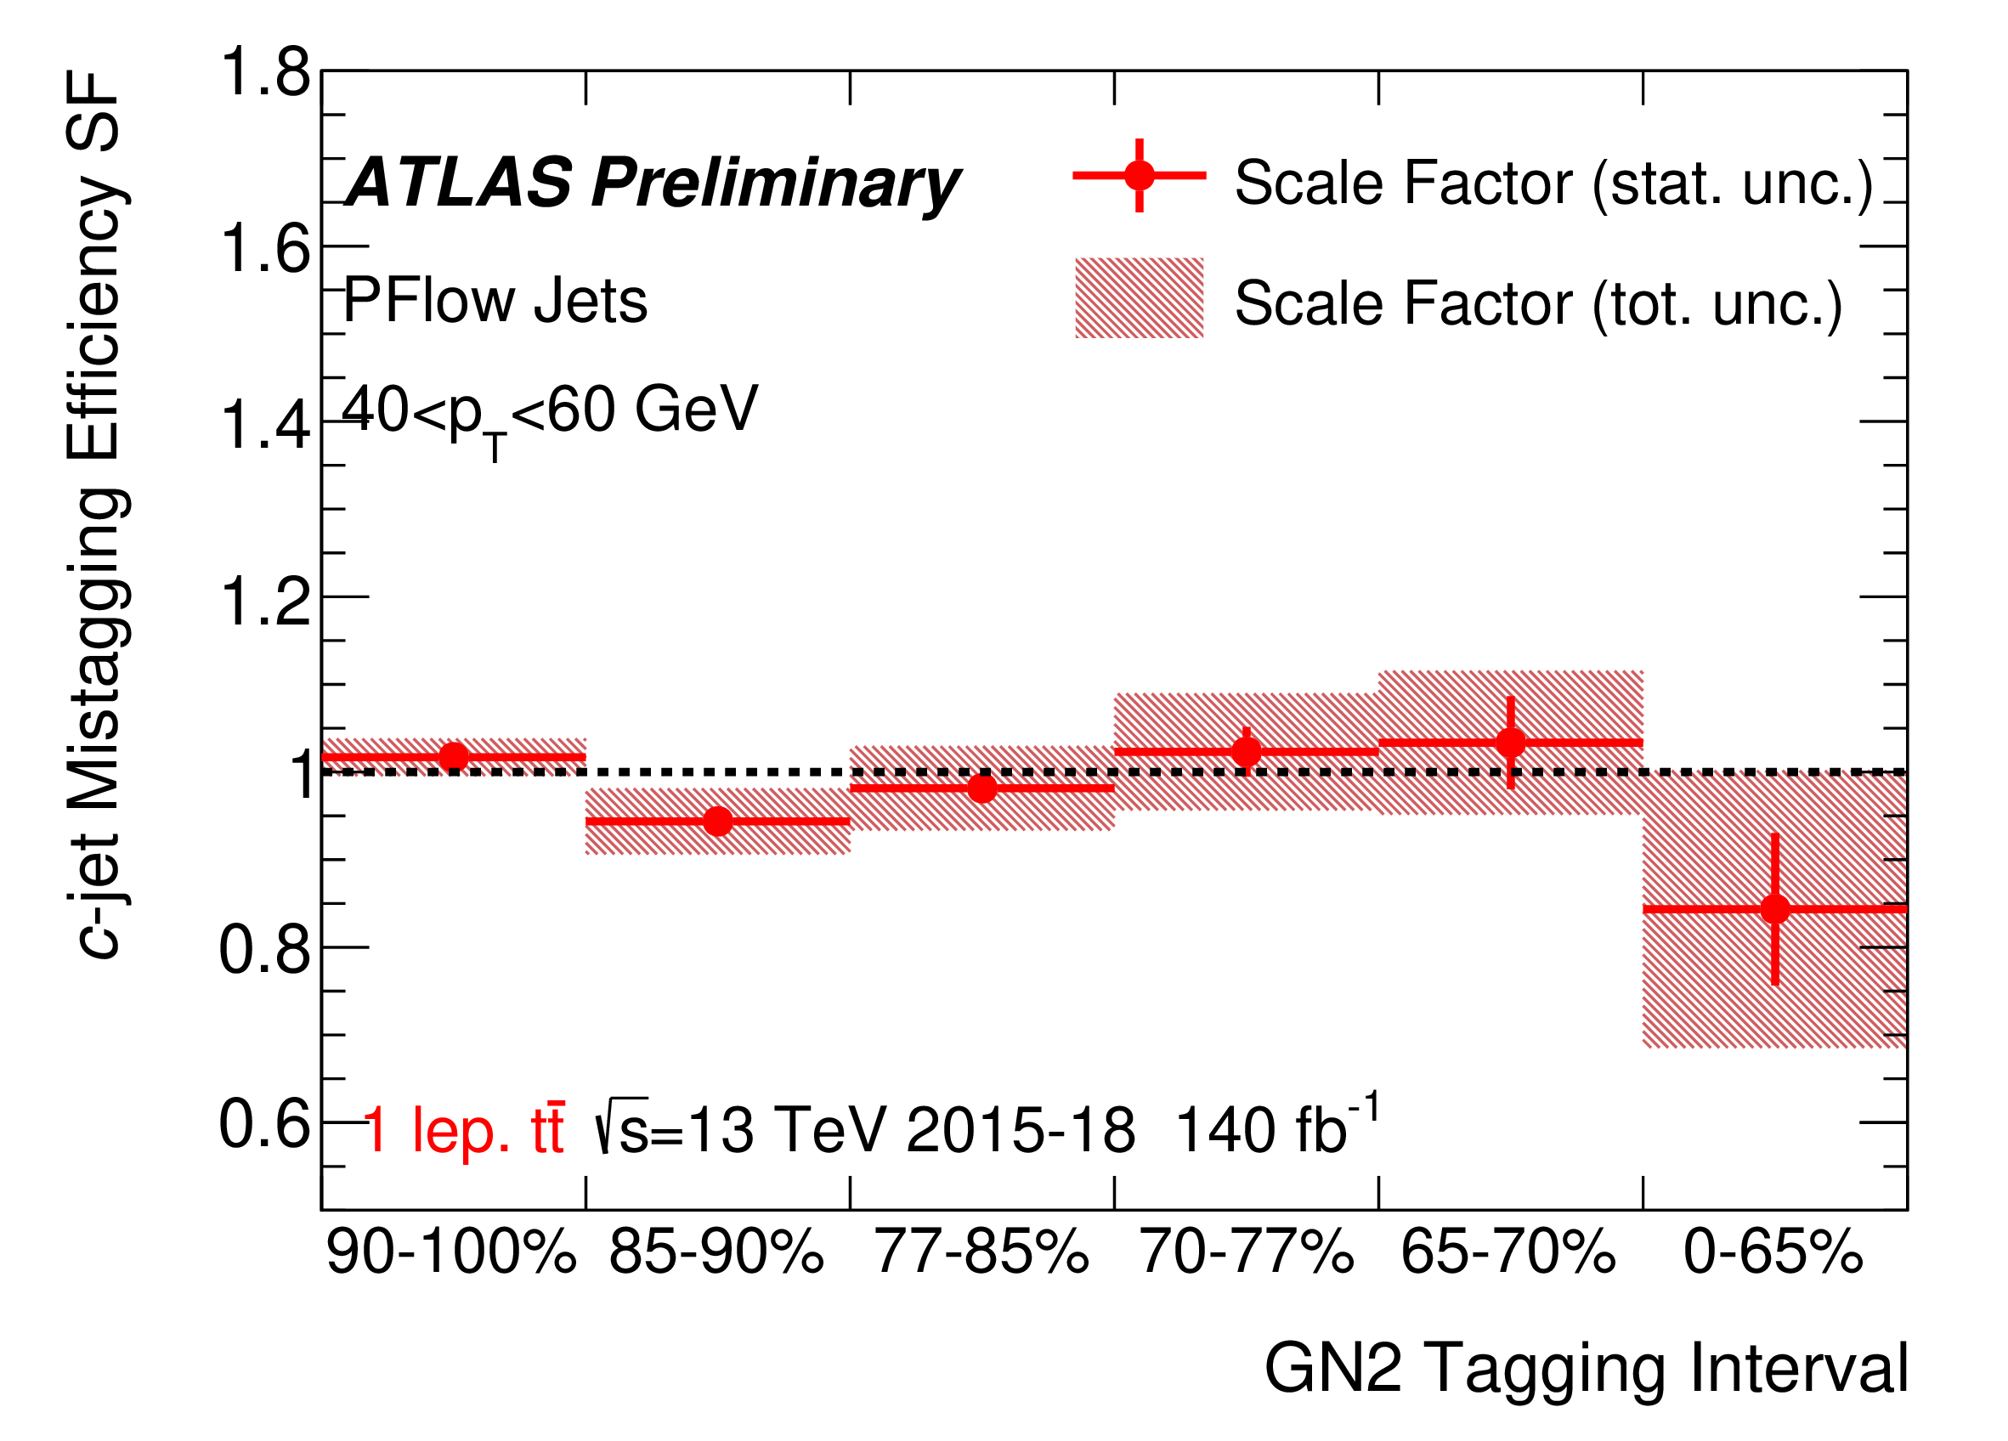
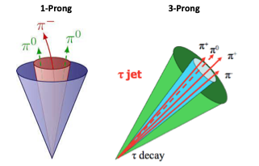
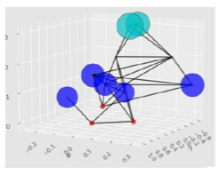
Tau and Heavy-Flavour ID
FTAG-2023-05
Liverpool heavily involved third-generation taggers, key for Higgs measurements + BSM searches
b/c-jet calibration (Andy, Nikos)
Simultaneous b-tagging efficiency + c-mis-ID probability from data using 1-lepton ttbar events
Dedicated c-tag calibration on-going
Two publications in progress
Tau reco/ID (Jordy, Monica, Mehul, Rob, Nikos)
Led by Jordy as subconvener
Focusing on improving ID of hadronically decaying taus using graph NNs (GNNs)
Liverpool developed one of two GNNs and currently comparing perf to b-tag approach
See Mehul’s talk for more details
Public note by end of year

Slide 8
Precision SM Measurements & Rare Processes
SCT + Analysis Software
SM Precision + rare processes
Tau reco. and ID
W mass, W/Z p_{T}, low/high-mass DY, ttZ, single top, rare tau decays
Lumi Measur-ement
b/c –jet tagging
Higgs physics
New physics searches
SM Higgs, Di-Higgs, BSM Higgs
SUSY, Dark Matter, Dark Sector, LLPs, LQs, ALPs, …

Slide 9
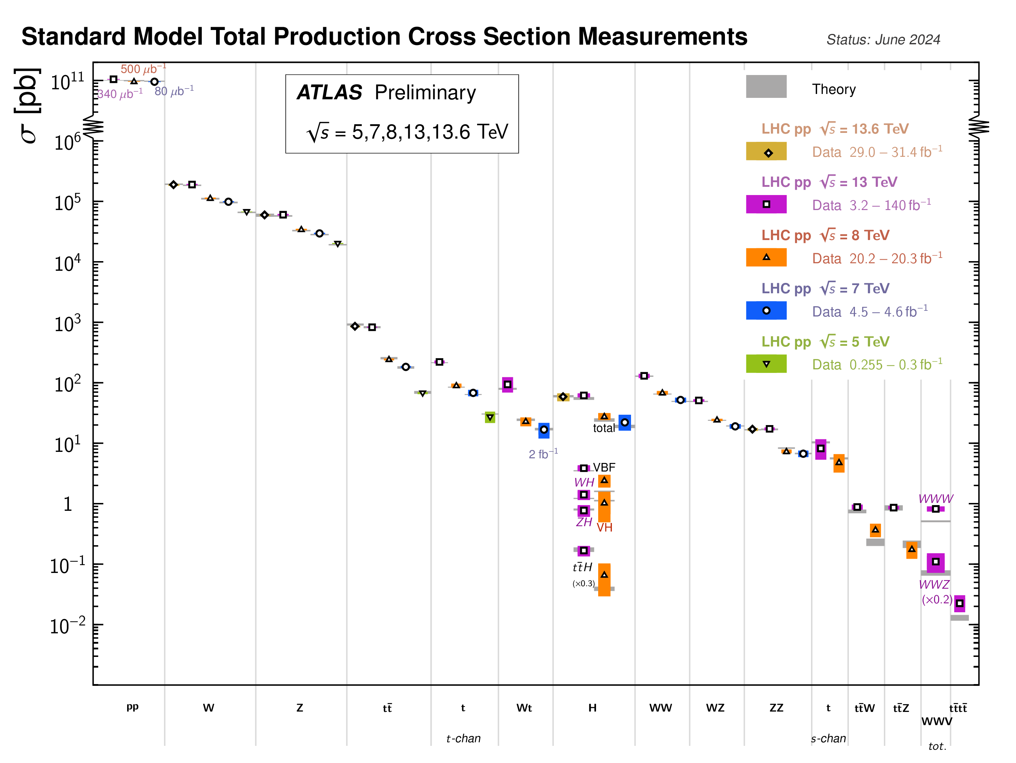
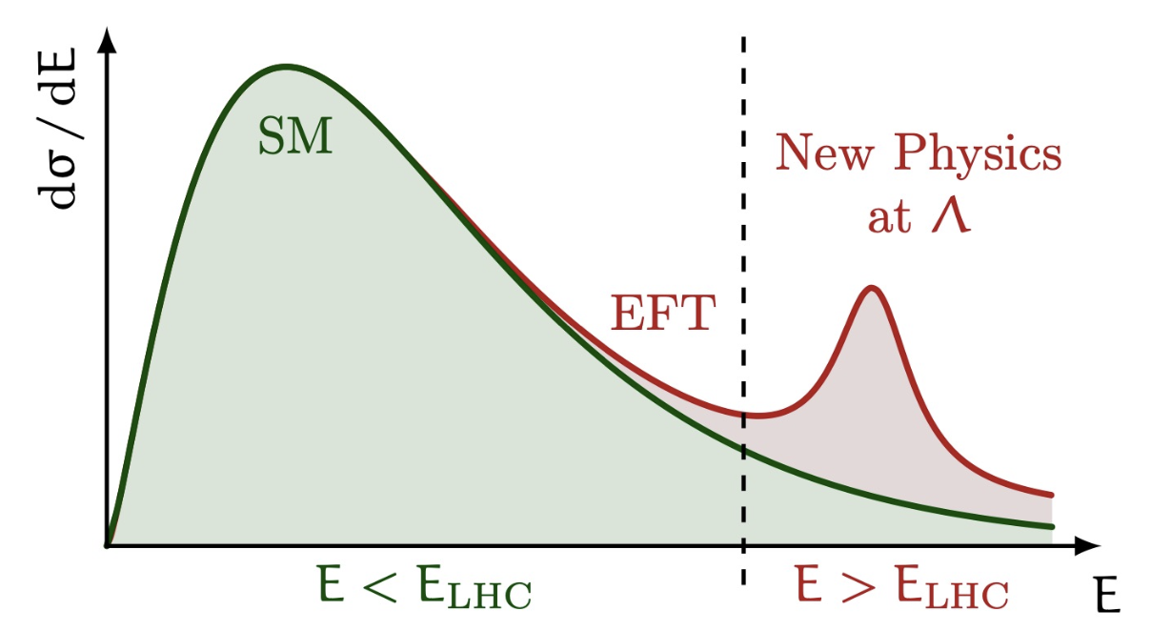
Standard Model Measurements
The LHC can make highly precise measurements of fundamental SM particles and interactions
Probing cross sections over 12 orders of magnitude down to some of rarest SM processes
Rivalling LEP sensitivity
Tests SM consistency in extreme phase space + searches for new physics effects beyond E_{LHC}
Model independent constraints in Effective Field Theories (EFTs)

Slide 10
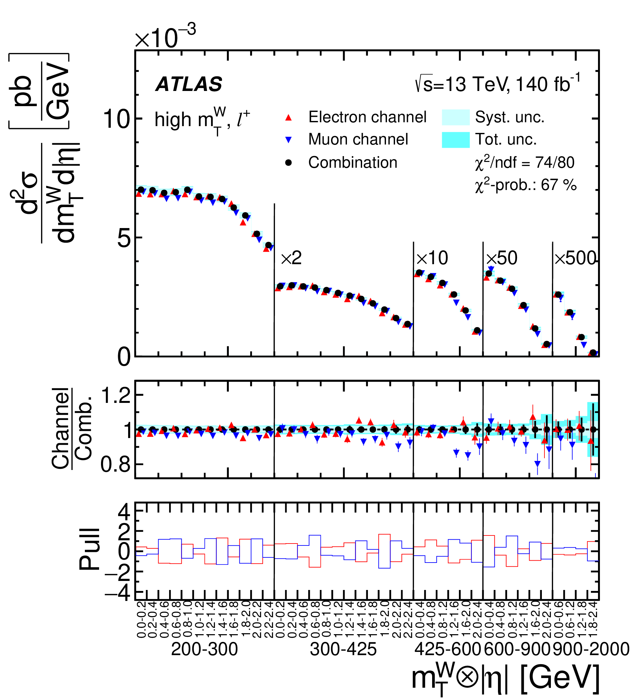
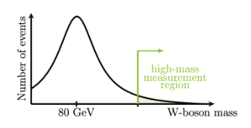
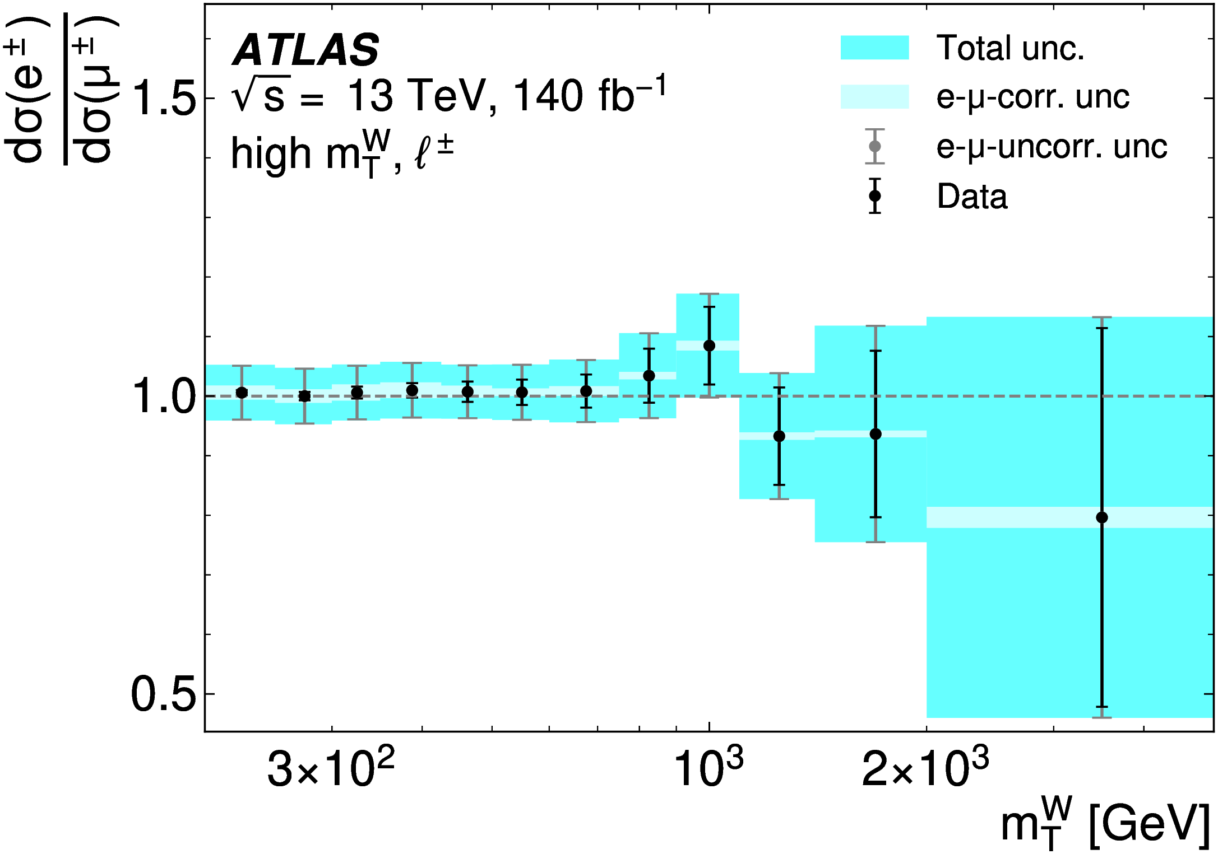
Low/High mass Drell Yan
arXiv:2502.21088
NC and CC Drell-Yan (DY) measurements away from W/Z peak are a powerful tool to study the proton structure (PDFs), test precision pQCD predictions and probe the EW sector of the SM
As well as LFU test and search for new physics effects
Recent full run-2 CC DY paper is first ever measurement of W cross-section at high m_{T} (Uta, Sam)
Double differential cross-section in m_{T} & η for e/μ up to 5 TeV
Ratio of e/μ shows no significant evidence of LFU
Place limits on lepton-quark operator in SM EFT
Subject of Samuel’s PhD thesis
Measurement of low and high-mass NC DY in progress (Uta, Jan)
Liverpool particularly involved in HO theory predictions

Slide 11
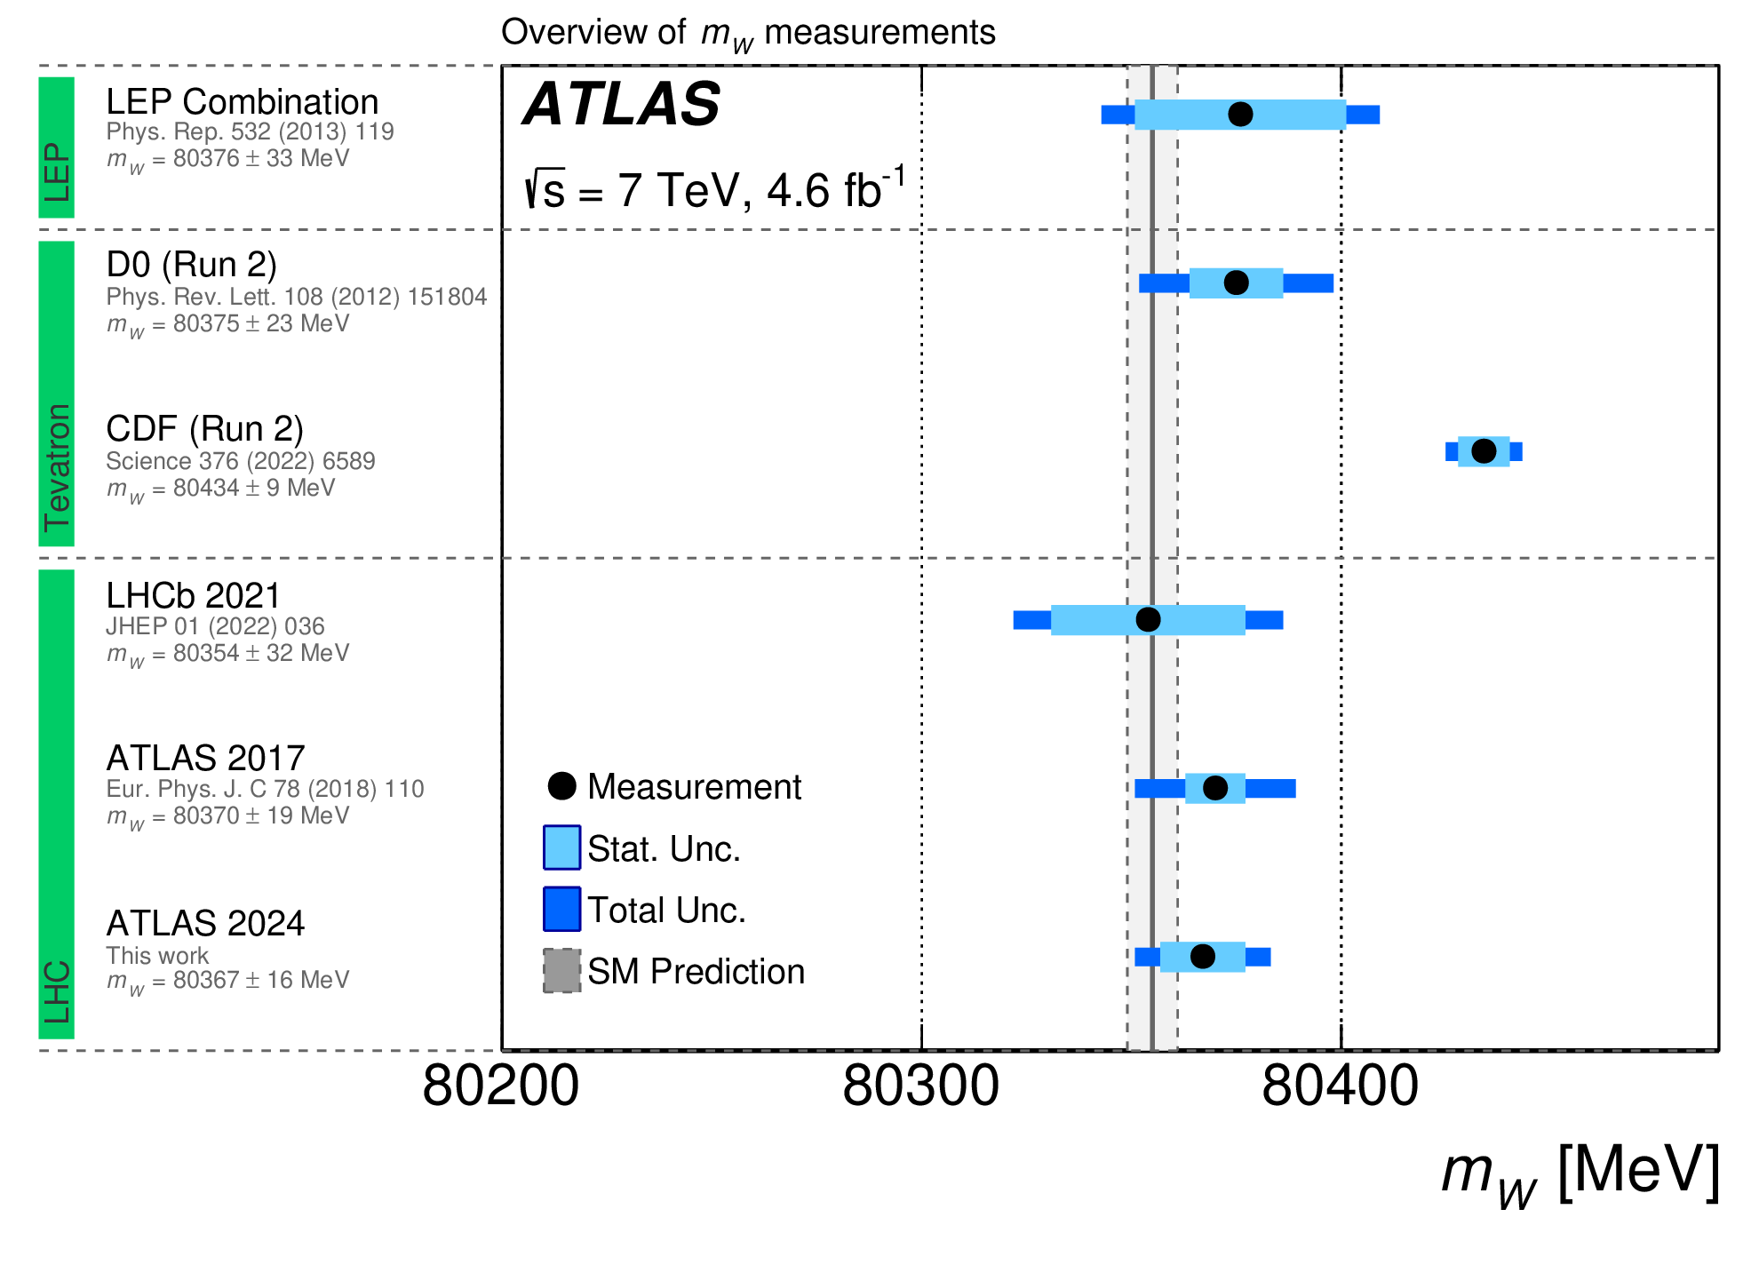
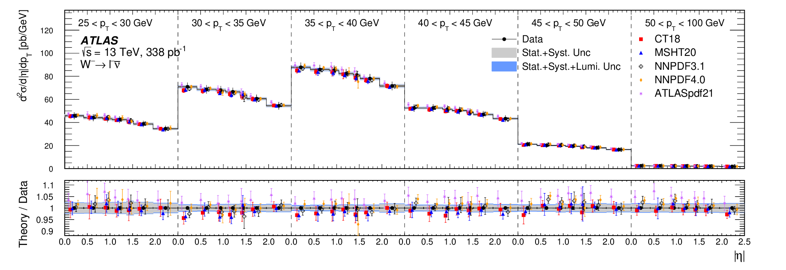
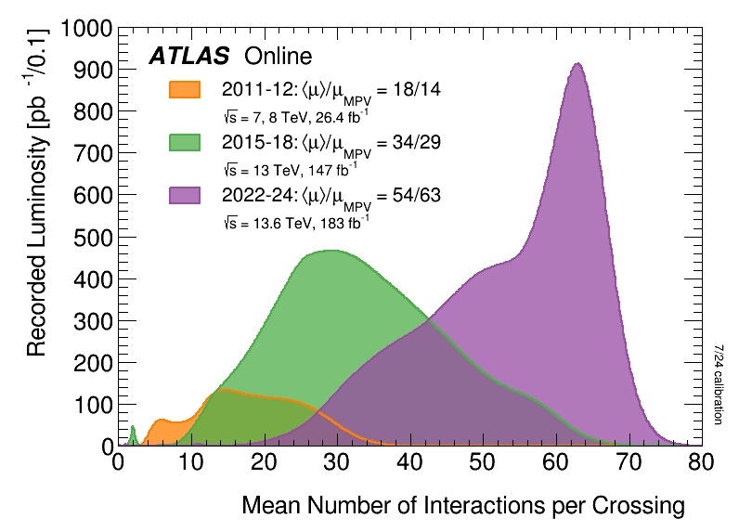
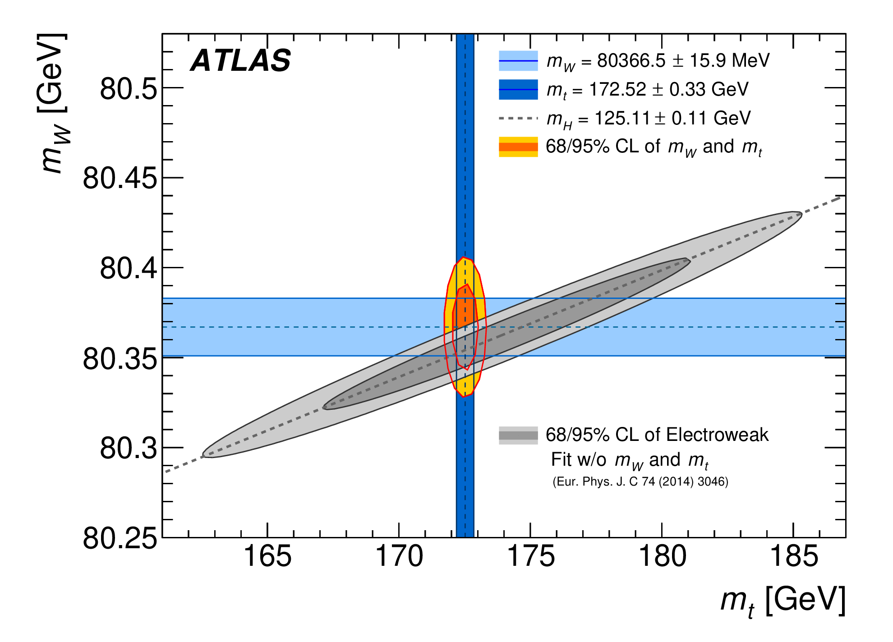
W mass
arXiv:2502.09403
arXiv:2403.15085
W mass is one of most precisely calculated quantities in the SM and LHC measurements are able to probe deviations at the level of 1 part in 10000.
Unique test of SM consistency + probe for new particles/forces
Long standing Liverpool leadership (Jan et al)
Precise run-1 measurement of mass (16 MeV)
First LHC measurement of width (Γ = 2202 ± 47 MeV)
Recently measured W x-sect differentially in lepton p_{T} & η
Dominant uncertainty on previous m_{W} + probe of pQCD/PDFs
Currently lead effort with 5 & 13 TeV low-pileup data
Josh working on in-situ electron E calibration + FSR (see talk)
Expected run-2 precision of 15 MeV, allowing to reach 10 MeV when combined with run-1 data
Tension with CDF

Slide 12
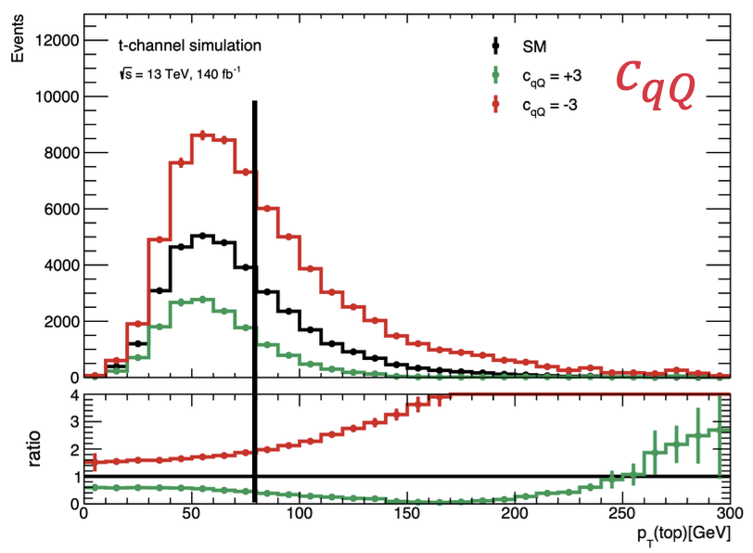
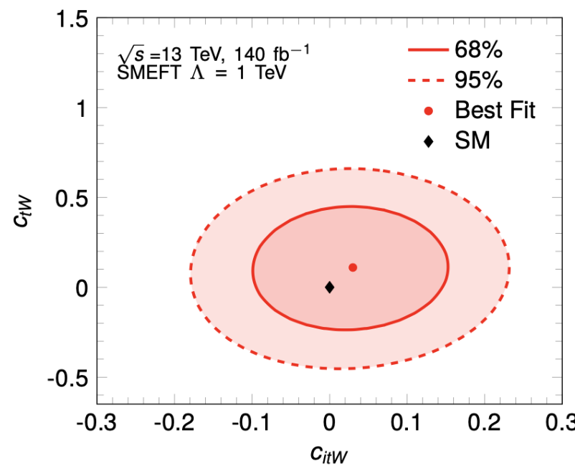
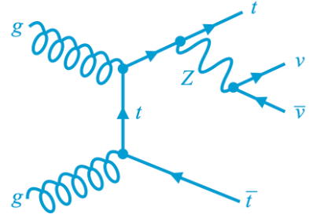
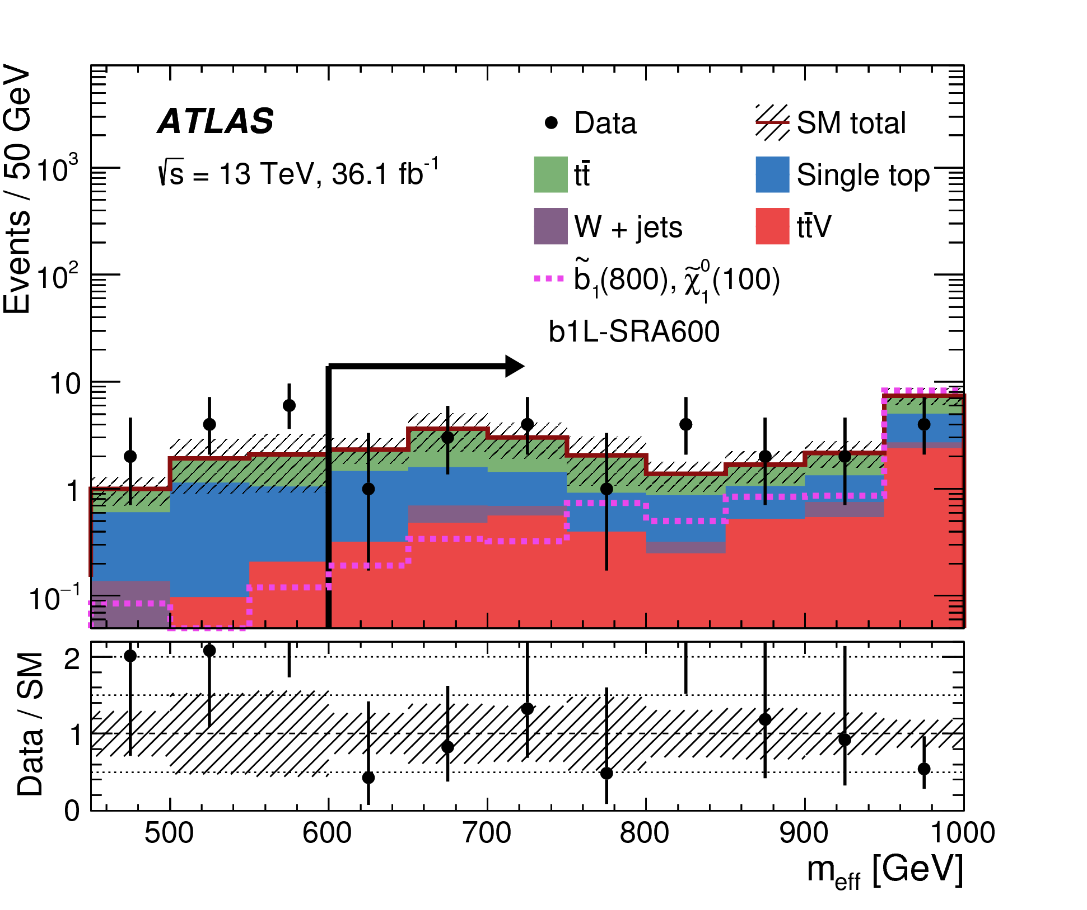
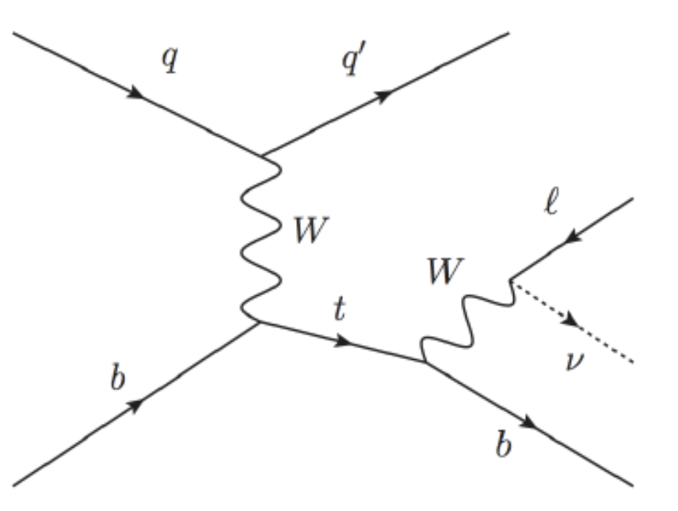
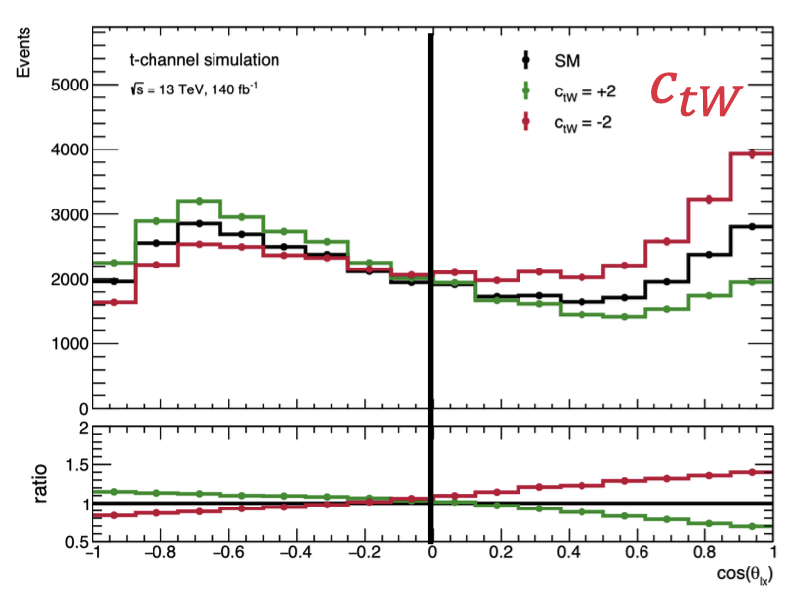
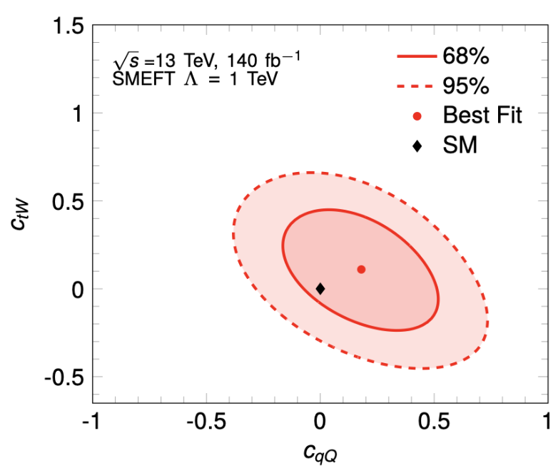
Top-quark Measurements
Jordy's Thesis
Heaviest SM particle provides unique access to bare quark and can only be produced at the LHC
t-channel single top analysis (Jordy’s thesis)
First simultaneous EFT determination in t-chan.
Measure x-section, p_{T} spectrum + angular vars to extract 3 Wilson coefficients: O³_{φq}, Ο³_{qQ} & O_{tW}
Latter split into Re+Im → World best limits on Im
ttZ cross-section in Z→νν channel (John)
Major background to many SUSY searches but has not yet been measured directly
Convert BSM search into x-section analysis benefiting from large Z → νν BR c.f. Z → ee, μμ
EFT interpretation sensitive to left-handed lepton and top-boson Wilson coefficients
Aiming for publication by the end of the year
On track for publication this summer
Notes:
O3phiq = left-hand b quark and left-handed top quark
O3qQ = four ferminon interations
OtW = chiral left-handed b, W and chiral right-handed top
Im part would be new CP violating interaction

Slide 13
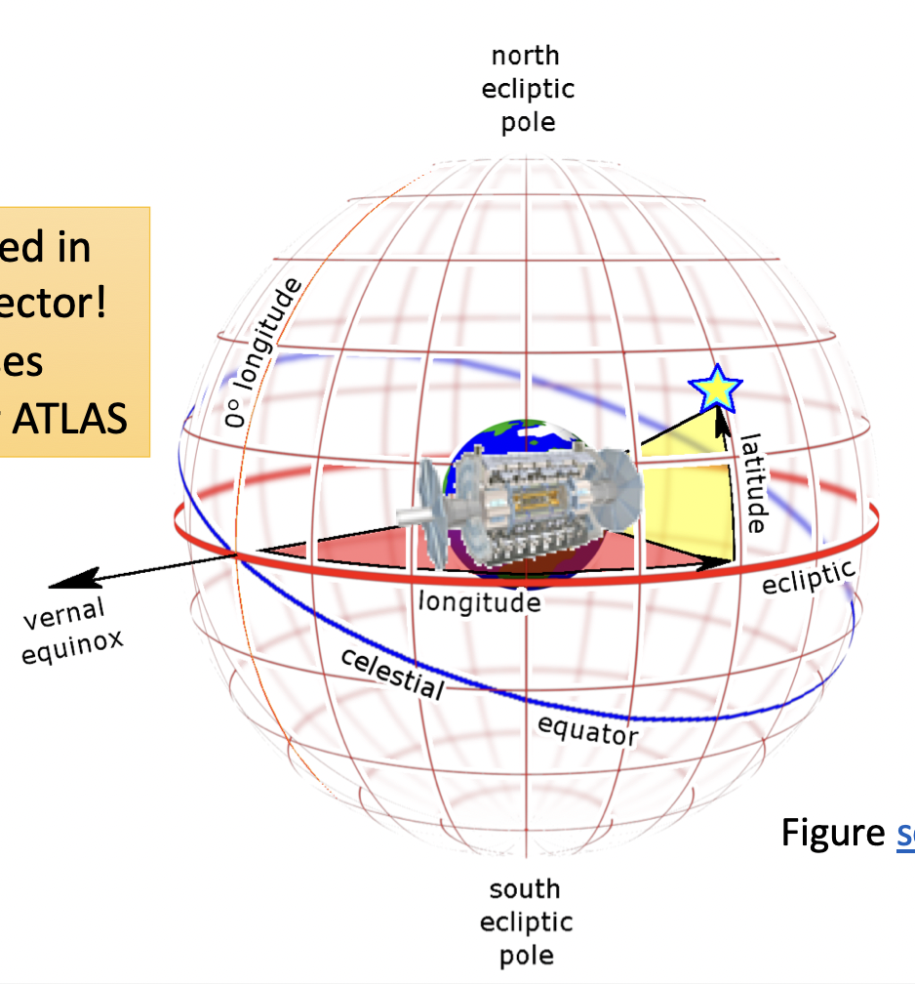
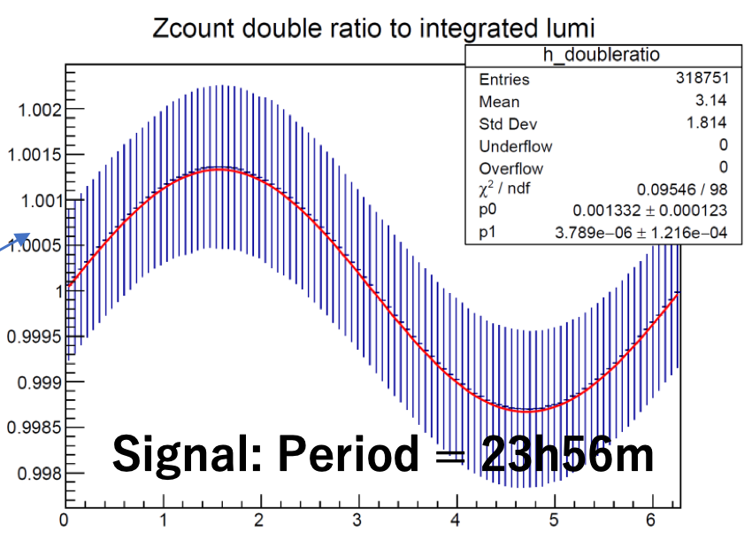
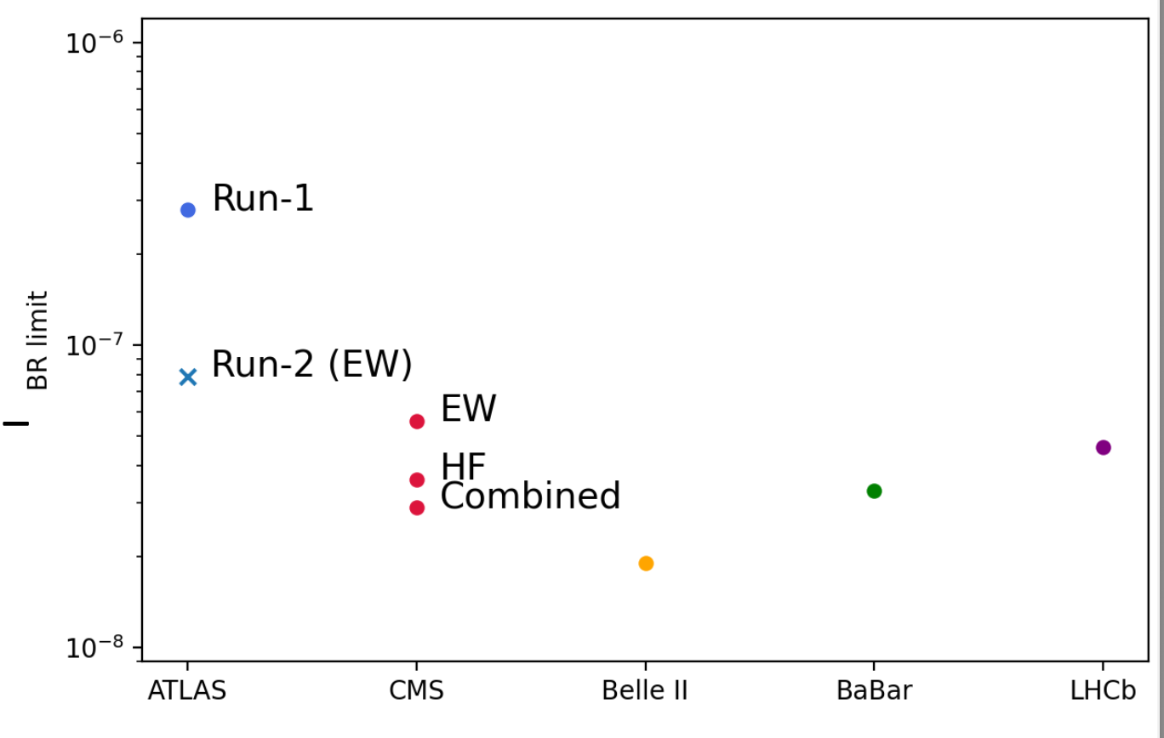
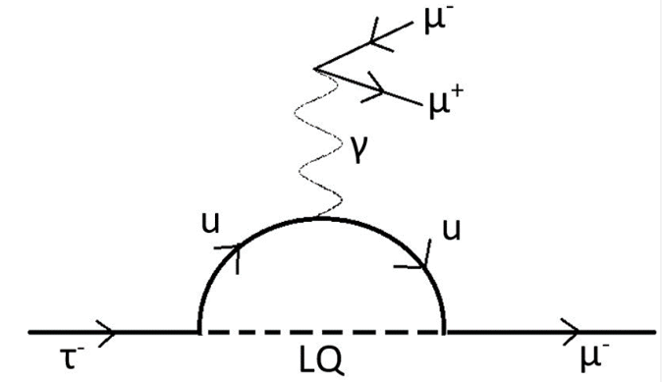
Measurements as Model-Independent BSM probes
Precision measurements and rare processes are powerful model-independent new physics probes
Searches for Lorentz + CPT invariance violation
Non-isotropic background field leads to time-dependent periodic modulations
Uta initiated novel time-dep. Z→ll measurement
Build on SM expertise and Z-counting lumi
Search for cLFV τ → 3μ (Carl, Conor, Jan)
Flavour not a fundamental symmetry of SM
cLFV searches provide model-indep. NP probe
Tau limits 10⁴ less stringent than muon
SM rate tiny (~10⁵⁵), but many BSM enchantments
Suffering a bit from lack of person power
Conor’s PhD thesis is first run-2 ATLAS analysis
Submission by end of Sept, followed by paper

Slide 14
Higgs Physics
SCT + Analysis Software
SM Precision + rare processes
Tau reco. and ID
W mass, W/Z p_{T}, low/high-mass DY, ttZ, single top, rare tau decays
Lumi Measur-ement
b/c –jet tagging
Higgs physics
New physics searches
SM Higgs, Di-Higgs, BSM Higgs
SUSY, Dark Matter, Dark Sector, LLPs, LQs, ALPs, …

Slide 15
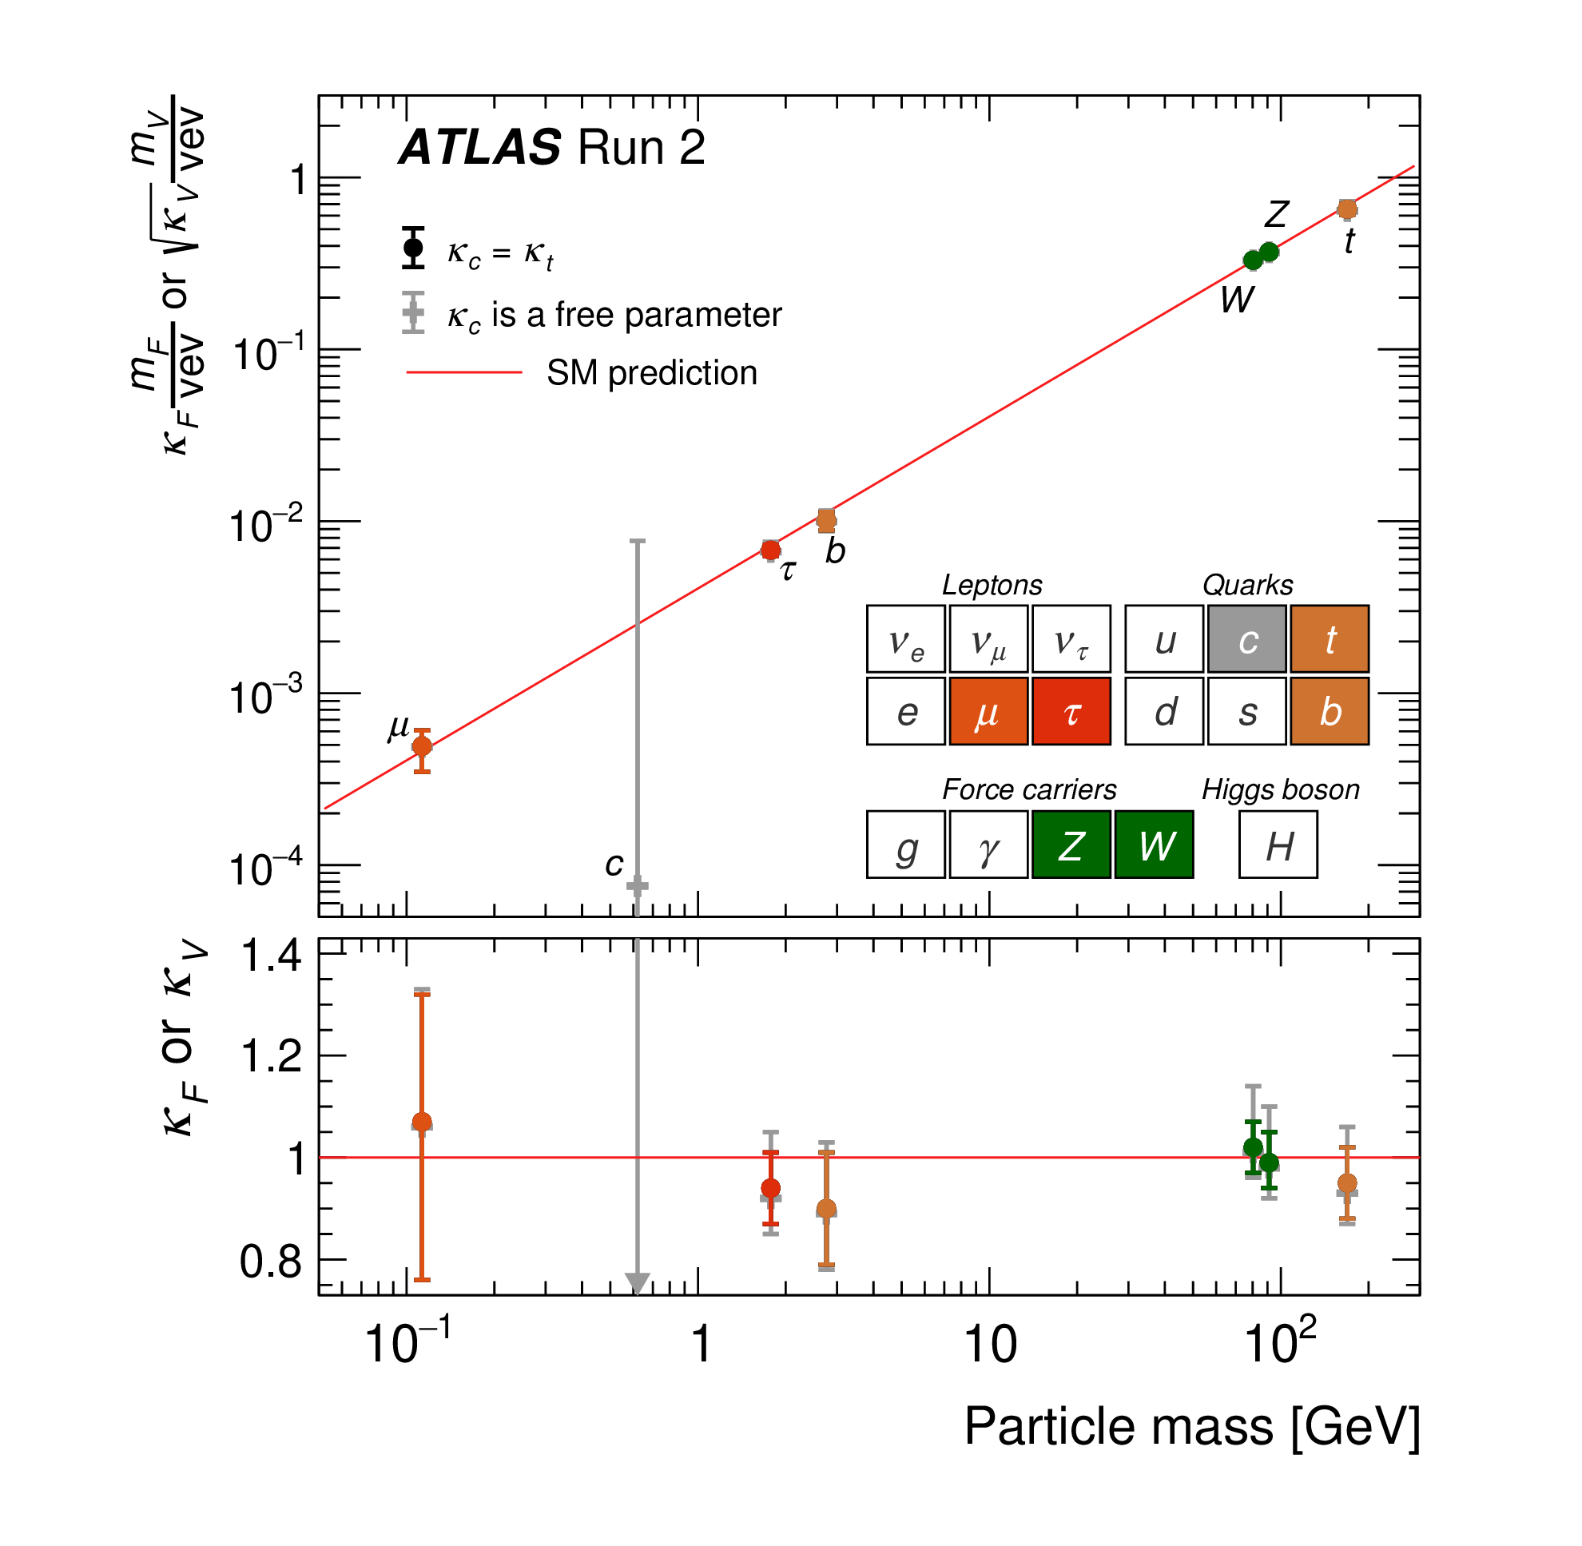
Higgs
The Higgs boson is central to the standard model
Key to understanding EWSB and evolution of Universe
Constrains any new physics getting mass from Higgs
See John’s talk for direct BSM Higgs searches
Have made huge progress since discovery
Measured mass to < 0.1%
125.11± 0.11 GeV
First measurement of width
4.5 +3.3 –2.5 MeV (SM: 4.1 MeV)
Couplings to vector bosons all measured
Including differentially as a function of p_{T}^{H} & N_{jet}
Couplings to 3rd gen fermions all measured
Including differentially as a function of p_{T}^{H} & N_{jet}
Couplings to second generation fermions within reach

Slide 16
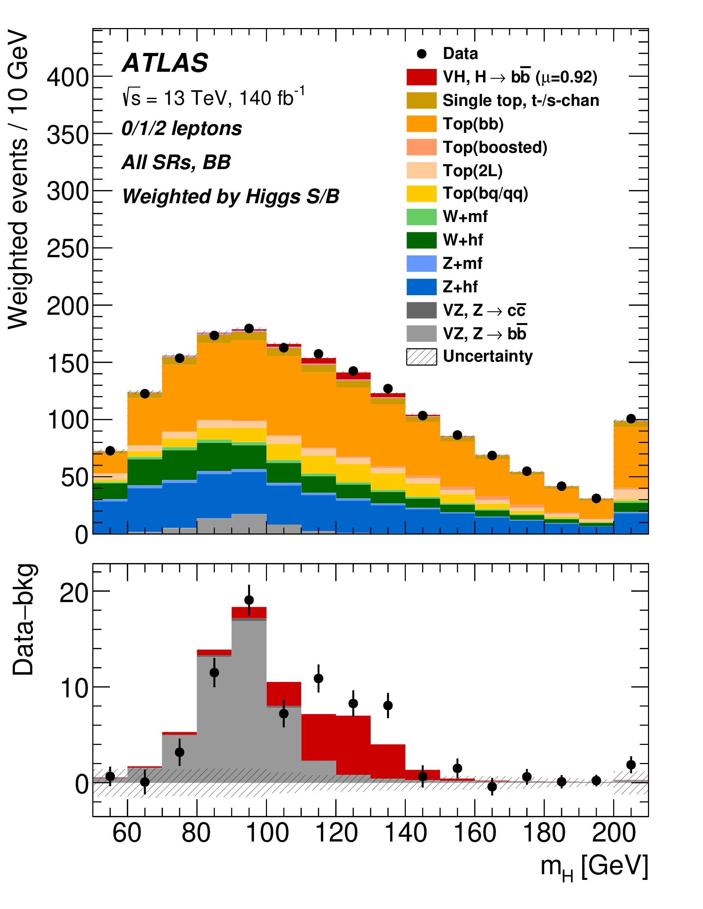
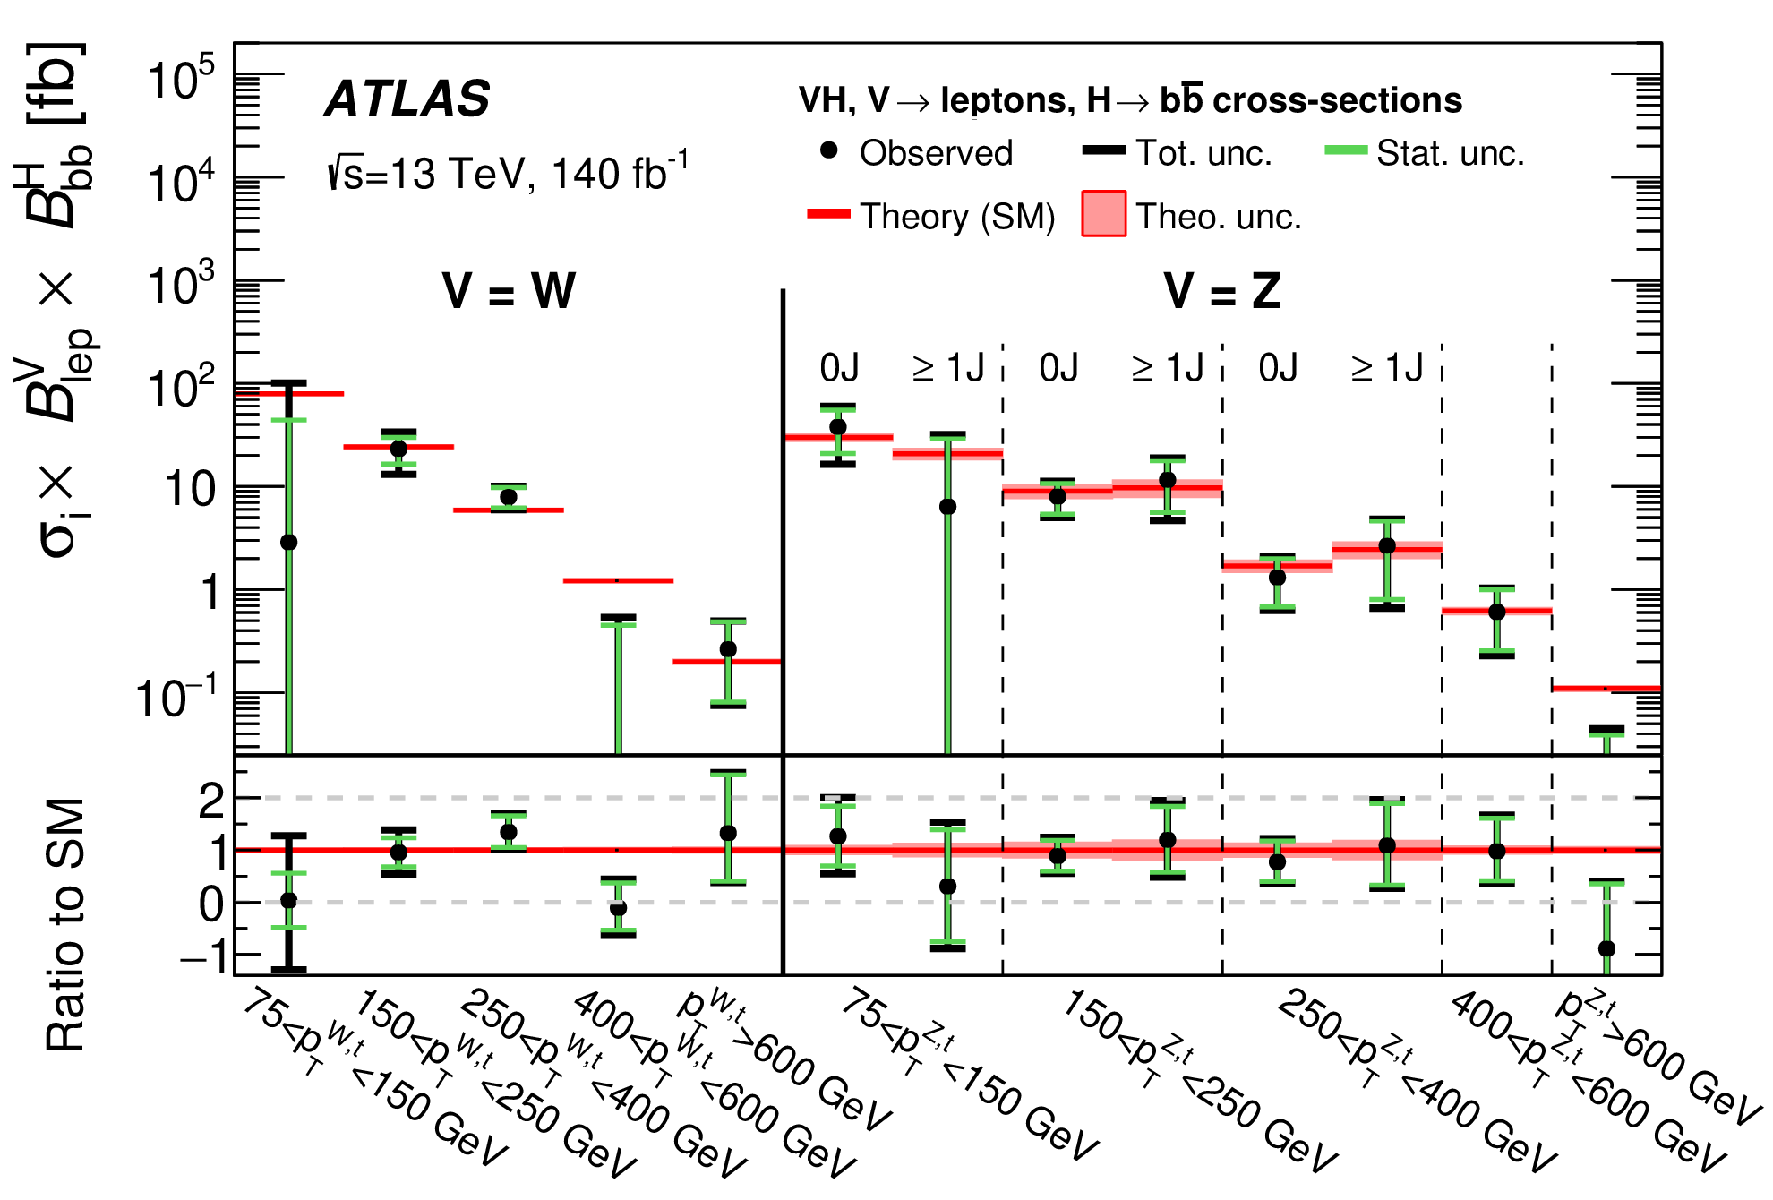
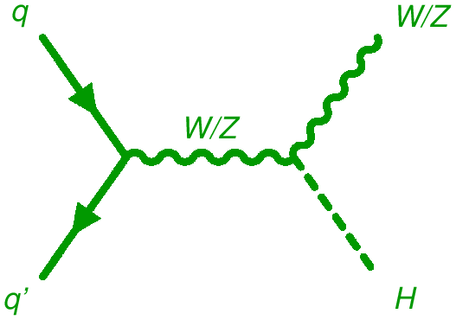
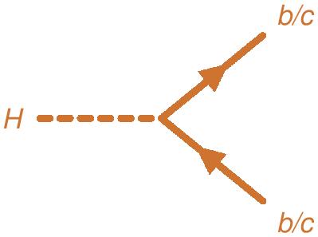
H → bb
arXiv:2410.19611
Long standing Liverpool involvement in H→bb (Andy et al)
Legacy run-2 paper (edited by Andy) published this year
Combined fit to H → bb and H → cc (next slide)
Subject of Ting’s PhD thesis
Event selection, MVA, theory corrections, statistical analysis
Differential cross-sections probing p_{T}^{H} > 600 GeV

Slide 17
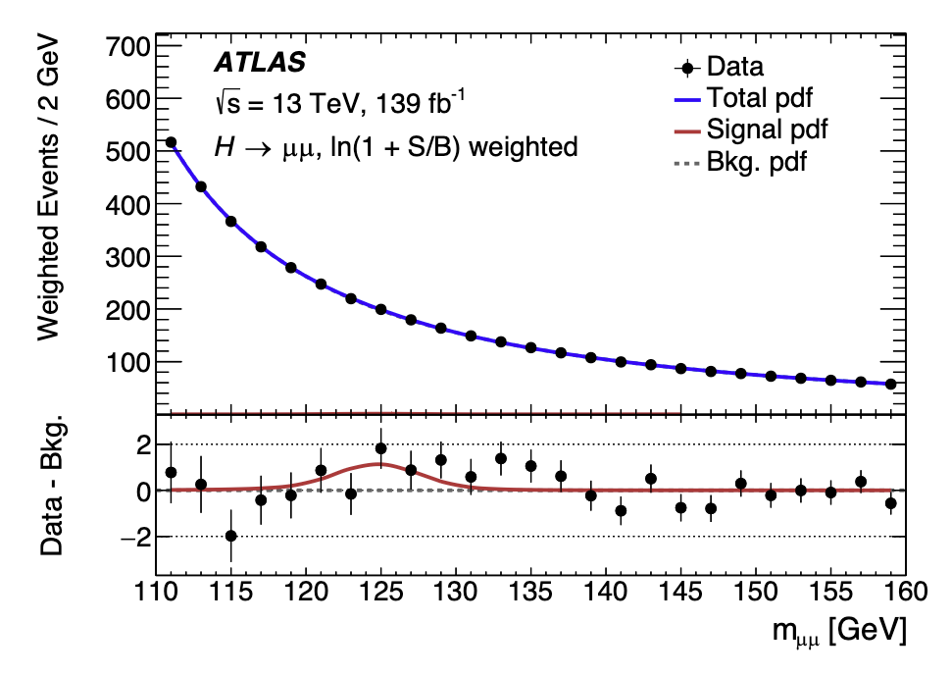
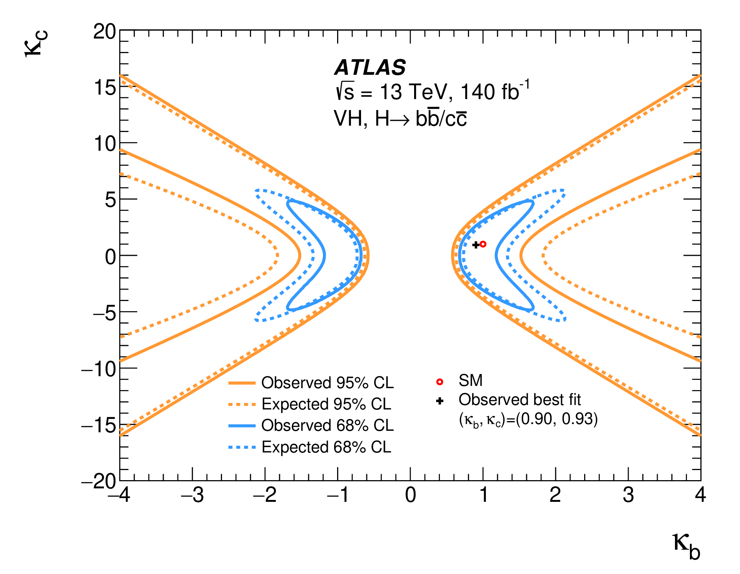
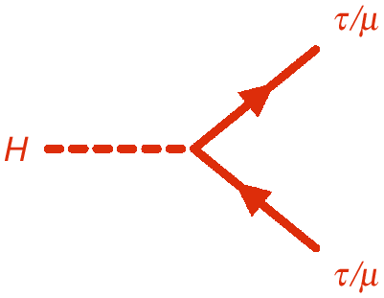
H → cc and H → μμ
arXiv:2410.19611
arXiv:2007.07830
H → cc (Andy, Ting)
Upper limit of 11.5 (10.6) x SM obs (exp)
Combined constraints on relative b- and c-coupling
Will continue HH → bb/cc with full run-3
H → μμ (Jan)
2σ evidence with run-2 data
Ongoing run-3 analysis aiming for 3σ evidence with run-2 + 2022-24 in summer
Followed by 5σ observation with full run-3 data from combined ATLAS+CMS
Previous run-2 result
Plan to reprise rare H→ee (first generation) and H → eμ (LFV) searches with full run-3 data
Giving a factor of 2-3 improvement in sensitivity

Slide 18
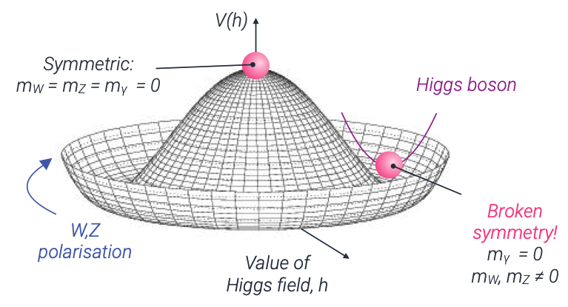
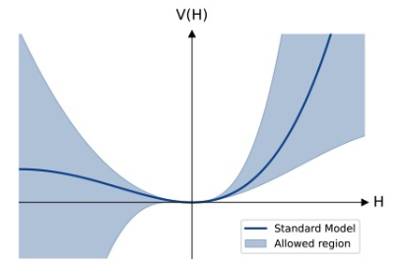
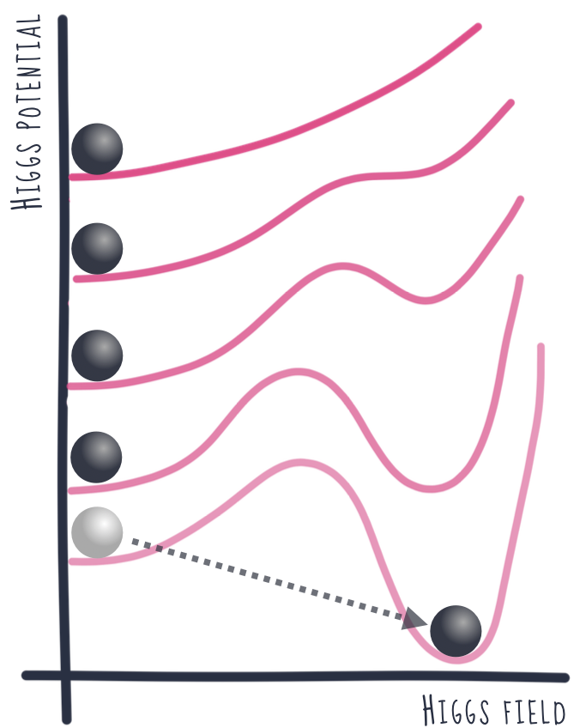
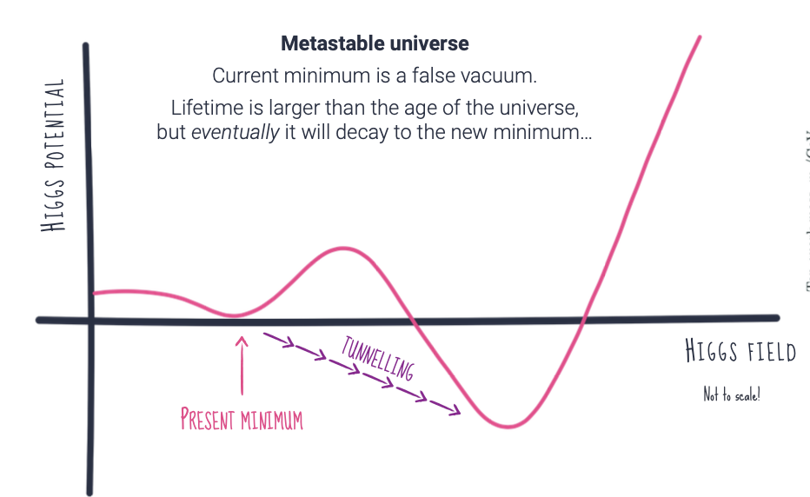
Higgs
The Higgs boson is central to the standard model
Key to understanding EWSB and evolution of Universe
Constrains any new physics getting mass from Higgs
See John’s talk for direct BSM Higgs searches
Have made huge progress since discovery
Measured mass to < 0.1%
125.11± 0.11 GeV
First measurement of width
4.5 +3.3 –2.5 MeV (SM: 4.1 MeV)
Couplings to vector bosons all measured
Including differentially as a function of p_{T}^{H} & N_{jet}
Couplings to 3rd gen fermions all measured
Including differentially as a function of p_{T}^{H} & N_{jet}
Couplings to second generation fermions within reach
But shape of Higgs potential still unknown
Many BSM models alter this with huge consequences
Uniquely probed via Di- and Tri-Higgs production
1st order phase transition?
Metastable universe?
Credit: K.Leney

Slide 19
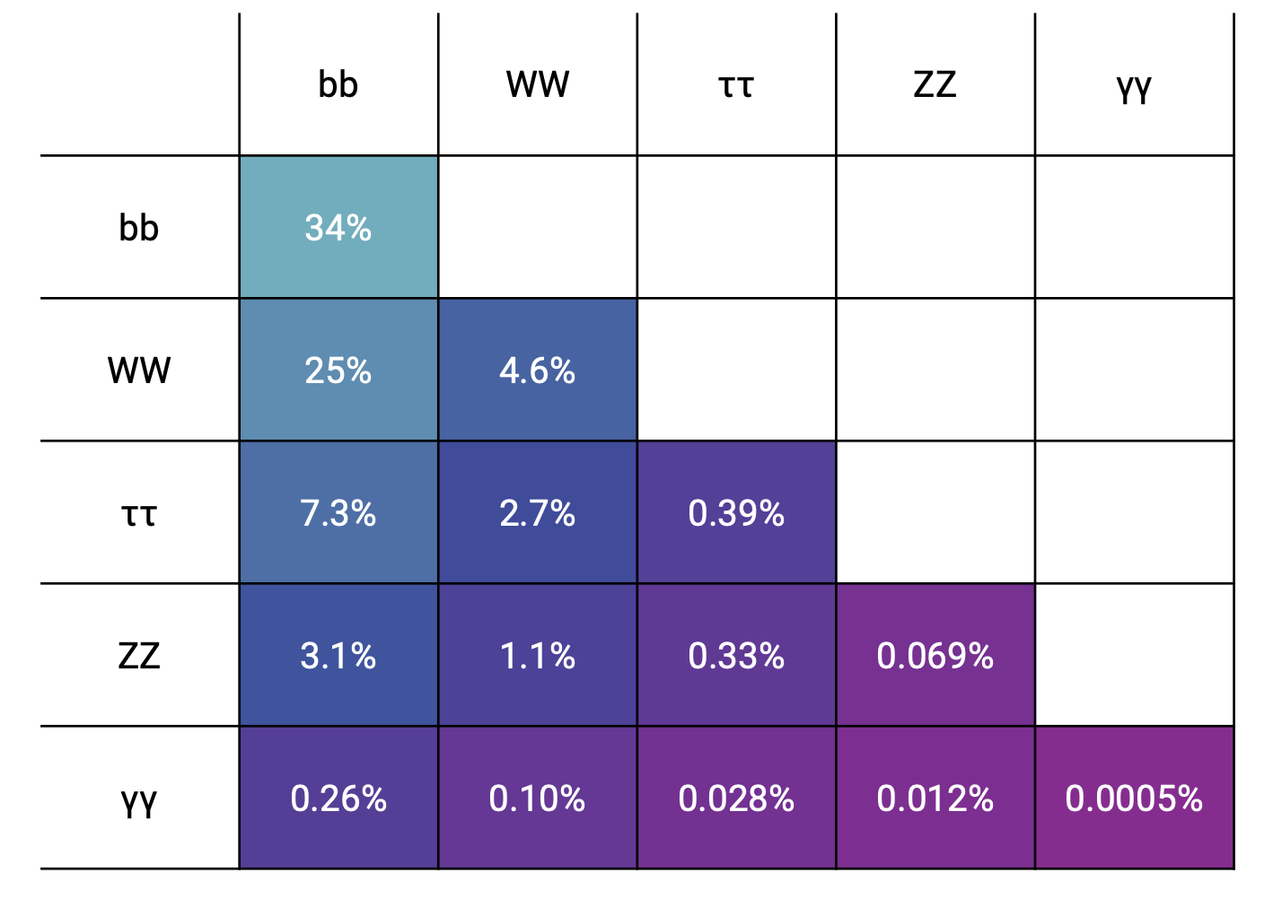
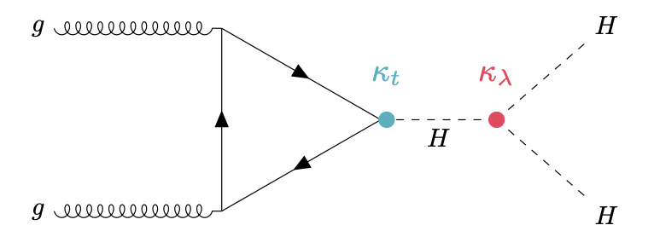
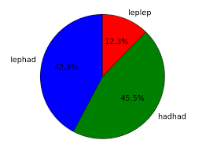
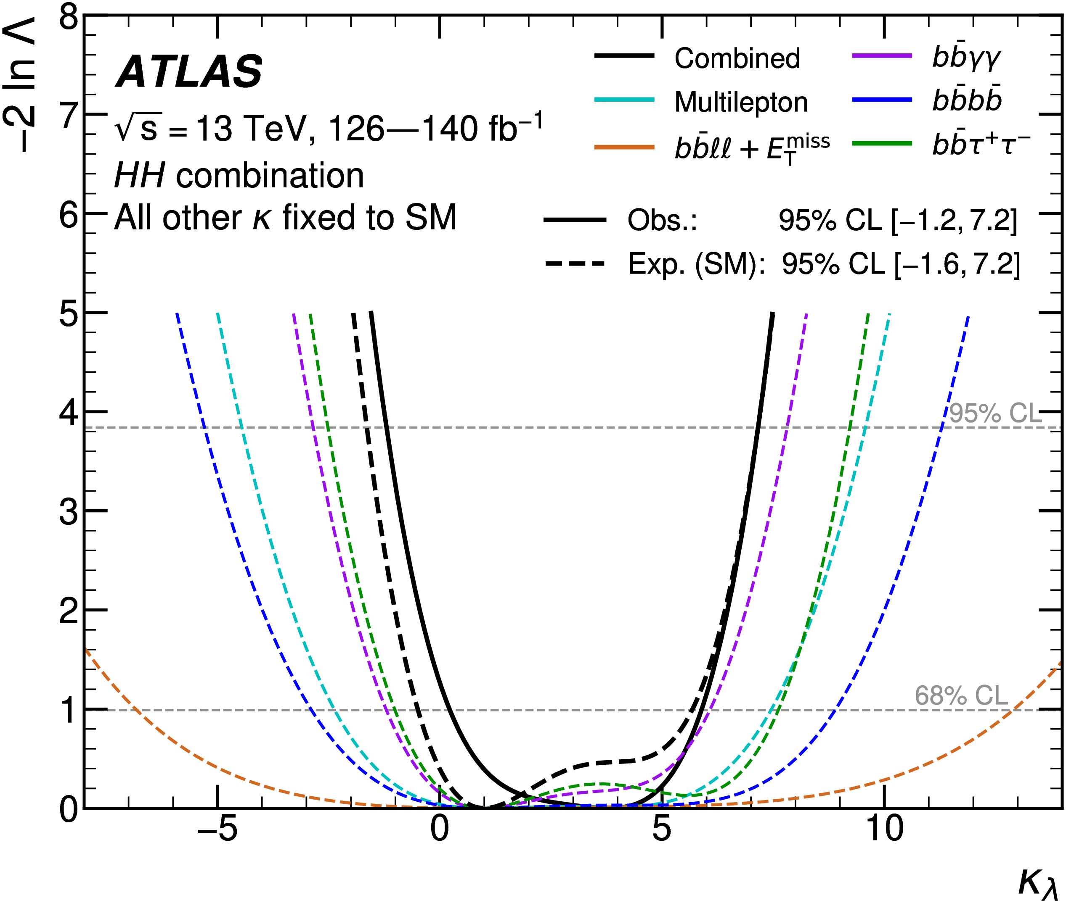
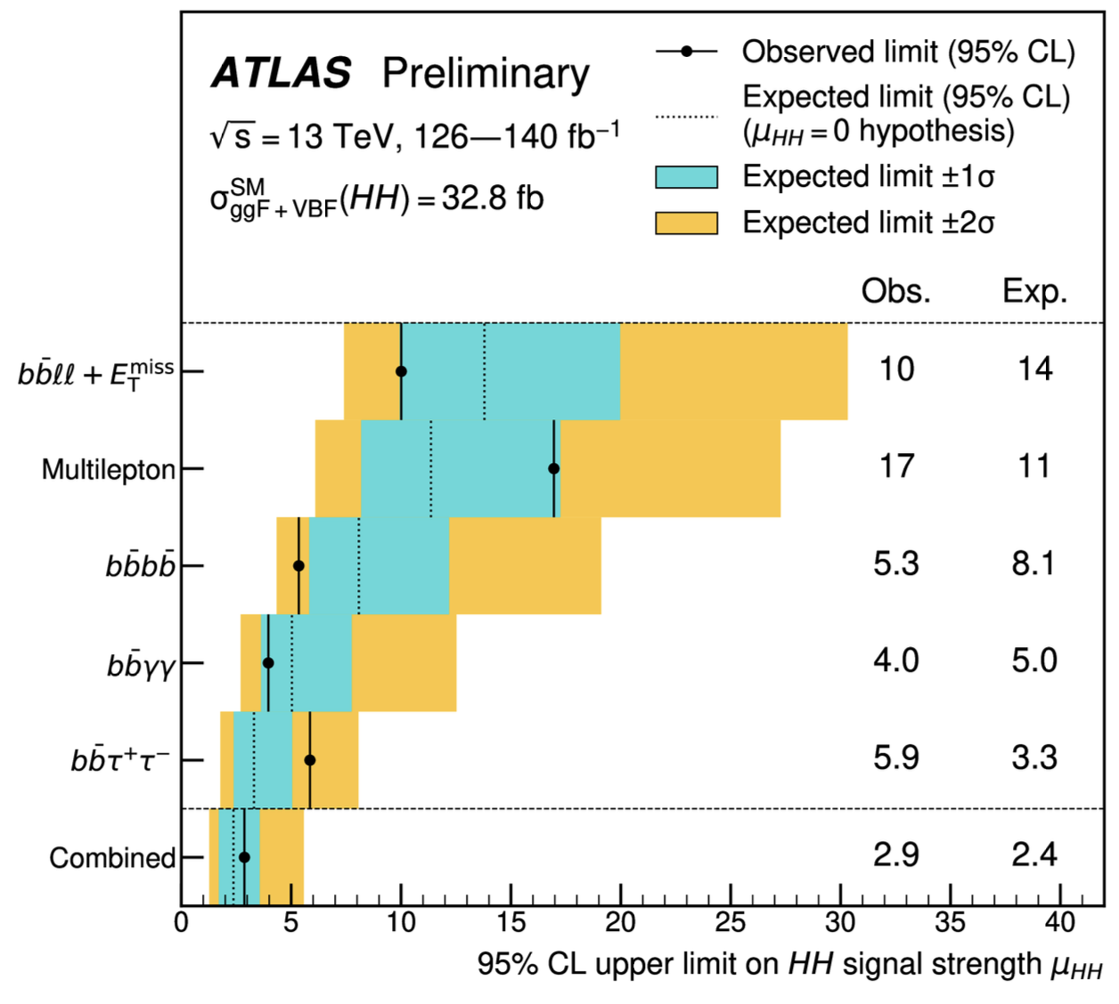
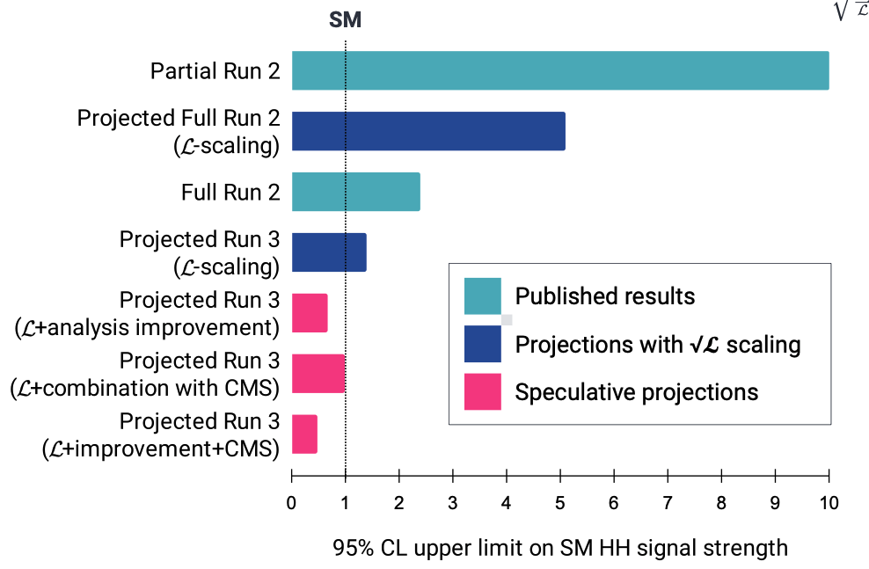
Di- and Tri-Higgs
arXiv:2404.12660
Di-Higgs production probes H self-coupling but σ_{ΗΗ} ≈ 1/1000 of σ_{Η}
Liverpool has been a driving force in HH→bbττ since start of run-2
Lead full run-2 lephad channel, giving most sensitive expected σ limit
Currently working on hadhad channel for run-2+3 (Carl, Jordy, Bhupesh)
Lead developer of analysis fwk (Jordy), Top modelling (see Bhupesh’s talk)
GNN S/B discriminant (Jordy, Carl) + NN di-tau mass regression (Alice MPHYS)
Aim for partial run-3 result by end of ‘25 + 3σ evidence with full run-2+3
bbττ is sweet spot of BR & bkg
λ₃
Improvements in τ/b ID, triggers, …

Slide 20
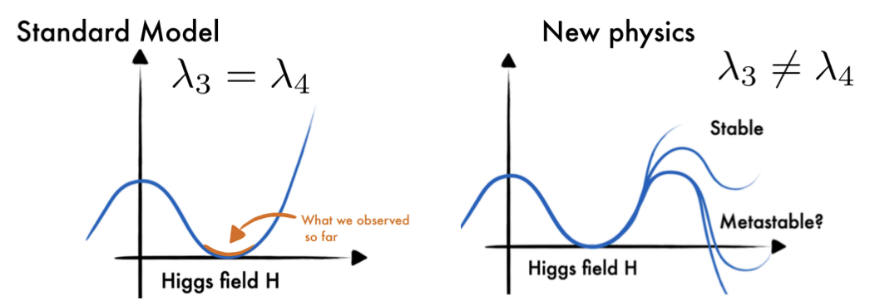
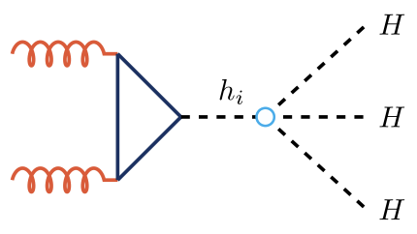
Di- and Tri-Higgs
arXiv:2404.12660
Di-Higgs production probes H self-coupling but σ_{ΗΗ} ≈ 1/1000 of σ_{Η}
Liverpool has been a driving force in HH→bbττ since start of run-2
Lead full run-2 lephad channel, giving most sensitive expected σ limit
Currently working on hadhad channel for run-2+3 (Carl, Jordy, Bhupesh)
Lead developer of analysis fwk (Jordy), Top modelling (see Bhupesh’s talk)
GNN S/B discriminant (Jordy, Carl) + NN di-tau mass regression (Alice MPHYS)
Aim for partial run-3 result by end of ‘25 + 3σ evidence with full run-2+3
bbττ is sweet spot of BR & bkg
λ₃
SM predicts λ₃ = λ₄
But BSM physics can make them different
Measure via Tri-Higgs in HHH → bbbbττ
Improvements in τ/b ID, triggers, …
λ₄

Slide 21
New Physics Searches
SCT + Analysis Software
SM Precision + rare processes
Tau reco. and ID
W mass, W/Z p_{T}, low/high-mass DY, ttZ, single top, rare tau decays
Lumi Measur-ement
b/c –jet tagging
Higgs physics
New physics searches
See John’s talk
SM Higgs, Di-Higgs, BSM Higgs
SUSY, Dark Matter, Dark Sector, LLPs, LQs, ALPs, …

Slide 22
Conclusion
ATLAS continues to perform vibrant and dynamic research covering a huge spectrum
From precise measurements to searches for new physics in unexplored phase space (John)
Detector performing efficiently despite challenging pile-up conditions
Coupled with significant ML-enabled improvements in simulation and reconstruction
Analysis of run-3 data, with factor >3 increase in luminosity expected, in full swing
Will provide a wealth of new results that form the long-term legacy of the LHC
Liverpool continuing to play a central role across ATLAS, recognised by several leadership roles
From detector operations, via simulation and reconstruction software, to physics analysis
Proposing novel analyses and exploiting state-of-the-art ML techniques (e.g. MUCCA)
Expect ≈10 further publications by end of 2025
With the HL-LHC just round the corner, we have only just scratched the surface of physics results
Liverpool playing a key role in ensuring ATLAS is ready to make the most of this (Helen)

Slide 23
None of this would be possible without ...
Max, who laid the groundwork for the LIV ATLAS group, and is sorely missed
Monica, who did an amazing job of leading the group the last 7+ years

