Slide 1
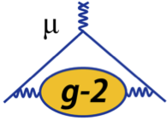
Yr 3 HEP presentation
Katie Ferraby
1

Slide 2
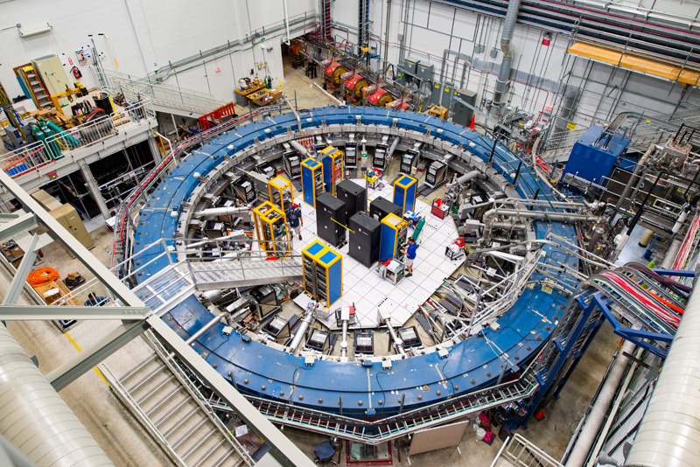
g-2
g-2 investigates the behaviour of the muons in a lab frame B-field.
g-2 is a storage ring experiment to measure the muon anomaly, $a_{μ}=\frac{g−2}{2}.$
The magnetic dipole moment is a measure of the strength of the muon’s interaction with a B-field.
The g-factor relates the magnetic dipole moment (MDM) of a particle to its spin.
$η$ is analogous to the g-factor – it relates the electric dipole moment (EDM) of a particle to its spin.
$\vec{μ}=g\frac{ⅇ}{2m}\vec{s}$
$\vec{d}=η\frac{ⅇ}{2m}\vec{s}$
MDM
EDM
2

Slide 3
EDM signature
Muon EDM causes the precession plane to tilt towards the centre of the storage ring.
The average vertical angle of the positrons oscillates at the g-2 frequency and has an amplitude proportional to the EDM signal.
We use a ~sinusoidal fit to the average positron vertical angle to get amplitude of oscillation.
The amplitude can be converted to the tilt in the precession plane and the EDM can be extracted.
3

Slide 4
Significance of the muon MDM and muon EDM
Muon EDM:
Muons should not have a measurable EDM because particle EDMs violate CP symmetry.
The matter antimatter asymmetry in the Universe can be explained with more sources of CP violation.
If the muon has an EDM, this can help further probe and explain the asymmetry.
Muon MDM:
MUonE will help “finalise” the theory value for the muon anomaly.
If the muon anomaly remains, this is evidence for new physics and a flaw in the Standard Model.
4

Slide 5
EDM fit function
Amplitude $\frac{π}{2}$ out of phase with the g-2 oscillation
Amplitude in phase with the g-2 oscillation
$$\left\langle θ_{y}\right\rangle =\frac{A_{EDM}\sin\left(ωt+φ\right)+A_{g−2}cos\left(ωt+ φ\right)}{1+A_{N}cos\left(ωt+ φ\right)}+c$$
Amplitude from the number of positrons oscillation
5

Slide 6
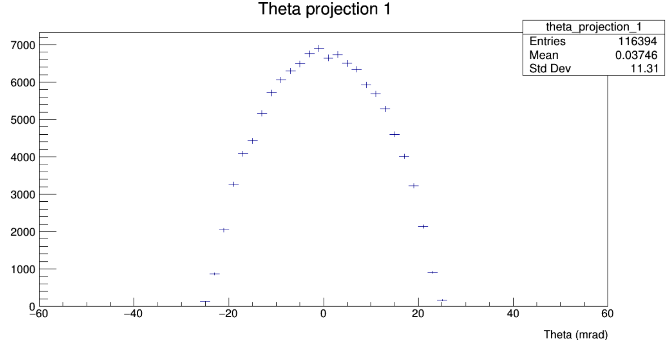
BNL vs FNAL
$$N_{D}$$
$$N_{U}$$
The angle the positron makes with the orbit plane
$$A_{±}=\frac{N_{U}−N_{D}}{N_{U}+N_{D}}=\frac{\sum_{θ_{y}>0}{p\left(θ,λ\right)}−\sum_{θ_{y}<0}{p\left(θ,λ\right)}}{\sum{p\left(θ,λ\right)}}$$
$${\left\langle θ_{y}\right\rangle }_{λ}=\frac{\sum{θp\left(θ,λ\right)}}{\sum{p\left(θ,λ\right)}}$$
We compare the statistical sensitivity of the two methods to parameterise the tilt; $A_{±}$ and ${\left\langle θ_{y}\right\rangle }_{λ}$
6

Slide 7
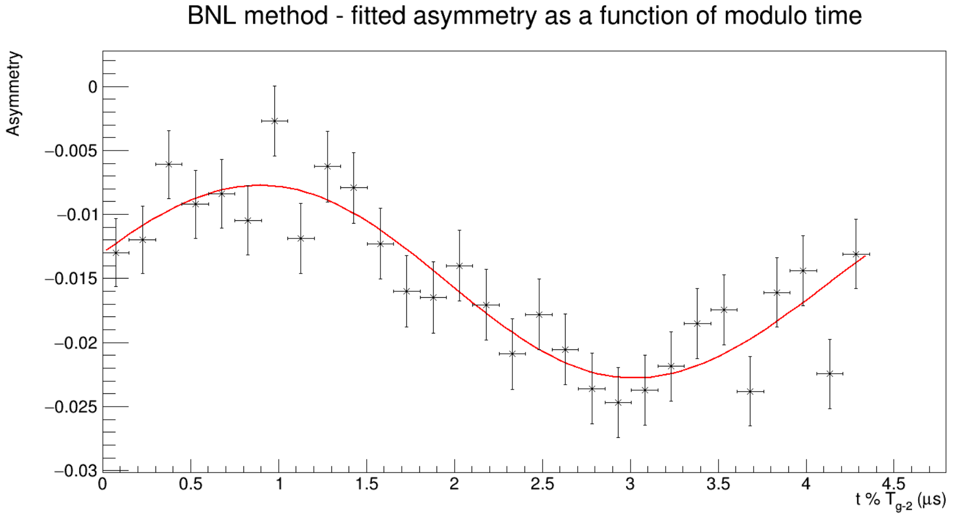
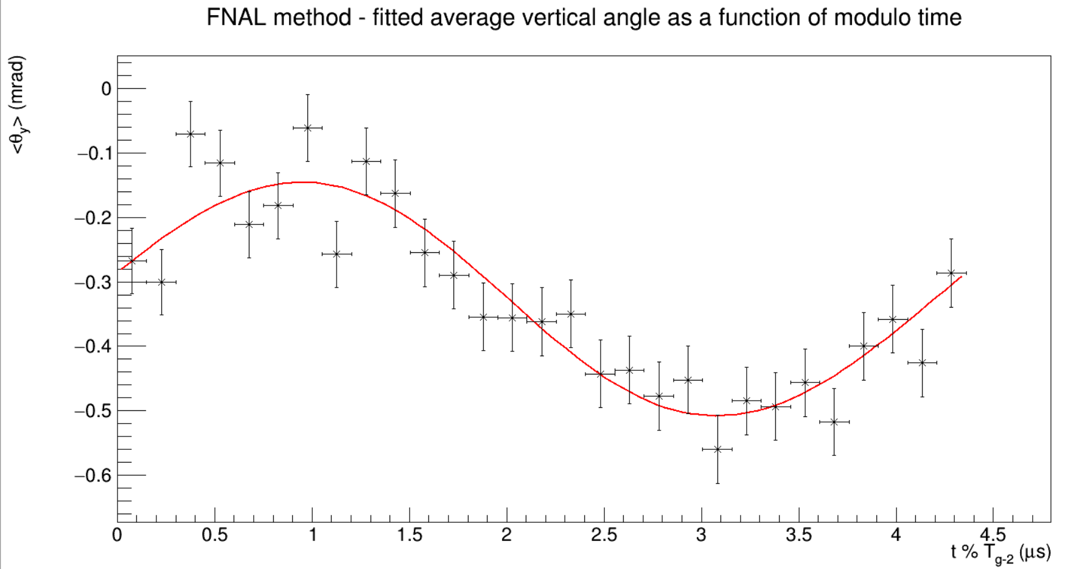
Fitted EDM plots
These plots use Monte Carlo data.
In the Monte Carlo dataset, there is an artificial EDM signal.
The raw data is blinded before the fits are applied by adding in an EDM of unknown size.
If there was no EDM, and no blinding applied, the average vertical angle would be flat.
1000 < p < 1250 MeV
1000 < p < 1250 MeV
7

Slide 8
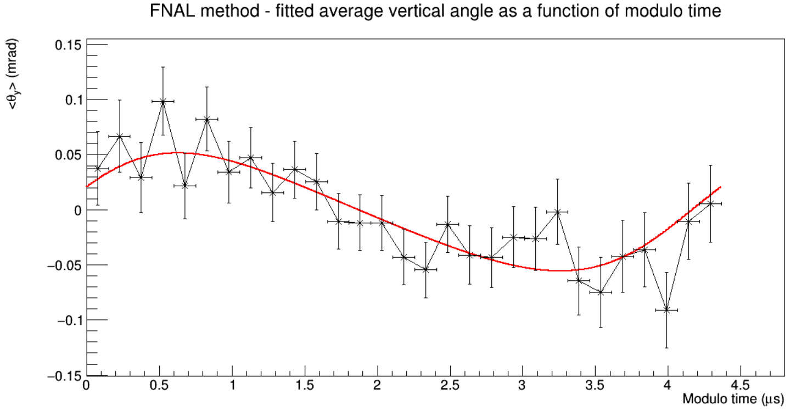
Figure of Merit (FOM)
We have no sensitivity to the EDM when the y-value equals 0.
We have maximum sensitivity when the y-value is at the max amplitude.
$$FOM=\sum_{i}{\frac{{\left\langle θ_{y,i}^{EDM}−θ_{y,i}^{no EDM}\right\rangle }^{2}}{{\left\langle σ_{θ_{i}}^{EDM}\right\rangle }^{2}+{\left\langle σ_{θ_{i}}^{no EDM}\right\rangle }^{2}}}=\sum_{i}{\frac{{\left\langle θ_{y,i}^{EDM}\right\rangle }^{2}}{{\left\langle 2σ_{θ_{i}}^{EDM}\right\rangle }^{2}}}$$
Based on the FOM, it is better to use the average vertical angle method as the statistical sensitivity is ~40% better than the asymmetry method.
8

Slide 9
Current plans
We’ve seen that using the average angle method is ~40% better than using the asymmetry method.
We now want to test a weighted average angle method and calculate its FOM.
We will weight based on the most sensitive vertical angles to an EDM for a given positron momentum.
New weighting terms
$${\left\{θ_{y}\right\}}_{λ}=\frac{\sum{θp\left(θ,λ\right)ω\left(θ,λ\right)}}{\sum{p\left(θ,λ\right)ω\left(θ,λ\right)}}$$
9

Slide 10
Muon anomaly
$$a_{μ}=\frac{g−2}{2}$$
$a_{μ}$ = $a_{μ}^{QED}$ + $a_{μ}^{EWK}$ + $a_{μ}^{QCD}$+ $\left(a_{μ}^{BSM}?\right)$
$a_{μ}^{HLO}$ is the largest source of uncertainty on the theoretical determination of $a_{μ}$ despite not being the largest contribution to $a_{μ}$.
MUonE is a muon-electron scattering experiment, the signal is from the precise measurement of the muon and electron angles for elastic events.
It will provide a new independent determination of the hadronic vacuum polarisation contribution to the muon anomaly, $a_{μ}^{HLO}$.
10

Slide 11
MUonE
MUonE timeline: 2023 run (2 stations), 2025 run (3 stations), full experiment 40 stations (post-LS3)
1 station
Background process*
(Nuclear pair production)
Signal process*
These events occur in each target.
If one of the outgoing tracks leaves the detector acceptance, a background event could look like a signal event as we only see one incoming and two outgoing tracks.
*Simplified event displays
11
11/12

Slide 12
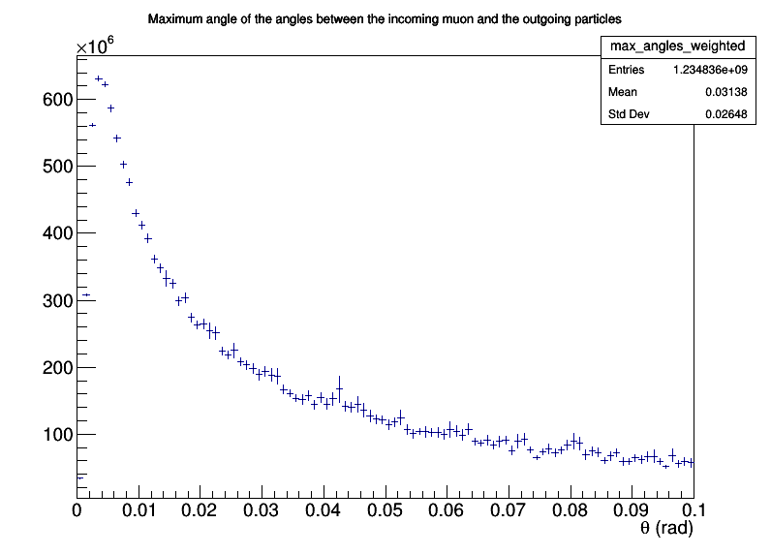
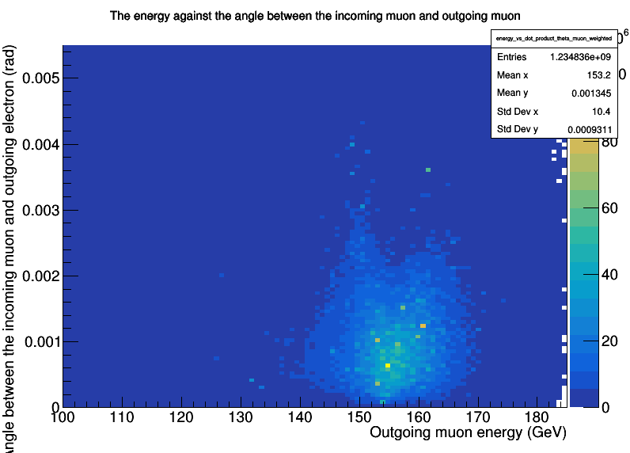
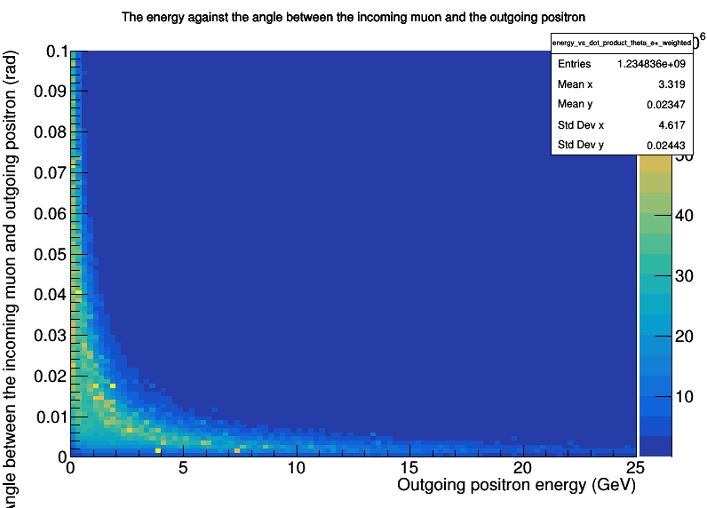
Background events - simulation
I’m studying the performance of the new MC generator so that it can be used to study pair production events which is a background process in MUonE.
I’m simulating nuclear background events using an event generator and a simulated target of 3cm. These plots help check that the events generated by MESMER produce kinematic distributions that match the expectation from theory.
Maximum angle of the angles between the incoming muon and the outgoing particles
The energy against the angle between the incoming muon and outgoing positron
In nuclear pair production, the electron and positron are typically emitted at small angles and low energies, especially at high muon energies. This forward-peaked distribution, seen in the data above, is consistent with a soft, collinear nuclear pair production process.
The energy against the angle between the incoming and outgoing muon
12

Slide 13
Conclusion:
g-2:
I’m working towards the final EDM limit that will be set by the Fermilab g-2 experiment and testing a new method for calculating the EDM limit.
MUonE:
Currently I’m working on a background-signal comparison and a background vs 2023/2025 test beam data.
The future plans of MUonE will be presented by Saskia.
Thank you!
13

Slide 14
Back up

Slide 15
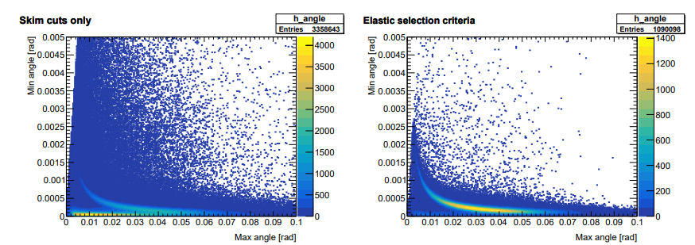
Background contamination
Background events contaminate the signal and even with selection cuts to remove background events, currently the cuts do not remove all background.
More analysis is needed to remove the background completely.
Remaining background events
Remaining background events

