Slide 1
MuEDM experiment
Joe Price

Slide 2
MuEDM @ PSI – frozen spin
Permanent EDMs give an additional source of CP violation
Can search for them directly in a storage ring:
AMM
term
EDM
term
Relativistic spin precession of a charged particle (Thomas-BMT equation)
Muon momentum, E-field and B-field form an orthogonal basis:
By applying an appropriate radial E-field to the muon we remove the AMM term.
Any observed spin precession would be due to a non-zero EDM.

Slide 3
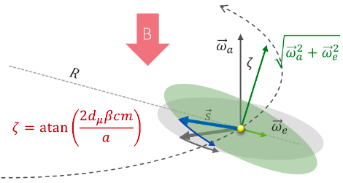
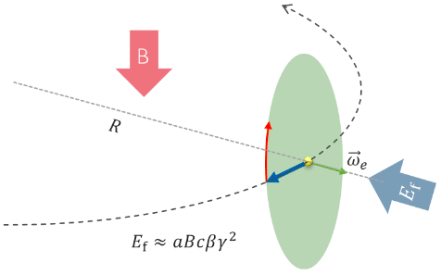
Frozen spin - visual
Without frozen spin condition an EDM tilts the precession plane
This is Fermilab-style EDM search
With frozen spin condition an EDM is the only cause of the precession
This is PSI-style EDM search
Advantage of frozen spin: Every positron is useful!

Slide 4
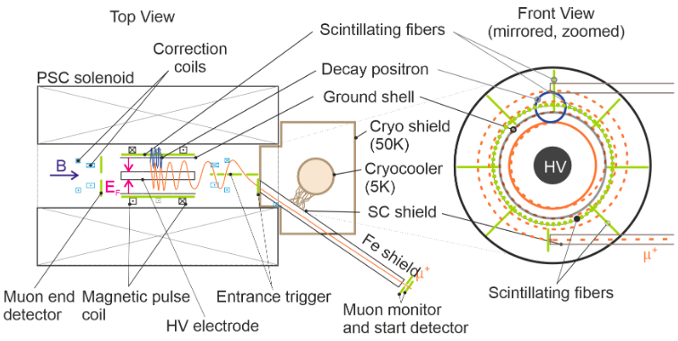
MuEDM@PSI - overview
Store muons one at a time, freeze spin, observe change in polarisation vector due to muon EDM by measuring positrons
Plan to run in 2 different phases with different muon momenta
Phase I (${|p}_{μ}|≈28$MeV) and Phase II ($|p_{μ}|≈125$MeV)
Projected sensitivity
Phase I: $σ(d_{μ})≤{3 × 10}^{−21}$e.cm
Phase II: ${σ(d_{μ})≤6 × 10}^{−23}$e.cm
arxiv 2501.18979 (EPJC to follow)

Slide 5
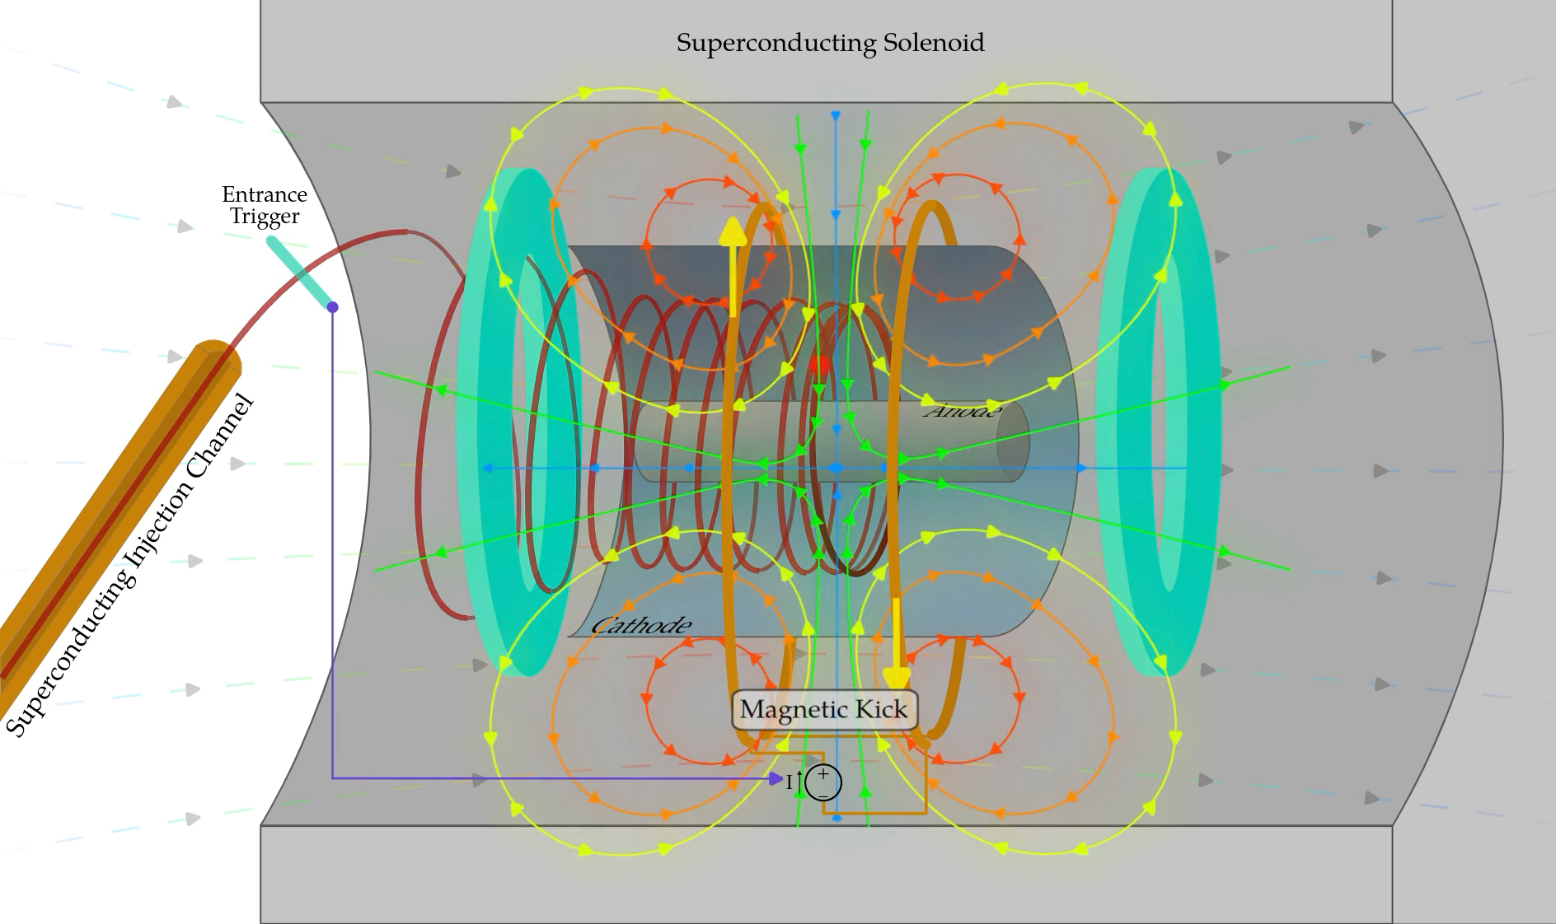
Magnetic kicker
Magnetic longitudinal ‘kick’ to keep injected muons in central orbit
Trigger configured in 2024 test beam – storage tests in 2025

Slide 6
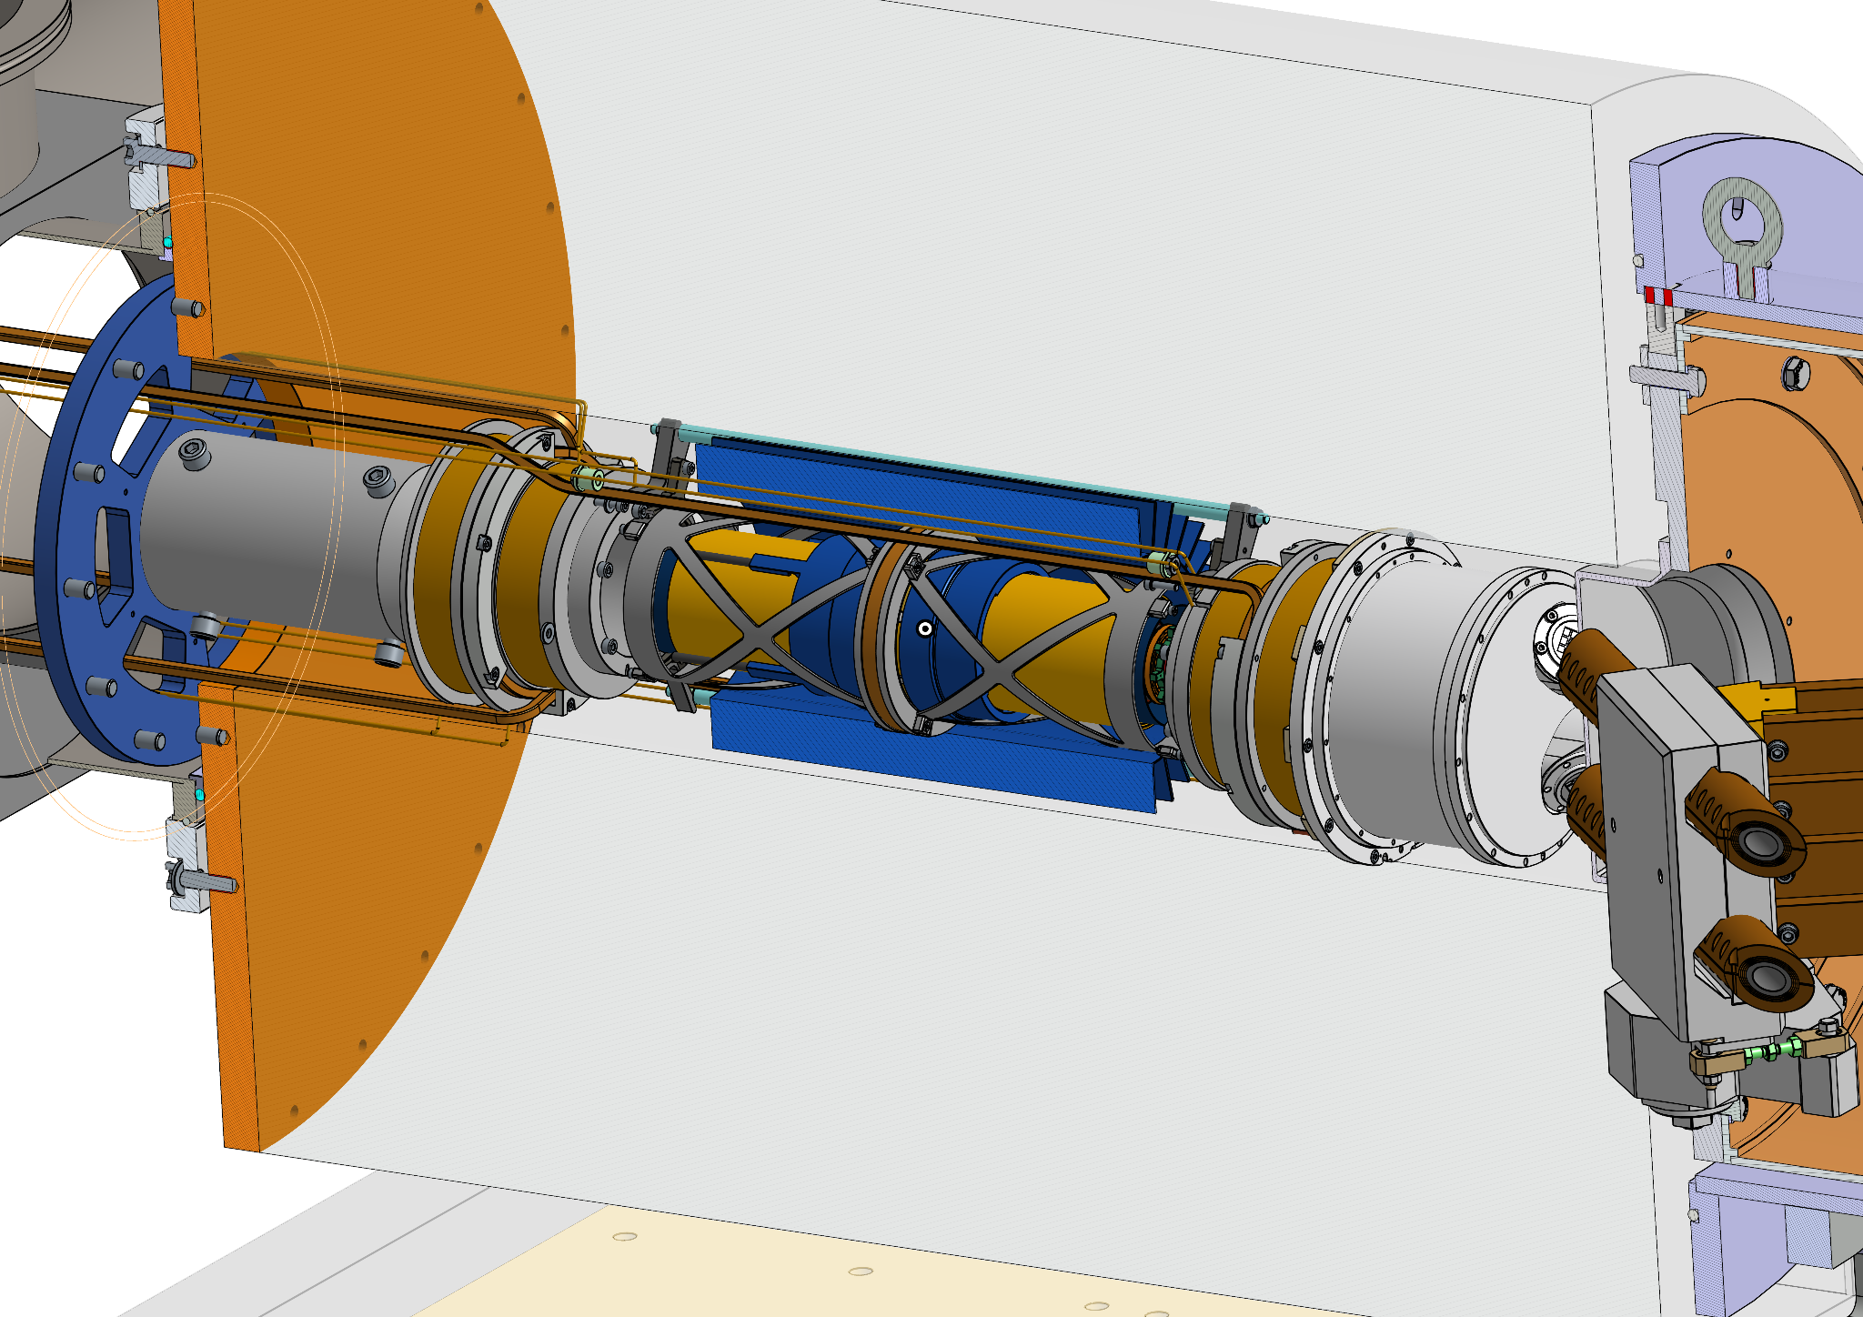
Magnetic field - storage
Design of correction coils finalised in 2024/5
Modified ‘correction coils’ to ensure storage in central B-field
Challenging windings for coils due to heat transfer and vacuum requirements
UK deliverable – Daresbury Laboratory

Slide 7
Magnetic field - storage
Dip for central storage
Monotonically increasing (just)
Modified ‘correction coils’ to ensure storage in central B-field
Challenging windings for coils due to heat transfer and vacuum requirements
UK deliverable – Daresbury Laboratory

Slide 8
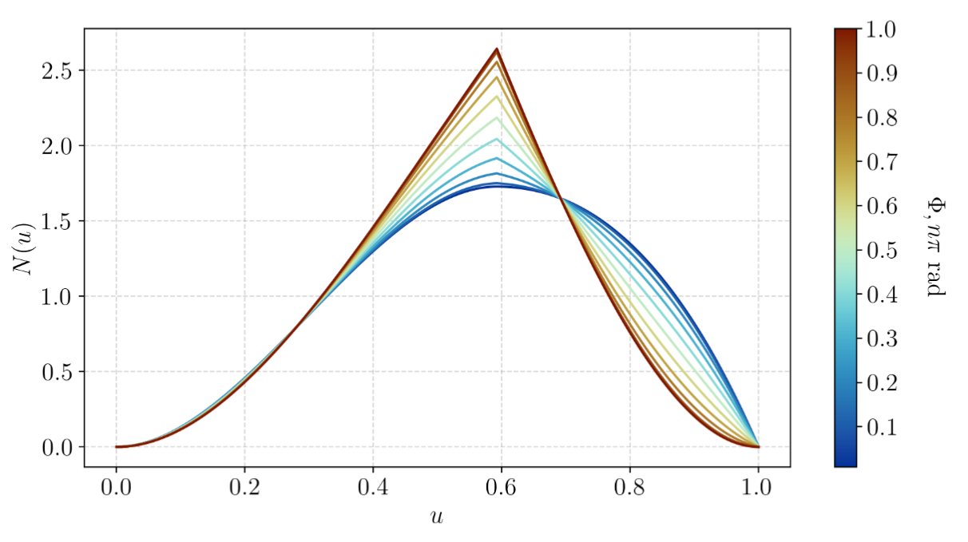
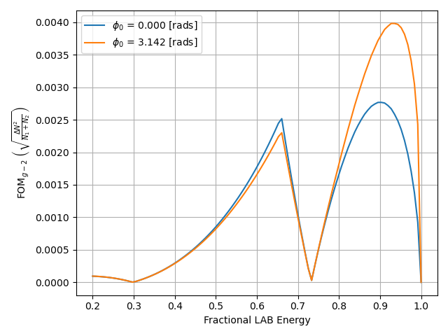
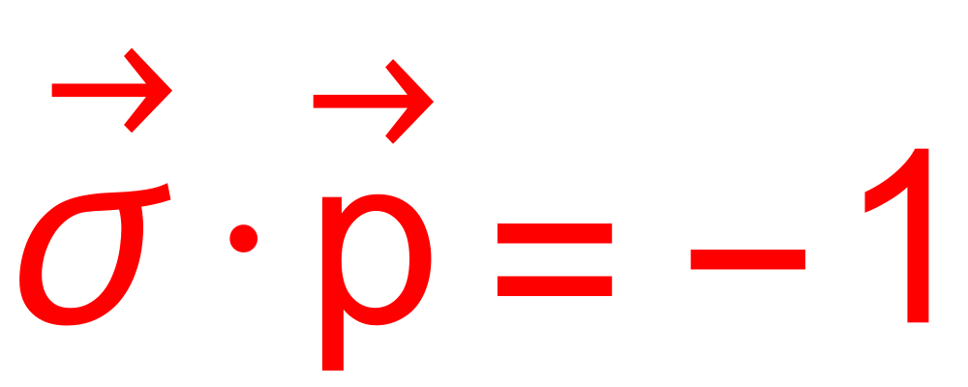
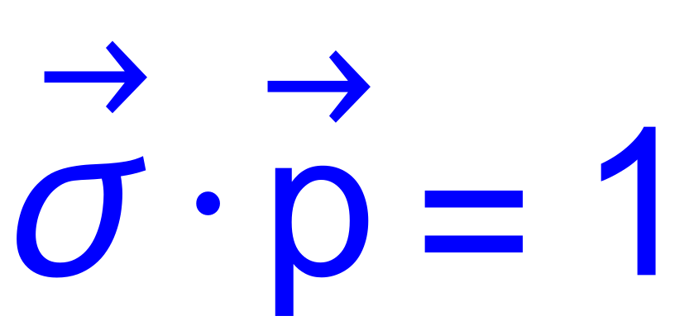
Demonstrating frozen spin method
Phase I
Phase II
Stored anti-muons will decay to positrons
Phase-I goal: demonstrate frozen spin method by ensuring no g-2 style oscillation
Need to know which positrons which are most sensitive to g-2
Momentum of most sensitive positrons shown above, also optimised for longitudinal angle – Work done here at Liverpool

Slide 9
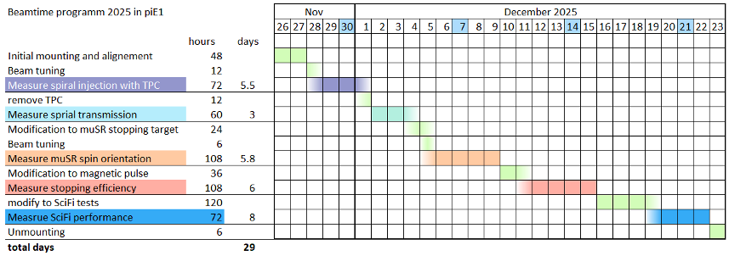
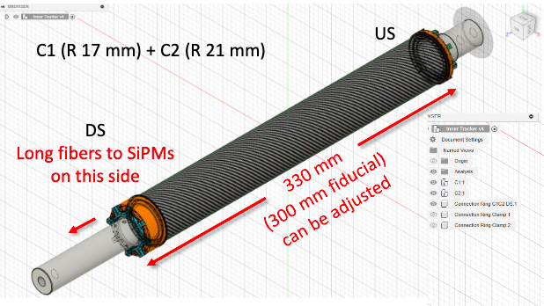
Timeline 2025
Test beam in November/December 2025
Prepare for data taking 2026!
Sci-Fi tracker to give sensitivity to AMM and EDM…

Slide 10
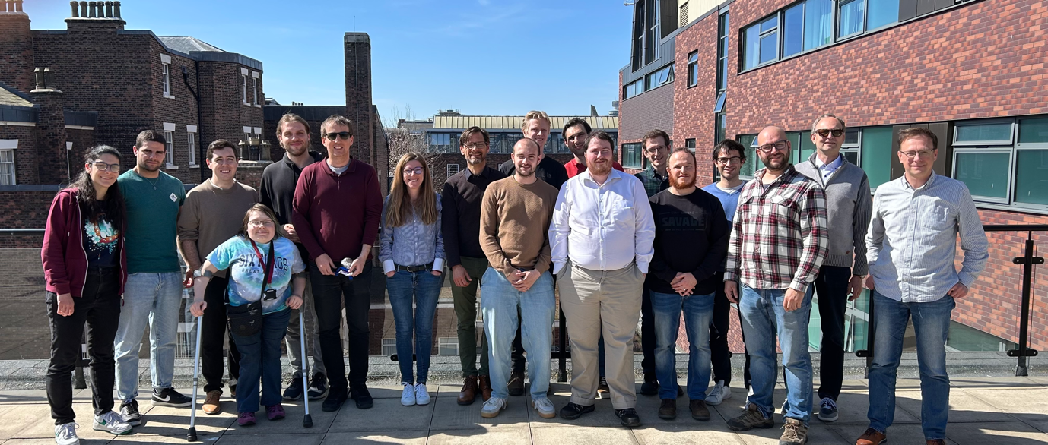
Conclusions
Collaboration meeting at Liverpool in April 2025
Liverpool members
Joe Price (Simulation coordinator)
Fedor Ignatov
Dominka Vasilikova
Themis Bowcock
Joost Vossebeld
MuEDM will measure the muon EDM in two stages, improving on the current sensitivity by 2, then 4 orders of magnitude
UK responsible for the correction coils (Lancaster)
Liverpool’s major input has been to simulation, optimising the placement of the sci-fi trackers.
Fedor joined in April, working on tracking
Applying for funding for the tracker build for phase II…

