Slide 1
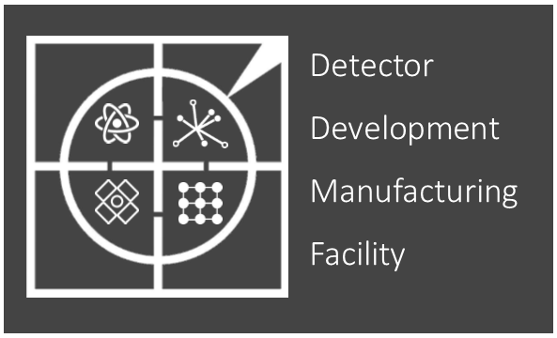
2024-25 Review
Mark Whitley

Slide 2
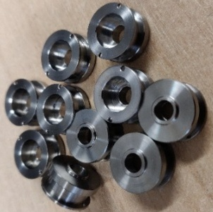
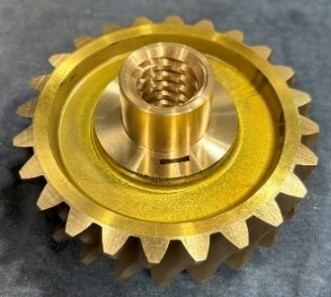
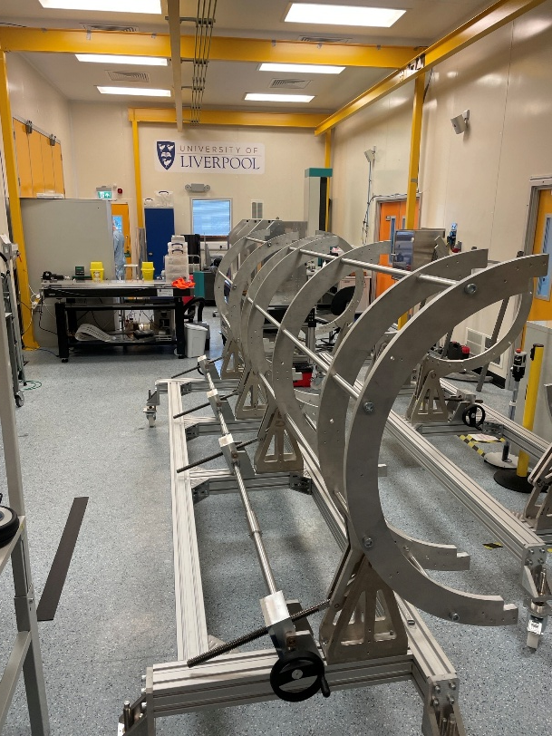
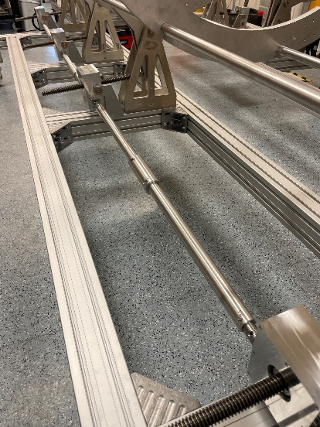
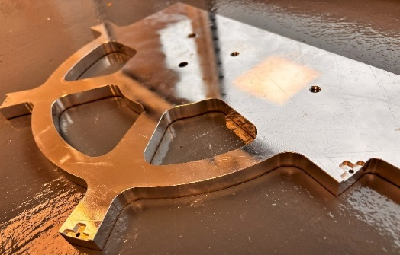
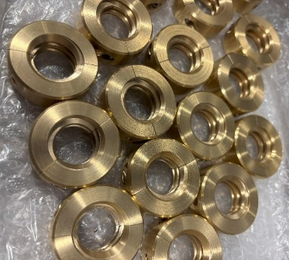
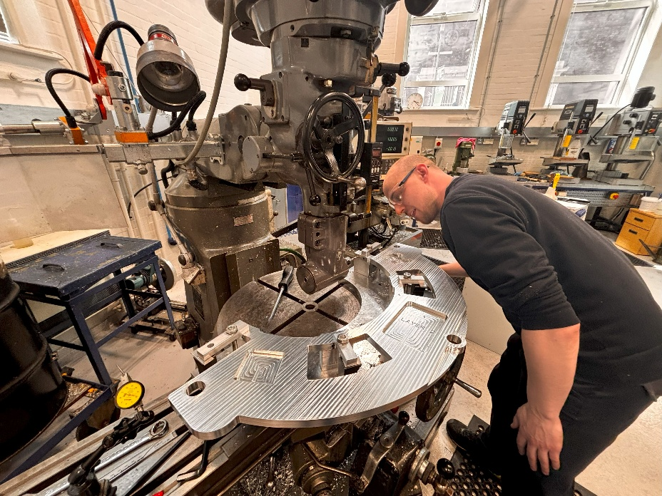
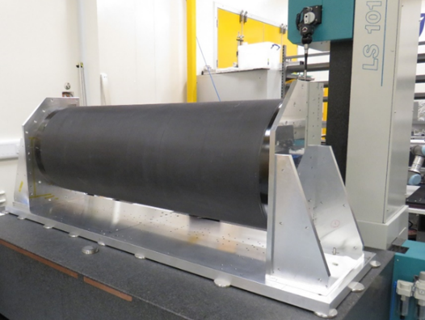
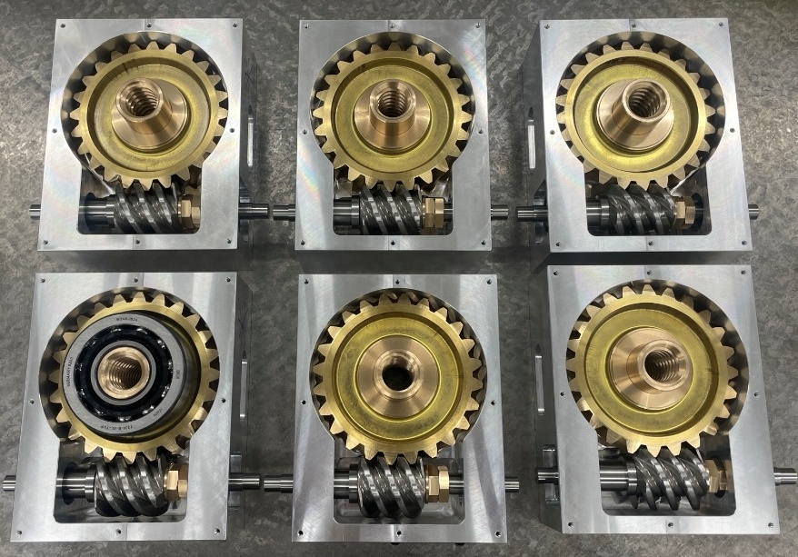
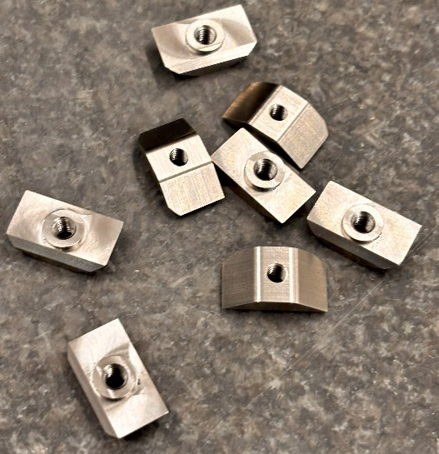
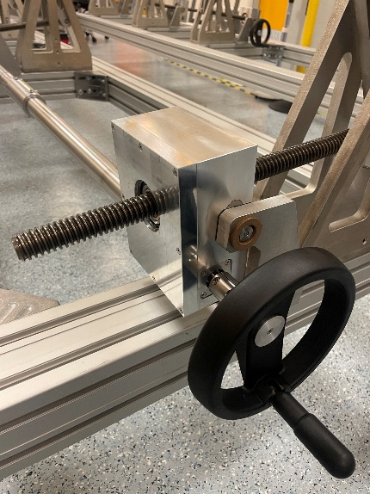
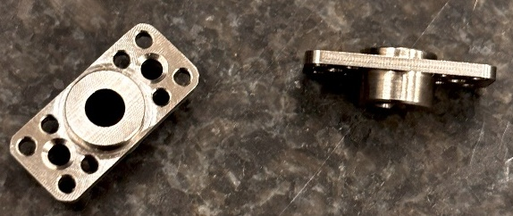
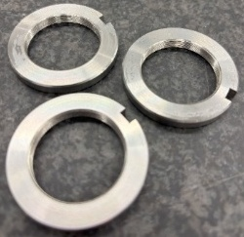
Showcase
A selection of Atlas components

Slide 3
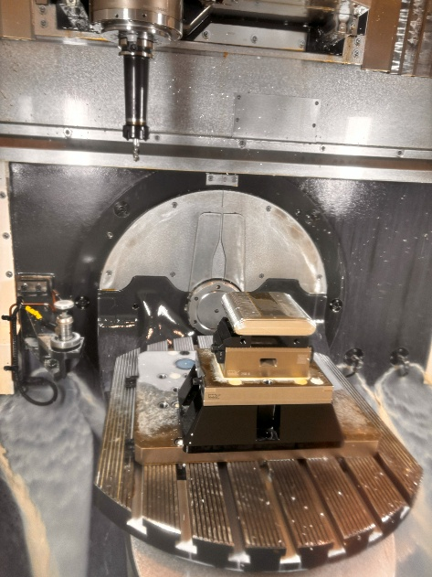
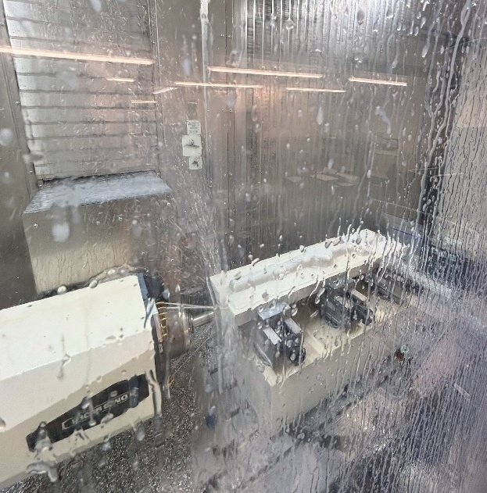
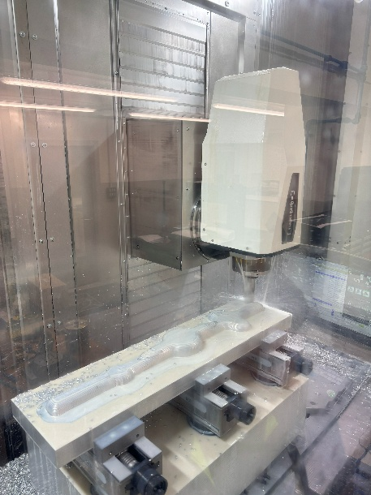
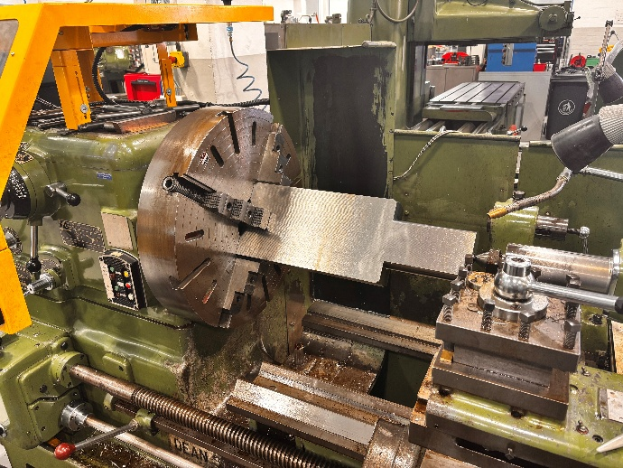
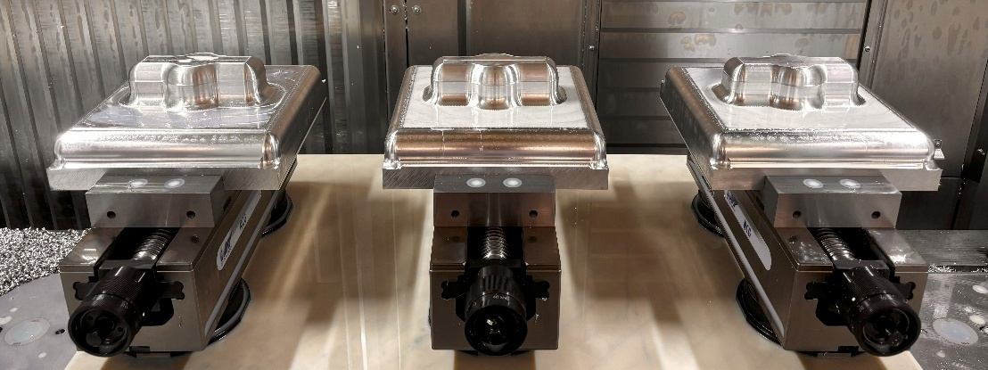
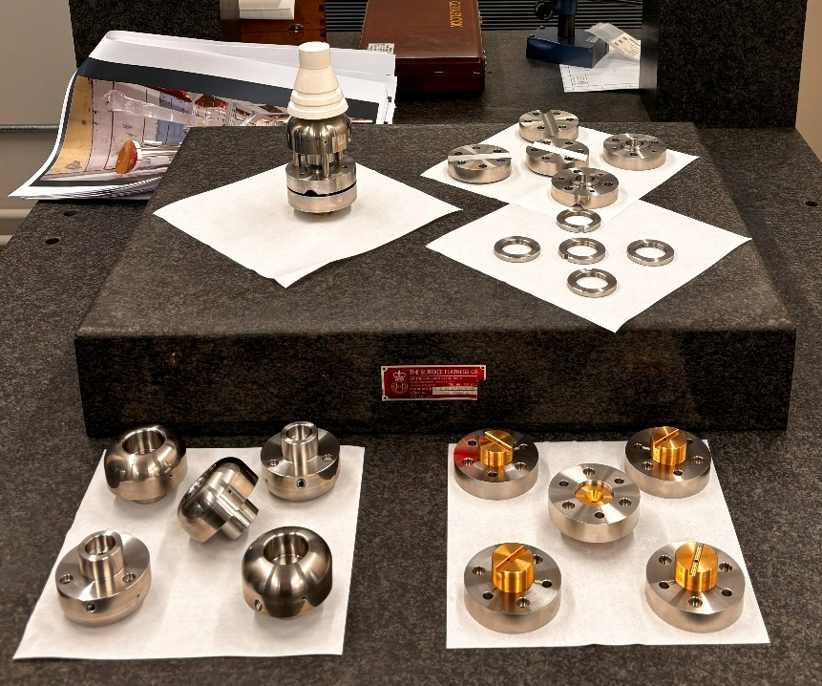
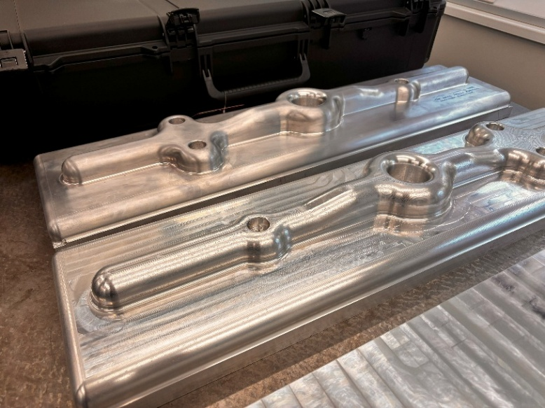
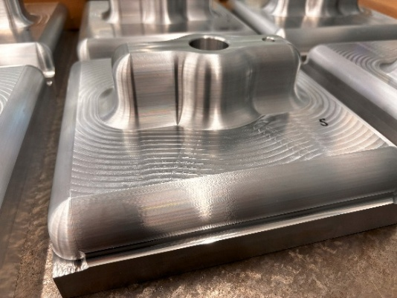
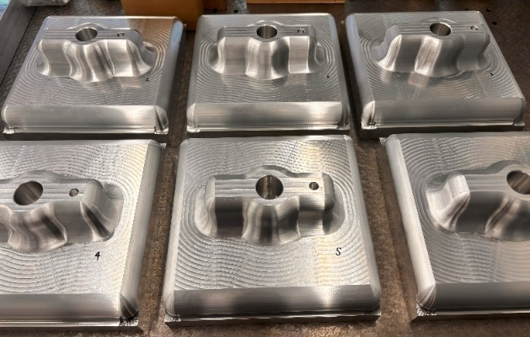
Showcase
A selection of pEDM components

Slide 4
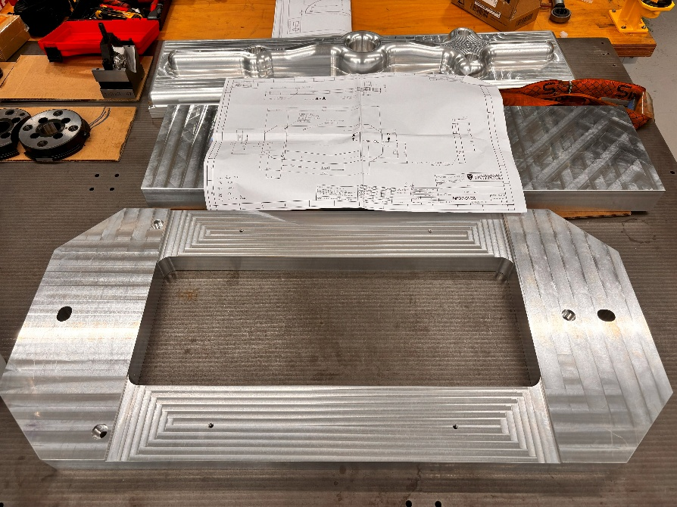
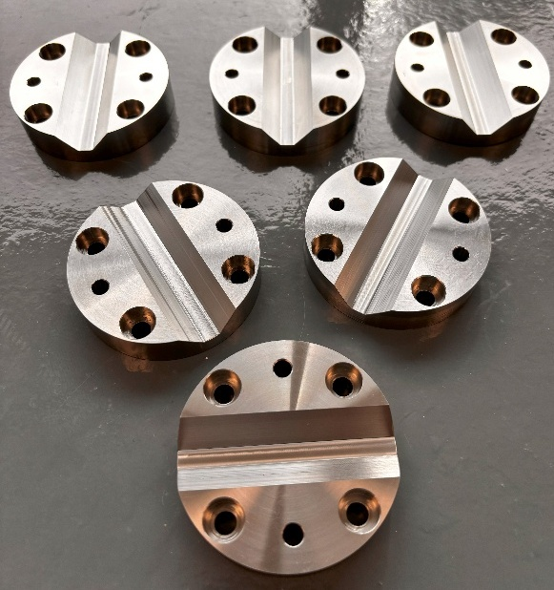
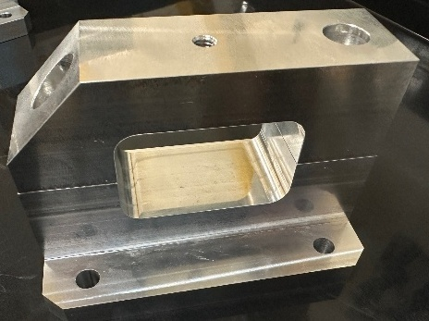
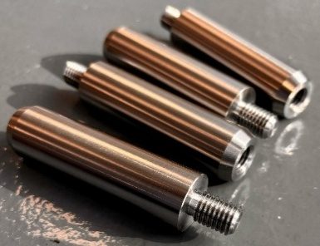
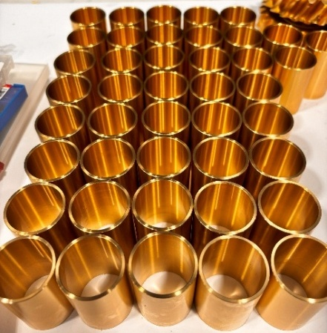
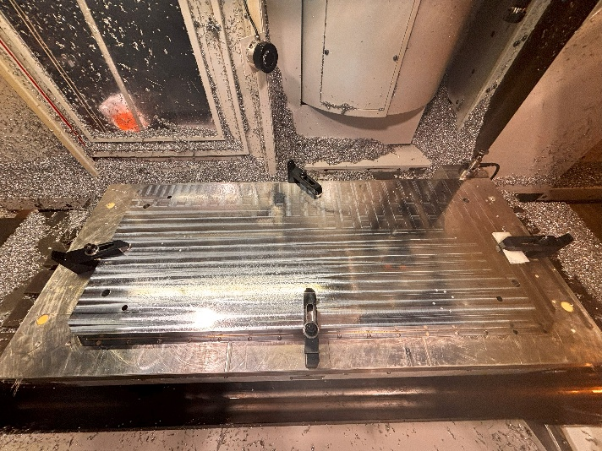
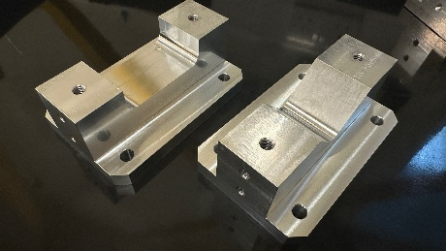
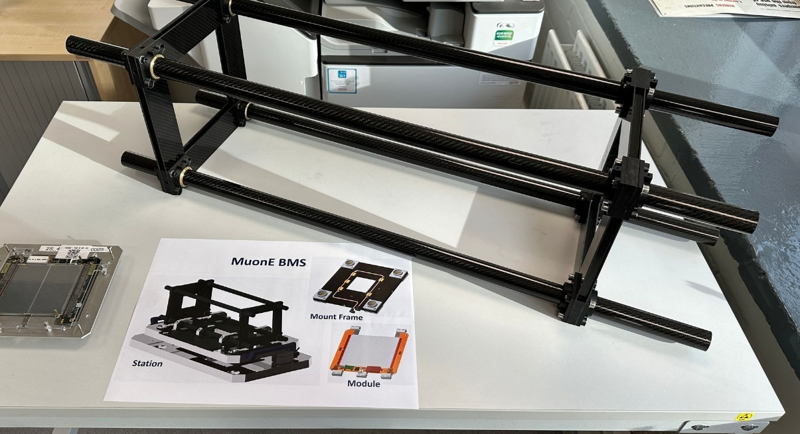
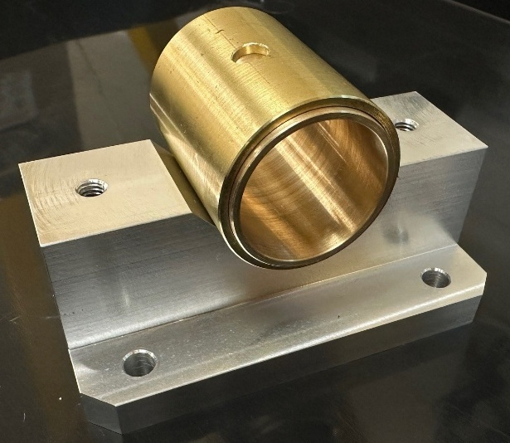
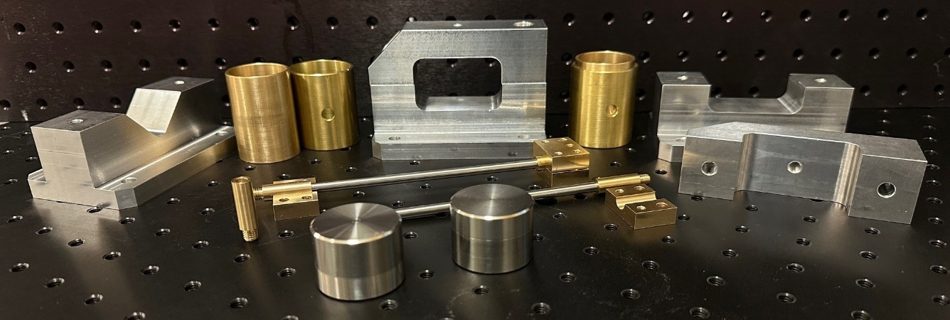
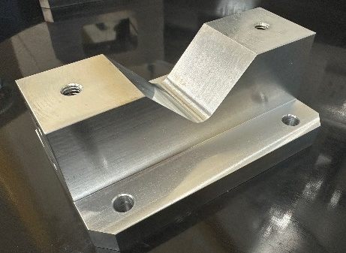
Showcase
Mixture of MUonE parts

Slide 5
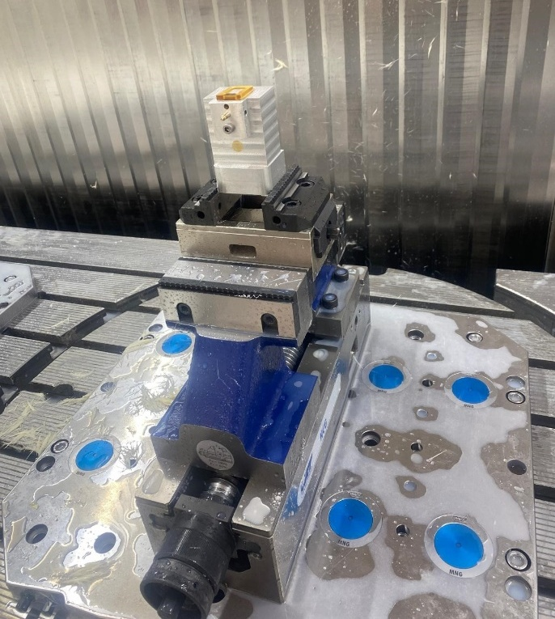
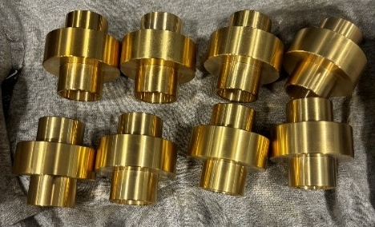
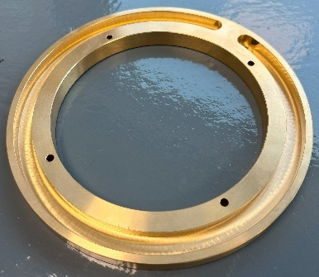
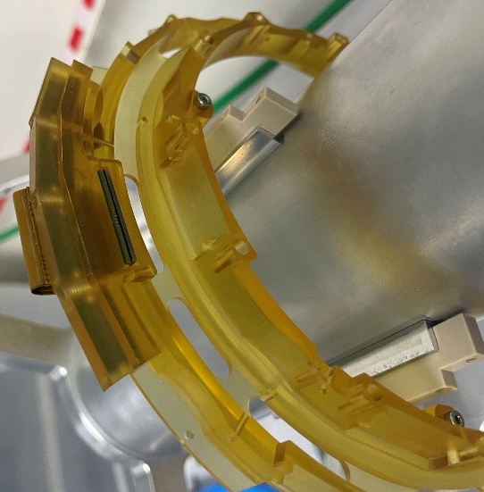
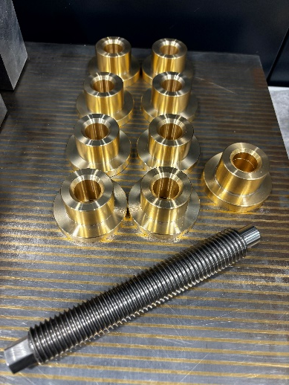
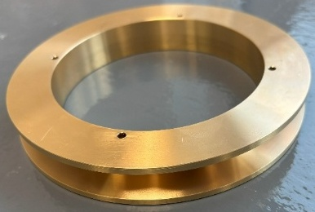
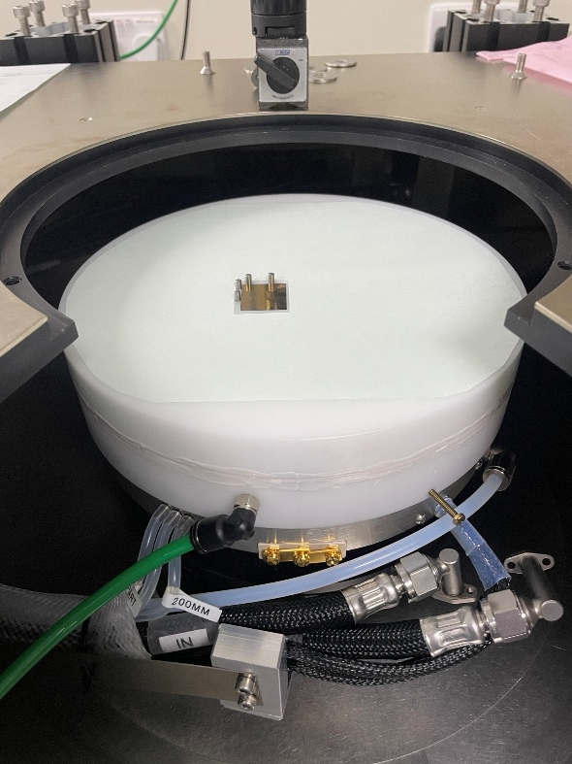
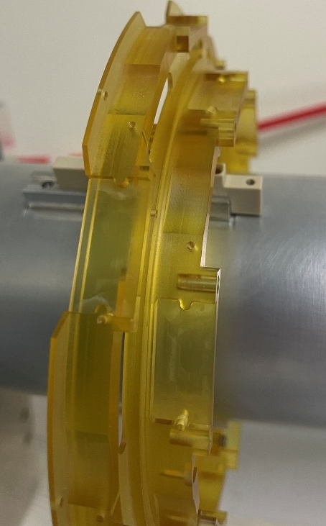
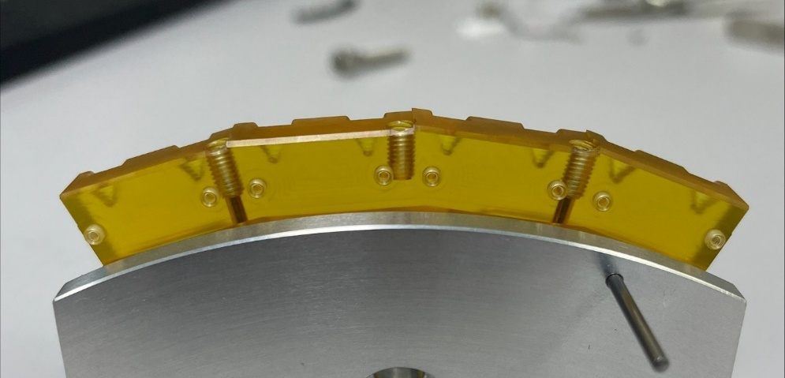
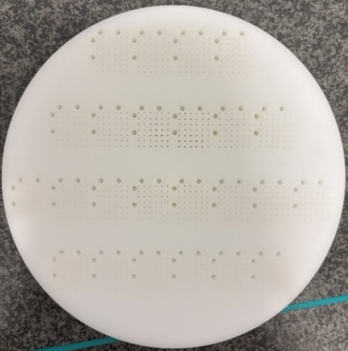
Showcase
Mixture of Atlas, AION, THGEMs and Mu3e parts

Slide 6
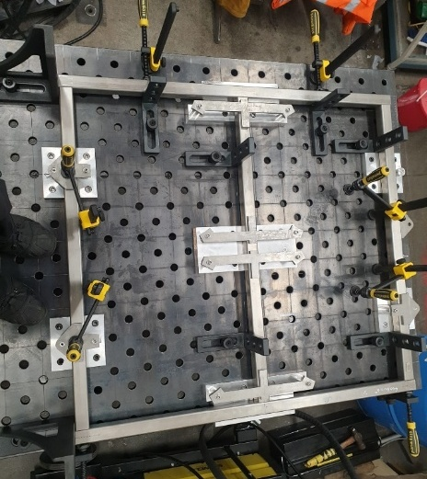
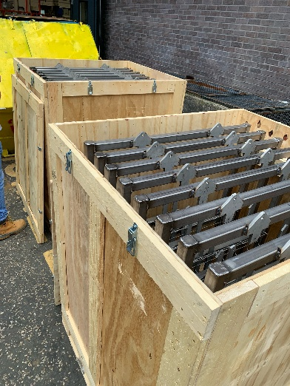
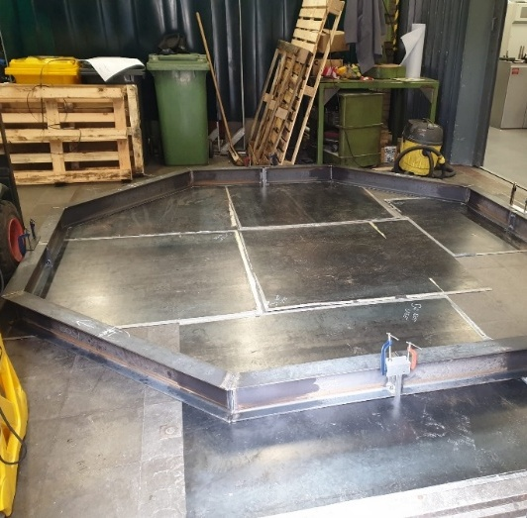
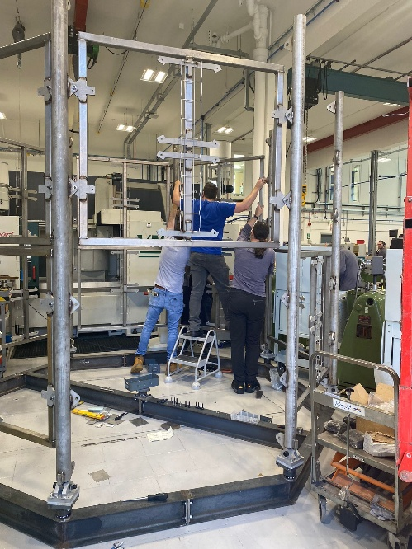
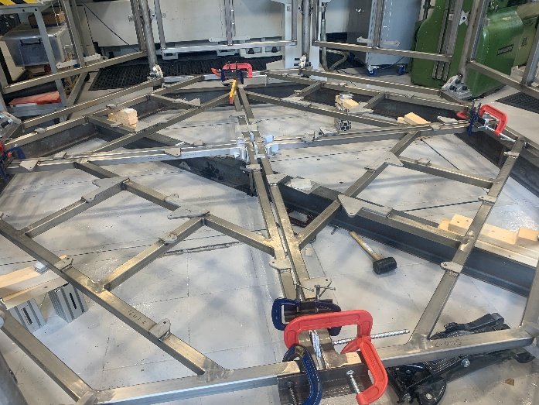
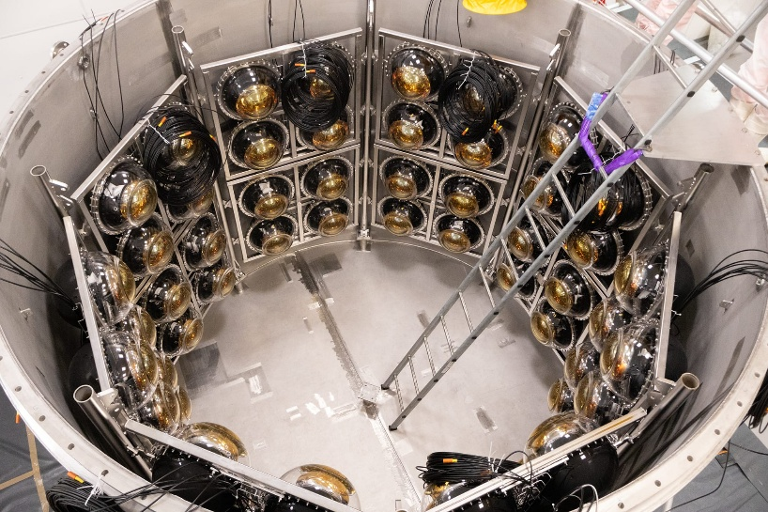
Showcase
BUTTON construction here and down the mine in Boulby

Slide 7
Refurbishments
Last year I announced that we had almost completed our renovations this has not changed much!
Completion of the basement upgrade has been hindered as we have had several flooding events these have caused quite a lot of disruption.
The water comes through the outside wall after a substantial downpour of rain. This has happened in the past however the penetration into our working space was not so disruptive. Our new internal walls seem to be letting the water straight through.
Black wire with earth tape and in earth terminal
Black wire folded back and tapped up not in earth terminal which is available
We had a very serious incident occur in our workshop. One of the team received an electrical shock when turning on an isolator to one of our lathes. He is alright although he was a shaken (but not stirred) by this event. It appears that during the renovation and the complete reconnection of all our machines, some of them were left without an earth connection. The machine in question had a very small current leakage from the digital readout, meaning that most probably this was a lower voltage event that’s not to say it was not serious. This resulted in the whole workshop being shutdown for almost two weeks and a full electrical inspection carried out. A further four machines were found to have a similar kind of fault! These faults were promptly corrected and a full investigation is still ongoing with the school and university safety offices.
Property and Campus Services are aware of this situation and have started their investigation. Hopefully, it will not be long before they have a permanent solution for us.

Slide 8
AML
AML Facilities
Co-curing of the Atlas half rings This embeds the pre machined carbon foam core structures, by using the resin within carbon fibre
Atlas half cylinders

Slide 9
AML
Composite and 3D printed parts for MUonE
Onyx (Nylon + chopped Carbon fibre) 3D printed parts

Slide 10
None of this would be possible without…
A BIG thank you to
Tom Gibbs, Tony Watling, Rob Malley, Warren Jones, Levi Cornah,
Luke Marshall, Kevin McCormick, Daniel Hollywood, Paul Sinclair and Paul Cook.
for their excellent effort, help and support through another busy year
Notes:
14

Slide 11
That’s all folks
thanks for listening
Notes:
15

