Slide 1
CTA highlights 2019 – Southern site
Nacho Minaya and Tim Greenshaw
Site agreement signed.
Southern site manager appointed.
Seismic study commissioned with ESO support.
When completed, award design contracts for telescope foundations, roads and power distribution (2020).
Award construction contracts in 2020…2022.
Negotiating
CTA use of
BELLA (45
channel optical
link between
Europe and
Latin America).
CTA
infrastructure
on southern
site now:
Preliminary building plans:
1

Slide 2
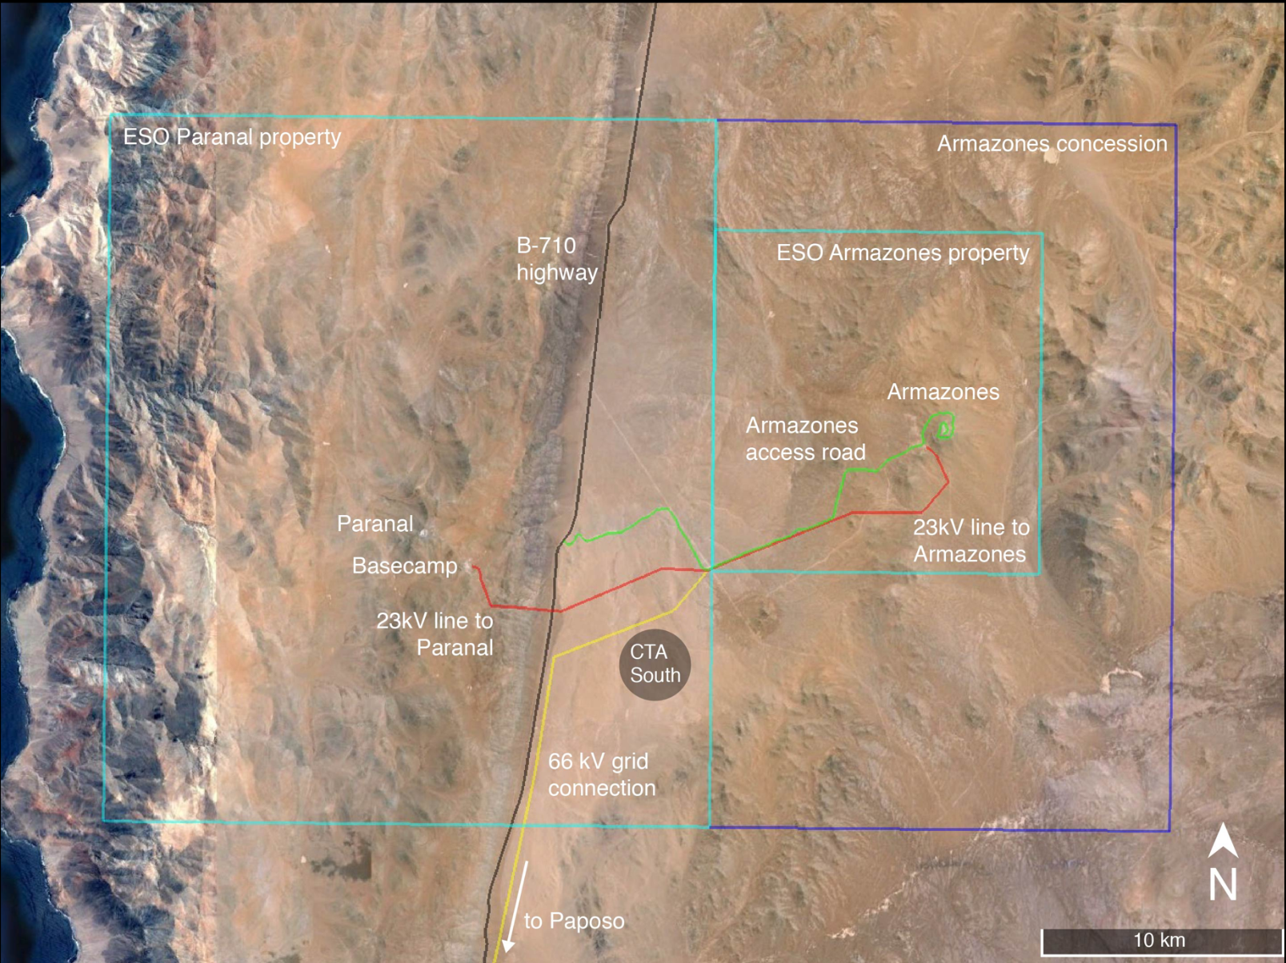
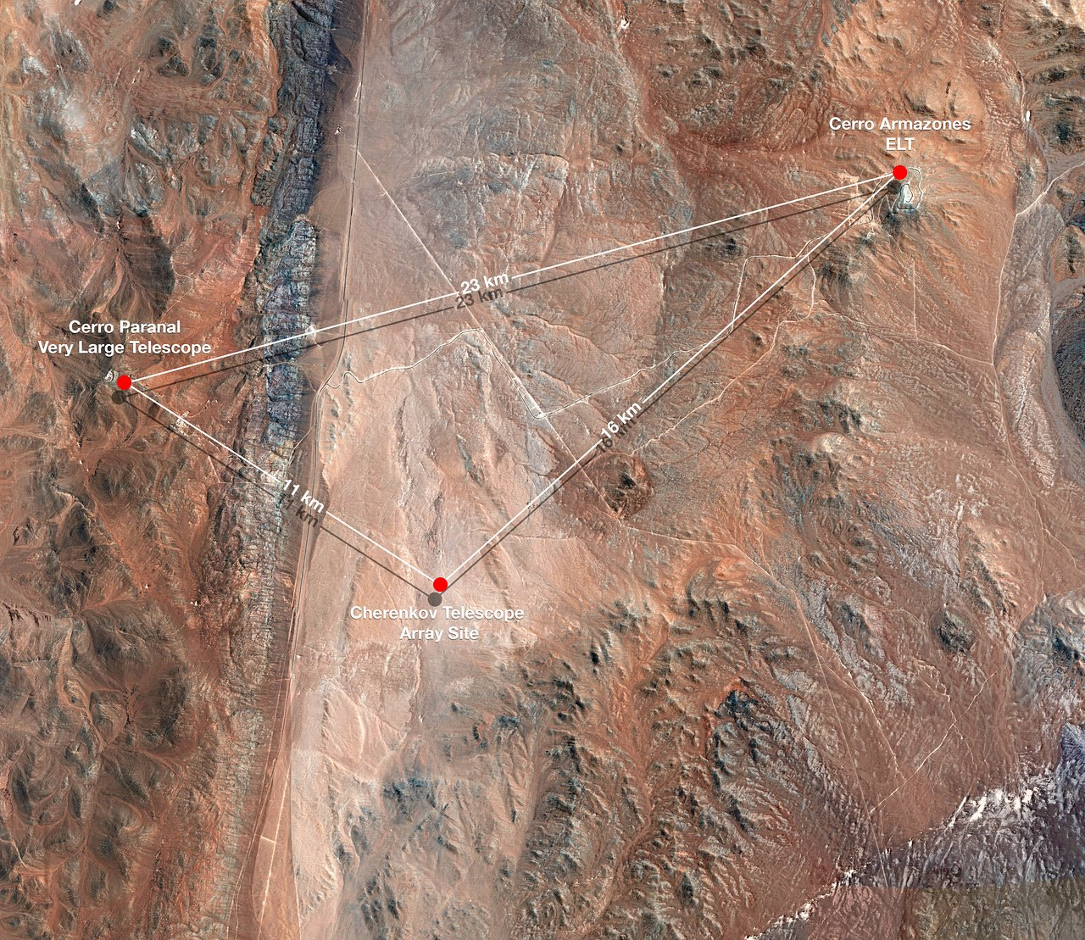
Southern site – Paranal, Pampa Remiendo
2

Slide 3
CTA highlights 2019 – telescopes
From 3 possible
SSTs and cameras,
CTA selected
ASTRI structure
and CHEC camera.
Tested together in Sicily this year:
Atmospheric Cherenkov technique:
3

Slide 4
CTA highlights 2019 – telescopes
Selection of recorded events, showing Cherenkov light generated in EM showers in atmosphere by cosmic rays and photons.
Sampling frequency 1 GHz.
4

Slide 5
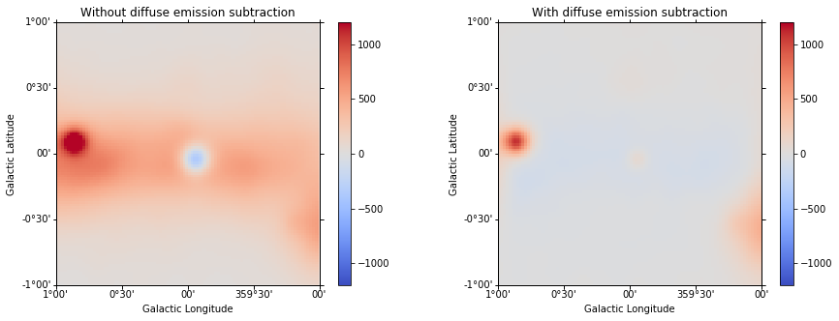
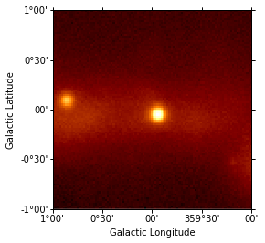
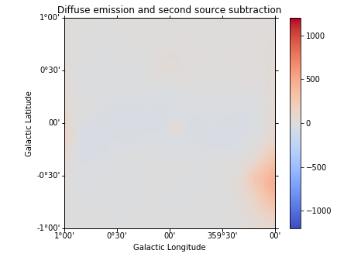
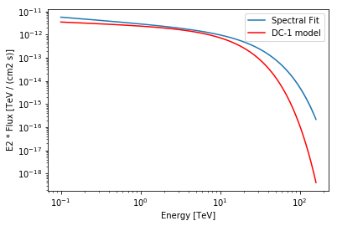
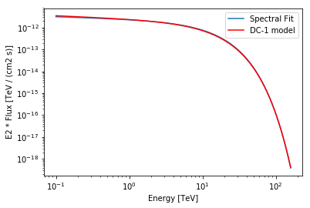
CTA Highlights 2019
As part of preparation of data analysis pipeline and Monte Carlo, Data Challenge 1 released.
Example, raw gamma ray image of Galactic Centre:
Analysis using GammaPy…
…successfully reconstructs
input gamma ray spectrum:
5

Slide 6
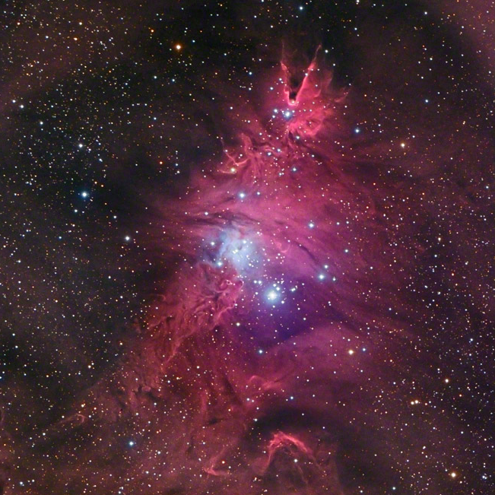
Merry
Christmas!
NGC 2264 (the Christmas Tree nebula).

