Slide 1

Silicon Tracker Development for DAMPE-II
Slides for Liverpool PP Meeting
Tim Jones
&
Shen Wang (Purple Mountain Observatory)

Slide 2
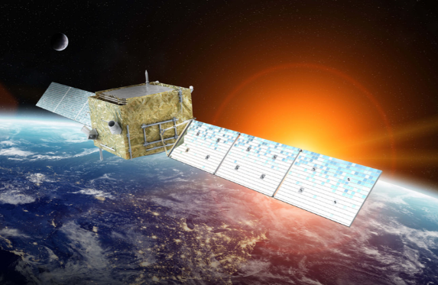
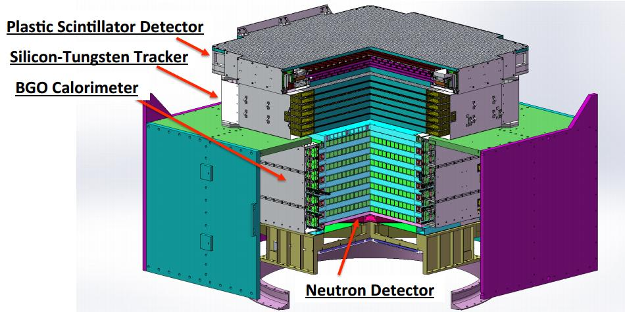
DAMPE-II Project
With direct access to cosmic photons covering a wide energy range from GeV to TeV, and with a much improved pointing and energy resolution compared with the Fermi-LAT, the DAMPE-II mission aims to probe two key scientific questions in Particle Astrophysics:
What is the origin of cosmic rays?
How can high energy particles and gravitational waves tell us about the extreme universe?
Apparatus is a satellite-based tracking system and calorimeter

Slide 3
Liverpool & PMO
In 2017 Liverpool PP and Purple Mountain Observatory (PMO, Nanjing) began collaborating on silicon tracker R&D to develop the tracker for DAMPE-II
PMO are supporting Shen Wang (PhD student) to be at Liverpool for 2 years
Main thrust of R&D is to develop silicon strip ladders and readout hybrids
Aim is to assemble & test two 7-sensor ladders by mid 2020

Slide 4
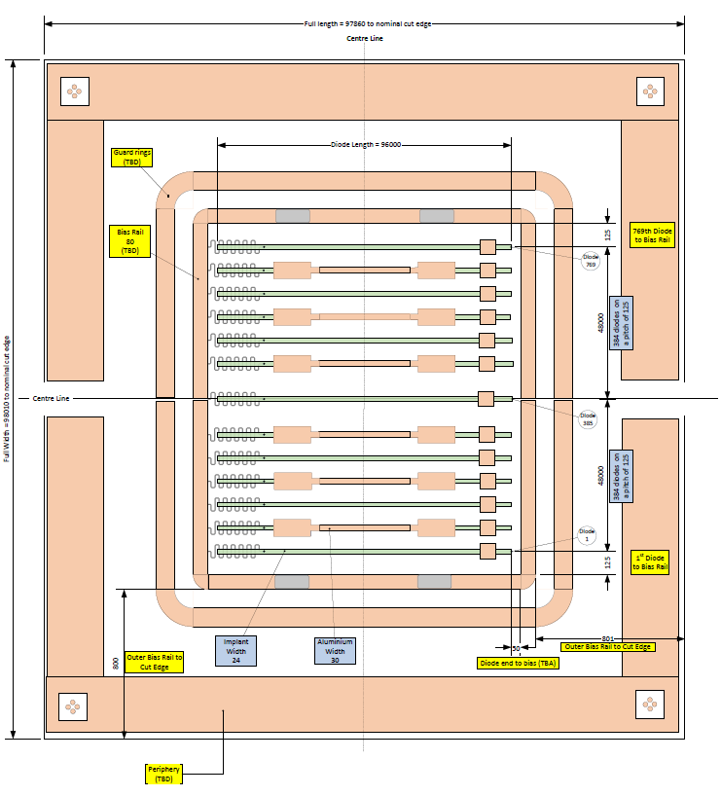
Sensor Design
Working with Micron Semiconductor (UK) to develop a new sensor geometry optimized for DAMPE-II
97.86(L) x 98.00 (W)
384 r/o channels with 1 intermediate floating strip
Delivery due January 2020

Slide 5
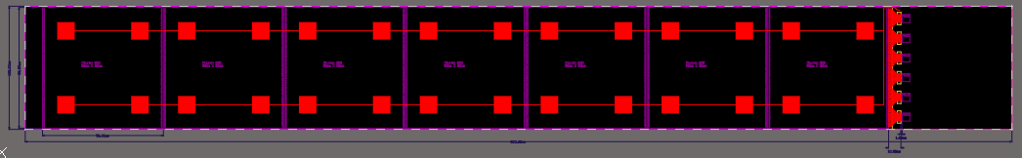
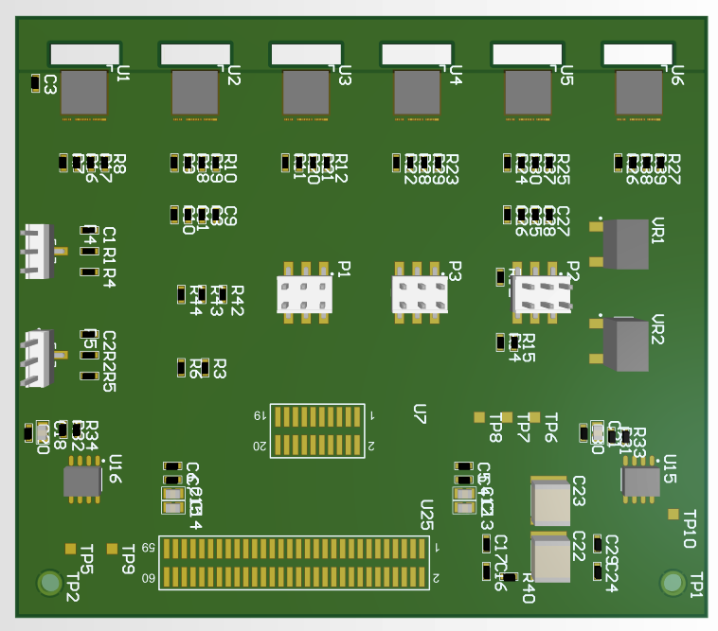
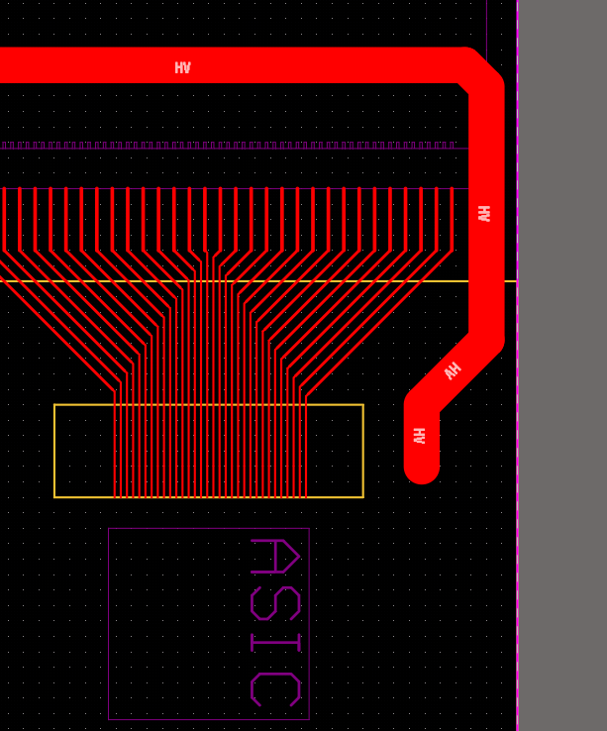
Ladder Design & Hybrids
7-sensor long ladder with one readout hybrid populated with 6 IDE1140 ASICs
Integrated fan-in structure to adapt from 96µm ASIC input pitch to 250µm pitch strips
Readout hybrid with wire-bonding apertures allowing access to lower fan-in
Design complete – review early 2020 then manufacture, populate, test, integrate, etc…
800mm

