Slide 1
A search for resonant and non-resonant di-Higgs production in bbtautau channel with the ATLAS detector
Zhiyuan Jordan Li
Supervisor: Carl Gwilliam, Andrew Mehta, Nikolaos Rompotis
Christmas meeting
12/12/2019

Slide 2
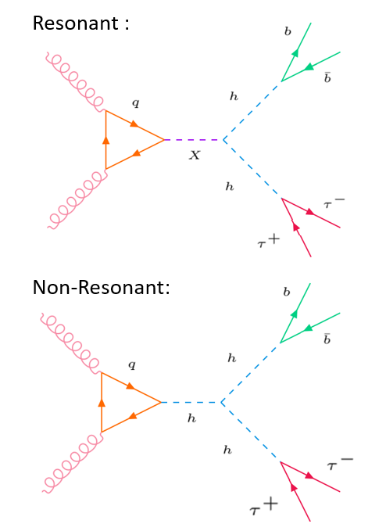
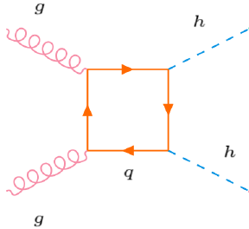
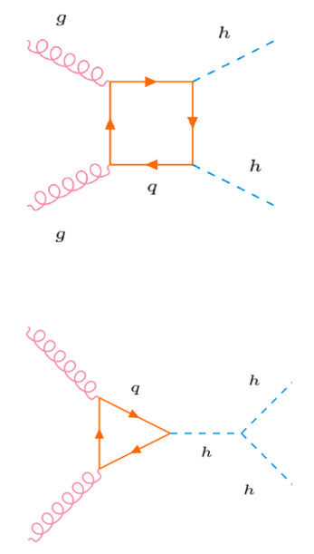
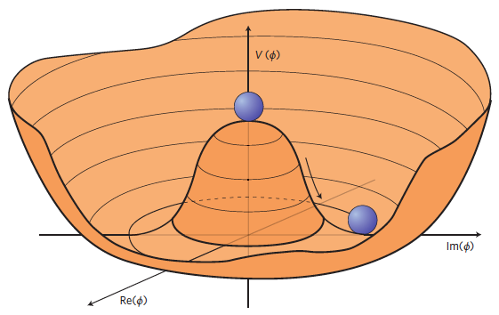
di-Higgs Overview
Box diagram:
Two ways of non-resonant di-Higgs production.
The Higgs mechanism (HM) is governed by the Higgs potential.
A direct probe to HM: Higgs trilinear coupling constant $λ_{HHH}$.
Only the triangle diagram is sensitive to the $λ_{HHH}$!
Triangle diagram:
Higgs potential:
2
2

Slide 3
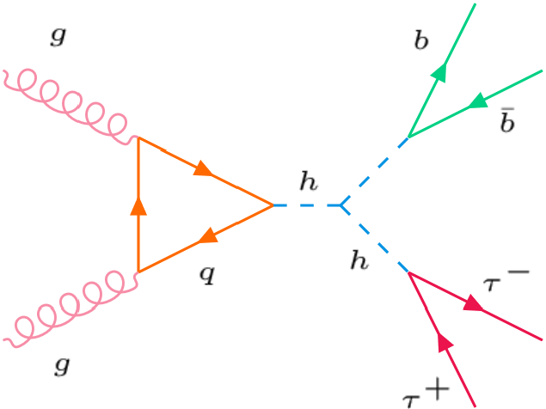
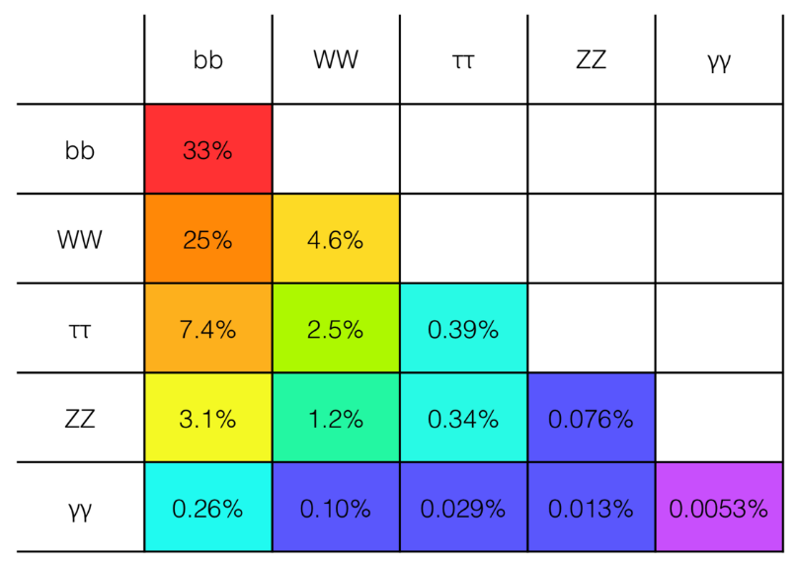
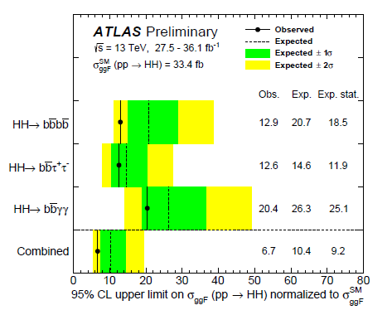
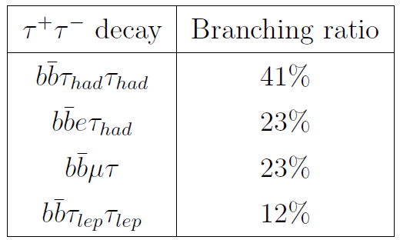
bbtautau overview
$bbττ$features:
Relatively small background.
Relatively high branching ratio.
Branching ratio:
leptonic
hadronic
$bbττ$ is currently the most sensitive decay channel!
This study will focus on LepHad channel

Slide 4
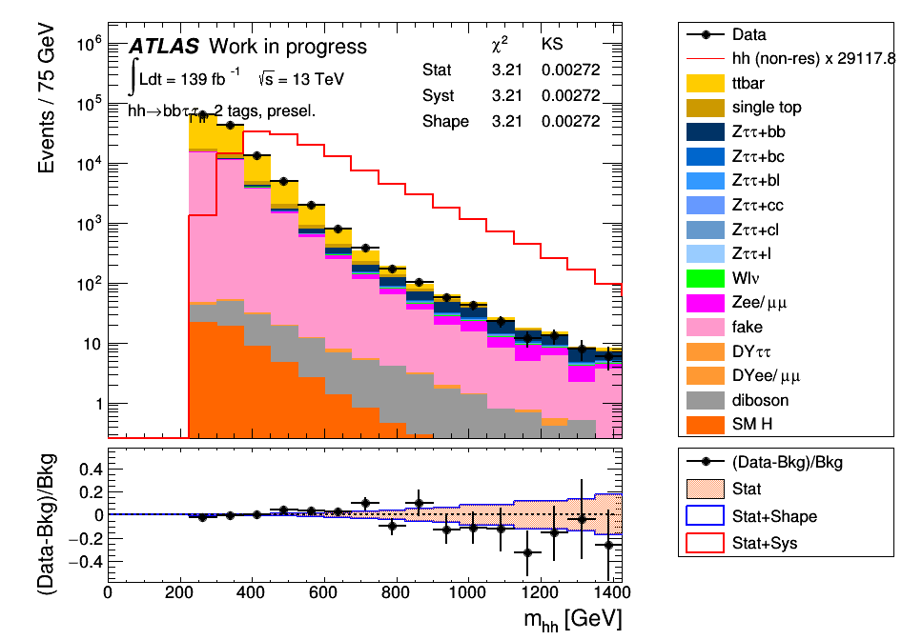
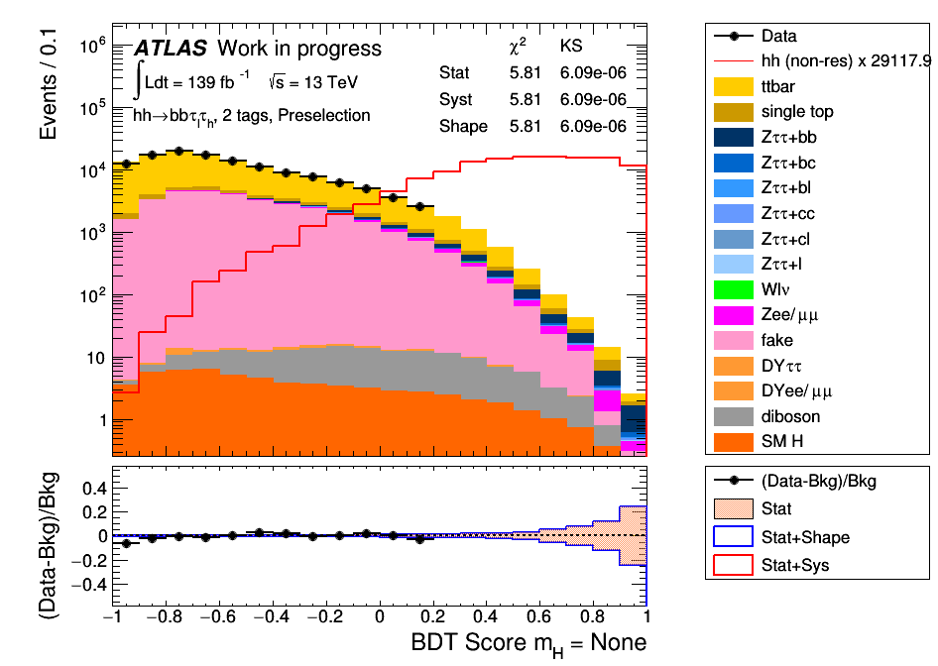
Event selection
Events with the required final state, passing the single lepton trigger (SLT) are selected.
Boosted decision tree (BDT) is used to further separate the signal and background.
Inputs of BDT uses various kinematic variables.
$BDT$ Input:
$BDT$
Score:
The BDT output (BDT score) is used as the discriminant.
4

Slide 5
Results
Results:
Without further improvement to the previous analysis except higher luminosity.
Upper limits are set on non-resonant di-Higgs production at 95% CL are calculated for full run2 data.
Non-res | Observed | -2σ | -1σ | Expected | +1σ | +2σ
Full Run2 Result
Xs[pb] | Blinded | 0.012 | 0.016 | 0.022 | 0.031 | 0.041
Xs/Xs(SM)[pb] | Blinded | 4.89 | 6.57 | 9.11 | 12.68 | 17.00
Previous analysis: 21.46
Improvement:
Implementation of the new b-jet tagger.
Average gain of ~9% in limits!
Work going on the analysis with new recommendation.
Plans:
A paper in summer with resonant result, another one in late 2020 with non-resonant result.

Slide 6
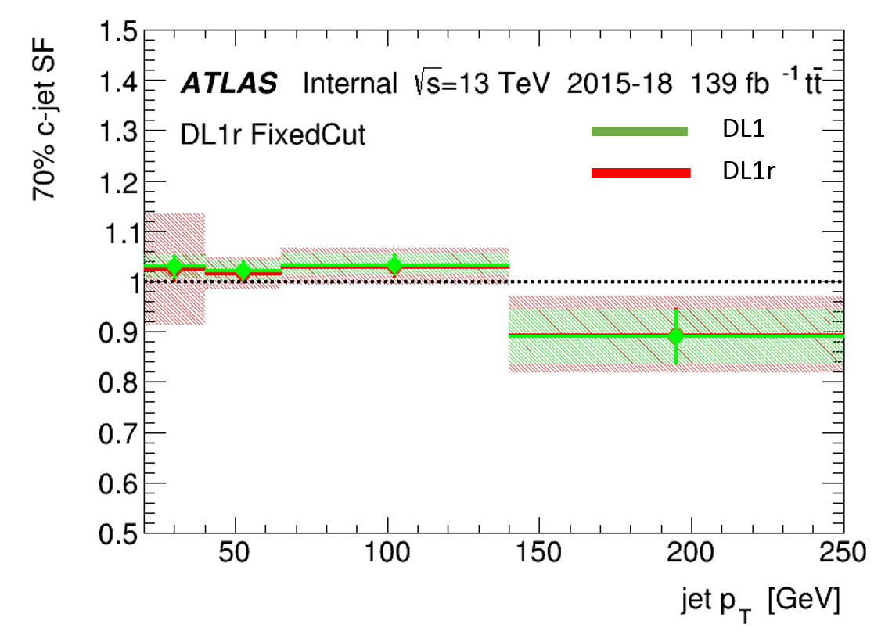
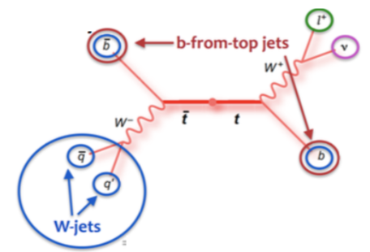
Additional remarks
Results:
Carried out the latest Charm jet calibration with Andy and Nikos.
Qualification task:
C-jet calibration: measuring the rate of c-jets mis-identified as b-jets with semi-leptonic $t\overline{t}$ decay.
Improvement:
Developing a new selection which can increase ~60% of statistics.
Plans:
Provide official light-jet mis-tag calibration for all ATLAS analysers for spring conferences and qualify as an ATLAS author by spring.

