Slide 1


Batch spacing optimization at SPS injection by Reinforcement Learning
M. Remta, S. Rezagholi, F. Velotti

Slide 2
Contents
Motivation
Introduction
Environment
Algorithm
Results
Conclusion

Slide 3
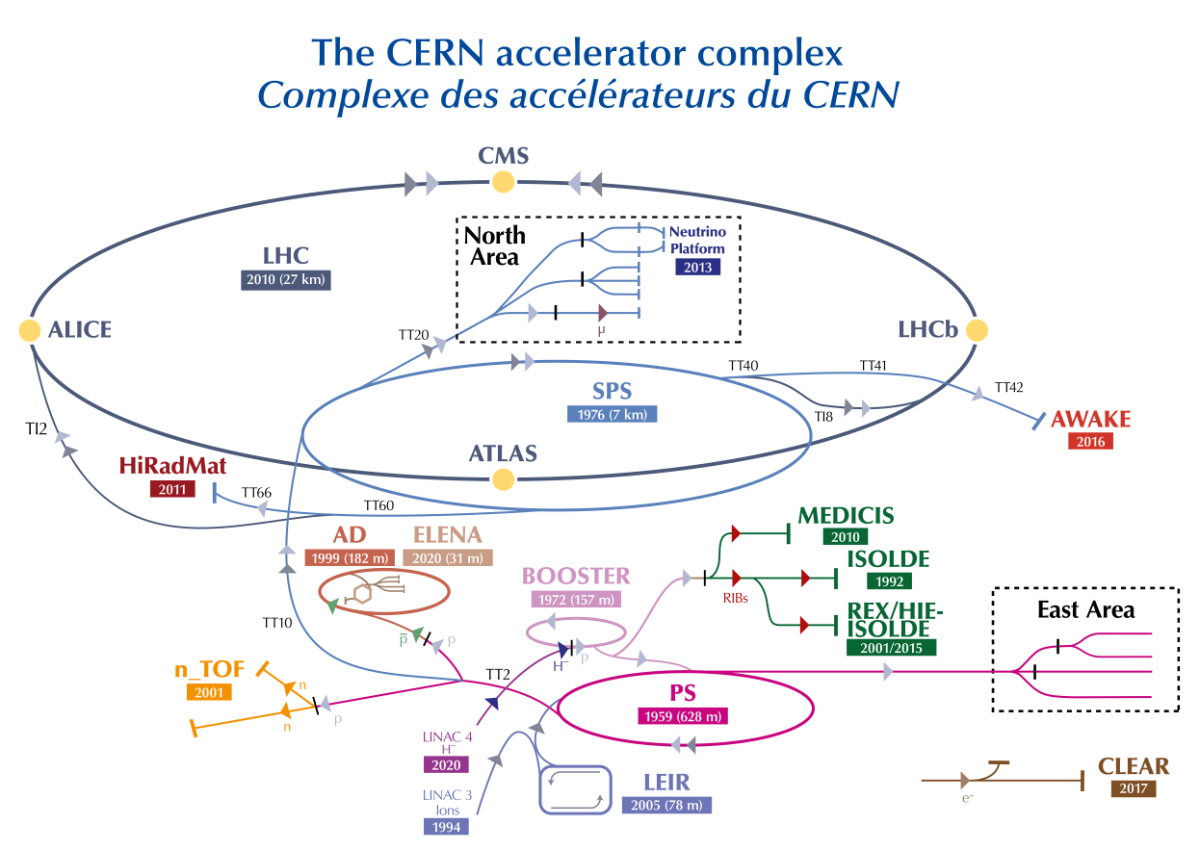
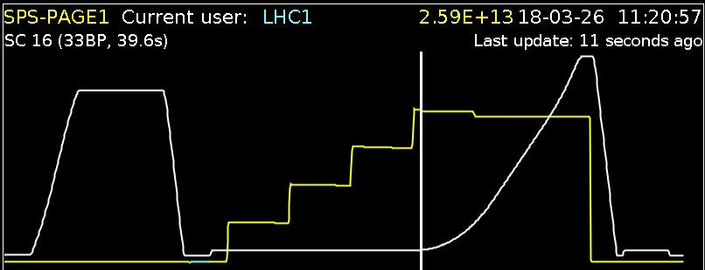
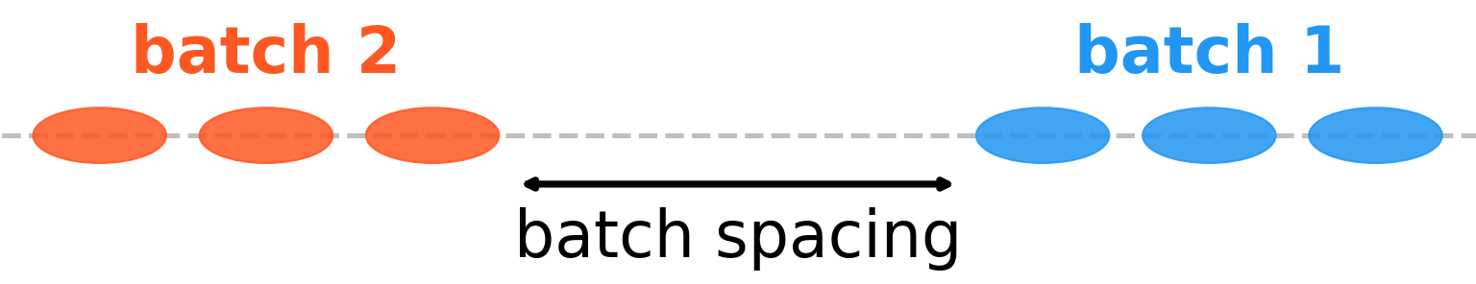
Motivation
For LHC-filling, multiple batches are injected into the SPS.
Batch spacing: gap between batches to pulse injection kickers.
SPS batch spacing 225 ns -> 200 ns: 6% increased luminosity in the LHC.
Notes:
Introduction: Proton chain Multiple transfers of beam from SPS to LHC
Also, multiple injections into the SPS from PS. Batch spacing.

Slide 4
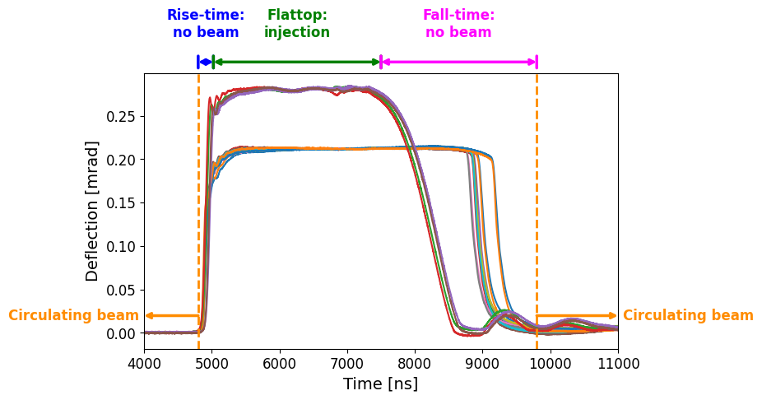
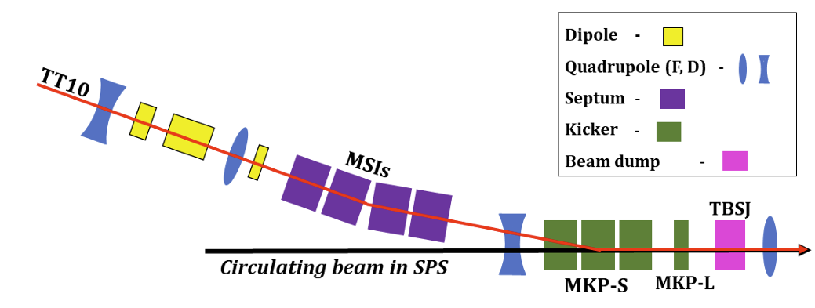
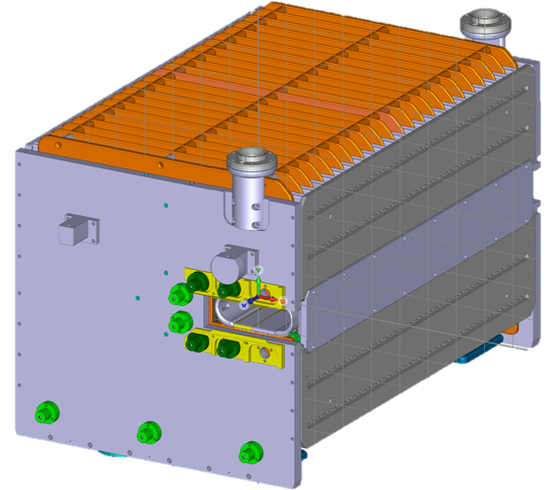
The SPS injection system
16 injection kickers
12 of type S.
4 of type L.
Fast-pulsed.
Powered in pairs of two -> 8 circuits.
Eight independently controlled switches, one per circuit.
E. Waagaard, et al., "Design of a new CERN SPS injection system via numerical optimisation," JACoW IPAC2023, MOPA097 (2023). https://doi.org/10.18429/JACoW-IPAC2023-MOPA097

Slide 5
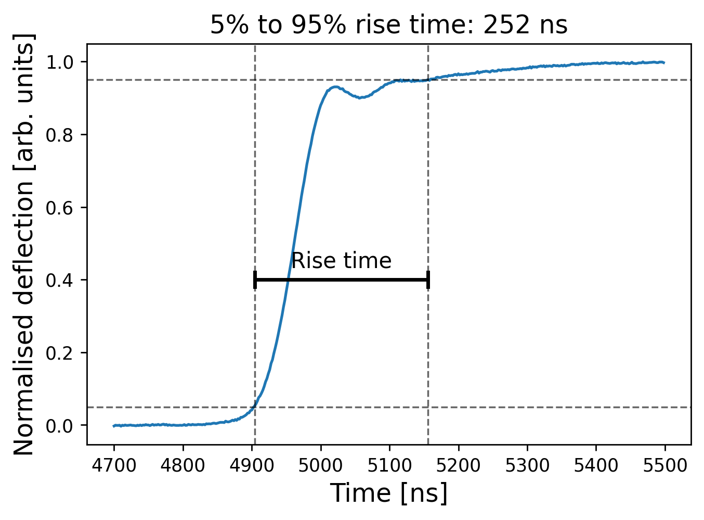
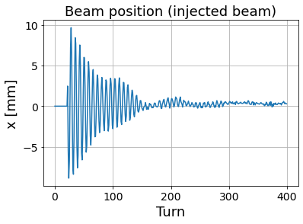
Problem
Injection kicker rise time was designed for 225 ns spacing.
Flat-top ripples before stabilising.
Reduced spacing of 200 ns:
Non-zero kick to the circulating beam.
Insufficient deflection of the injected beam.
Both beams oscillate (injection oscillations):
Filamentation.
Halo population.

Slide 6
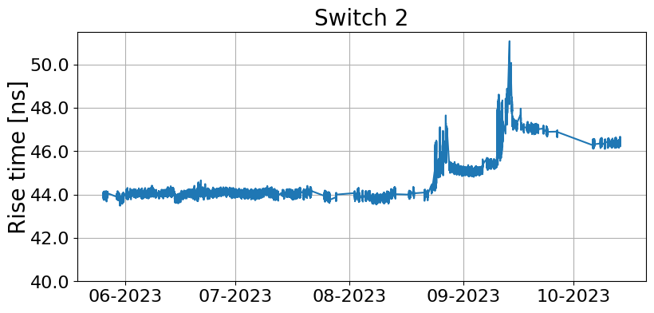
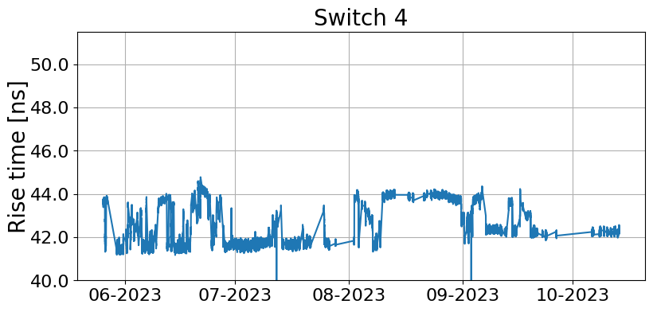
Baseline
Initially, synchronisation of kickers was done manually [1]:
Align waveforms according to time-of-flight.
Shift waveforms to equalise oscillation amplitude of beams.
Replaced by numerical optimisation [2]:
Bounded Optimisation by Quadratic Approximation (BOBYQA).
Explores aggressively -> disruptive.
In the median, 246 steps to converge.
System drifts require re-running the algorithm.
Reinforcement learning as alternative.
[1] W. Bartmann, et al., "Impact of LHC and SPS Injection Kicker Rise Times on LHC Filling Schemes and Luminosity Reach," JACoW IPAC2017, TUPVA007 (2017). https://doi.org/10.18429/JACoW-IPAC2017-TUPVA007 [2] E. W. Waagaard, "Optimising the present and designing the future: a novel SPS injection system," Master's thesis, 2022. https://repository.cern/records/ra4pn-n7n17

Slide 7
Goals for the RL agent
Optimiser: reach optimal working point from bad initial states.
Active controller: Maintain optimal working point when the system drifts.
Train exclusively in simulations:
Beam time in the SPS is scarce.
Avoid losing high-energy beam.
Real system drifts slowly -> limited variation when training on the accelerator.

Slide 8
Environment

Slide 9
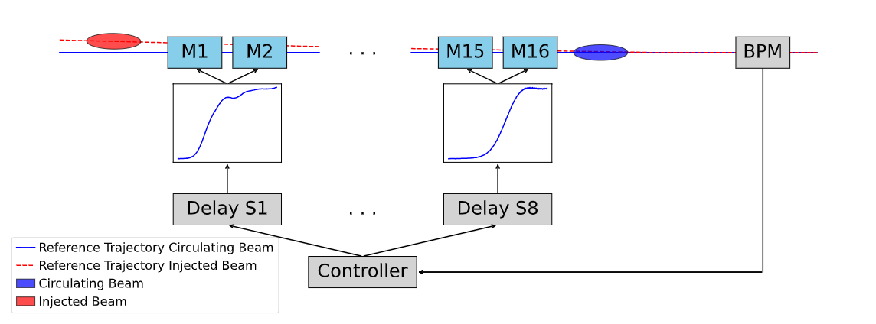
Overview

Slide 10
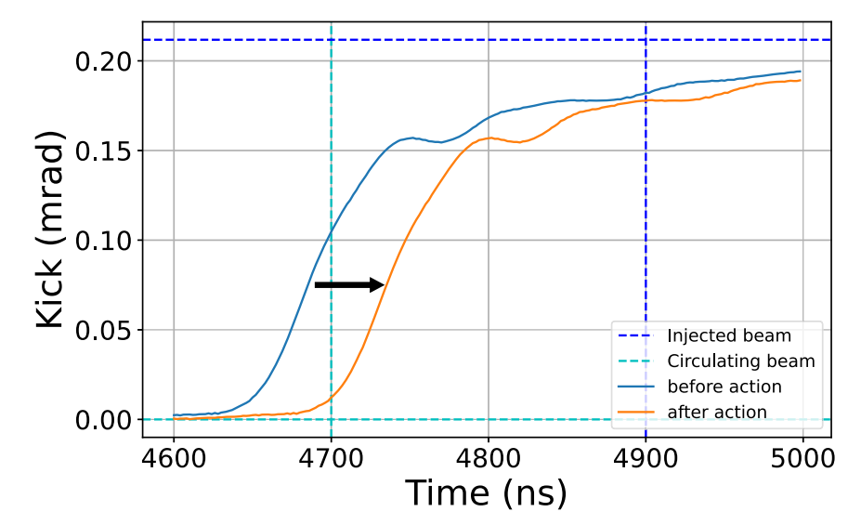
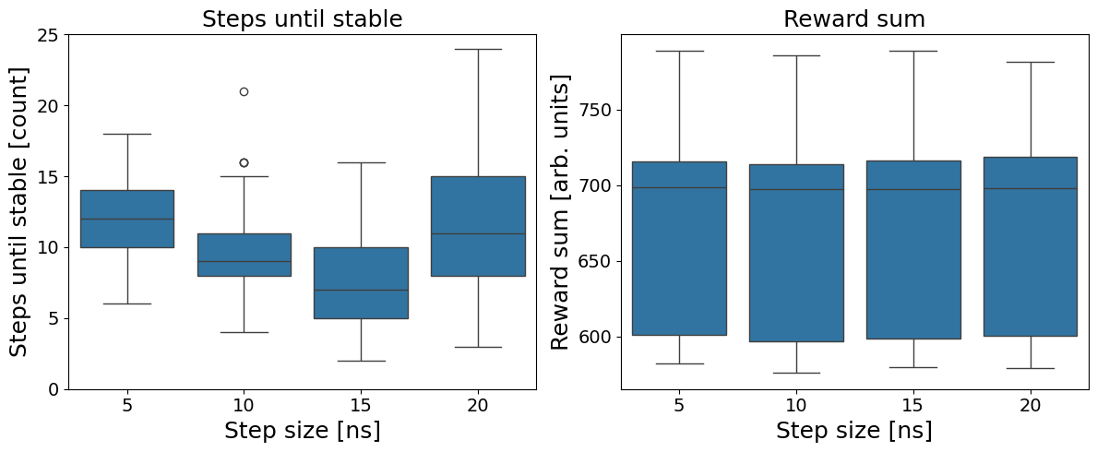
Action space
Action space: change to delays a ∈ [-15 ns, 15 ns]⁸.
Delta-action approach: 𝜏_{i+1} = 𝜏_{i} + a_{i}.
Absolute actions were not robust to noise.
Optimised step size in simulations.

Slide 11
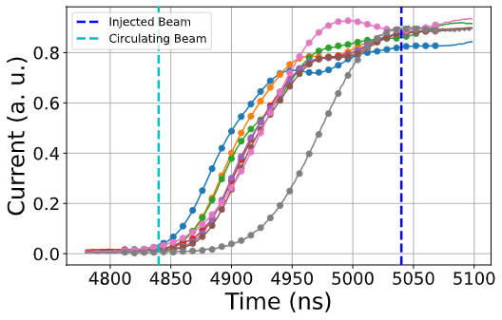
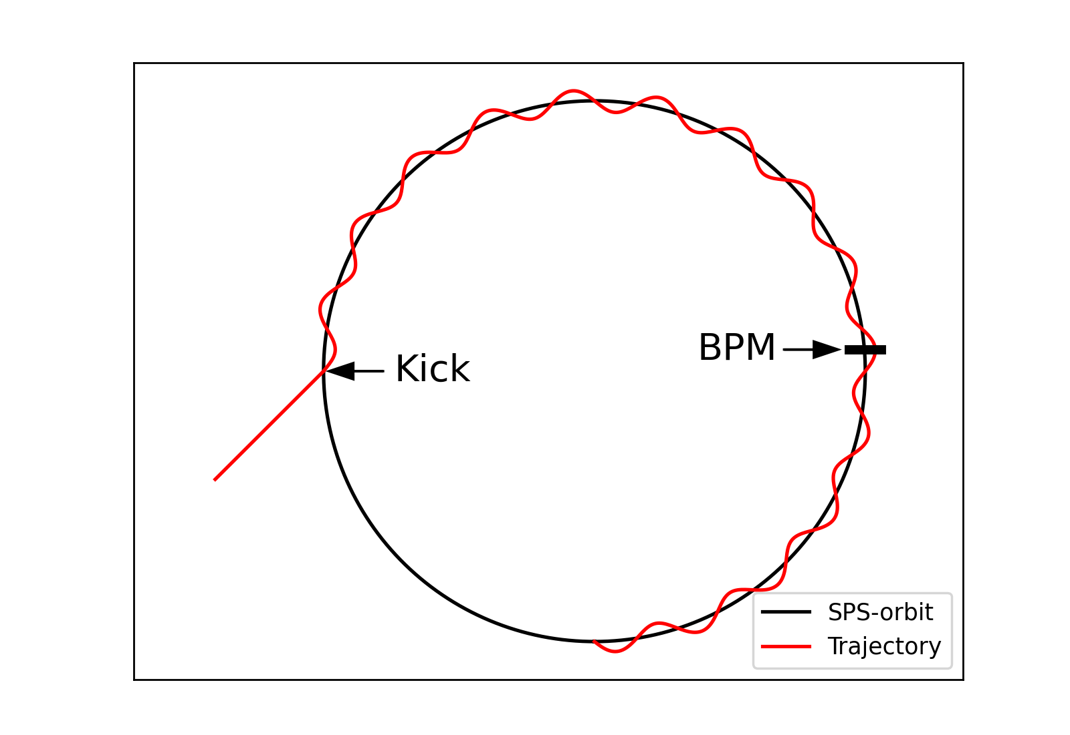
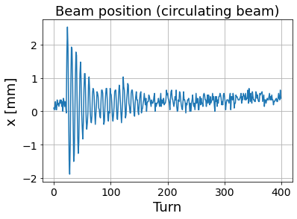
Observation space
266 dimensions in total.
Current measured in each circuit -> waveforms.
33 datapoints per waveform, covering 264 ns.
Centred at the half-point between beams.
Waveforms normalised individually.
Amplitude of injection oscillations at a BPM downstream of the kickers.

Slide 12
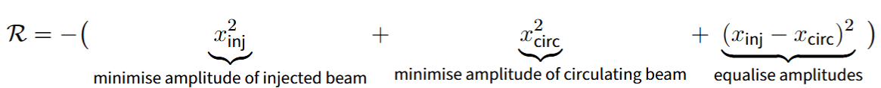
Reward
Loss function for numerical optimiser performed well.
Chose negated loss function as reward.

Slide 13
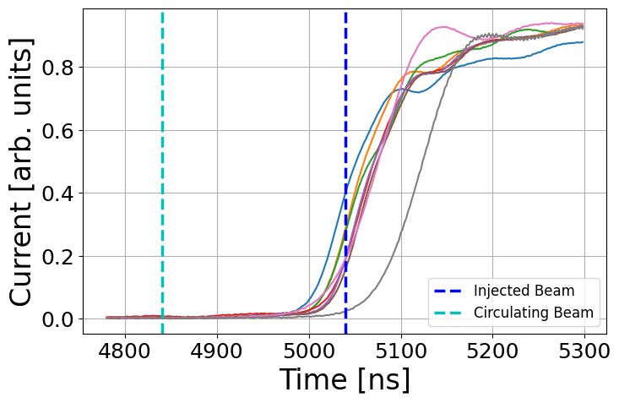
Time horizon and terminal states
Agent as active controller -> infinite horizon is the natural choice.
Drawback: agent can shift waveforms arbitrarily far.
Machine protection: terminal states?
Beam loss.
Boundary on absolute settings 𝜏.
Reward goal.
}
negative reward -> terminate asap.
Artificial terminal states can create unwanted incentives.
Solution: no terminal states
Truncation in training.
Shielding during inference.

Slide 14
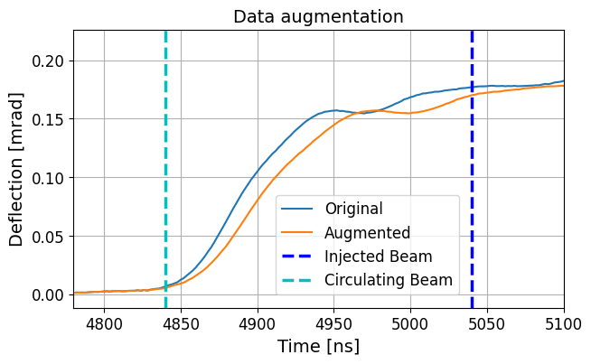
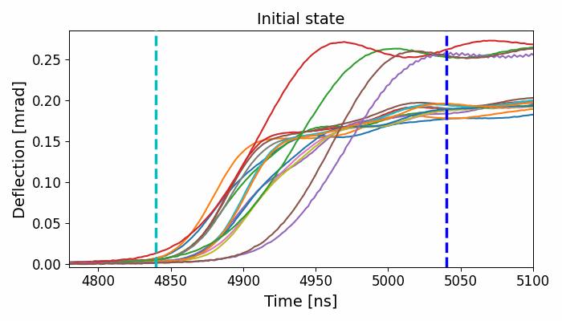
Training environment
Simulation of the real machine.
Truncate episodes after 1000 steps.
Waveform data:
100 sets of measurements.
Augmentation: randomly increase rise times up to 20%.
Randomise initial settings:
Global shift u ~ N(0, 10 ns).
Individual shift v_{i} ~ N(0, 5 ns).
2nd-order transfer matrices from injection region to BPM.

Slide 15
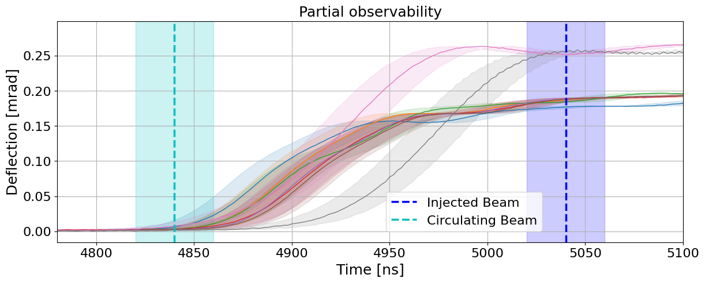
Partial observability
Arrival time of beams is estimated.
Waveforms measurements might not be perfectly synchronised.
Apply hidden shifts in simulations:
Global shift: δ ~ U(-20 ns, 20 ns)
Individual shift: ε ~ U(-15 ns, 15 ns)

Slide 16
Algorithm

Slide 17
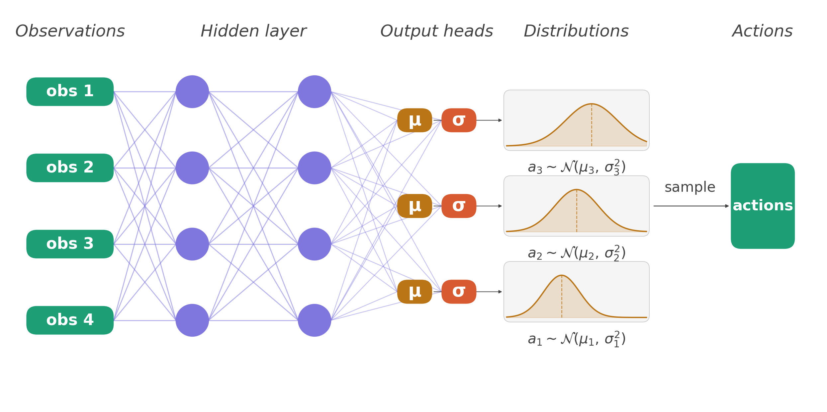
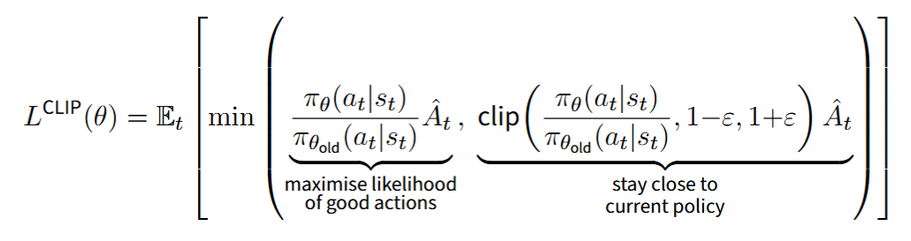
Proximal Policy Optimisation (PPO)
Stochastic policy: actions are drawn from a distribution.
Policy network: outputs parameters of distribution.
Policy update is clipped to prevent large changes.

Slide 18
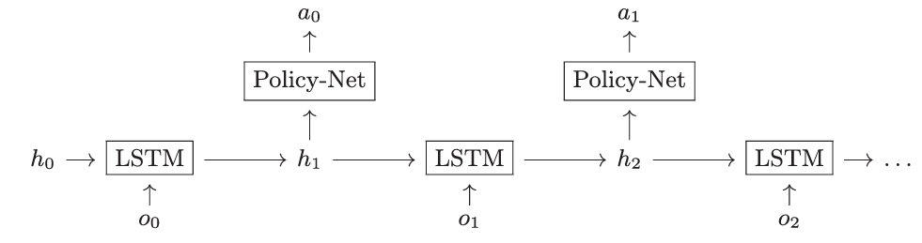
PPO + LSTM
Equip agent with memory to solve the partially observable environment.

Slide 19
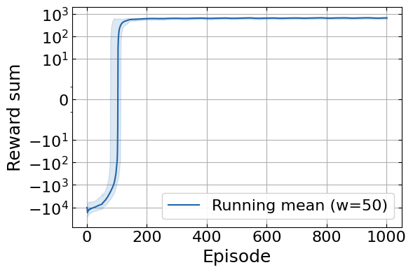
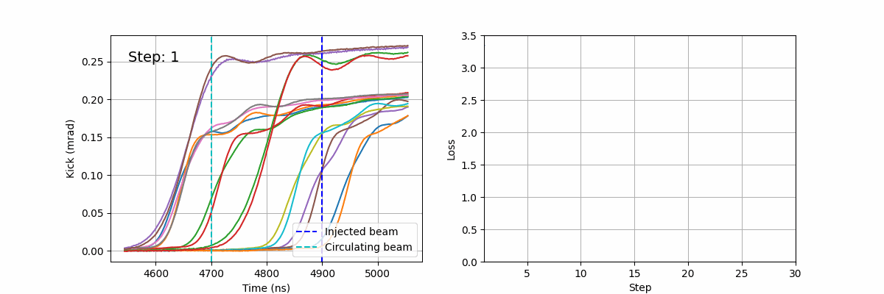
Training & Hyperparameters
Training budget: 10⁶ steps.
Hyperparameter tuning:
Discount factor
Training parameters
Network architecture

Slide 20
Results

Slide 21
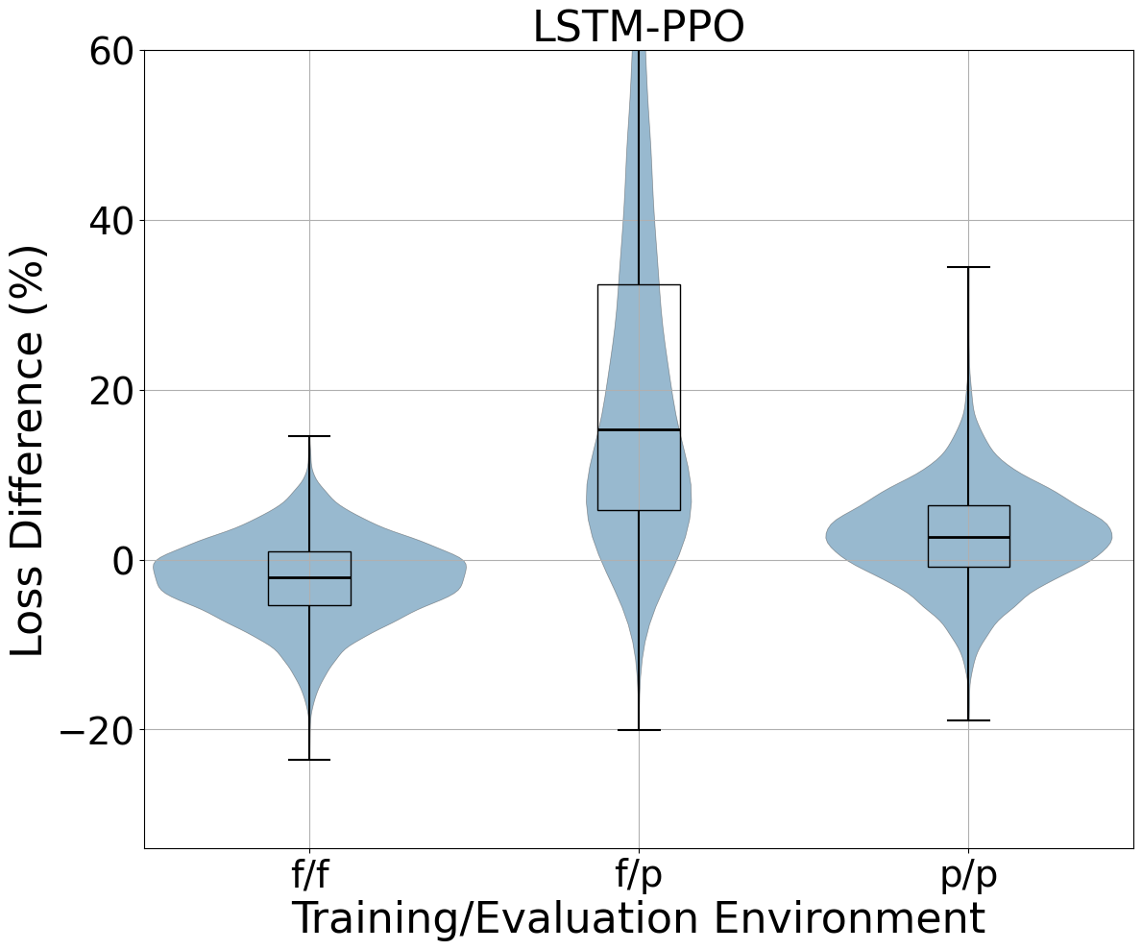
Simulations
Benchmarked agent against BOBYQA on 10⁴ episodes.
Agent performs on par with optimiser.
Agent optimises significantly faster.
x35 speed-up
 | RL agent | Numerical Optimiser
Steps until converged | 7 | 246

Slide 22
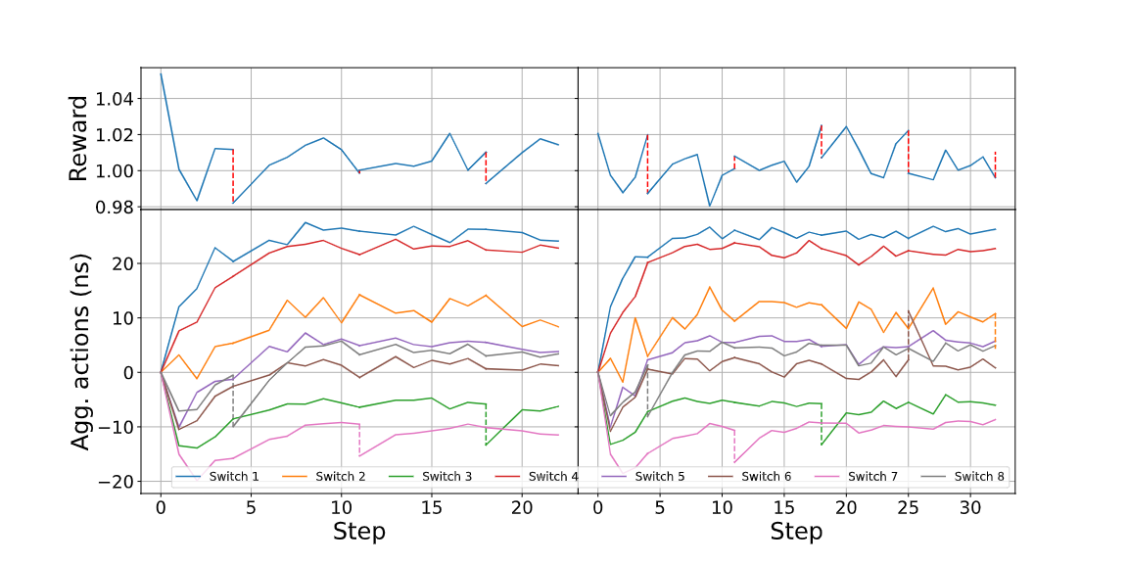
Dedicated study (2024)
Agent tested as active controller.

Slide 23
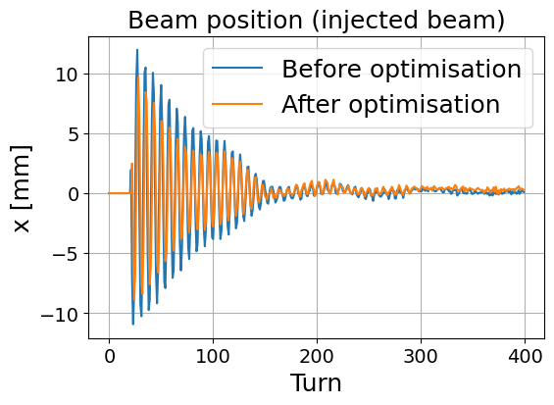
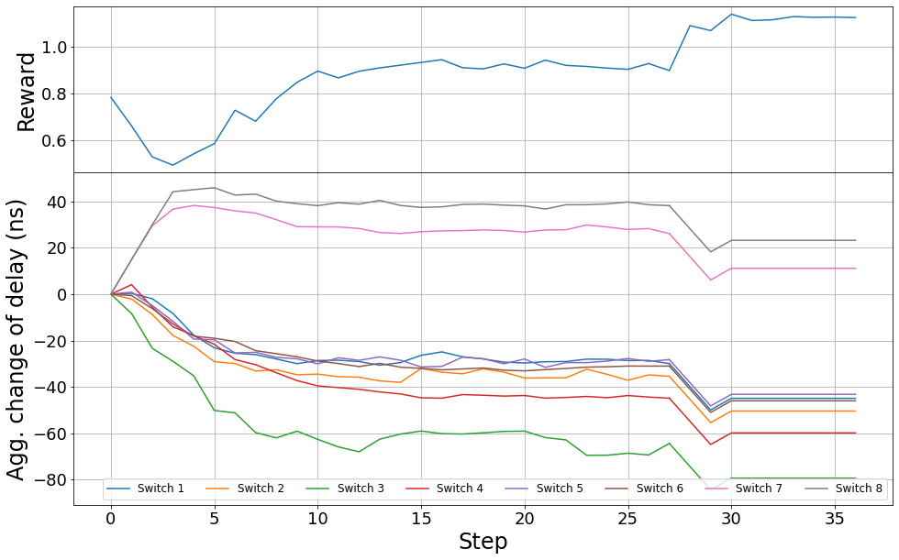
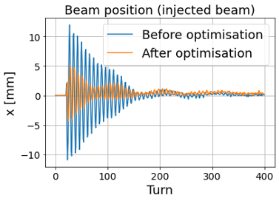
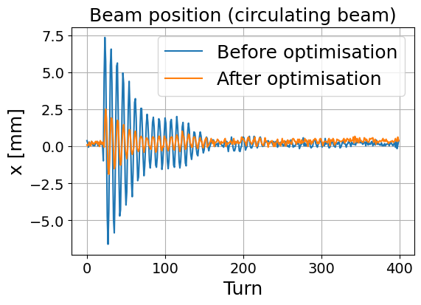
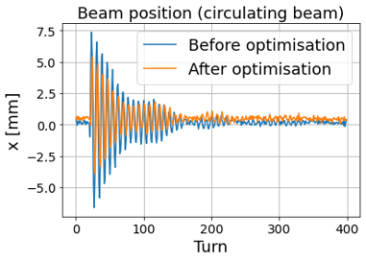
SPS commissioning (2026)
Deployed the same agent as optimiser.
Manual intervention
Improved, but unbalanced

Slide 24
SPS commissioning (2026)
Deployed the same agent as optimiser.
Improved, but unbalanced

Slide 25
SPS commissioning (2026)
Deployed the same agent as optimiser.
Manual intervention

Slide 26
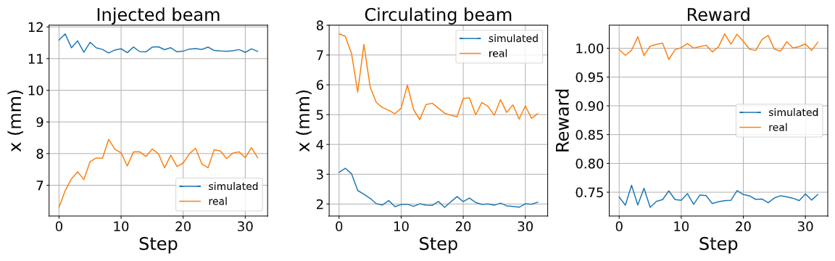
Simulation-reality-gap
Inversion of discrepancy hints at global shift.

Slide 27
Conclusion
Train exclusively in simulations ✅
Active controller ✅
Optimiser (✅)
Learnings:
Diverse experience in training.
Simulated partial observability.
Agents with memory.
Future work:
Match simulations to accelerator.
Translation invariant observation space.

Slide 28


Paper
Repository

Slide 29
Backup

Slide 30
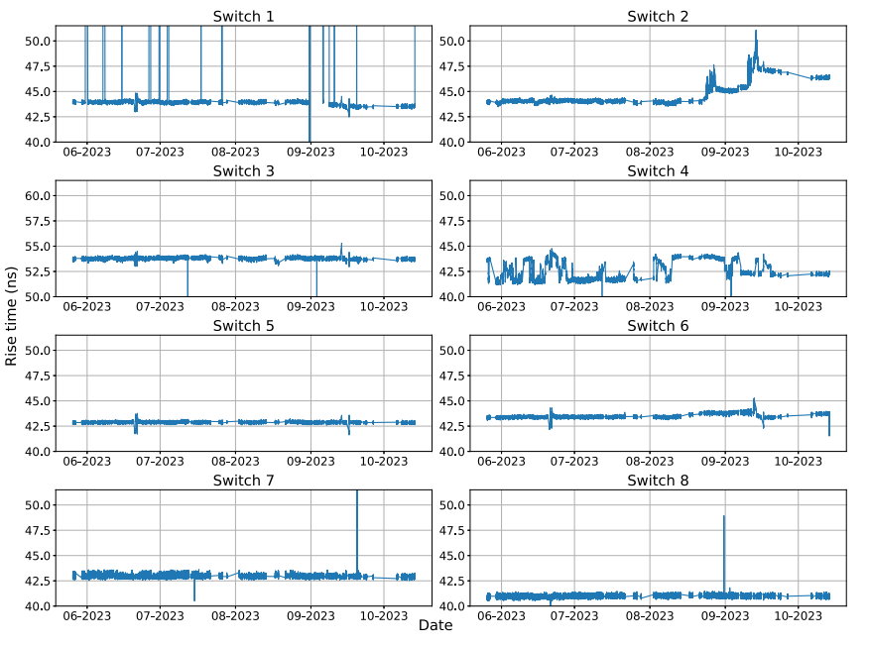
Historical rise times

Slide 31
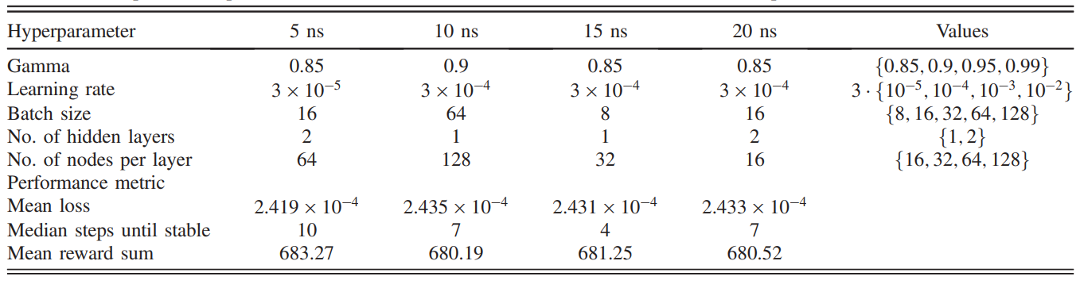
Step size study: PPO hyperparameter

Slide 32
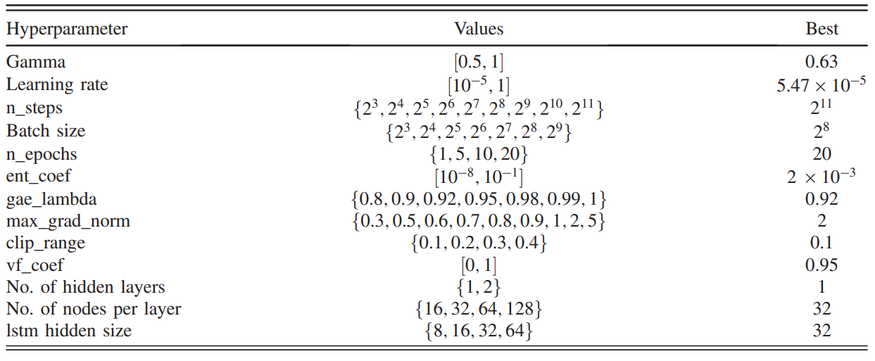
Hyperparameter: LSTM-PPO

