Slide 1
Extending RL with BO and Online Sys Id for SPS-North Area Beam Commissioning
Presenter: Adrián Menor de Oñate Acknowledgements: Michael Schenk, Verena Kain, Borja Rodriguez Mateos, Niky Bruchon, Nikolaos Charitonidis, Giovanni Dal Maso, Alexander Huschauer, SPS OP 25-03-2026
Notes:
Part of the NA beam commissioning.

Slide 2
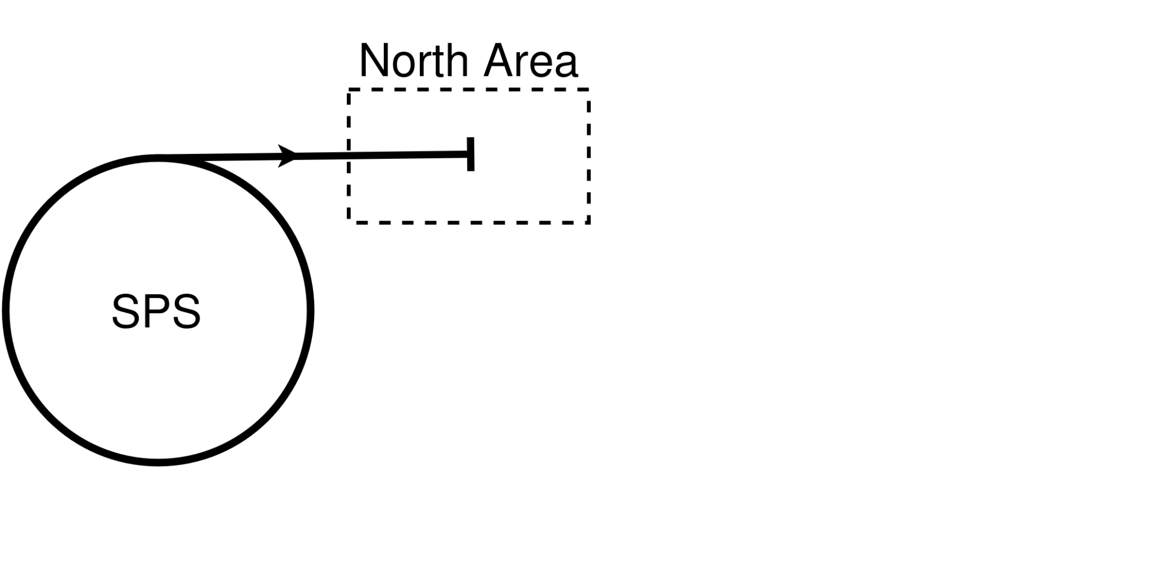
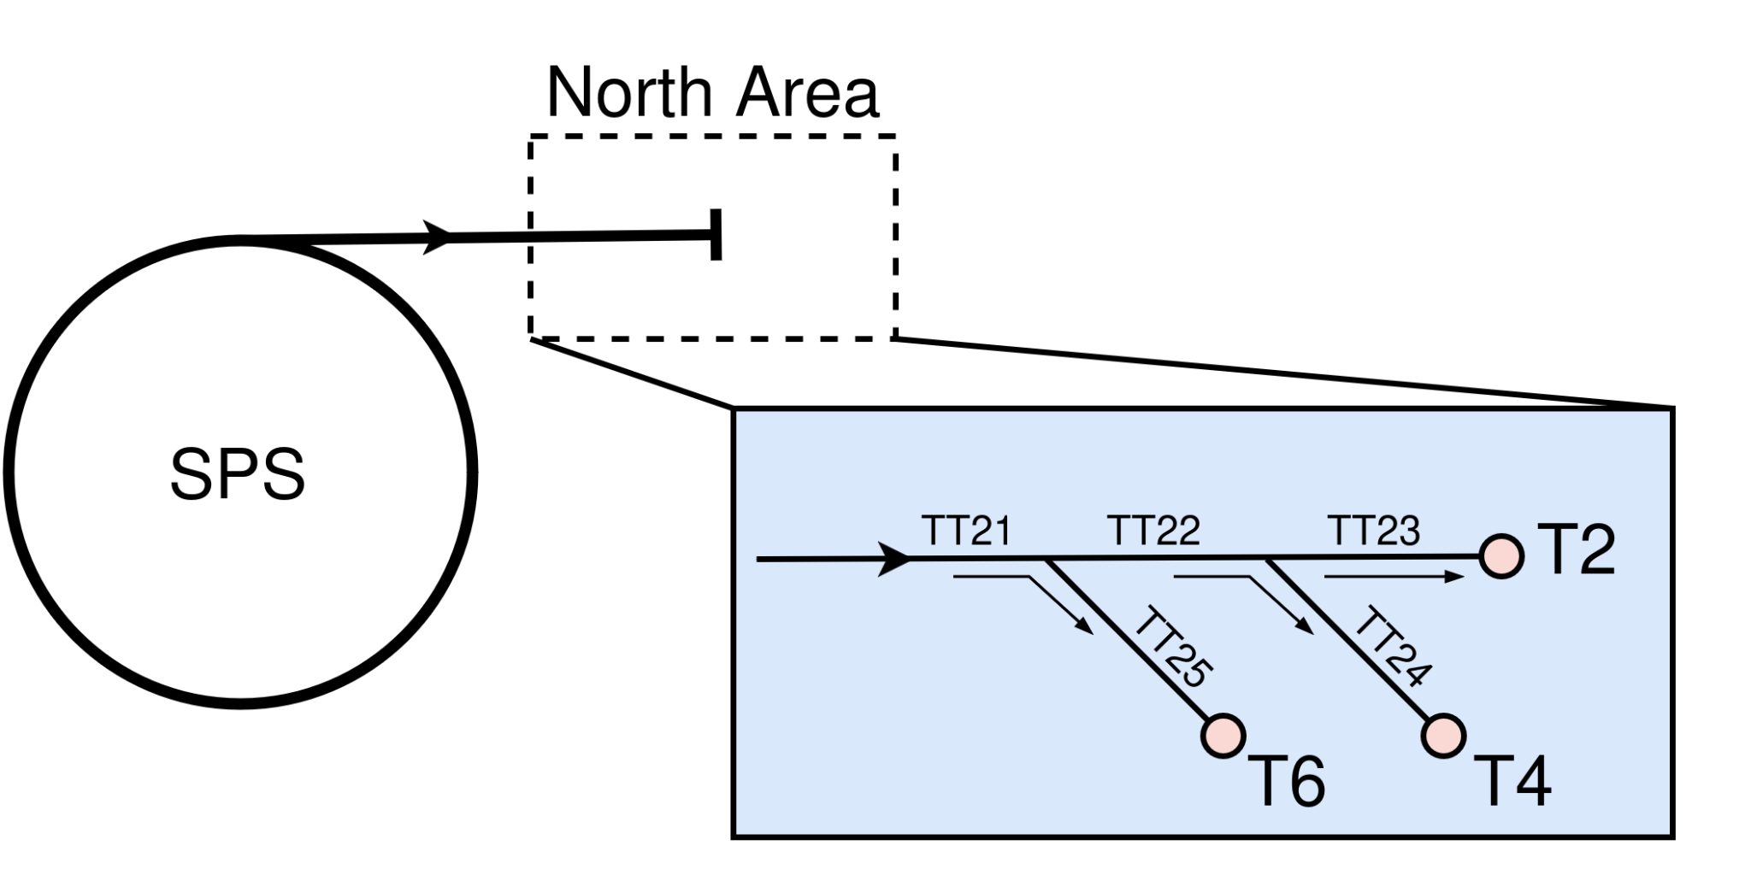
The SPS-North Area Transfer Lines
Goal: Having an aligned beam in the transfer lines, and target efficiency
Act via dipole magnets (correctors), and movable monitors
Observations?

Slide 3
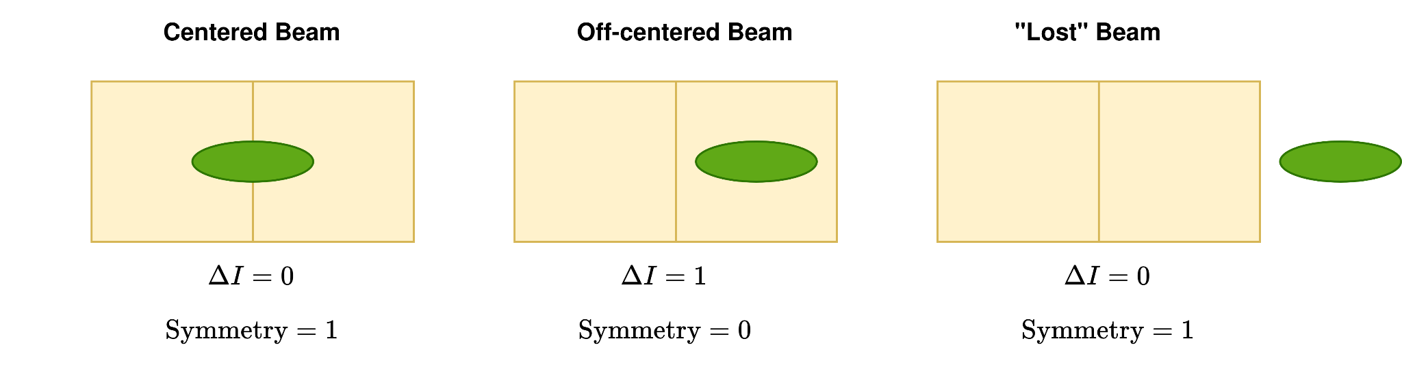
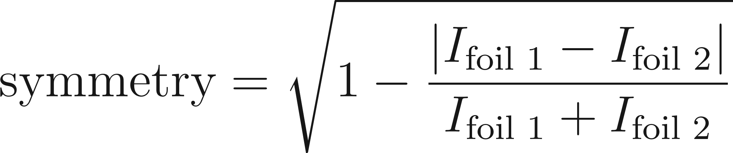
Observation Challenges
There are no conventional beam position monitors available!
Split foils (BSPs) are used instead
Classical control algorithms (currently used) fail when the beam is only on one foil
Beam
Foil

Slide 4


Commissioning the Beam
Severe Misalignment Steering
High Symmetry Steering
Polarity Estimation
Optimisation of the Targets
RL
Do we just use RL for everything?
How do we approach this complex automation?

Slide 5



Problem Specifications
Operational testing time is limited to ~2 times per year
Automation solution must allow for performing the different commissioning activities
The different commissioning automations must be independently testable
Limiting complexity is key

Slide 6
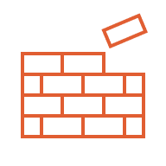

Building an Automation Solution
RL
Autopilots
BO
Interfaces
Controls
SPS
NA
Automated SPS-NA beam commissioning

Slide 7
Commissioning the Beam
Severe Misalignment Steering
High Symmetry Steering
Polarity Estimation
Optimisation of the Targets
RL

Slide 8
Steering From Severe Misalignment

Slide 9
Steering from Severe Misalignment
Beam can be completely off the foils (BSPs)
!
!
!
SPS Beam
Corrector
BSP
BSP

Slide 10
Steering from Severe Misalignment
Beam can be completely off the foils (BSPs) → Beam threading
!
!
!
SPS Beam
Corrector
BSP
BSP
Segment 1
Segment 2
Segment 3

Slide 11
Steering from Severe Misalignment
Beam can be completely off the foils (BSPs) → Beam threading
!
SPS Beam
Corrector
BSP
BSP
Segment 1

Slide 12
Steering from Severe Misalignment
Beam can be completely off the foils (BSPs) → Beam threading
!
SPS Beam
Corrector
BSP
BSP
Segment 2

Slide 13
Steering from Severe Misalignment
Beam can be completely off the foils (BSPs) → Beam threading
SPS Beam
Corrector
BSP
BSP
Segment 2

Slide 14
Steering from Severe Misalignment
Beam can be completely off the foils (BSPs) → Beam threading
SPS Beam
Corrector
BSP
BSP
Segment 3

Slide 15
Steering from Severe Misalignment
Beam can be completely off the foils (BSPs) → Beam threading
SPS Beam
Corrector
BSP
BSP
Segment 3

Slide 16
Steering from Severe Misalignment
Beam can be completely off the foils (BSPs) → Beam threading
SPS Beam
SPS Beam
BSP
Corrector
BSP
Corrector
BSP
BSP

Slide 17

Design Choices
Try corrector settings until putting the beam on the foils, then get a sample efficient picture of the optimization landscape and optimize symmetries
Could use RL but…
Corrector polarities are not known
The exploration strategies for this problem are already known
We don’t want to train online, machine time matters
Other (simpler) schemes work too

Slide 18


Bayesian Optimization
Actions are relative
First do quasi random actions
Then Bayesian optimization
Gaussian Process (GP) Model
New data
$$f\left(x\right)\sim GP(m\left(x\right), k\left(x,x^{′}\right))$$
Transfer Line
Acquisition Function
$action=θ_{0}$+$∆θ$

Slide 19
BO Results
31st of March 2026

Slide 20
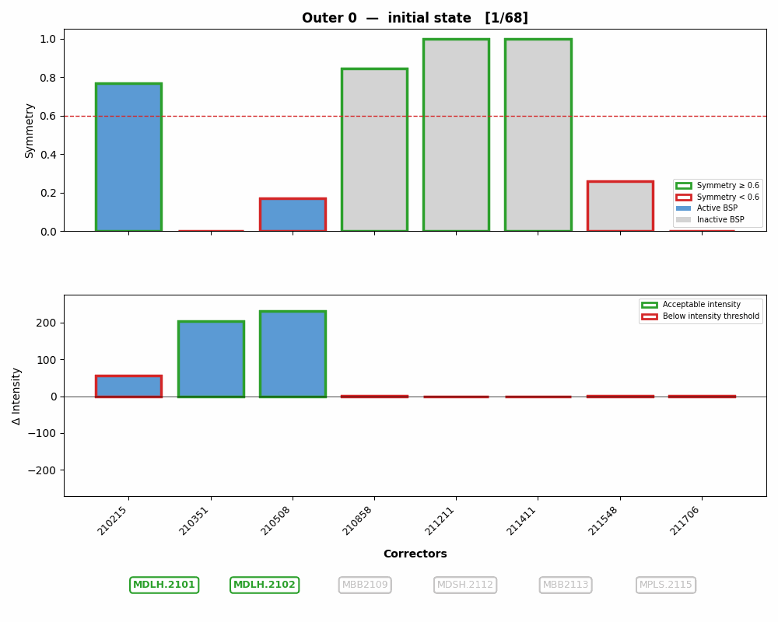
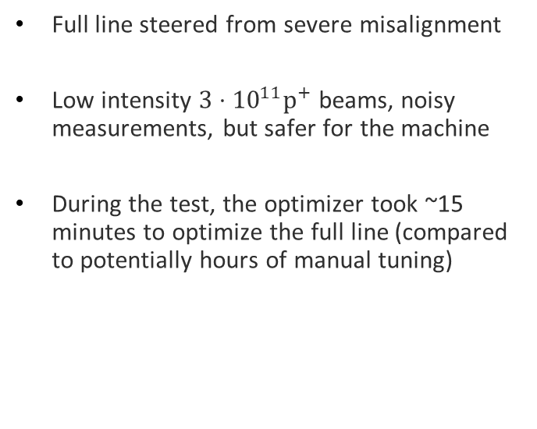
Threading the TT21 H Line
Full line steered from severe misalignment
Low intensity $3⋅{10}^{11}p^{+}$ beams, noisy measurements, but safer for the machine
During the test, the optimizer took ~15 minutes to optimize the full line (compared to potentially hours of manual tuning)
31st of March 2026
20

Slide 21
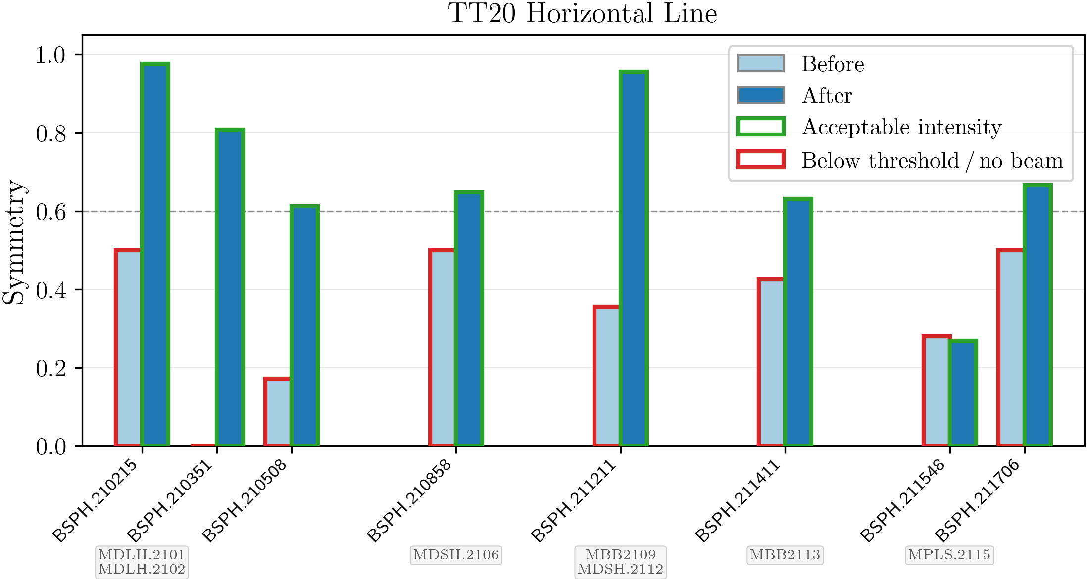
Threading the TT21 H Line
31st of March 2026
21

Slide 22

Commissioning the Beam
Severe Misalignment Steering
High Symmetry Steering
Polarity Estimation
Optimisation of the Targets
RL
BO + Quasi Random Search

Slide 23
Commissioning the Beam
Severe Misalignment Steering
High Symmetry Steering
Polarity Estimation
Optimisation of the Targets
RL
BO + Quasi Random Search

Slide 24
Polarity Estimation

Slide 25
Design Choices
We need a sample efficient identification of the polarities
Could use RL but…
Optimization setup becomes complex (reward function?)
Simpler methods (kick response) are simpler, more maintainable

Slide 26


Algorithm
Kick response on the correctors
Changes in BSPs $∆I$ are compared against simulation model
$$θ$$
BSP
Corrector
Corrector
31st of March 2026
26
MDAH.2303

Slide 27

Algorithm
Kick response on the correctors
Changes in BSPs $∆I$ are compared against simulation model
$$θ$$
BSP
Corrector
Corrector
31st of March 2026
27

Slide 28
Algorithm
Kick response on the correctors
Changes in BSPs $∆I$ are compared against simulation model
$$θ$$
BSP
Corrector
Corrector
31st of March 2026
28
MDAH.2303
MDAH.2307

Slide 29
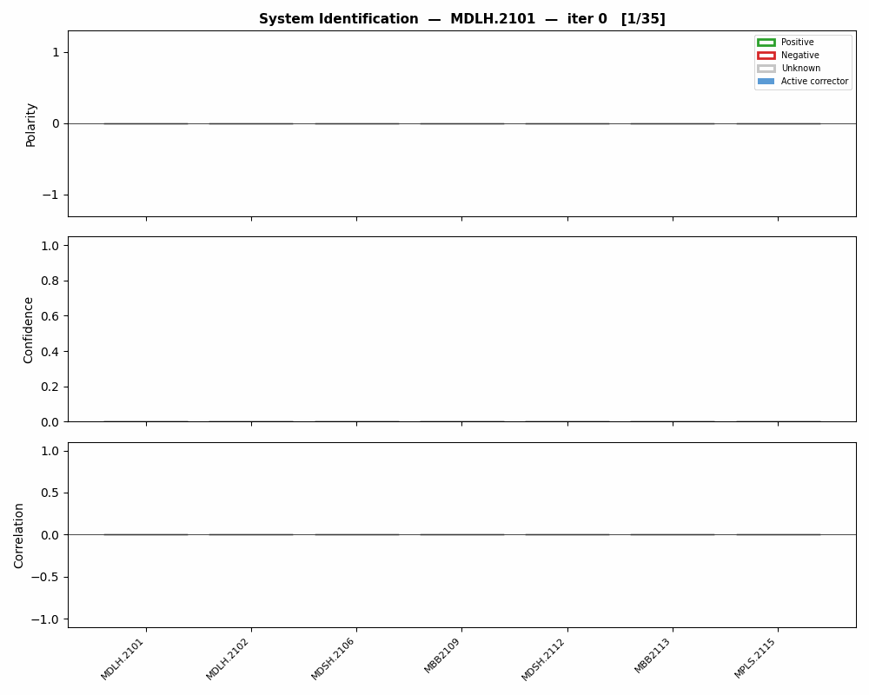
Reality
During the test, the optimization took ~7 minutes to identify all the polarities
31st of March 2026
29
MDAH.2303
MDAH.2307

Slide 30

Test Results
Corrector | 2101 | 2102 | 2106 | 2109 | 2112 | 2113 | 2115
Run 1
Run 2
7/7 (100%)
6/7 (86%)
31st of March 2026
30
MDAH.2303
MDAH.2307

Slide 31
Commissioning the Beam
Severe Misalignment Steering
High Symmetry Steering
Polarity Estimation
Optimisation of the Targets
RL
BO + Quasi Random Search
Kick Response
31st of March 2026

Slide 32
Commissioning the Beam
Severe Misalignment Steering
High Symmetry Steering
Polarity Estimation
Optimisation of the Targets
RL
BO + Quasi Random Search
Kick Response
31st of March 2026

Slide 33
Steering the Line for High Symmetry
31st of March 2026

Slide 34
Design Choices
Can we use RL here?…
Corrector polarities are known
Designing a controller to tradeoff symmetries at the different monitors for high target symmetry is complex → can use RL to discover control strategies
Accurate simulation model allow for training offline
Need to steer the line to a high symmetry, even from situations where the beam is in one foil only
31st of March 2026

Slide 35
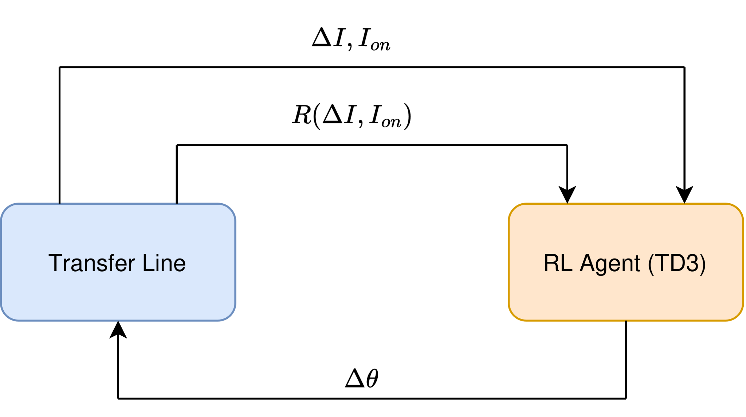
Reinforcement Learning Setup
More info in the poster!
Dipoles’ settings
31st of March 2026

Slide 36
RL Results
31st of March 2026

Slide 37
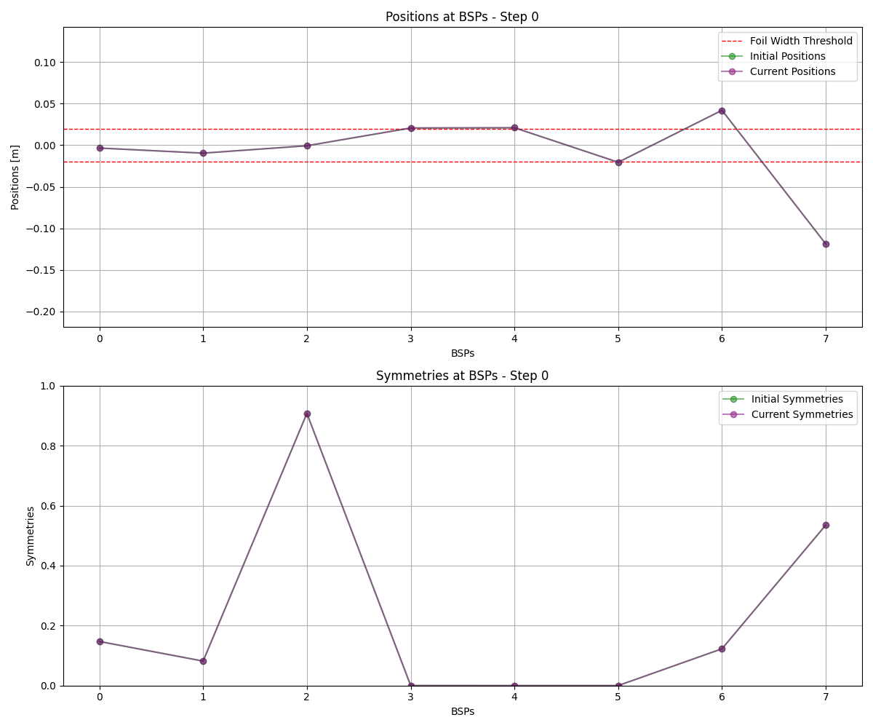
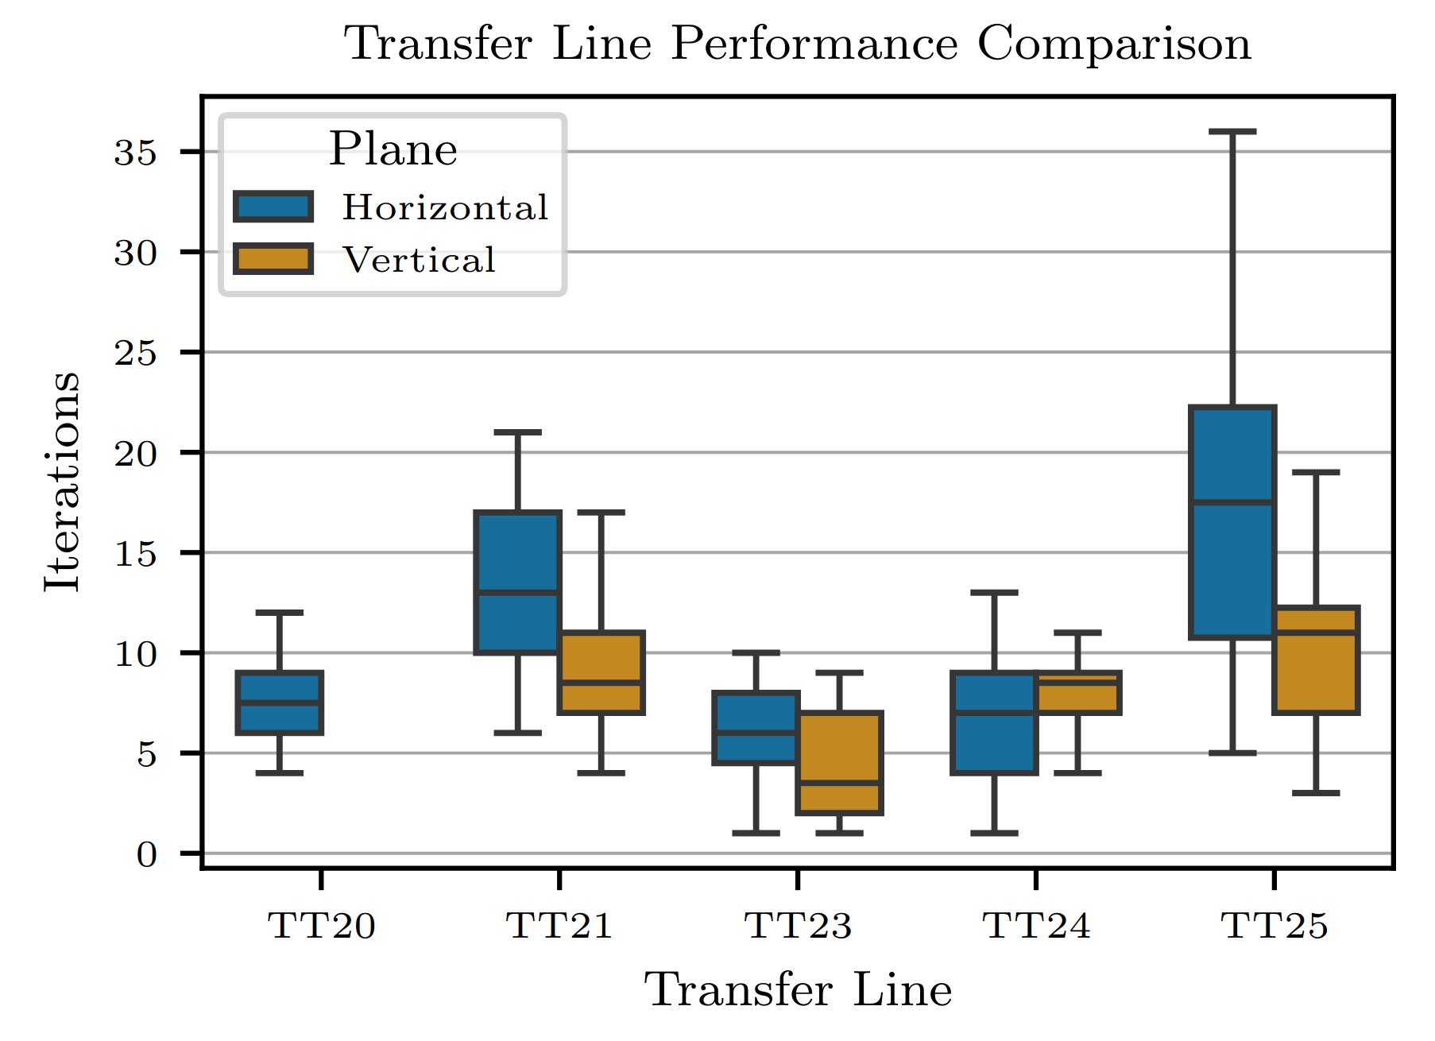
Simulation
31st of March 2026

Slide 38
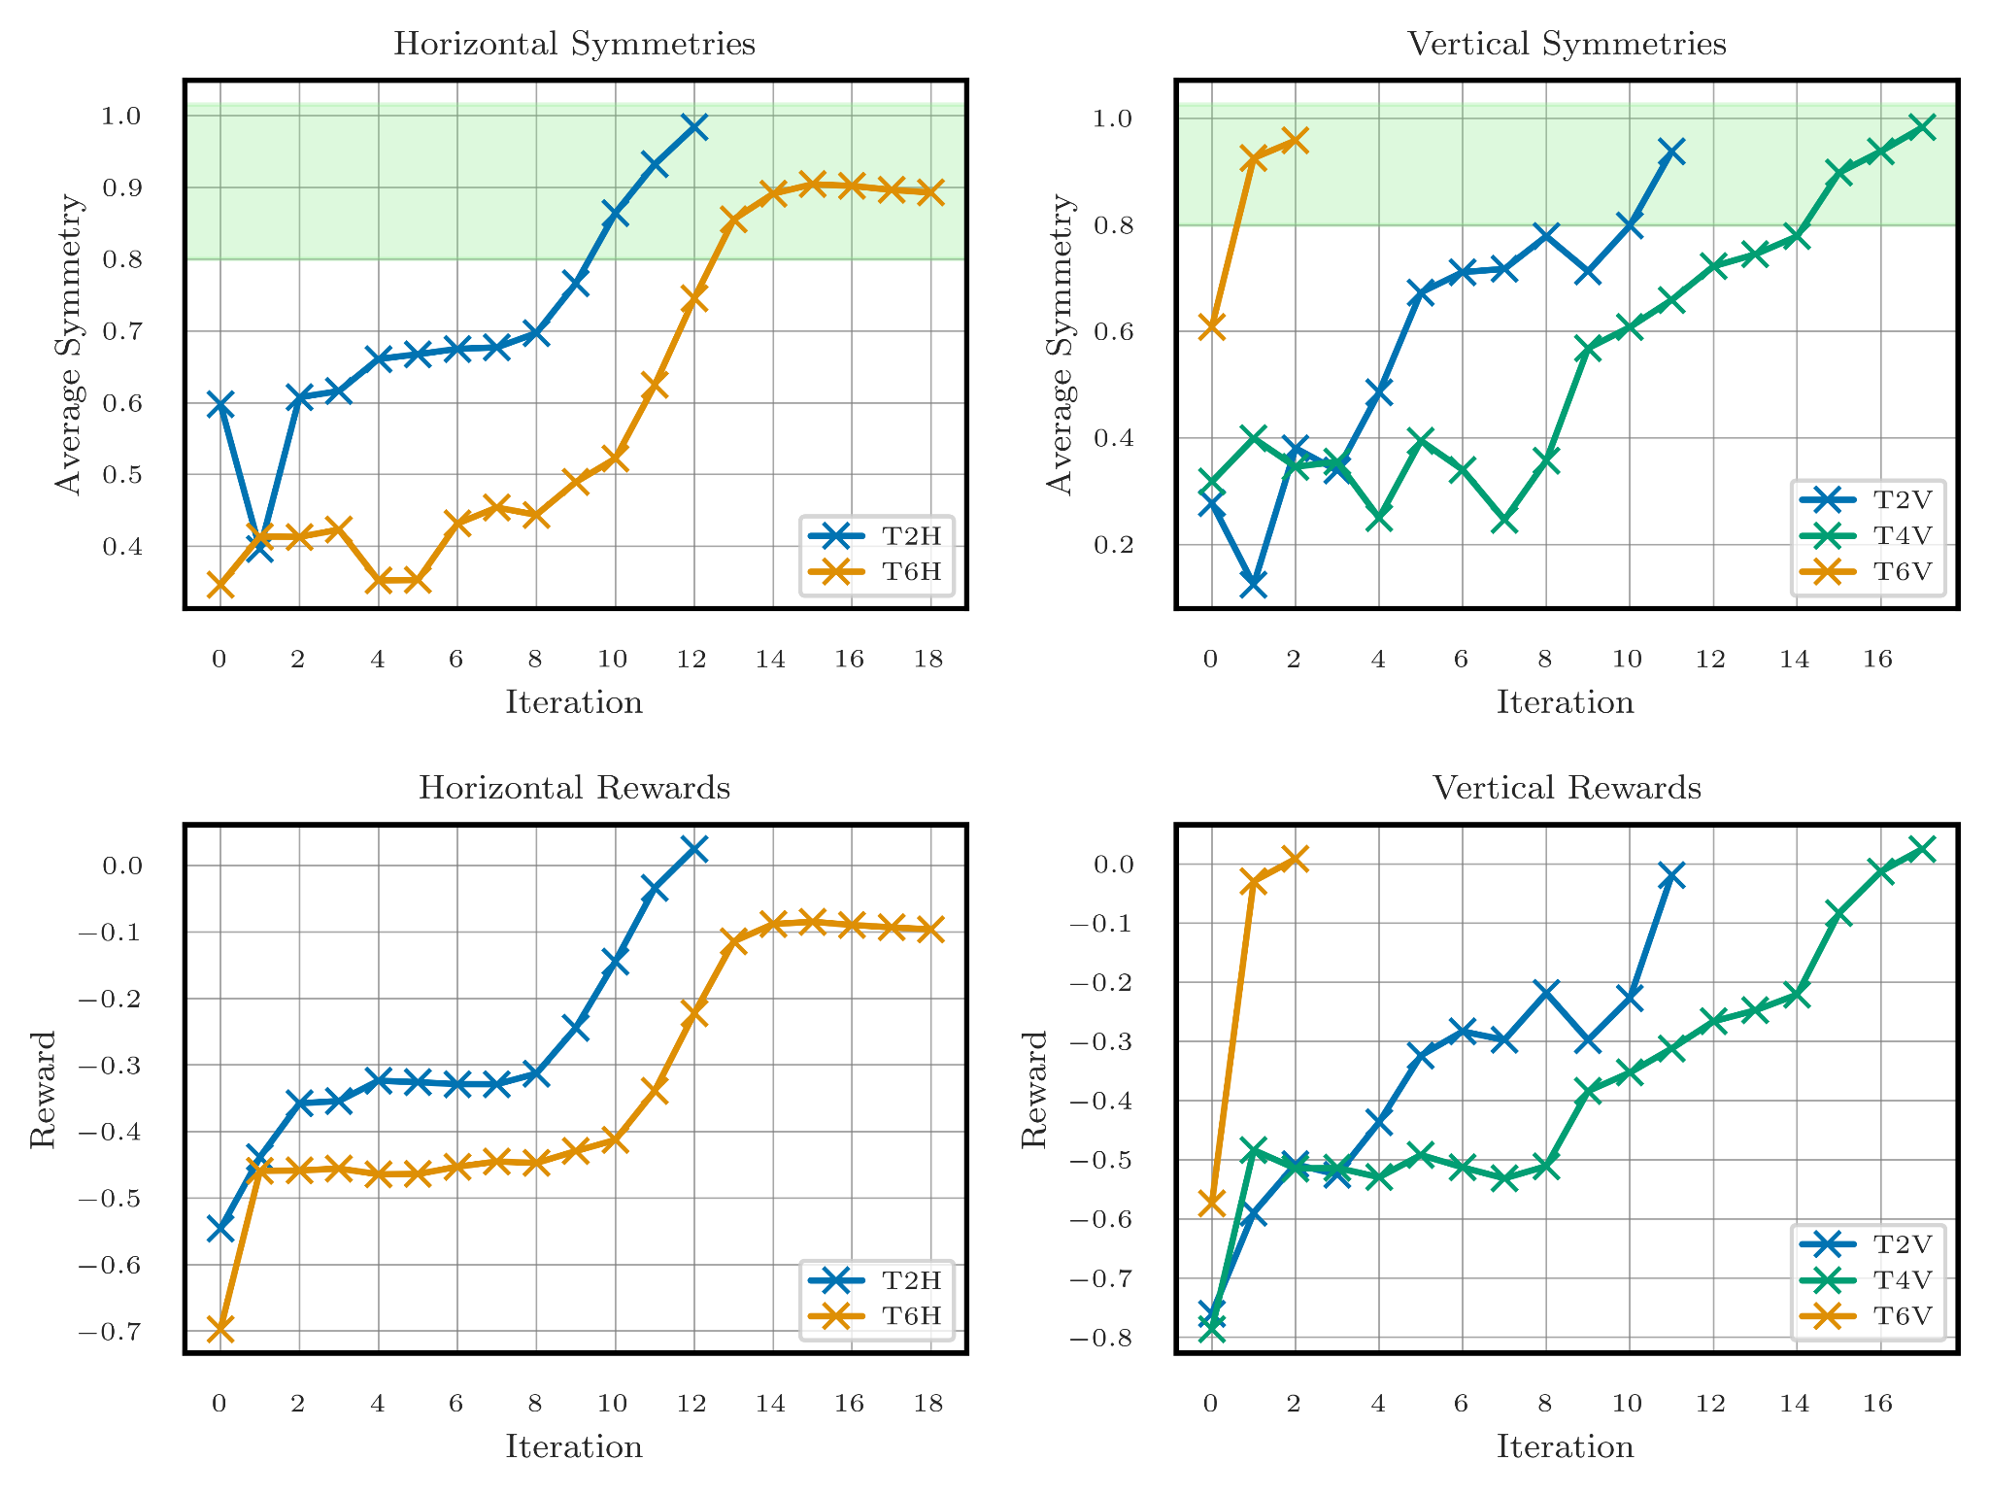
Reality
31st of March 2026

Slide 39
Commissioning the Beam
Severe Misalignment Steering
High Symmetry Steering
Polarity Estimation
Optimisation of the Targets
BO + Quasi Random Search
Kick Response
RL
31st of March 2026

Slide 40
Commissioning the Beam
Severe Misalignment Steering
High Symmetry Steering
Polarity Estimation
Optimisation of the Targets
BO + Quasi Random Search
Kick Response
RL
31st of March 2026

Slide 41
Optimizing the Targets
31st of March 2026

Slide 42
Optimizing the Targets
BSM = movable split monitor
TBIU = target beam instrumentation upstream
SPS Beam
Target
Target
SPS Beam
BSM
BSM
TBIU
TBIU
31st of March 2026
Notes:
Explain how we wait for the YASP autopilot to steer.

Slide 43
Design Choices
Need to find the optimum BSM, TBIU positions while we keep steering for high symmetry at the targets
We could use RL but…
RL system is complex (hierarchical, multi-objective, etc)
Need a system that can swiftly adapt to different target configurations (number of scintillators, etc)
We can simply act in a modular way from what we already have
31st of March 2026

Slide 44
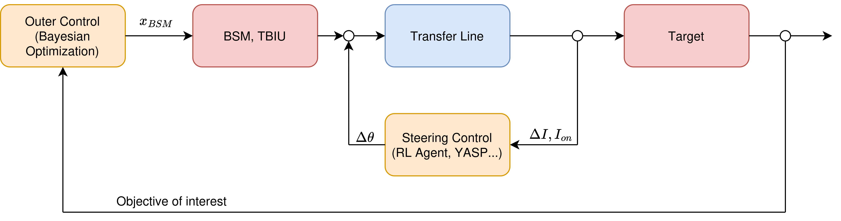
Automating The Target Setup
BSM = movable split monitor
TBIU = target beam instrumentation upstream
Steering Algorithm (RL, etc)
31st of March 2026

Slide 45
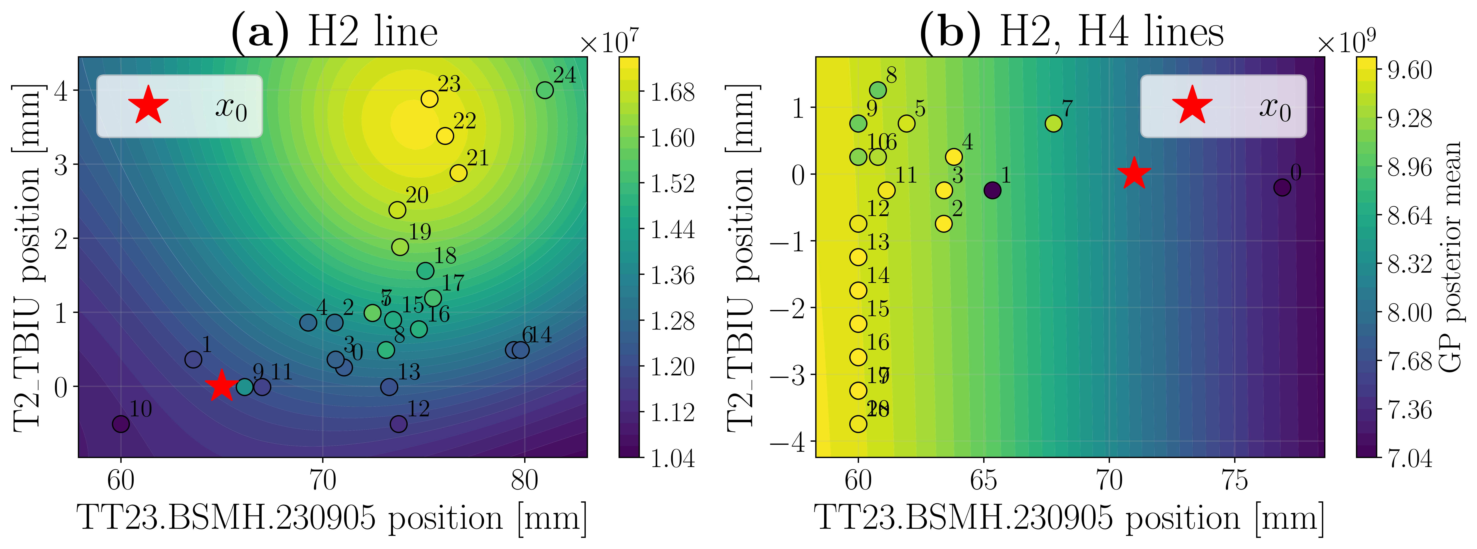
Test Results
Optimization of both setups
31st of March 2026

Slide 46
Commissioning the Beam
Severe Misalignment Steering
High Symmetry Steering
Polarity Estimation
Optimisation of the Targets
BO + Quasi Random Search
Kick Response
RL
BO
31st of March 2026

Slide 47
Conclusion
RL is a great tool to discover control policies
It can come at the cost of complexity, slow learning online, and maintainability
Properly using it in complex automations is challenging and essential
RL
Autopilots
BO
Interfaces
Controls
SPS
NA
Automated SPS-NA beam commissioning
31st of March 2026

Slide 49
Backup slides

Slide 50
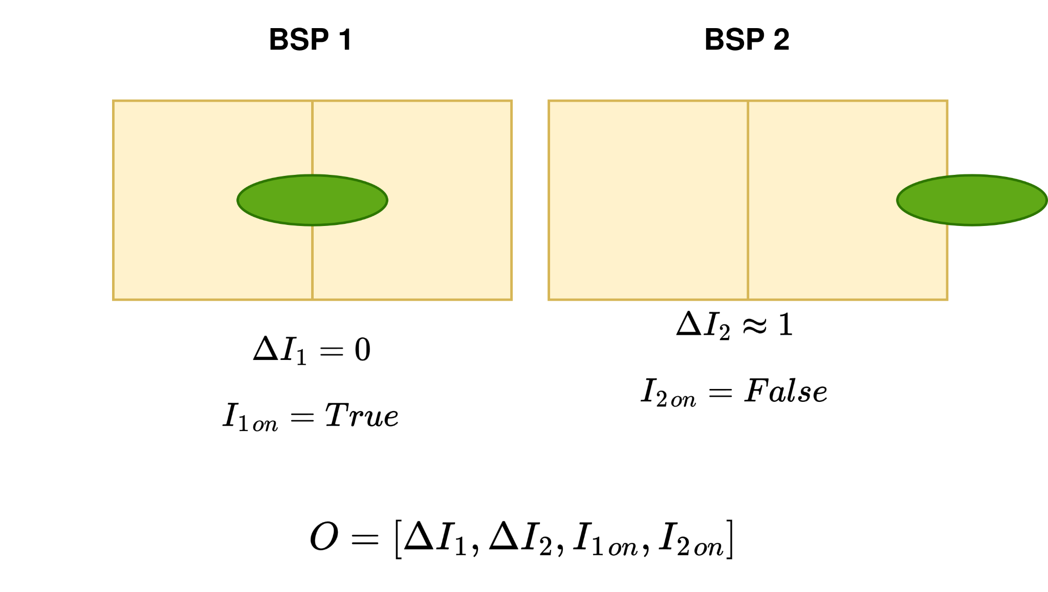
Reinforcement Learning Setup
Example
Dipoles’ settings
March 25ᵗʰ 2026

Slide 51
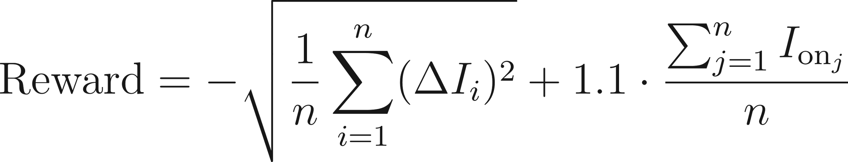
Reward Function
Centered beam
No beam loss
March 25ᵗʰ 2026

Slide 52
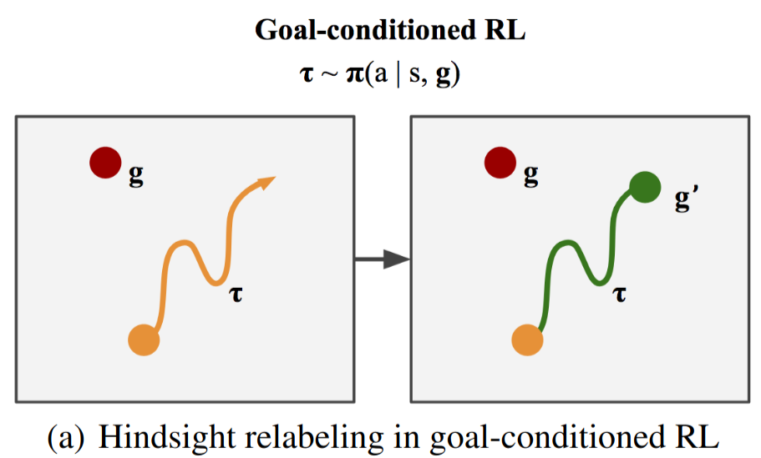
Reinforcement Learning Agent
TD3 algorithm
Hindsight Experience Replay (HER) buffer
Robust against sparse reward functions
Implicit curriculum learning
Image: Packer, C., Abbeel, P., & Gonzalez, J. E. (2021). Experience Replay for Sparse Reward Meta-RL. 35th Conference on Neural Information Processing Systems (NeurIPS 2021).
March 25ᵗʰ 2026

Slide 53
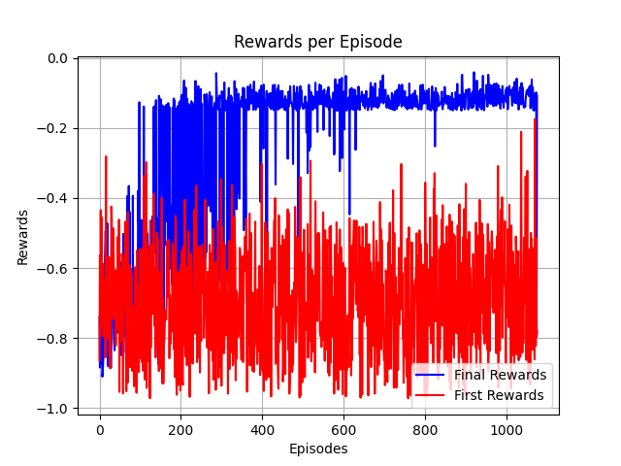
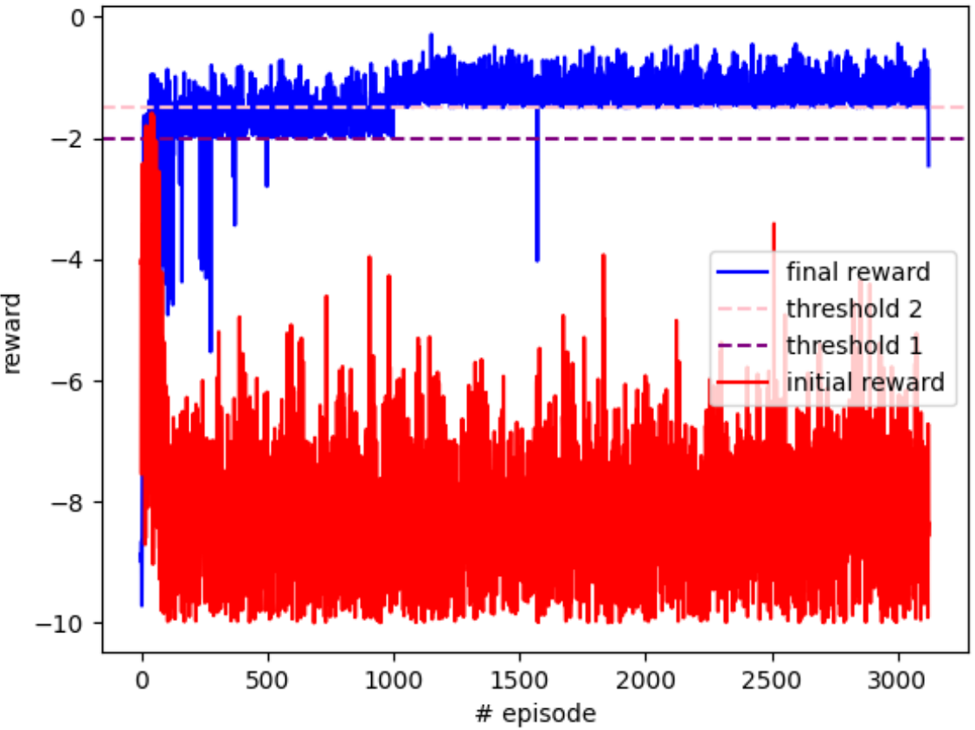
Hindsight Experience Replay (HER)
Train with larger actions and harder stopping criteria
No need for curriculum learning
W/O HER
HER
March 25ᵗʰ 2026

Slide 54
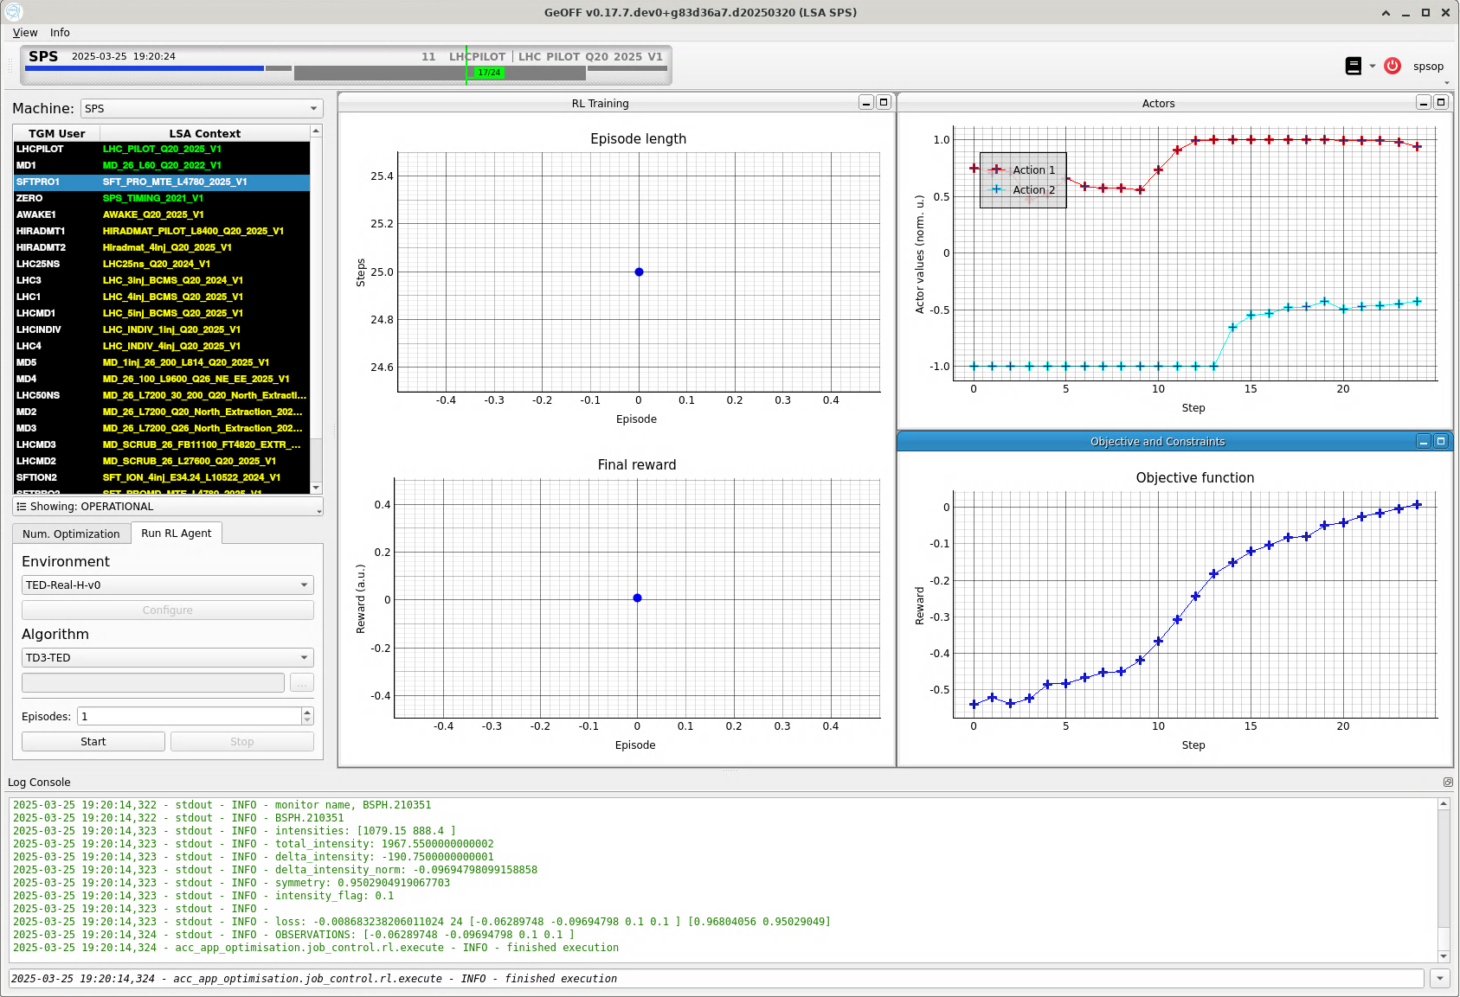
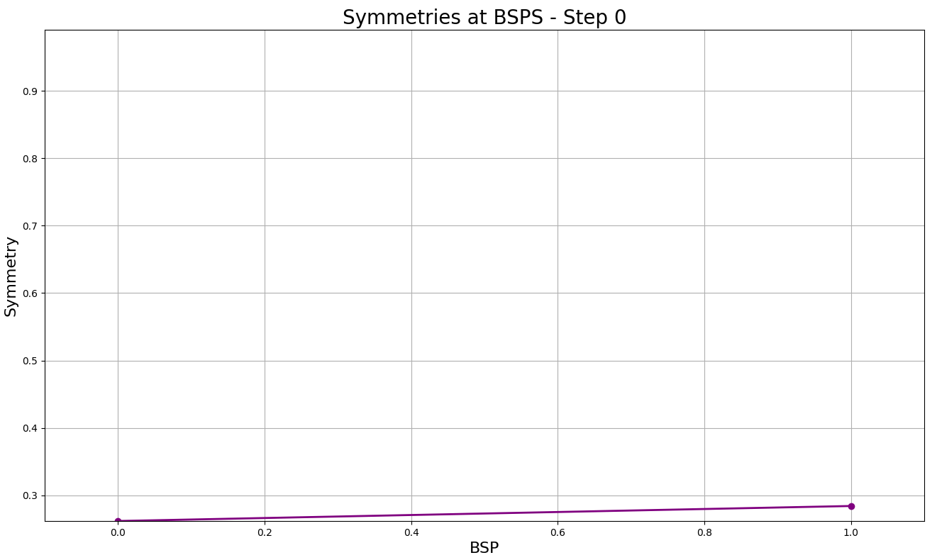
Reality
March 25ᵗʰ 2026

Slide 55
Reality

Slide 56
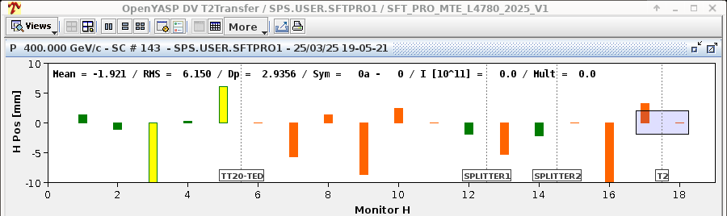
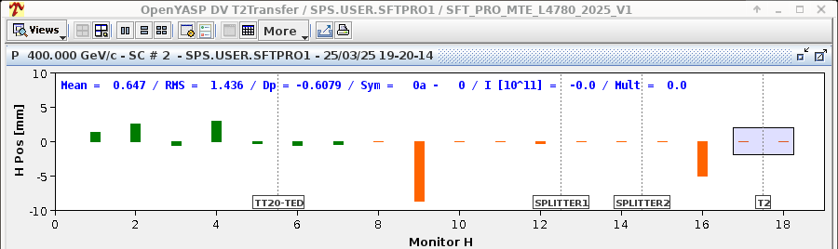
Reality
Before
After

Slide 57
Simulation vs Reality
 | Simulation | Reality
Beam loss flag | Mean beam position | Intensity threshold
Noise | Initial magnet settings | Magnet settings, beam conditions etc

Slide 58
Conclusion
The RL policies successfully transfer to the real world
The beam can be successfully steered in the different tests
The RL pipeline is flexible to adapt to the different transfer lines

Slide 59

Bringing the Beam Back

Slide 60
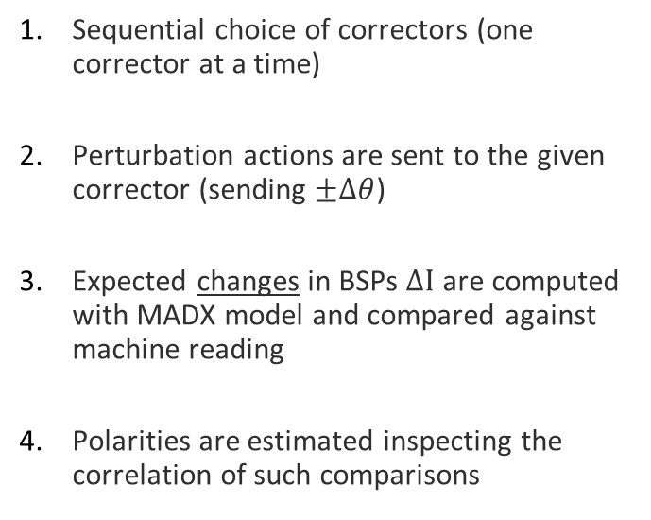
Algorithm
Sequential choice of correctors (one corrector at a time)
Perturbation actions are sent to the given corrector (sending $±∆θ$)
Expected changes in BSPs $∆I$ are computed with MADX model and compared against machine reading
Polarities are estimated inspecting the correlation of such comparisons
$$θ$$
BSP
MDAH.2303
MDAH.2307
March 25ᵗʰ 2026
60
MDAH.2303

Slide 61
Algorithm
Sequential choice of correctors (one corrector at a time)
Perturbation actions are sent to the given corrector (sending $±∆θ$)
Expected changes in BSPs $∆I$ are computed with MADX model and compared against machine reading
Polarities are estimated inspecting the correlation of such comparisons
$$θ$$
BSP
MDAH.2303
MDAH.2307
March 25ᵗʰ 2026
61

Slide 62
Algorithm
Sequential choice of correctors (one corrector at a time)
Perturbation actions are sent to the given corrector (sending $±∆θ$)
Expected changes in BSPs $∆I$ are computed with MADX model and compared against machine reading
Polarities are estimated inspecting the correlation of such comparisons
$$θ$$
BSP
MDAH.2303
MDAH.2307
March 25ᵗʰ 2026
62
MDAH.2303
MDAH.2307

