Slide 1
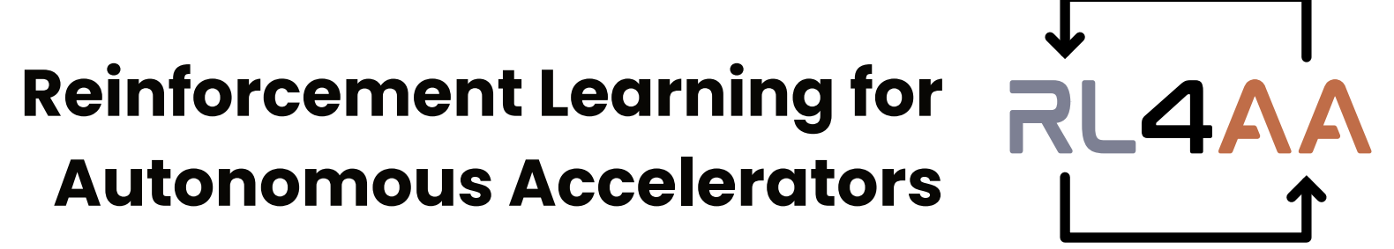
Reinforcement Learning for Real-Time Cyclotron Tuning:
Results from the PSI Injector 2 Experiment
RL4AA’26, Liverpool, UK
31st March 2026
Malek HAJ TAHAR

Slide 2
Part I: Experimental Approach
Part II: Reinforcement Learning Results
Part III: Evaluating RL model Reliability
Part IV: Tuning Strategy for High Current

Slide 3
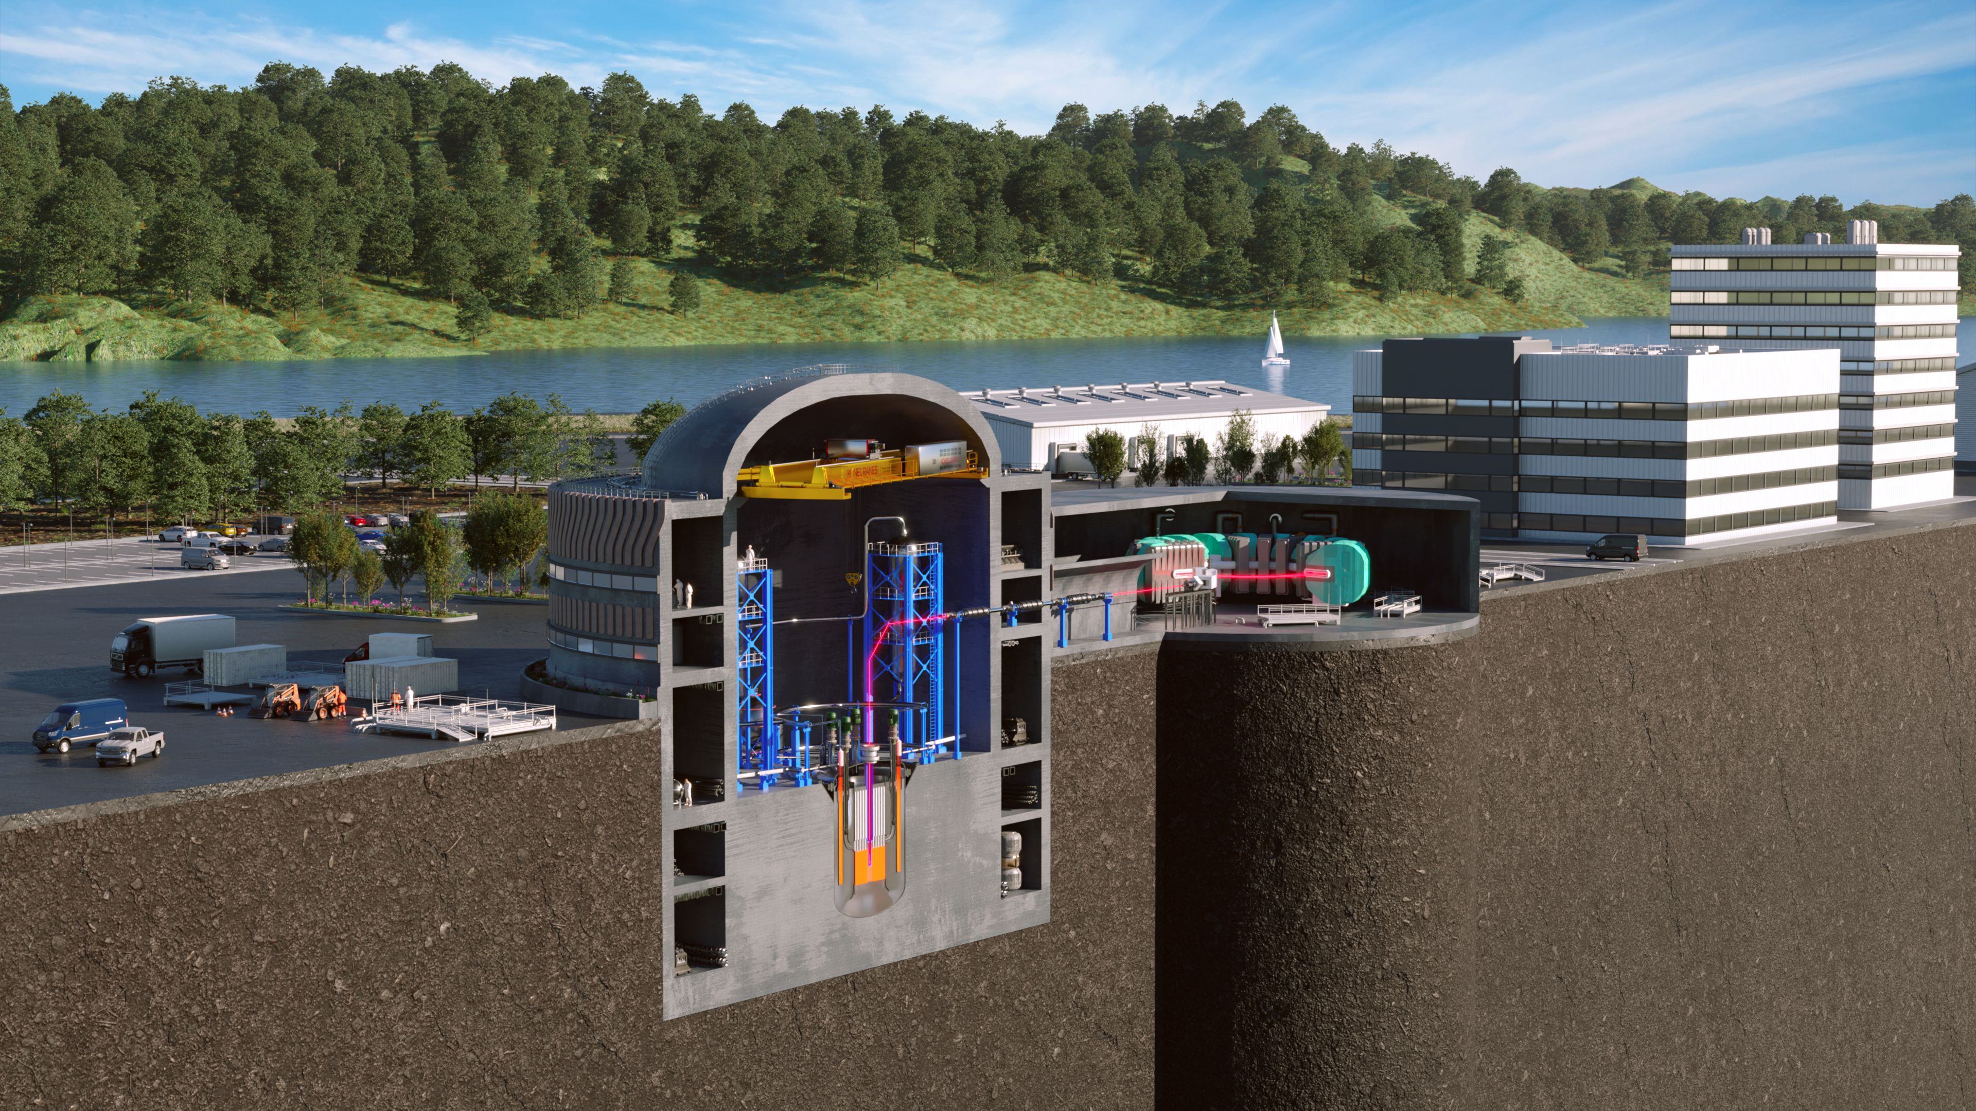
Subcritical Transmuting Accelerated Regenerative Technology (START)
Cyclotron
800 MeV ─ 5 mA
Lead-Cooled Reactor
Spallation target
4 MW liquid metal

Slide 4
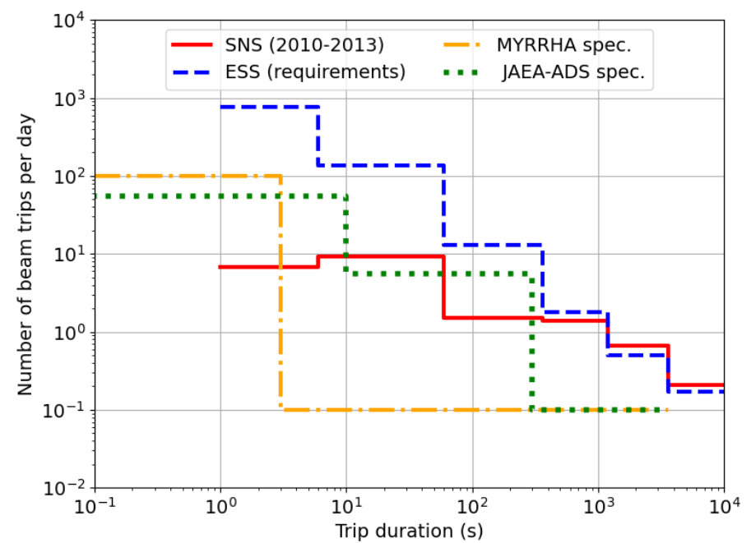
Challenges for High Reliability
High Reliability Requirements:
  Ensure high plant availability
  Limit thermal stress on critical components (target, subcritical blanket, fuel assemblies)
Current Data:
  Reliability is 2-3 orders of magnitude below ADSR requirements
Next steps:
  Most R&D efforts focused on how to ensure the most reliable high power cyclotron design & operation
Beam trips frequencies
Overview of ADS Projects in the World (cern.ch)

Slide 5
ML-based tuning: Motivation
Transform cyclotron operation from manual tuning to intelligent self-optimization, using Machine Learning (ML):
  Rapid beam tuning during start-up
  Continuous adaptation to changing machine conditions
  Enhanced beam quality, stability, and reliability: shall adapt to different turn numbers (5 in this experiment) and various resonators setups (2, 3 or 4 resonators)
  Maximized energy efficiency and system robustness
  Lower reliance on expert operators and significant time savings in setup and retuning
PSI Injector 2 identified as an ideal testbed for investigating ML-based tuning strategies

Slide 6
Strategic Questions
Convergence: How quickly can an ML model reach optimal control in a real machine environment? Is convergence possible within a few hours?
Pretraining Utility: How effective is surrogate-based or simulation-based pretraining for speeding up convergence?
Generalization Across Turns: Does a model trained on one turn number generalize to others? If not, can transfer learning reduce retraining time?
Drift Compensation: How frequently must a trained model be retrained to counteract thermal or magnetic drifts?
Scalability to High Current: Does the ML policy learned at low beam current remain valid at high current operation?
Can a machine be taught to operate a cyclotron with limited human intervention?

Slide 7
PART I: Experimental Approach

Slide 8
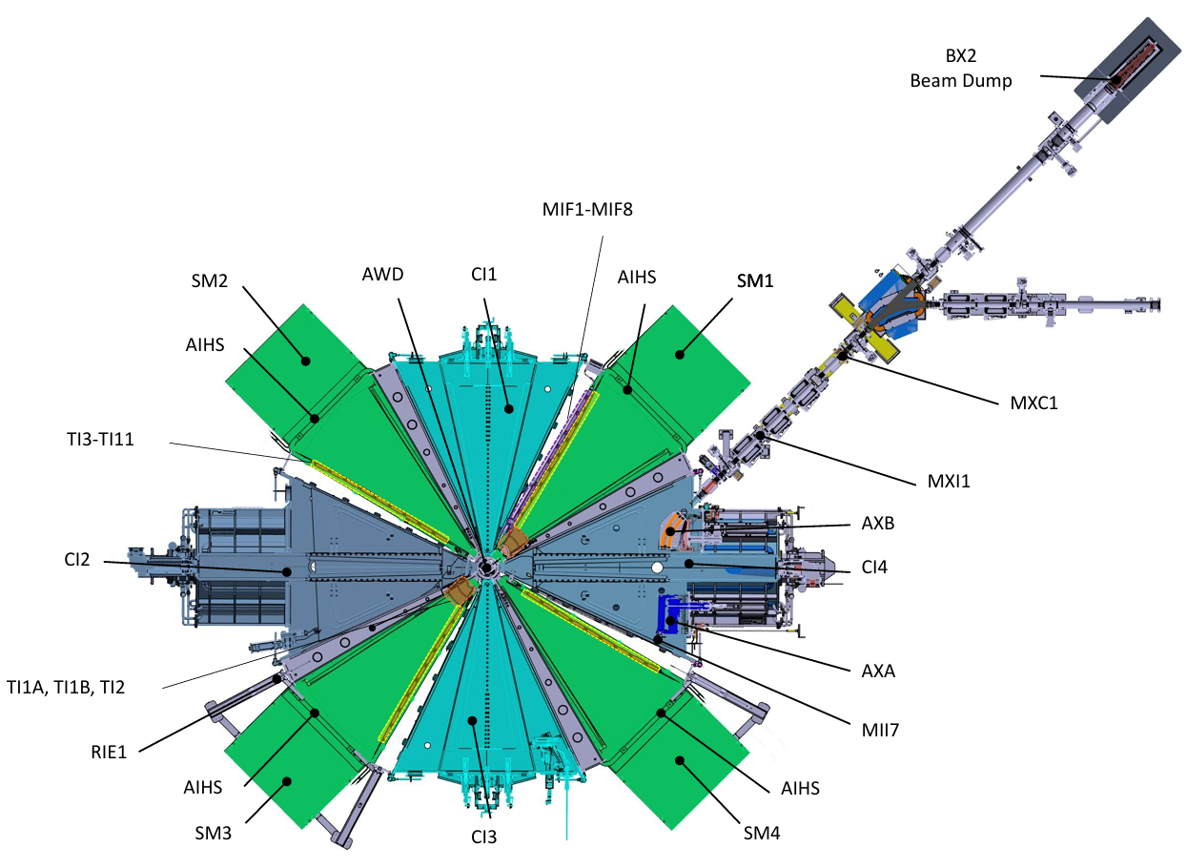
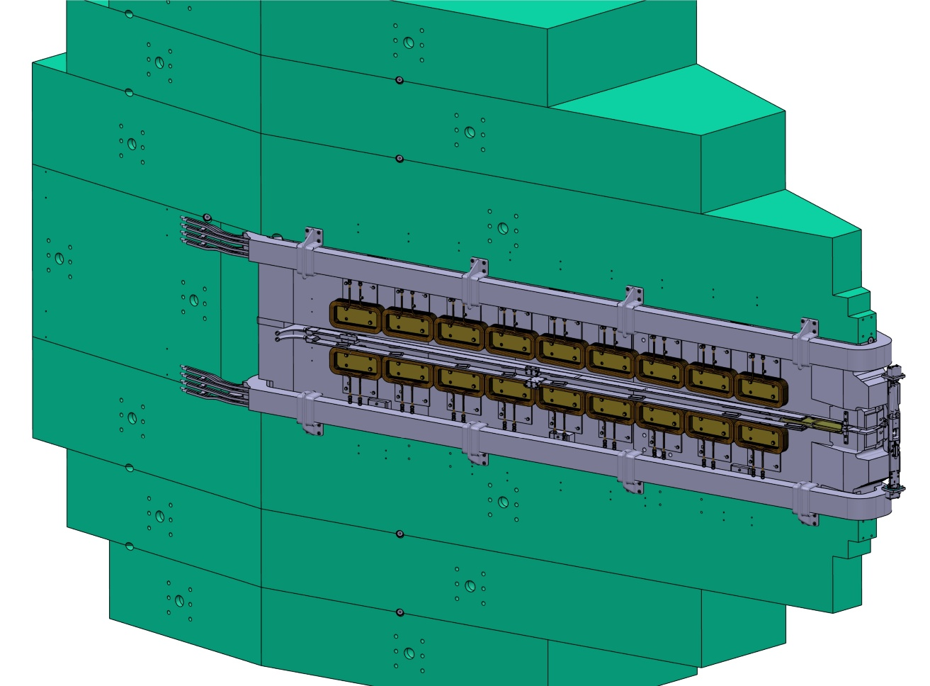
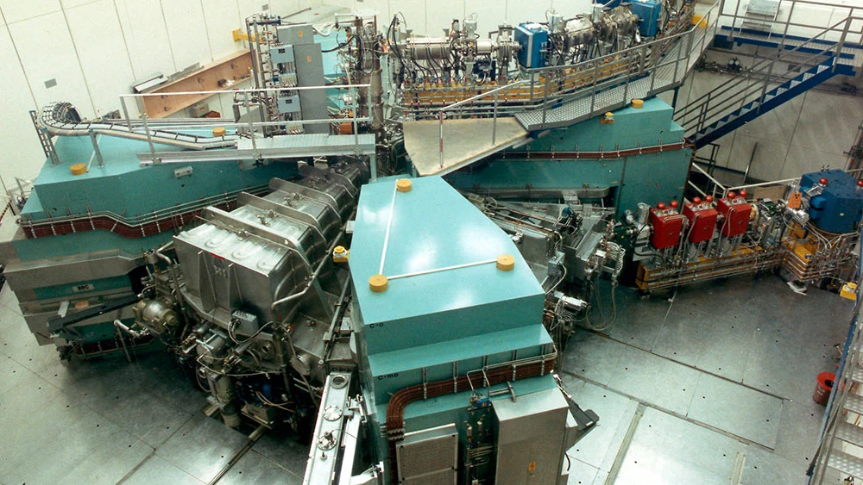
Injector 2 Cyclotron
Main coil
MIF8
Trim coil
Cross section of one magnet of PSI Injector 2 cyclotron
  14 actuators are used at once to modify the magnetic field and energy gain per turn
  13 observables include phase probes, loss monitors, temperature sensors, beam current, turn number (feedback from oper)

Slide 9
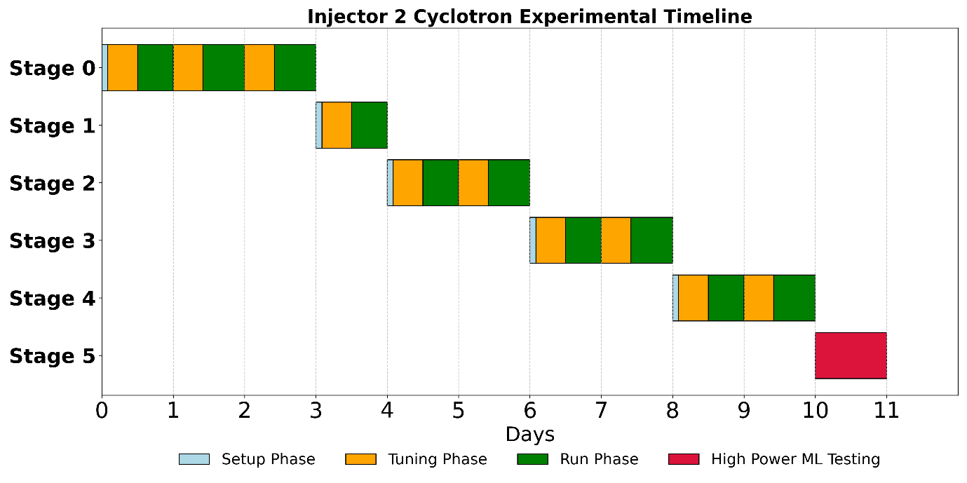
Phase Breakdown of Executed Experiment
12 full days of beam development granted:
Stage | Turn number | Resonators setup (Res 1, Res 2, Res 3, Res 4) kVp
0 | 72 | 430, 429, 451, 0
1 | 73 | 430, 401, 449, 0
2 | 74 | 430, 371, 448, 0
3 | 89 | 430, 0, 449, 0
4 | 60 | 430, 428, 448, 428
3 resonators
2 resonators
4 resonators
Operators
Machine Learning
ML Reliability
Setup Phase (8:00–10:00): Operators configured the machine to the desired turn number using the resonator settings listed in Table
Tuning Phase (Daytime): Machine learning agents (RL or BO) were trained at low beam currents (~20 μA)
Run Phase (Evening/Night): After tuning, the ML agent was left in autonomous control during nighttime to assess long-term reliability and safety

Slide 10
Operator Tuning Across Turns
Turn change | Number of interlocks activated during tuning | Tuning time
72 -> 73 | 3 | 10 min
73 -> 74 | 3 | 9 min
74->89 | 7 | 47 min
89->60 | 0 | 10 min
Turn 72 was already setup and running
Tuning complexity increased significantly with reduced number of resonators (e.g. 2 resonators at Turn 89)
The 89-turn setup required 7 interlock recoveries and took nearly 5x longer to tune
Summary of initial set-up fine tuning procedures across turns
Setup phase went very smoothly thanks to very experienced operators (we assumed 2 hours tuning time)
→ Gave us precious time to perform our experiments (next)

Slide 11
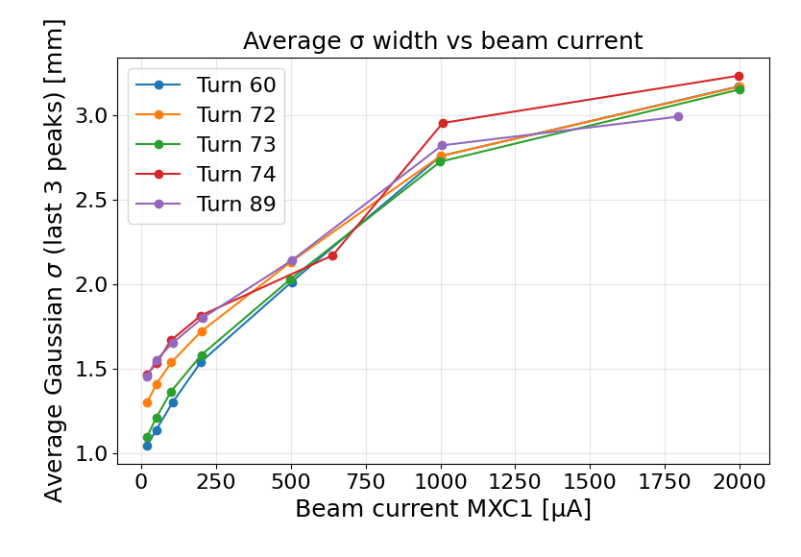
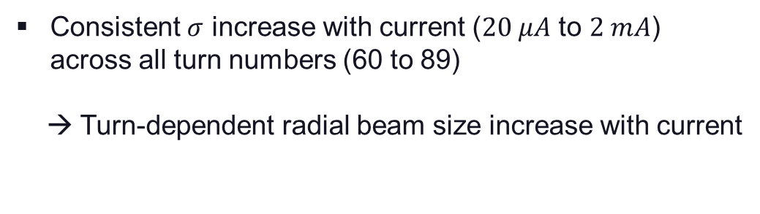
Beam Size Evolution with Current
Characterize the radial size of the extracted beam using the RIE1 probe for various turn configurations and beam currents
Consistent $σ$ increase with current ($20 μA$ to $2 mA$) across all turn numbers (60 to 89)
→ Turn-dependent radial beam size increase with current

Slide 12
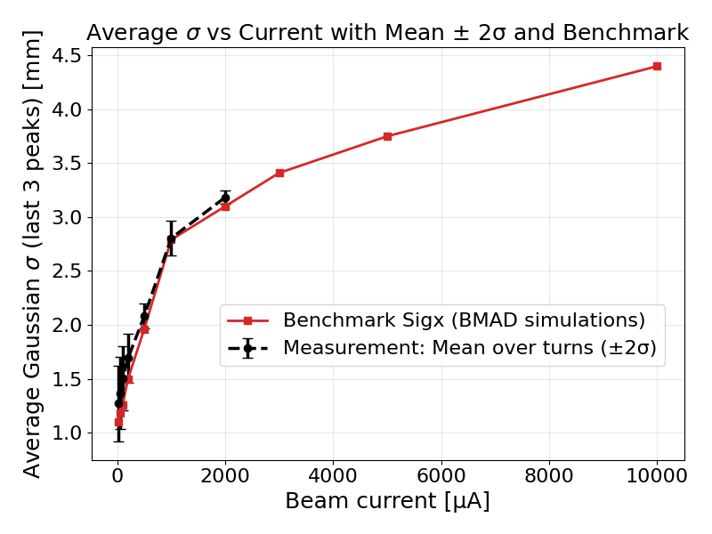
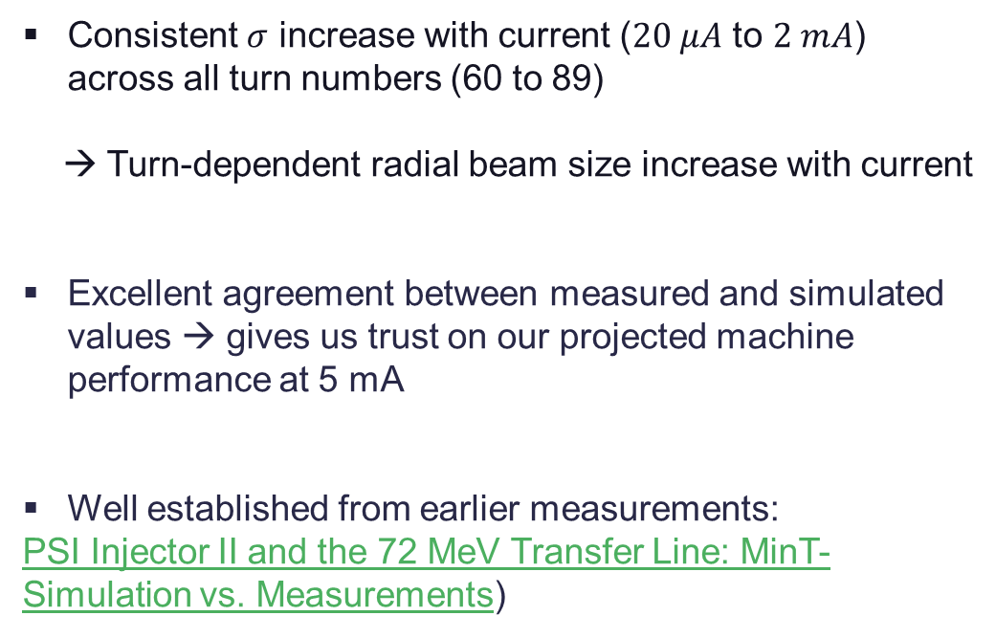
Beam Size Evolution with Current
Characterize the radial size of the extracted beam using the RIE1 probe for various turn configurations and beam currents
Consistent $σ$ increase with current ($20 μA$ to $2 mA$) across all turn numbers (60 to 89)
→ Turn-dependent radial beam size increase with current
Excellent agreement between measured and simulated values → gives us trust on our projected machine performance at 5 mA
Well established from earlier measurements:
PSI Injector II and the 72 MeV Transfer Line: MinT-Simulation vs. Measurements)

Slide 13
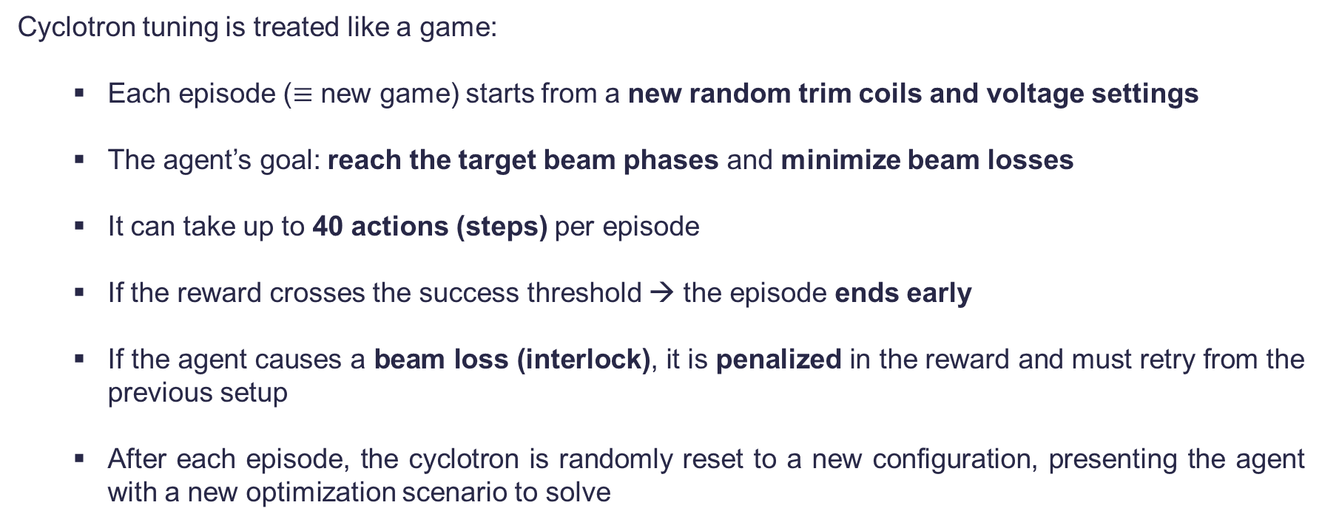
How the Agent Interacts with the Machine
Cyclotron tuning is treated like a game:
  Each episode ($≡$ new game) starts from a new random trim coils and voltage settings
  The agent’s goal: reach the target beam phases and minimize beam losses
  It can take up to 40 actions (steps) per episode
  If the reward crosses the success threshold → the episode ends early
  If the agent causes a beam loss (interlock), it is penalized in the reward and must retry from the previous setup
  After each episode, the cyclotron is randomly reset to a new configuration, presenting the agent with a new optimization scenario to solve

Slide 14

Reward Shaping
Algorithm: Twin Delayed Deep Deterministic Policy Gradient (TD3)
Objectives: Guide the RL agent toward:
      ✔ Precise phase alignment (beam quality)
      ✔ Minimal beam losses (machine protection)
      ✔ Efficient control (limited actuator usage)
Reward formulation:
Key Design Features
      Outer probes weighted higher → focus on extraction quality of the beam
      Bounded reward (tanh) → stable training
      Interlock penalty (hard) → enforces safety
      Trim coil penalty → avoids over-correction
Reward shaping transforms RL into a physics-informed, safety-aware controller
→ Simulation studies suggest that convergence can be achieved within fewer than 1000 timesteps.
$$R=R_{beam}+P_{interlock}+P_{trim}$$

Slide 15
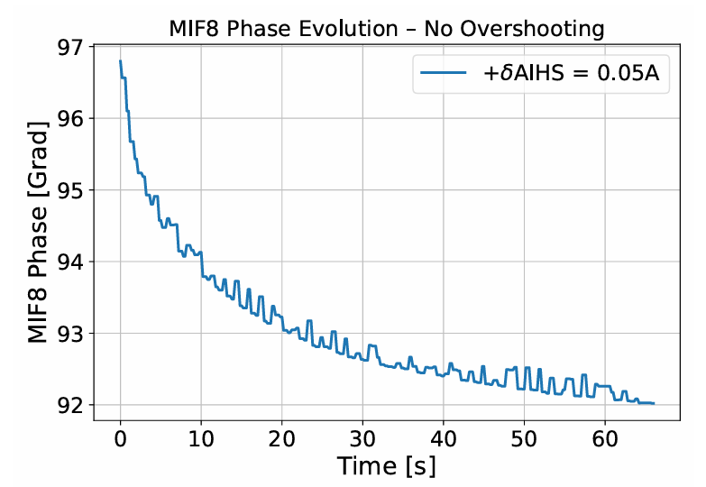
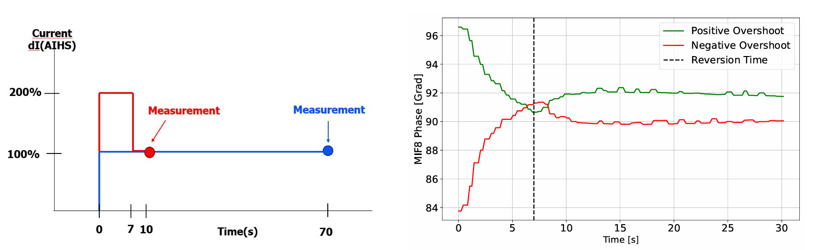
Magnetic Field Response
Overshooting Strategy:
The magnetic-field change (current) is briefly doubled (100% overshoot) and then returned to the target value after 7 s, reducing the effective settling time to ~10 s (≈6× faster) while remaining within interlock limits;
Step change in AIHS (main coil) → 60 seconds settling time on MIF8

Slide 16
Reinforcement Learning Results: Turn-by-Turn Progression
For more details:
M. Haj Tahar et al, First Experimental Demonstration of Machine Learning-Based Tuning on the PSI Injector 2 Cyclotron (under review)

Slide 17
Summary of RL Agent Training Performance
Turn | Resonators Active | Pretraining Used | Convergence Time | Avg. Final Reward | Interlocks | Notable Outcome
72 | 3 (R1, R2, R3) | No | 535 timesteps ~ 4 h | -0.06 | 21 (3 after conv) | First full training from scratch
73 | 3 (R1, R2, R3) | Yes | 291 timesteps ~ 2 h 20 min | -0.06 | 12 (0 after conv) | Fast convergence from surrogate
74 | 3 (R1, R2, R3) | Yes | 1117 timesteps ~ 5 h 50 min | -0.06 | 51 (3 after conv) | Transfer Learning from Turn 73 inadequate
89 | 2 (R1, R3) | Yes | 114 timesteps ~ 52 min | -0.055 | 0 | Most degraded config; still successful
60 | 4 (R1, R2, R3, R4) | No | 217 timesteps ~ 2 h 3 min | -0.06 | 4 (1 after conv) | Fast convergence under nominal conditions
Convergence is defined as the time required for the reinforcement learning agent to consistently solve any episode in fewer than 10 steps.
Objective: final reward > -0.08

Slide 18
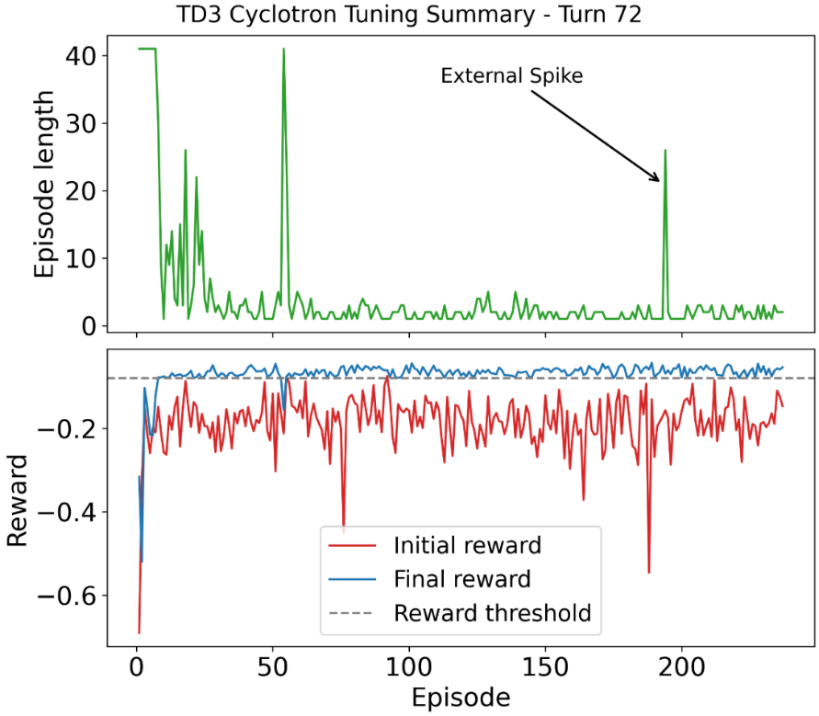
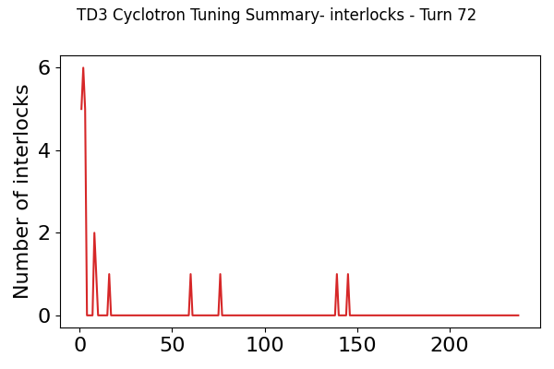
Turn 72 – Fast Convergence, Stable Operation
Turn 72 ▮ Turn 73 ▭ Turn 74 ▭ Turn 89 ▭ Turn 60 ▭
✔ Agent learns to solve the tuning task in < 5 steps after ~60 episodes
✔ Reward improves from ~–0.7 to –0.05 (×10 better)
✔ Episode length drops and stabilizes
✔ Convergence time consistent with simulations!
✔ Beam interlocks are avoided after early exploration
Training from scratch (7 hours in total)
Initial = machine state before action; Final = post-action result by the agent.

Slide 19
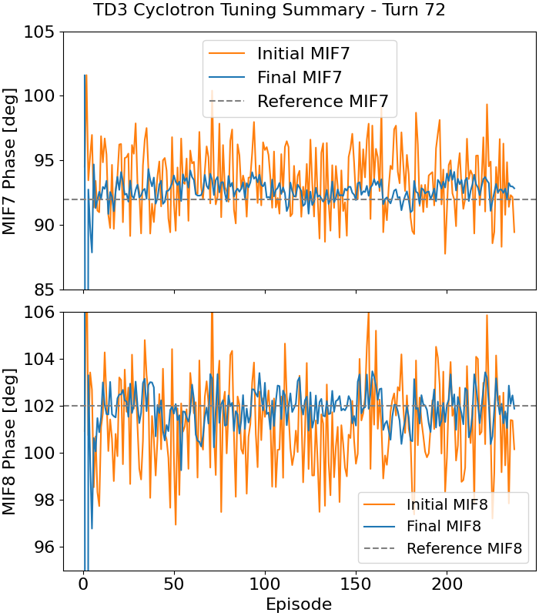
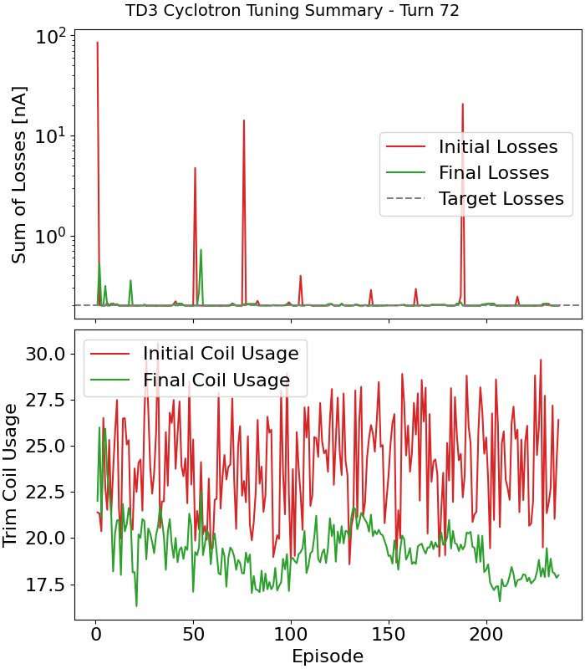
Turn 72 – Phase Accuracy and Loss Minimization
Turn 72 ▮ Turn 73 ▭ Turn 74 ▭ Turn 89 ▭ Turn 60 ▭
Typical warning loss levels: 30 nA
Zero losses
Final phases (MIF7 and MIF8) are within ±1° of target
Residual deviation is within measurement uncertainty
Beam losses drop by ~2 orders of magnitude
Less correction coils are needed by agent
Initial = machine state before action; Final = post-action result by the agent.

Slide 20
Summary of RL Agent Training Performance
Turn | Resonators Active | Pretraining Used | Convergence Time | Avg. Final Reward | Interlocks | Notable Outcome
72 | 3 (R1, R2, R3) | No | 535 timesteps ~ 4 h | -0.06 | 21 (3 after conv) | First full training from scratch
73 | 3 (R1, R2, R3) | Yes | 291 timesteps ~ 2 h 20 min | -0.06 | 12 (0 after conv) | Fast convergence from surrogate
74 | 3 (R1, R2, R3) | Yes | 1117 timesteps ~ 5 h 50 min | -0.06 | 51 (3 after conv) | Transfer Learning from Turn 73 inadequate
89 | 2 (R1, R3) | Yes | 114 timesteps ~ 52 min | -0.055 | 0 | Most degraded config; still successful
60 | 4 (R1, R2, R3, R4) | No | 217 timesteps ~ 2 h 3 min | -0.06 | 4 (1 after conv) | Fast convergence under nominal conditions
Convergence is defined as the time required for the reinforcement learning agent to consistently solve any episode in fewer than 10 steps.

Slide 21
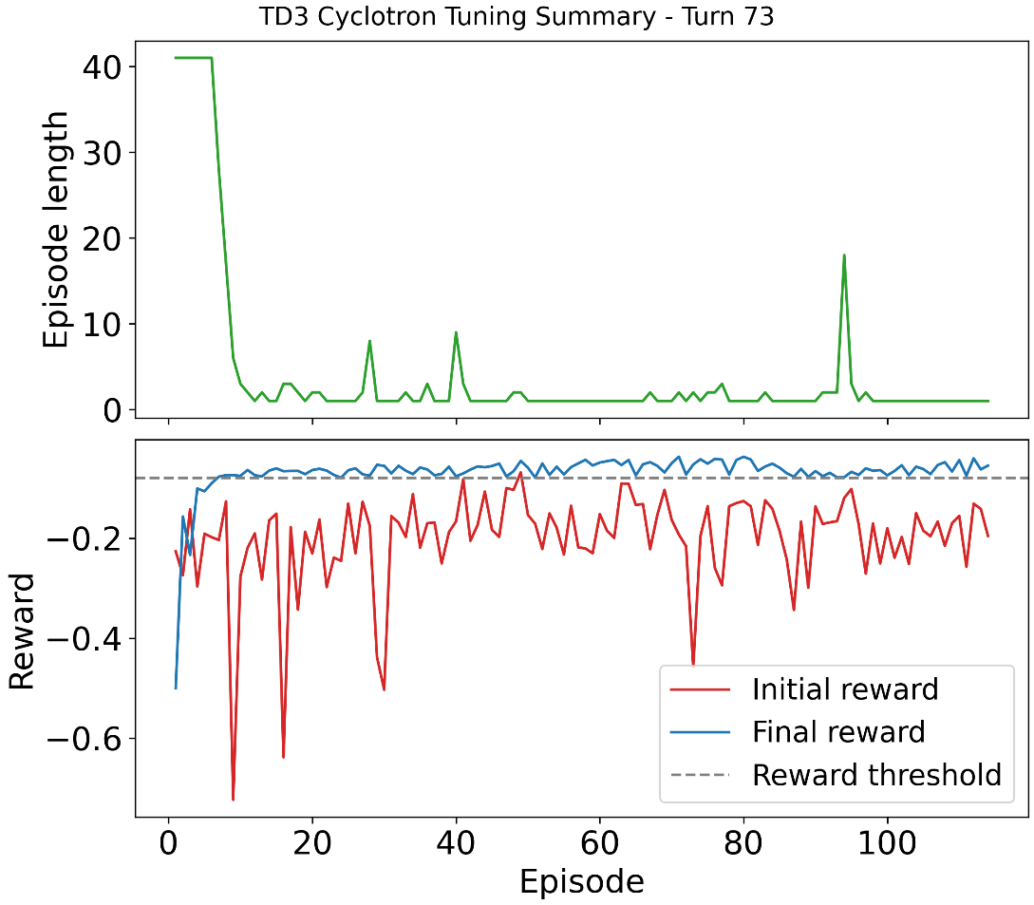
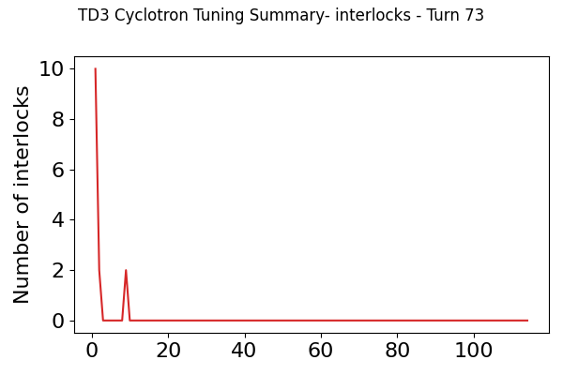
Turn 73
Turn 72 ▭ Turn 73 ▮ Turn 74 ▭ Turn 89 ▭ Turn 60 ▭
✔ Beam interlocks are avoided after early exploration
Pre-trained RL model from historical data (3 h 53 min)
Two models tested on evaluation mode 12 hours later: pre-trained model outperforms the one from scratch

Slide 22
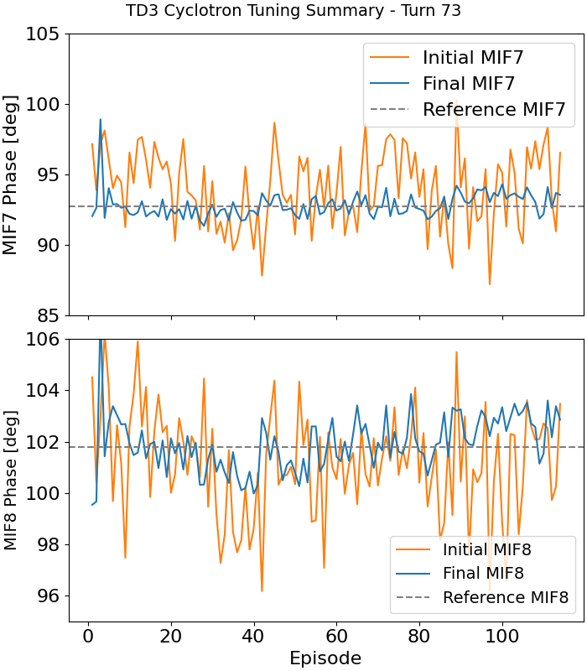
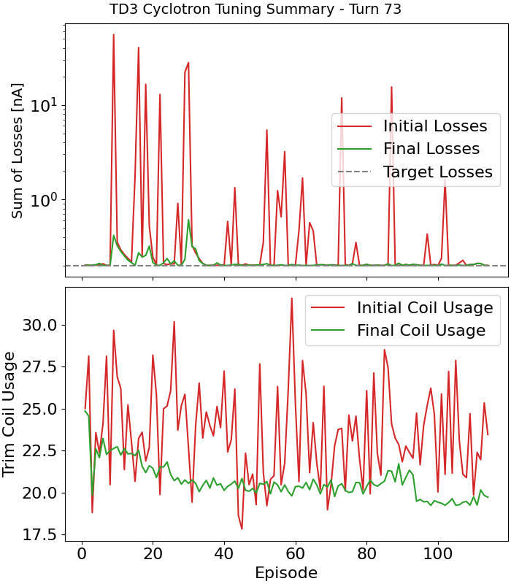
Turn 73
Turn 72 ▭ Turn 73 ▮ Turn 74 ▭ Turn 89 ▭ Turn 60 ▭
Zero losses
Final phases (MIF7 and MIF8) are within ±1° of target
Residual deviation is within measurement uncertainty
Beam losses drop by ~2 orders of magnitude
Less correction coils are needed by agent

Slide 23
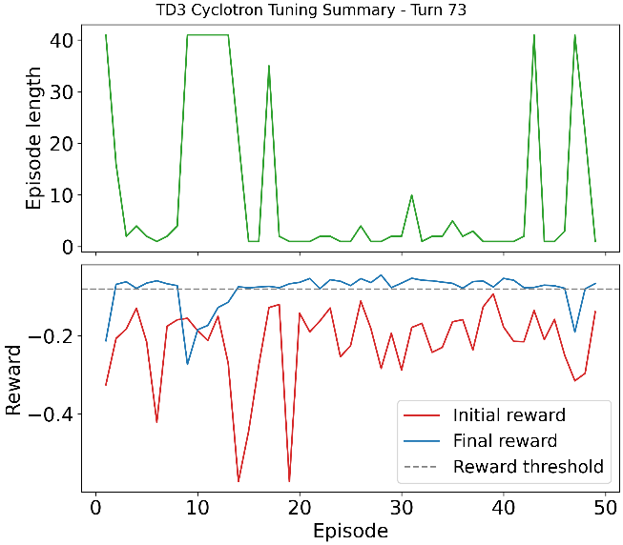

Turn 73: training vs no training
Turn 72 ▭ Turn 73 ▮ Turn 74 ▭ Turn 89 ▭ Turn 60 ▭
Results without pretraining
Results with pretraining
Pretraining from a surrogate model significantly accelerated learning and provided a strong initialization

Slide 24
Summary of RL Agent Training Performance
Turn | Resonators Active | Pretraining Used | Convergence Time | Avg. Final Reward | Interlocks | Notable Outcome
72 | 3 (R1, R2, R3) | No | 535 timesteps ~ 4 h | -0.06 | 21 (3 after conv) | First full training from scratch
73 | 3 (R1, R2, R3) | Yes | 291 timesteps ~ 2 h 20 min | -0.06 | 12 (0 after conv) | Fast convergence from surrogate
74 | 3 (R1, R2, R3) | Yes | 1117 timesteps ~ 5 h 50 min | -0.06 | 51 (3 after conv) | Transfer Learning from Turn 73 inadequate
89 | 2 (R1, R3) | Yes | 114 timesteps ~ 52 min | -0.055 | 0 | Most degraded config; still successful
60 | 4 (R1, R2, R3, R4) | No | 217 timesteps ~ 2 h 3 min | -0.06 | 4 (1 after conv) | Fast convergence under nominal conditions
Convergence is defined as the time required for the reinforcement learning agent to consistently solve any episode in fewer than 10 steps.

Slide 25
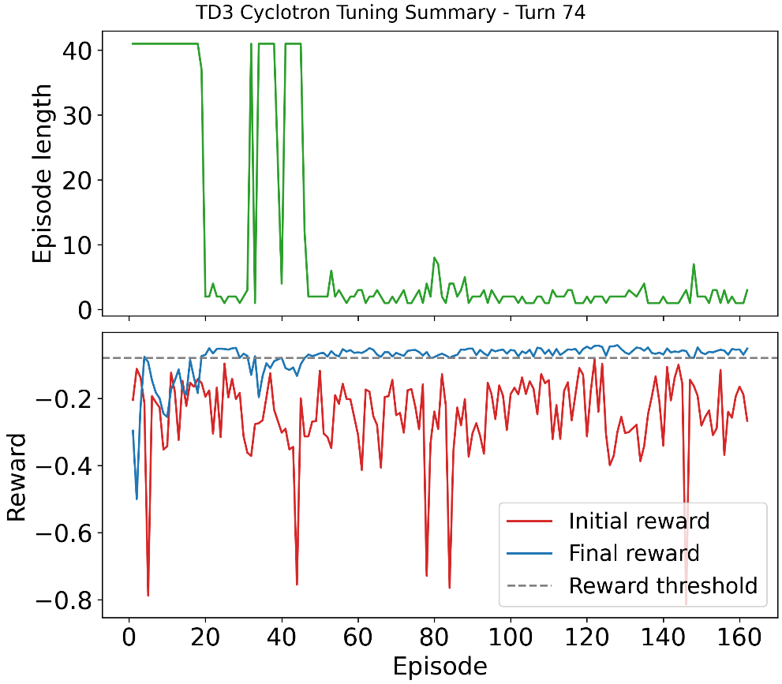
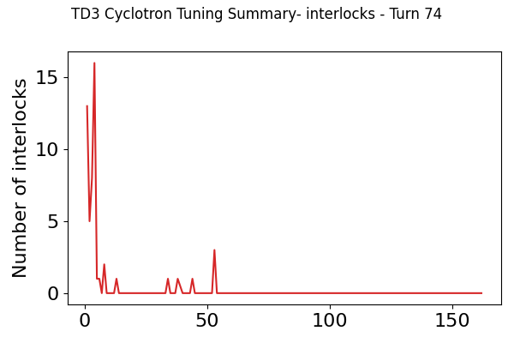
Turn 74: Transferability of Pretrained RL Actor
Turn 72 ▭ Turn 73 ▭ Turn 74 ▮ Turn 89 ▭ Turn 60 ▭
Pre-trained RL actor from turn 73 (7 h 50 min)
Test conducted: RL actor trained at turn 73 was applied to Turn 74
Performance degraded compared to training from scratch → turn-specific training is essential

Slide 26
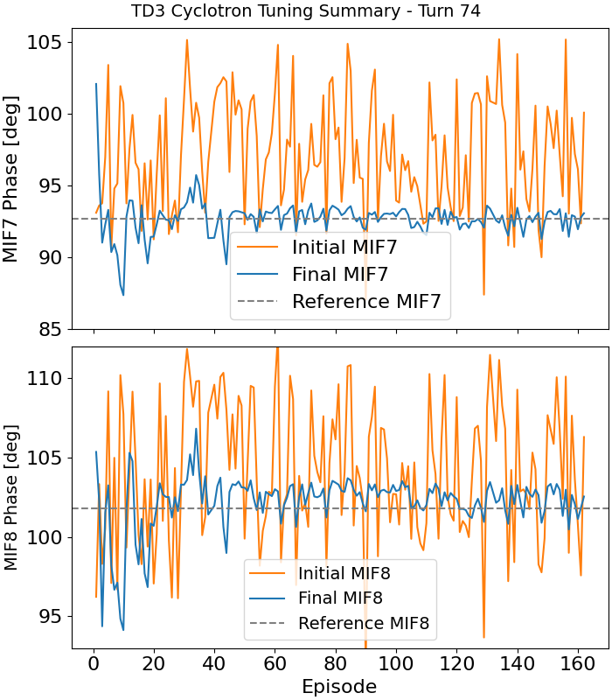
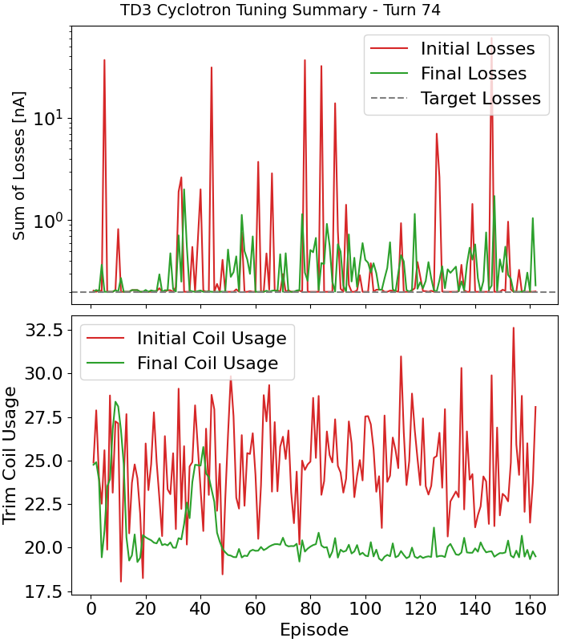
Turn 74
Turn 72 ▭ Turn 73 ▭ Turn 74 ▮ Turn 89 ▭ Turn 60 ▭
Even small shifts in turn number invalidate prior knowledge: losses are higher than normal

Slide 27
Lessons Learned from Real-Time RL Control – Turn-by-Turn Deployment
Simulation results provided an accurate starting point, helping shape a realistic RL training environment for the live cyclotron
Training a model for a single turn typically takes 3 to 6 hours (less than 1000 timesteps), depending on exploration noise chosen
We systematically validated across different turn numbers to confirm the robustness of the RL strategy in all machine configurations
A model trained on one turn is not valid for another, hence the multi-turn training effort
The agent quickly learns to avoid beam losses (interlocks) by internalizing strong penalties during training, a key success factor for safe & reliable deployment

Slide 28
Evaluating RL Model Reliability Under Real Conditions
  • RL agent operates in evaluation mode, continuously controlling the machine
  • Tested overnight for robustness to drifts and perturbations
  • Agent monitors reward and reacts when performance drops

Slide 29
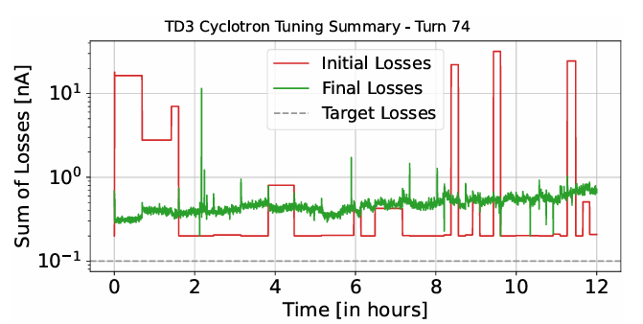
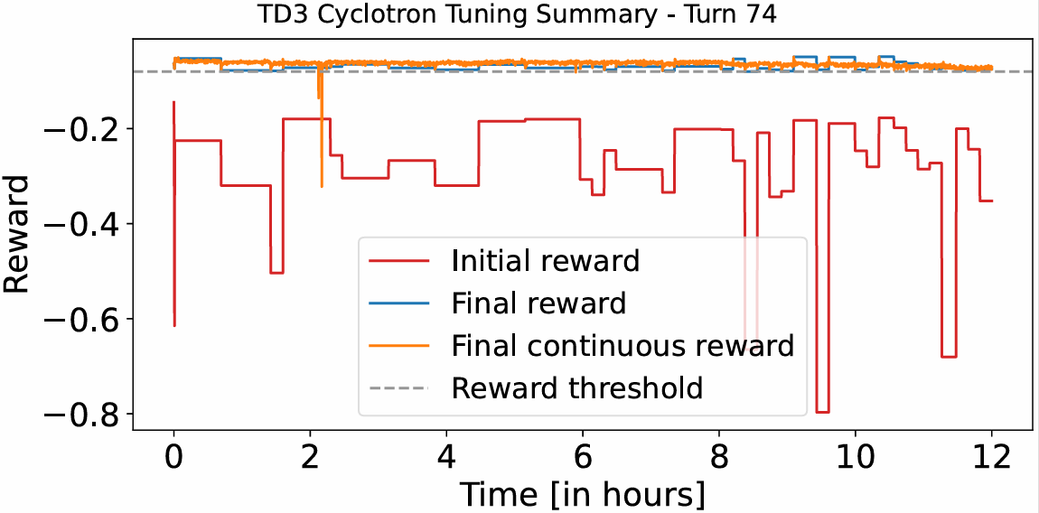
Evaluation mode – Turn 74 (3 resonators)
Model reliability
Trained model in the morning, launched in evaluation mode from 7pm to 7am
Throughout the night, the machine was intermittently perturbed with random coil kicks to test model robustness
The RL agent consistently restored beam quality:
  No interlocks triggered
  Final reward remained high, losses stayed low
A 30-minute retraining corrected this drift → performance fully restored → importance of intermittent retraining

Slide 30
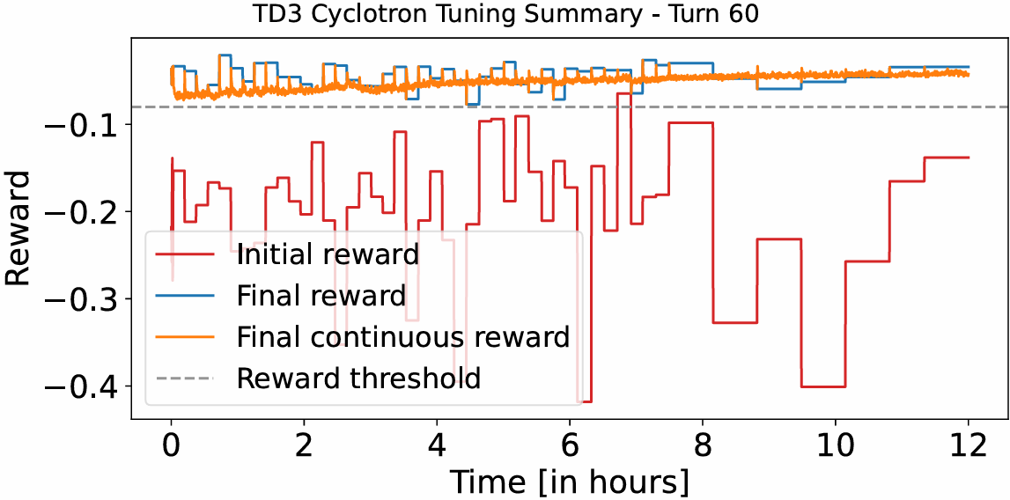
Evaluation mode – Turn 60 (4 resonators)
Model reliability
Trained model during the day, launched in evaluation mode from 9pm to 9am:
  No interlocks triggered
  Succeeds to exceed the new reward threshold level and bring losses to nearly vanishing levels

Slide 31
Key Takeaways – Model Reliability in Real Operation
Model reliability
First live deployment of an RL-based control loop on a cyclotron, running autonomously for 12 hours
→ Continuously tuned in real time, adapting to drift and fluctuations
Successfully tested under three machine configurations:
  All 4 resonators (Turn 60)
  Only 3 resonators (Turn 74)
  Only 2 resonators (Turn 89)
→ The RL agent consistently recovered and adapted
Demonstrated that RL-based tuning can become the default control strategy for future systems like the TMX cyclotron
Intermittent retraining boosts robustness: overnight tests showed that occasional retraining helps recover optimal performance
Current limitation: validated at 20 μA, i.e., relatively low current
→ How will this scale to high-current, high-power regimes?

Slide 32
PART IV: Tuning Strategy for High Current

Slide 33
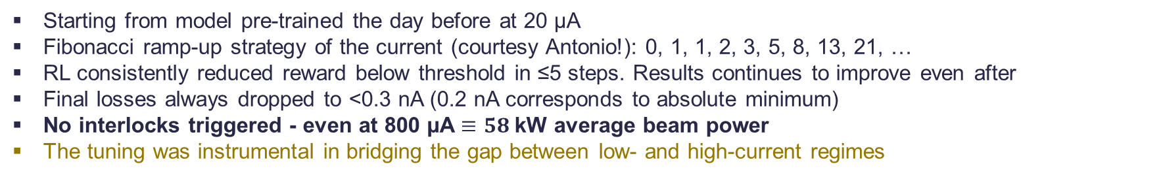
From 20 µA to 800 µA: Validating RL Tuning Across Beam Currents
1.5 hour effective beam time in total
Beam current | Initial reward | Final reward | Initial losses | Final losses | Nb of steps | Nb of interlocks
50 µA | -0.14 | -0.041 | 0.2 nA | 0.2 nA | 1 | 0
100 µA | -0.25 | -0.046 | 2.0 nA | 0.2 nA | 3 | 0
200 µA | -0.48 | -0.038 | 17.1 nA | 0.2 nA | 2 | 0
300 µA | -0.77 | -0.060 | 95.0 nA | 0.3 nA | 3 | 0
500 µA | -0.33 | -0.062 | 7.0 nA | 0.2 nA | 3 | 0
800 µA | -0.54 | -0.069 | 23.3 nA | 0.3 nA | 5 | 0
Starting from model pre-trained the day before at 20 µA
Fibonacci ramp-up strategy of the current (courtesy Antonio!): 0, 1, 1, 2, 3, 5, 8, 13, 21, …
RL consistently reduced reward below threshold in ≤5 steps. Results continues to improve even after
Final losses always dropped to <0.3 nA (0.2 nA corresponds to absolute minimum)
No interlocks triggered - even at 800 µA $≡58$kW average beam power
The tuning was instrumental in bridging the gap between low- and high-current regimes

Slide 34
Conclusion
Reliable high-power cyclotrons are essential for Accelerator-Driven Systems (ADS).
Progress across hardware, design optimization, and operations forms the foundation for meeting reliability targets.
Machine Learning-assisted tuning offers a promising path to fast fault compensation and robust operation.
PSI Injector 2 experiment demonstrated feasibility; HIPA will be the next step toward ADS-scale deployment.

Slide 35
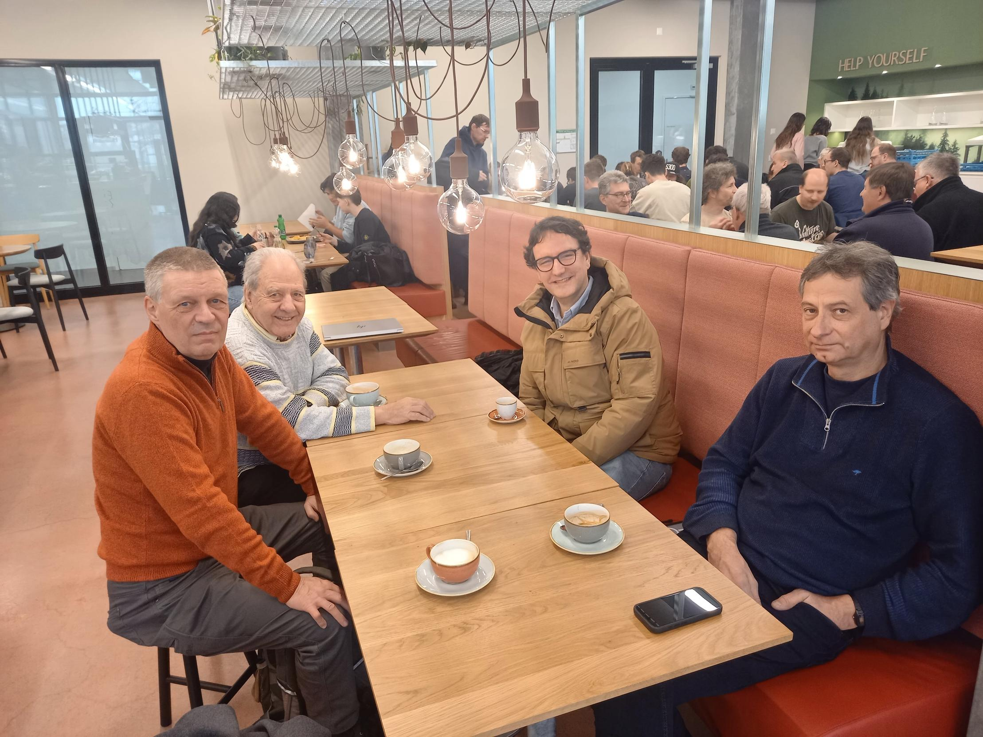
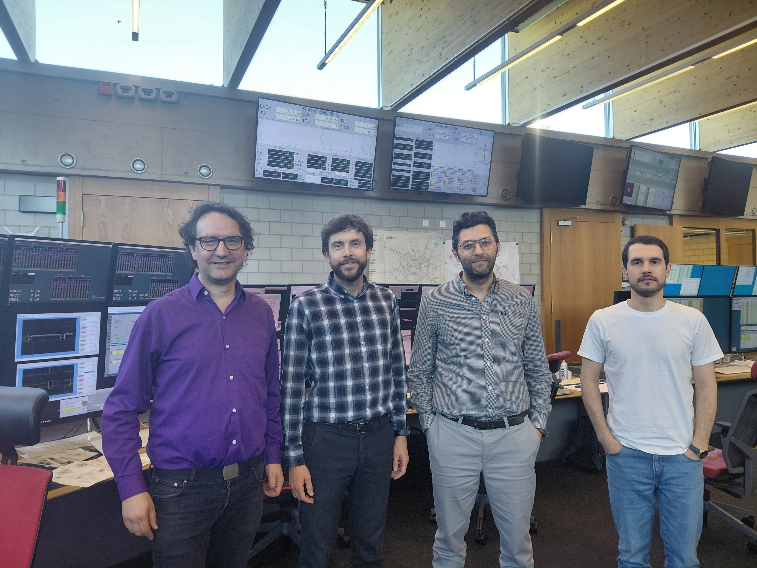
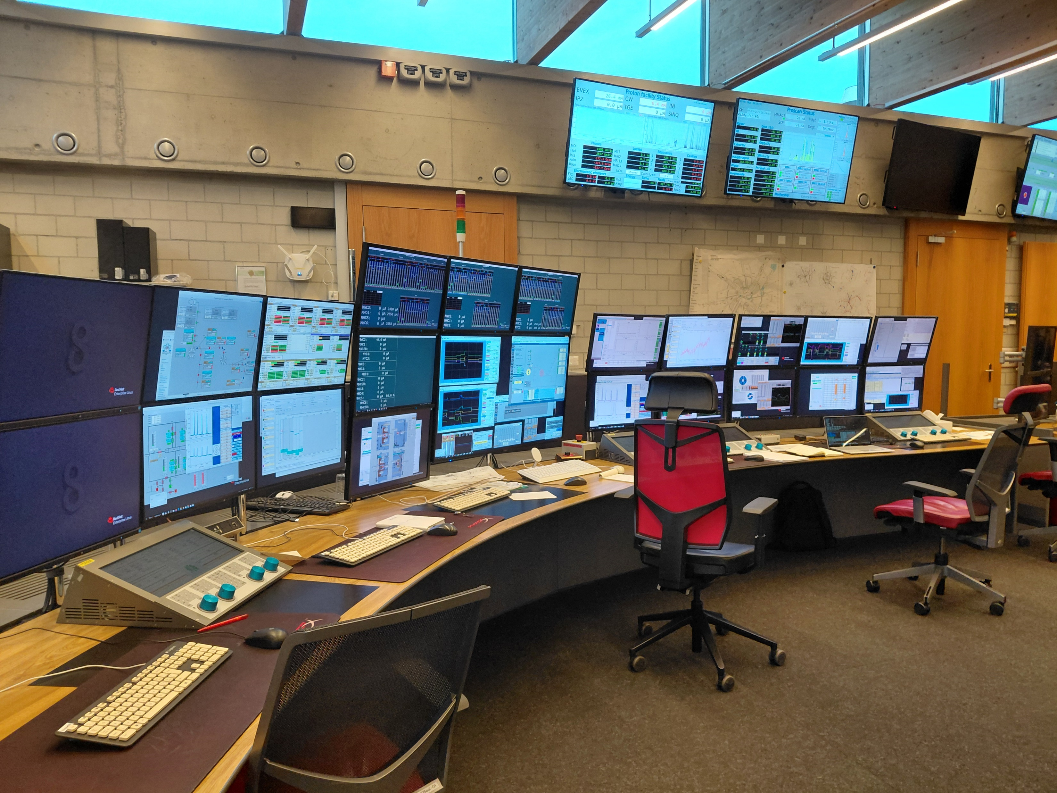
Acknowledgements
25.02.2025
01.05.2025
Acknowledgements:
The success of this RL-based tuning project at PSI Injector 2 was made possible by the contributions, support, and collaboration of many talented individuals and teams, from PSI and TRANSMUTEX, in particular:
Evgeny Solodko for his continuous involvement from the beginning, for his work on the historical data, surrogate model and on-site deployment
Marco Bocchio for elaborating an alternative approach (BO) and contributing to help refine our method
Serge Marquie for his invaluable support and stimulating discussions regarding the ML models
Jochem Snuverink for setting up the TMX server infrastructure and continuous help and support with technical aspects
The Cyclotron team at PSI: Antonio Barchetti for his availability, advice and support during critical phases of deployment,
Christian Baumgarten, Joachim Grillenberger, Markus Schneider, Mariusz Sapinski and Rudolf Dolling for their impactful discussions, suggestions and support
Franklin Servan-Schreiber (CEO), Donovan Maire (CTO) and Marco Busch (head Acc) for their continuous support

Slide 36
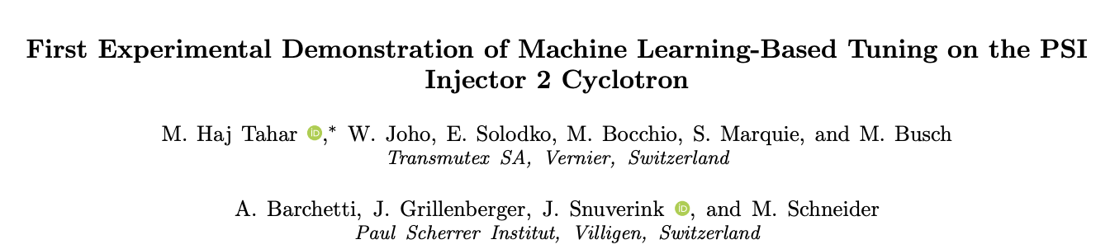
Reference
First Experimental Demonstration of Machine Learning-Based Tuning on the PSI Injector 2 Cyclotron
Under review in Physical Review Accelerators and Beams

Slide 37
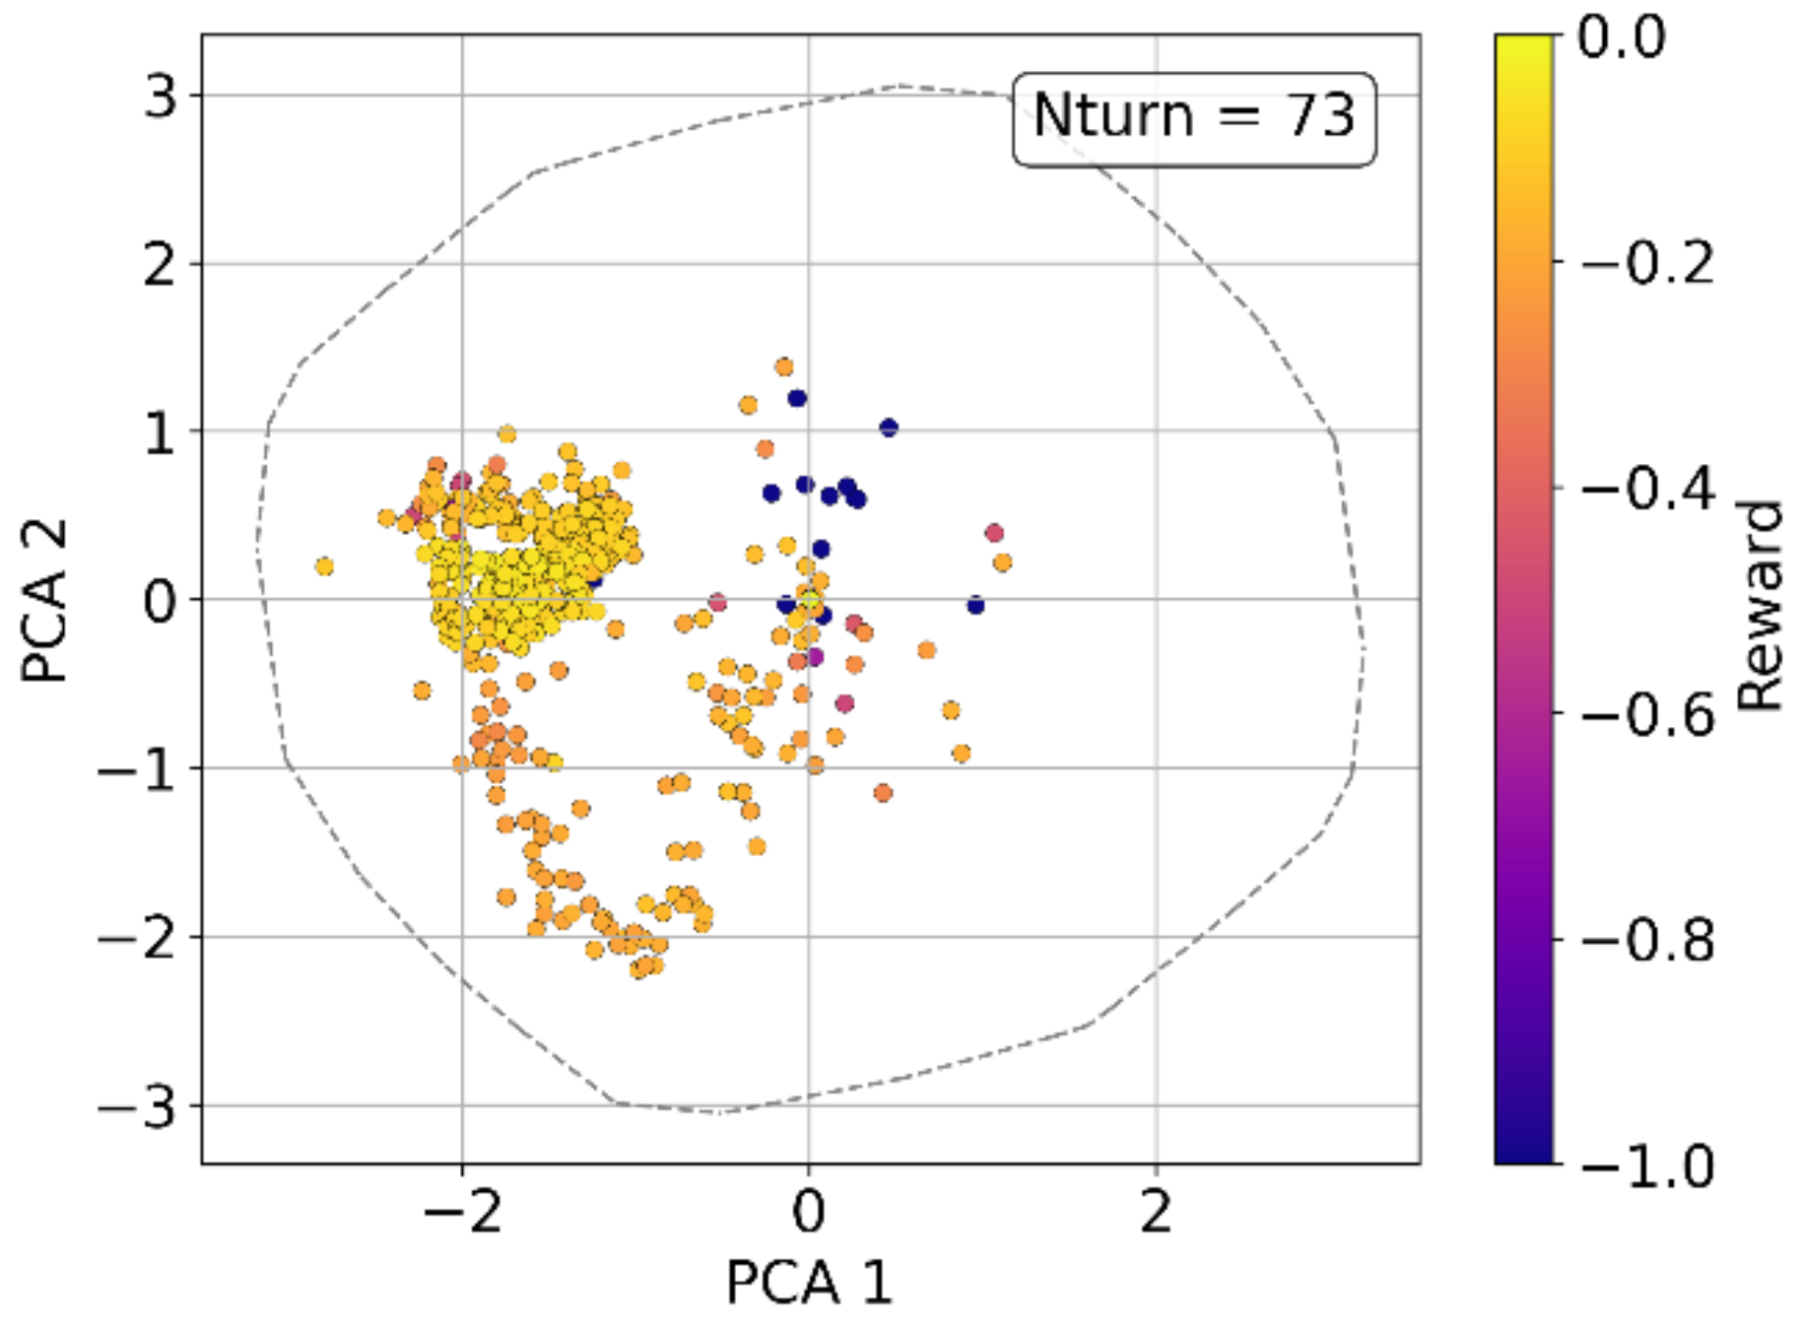
RL agent navigates away from unsafe configurations to most reliable settings
Minimum Beam loss
Learning samples
Beam interruption
PCA1 and 2 are linear combination of the 14 tunable parameters. Weights selected to best represent evolution in 2D

