Slide 1

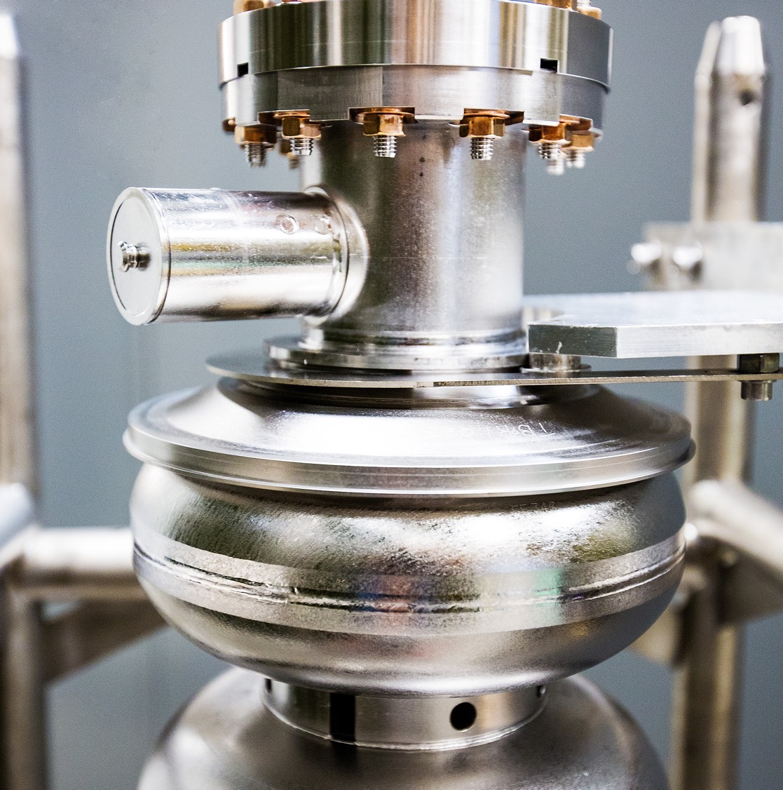
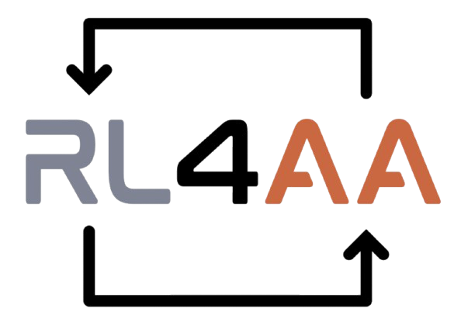
AIOP Target Optimization
Maximizing Polarization w/ Uncertainty
Aware Reinforcement Learning
March. 31st 2026
Armen Kasparian
Researched in support with Monibor Rahman and the Jefferson Lab Data Science Department / EPSCI Group

Slide 2
The Challenge
Solid cryogenic polarized targets require continuous tuning of the microwave frequency to compensate for radiation damage and evolving material properties
This task is performed by human operators
Traditionally through trial and error
Large variance in the output with different operators acting differently with controlling the microwave
Individual experience driven heuristics lead to large variance in actions

Slide 3
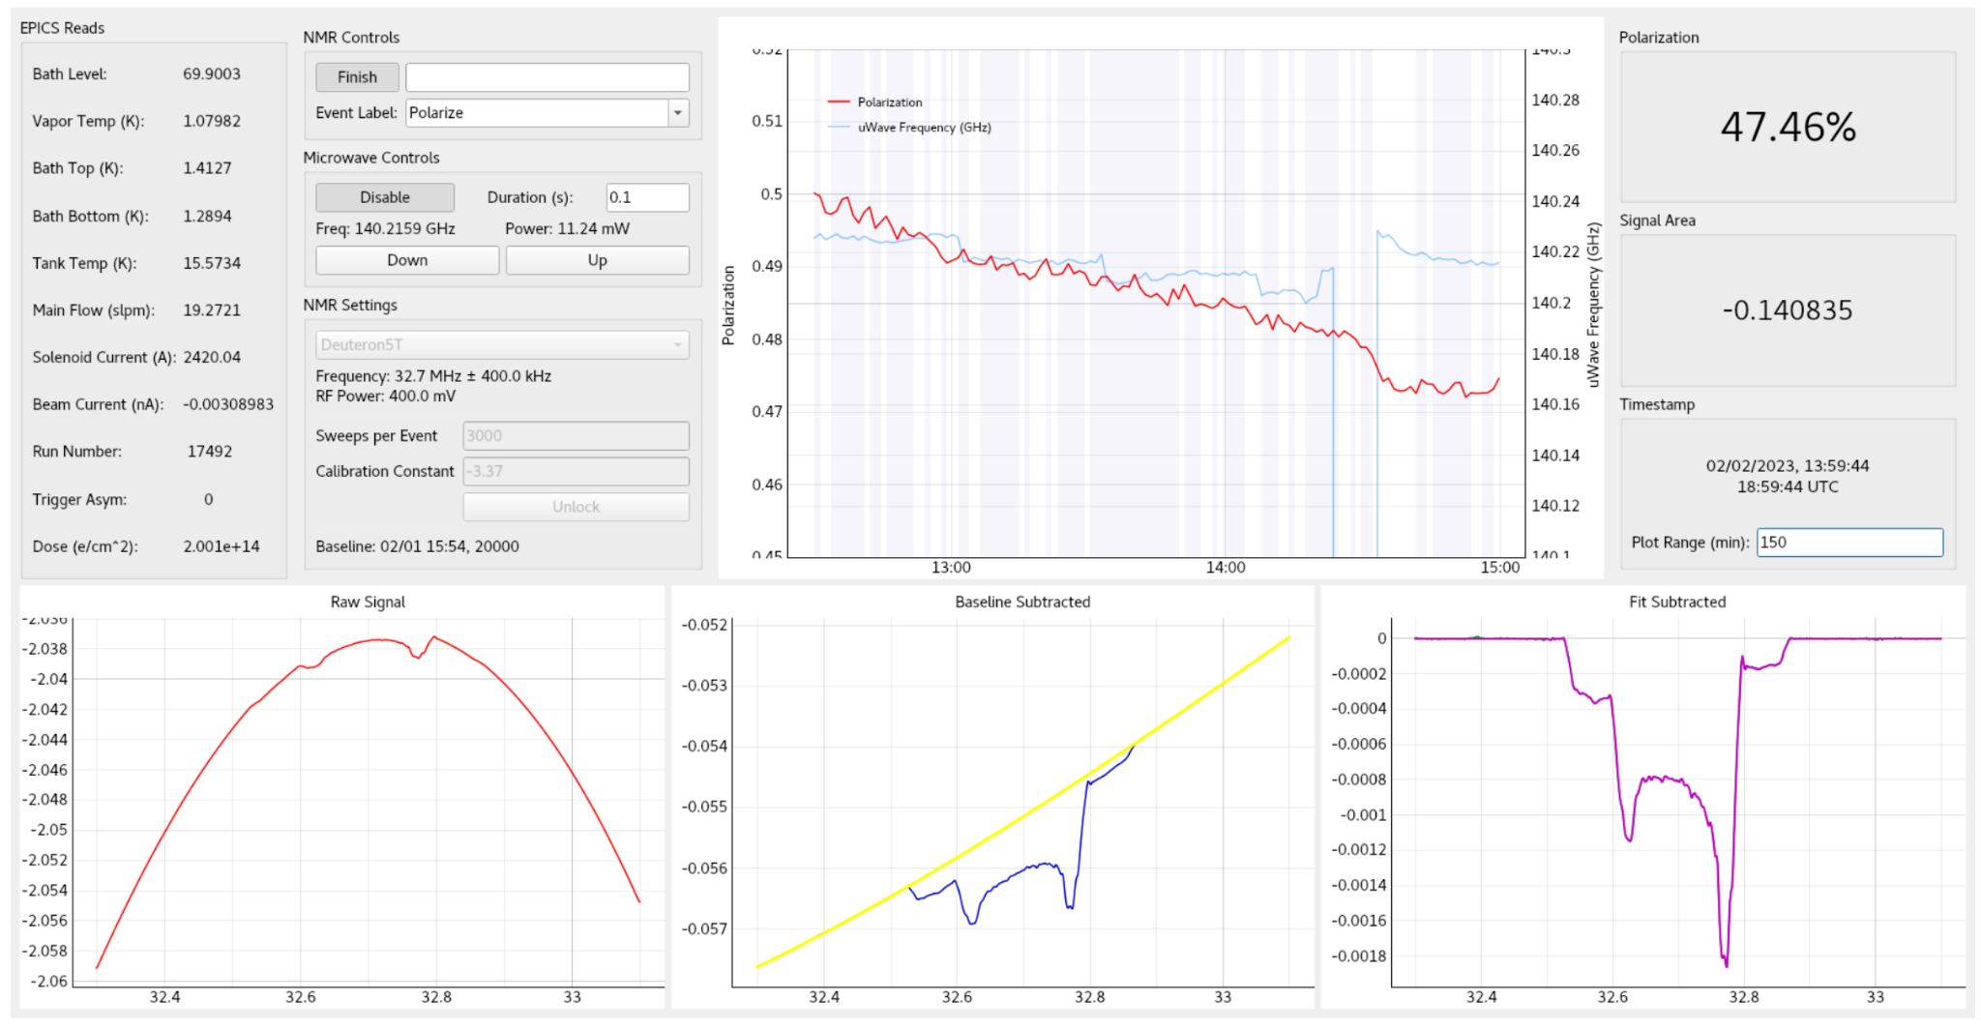
Understanding the Challenge
We want to nudge the microwave frequency to keep the polarization as high as possible before we anneal (reset)
Operator manually nudges frequency up and down

Slide 4
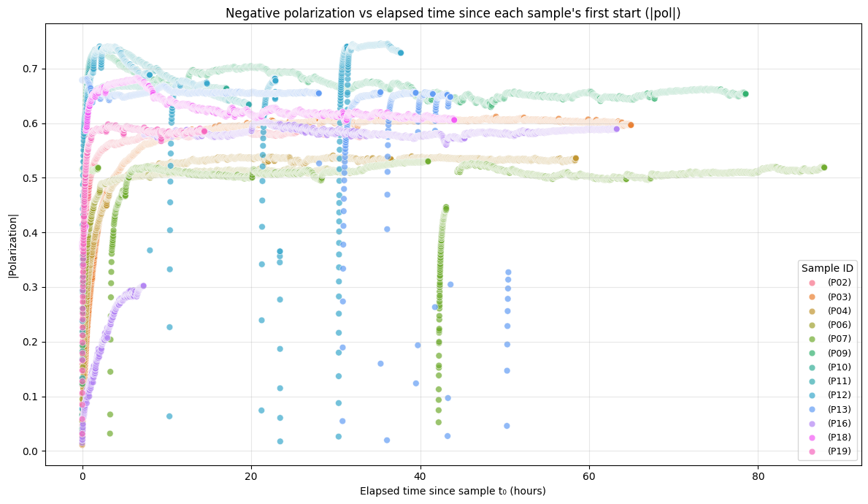
Understanding the Experimental Data
Samples were dosed with beam at a specific current and microwave frequency
Samples microwave frequency is nudged by human operators to try and keep polarization over a threshold
Once threshold hit, sample pulled for an annealing event to try and restore some polarization

Slide 5
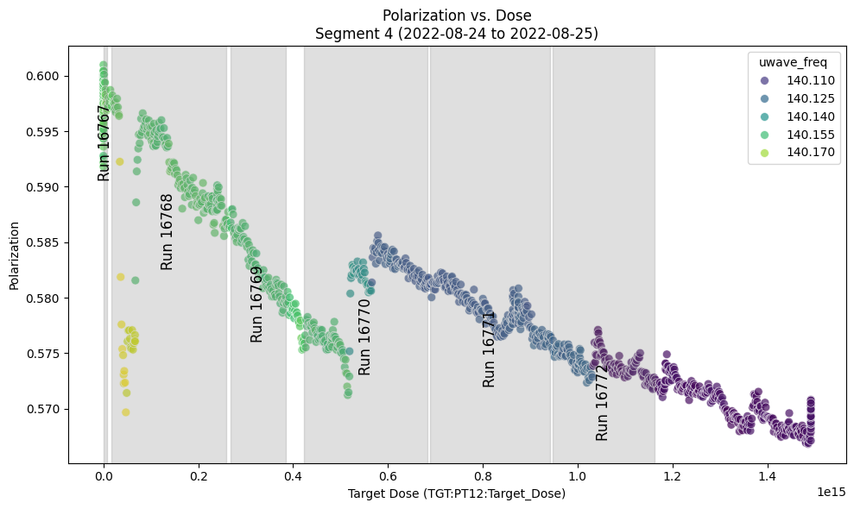
Looking at a Specific Sample P07
Sample P07 shows an experiment where the human operator made 3 distinct changes to the microwave frequency they may not have been optimal

Slide 6
Sample P07 Potential Optimal Settings
Potential Optimal Frequency
Potential Optimal Nudge
Note: this relies on a linear relationship between Polarization and Target Dose/Current/Microwave Frequency

Slide 7
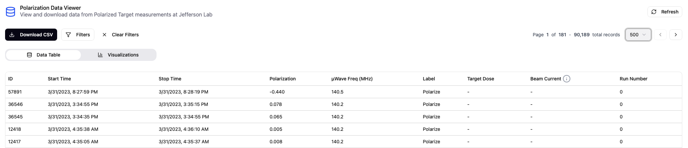
Current Experimental State
Experiments currently concluded with new runs planned for late 2026/2027*
What do we have?
Historical dataset showing microwave frequency changes from operators variables from experiment
Dataset made available courtesy of Torri Jeske of the EPSCI Group

Slide 8
Timeline
Single Sample GP
Single Sample Modelling
Gymnasium Environment
Solving w/ RL
Multi Sample GP
Multi Sample Modelling
Solving w/ RL and LUTs
Solving w/ Differential RL

Slide 9
Single Sample Surrogate Modelling w/ Uncertainties
Single Sample GP
Single Sample Modelling
Gymnasium Environment
Solving w/ RL
Multi Sample GP
Multi Sample Modelling
Solving w/ RL and LUTs
Solving w/ Differential RL

Slide 10
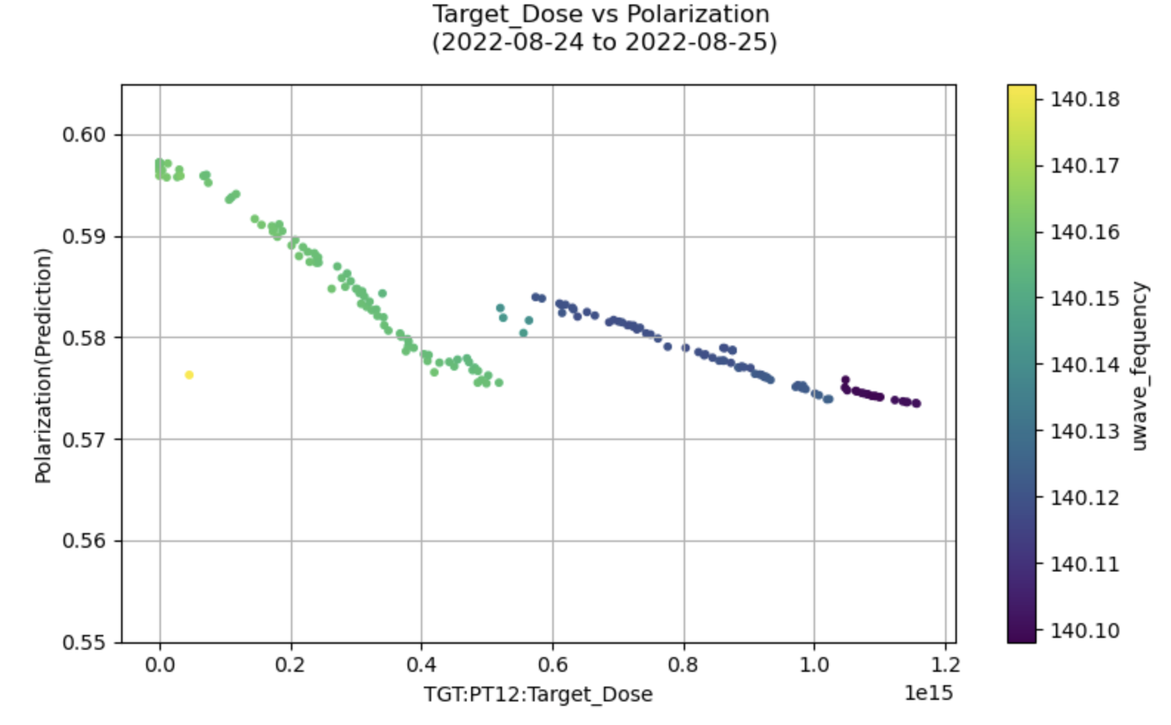
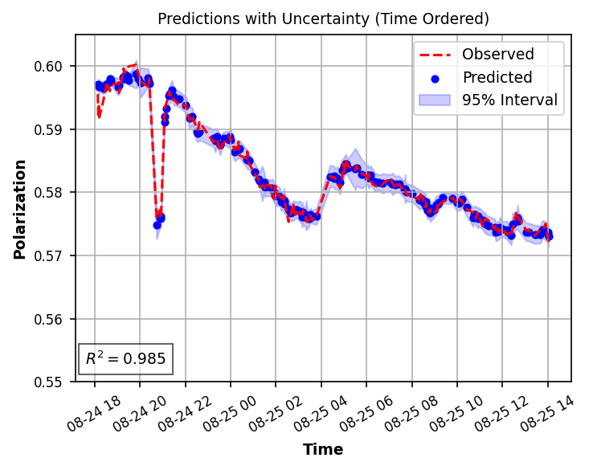
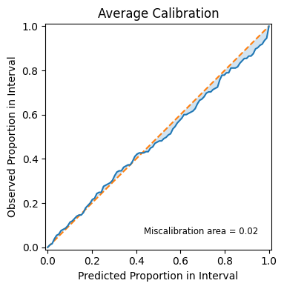
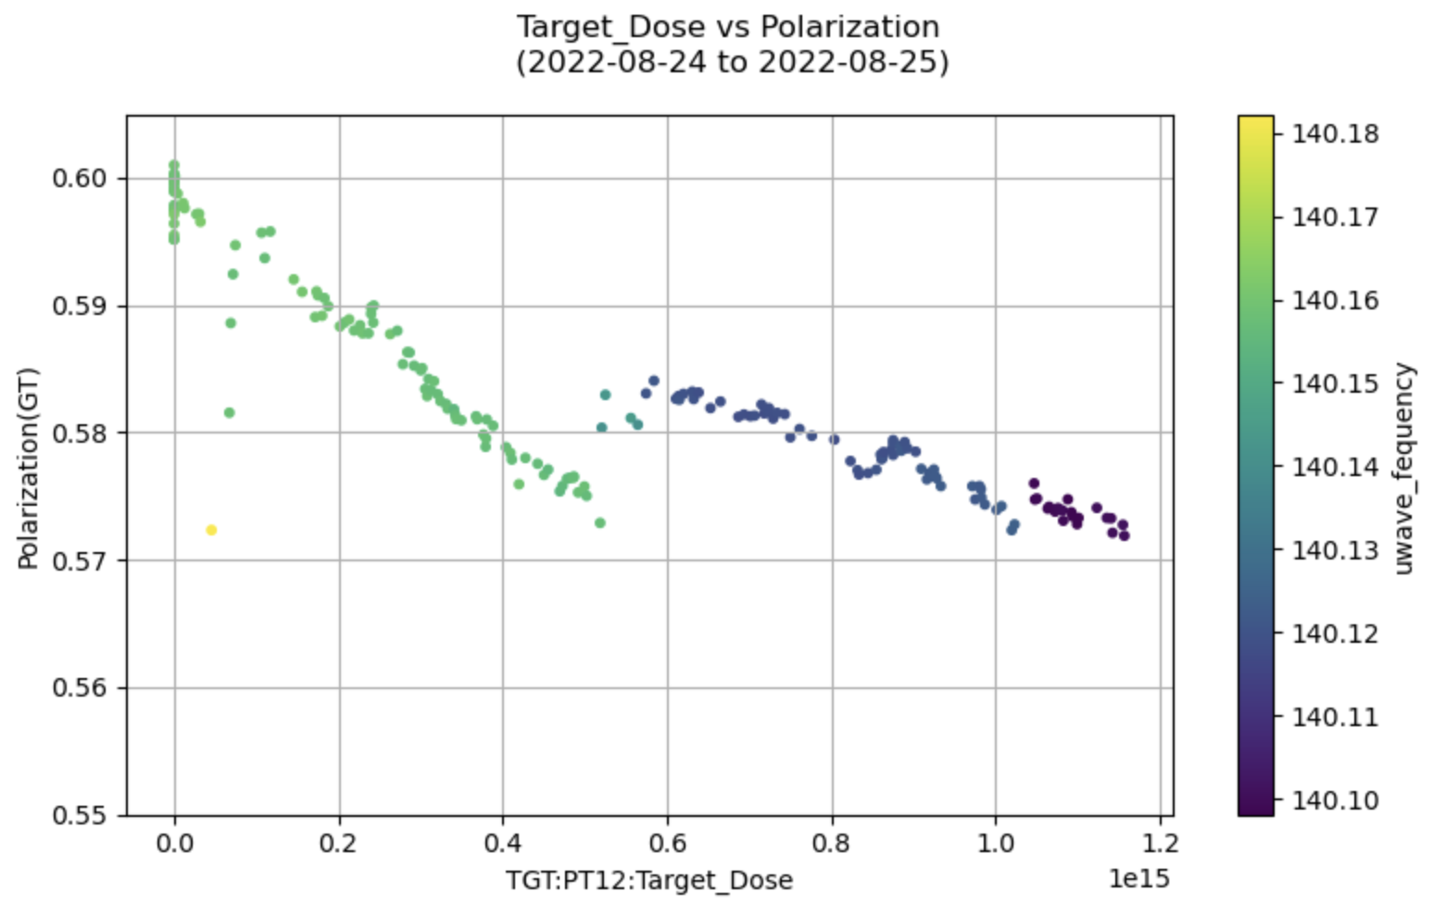
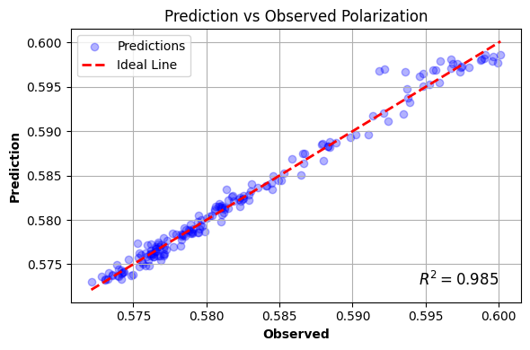
P07 Data Driven Surrogate Models with Uncertainties
Machine learning models designed to predict the polarization with uncertainties of the P07 sample given the Frequency, Dose, and Current
MLP
GP
Notes:
GP
Input: Frequency, Dose, Current
Output: Predicted Polarization, Std
z-score normalization
Laplace, RBF, Cauchy
MLP
Input: Frequency, Dose, Current
Output: Predicted Polarization, Std
Two hidden layers: [64, 32]
Adam Optimizer
NLL Loss function
10% Dropout after each hidden layer
Early Stopping

Slide 11
Gymnasium Single Sample Environment Structure
Single Sample GP
Single Sample Modelling
Gymnasium Environment
Solving w/ RL
Multi Sample GP
Multi Sample Modelling
Solving w/ RL and LUTs
Solving w/ Differential RL

Slide 12
Polarization Gymnasium Environment
State Space (5/6/7/8):
[Microwave Frequency Normalized, Target Dose Scaled, Beam Current, Predicted Polarization Mean, Predicted Polarization Std, Lower Confidence Bound, Frequency Derivative, Previous Action]*
Action Space (Continuous and Discrete) [139.50, 142.50]*:
Discrete (3): [0: Decrease Freq, 1: No Change, 2: Increase Frequency]*
Continuous (1): [-1.0, +1.0] scaled scale factor [0.05]*
Reward:
Maximize total polarization over an episode while respecting model uncertainties
Driven by Lower Confidence Bound
Terminal States:
Polarization drops below configurable threshold
Reaches end of data trajectory
*configurable

Slide 13
Polarization Gymnasium Environment Details
Models take in Dosage, Beam Current, and Frequency
Frequency determined by agent delta action
Real experimental data read in from Sample P07 for dosage and beam current values
Environment (Action)
Surrogate Model
(Freq + Action, Dose, Current)
Action
Agent (State)
Reward (State, Action)
SARSA
Notes:
Step Walkthrough
Agent sends action to environment
Action is added to the current frequency (bounds checking with clipping)
Updated frequency, current dose, current current is passed through configured model prediction function
Internally calls the MLP/GP with associated normalization/scaling built in and returns back predicted mean and standard deviation
Reward calculated through function call
Check for any terminal states
update current observation and pass back SARSA to agent for next step

Slide 14
Solving Single Sample Environment with TD3
Single Sample GP
Single Sample Modelling
Gymnasium Environment
Solving w/ RL
Multi Sample GP
Multi Sample Modelling
Solving w/ RL and LUTs
Solving w/ Differential RL

Slide 15
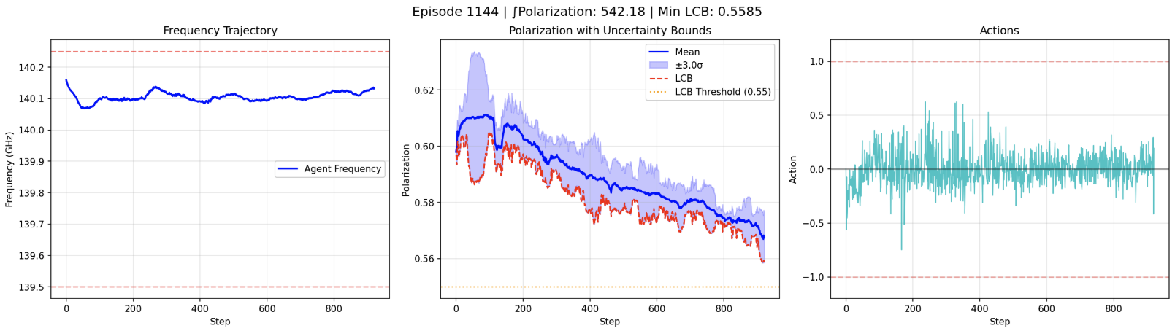
Results: TD3 Visualization
Visualization of a training episode of the TD3 agent rendered showing the actions taken and the trajectory chosen by the agent.
Integral of polarization over episode

Slide 16
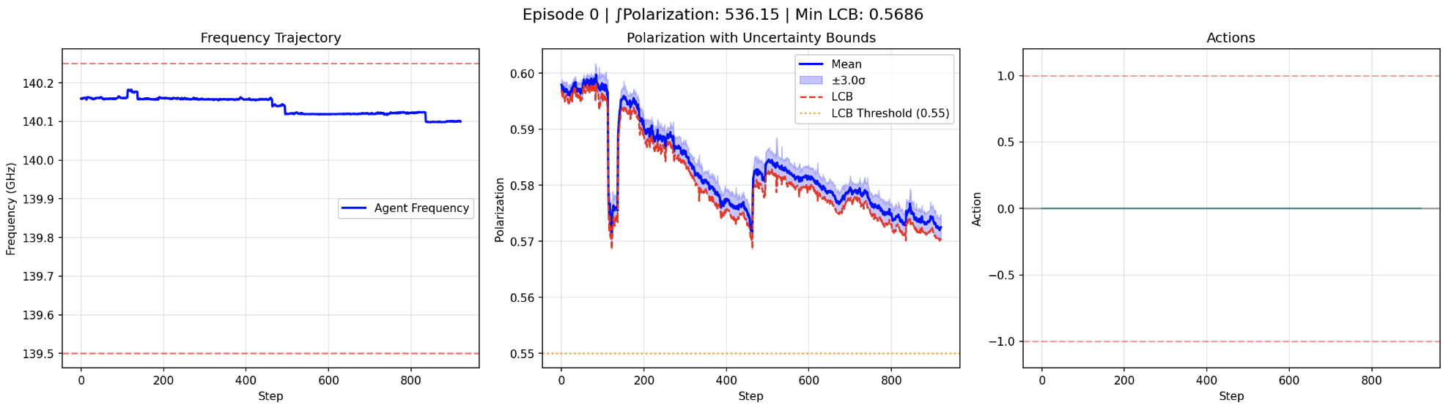
Results: TD3 Policy Comparison to Operator Baseline
Operator Baseline
TD3 Policy
Notes:
Try to get a figure where they are on top of each other

Slide 17
RL & Environment Hypothesis
Environment is setup properly but the agent is only learning a solution matching the operator!
Hypothesis:
RL agent is unable to learn a policy that is “better” than the human operator as the uncertainties in the data driven model make out of distribution solutions (ones that the operator did not explore) have too much uncertainty and thus disincentivize the RL agent.
What can we do about this?
Notes:
We can decrease the weight on the uncertainty
Not a good idea as we are basically allowing the agent to stray deeper into unknown state spaces
Solutions may not be correct
If the agent is staying away from out of distribution solutions do to uncertainty in the models predictions, what if we had a model that had more information from other samples?

Slide 18
Multi Sample Surrogate Modelling w/ Uncertainties
Single Sample GP
Single Sample Modelling
Gymnasium Environment
Solving w/ RL
Multi Sample GP
Multi Sample Modelling
Solving w/ RL and LUTs
Solving w/ Differential RL

Slide 19
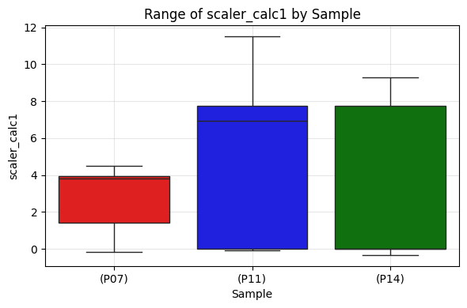
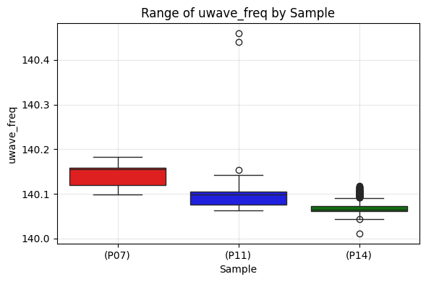
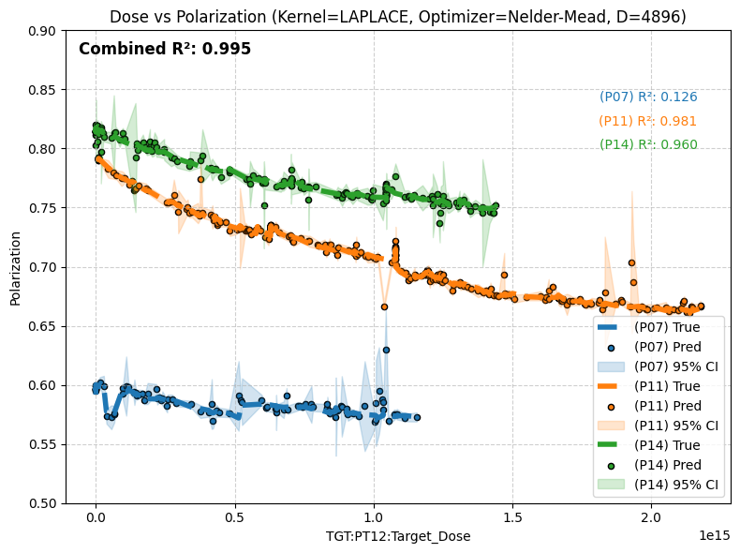
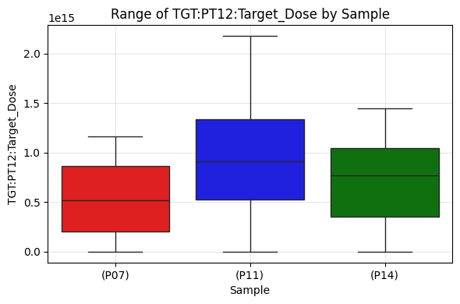
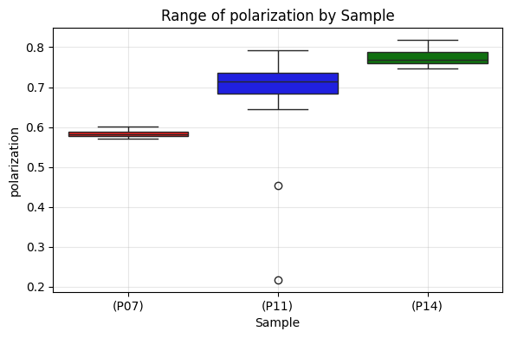
Multi Sample Models
We can use a GP(A) trained on multiple samples to increase the models ability to generalize the polarization prediction across different frequencies/doses/currents

Slide 20
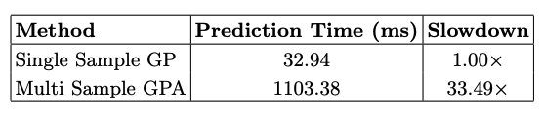
Multi Sample GP(A) Model Challenge
More samples = More Data Points = Larger Matrix = More Time
Timing test shows this
Single sample model prediction time (GP): 32.94 ms
Multi sample model prediction (three sample gp): 4638.37 ms
Multi sample model prediction time (three sample gpa, D=4098): 1103.38 ms
This is not fantastic…
We need potentially millions of steps for training an RL policy!
Could make our training a lot slower!

Slide 21
Solving Multi Sample Environment with TD3 and LUTs
Single Sample GP
Single Sample Modelling
Gymnasium Environment
Solving w/ RL
Multi Sample GP
Multi Sample Modelling
Solving w/ RL and LUTs
Solving w/ Differential RL

Slide 22
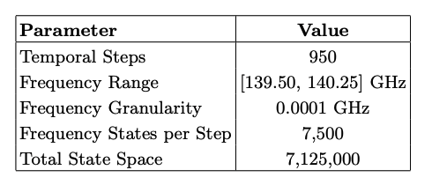
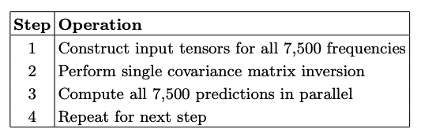
We can do … a LUT!
A LUT (Look Up Table) allows us to precompute the state action space and allow us to bypass the forward pass of the GP(A) during training
Rare that you are able to do this!
Notes:
Our environment has ~950 time steps (as per the data)
At each time step we allow clip the max and min frequency range to be between [139.50, 140.25]
If we allow a minimum of 0.0001 change to the microwave frequency this brings the number of possible states per each step to be .75/0.0001 or 7500 possible states
7500 * ~950 = 7,125,000 potential states our agent can be in
Since we aren’t predicting sequentially (as we have to do in RL as we do not know our trajectory until our agent makes an action) we can batch process all the predictions together!

Slide 23
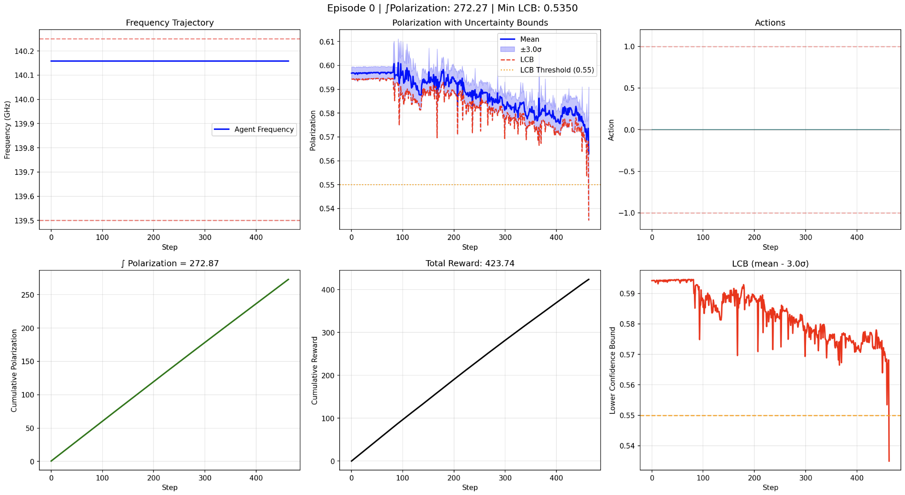

Validating the LUT
Run environment with default starting parameters and with no action
Both in the GPA model environment and the LUT environment
They be the same
LUT
17 seconds
GPA Model
593 seconds

Slide 24
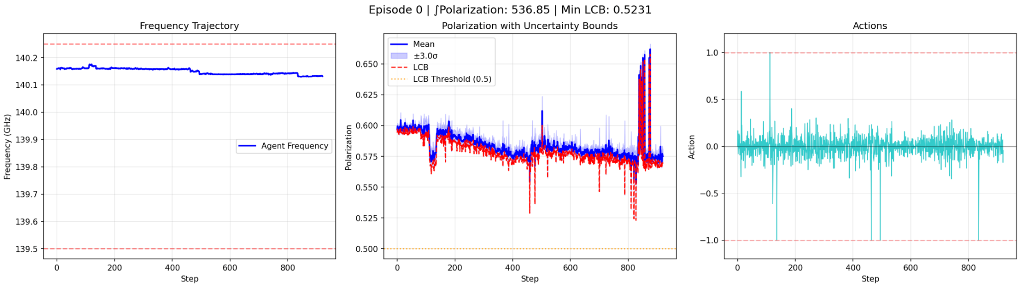
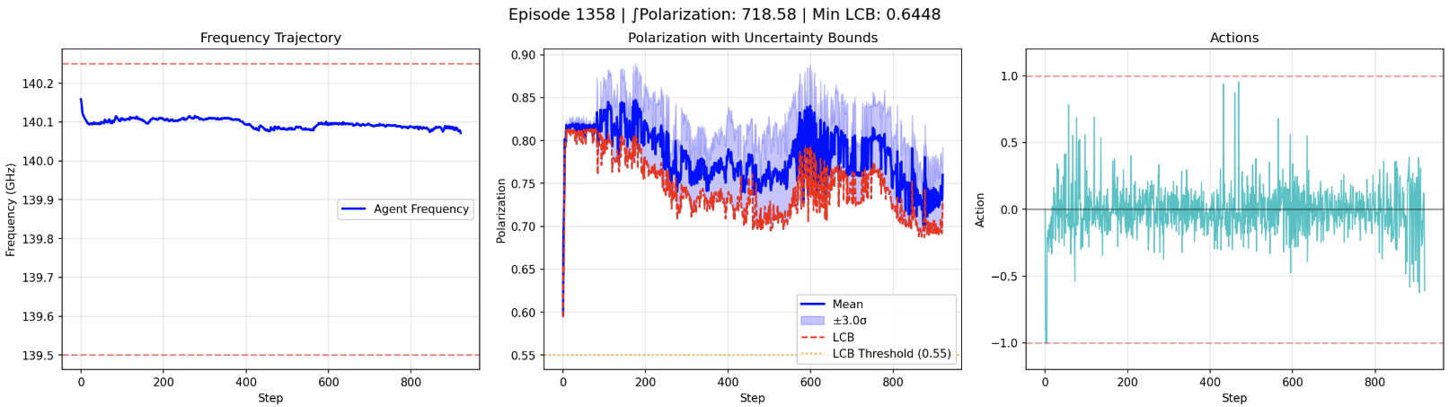
Results: TD3 P07 Policy Comparison to Baseline
P07
Operator Baseline
TD3 P07 Policy
Notes:
Label P07 run for the operator and the run

Slide 25
Solving Multi Sample Environment with Differential TD3
Single Sample GP
Single Sample Modelling
Gymnasium Environment
Solving w/ RL
Multi Sample GP
Multi Sample Modelling
Solving w/ RL and LUTs
Solving w/ Differential RL

Slide 26
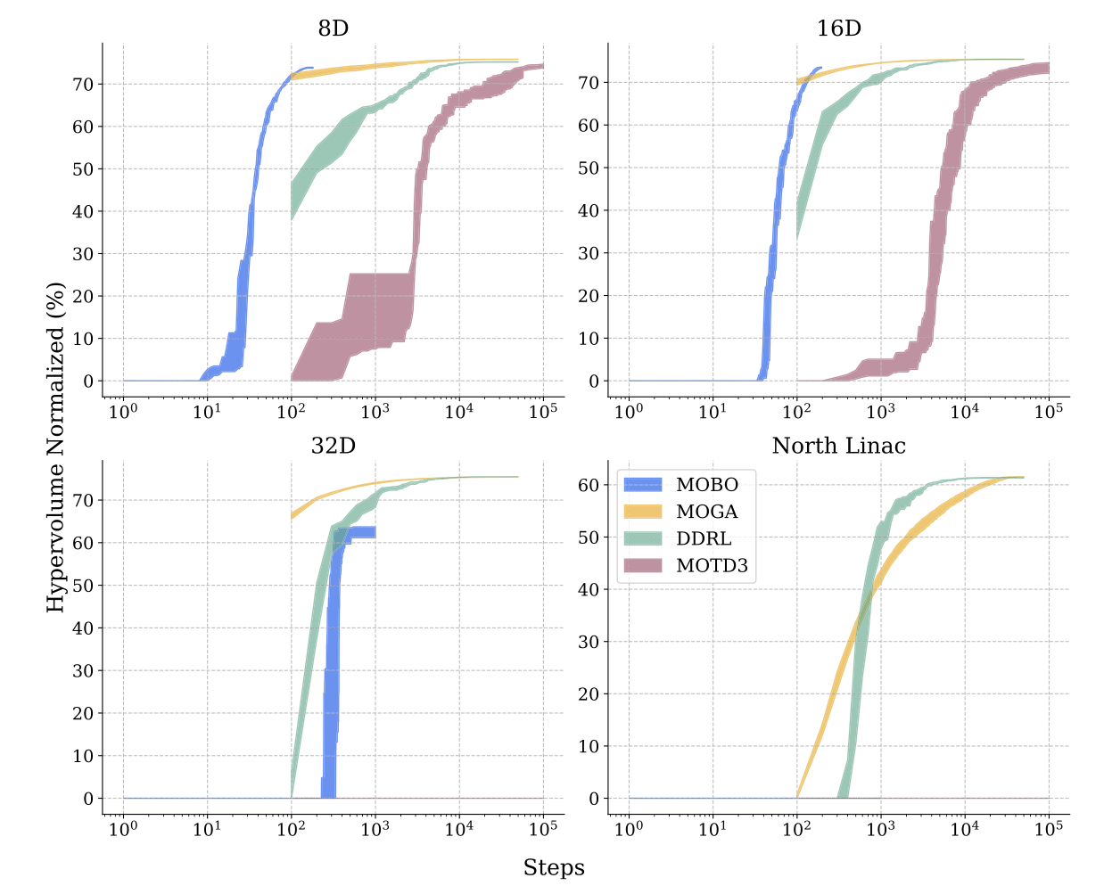
Differentiability: the what and why
Previous paper:
Harnessing the power of gradient-based simulations for multi-objective optimization in particle accelerators
Showed that higher dimensional multi objective problems greatly aided by gradient assisted RL
Gradients through the environment guide actor model in agent towards the optimal solution
Single step multi objective environment
Notes:
Decision was made to explore differentiability in environment and agent to see if it would help us not have to use a LUT (precomputation)
LUT is a brute force method where we precompute the state/action space using batching
Each step takes a longer amount of time with multi sample models
Differentiability hopefully allows an agent to learn the optimal solution in less samples = less time required to learn

Slide 27
How do we do this?
Environment (Actions, States)
Prime Environment
GP(A) model must be differentiable
Given an action can I calculate how it affects the change of the state
Environment must be differentiable
Given an action can I calculate how it affects the change of the reward
Environment must be primed with states as well as actions
Needs to know which state the actor was in when it generated each action for stateless forward pass
Environment step must accept batches
Training runs on batches not single step trajectories. Step function now must accept batch of actions and states as input
Agent must be able to utilize these gradients
During training, given the state of the environment determine the action and learn from the gradients passed back from environment how optimal that action was
Actions
Model (Freqs + Actions)
Agent (States)
Rewards
Rewards (States, Actions)

Slide 28
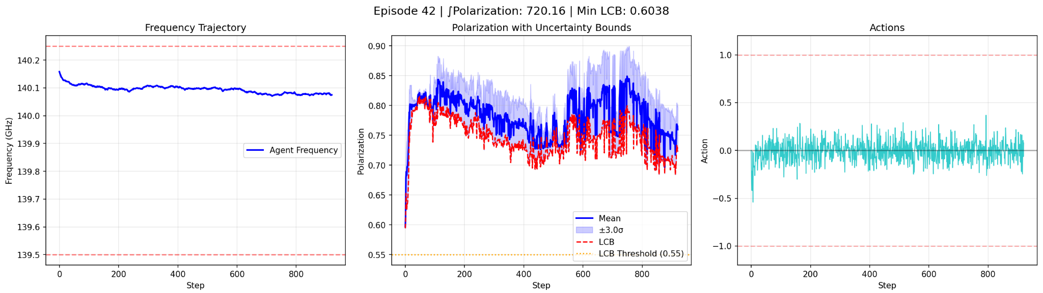
Results: Differential TD3 Agent
Converged to similar optimal solution as traditional RL agent
N-Step rollout with training that directly interfaces with differential environment increases step/episode time tremendously
This was understood to be a limitation! But did we take less steps to converge to an optimal solution and thus take less time?
No! While the differential solution was able to find optimal ~2000 steps after warm up and the non diff RL required ~2500 steps to find optimal after warm up the time increase per step during training was much higher and made it not faster
Diff TD3 Policy

Slide 29
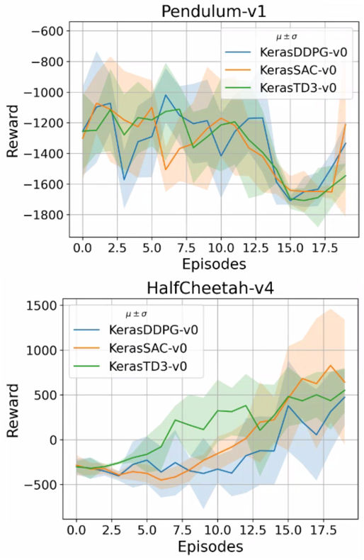
Scientific Optimization Control Toolkit (SOCT)
https://github.com/JeffersonLab/SciOptControlToolkit
Composable
•Easy to add new agents and environments
•Registration mechanism
•Allows for easy development and use of new components
Standard Gymnasium API
•Utilize industry standard environment specification
Visualizations
•Tensorboard integration allows for live monitoring of training
Reproducible
•Models and configurations are saved and stored for inference/retraining
•Easily pull in previous runs for continued research

Slide 30
Next Steps
Data driven surrogate modelling with uncertainties we can train RL agents to effectively learn solutions closer to optimal than human operators while respecting the uncertainties and limitations of the historical data
Differential simulations and environments can decrease the number of samples required to converge but potentially still take more wall time with the increased algorithm complexity
Future effort into how we can design this to be deployable when the experiment comes back online
Thank you!
Feel free to reach out at armenk@jlab.org
This is prepublished work and is subject to modification!

Slide 31
Appendix

Slide 32
Environment Setup: Observation and Reward Structure
Observation Space
[Microwave Frequency Normalized, Target Dose Scaled, Beam Current, Predicted Polarization Mean, Predicted Polarization Std, Lower Confidence Bound, Frequency Derivative, Previous Action]
Components
Normalized microwave frequency helps agent learn state space better and keeps observations on similar scale
Lower Confidence Bound = Predicted Mean - k * predicted std
Frequency Derivative = (current frequency - previous frequency) / continuous action scale
Lets the policy know which way and how quickly we are moving
Previous Action provides the agent some history for the policy
Rewards Structure
Reward = LCB + Action Penalty + Frequency Change Penalty
Reward Components
LCB: Same as in observation
Action Penalty: - (action penalty weight * exp(action) * reward scale)
Added to encourage smaller more conservative actions (over slamming action bounds!)
Promoting smooth actions
Frequency Change Penalty: -abs(Frequency Derivative) * frequency change weight * reward scale
Designed to discourage abrupt frequency jumps
Promoting smooth trajectories

Slide 33
Project Timeline
Single Sample Surrogate Modelling with Uncertainties
Gymnasium Single Sample Environment Structure
Solving Single Sample Environment with TD3
Multi Sample Surrogate Modelling with Uncertainties
Solving Multi Sample Environment with TD3 & LUTs
Solving Multi Sample Environment with Differential TD3

Slide 34
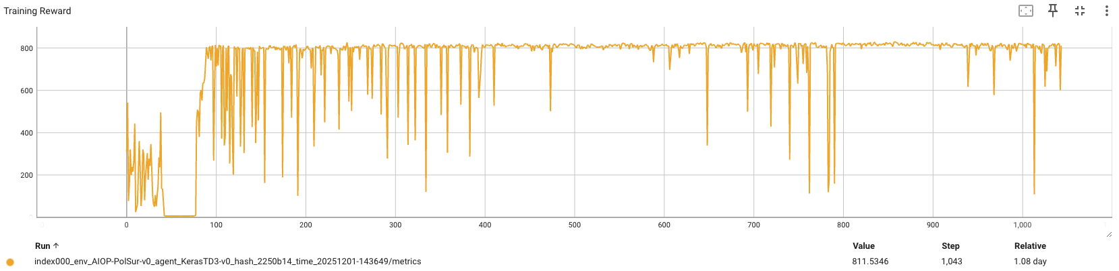
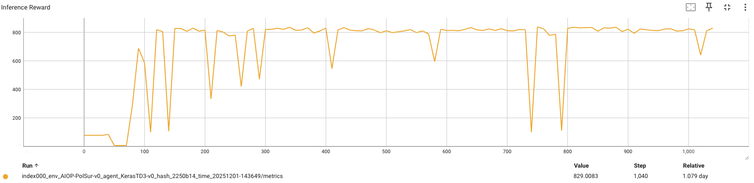
Results: TD3
Action Range
[+/-0.05]
The policy model is learning!

Slide 35
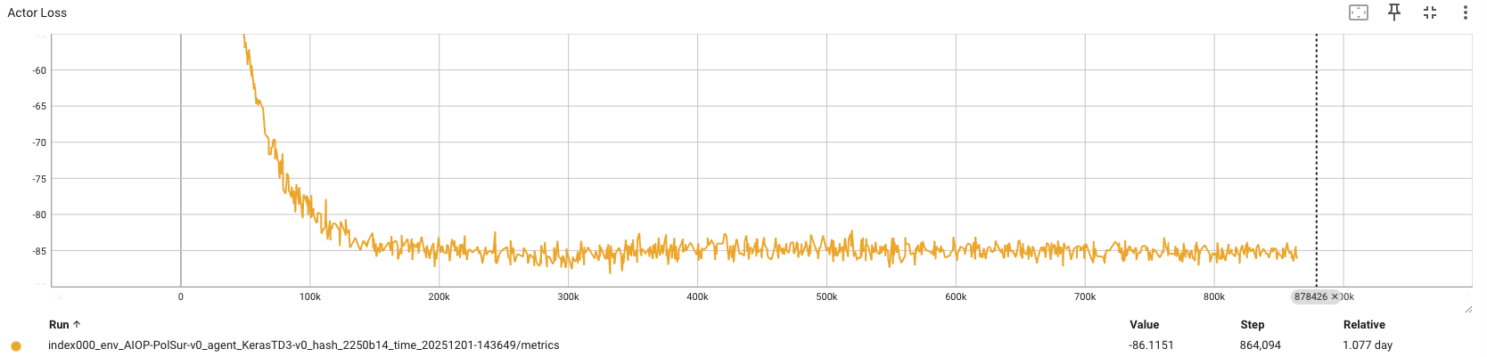
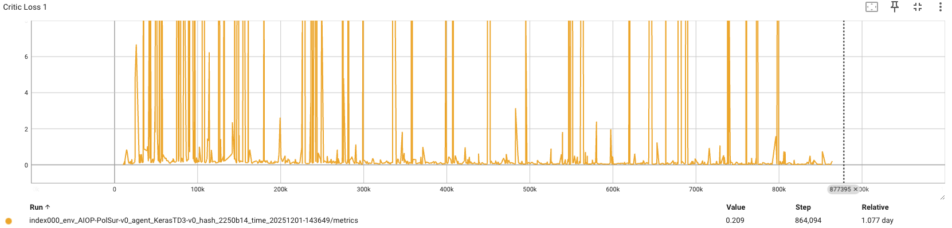
Results: TD3 Actor/Critic Losses

Slide 36
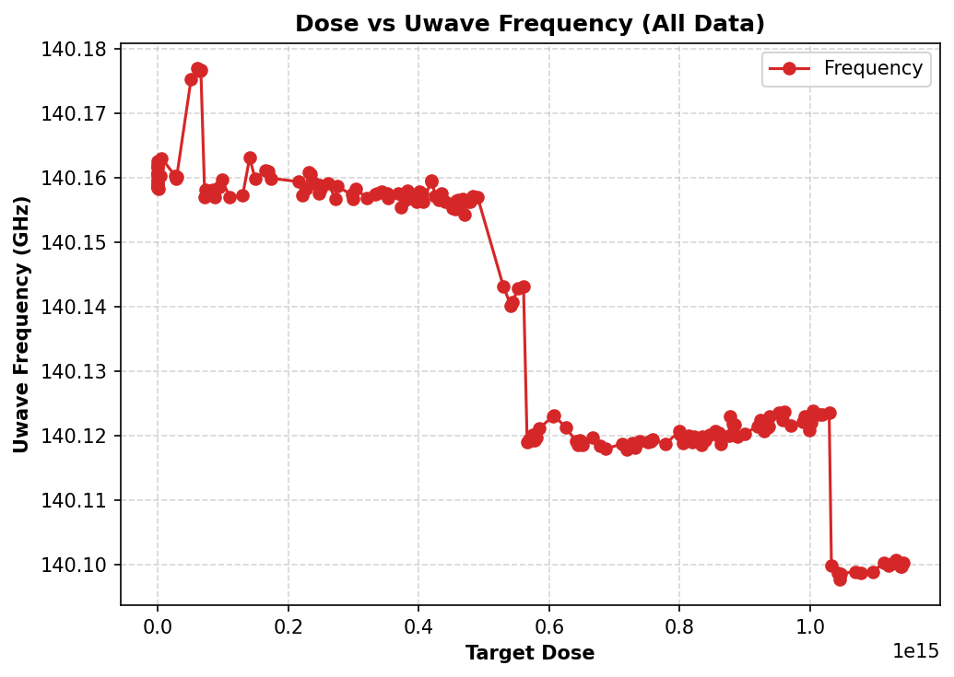
Data Distributions
Studies into the dataset utilized for training the P07 sample show three distinct clusters of data
~140.159
~140.120
~140.100
This is definitely the cause of the models uncertainties limitation!

Slide 37
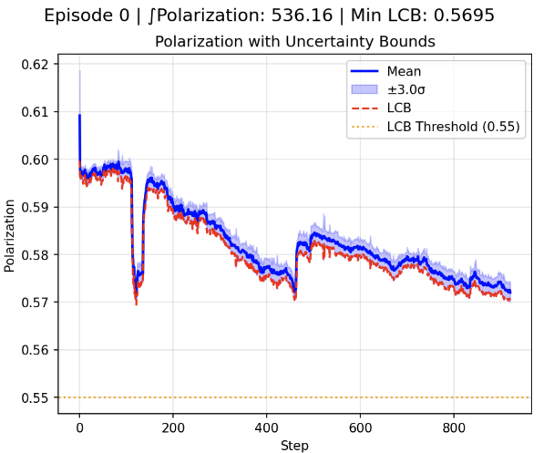
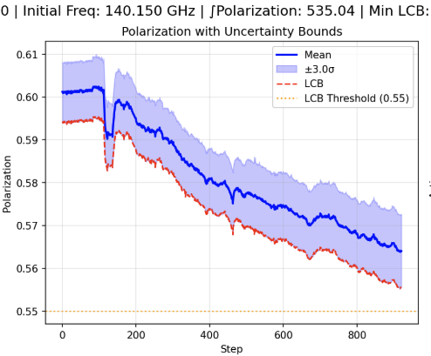
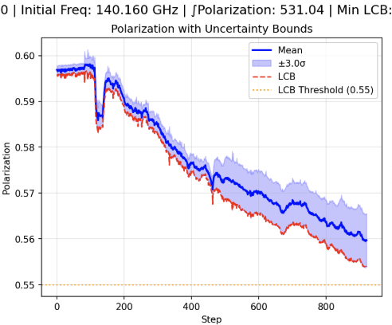
Frequency Scans at 140.160
Tested at 140.160 shows that the models uncertainties drop as we move into distribution
Data through Environment
Set 140.150 value
Set 140.160 value

Slide 38
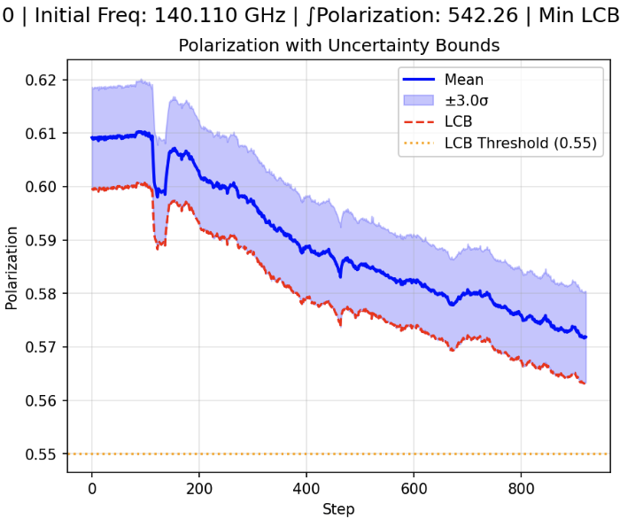
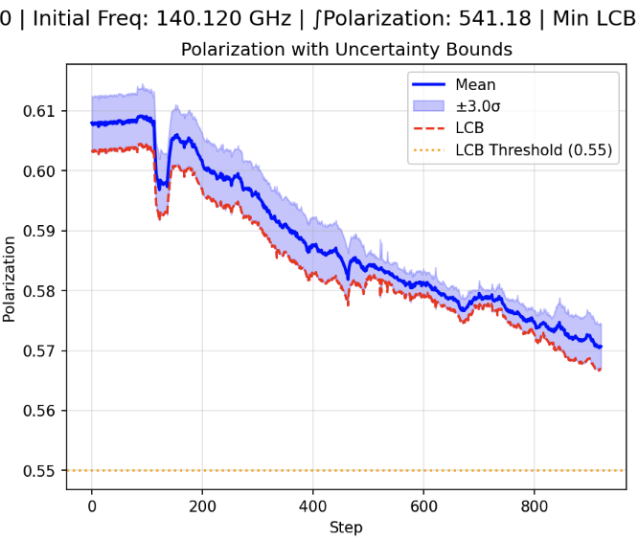
Frequency Scans at 140.120
Tested at 140.120 shows that the models uncertainties drop as we move into distribution
Data through Environment
Set 140.110 value
Set 140.120 value

Slide 39
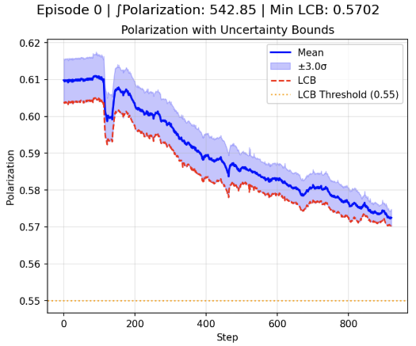
Frequency Scans at 140.100
Tested at 140.100 shows that the models uncertainties drop as we move into distribution’
Looking back at the data Monibor has provided we can see we have the least amount of data at the 140.100 mark leading to small perturbations of the value causing higher uncertainties than seen at 140.120
Data through Environment
Set 140.110 value
Set 140.100 value

Slide 40
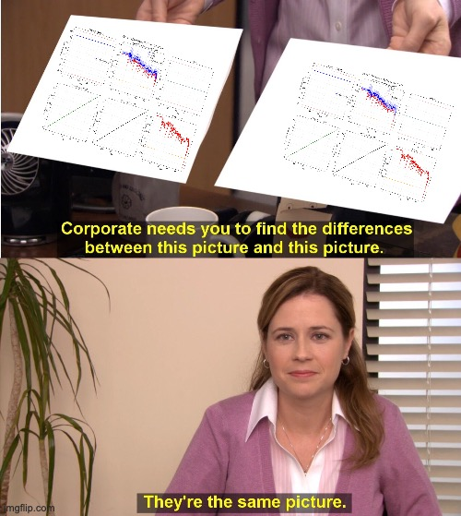

Slide 41
Results: Multi Sample vs Single Sample Baseline Operator
Single Sample Model Operator Baseline
Multi Sample Model Operator Baseline

Slide 42
GP(A) must be differentiable
Monibors models were built utilizing standard scalar transforms and numpy calls
This works great but for gradients it breaks the tensorflow graph
Replace all numpy calls with Tensorflow equivalents and removed all .numpy casts
Scikits standard scalar (returns numpy) replaced with Tensorflow tensor calculations
In the process of doing this found an interesting method of speeding up the inference!
Instead of using the Tensorflow matrix inversion function we can utilize the Tensorflow Cholesky Solve once and reuse it through our inference!
Tested and provides the same results as the Tensorflow matrix inversion with a single upfront cost of calculation (about 6 seconds) then drops inference down!
This speeds up the inference of the GP(A) models!
Link to github issue for more information on implementation etc!
Work done into functions for backward compatibility so we do not have to retrain models!

Slide 43
2) Environment must be differentiable
Gymnasium environments are not designed to differentiable by design
Doesn’t mean it isn’t possible just means you have to be very cognizant in designing
While the environment contains the simulation for modelling everything between receiving the action from the agent and returning the reward to the agent must also be differentiable and not break the tensorflow graph
Loading and utilization of the variables (current and dose) must be done in a certain way with Tensorflow constants
All calculations utilized in reward function must be done with Tensorflow operations
Logging must be done without breaking or casting Tensorflow variables to numpy arrays (use mirrored variables
We must prime the environment with the state (set all simulation in the right state that the agent utilized for generating it’s action)
This must be done not only for single action calls but batches actions and states
Caveat: Initially designed to be built in the step(action) function but moved to step_prime(actions, states) function as unlike the step() function we need to prime the state of the environment and pass through the state as well as support batches of states and actions!
Note: Still need to catalogue and write about this on Github!

Slide 44
3) Reinforcement Learning Agent must use Gradients
Previously developed agent made for paper developed for single step optimization environments
Not many modifications needed to be made other than reintroduce use of batched sampling from buffer for training of the actor
Replace the critic with the environment
Does this count as reinforcement learning as we have removed the Bellman equation?!
Agent now makes a call to the environment in the training function in a Tensorflow gradient tape
Passes the state of the environment utilized for action generation through the actor model as well as the action through the step_prime(actions, states) function as we must prime the environment before we make the calculation

Slide 45
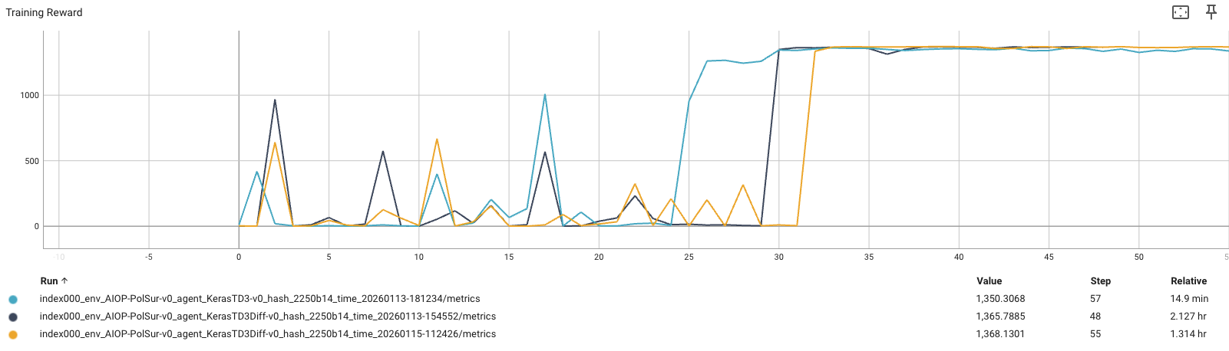
Early Results: DRL vs RL
Model: gpa_rff_LAPLACE_Nedler-Mead_D4096.pkl
Note: This was compared against the LUT

Slide 46
Traditional TD3 vs. Differential TD3 Agent
Traditional
• Actor: Single gradient signal from critic Q-value. Critic is the only source of information about future consequences.
• Critic: Single step Bellman target from real data. Learns value from one transition at a time, learning its own estimate for the future through individual experiences.
Differential
• Actor: N-steps of direct, low-variance gradient from the differentiable model with the critic value estimation for long-horizon value at end of N-steps.
• Critic: N-step targets from model rollouts replace single step Bellman equation learning. The critic gets multi-step return information rather than trusting its own single step value estimation of the state action.

