Slide 1
Introduction to reinforcement learning
 | Department of Physics
Dr. Andrea Santamaria Garcia
Lecturer
Reinforcement Learning for Autonomous Accelerators workshop 2026 (Liverpool)

Slide 2

Disclaimer
This lecture:
Is meant for people that are new to RL.
Will introduce you to the foundational concepts and ideas used in RL.
You are not supposed to understand everything, but get some keywords, concepts, and pointers
Remember that this topic is usually learned in one semester or more

Slide 3
OUTLINE
Theoretical foundations of reinforcement learning (26 slides)
Trial-and-error concepts (agent, reward, goal, reward is enough, trade-off between exploitation and exploration, sequential decision making)
Optimal control concepts and dynamic programming (Markov decision processes (MDPs), Markov property, partially observable Markov decision processes (POMDPs), reward and return, policy, value function, the Bellman equation)
An illustrative toy problem: gridworld (7 slides)
Policy evaluation (exact), policy evaluation (iterative)
How does an agent actually learn? (9 slides)
The RL goal, optimal policies, Bellman optimality equations, policy improvement, application to gridworld problem, greedy actions
Sampling and approximation methods (8 slides)
Monte Carlo learning, temporal difference learning

Slide 4
THEORETICAL FOUNDATIONS OF REINFORCEMENT LEARNING

Slide 5
Learning paradigms (ML)
Ways of learning from data
Notes:
Organise how information is obtained and used.
How does the system gain information?

Slide 6
Reinforcement learning
More than machine learning: intellectual inheritance

Slide 7
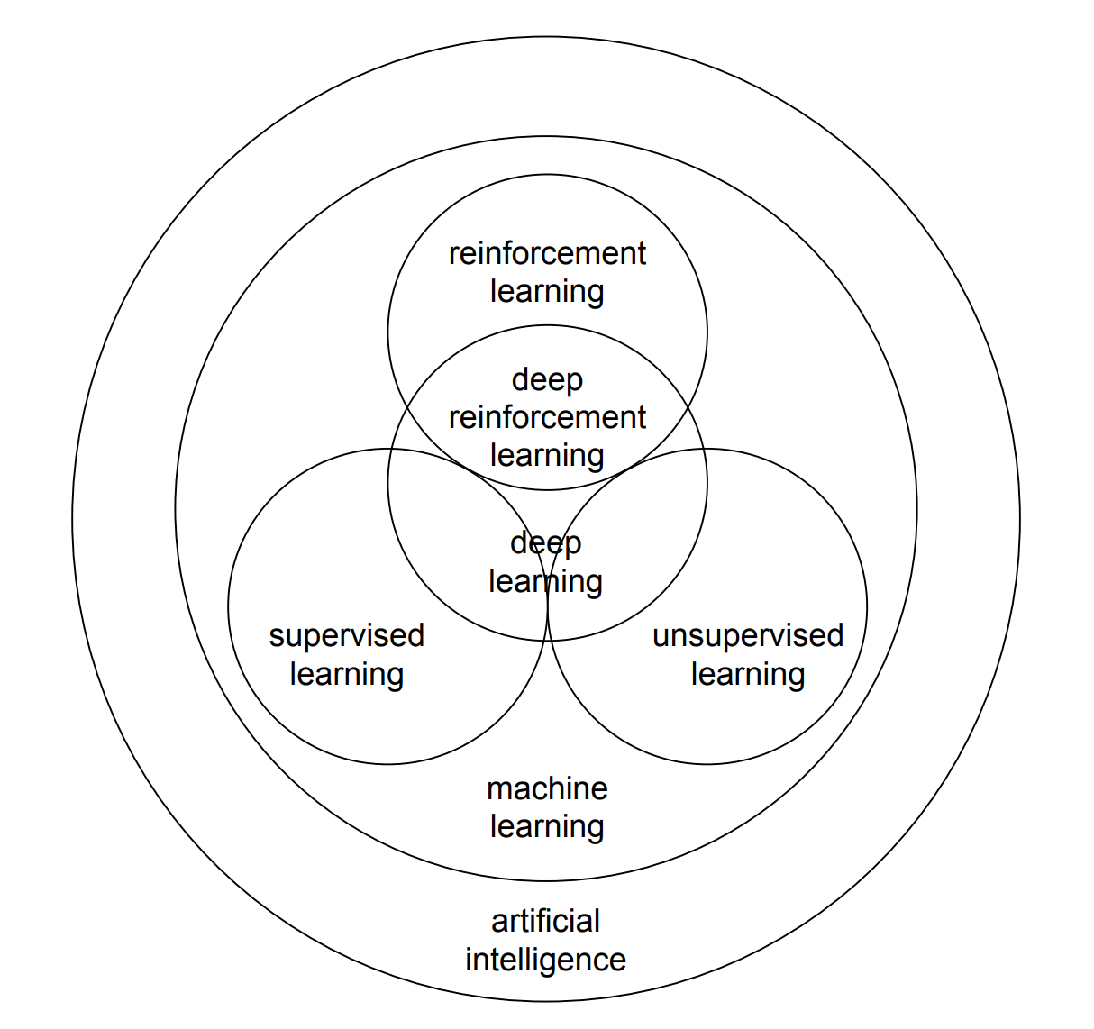
All learning paradigms have deep learning variants (i.e., uses neural networks)
Today modern RL refers to deep RL

Slide 8
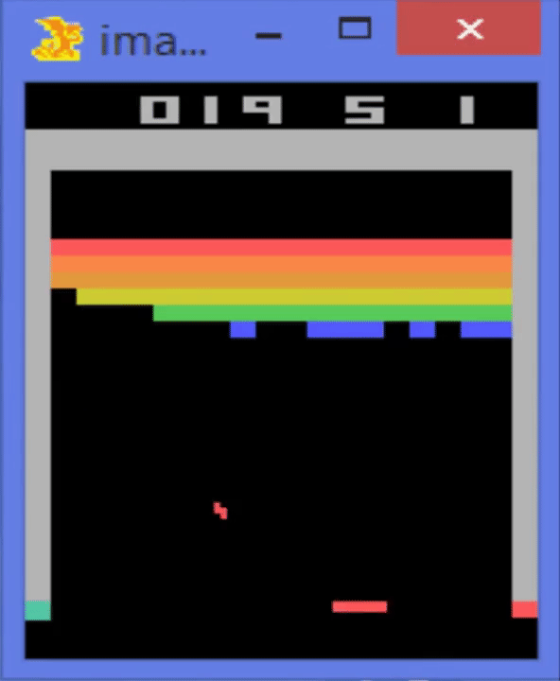

Deep reinforcement learning
Opened the door to high dimensional environments
https://arxiv.org/abs/1707.02286
https://www.deepmind.com/publications/playing-atari-with-deep-reinforcement-learning

Slide 9
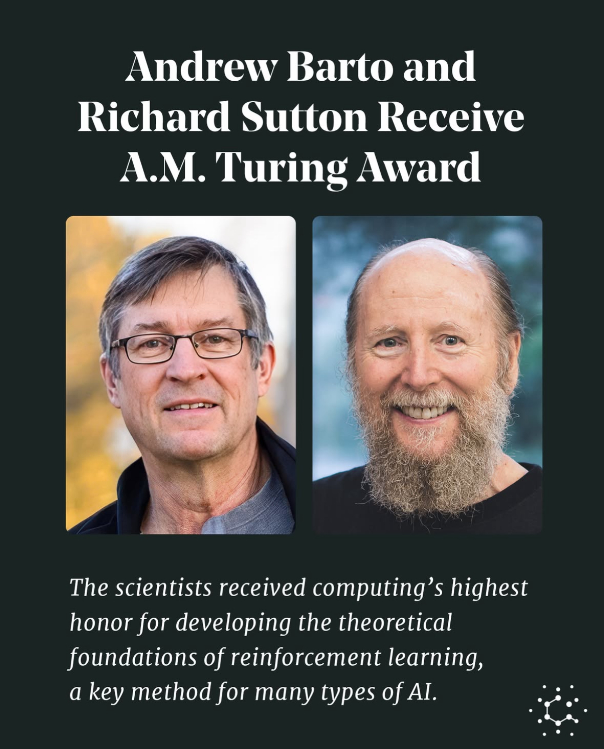
Reinforcement learning: recent recognition
“Reinforcement learning is simultaneously a problem, a class of solution methods that work well on the problem, and the field that studies this problem and its solution methods”
- Sutton & Barto
What we understand today as RL (established in the 1980s) inherits concepts from:
trial-and-error learning
optimal control
temporal difference learning
2024 Turing Award

Slide 10
The pillars of reinforcement learning
No deep RL just yet!
Trial-and-error learning
Behaviour adapts through reward feedback
Actions that lead to favourable outcomes are reinforced
Exploration vs exploitation emerges naturally
Provides the behavioural basis:
→ Learning through interaction and delayed consequences
Behavioural foundation
Optimal control and dynamic programming
Sequential decision making under uncertainty
Markov decision processes (MDPs)
Bellman equation and value functions
Policy optimisation
Provides the formal structure:
→ Defines what “optimal behaviour” means
Mathematical decision framework
Temporal difference learning
Computational learning mechanism
Learns from partial experience
Bootstraps future value estimates
Online, sample-based updating
Model-free learning
Provides scalability:
→ Makes optimal control feasible without knowing the model
Notes:
Some people might call it dynamic programming or sequential decision making instead of optimal control
MDPs are also studied in operations research

Slide 11



Trial-and-error concepts
The RL problem: agent, goal, and reward
An agent must learn through trial-and-error interactions with a dynamic environment
Agent
executes action
receives observation
→ receives scalar reward
Reward
scalar feedback signal $r_{t}$ that indicates how well the agent is doing at step $t$
Goal
maximisation of cumulative reward through selected actions
Reward shaping is non-trivial

Slide 12
Trial-and-error concepts
The RL problem: agent, goal, and reward

Slide 13
Trial-and-error concepts
The RL problem: agent, goal, and reward
"Reward is enough" by Silver et al. (2021)
Proposes that the concept of reward maximization is a sufficient framework to achieve artificial general intelligence (AGI).
The authors argue that complex intelligent behaviours (such as perception, language, and social intelligence) can emerge from agents solely driven by the goal of maximizing cumulative reward in their environments.
Some people argue that additional mechanisms, such as intrinsic motivation, curiosity, or structured learning paradigms, might be necessary to replicate the full spectrum of human intelligence.
Nevertheless, the single objective of reward maximisation has proven to be extremely powerful.
“Scalar reward is not enough”: a response to Silver et al. (2021)

Slide 14

Trial-and-error concepts
Trade-off between exploitation and exploration
Actions may have long-term consequences
Reward might be delayed
(does not happen immediately)
Should the agent sacrifice immediate reward to gain more long term reward?

Slide 15
Trial-and-error concepts
Trade-off between exploitation and exploration
The agent needs to:
Exploit what it has already experienced in order to obtain reward now.
Explore the environment to select better actions in the future by sacrificing known reward now.
…and both cannot be pursued exclusively without failing at the task
Too much exploitation
the agent might converge prematurely to a suboptimal strategy
Too much exploration
the agent spends too much time testing bad actions, delaying convergence to an optimal strategy

Slide 16


Trial-and-error concepts
Trade-off between exploitation and exploration
All RL algorithms must implicitly or explicitly address this trade-off (e.g., assessing the value of actions and estimating future reward).
The right balance depends on the problem, environment, and computational constraints.
Examples of different strategies:
ε-greedy schedule: with small probability ε select a random action, otherwise choose the current best, typically decreasing ε over time to shift from exploration to exploitation.
Softmax / Boltzmann: sample actions probabilistically according to their estimated value, so higher-value actions are favoured but all remain possible depending on a temperature parameter.
Optimism / UCB-style: select actions by balancing estimated value with an uncertainty bonus, favouring options that are either promising or under-explored.
Finite vs. infinite horizons
In finite horizon settings exploration pressure decays as the horizon shrinks. In long-term settings, exploration can be spread.
Deterministic vs. stochastic environments
In deterministic settings, exploration can decay once the optimal policy is identified. In stochastic settings, uncertainty may persist, requiring continued sampling.
Notes:
The most important feature distinguishing reinforcement learning from other types of
learning is that it uses training information that evaluates the actions taken rather
than instructs by giving correct actions. This is what creates the need for active
exploration, for an explicit search for good behaviour. Purely evaluative feedback indicates
how good the action taken was, but not whether it was the best or the worst action
possible. Purely instructive feedback, on the other hand, indicates the correct action to
take, independently of the action actually taken

Slide 17
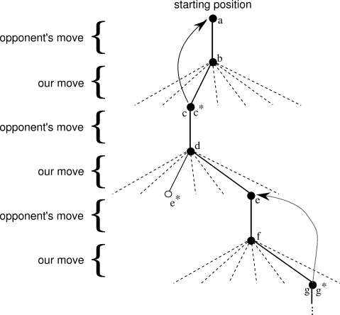
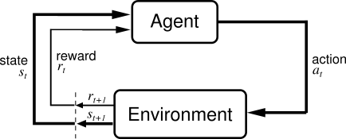
Trial-and-error concepts
How to formalise sequential decision making?
exploratory move
The famous RL loop
Images from Sutton & Barto
A sequence of tic-tac-toe moves

Slide 18

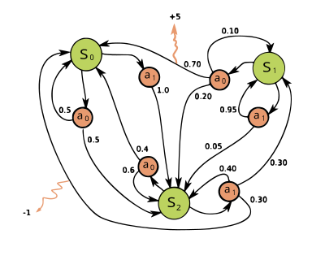







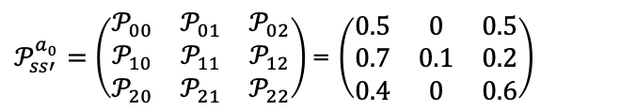

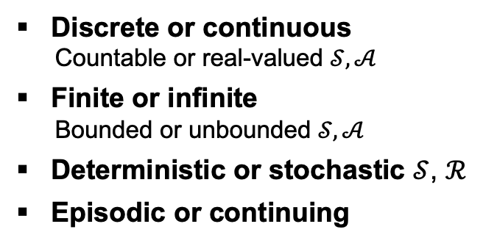

Optimal control concepts
Discrete or continuous
Countable or real-valued $𝒮, 𝒜$
Finite or infinite
Bounded or unbounded $𝒮, 𝒜$
Deterministic or stochastic $𝒮$, $ℛ$
Episodic or continuing
Markov Decision Processes (MDPs)
A mathematical framework for modelling stochastic decision making
A Markov Decision Process is a 5-tuple:
$$(𝒮, 𝒜,𝒫,ℛ, γ)$$
$$𝒮$$
state space (all valid states)
$$𝒜$$
action space (all valid actions)
$$ℛ$$
reward function
$r=ℛ(s,a,s′)$ = $ℛ_{ss′}^{a}$
Immediate reward
MDP example from Wikipedia
$$𝒫$$
transition probability function
$$𝒫_{ss′}^{a}=ℙ[s^{′}|s,a]$$
Probability of transitioning to state $s′$after taking action $a$ while being in state $s$
$$𝒜=\left\{a_{0}, a_{1}\right\} ; 𝒮=\left\{s_{0},s_{1},s_{2}\right\} ;{ ℛ}_{s_{1}s_{0}}^{a_{0}}= +5 ;{ ℛ}_{s_{2}s_{0}}^{a_{1}}=−1$$
$$γ$$
discount factor
$𝒫_{ss′}^{a_{0}}=\left(\begin{matrix}𝒫_{00} & 𝒫_{01} & 𝒫_{02} \\ 𝒫_{10} & 𝒫_{11} & 𝒫_{12} \\ 𝒫_{20} & 𝒫_{21} & 𝒫_{22}\end{matrix}\right)$ = $\left(\begin{matrix}0.5 & 0 & 0.5 \\ 0.7 & 0.1 & 0.2 \\ 0.4 & 0 & 0.6\end{matrix}\right)$
Notes:
Ask public:
Is this MDP discrete or continuous?
Finite or infinite?
Deterministic or stochastic state transition?
Do we usually know the state transitions? → simulation
The reward depends on the current state of the environment, the action just taken, and the next state
An episodic task is one where interaction is naturally broken into episodes with a terminal state. After termination, the environment resets. Example: game of chess.

Slide 19
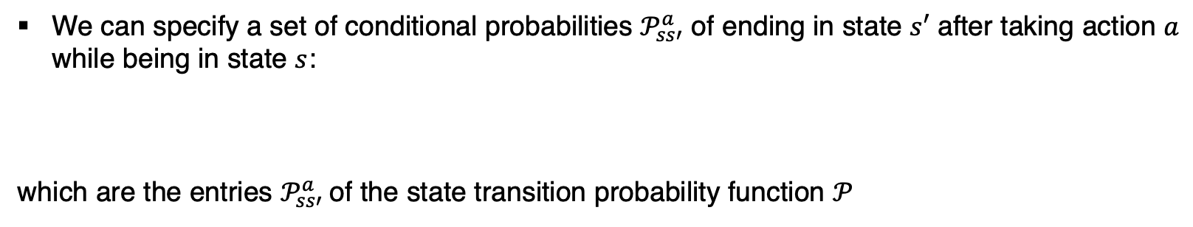
Optimal control concepts 💡
The Markov property
What makes MDPs computationally tractable is the assumption of the Markov property
→ offers simplifications that considerably alleviates computational demands
The Markov property states that the system’s next state is conditionally independent of all previous states given the current state, or in other words, that the future is independent of the past, given the present.
This property allows to discard the history of the process, making it memoryless.
We can specify a set of conditional probabilities $𝒫_{ss′}^{a}$ of ending in state $s′$ after taking action $a$ while being in state $s$:
which are the entries $𝒫_{ss′}^{a}$of the state transition probability function $𝒫$
$$𝒫=ℙ\text{[}{{ s}_{t+1},r_{t}|s}_{t},a_{t},s_{t−1},a_{t−1},…,a_{0} ,s_{0}] =ℙ{[s}_{t+1},r_{t}|s_{t},a_{t}]$$
Notes:
Computationally tractable: you can solve it with a reasonable amount of computational resources and time
This property allowed the development of efficient algorithms

Slide 20


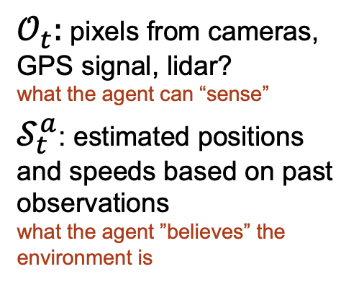
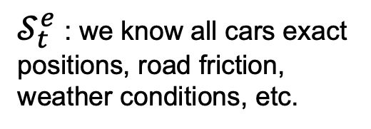

Optimal control concepts
Example: autonomous driving
The Markov property
Is the Markov property a reasonable assumption?
If we can observe the full state, yes.
state of the agent (belief)
Fully observable environments
The agent directly observes the true state of the environment, which includes everything relevant
$𝒪_{t}=𝒮_{t}^{a}=𝒮_{t}^{e}$
$𝒮_{t}^{e}$: we know all cars exact positions, road friction, weather conditions, etc.
observation
true state of the environment
$𝒪_{t}:$ pixels from cameras, GPS signal, lidar?
what the agent can “sense”
$𝒮_{t}^{a}$: estimated positions and speeds based on past observations
what the agent ”believes” the environment is
:
In real-world environments the agent receives partial observations
Partially observable environments
The agent receives partial observations and must create its own state representation
$𝒪_{t}≠𝒮_{t}^{a}≠𝒮_{t}^{e}$
partial, noisy, filtered
Notes:
Computationally tractable: you can solve it with a reasonable amount of computational resources and time
Subindex t: observation received at time step t
Belief = agent state

Slide 21
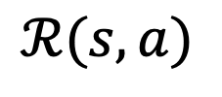








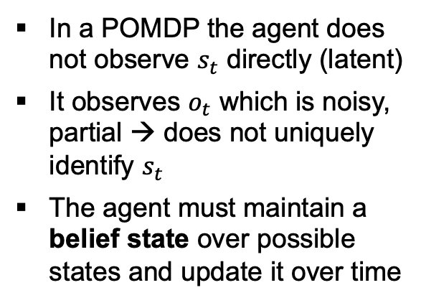
Optimal control concepts
Partially observable Markov decision processes (POMDP)
A POMDP is a 7-tuple:
$$(𝒮, 𝒜,𝒯,ℛ, Ω, 𝒪, γ)$$
$$𝒮$$
true state space (all valid states) - hidden
In a POMDP the agent does not observe $s_{t}$ directly (latent)
It observes $o_{t}$ which is noisy, partial → does not uniquely identify $s_{t}$
The agent must maintain a belief state over possible states and update it over time
$$𝒜$$
action space (all valid actions)
$$𝒯(s^{′}|s,a)$$
transition probability function
$$ℛ(s,a)$$
reward function
$$Ω$$
observation space (all valid observations)
$$𝒪(o|s′)$$
observation probability function
$$γ$$
discount factor
$$b_{t}\left(s\right)=P(s_{t}=s|o_{1:t, }a_{1:t−1})$$
Most real-world problems are partially observable
Notes:
An MDP is memoryless in the state, not in the trajectory. A POMDP becomes an MDP in belief space.
Some POMDPs are defined as 8-tuple with N: time-horizon of the process
A consequence of this property is that the optimal behavior may often include (information gathering) actions that are taken purely because they improve the agent's estimate of the current state, thereby allowing it to make better decisions in the future.

Slide 22

Optimal control concepts
Partially observable Markov decision processes (POMDP)
A belief is:
a probability distribution over latent states (explicit uncertainty)
a minimal sufficient statistic of the entire history (posterior dist.)
a compressed representation of uncertainty (all earlier history is encoded in the belief)
If you choose a latent state that omits relevant variables, belief will not be sufficient
Belief assumes the state definition is complete
$$b_{t}\left(s\right)=P(s_{t}=s|o_{1:t, }a_{1:t−1})$$
Maintaining a belief:
restores the Markov property in belief space
transforms the problem into an MDP over a continuous belief space
increases computational complexity dramatically (state space → space of probability measures). Exact solutions intractable.
Key takeaway: in a POMDP, the latent state evolves according to a Markov process, but because the state is not directly observable, the observation history is required for optimal decisions. However, this history can be compressed into a belief state, which restores the Markov property in belief space.
Notes:
Key takeaway: in a POMDP, the latent state evolves according to a Markov process, but because the state is not directly observable, the observation history is required for optimal decisions. However, this history can be compressed into a belief state, which restores the Markov property in belief space.
Although the underlying dynamics of the POMDP are still Markovian, since we have no direct access to the current state, our decisions require keeping track of (possibly) the entire history of the process, making this a non-Markovian process. The history at a given point in time is comprised of our knowledge about our starting situation, all actions performed and all observations seen.
If system dynamics depend on temperature but you do not include temperature in the state, your model is misspecified. Belief tracking cannot fix that.
You need a mapping, Usually used remove history (Kalman filter, so not history),

Slide 23
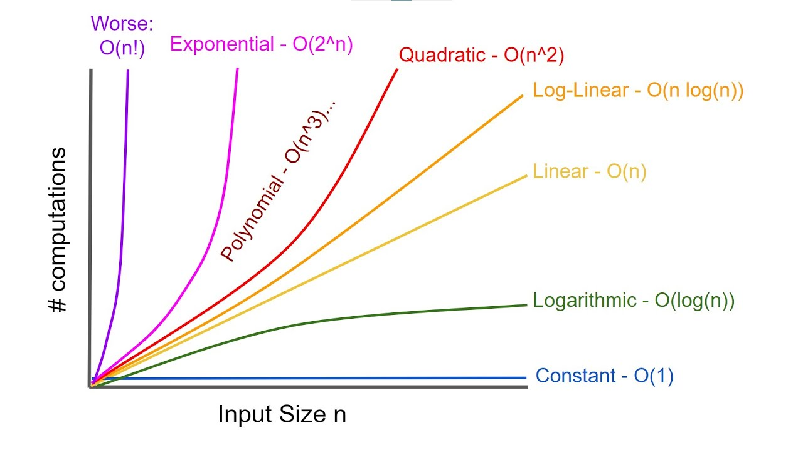
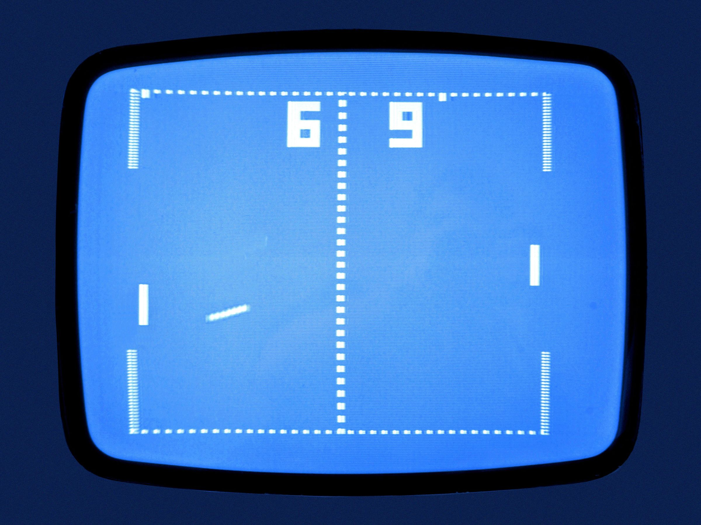
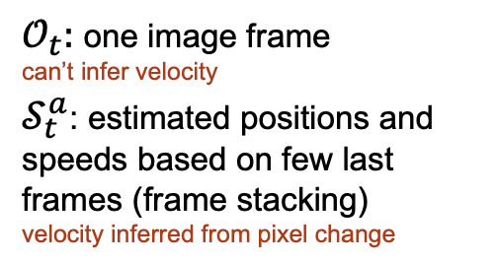
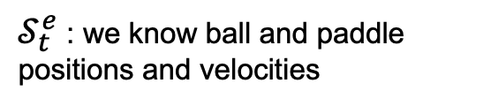
Optimal control concepts
Partially observable Markov decision processes (POMDP)
Finite-state MDP is solvable in polynomial time
Finite-state POMDP:
PSPACE-hard (infinite horizon)
EXPTIME-hard (finite horizon)
because belief space is continuous and planning branches over observation histories
Example: Atari pong
Memory-based approximations
$𝒮_{t}^{e}$: we know ball and paddle positions and velocities
Most deep RL methods do not maintain an explicit belief distribution, but use approximations and learn a hidden state representation:
$𝒪_{t}:$ one image frame
can’t infer velocity
$𝒮_{t}^{a}$: estimated positions and speeds based on few last frames (frame stacking)
velocity inferred from pixel change
Stacking recent observations to approximate motion
Recurrent neural networks
Memory augmented (transformers)
Probabilistic reasoning
→ no guarantees of optimality under partial observability
Notes:
Memory-based methods approximate belief tracking with learned representations, avoiding explicit planning in belief space and thus sidestepping the exponential complexity of exact POMDP solutions.
Because memory-based methods replace Bayesian belief updates with learned embeddings, they forfeit the theoretical guarantees associated with principled belief-state planning.

Slide 24
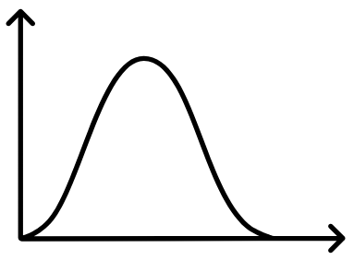

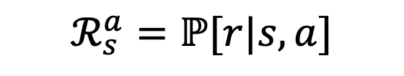


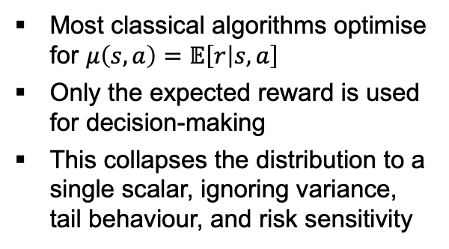

Optimal control concepts
Reward distribution
In real-world environments, reward is typically stochastic
The same state-action pair can yield different rewards due to stochastic dynamics or unmodelled factors
The received reward is not fixed but rather sampled from a distribution
$ℛ_{s}^{a}=$ $ℙ[r|s,a]$
Probability of receiving a reward $r$ given $s$ and $a$
Reward distribution or model
Most classical algorithms optimise for $μ\left(s,a\right)=𝔼\left[r | s,a\right]$
Only the expected reward is used for decision-making
This collapses the distribution to a single scalar, ignoring variance, tail behaviour, and risk sensitivity
$$μ\left(s,a\right)=𝔼[r|s,a]$$
Alternatives
Estimate distribution parameters from samples
Model the full reward distribution explicitly (model-based RL, Bayesian RL, distributional RL)
$$ℛ_{s}^{a}$$
$$ℛ=μ\left(s,a\right)+ε$$
noisy sample
Notes:
distributional RL, uncertainty-aware exploration, and robust learning
Even if the agent has performed the same action, hidden factors that changed will slightly affect the reward
Central Limit Theorem: when many small independent sources of noise (e.g., friction, wind, sensor error) affect the outcome, their combined effect tends toward a Gaussian distribution.
We’re modeling the noise, i.e., the uncertainty or variability in observed rewards, not the reward function itself being a distribution

Slide 25
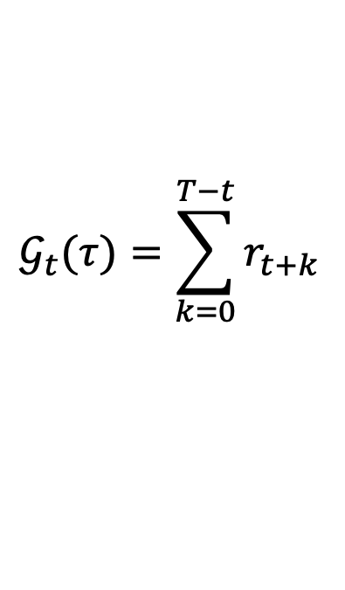
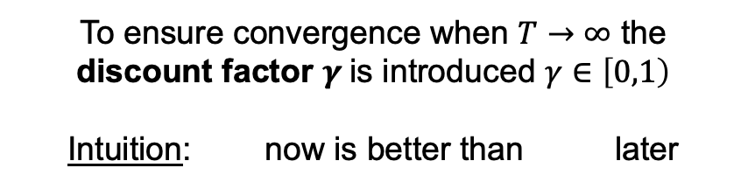
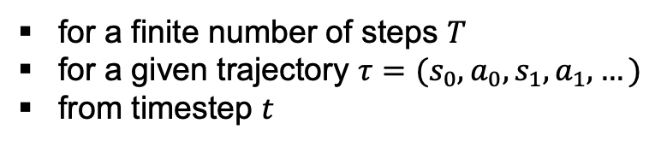
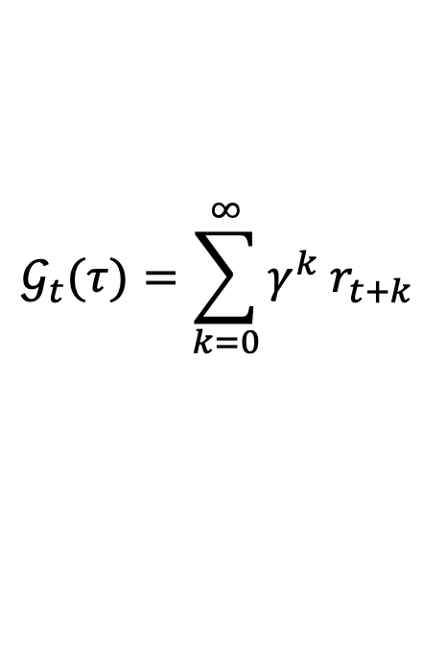
Optimal control concepts
Return
The return is the total cumulated reward from a given step onward
Finite-horizon return
Infinite-horizon discounted return
$$𝒢_{t}(τ)=\sum_{k=0}^{T−t}{r_{t+k}}$$
$$𝒢_{t}(τ)=\sum_{k=0}^{∞}{{γ^{k} r}_{t+k}}$$
for a finite number of steps $T$
for a given trajectory $τ={(s}_{0},a_{0},s_{1},a_{1},…)$
from timestep $t$
To ensure convergence when $T→∞$ the discount factor $γ$is introduced $γ∈\left[0,1\right)$
Intuition: now is better than later
Notes:
It values immediate reward over delayed reward (human-like)
It deals with uncertainty about the future (no perfect model of env.)
G is a distribution because it changes across episodes
In some notations G is R

Slide 26

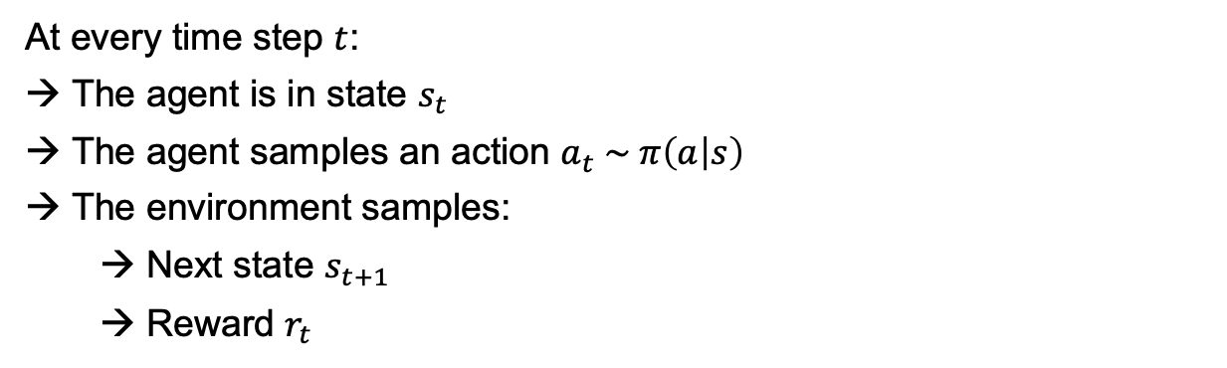


Optimal control concepts
Policy
The policy function is:
a map from state to action
completely defines how the agent will behave
a distribution over actions given a certain state
$$π :𝒮→𝒜$$
Deterministic:
$$π\left(s\right)=a$$
Stochastic:
$$π\left(a | s\right)=ℙ[a|s]$$
Probability of taking a specific action by being in a specific state
At every time step $t$:
The agent is in state $s_{t}$
The agent samples an action $a_{t} \sim π\left(a | s\right)$
The environment samples:
Next state $s_{t+1}$
Reward $r_{t}$
Sample randomly from a Gaussian dist. or from model
Given by your simulation, experiment, or model

Slide 27


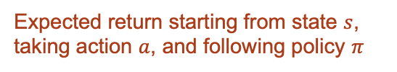


Optimal control concepts
Value function
The value function is:
an estimation of expected future return, gives “value” to an action.
used to choose between states depending on how much reward we expect to get.
depends on the agent’s behaviour (policy → action).
a way to compare policies.
State-value function
Expected return starting from state $s$and following policy $π$(evaluates the policy)
$$𝒱^{π}\left(s\right)=𝔼_{π}\left[𝒢_{t} \right| 𝒮_{t}=s]$$
Action-value function
Expected return starting from state $s$, taking action $a$, and following policy $π$
given policy
”Q function”
$$𝒬^{π }\left(s,a\right)=𝔼_{π}\left[𝒢_{t} \right| 𝒮_{t}=s,{ 𝒜}_{t}=a]$$
$$𝒢_{t}$$
where the return distribution is centered
Notes:
What would happen without the Markov property?
→ The value function V(s) (expected return from state s) would be ill-defined because s wouldn’t contain enough info about future outcomes.

Slide 28







Dynamic programming
The Bellman equation
Decomposition of expected return into immediate reward + expected future return
$$𝒢_{t}=r_{t}+γ𝒢_{t+1}$$
Recursive structure where we can define the value of a state in terms of its successor states
$$𝒱^{π}\left(s\right)=𝔼\left[𝒢_{t} \right| 𝒮_{t}=s]$$
$$=𝔼\left[r_{t }\text{+} {γ r}_{t+1}+{γ^{2} r}_{t+2}…\right| 𝒮_{t}=s]$$
$$=𝔼\left[r_{t }\text{+} {γ (r}_{t+1}+{γ r}_{t+2}…)\right| 𝒮_{t}=s]$$
$$=𝔼\left[r_{t} \text{+} {γ 𝒢}_{t+1}\right| 𝒮_{t}=s]$$
$$𝒱^{π}\left(s\right)=𝔼[r \text{+} γ𝒱^{π}(s′)]$$
$𝔼\left(f\right)=𝔼$($𝔼$(f))

Slide 29
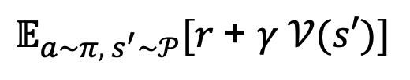
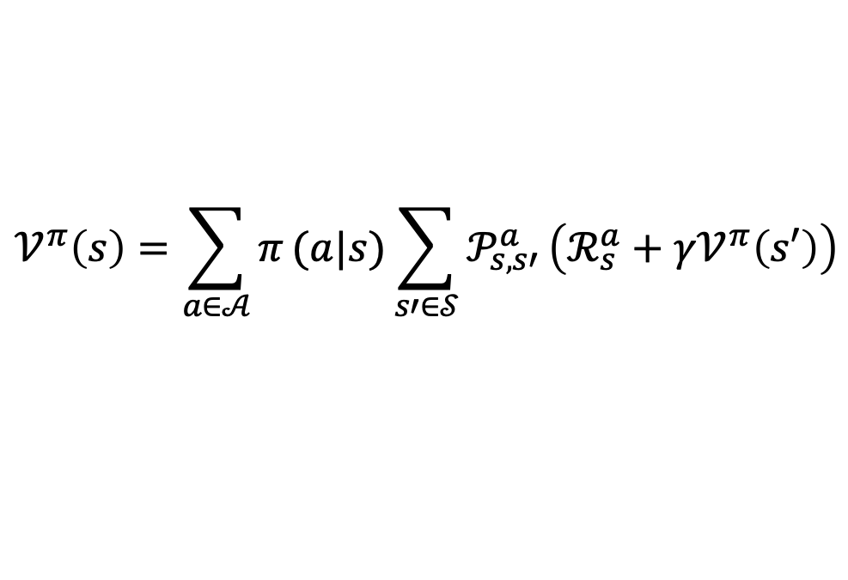
Dynamic programming
The expanded Bellman equation
In stochastic environments we need to take the expected value over all possibilities (actions, states):
$$𝔼_{a\sim π, { s}^{′}\sim 𝒫}[r \text{+} γ 𝒱(s′)]$$
We can expand the Bellman equation to explicitly account for it through the law of total expectation:
$$𝒱^{π}\left(s\right)=\sum_{a∈𝒜}{π}(a|s)\sum_{s′∈𝒮}{𝒫_{s,s′}^{a}}\left(ℛ_{s}^{a}+γ𝒱^{π}\left(s′\right)\right)$$
discrete case
Notes:
In most practical settings either the reward is deterministic, or if stochastic only the mean is used for value estimation

Slide 30
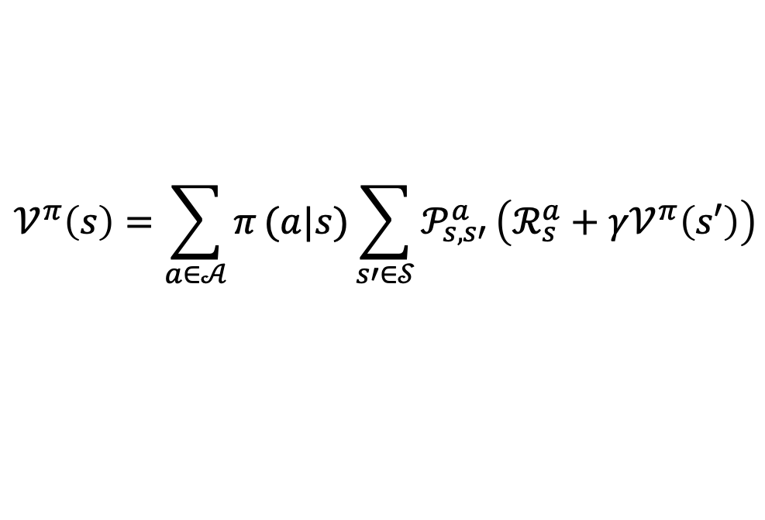

Dynamic programming
The expanded Bellman equation
$$𝒱^{π}\left(s\right)=\sum_{a∈𝒜}{π}(a|s)\sum_{s′∈𝒮}{𝒫_{s,s′}^{a}}\left(ℛ_{s}^{a}+γ𝒱^{π}\left(s′\right)\right)$$
How to solve it?
Directly
System of $𝒮$simultaneous linear equations with $𝒮$ unknowns
Approximation
Temporal-difference learning
Sampling
Monte Carlo methods
Iteration
Dynamic programming
Computational complexity
Notes:
In most practical settings either the reward is deterministic, or if stochastic only the mean is used for value estimation

Slide 31
An illustrative toy problem: gridworld

Slide 32
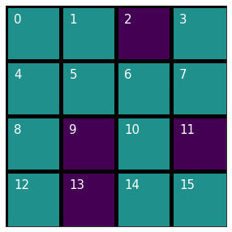

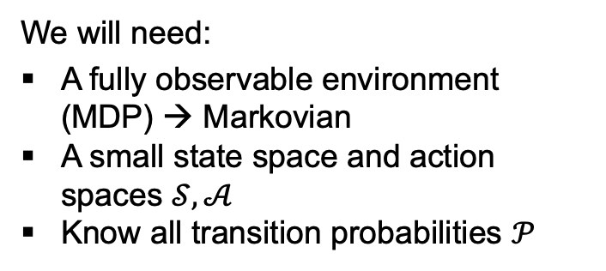


Gridworld toy problem
Welcome to gridworld!
Let’s use all the optimal control concepts we have learned and solve the Bellman equation directly and exactly
$$𝒮=\left(0, 1, 3, 4, 5, 6, 7, 8, 10, 12, 14, 15\right)$$
$$𝒜=(↑,↓, ←,→)$$
$$𝒫_{s,s′}^{a}=1$$
Deterministic environment
We will need:
A fully observable environment (MDP) → Markovian
A small state space and action spaces $𝒮, 𝒜$
Know all transition probabilities $𝒫$

Slide 33
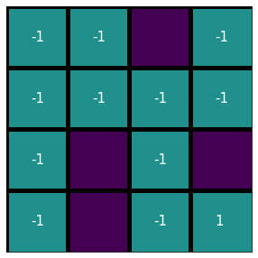




Gridworld toy problem
$$𝒮=\left(0, 1, 3, 4, 5, 6, 7, 8, 10, 12, 14, 15\right)$$
$$𝒜=(↑,↓, ←,→)$$
$$𝒫_{s,s′}^{a}=1$$
Deterministic environment
Our goal: get to state 15 (out of the maze)
Agent’s goal: cumulate reward
Reward design: why negative?
$$ℛ$$

Slide 34
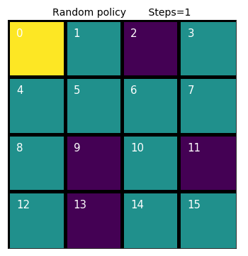





Gridworld toy problem
$$𝒮=\left(0, 1, 3, 4, 5, 6, 7, 8, 10, 12, 14, 15\right)$$
$$𝒜=(↑,↓, ←,→)$$
We need a policy: what is the simplest?
$$𝒫_{s,s′}^{a}=1$$
Deterministic environment
$$π\left(a | s\right)=ℙ\left[↑, ↓, ←,→ | { 𝒮}_{t}\right]=0.25$$
$$ℛ=$$
$$−1 ∀s, s≠15$$
$$1 s=15$$
Let’s see the random policy in action

Slide 35
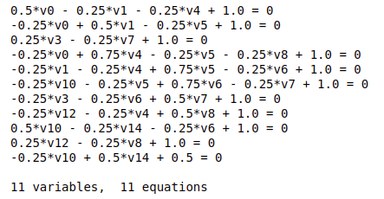
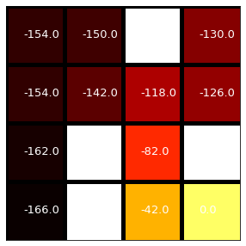

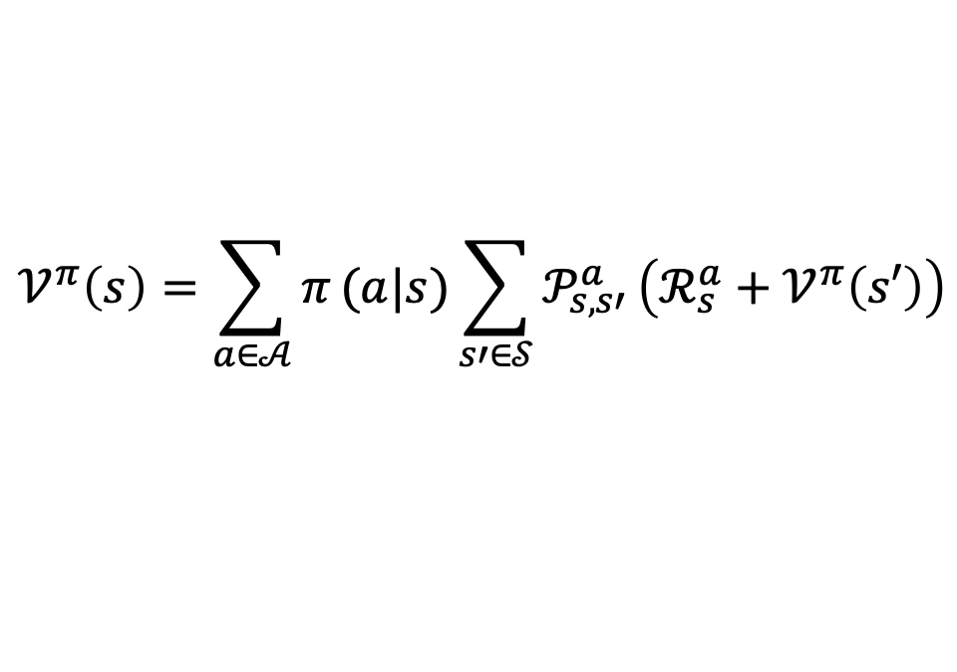
Gridworld toy problem
$$𝒮=\left(0, 1, 3, 4, 5, 6, 7, 8, 10, 12, 14, 15\right)$$
$$𝒜=(↑,↓, ←,→)$$
Let’s solve our set of simultaneous equations
$$𝒫_{s,s′}^{a}=1$$
Deterministic environment
$$ℛ=$$
$$−1 ∀s, s≠15$$
$$𝒱^{π}\left(s\right)=\sum_{a∈𝒜}{π}(a|s)\sum_{s′∈𝒮}{𝒫_{s,s′}^{a}}\left(ℛ_{s}^{a}+𝒱^{π}\left(s′\right)\right)$$
$$1 s=15$$
$$π\left(a | s\right)=ℙ\left[↑, ↓, ←,→ | { 𝒮}_{t}\right]=0.25$$
Value of random policy
Brute force
We can see this way of solving it won’t scale with the number of states

Slide 36
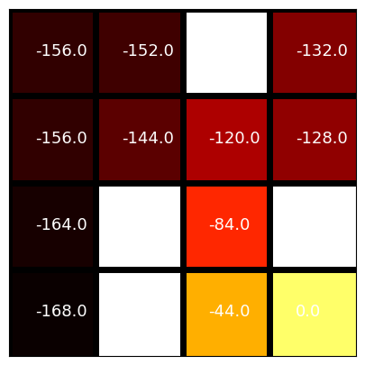
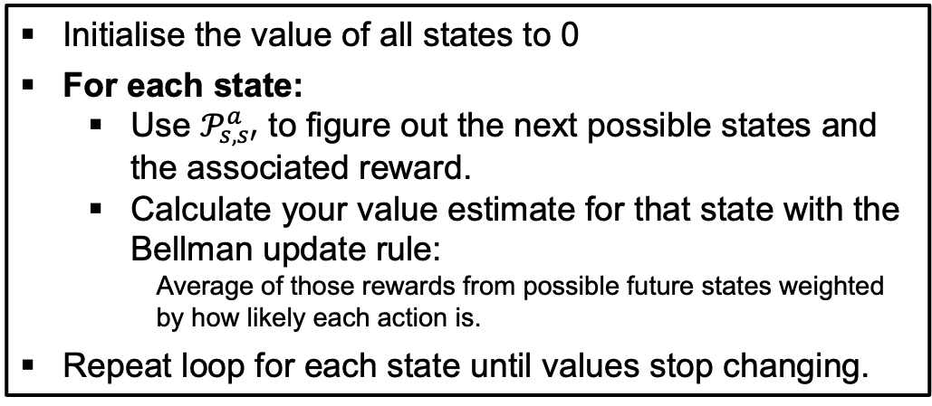
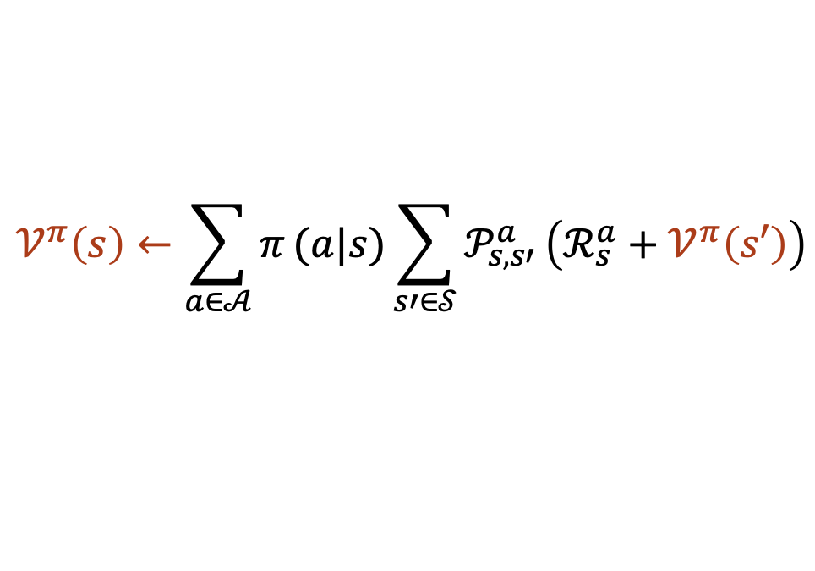
Gridworld toy problem
$$𝒮=\left(0, 1, 3, 4, 5, 6, 7, 8, 10, 12, 14, 15\right)$$
$$𝒜=(↑,↓, ←,→)$$
The Bellman equation becomes an update rule:
$$𝒫_{s,s′}^{a}=1$$
Deterministic environment
$$ℛ=$$
$$−1 ∀s, s≠15$$
$$𝒱^{π}\left(s\right)←\sum_{a∈𝒜}{π}(a|s)\sum_{s′∈𝒮}{𝒫_{s,s′}^{a}}\left(ℛ_{s}^{a}+𝒱^{π}\left(s′\right)\right)$$
$$1 s=15$$
$$π\left(a | s\right)=ℙ\left[↑, ↓, ←,→ | { 𝒮}_{t}\right]=0.25$$
Initialise the value of all states to 0
For each state:
Use $𝒫_{s,s′}^{a}$ to figure out the next possible states and the associated reward.
Calculate your value estimate for that state with the Bellman update rule:
Average of those rewards from possible future states weighted by how likely each action is.
Repeat loop for each state until values stop changing.
Value of random policy
Dynamic programming
Computationally less expensive, but also won’t scale
Notes:
Iterative policy evaluation

Slide 37
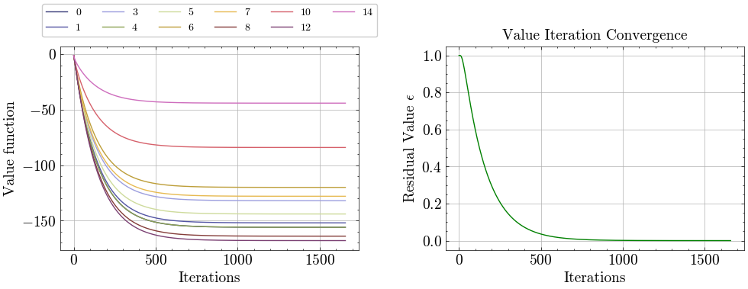
Gridworld toy problem
Policy evaluation with value iteration (dynamic programming)
⭐️
Notes:
Iterative policy evaluation

Slide 38
What have we learned?
MDPs formalise control problems by capturing the dynamics (transitions) and objectives (rewards).
The value function tells us how good it is to be in each state and evaluate a policy.
The policy represents the control strategy.
The Bellman equation breaks down the global optimisation problem into local, recursive subproblems.
Turns a long-term planning problem into a set of local updates.
Enables both exact and approximate solutions.
Enables the computation of value functions and provides mathematical foundation to find the optimal policy.
?
But the agent has not learned so far! we have only evaluated the policy
Learning means updating your policy, your control strategy

Slide 39
How does an agent actually learn?

Slide 40


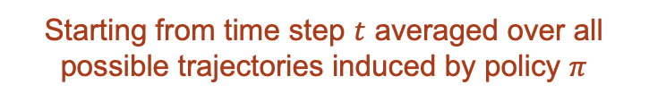


The reinforcement learning goal
The expected return is:
$$J\left(π\right)=𝔼_{π}[𝒢_{t}]$$
Goal
maximization of cumulative reward through selected actions
Starting from time step $t$ averaged over all possible trajectories induced by policy $π$
The optimisation problem can be expressed as:
$$π^{∗}=\arg{\max{J(π)}}$$
$$π$$
where $π^{∗}$ is the optimal policy
The optimal policy will tell you the optimal action to take in each state
→ the control problem is completely solved
Notes:
Measuring from time t matters for time-dependent decisions, bootstrapping, and credit assignment.

Slide 41


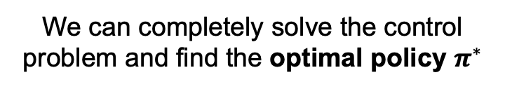
The reinforcement learning goal
Ideal setting
State fully observable
MDP
Model known and tractable
Value function computable
Optimal policy computable
Real world
State partially observable
POMDP
Model unknown or learned
Value function approximated
Policy approximated
vs
We can completely solve the control problem and find the optimal policy $π^{∗}$
We just want good-enough policies that are robust, generalizable, sample-efficient, and safe
Notes:
Measuring from time t matters for time-dependent decisions, bootstrapping, and credit assignment.

Slide 42
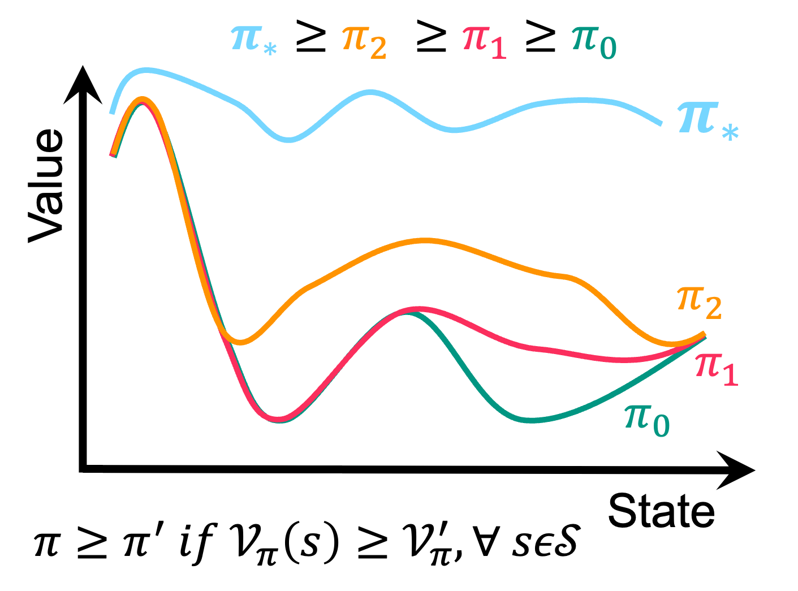

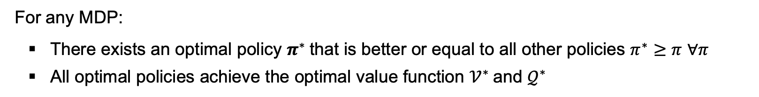
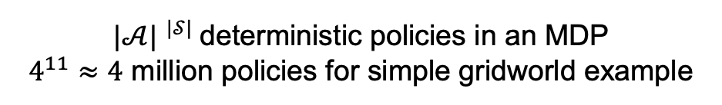
But how can we get the best policy?
For any MDP:
There exists an optimal policy $π^{∗}$that is better or equal to all other policies $π^{∗}≥π$ $∀π$
All optimal policies achieve the optimal value function $𝒱^{∗}$and $𝒬^{∗}$
So…do I have to calculate the value of every policy and compare them?
${|𝒜| }^{|𝒮|}$deterministic policies in an MDP
$4^{11}≈4$ million policies for simple gridworld example

Slide 43
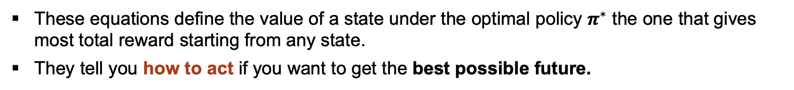
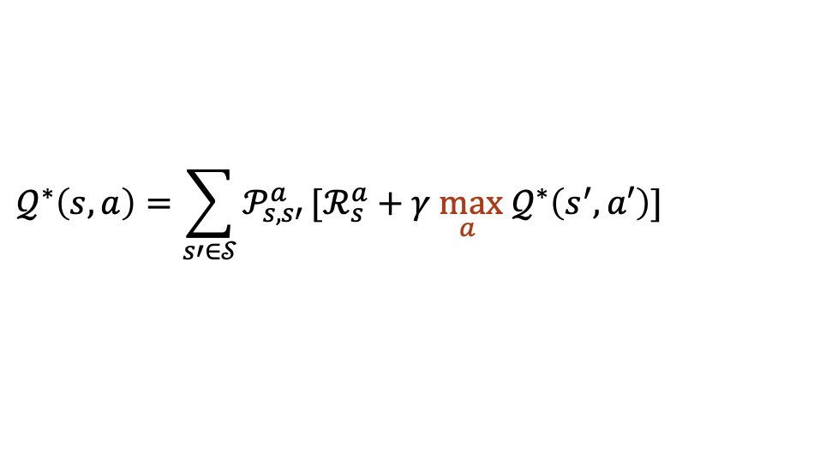

Bellman optimality equations
All optimal policies achieve the optimal value function:
$𝒱_{π}^{∗}\left(s\right)=max{𝒱_{π}(s)}$ $∀ sε𝒮$
$𝒬_{π}^{∗}\left(s\right)=\max{𝒬_{π}(s)}$ $∀ sε𝒮, aε𝒜$
These equations define the value of a state under the optimal policy $π^{∗}$ the one that gives most total reward starting from any state.
They tell you how to act if you want to get the best possible future.
$$𝒱^{∗}\left(s\right)=\max_{a}{\sum_{s′∈𝒮}{𝒫_{s,s′}^{a}}[ℛ_{s}^{a}+γ𝒱^{∗}\left(s′\right)]}$$
$$𝒬^{∗}\left(s,a\right)=\sum_{s′∈𝒮}{𝒫_{s,s′}^{a}}[ℛ_{s}^{a}+γ{\max_{a} 𝒬}^{∗}\left(s^{′},a′\right)]$$
Want to know learn a policy
Discrete action spaces (can enumerate actions
How good is it to take an action from that state
Maximum value over every next possible state and action
Policy is fixed
Continuous action spaces
How good is it to be in a state
We can use this!

Slide 44







Policy improvement
improvement
$$π_{1}→𝒱^{π1}→π_{2}→…→π_{∗}$$
Let’s consider a non-optimal policy $π$ and its value function $𝓥^{π}$
We can select an action that is greedy with respect to it to improve the policy
evaluation
$$π ′\left(s\right)=\underset{a}{arg max}{𝒬^{π}(s,a)}$$
Greedy action
We have it from our policy evaluation
$$=\underset{a}{arg max}\left(ℛ_{s}+γ\sum_{s^{′}∈𝒮}{𝒫_{s,s^{′}}}𝒱_{π}(s′)\right)$$
next policy
If the action has a higher value, the policy is better
$𝒱^{∗}$is the unique solution to the Bellman optimality eq.
If this greedy operation does not change $𝒱$, then it converged to the optimal policy because it satisfies the Bellman optimality eq.
Images from http://incompleteideas.net/book/ebook/node46.html
Notes:
Iterative policy evaluation
Generalised policy iteration
R is deterministic from the model’s perspective, it’s known immediately, does not depend on s’ → we don’t take the expectation

Slide 45














Gridworld toy problem
$$𝒮=\left(0, 1, 3, 4, 5, 6, 7, 8, 10, 12, 14, 15\right)$$
$$𝒜=(↑,↓, ←,→)$$
Policy improvement
$$𝒫_{s,s′}^{a}=1$$
Deterministic environment
$$ℛ=$$
$$−1 ∀s, s≠15$$
$$π^{∗}\left(s\right)=\underset{a}{arg max}\left(ℛ_{s}+γ\sum_{s^{′}∈𝒮}{𝒫_{s,s^{′}}}𝒱^{∗}(s′)\right)=\underset{a}{arg max{ 𝒬}^{∗}}$$
$$1 s=15$$
$$π\left(a | s\right)=ℙ\left[↑, ↓, ←,→ | { 𝒮}_{t}\right]=0.25$$
Calculate the value for your current policy with value iteration (what we did before).
For each state:
Look at the next possible states and their value.
Choose the action that will give you the maximum value and save it in an array.
Repeat loop for each state until actions stop changing.
$$→$$
“one-step lookahead”
$$↓$$
$$↓$$
$$↓$$
Dynamic programming
$$→$$
$$→$$
$$↓$$
$$↓$$
$$↓$$
$$↓$$
$$↓$$
$$→$$
🥳
{0: 'right', 1: 'down', 3: 'down', 4: 'right', 5: 'right', 6: 'down', 7: 'left', 8: 'up', 10: 'down', 12: 'up', 14: 'right', 15: 0.0}
$$π^{∗}$$
Takes one iteration
Notes:
Iterative policy evaluation

Slide 46


Gridworld toy problem
$$𝒮=\left(0, 1, 3, 4, 5, 6, 7, 8, 10, 12, 14, 15\right)$$
$$𝒜=(↑,↓, ←,→)$$
Policy improvement
$$𝒫_{s,s′}^{a}=1$$
Deterministic environment
$$ℛ=$$
$$−1 ∀s, s≠15$$
$$π^{∗}\left(s\right)=\underset{a}{argmax}\left(ℛ_{s}+γ\sum_{s^{′}∈𝒮}{𝒫_{s,s^{′}}}𝒱^{∗}(s′)\right)=\underset{a}{arg max{ 𝒬}^{∗}}$$
$$1 s=15$$
$$π\left(a | s\right)=ℙ\left[↑, ↓, ←,→ | { 𝒮}_{t}\right]=0.25$$
$$→$$
$$𝓠$$ | $$↑$$ | $$↓$$ | $$←$$ | $$→$$
$$s_{0}$$ | $𝓠$($s_{0}↑$) | $𝓠$($s_{0},↓$) | $𝓠$($s_{0}$, $←$) | $𝓠$($s_{0}$, $→$)
$$s_{1}$$ | $𝓠$($s_{1},↑$) | $𝓠$($s_{1},↓$) | $𝓠$($s_{1}$, $←$) | $𝓠$($s_{1}$, $→$)
$$⋮$$
$$s_{14}$$ | $𝓠$($s_{14},↑$) | $𝓠$($s_{14},↓$) | $𝓠$($s_{14}$, $←$) | $𝓠$($s_{14}$, $→$)
“one-step lookahead”
$$↓$$
$$↓$$
$$↓$$
$$→$$
$$→$$
$$↓$$
$$↓$$
$$↓$$
$$↓$$
$$↓$$
$$→$$
🥳
{0: 'right', 1: 'down', 3: 'down', 4: 'right', 5: 'right', 6: 'down', 7: 'left', 8: 'up', 10: 'down', 12: 'up', 14: 'right', 15: 0.0}
$$π^{∗}$$
Takes one iteration
Notes:
Iterative policy evaluation

Slide 47






About greedy actions
Cool. So, if the value function gives “value” to an action…we just keeping choosing the action with more value every time! problem solved.
Well, this only works if the environment is fully observable, and we know the model.
:
:
In partially observable environments we have estimations of the values of the actions:
$𝒬_{t}\left(s,a\right)$→ estimation
$q_{t}^{∗}\left(s,a\right)$→ exact
We want $|𝓠(a)−q^{∗}(a)|$ to be minimal
Example of value estimation: sample-average method
$$𝒬_{t}(a)≐\frac{\text{sum} \text{of} \text{rewards} \text{when} a \text{taken} \text{prior} \text{to} t}{\text{number} \text{of} \text{times} a \text{taken} \text{prior} \text{to} t}$$
$$\lim_{t→∞}{𝒬_{t}\left(a\right)=q^{∗}(a)}$$

Slide 48









About greedy actions
$$𝒬_{π}\left(s,a\right)=𝔼_{π}\left[𝒢_{t} \right|s, a]$$
Greedy action:
$$a_{t}≐\underset{a}{arg max}{𝒬_{t} (s,a)}$$
select action with most value → pure exploitation
Near-greedy action:
small probability $ε$to select randomly from all actions → ensures sufficient exploration
Does greedy action work? → it will depend on the uncertainties
$$μ\left(s,a\right)=𝔼[r|s,a]$$
$$μ\left(s,a\right)+ε$$
true expected reward
noisy sample
$$𝒢_{t}$$
$$𝒢_{t}$$
$ℛ=$ deterministic + stochastic components
$$q^{∗}\left(s,a\right)$$
$$q^{∗}\left(s,a\right)$$
If reward and transitions are deterministic, one sample is sufficient
If value uncertainty is large, more exploration is required to reduce estimation error.
Notes:
You can reduce epsilon over time
Near-greedy is not differentiable
By selecting greedy in POMDPs you are overfitting to noise

Slide 49
summary

Slide 50
Summary: introduction to RL
Reinforcement learning formalises sequential decision-making under uncertainty.
MDPs provide the mathematical structure: state, transition dynamics, reward, discounting, and the Markov property.
The Bellman equation converts a global optimisation problem into recursive local updates (dynamic programming).
When the model is known and tractable, we can compute the exact value function and optimal policy.
In realistic settings, environments are stochastic, partially observable, and high-dimensional (POMDPs).
Exact solutions become computationally intractable → we rely on sampling, approximation, and learning from interaction.
Exploration is required when value estimates are uncertain. Purely greedy control is insufficient.
The practical objective is not perfect optimality, but robust, good-enough policies under uncertainty and computational constraints.

Slide 51
Sampling and approximation methods

Slide 52


The expanded Bellman equation
How to solve it?
$$𝒱^{π}\left(s\right)=\sum_{a∈𝒜}{π}(a|s)\sum_{s′∈𝒮}{𝒫_{s,s′}^{a}}\left(ℛ_{s}^{a}+γ𝒱^{π}\left(s′\right)\right)$$
Directly
System of $𝒮$simultaneous linear equations with $𝒮$ unknowns
Approximation
Temporal-difference learning
Sampling
Monte Carlo methods
Iteration
Dynamic programming
Computational complexity
Notes:
In most practical settings either the reward is deterministic, or if stochastic only the mean is used for value estimation

Slide 53



Transitioning to “modern” RL
Ideal setting
State fully observable
MDP (finite, discrete)
Model known and tractable
Value function computable
Optimal policy computable
Real world
State partially observable
POMDP
Model unknown or learned
Value function approximated
Policy approximated $π≈π^{∗}$
vs
Classical dynamic programming
Modern RL (model free!)
The Bellman operator is evaluated exactly using the known transition model
Expectations are computed analytically from $𝒫(s|s,a)$
Value functions are obtained via deterministic fixed-point iteration
Convergence is algebraic and guaranteed under contraction of the Bellman operator
The Bellman operator is approximated via stochastic samples
Expectations are replaced by sample-based estimators
Value functions are learned through stochastic approximation
Convergence is statistical and depends on sampling, noise, and step sizes
Notes:
In simulation you can build your own model from samples

Slide 54







Monte Carlo learning
The experience is organised in episodes:
We have access to a black box model that we query sequentially (simulation or real-world)
We get samples of trajectories
We don’t know $𝒫$
$$s_{0},a_{0},r_{1},s_{1},a_{1},r_{2}, …,s_{T−1},a_{T−1},r_{T}$$
…
Episode 1
$$s_{0},a_{0},r_{1},s_{1},a_{1},r_{2}, …,s_{T−1},a_{T−1},r_{T}$$
Under policy $π$
Episode M
The first-visit MC variant averages returns only from the first occurrence of each state per episode
As the number of visits tends to infinity, the estimator converges by the law of large numbers:
Value estimation $𝓥^{π}(s)$
Every visit MC
Loop through each episode $t=T, T−1, …, 0$ to see when each state $s$ was visited
Each time a particular $s$ is visited update the return
$$𝒢←γ𝒢+ℛ_{t+1}$$
Average the returns to estimate $𝒱^{π}\left(s\right):$
$$\lim_{t→∞}{𝒱_{t}\left(s\right)=v^{π}(s)}$$
$$𝒱\left(s\right)≈\frac{1}{N(s)}\sum_{i=1}^{N(s)}{𝒢_{t}^{(i)}}$$
Monte Carlo estimates the expectation in the Bellman equation by empirical averages of full returns
$N$ = # of times $s$ was visited across episodes
Notes:
N is the number of times state s was visited across episodes

Slide 55




Monte Carlo learning
Conceptually simple: direct empirical estimation of expected return
No model $𝒫$ required: uses only observed trajectories
Unbiased estimator of $v^{π}(s)$
Foundation for many modern policy gradient methods
Let’s try this by considering 1000 episodes from our gridworld example for state $s=0$(initial state) and a random policy:
Requires full episodes before updating (slow learning, expensive simulation or experiment)
High variance: returns depend on long stochastic trajectories
Sample inefficient: many visits needed for accurate estimates
No bootstrapping: slow propagation of value information
MC estimation: -156.66
Exact value we calculated: -156.0
Can we update before the episode ends?
well, yes, we can
Notes:
Variance is high because: Return accumulates stochastic rewards / It depends on long trajectories / It does not bootstrap
Most of the time you get small negative rewards. Occasionally you get a large positive reward. Two visits to the same state may produce wildly different returns depending on what happened far in the future.
MC waits until the end and uses the raw return so it inherits all trajectory randomness directly
As \gamma \to 1, returns become long-range sums → variance explodes.
Even if rewards are independent, states and rewards along a trajectory are correlated through dynamics so returns from nearby visits are not independent samples. This slows convergence further.
Monte Carlo is unbiased because it estimates an expectation with a sample mean of independent and identically distributed draws from the correct distribution. It is high variance, but centred correctly.
In reinforcement learning, returns are not strictly i.i.d. because: Trajectories are temporally correlated / Successive visits may come from related episodes / The policy might change during learning.
So strictly speaking, MC relies on weaker ergodicity assumptions, not perfect independence. It requires: The process is stationary under policy \pi. / The Markov chain induced by \pi is ergodic. / Each state is visited infinitely often.
Time averages converge to expectations. → That is an ergodic theorem for Markov chains.
Convergence fails if The policy changes continuously during learning / Some states are not visited infinitely often / The Markov chain is not ergodic
“Monte Carlo converges because the return sequence forms a stationary ergodic process under a fixed policy, and the law of large numbers extends to such processes even without independence.”

Slide 56


Temporal difference learning
How to compute the averages of action-value methods with constant memory and constant computation step, i.e., without storing and averaging a lot of data in tables?
Dynamic programming
Memory: must store full transition model $𝒫(s|s,a)$ and value function over all states
Computation per update: requires summing over all possible next states (full expectation)
Monte Carlo
Memory: must store complete trajectories (or future rewards) until episode termination
Computation per update: computes full returns by summing over the entire remaining trajectory
exact expectation
empirical full return
stochastic fixed-point bootstrapping
TD replaces exact expectation with a stochastic one-step update using the current estimate itself (bootstrapping)
It trades exactness for incremental, constant-memory updates that converge to the Bellman fixed point
Temporal difference
Memory: stores only current value estimates, no model and no trajectory buffering required
Computation per update: constant per step, uses a single transition $(s, r, s’)$
Bootstrapping means updating an estimate using another estimate in place of an exact quantity
Notes:
A fixed point of an operator T is a function V such that: T V = V
The Bellman fixed point is the value function that solves the Bellman equation
The Bellman fixed point is the value function that remains unchanged under the Bellman update, i.e. the self-consistent solution of the Bellman equation.
It is like solving: x = A x + b
which yields: x = (I - A)^{-1} b

Slide 57



Temporal difference learning
Bellman equation:
$$𝒱^{π}\left(s\right)=𝔼\left[r \text{+} γ𝒱^{π}\left(s^{′}\right)\right]=\sum_{a∈𝒜}{π}(a|s)\sum_{s′∈𝒮}{𝒫_{s,s′}^{a}}\left(ℛ_{s}^{a}+γ𝒱^{π}\left(s′\right)\right)$$
Full expectation, sum over all states and actions required
TD update:
$$𝒱\left(s\right)←𝒱\left(s\right)+α[r’+γ𝒱\left(s^{′}\right)−𝒱\left(s\right)]$$
The target itself depends on the current value estimate (bootstrapping)
Target
No expectation, one sample only
New estimate ← Old estimate + Step size (Target - Old estimate)
Temporal difference error
Online updates: learns after each transition, no need to wait for episode termination
Constant memory and computation per step: uses only $(s, r, s’)$
Lower variance than Monte Carlo: bootstrapping reduces trajectory-level noise
Scales better to continuing tasks: naturally handles infinite-horizon settings.
Bootstrapping introduces bias: the target depends on current estimates
Convergence requires conditions: appropriate step sizes and sufficient exploration
Requires explicit representation of each state, impractical for very large or continuous state spaces
Notes:
Bootstrapping introduces estimation bias because the update target depends on a quantity that is itself an estimate.
Discrepancy in expectation = bias
asymptotically, the bias disappears.
TD does not propagate reward information backward instantly.
It requires revisiting states.
Note: create an example slide

Slide 58
Summary
Tabular solution methods for finite MDPs
Methods | Techniques | Model-based | Bootstrapping | Algorithms
Dynamic programming | Iterative | Yes | Yes | Policy evaluation Policy iteration Value iteration
Monte Carlo | Sampling (episode-based estimation) | No | No | First-visit MC Every-visit MC
Temporal difference | Approximation (sampling + approximation) | No | Yes | TD(0) Q-learning SARSA
Model-based = we know the transition dynamics $𝒫$ of the problem

Slide 59



Summary
$𝒱$ or $𝒬$ and $π$ are stored as arrays
What happens to infinite or continuous MDPs? $𝒱\left(s\right)?$
Can we identify and enumerate all states and actions?
Tabular solution methods for finite discrete MDPs
Image from Sutton & Barto
Model-free deep RL
Function approximation of $𝓥$ / $𝓠$ and $π$
Opens the door to high dimensional continuous problems (tractable)
Can learn abstract features
Introduces bias, variance, and stability challenges
Fewer convergence guarantees
The function we learn can generalise to states never seen before
Parameters $θ$ are shared over all states
Generalisation only as good as data
Notes:
You cannot:
Store a separate V(s) for each state.
Visit each state infinitely often (Convergence requires every state to be visited infinitely often)
Solve “one Bellman equation per state” directly.

Slide 60

THANK YOU FOR YOUR ATTENTION!
What questions do you have for me?
resources
Dr. Andrea Santamaria Garcia
Lecturer at University of Liverpool
Cockcroft Institute
Sutton & Barto book
https://arxiv.org/pdf/cs/9605103.pdf
Reinforcement learning lectures by David Silver
https://spinningup.openai.com/en/latest/
Coursera RL specialization
https://arxiv.org/pdf/1810.06339.pdf
ansantam@liverpol.ac.uk
https://www.linkedin.com/in/ansantam/
https://github.com/ansantam
https://instagram.com/ansantam
https://www.liverpool.ac.uk/people/andrea-santamaria-garcia

