Slide 1
Introduction to CLARA
Alexander Brynes | UKRI-STFC, ASTeC
On behalf of the CLARA team
30th March 2026
Alexander Brynes | Senior Accelerator Physicist
UKRI STFC Daresbury Laboratory
alexander.brynes@stfc.ac.uk

Slide 2
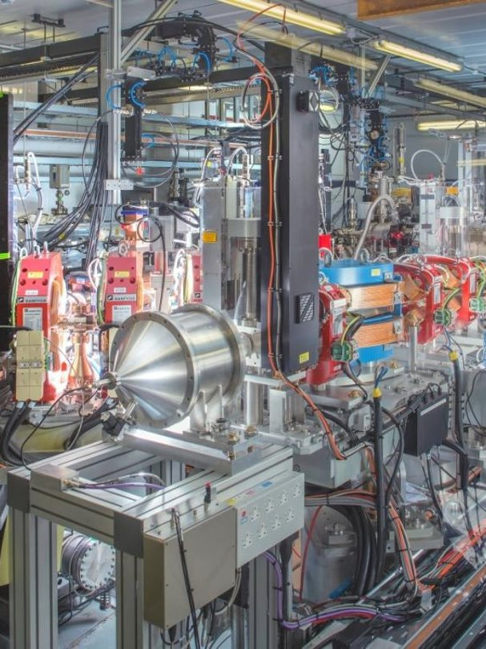
Contents
1 CLARA
  History & first commissioning results
2 User Experiments
  Highlights from early 2026
3 Future Plans
  Beam & laser commissioning, more users, ML applications

Slide 3
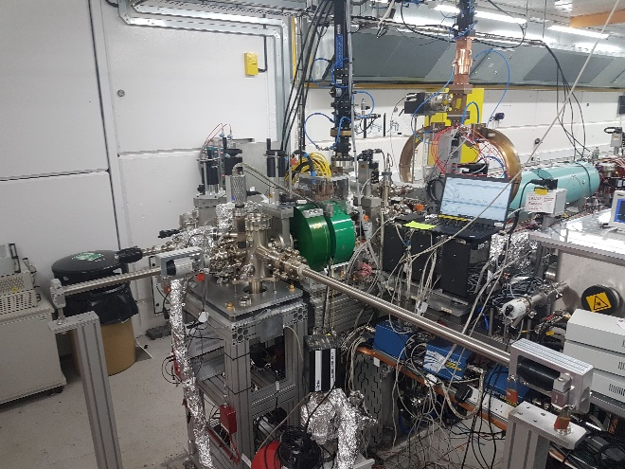
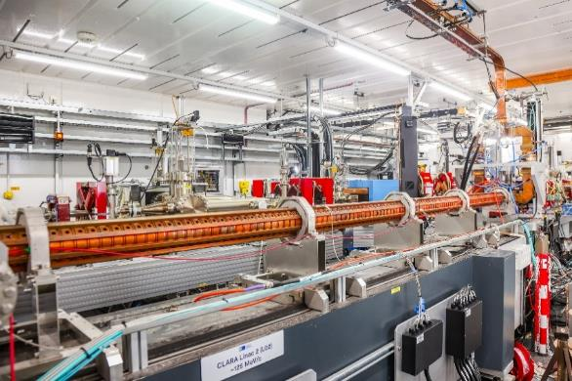
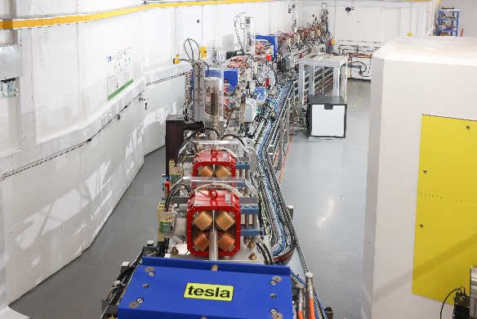
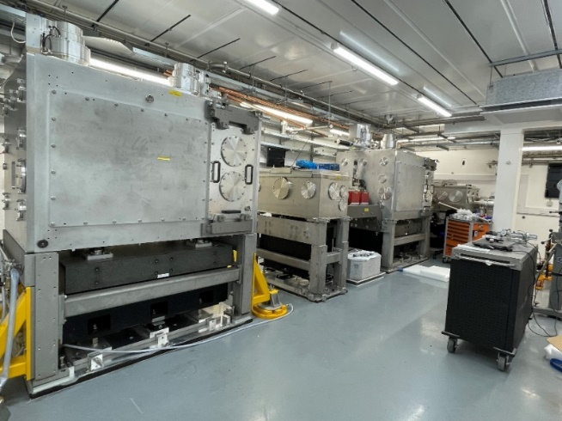




CLARA
What is CLARA?
Timeline
250 MeV high-brightness electron linear accelerator facility [1,2]:
  Up to 100 Hz repetition rate
  Up to 250 pC
  Bunch lengths down to few 10s fs
Test-bed for:
  Advanced acceleration techniques
  VHEE radiotherapy
  Novel beam diagnostics
  Phase space manipulation
Year | Milestone
2012 | CLARA FEL design published [3]
2013 – 2016 | VELA gun test stand commissioning (5 MeV/c) [4]
2017 | CLARA front end & 400 Hz S-band gun installed
2017 – 2020 | CLARA front end commissioning and user experiments (35 MeV/c) [1]
2021 – 2024 | CLARA & FEBE installation [2]
2025 – present | CLARA/FEBE technical & beam systems commissioning (250 MeV/c)
2026 – present | User experiments

Slide 4
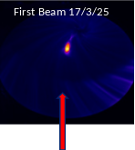
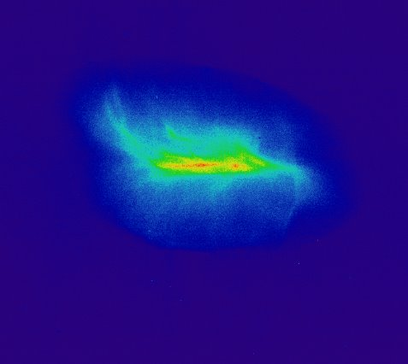
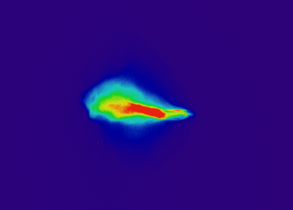
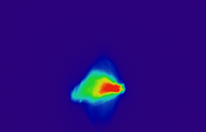
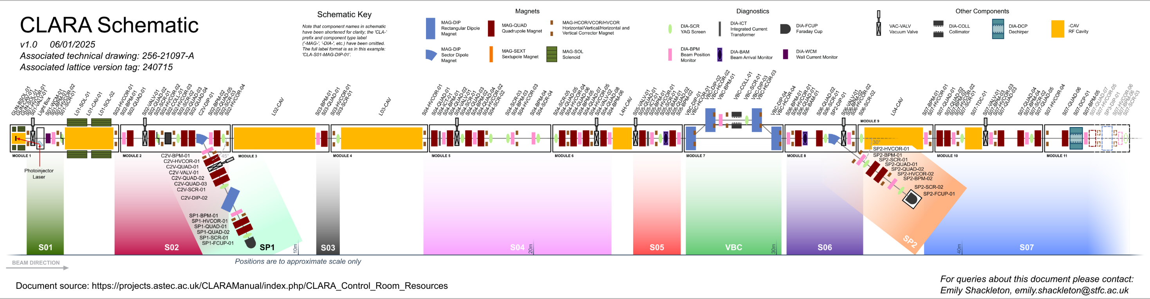
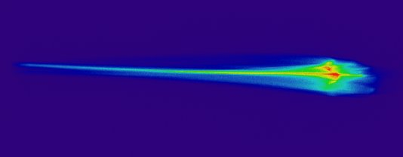
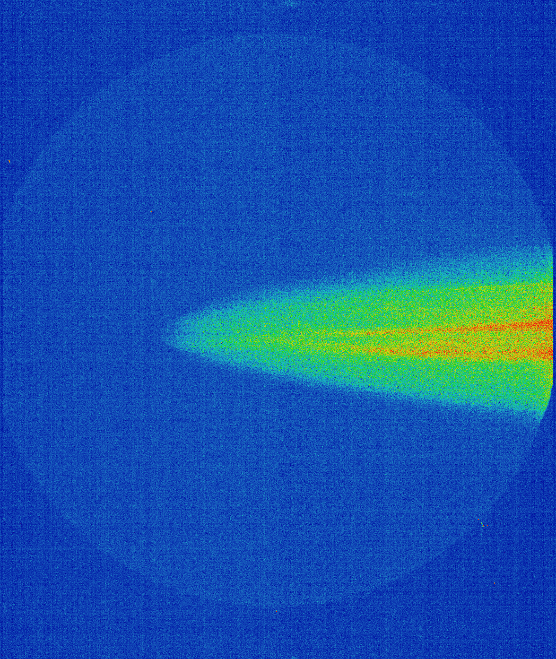
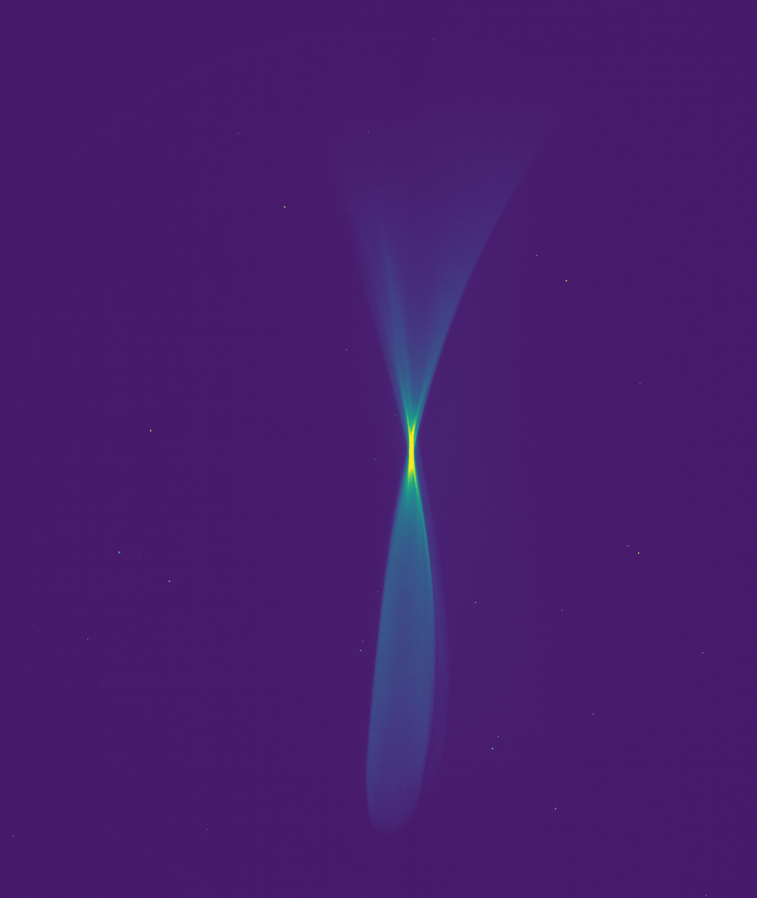
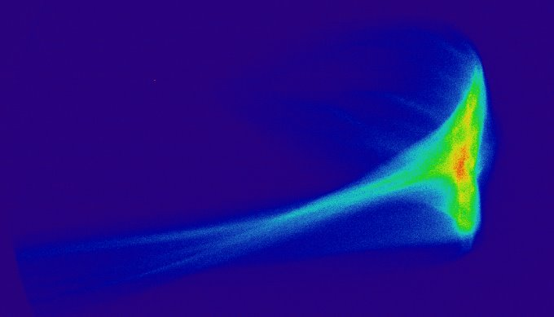
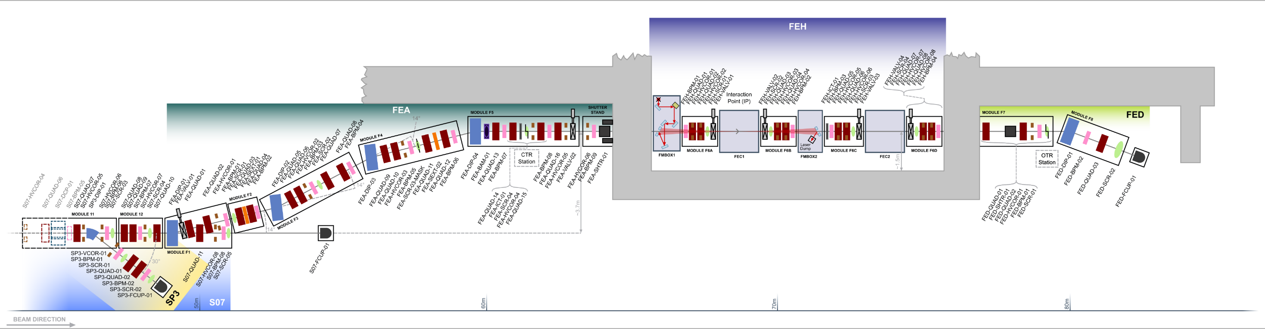
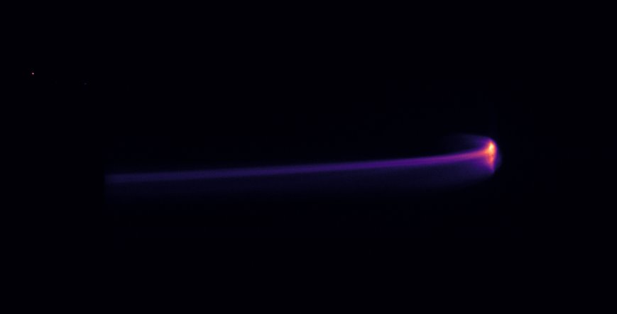
First Commissioning Results
Linac02 on , 28/3/25
Linac03 on , 2/4/25
Linac04 on , 2/4/25
Linac02 on 1/4/25
E=72 MeV
Beam Momentum
= 3.9 MeV/c
Beam Momentum
= 3.9 MeV/c
+ TDC beam streaking
on 11/4/25
E =240 MeV
Length ~30ps
Linac02 & 03 on 2/4/25
E=160 MeV
Linac02 & 03 on 2/4/25
E=160 MeV
Linac02, 03 & 04 on, 2/4/25
E = 250 MeV

Slide 5
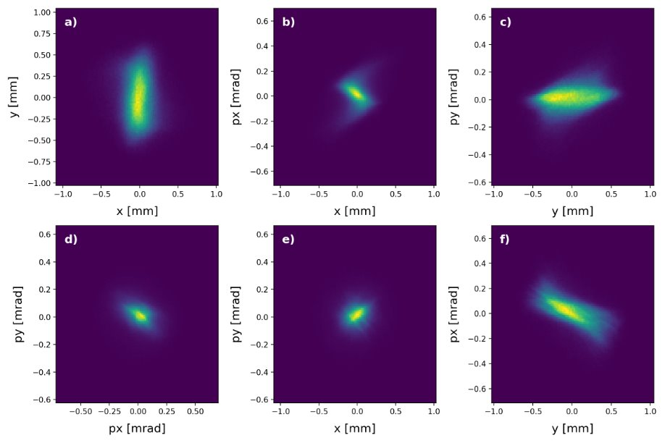
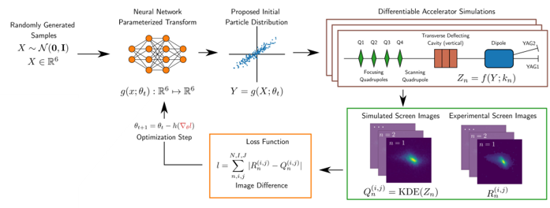
Phase Space Tomography
Tomographic reconstruction of 20 pC beam
4D Reconstruction
4D phase space tomography has been used to characterize the CLARA beam along the linac [5]
Generative phase space reconstruction (GPSR) has been used as the analysis method [6]
By using differentiable simulations, a neutral network can be trained to learn the phase space
Measured beam parameters at injector exit (250 pC)
Parameter​ | Horizontal​ | Vertical​
Twiss α_{x,y}​ | -3.59​ | -4.23​
Twiss β_{x,y} [m]​ | 22.0​ | 33.6​
Emittance [µm]​ | 0.70​ | 0.72​
GPSR method for reconstructing phase space from experimental data [Roussel et al, PRAB 27, 094601 (2024)​]

Slide 6
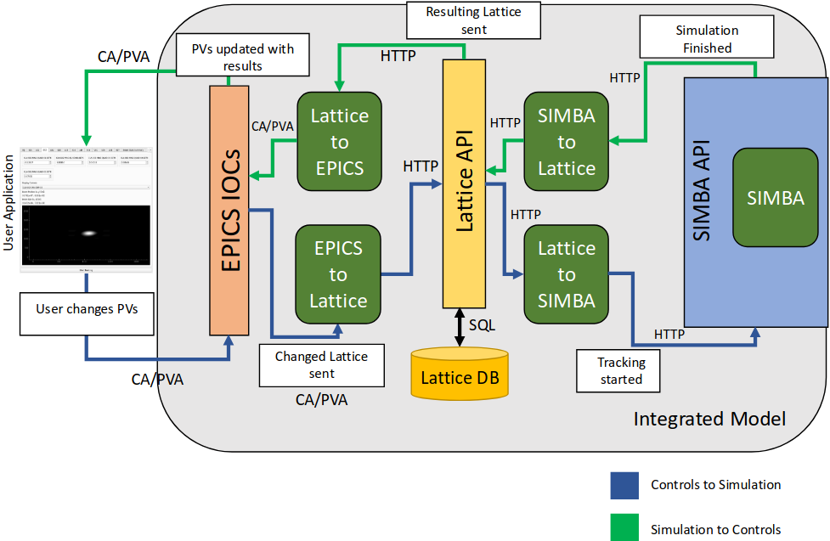
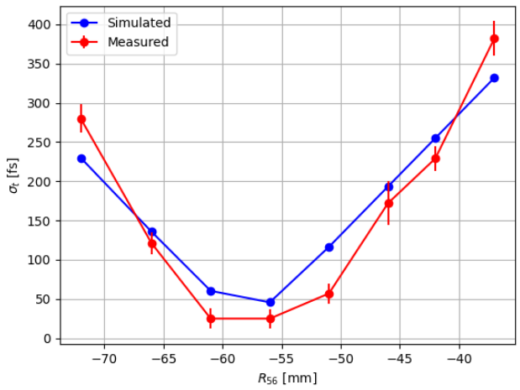
Digital Twin
Architecture
Validation
A digital shadow has been developed and validation has begun.
Virtual control system is updated based on real machine settings.
This is fed into a simulation / ML model which updates virtual diagnostics.
Initial comparisons between real and virtual diagnostics are promising.
Can be used to train ML models, and eventually for offline ML (RL) optimisation
Comparison between measured and virtual bunch length

Slide 7
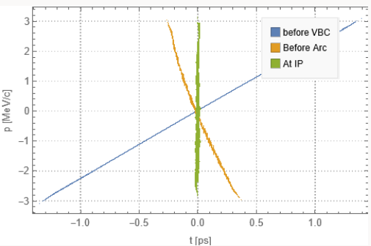
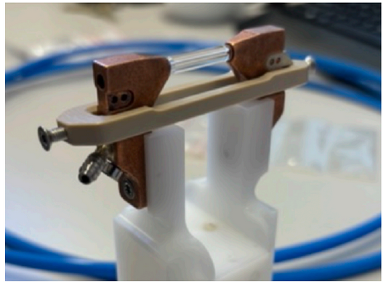
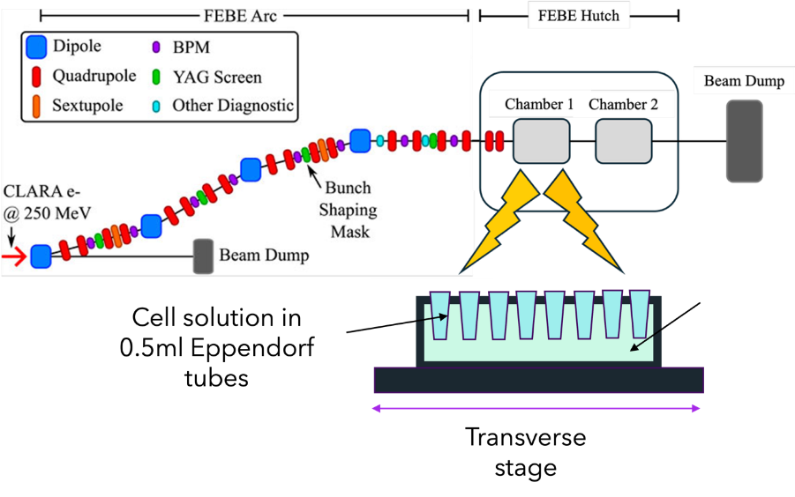
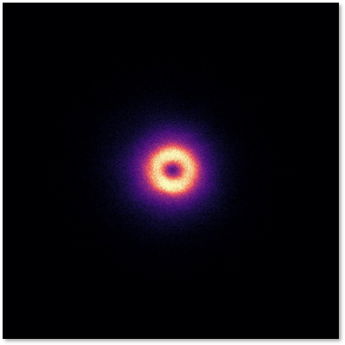
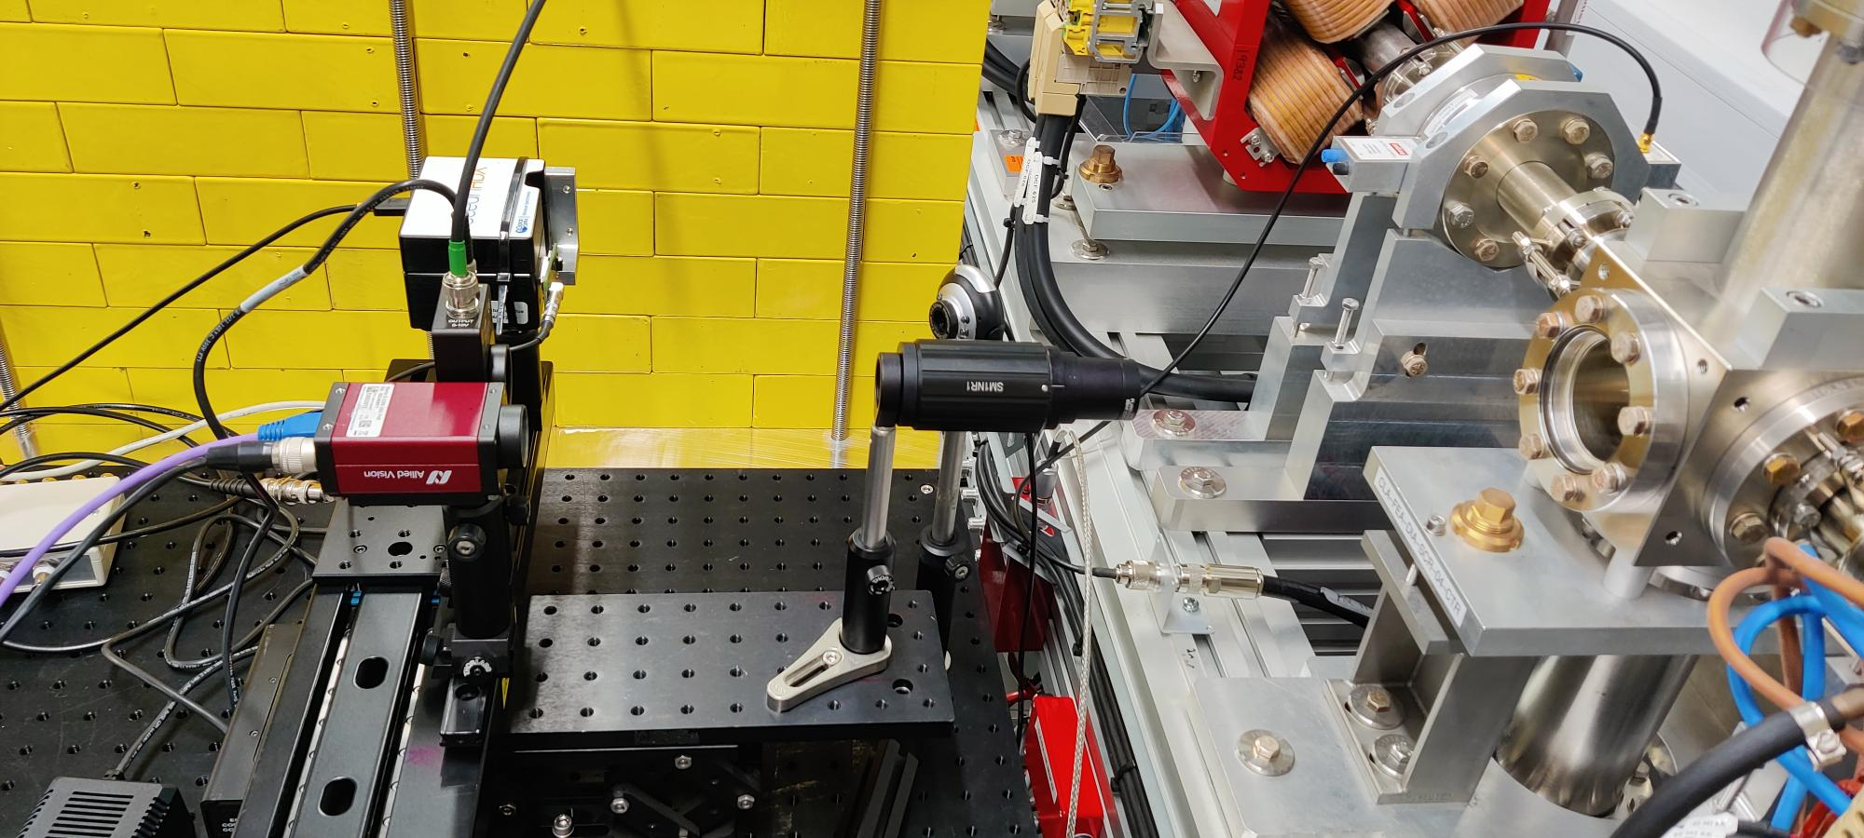
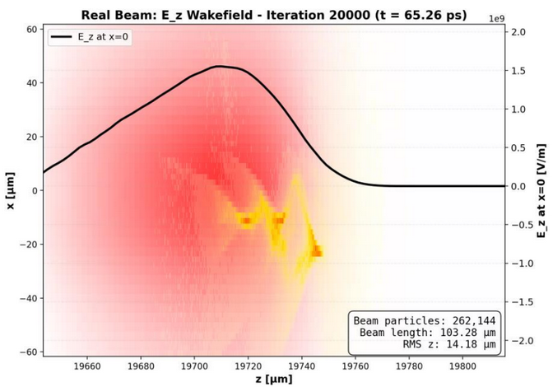
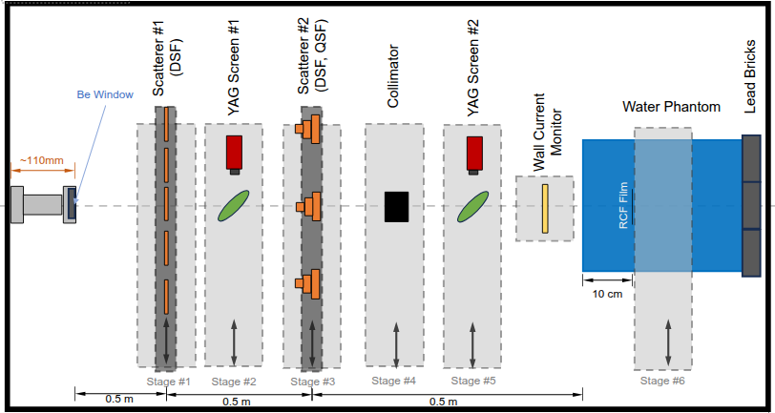
First User Experiments (Preliminary Results)
Transverse Diagnostics
U. Liverpool
Bunch Length Diagnostics
DESY
VHEE Radiotherapy
U. Manchester, CERN
Plasma Acceleration
U. Oxford, JAI
An emittance diagnostic based on a single-shot pepper-pot using OTR has been tested.
Transverse beam sizes were measured far below the resolution of CLARA YAG screens.
Novel low-charge diagnostics based on CTR were installed and tested across a range of bunch lengths.
Biological samples were irradiated with varying dose rates to quantify cell survival rates.
First VHEE FLASH radiotherapy in Europe!
A discharge-capillary-based plasma module is to be installed to enable studies of non-linear plasma lensing.
Will be useful to inform the proposed HALHF facility [7].
​​
​​
Spatially Coherent OTR​
Beam Size < 50 μm​

Slide 8
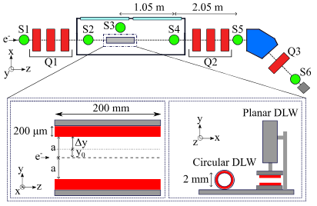
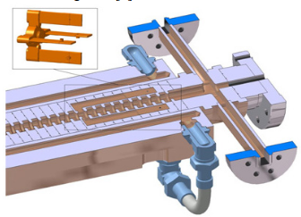
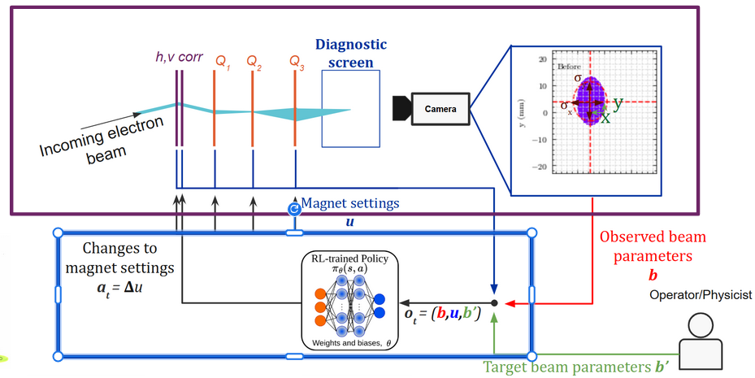
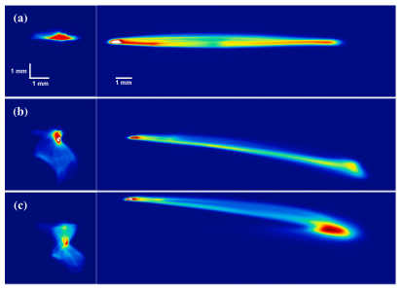
Future Plans – Commissioning
Phase Space Manipulation
Beam Characterization
Automation
A passive dielectric dechirper is being commissioned [8].
This offers an alternative to RF-based deflectors for measuring and controlling the longitudinal phase space
Numerous systems are undergoing technical commissioning.
Full control over the beam phase space requires the 4th harmonic RF cavity to be conditioned [9].
With the digital shadow deployed, we can explore advanced ML-based tuning methods to optimize setups offline and develop predictive diagnostics.
RL tuning may become crucial for the future operation of CLARA!

Slide 9
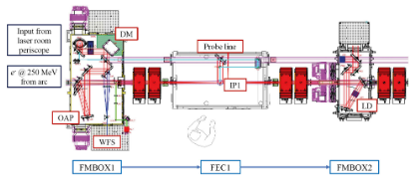
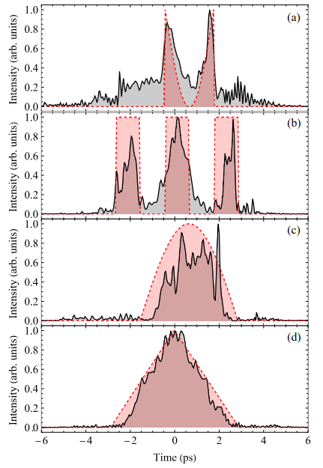
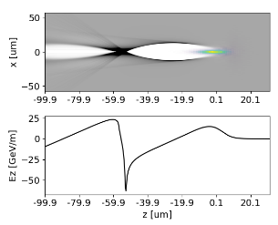
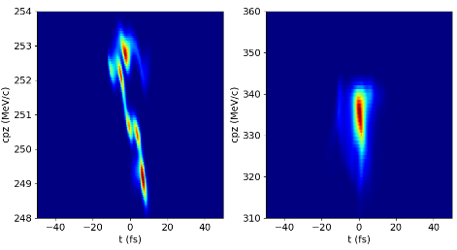
Future Plans – Commissioning & Users
Terawatt Laser
Plasma Acceleration
Beam Profile Shaping
A 100 TW (~25 fs) laser is undergoing initial commissioning [2].
This is to be used to explore laser-based plasma wakefield acceleration and ionization.
Beam- or laser-driven plasma wakefield acceleration will form a large part of the CLARA user programme.
The FEBE chamber can accommodate a range of possible plasma experiments.
Dual beams in a drive-witness configuration can be produced via a mask.
ML methods can be used to modulate the photoinjector laser to produce arbitrary pulse shapes [10].

Slide 10
Summary
Summary
References
CLARA technical systems commissioning at full beam energy is underway, indicating good quality high-brightness beams.
Friendly user program (Jan – Apr) has been successful so far!
Further commissioning work to do:
  Bunch compression linearization with 4th harmonic cavity.
  Dielectric dechirper commissioning.
  Deployment and training of digital twin.
  TW laser commissioning for future user programs.
[1] Angal-Kalinin et al, PRAB 23, 044801 (2020)
[2] Snedden et al, PRAB 27, 041602 (2024)
[3] Clarke et al, JINST 9(05), T05001 (2014)
[4] Militsyn et al, Proc. IPAC'14, THPRO052 (2014)
[5] Wolski et al, PRAB 25, 122803 (2022)
[6] Roussel et al, PRAB 27, 094601 (2024)
[7] Foster et al, New J. Phys. 25, 093037 (2023)
[8] Overton et al, NIM A, 1072, 170160 (2025)
[9] Cowie et al, Proc. IPAC'18, THPAL084 (2018)
[10] Pollard et al, Proc. IPAC'23, THPL034 (2023)
Acknowledgements
Many thanks to the entire CLARA team for delivering a successful installation, promising initial commissioning results and a flourishing user programme!

