Slide 1

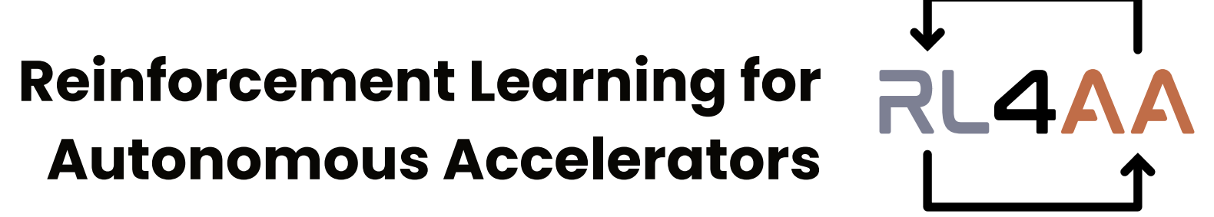

RL4AA’26
RL Challenge
Opening
Joel Wulff

Slide 2

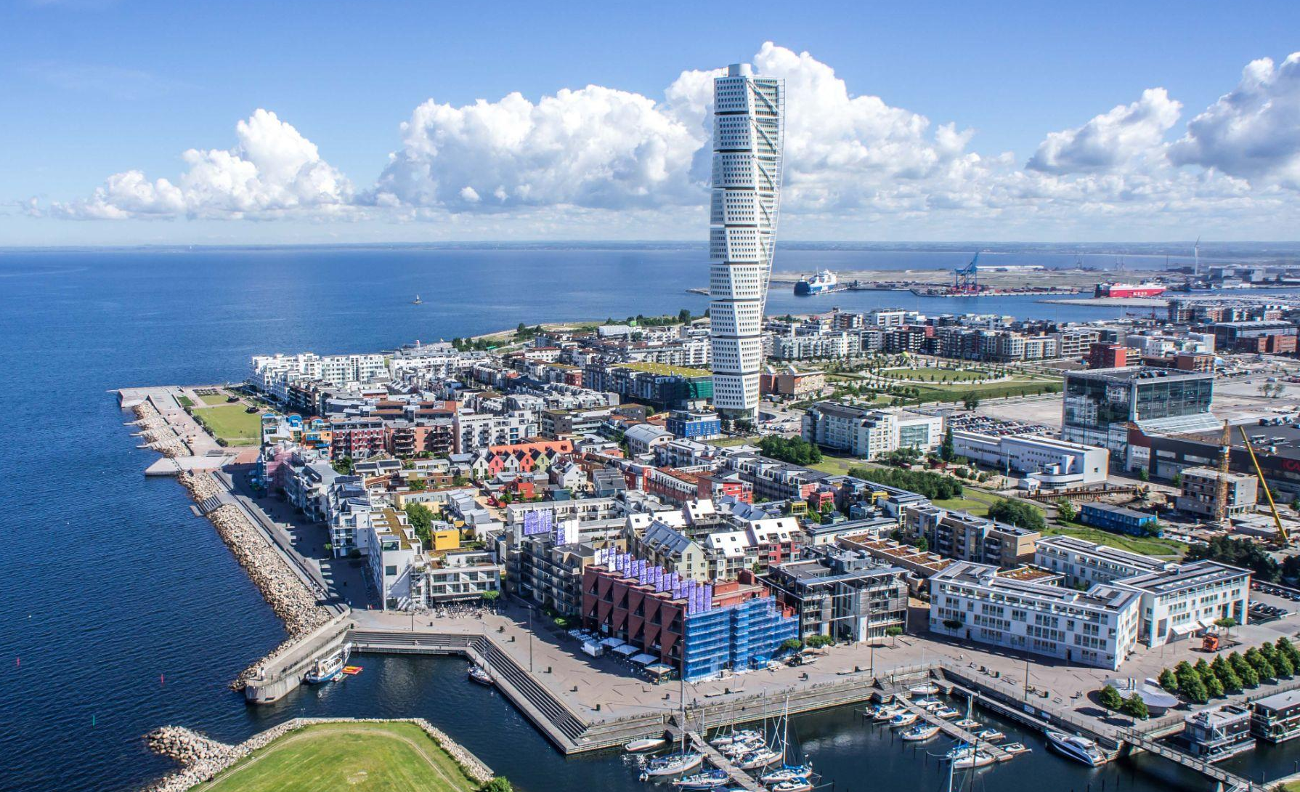
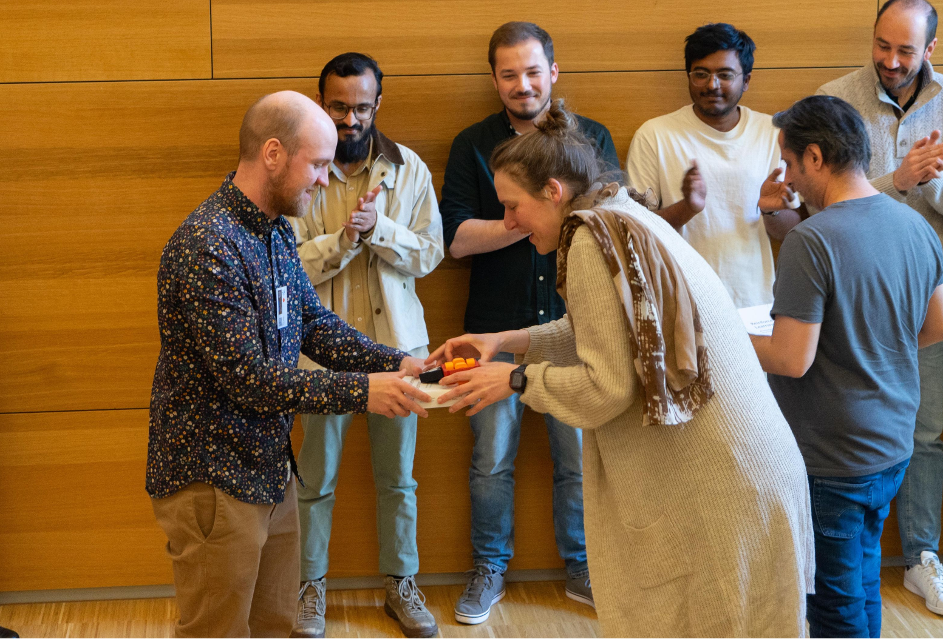
Introduction - Who am I?
Why am I working on this hands-on?
Attended RL4AA’25
→ Team won the challenge!
Invited to participate in organization of RL4AA’26 :)
Joel Wulff
Fellow @ CERN (SY-RF group)
Focusing on automation, anomaly detection and ML (including RL*)
Love skiing!
From Malmö, Sweden
*See talk/poster!

Slide 3

Introduction - Who am I?
Why am I working on this hands-on?
Attended RL4AA’25
→ Team won the challenge!
Invited to participate in organization of RL4AA’26 :)
Joel Wulff
Fellow @ CERN (SY-RF group)
Focusing on automation, anomaly detection and ML (including RL*)
Love skiing!
From Malmö, Sweden
*See talk/poster!

Slide 4
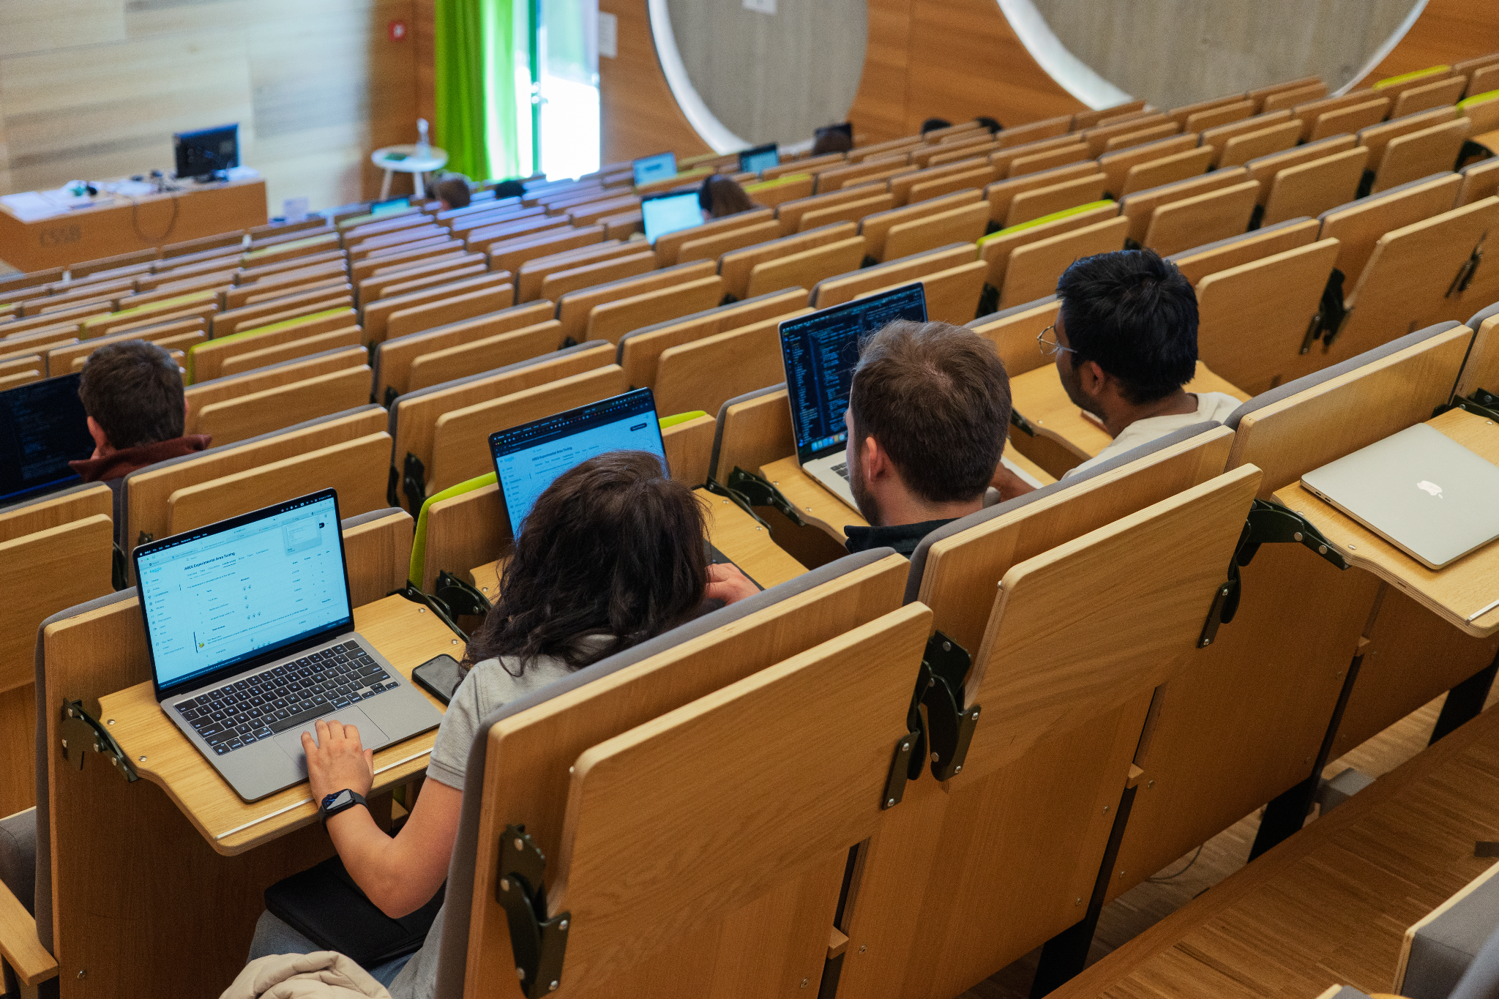



2026 Challenge: Motivation
What is the goal of this coding challenge?
RL4AA23
Provide a hands-on experience with Reinforcement Learning in python,
Collaborate and apply it to a real accelerator physics problem,
Provide the initial confidence and resources to explore RL in your own research!

Slide 5





Reinforcement learning: Quick recap
What is our environment?
→ define the problem we want to solve!
?
RL4AA23
Agent: the thing taking actions (algorithm, Operator, …)
Environment: the world in which the agent lives
State: a complete description of the world in a certain moment
Observation: a (possibly partial) view of the state
Return: the discounted future rewards (what we want to find a behaviour that maximises!)
OBSERVATIONS
New state:
Reward:
Action:
AGENT
ACTIONS
ENVIRONMENT

Slide 6
The task

Slide 7
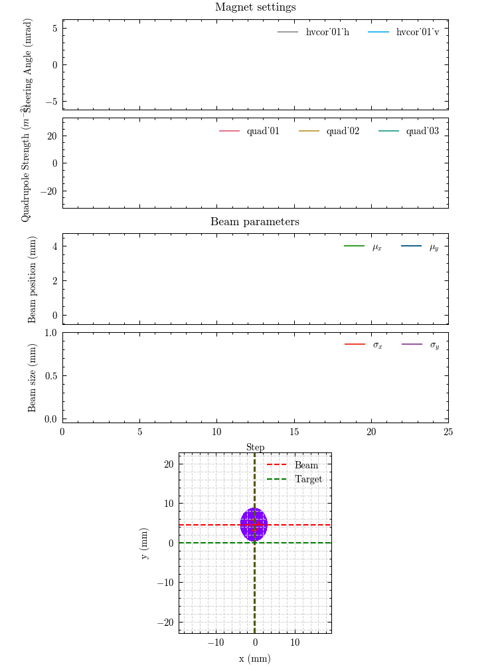
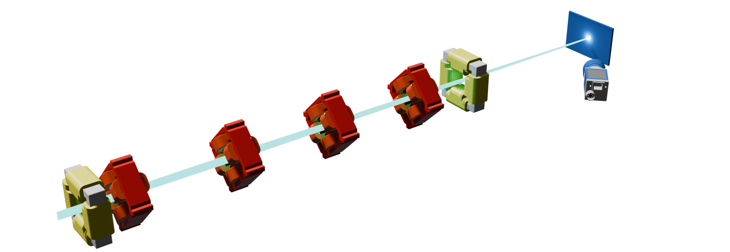
2026 Challenge
Transverse tuning of an electron beam at CLARA
Main goal: Aligning and focusing beam on a diagnostic screen as efficiently (e.g. fast) as possible
→Automate tuning of magnet strengths using Reinforcement Learning Agents
SAC-agent trained for 100k timesteps with secret reward ;)
Example of trained agent!

Slide 8
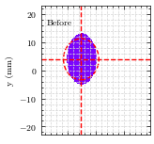
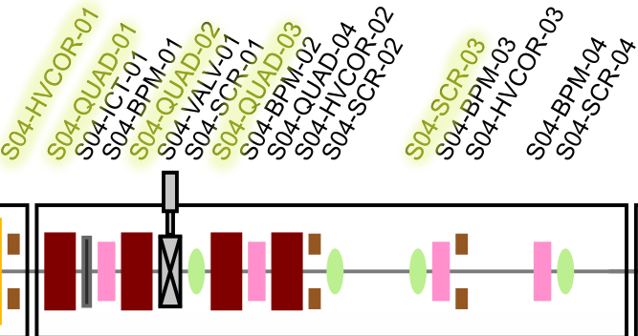
The transverse tuning problem
Focus on small segment of CLARA beam line (S04)
Restricted to subset of magnets → Constrains task to allow reasonable training time
Diagnostic screen
h,v corr
Q₁
Q₂
Q₃
σ_{y}
σ_{x}
y
Camera
x
Incoming electron beam
5d-action space:
H. V. corrector magnet
3 quadrupoles
Observable: beam on diagnostic screen
Beam transv. size (σ_{x}, σ_{y})
Beam transv. pos. (x, y)
GOAL: reach target beam size and position
(fixed to as small as possible and 0,0 for the challenge)
Snippet of CLARA S04 segment beamline

Slide 9
The transverse tuning problem: Manual tuning loop
Operator sees settings, beam parameters, and acts on magnet settings to reach his target beam
Diagnostic screen
h,v corr
Q₁
Q₂
Q₃
σ_{y}
σ_{x}
y
Camera
x
Incoming electron beam
How can we adapt the loop, to include an RL agent?
Magnet settings
u
Observed beam parameters
b
Changes to magnet settings
a_{t} = 𝚫u
Lets change the horizontal corrector to move to the center!
Operator/Physicist

Slide 10
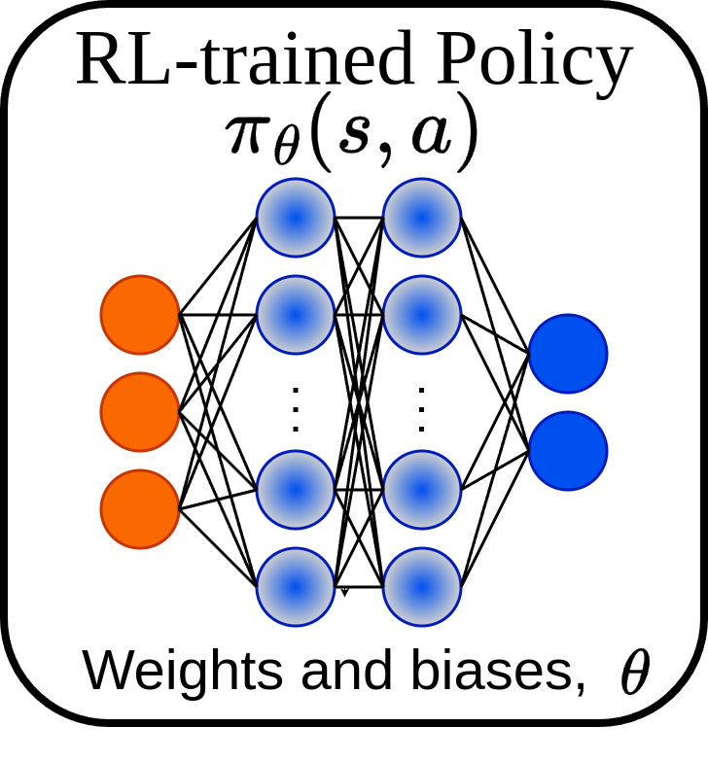
The transverse tuning problem: RL tuning loop
Agent sees settings, beam parameters, and target beam (environment), and acts on magnet settings
Diagnostic screen
h,v corr
Q₁
Q₂
Q₃
σ_{y}
σ_{x}
y
Camera
x
Incoming electron beam
How can we adapt the loop, to include an RL agent?
Magnet settings
u
Observed beam parameters
b
Changes to magnet settings
a_{t} = 𝚫u
Operator/Physicist
o_{t} = (b,u,b’)
Fixed during challenge!
Target beam parameters b’

Slide 11
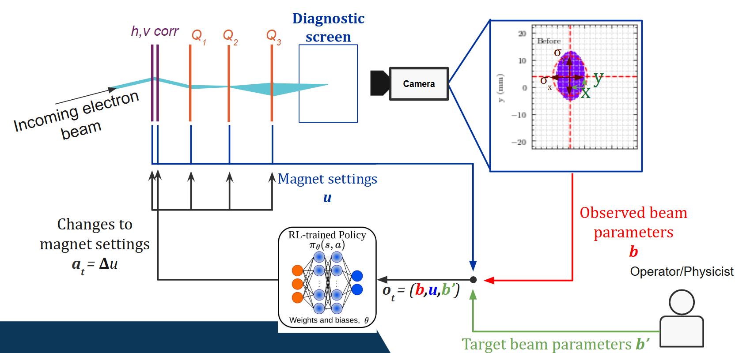
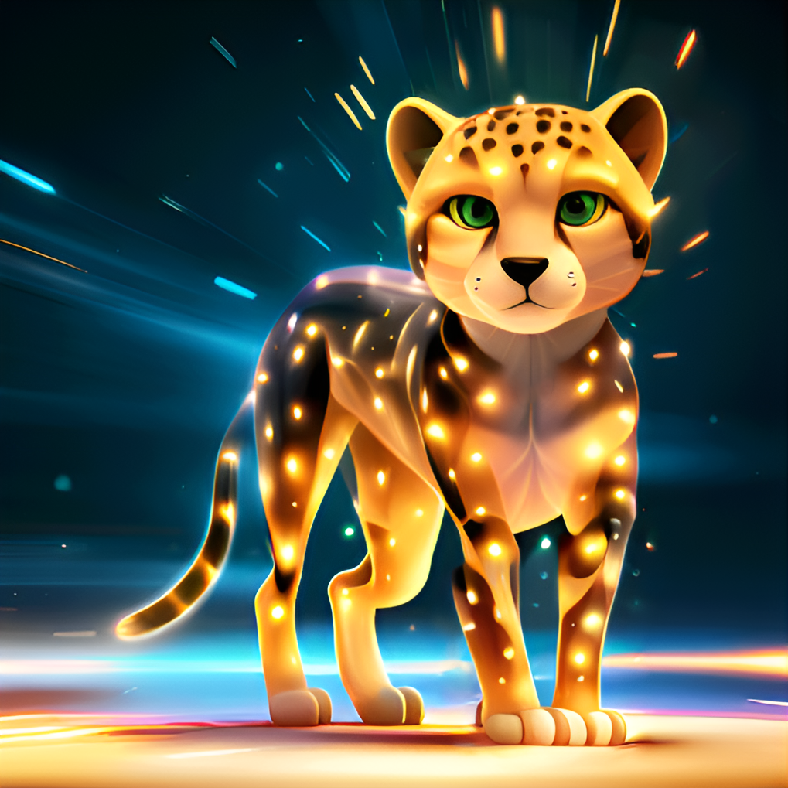
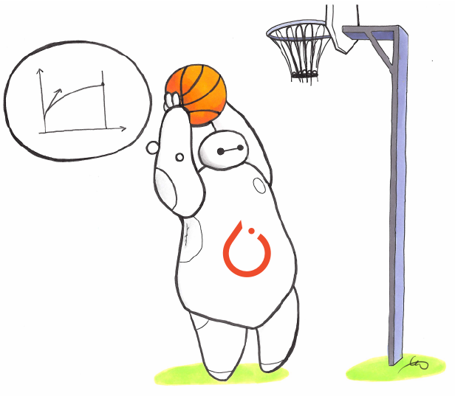
The transverse tuning problem: Training the RL
Agent-environment interaction loop
Environment:
No accelerator available for each team →Simulated beamline (Cheetah)
Agent:
Off-policy RL agents
→ Algorithms supplied by stable-baselines3
r_{t}
Reward r_{t} to be defined by you!

Slide 12
Main challenges
Designing a reward
Choosing and tuning RL/env. hyperparameters
Limitations:
Max 100k total timesteps,
Off-policy algorithms: SAC or TD3.

Slide 13
Main challenges
Designing a reward
Choosing and tuning RL/env. hyperparameters
Limitations:
Max 100k total timesteps,
Off-policy algorithms: SAC or TD3.

Slide 14
Going from optimization to RL
Optimization
Reinforcement Learning
Goal: minimize an objective function
Transverse tuning: minimize difference between target and current beam.
Goal: maximize cumulative reward
Transverse tuning: a reward, that encourages minimization of target and current beam difference?
Reward = -Objective?

Slide 15
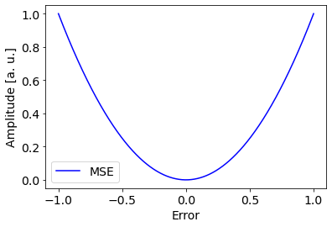
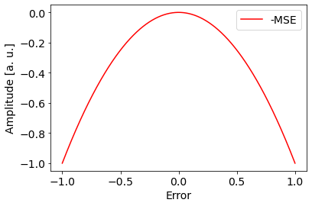
Defining a good reward: the naive solution
Example: Maximize the negative objective?
Objective
Reward = -Objective
Question: Can you see a potential problem with this reward?
As the input variable converges to the optimum (error = 0),the reward vanishes
Actions close to the optimum barely get any difference in reward
→ can lead to trained agents not reaching the optimum (or doing it slowly)

Slide 16
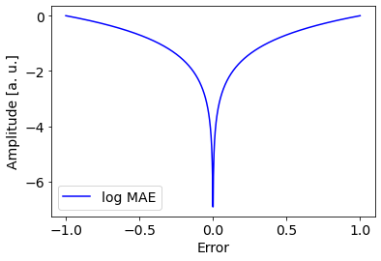
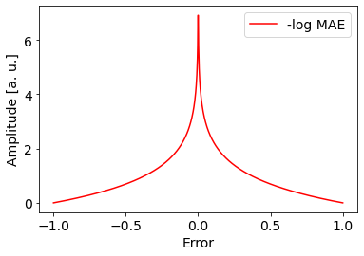
Defining a good reward: a slightly less naive solution
A better formulation (for RL): the log of Mean Absolute Error (MAE)
Objective
Reward = -Objective
As the input variable converges to the optimum (error=0), the reward increases
Takeaway: standard optimization objectives may not translate directly to RL rewards. Key to consider effects on policies!
N.B: This type of reward is in the BasicReward provided in the notebook. It requires further modification for successful agent training!

Slide 17
Reward shaping: many options!
Be creative with your rewards!
Combine sparse and dense reward components
Multi-step learning?
First learn to get on screen, then to focus the beam?
Sparse rewards
On diagnostic screen or not?
Close to target?
Dense rewards
Distance to target?
Improvement from last step?

Slide 18
Main challenges
Designing a reward
Choosing and tuning RL/env. hyperparameters
Limitations:
Max 100k total timesteps,
Off-policy algorithms: SAC or TD3.

Slide 19
Tuning hyperparameters
Not a replacement of a good reward!
However, could:
Change training speed dramatically
Lead to stronger final agents
→ Especially considering 100k timesteps limitation

Slide 20
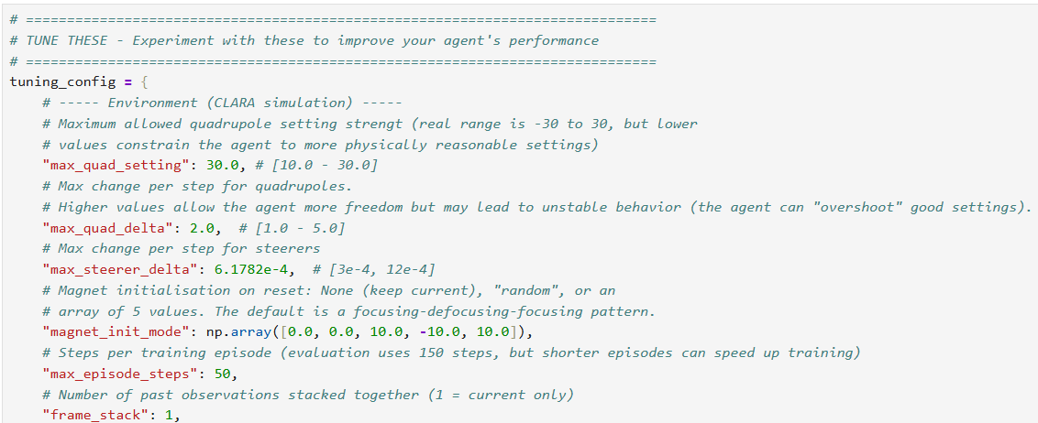
Environment hyperparameters
Comments in the code
Suggested tuning ranges in [min, max]
Example: maximum change of magnet strengths in one step
Example: maximum steps during training before terminating episode

Slide 21
Algorithm hyperparameters
Generic parameters:
batch_size: steps to take before performing gradient update
learning_rate: coefficient applied to gradient step
buffer_size: nbr of tuples to keep in replay buffer (recommended to keep large)
gamma: reward discount factor (lowering puts more focus on instant rewards over estimated future rewards)
SAC specific:
ent_coef: Entropy regularization coefficient.
Controlling exploration/exploitation trade-off (1 = full exploration, 0 = full exploitation). Defaults to ‘auto’ to automatically learn (and ‘auto_0.1’ for using 0.1 as initial value). With limited training time, fixed values may perform better…
TD3 specific:
target policy smoothing: Noise added to target policy during critic update. Controlled through target_policy_noise and target_noise_clip
Exploration noise (action noise): added to actions to encourage exploration.
Controlled through action_noise_type, action_noise_std
Good candidates for initial tuning!
More info: SB3 docs: SAC , TD3

Slide 22
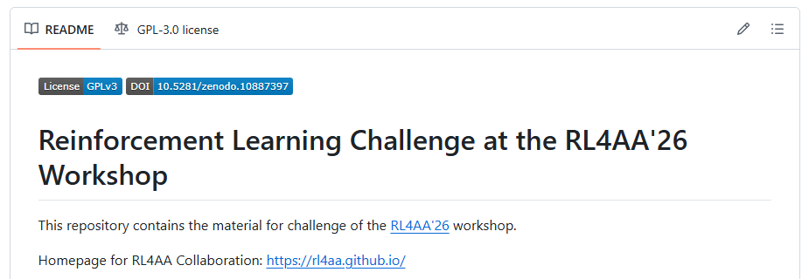

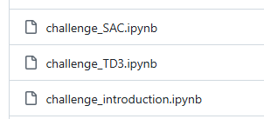
The challenge setup
Code on github: RL4AA/rl4aa26-challenge
Main points of interaction divided into three jupyter notebooks
Challenge_introduction.ipynb
Background, overview of problem, interactive 3D/2D simulation enabling manual tuning
Challenge_sac.ipynb
Main notebook for training SAC RL agent
Challenge_td3.ipynb
Main notebook for training TD3 RL agent
Let’s go through the structure of the SAC notebook!

Slide 23
The RL notebook structure
Notebook + Weights and Biases demo!
Weights and Biases project
Challenge github: https://github.com/RL4AA/rl4aa26-challenge

Slide 24
Next steps…
Go through the introduction notebook
Work on the problem in teams
(Today afternoon and the whole workshop)
Make sure your runs are being registered and uploading to WandB!
Win the prize!

Slide 25


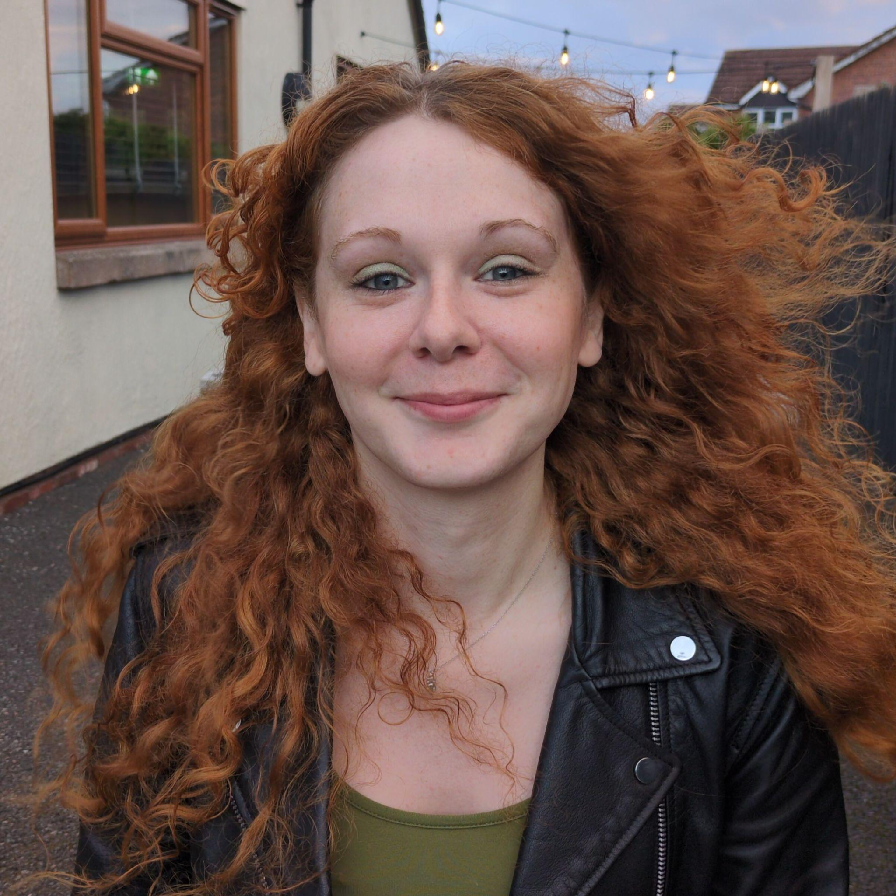
Ask us for help!
RL4AA23
Joel Wulff
Andrea Santamaria Garcia
Amy Pollard
We are here to help! Feel free to ask us both during the dedicated session, or in one of the breaks of the workshop. Good luck!
Links
Challenge github: https://github.com/RL4AA/rl4aa26-challenge
Indico challenge session: https://indico.ph.liv.ac.uk/event/2025/sessions/1451/#20260330

Slide 26
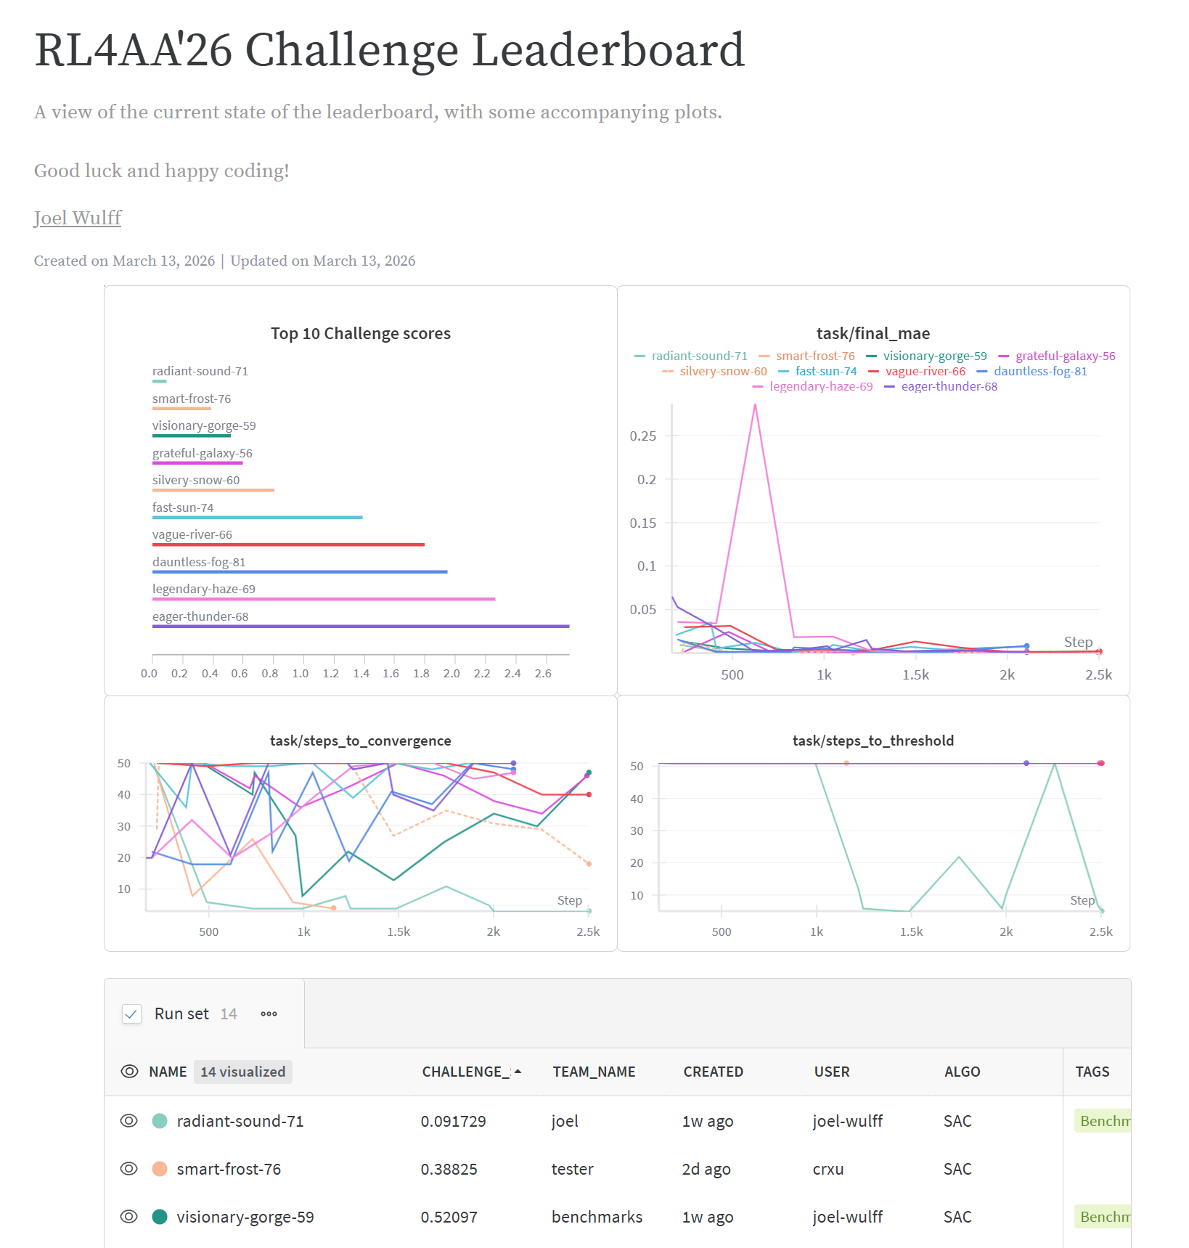
Questions?
Links
Weights and Biases project: https://wandb.ai/rl4aa26-challenge/challenge-leaderboard?nw=63171wvlqr
Leaderboard: Leaderboard report
Challenge github: https://github.com/RL4AA/rl4aa26-challenge
Indico challenge session: https://indico.ph.liv.ac.uk/event/2025/sessions/1451/#20260330

Slide 27
RL Challenge
Group assignment
Joel Wulff

Slide 28
Method
Divided into teams according to:
Home institute (to promote new connections!)
RL experience (some advanced, some beginner)
Work experience (student, staff, lecturer, etc.)
Assigned a team captain
→ Team member with slightly more RL experience!

Slide 29
All teams
 | Team captain | Participant 2 | Participant 3 | Participant 4 | Participant 5
Team 1 | Adrián Menor | Jordan Byrne | Sarah Trausner | Penny Madysa | -
Team 2 | Matthias Remta | Michail Sapkas | Christopher Arran | Eiad Hamwi | Chong Shik Park
Team 3 | Fan Jiaqi | Giacomo Tangari | Storm Mathisen | Georg Weinberger | Sara Zoccheddu
Team 4 | Andrea Vella | Jake Flowerdew | Oliver Betteridge | Xingchi Liu | -
Team 5 | Ignacio D. Lopez-Miguel | Filip Peczek | Kirill Fedorov | CE LI | -
Team 6 | Armen Kasparian | Johannes Alexander Jaeger | Subindev Devadasan | Raunakk Banerjee | -
Team 7 | Guillermo Hijano | Daniele Zebele | Lu ZHAO | Adnan Ghribi | -
Team 8 | Juan Manuel Montoya | Smita Singh | Emily Archer | Matt Pereira | -
If you have not been assigned a team, but want to participate in the challenge, approach me after this!

