Slide 1

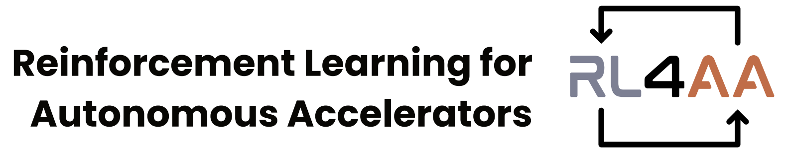

RL4AA’26
RL Challenge
Closing
Joel Wulff

Slide 2
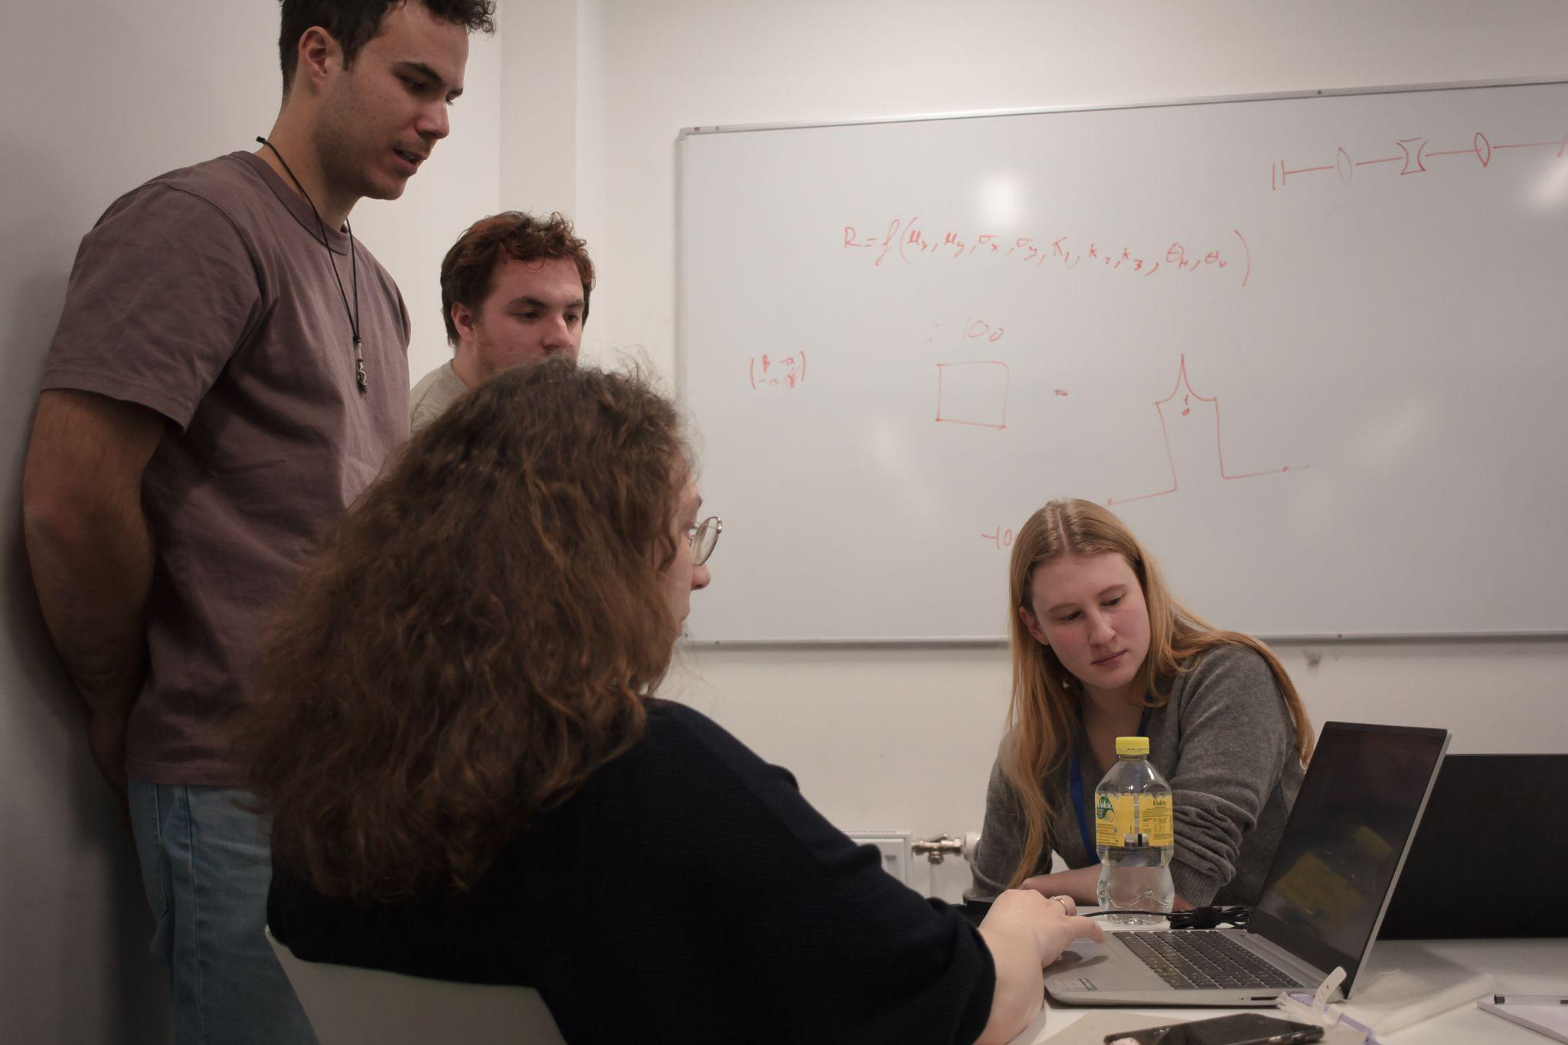
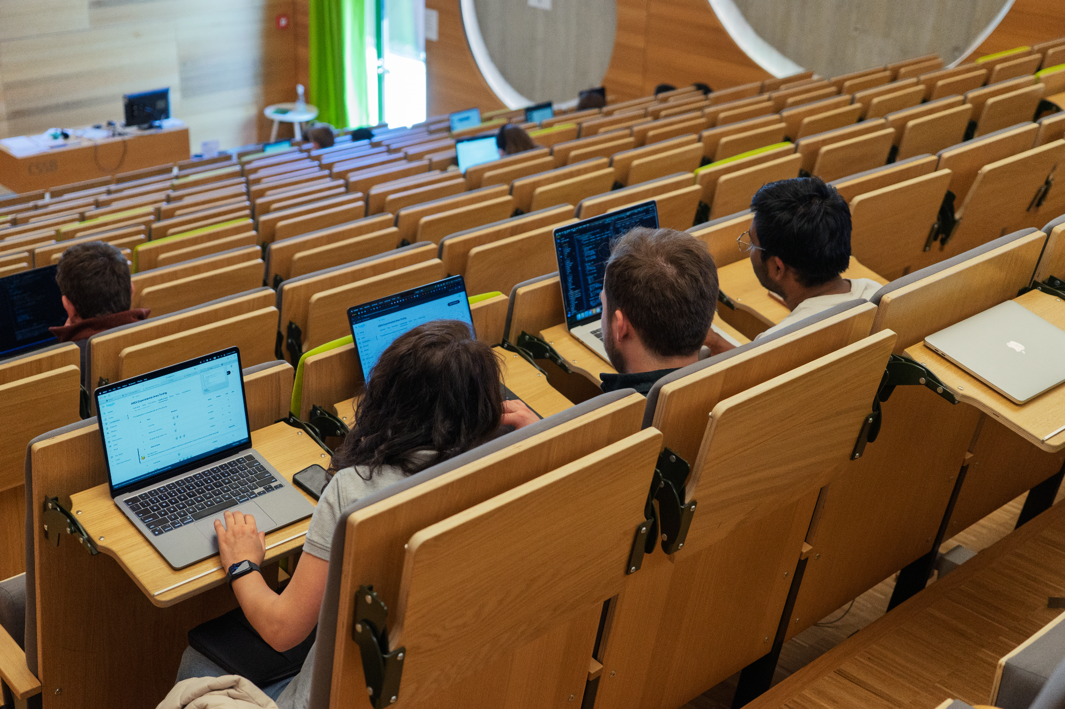
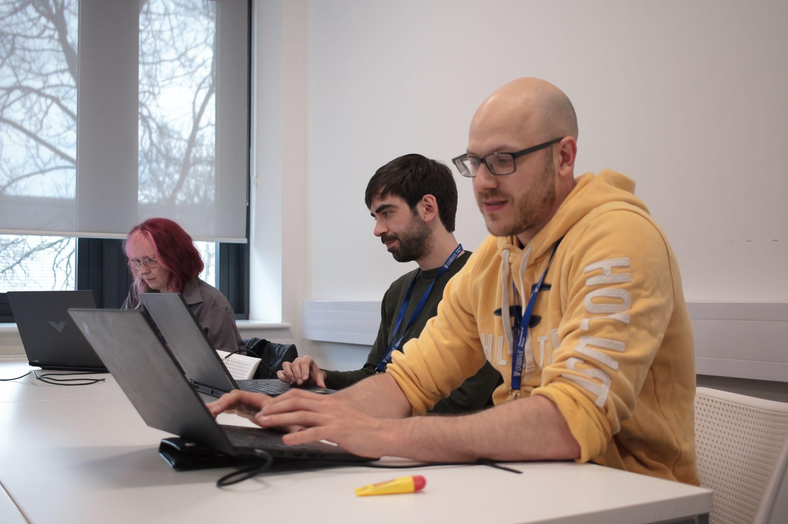
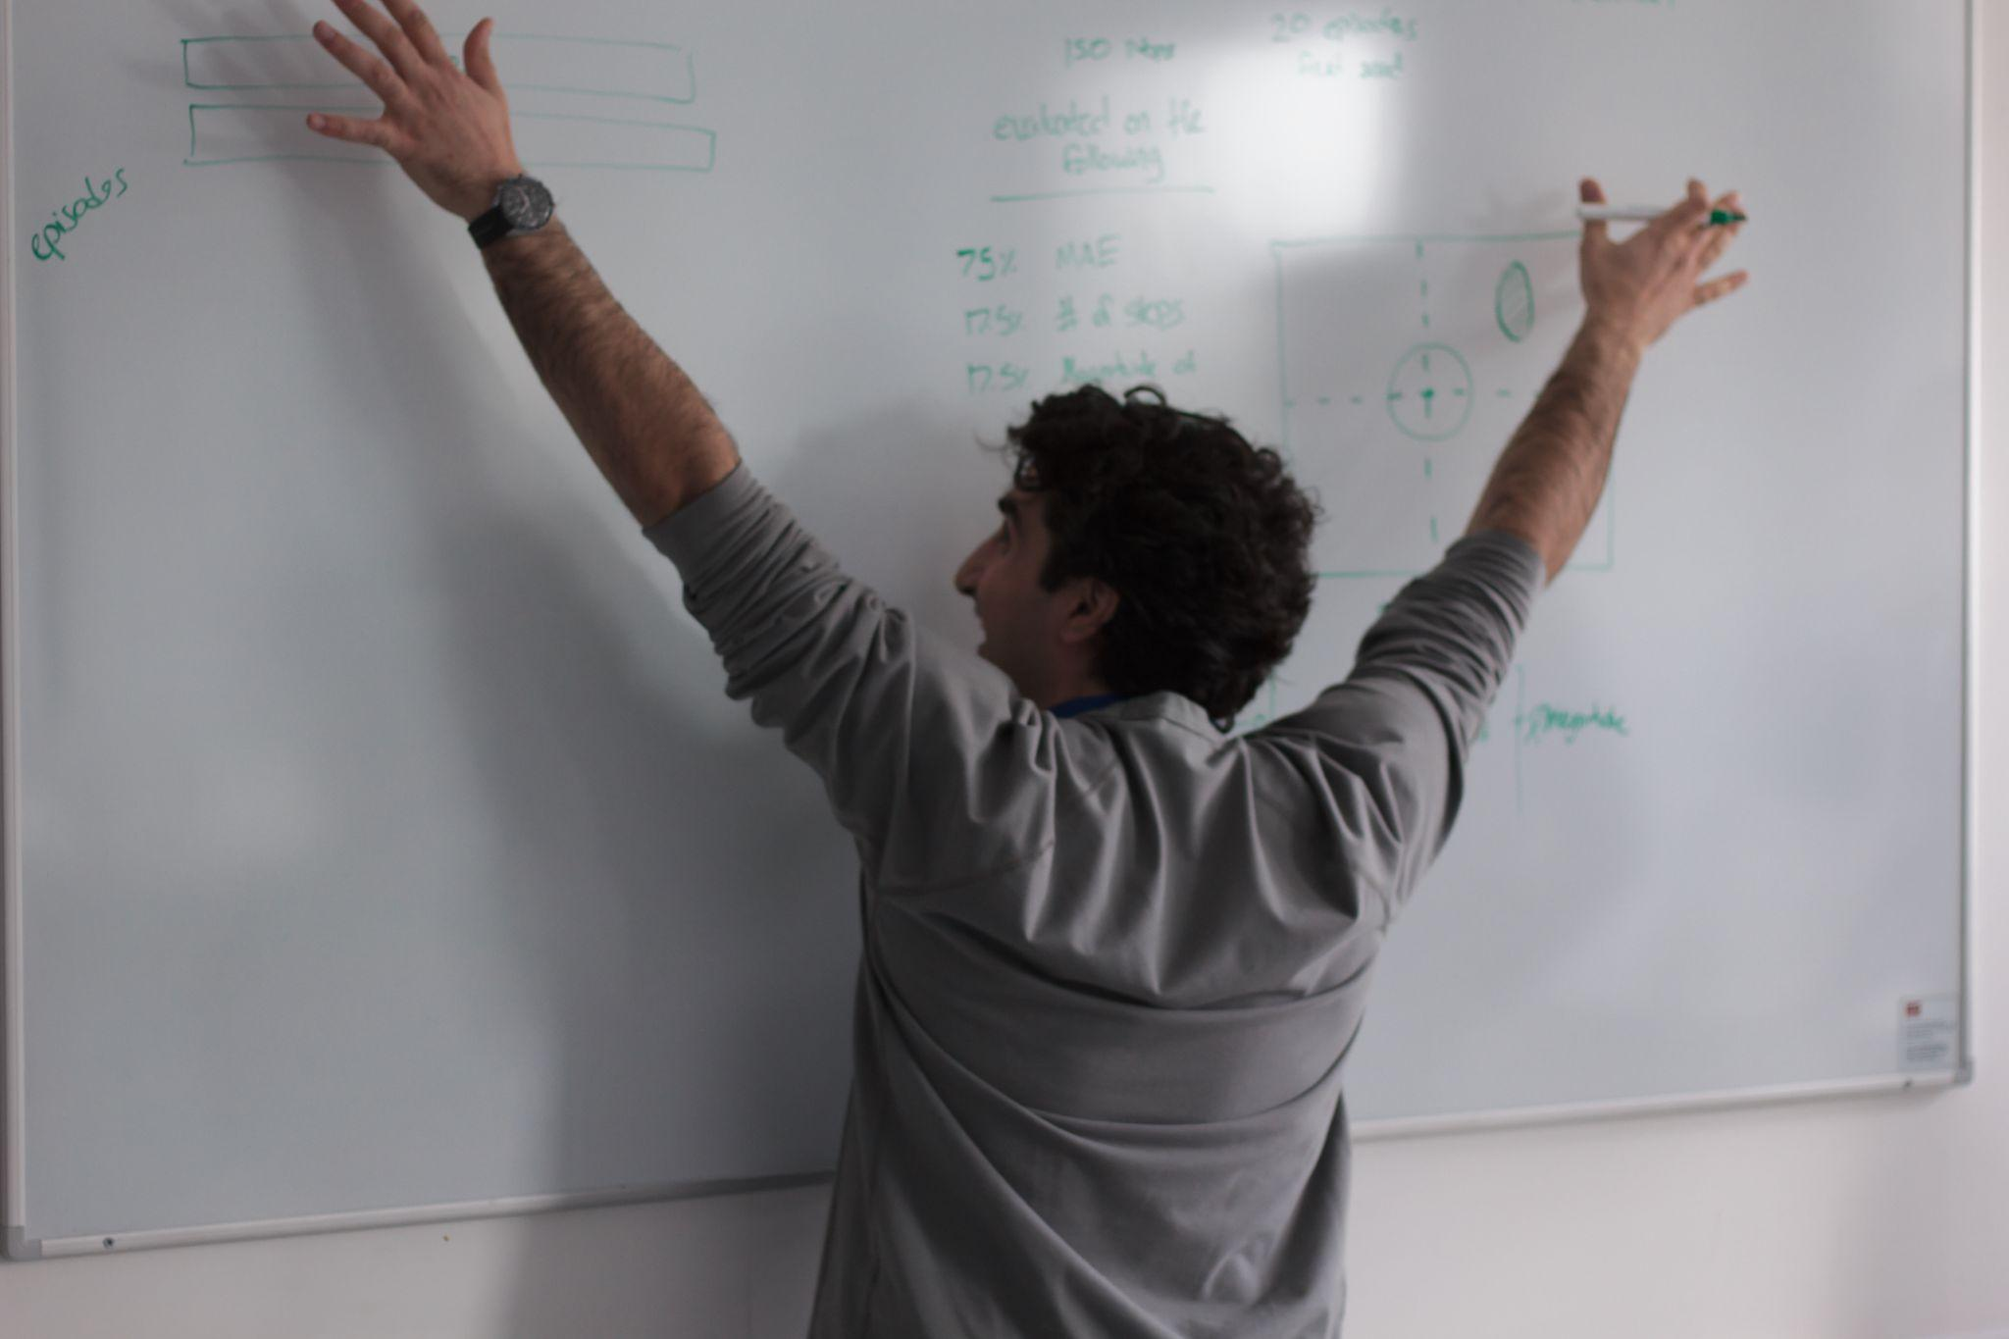
Well done!
We saw a lot of collaboration 😁
People discovering RL for the first time
People trying mostly SAC…
And some TD3!
Reinforcement learners adapting to the problem
Some participants coding deep into the last day!
RL4AA23
We hope to have convinced you about the power of RL!
Secret work!

Slide 3
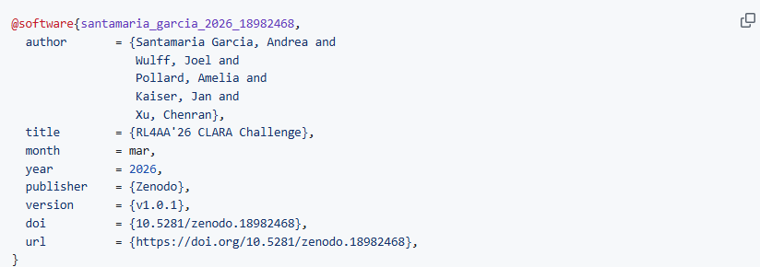

Before we go any further
The code and materials provided here are the result of significant effort, including state-of-the-art research. We share these resources in good faith, aiming to contribute to the community and advance knowledge in our field. If you use or build upon any part of this tutorial, whether in research, software, or educational materials, proper citation is required!
RL4AA23
Link to Zenodo entry
By using this repository, you acknowledge and respect the effort behind it. We appreciate your support in maintaining academic integrity and fostering an open, collaborative environment.

Slide 4

And now…the results!
At 14:18 on last day, more than 2600 runs on WandB!
Before we go to the top teams… Honorable mention to Best TD3 submission, and third place overall: FineTuners!
Now for the top of the leaderboard…

Slide 5
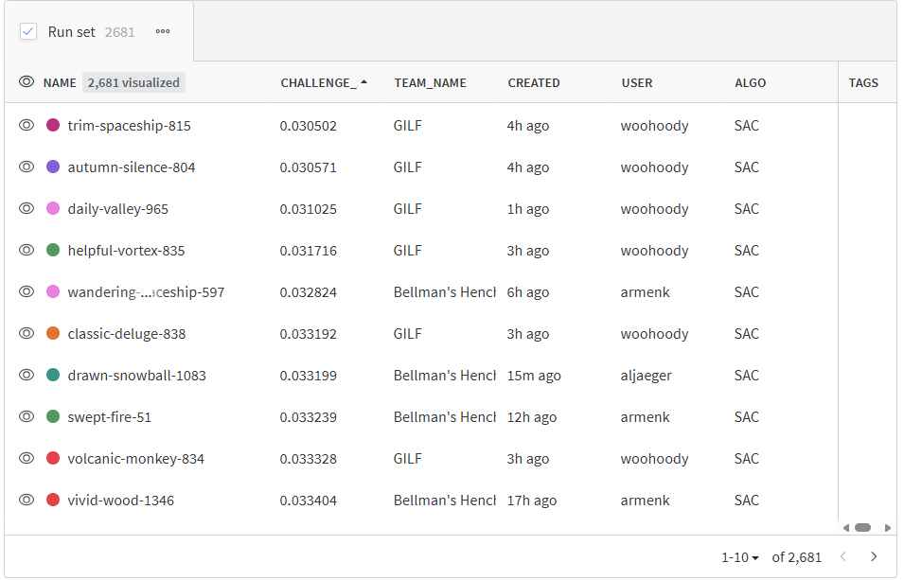
And now…the results!
Close fight between two teams!
2nd place on the leaderboard:
Bellman’s Henchmen
1st place on the leaderboard:
GILF
Prizes will be handed out later, first, let’s hear from the winning teams!

