Slide 1


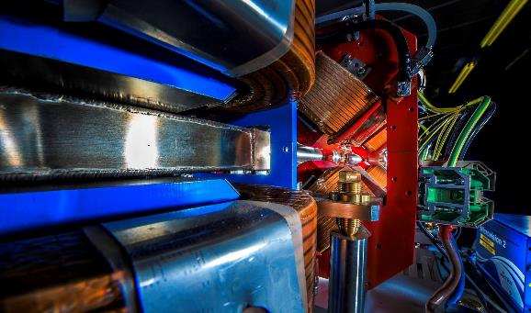
Making a brighter future through advanced accelerators
Welcome to Daresbury Laboratory
Peter McIntosh
Interim Director of ASTeC
1st April 2026
Reinforcement Learning for Autonomous Accelerators 2026 Workshop (RL4AA’26)

Slide 2

UK Research and Innovation (UKRI) Science and Technology Facilities Council (STFC)
We work with the UK government to invest ~ £9 billion a year in research and innovation by partnering with academia and industry to make the impossible, possible.
Through the UK’s 9 leading academic and industrial funding councils, we create Knowledge with Impact.

Slide 3

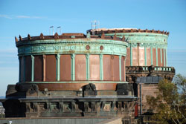
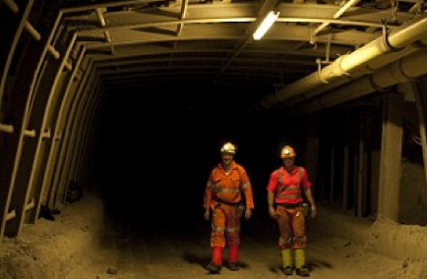
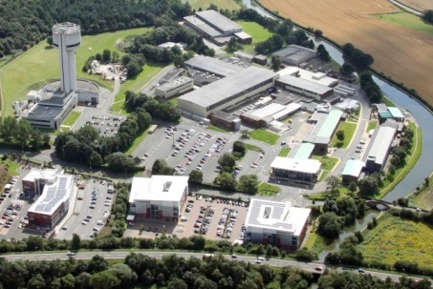
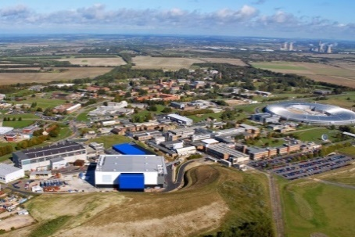
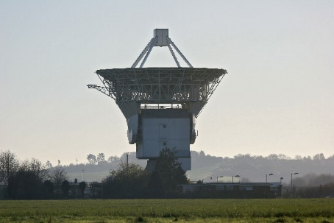
STFC National Laboratories
Astronomy Technology Centre
Boulby Underground Laboratory
Daresbury Laboratory
Rutherford Appleton Laboratory
Chilbolton Observatory
STFC FY25/26 budget - £618m
3

Slide 4
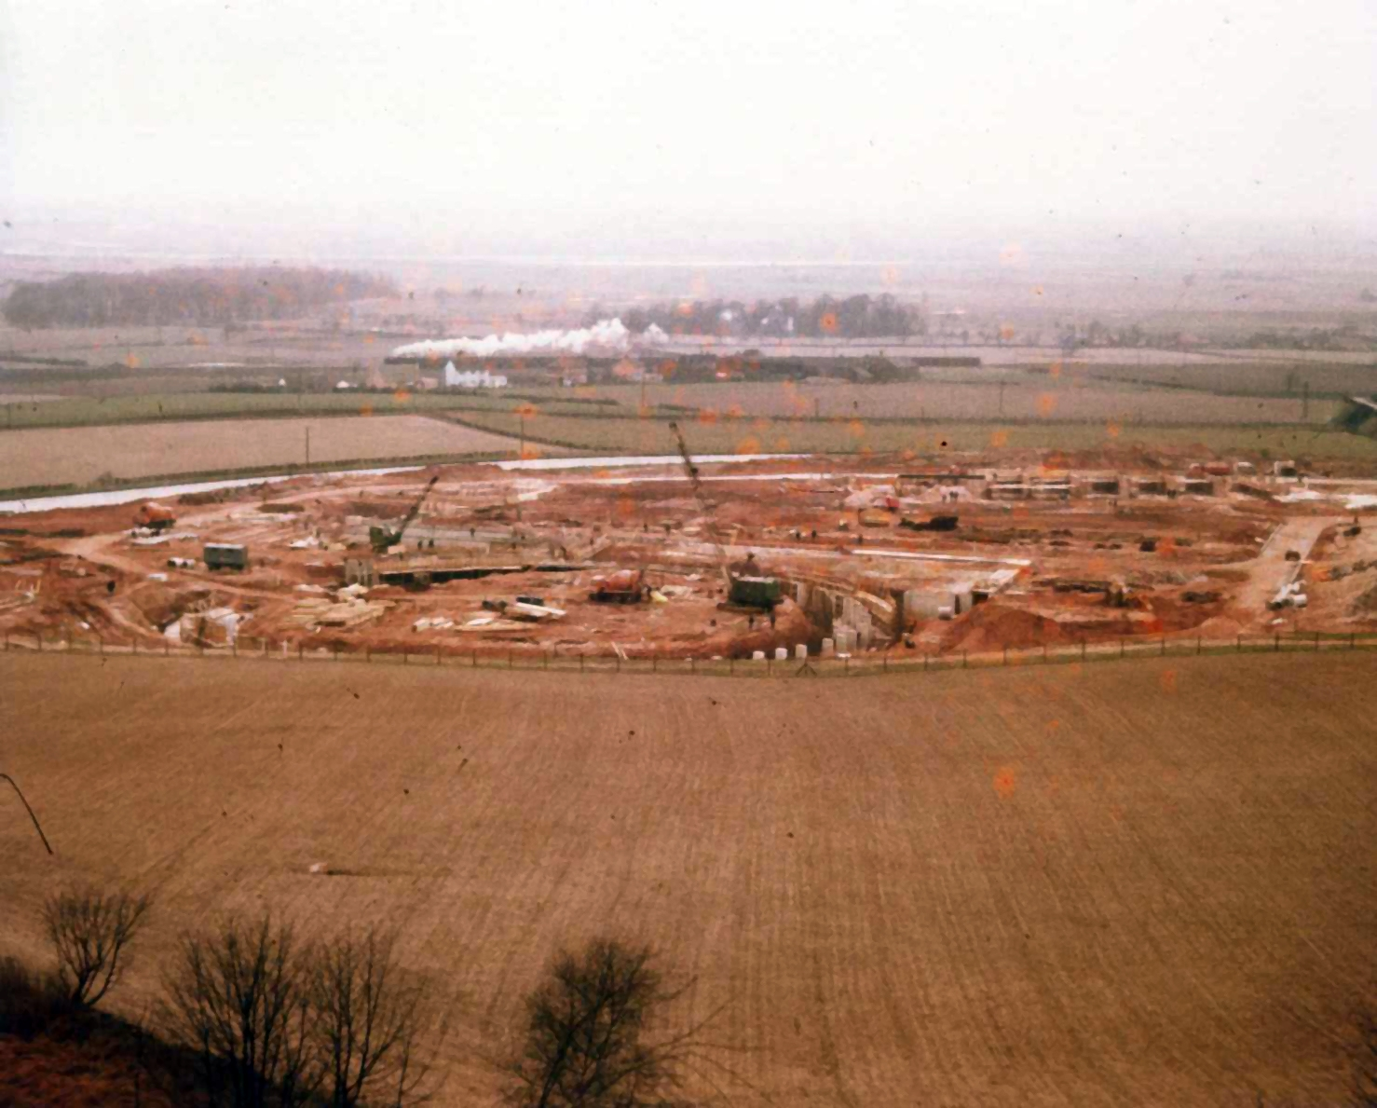
History of Daresbury
Daresbury was established in 1962 to host a 5 GeV electron synchrotron for particle physics.
NINA NINA began operations in December 1966, remarkable progress considering the team started from a green field only four years earlier.
Feb 1964
Foundations of the ring in the foreground
Steam train in the background !
The circumference of NINA was ~220m
4

Slide 5
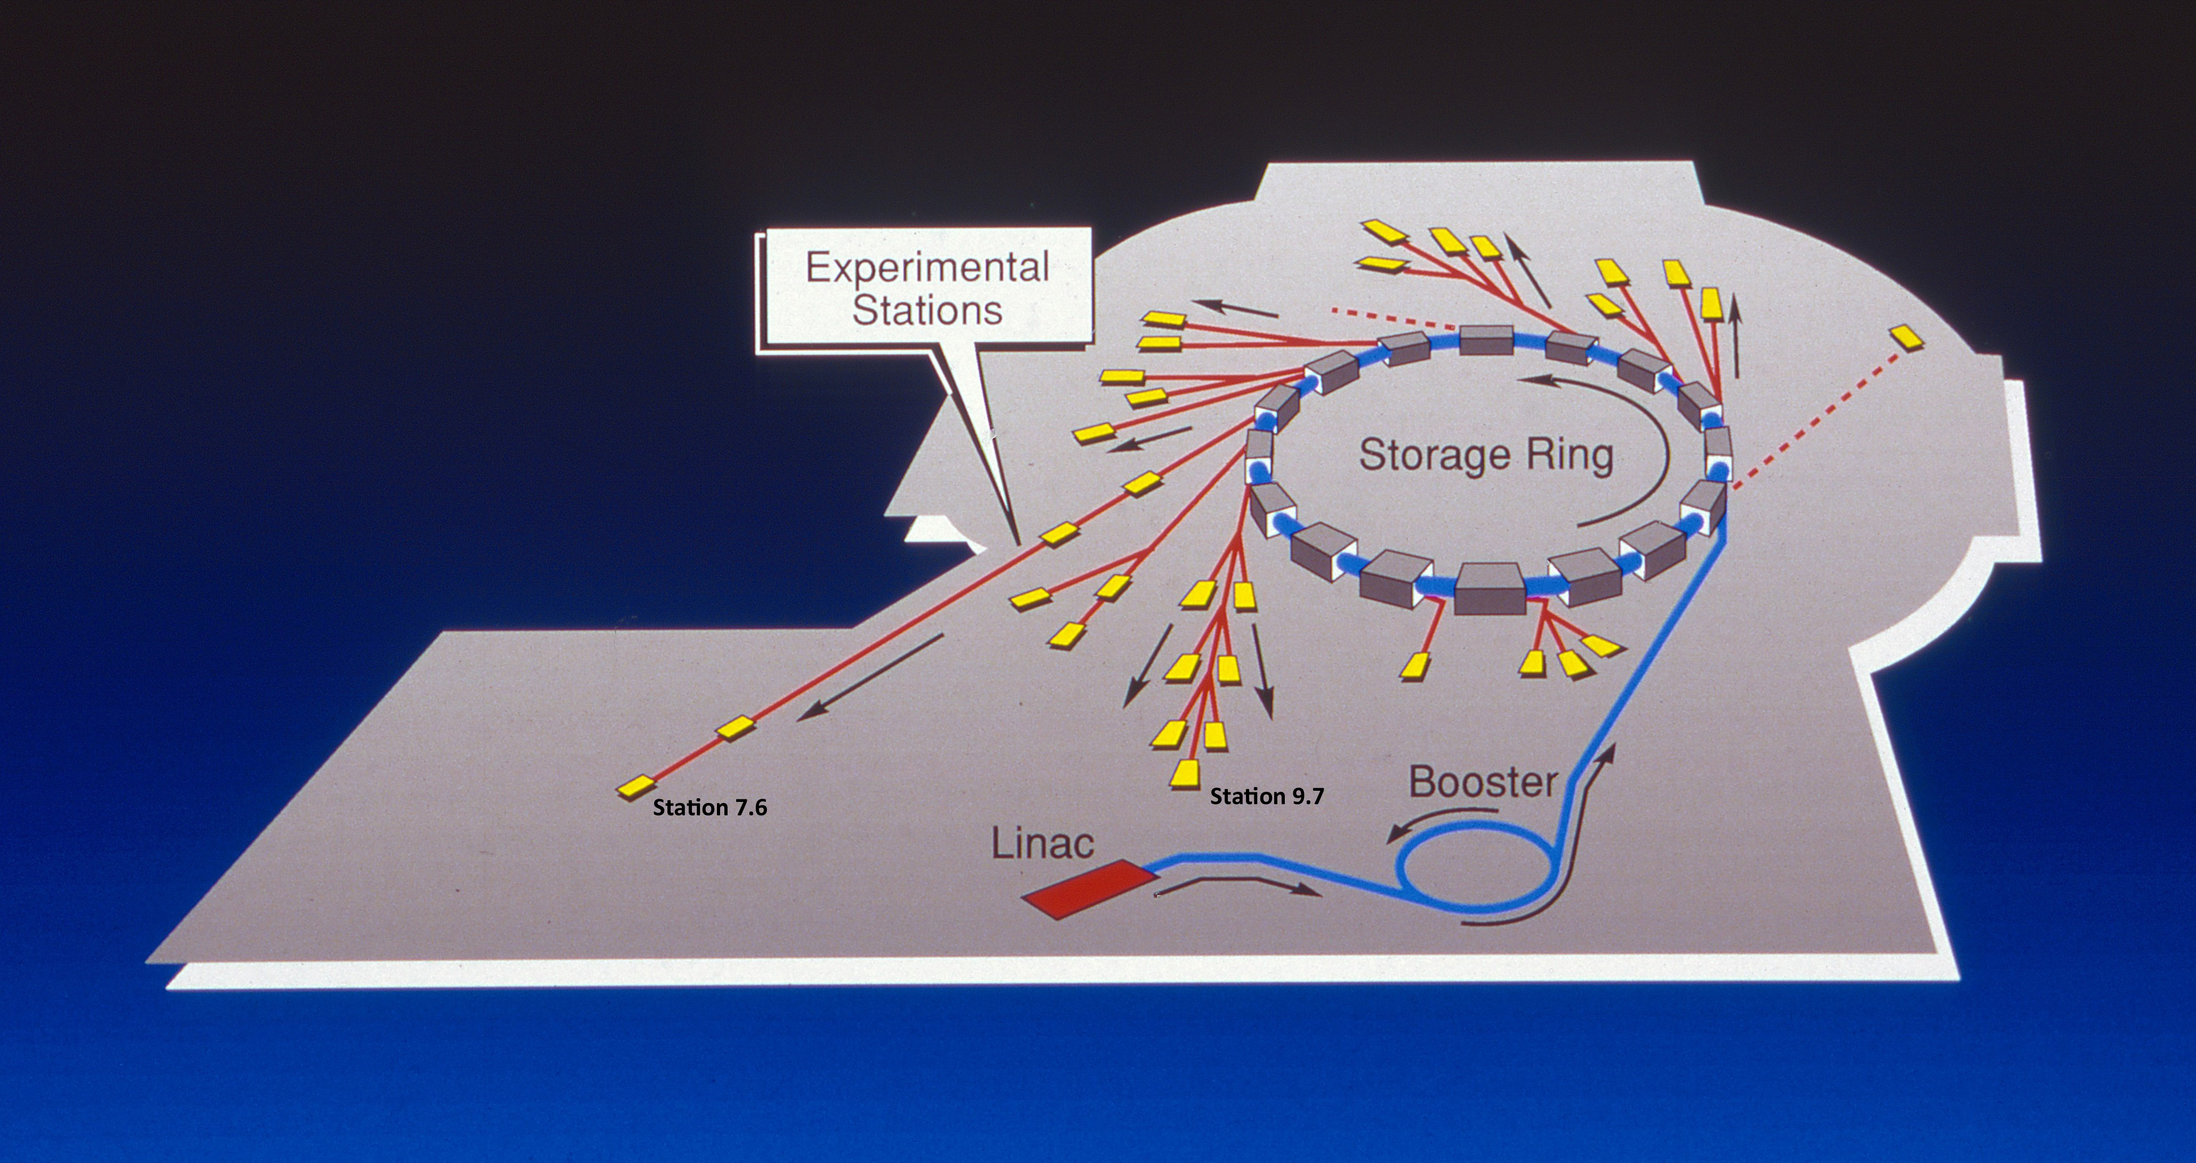
The Synchrotron Radiation Source (SRS)
With NINA expected to close in 1977, a new ambitious proposal was to build a dedicated accelerator based light source covering the full spectrum from IR to hard X-rays – the SRS.
The facility was approved to start construction from April 1975.
The cost of the SRS was estimated to be £2.7m, plus £300k for beamlines and experimental equipment, and was expected to take 4 years (first operation IN 1980).
The target was to achieve a high photon flux at 1 Angstrom (0.1 nm) from the bending magnet sources – this set the combination of electron energy of 2 GeV and dipole field of 1.2 T
SRS closed in 2008
(28-yr operation)
5

Slide 6
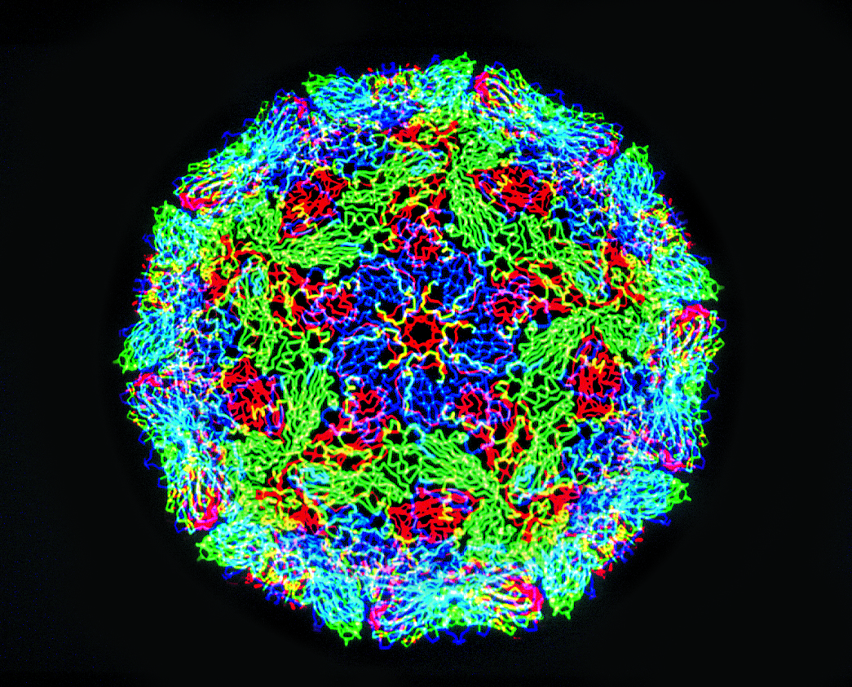
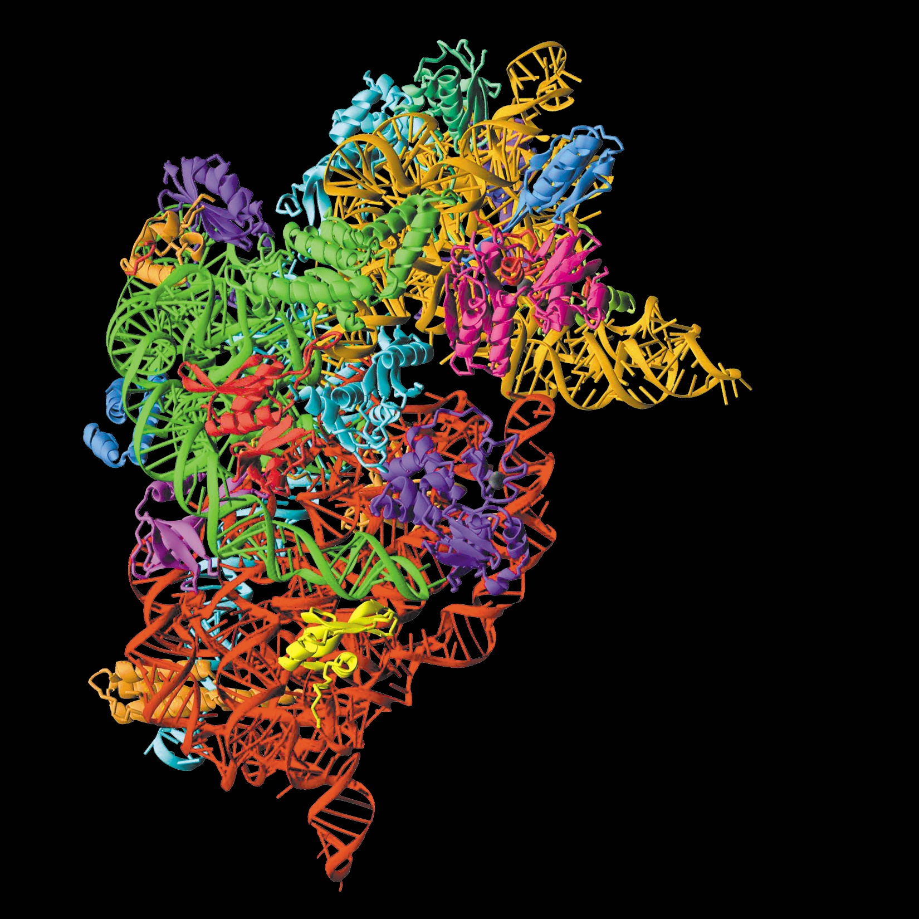
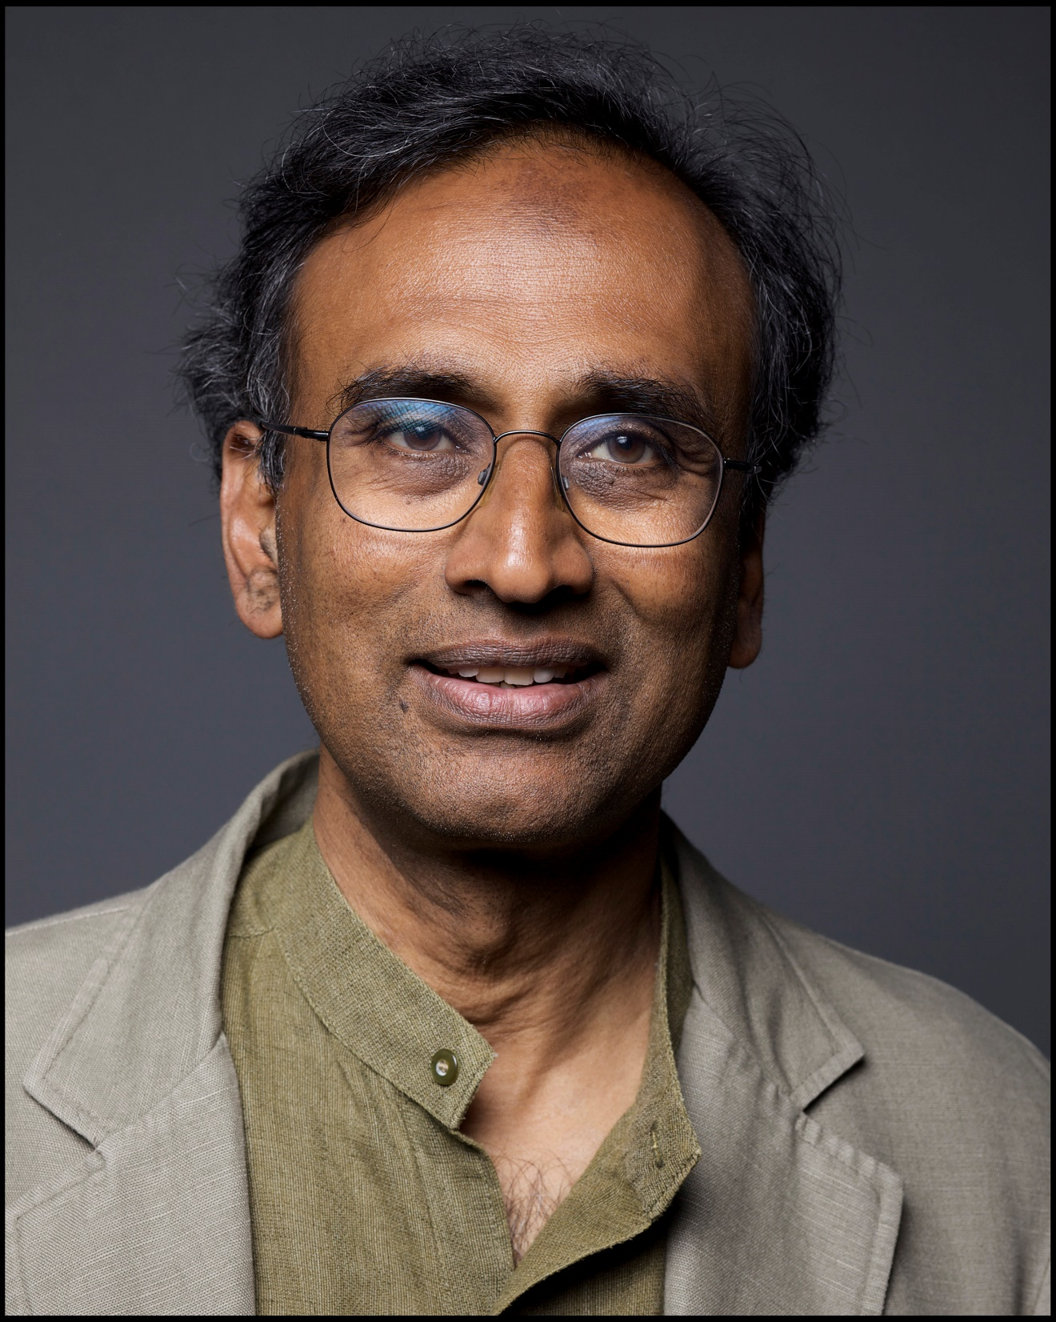
SRS Science Impact
The structure of foot and mouth disease virus was solved using data from the SRS in the late 1980’s - Dave Stuart (Diamond and Oxford)
This was the first animal virus structure to be solved in Europe and was published in Nature.
John Walker won a share of the 1997 Nobel Prize for Chemistry for solving the structure of the F1 ATPase enzyme using the SRS. In both plants and animals, energy is stored and transported by adenosine triphosphate (ATP).
Venki Ramakrishnan won a share of the 2009 Nobel Prize for Chemistry for solving the structure of the ribosome, the molecular machine that constructs proteins from ‘instructions’ coded in mRNA.
All of whom used the SRS for their research!
6

Slide 7
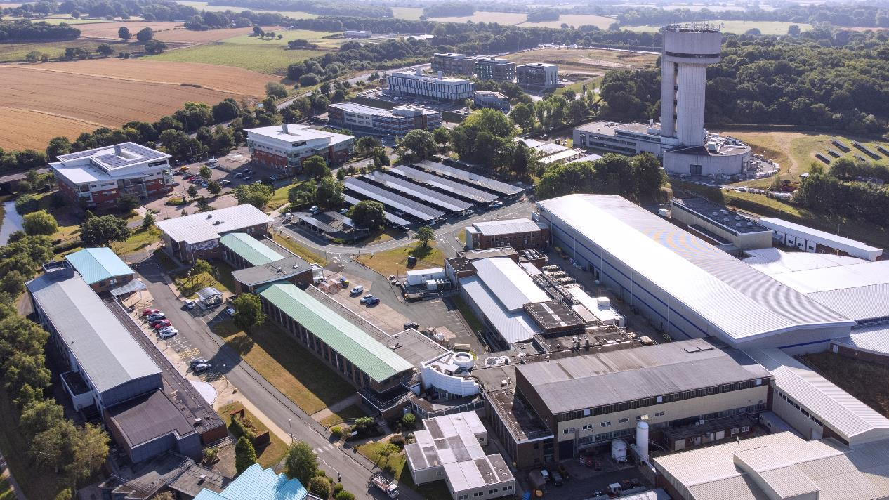
Daresbury Laboratory and Campus Today
Daresbury Laboratory is an STFC National Laboratory with ~ 650 staff.
Major activities are centred around particle accelerators, scientific computing, high performance computing
and nuclear physics.
The wider campus hosts >160 businesses and the Cockcroft Institute.
Approx 2000 people in total.
7

Slide 8






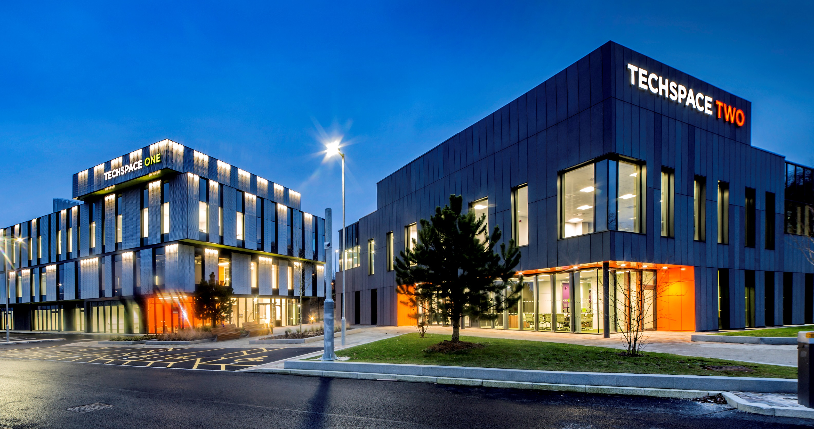
Daresbury Campus Companies
Over 160 high-tech companies:
~20% international companies.
Sector focus:
Advanced Engineering & Materials (55)
Life Sciences & Healthcare (48)
Digital (53)
Energy & Environmental (14)
Sales growth 25% pa
6% company failure rate
76% companies collaborate on campus
Image © STFC John Dawson
8

Slide 9
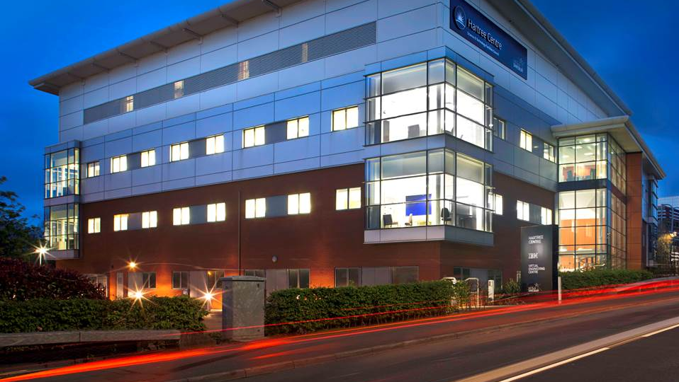

The Hartree Centre
STFC’s high performance computing, data analytics and AI research centre.
Staff based in the building include:
STFC
IBM Research
University of Liverpool, Virtual Engineering Centre
9
Notes:
First IBM Research base in the UK
25+ IBM Research staff
20 VEC staff
Atos have a hot desking office & permanent technical staff
Fostering collaboration and creating a hub for digital technical expertise to the North West
Key asset in Northern Powerhouse
Partner in LCR4.0 programme – 3 year programme to digitise SMEs in the Liverpool City Region, 100 SMEs engaged in the first year
The University of Liverpool runs an MSc in Big Data and HPC in conjunction with the Hartree Centre

Slide 10
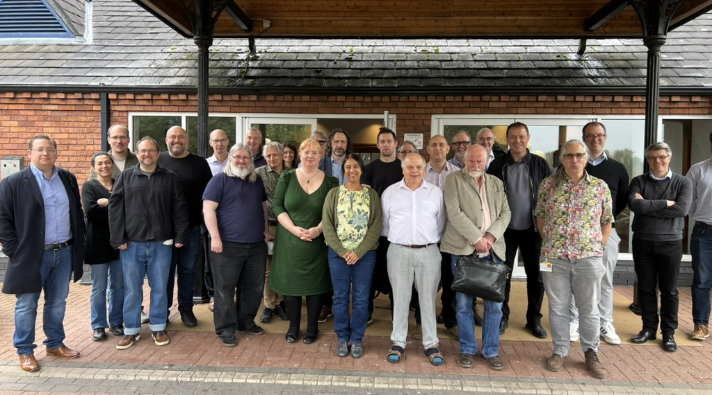
Cockcroft Institute
Formed in 2006
Partner organisations
Lancaster (Physics and Engineering),
Liverpool (Physics and Engineering)
Manchester (Physics)
Strathclyde (Physics)
STFC ASTeC
People
Academics: 32
Postdocs : 23
PhD students : 86
Publications (2021 – now)
CI academic authors: 649
Unique papers: 448
Peer reviewed: 207
High profile: 23
10

Slide 11
Strategic Focus
Cockcroft research divided into major three themes:
Frontier facilities (e.g., HL-LHC, UK-XFEL, FCC-ee )
Novel acceleration (Laser and plasma wakefield acceleration, e.g. AWAKE)
Applications of accelerators (Proton beam therapy, VHEE, materials processing)
Underpinning capability for all projects:
Radiofrequency techniques (high efficiency klystrons, LLRF, thin films)
Advanced diagnostics (gas jet emittance measurement)
Beam dynamics, simulations (e.g., Cheetah, BDSIM) , AI/ML (this workshop)
Future research areas related to RL4A:
Application of AI/ML to accelerators
Digital twins and shadows
11

Slide 12
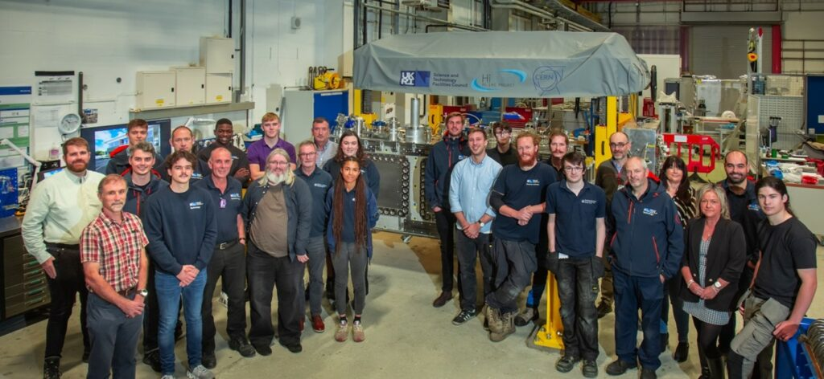
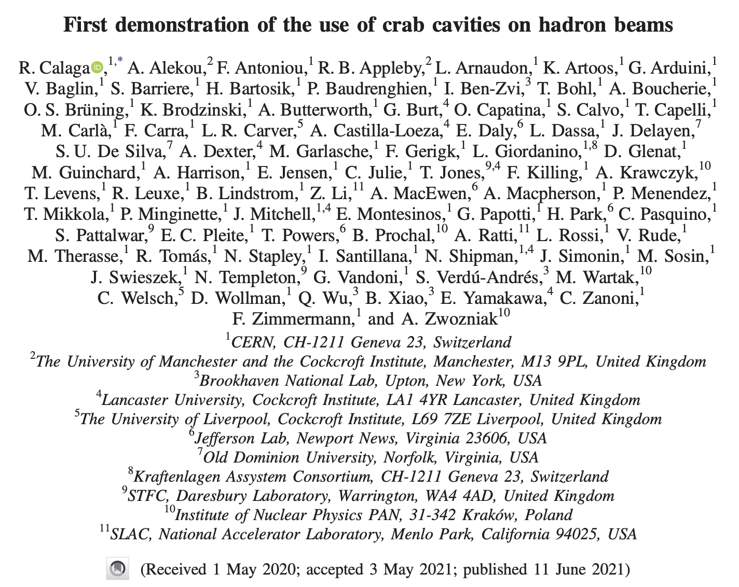
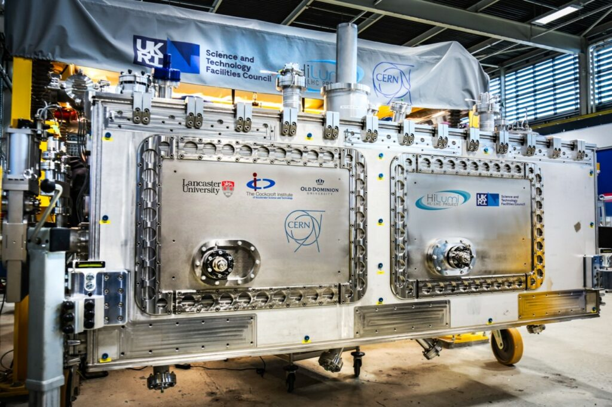
Frontier facilities (HL-LHC crab cavities)
12

Slide 13
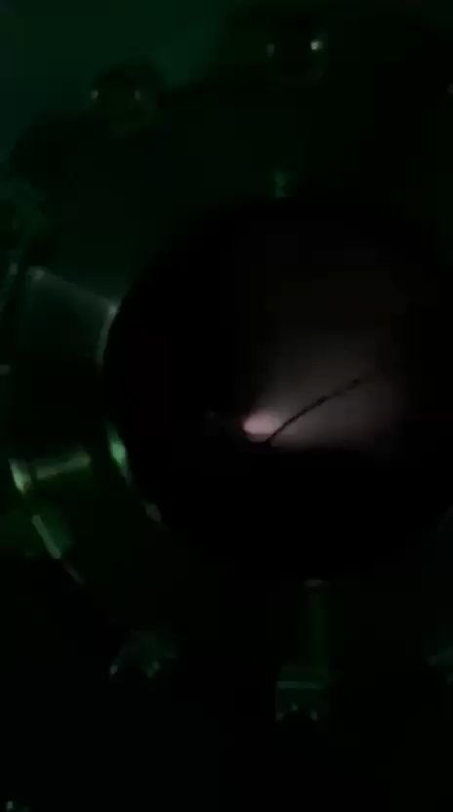
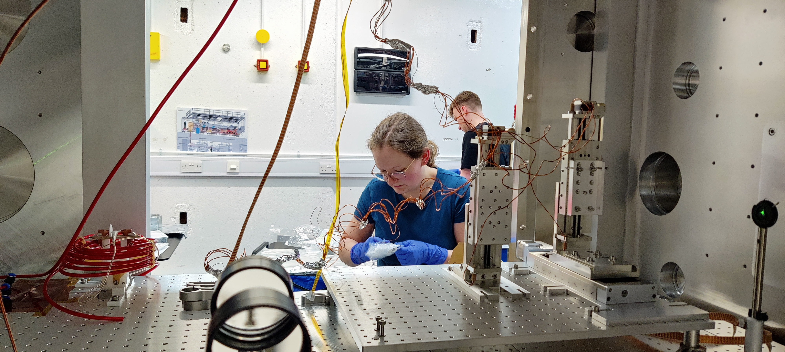
Novel Acceleration (HALHF@CLARA)
Currently team are visiting CLARA from Oxford/Oslo/DESY (and CI) to perform initial plasma lens studies for plasma staging.
13

Slide 14
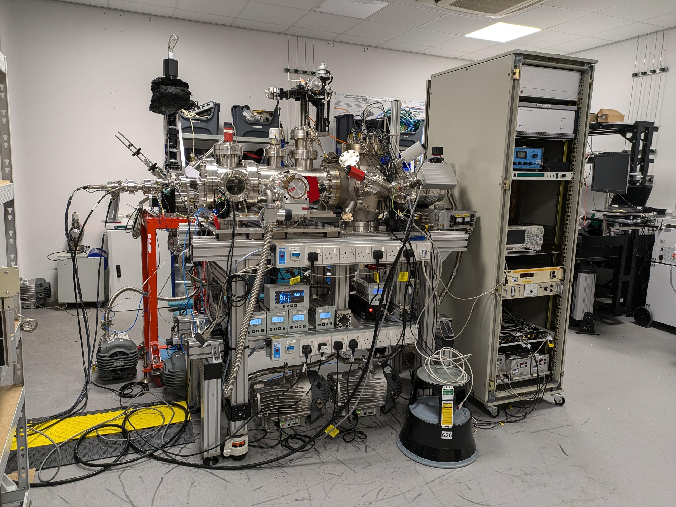
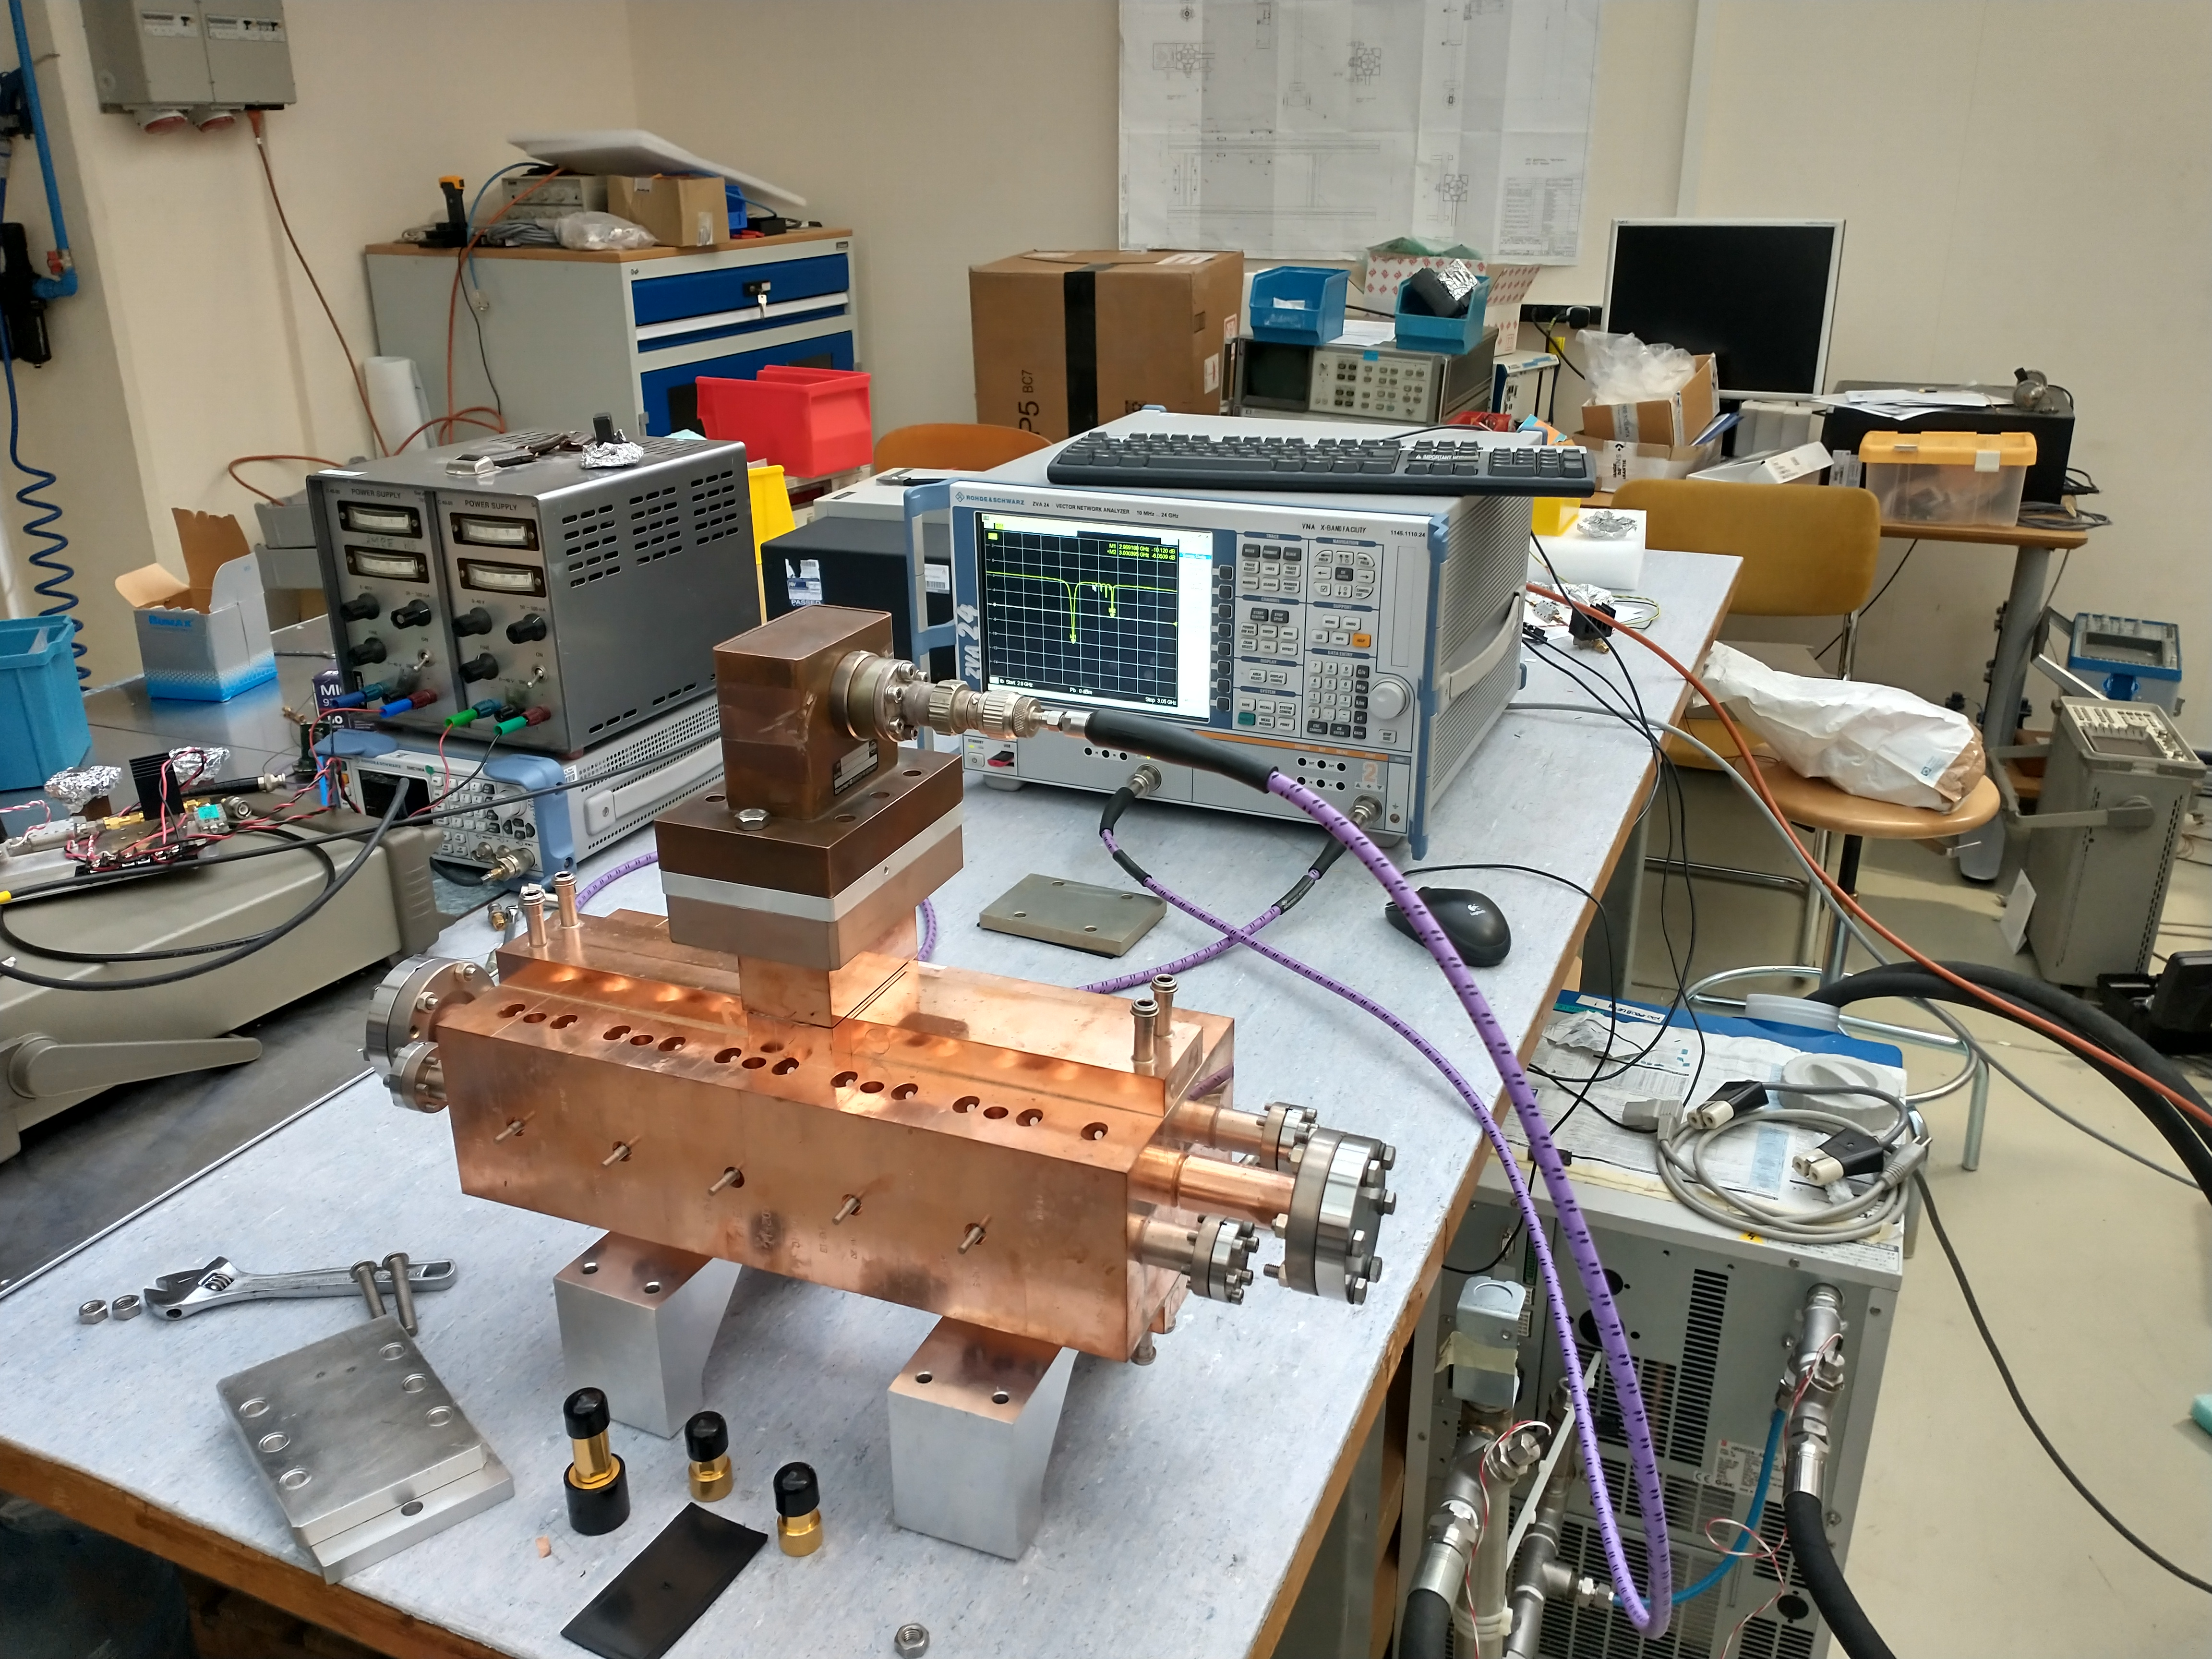
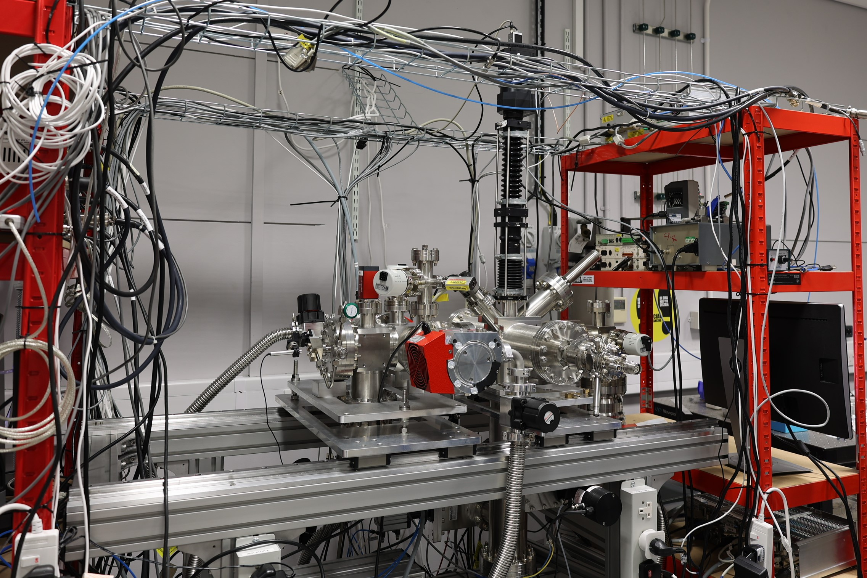
Underpinning Technologies
Beam instrumentation
Gas jet technology applicable to LHC diagnostics, PWFA/LWFA and proton dosimetry
Radio frequency techniques
RF generation is a critical issue for almost all practicable accelerators.
High gradient proton therapy linac : PROBE
Case: Gas jet dosimetry system for proton therapy.
Gas jet system development for HL-LHC
14

Slide 15
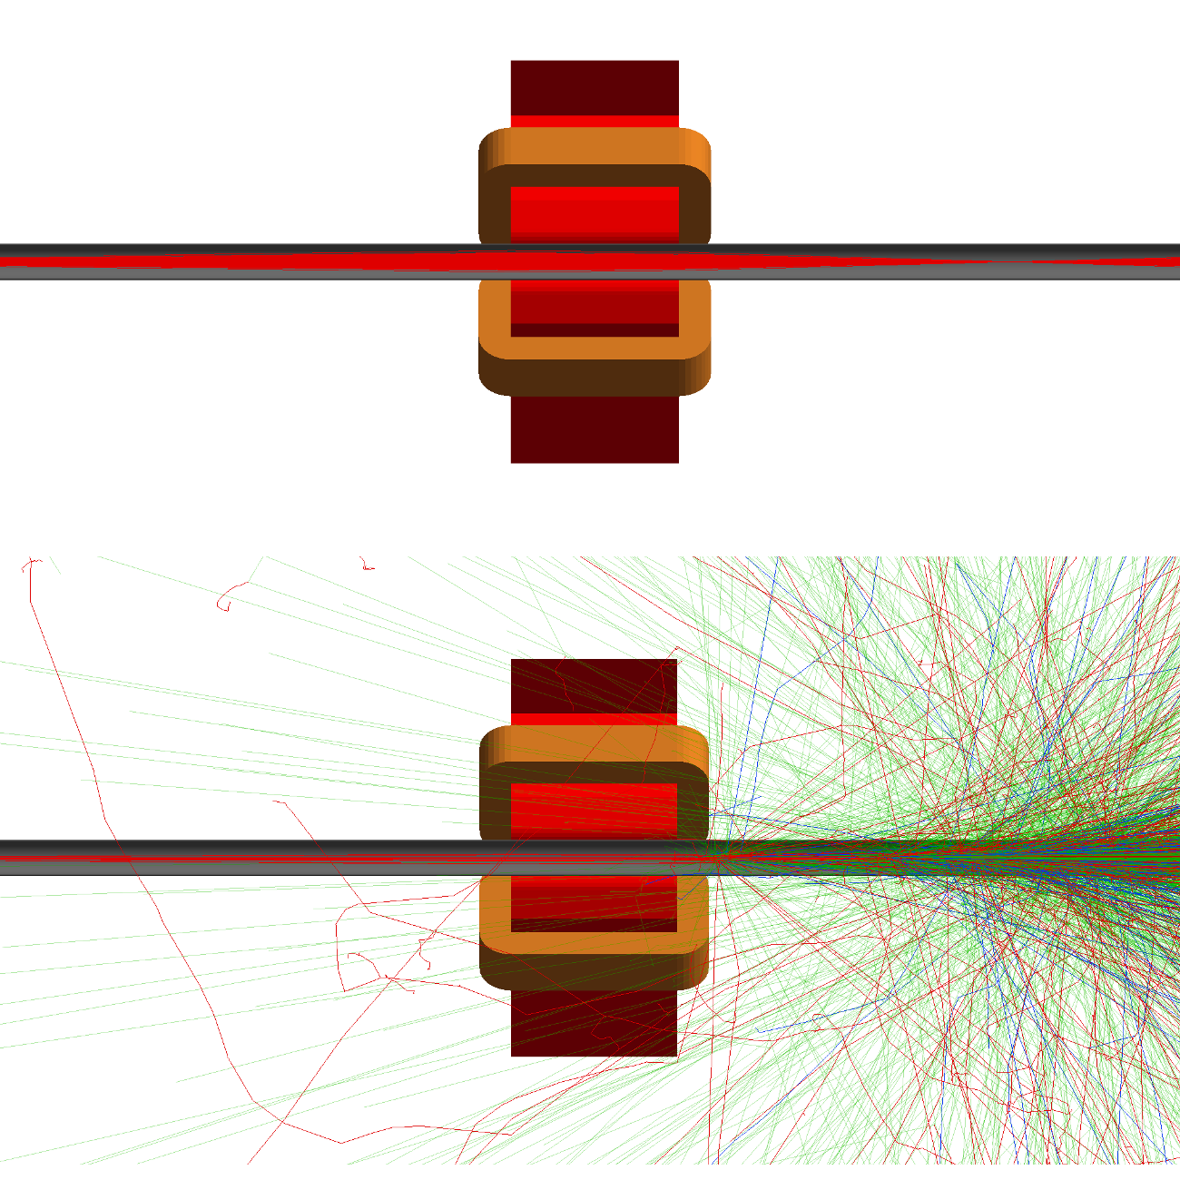
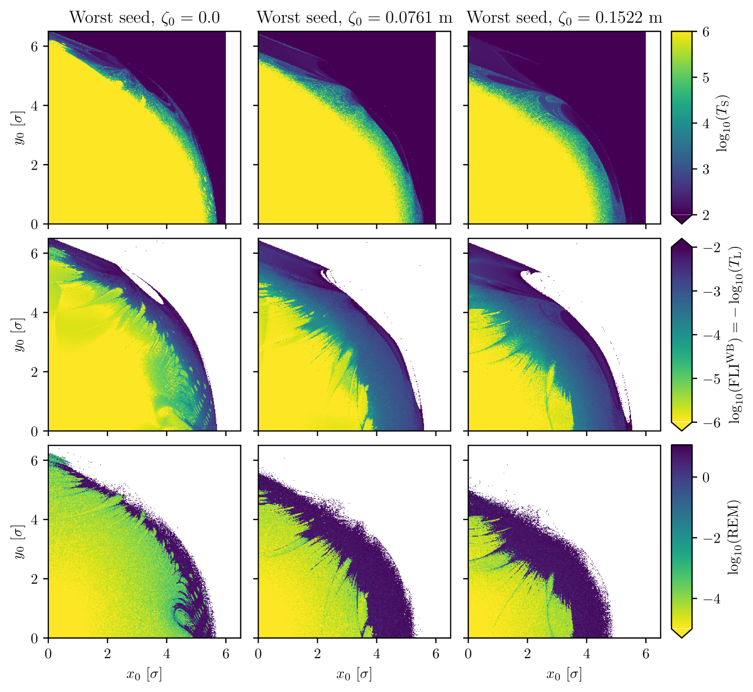
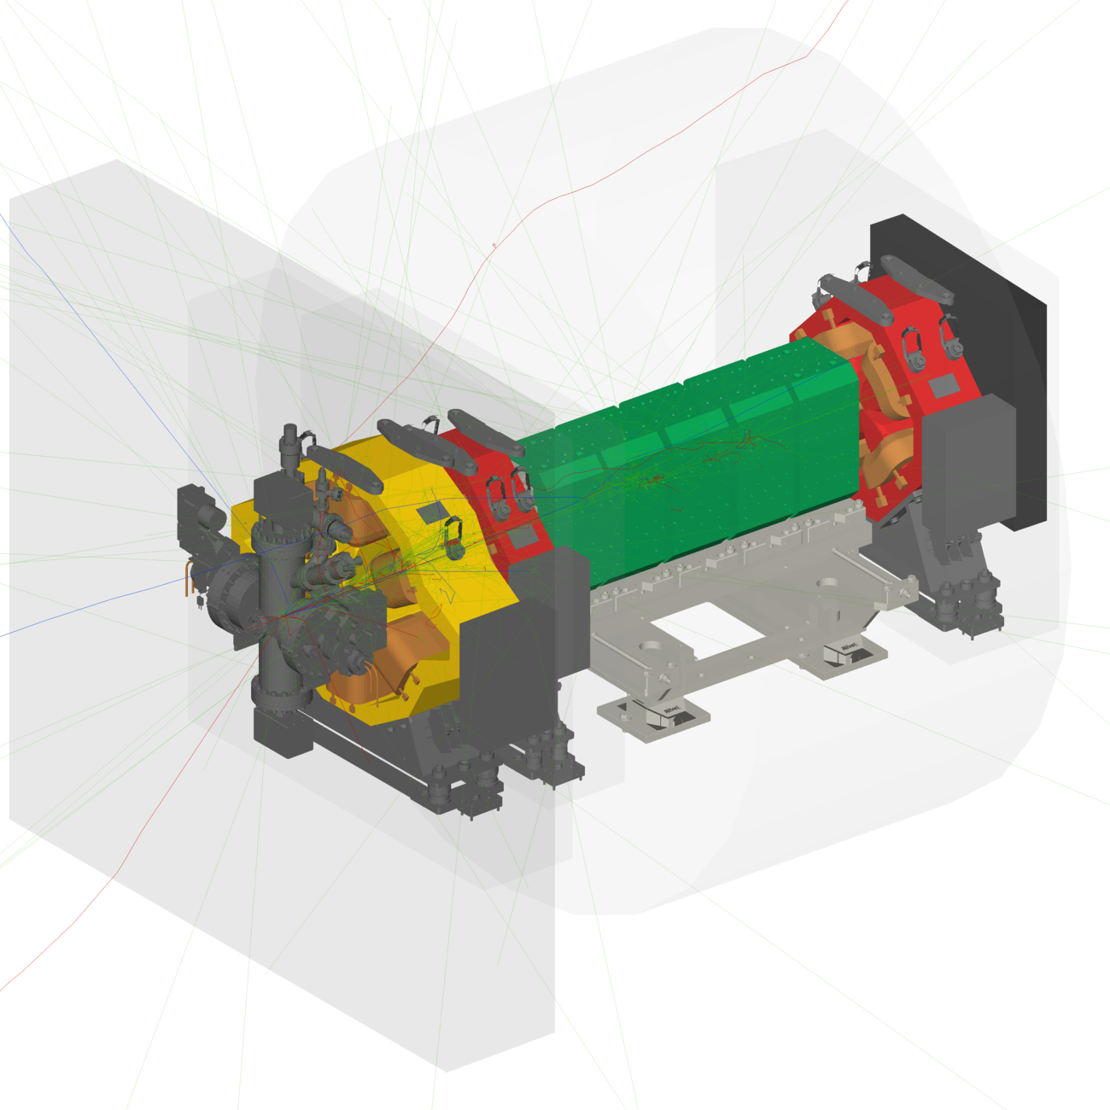
Simulation and Beam Dynamics
BDSIM
Geant4 code to rapidly prototype radiation environment of accelerators
Beam dynamics
Fundamental studies for HL-LHC. Chaos indicators in dynamic aperture
https://bdsim-collaboration.github.io/web/
15
https://arxiv.org/html/2504.12741v1

Slide 16
Accelerator Science and Technology Centre (ASTeC)
UKRI’s Centre of Excellence in particle accelerator R&D.
Development of major new types of accelerators and provide In-Kind Contributions overseas.
Based at Daresbury Laboratory with >110 staff.
In partnership with Technology Department and CI, contain all the skills/expertise to develop accelerators from Cradle to Grave:
A One Stop Shop!
16

Slide 17
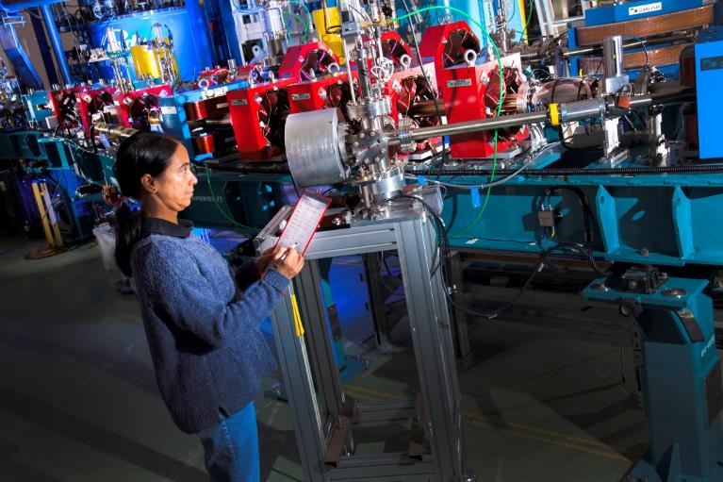
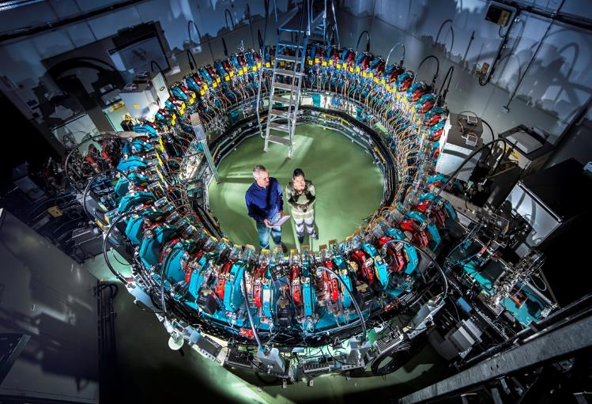
First Innovative Accelerators in the UK
ALICE – Europe’s only SRF ERL Accelerator
EMMA – World’s only NS-FFAG Accelerator
17

Slide 18
CLARA
Compact Linear Accelerator for Research and Applications
A major upgrade of CLARA is now installed, which increases its capability significantly.
Delivering for Friendly User Operations right now.
Upgrades expect to establish CLARA as one of Europe’s premier accelerator test facilities.
CLARA has potential to become a fully operational facility, able to support an increased community of users.
CLARA Upgraded Beam Parameters:
Up to 250 MeV electron beam
10 Hz to 100 Hz (400 Hz possible at <200 MeV)
10 TW to 120 TW
~1 ps to ~50 fs bunch length
18

Slide 19
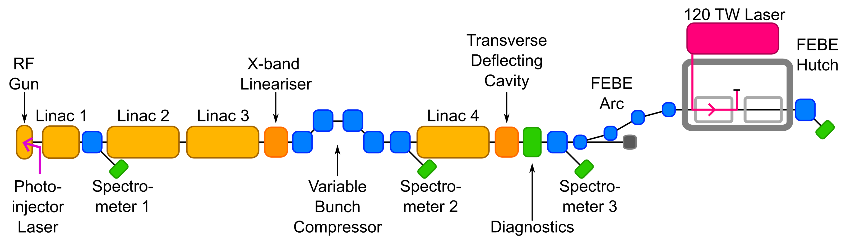
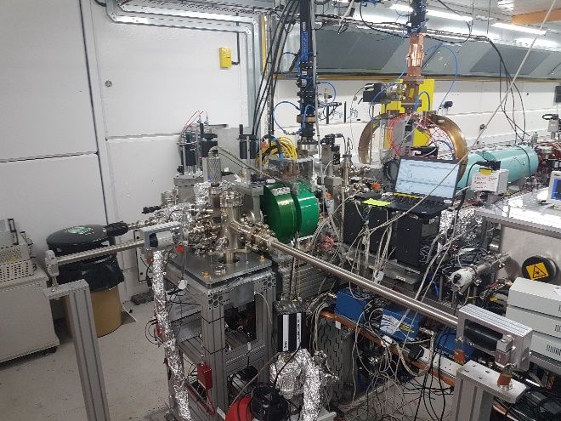
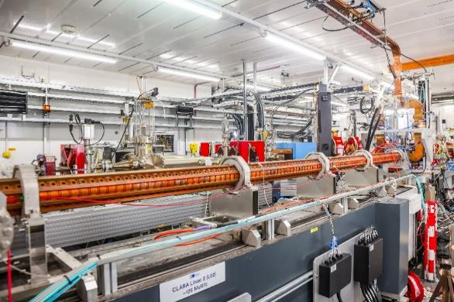
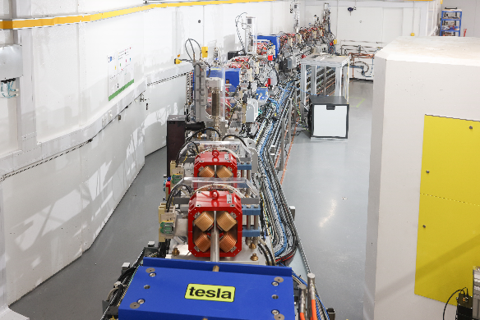
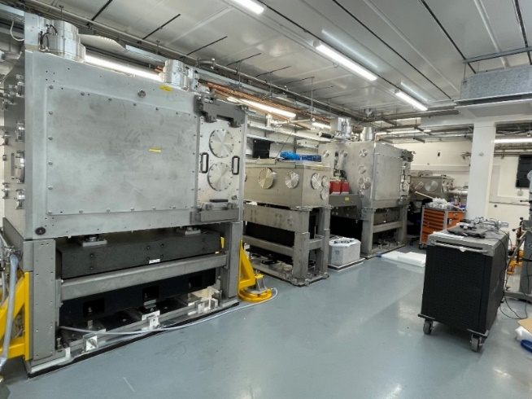
CLARA Layout
Accelerator Hall
~90m x 3.5m x 3m
Generate
Accelerate + Manipulate + Accelerate
Characterise in 6D
Experiment
19
CLARA Gun
S-band Linac
Arc to FEBE hutch
FEBE hutch

Slide 20
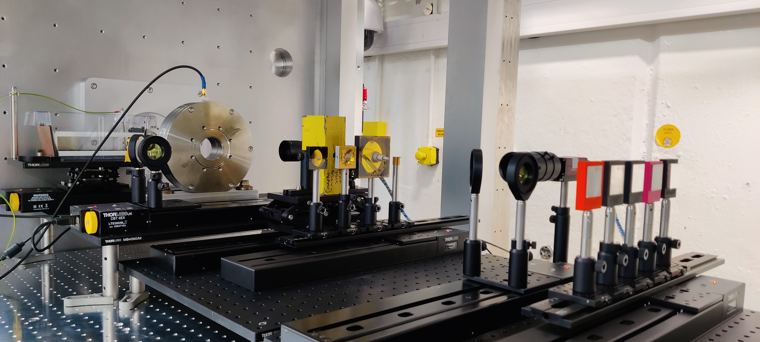
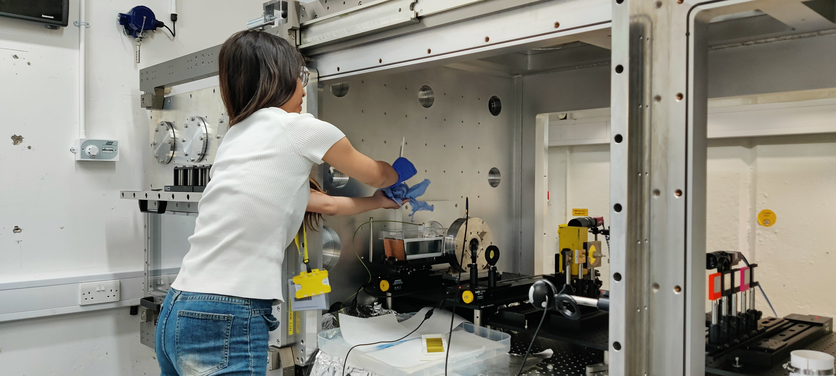
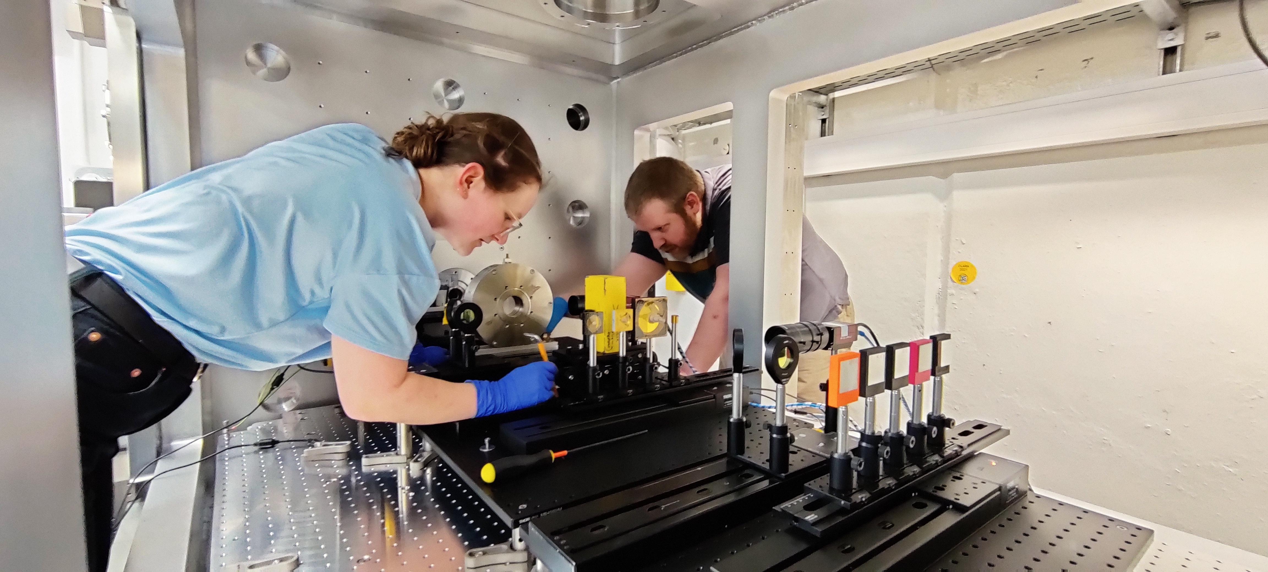
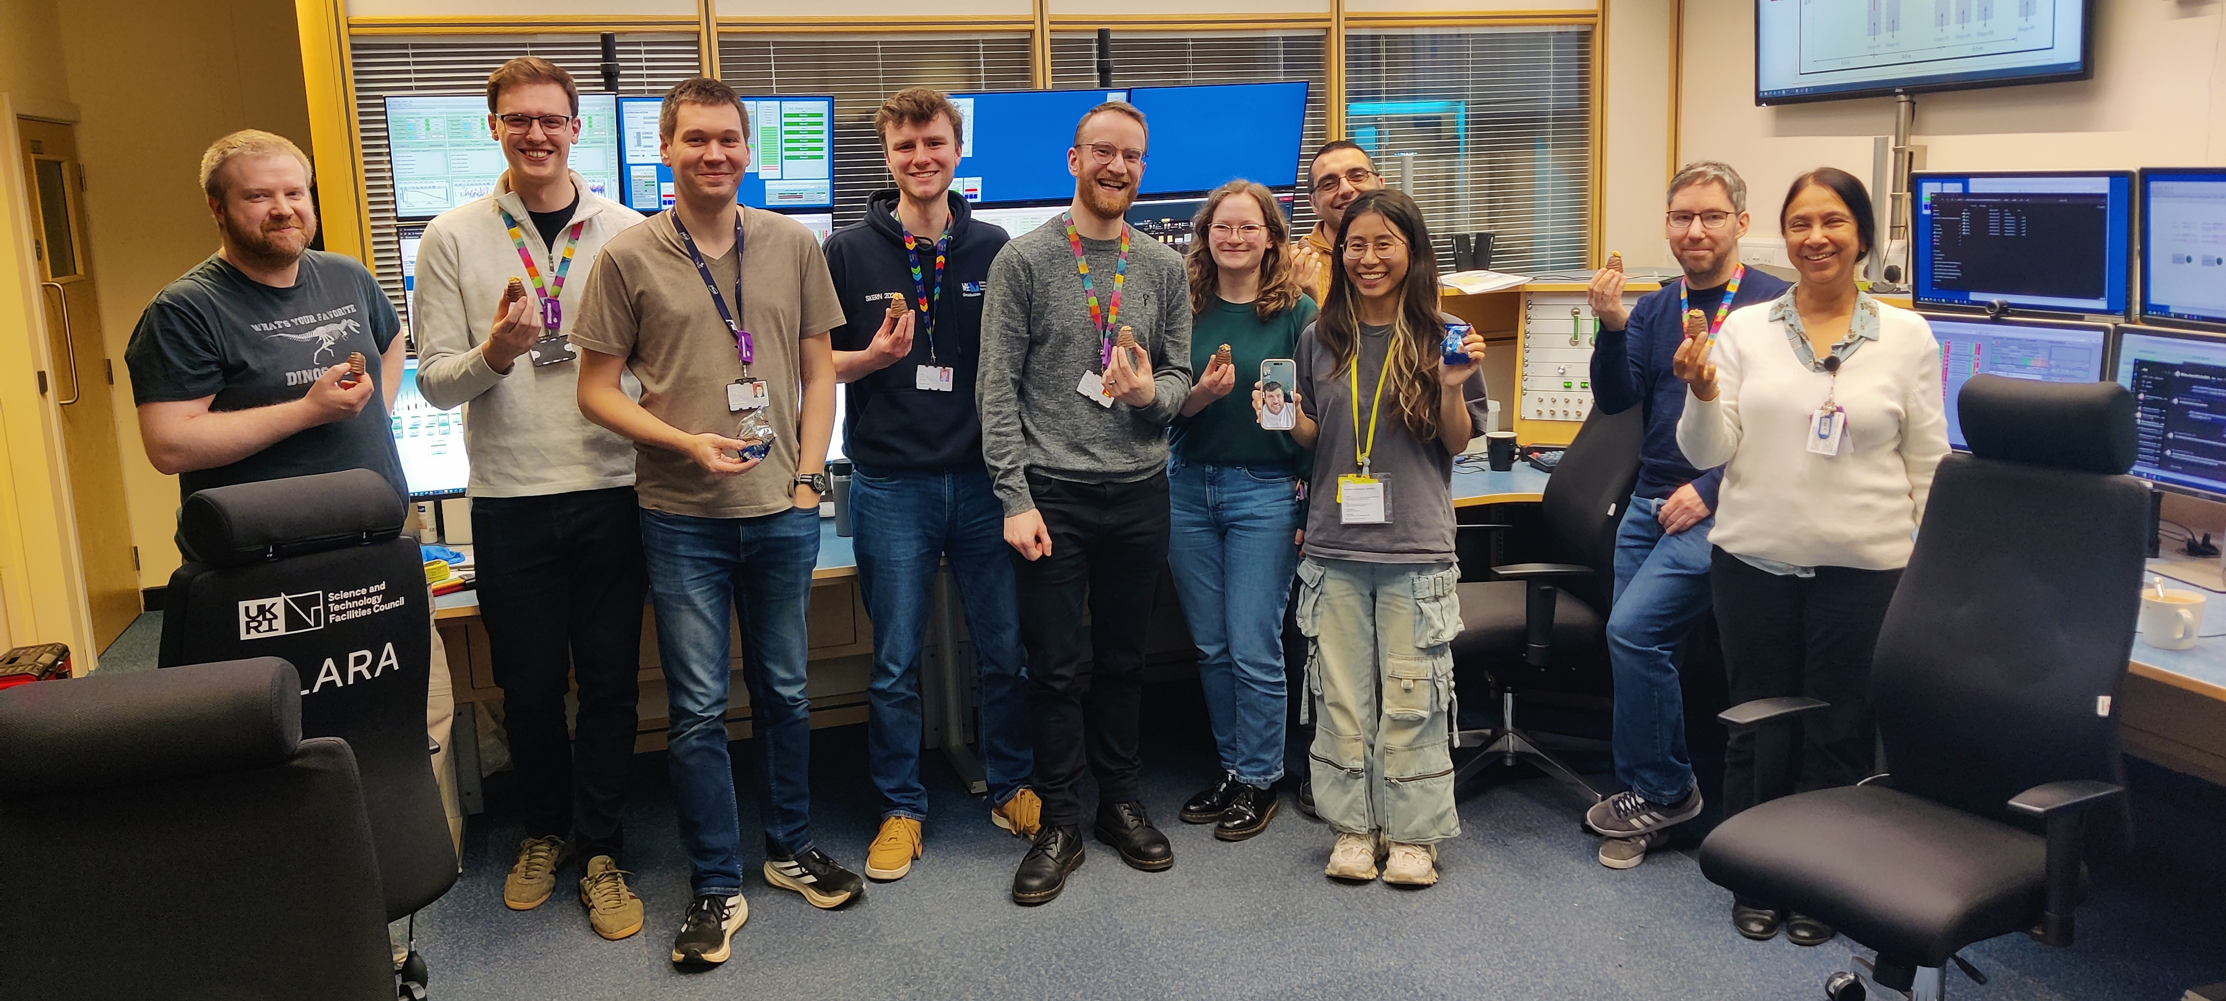
VHEE Dosimetry – 2nd-6th March
Completed Successfully!
University of Oxford/JAI, CERN
20

Slide 21
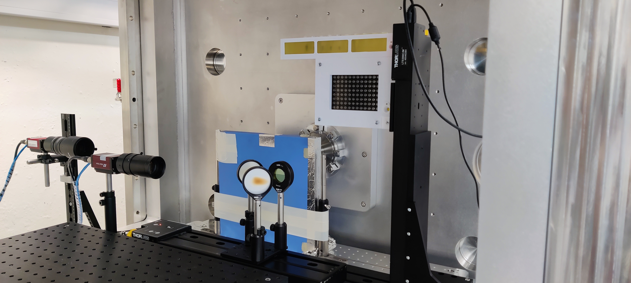
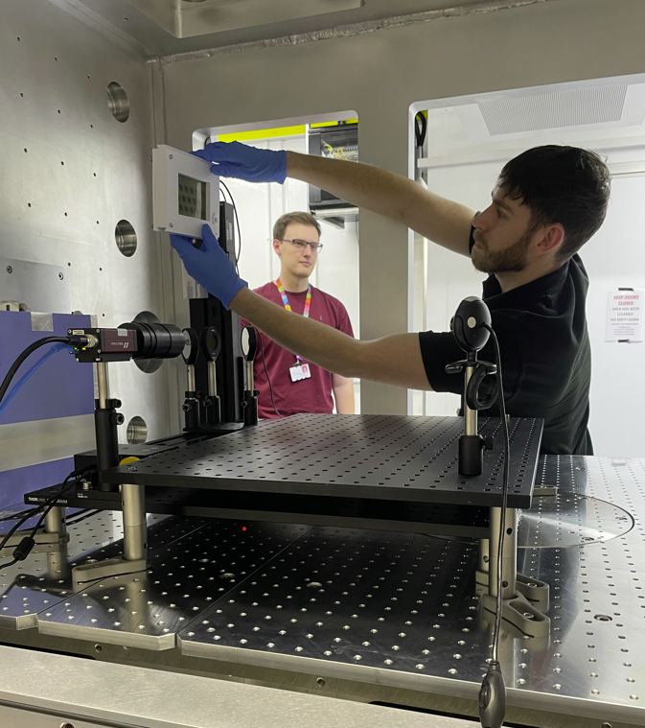
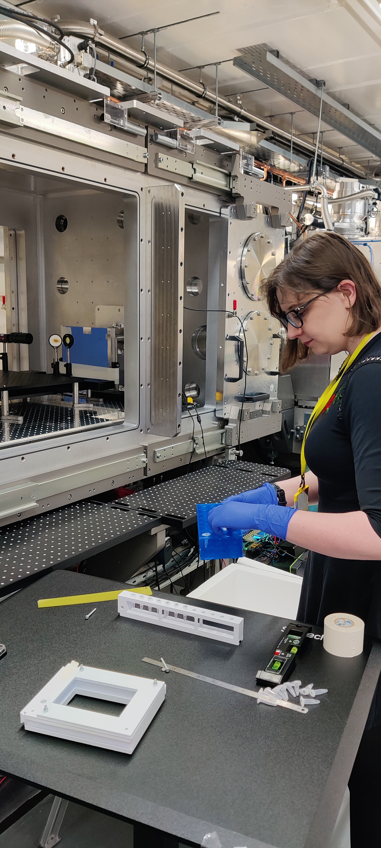
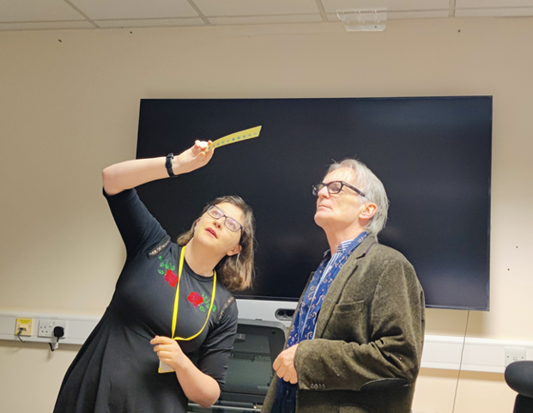
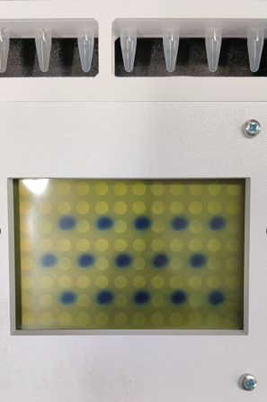
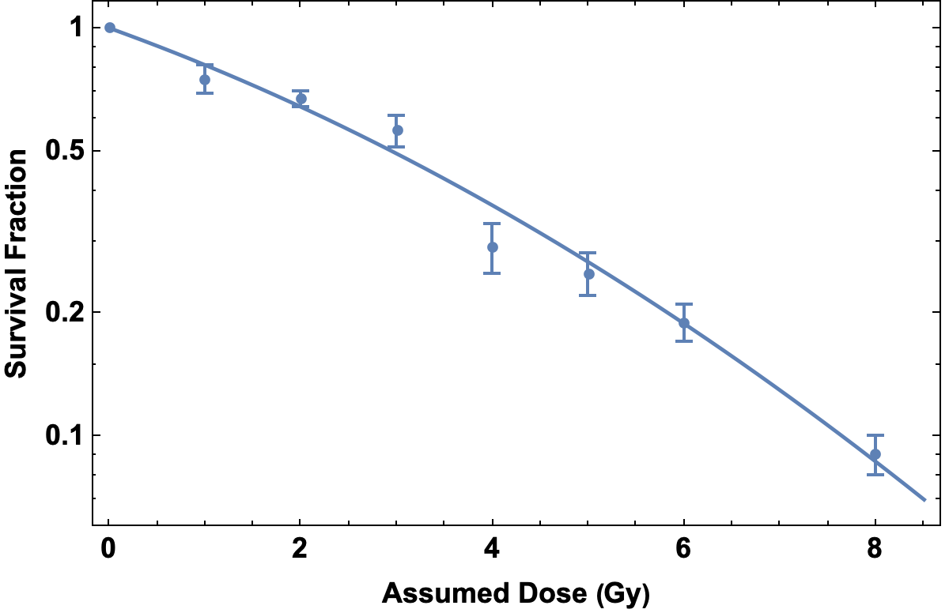
VHEE FLASH/Conventional Cell Irradiation – 9th -13th March
Completed Successfully!
University of Manchester/CI, The Christie Hospital
Survival curve for irradiation of human lung cancer cells.
21

Slide 22
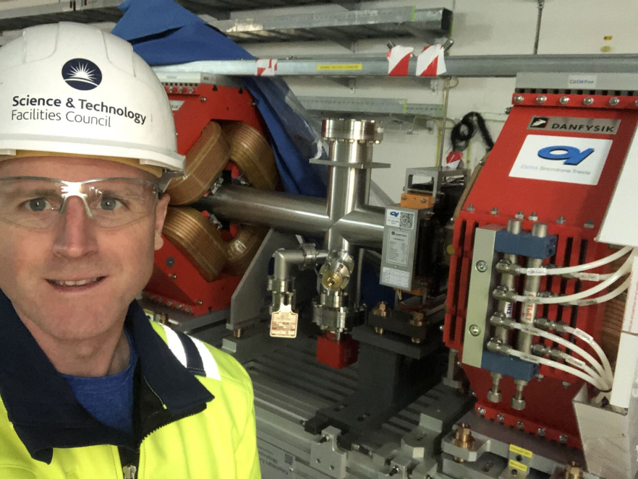
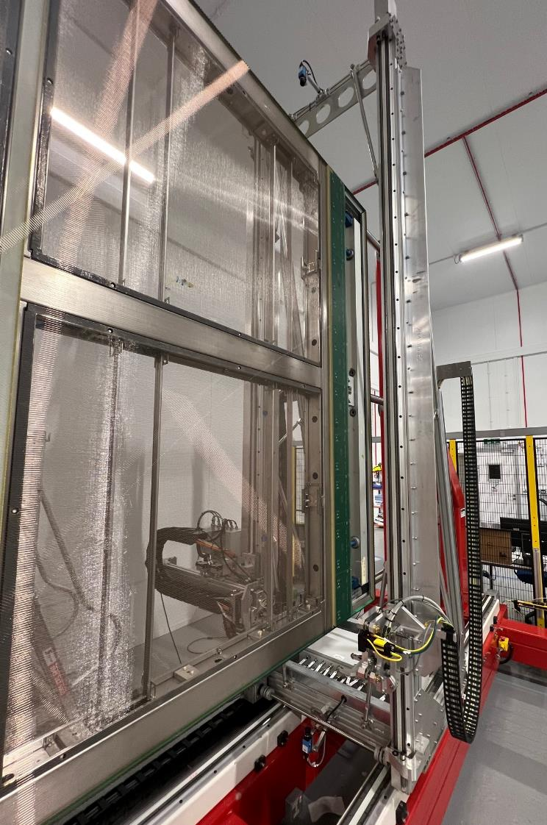
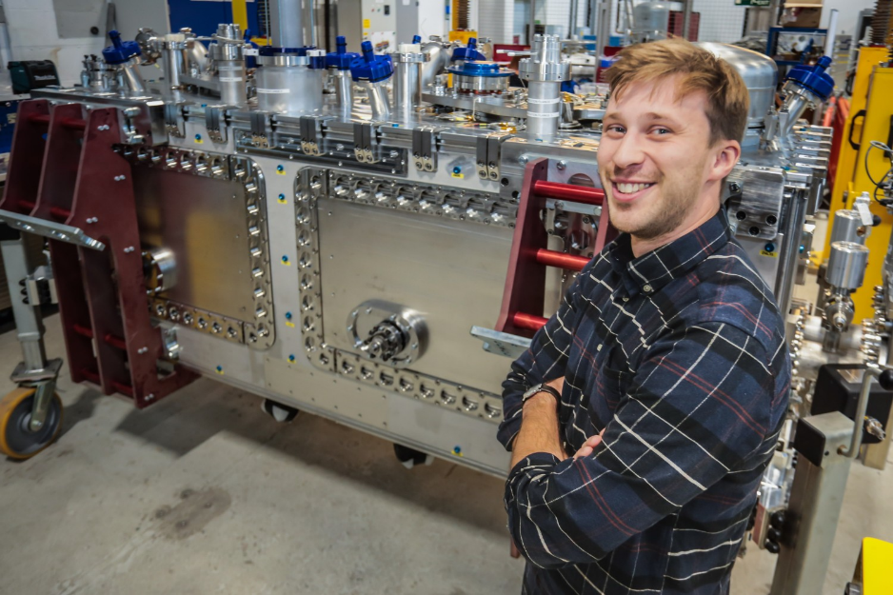
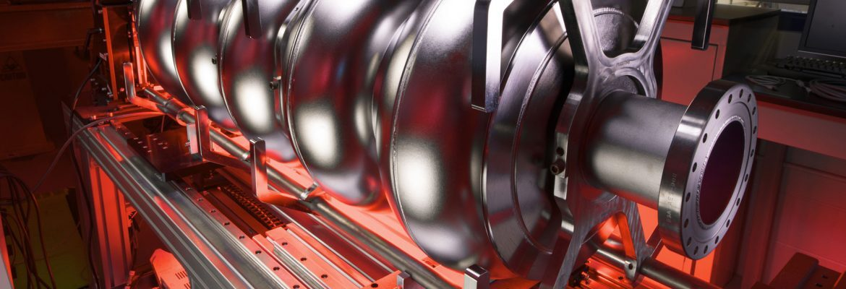
In Kind Contributions
Daresbury delivering major in-kind contributions to international accelerator projects.
European Spallation Source (2015 – 2025)
Superconducting RF Cavities – Complete.
Linac Warm Units – Complete.
RF Waveguide Distribution System – Complete.
LBNF/DUNE (2019 – 2027)
3 High Beta SRF Cryomodules for PIP-II.
137 APA Detectors.
High Luminosity-LHC (2019 – 2027)
Crab Cavity Cryomodules – prototype delivered and tested on SPS.
4 Production Cryomodules.
22

Slide 23
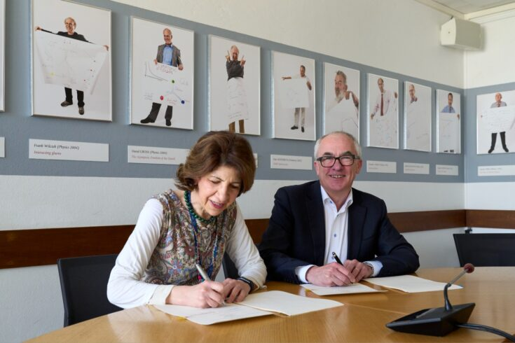
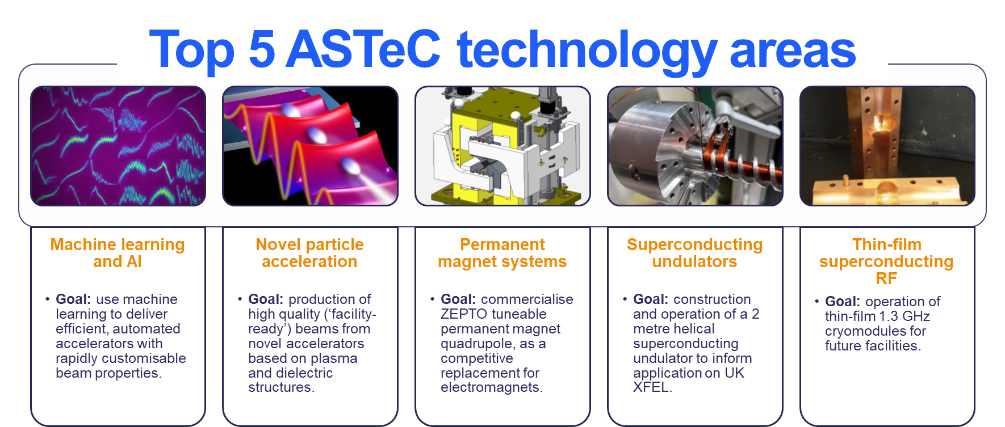
Sustainable Accelerator R&D
ASTeC carries out R&D that aligns with STFC’s Strategic Framework for Accelerators – supports long term infrastructure priorities and/or R&D roadmap for European Strategy for PP.
Emphasis on Future Sustainability of Accelerators.
CLARA accelerator test user facility directly supports academic and industrial communities.
STFC and CERN support environmentally sustainable physics – UKRI – Mar 2024
23

Slide 24

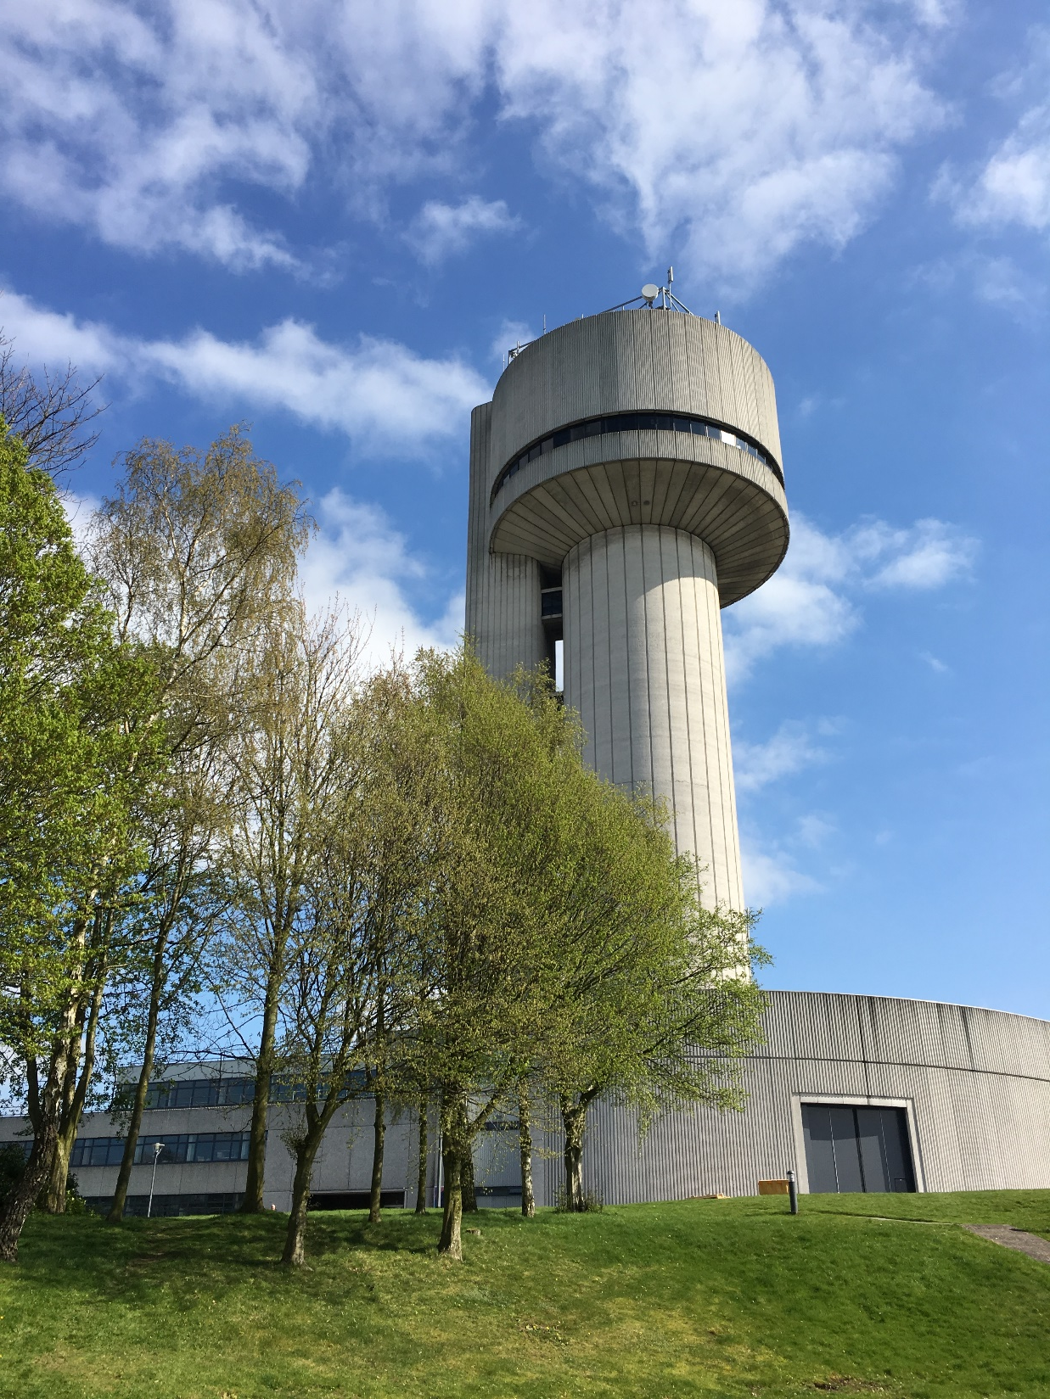
STFC Daresbury Laboratory THANK YOU
www.astec.stfc.ac.uk

