Slide 1
RL control for AGS Injection in silico
Eiad Hamwi
on behalf of the EIC-BeamAI collaboration
Reinforcement Learning for Autonomous Accelerators
March 30th – April 1st

Slide 2
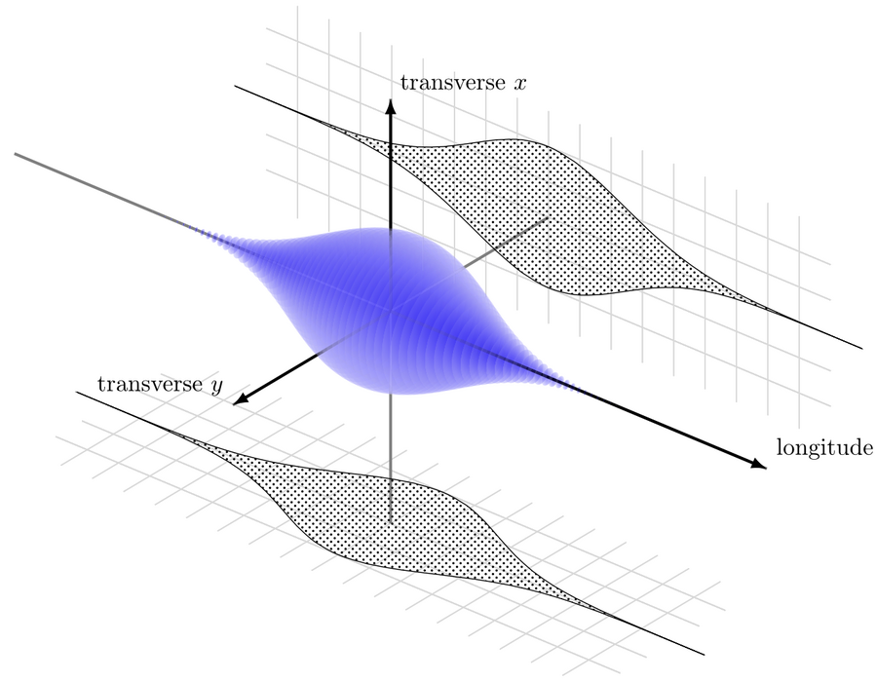
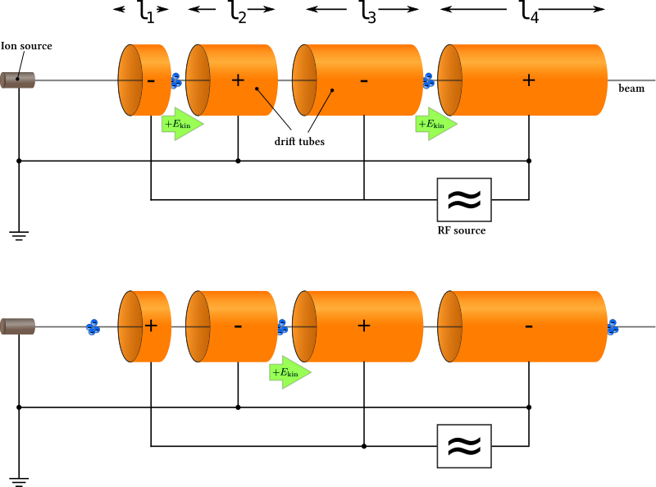
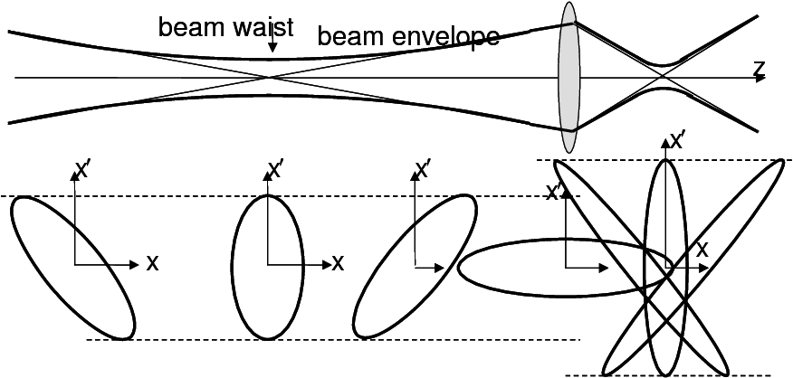
Charged Particle Acceleration
Dense charged beams are the foundation of many technologies:
Cancer treatment
Food irradiation
Medical imaging
Last, but not least: particle accelerators
RL4AA ‘26
Eiad Hamwi

Slide 3
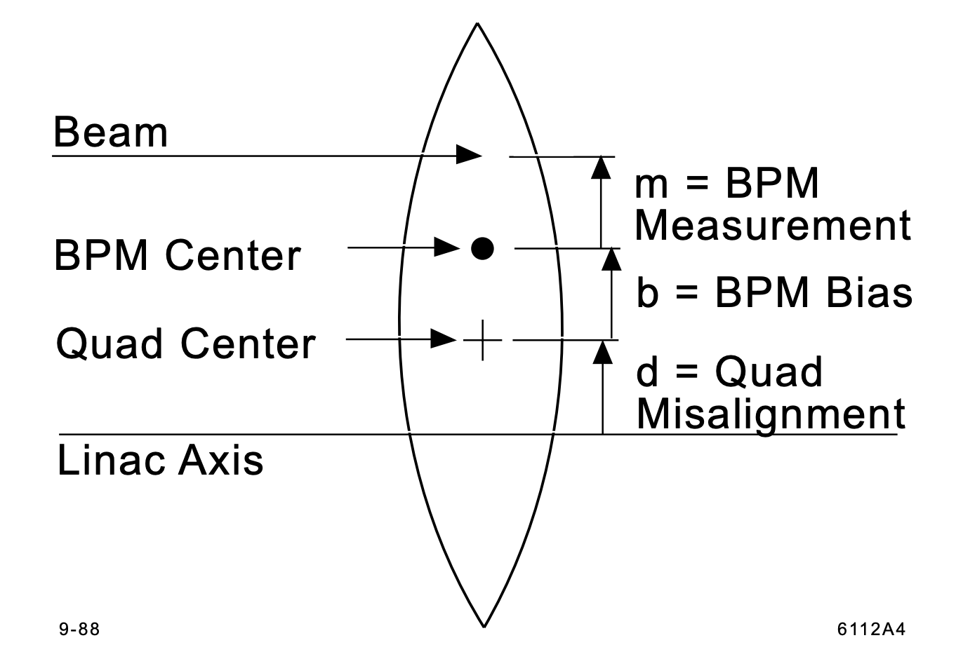
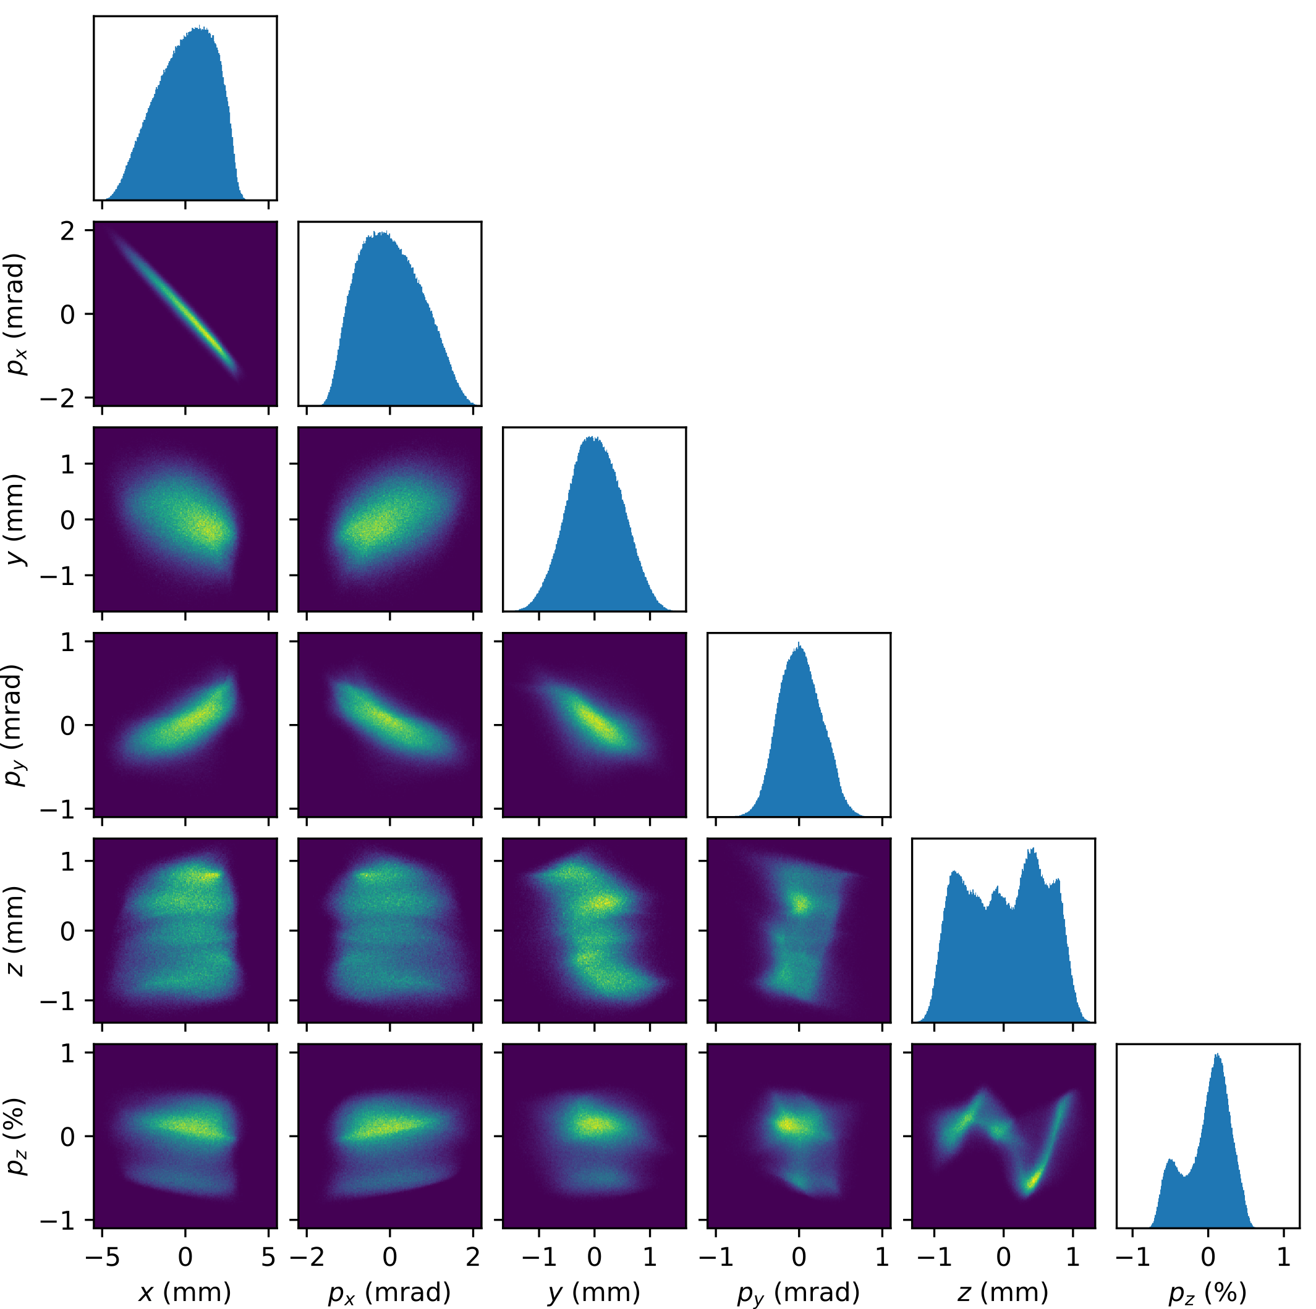
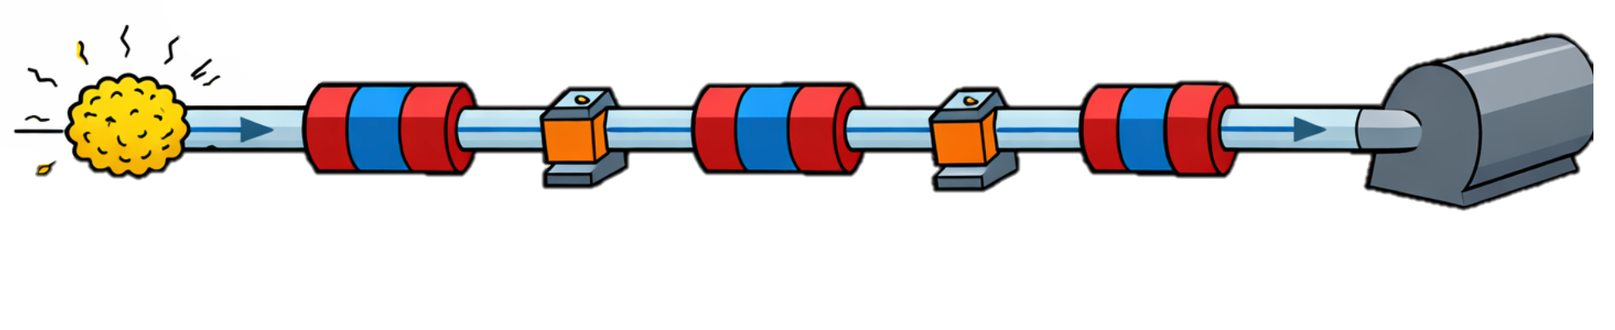
Linac control problem
Linear accelerators / transfer lines require precise configurations for stability
Beam centroid position (dipoles)
Beam spatial distribution (quadrupoles, sextupoles, etc…)
Beam energy distribution (RF cavities)
Magnet misalignments cause feed-down of nonlinear magnetic fields
Quadrupole (Focusing) Magnet
Dipole (Steering) Magnet
R. Roussel, et al (2024). Efficient 6D phase space reconstruction from experimental measurements using generative machine learning.
RL4AA ‘26
Eiad Hamwi

Slide 4
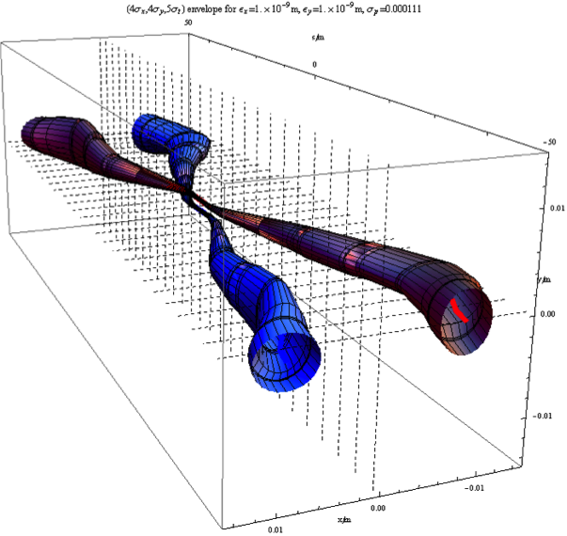
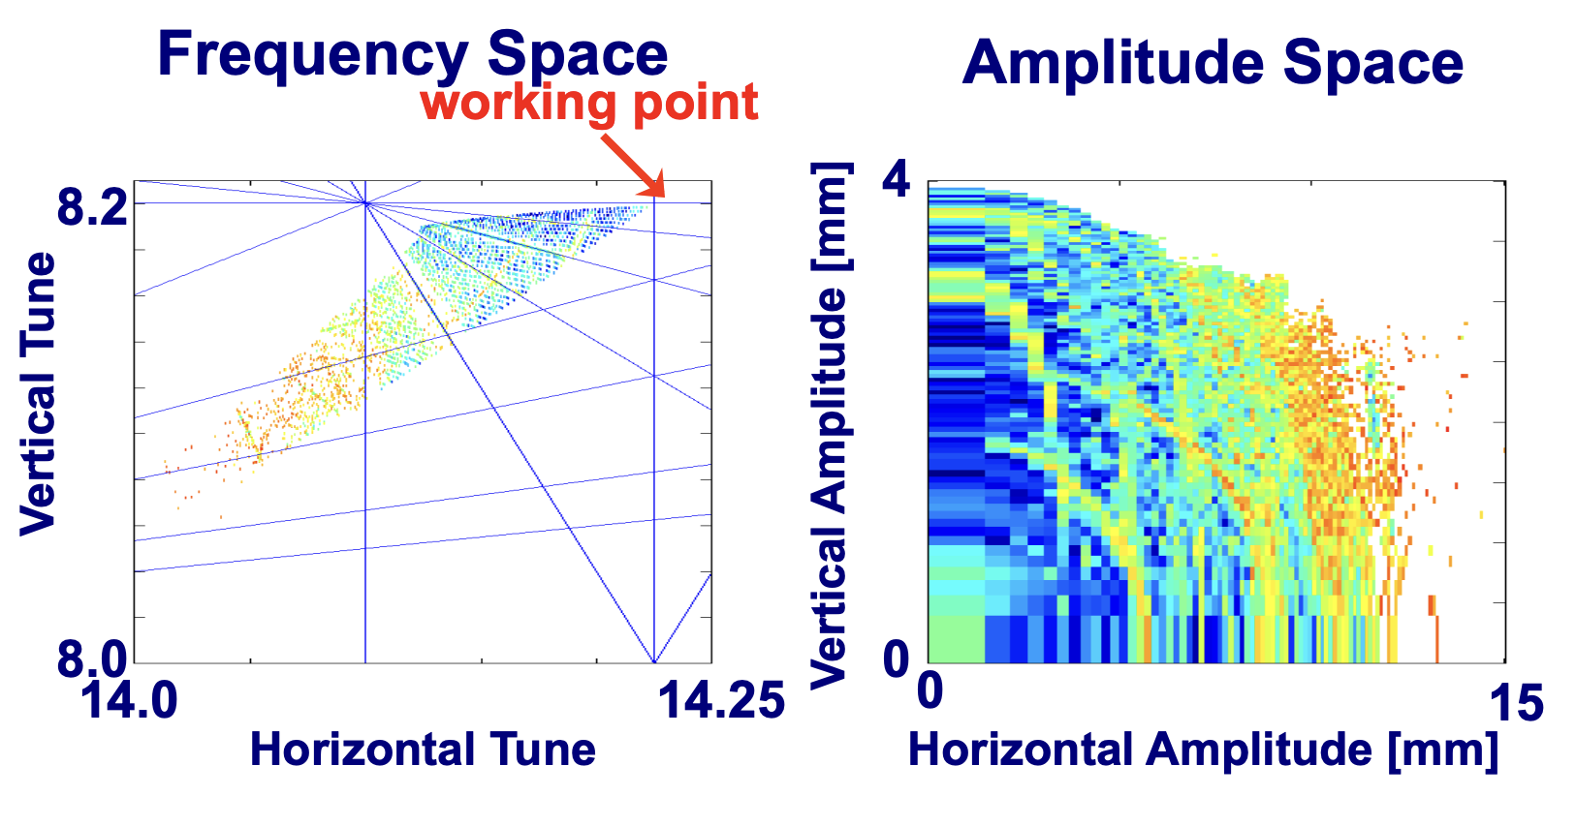
Synchrotron control problem
https://www.quantumdiaries.org/author/anna-phan/page/2/
Synchrotrons require high precision for stability
Periodicity introduces a new frequency to the system
Exacerbates effects of any misalignment (integer resonances)
Possibility of (destructive) coupling of beam oscillations with revolution frequency (fractional resonances)
Storage rings / light sources have extremely tight constraints for beam lifetime & quality
Colliders tighten constraints even further
C. Steier, “Nonlinear Lattice Characterization” USPAS (2015)
RL4AA ‘26
Eiad Hamwi

Slide 5
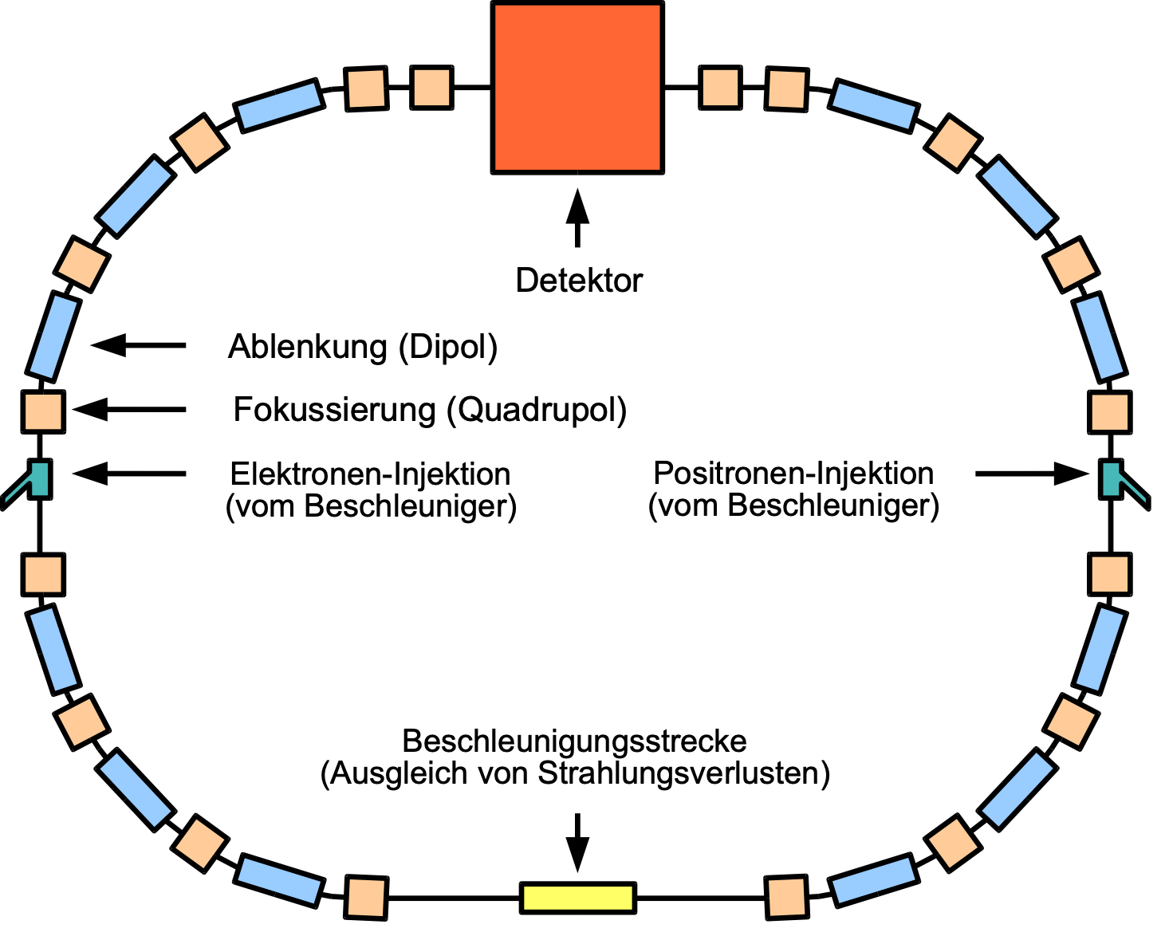
Synchrotron inference problem
Synchrotrons require high precision for stability
Magnet alignment
Magnet field multipole strengths
Collective effects characterization
Methods:
Beam-based alignment (informs orbit)
Orbit-response matrix (informs fields)
Quad tune scans (informs fields)
LOCO (informs fields and orbit)
Other than LOCO, these methods are usually executed independently and incoherently
https://commons.wikimedia.org/wiki/File:Storage_ring_de.svg
RL4AA ‘26
Eiad Hamwi

Slide 6
Synchrotron regimes
There are primarily five/six stages of commissioning in synchrotrons:
Beam injection / threading
Transverse phase space capture
Longitudinal phase space capture
Energy ramping
𝛄-transition (if unlucky)
Beam extraction
RL4AA ‘26
Eiad Hamwi

Slide 7

Beam threading
In this stage, the synchrotron is effectively a transfer line
Can be treated like a sequential optimization problem
RL4AA ‘26
Eiad Hamwi

Slide 8



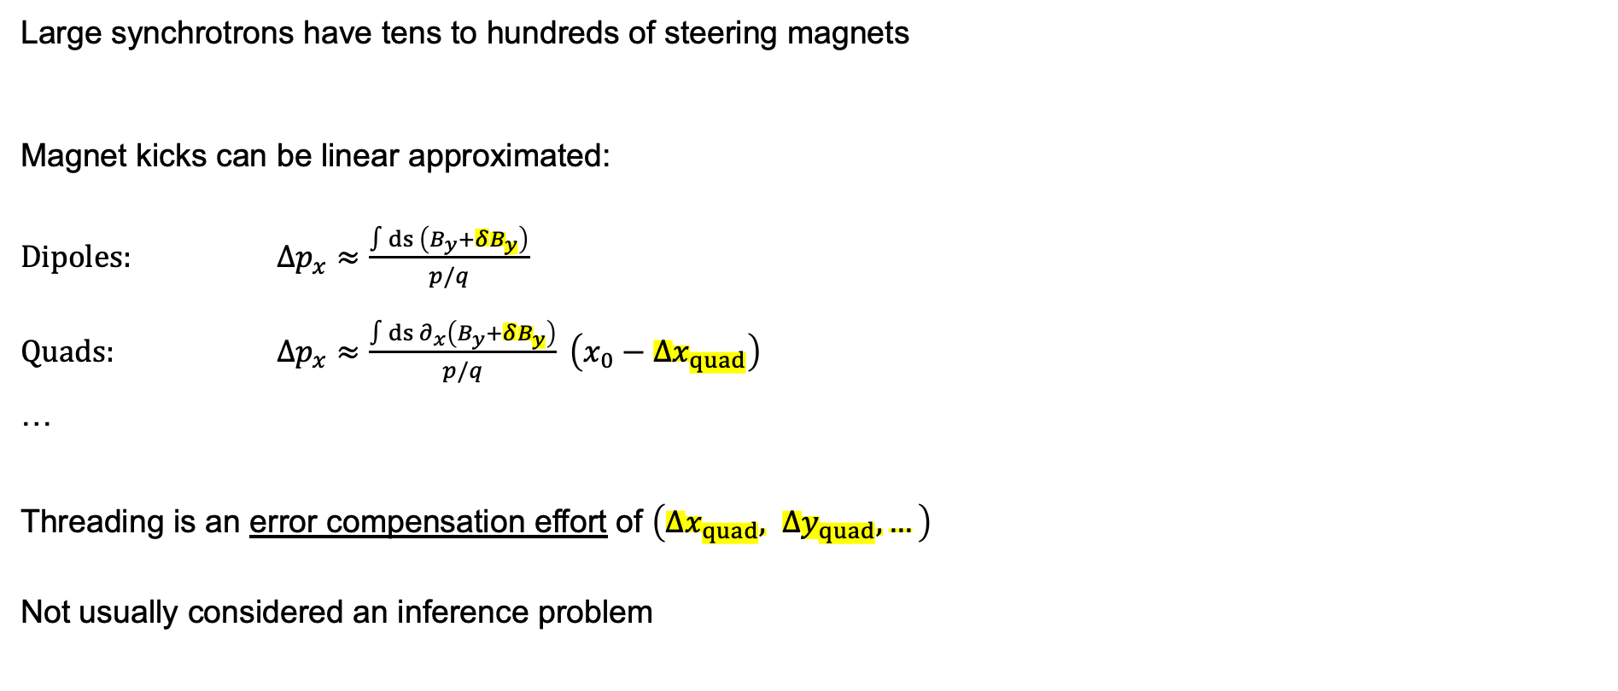


Beam threading
Large synchrotrons have tens to hundreds of steering magnets
Magnet kicks can be linear approximated:
Dipoles: $Δp_{x}≈\frac{∫ds \left(B_{y}+δB_{y}\right)}{p/q}$ Quads: $Δp_{x}≈\frac{∫ds ∂_{x}\left(B_{y}+δB_{y}\right)}{p/q} \left(x_{0}−{Δx}_{quad}\right)$
… Threading is an error compensation effort of $\left({Δx}_{quad}, {Δy}_{quad}, …\right)$
Not usually considered an inference problem
RL4AA ‘26
Eiad Hamwi

Slide 9

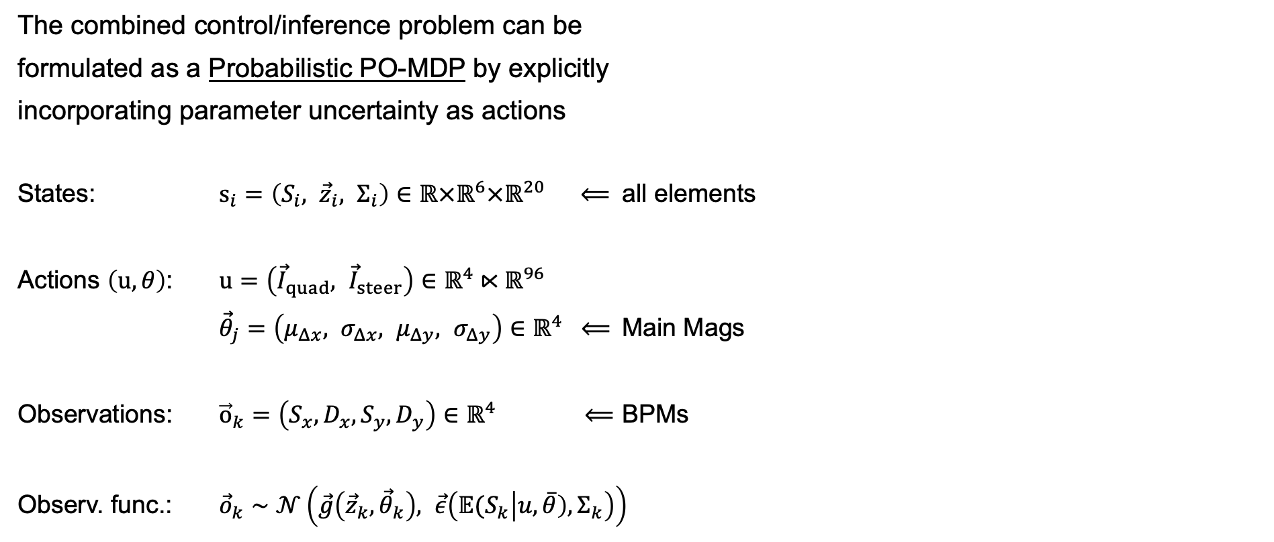




Beam threading using MPC
The combined control/inference problem can be
formulated as a Probabilistic PO-MDP by explicitly
incorporating parameter uncertainty as actions
States: $s_{i}=\left(S_{i}, {\vec{z}}_{i}, Σ_{i}\right)∈ℝ×ℝ^{6}×ℝ^{20}$ $⟸$ all elements
Actions $\left(u,θ\right)$: $u=\left({\vec{I}}_{quad}, {\vec{I}}_{steer}\right)∈ℝ^{4}⋉ℝ^{96}$
${\vec{θ}}_{j}=\left(μ_{Δx}, σ_{Δx}, μ_{Δy}, σ_{Δy}\right)∈ℝ^{4} ⟸$ Main Mags
Observations: ${\vec{o}}_{k}=\left(S_{x},D_{x},S_{y}, D_{y}\right)∈ℝ^{4}$ $⟸$ BPMs
Observ. func.: ${\vec{o}}_{k}∼𝒩\left(\vec{g}\left({\vec{z}}_{k}, {\vec{θ}}_{k}\right), \vec{ε}\left({𝔼(S}_{k}\left|u,\overline{θ}\right),Σ_{k}\right)\right)$
RL4AA ‘26
Eiad Hamwi

Slide 10
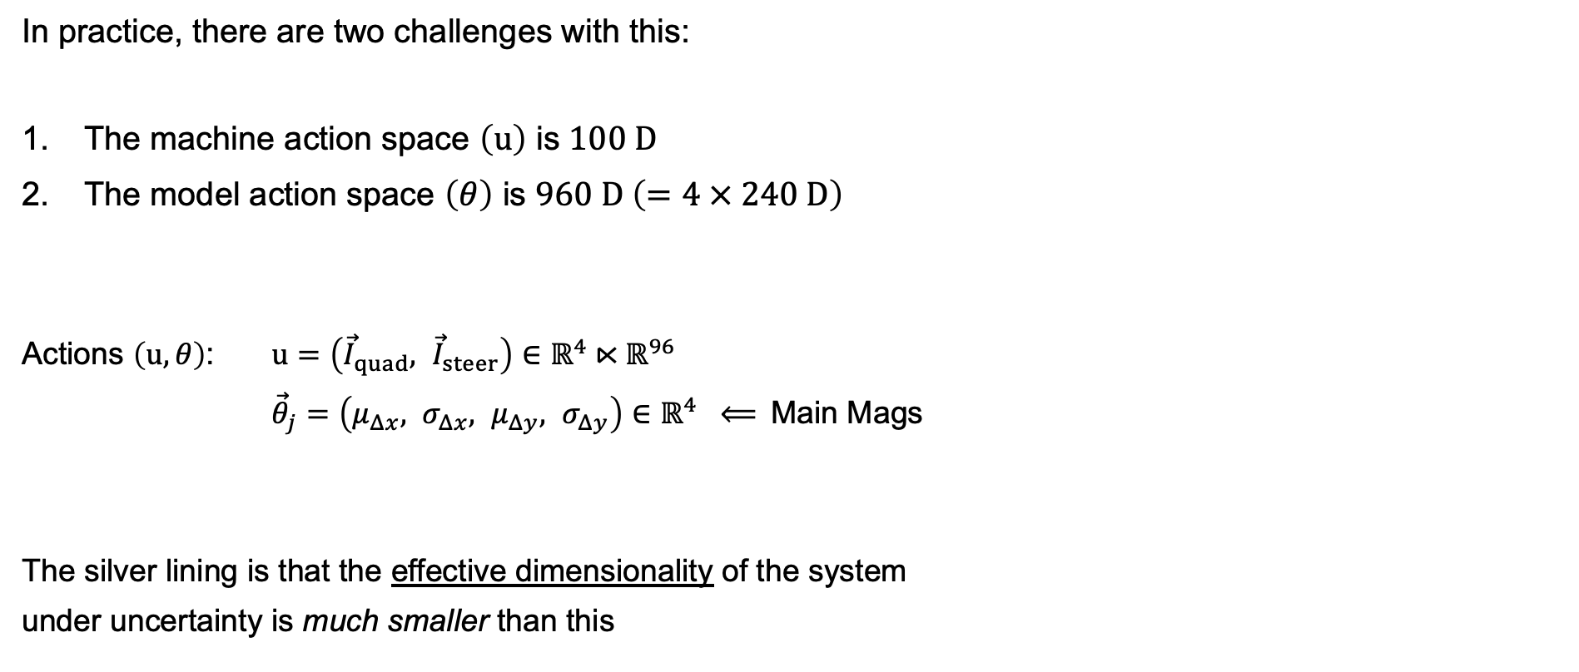
Challenges with the MPC space
In practice, there are two challenges with this:
The machine action space $\left(u\right)$ is $100 D$
The model action space $\left(θ\right)$ is $960 D \left(=4 × 240 D\right)$
Actions $\left(u,θ\right)$: $u=\left({\vec{I}}_{quad}, {\vec{I}}_{steer}\right)∈ℝ^{4}⋉ℝ^{96}$
${\vec{θ}}_{j}=\left(μ_{Δx}, σ_{Δx}, μ_{Δy}, σ_{Δy}\right)∈ℝ^{4} ⟸$ Main Mags
The silver lining is that the effective dimensionality of the system
under uncertainty is much smaller than this
RL4AA ‘26
Eiad Hamwi

Slide 11
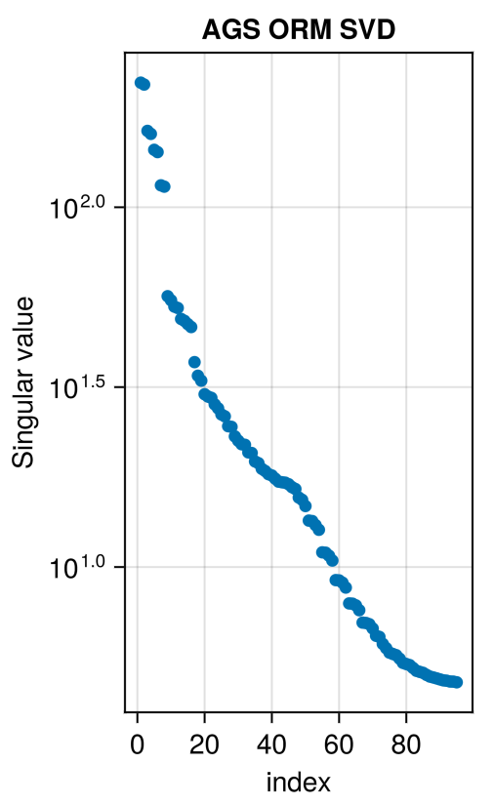
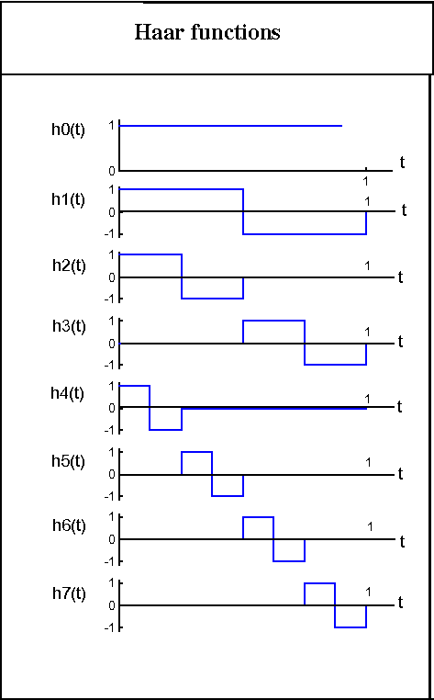
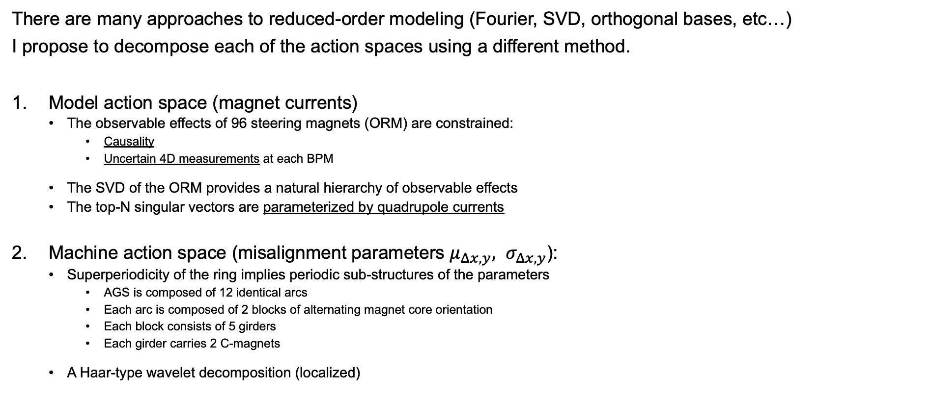
Decomposing the MPC action space
There are many approaches to reduced-order modeling (Fourier, SVD, orthogonal bases, etc…)
I propose to decompose each of the action spaces using a different method.
Model action space (magnet currents)
The observable effects of 96 steering magnets (ORM) are constrained:
Causality
Uncertain 4D measurements at each BPM
The SVD of the ORM provides a natural hierarchy of observable effects
The top-N singular vectors are parameterized by quadrupole currents
Machine action space (misalignment parameters $μ_{Δx,y}, σ_{Δx,y}$):
Superperiodicity of the ring implies periodic sub-structures of the parameters
AGS is composed of 12 identical arcs
Each arc is composed of 2 blocks of alternating magnet core orientation
Each block consists of 5 girders
Each girder carries 2 C-magnets
A Haar-type wavelet decomposition (localized)
Hariharan, et al. Haar wavelet method for solving Fisher's equation. (2019) Appl. Math. Comput., 211, 284-292.
RL4AA ‘26
Eiad Hamwi

Slide 12
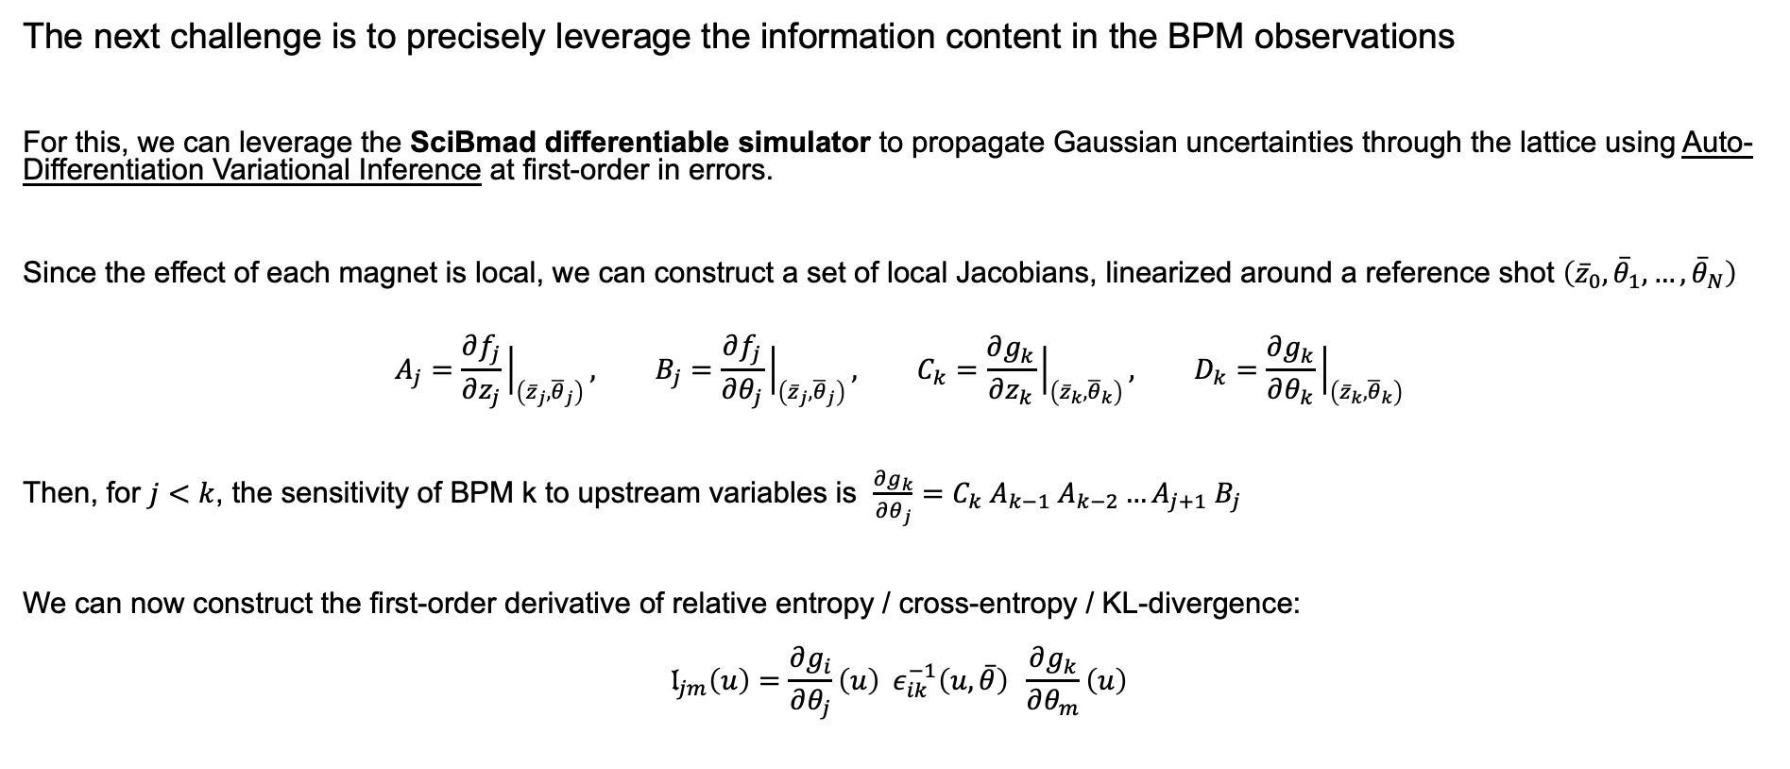
Rewarding information gain
The next challenge is to precisely leverage the information content in the BPM observations
For this, we can leverage the SciBmad differentiable simulator to propagate Gaussian uncertainties through the lattice using Auto-Differentiation Variational Inference at first-order in errors.
Since the effect of each magnet is local, we can construct a set of local Jacobians, linearized around a reference shot $\left({\overline{z}}_{0},{\overline{θ}}_{1},…,{\overline{θ}}_{N}\right)$
$$A_{j}=\frac{∂f_{j}}{∂z_{j}}{\left.​\right|}_{\left({\overline{z}}_{j},{\overline{θ}}_{j}\right)}, B_{j}=\frac{∂f_{j}}{∂θ_{j}}{\left.​\right|}_{\left({\overline{z}}_{j},{\overline{θ}}_{j}\right)}, C_{k}=\frac{∂g_{k}}{∂z_{k}}{\left.​\right|}_{\left({\overline{z}}_{k},{\overline{θ}}_{k}\right)}, D_{k}=\frac{∂g_{k}}{∂θ_{k}}{\left.​\right|}_{\left({\overline{z}}_{k},{\overline{θ}}_{k}\right)}$$
Then, for $j<k$, the sensitivity of BPM k to upstream variables is $\frac{∂g_{k}}{∂θ_{j}}=C_{k} A_{k−1} A_{k−2}…A_{j+1} B_{j}$
We can now construct the first-order derivative of relative entropy / cross-entropy / KL-divergence:
$$𝔩_{jm}\left(u\right)=\frac{∂g_{i}}{∂θ_{j}}\left(u\right) ε_{ik}^{−1}\left(u,\overline{θ}\right) \frac{∂g_{k}}{∂θ_{m}}\left(u\right)$$
RL4AA ‘26
Eiad Hamwi

Slide 13
Reward function shaping
The MPC agent needs to balance optimizing machine performance and system ID
Safety constraints demand a strong biasing against beam loss, dictated by the BPM sum signals.
During commissioning, beam should be dumped after first turn, since beam is likely not on closed-orbit.
Then system-identification is naturally re-incentivized, and MPC can push the machine towards resonances to inflate sensitivity.
Furthermore, the agent has access to the exact first-order sensitivities and can easily extend to many (small) steps.
This offers a robust approach to beam threading and system identification via a control-as-inference paradigm.
RL4AA ‘26
Eiad Hamwi

Slide 14
Summary
Probabilistic MPC and fast differentiable physics models can explicitly represent model uncertainty.
Degeneracies / trade-offs in parameter uncertainties can be explicitly characterized.
Control-as-inference paradigm is essential for minimally-invasive system identification.
Thank you!
RL4AA ‘26
Eiad Hamwi

