Slide 1
Comments on some recent meetings ILCaMS, 13/6/26 in the GFlex
Meeting on 13/6/25 in the Gflex.
Agenda:
Welcome (Liz Laird)
Strategy and Resources
HLS & ILCaMS Research Strategy (Liz Laird)
Support and Resources available across Institute and UoL (Ian Craig)
ILCaMS Departmental Research Presentations
Musculoskeletal & Ageing Science (Liz Laird)
Cardiovascular & Metabolic Medicine (Parveen Sharma)
Eye & Vision Sciences (Reinhold Medina)
Women’s & Children’s Health (David Lissauer & Paul McNamara)
School of Dentistry (Sondos Albadri)
School of Medicine (Sarah Hart)
Collaboration/Innovation Sprint (Alys Kay)
Inter-Departmental/Faculty Collaboration
Health & Life Sciences (Sophie Archard)
Science & Engineering (Laura O’Keefe)
Humanities & Social Sciences (Chris Williams)
Large Interdisciplinary Grant Applications and Networks
Experimental arthritis treatment for children (Michael Beresford)
EpiSafe (Shakila Thangaratinam)
Regenerative Medicine Network (Bettina Wilm)
Developing Collaborative Research Opportunities (Alys Kay)
Close (Liz Laird)

Slide 2
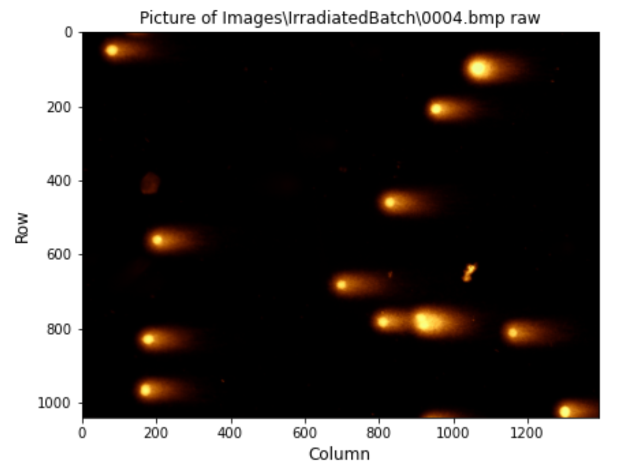
ILCaMS
ILCaMS stands for Institute of Life Course and Medical Sciences.
Following recommendations of Scientific Advisory Board, want to broaden their collaborations in and outside Liverpool.
Some information on their research portfolio was provided.
Any new projects/collaborations for Physics?
Slides shown in the meeting are here.
My brief notes are here.
Potential points of interest include the following.
Institute of Population health (analysis of health data).
Institute of systems molecular and integrative biology (molecular and clinical cancer medicine).
Interest in data/image analysis?

Slide 3
ILCaMS
School of dentistry, Kazia Gurzawska-Comis is working with organoid models.
There is a faculty Health Technologies network to which Physics is contributing (antimicrobial surfaces, cancer diagnosis/treatment, eye disease, Clatterbridge…)
Experimental Arthritis Treatment Centre for Children, EATC4C, interest in development of prognostic biomarkers.
Can IR imaging contribute?

Slide 4
LIV.INNO data science in healthcare
Meeting 25/6/25 in the Spine.
Agenda is here.
Some points of interest.
Alder Hey
Innovation Hub (e.g. rapid prototyping).
AI and Data Lab. (AI used to assist clinical Admin. E.g. targeting patients with appointments). Contact Olufemi Olajide.
The Walton Centre
Surgical implants to recover neurological function.
Replace some aspects using wearables? Contact Deepti Bhargava.
Manchester Division of Cancer Sciences,
Use post radiotherapy prostate specific antigen levels for cancer risk assessment. Contact Jane Shortall.

Slide 5
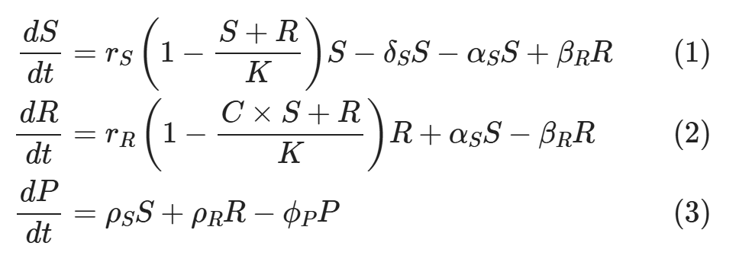
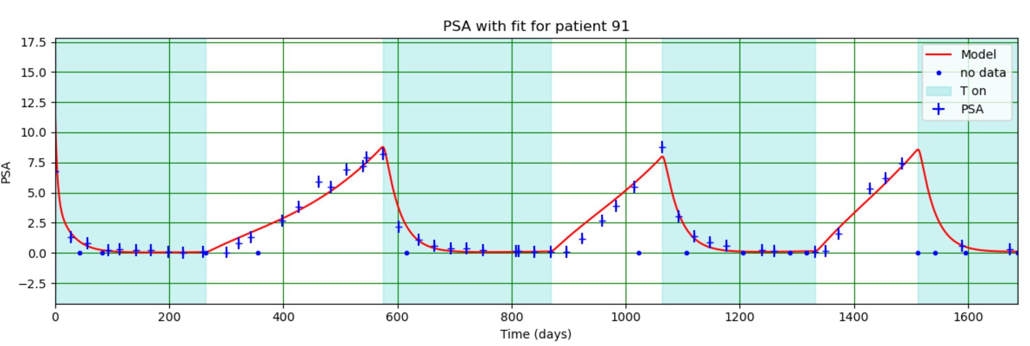
LIV.INNO data science in healthcare
C.f. Phys498 project modelling PSA dynamics during adaptive therapy for prostate cancer.
Data provided by Gatenby et al.
Will get in touch with Jane…
Equations:
Fit to data:

Slide 6
Possible next steps
Start a Medical Physics seminar series.
Invite potential collaborators to present their work to the Medical Physics group.
Take the opportunity to show them relevant capabilities in Physics (sensors, 3D printing, imaging techniques, AI expertise…).
Explore possibility of joint student projects, joint PhD supervision…
Find out about seminars in ILCaMS.
Go along and talk to people.
Present the work we do in Physics.
They know as little about what we do as we do about their research!
Find out about the Faculty’s Health Technology Network.
Does it organise meetings and seminars?
Should we try and breath life into it or do our own thing?
Any other thoughts?

