Slide 1
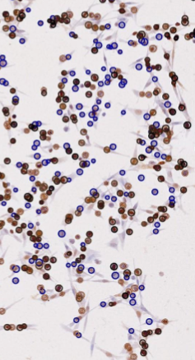
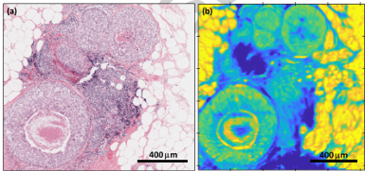
Recent student projects
Chika Eze
Thiazzi Anakrazia
Safaa Al Jedani
Practicing histologist
Neoadjuvant breast cancer
Application of IR and MLA
Prediction of treatment plan effectiveness
Uveal melanoma cancer cell line study
Application of IR and MLA
Relation of IR biomarkers to genetic signatures
Developed automated analysis for cell identification
Head and Neck cancer
Application of IR (FTIR and O-PTIR) and MLA
Image fusion of HnE and IR images
Application of CNN’s to IR images

