Slide 1
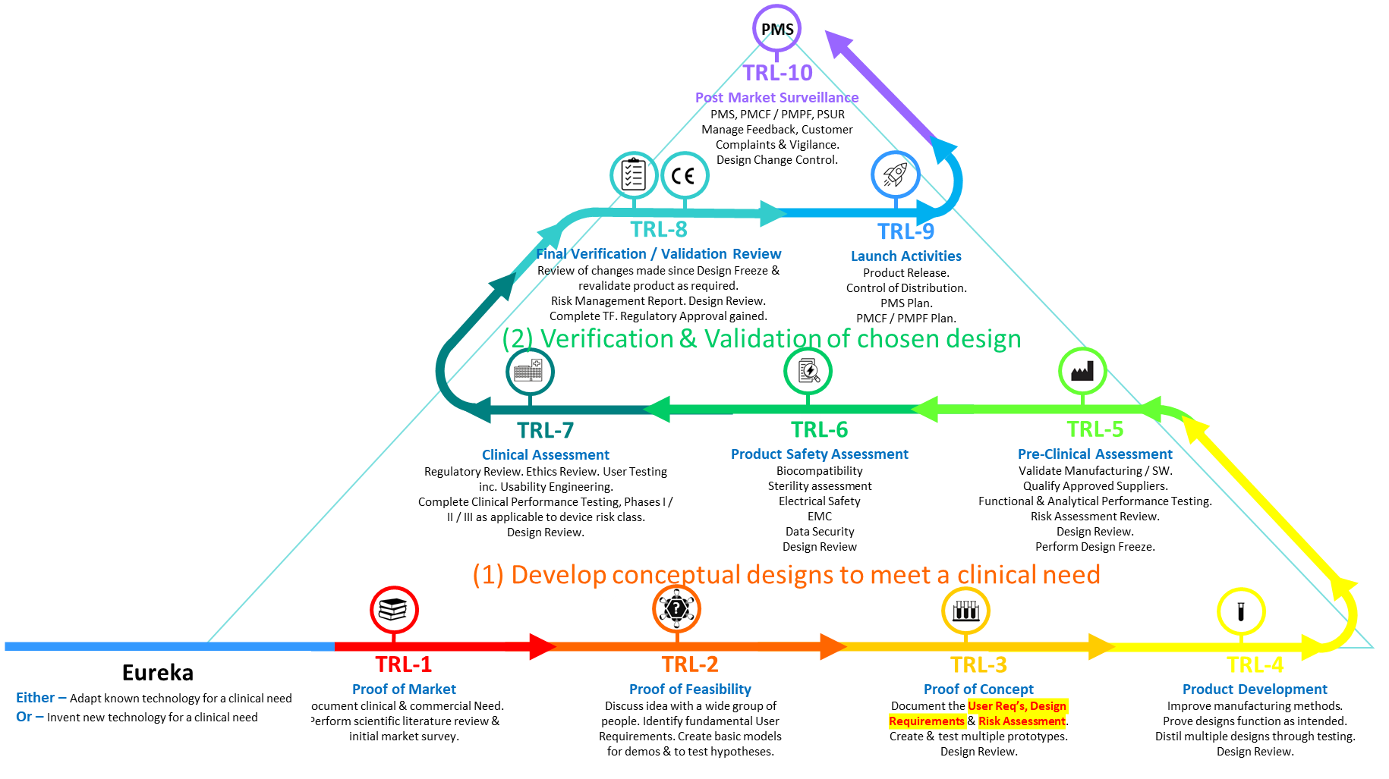
Commercialisation Pathway Challenges
*Richard Hall, QMS Consultancy Ltd

Slide 2
Commercialisation Pathway Challenges
*Richard Hall, QMS Consultancy Ltd

Slide 3
Commercialisation Pathway Challenges
Initial Funding
*Richard Hall, QMS Consultancy Ltd

Slide 4
Commercialisation Pathway Challenges
IP
Patents vs Know-How
TTO’s @ Uni
Research conflicts
*Richard Hall, QMS Consultancy Ltd

Slide 5
Commercialisation Pathway Challenges
Regulation
QMS Consultancy
Outsourcing
Technical files
*Richard Hall, QMS Consultancy Ltd

Slide 6
Commercialisation Pathway Challenges
Spinout (Money)
Investment
UoL agreements
Expertise
Balance
*Richard Hall, QMS Consultancy Ltd

Slide 7
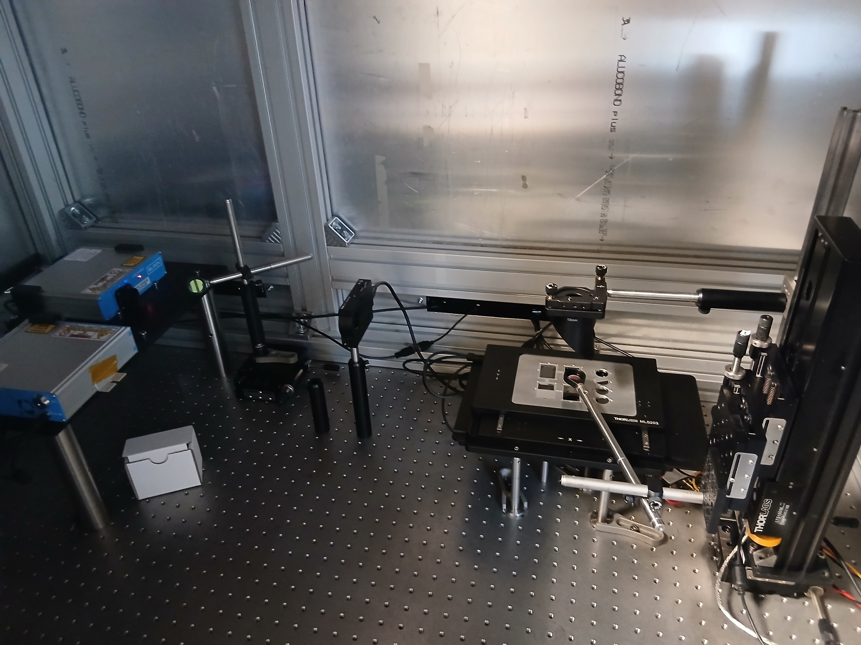
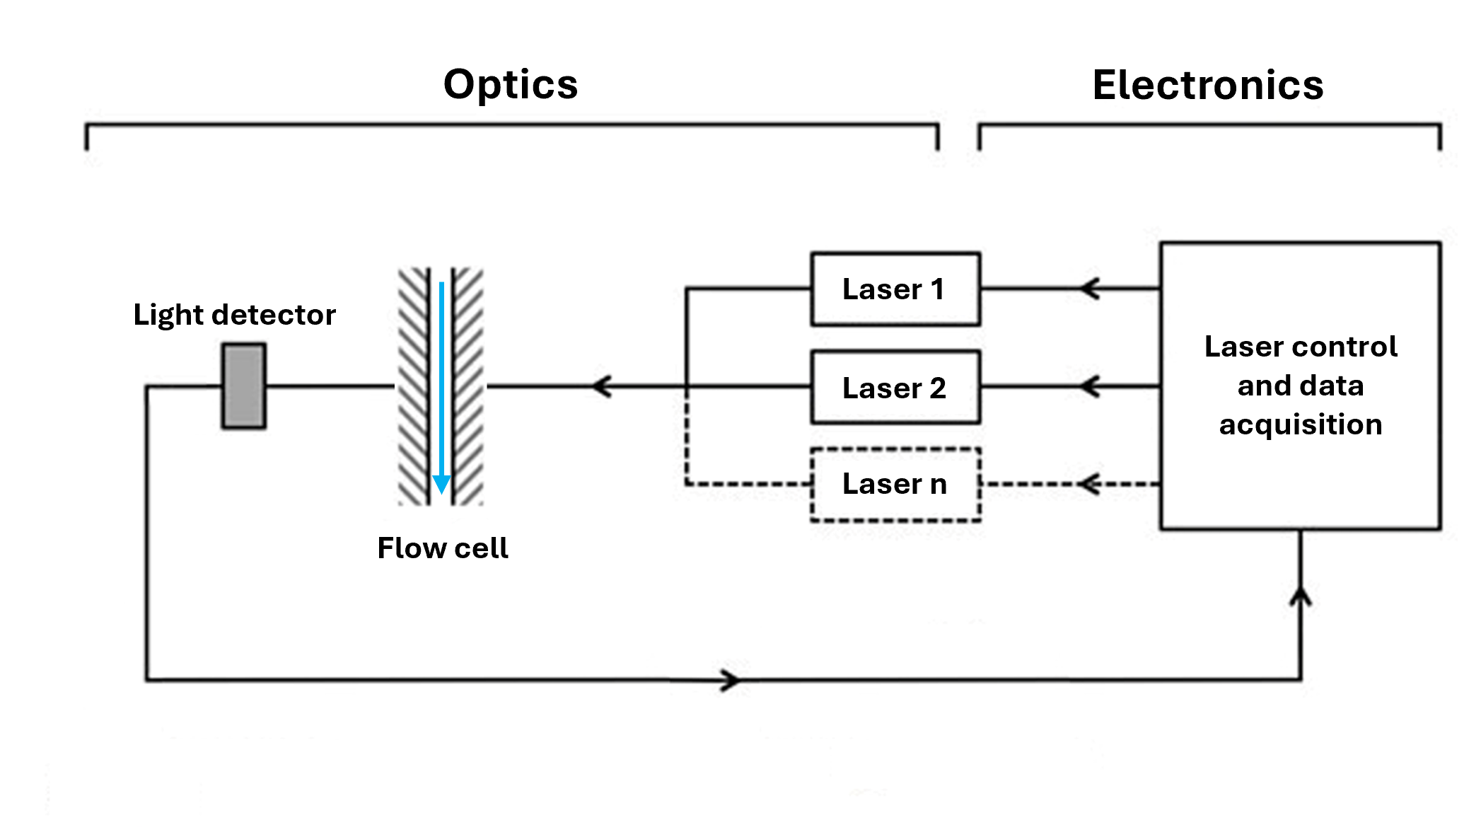
Commercialisation Pathway Challenges
*Richard Hall, QMS Consultancy Ltd

