Slide 1
Diagnostic techniques in plasma-based accelerators
H. D. Zhang*, University of Liverpool
*haozhang@liverpool.ac.uk

Slide 2
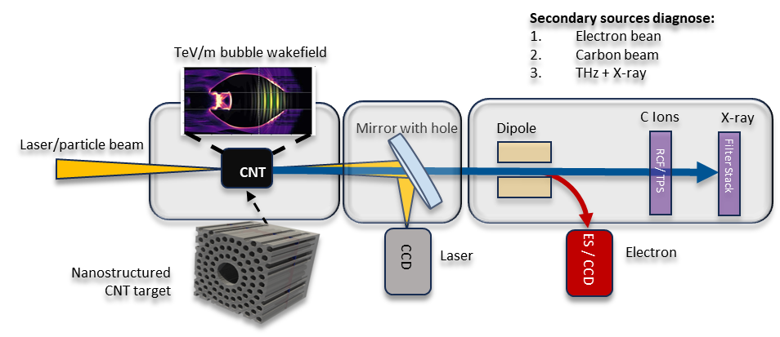
Typical plasma-based accelerator system
Credit: Bifeng Lei

Slide 3
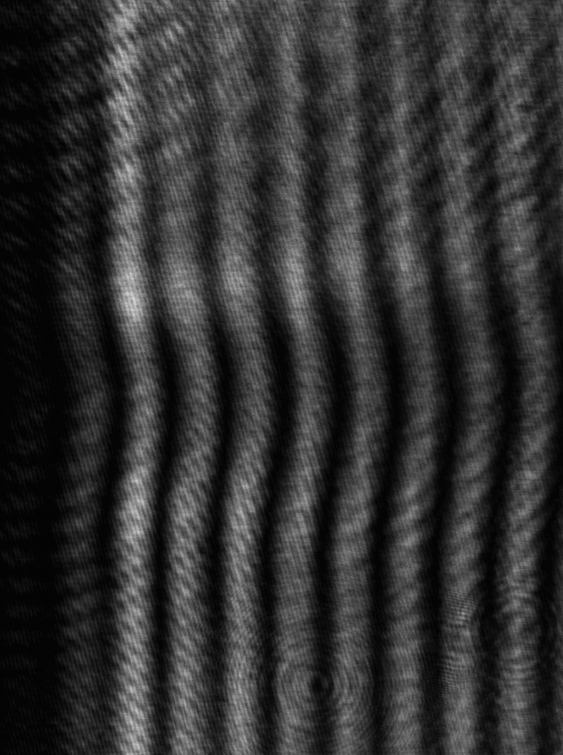
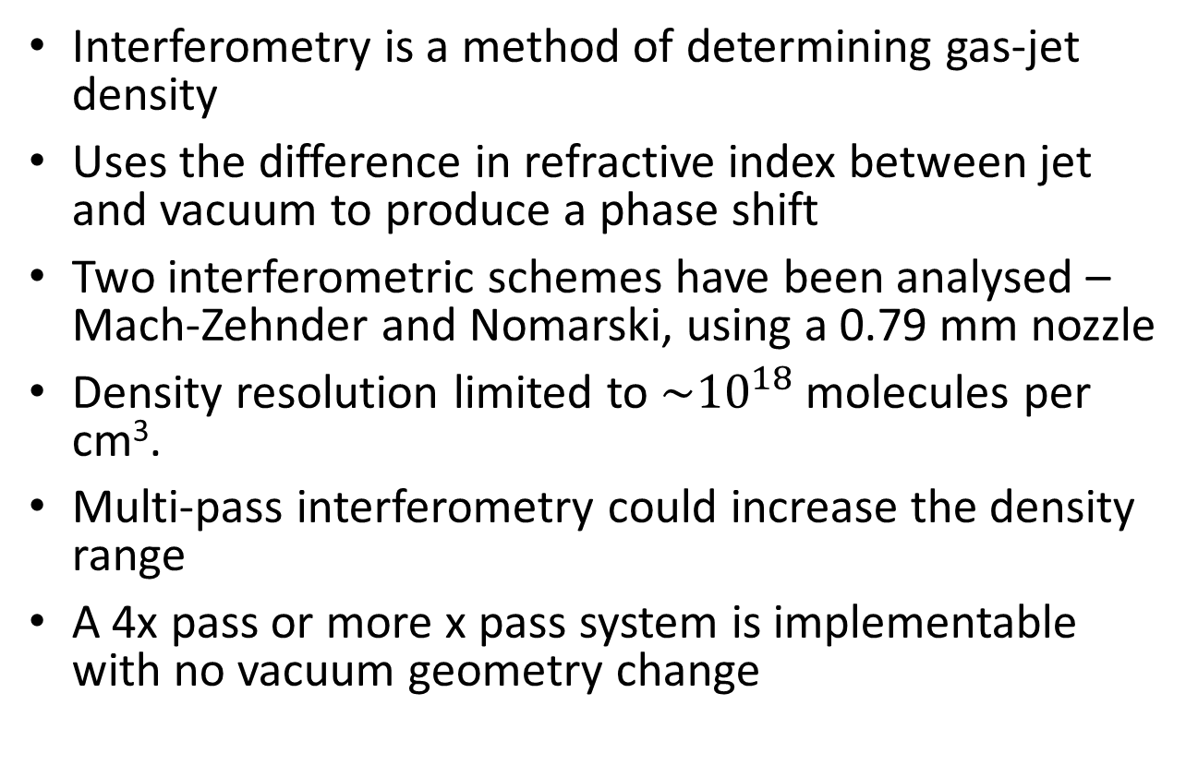
Plasma diagnostics
Interferometry is a method of determining gas-jet density
Uses the difference in refractive index between jet and vacuum to produce a phase shift
Two interferometric schemes have been analysed – Mach-Zehnder and Nomarski, using a 0.79 mm nozzle
Density resolution limited to $\sim {10}^{18}$ molecules per cm³.
Multi-pass interferometry could increase the density range
A 4x pass or more x pass system is implementable with no vacuum geometry change
Notes:
the refractive index

Slide 4
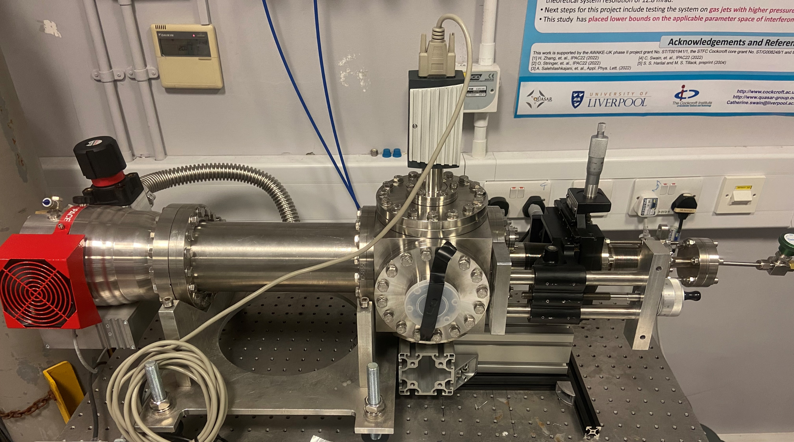
Experimental Characterising
Nozzle
TMP
XYZ nozzle manipulator

Slide 5
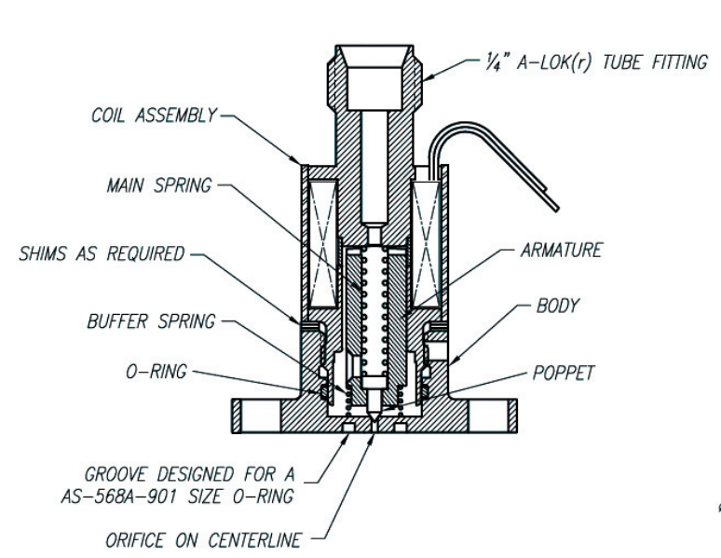
Parker pulsed valve

Slide 6
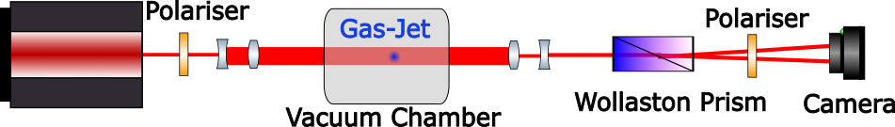
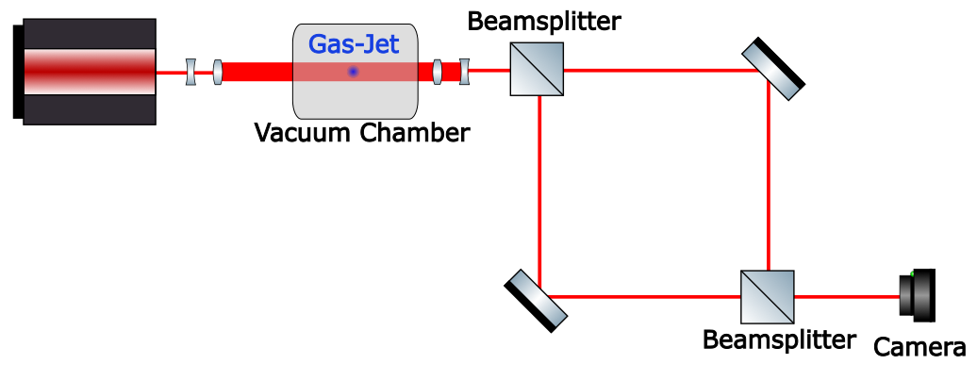
Mach-Zehnder and Nomarski Set-Up
Nomarski
Mach-Zehnder

Slide 7
Nomarski interferometry
Uses a Wollaston prism to create the overlapping beam paths
Wollaston prism splits unpolarised light into an orthogonally plane polarised ordinary and extra-ordinary beams
Light polarised at 45⁰ passes through gas-jet. Split into two beams, one at 0⁰, the other at 90⁰.
Final polariser recombines beams so an interference pattern can be obtained.

Slide 8
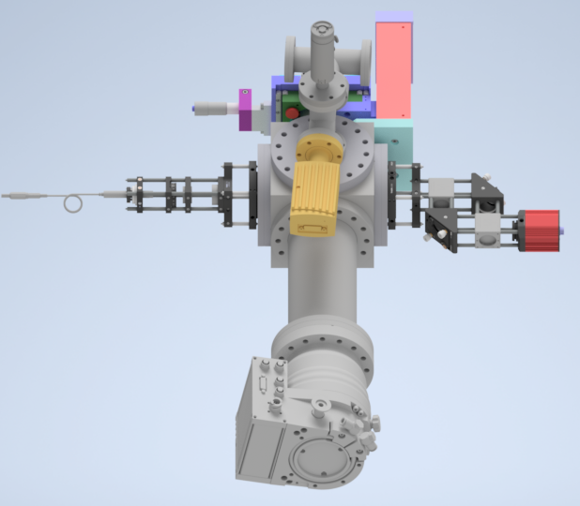
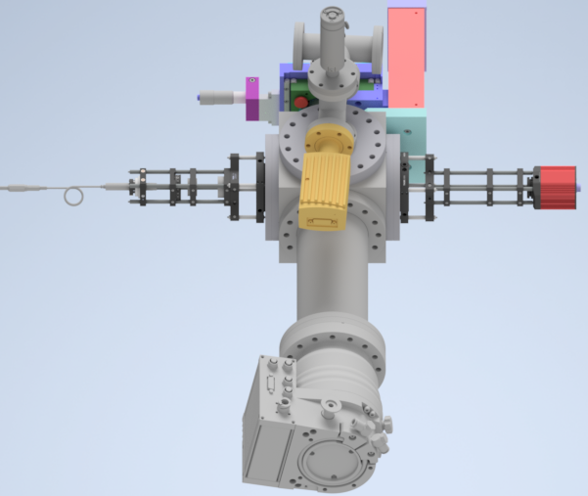
MZ and Nomarski Systems
MZ Interferometer
Nomarski Interferometer
Alignment + set-up easier with Nomarski

Slide 9
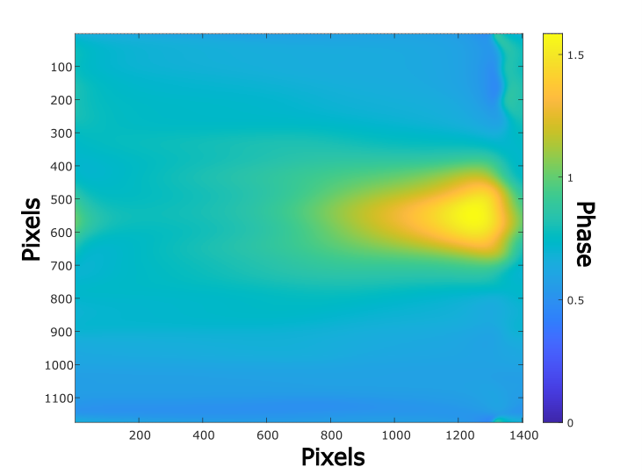
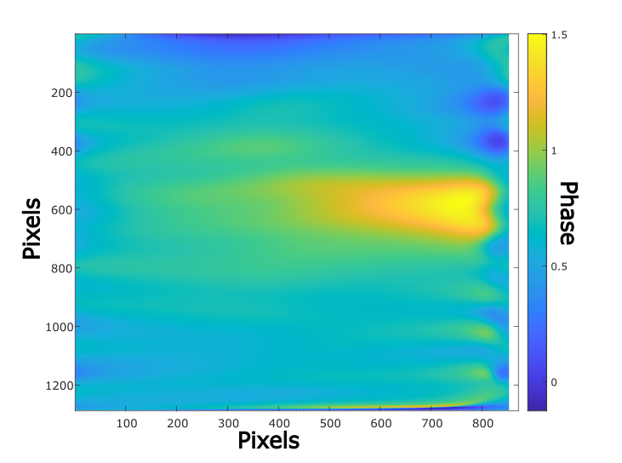
Interferometry – Phase Maps
Nomarski
Mach-Zehnder

Slide 10
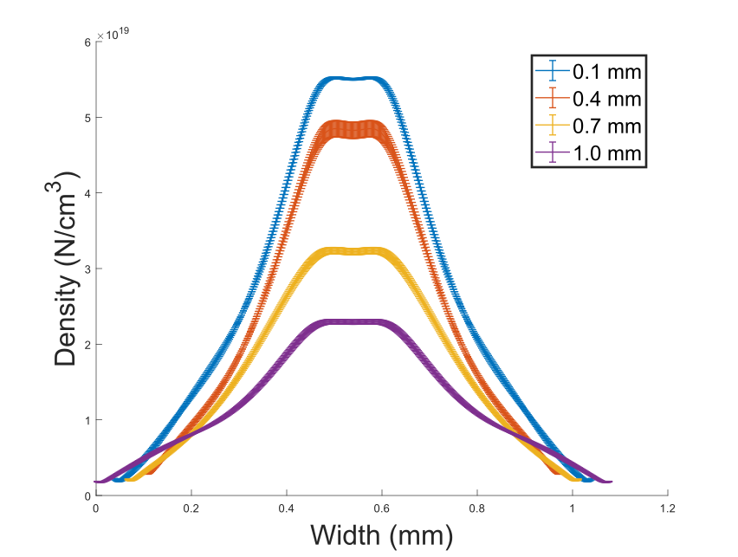
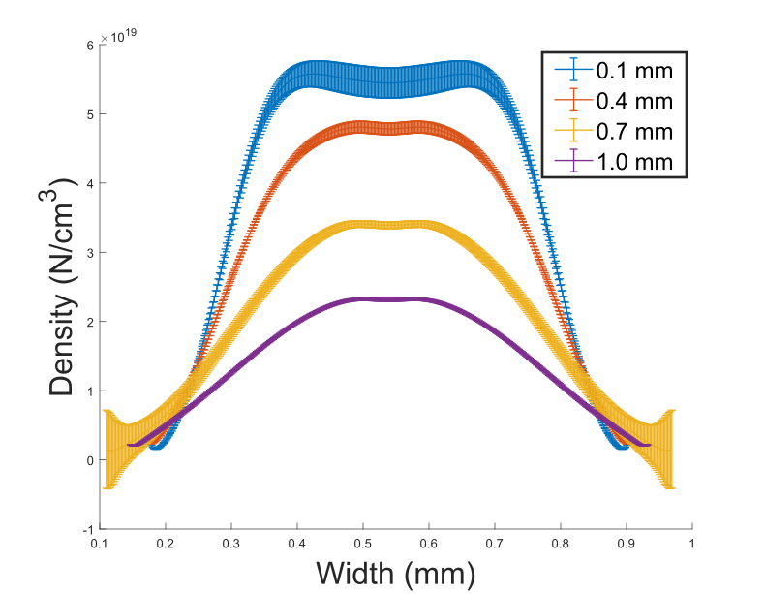
Interferometry – Density Comparison
Nomarski
Mach-Zehnder
Analysed with IDEA [8]

Slide 11
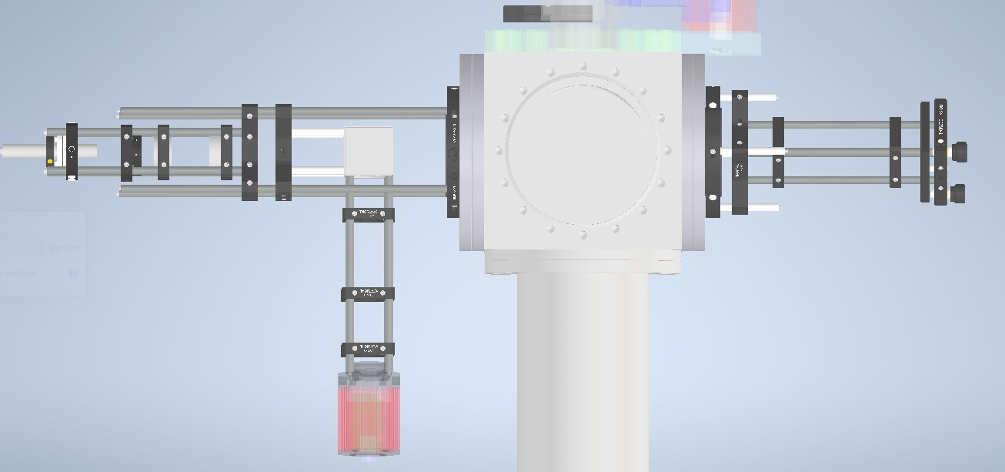
Double-Pass at the CI
Pass 1
Pass 2

Slide 12
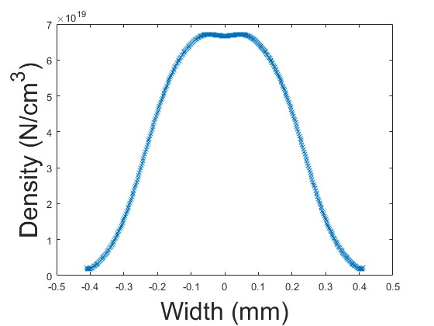
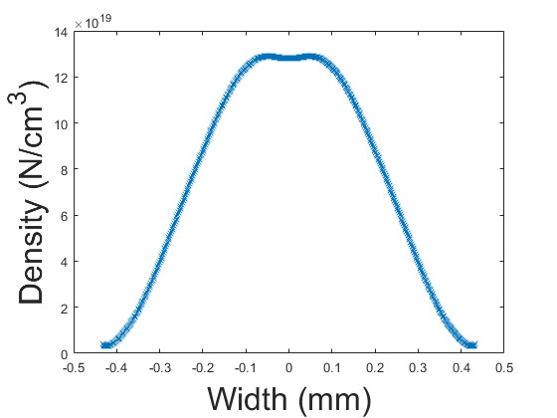
Double-Pass Results
Have preliminary results from the double-pass set-up
Below is a comparison of the single and double pass systems
Double pass artificially shows twice the density – signal strength is twice as large as expected

Slide 13
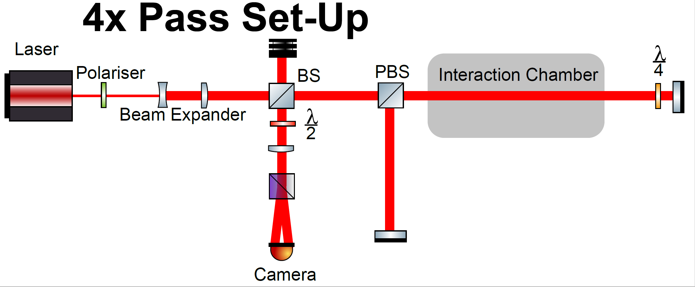
4 x Pass

Slide 14
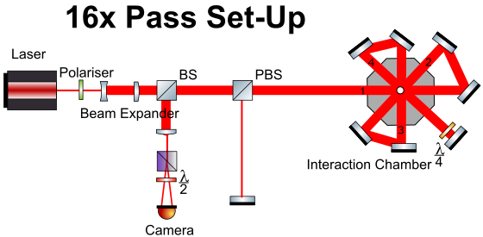
More pass

Slide 15
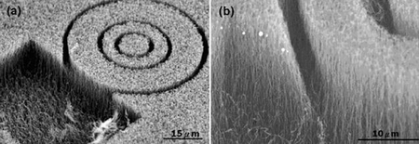
For CNT forest
Scanning electron microscope (SEM) images.
Appl. Phys. Lett. 91, 093121 (2007)

Slide 16
Typical plasma-based accelerator system
Credit: Bifeng Lei

Slide 17
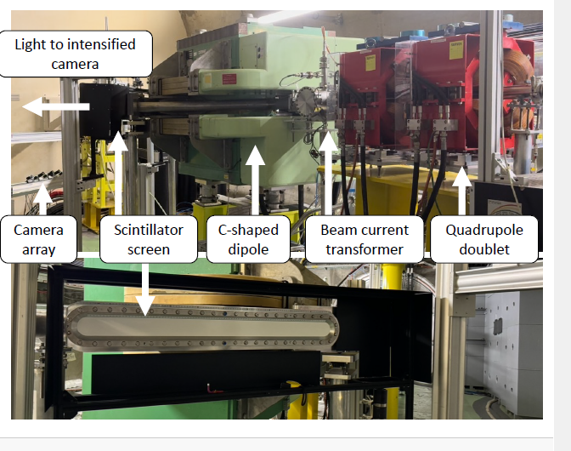
Energy Spectrometer
Things to consider:
Separate electrons from laser/drive beam.
Full energy distribution (interested spectrum) into transverse distribution (0.1-1 GeV with 100 µm CNT lengths)
Dipole field.
Screen size.
Synchronized camera & continuous camera
Beam size (10s µm)
Intensity => choice of Phosphor.
The AWAKE Spectrometer
Credit: F. Pannell

Slide 18
Other parameters to consider
Sizes (10s µm) => Measured by 2 Energy spectrometers.
Bunch length (10s fs) => Will be challenging for non-interceptive.
Charge/current (100 pC – 1 nC)
Faraday cup.
ICT from Bergos
Emittance (10s mm mrad) ???

Slide 19
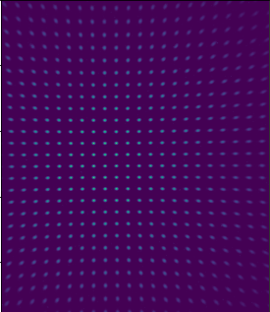
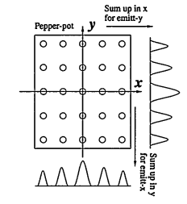
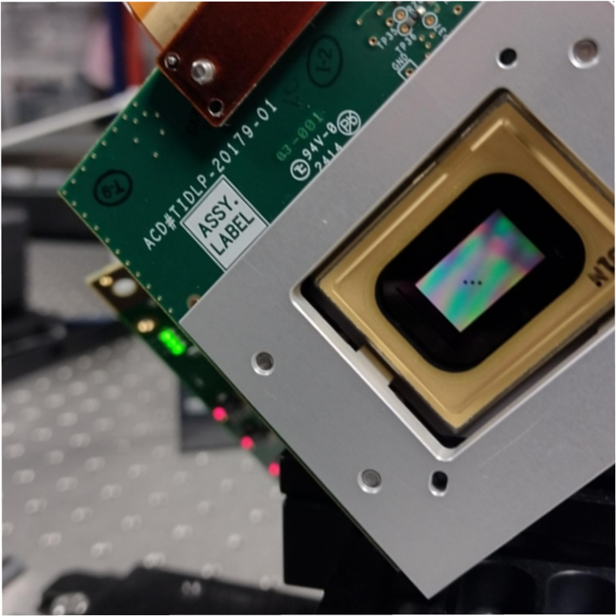
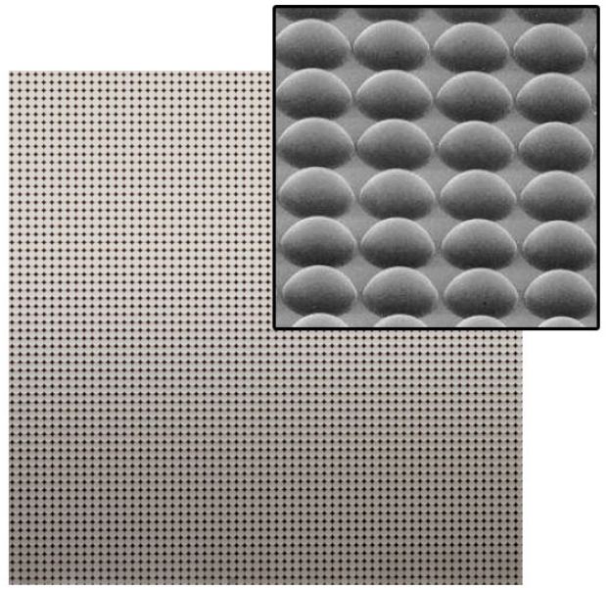

Pepperpot emittance measurements
Slides from C. Swain
Screen
Mask
j^{th} beamlet intensity
n_{j}
OTR
Beam
σ_{j}
Beamlets
x_{j}
[1]
[2]
[1]
[2]https://www.thorlabs.com/newgrouppage9.cfm?objectgroup_id=2861
[1] M. Zhang, "Emittance Formula for Slits and Pepper-pot Measurement", FERMILAB-TM-1988, Oct. 1996

Slide 20

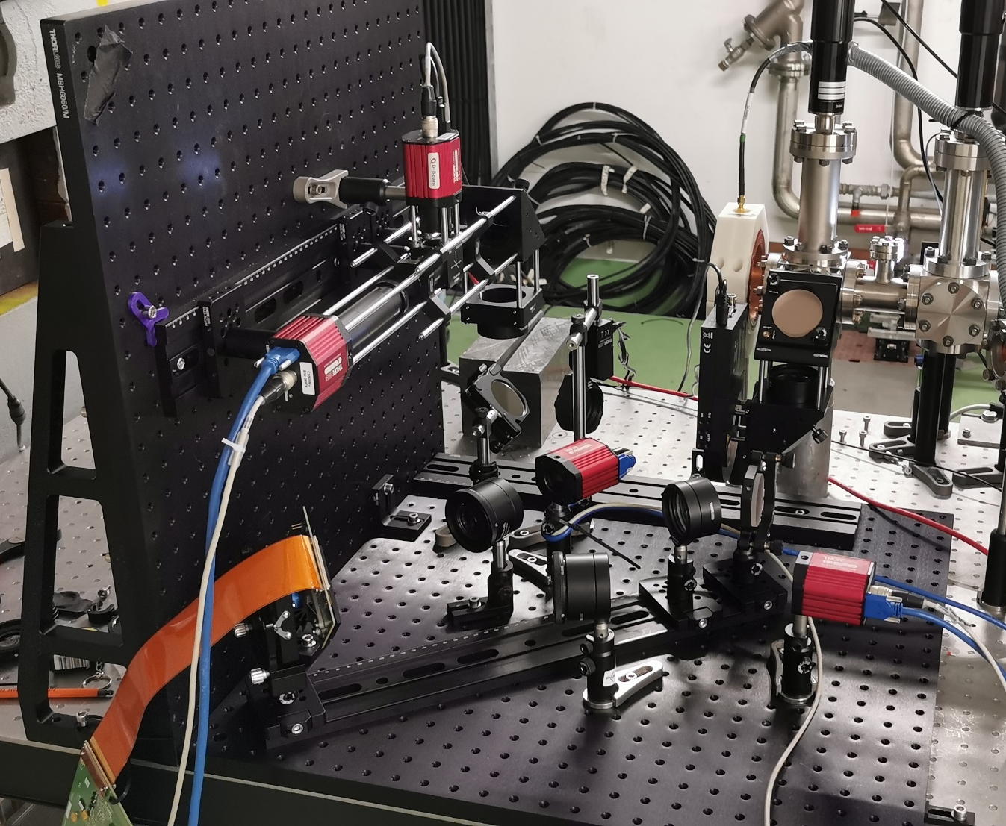
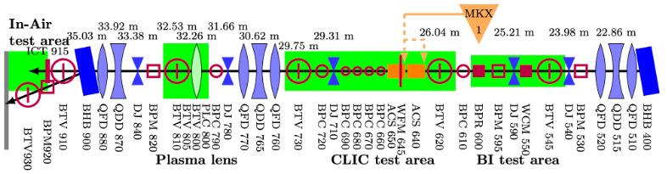
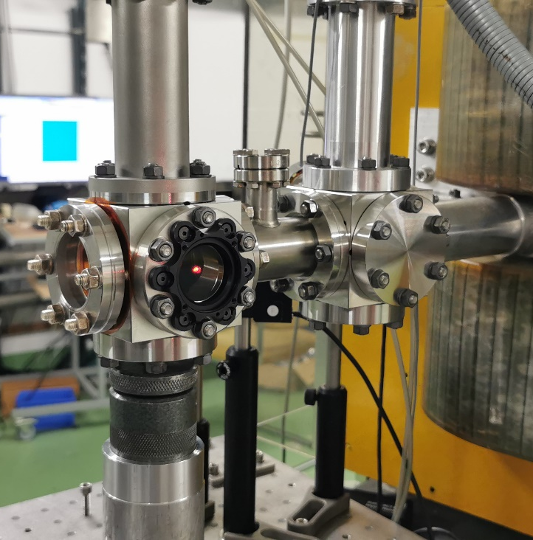
Experimental setup
Slides from C. Swain
MLA
DMD

Slide 21
Thank you for your attention!
Any questions?

