Slide 1
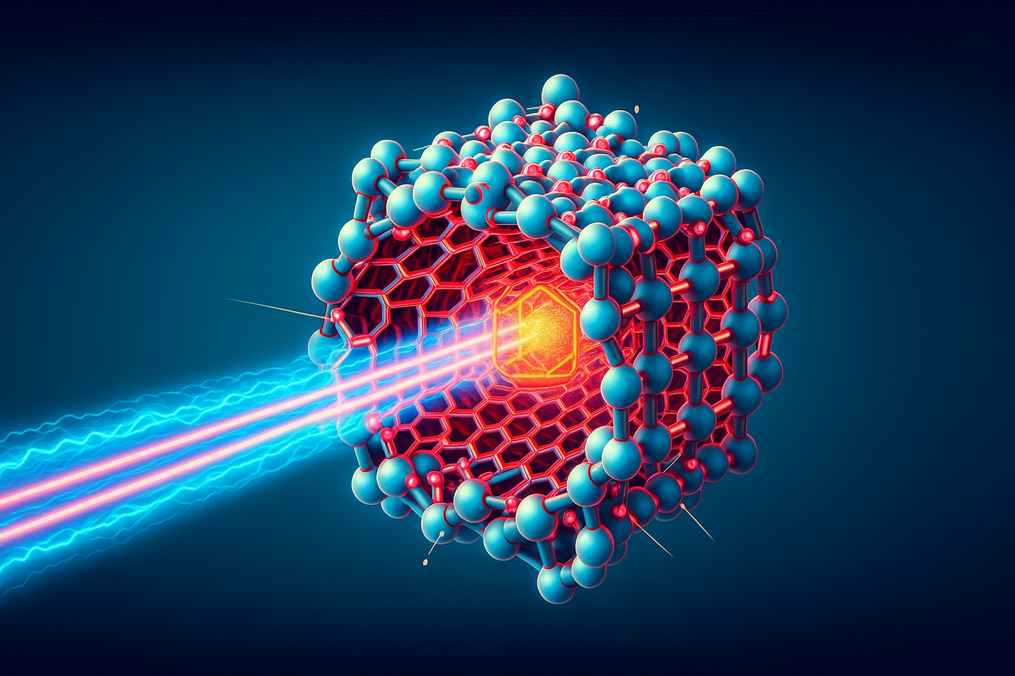
Welcome to NanoAc 2025!!
Prof Dr Carsten P Welsch
Head of Accelerator Science

Slide 2
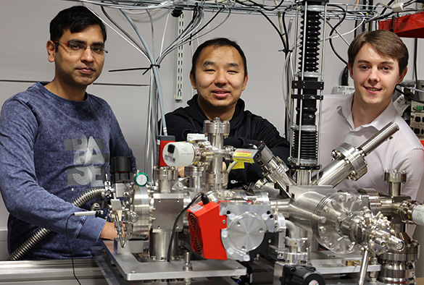
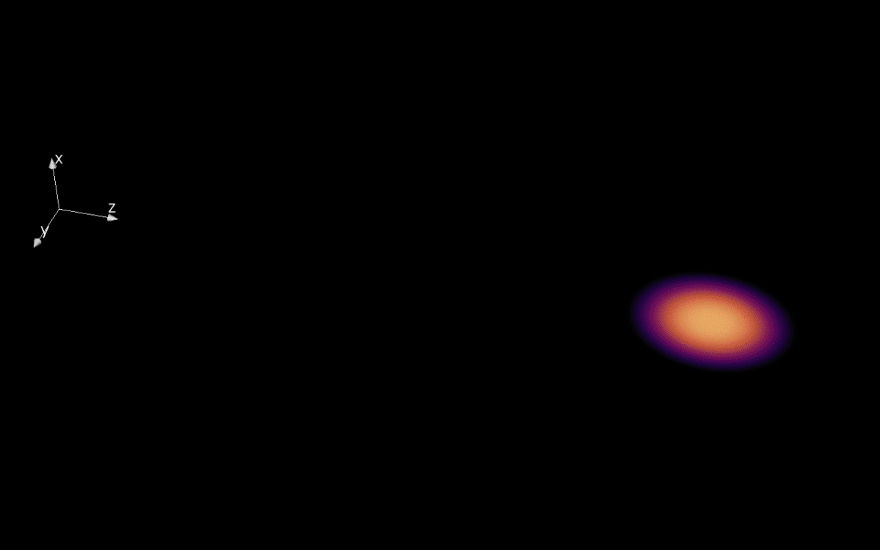
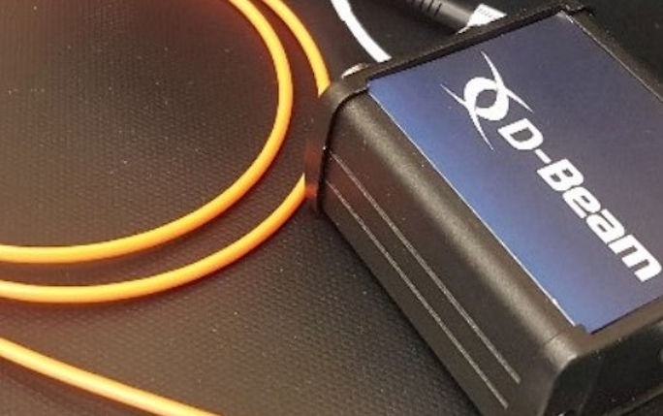
Liverpool accelerator science
R&D across frontier accelerators, novel accelerators and accelerator applications, underpinned by data science and AI research;
Only group that is active across the entire spectrum of Cockcroft Institute research.

Slide 3


Slide 4
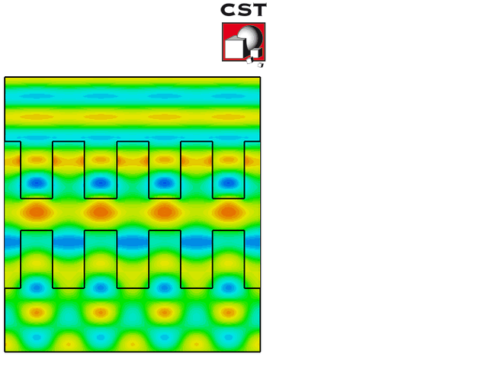
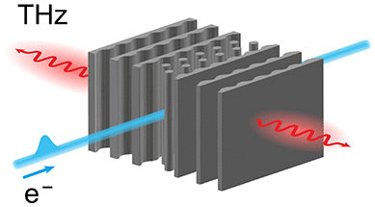
Micro Accelerator R&D
Started in 2010 with R&D into Dielectric Laser Accelerators (DLAs) – core element in LA³NET and LIV.DAT;
Research driven by (generations of) PhD students;
Significant progress made in structure design, energy efficiency studies and also in using structures as THz source for efficient diagnostics: Amir Aimidula, Yelong Wei, Gyanendra Yadav.
Went on to consider CNTs and Graphene: Cristian Bontoiu, now: Bifeng Lei.
Notes:
To delete/replace pictures within the template, right click on the image and choose either ‘cut’ or ‘change picture’ from the drop down menu.

Slide 5
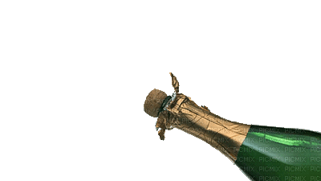
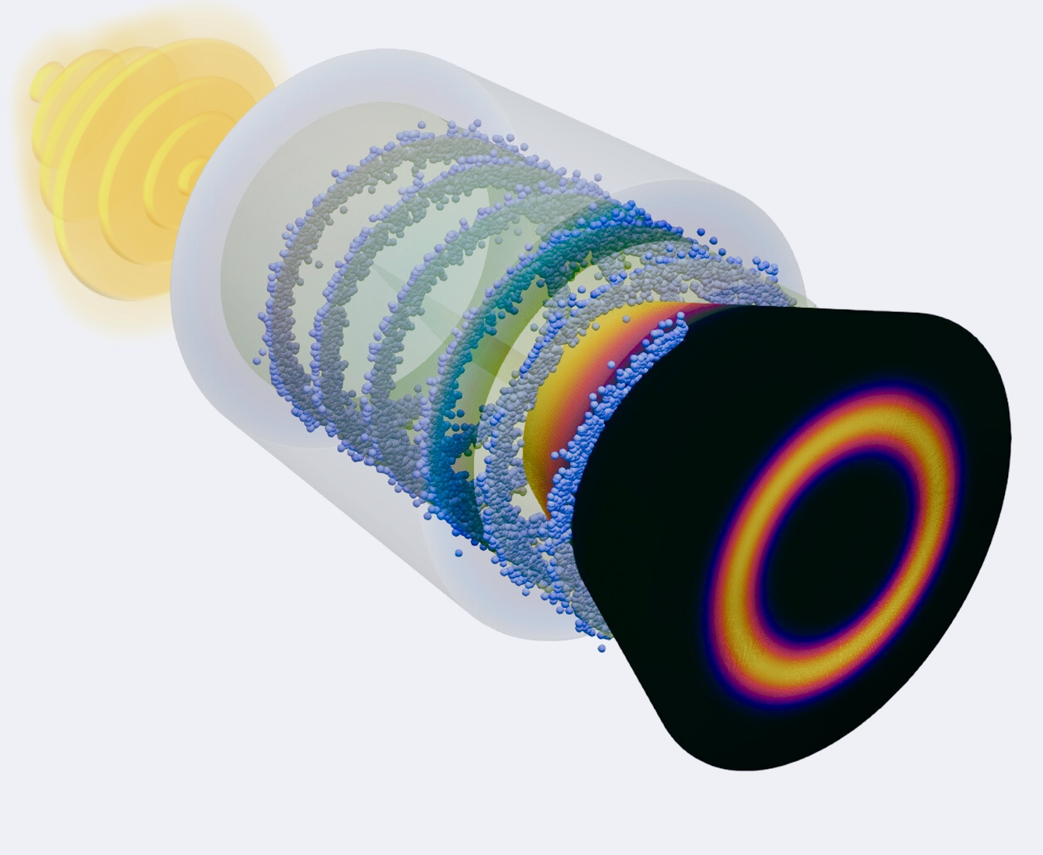
2025 Highlight
Congrats!
Bifeng Lei, et al., “Coherent synchrotron radiation by excitation of surface plasmon polariton on near-critical solid microtube surface”
Physical Review Letters, accepted

Slide 6
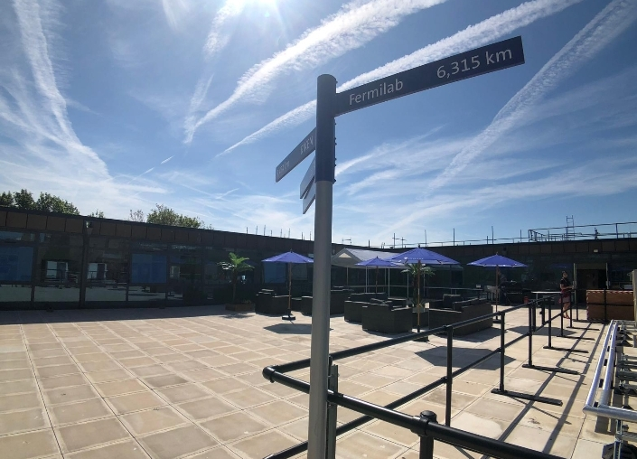

The QUASAR Group has established strategic partnerships with many key institutions, including:
Daresbury Laboratory
CERN
GSI/FAIR
We often realize joint PhD projects with our partners and are used to make the most out of distributed skills and infrastructures – this will also be key for our future work on ultra-compact accelerators.
Collaboration is key

Slide 7
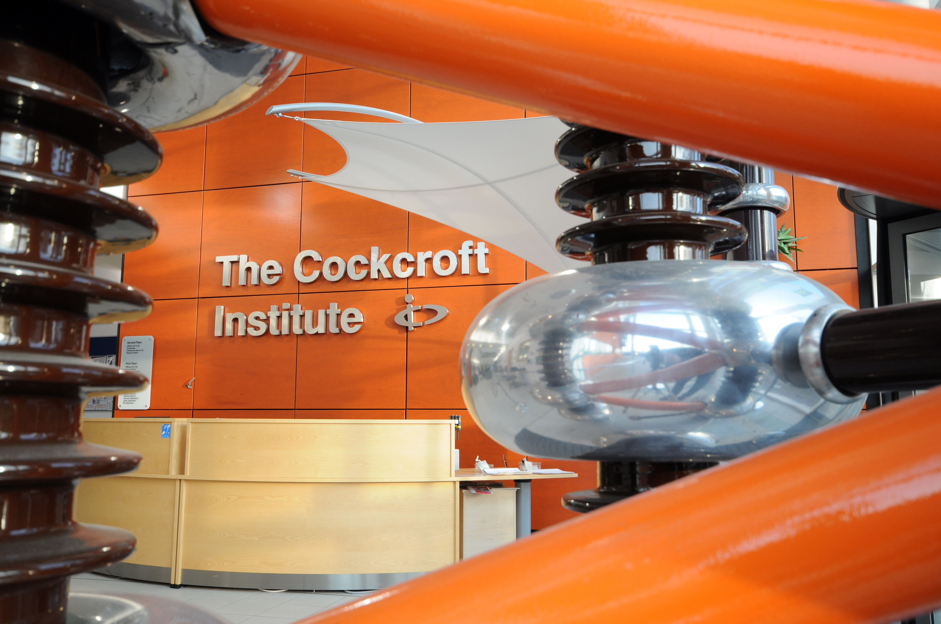
Accelerating R&D
for sCIence and soCIety

Slide 8
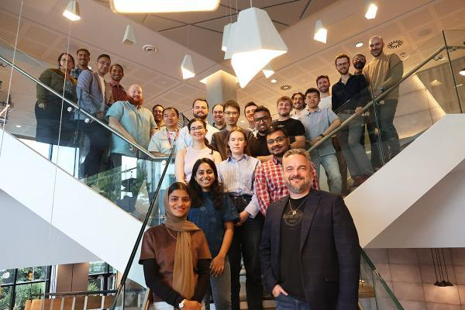


www.quasar-group.org

Slide 9
This workshop
Present & discuss the latest research
Identify a strategic roadmap for key technologies and science program
Establish a solid basis for future funding opportunities and collaborative R&D
Provide networking opportunities and get to know each other better.
Enjoy!

Slide 10
Selection of past R&D
CNT/Graphene
'Leaky surface plasmon-based wakefield acceleration in nanostructured carbon nanotubes', Bifeng Lei, et al., Plasma Phys. Control. Fusion 67 065036 (2025), https://doi.org/10.1088/1361-6587/ade00a
'Exploring ultra-high-intensity wakefields in carbon nanotube arrays: An effective plasma-density approach', A. Bonatto, et al.,, Physics of Plasmas 30, 033105 (2023); https://doi.org/10.1063/5.0134960
'TeV/m catapult acceleration of electrons in graphene layers’, C. Bonţoiu, et al., Sci Rep 13, 1330 (2023). https://doi.org/10.1038/s41598-023-28617-w
DLA and THz
'Inverse-Designed Narrowband THz Radiator for Ultrarelativistic Electrons', B. Hermann, et al., ACS Photonics 2022, 9, 4, 1143–1149 (2022), https://doi.org/10.1021/acsphotonics.1c01932
'Energy efficiency studies for dual-grating dielectric laser-driven accelerators', Y. Wei, et al., Nucl. Instr. Meth. A 909 (2018). https://doi.org/10.1016/j.nima.2017.12.049
'Investigations into dual-grating THz-driven accelerators', Y. Wei, et al., Nucl. Instr. Meth. A 877 (2018) https://doi.org/10.1016/j.nima.2017.09.050
'Dual-grating dielectric accelerators driven by a pulse-front-tilted laser', Y. Wei, et al., Applied Optics 56, 8201-8206 (2017) https://doi.org/10.1364/AO.56.008201
'Dual-gratings with a Bragg reflector for dielectric laser-driven accelerators', Y. Wei, et al., Physics of Plasmas 24, 073115 (2017); doi: http://dx.doi.org/10.1063/1.4993206
'Beam quality study for a grating-based dielectric laser-driven accelerator', Y. Wei, et al., Physics of Plasmas 24, 023102 (2017) doi: http://dx.doi.org/10.1063/1.4975080
'Numerically optimized structures for dielectric asymmetric dual-grating laser accelerators', A. Aimidula, et al., Physics of Plasmas.21, Issue 2 (2014), http://scitation.aip.org/content/aip/journal/pop/21/2/10.1063/1.4866020
'Numerical investigations into fiber laser based dielectric reverse dual-grating accelerator', A. Aimidula, et al.,, Nucl. Instr. Meth. A 740 (2014), http://www.sciencedirect.com/science/article/pii/S0168900213014903

Slide 11


