Slide 1
Flash Talk - Leverhulme Retreat
Cedric
17 Sep 2025

Slide 2
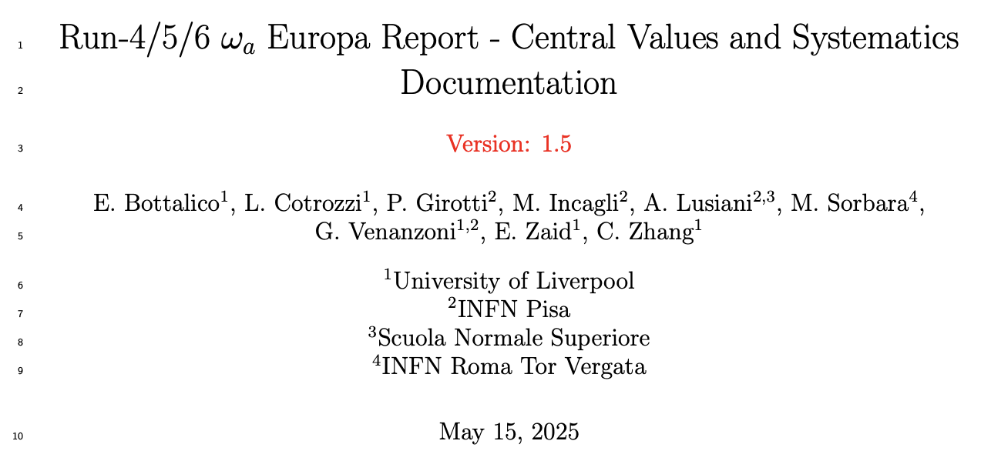
My work over the past two years
FNAL g-2
  Precession analysis – Europa group
  Slow-term systematics
  Beam dynamics – E field correction from trackers
MUonE
  Test beam 2023: shift, prompt analysis, running alpha sensitivity
  Test beam 2025: shift, prompt analysis, BMS DQM
J-PARC g-2
  Injection with a higher B field
Outreach: co-author article for The Conversation, the British Science Festival, ...
in total 98 related document at FNAL g-2 docdb

Slide 3
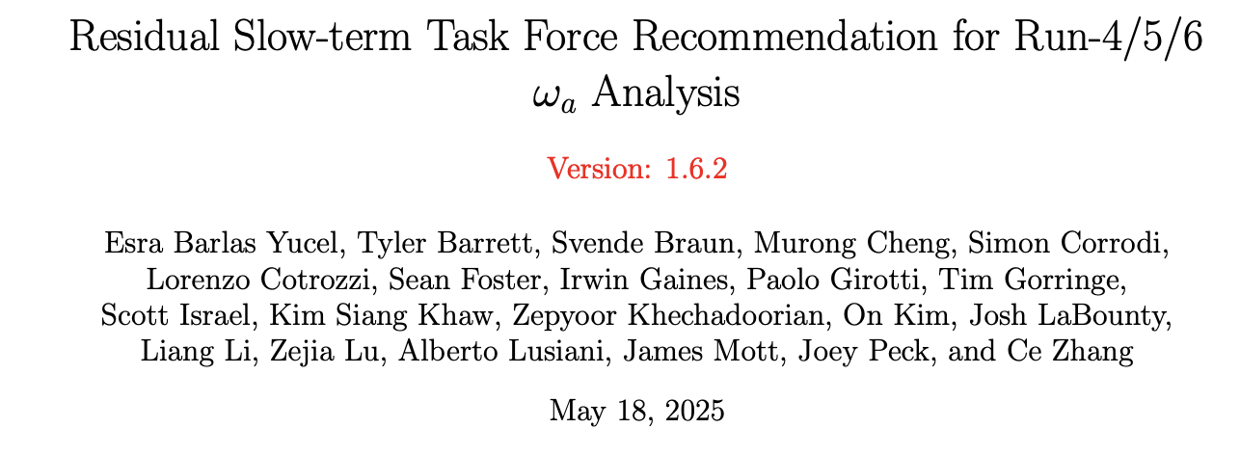
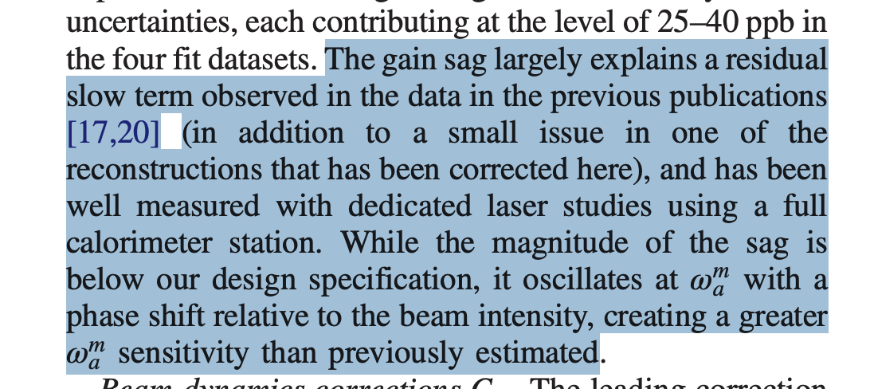
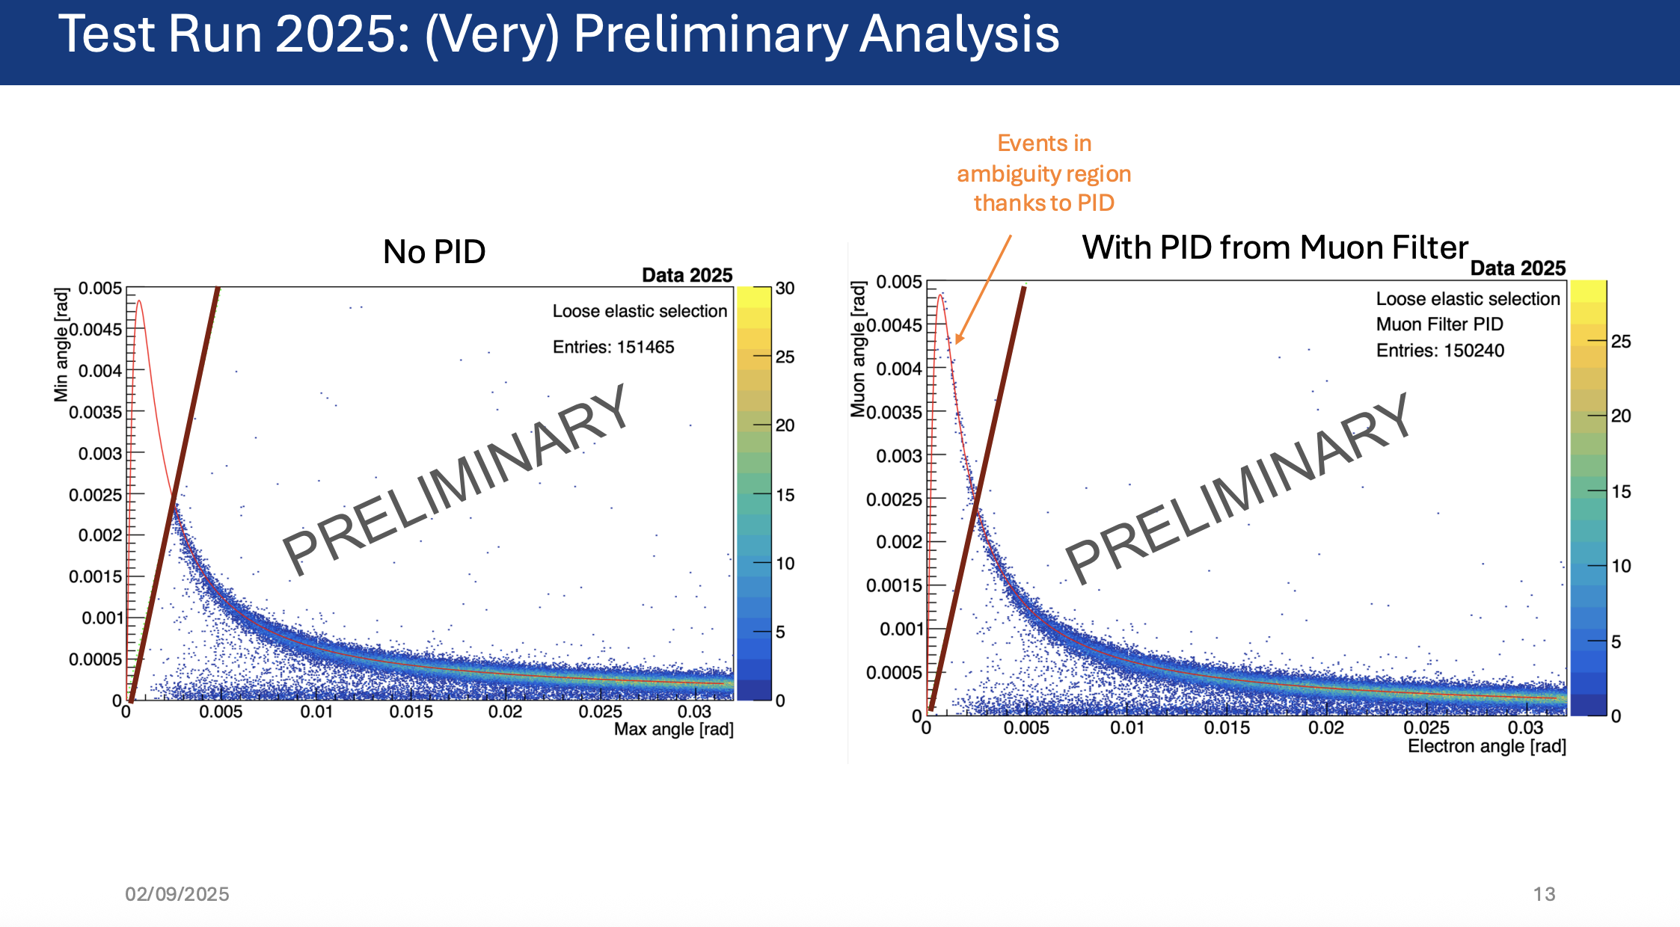
Some highlights
Slow-term correction for FNAL g-2
  Task force leader
  A discovery of the physics cause of the second largest systematic in the precession frequency analysis
  Gain effect in the calorimeter on the microsecond time scale
MUonE TB 2025
  Firstly approved elastic plots using muon filter PID
456 PRL paper
Nufact 2025 by Saskia

Slide 4
Looking ahead to the coming year
J-PARC g-2: a higher B field with a 3D injection towards a higher sensitivity
  under the high sensitivity group
Feasibility study for newly developed Chinese muon source facilities
  CIADS: low-energy muon source (surface muon, muonium atom, ...)
  HIAF: GeV-level muon source (mu-e scattering, ...)
Help with MUonE data analysis
Other research topics? (MCF? New Physics in MUonE? proton EDM?)
More outreach activities: public lectures, popular science, ...

Slide 5
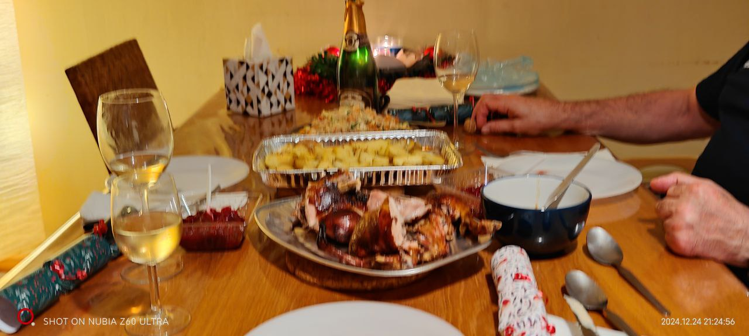
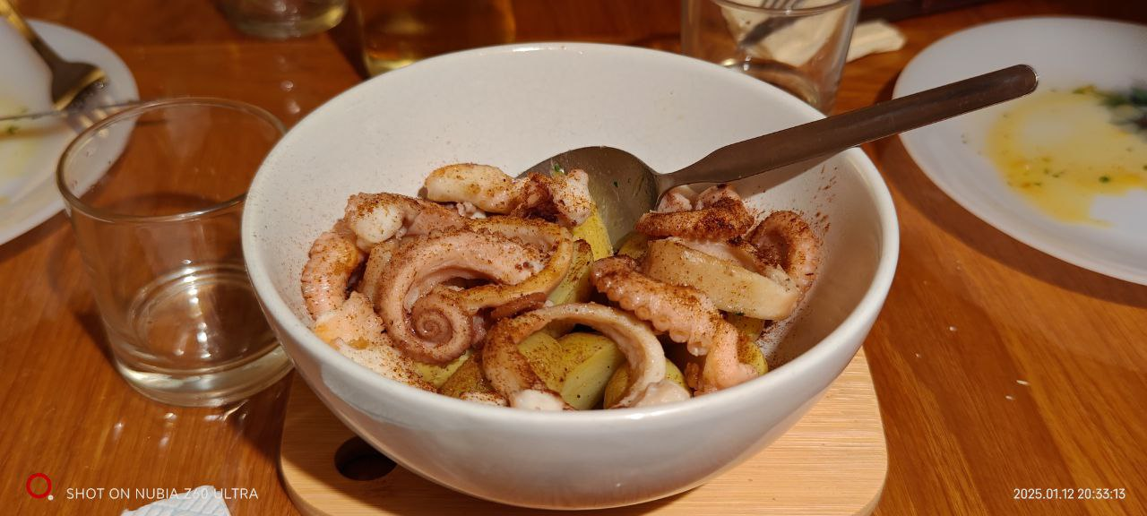
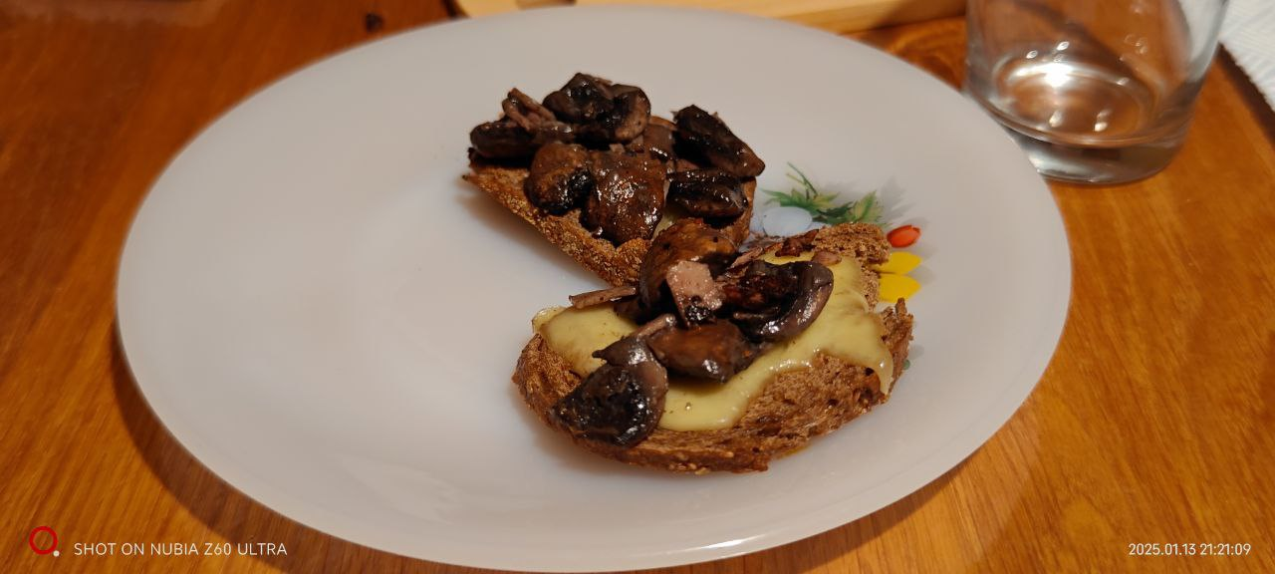
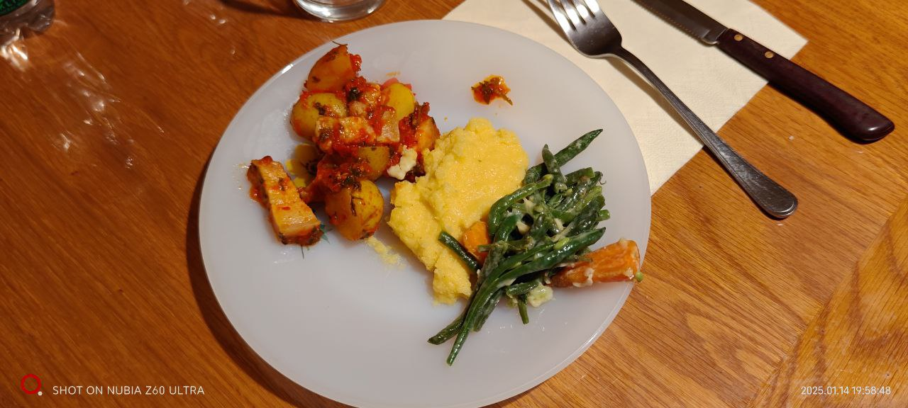
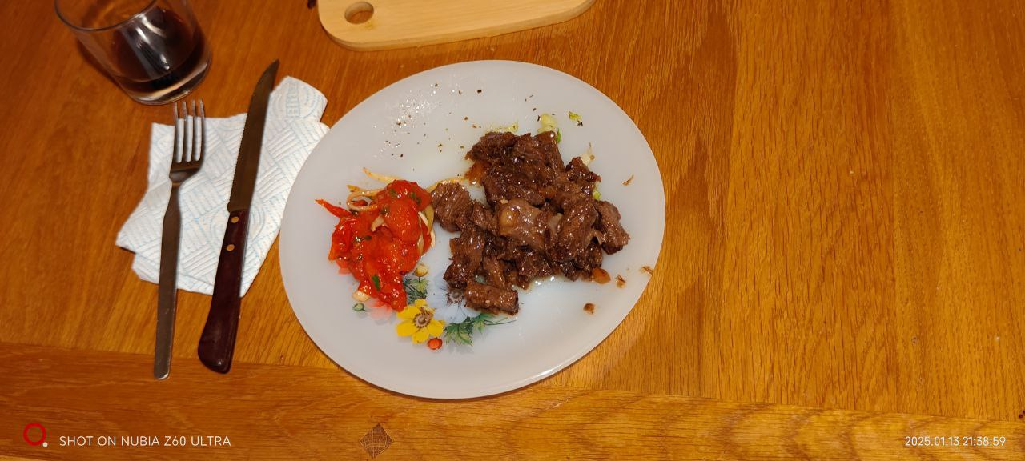

Slide 6

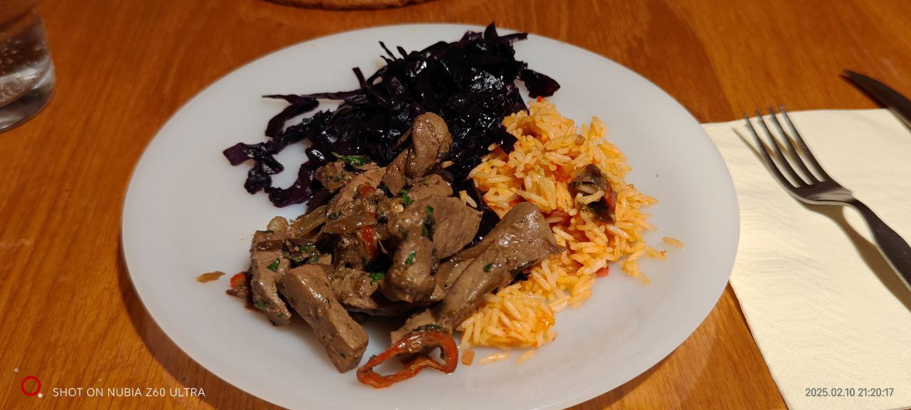
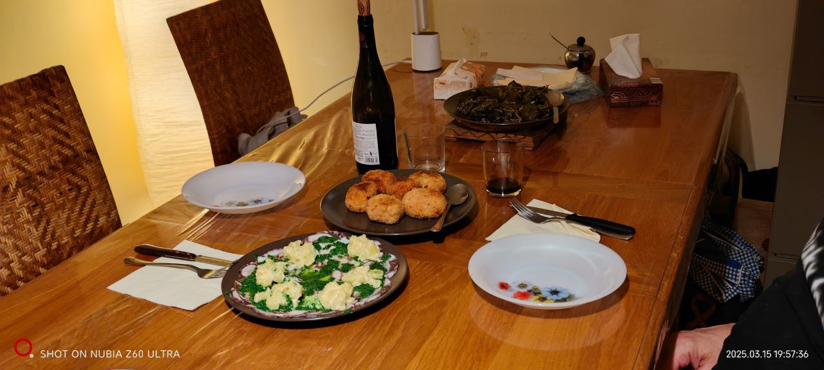
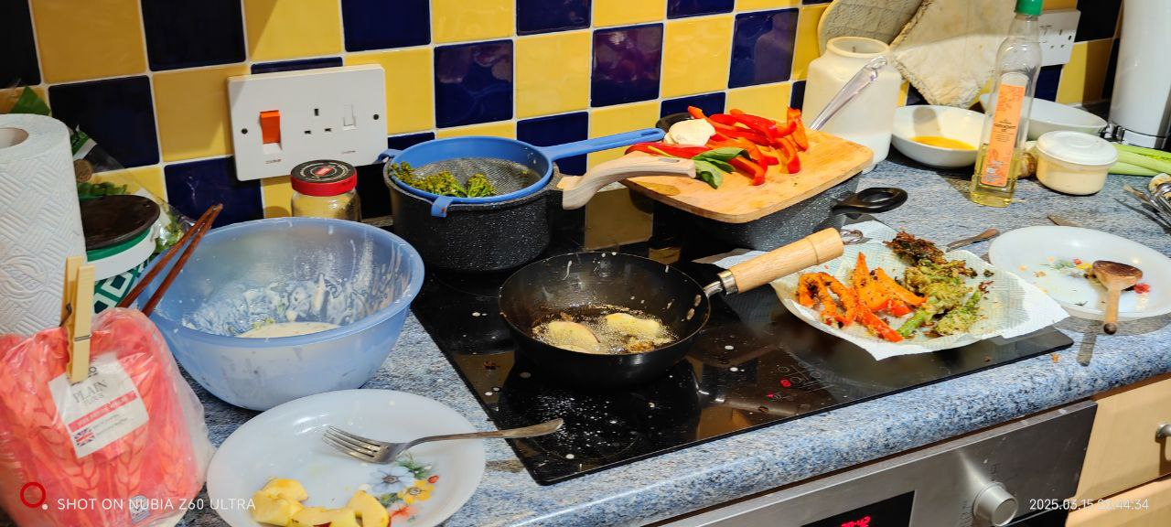

Slide 7
Thank you

