Slide 1


My Journey into the Muon world
Estifa’a Zaid

Slide 2
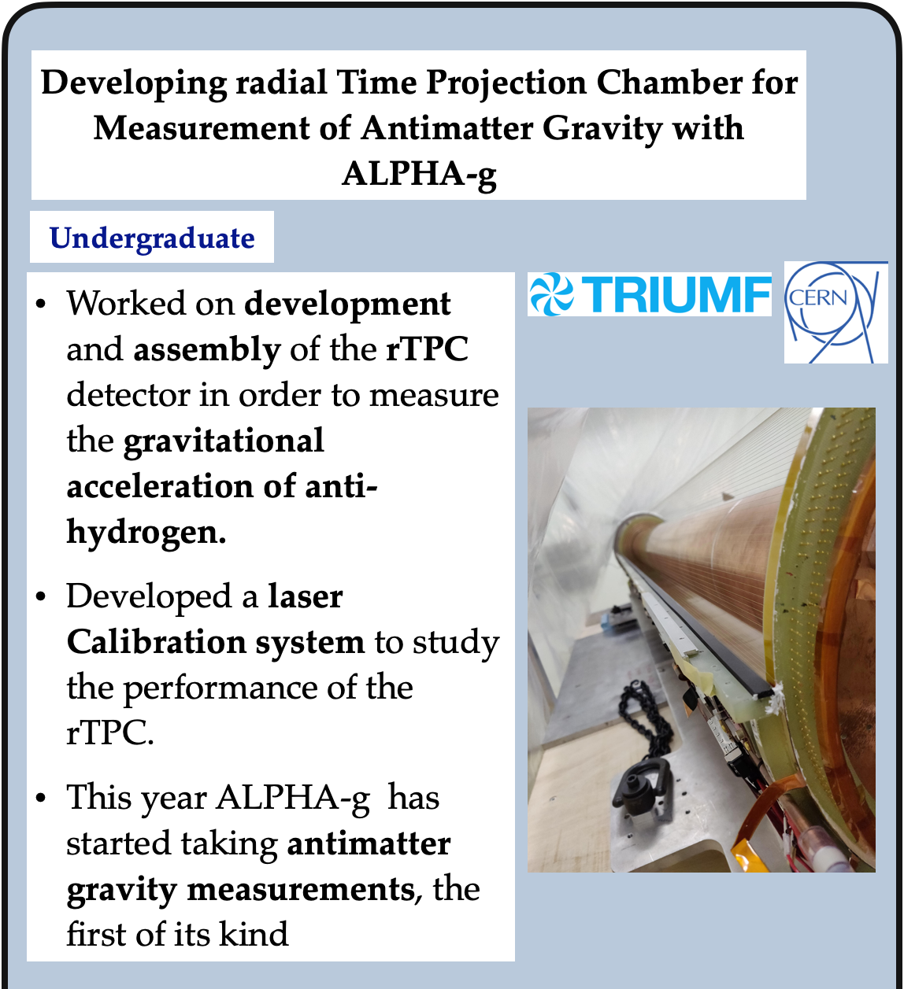
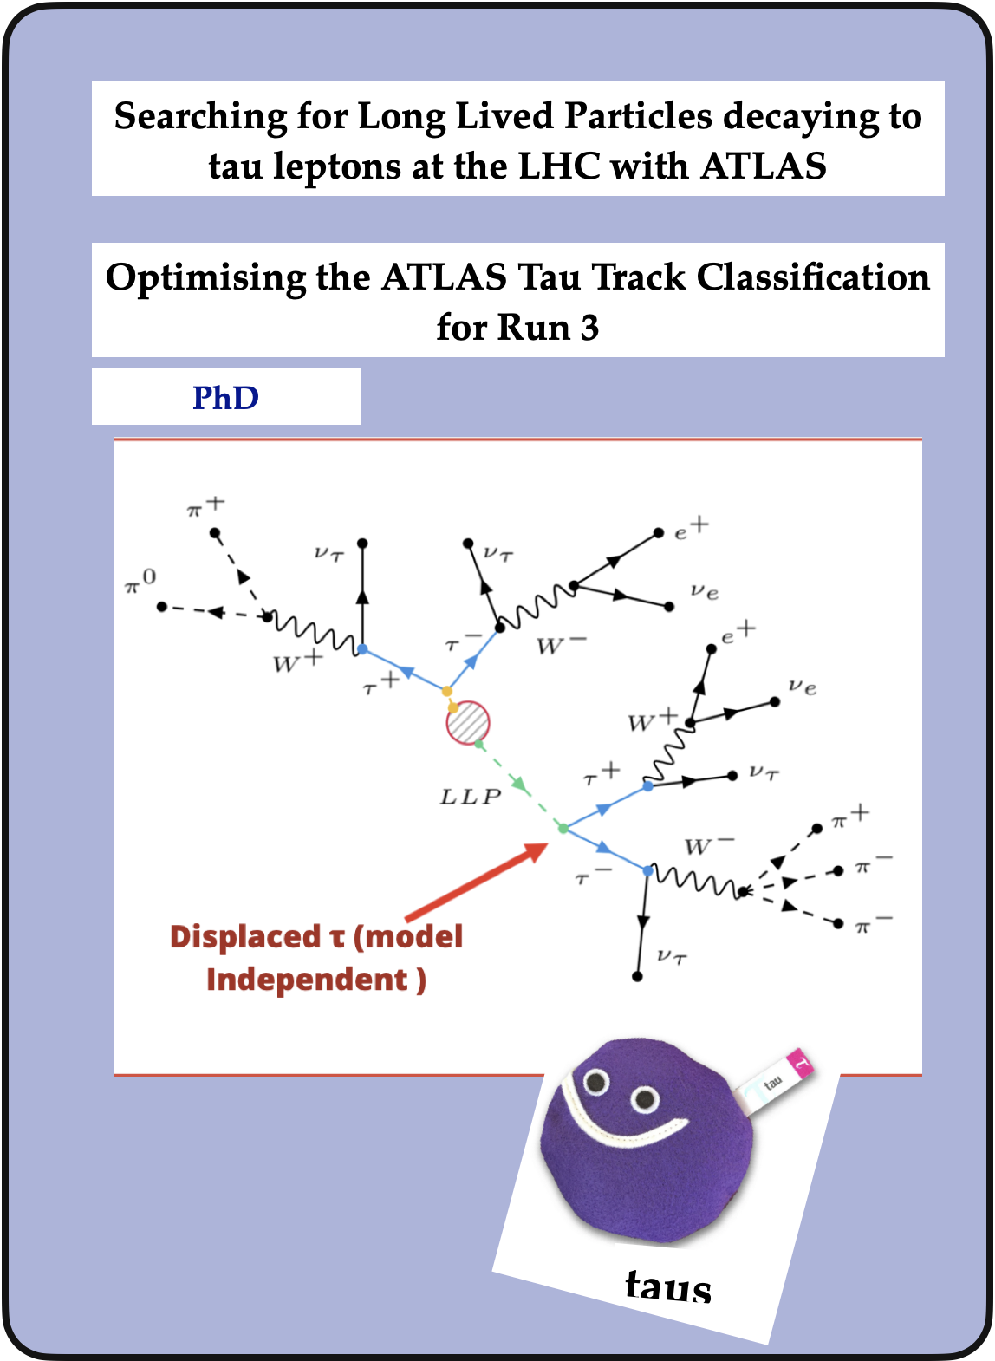
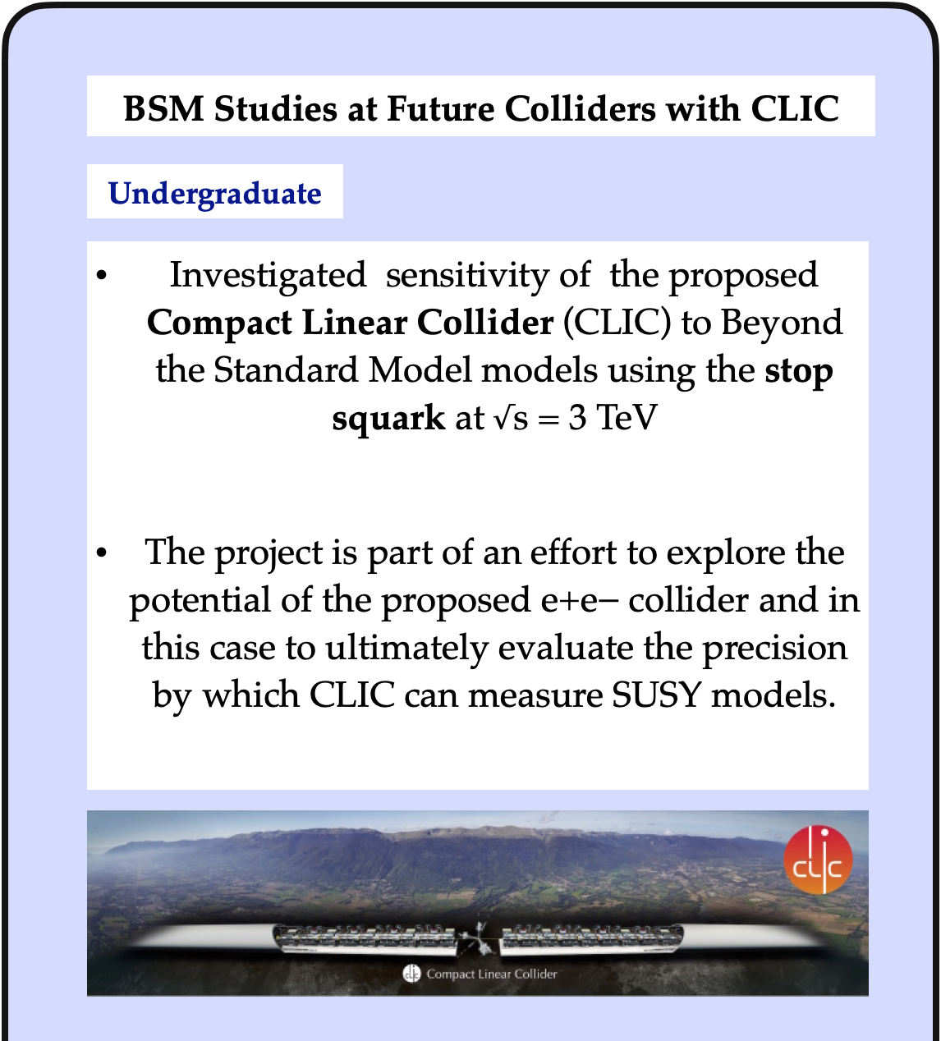

Slide 3
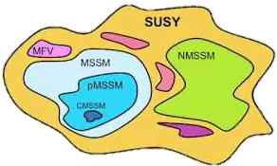
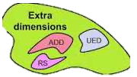



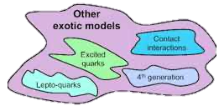
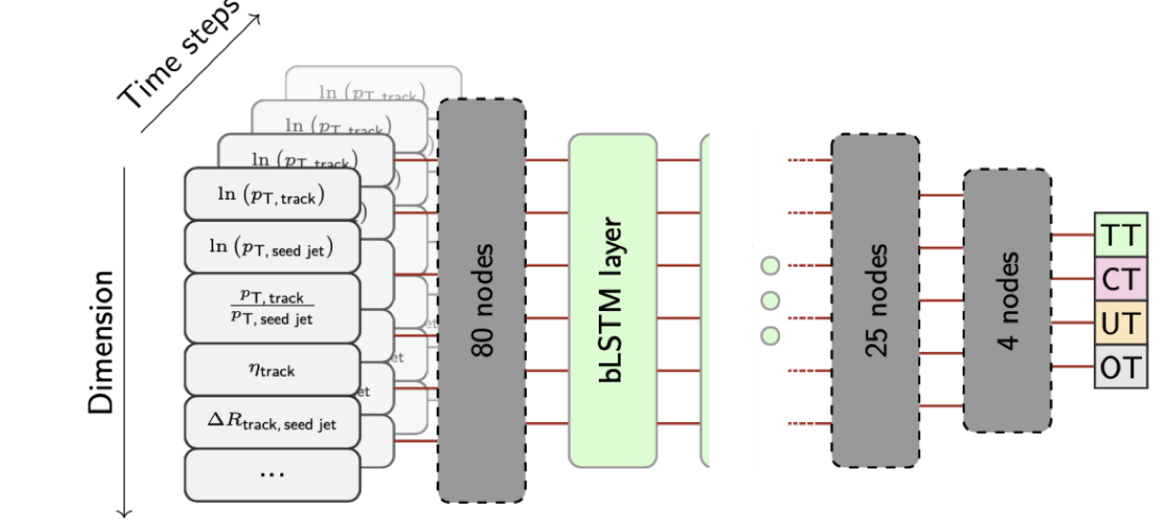
Beyond The Standard Model
Searching for Long Lived Particles decaying to tau leptons with ATLAS
New Physics
Composite Higgs

Slide 4

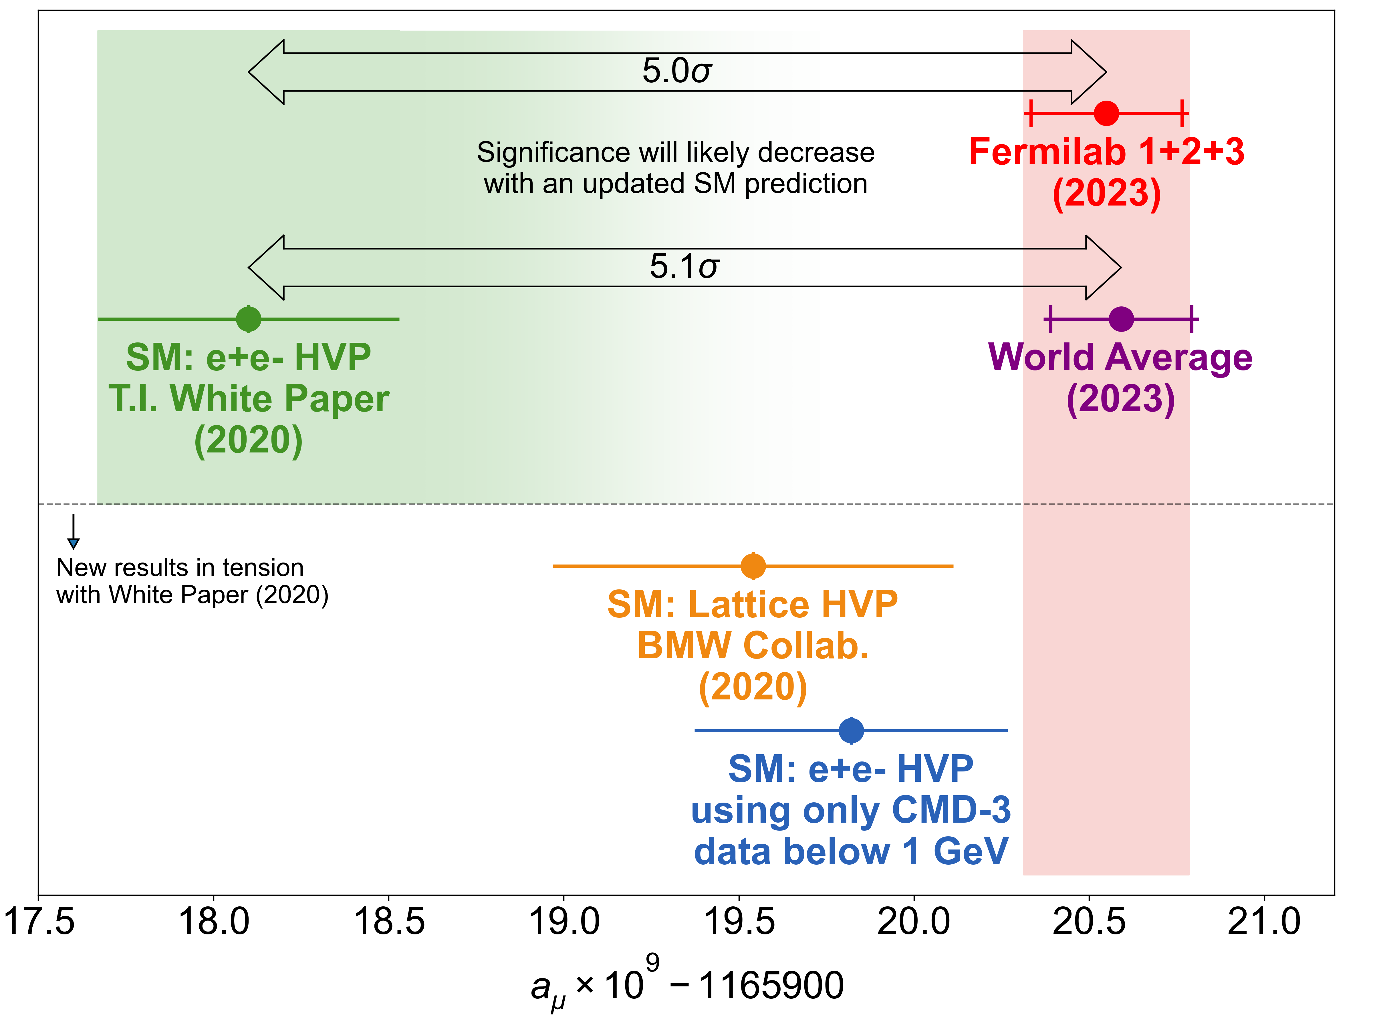

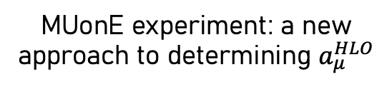
My Current efforts
Joined a large group with the aim of helping to clarify the muon g-2 puzzle.
Muon g-2 Experiment at Fermilab Run 4+5+6
New KLOE hadronic cross section measurement
MUonE experiment: a new approach to determining $a_{μ}^{HLO}$
New!

Slide 5
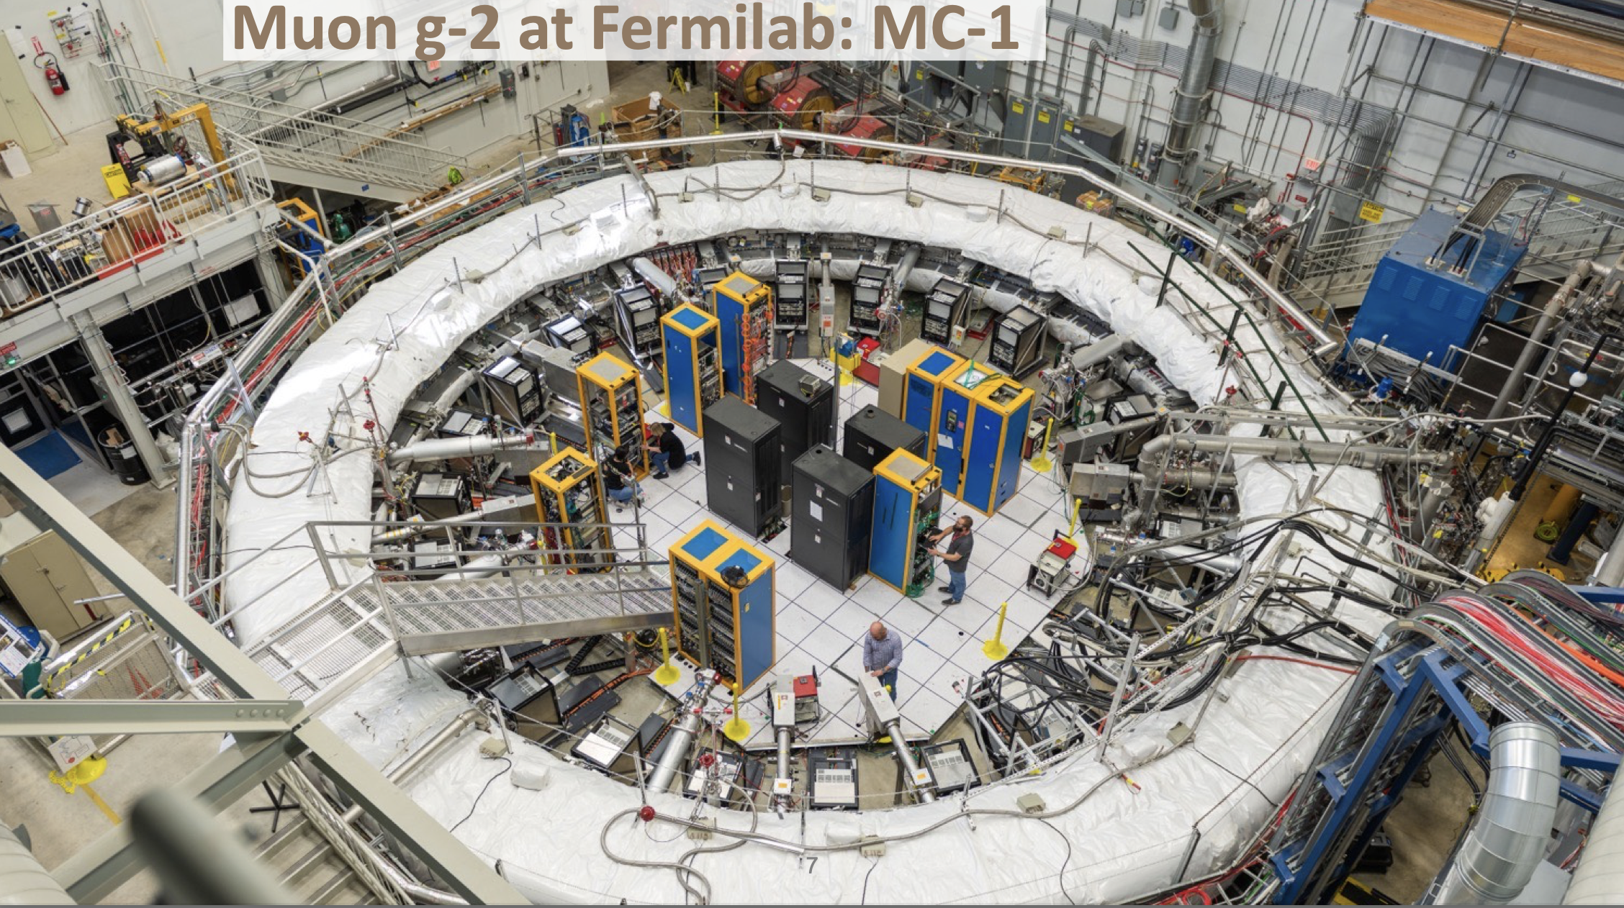

Slide 6
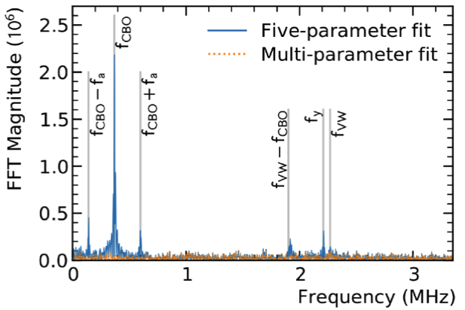
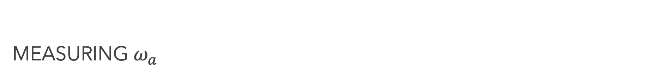
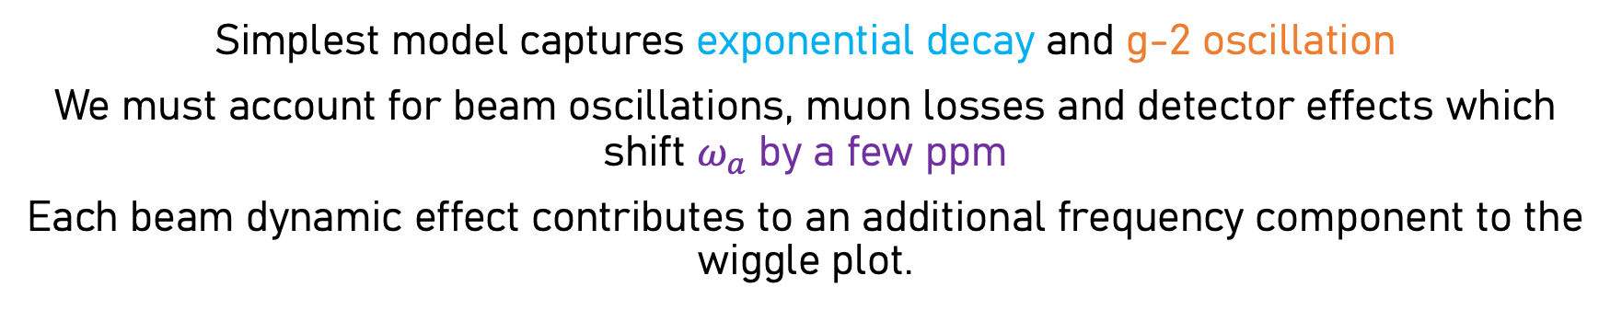
Measuring $ω_{a}$
Simplest model captures exponential decay and g-2 oscillation
We must account for beam oscillations, muon losses and detector effects which shift $ω_{a}$ by a few ppm
Each beam dynamic effect contributes to an additional frequency component to the wiggle plot.
From 5 parameters to over 30!

Slide 7
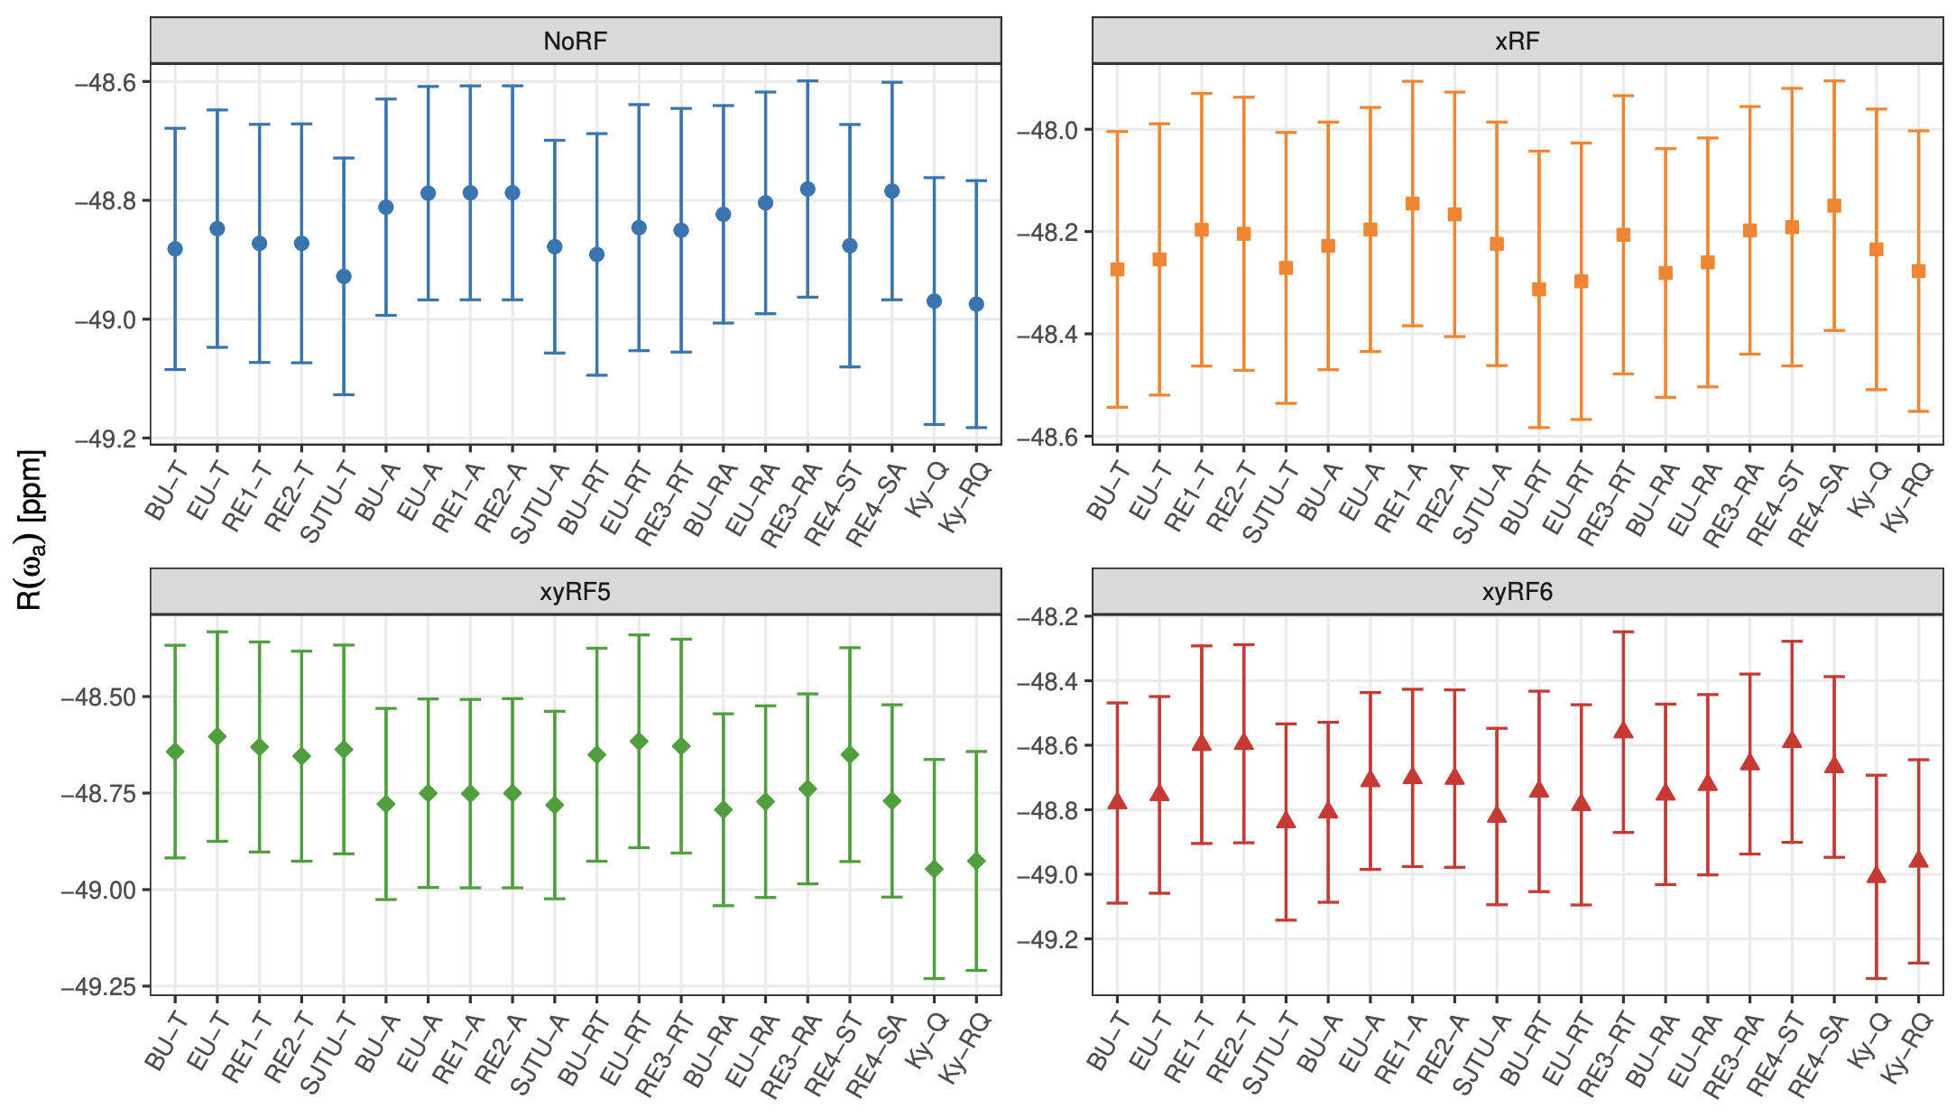
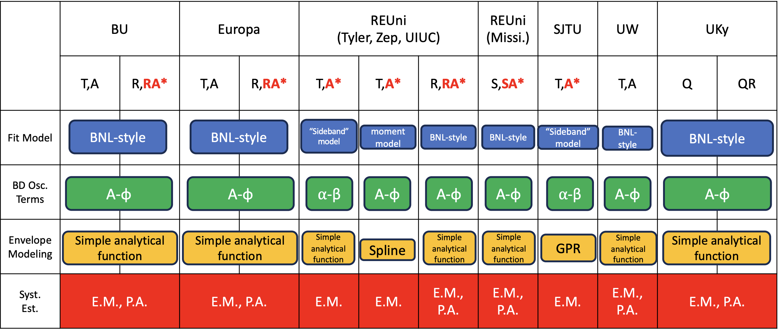
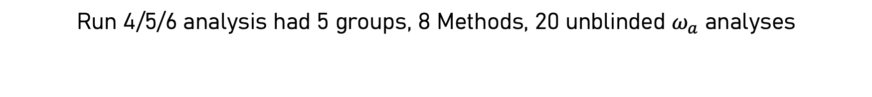
Power in diversity of approaches
Run 4/5/6 analysis had 5 groups, 8 Methods, 20 unblinded $ω_{a}$ analyses

Slide 8
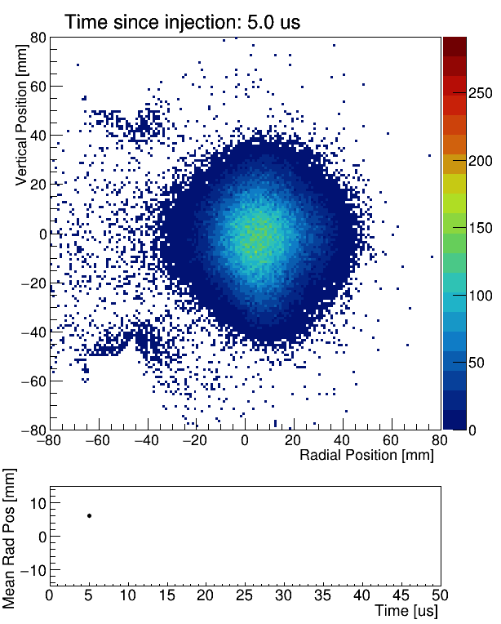
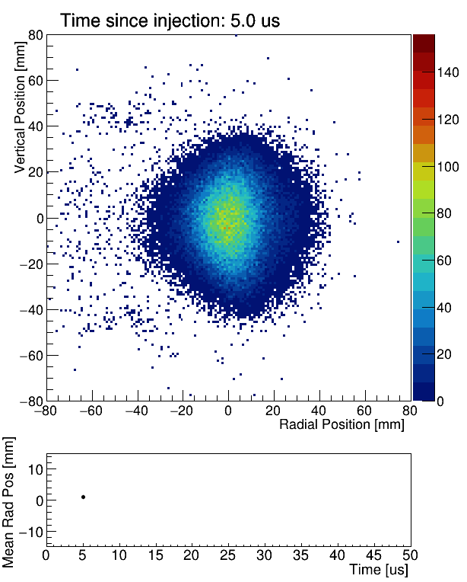
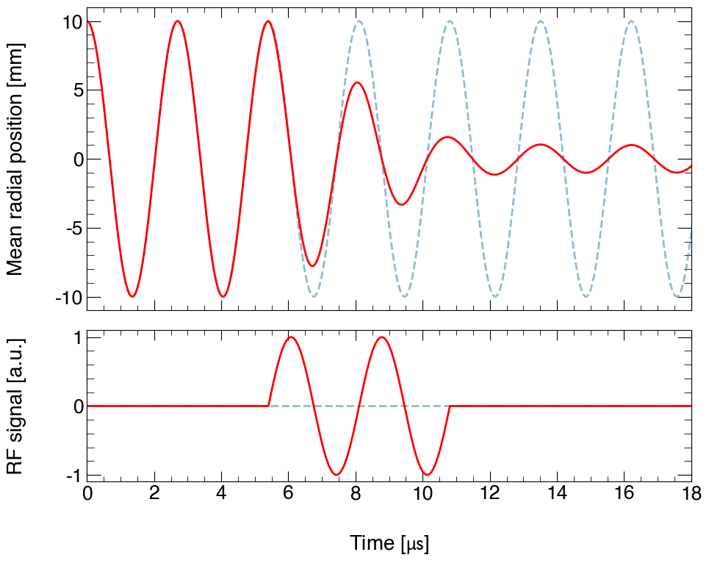
Main Improvements Coherent betatron oscillation Task Force
Additional RF on ESQ Significant reduction in oscillation amplitude
No Additional RF on ESQ
RF has reduced CBO greatly
RF acts like a forced harmonic oscillator (for 6 μs)
If tuned correctly to the CBO frequency:
Phase-shifts different muon distributions
Reduces the oscillation of the mean of the particle ensemble (reduces the coherence)
Split data into 4 datasets
noRF, xRF, xyRF5, xyRF6

Slide 9
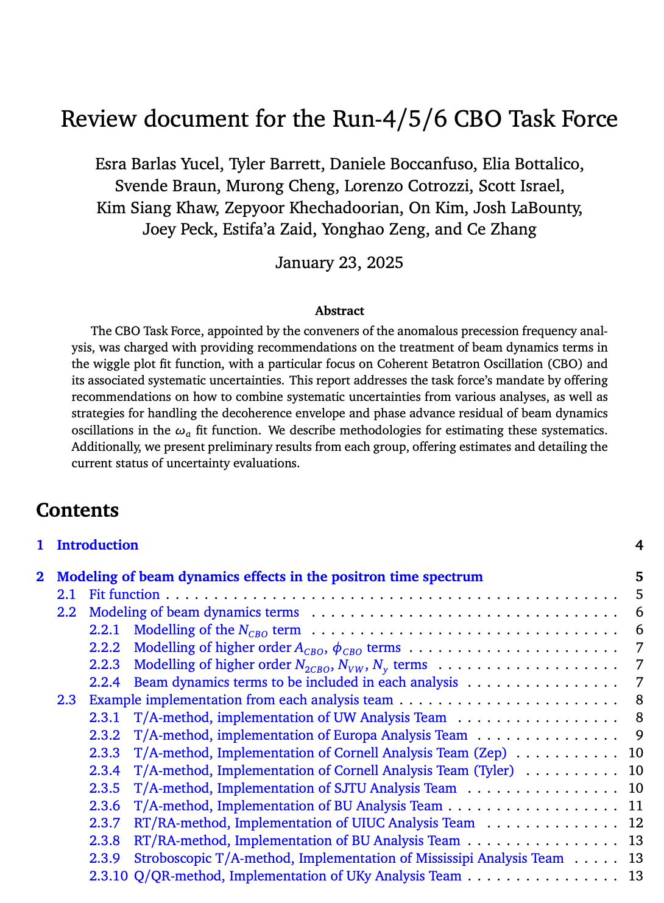
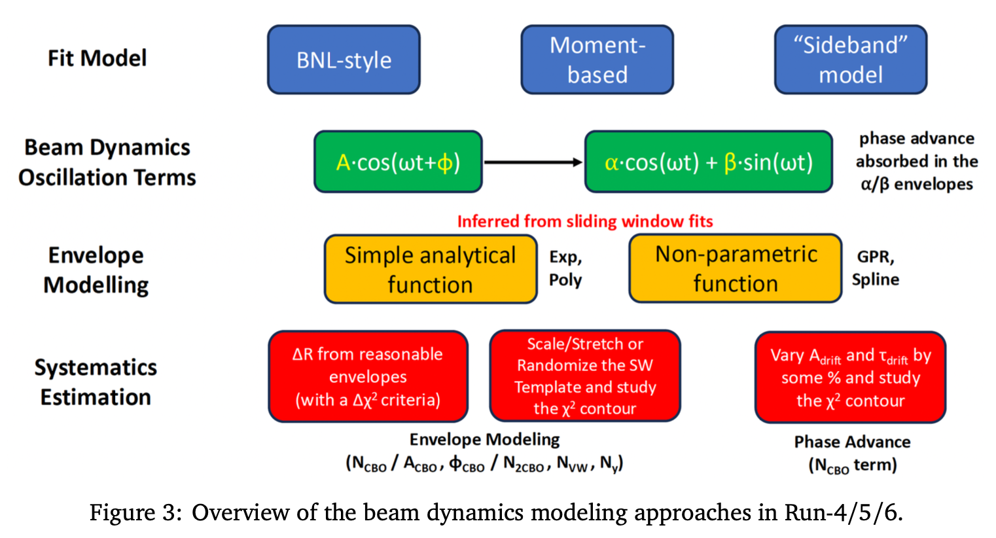
Coherent betatron oscillation Task Force

Slide 10
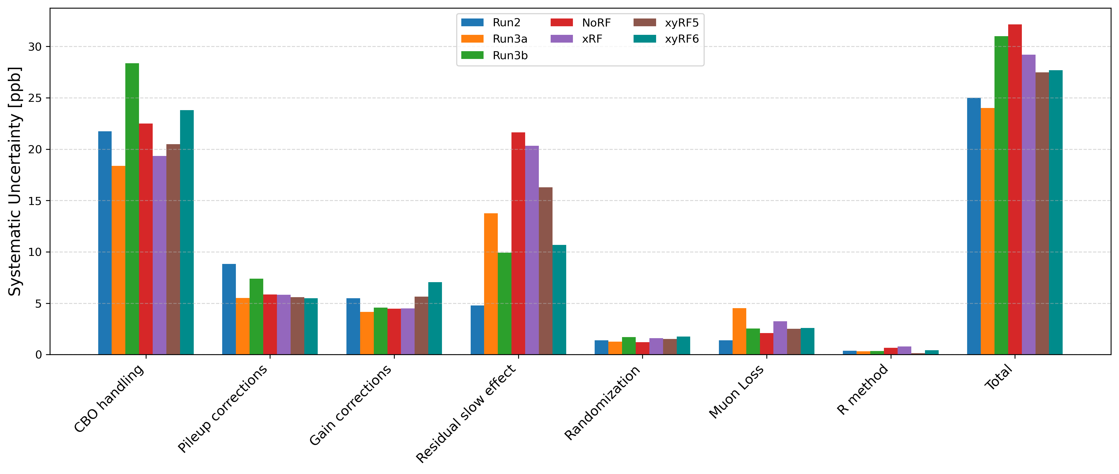
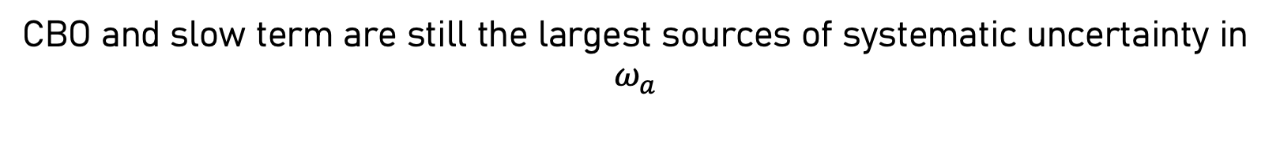
Systematic Uncertainties
CBO and slow term are still the largest sources of systematic uncertainty in $ω_{a}$

Slide 11
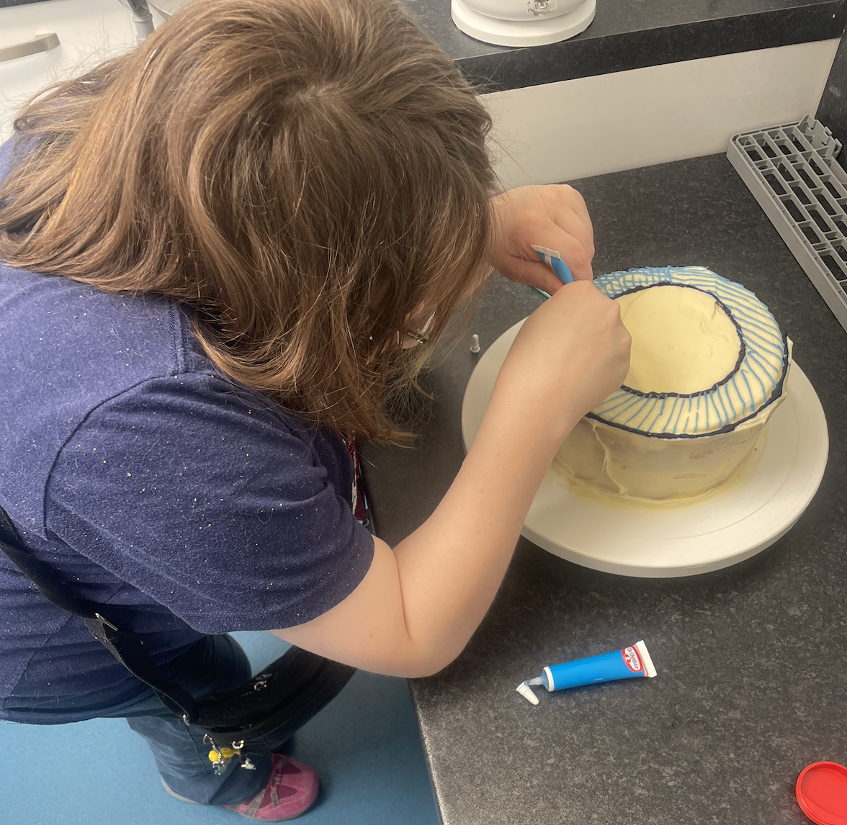
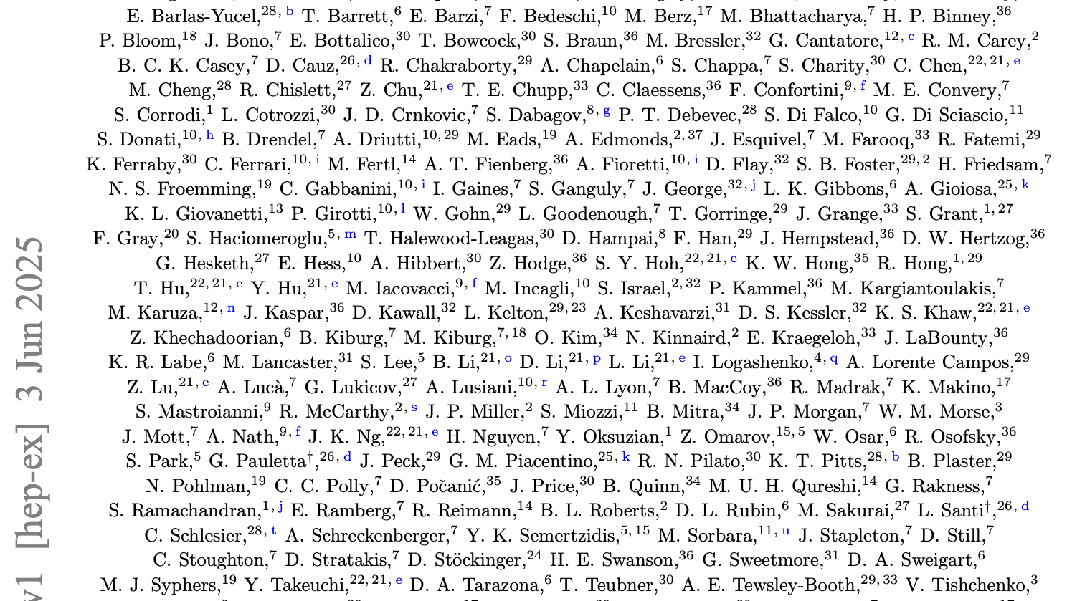
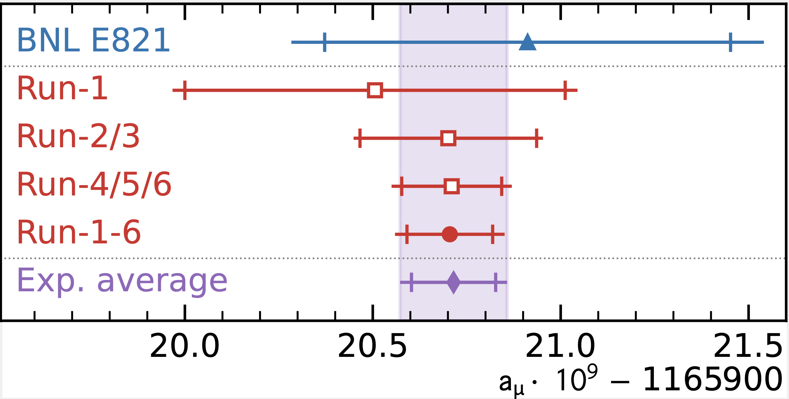
Result out !!!!

Slide 12
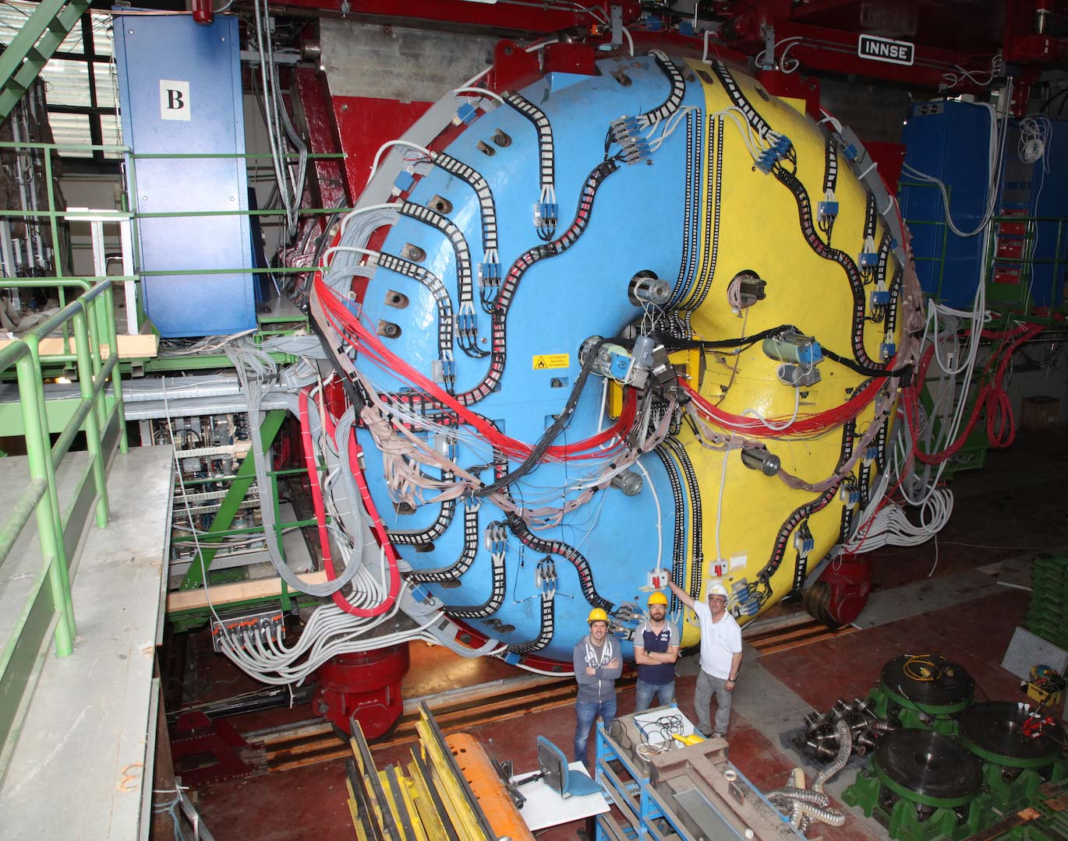

Slide 13
Current KLOE hadronic cross section analysis

Slide 15
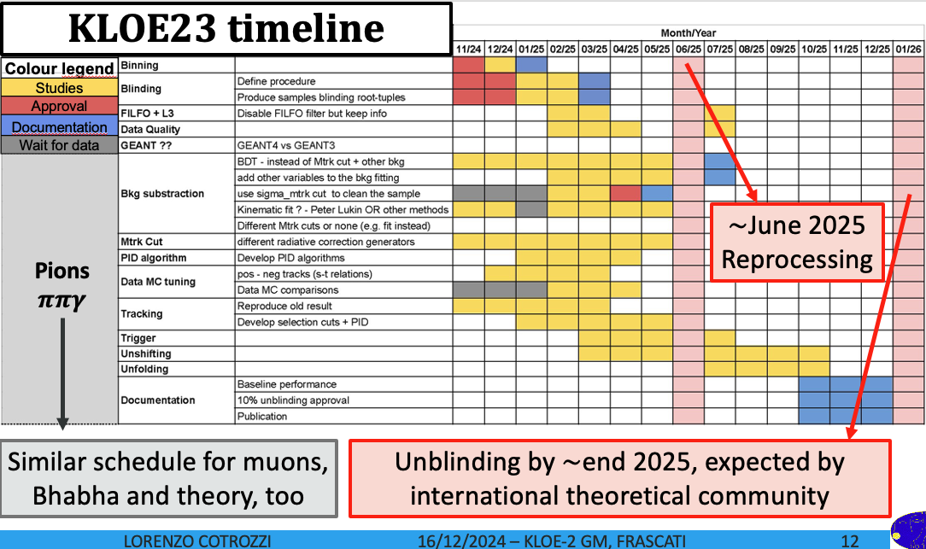

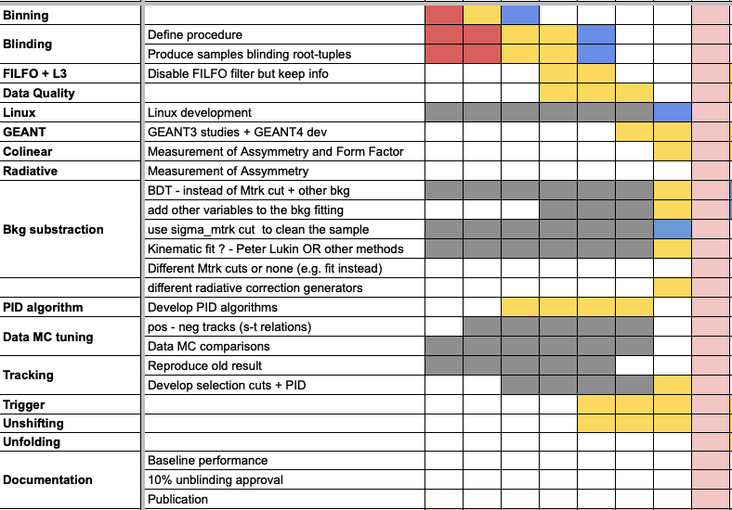

Slide 19


Thank you Very Much

