Slide 1
MUonE and g-2
Katie Ferraby

Slide 2
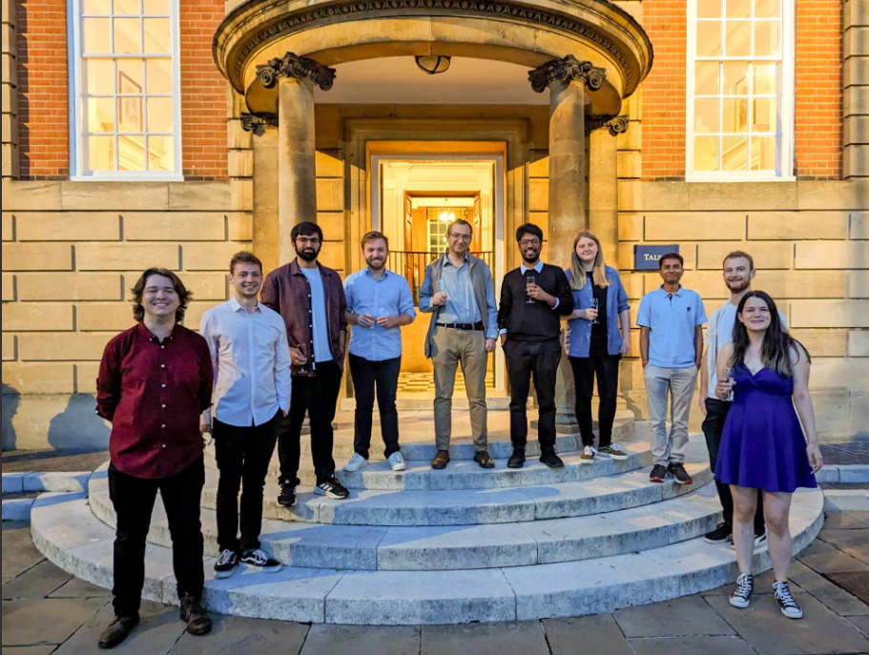

Slide 3
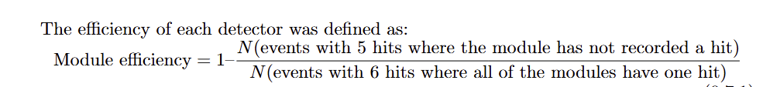

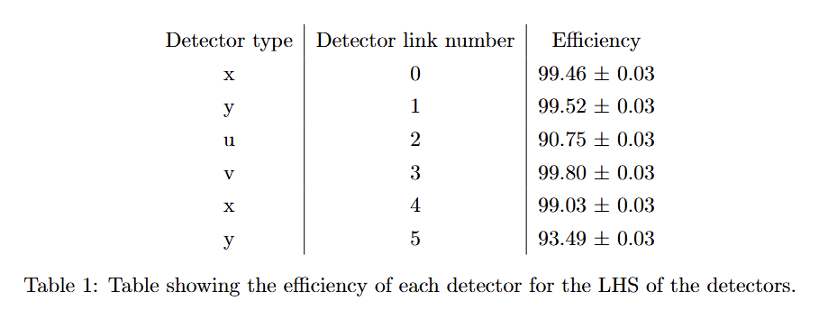
Simple efficiency
3

Slide 4


Slide 5
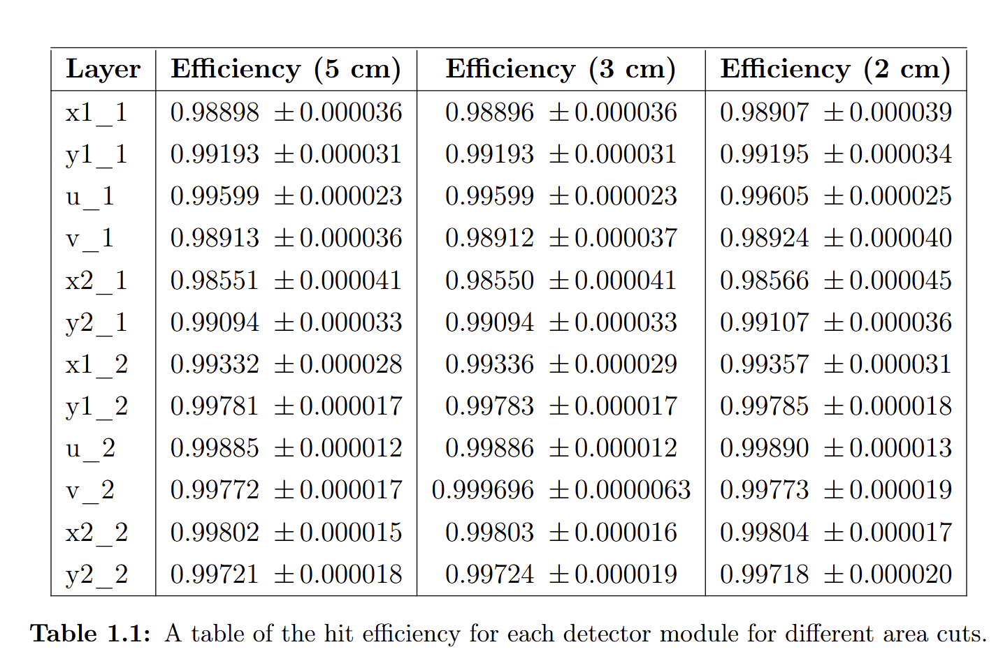
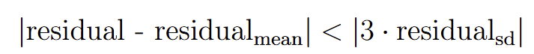
Hit efficiency
I remove one module from the data and reconstruct the data without that module
I compare this reconstruction to the raw data
I add to the count for the hit efficiency if the residual passes the condition below
Residual = x_track from reconstruction – x_track from raw data for that module
X_track
raw
residual
X_track
reconstruction

Slide 6
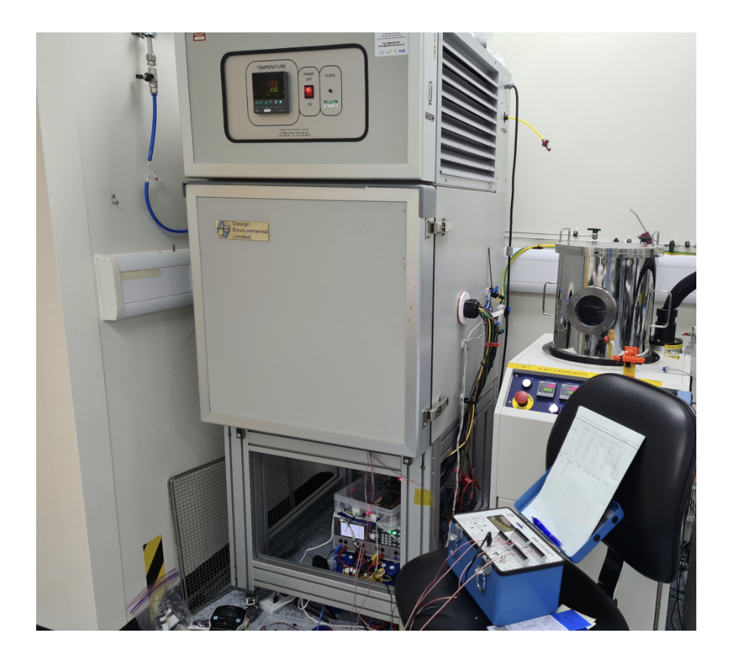
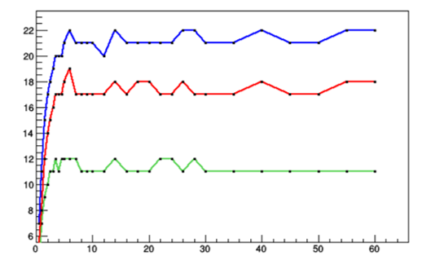
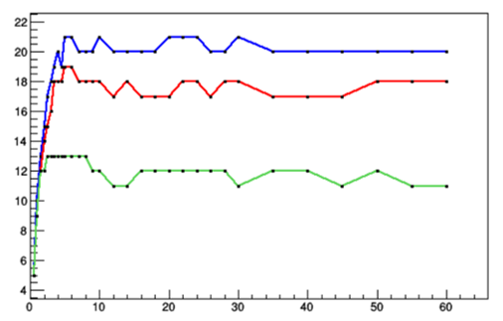
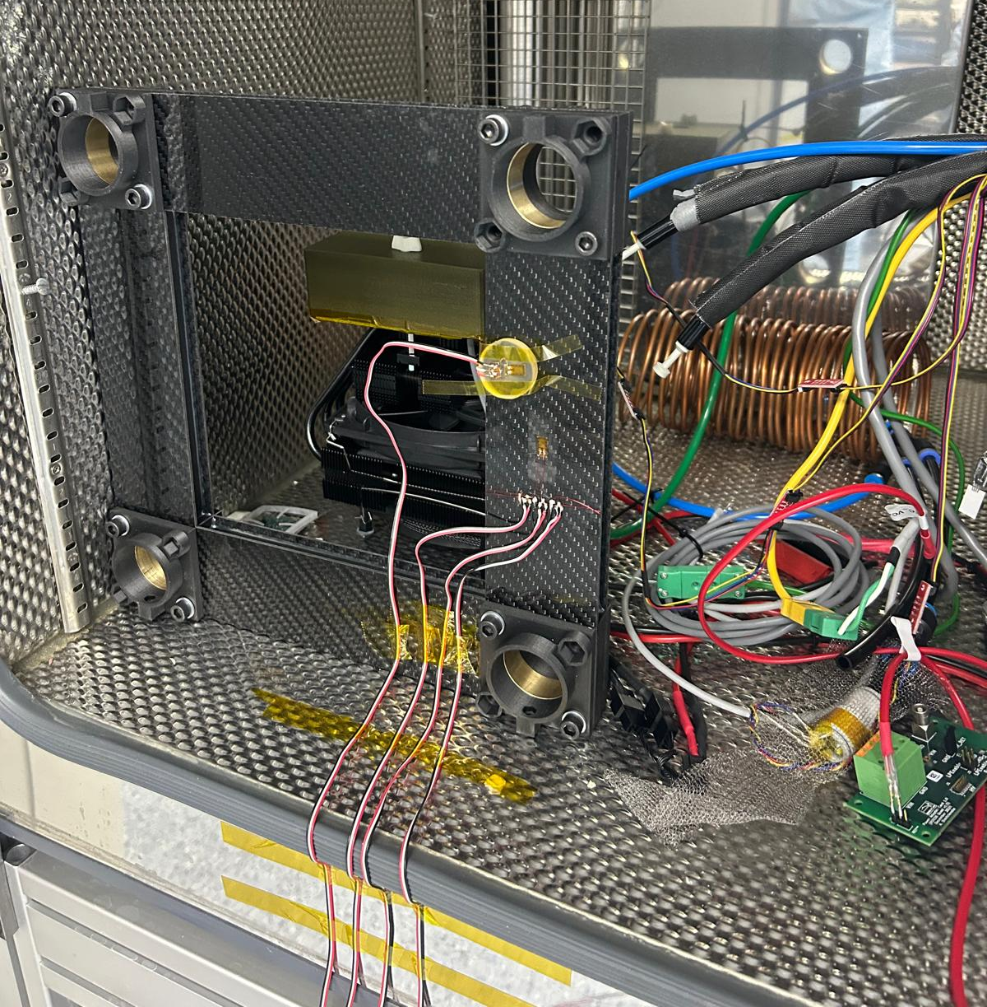
Hardware studies
We attached sensors to every side of a mock up detector support frame to determine the stability of the frame.
Measurements were taken for a temperature rise from 20 to 25 degrees and then the frame was rotated, and the measurements were repeated:
For the first 5 minutes, a strain reading was taken every 30 seconds.
For the next 5 minutes, a strain reading was taken every minute.
For the next 20 minutes, a strain reading was taken every 2 minutes.
For the last 30 minutes, a reading was taken every 5 minutes.

Slide 7
Hardware studies
Conclusions:
The plots showed uneven initial heating, followed by temperature equalisation and redistribution of internal forces.
In the unrotated case, channels 1 and 2 behave differently, while in the rotated case they behave similarly.
This indicates that rotation changes the stress distribution in the structure, likely by altering the expansion-driven load paths —the routes through which thermal expansion forces are transmitted and reacted within the structure.
There is less strain in the side of the frame due to the fibres being rather than woven like the front and back.
The front and back frame readings were slightly different, implying there was small bending happening.

Slide 8
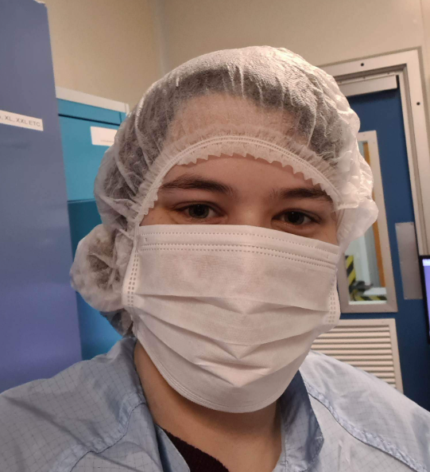
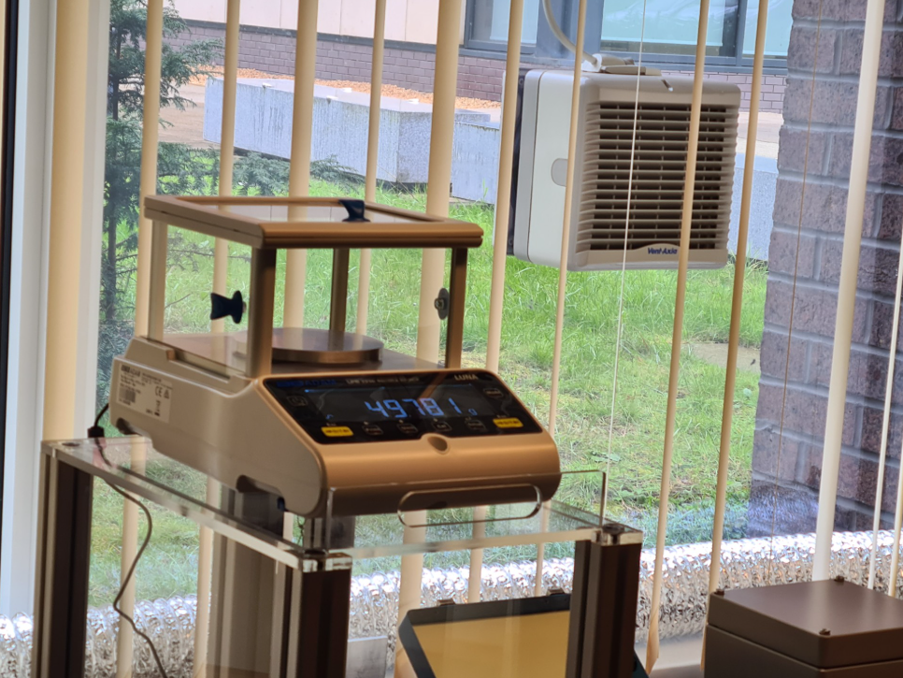

Slide 9
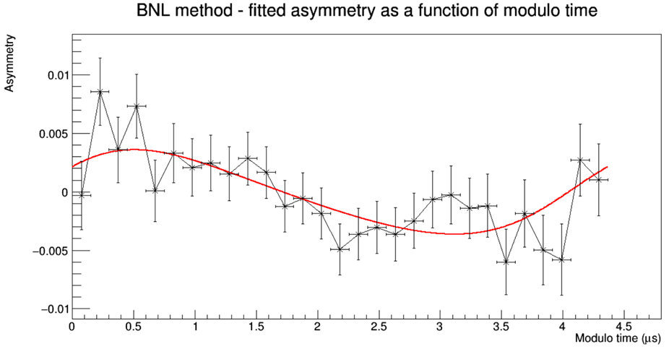
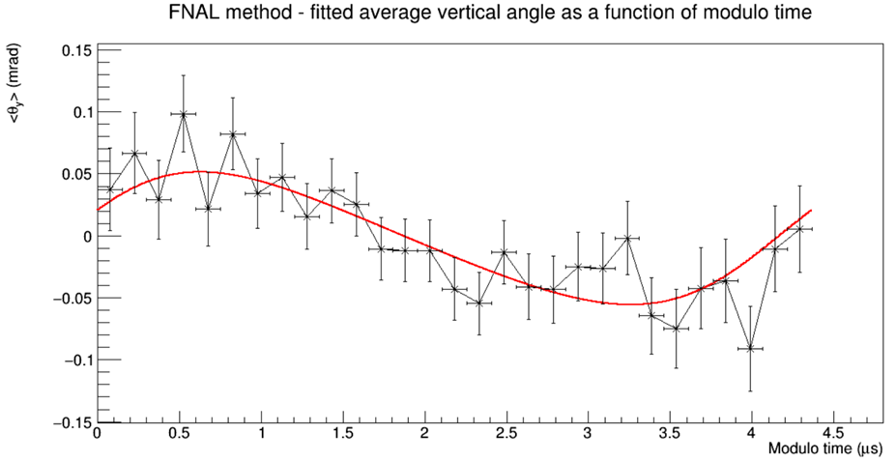
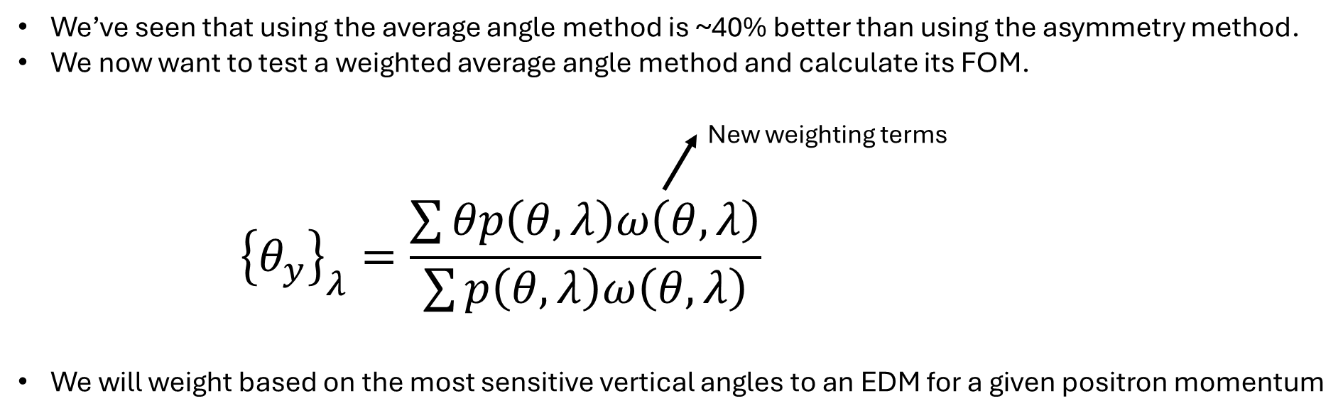
g-2

Slide 10
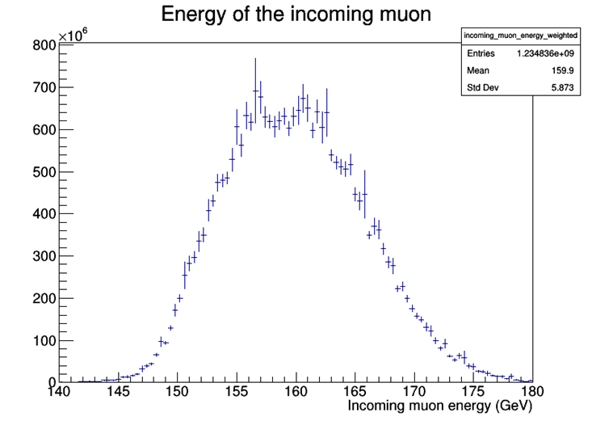
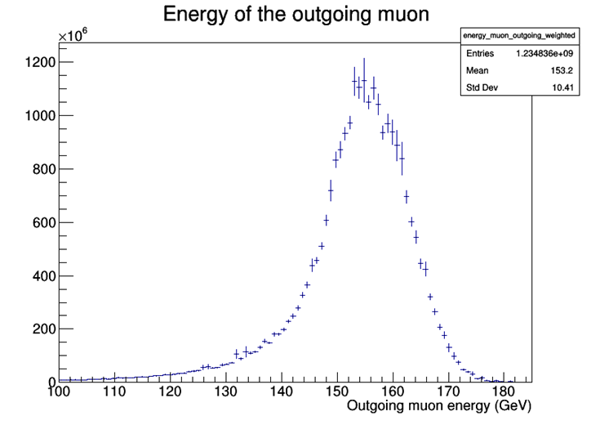
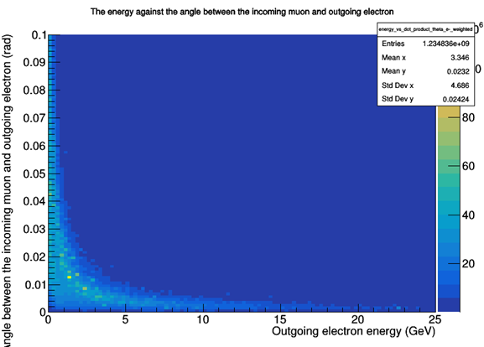
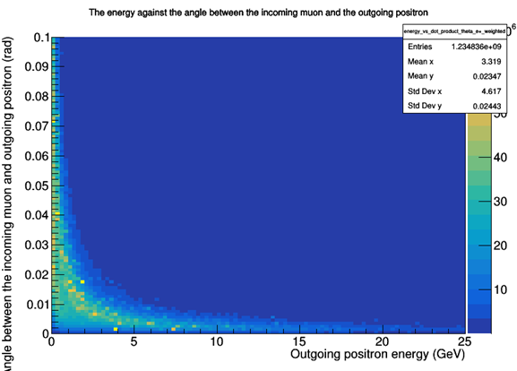
Truth kinematics
Before looking at the reconstructed background events, I analysed the truth kinematics to determine if the generator was producing events correctly and there was no strange behaviour.
In nuclear pair production, the electron and positron are typically emitted at small angles and low energies, especially at high muon energies.
This forward-peaked distribution, seen in the data above, is consistent with a soft, collinear nuclear pair production process.

Slide 11
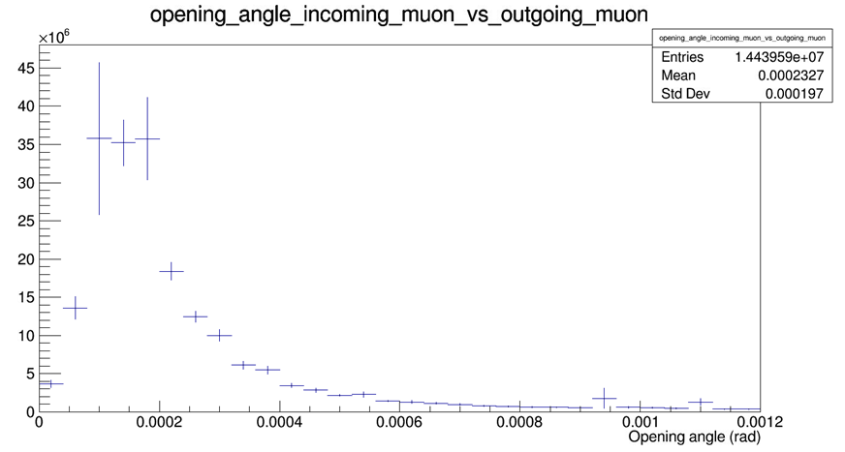
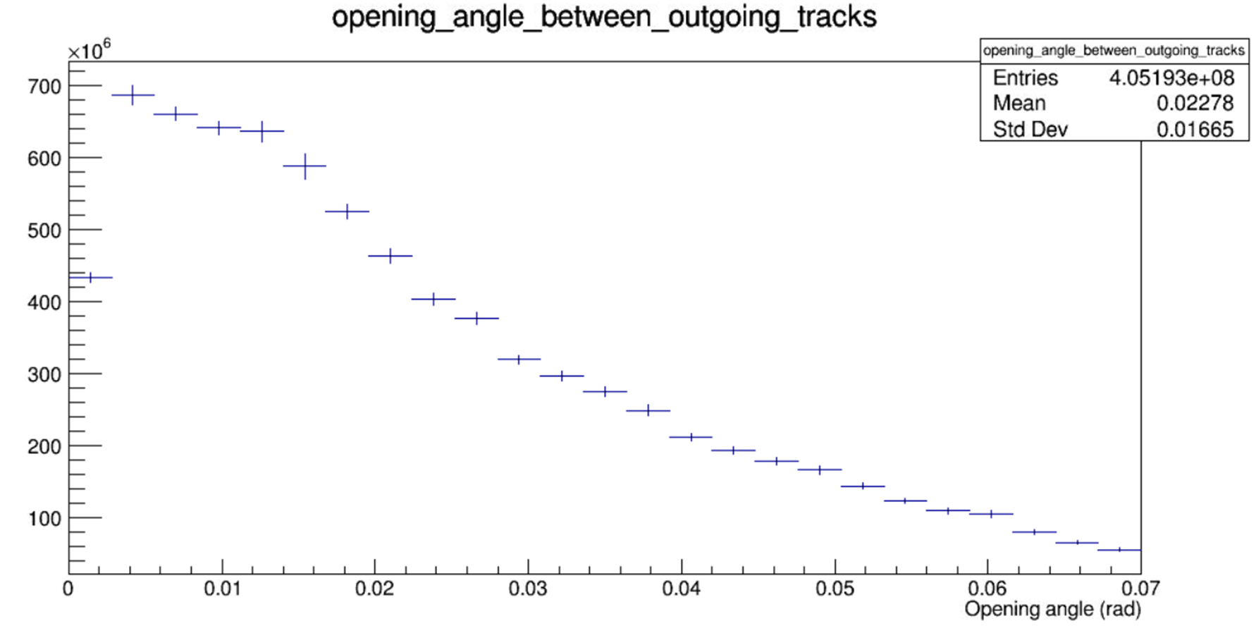
Equivalent events:
50M signal generated events gives 19M equivalents events.
40M background generated events gives 14,000 equivalent events as the background generator is likely very inefficient.
We spent a long time trying to reduce the size of the reconstructed files to get an acceptable number of stats for background event analysis.
Background studies:
I've studied truth vs reconstruction and simulation vs data for the background events to investigate background studies and then to compare them to signal events -> I need to finish analysing the results.
The goal is to identify how to remove even more of the unwanted background events.

Slide 12


I’m back in the office next week
I finished my 6-month placement last Friday!

Slide 13
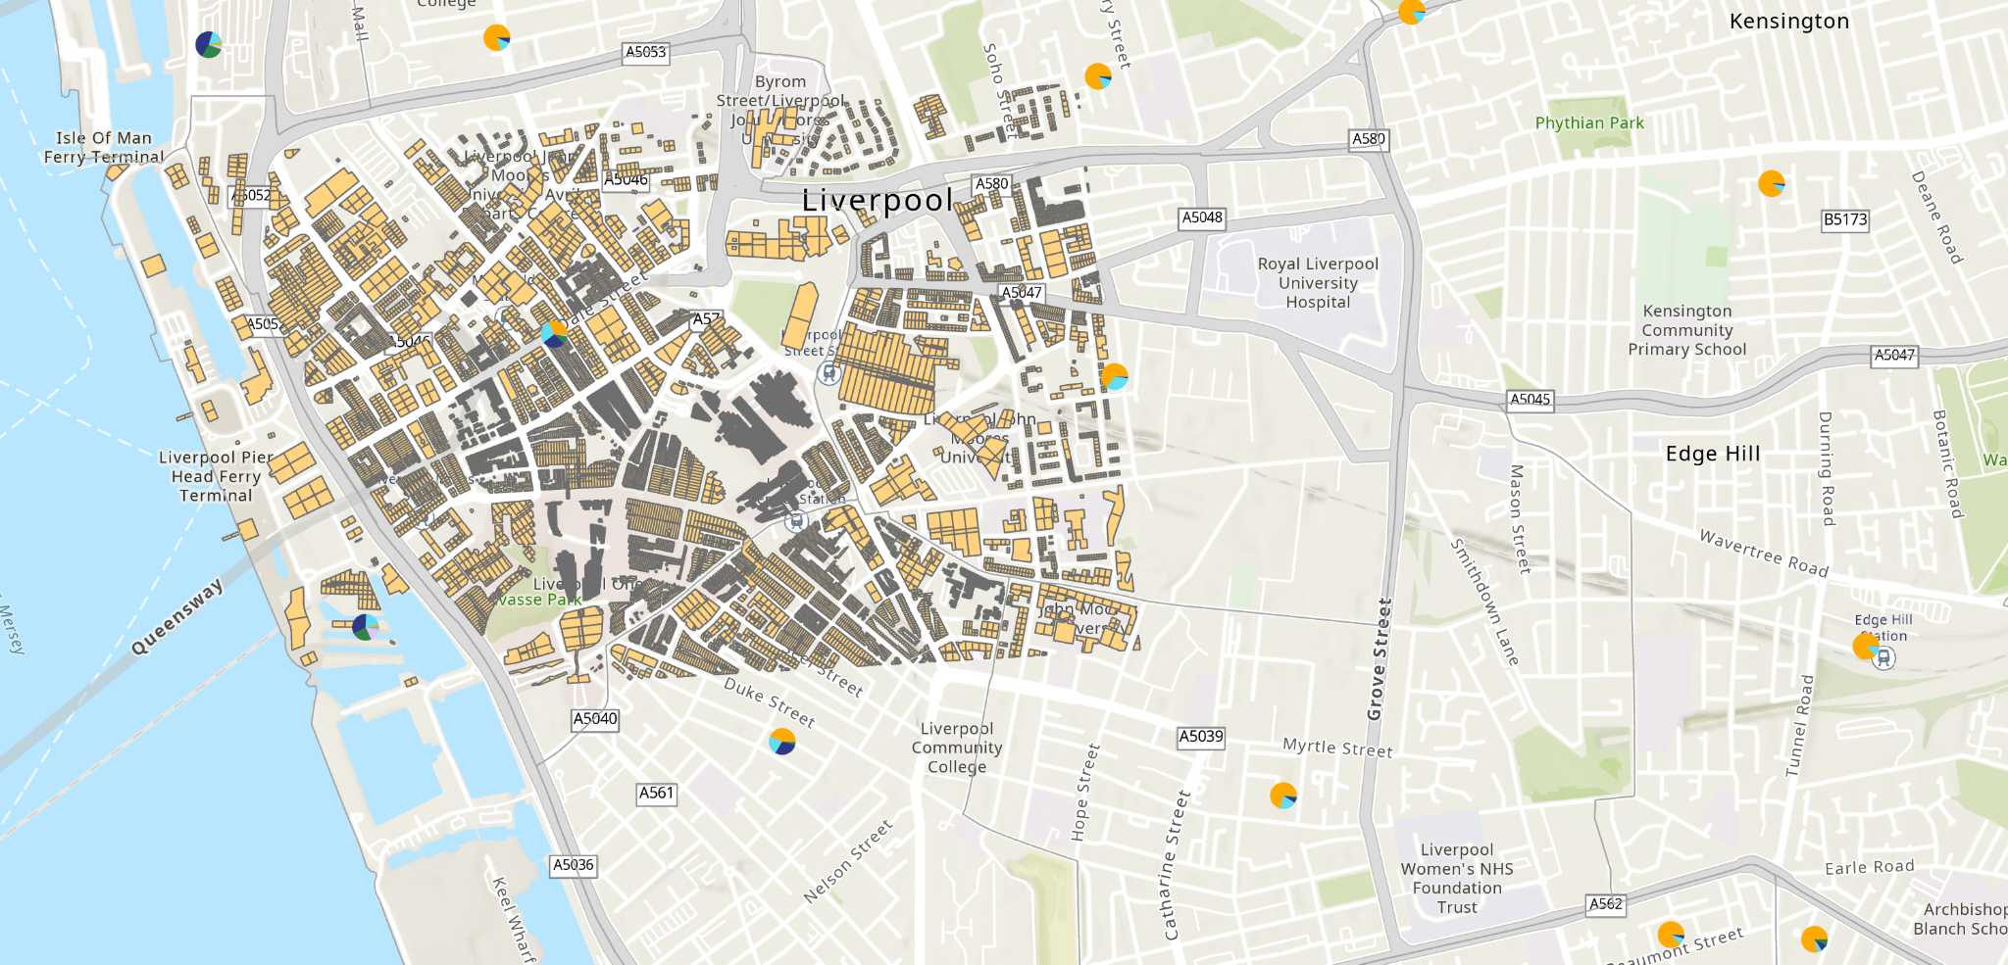
One of the main projects on the placement was working with Housing Associations (HA) and Liverpool City Council to come up with a generalised plan to upgrade/improve houses across Liverpool and fund it.
We worked with HAs to try and group what different areas, house ages etc needed – wall insulation, double glazing etc.
We were helping to determine the best financial model and pay back times for the homeowners and the investors.
I calculated the size of roofs and number of solar panels we could put on every house in Liverpool.

Slide 14
Now I’m back:
Help with the final EDM result for g-2
Familiarise myself with the new software updates and new test beam equipment/components
Analyse the 2025 test beam data

Slide 15

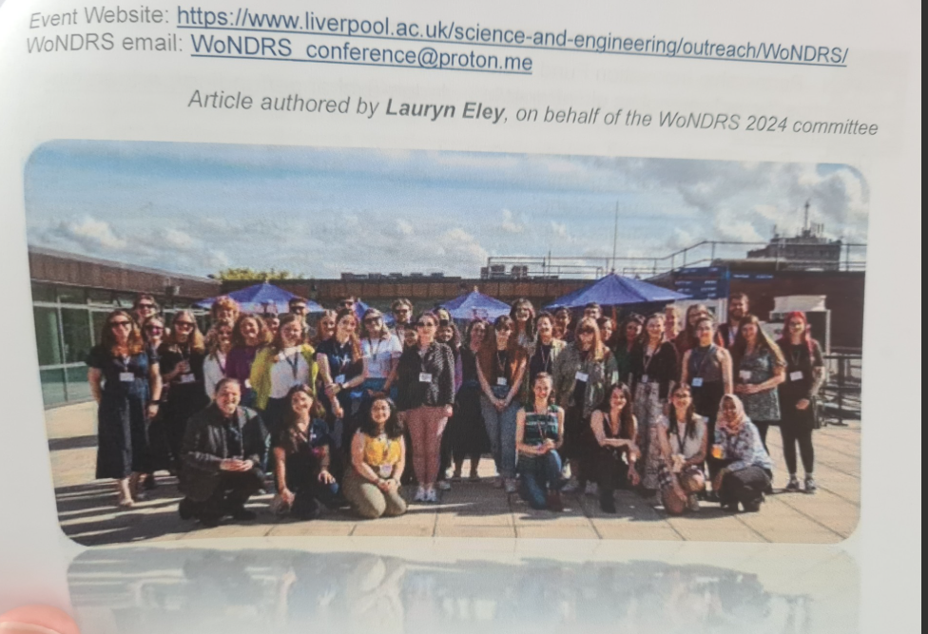
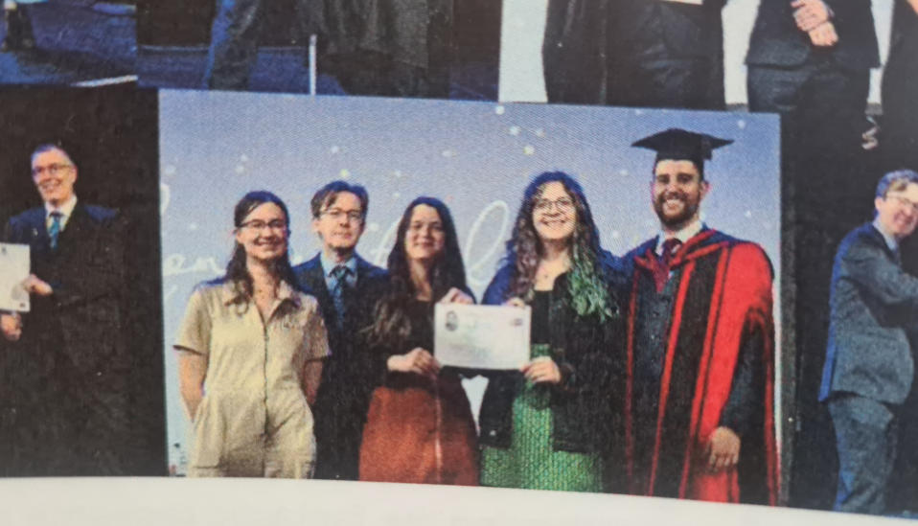

Slide 16




Thank you

Slide 17



