Slide 1








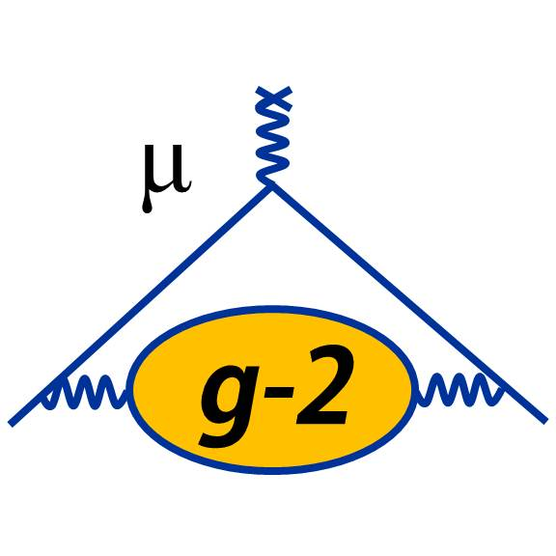





Lorenzo’s past, present and future
Lorenzo Cotrozzi (University of Liverpool)

Slide 2
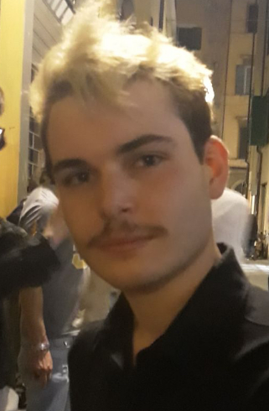


Beginnings in Pisa
PhD on Muon g-2: Run-2/3 waEuropa
NePSi23 workshop
Run-2/3 release & Fermilab YouTube video

Slide 3
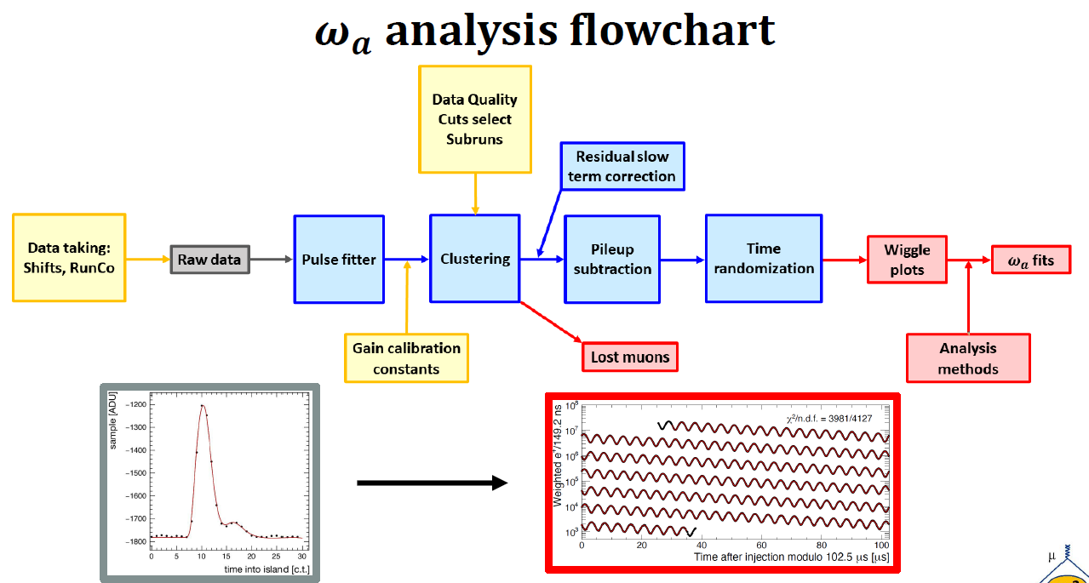

Slide 4
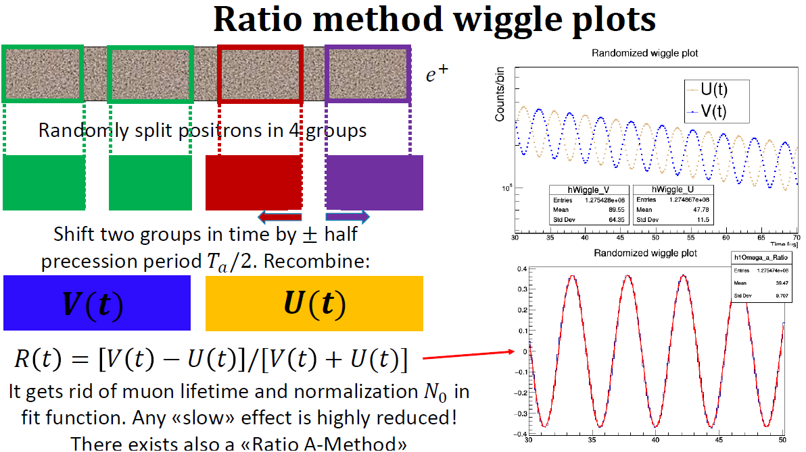

Slide 5
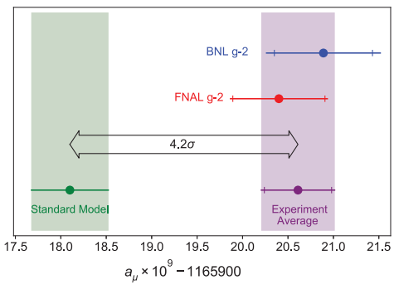
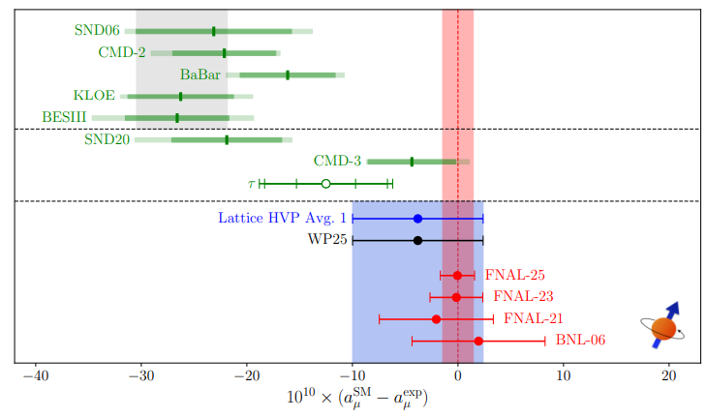
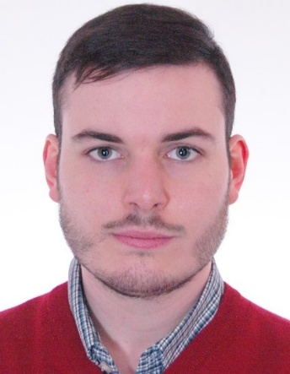
Darker times…
*Imagine the weather change from Pisa to Liverpool*

Slide 6
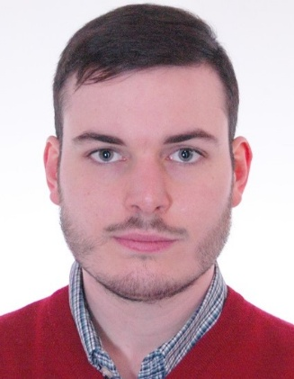
Research activities in Liverpool
Muon g-2 @FNAL
RadioMonteCarLow2
KLOE-nxt
JPARC g-2/EDM
All pieces of the Muon g-2 puzzle

Slide 7
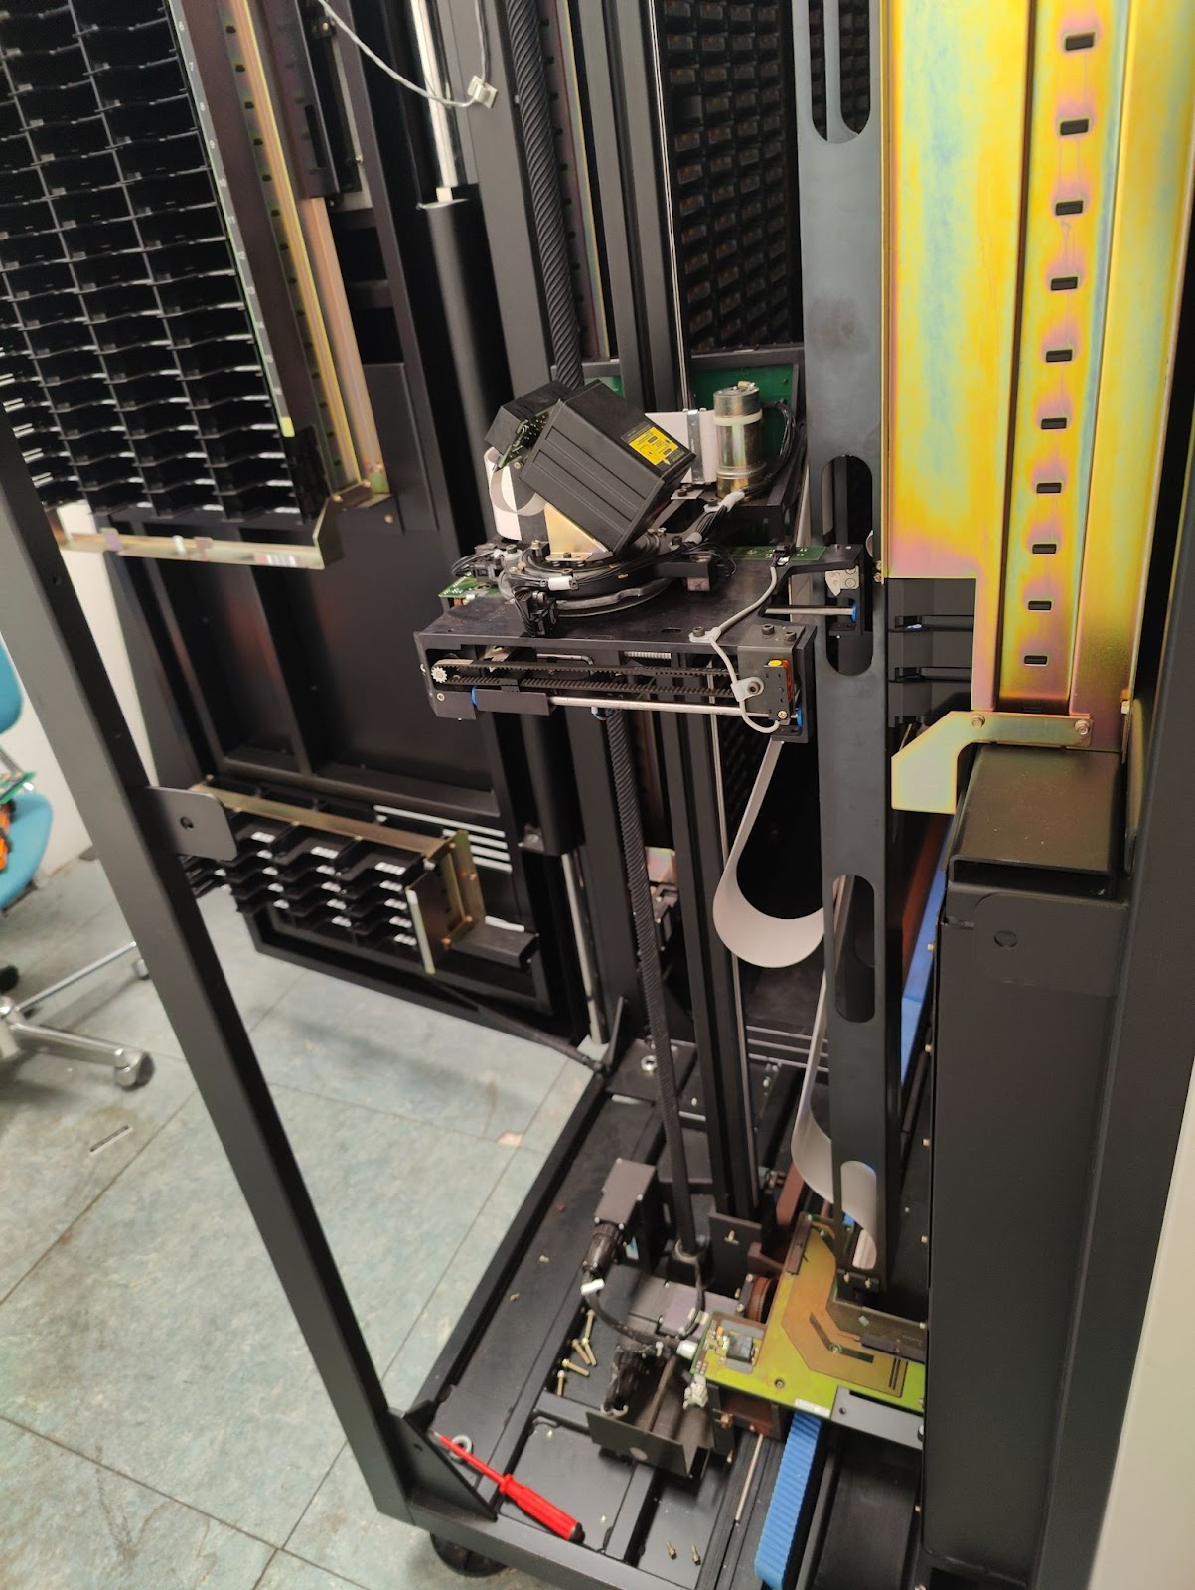
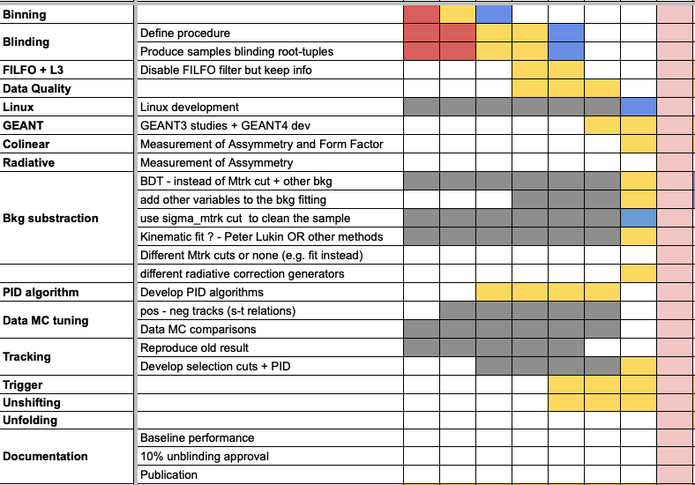
KLOE-nxt

Slide 8
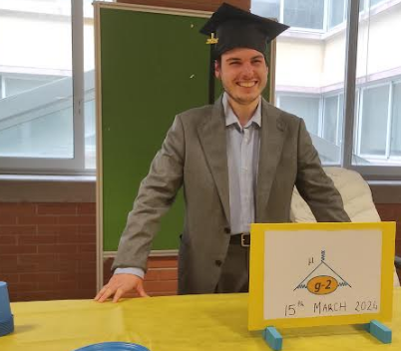

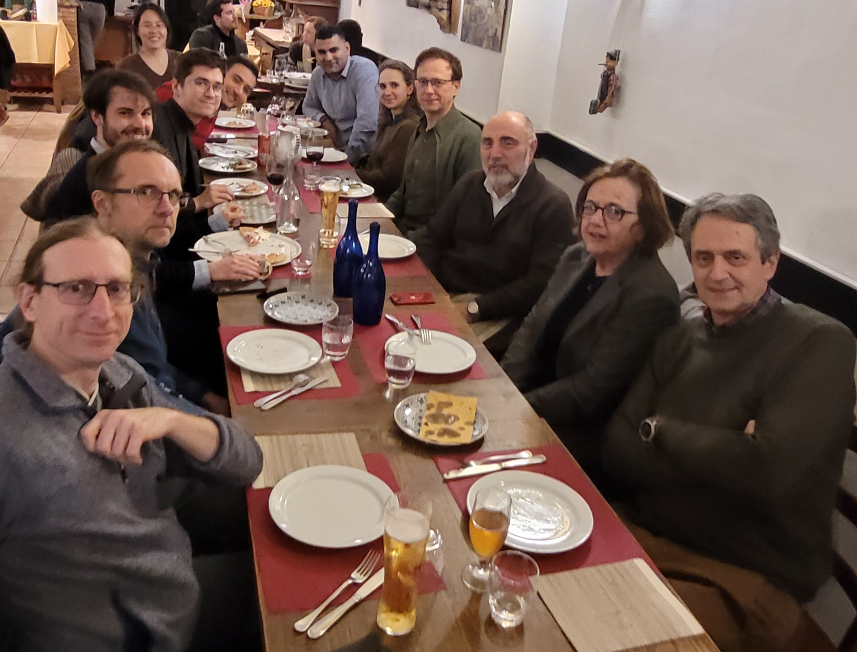
Recent happy memories
Released in cinemas
Enters the Top League, «Serie A»
Food in Frascati

Slide 9
Other roles
Run Coordinator for Run-5 and Run-6 – 7 months
G2early/Speakers committee representative – 2 years
Another g-2 committee – 53 days

Slide 10
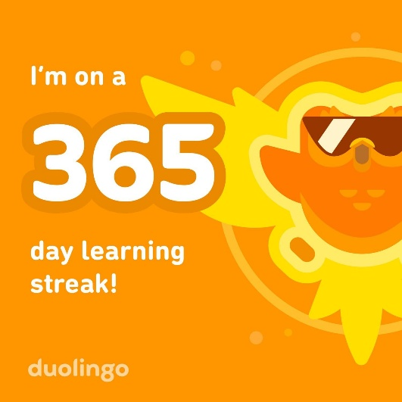
Future prospects and goals
Obtain this →
Contribute to this →

Slide 11
It’s pie time!

Slide 12
It’s pie chart time!
Papers & Proceedings: 17
Conference talks, Posters & Outreach: 22

Slide 13


THANK YOU FOR
YOUR ATTENTION!

