Slide 1



Antimatter and ALPHA (Antihydrogen Laser PHysics Apparatus)
Abbygale Swadling
PhD Student, University of Calgary
https://alpha.web.cern.ch/

Slide 2
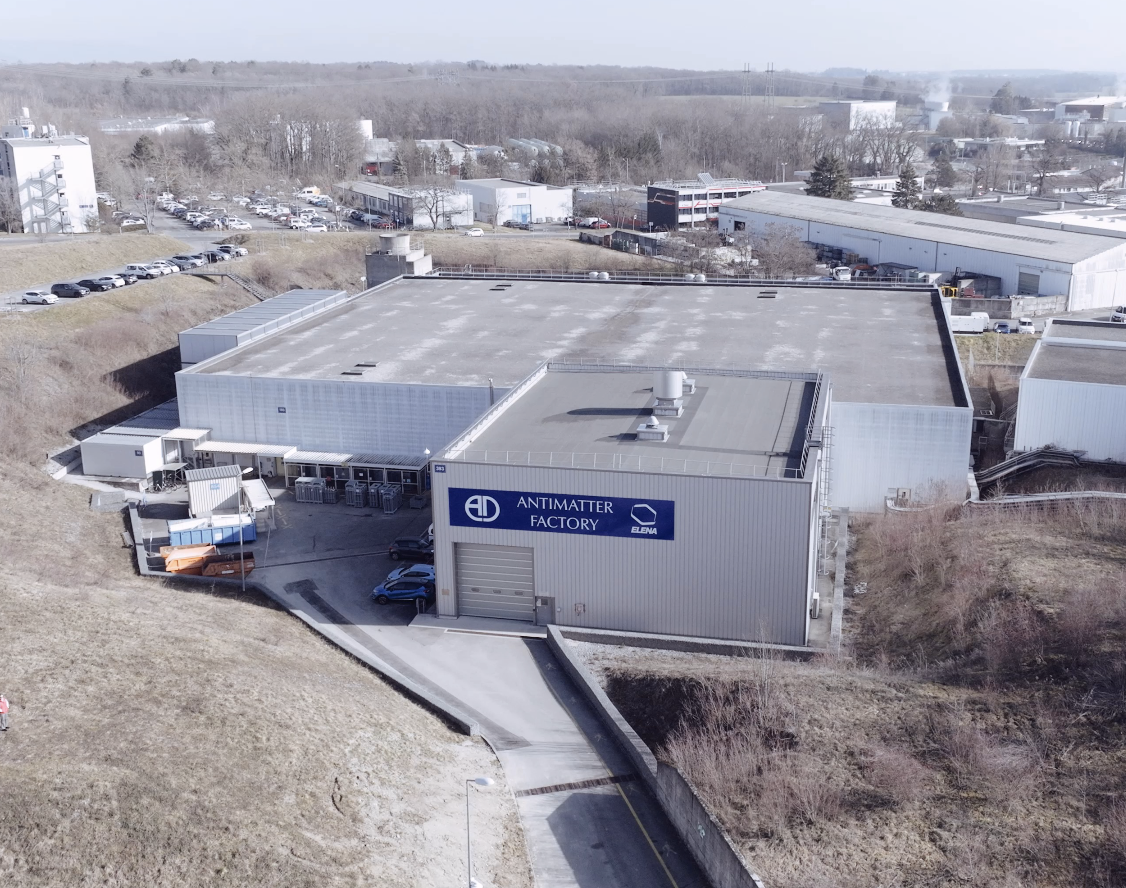
What will we cover?
Introduction
Antimatter Overview
ALPHA
Experiments with antihydrogen

Slide 3
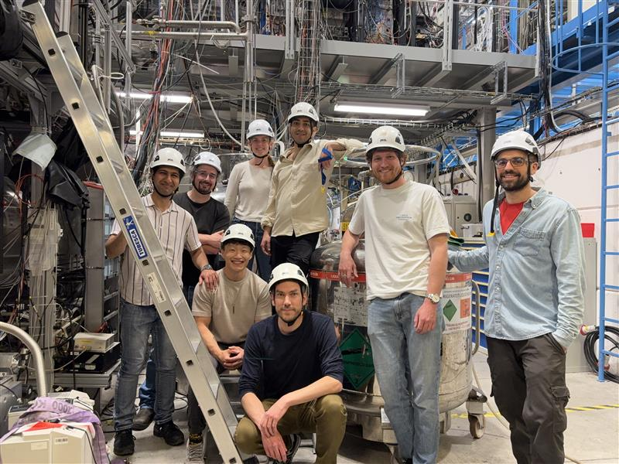
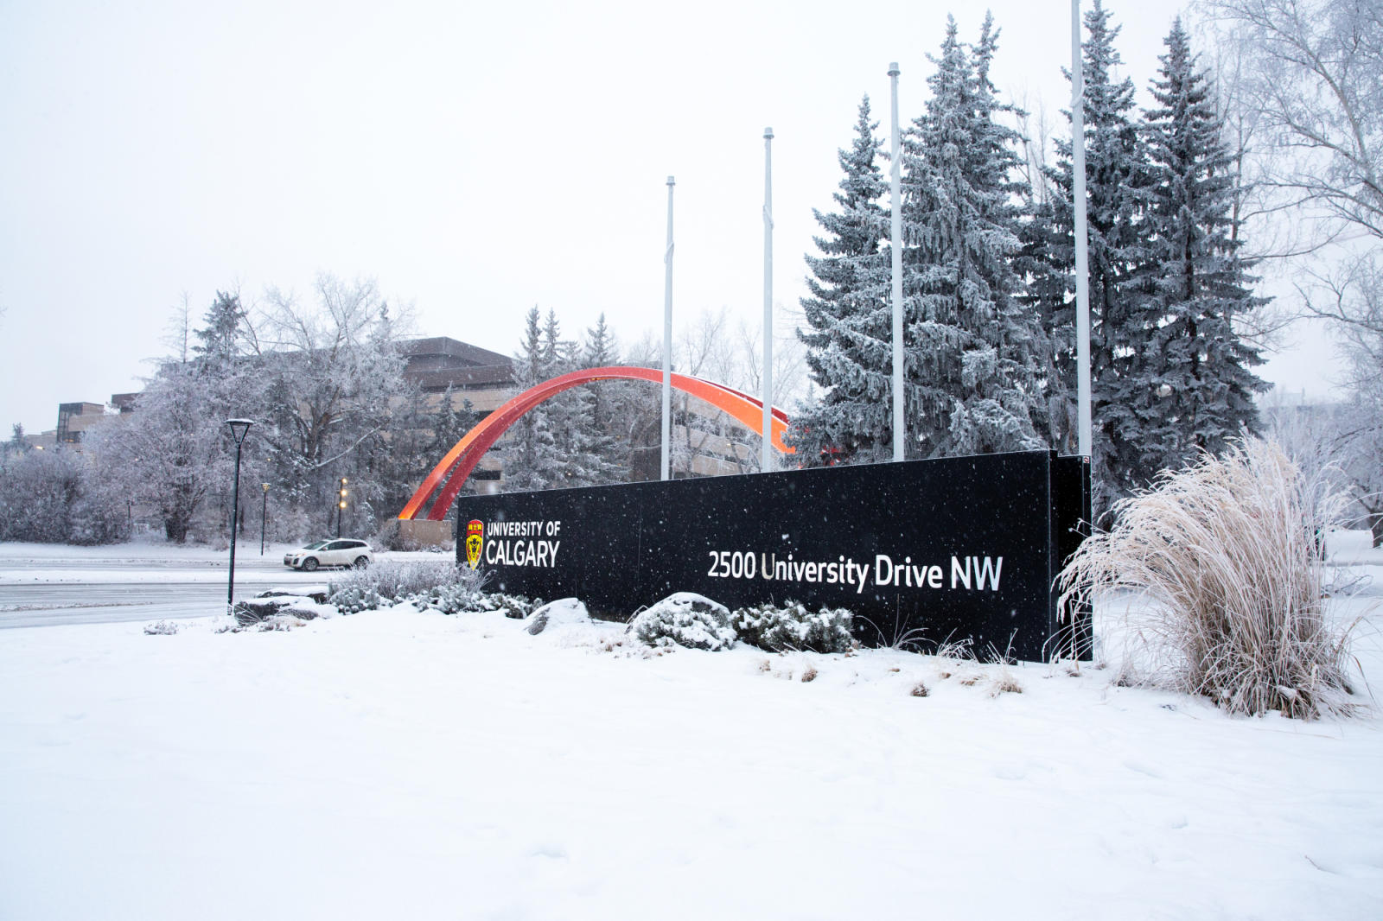
Introduction
2019-2023 Bachelor of Science, Honors Physics
2023-now PhD, Physics (working with ALPHA)

Slide 4

Introduction
University of Calgary
CERN
  ~69 members
  17 institutions

Slide 5


Overview
What is antimatter?
Why study antimatter?
How is antimatter made?
What can we do with anti-atoms?
$$e^{+}$$
$$\overline{p}$$

Slide 6
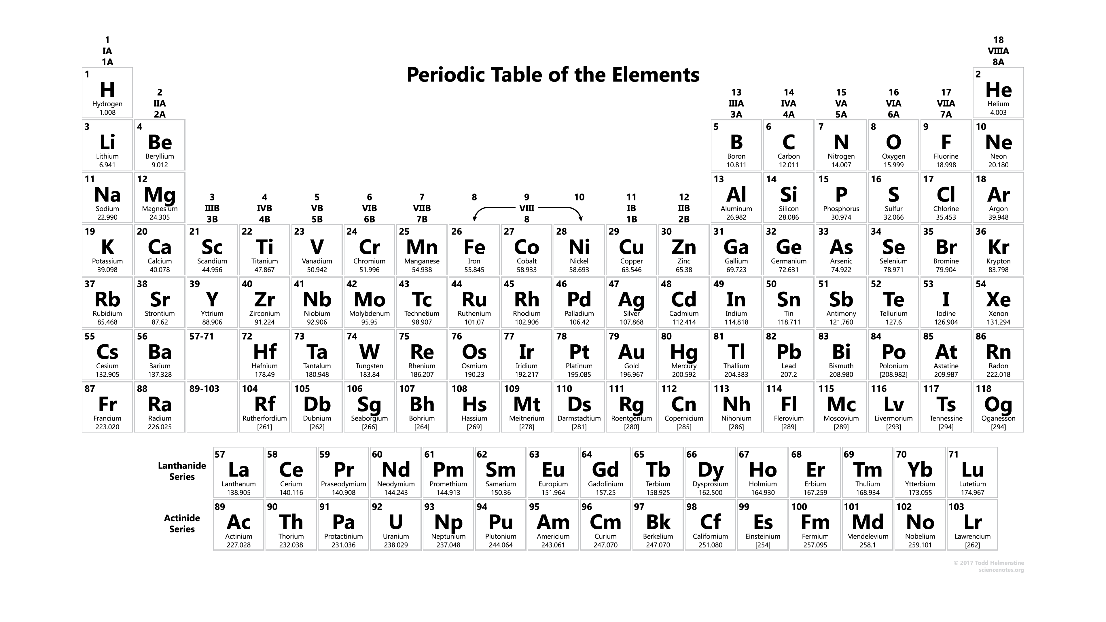
Matter

Slide 7


Matter
$$p$$
$$e^{−}$$

Slide 8
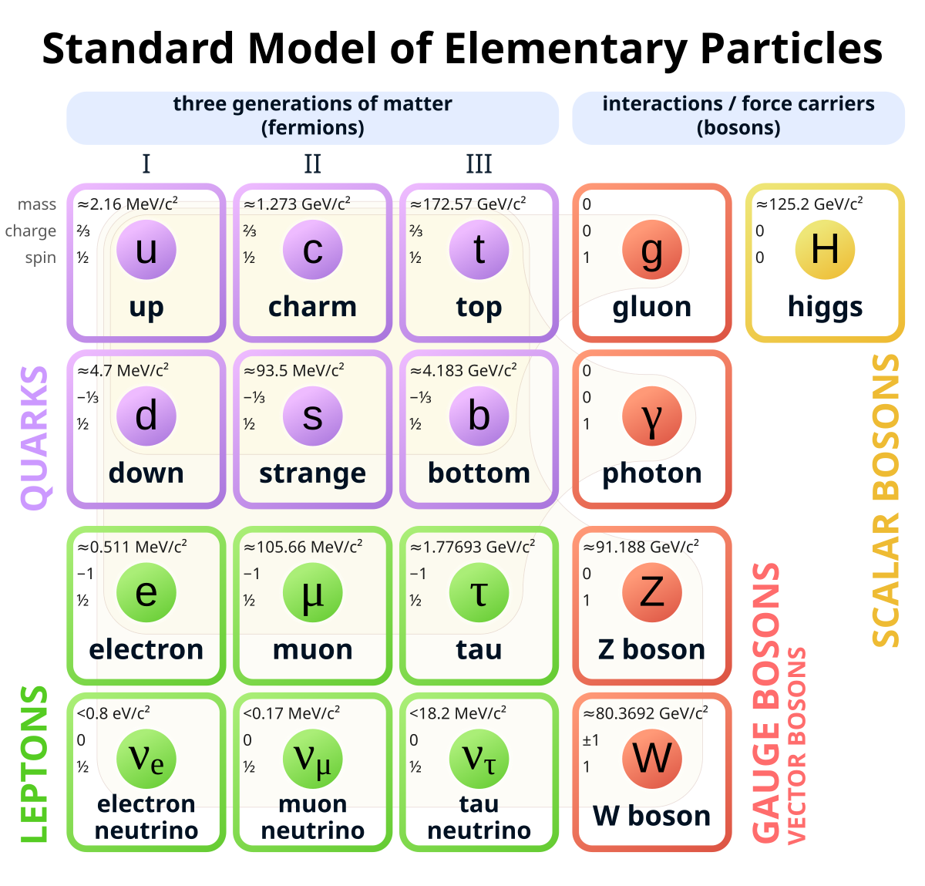





Matter
$$d$$
$$u$$
$$u$$
$$p$$
$$e^{−}$$
Hydrogen
https://en.wikipedia.org/wiki/File:Standard_Model_of_Elementary_Particles.svg

Slide 9
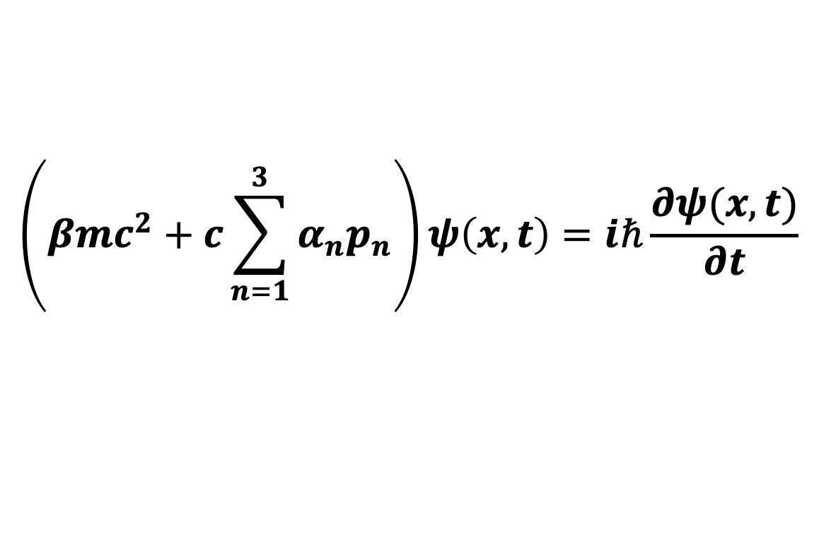

Prediction of Antimatter
In 1928 Paul Dirac predicted the existence of antimatter
The Dirac equation
  $ψ\left(x,t\right)$ is the wavefunction for an electron
$$\left(βmc^{2}+c\sum_{n=1}^{3}{α_{n}p_{n}}\right)ψ\left(x,t\right)=iℏ\frac{∂ψ(x,t)}{∂t}$$

Slide 10
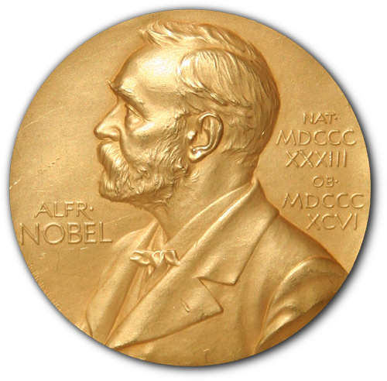
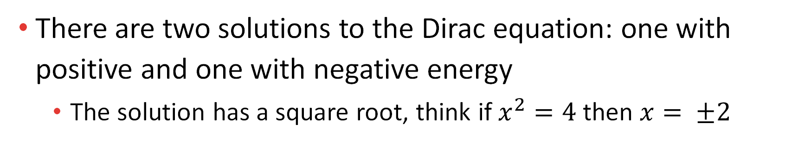


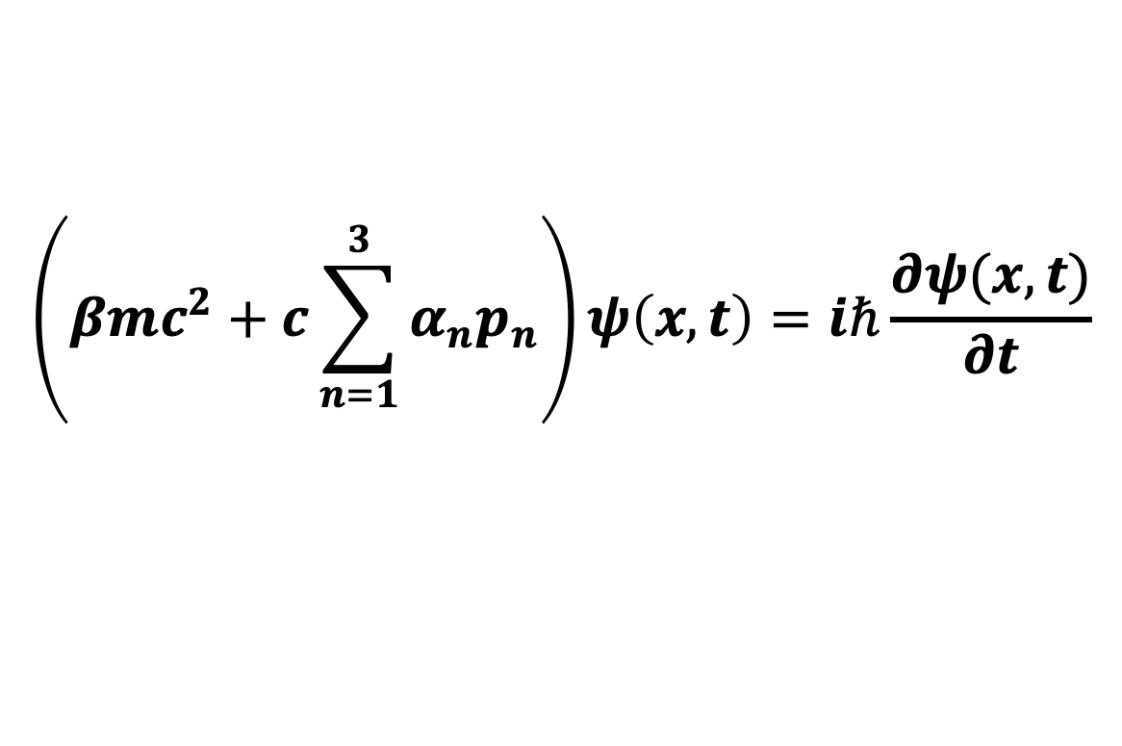
Prediction of Antimatter
$$\left(βmc^{2}+c\sum_{n=1}^{3}{α_{n}p_{n}}\right)ψ\left(x,t\right)=iℏ\frac{∂ψ(x,t)}{∂t}$$
There are two solutions to the Dirac equation: one with positive and one with negative energy
  The solution has a square root, think if $x^{2}=4$then $x= ±2$
$$e^{−}$$
$$e^{+}$$
electron
positron

Slide 11
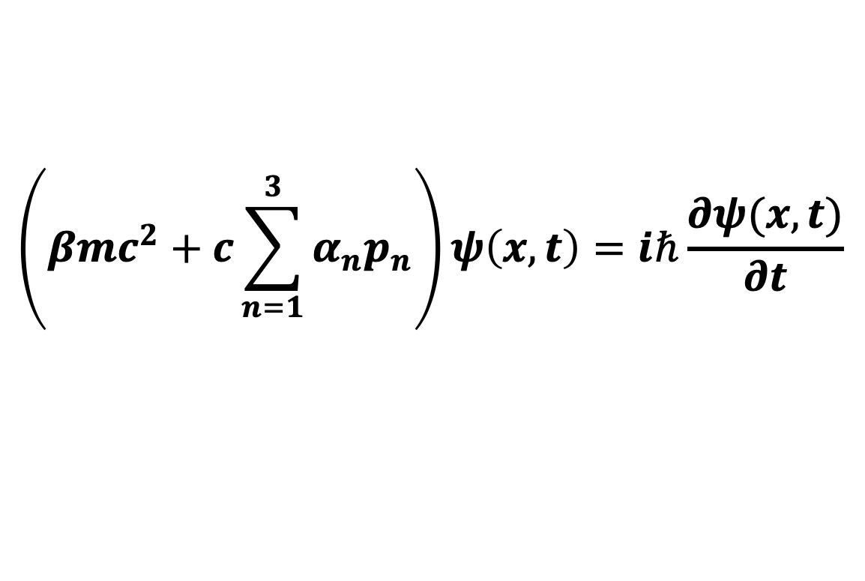


Prediction of Antimatter
$$\left(βmc^{2}+c\sum_{n=1}^{3}{α_{n}p_{n}}\right)ψ\left(x,t\right)=iℏ\frac{∂ψ(x,t)}{∂t}$$
$$e^{−}$$
$$e^{+}$$
electron
positron
Not negative energy but opposite charge and same mass

Slide 12
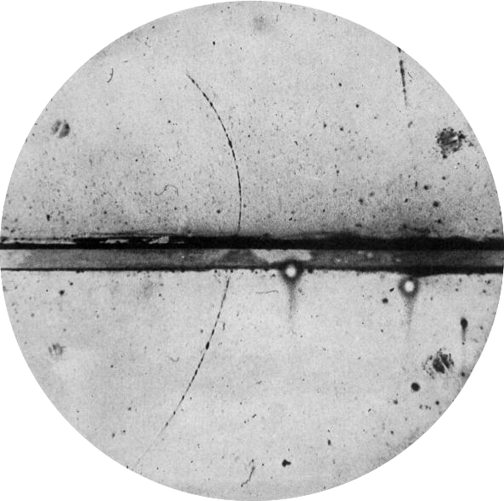

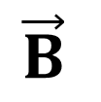
Observation of Antimatter
In 1932 Carl Anderson observed the positron looking at particle tracks in a cloud chamber
$$e^{+}$$
$$\vec{B}$$

Slide 13





Matter and Antimatter
When matter and antimatter come together they annihilate
Antiparticles can be produced via pair production
$$e^{−}$$
$$e^{+}$$
$$e^{+}$$
$$e^{−}$$
$$p$$

Slide 14
Why study antimatter?
Baryon asymmetry problem
  Baryons are hadrons composed of three quarks
When the Universe was created equal numbers baryons (matter) and antibaryons (antimatter) should have been produced
Where is all of antimatter?

Slide 15
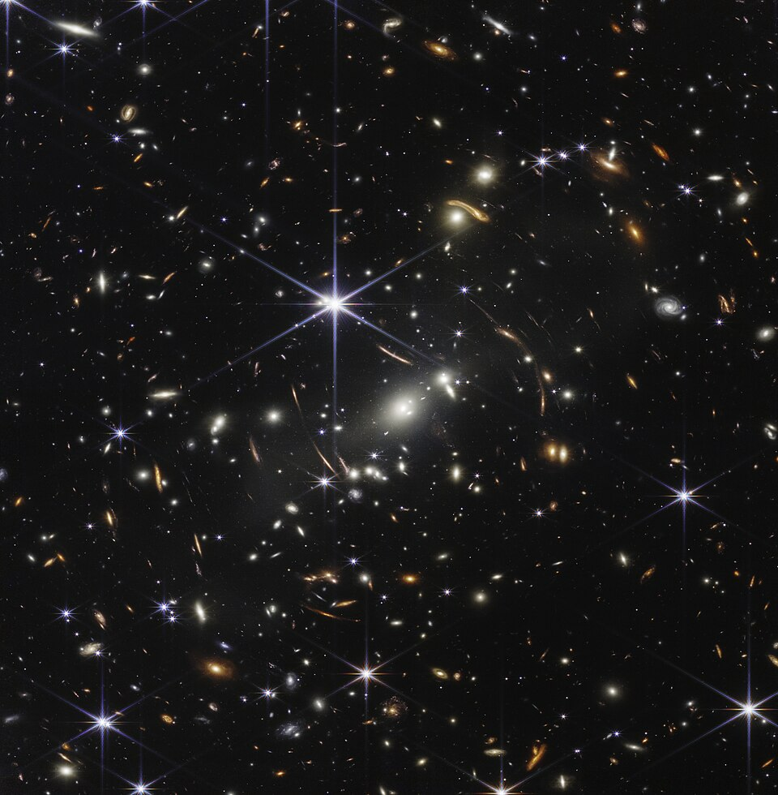

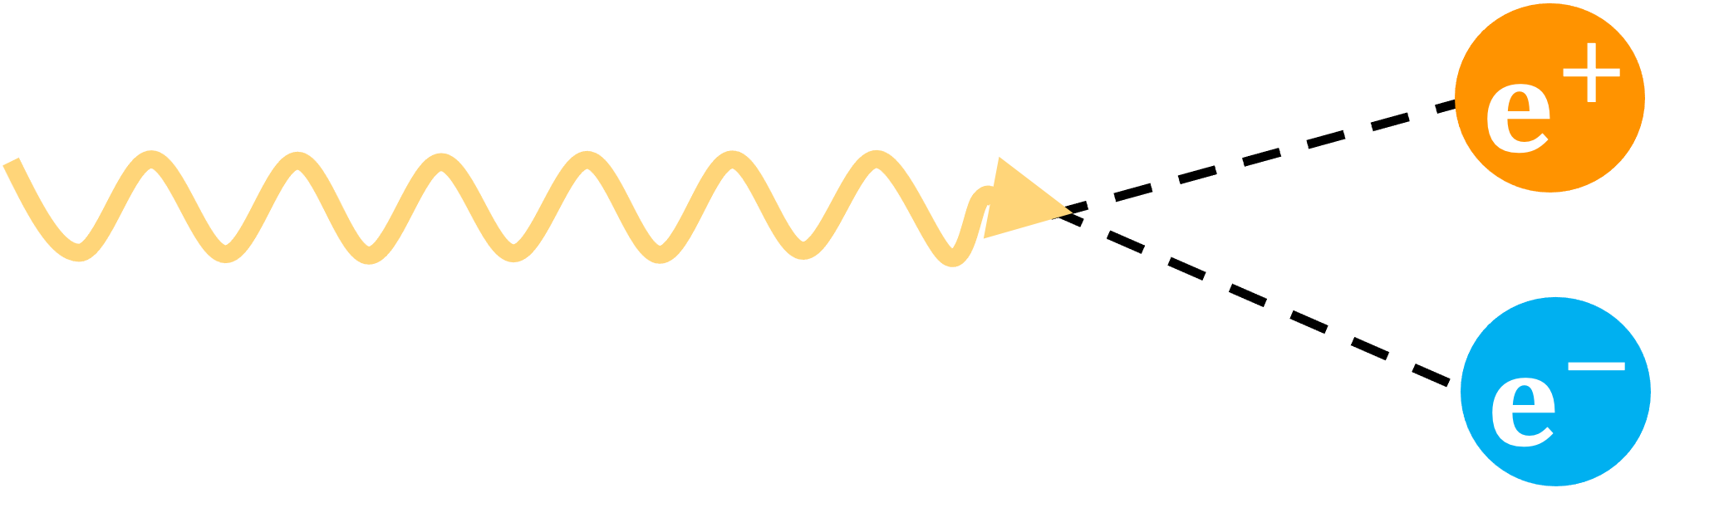

Where can we find antimatter?
Antimatter is naturally found on earth in small quantities
  Bananas emit positrons
Pair production
High energy collisions in space
Antimatter is also made at CERN

Slide 16
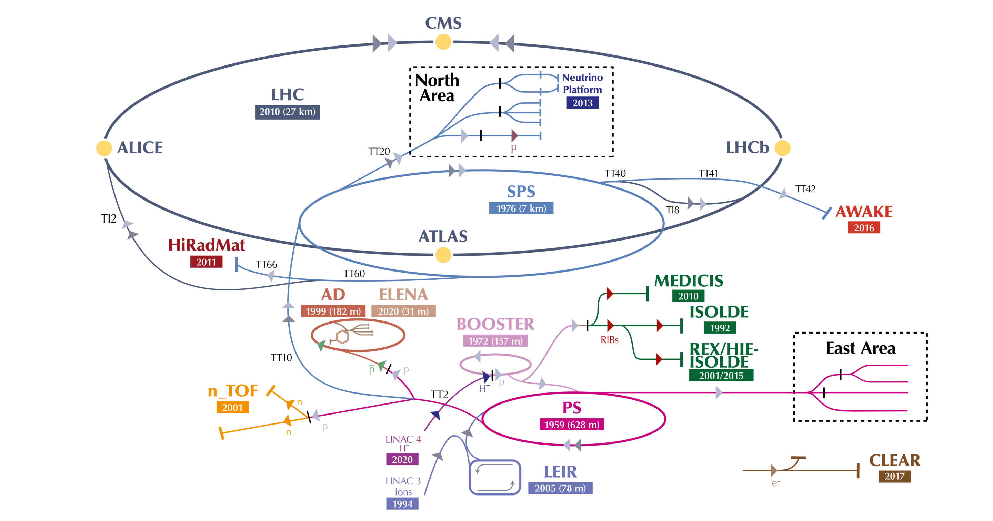
CERN Accelerator Complex
https://en.wikipedia.org/wiki/Antiproton_Decelerator#/media/File:CERN_accelerator_complex_2022.png

Slide 17
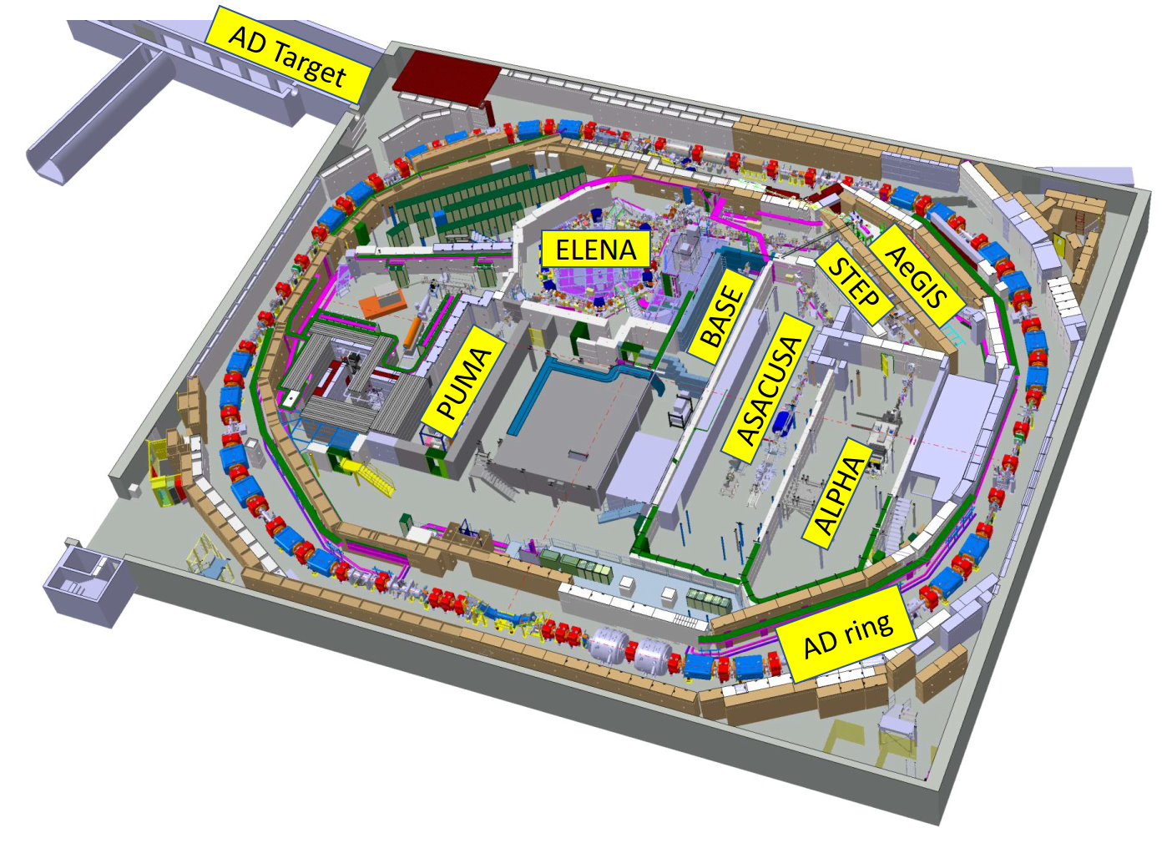
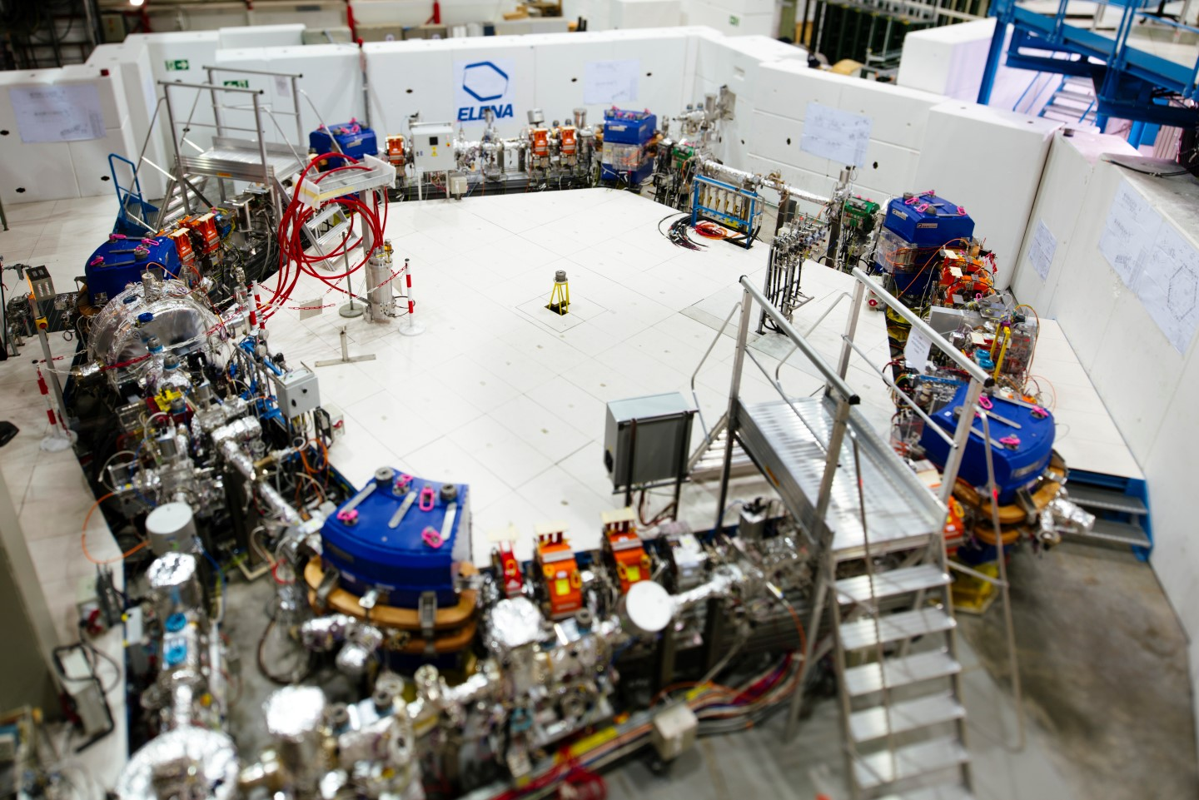
Antiproton Decelerator and ELENA
https://be-dep-ea.web.cern.ch/content/ad-elena-complex-antimatter-factory

Slide 18
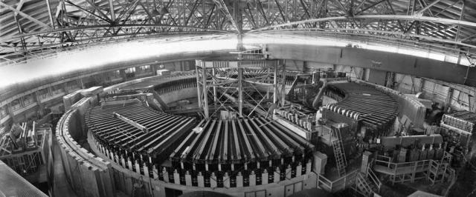
Antiprotons
First created in the Bevatron at Lawrence Berkeley National Laboratory in 1955 by Emilio Segrè and Owen Chamberlain

Slide 19

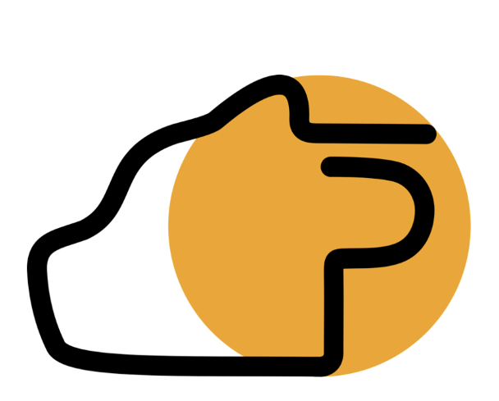





Antimatter Experiments in the AD

Slide 20










Hydrogen vs Antihydrogen
$$\overline{d}$$
$$\overline{u}$$
$$\overline{p}$$
$$\overline{u}$$
$$d$$
$$e^{+}$$
$$u$$
$$p$$
$$u$$
Antihydrogen
$$e^{−}$$
Hydrogen

Slide 21

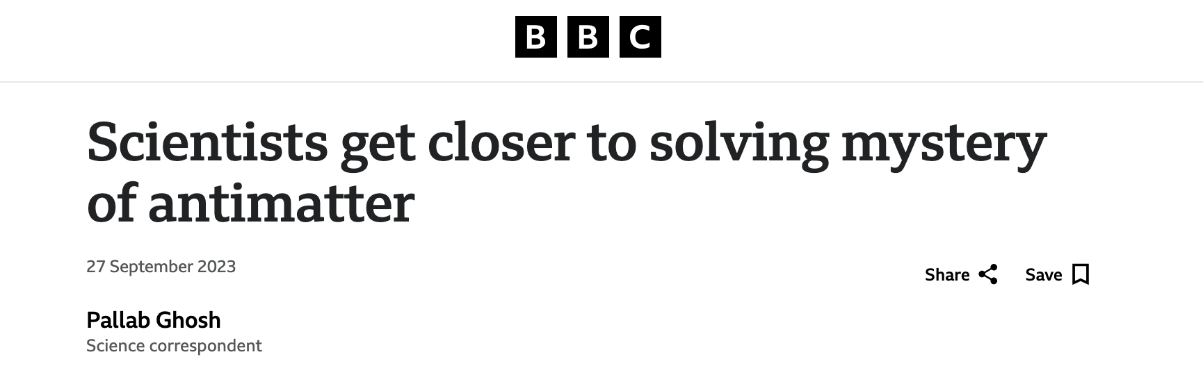
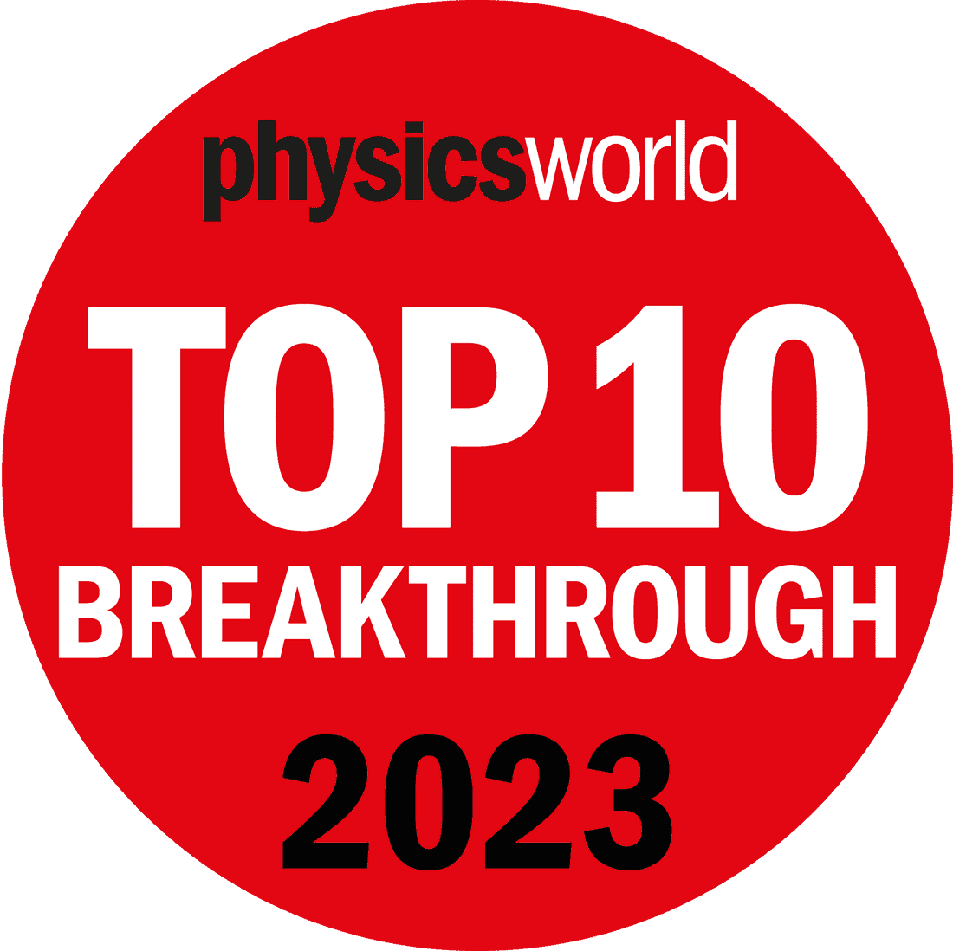
What can you do with antihydrogen?
Goal: Look for matter-antimatter asymmetries that are not theoretically predicted
Experiments
  Antihydrogen spectroscopy
  Laser cooling of antihydrogen
  Charge neutrality measurements
  Measurements of the effect of gravity on antimatter

Slide 22


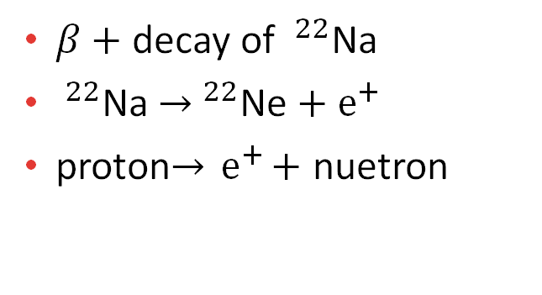
Antihydrogen
Produced at ALPHA
$β+$ decay of $^{22}$Na
$^{22}$Na ${→ }^{22}$Ne${ + e}^{+}$
proton$→{ e}^{+}+$ nuetron
$$e^{+}$$
$$\overline{p}$$
Provided by CERN

Slide 23
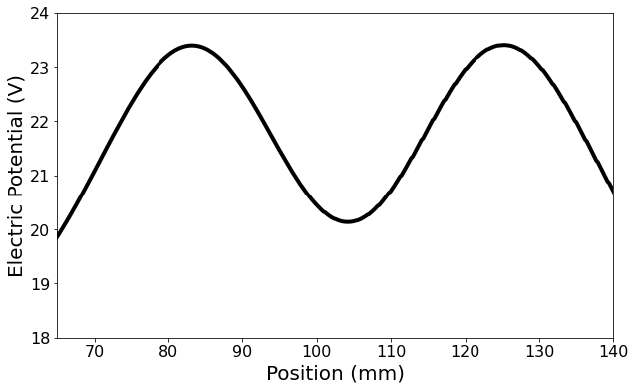


How is antihydrogen produced in ALPHA?
Positron and antiproton plasmas are slowly merged together
$$\overline{p}$$
Charged Particles
$$e^{+}$$
Can be trapped using time varying electric fields
Can be trapped using magnetic fields
Can be trapped using both electric and magnetic fields

Slide 24
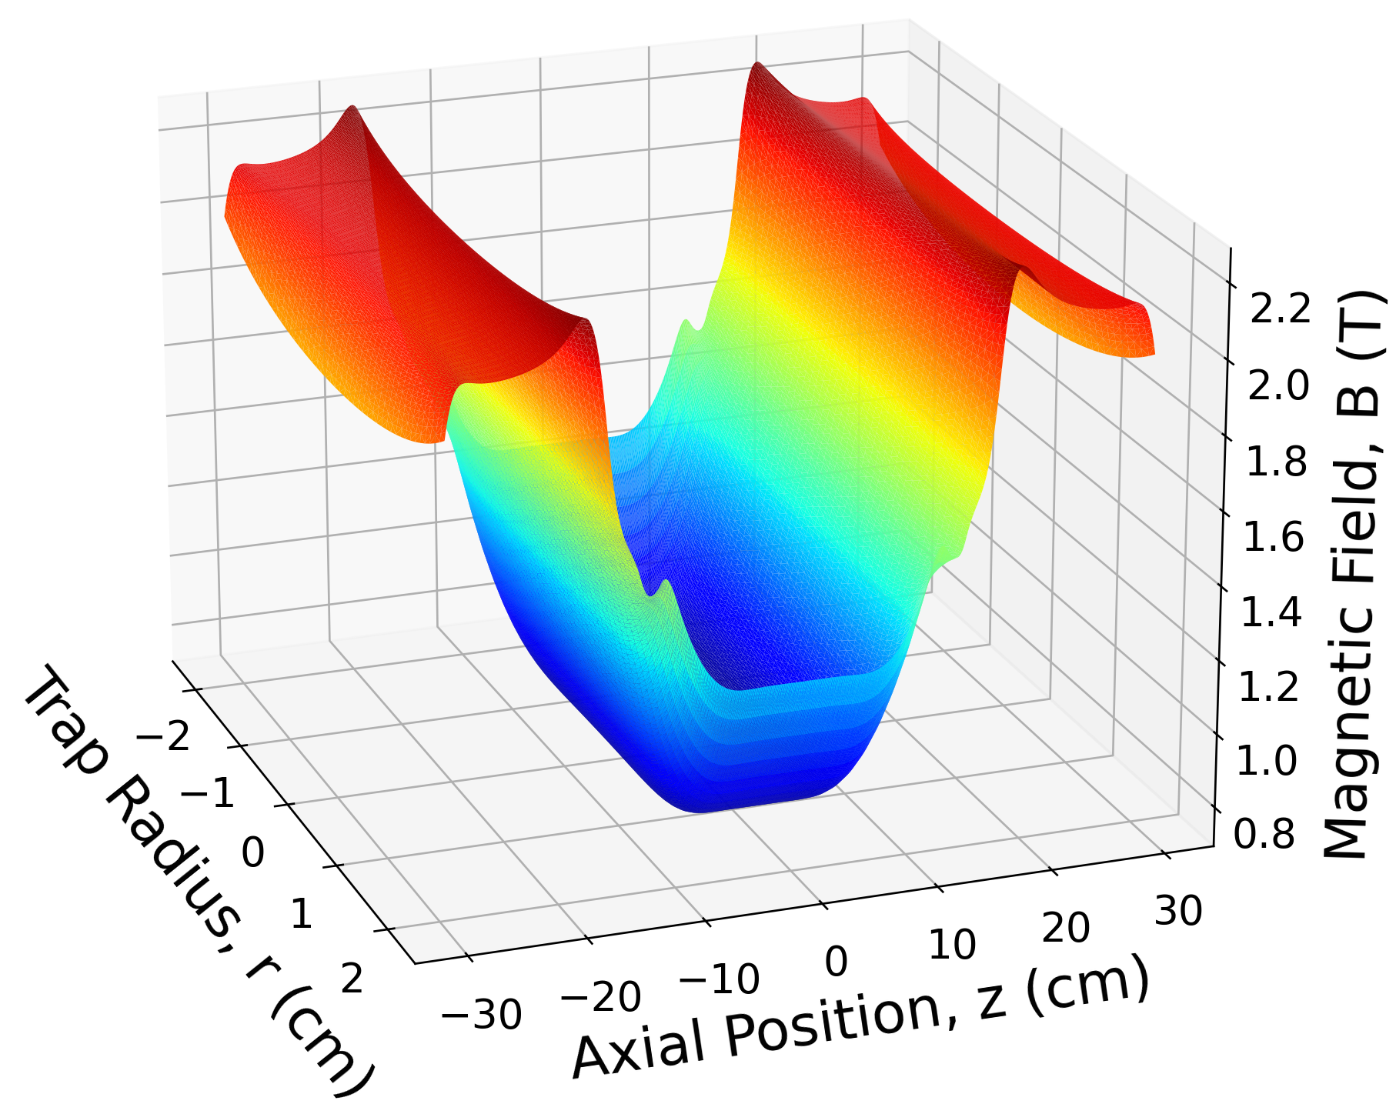
Trapping Antihydrogen
Neutral Atoms
Can be trapped using magnetic fields
The magnetic dipole moment interacts with the magnetic field

Slide 25
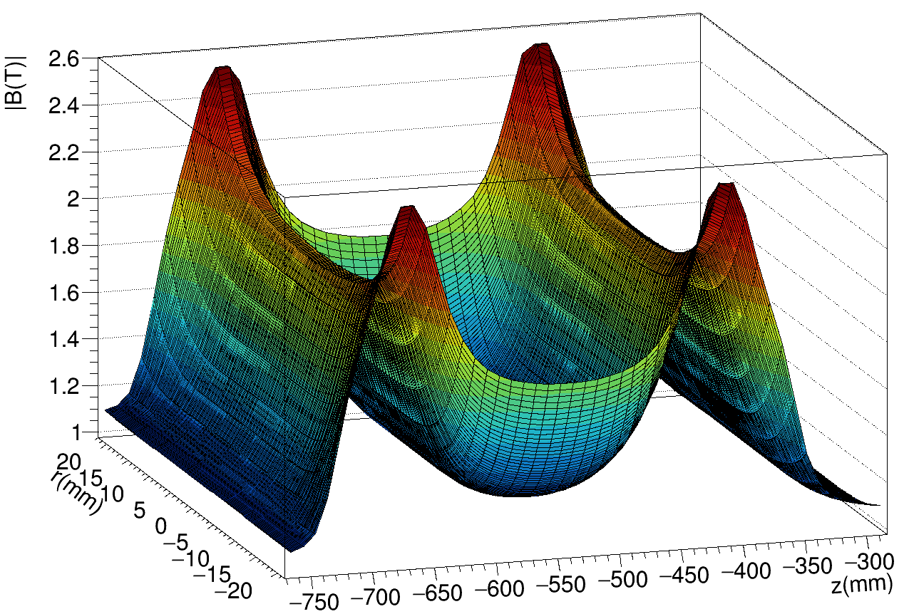
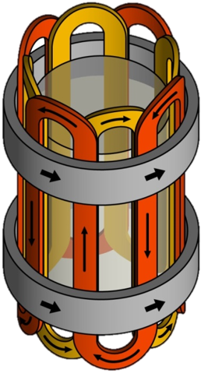
Trapping Antihydrogen

Slide 26


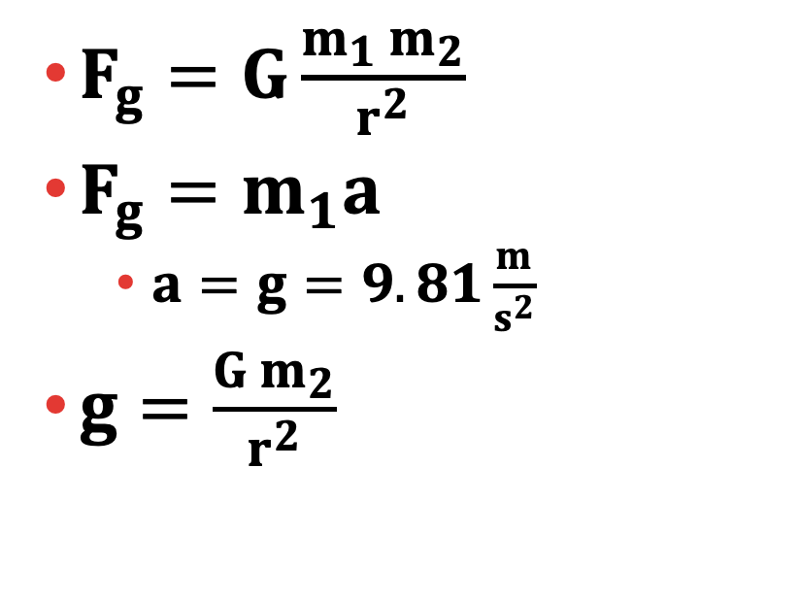


Gravity
$$m_{1}$$
$F_{g}=G\frac{m_{1}{ m}_{2}}{r^{2}}$
$F_{g}=m_{1}a$
  $a=g=9.81\frac{m}{s^{2}}$
$g=\frac{G m_{2}}{r^{2}}$
$$m_{2}$$

Slide 27

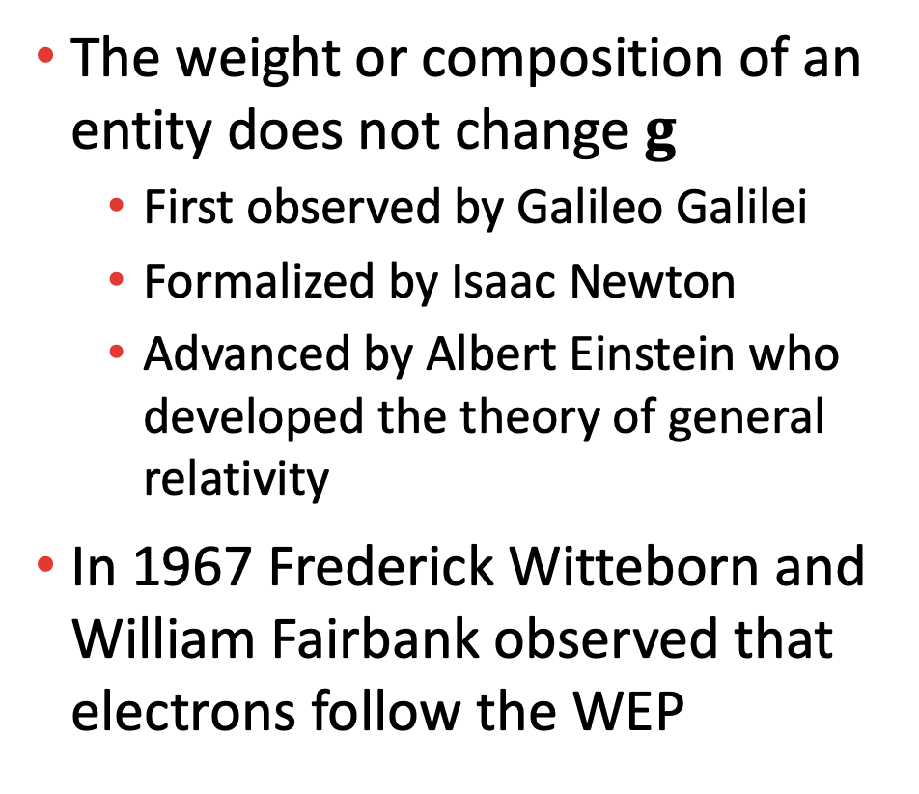
The Weak Equivalence Principle (WEP)
The weight or composition of an entity does not change $g$
  First observed by Galileo Galilei
  Formalized by Isaac Newton
  Advanced by Albert Einstein who developed the theory of general relativity
In 1967 Frederick Witteborn and William Fairbank observed that electrons follow the WEP

Slide 28


Antimatter and the WEP
The WEP says that matter and antimatter will fall the same
The WEP has never been observed to break
The matter antimatter asymmetry could be solved by a WEP breaking
$$H$$
$$\overline{H}$$

Slide 29
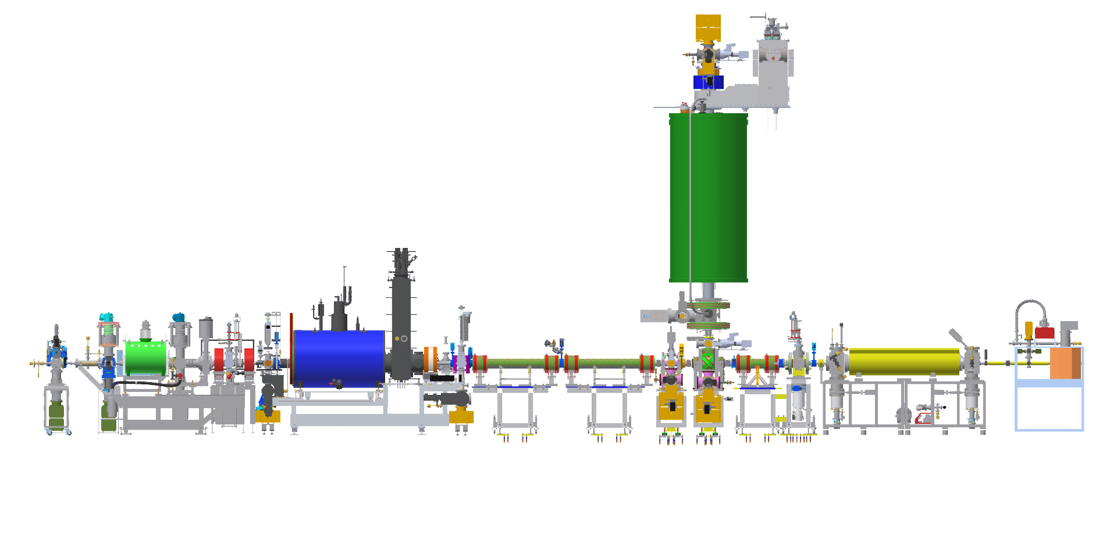

The ALPHA Experiment
ALPHA-g
Catching Trap
Positron Source
$$\overline{p}$$
ALPHA-2
Positron Accumulator
Image Credit: Prof. Steven Armstrong Jones and The ALPHA Collaboration

Slide 30
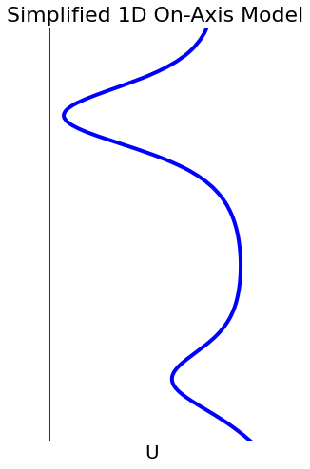



How does ALPHA-g work?
$U=μ\left|B\right|+mgh$
$$\overline{H}$$
$$h$$

Slide 31
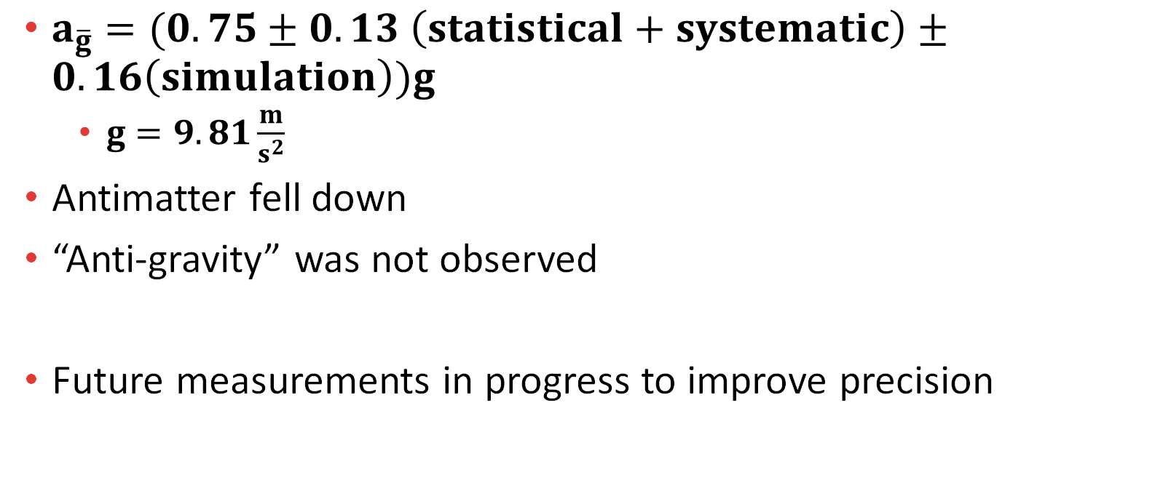
Does antimatter fall up or down?
$a_{\overline{g}}=(0.75±0.13 \left(statistical+systematic\right)±0.16\left(simulation\right))g$
  $g=9.81\frac{m}{s^{2}}$
Antimatter fell down
“Anti-gravity” was not observed
Future measurements in progress to improve precision

Slide 32
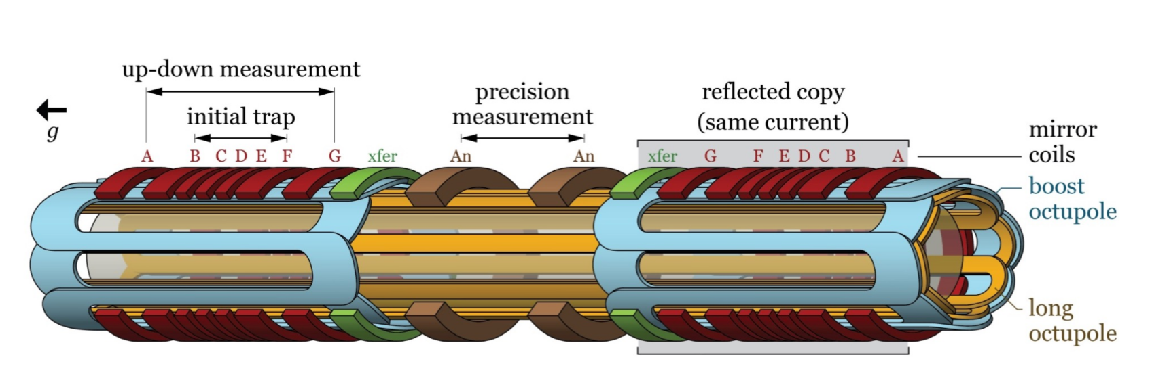
Future Measurements
Better control of magnetic fields
Better ability to measure magnetic fields

