Slide 1

The
Standard
Model
Thomas McKelvey

Slide 2
Outline
A Brief Overview of Some Major Discoveries of the SM
Theoretical Framework of the SM
The SM

Slide 3
A Brief History of the SM

Slide 4
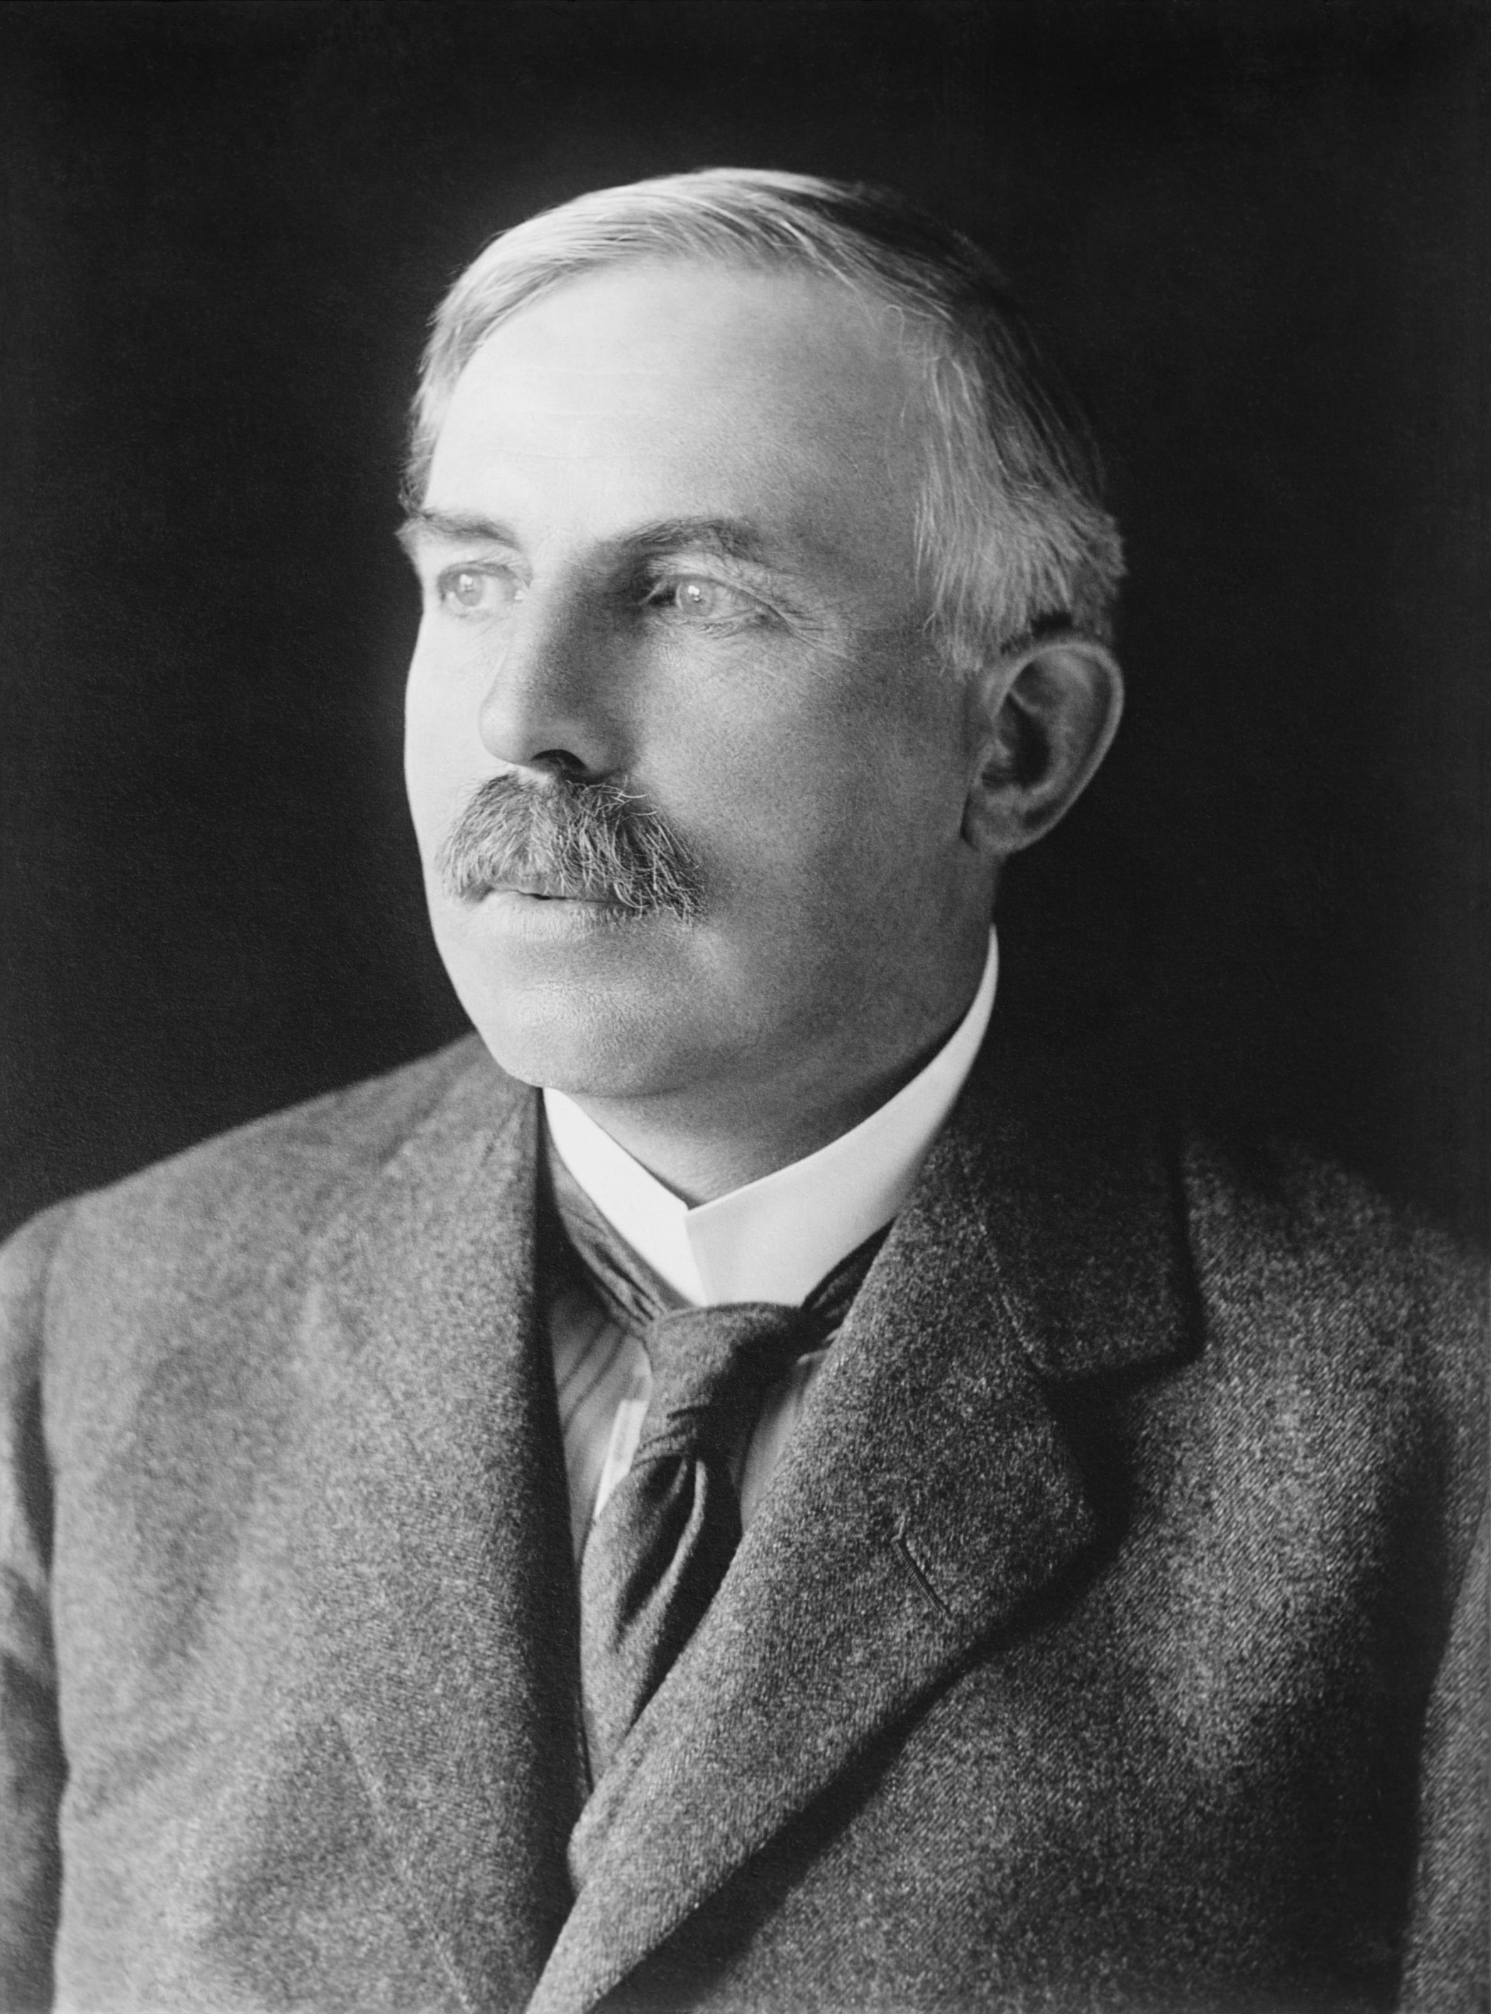
The Proton - 1920
The name ‘proton’ is coined by Ernest Rutherford following experiments with Nitrogen.

Slide 5
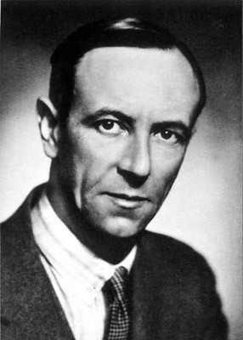
The Neutron - 1932
The neutron is discovered by James Chadwick at the Cavendish Laboratory in Cambridge.

Slide 6
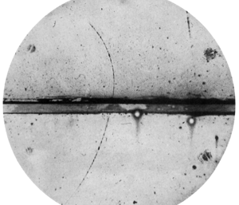
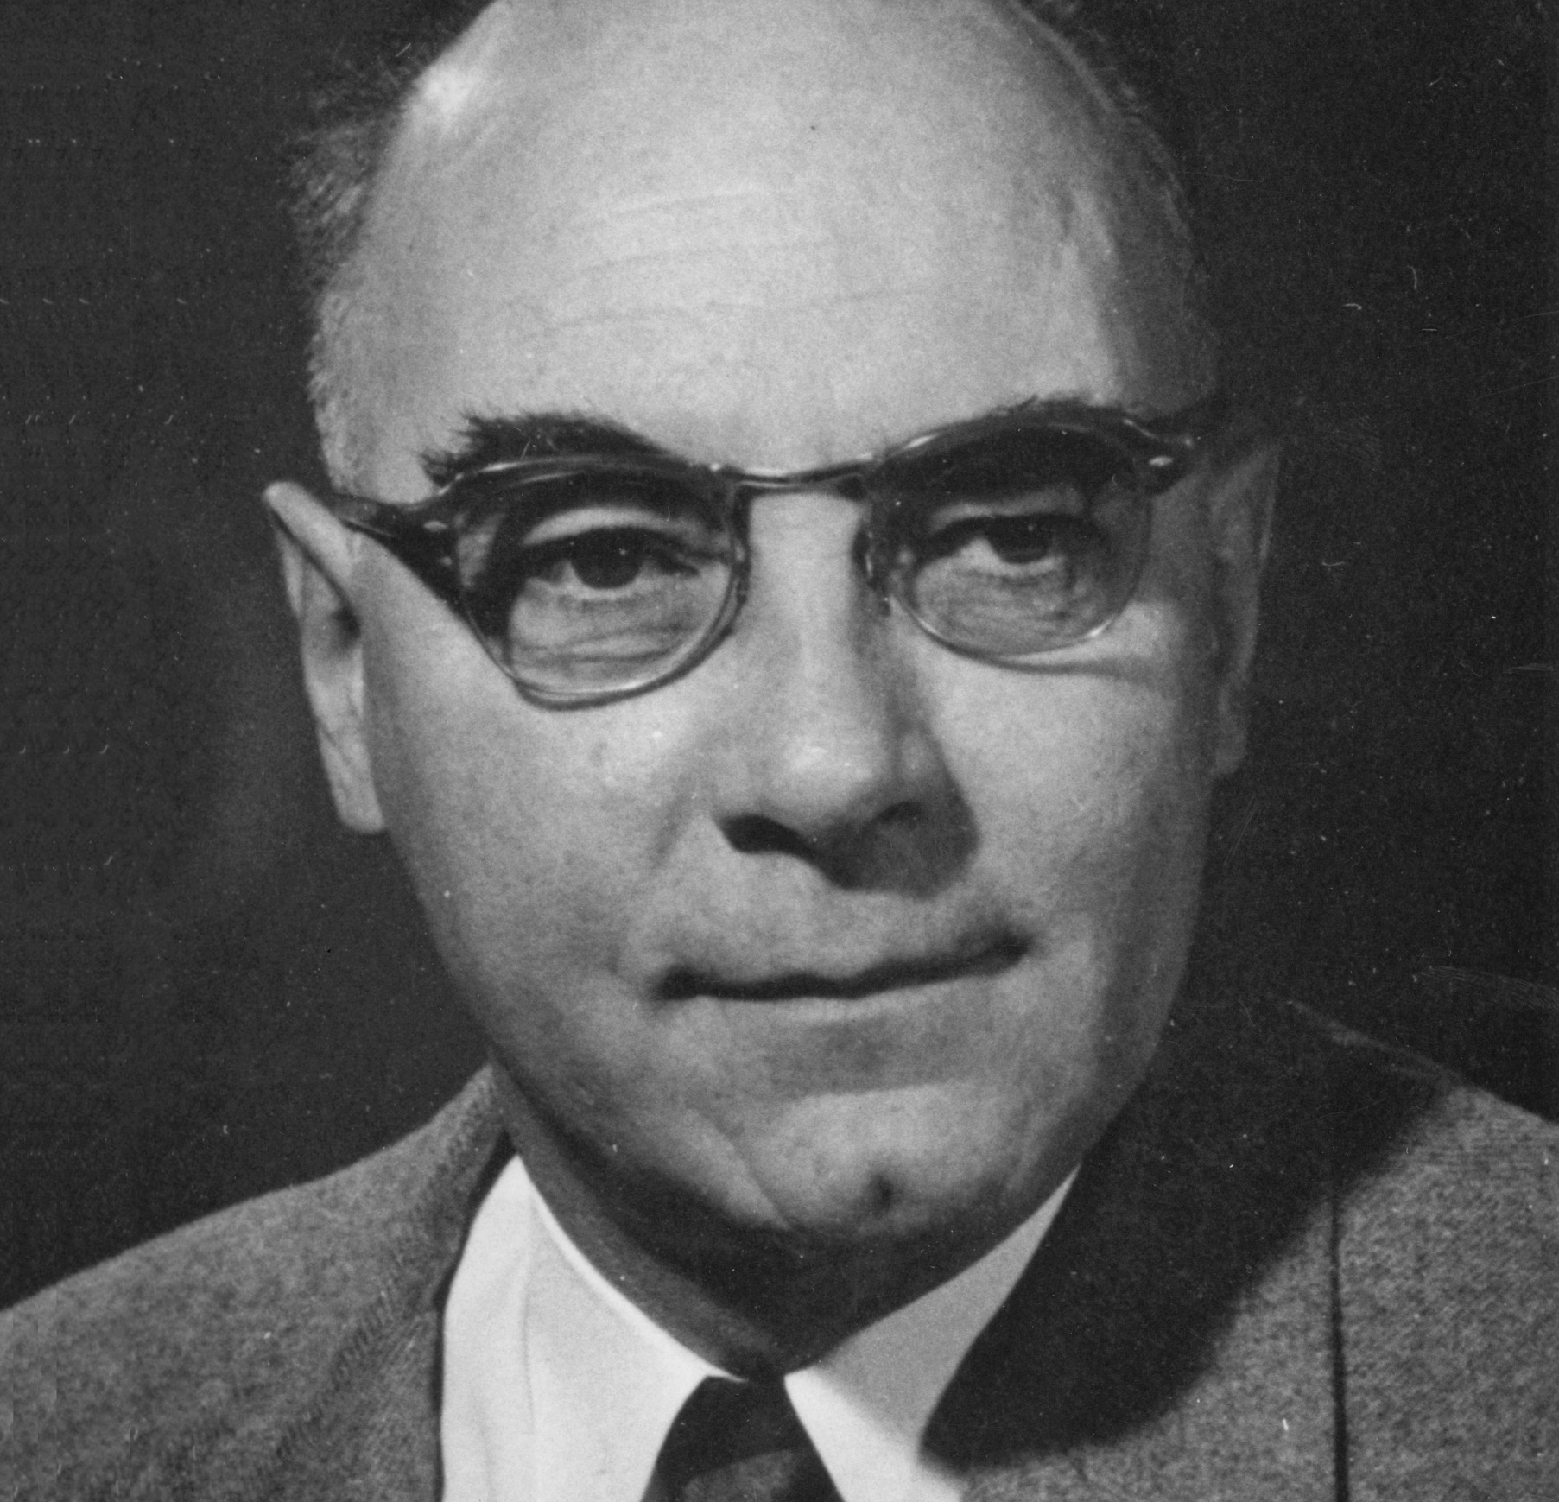
The Positron - 1932
Carl David Anderson discovers the positron by studying cosmic rays, and captures the first image using a cloud chamber.

Slide 7
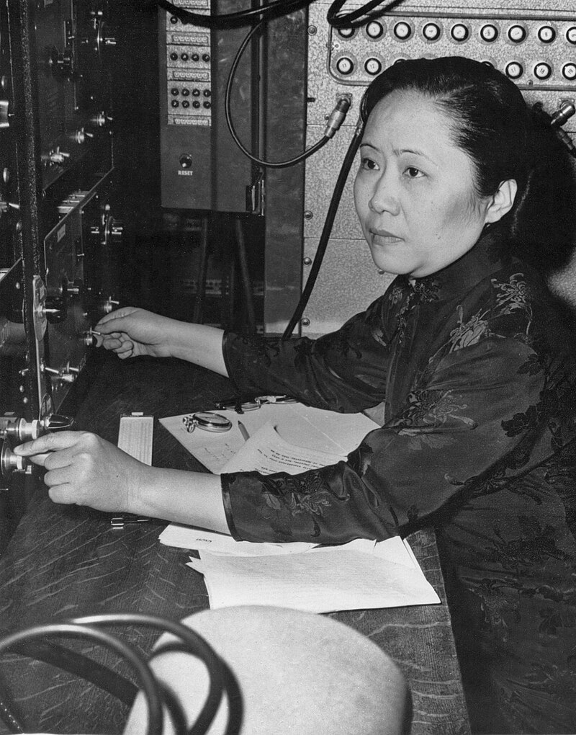
Parity Violation -1956
Wu conducts an experiment which shows that weak decays do not have mirror symmetry – a vital step to finding matter/antimatter asymmetry.

Slide 8
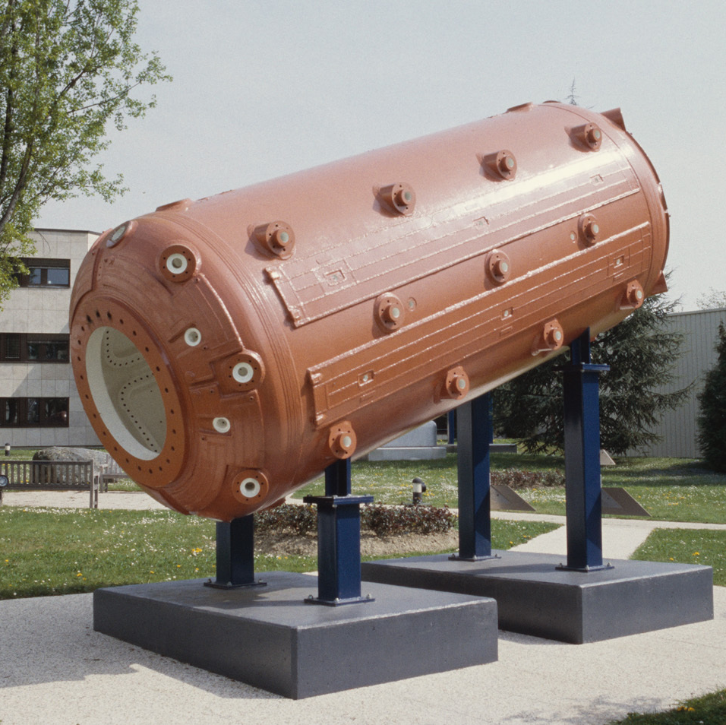
W and Z bosons – 1970s
Neutral and charged currents were proposed in the 1960s but not observed until the 1970s.

Slide 9
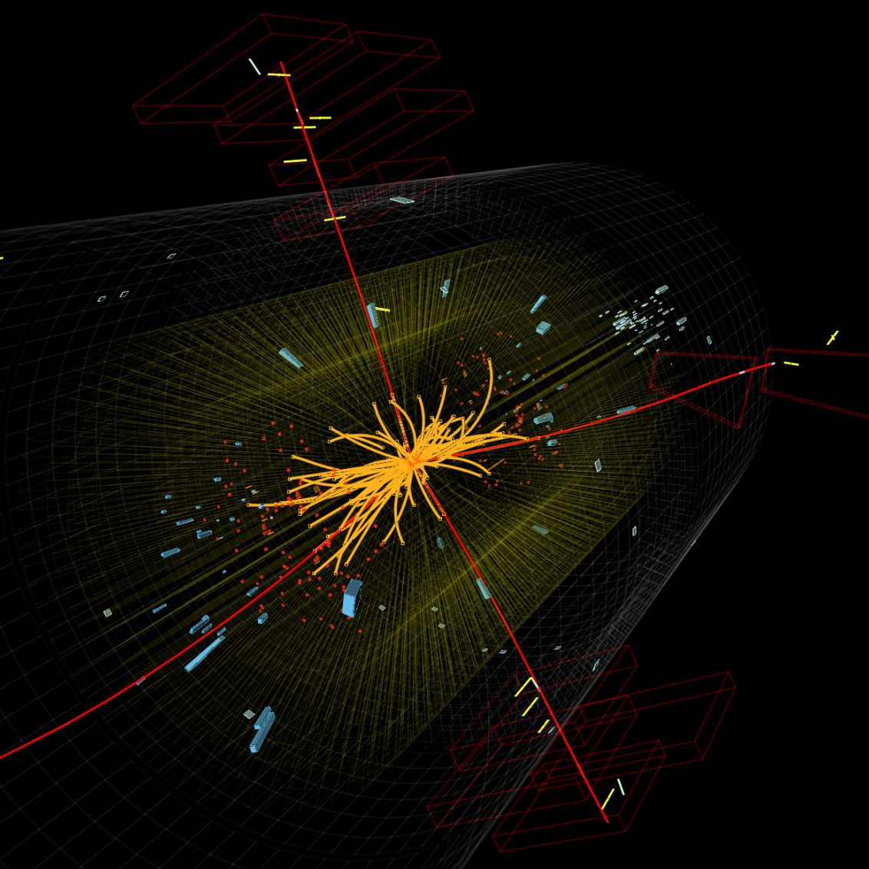
Higgs Boson - 2012
The Higgs Boson was discovered
At CERN in 2012. Adding the final
particle predicted by the
Standard Model.

Slide 10
Theoretical Framework
(Not Vital – But Interesting)

Slide 11
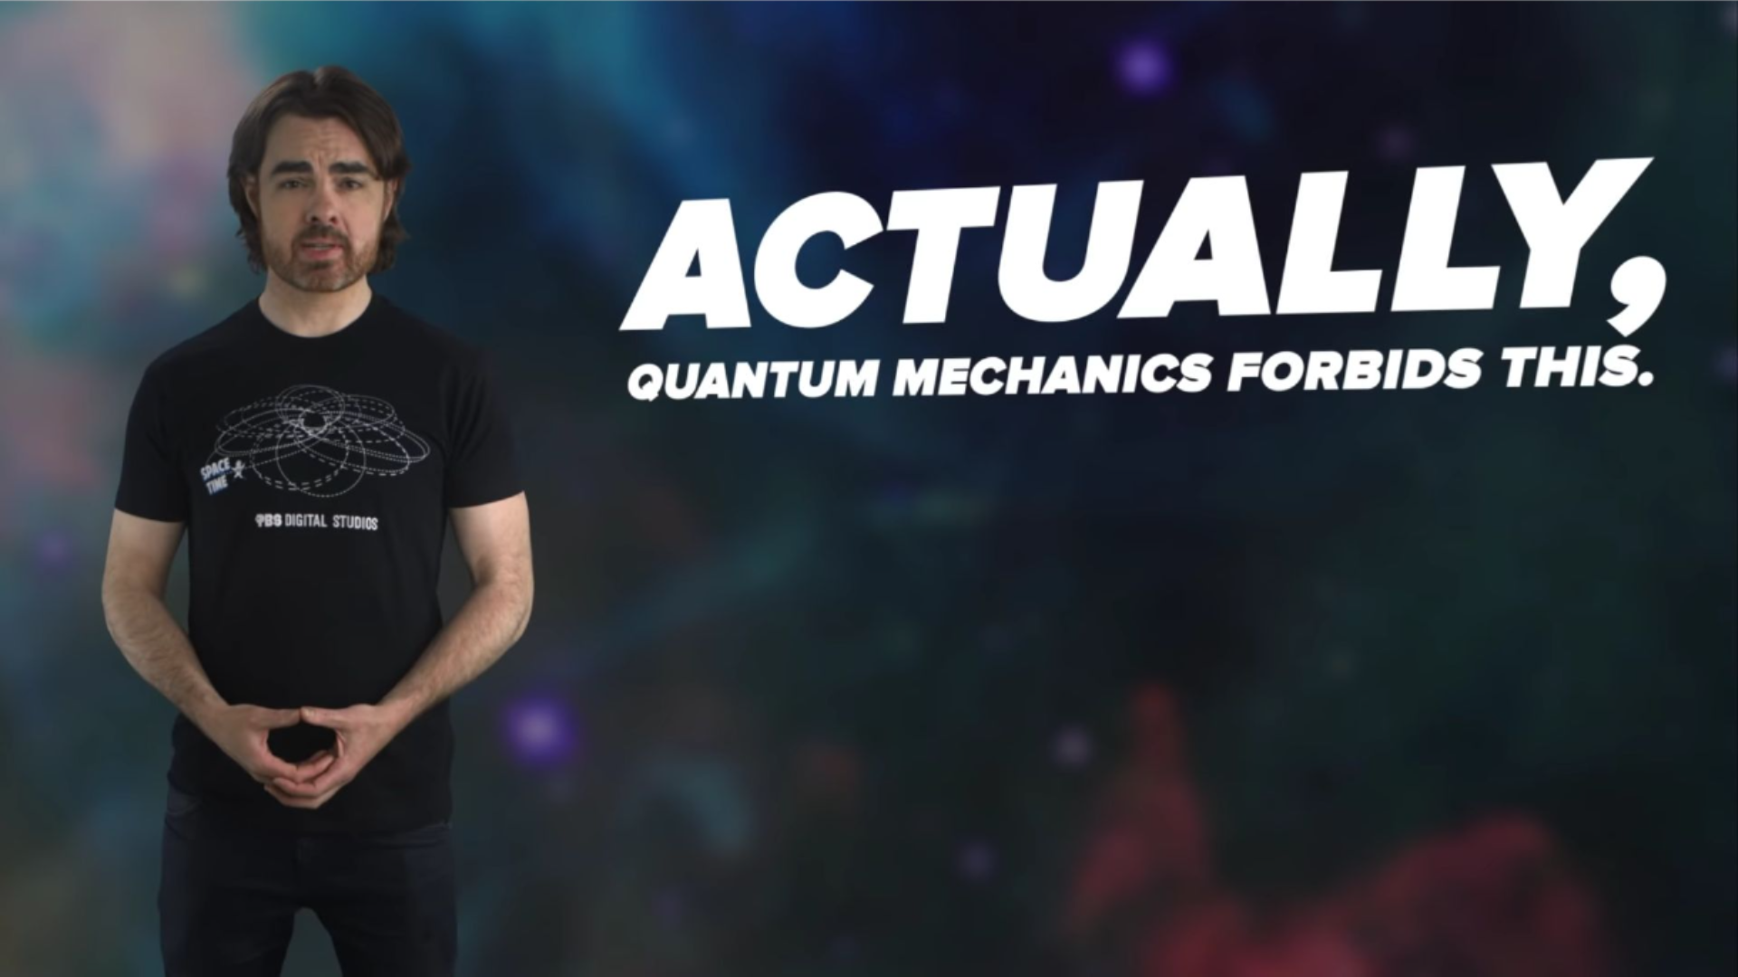
Do we have a simple framework that explains everything?

Slide 12
WHAT IS THE STANDARD MODEL?
QUANTUM FIELD THEORY
THEORY OF QUANTISED FIELDS
Excitations of fields come in discrete lumps, or ‘quanta’
Mathematical functions of coordinates

Slide 13
How To Do Quantum Field Theory
Start With Nothing.
1
Make Something.
2
Destroy It.
3

Slide 14
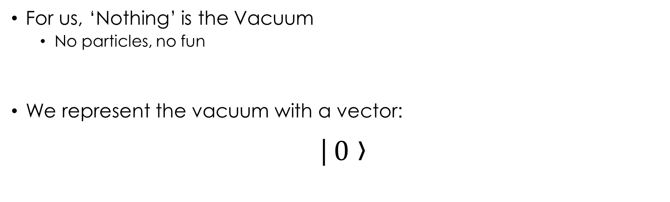
Start With Nothing.
For us, ‘Nothing’ is the Vacuum
  No particles, no fun
We represent the vacuum with a vector:
|$0$ ›

Slide 15
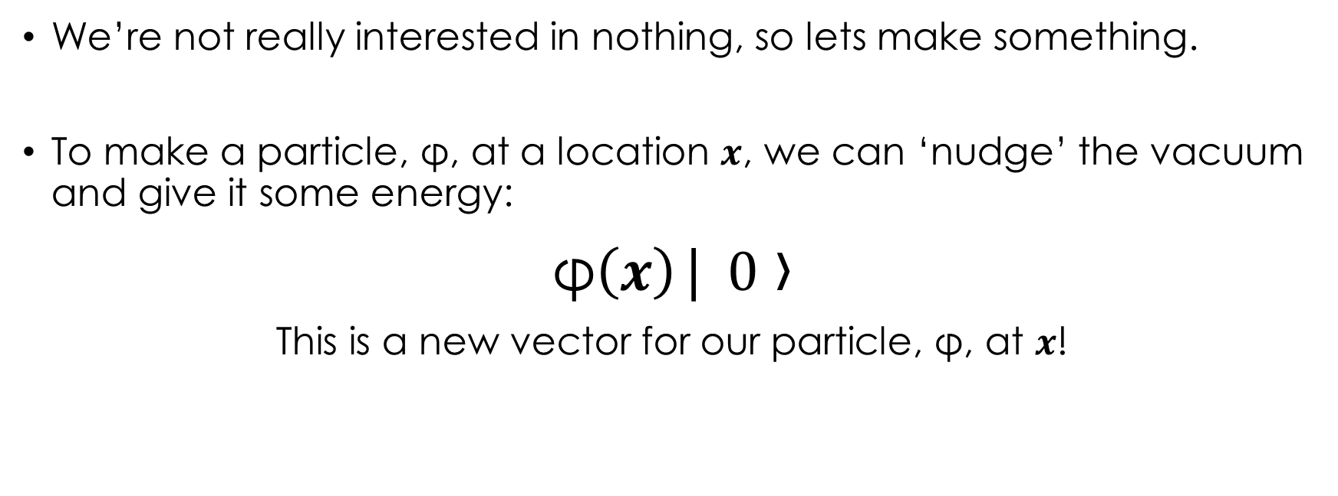
Make Something.
We’re not really interested in nothing, so lets make something.
To make a particle, φ, at a location $x$, we can ‘nudge’ the vacuum and give it some energy:
φ$\left(x\right)$| $0$ ›
This is a new vector for our particle, φ, at $x$!

Slide 16
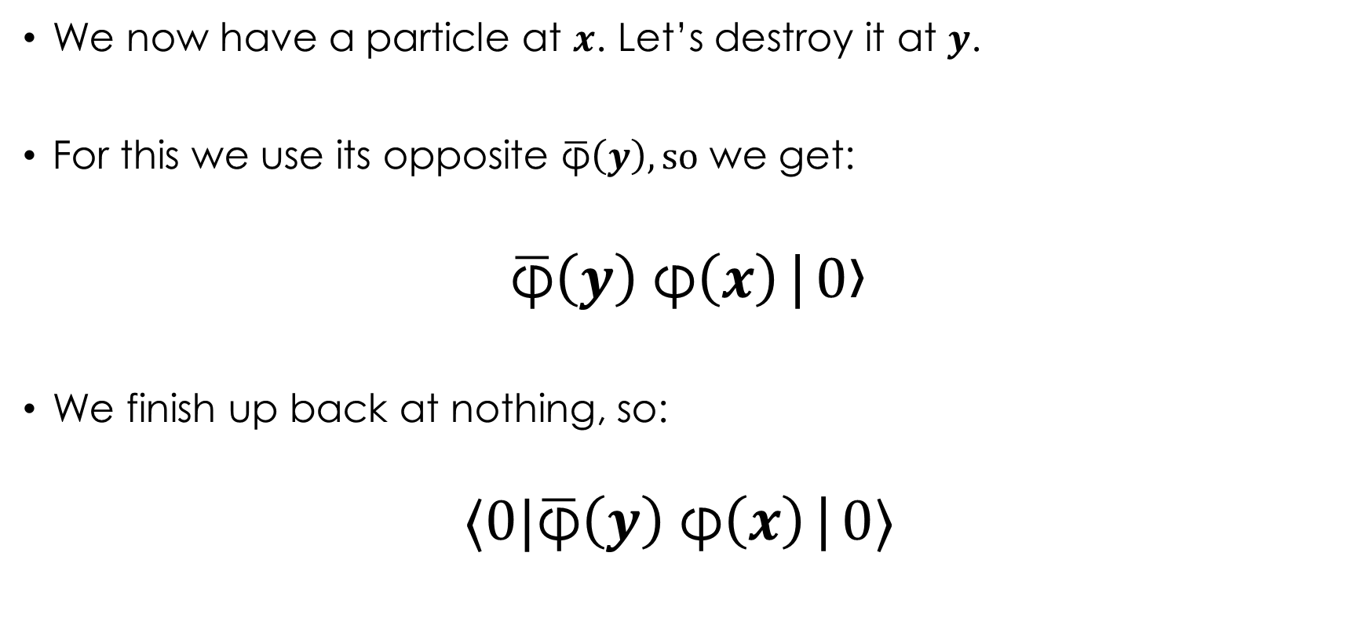
Destroy It.
We now have a particle at $x$. Let’s destroy it at $y$.
For this we use its opposite $\overline{\text{φ}}\left(y\right), so$ we get:
$$\overline{\text{φ}}\left(y\right) \text{φ}\left(x\right)\text{|}0\text{›}$$
We finish up back at nothing, so:
$$⟨0|\overline{\text{φ}}\left(y\right) \text{φ}\left(x\right)\text{|}0⟩$$

Slide 17



Okay? So, What Was The Point?
We made $⟨0|\overline{\text{φ}}\left(y\right) \text{φ}\left(x\right)\text{|}0⟩$, but what is it?
The probability that a particle, φ, goes from $x$ to $y$!
We represent this in a diagram with a line:
$$x$$
$$y$$

Slide 18

Multiple Fields
For real calculations, we may have terms like $⟨0|{\overline{\text{φ}}\left(y\right)}^{3} {\text{φ}\left(x\right)}^{3}\text{|}0⟩$
Seem scarier, but can actually be handled easily.
Wick’s Theorem, briefly:
We can make any $⟨0|{\overline{\text{φ}}\left(y\right)}^{n} {\text{φ}\left(x\right)}^{n}\text{|}0⟩$out of lots of $⟨0|\overline{\text{φ}}\left(y\right) \text{φ}\left(x\right)\text{|}0⟩$

Slide 19
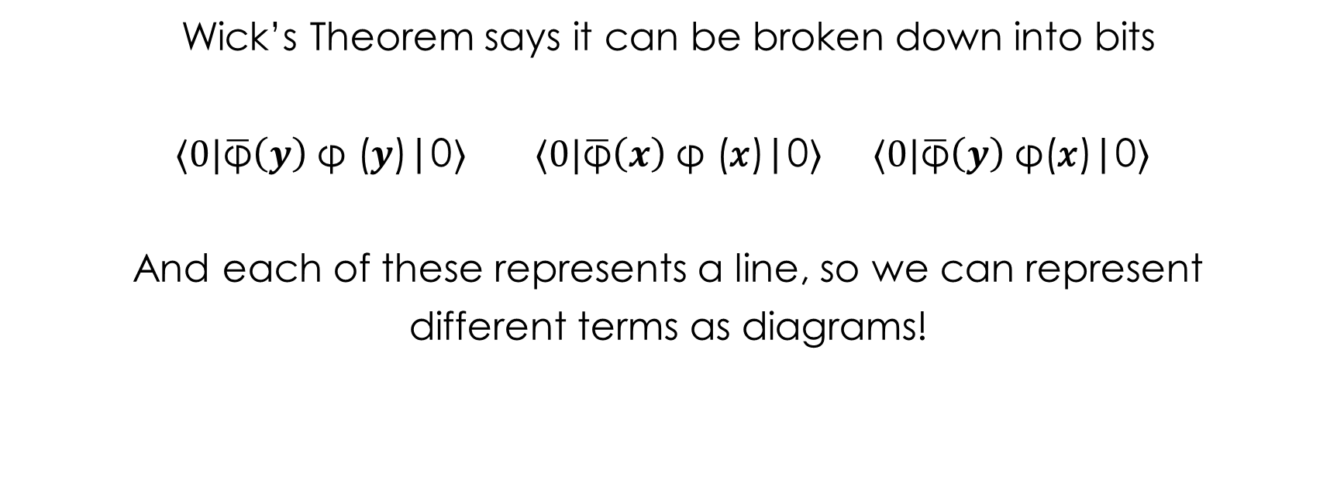

What Does $⟨0|{\overline{\text{φ}}\left(y\right)}^{3} {\text{φ}\left(x\right)}^{3}\text{|}0⟩ \text{Look} \text{Like}\text{?}$
Wick’s Theorem says it can be broken down into bits
$⟨0|\overline{\text{φ}}\left(y\right) \text{φ}\text{ (}y\text{)}\text{|}\text{0}⟩$ $⟨0|\overline{\text{φ}}\left(x\right) \text{φ}\text{ (}\text{x}\text{)}\text{|}\text{0}⟩$ $⟨0|\overline{\text{φ}}\left(y\right) \text{φ}\text{(}\text{x}\text{)}\text{|}\text{0}⟩$
And each of these represents a line, so we can represent
different terms as diagrams!

Slide 20

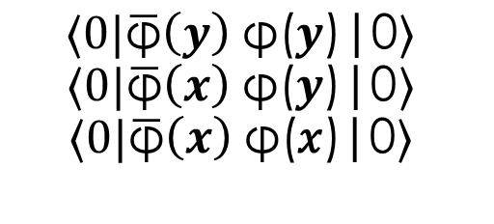





What Does $⟨0|{\overline{ \text{φ}}\left(y\right)}^{3} {\text{φ}\left(x\right)}^{3}\text{|}0⟩ \text{Look} \text{Like}\text{?}$
$$x$$
$$y$$
$$x$$
$$y$$
$$⟨0|\overline{\text{φ}}\left(y\right) \text{φ}\text{(}y\text{)}\text{|}\text{0}⟩$$
$$⟨0|\overline{\text{φ}}\left(x\right) \text{φ}\text{(}y\text{)}\text{|}\text{0}⟩$$
$$⟨0|\overline{\text{φ}}\left(x\right) \text{φ}\text{(}\text{x}\text{)}\text{|}\text{0}⟩$$
$${\left(⟨0|\overline{ \text{φ}}\left(y\right) \text{φ}\left(x\right)\text{|}\text{0}⟩\right)}^{3}$$

Slide 21
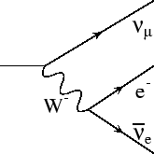
Feynman Diagrams
Diagrammatic way of showing interactions.
When calculated, give probabilities of a particular process.
These diagrams are invaluable to help us understand and calculate particle interactions.

Slide 22

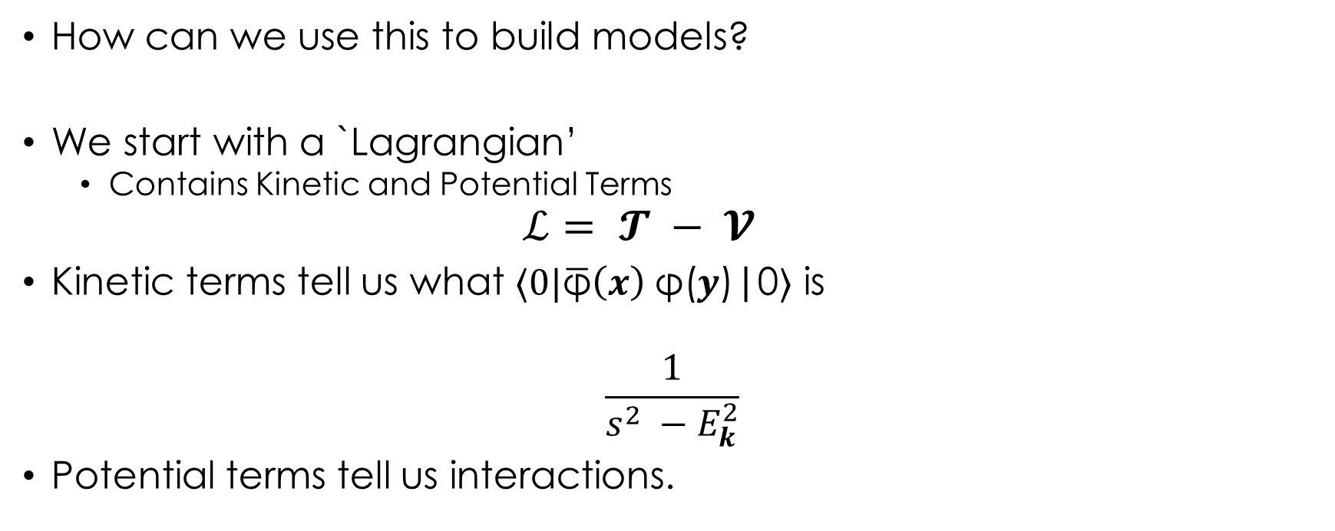

Models
How can we use this to build models?
We start with a `Lagrangian’
  Contains Kinetic and Potential Terms
  $$ℒ= 𝓣 − 𝓥$$
Kinetic terms tell us what $⟨0|\overline{\text{φ}}\left(x\right) \text{φ}\text{(}y\text{)}\text{|}\text{0}⟩$ is
$$\frac{1}{s^{2} −E_{k}^{2}}$$
Potential terms tell us interactions.
$$x$$
$$y$$

Slide 23
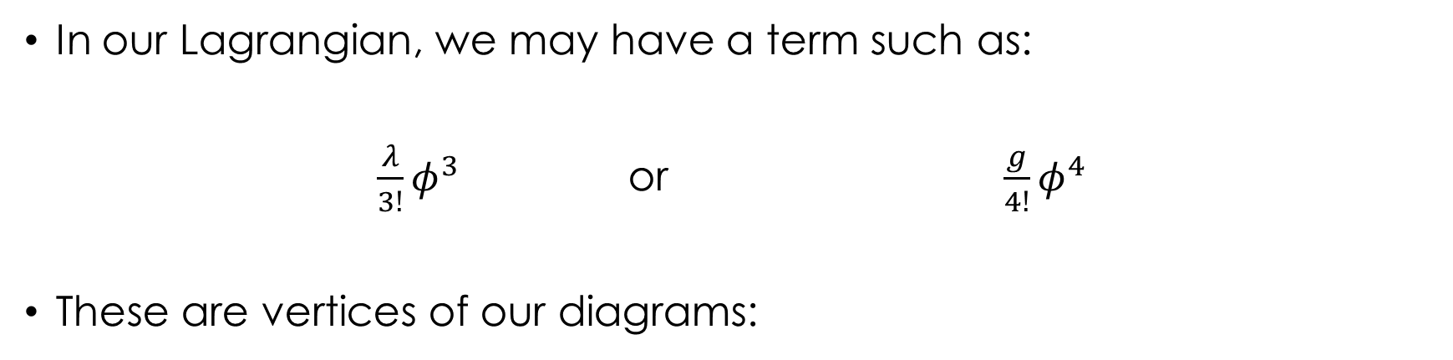

Interactions
In our Lagrangian, we may have a term such as:
${\frac{λ}{3!}φ}^{3}$ or $\frac{g}{4!}φ^{4}$
These are vertices of our diagrams:
$$λ$$
g
Notes:
Lambda and g indicate how strong these interactions are.

Slide 24
HOW TO DEFINE PARTICLES?
We can define different particles through invariant quatities:
Mass
Spin
Charge
Lepton Number
….
Notes:
Mass and spin are particularly important

Slide 25
The SM
(Important bit)

Slide 26
PARTICLE CONTENT OF THE SM
SM particles come in 3 major classes:
Fermions
Vectors
Scalars
Spin – ½
Leptons (e μ τ)
Quarks (up, down)
Spin – 1
Photons, W, Z
Gluons
Spin – 0
Higgs Boson

Slide 27
PARTICLE CONTENT OF THE SM
SM particles come in 3 major classes:
Bosons
Fermions
Vectors
Scalars
Spin – ½
Leptons (e μ τ)
Quarks (up, down)
Spin – 1
Photons, W, Z
Gluons
Spin – 0
Higgs Boson
Matter
Interactions
Matter/Interaction

Slide 28
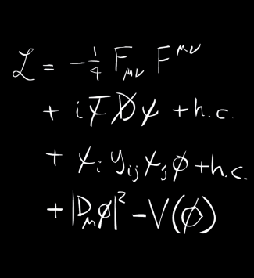
SM Lagrangian
Kinetic Gauge Field Terms.
Kinetic Fermion Term.
Tri-Linear term (Generates mass).
Higgs Terms.

Slide 29
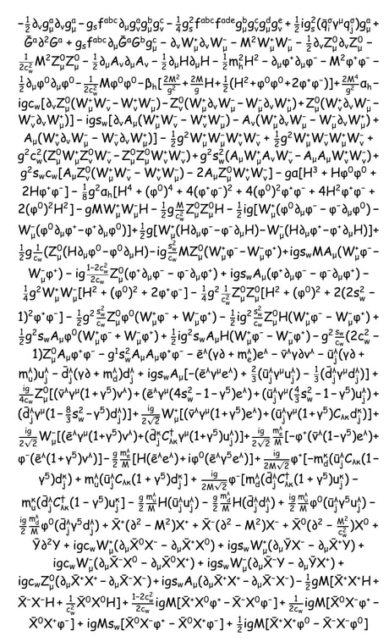
The Real SM Lagrangian
Looks Far scarier
Actually just the same as before but for lots more fields
Written every term explicitly

Slide 30
Fermions
Spin – ½
Anti-symmetric under particle exchange → States of 2 Indistinguishable Particles Forbidden (Pauli Exclusion)
Combine to make heavier particles
Baryons → Protons, Neutrons
Mesons → Kaons, Pions

Slide 31
Leptons or Quarks?
Leptons
Quarks
Fermion
Interact with Photons
Interact with W, Z
Do not interact with gluons
Fermion
Interact with Photons
Interact with W, Z
Interact with gluons

Slide 32
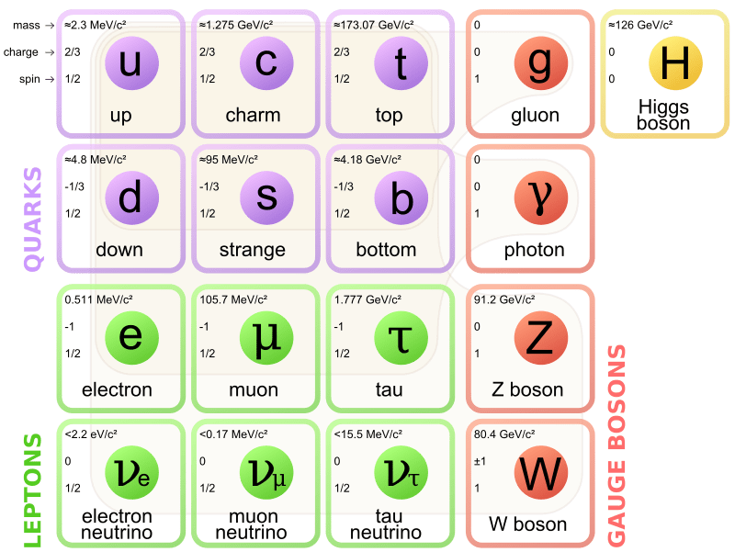
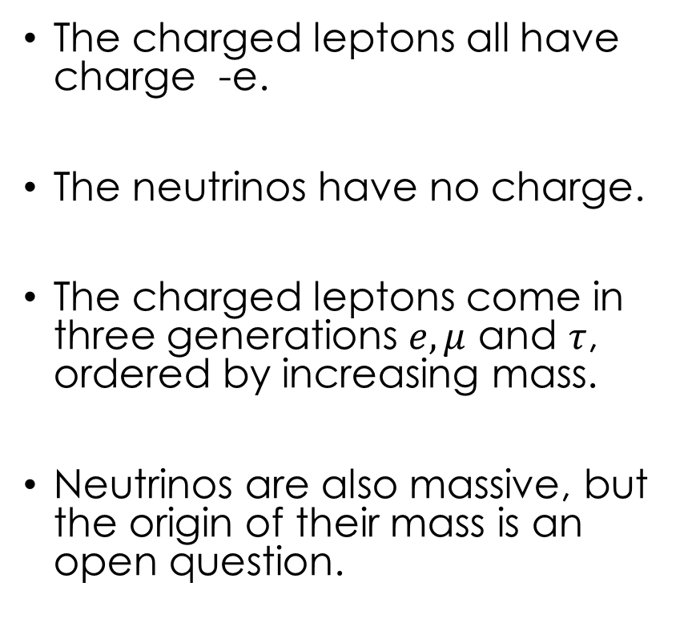
Leptons
The charged leptons all have charge -e.
The neutrinos have no charge.
The charged leptons come in three generations $e, μ$ and $τ$, ordered by increasing mass.
Neutrinos are also massive, but the origin of their mass is an open question.

Slide 33
Quarks
Like the Leptons, the Quarks come in generations ordered by their mass.
The ‘up-type’ quarks (u, c, t) have charge +(2/3)e.
The ‘down-type’ quarks (d, s, b) have charge –(1/3)e.

Slide 34
Antimatter
For every fermion except the neutrino, we know there also exist antimatter particles.
Antimatter has the same mass, spin, but equal and opposite conserved charges.

Slide 35
Interactions
Particles are grouped according to underlying symmetries.
These symmetries give rise to interactions between particles in the symmetry group.
Interactions are mediated by ‘gauge fields’.

Slide 36
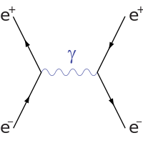
Electomagnetic Interactions
EM interactions occur between charged particles.
The EM interation is mediated by photons, which are massless.
Since photons are massless, the EM interaction has infinite range.

Slide 37
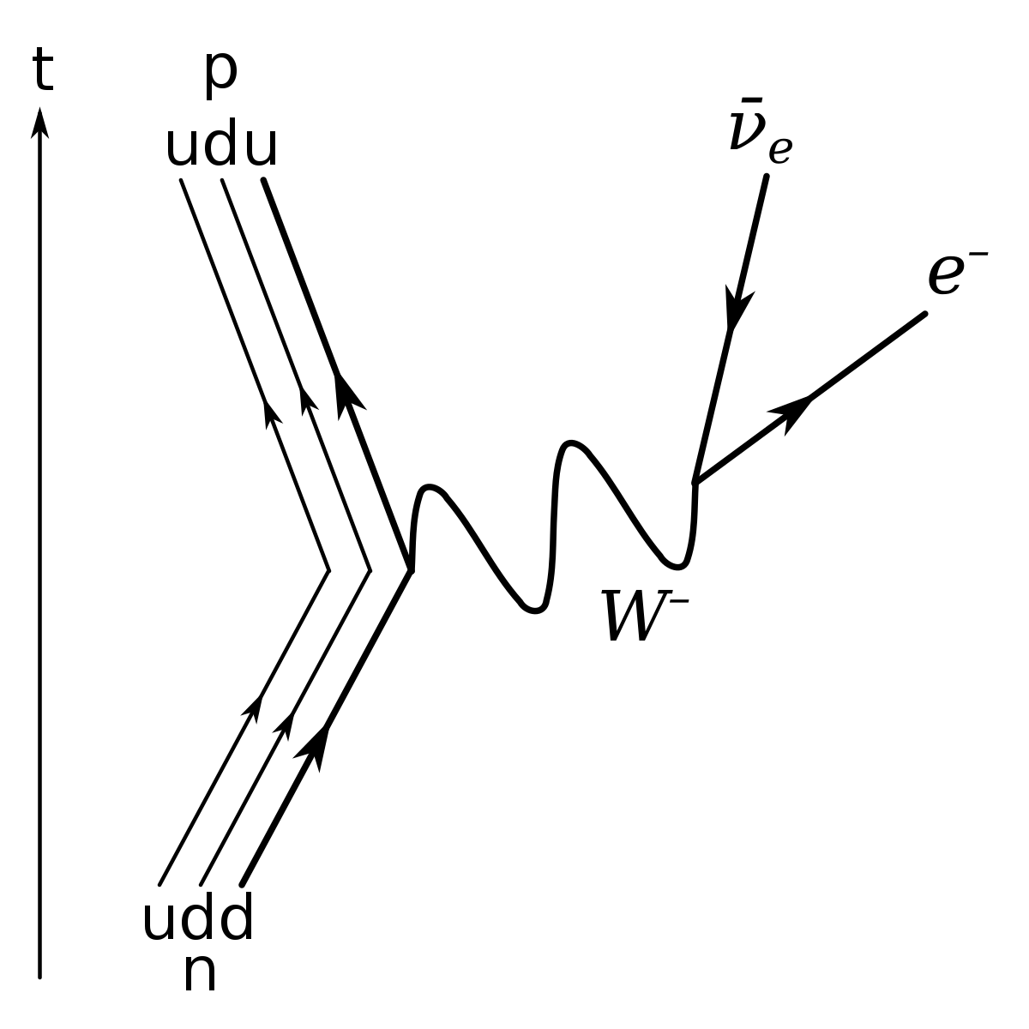

Weak Interactions
The weak interaction mediates nuclear decays
n → p + e + $ν_{e}$
Unlike Photons, W bosons / Z bosons are massive, so the interaction range is almost point-like.
$$ΔE Δt \sim ℏ ⇒d∼\frac{ℏc}{mc^{2}}= \frac{197}{\left(\frac{mc^{2}}{MeV}\right)} fm$$
W bosons carry charge, however Z bosons are neutral.

Slide 38
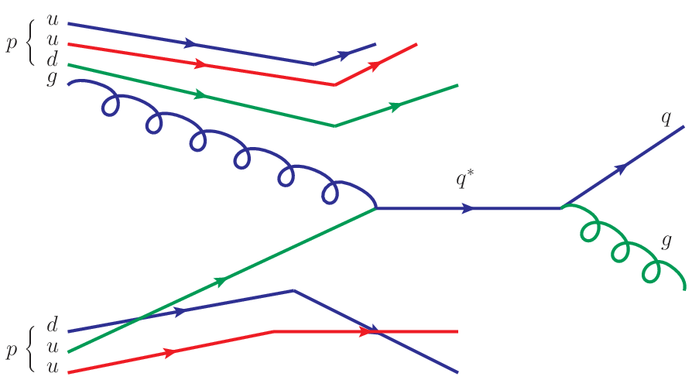
Gluon Interactions
Gluons only interact with colour charges.
Only quarks and gluons carry colour charge.
Asymptotic freedom: strength of interaction falls to zero at high energy.
Confinement: allows quarks to form bound states at low energy.

Slide 39
Bound States
Due to the Pauli exclusion principle, lepton bound states are not possible.
The addition of the colour charge for quarks means that we can form bound states of quarks.
However, the bound states must be colourless.

Slide 40
Colourless Bounds States (Hadrons)
Mesons
Baryons
Composed of 2 quarks with opposite colour.
Quarks have colour charge, and anti-quarks have anti-colour charge, so mesons are typically quark-antiquark pairs.
Composed of 3 quarks with RGB colour combinations
Make up much of our world:
  Protons
  Neutrons

Slide 41

Pions
Some mesons have a special rôle to play in our day to day lives.
Notably the pion mediates the ‘residual strong force’ which helps to bind nuclei together.
The pion has a mass around 14% the mass of the proton, hence the range of the residual strong force is short ~ ${10}^{−15}$

Slide 42
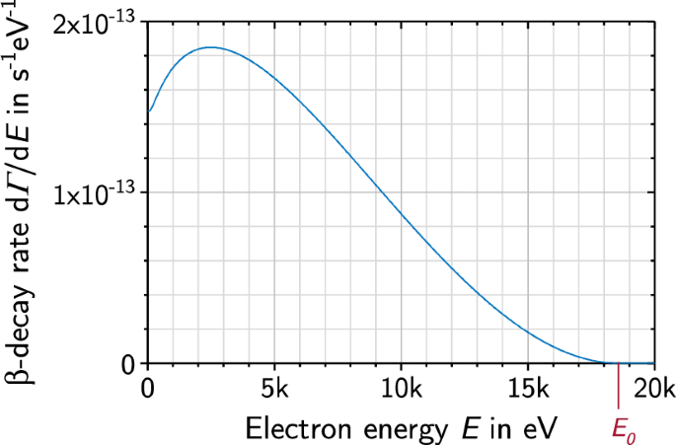
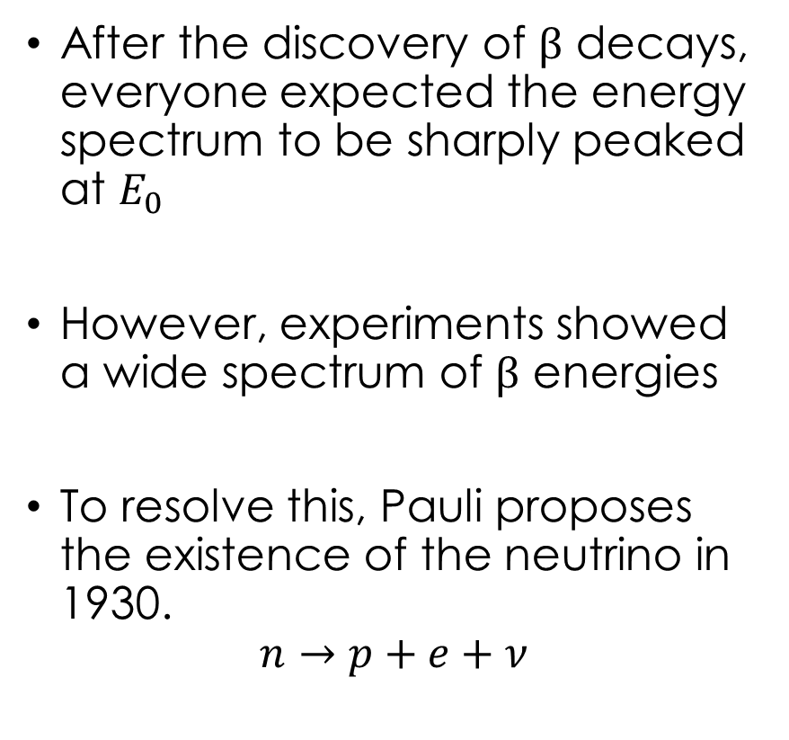
Neutrinos
After the discovery of $β$ decays, everyone expected the energy spectrum to be sharply peaked at $E_{0}$
However, experiments showed a wide spectrum of $β$ energies
To resolve this, Pauli proposes the existence of the neutrino in 1930.
$$n→p+e+ν$$

Slide 43


Higgs Field and Particle Masses
Due to the symmetry structure of the SM, mass terms are forbidden.
The Higgs field, $φ$, is unique in that it is the only field which has a non-zero vacuum state.
We can define a proper particle state with zero vacuum by shifting the value $φ=v+φ$.
This creates a well defined Higgs Boson field, and the value $v$ gives mass to SM particles.

Slide 44
What do we see in detectors?
i.e. SM is good, but does it even work?

Slide 45
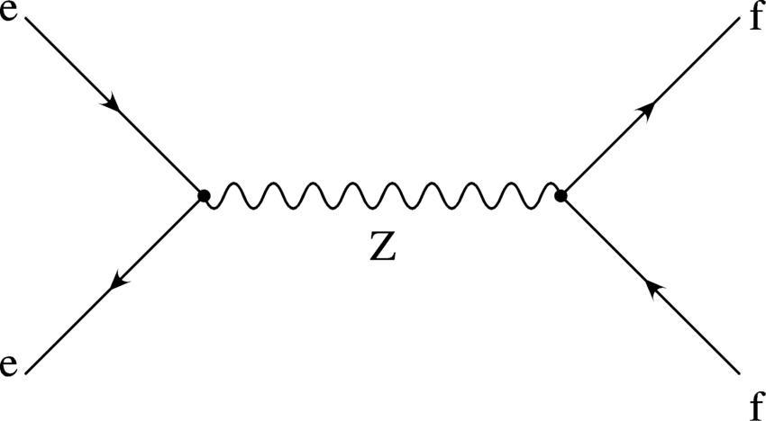
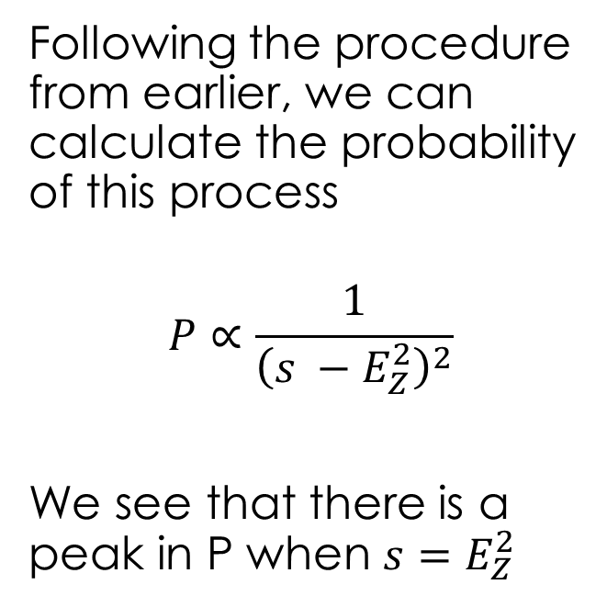
Example: Z boson
Following the procedure from earlier, we can calculate the probability of this process
$$P∝\frac{1}{{\left(s −E_{Z}^{2}\right)}^{2}}$$
We see that there is a peak in P when $s=E_{Z}^{2}$

Slide 46
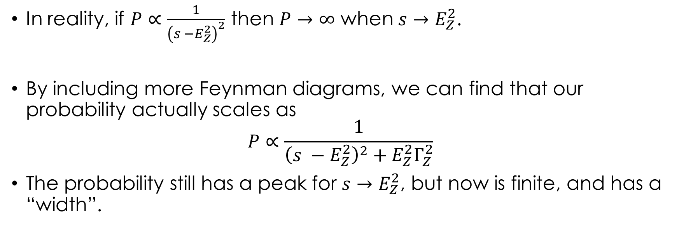
Tamed Infinities
In reality, if $P∝\frac{1}{{\left(s −E_{Z}^{2}\right)}^{2}}$ then $P→∞$ when $s→E_{Z}^{2}$.
By including more Feynman diagrams, we can find that our probability actually scales as
$$P∝\frac{1}{{\left(s −E_{Z}^{2}\right)}^{2}+E_{Z}^{2}Γ_{Z}^{2}}$$
The probability still has a peak for $s→E_{Z}^{2}$, but now is finite, and has a “width”.

Slide 47
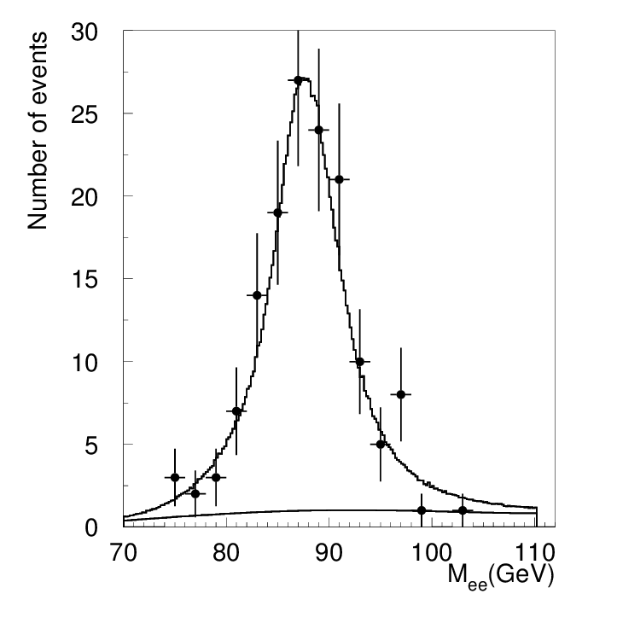
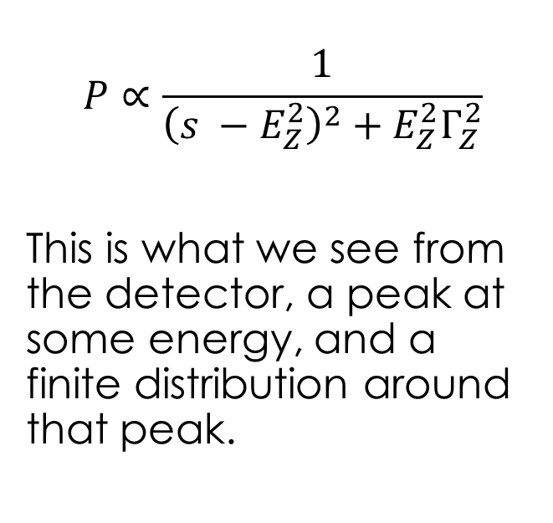
Z Peak
$$P∝\frac{1}{{\left(s −E_{Z}^{2}\right)}^{2}+E_{Z}^{2}Γ_{Z}^{2}}$$
This is what we see from the detector, a peak at some energy, and a finite distribution around that peak.

Slide 48
What don’t we understand?
Disclaimer: List is incomprehensive, changes regularly, and was written by someone who hasn’t done an experiment since 2017.

Slide 49
What Don’t We Understand?
Quantum Gravity
Matter/Antimatter asymmetry
Neutrino Masses, c.f oscillations
Muons (g-2 possibly explained now?)
Inflation Physics
Dark Matter / Dark Energy
Black Hole Physics
So, so much more…

Slide 50
Summary
The SM is a QFT and is the most complete understanding we have of the particles which make everything, and their interactions.
Despite being nearly 50 years old, it remains the most accurate model we have.
This said, there are obvious shortcomings that need to be solved, neutrino masses, dark matter, etc.

Slide 51
Thanks for Listening!
Questions?

