Slide 1





Forward Thinking:
Physics in the Forward Region at the LHC
Sinead Eley (sinead.mary.eley@cern.ch)
University of Liverpool

Slide 2

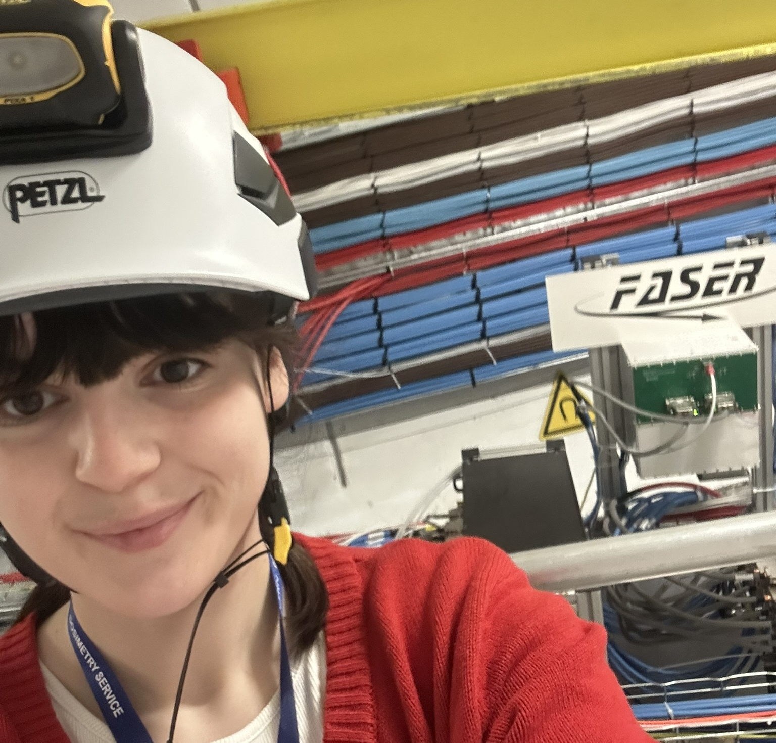




Who am I (and why am I qualified to give this talk …)
MPhys
PhD Student working on FASER
Spend my time working on BSM searches / neutrino measurements
PhD

Slide 3
Motivation

Slide 4
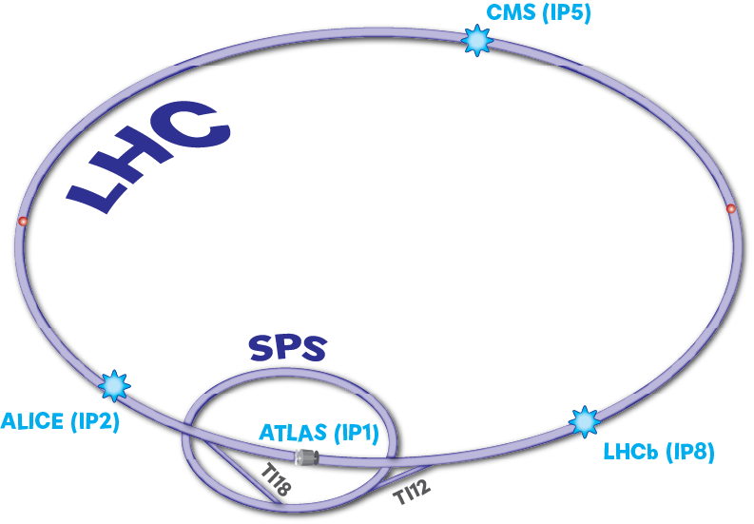
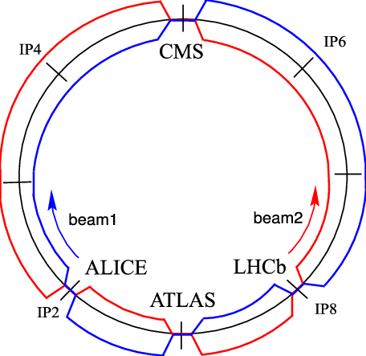
LHC
Around a billion collisions between protons take place per second at the LHC
Takes place at ‘interaction points’ within large experiments that are located on the LHC beamline
4 big experiments on the beamline :
  ATLAS
  CMS
  ALICE
  LHCb
Experiments located on beamline can detect a lot of what is produced in these collisions – but not everything … why?

Slide 5
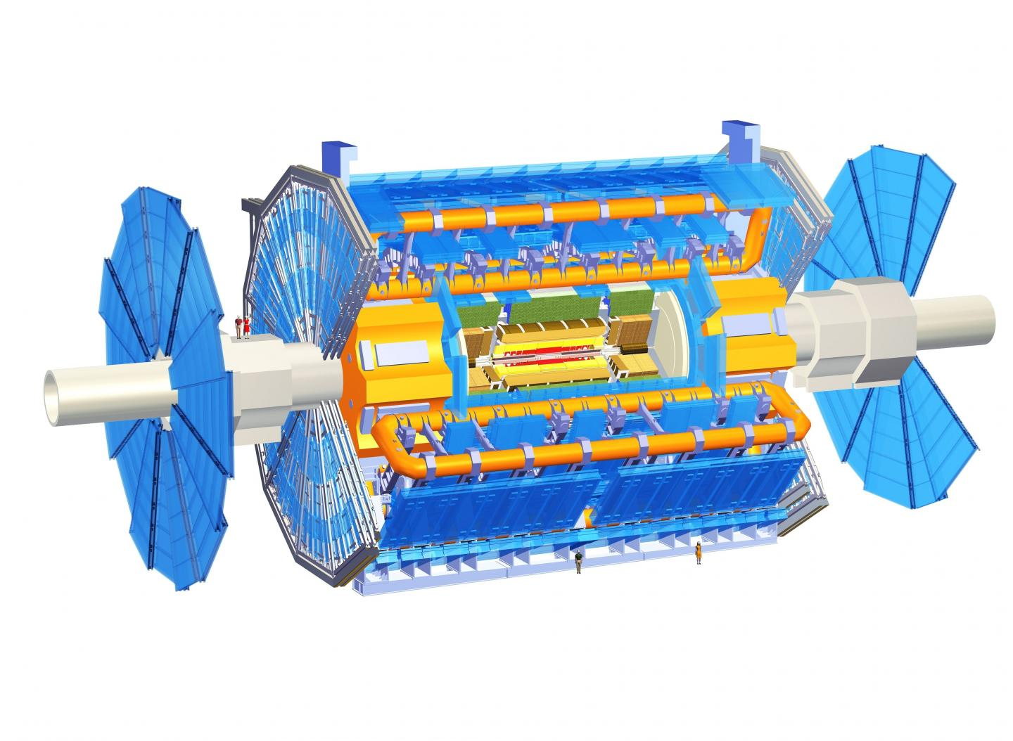

Taking ATLAS as an example
Collisions take place in the middle of ATLAS
LHC Beam Pipe

Slide 6
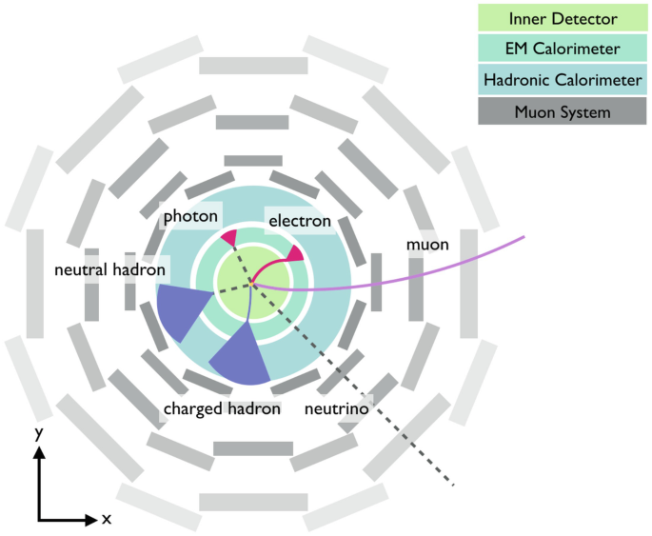
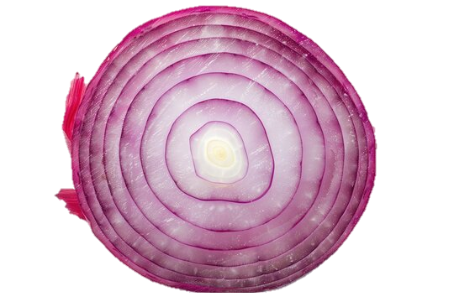
Taking ATLAS as an example
LHC Beam Pipe
Collisions take place in the middle of ATLAS
ATLAS record’s as much information about what is produced in collisions as it can
Designed like an onion
  Layers of detectors with the collision happening in the centre
Lots of particles will spread out sideways into the detector
  Some particles will continue to travel straight on
  This region with angles close to the beam is called the forward region

Slide 7
What tends to want to go forward?
High momentum particles
  Particles that take most of the energy of the collisions
  Most of the energy emitted at low angles with respect to the beam line (aka in the forward region)
Collision
High Momentum Particle
LHC Beam Pipe

Slide 8
What tends to want to go forward?
Weakly Interacting particles
  Particles that tend to ‘disappear without a trace’
  They don’t interact often and tend to need lots of distance and material to interact with to make a decay more likely
  Means these particles could exist for a longer time/ distance than is typical of a particle created in a collision
Collision
Weakly Interacting Particle
LHC Beam Pipe

Slide 9
Potential particles in forward region
Neutrinos
  Sometimes known as a ‘ghost’ particle
  Known to be created in LHC collisons
  Hard to detect due their long-lifetimes and lack of interaction with matter
Other long lived particles
  E.g. muons
  These mesons tend to be highly energetic and exist for macroscopic distances within the LHC
  Think about the cosmic rays that come to earth – they contain both neutrinos and muons!

Slide 10
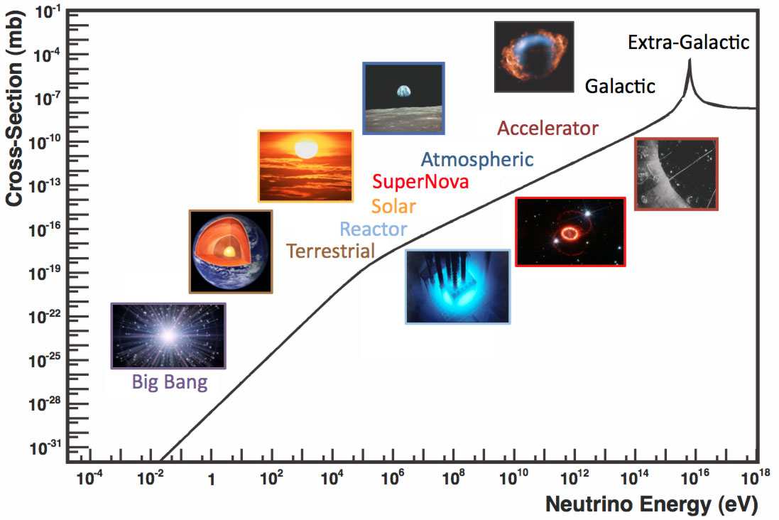
Why do we care about this?
We know a lot about neutrinos created by :
  Accelerators on a fixed target (e.g. nuclear reactors)
  Astrophysical processes (supernovae etc)
We currently know very little about neutrinos in the energy range between these
  Neutrinos created in collisions at particle colliders fill in this gap!

Slide 11

Why do we care about this?
Maybe something new?
  Potential for new particles that we have discovered and that the standard model can’t explain to be produced in these collisions
  Could be both weakly-interacting and long-lived – so maybe that’s why we haven’t seen them yet?
  Could help us to understand dark matter and other phenomena

Slide 12
In practice

Slide 13
Creating an environment to detect this
Thanks to theory (and simulations) we can place detectors in strategic locations around the LHC to make use of this forward flux
Ideally we want these detectors to be able to:
  Detect and measure neutrinos
  Search for new physics (that could potentially be long lived)

Slide 14
Creating an environment to detect this
Thanks to theory (and simulations) we can place detectors in strategic locations around the LHC to make use of this forward flux
Ideally we want these detectors to be able to:
  Detect and measure neutrinos
  Search for new physics (that could potentially be long lived)

Slide 15
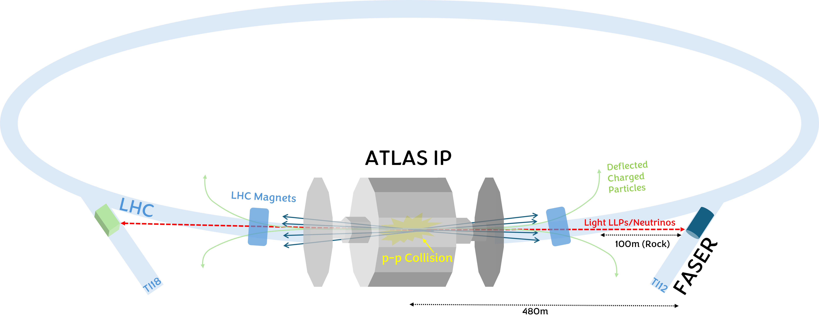
Forward Region @ LHC
Utilising the particles created in the forward direction at ATLAS
Two disused tunnels at the LHC are perfect locations to benefit from these particles
Both are located behind ~ 100m of rock
~ 500m from where the collision takes place

Slide 16
Detectors in Forward Region
Two detectors are placed in locations which benefit from forward-going particles created in collisions at ATLAS
  Either side of the collision point
  Similar goals
  Cover a slightly different range of angles
  Slightly different detector technologies

Slide 17
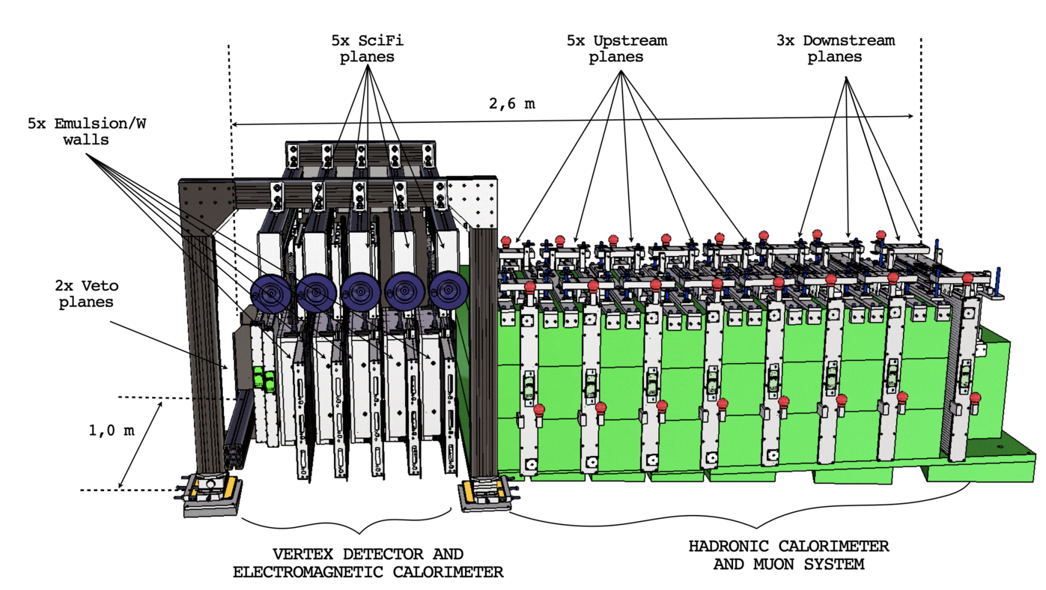
Detectors in Forward Region
SND (Scattering Neutrino Detector)
  2.6m in length and 1m wide
  Located in tunnel TI18
  Measures neutrino properties
  Consists of target region and muon system (uses both emulsion and electronic components)

Slide 18
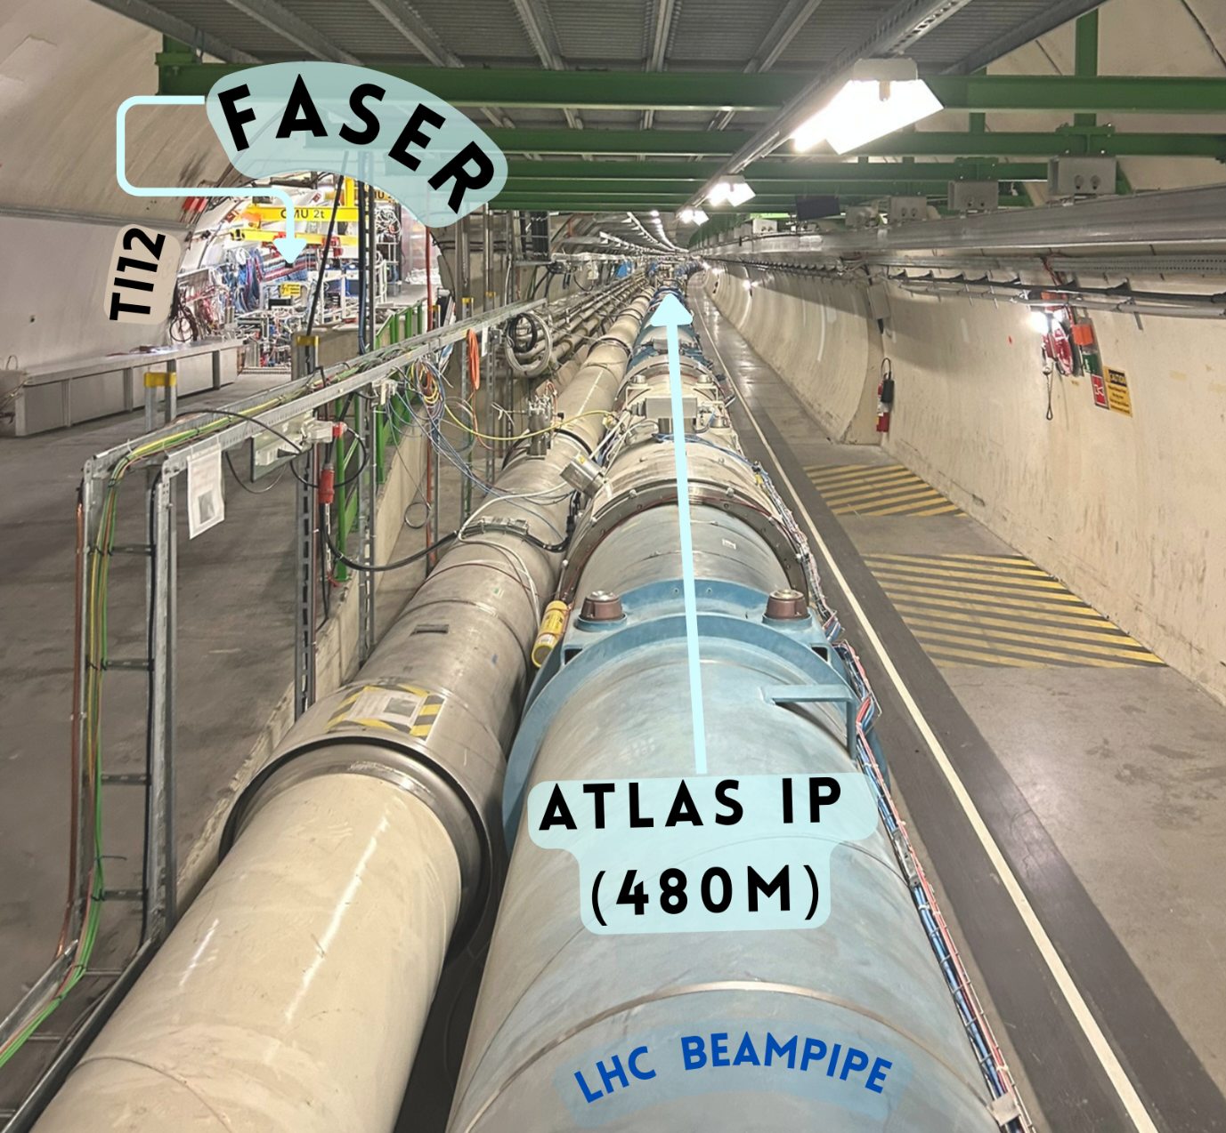
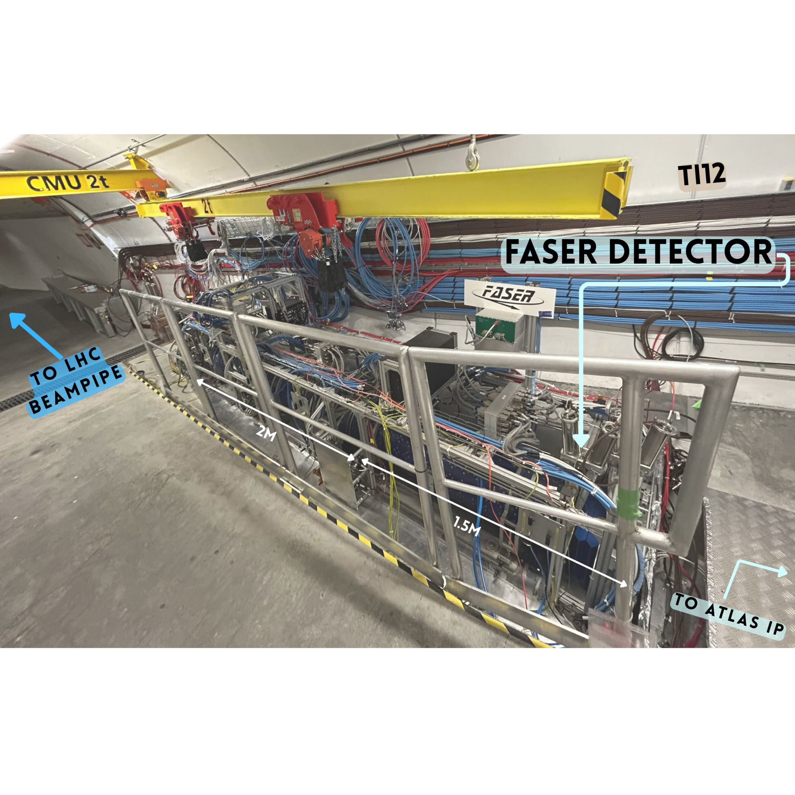
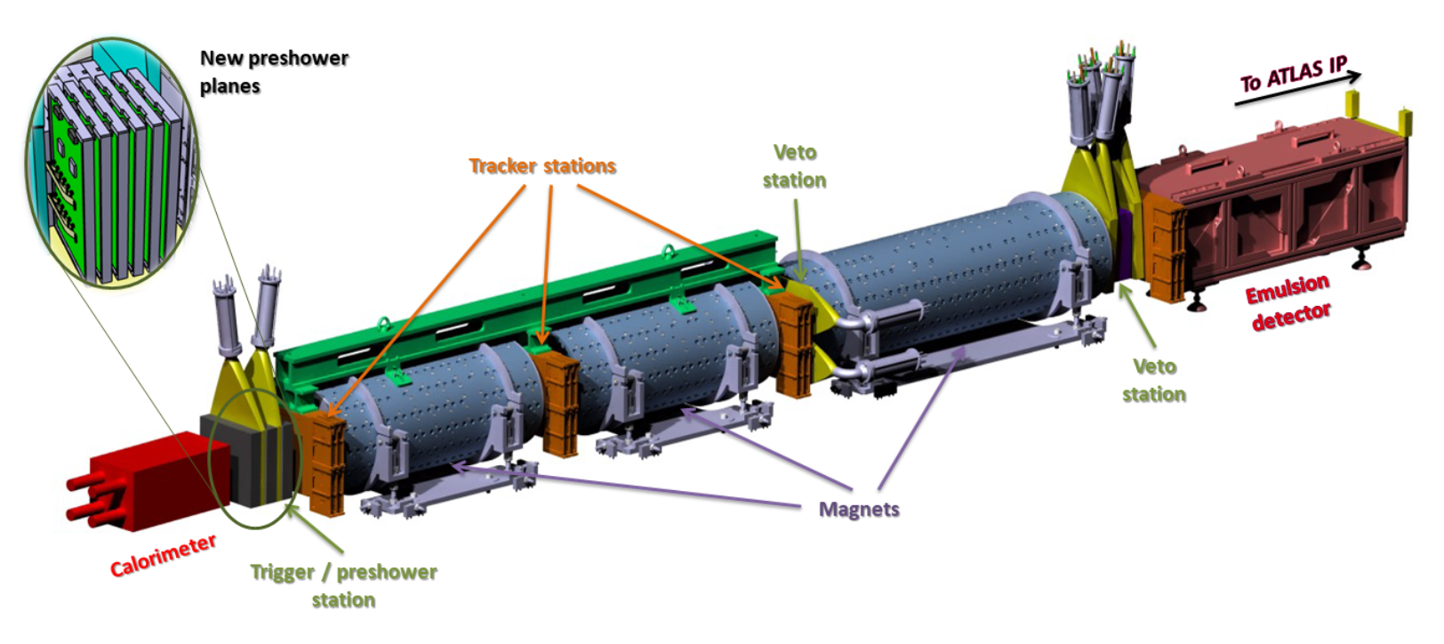
Detectors in Forward Region
FASER (Forward Search Experiment)
  Small detector (10cm radius and 7m in length)
  Located in tunnel TI12
  Electronic detector and emulsion detector
  Measures neutrino properties and searches for new physics

Slide 19
Did it work out?

Slide 20
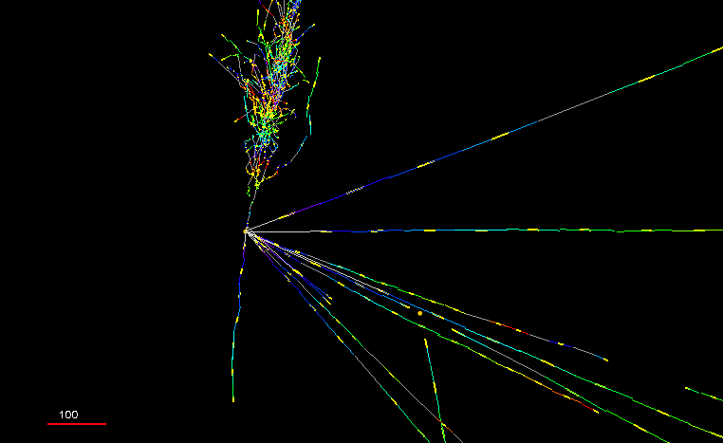
A Win for Forward Physics
Neutrinos were first detected in 1970 using a bubble chamber
Although colliders such as the LHC have been running for years there had never been a collider neutrino detected directly
Until FASER directly detected collider neutrinos for the first time in 2023!

Slide 21
Looking Forward to the Future?

Slide 22
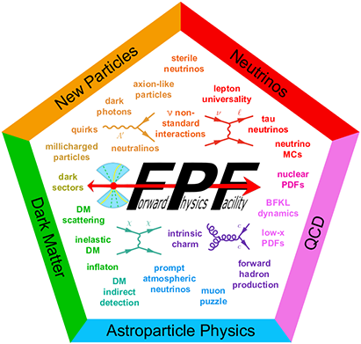
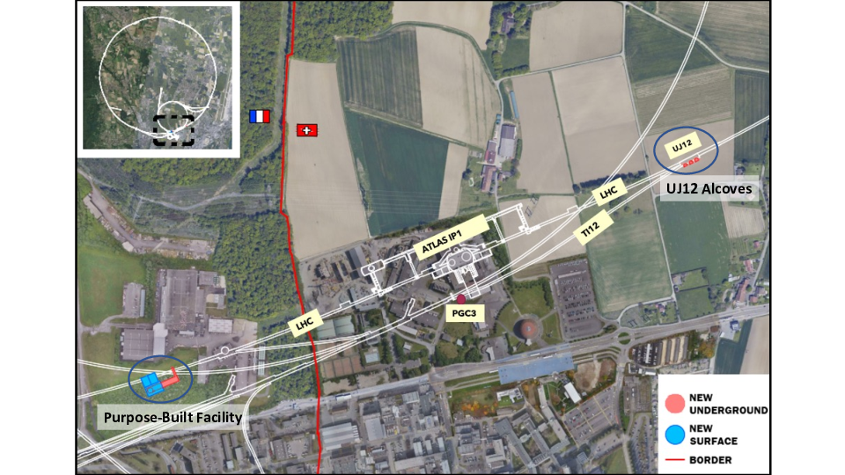
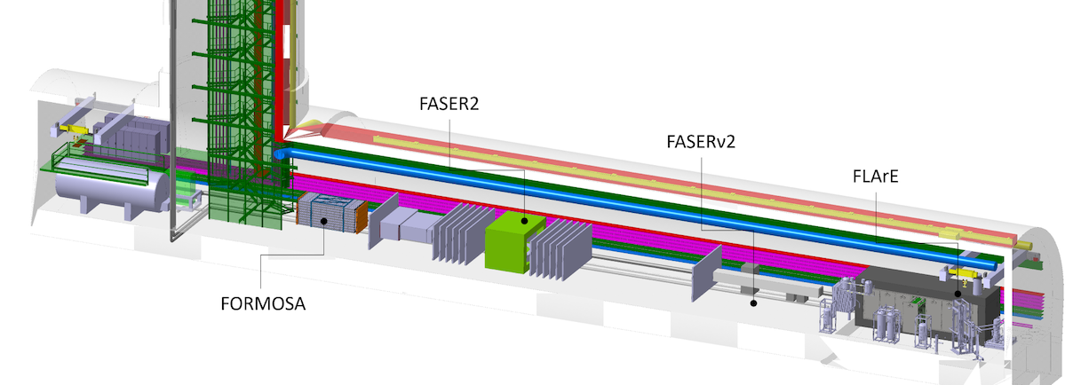
Dedicated Facility for Forward Physics?
Future of forward physics at cern hopefully includes a dedicated facility
A new cavern near the ATLAS interaction point is proposed
  Forward Physics Facility
  Will be accessible while LHC beam is operational
  4 experiments will be housed that are dedicated to forward physics
  Goals of collider neutrino measurements and improved sensitivity for new physics searches among others

Slide 23
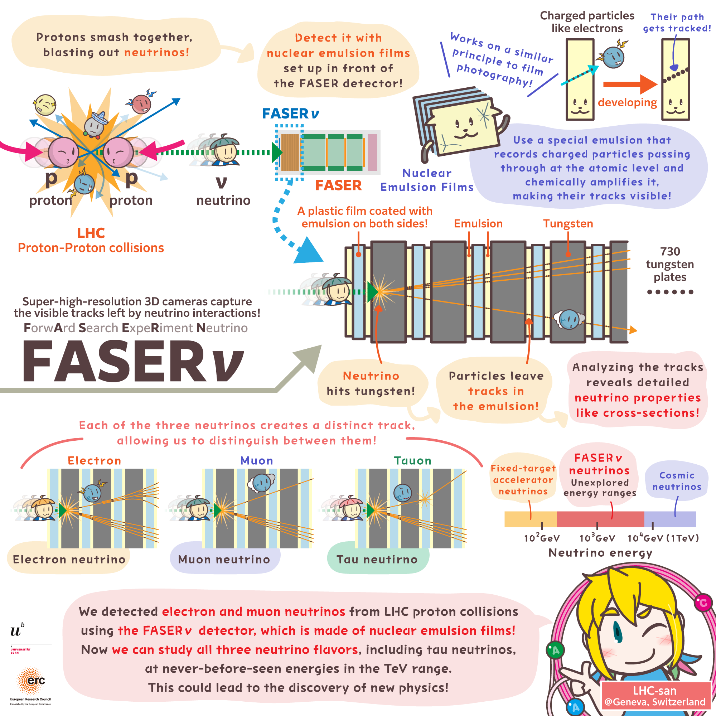
Summary
So much potential in forward region @ the LHC
Makes use of regions that ‘classical’ collider detetctors can’t reach
Gives great opportunity to study :
  Neutrinos
  New physics
Already some great results
  First collider neutrinos detected
Lots of promise for new forward physics facility
  Build on already proven forward physics programs
Lots more to come in coming years/decades

Slide 24


Any Questions?
Thanks for listening ☺
sinead.mary.eley@cern.ch

Slide 25
BACK UP

Slide 26
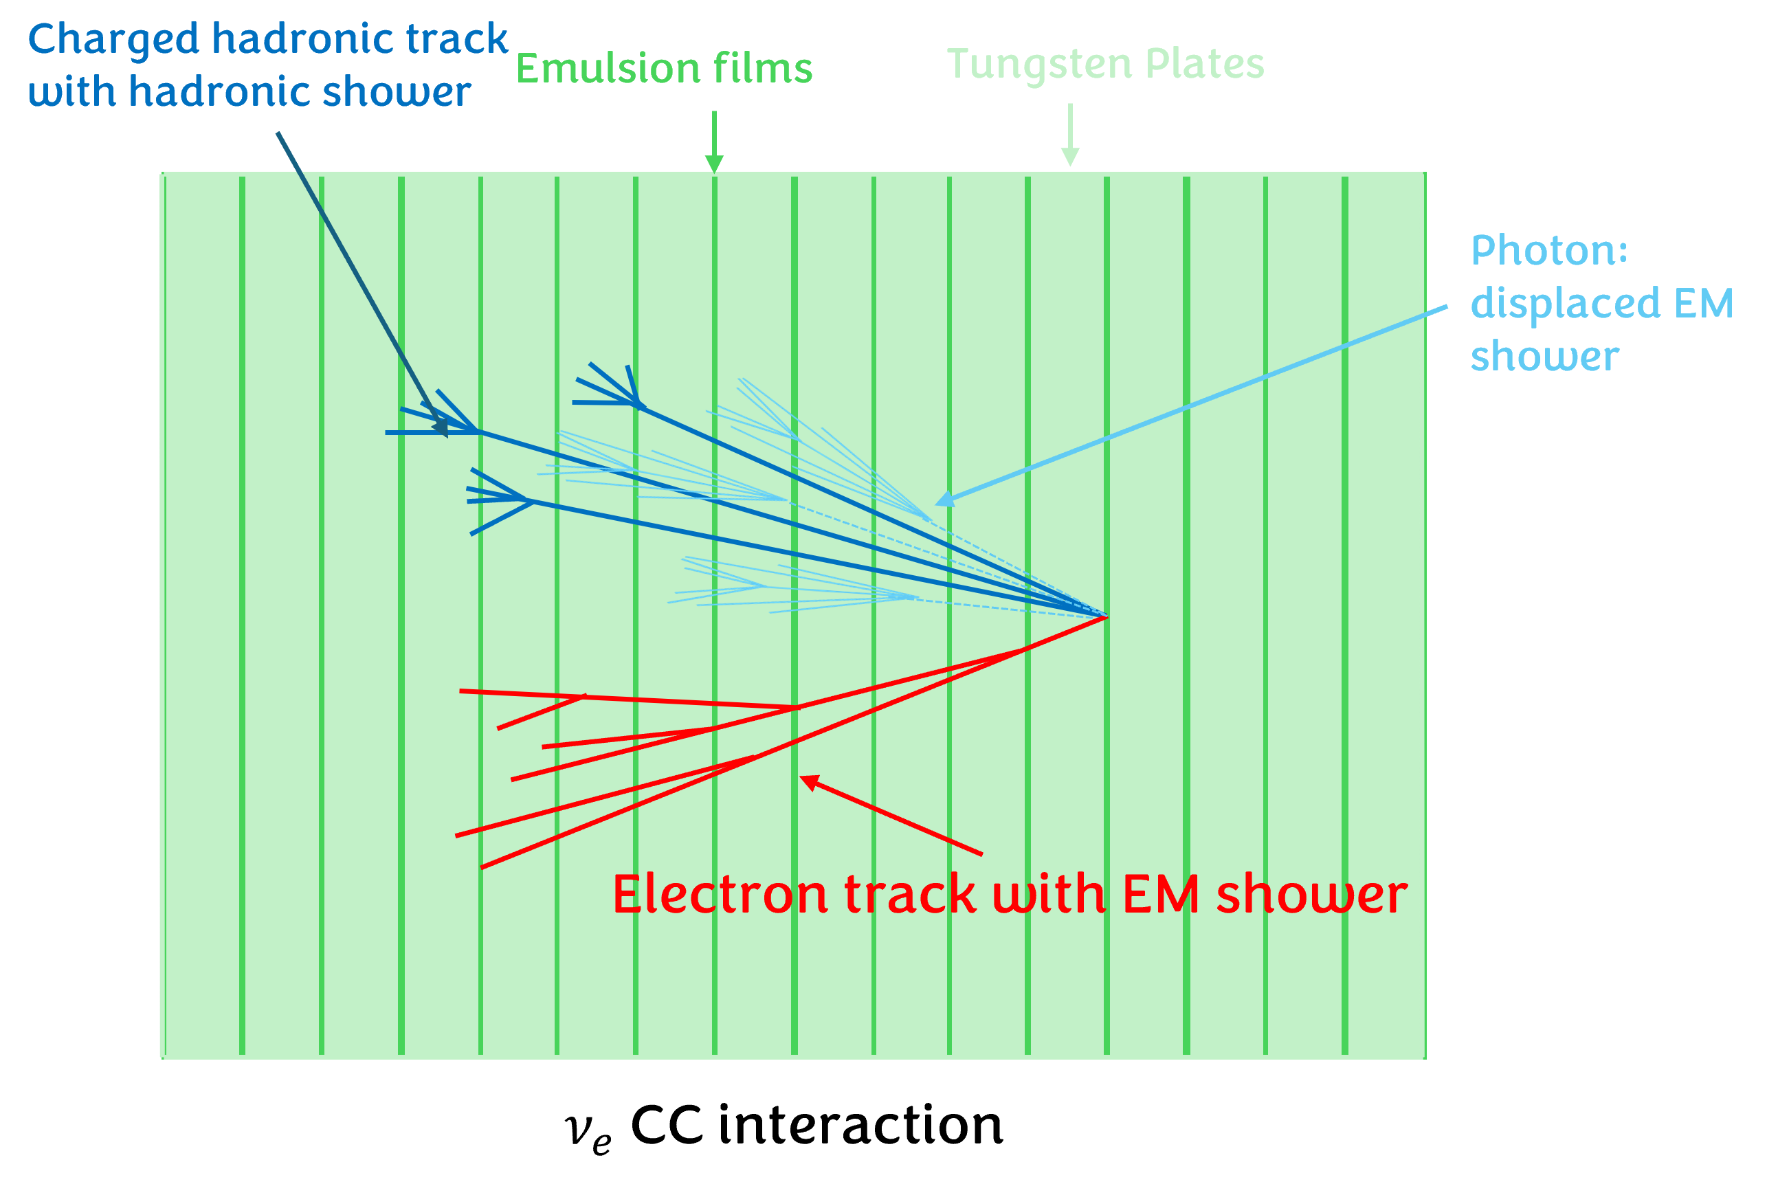
FASER : Detector Design
Two main components:
  Electronic Detector (FASER)
  Emulsion Detector (FASERNu)
Box made of emulsion film & tungsten sits in front of electronic detector
Physically records neutrino interactions in the material
Only in LHC for ~1 month at a time
  Films have to be developed afterwards & then sent to Japan to be processed

Slide 27
FASER : Detector Design
Two main components:
  Electronic Detector (FASER)
  Emulsion Detector (FASERNu)
Used for neutrino analyses and BSM searches
Consists of :
  Scintillators
  EM calorimeter
  Tracking spectrometer & decay volume
    Includes a 0.55 T magnet

Slide 28
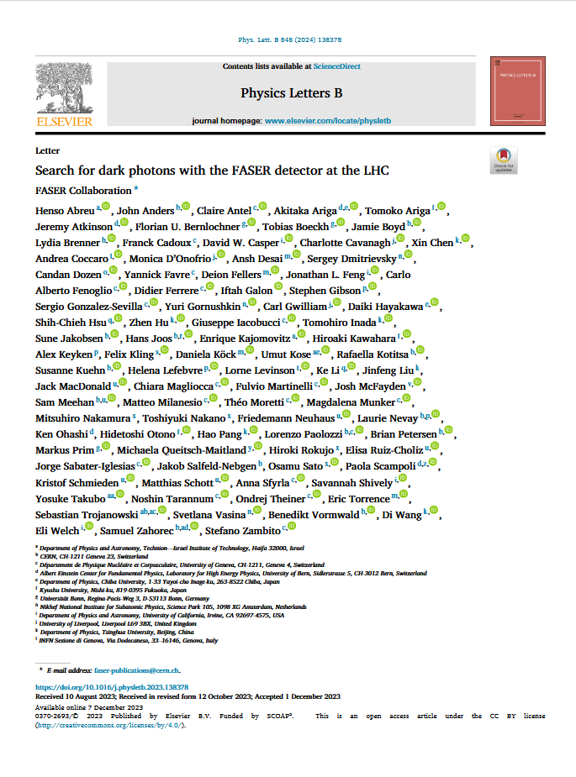
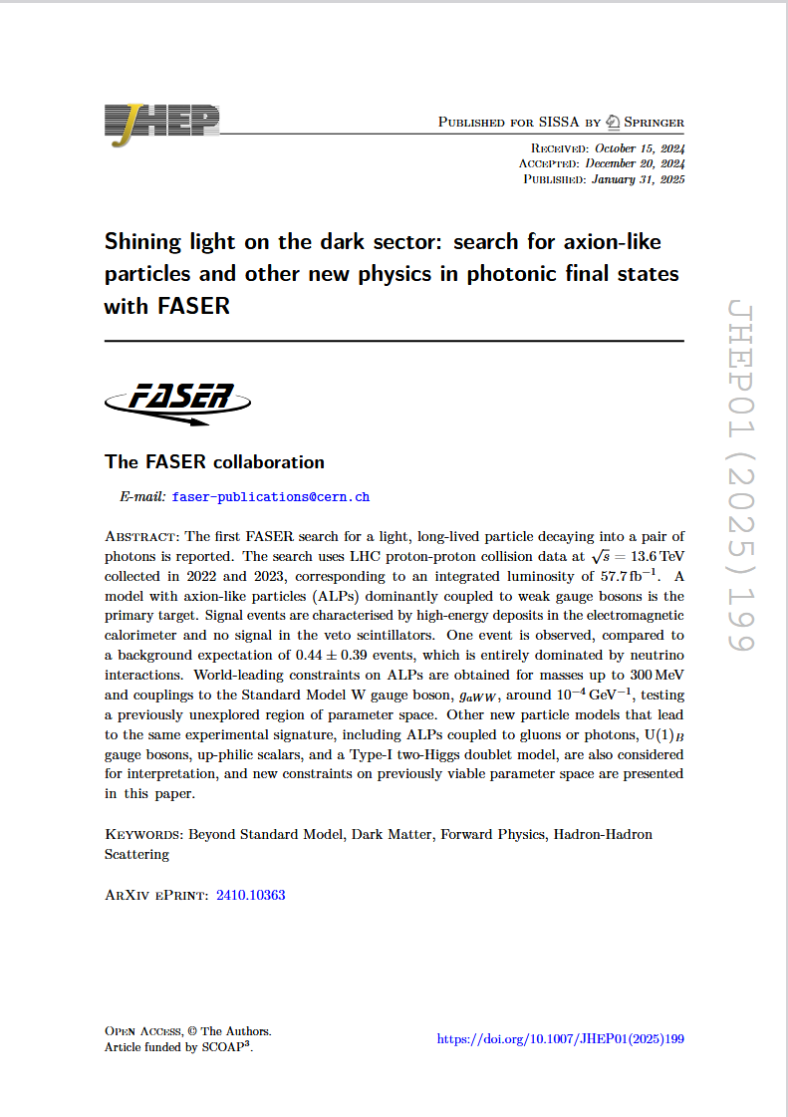
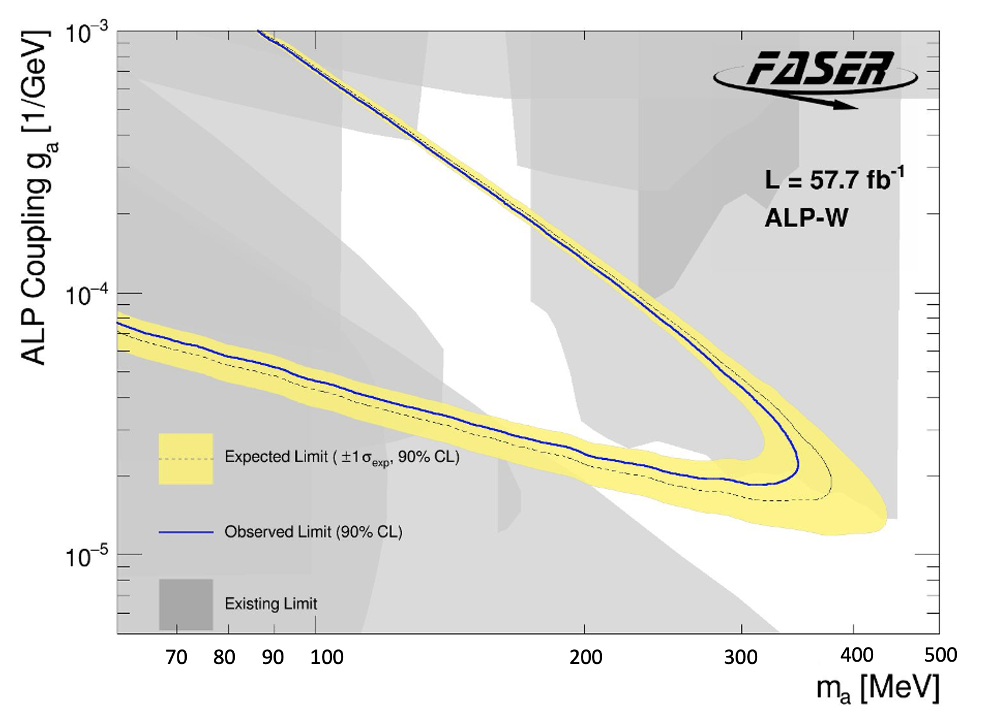
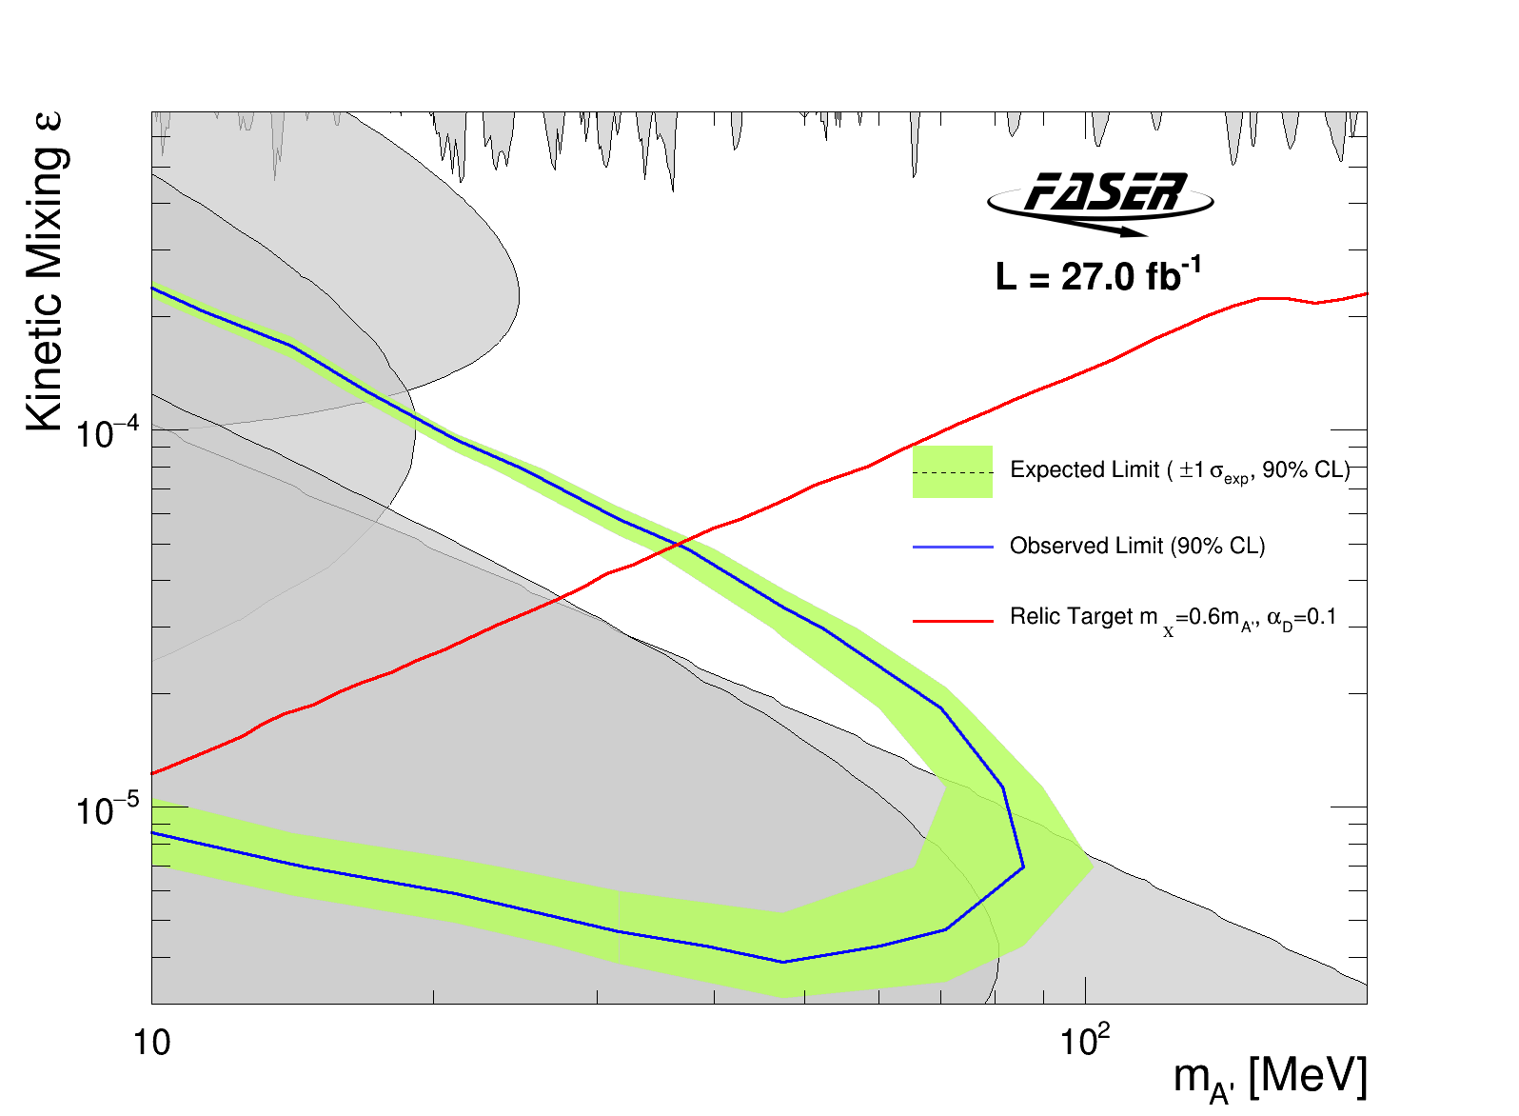
FASER : Physics Results
In FASER’s first 3 years of data taking, produced some good physics results
  Both searches for new physics
Dark Photons
Axion Like Particles

Slide 29
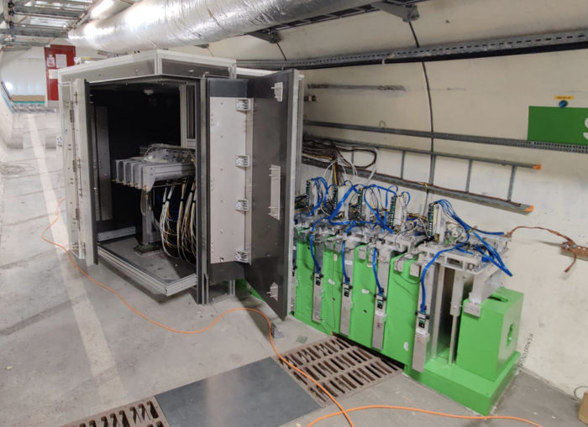

SND
Studies neutrino interactions at the LHC
Opposite side of the ATLAS but same location wrt collision
  Positioned off the beamline
Approved in 2021 & started taking data in 2022
Optimised for the identification of the neutrino flavours
Different design to FASER
  Different angular acceptance ( 7.2 $<η<8.4)$
  Detects small angle neutrinos from collisions (but larger than FASER$ν$)
SND share an emulsion lab at CERN with FASER

Slide 30

SND Detector Design
SND has two main components:
  Vertex detector & EM calorimeter
  Hadronic calorimeter & muon system
Veto & Target Region
Tags muons using scintillators in veto planes
Emulsion cloud chambers
  Tungsten/emulsion plates
SciFi planes give timing & position information
Goals for the veto & target region:
  Vertexing
  $τ$ ID
  Energy measurements (EM)

Slide 31
SND Detector Design
SND has two main components:
  Vertex detector & EM calorimeter
  Hadronic calorimeter & muon system
Plastic scintillator & iron planes
Muon identification system
Timing information
Hadronic energy measurement
Goals:
  ID muons, useful for CC interactions & identifying charmed hadron production

Slide 32
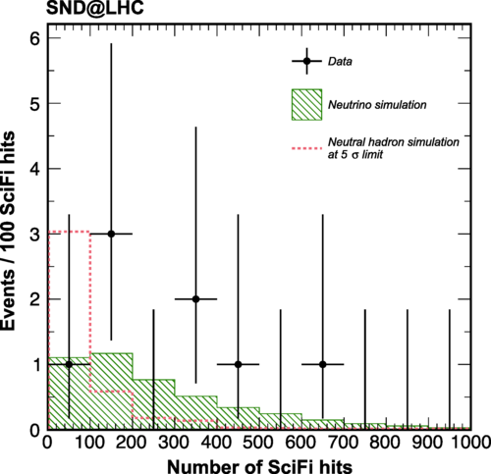
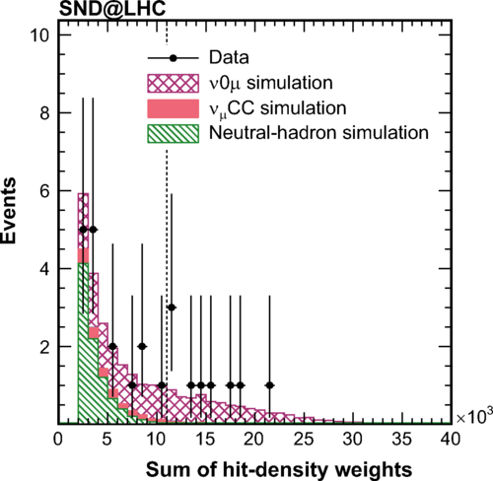
SND : Physics Results
Observation of collider muon neutrinos
Observation of neutrino interaction with no muons in final state

