Slide 1

22/08/2025
CAKE
Controlled Antimatter Kinematic Experiment
Annabelle Davies, Helen Cao, Nathan Cooper, Alastair Zhang
Notes:
This presentation will explore how data modelling helps businesses make decisions and how spreadsheet tools support this process.

Slide 2
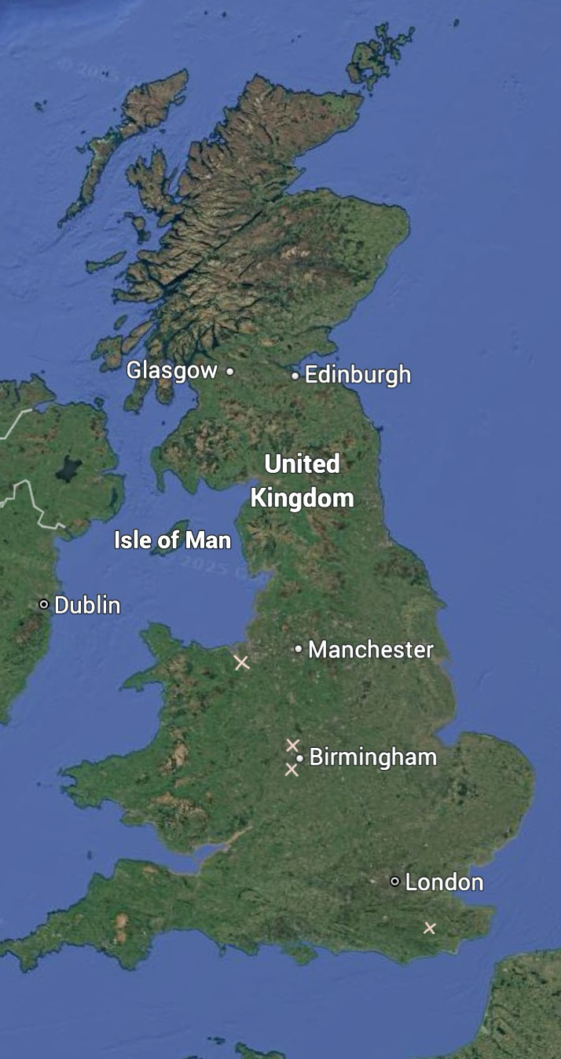

About Us
Notes:
This presentation will explore how data modelling helps businesses make decisions and how spreadsheet tools support this process.

Slide 3
Our Problem
Matter-antimatter asymmetry
Matter and antimatter should be equal. (Pair production)
There an abundance of matter.
There is very little antimatter in comparison.
This suggests there is some sort of asymmetry.
We already have ALPHA experiment looking at the WEP
This measures g in relation to antimatter.
However this suggests g is close to 9.81
Notes:
This presentation will explore how data modelling helps businesses make decisions and how spreadsheet tools support this process.

Slide 4
Hypothesis
Null Hypothesis: The SM is correct
Alternative Hypothesis: The SM is missing particles.
Experiment aims to prove that the Null Hypothesis is incorrect.
Notes:
This presentation will explore how data modelling helps businesses make decisions and how spreadsheet tools support this process.

Slide 5

The Layers
Detector- detects muons
Icing
Upper Sponge
Magnet: Keeps the particles on track
Filling
Calorimeters: Measures the energy of the particles (EM or Hadronic)
Lower Sponge
Tracking: Records the path of charged particles
Notes:
This presentation will explore how data modelling helps businesses make decisions and how spreadsheet tools support this process.

Slide 6
Our particle accelerator
CAKE will begin from a LINAC, and then into a PS.
The proton beam will then be smashed into a block of material (proton rich iridium).
This is similar to the beginning of the AD
To filter the antiprotons from the electrons, we will use a magnetic field.
Electrons have higher speeds so will pass through less affected.
The antiproton beam will then be sent through the existing accelerators (PS, SPS) to speed it up to close to the speed of light.
The existing LHC can then be used.
The dipole and quadrupole magnets will have to be switched in order to account for the change in charge.
Notes:
This presentation will explore how data modelling helps businesses make decisions and how spreadsheet tools support this process.

Slide 7
Why Cake?
Never properly collided high energy antiprotons
Can compare events from LHC
If it’s largely similar upholds SM
If there’s any significant differences may explain asymmetry
This might help aid theories for matter-antimatter asymmetry
Other Benefits:
Effectively no additional cost as using pre existing construction
Will only have to reverse magnets
Notes:
This presentation will explore how data modelling helps businesses make decisions and how spreadsheet tools support this process.

Slide 8
Further experiments
Proton-antiproton
High energy
Unknown outcomes
Tevatron previously only 1TeV
LHC can produce much higher energies
Notes:
This presentation will explore how data modelling helps businesses make decisions and how spreadsheet tools support this process.

Slide 9
Any Questions !!!!!?
CAKE
Controlled Antimatter Kinematic Experiment
Notes:
This presentation will explore how data modelling helps businesses make decisions and how spreadsheet tools support this process.

