Slide 1

S terile
N eutrino
O scillation
E xperiment
Notes:
Neutrino get their mass from. Are there sterile neutirnos?
How do you measure sterile neutrinos?
-new decay and measure kinematic conservation
Problems with this method? Don’t interact via standard model since right handed. Can't do a direct search, so do am indirect search. Comprehensive measurement of all neutirno oscillations and look for anomolies or missing momentum.
Create tau neutrinos. Get decay for this. Tau goes to electron and electorn neutrino or muon and muon neutrino. Tau decay. ,meausre how many of all types of neutrinos produced. Put one detector very close. Put one very far away and measure how many are left. 17% of time decays into electron electron neutrino and tau neutrino. The rest goes into tau neutrinos and pions. Produce taus, cascading effect of ectra tau neutrinos, and everything else. If you know proportion at production, you can analyse on further detectors. If not ratio similar to predicted based on distance of second detector, you know it is producing something else which is unaccounted for. If number at beginning doesn’t agree with at end, you know theres something missing.

Slide 2
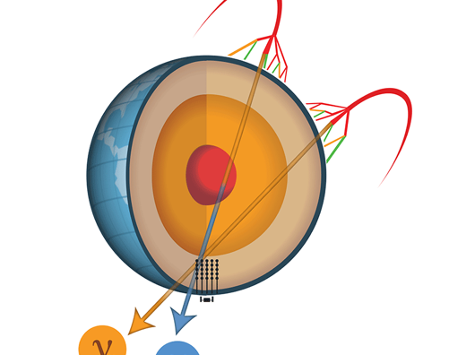
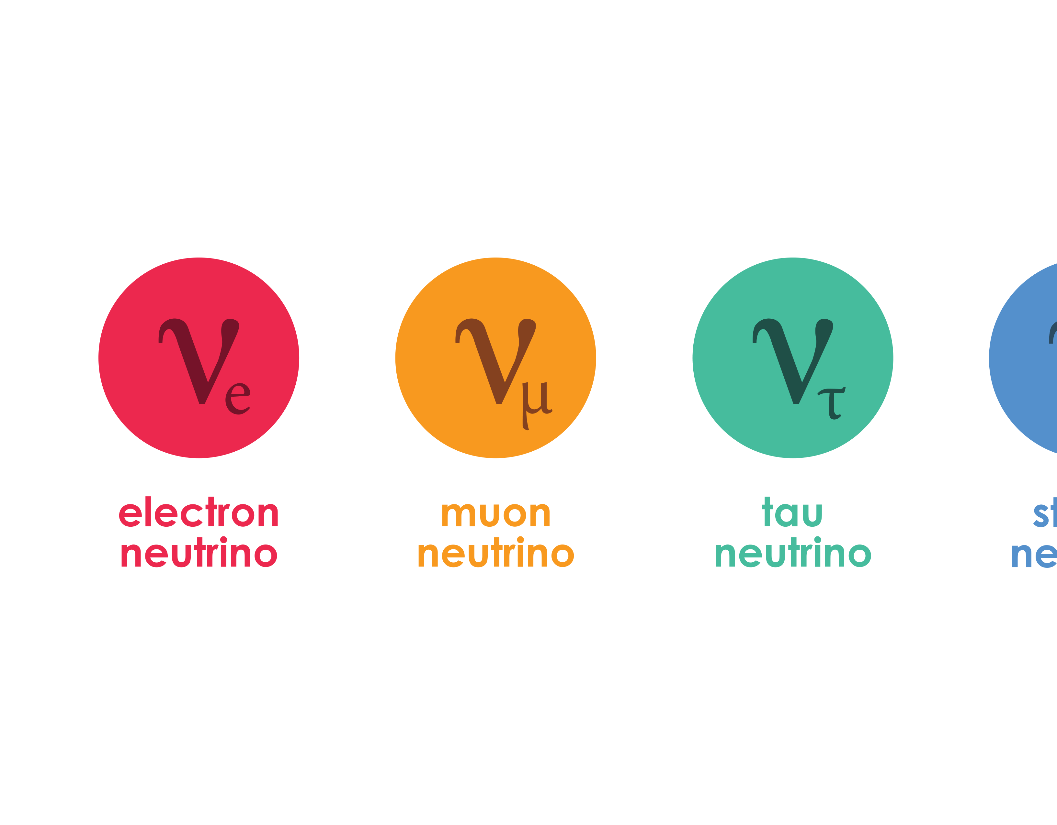
What Are Sterile Neutrinos?
Proposed 'Fourth Generation' of Neutrino
Existence hinted through anomalies in experiments (eg. LSND Anomalies, MiniBooNE)
Right-Handed – does not experience the weak force (only through gravity)
They rarely interact with matter, so large sensitive detectors must be used
Notes:
Tau neutrino experiments – mechanism to produce tau neutrino, accelerate it fast enough it lasts longer. Liquid argon? Mechanism by which they produce the muon neutrinos. Detectors earlier and later. Tau neutrino generation
Produce electron neutrinos
Produce muon neutrinos
Produce tau neutrinos
Proton accelerator hits a fixed target and creates pions. Producing pions. Pions decay into muon neutrinos. Very clean. Produces some other stuff too. Use magnets to bend things away from pions so get very pure pion beams. Pions easy to produce. Getting tau neutrino difficult
See how tau oscillates as they may oscillate into sterile

Slide 3
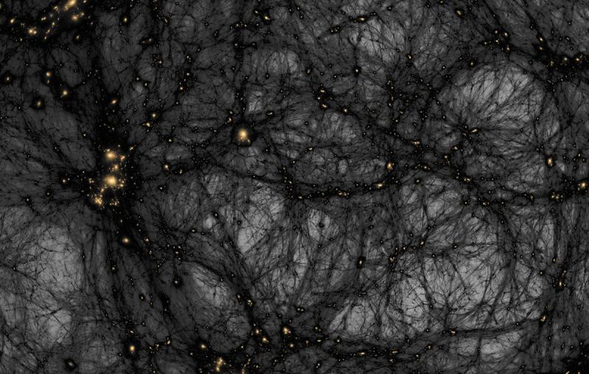
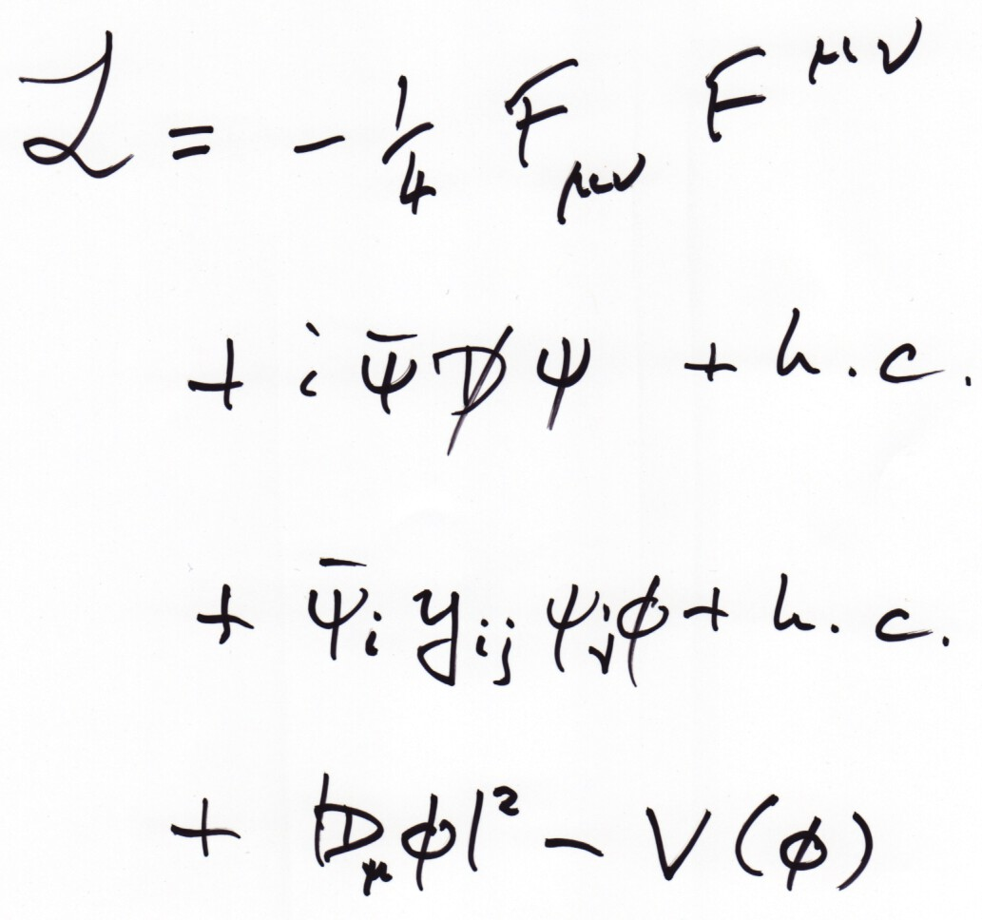
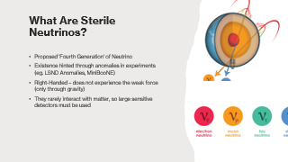
Why Test the Hypothesis?
Sterile neutrinos could potentially identify the source of dark matter
Could help us revise the Standard Model and further our understanding of the universe
They could also justify the smallness of neutrino mass
Notes:
Tau neutrino experiments – mechanism to produce tau neutrino, accelerate it fast enough it lasts longer. Liquid argon? Mechanism by which they produce the muon neutrinos. Detectors earlier and later. Tau neutrino generation
Produce electron neutrinos
Produce muon neutrinos
Produce tau neutrinos
Proton accelerator hits a fixed target and creates pions. Producing pions. Pions decay into muon neutrinos. Very clean. Produces some other stuff too. Use magnets to bend things away from pions so get very pure pion beams. Pions easy to produce. Getting tau neutrino difficult
See how tau oscillates as they may oscillate into sterile

Slide 4
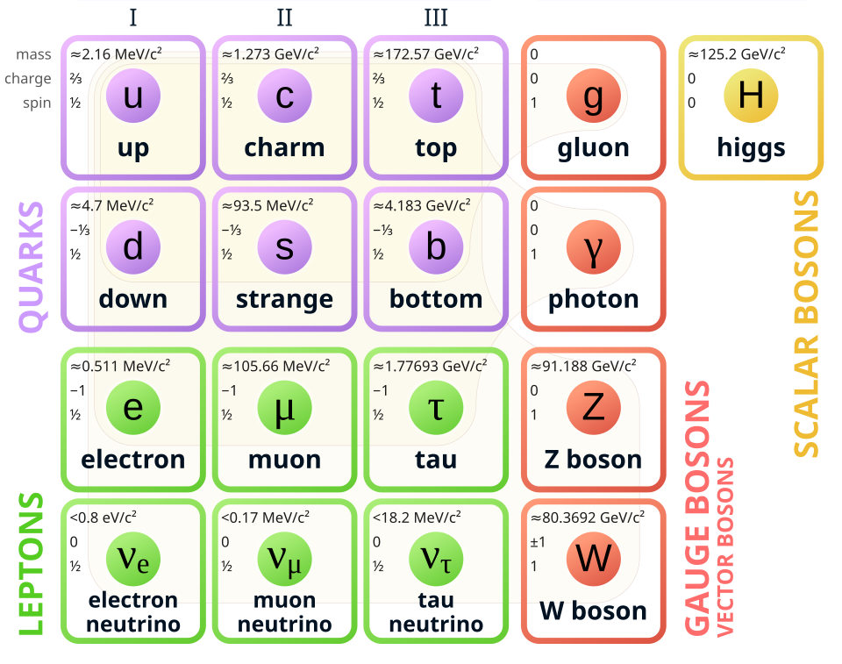
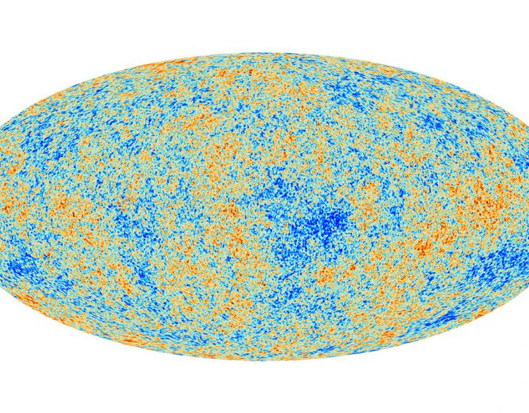
Problems with Detecting Sterile Neutrinos
Sterile Neutrinos only interact via mixing with active neutrinos; Very Rare
Right-Handed Chirality → doesn’t interact with the weak force; only interacts with gravity therefore difficult to detect as not a part of SM and is extremely weak on quantum scale
Neutrino experiments very susceptible to background interference from solar emission and cosmic neutrino background
Not part of SM: No established detection framework
Notes:
Tau neutrino experiments – mechanism to produce tau neutrino, accelerate it fast enough it lasts longer. Liquid argon? Mechanism by which they produce the muon neutrinos. Detectors earlier and later. Tau neutrino generation
Produce electron neutrinos
Produce muon neutrinos
Produce tau neutrinos
Proton accelerator hits a fixed target and creates pions. Producing pions. Pions decay into muon neutrinos. Very clean. Produces some other stuff too. Use magnets to bend things away from pions so get very pure pion beams. Pions easy to produce. Getting tau neutrino difficult
See how tau oscillates as they may oscillate into sterile

Slide 5
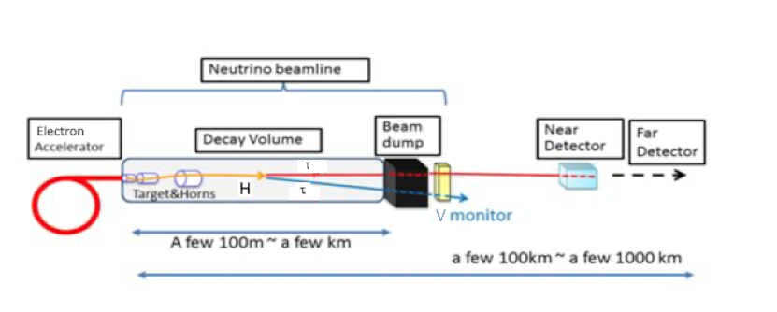
The Testing Method
Use circular accelerator to energize initial electrons, enter into a linear fixed target accelerator to produce the beam
Through decay of tau, produce beam of 3 known types of neutrinos in SM
Use 2 detectors and measure the proportion of 3 types in the 1st detector and from kinematic calculations, predict the proportion of each in 2nd detector and analyze results observed
If observations disagree with predictions, there is something missing from results (additional neutrino state)
More comprehensive overview as tau neutrinos
have not been used previously in any accelerator
Testing neutrinos at source compared to
those recorded after.
1. Higgs Production
Electrons are accelerated to around 125 GeV and collide with a fixed target, occasionally producing Higgs bosons. (Using electrons instead of protons as cleaner)
2. Higgs Decay
The Higgs decays into τ⁺τ⁻ pairs. Each tau then decays into Standard Model particles, including neutrinos. Some of these neutrinos could transform into sterile neutrinos, which don’t interact with detectors.
3. Detecting Missing Energy
A near detector measures the neutrinos produced by the decays. A far detector measures neutrinos after a distance. Any deficit at the far detector suggests energy carried away by sterile neutrinos.
4. Using a Magnetic Field
A strong magnetic field deflects charged particles (electrons, muons, hadrons) while leaving neutral particles, including neutrinos, unaffected. This ensures that missing energy can be attributed to invisible neutrinos rather than other particles.
Notes:
Tau neutrino experiments – mechanism to produce tau neutrino, accelerate it fast enough it lasts longer. Liquid argon? Mechanism by which they produce the muon neutrinos. Detectors earlier and later. Tau neutrino generation
Produce electron neutrinos
Produce muon neutrinos
Produce tau neutrinos
Proton accelerator hits a fixed target and creates pions. Producing pions. Pions decay into muon neutrinos. Very clean. Produces some other stuff too. Use magnets to bend things away from pions so get very pure pion beams. Pions easy to produce. Getting tau neutrino difficult
See how tau oscillates as they may oscillate into sterile
1. Higgs Production
Electrons are accelerated to around 125 GeV and collide with a fixed target, occasionally producing Higgs bosons. (Using electrons instead of protons as cleaner)
2. Higgs Decay
The Higgs decays into τ⁺τ⁻ pairs. Each tau then decays into Standard Model particles, including neutrinos. Some of these neutrinos could transform into sterile neutrinos, which don’t interact with detectors.
3. Detecting Missing Energy
A near detector measures the neutrinos produced by the decays. A far detector measures neutrinos after a distance. Any deficit at the far detector suggests energy carried away by sterile neutrinos.
4. Using a Magnetic Field
A strong magnetic field deflects charged particles (electrons, muons, hadrons) while leaving neutral particles, including neutrinos, unaffected. This ensures that missing energy can be attributed to invisible neutrinos rather than other particles.
1. Higgs Production
Electrons are accelerated to around 125 GeV and collide with a fixed target, occasionally producing Higgs bosons. (Using electrons instead of protons as cleaner)
2. Higgs Decay
The Higgs decays into τ⁺τ⁻ pairs. Each tau then decays into Standard Model particles, including neutrinos. Some of these neutrinos could transform into sterile neutrinos, which don’t interact with detectors.
3. Detecting Missing Energy
A near detector measures the neutrinos produced by the decays. A far detector measures neutrinos after a distance. Any deficit at the far detector suggests energy carried away by sterile neutrinos.
4. Using a Magnetic Field
A strong magnetic field deflects charged particles (electrons, muons, hadrons) while leaving neutral particles, including neutrinos, unaffected. This ensures that missing energy can be attributed to invisible neutrinos rather than other particles. 1. Higgs Production
Electrons are accelerated to around 125 GeV and collide with a fixed target, occasionally producing Higgs bosons. (Using electrons instead of protons as cleaner)
2. Higgs Decay
The Higgs decays into τ⁺τ⁻ pairs. Each tau then decays into Standard Model particles, including neutrinos. Some of these neutrinos could transform into sterile neutrinos, which don’t interact with detectors.
3. Detecting Missing Energy
A near detector measures the neutrinos produced by the decays. A far detector measures neutrinos after a distance. Any deficit at the far detector suggests energy carried away by sterile neutrinos.
4. Using a Magnetic Field
A strong magnetic field deflects charged particles (electrons, muons, hadrons) while leaving neutral particles, including neutrinos, unaffected. This ensures that missing energy can be attributed to invisible neutrinos rather than other particles.

Slide 6
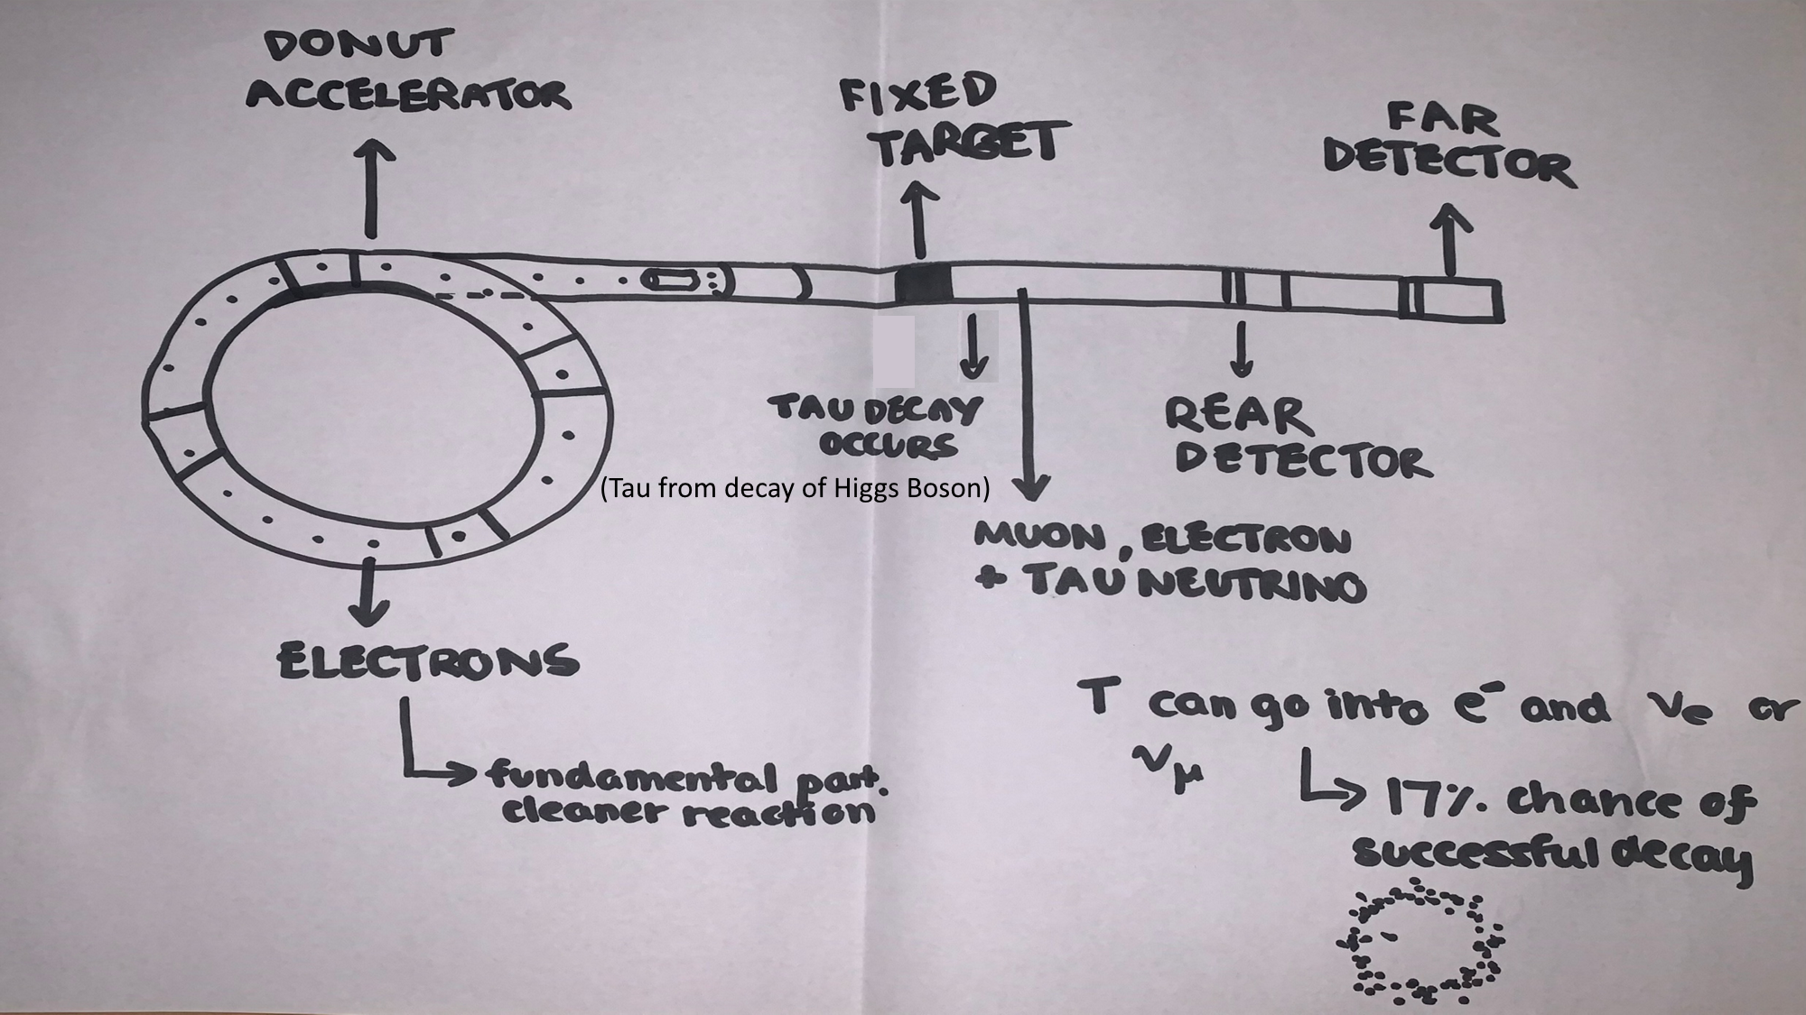

Slide 7
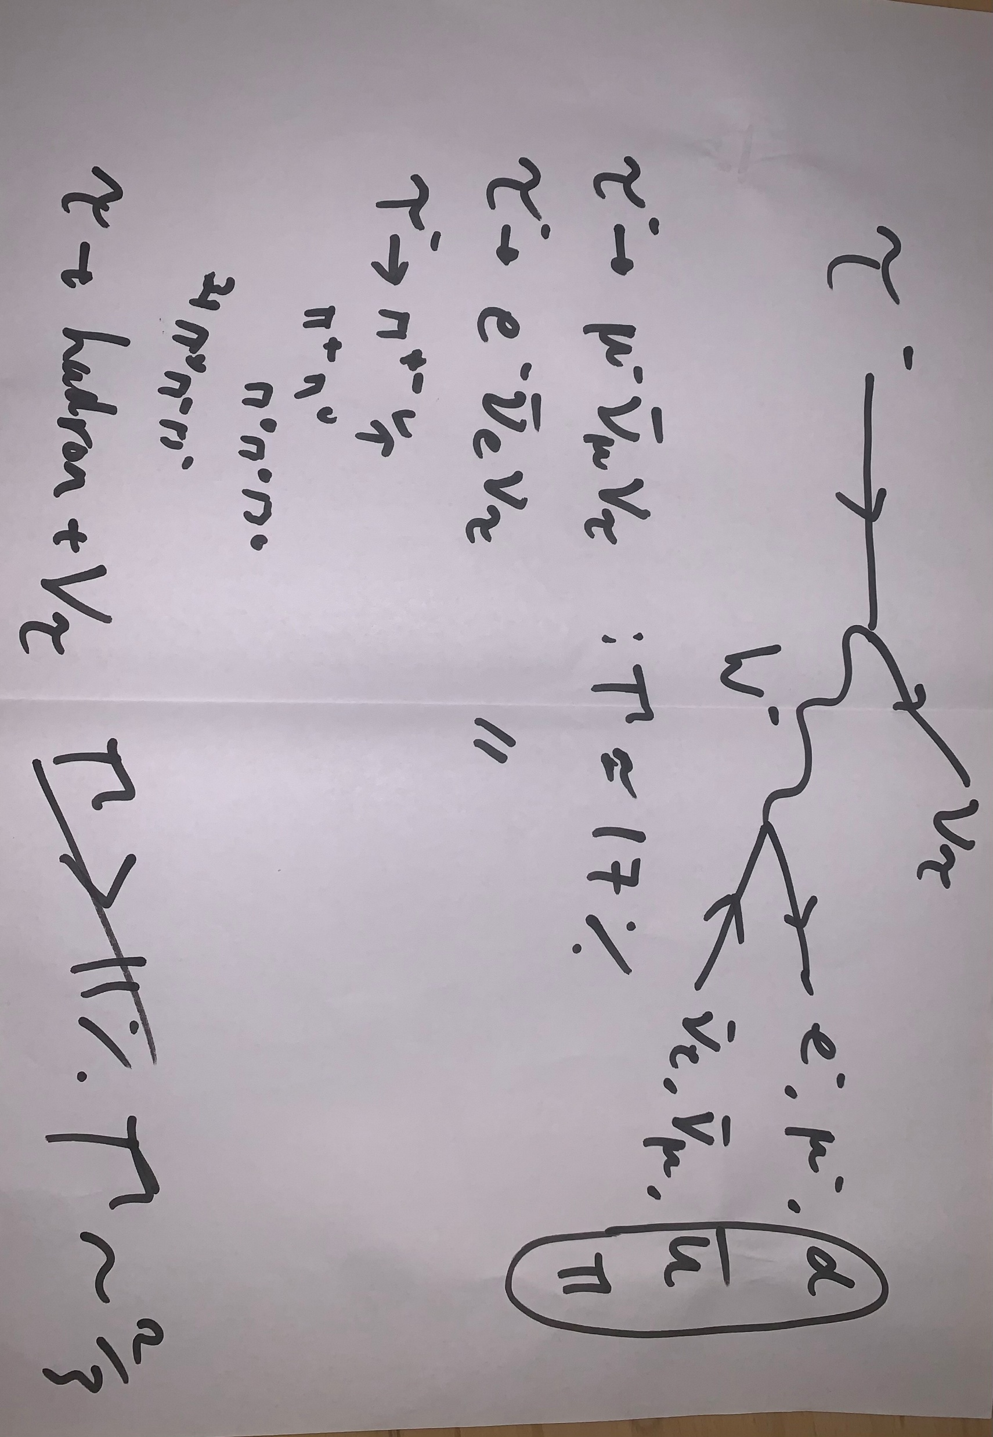
Notes:
Here you can see the tau decay processes by which we plan to source our neutrinos. You can also see their consequent probabilities of success, which as you can see are all above 17%. While these probabilities are high, taus have not previously been used in neutrino experiments due to their short-lived nature, being over 3000 times the mass of the electron, making them very short-lived.
You can also see our pion sources for the experiment, demonstrated in our feynmann diagram

Slide 8

Detecting the neutrinos
Detection Chain
Electron, muon and tau neutrinos produced but need to isolate these neutrinos
Magnetic fields to bend these charged particles into other absorbers/ detectors
As neutral and weakly interacting, neutrinos pass straight through
Cherenkov Radiation
Charged particles moving faster than light in a medium (using water in this case) emit Cherenkov light.
This light forms a ring on a surrounding detector:
Electrons → fuzzy diffuse ring
Muons → sharp, clear ring
Tau Detection
Taus are short-lived: decay occurs before reaching detectors
Commonly decay into pions which can be detected in RICH (Ring-Imaging Cherenkov) detectors, distinguished by Cherenkov angle.

Slide 9
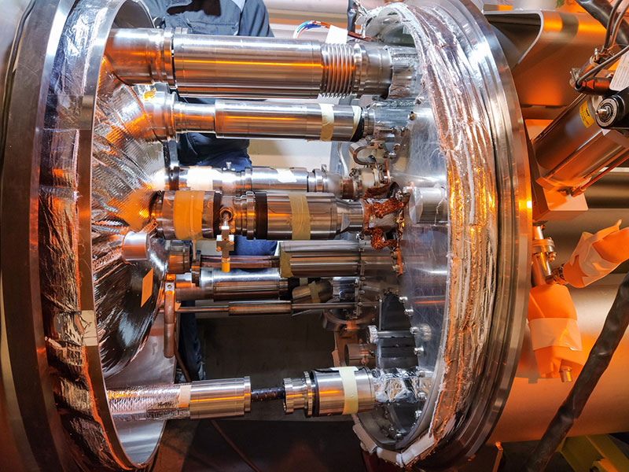
Materials proposed
Niobium-Titanium (Nb-Ti) for superconducting magnets
Graphite for target
Aluminium magnetic horns
Electrons
Sources
Notes:
Graphite withstands intense heat and radiation without degrading auickly
Horn focus charged secondary particles
Aluminium light weight, conducts electricity well, resists radiation damage
Superconducting magnets important for filtering other particles to make a clean beam of tau neutrinos

Slide 10

Other uses of Sterile Neutrinos
Sterile Neutrino Decay as a Radiation Source (speculative):
If sterile neutrinos decay into X-rays, this could be harnessed in therapeutic techniques (highly theoretical, if at all feasible).
Neutrino Detectors for Monitoring Nuclear Reactors:
If sterile neutrino oscillations exist, understanding them could improve neutrino-based nuclear monitoring for non-proliferation.

Slide 11
Q+A

