Slide 1
Searching for a muon EDM at the Fermilab Muon g-2 experiment
Liverpool HEP seminars, 21/10/25
Dominika Vasilkova
Slide 1

Slide 2

BSM physics: a lot of things we don’t know…
Despite the great success of the Standard Model (SM), many ongoing mysteries for Particle Physics!
What’s going on with dark matter?
Why do we have three generations in the SM, and why do they have the structure they do?
Why wasn’t there more antimatter in the early universe? Where’s the CP violation needed to cause that?
Is there any physics beyond the Standard Model (besides what we’ve already found) ?
+ much more!

Slide 3
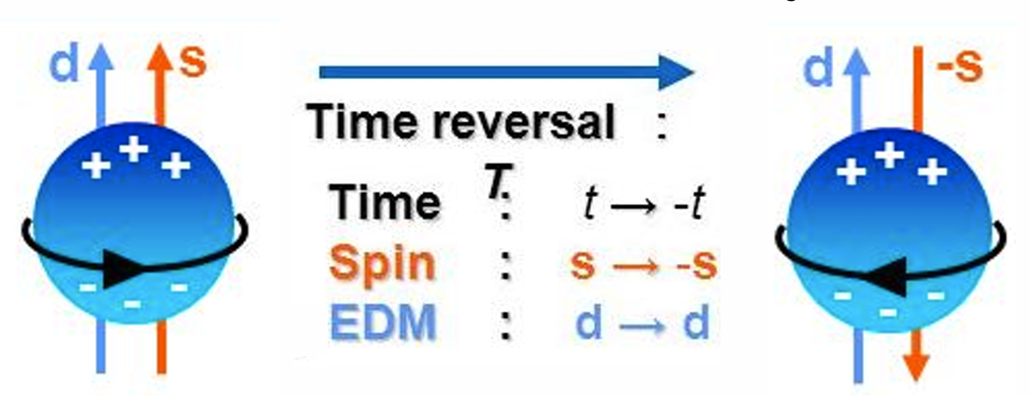
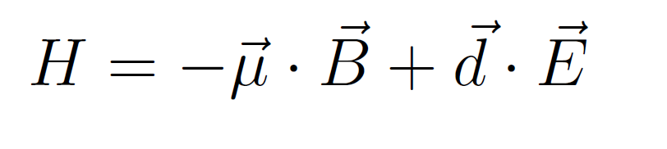
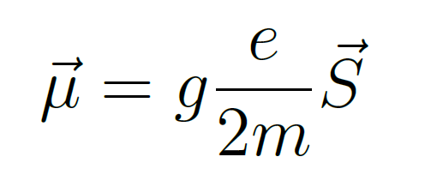
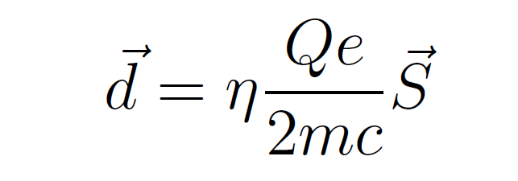

Enter the noble electric dipole moment!
Test the SM via precision measurements of the fundamental electric dipole moment (EDM) of particles.
EDM is a measure of the overall polarity of the system – charge asymmetry along the spin axis.
  “How spherical are fundamental particles?”
Analogously to magnetic dipole moment (MDM): permanent non-zero EDM + an external E field = torque force on particle.
  Leads to EDM-induced motion, which is generally how you look for it!
MDM:
EDM:
d$∙$E changes under T as E is polar – so the EDM interaction is CP-violating!

Slide 4
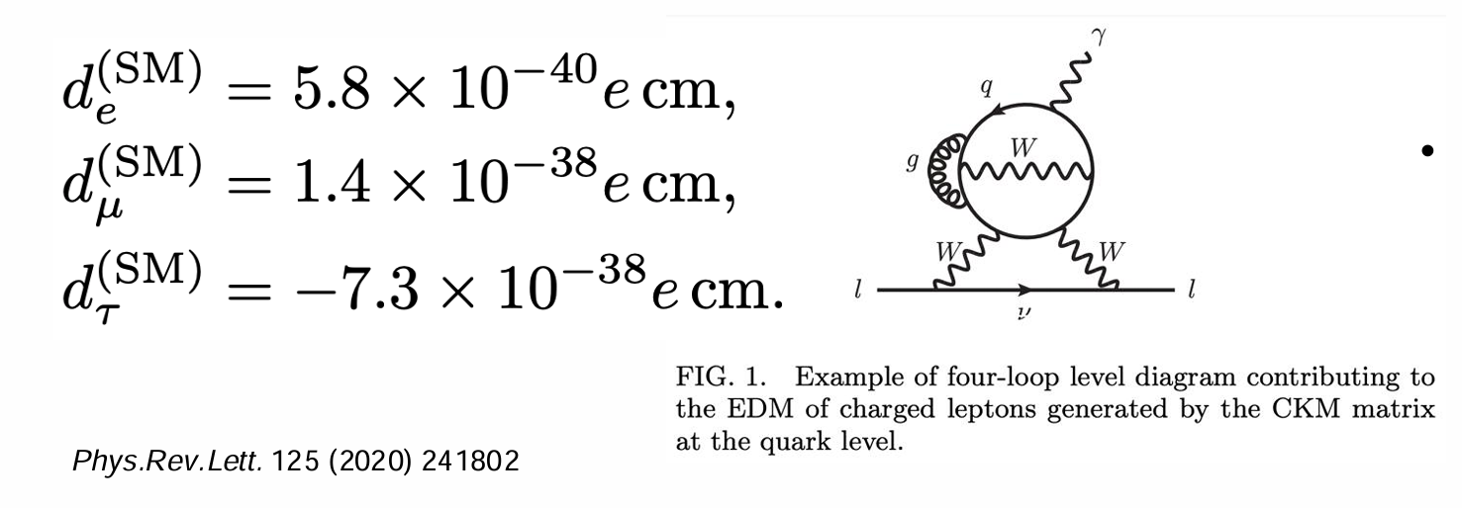

EDMs in the SM
EDMs do arise in the Standard Model, for both fundamental and composite particles:
Fundamental: leptons get nonzero terms from quark EDMs (complex phase in CKM matrix) , but first contributions come at the four loop level, so very tiny!!
Composite (neutron and proton) EDM arises from CKM CP phase via hadronic loops, also predicted to be very small, O(~${10}^{−31} e ∙cm$).

Slide 5
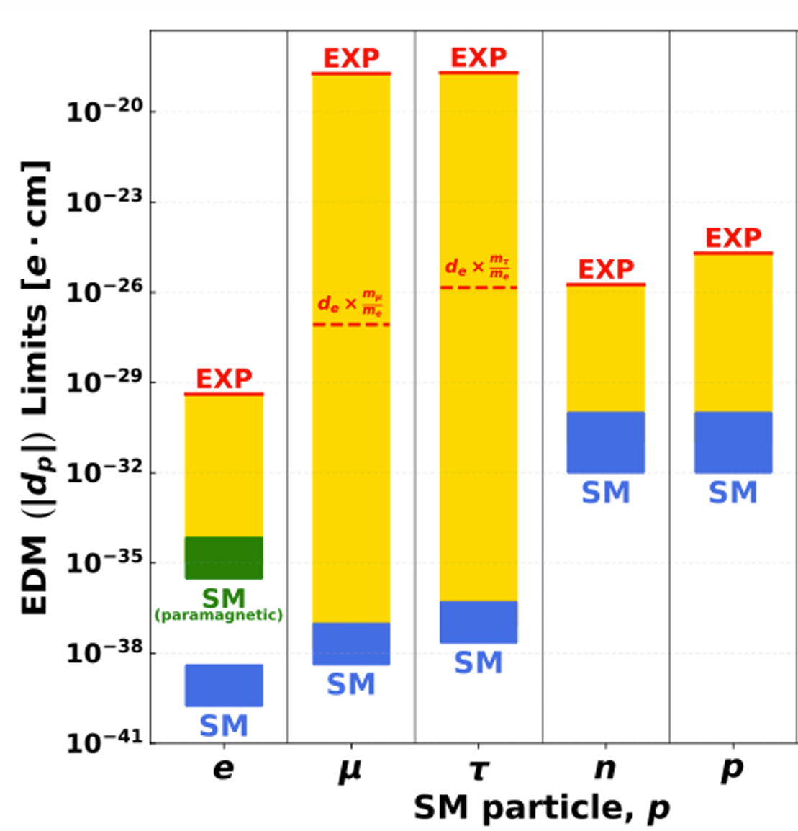
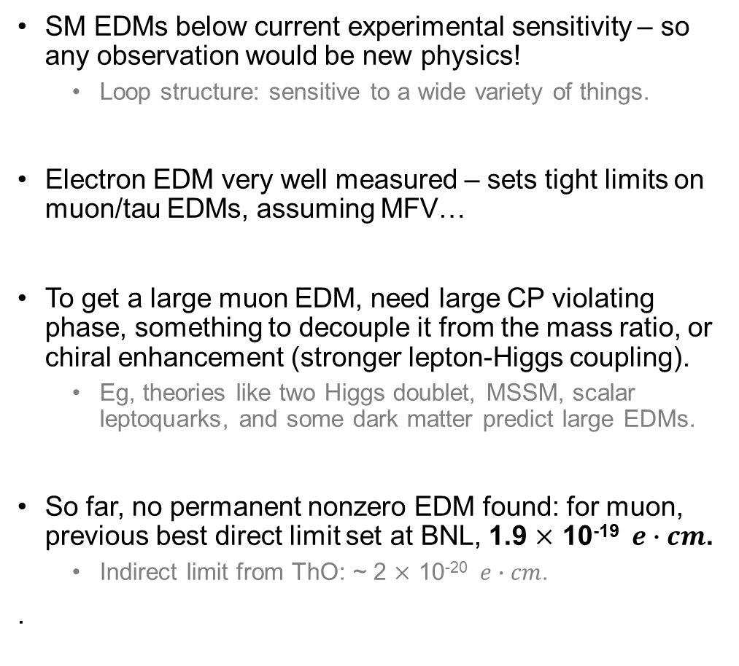
BSM searches for the muon EDM
SM EDMs below current experimental sensitivity – so any observation would be new physics!
  Loop structure: sensitive to a wide variety of things.
Electron EDM very well measured – sets tight limits on muon/tau EDMs, assuming MFV…
To get a large muon EDM, need large CP violating phase, something to decouple it from the mass ratio, or chiral enhancement (stronger lepton-Higgs coupling).
  Eg, theories like two Higgs doublet, MSSM, scalar leptoquarks, and some dark matter predict large EDMs.
So far, no permanent nonzero EDM found: for muon, previous best direct limit set at BNL, 1.9 $×$ 10⁻¹⁹ $e∙cm$.
  Indirect limit from ThO: ~ 2 $×$ 10⁻²⁰ $e∙cm$.
.

Slide 6
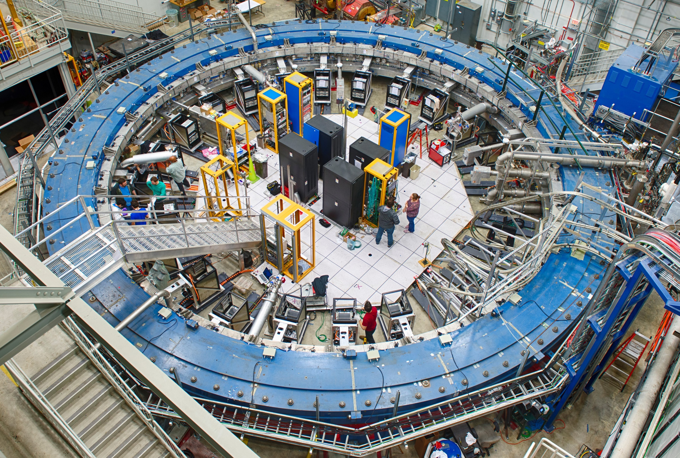
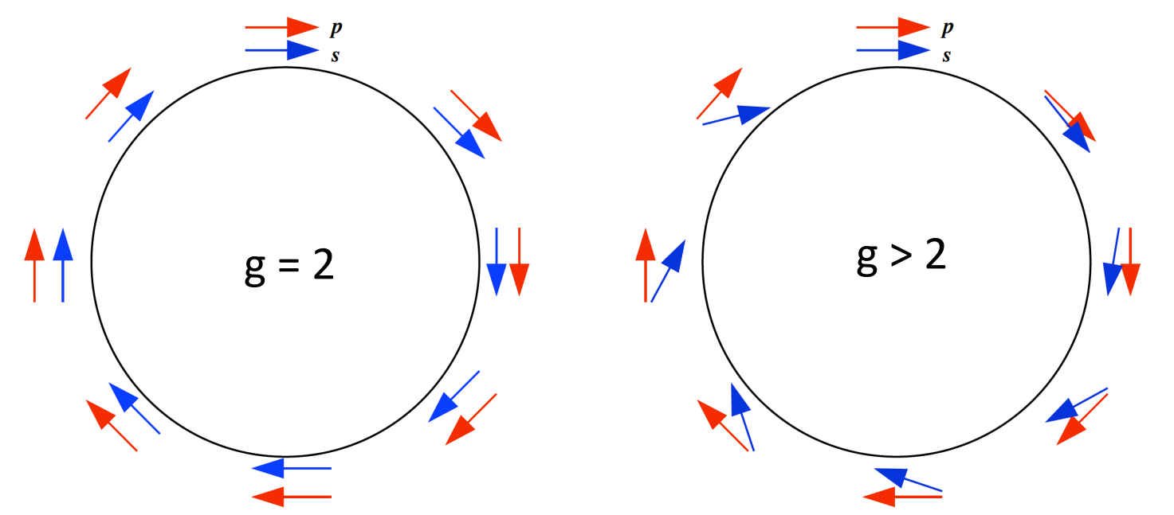


BNL’s successor – Muon g-2 at Fermilab!
µ+
Main goal was to measure the muon magnetic dipole moment (MDM) to 140 ppb (target surpassed with final result this summer!).
  But, can also use this setup to measure the muon EDM…
Beam of polarized muons in a storage ring, 1.45 T vertical B field.
Two oscillations: cyclotron frequency and spin precession from MDM . Measure the difference:
$$\frac{ⅇB}{m_{µ}}$$
$$ω_{a}=ω_{s}−ω_{P}≅ a_{µ}$$

Slide 7
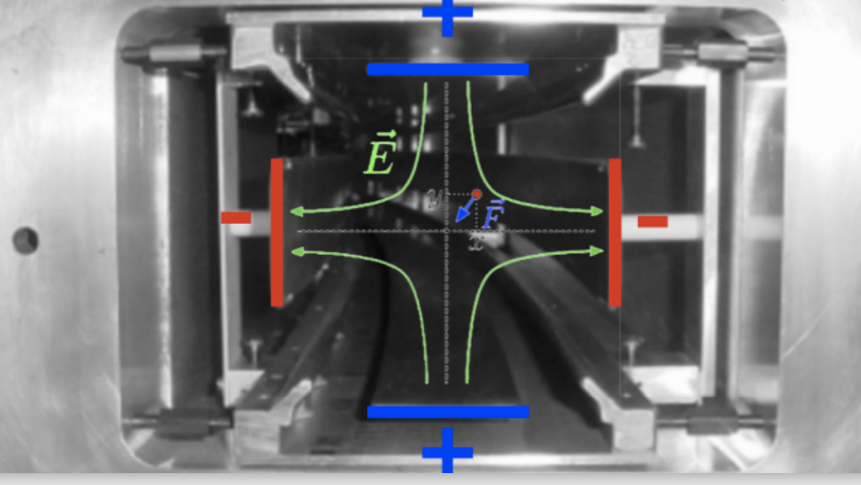
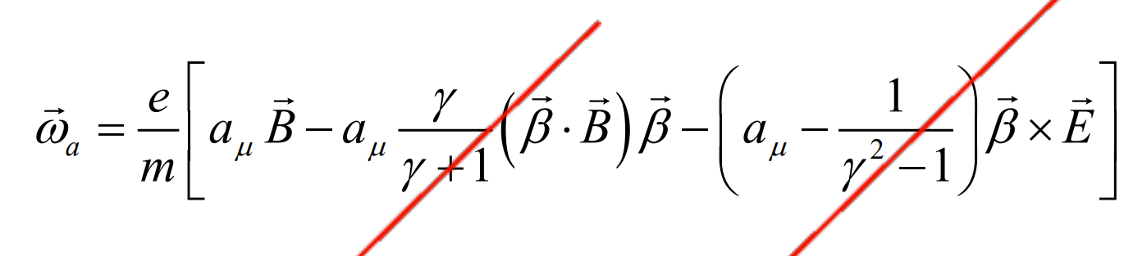
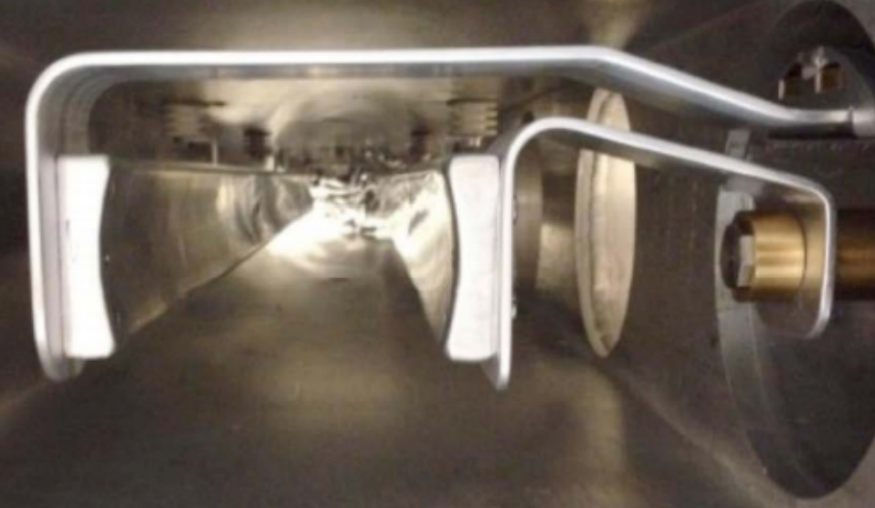
Muon storage
Magnet: provides radial focusing + field for g-2.
Inflector: Prevents large beam deflections on entry.
  Located at entrance to ring, cancels local B field.
Kicker: Pushes incoming beam onto equilibrium orbit.
Electrostatic quadrupoles: vertical focusing.
Inflector
Kicker
Quads
0 when in a flat plane
0 at the ‘magic momentum’ = 3.094 GeV

Slide 8
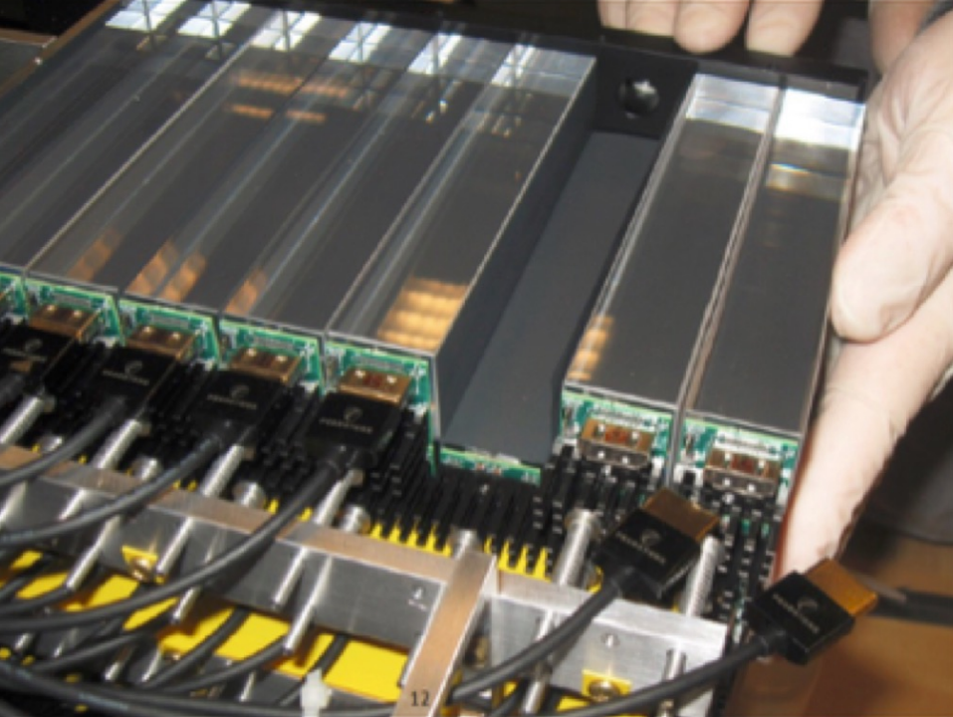
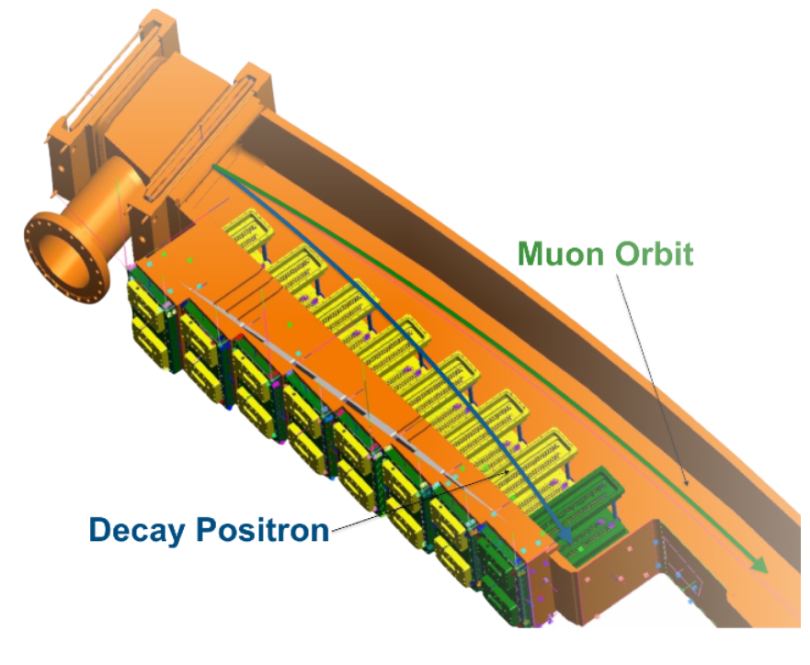
Main detector systems
Two main detector systems: calorimeters and trackers.
24 PbF₂ calorimeters around inside of ring:
  54 crystals read by SiPMs.
  Calibrated using laser system.
2 straw tracker stations (“12” and “18”):
  8 modules per station, 4 x 32 straws Ar:C₂H_{6.}
  Hits grouped and fitted into tracks, which are extrapolated to decay.
  Crucial for beam dynamics + muon distribution understanding.
Trackers
Calorimeters

Slide 9
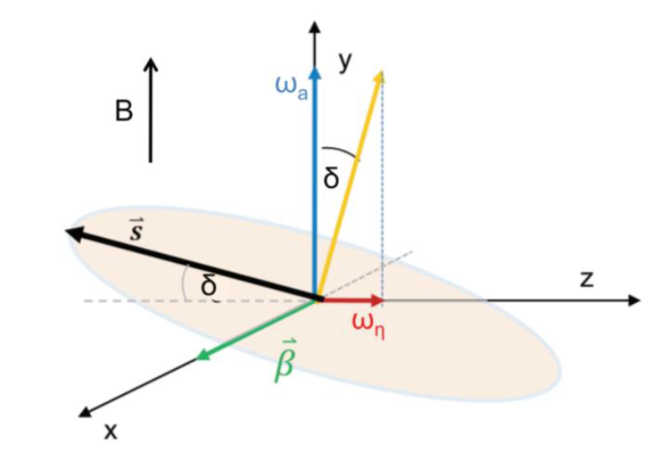
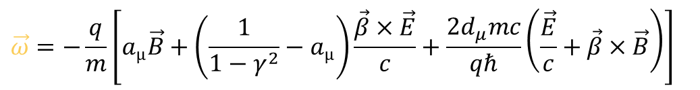



Measuring the muon EDM
A non-zero EDM introduces an extra term into the oscillation of the muons:
  (due to Lorentz transformation of B field)
Two key effects:
A (very) small increase in the precession frequency.
A second ‘tilt’ precession, π/2 out of phase with g-2 and perpendicular to it.
  Vertical angle max when spin/momentum are perpendicular.
$$\vec{ω}=−\frac{q}{m}\left[a_{µ}\vec{B}+\left(\frac{1}{1−γ^{2}}−a_{µ}\right)\frac{\vec{β}×\vec{E}}{c}+\frac{2d_{μ}mc}{qℏ}\left(\frac{\vec{E}}{c}+\vec{β}×\vec{B}\right)\right]$$
g-2 precession $\vec{ω}$_{a}
EDM precession $\vec{ω}$_{η}
$$δ=\tan^{−1}{\frac{ω_{η}}{ω_{a}}} ≈\frac{ω_{η}}{ω_{a}}= \frac{βη}{2a_{µ}}$$

Slide 10
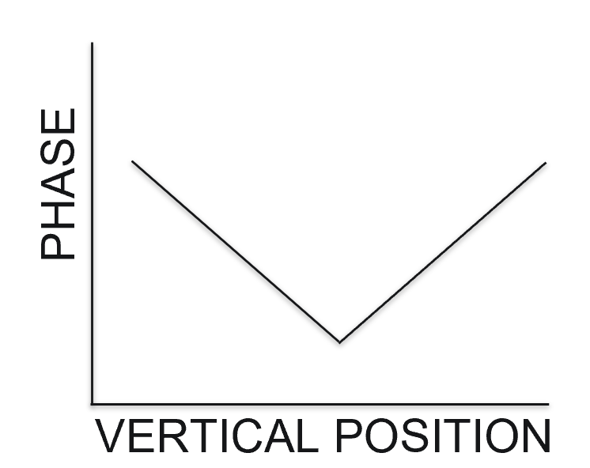
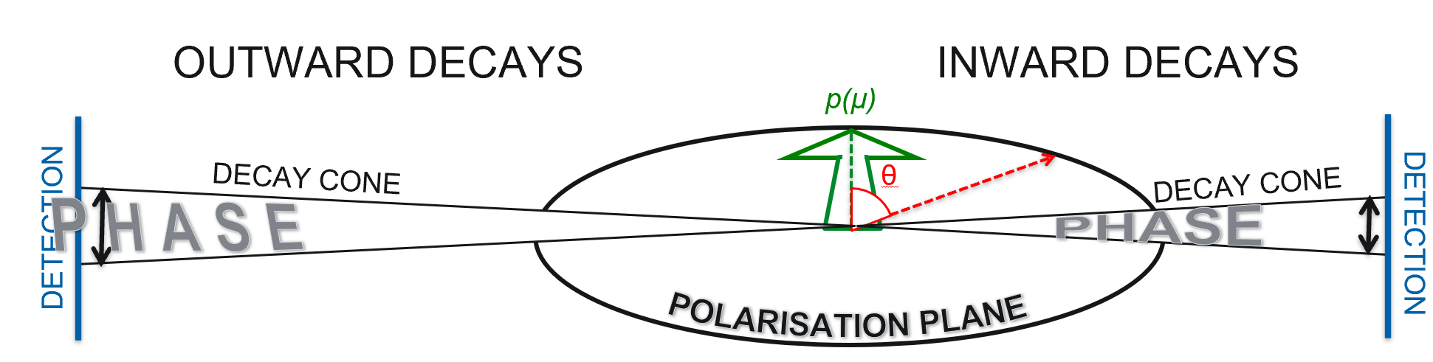
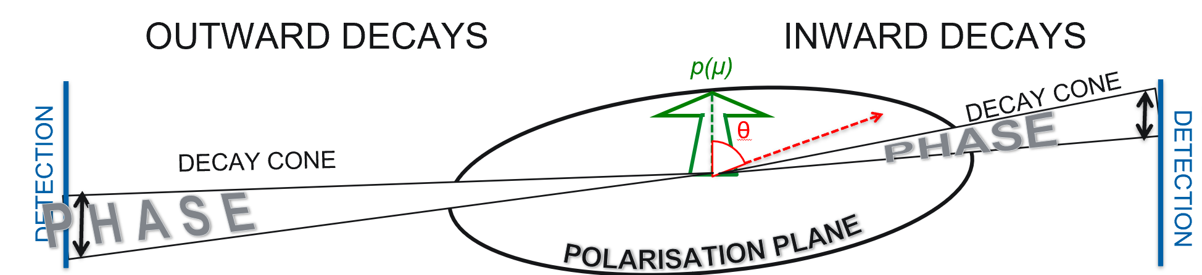
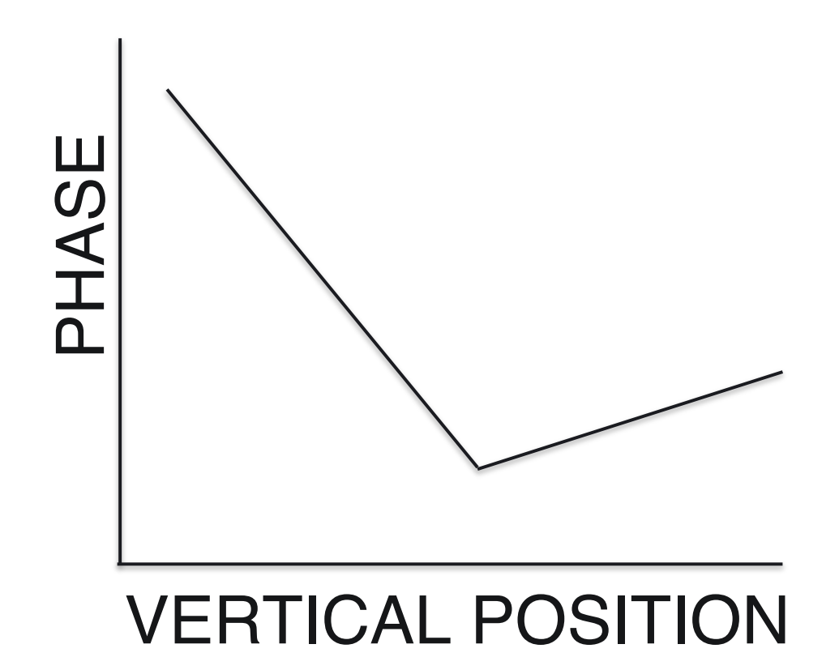
EDM signals at Fermilab g-2
Phase difference: using calorimeters to look for a vertical asymmetry between ingoing and outgoing positrons.
  Systematically limited at BNL/FNAL: mainly by calorimeter alignment.
No EDM:
With EDM:

Slide 11
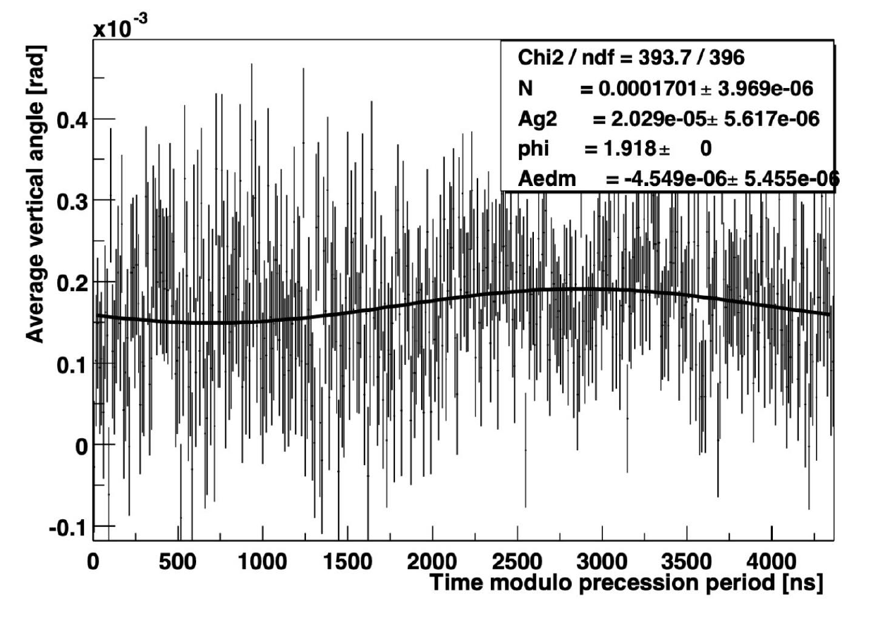
EDM signals at Fermilab g-2
Direct vertical angle oscillation measurement:
Plot average vertical angle as a function of time, look for an oscillation at the g-2 frequency but out of phase with it.
Can hypothetically do this with both calorimeters and trackers:
  Calorimeters have much higher statistics, but despite vertical segmentation, not good position measurement.
  Trackers have lower stats (due to there only being two) but a hit resolution of ~ 100µm – so with enough muons, this becomes the better method!
FNAL collected > 21x BNL – so tracker method wins!
BNL 2000 data

Slide 12
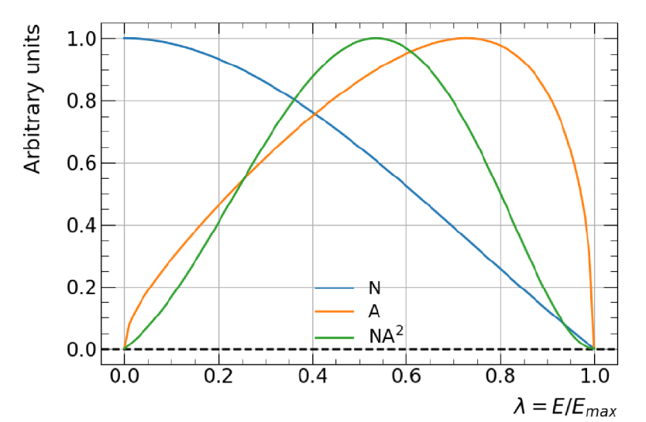
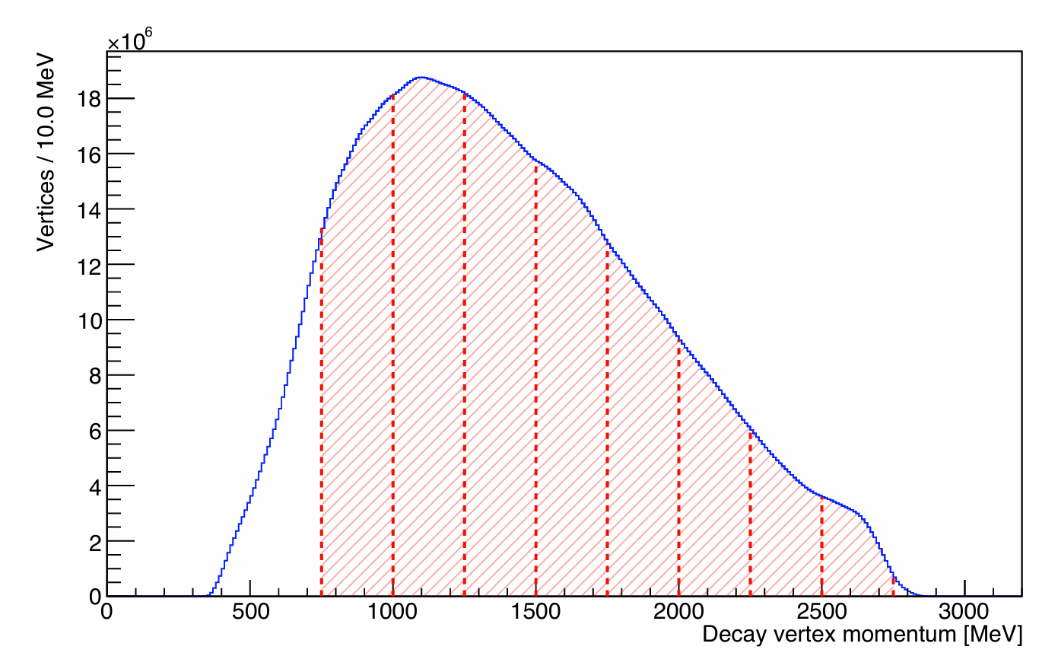
Analysis cuts and setup
The EDM signal depends on momentum, combined with the number distributions, have greatest sensitivity in the mid-momentum ranges.
  So perform a momentum-binned analysis!
  Momentum range chosen is 750-2750 MeV, 8 bins of width 250 MeV.
Unstable beam at very early times, so analysis start is 6 g-2 periods after the start of a ‘fill’ (when muons are injected into the ring).

Slide 13
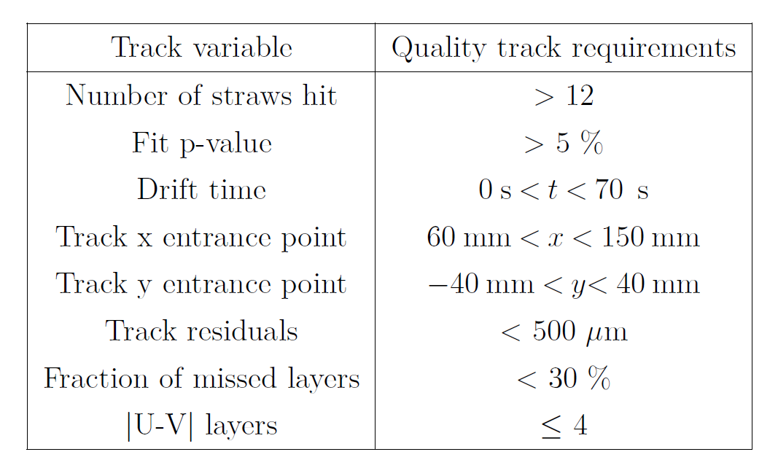
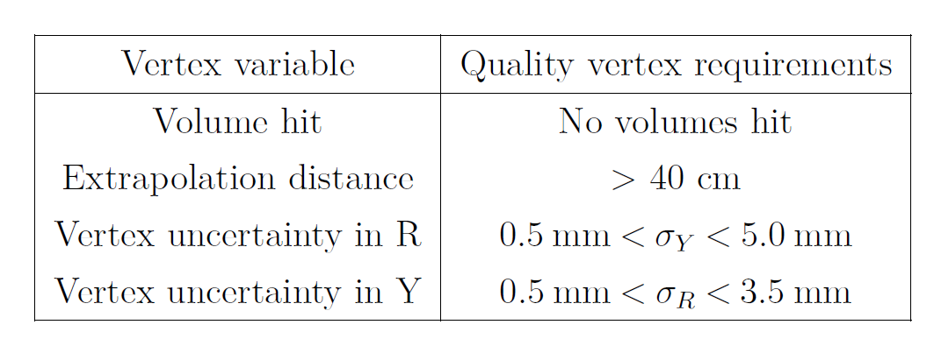
Analysis cuts and setup
Vertex/tracker quality cuts: to ensure high accuracy in extrapolation, remove a subset of tracks and vertices:
Analysis split per station, and per dataset: Run 2, Run 3a and Run 3b (for Run 2/3 analysis).
  Run 1 data found to have large variations due to damaged quad resistors, so not used for the analysis.
  Later data (Run 4/5/6) will also eventually be analysed for the final result.
11
40%
Values changed slightly for the EDM analysis to maximise stats!

Slide 14
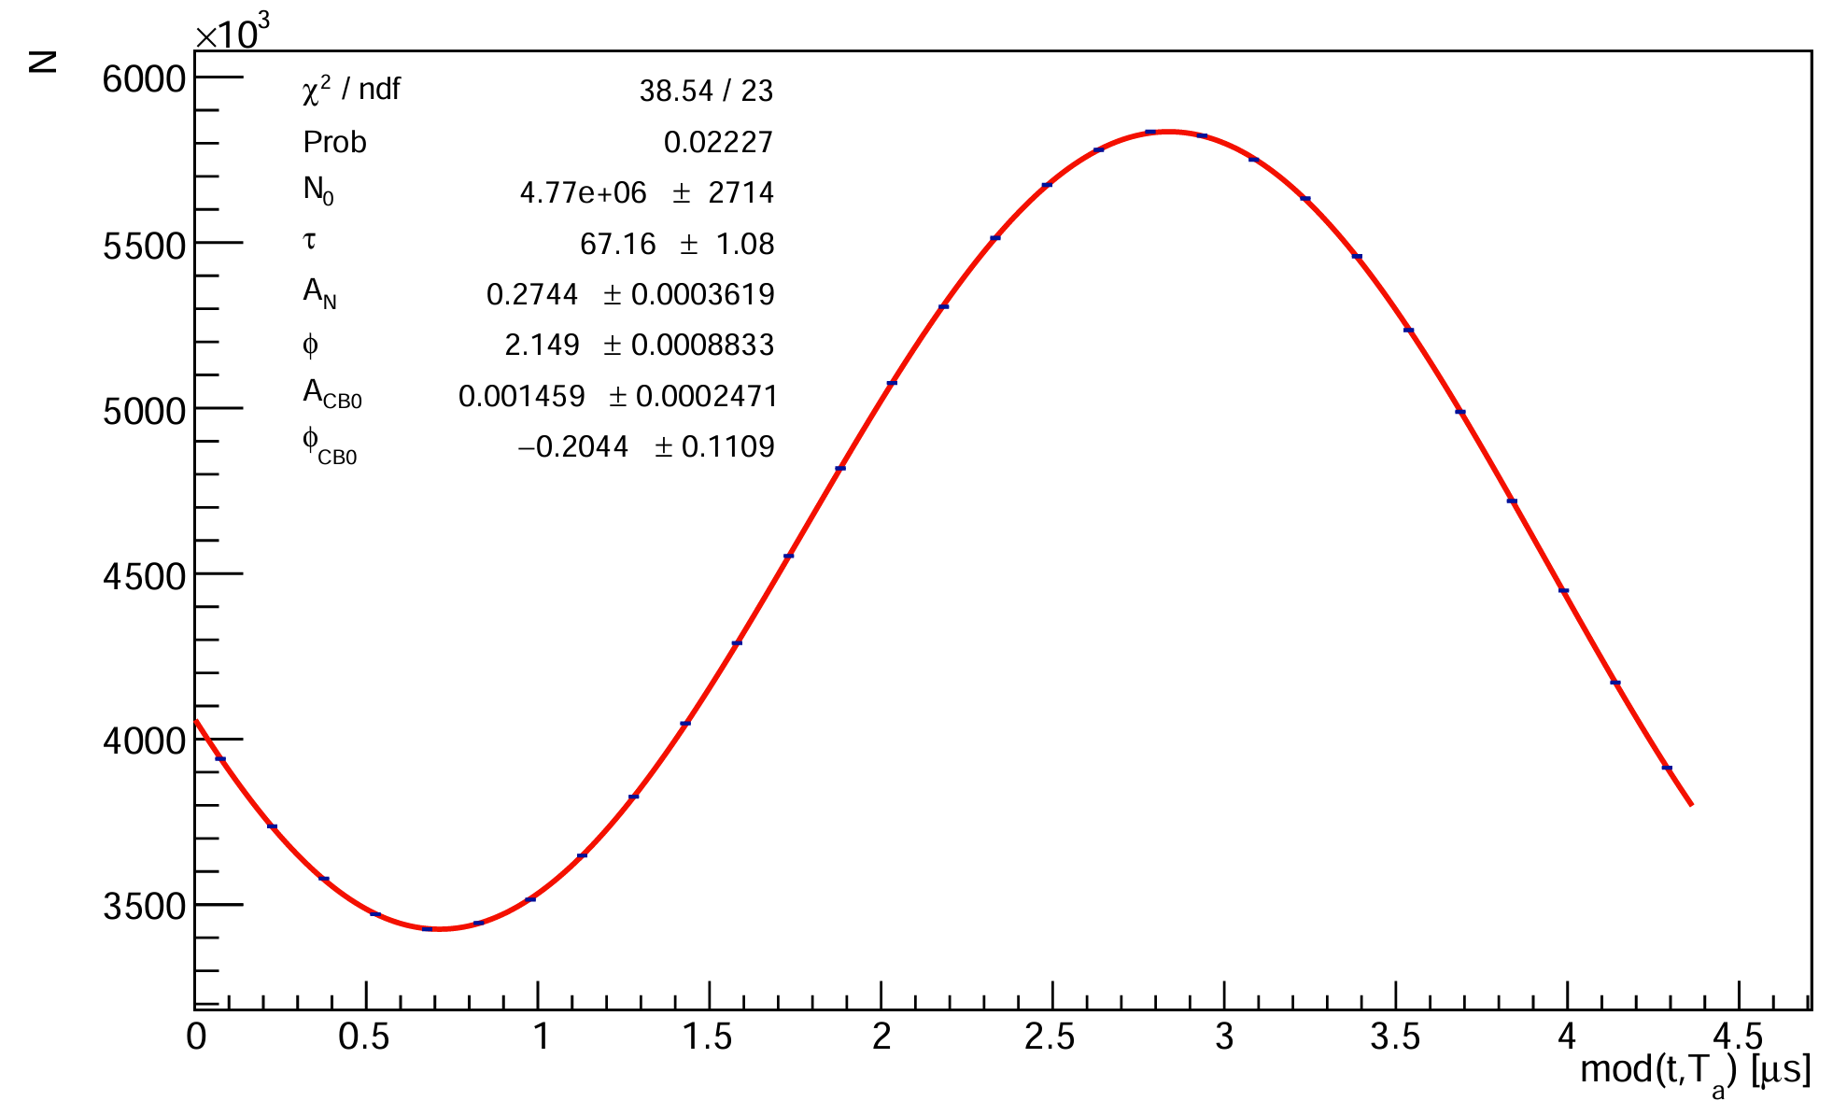
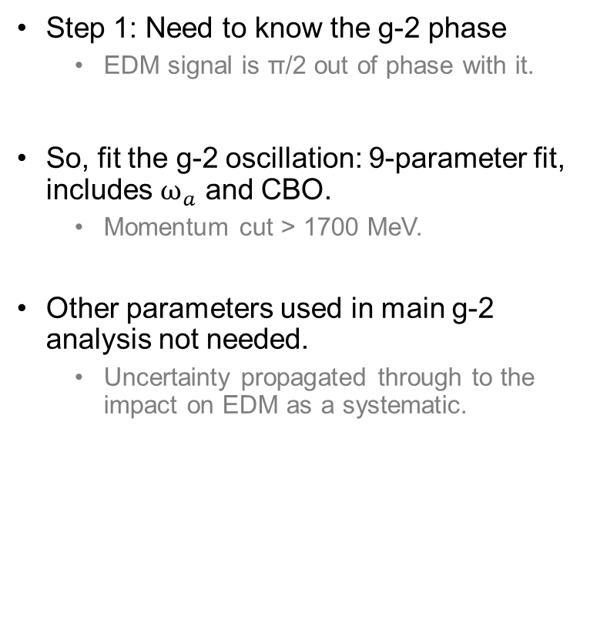
Extracting the EDM signal
Step 1: Need to know the g-2 phase
  EDM signal is π/2 out of phase with it.
So, fit the g-2 oscillation: 9-parameter fit, includes $ω_{a}$ and CBO.
  Momentum cut > 1700 MeV.
Other parameters used in main g-2 analysis not needed.
  Uncertainty propagated through to the impact on EDM as a systematic.
PRELIMINARY
g-2 wiggle
CBO terms

Slide 15
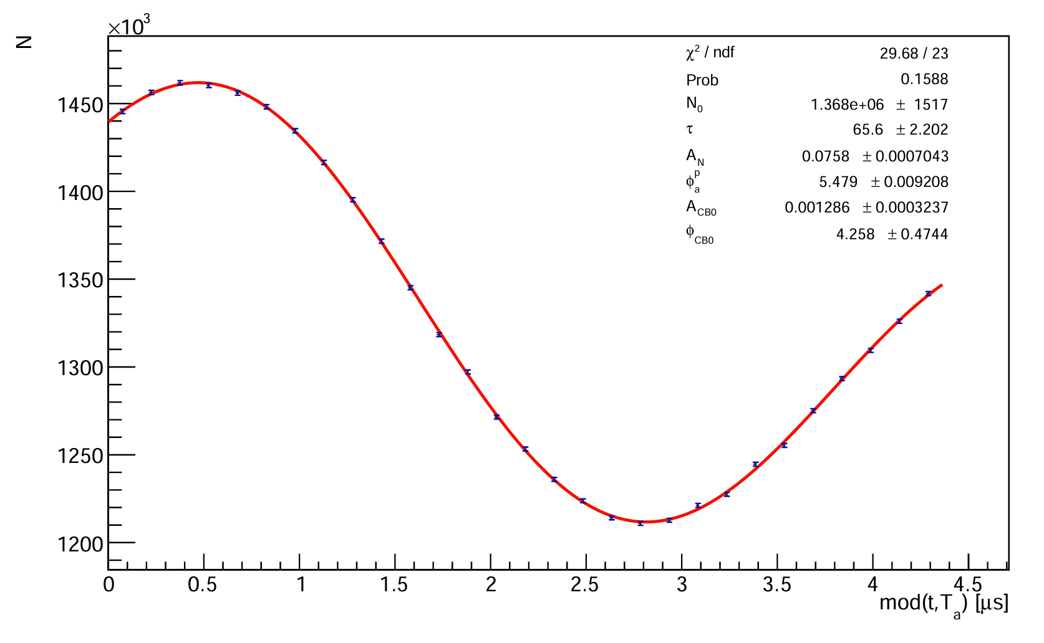
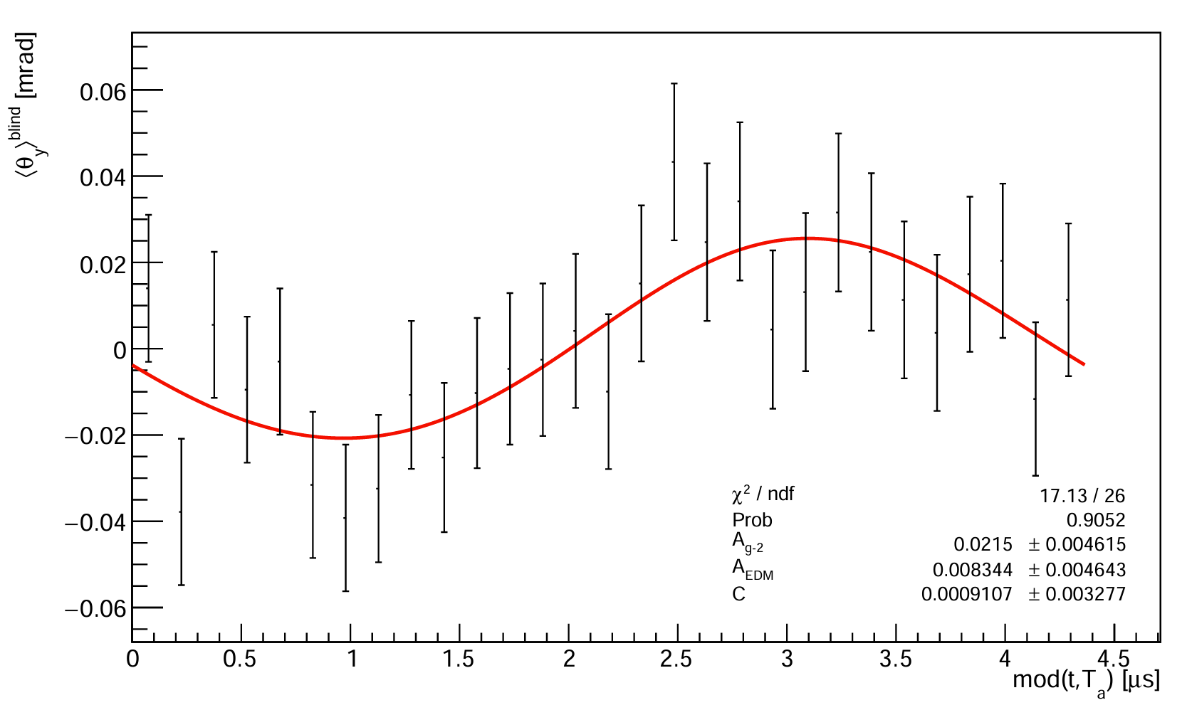
Extracting the EDM signal
Then, fit the average vertical angle oscillation using the g-2 phase.
  Denominator from momentum binned N(t) fit.
  EDM is the out-of-phase amplitude.
750-1000 MeV, Run 3b, s18
PRELIMINARY
PRELIMINARY
Phase from > 1700 MeV N(t) fit
EDM amplitude
Momentum-binned N(t) fit parameters

Slide 16
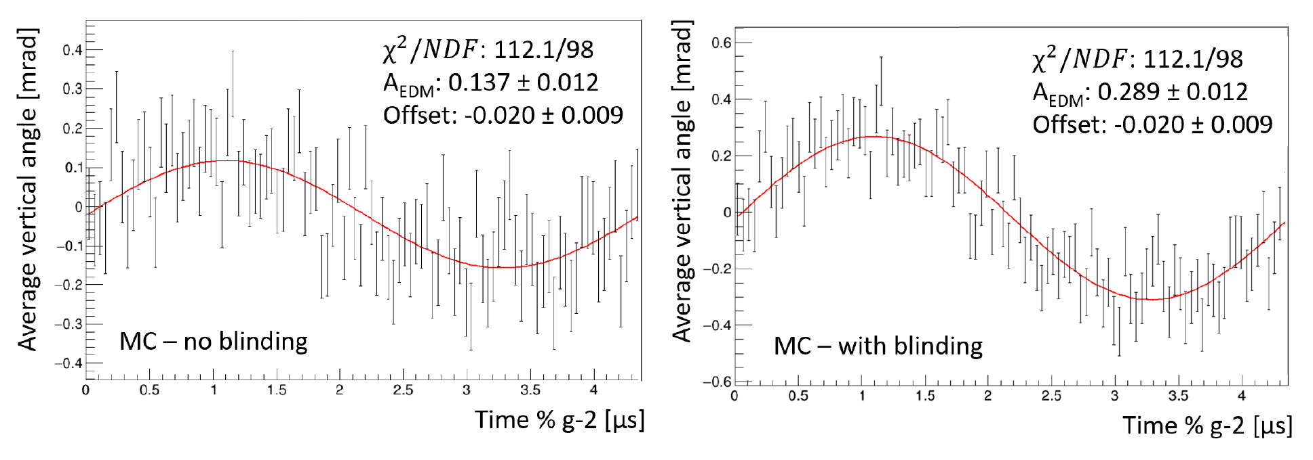
Blinding the EDM
Need to blind the vertical angle oscillation to prevent bias in the analysis.
Achieve this by injecting a very large fake signal in each momentum bin.
  Amplitude sampled randomly from a gaussian distribution, chosen to be >> BNL limit.
  Includes momentum dependence of A_{EDM} + reductions in measurable tilt (more on this later).
Unblinding happens in stages: e.g. relative unblinding of datasets to check consistency before final unblinding.

Slide 17
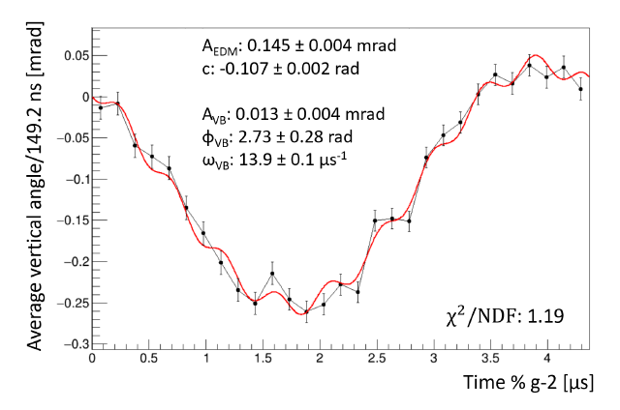
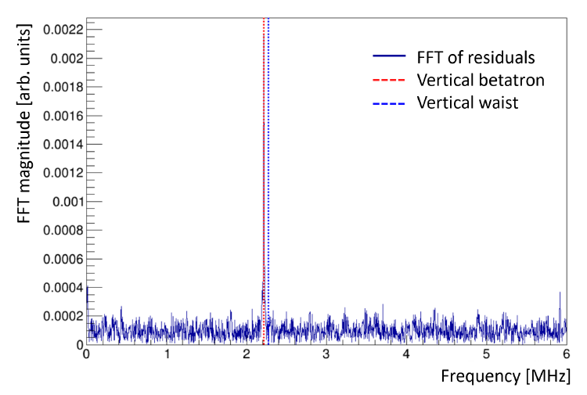
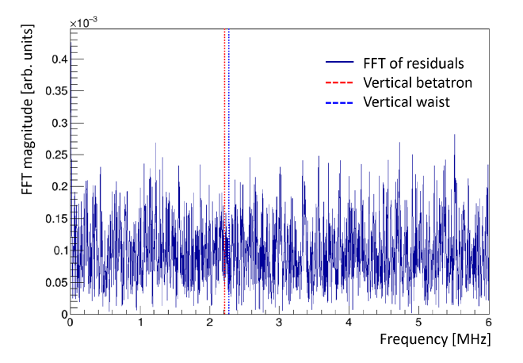
Accounting for beam oscillations
Largest effect comes from vertical betatron motions – data is time-randomized to remove this.
  FFTs used to confirm removal/lack of other oscillations.

Slide 18
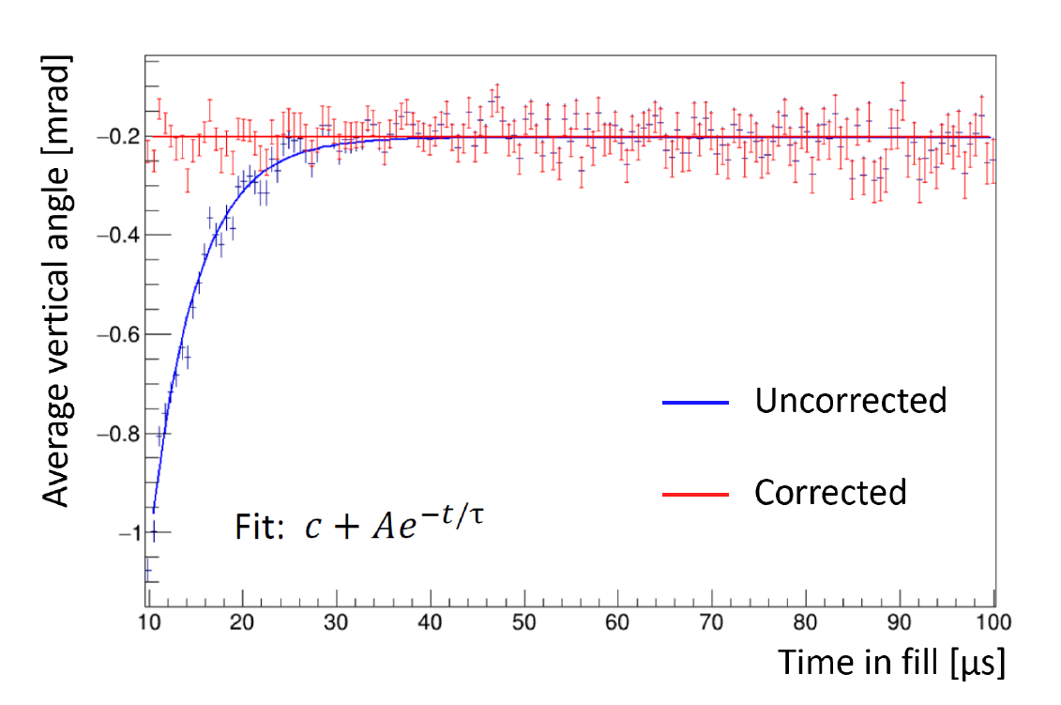
Accounting for beam oscillations
Early-time rise seen in the average vertical angle – from a combination of ‘tracker pileup’ (space-charge effect) and quadrupole charging time.
Previously limited the start time cut of the analysis – fitting and correcting allows a shift to 6 g-2 periods for more stats.

Slide 19

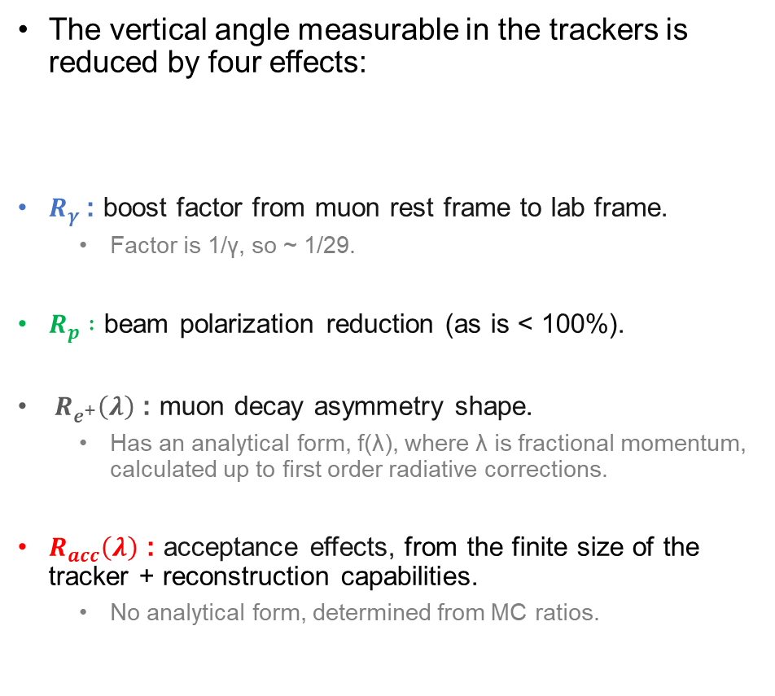


Reductions to the measured vertical angle
The vertical angle measurable in the trackers is reduced by four effects:
$R_{γ}$: boost factor from muon rest frame to lab frame.
  Factor is 1/γ, so ~ 1/29.
$R_{p} :$ beam polarization reduction (as is < 100%).
${ R}_{e^{+}}\left(λ\right)$: muon decay asymmetry shape.
  Has an analytical form, f(λ), where λ is fractional momentum, calculated up to first order radiative corrections.
$R_{acc}\left(λ\right)$ : acceptance effects, from the finite size of the tracker + reconstruction capabilities.
  No analytical form, determined from MC ratios.
(Tilts not to scale)
‘True’ maximum tilt
Measured tilt$= R_{γ}{ R_{p} R}_{e^{+}}\left(λ\right) R_{acc}\left(λ\right)$ True tilt
EDM amplitude
‘Measured’ tilt
All positrons ($R_{e^{+}}\left(λ\right)$)
Detected positrons ($R_{acc}\left(λ\right)$)
Momentum

Slide 20
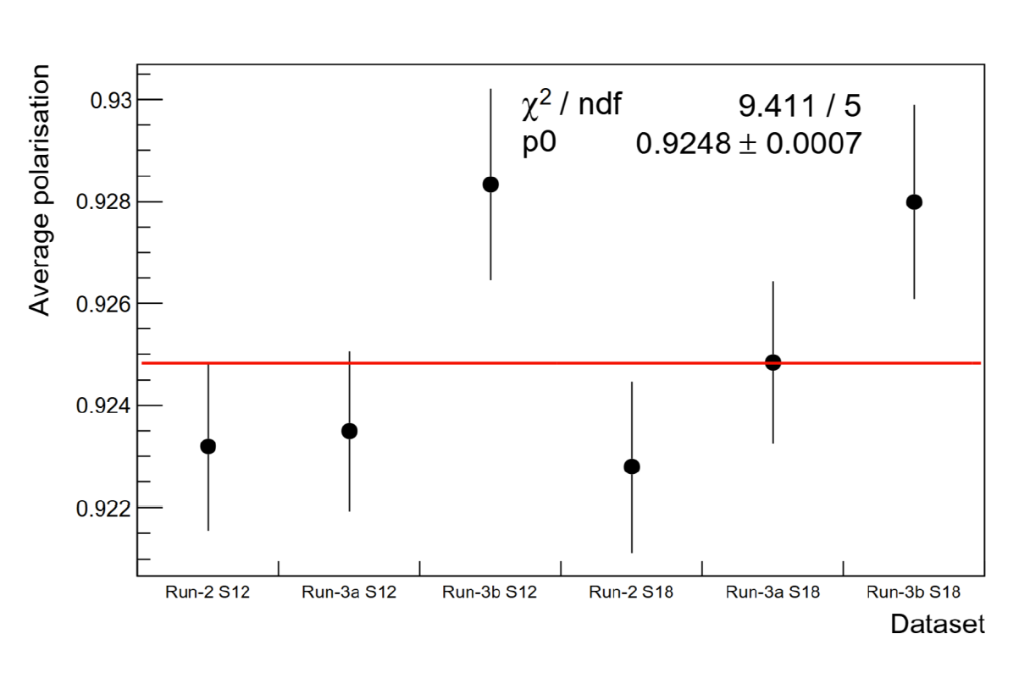
Beam polarization R_{p}
In ideal case, beam would be 100% polarized - in practice is a bit less.
  Reduces spin alignment, so impacts EDM sensitivity.
  Need to quantify the percentage – then correction becomes %/100 + uncertainty.
g-2 decay asymmetry also depends on the polarization – sets the amplitude of the wiggle.
So, we can use this to determine the reduction from this effect + compare to previous measurements.
Gives a correction factor of 0.94 ± 0.03.

Slide 21
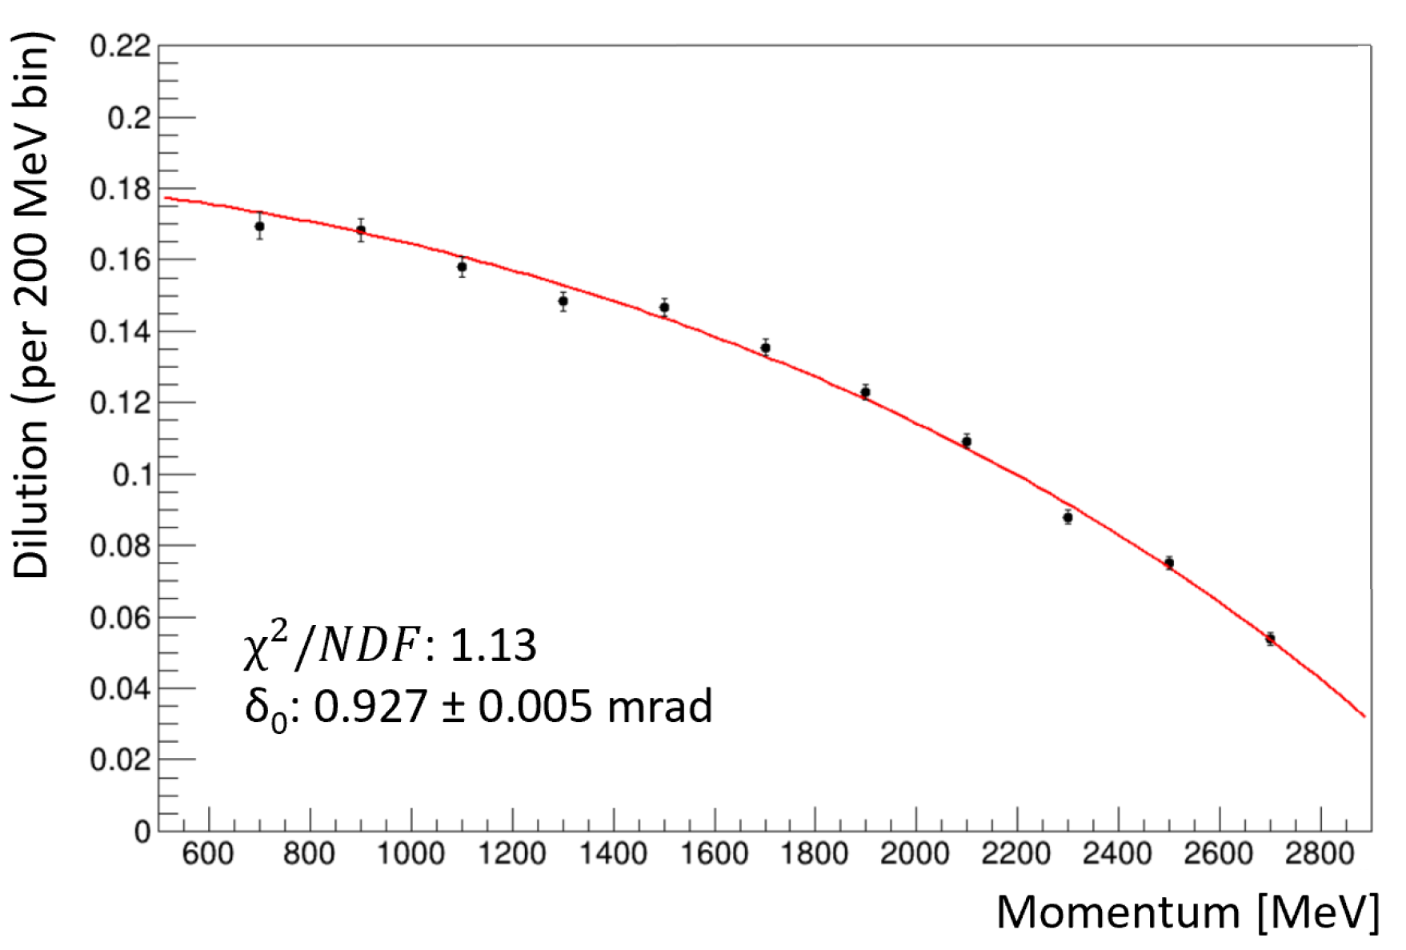
Decay asymmetry R_{e+}(λ)
Not all positrons are emitted exactly along the spin: Michel decay distribution.
Can calculate the shape of this analytically to first order, but need higher order effects for accuracy.
  So use MC to get the shape – generate decays to check final distribution.
Is momentum dependent – so each bin of the analysis needs its own correction.
R_{e+}(λ)

Slide 22
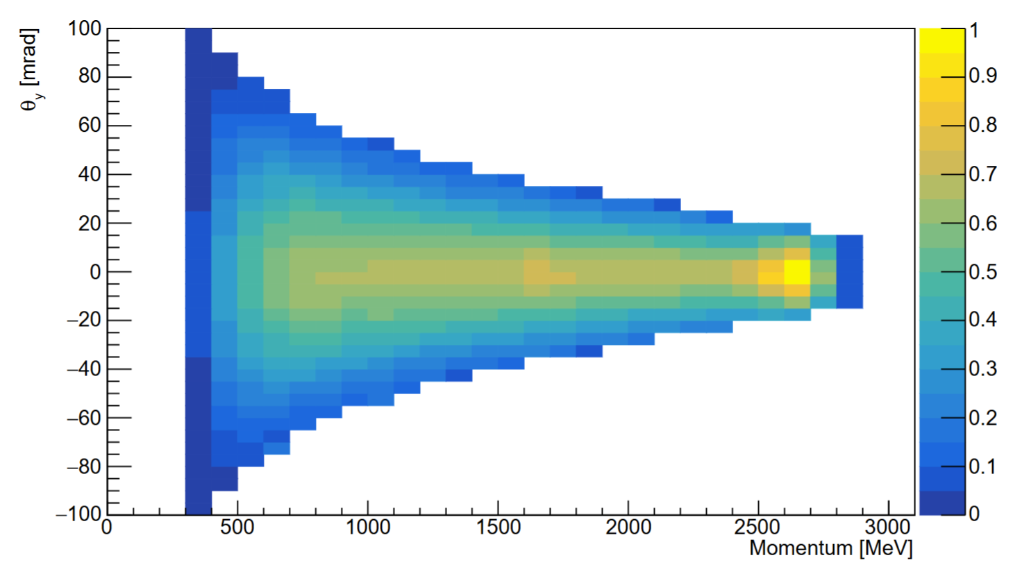
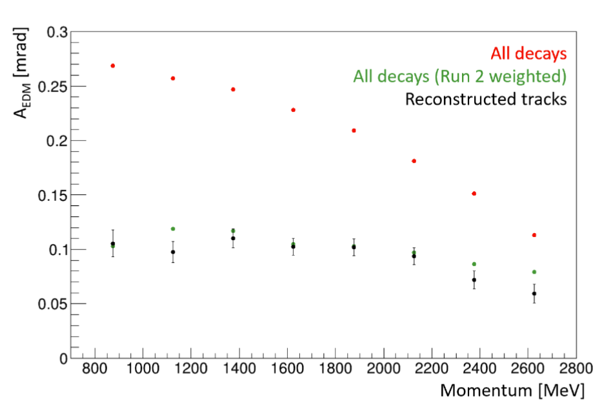
Tracker acceptance R_{acc}(λ)
Not every decay hits the trackers + not all hits can be reconstructed.
Momentum-dependent – no analytical way to do this, so get this from MC with geometry.
Run two MC samples with a large injected EDM (30x the BNL limit):
  ‘All decays’: this keeps every single decay, irrespective of tracker reconstruction.
  ‘Track reco’: this only keeps the things that the tracker actually extrapolates to the vertex.
Calculate the fitted EDM amplitudes of both: the ratio of the two gives the correction.

Slide 23
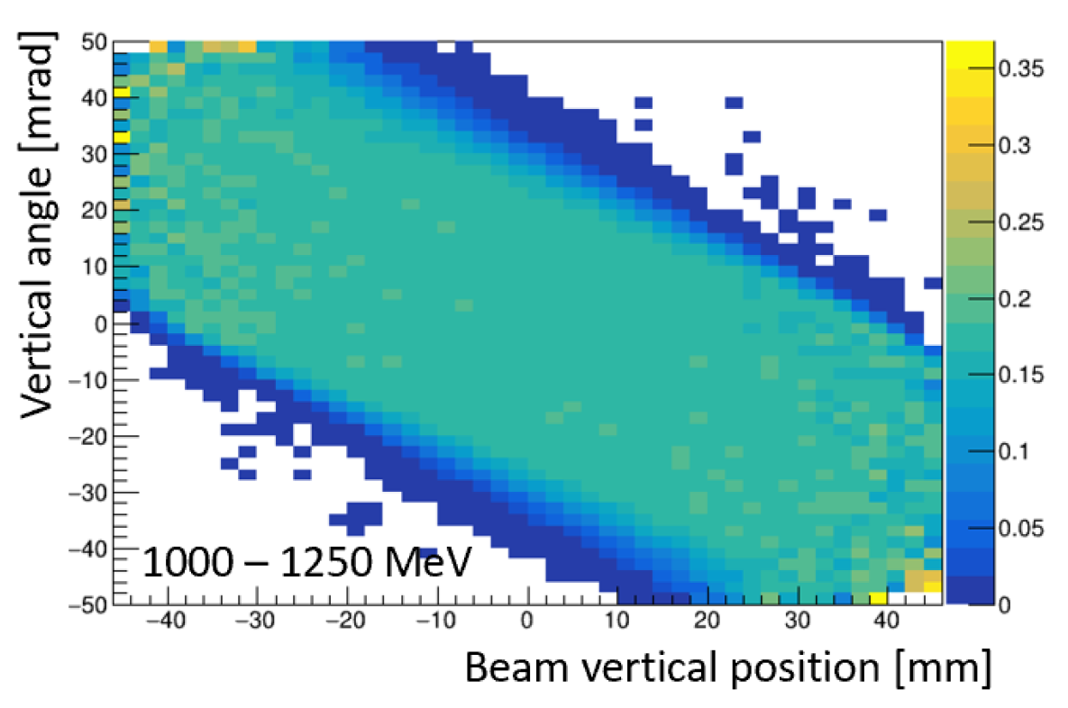
Tracker acceptance R_{acc}(λ)
But.. raw ratio limited by stats of tracker MC – which loses a lot of decays!
  Leads to very large (dominant) uncertainties from this correction.
Solution: what would it look like if we had trackers all the way around the ring?
Use acceptance maps – 2D ratio of vertical decay angle/vertical decay position for the two MCs
  One map per momentum bin, station, dataset
  Apply map to the higher stats all decays MC + renormalize the map to let more decays through, while maintaining shape.
  Improves the uncertainties by a factor of 3.
  Extra correction ‘scaling’ needed to account for beam MC/data MC differences.

Slide 24
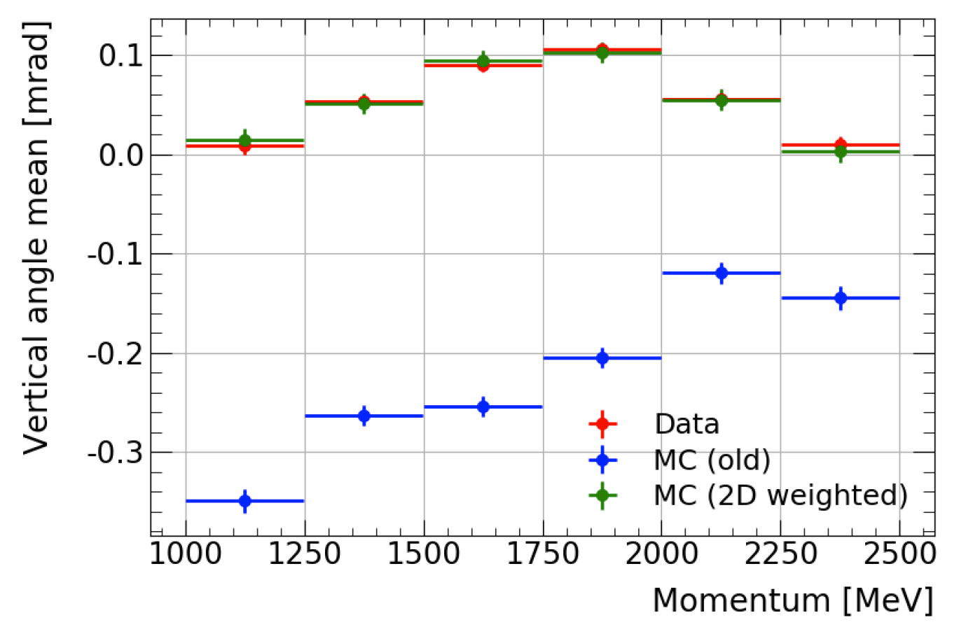
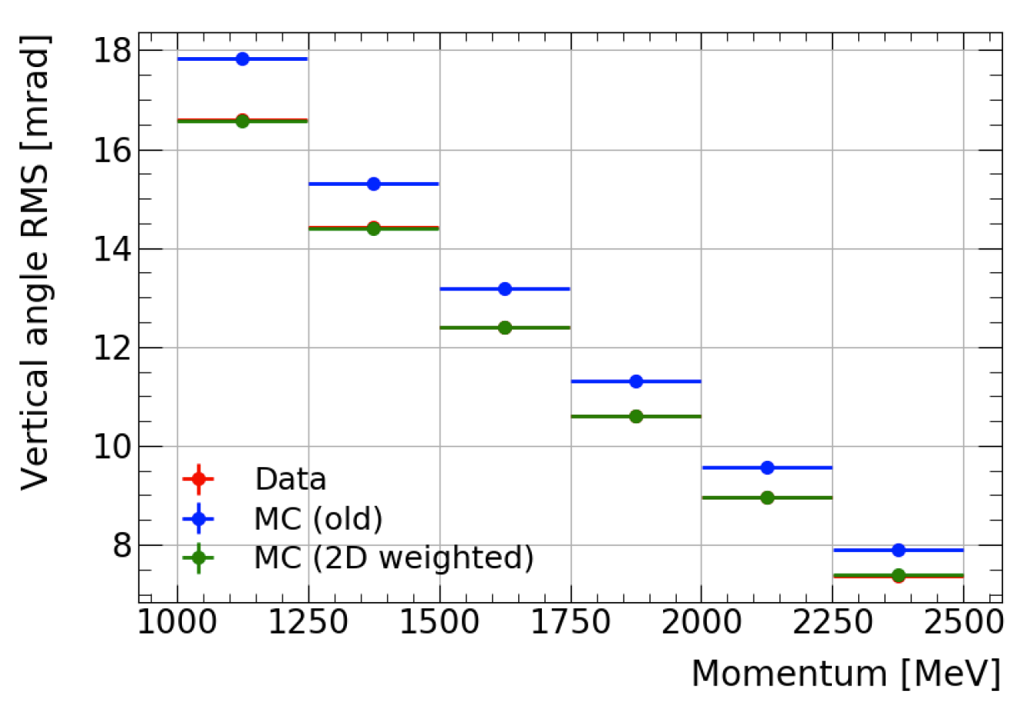
Data/MC matching
Distributions in data and MC do not match perfectly, so a weighting is applied based on individual run period datasets to ensure the acceptance corrections are accurate.
  Is a 2D weighting of vertical angle and detected beam vertical position, applied in the analysis momentum bins and interpolated for each decay’s exact momentum.
All residual difference treated as a systematic uncertainty: small compared to the statistical uncertainty (<1%).
PRELIMINARY
PRELIMINARY

Slide 25
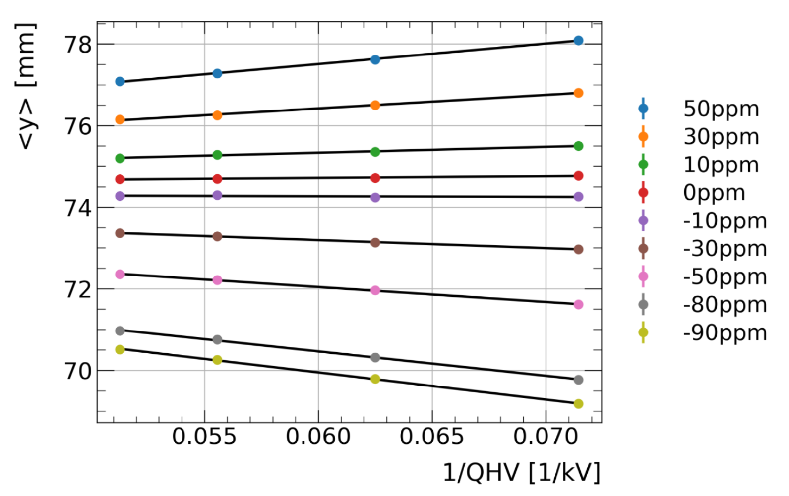
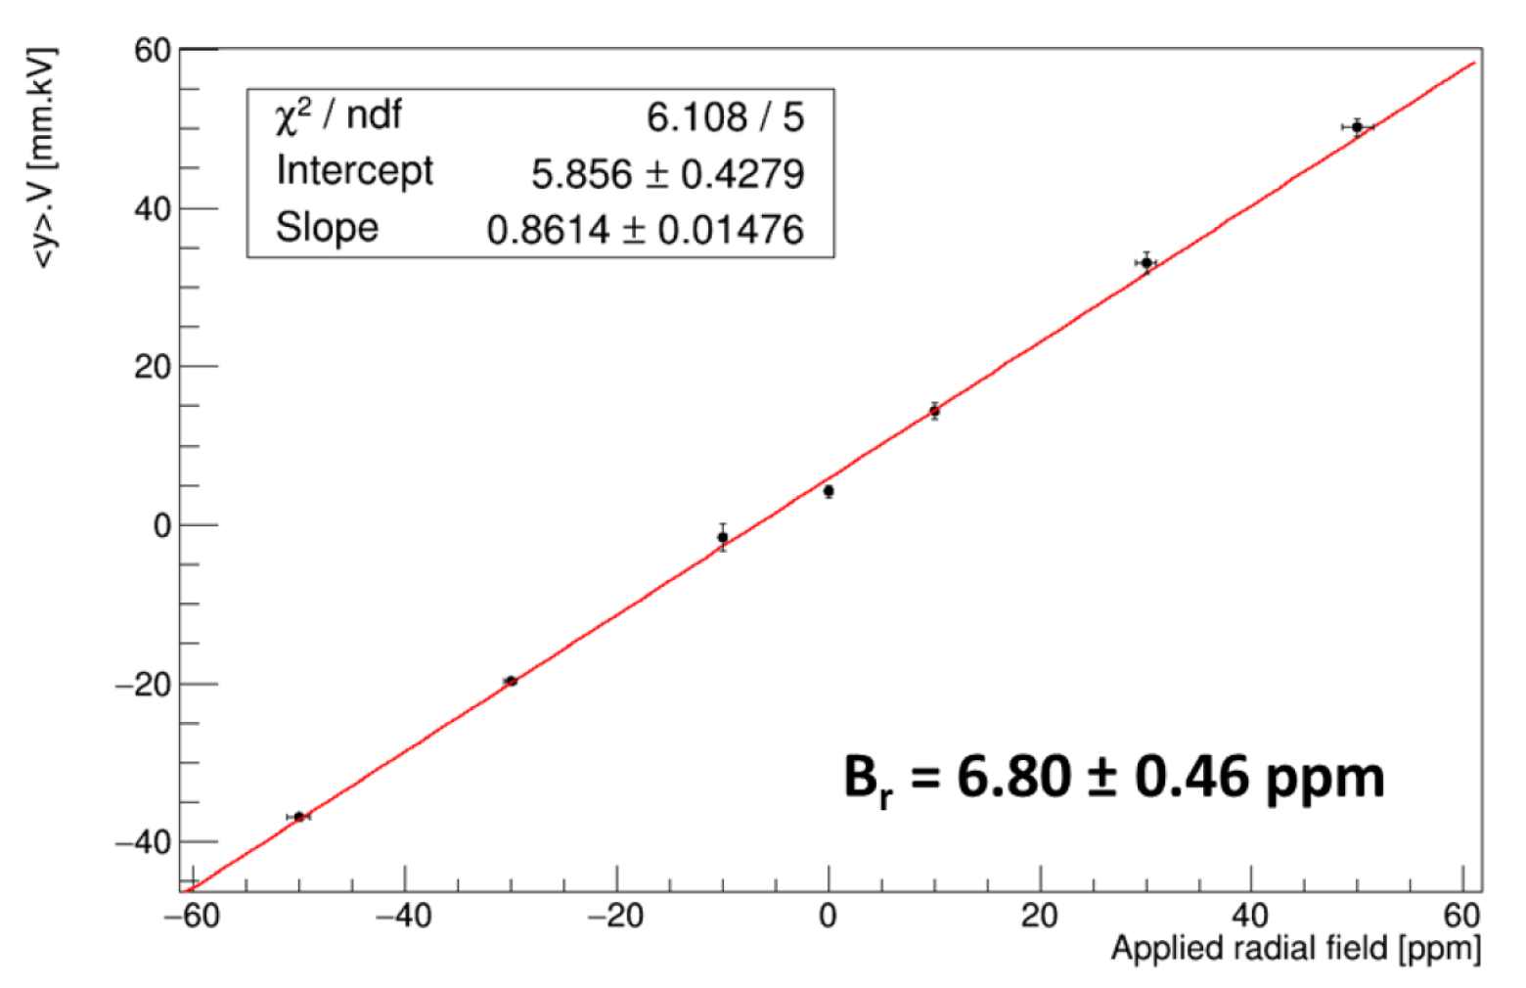
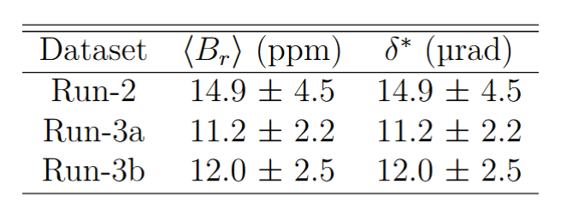
Potential sources of fake EDM – Radial field
Given the EDM signal is a tilted precession plane/vertical asymmetry, important to properly understand how large any ‘fake EDM’s could be.
A radial B field component in the ring would also cause a tilt of the precession plane.
  Suppressed by a factor of γ in the muon rest frame.
Perform radial field scans to measure, extrapolate to all data using the beam Y position.
  Means we can use the average for each dataset, and subtract the tilt off like a background.

Slide 26
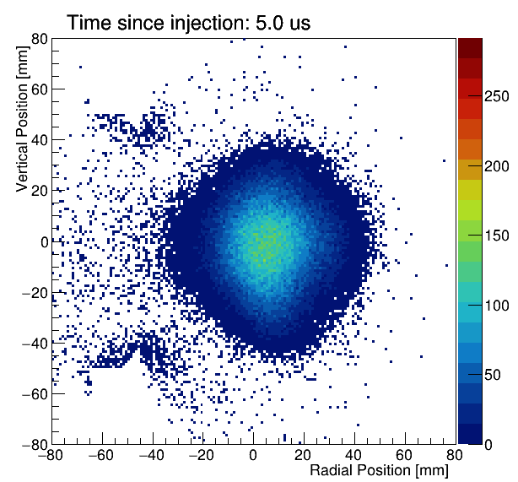
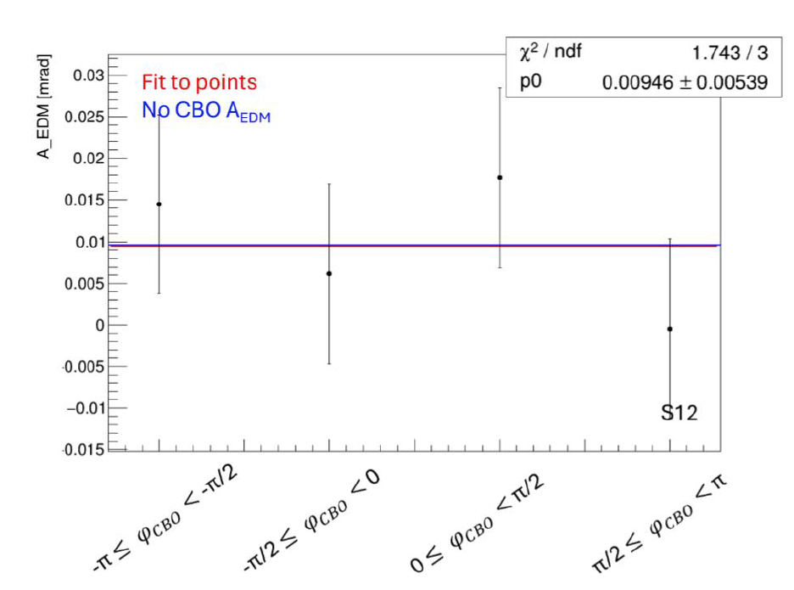
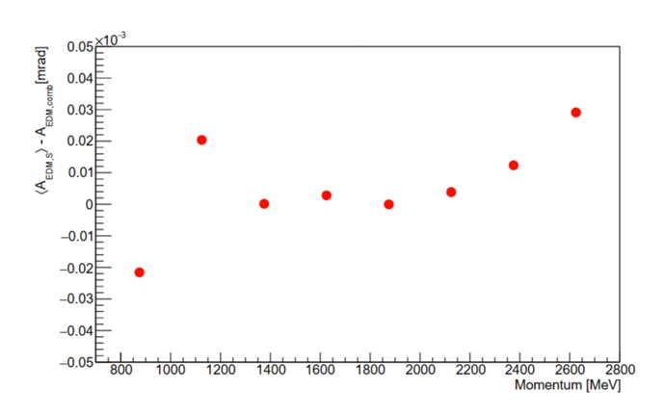
Potential sources of fake EDM – CBO
The coherent betatron oscillation (CBO) is a radial beam oscillation in the data – shows up in the g-2 fits.
Tracker acceptance couples the radial and vertical motion, so could end up with a time-varying vertical asymmetry.
Data
Quantify size of effect in both data and MC as cross-checks:
  Data: use station differences, as CBO phase is π/2 out of phase.
  MC: Look at A_{EDM} with/without CBO.
  Upper bound sets uncertainty.
MC
PRELIMINARY

Slide 27


Analysis cross-checks
‘Sideband’ frequency searches
  Change frequency of modulation/fit, look for in-phase and out-of-phase terms, should be zero if there’s nothing there!
  ‘Random’ frequency is zero out-of-phase in fits.
  CBO seems to be slightly nonzero – investigating this further.
Start time scans
  Fit parameters, look to see if the start time impacts the parameter meaningfully.
  Could indicate an unaccounted-for beam effect.
  All scans within expected variation.

Slide 28

Systematic uncertainties
Analysis is statistically limited – stat. unc is ~ 2x larger than any of the systematics.
Largest systematics all roughly comparable:
  Uncertainty in track reconstruction (reco).
  Impact of CBO beam oscillation (beam dyn).
Align and R_{p} scale with measured A_{EDM} – currently, large blinding EDM, so will reduce.
  Active work ongoing to better understand impact of tracker alignment, both in reconstruction and with the beam.
Expect beam dynamics uncertainty to be our largest after unblinding.
PRELIMINARY
These scale with A_{EDM}
Blinded data = large A_{EDM}

Slide 29


Preliminary blinded Run 2/3 results
Relative unblinding of Run 2/3 performed.
  Results show good agreement.
Points combined + fitted using the Best Unbiased Linear Estimator (BLUE) method to account for correlations:
PRELIMINARY

Slide 30

Preliminary blinded Run 2/3 results
Assuming zero signal is observed, plan to set limit using the Feldman-Cousins method.
  Matches most recent electron EDM results so easier to compare!
Assuming central value = 0 after unblinding, gives a limit of 3.3 $× {10}^{−20} e∙cm$ – 5.5x improvement vs BNL.
  Is the ‘best case scenario’, in practice a nonzero d_{µ} will increase this.
PRELIMINARY

Slide 31

Timelines for FNAL analysis
Run 2/3: analysis mostly complete, in collaboration review.
  Expect results this year… (hopefully!)
Run 4/5/6 + full dataset:
  Analysis started, ~ 4x as much data as Run 2/3.
  Final result will be a combination of runs 2-6.
  Expected to improve on BNL limit by ~ an order of magnitude.

Slide 32





What’s next for the muon EDM?
J-PARC g-2: also planning on making an EDM measurement, targeting 1 order of magnitude further (~ 10⁻²¹ $e∙cm$).
Neither FNAL or J-PARC are dedicated muon EDM: limits sensitivity. Enter muEDM at PSI!
  Designed to maximise EDM sensitivity using frozen spin technique: ‘freeze’ g-2 precession to allow EDM signal to build up over time – every positron is useful!
Planning ‘Phase 1’ measurement before PSI shutdown in 2027 (~ 3-4x better than BNL limit)
  ‘Phase 2’ afterwards, final target ~ 10⁻²³ $e∙cm$.

Slide 33
Bonus slides

Slide 34

Fermilab muon beamline
Protons incident on a target make pions.
Pions are stored in the delivery ring until they decay into muons.
Muons injected into our ring.

Slide 35
The radial field - measurement
A non-zero radial field introduces a fake EDM signal due to also tilting the precession plane.
Need to measure this very precisely to not be limited by the uncertainty.
  ~ 1ppm is achievable by performing a radial field scan:

Slide 36


Radial field - results
Scans are performed in Run 4/5/6 – so need to extrapolate the measurements to Runs 1/2/3 using the vertical beam position.
Sufficient precision for this to not be the limiting systematic.
S. Grant

