Slide 1
PDRA School Award
(and Other Small Funding Opportunities)
Vincent Richardson

Slide 2
Why should you care?
Opportunity to gain complimentary research skills/experience or boost CV through conference attendance/organisation or professional development
Small research trips/projects are an excellent tool to boost research output
Can be used as seed funding to support larger funding applications either through proof-of-concept measurements or as demonstration of interest
Ultimately, a great way to do things you want to do that fall outside of current role

Slide 3
What do these schemes typically cover?
Varies from scheme to scheme, typically uses include:
  Conference travel
  Consumables/small pieces of equipment for targeted projects
  Research trips to establish/develop new collaborations
  Travel to perform beamtime measurements
  Industry placements
  Professional development courses

Slide 4
What schemes exist/have existed?
SPS Postdoctoral Development Award
UoL Early Career Researcher and Returners Fund
EU COST Short Term Scientific Missions (there are hundreds, need to find a thematic fit)
IoP, RSC etc all run small schemes, especially for travel costs
Specific fields also likely to have bodies that run funding calls

Slide 5
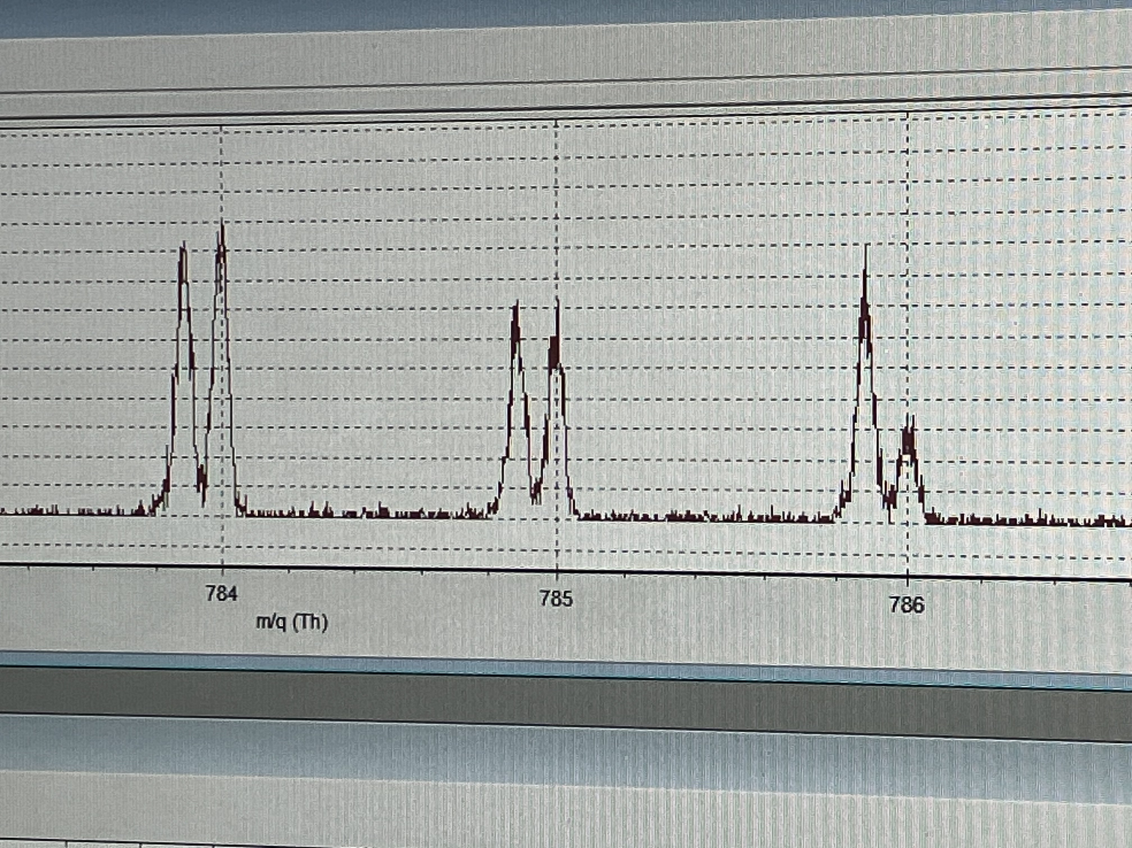
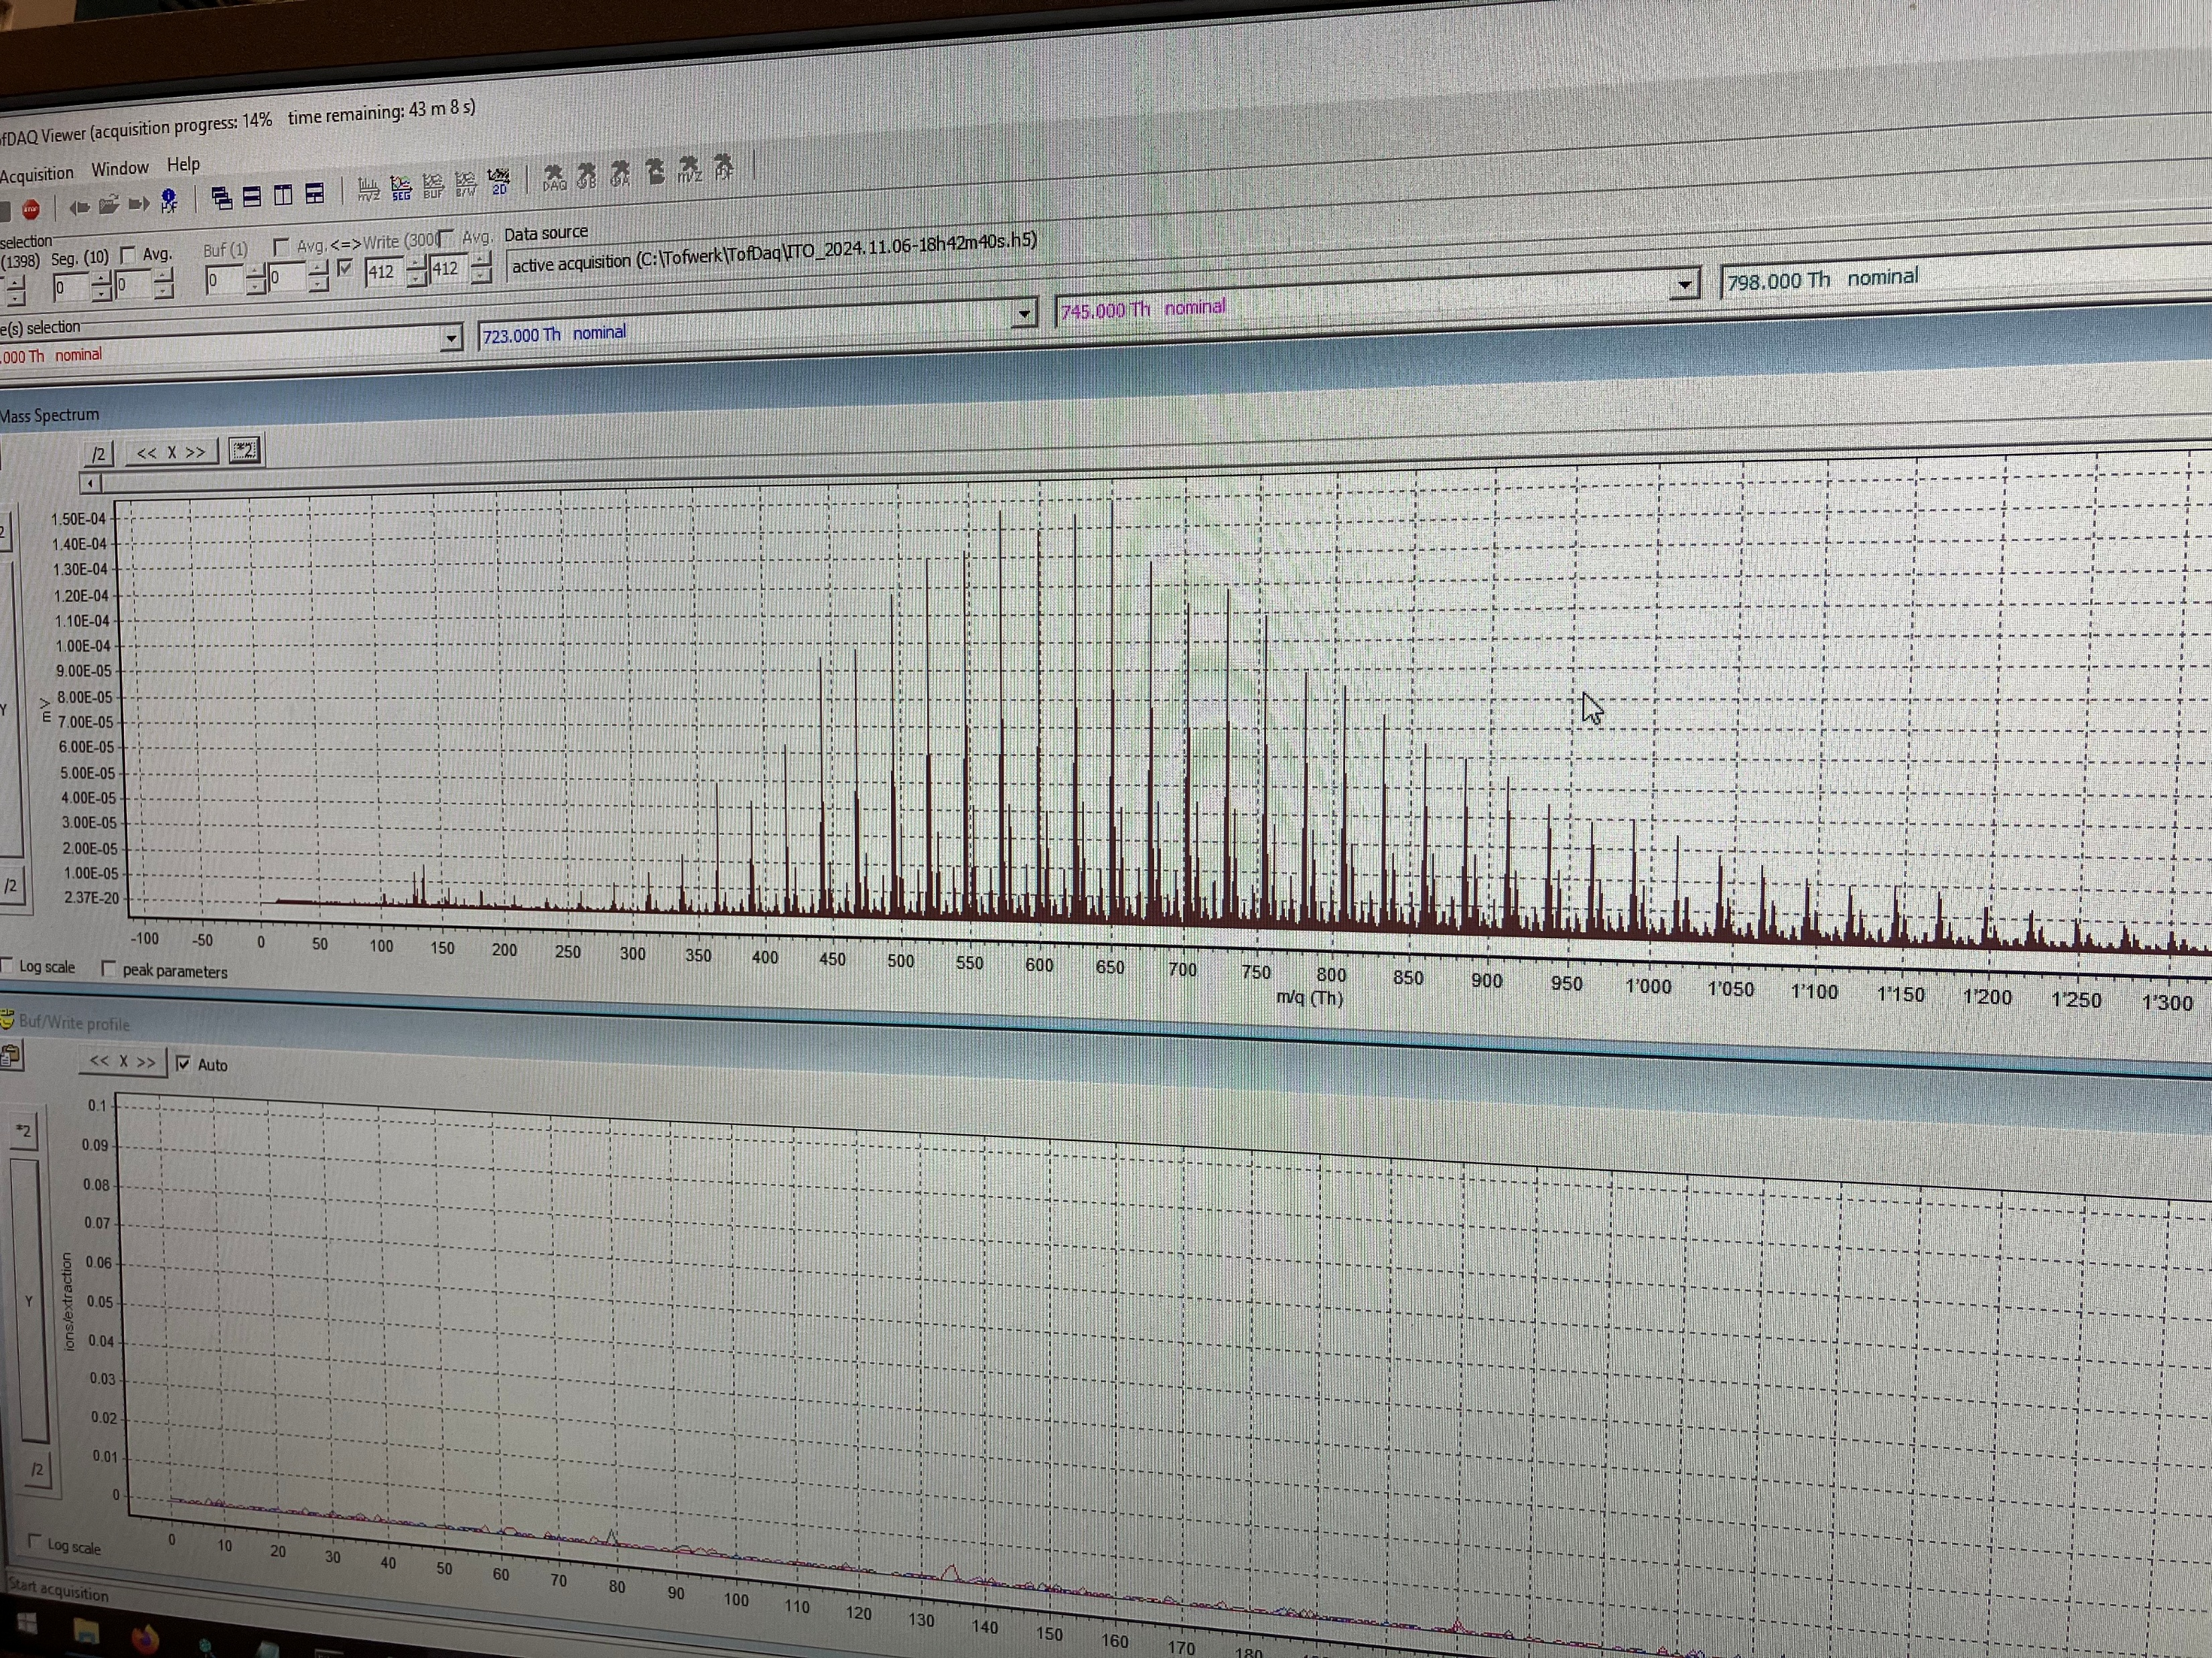
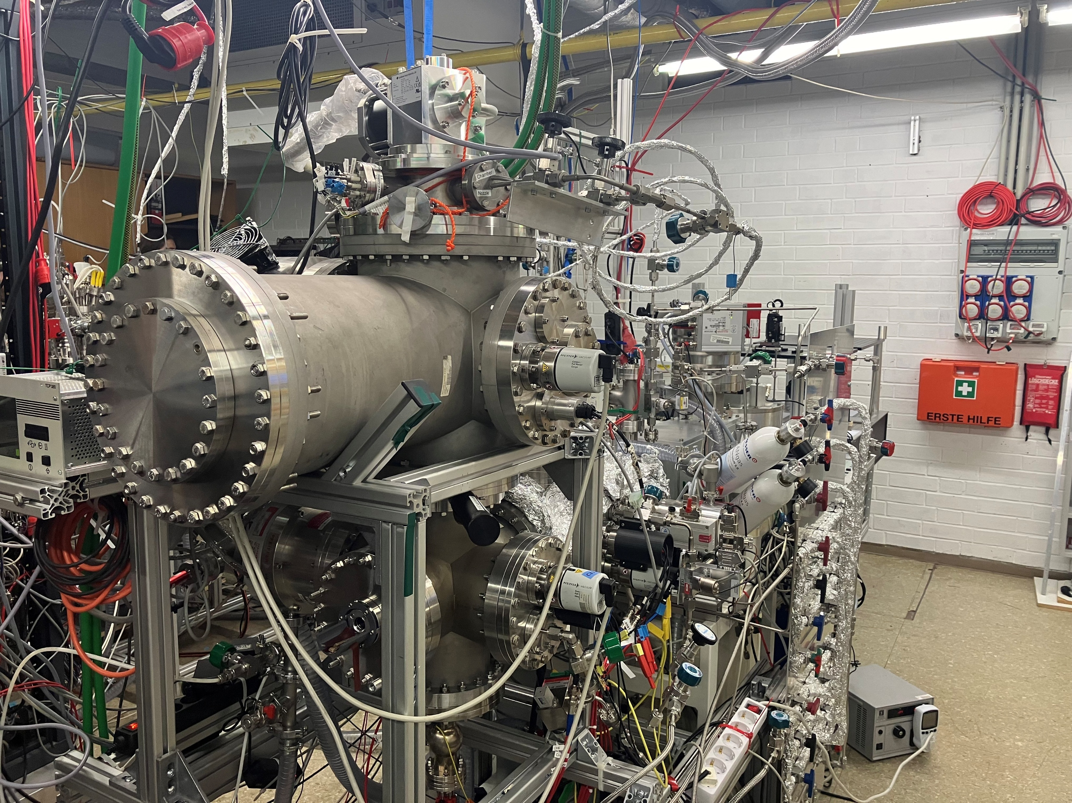
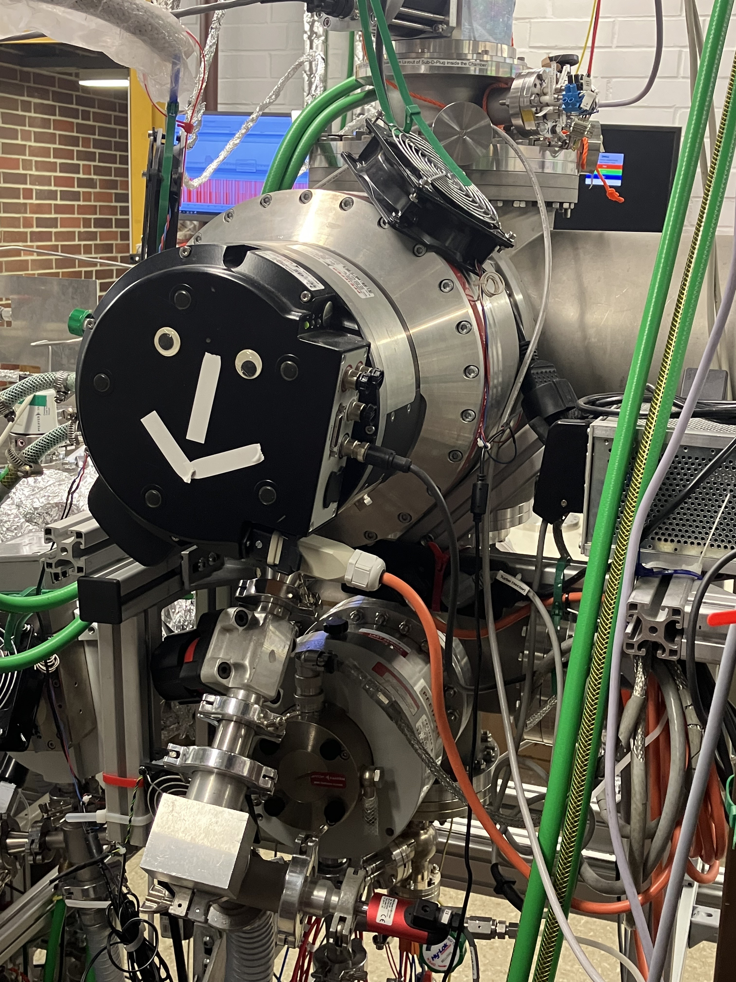

Slide 6
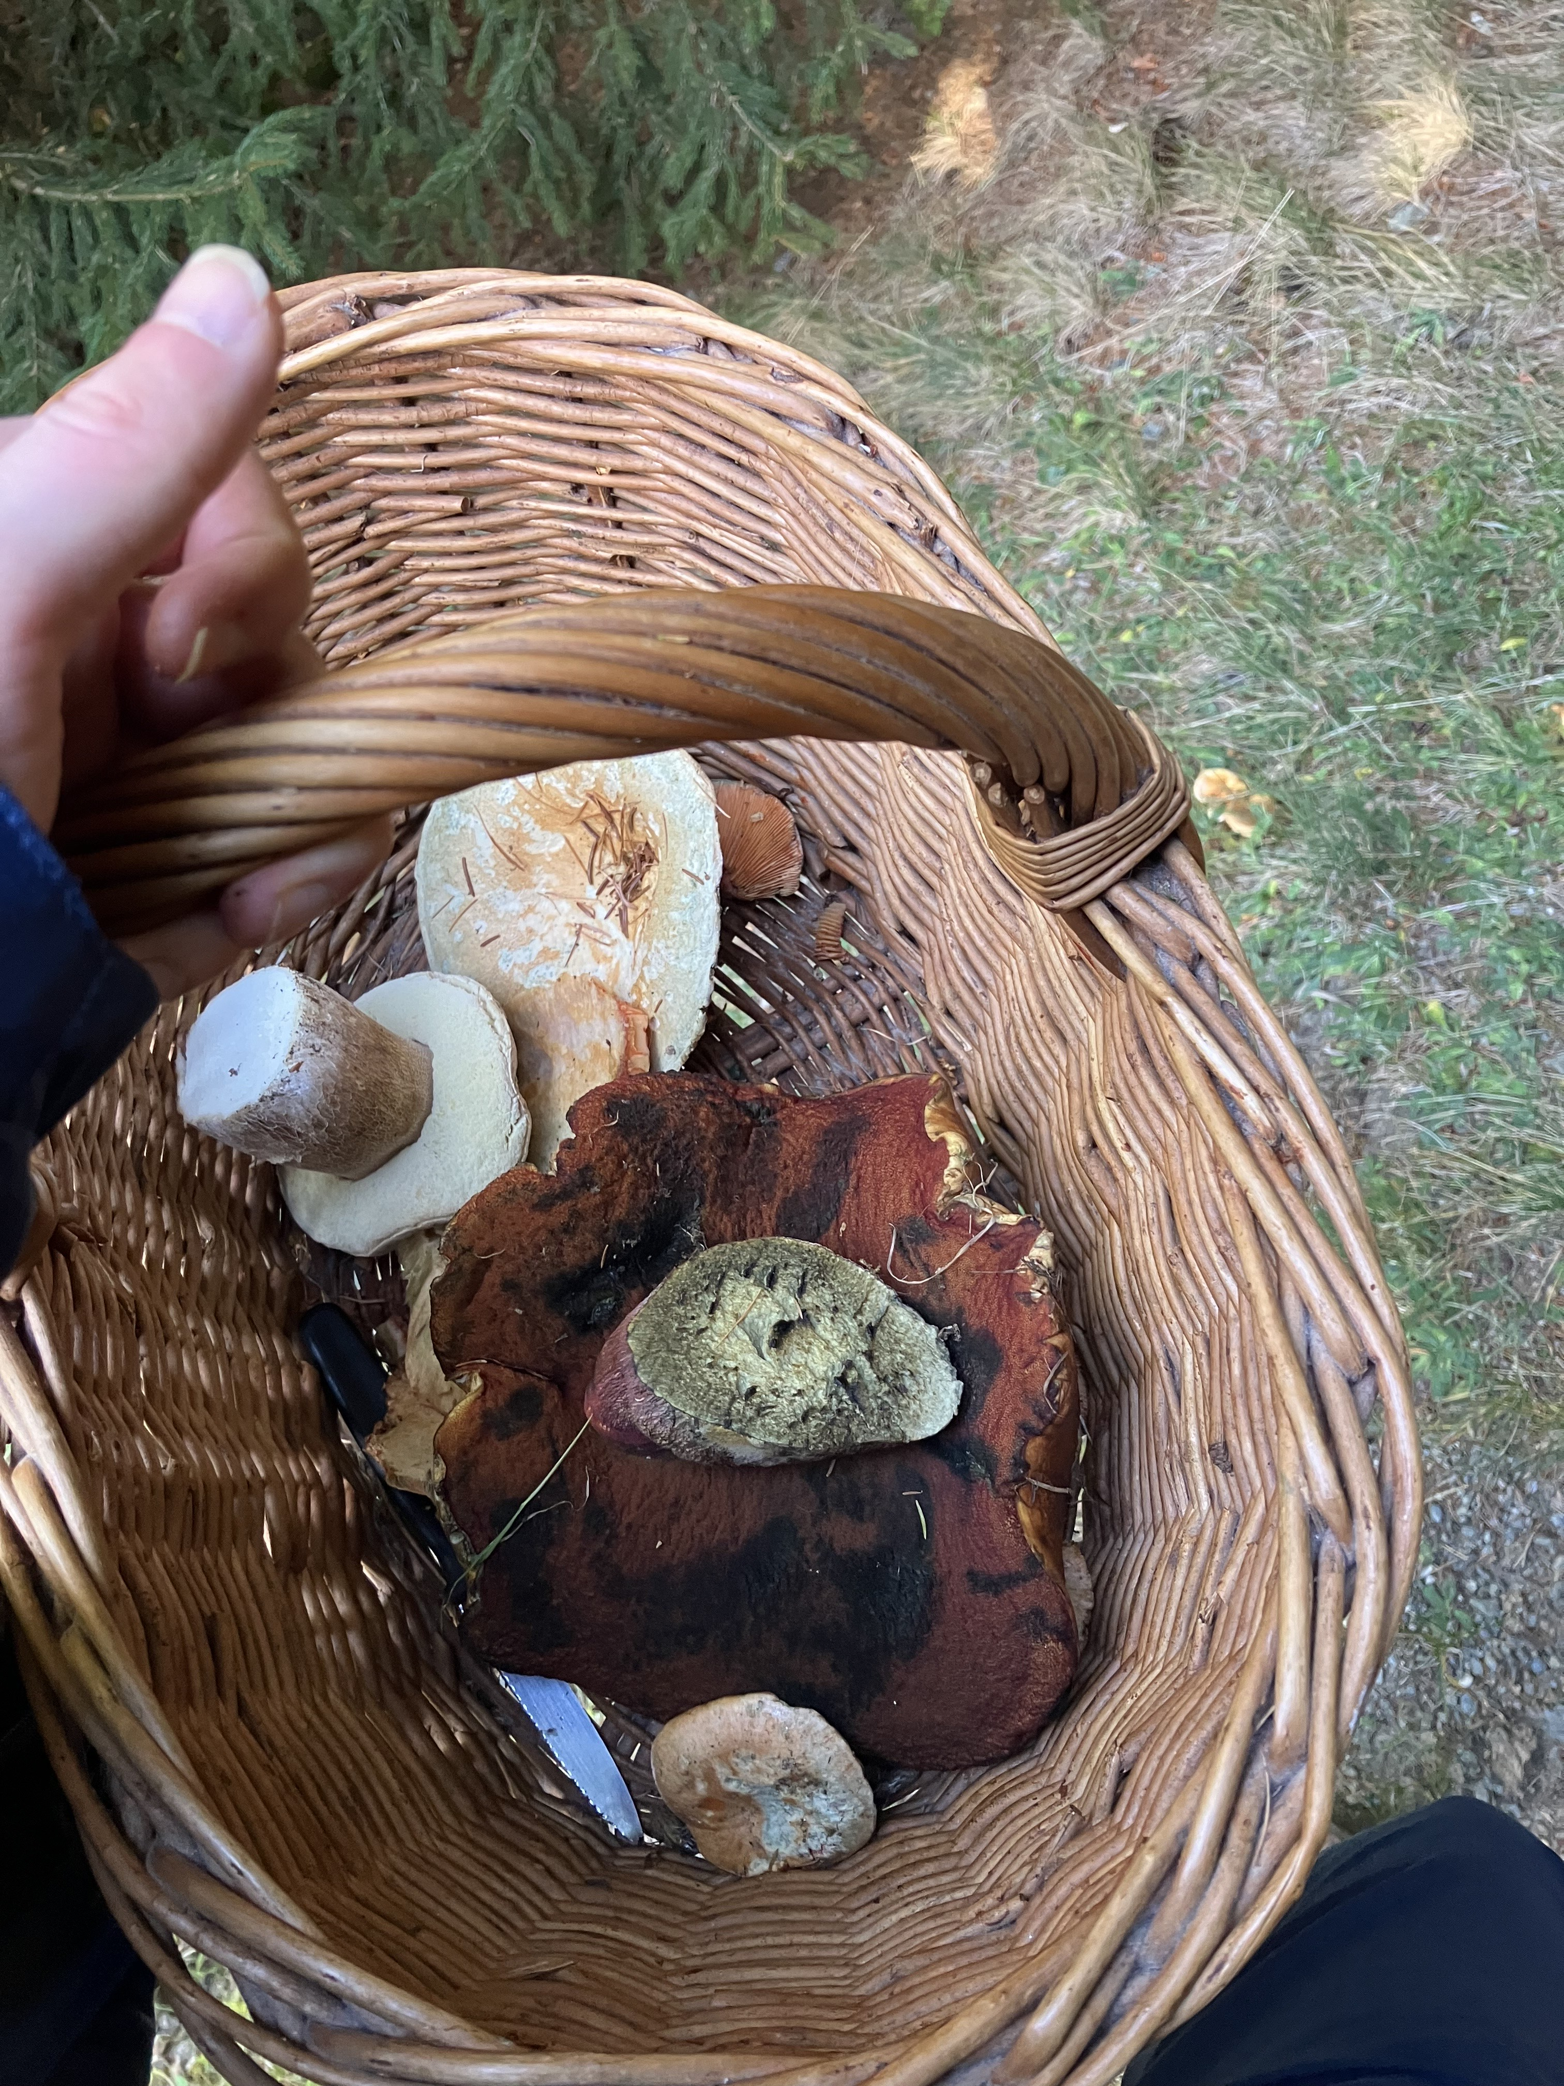



Slide 7

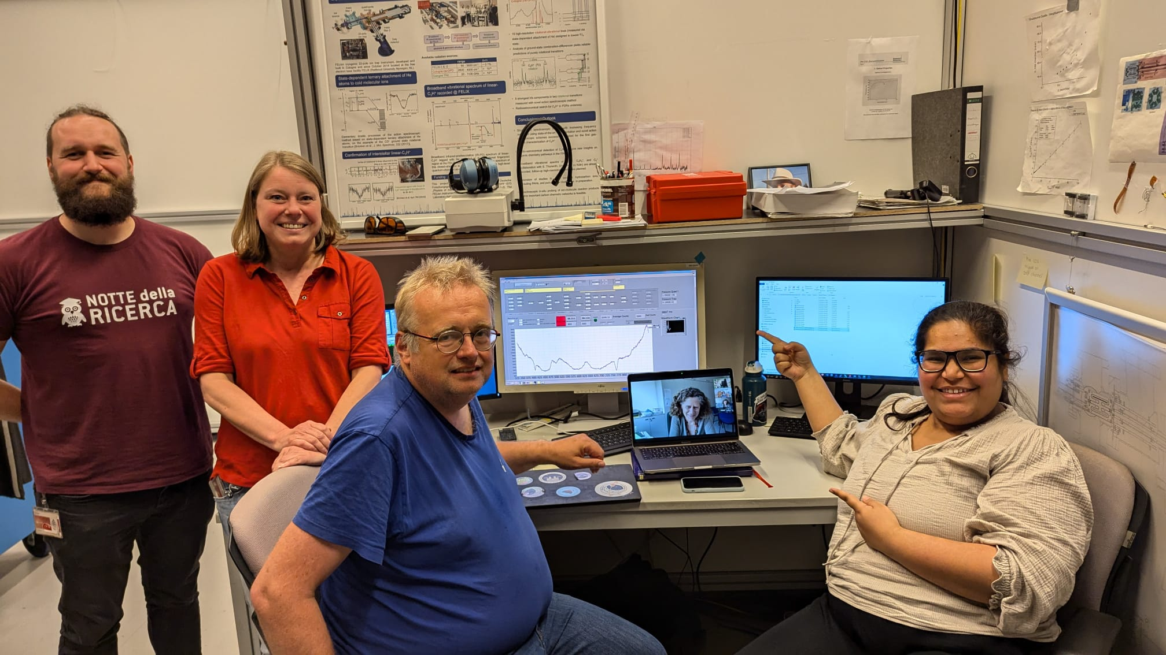

Slide 8
Things to Keep in Mind
Try and be proactive in developing ideas that you can then find funding for, not the other way around
Don’t overestimate what you can get for your money, you can always find ways to use excess funding
You can usually try and get multiple funders to cover the costs of the same project, so apply as widely as you can
Perseverance (and resilience) is essential

