Slide 1

Status and plans of EDMs. Proton storage ring EDM experiment at BNL.
Yannis K. Semertzidis
In-person presentation
MPP2025, Liverpool
November 11-13, 2025
EDM physics interest is growing and gaining more appreciation for its NP reach
Studies of EDMs of various systems have been proposed and making progress
First frozen spin storage ring EDM on the muon has been approved at PSI!
New PhD work (Jonathan Lee, Stony Brook Univ.) on storage ring EDM, high-sensitivity concept development, has cross-checked systematic errors mitigation plan using entirely independent tools.

Slide 2
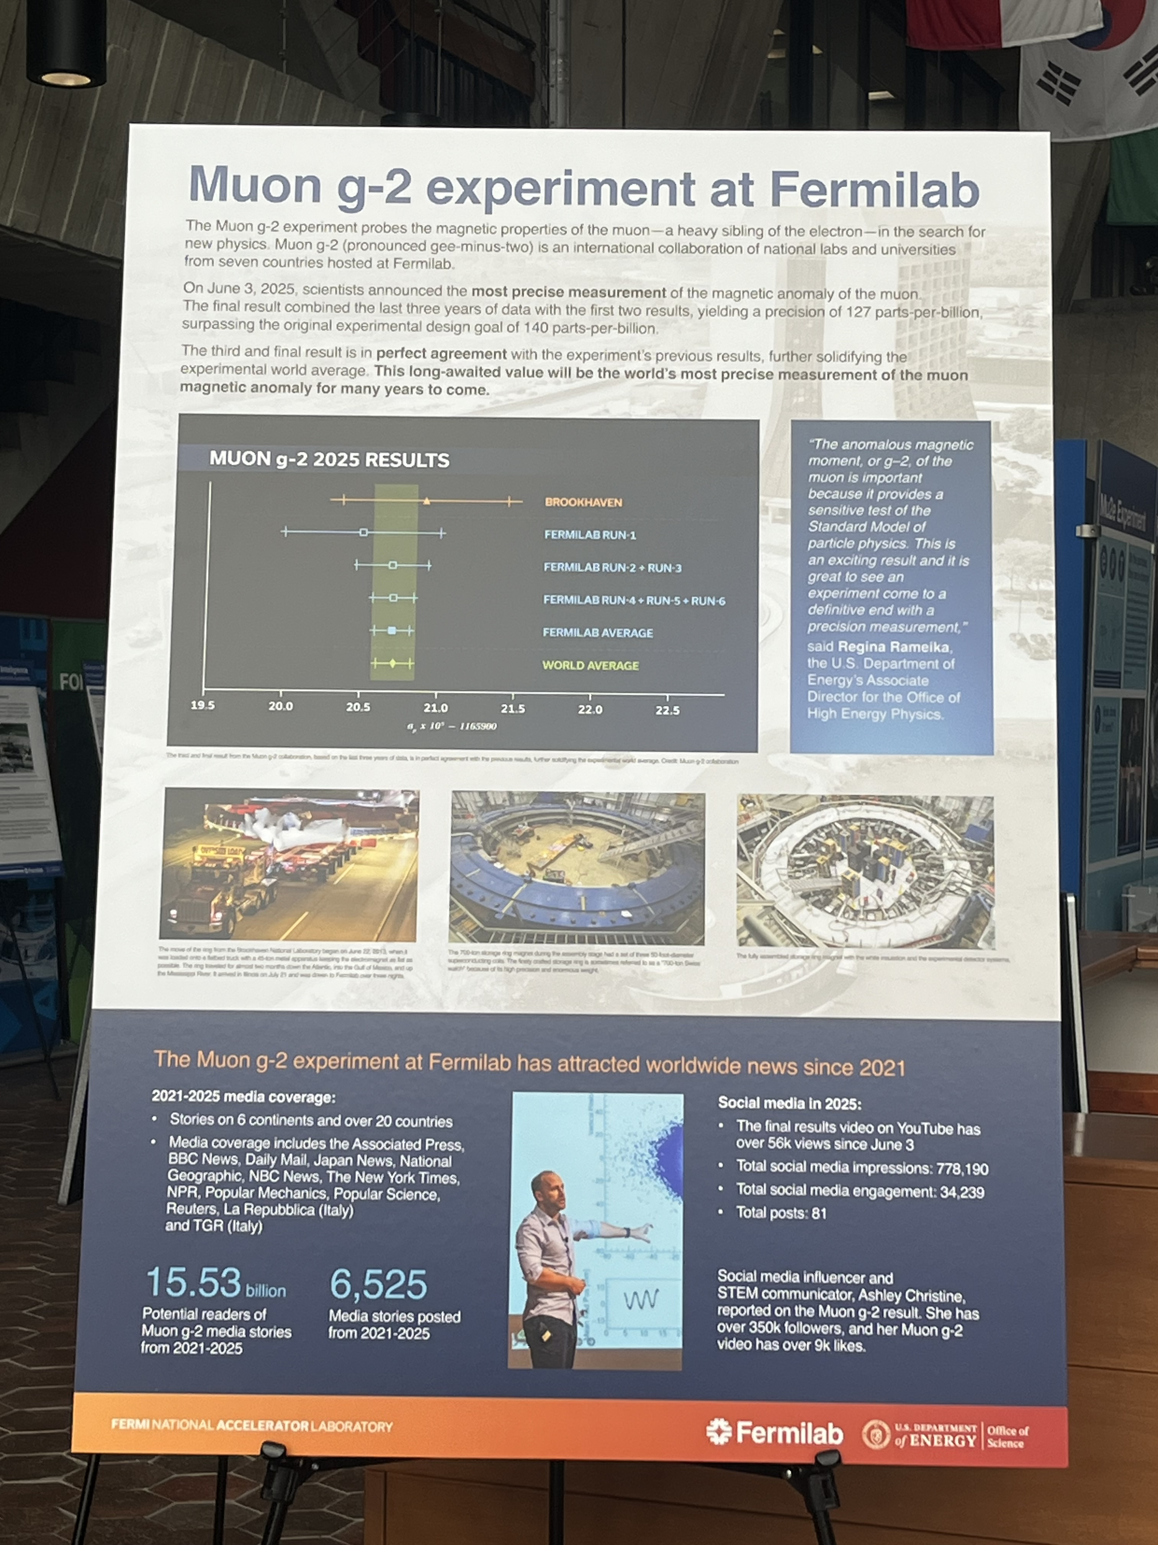
U.S. Secretary of Energy, Chris Wright, visited Fermilab on July 17 (Photo: Brendan Casey)
The very first poster he saw when he entered the Wilson Hall at Fermilab: Muon g–2, about an amazing experiment.
2021-2025 media coverage with 15.53 billion potential readers and 6,525 media stories!

Slide 3
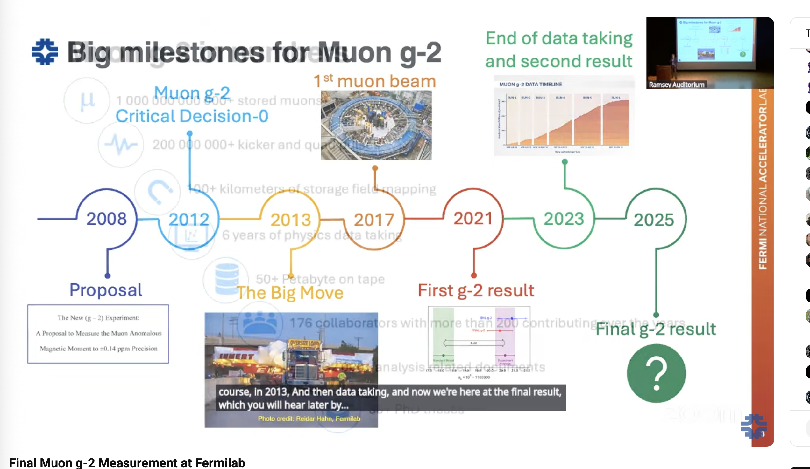
Slide by Peter Winter, co-spokesperson Fermilab, June 3

Slide 4
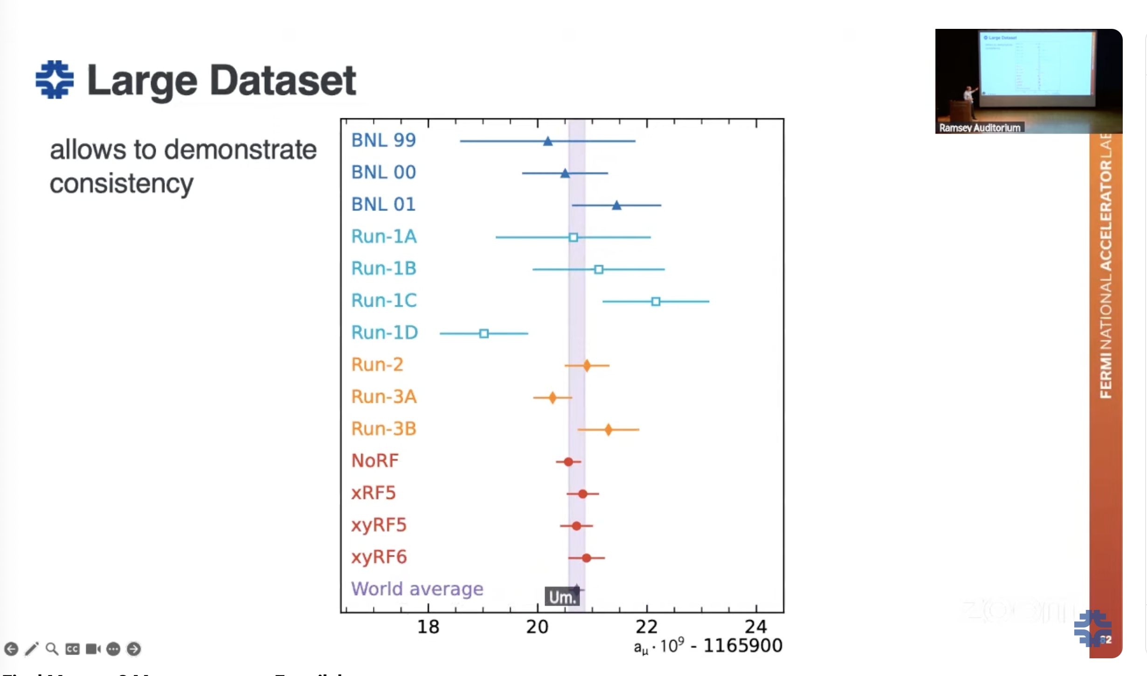
Announcement talk by Simon Corrodi, June 3
Blind analysis!
Beautiful experimental results (High-precision in storage rings)

Slide 5
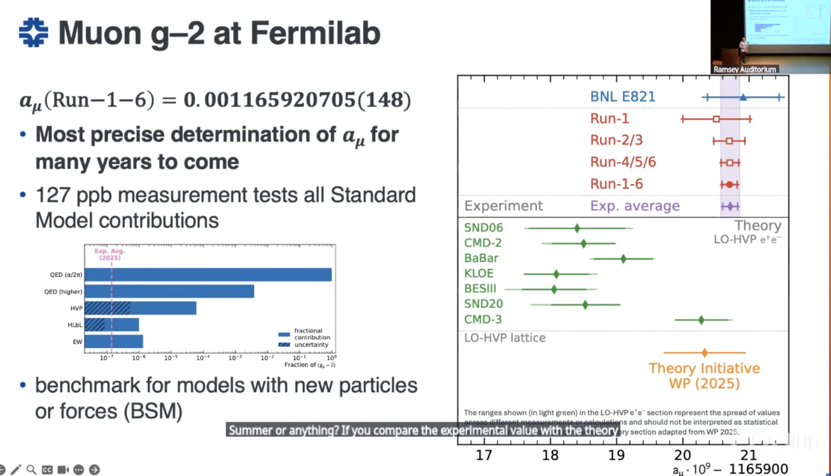
Slide by Simon Corrodi
Blind analysis!
Theory results under intense progress (applying blind analysis)

Slide 6
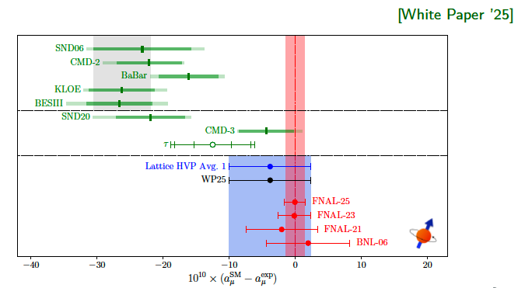
Status of theory and experiment of Muon g–2

Slide 7
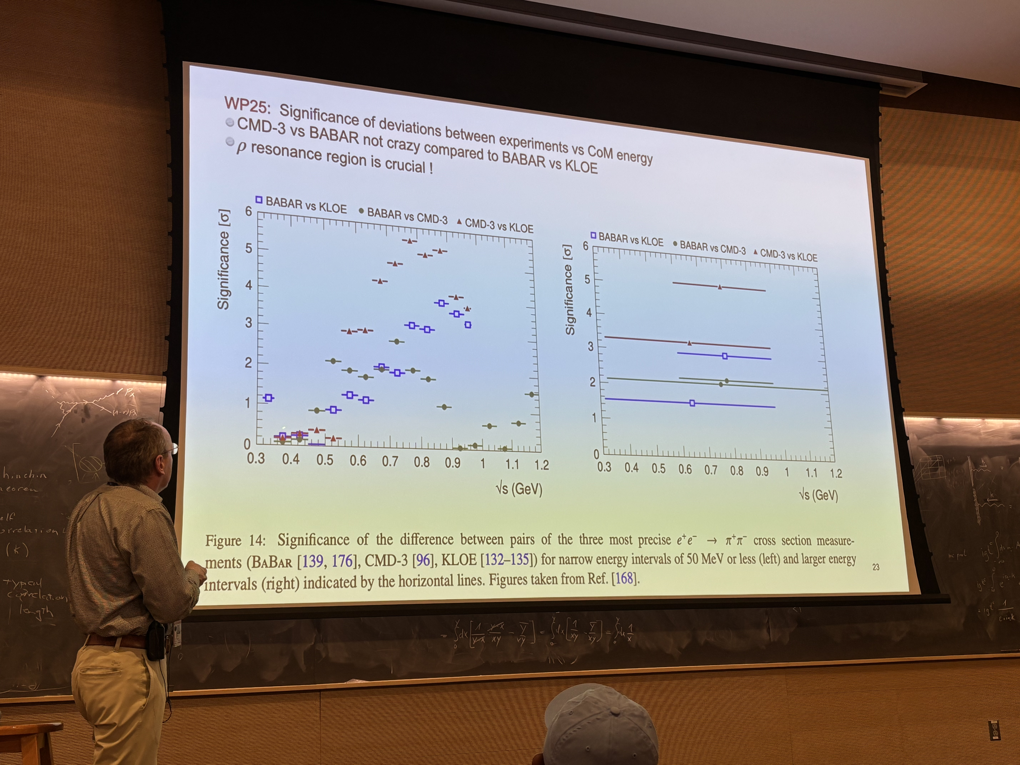
Peter Boyle, colloquium on the theory of muon g-2; BNL, July 22, 2025
He predicted that lattice QCD will match the experimental error within five years!
It may be possible to do better by a factor of ~2 in the experiment with mostly present equipment, significantly more with muon collider technology. It would be fun to design an upgrade!

Slide 8
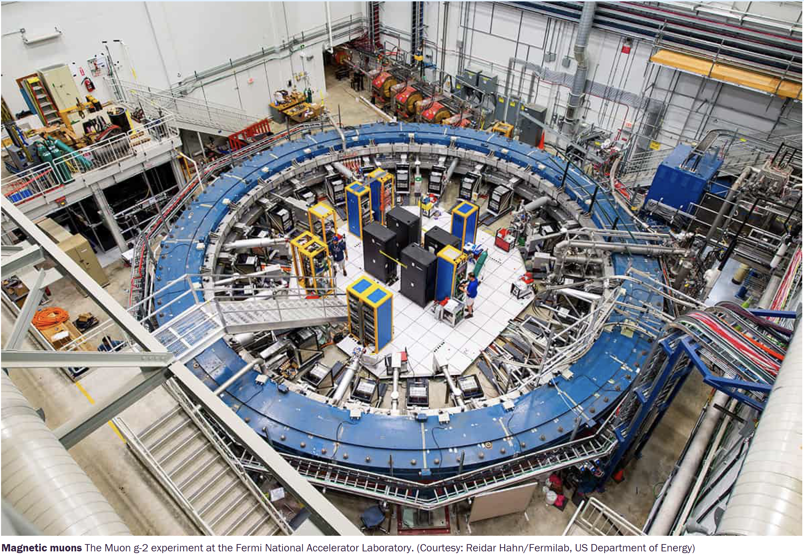
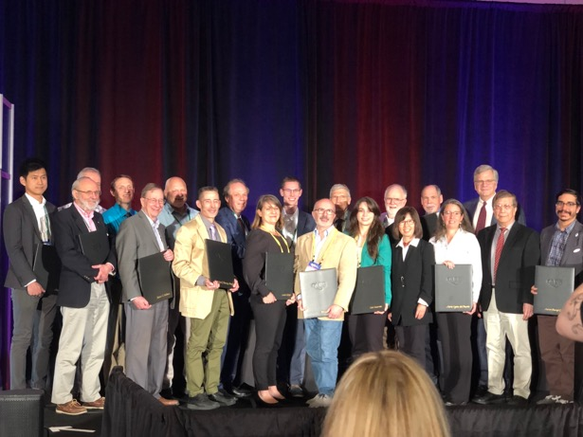
Bill Morse, Lee Roberts 2023 Panofsky Prize
We built the largest single diameter (15m) superconducting magnet coil at the time. Moved it across the country to repeat the experiment.
Uniformity of B-field (1.5T) in cross-section to better than 10⁻⁶ measured it (absolute) to better than 10⁻⁷ calibrated with two independent methods
Developed a trolley system measuring the B-field in situ (>5000 points)
Introduced a new DC inflector with innovative B-field shield at 3T without being detectable at storage region <10 cm away
Built a fast (200ns, 300G) magnet (kicker) without ferrite, measured the pulsed B-field eddy currents to 10⁻⁸ requiring enormous dynamic range
Developed electrostatic quads with twice the CERN gradient; measured the Electric field gradient.
Our calorimeter detectors had to have time stability, early to late in storage, of <20ps, measured it <2ps; gain stability to 10⁻⁴
Used combinatorics to remove pileup pulses; segmented calo detectors
Traceback system monitoring motion in real time, without affecting muons
Used RF, riding on the quads, for 30𝜇s to adjust coherent beam motion and reduce muon losses, both by an order of magnitude
…
Project manager (Chris Polly, Fermilab) received DOE management Prize!
On time, on budget! We deliver!

Slide 9
Electric Dipole Moments

Slide 10

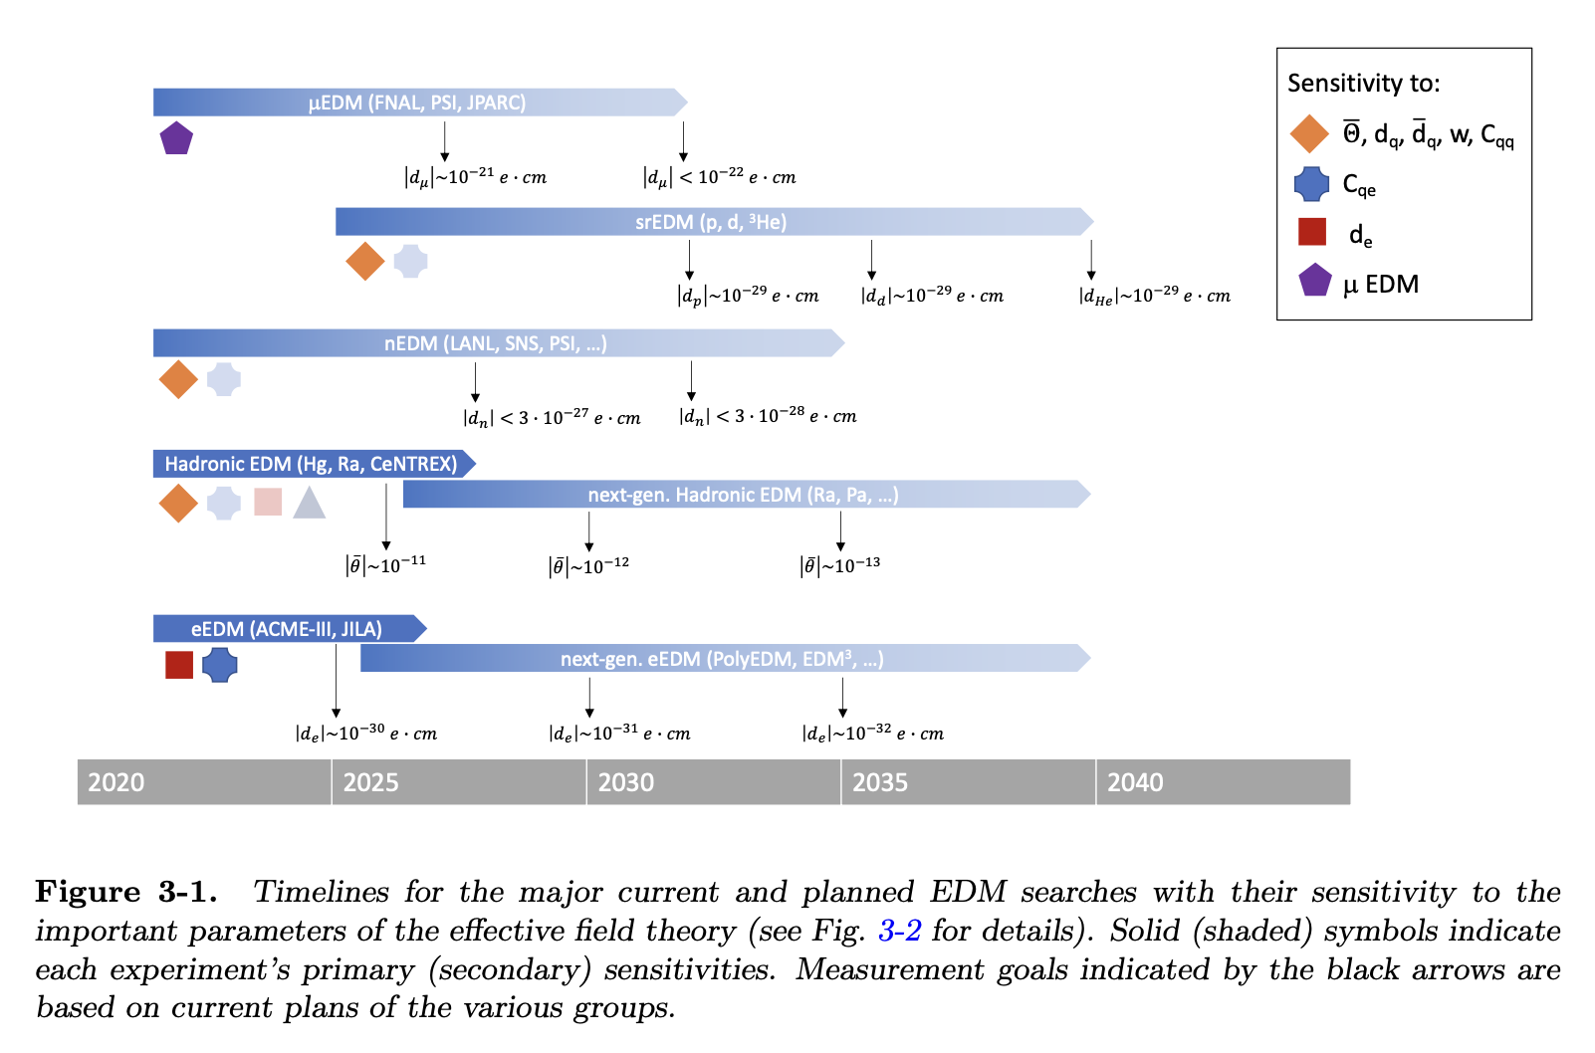
EDM timelines, from Snowmass 2021 (2022).
pEDM ready to go
Blum, Winter et al.

Slide 11
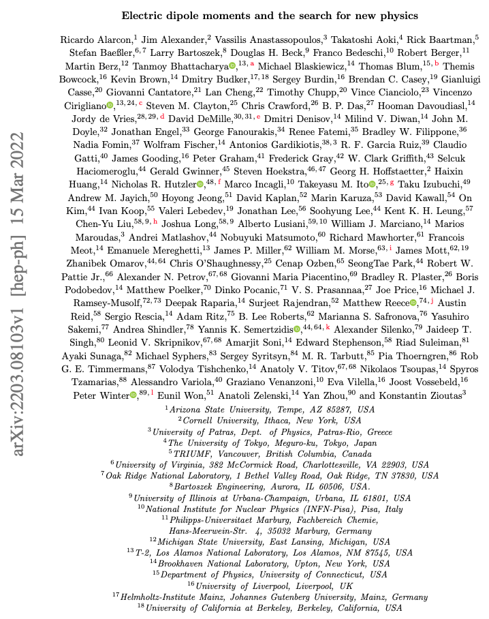
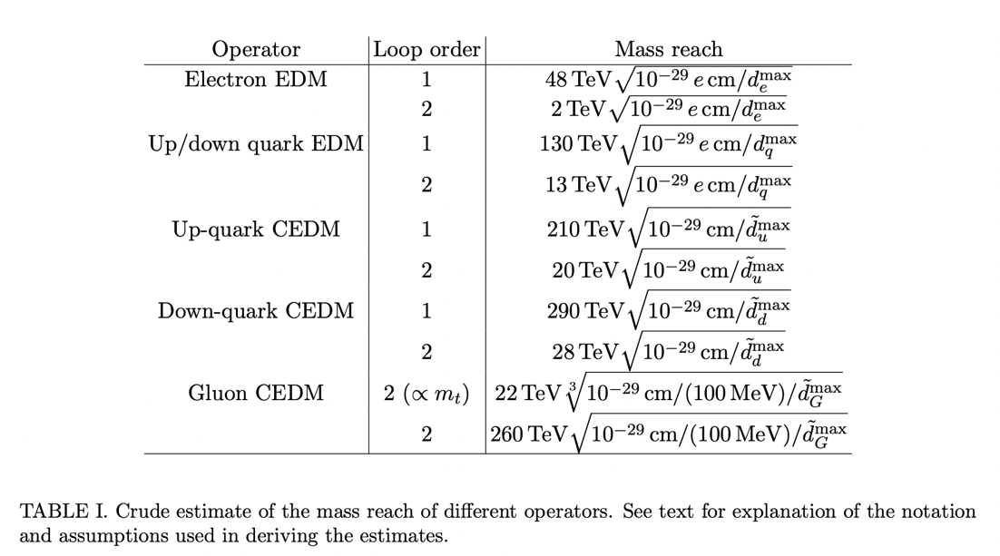
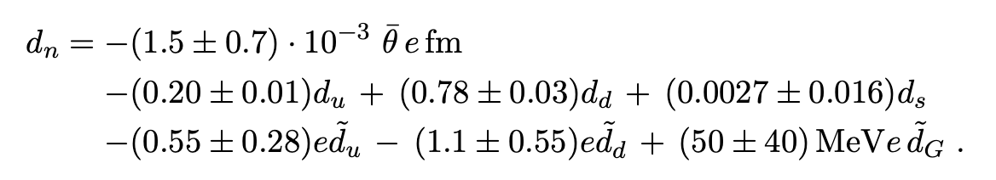
Snowmass paper on EDMs, why many EDMs:

Slide 12
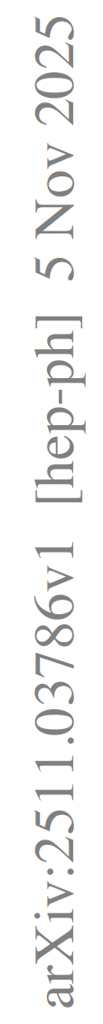
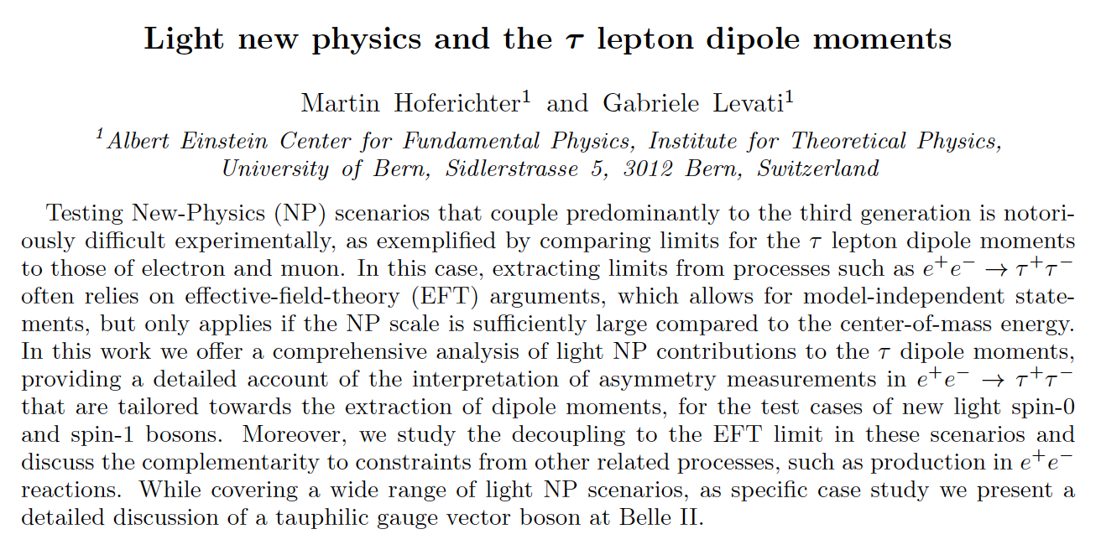
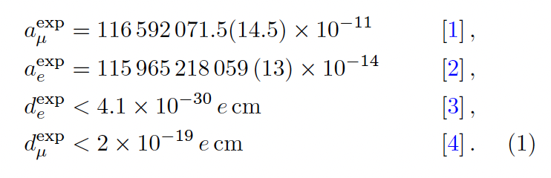
Other news on EDMs

Slide 13

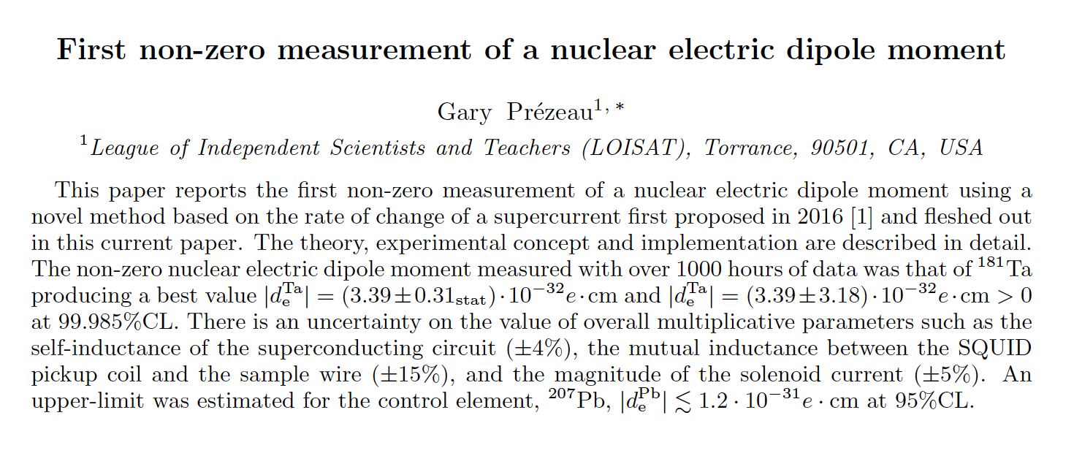
Other news on EDMs

Slide 14
From g–2 to EDM — Precision Spin Physics at Work
Muon g–2 @ Fermilab: World's most precise SM magnetic moment test.
Since 1987: From BNL to Fermilab — over 35 years storage ring magnetic/electric dipole moment work
Final g–2 result announced this week — historic milestone.
g–2 and EDM use spin precession in storage rings to probe fundamental physics.

Slide 15
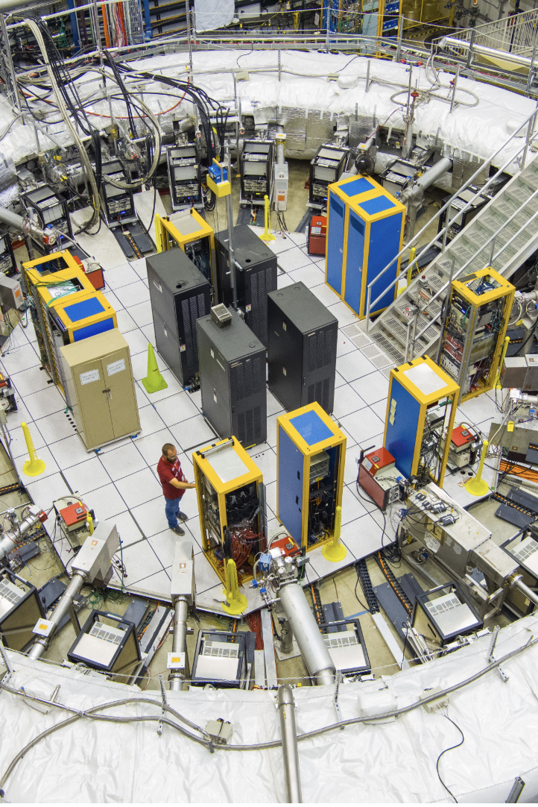
From muons to protons
Muons:
Observe time and energy
Muon lifetime: 64.4 μs (a whole storage time lasts ~1ms)
Proton EDM:
Proton polarimetry
Proton beam with “infinite” lifetime and small phase-space for huge statistics gain

Slide 16
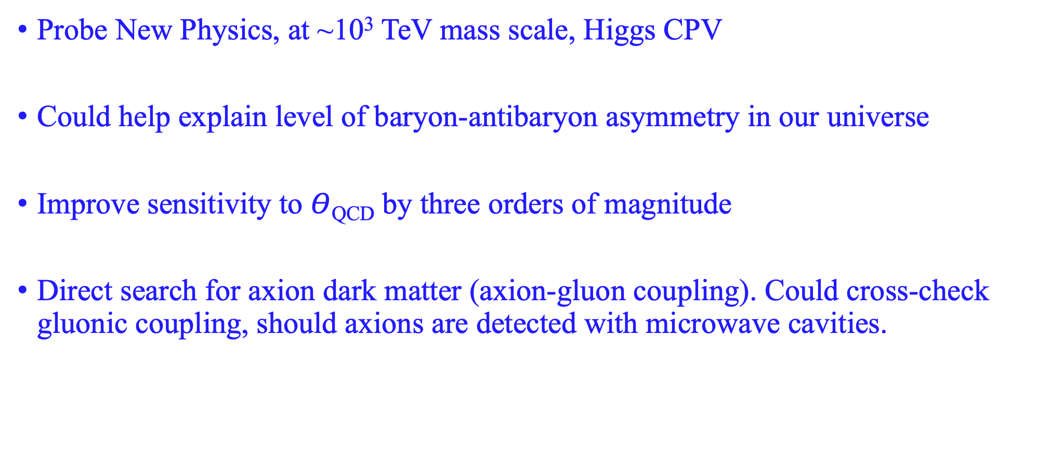
Motivation of pEDM at 10⁻²⁹ e-cm
Probe New Physics, at ~10³ TeV mass scale, Higgs CPV
Could help explain level of baryon-antibaryon asymmetry in our universe
Improve sensitivity to $Θ$_{QCD} by three orders of magnitude
Direct search for axion dark matter (axion-gluon coupling). Could cross-check gluonic coupling, should axions are detected with microwave cavities.

Slide 17
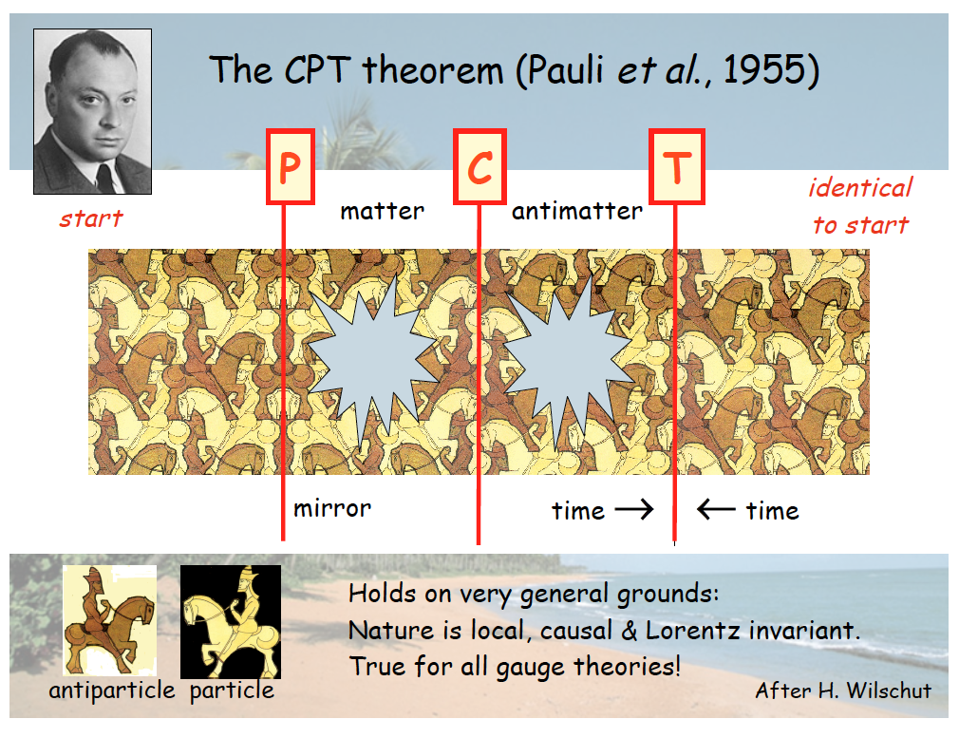

Slide 18
T-time symmetry
T-symmetry describes physics phenomena that are independent of the direction of time.

Slide 19
Clock-wise (CW) motion in a storage ring
Notes:
19

Slide 20
Counter-Clock-wise (CCW) motion
Notes:
20

Slide 21
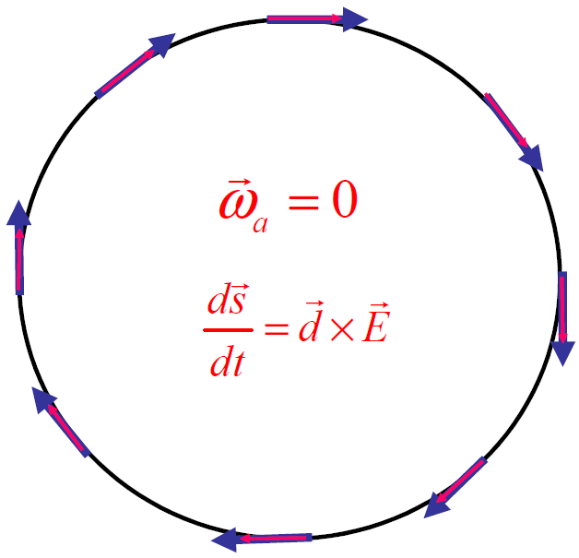
Storage Ring EDM experiments
(or how to create a Dirac-like particle in a storage ring)
Electric bending, w/
“magic” momentum
Notes:
21

Slide 22
Electric fields: Freezing the g-2 spin precession
${\vec{ω}}_{a}$= $−\frac{q}{m}\left[a−{\left(\frac{mc}{p}\right)}^{2}\right]\frac{\vec{β}×\vec{E}}{c}$ = 0
The g-2 spin precession is zero at “magic” momentum (3.1GeV/c for muons,…), so the focusing system can be electric
p=$\frac{mc}{\sqrt{a}}, with a=G=\frac{g−2}{2}, γ_{m}=\sqrt{1+1/a}$
The “magic” momentum concept with electric focusing was first used in the last muon g-2 experiment at CERN, at BNL & FNAL.

Slide 23
Storage ring Electric Dipole Moments
Phys. Rev. Lett. 93, 052001 (2004)
Frozen spin method:
Spin aligned with the momentum vector
Radial E-field precesses EDM/spin vertically
Monitoring the spin using a polarimeter

Slide 24
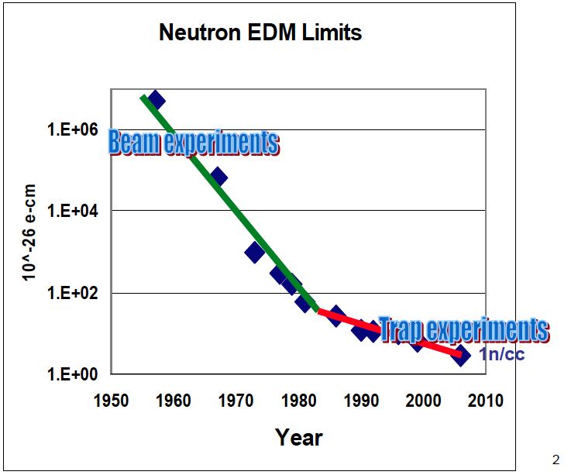
Proton storage ring EDM experiment is combination of beam + a trap
B. Morse

Slide 25
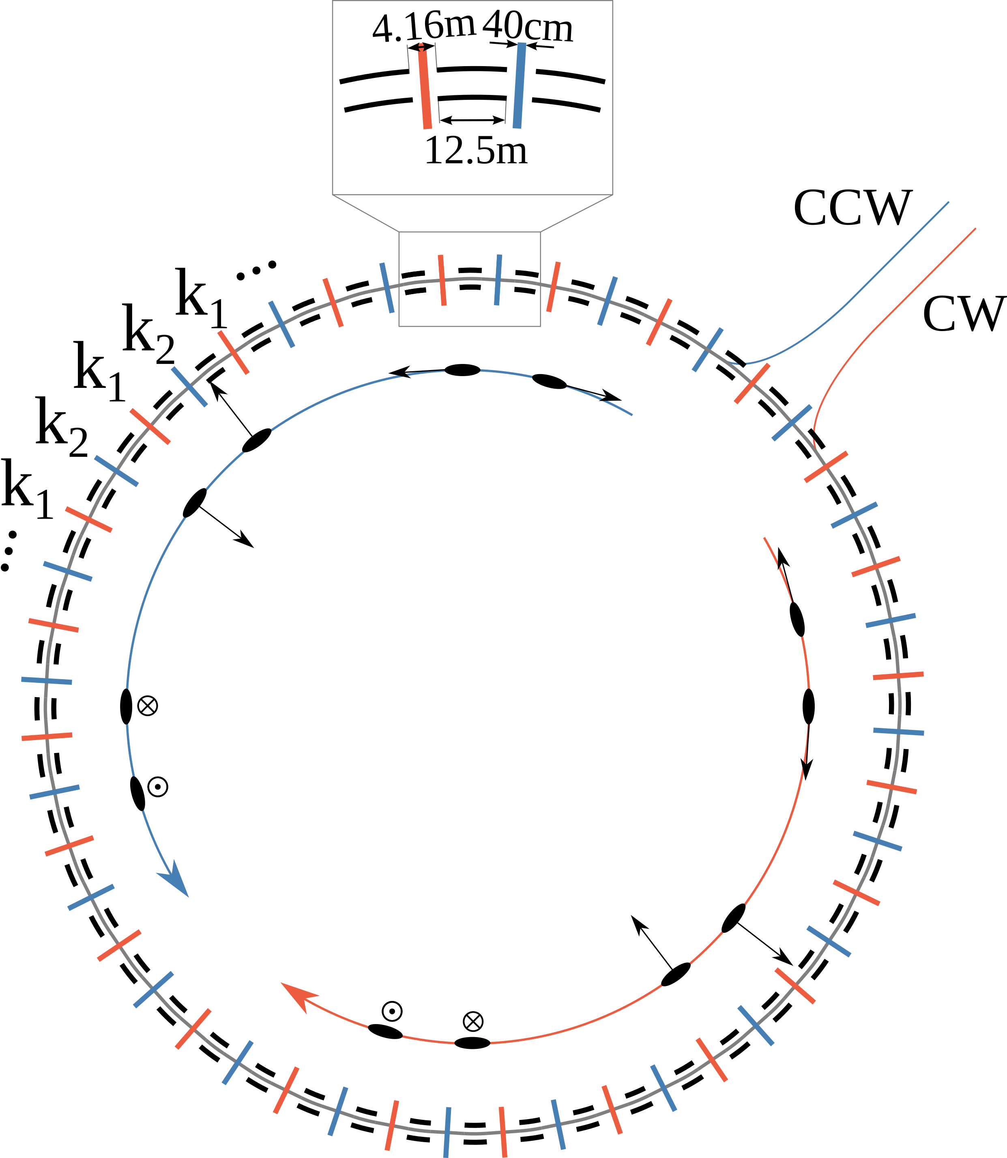
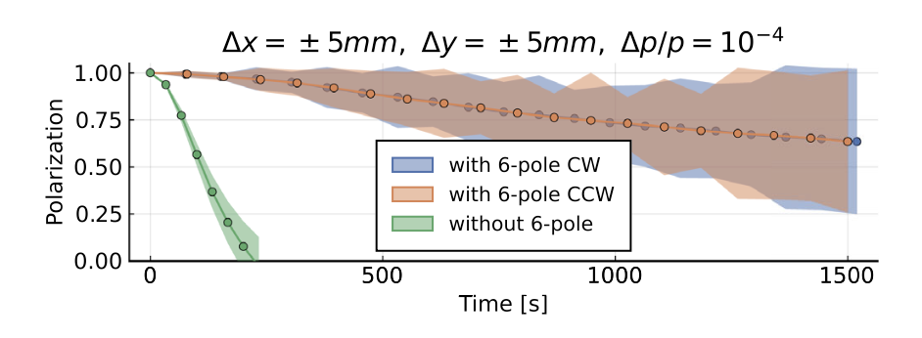
Hybrid, symmetric lattice storage ring. Spin Coherence Time with sextupoles
Z. Omarov et al., PHYS. REV. D 105, 032001 (2022)
Hybrid (magnetic and elecric) sextupoles were used to achieve long SCT.
SCT with Intra-Beam-Scattering/Stochastic-Cooling is >>10 longer

Slide 26
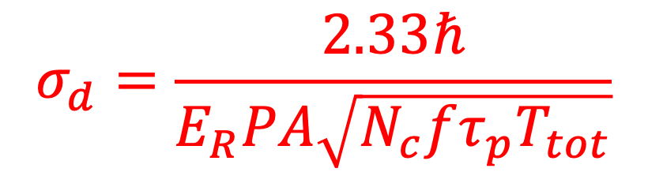
Proton Statistical Error (233MeV): 10⁻²⁹ e-cm
Phys. Rev. D 104, 096006 (2021)
$$σ_{d}=\frac{2.33ℏ}{E_{R}PA\sqrt{N_{c}fτ_{p}T_{tot}}}$$
τ_{p} : 2×10³s Polarization Lifetime (Spin Coherence Time)
A : 0.6 Left/right asymmetry observed by the polarimeter
P : 0.8 Beam polarization
N_{c} : 4×10¹⁰p/cycle Total number of stored particles per cycle (10³s)
T_{Tot}: 2×10⁷s Total running time per year
f : 1% Useful event rate fraction (efficiency for EDM)
E_{R} : 4.5 MV/m Radial electric field strength
Studying ways to increasing efficiency; Quantum readout?
Notes:
Yannis Semertzidis, BNL
26

Slide 27
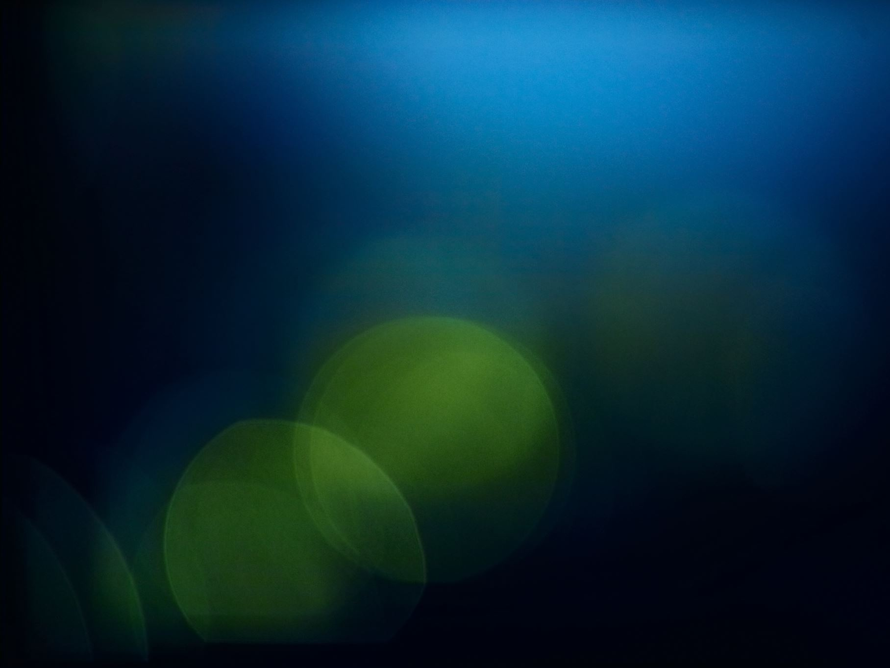
Can we do better than 10⁻²⁹ e⋅cm?
More efficient polarimeter (quantum readout?)
Spin coherence time (SCT) >> 2000s
Stochastic cooling (more beam, even longer-“infinite” SCT)
Combined electric bending/magnetic focusing ring
Possible, perhaps at least on statistics, to reach down to SM

Slide 28
Issues/solutions: Electric bending, IBS and SCT
In storage rings where a significant part of pending is provided by electric fields: Critical impact on IBS (intra-beam-scattering) and SCT (spin-coherence-time).
IBS and negative slip factor (above transition for stable storage) prolongs SCT very effectively due to the exchange of phase-space populations.
Stochastic cooling can be further used to effectively combat IBS and prolong SCT to “infinity”.

Slide 29
Systematics

Slide 30
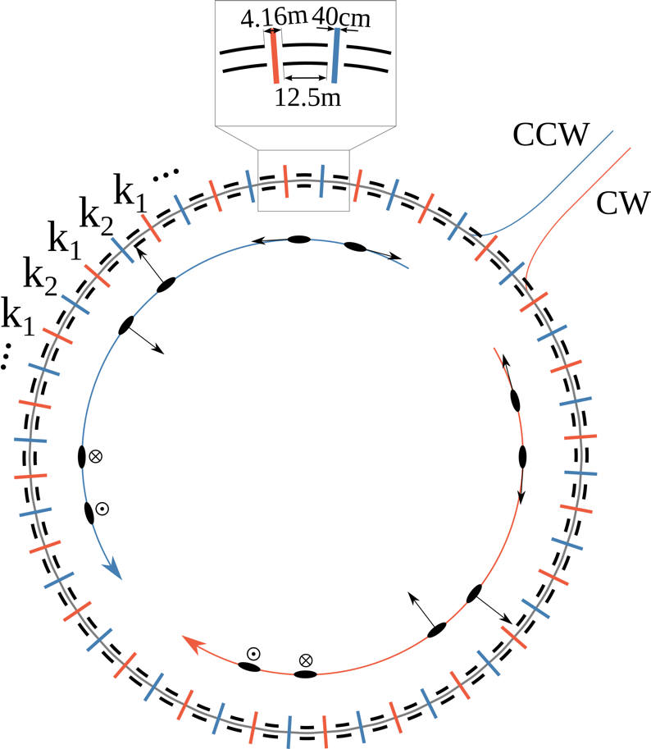
Symmetries against systematic errors
Clock-wise (CW) vs. Counter-Clock-Wise (CCW)
Eliminates vertical Electric field background
Hybrid lattice (electric bending, magnetic focusing)
Shields against background magnetic fields
Highly symmetric lattice (24 FODO systems)
Eliminates vertical velocity background
Positive and negative helicity
Handles polarimeter systematic errors
Flat ring to 0.1 mm, beams overlap within 0.01 mm, spin-based alignment, quad current flipping
Geometrical phases; High-order vertical E-fields

Slide 31
Spin-based alignment
Spin-based alignment for effects that depend on combination of two or more background fields.
Use spin of stored particles to provide information on the background fields
Counter-act the background fields to level the ring lattice (0.1mm) and reduce the CW and CCW beam separation to the specs (0.01mm).

Slide 32
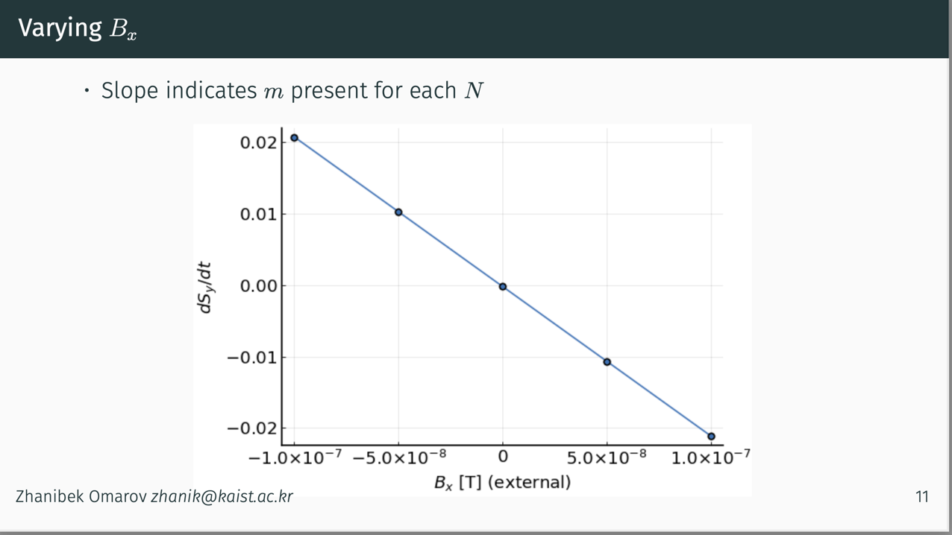
Spin-based alignment/background reduction
Omarov’s method: a combination of background fields can create false EDM signals. Artificially inflate one component to reduce the other.
From Zhanibek Omarov’s presentation
Vary the radial B-field (B_{x}) and observe the ds_{y}/dt slope vs. B_{x}.
The EDM signal does not depend on the value of B_{x}.
Tune out the background field (here electric field focusing) until we get zero slope in ds_{y}/dt vs. B_{x}.
Vertical offset indicates EDM
No EDM

Slide 33
Simultaneous clock-wise and counter-clock-wise motion
Possible in an electric storage ring
Notes:
33

Slide 34
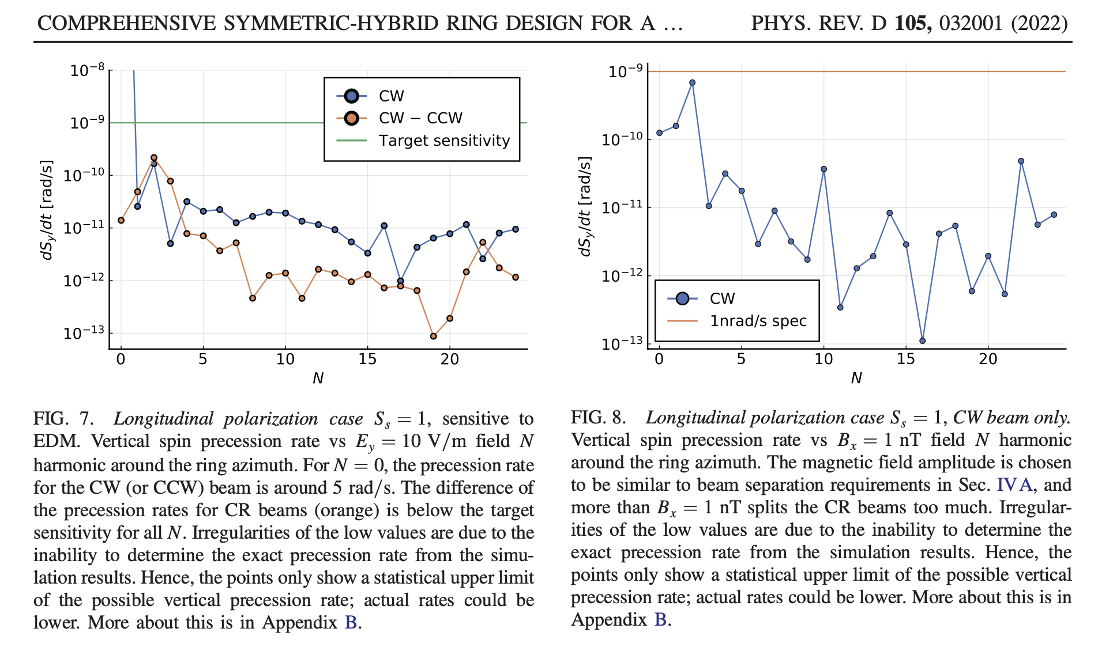
E_{y} and B_{x} effects as a function of azimuthal harmonic N
B-field
E-field

Slide 35
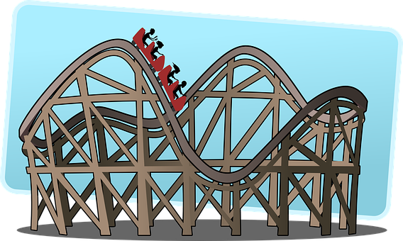
Ring planarity is important
0.1 mm
Quads: 0.1T/m, 0.4m

Slide 36
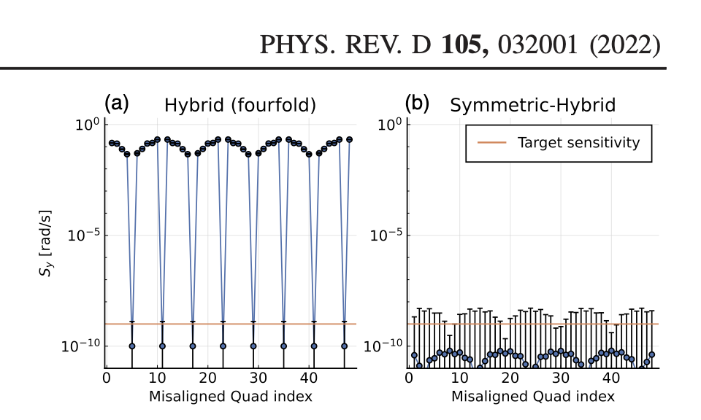
Symmetries play a critical role in combating systematic errors due to vertical velocity.
Z. Omarov et al.,
Radially polarized beam is shown here; sensitive to Vector Dark Matter/Dark Energy, P. Graham et al., PRD, 055 010, 2021. Use longitudinally polarized bunches for sensitivity to EDM (>10⁴ times less sensitive to vertical velocity effect).

Slide 37
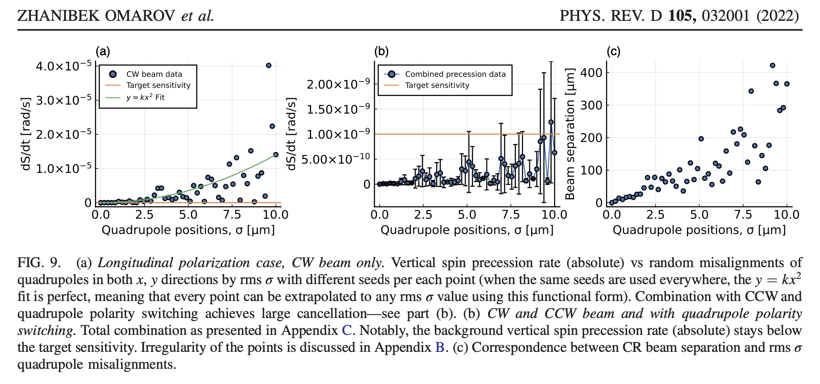
Vertical velocity and geometrical phase effects:
Magnetic quadrupoles 0.2T/m, positioning accuracy dominates background B-fields Mitigation by flipping quad polarity in ~10⁵ separate beam injections
After combination
Large effect!
Using spin-based alignment

Slide 38
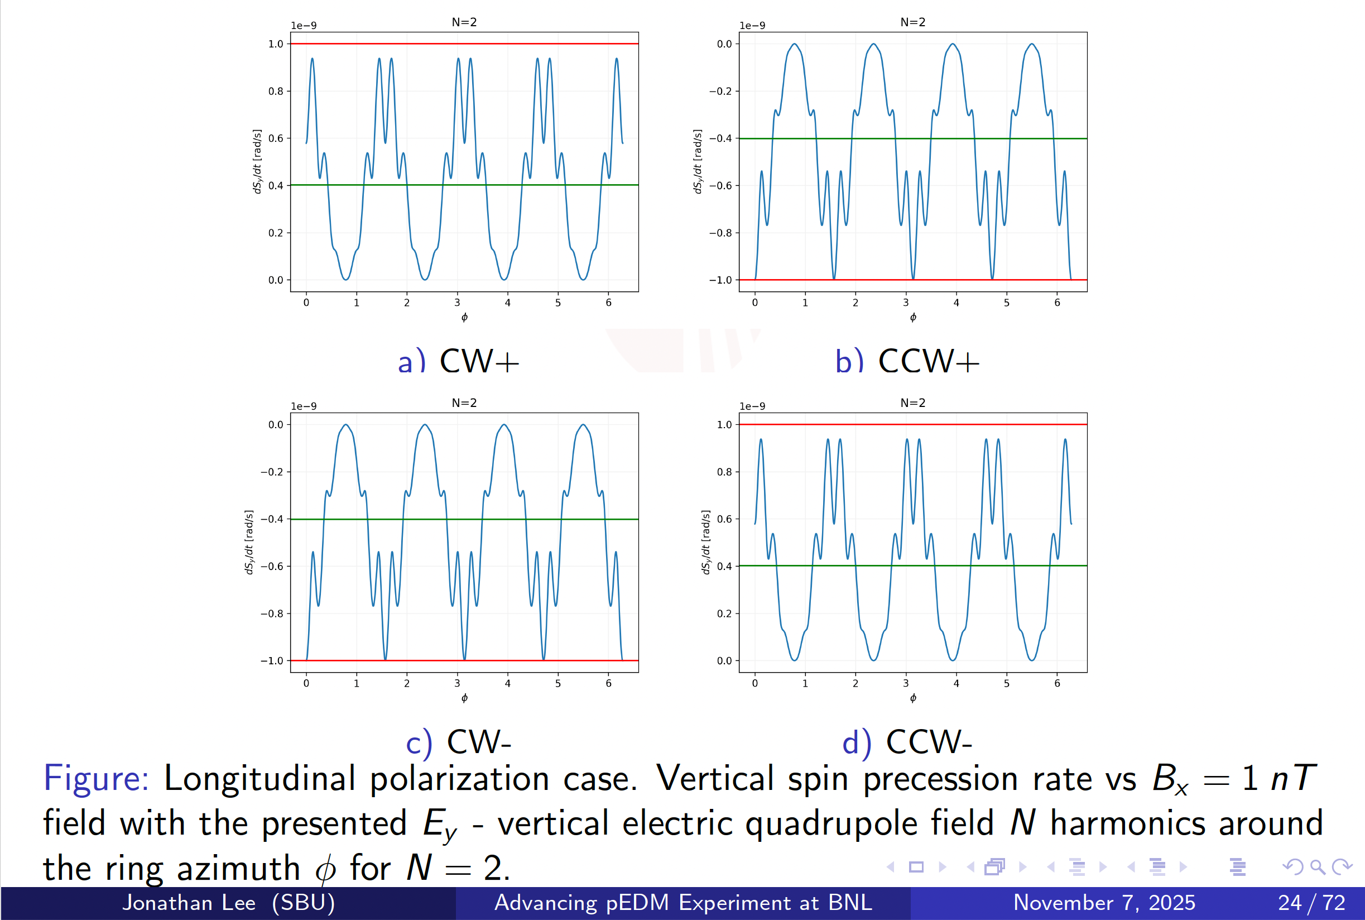
Systematic effects due to electric quadrupole effects
Jonathan Lee (SBU)
PhD thesis defense

Slide 39
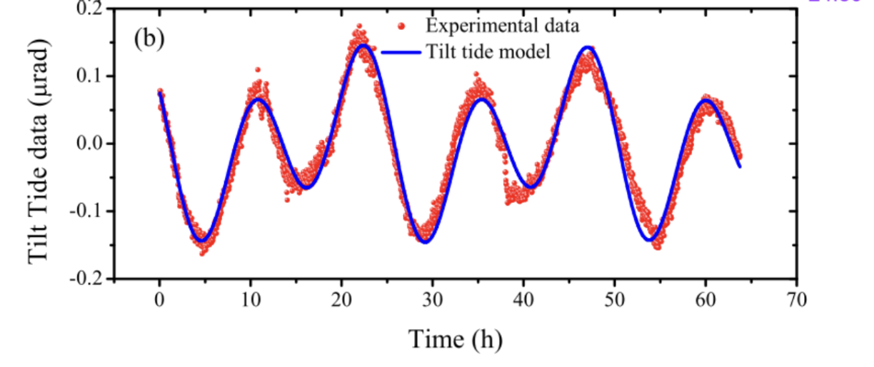
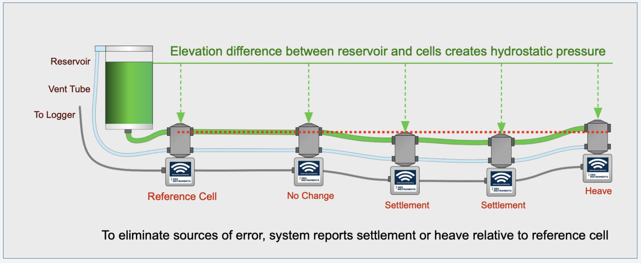
Ring planarity critical to control geometrical phase errors
Numerous studies on slow ground motion in accelerators, Hydrostatic Level System for slow ground motion studies at Fermilab.
Thorough review by Vladimir Shiltsev (FNAL):
https://arxiv.org/pdf/0905.4194.pdf

Slide 40
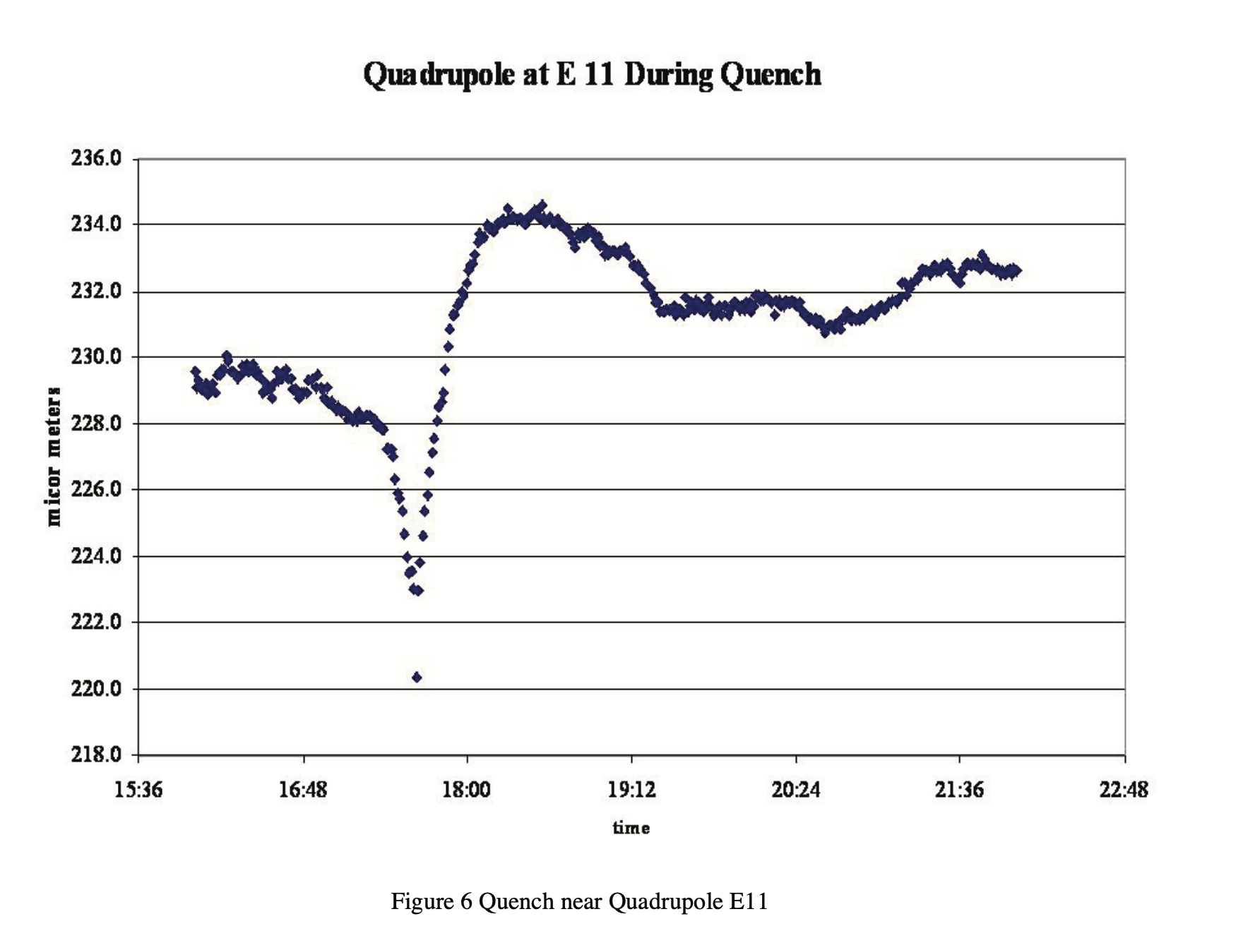

Slide 41
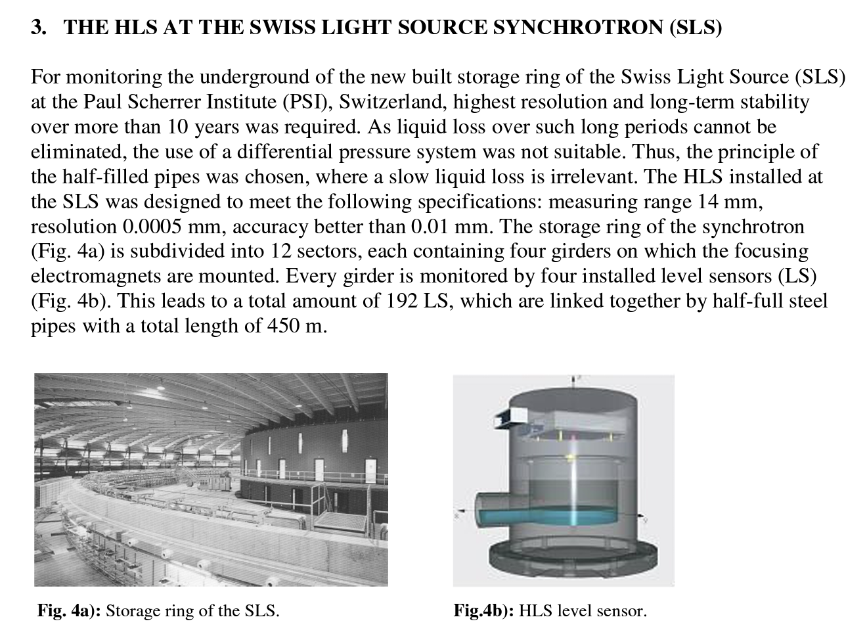
HLS at the Swiss Light Source Synchrotron

Slide 42
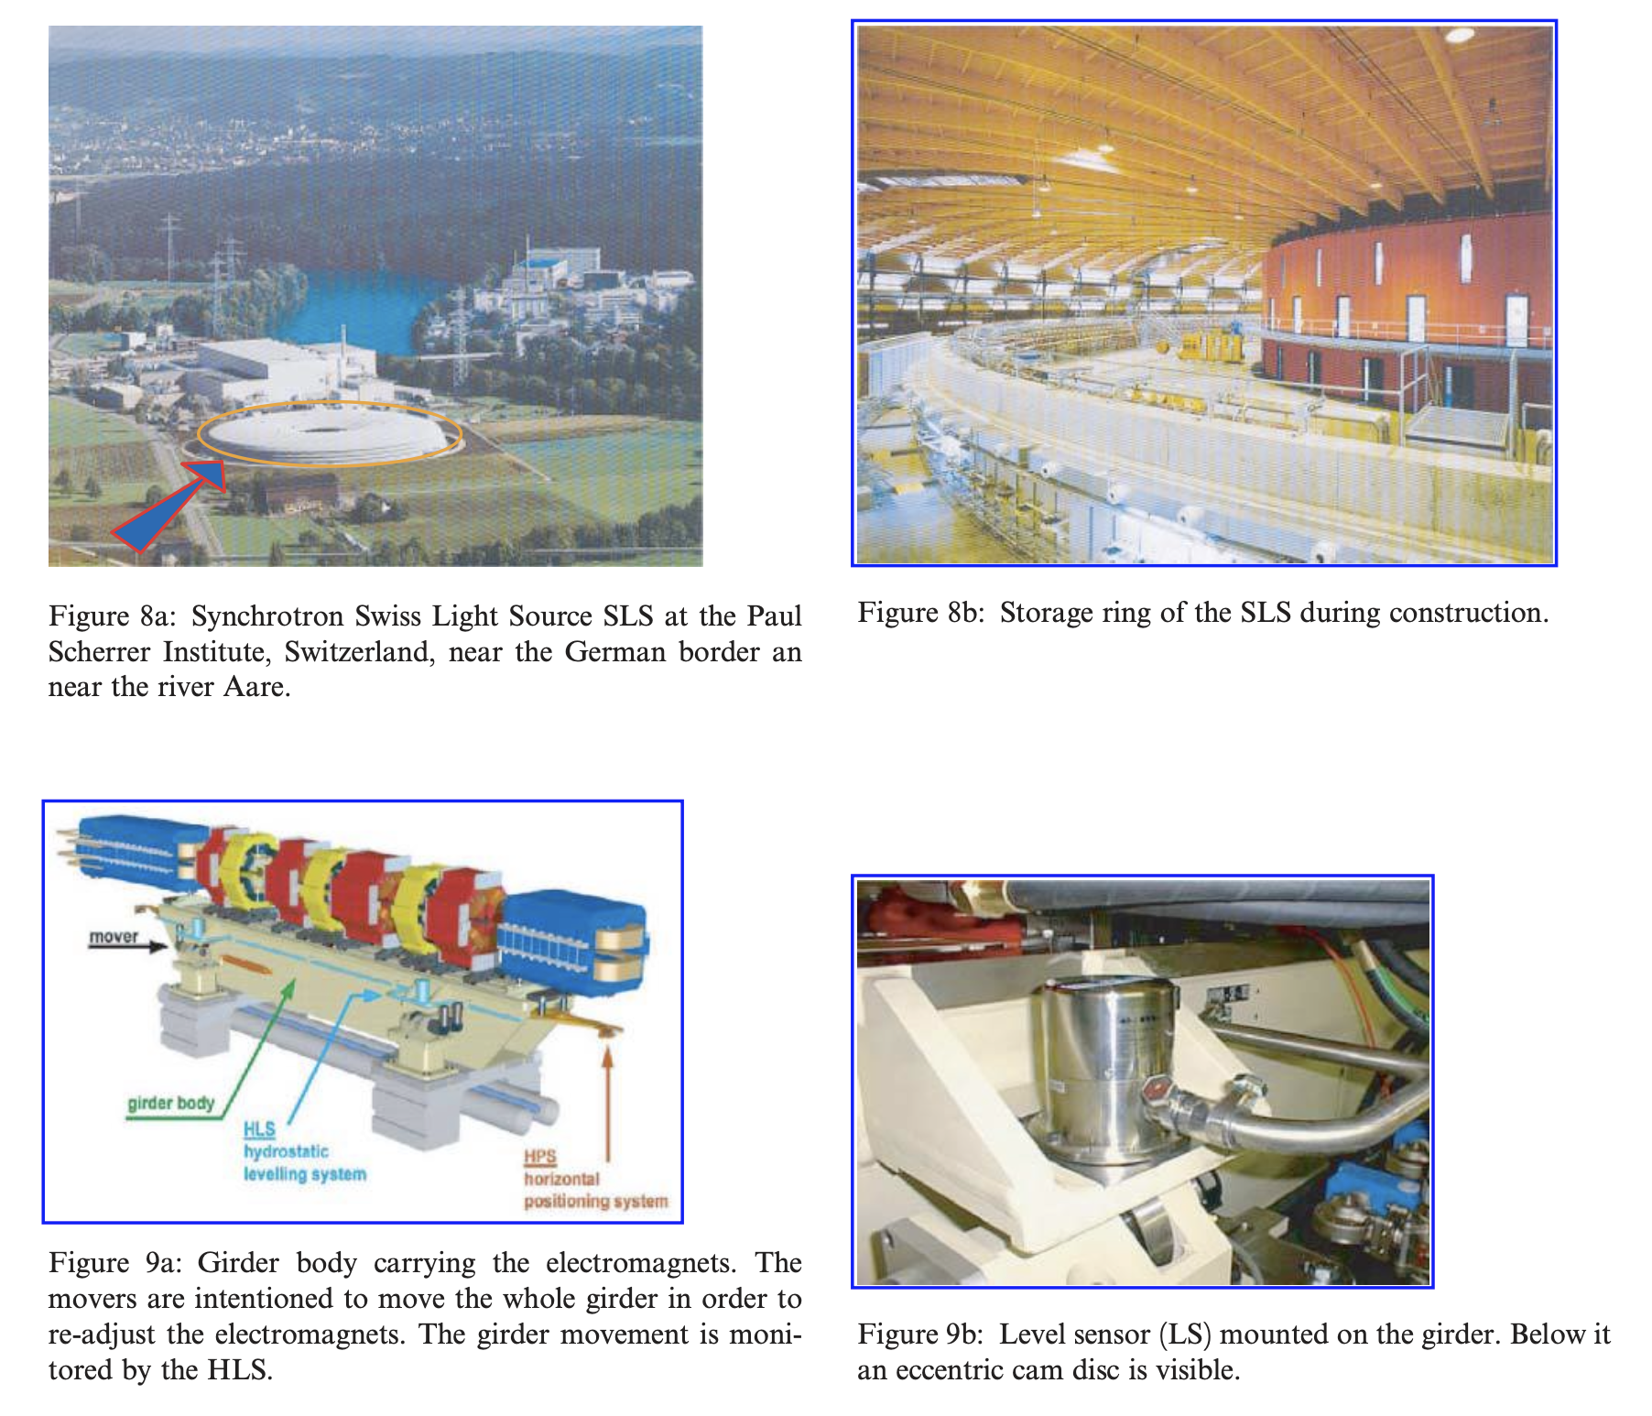
HLS at the Swiss Light Source Synchrotron

Slide 43
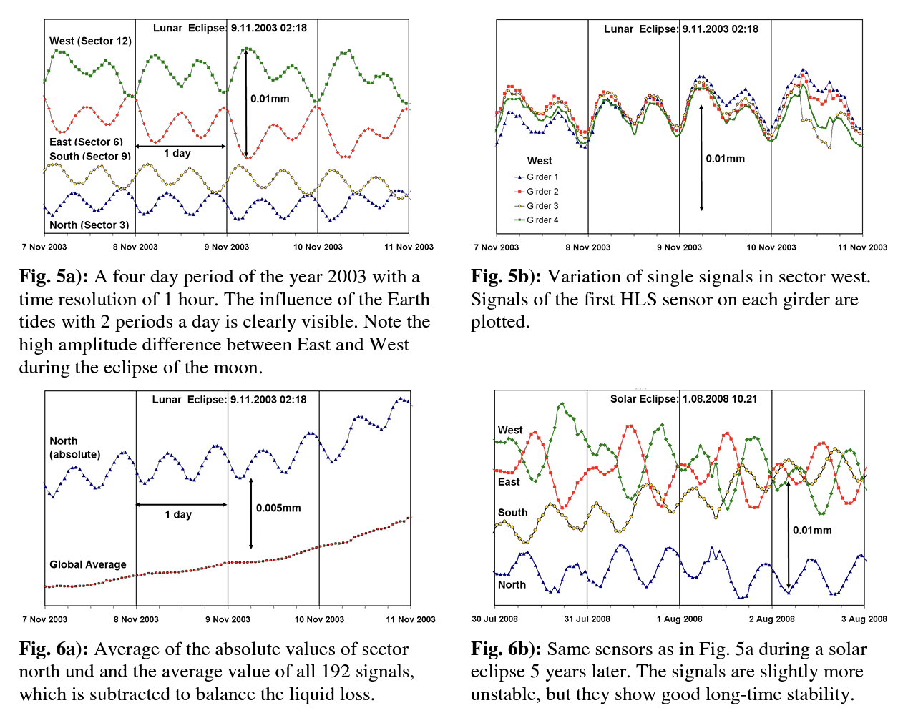
HLS at the Swiss Light Source Synchrotron

Slide 44
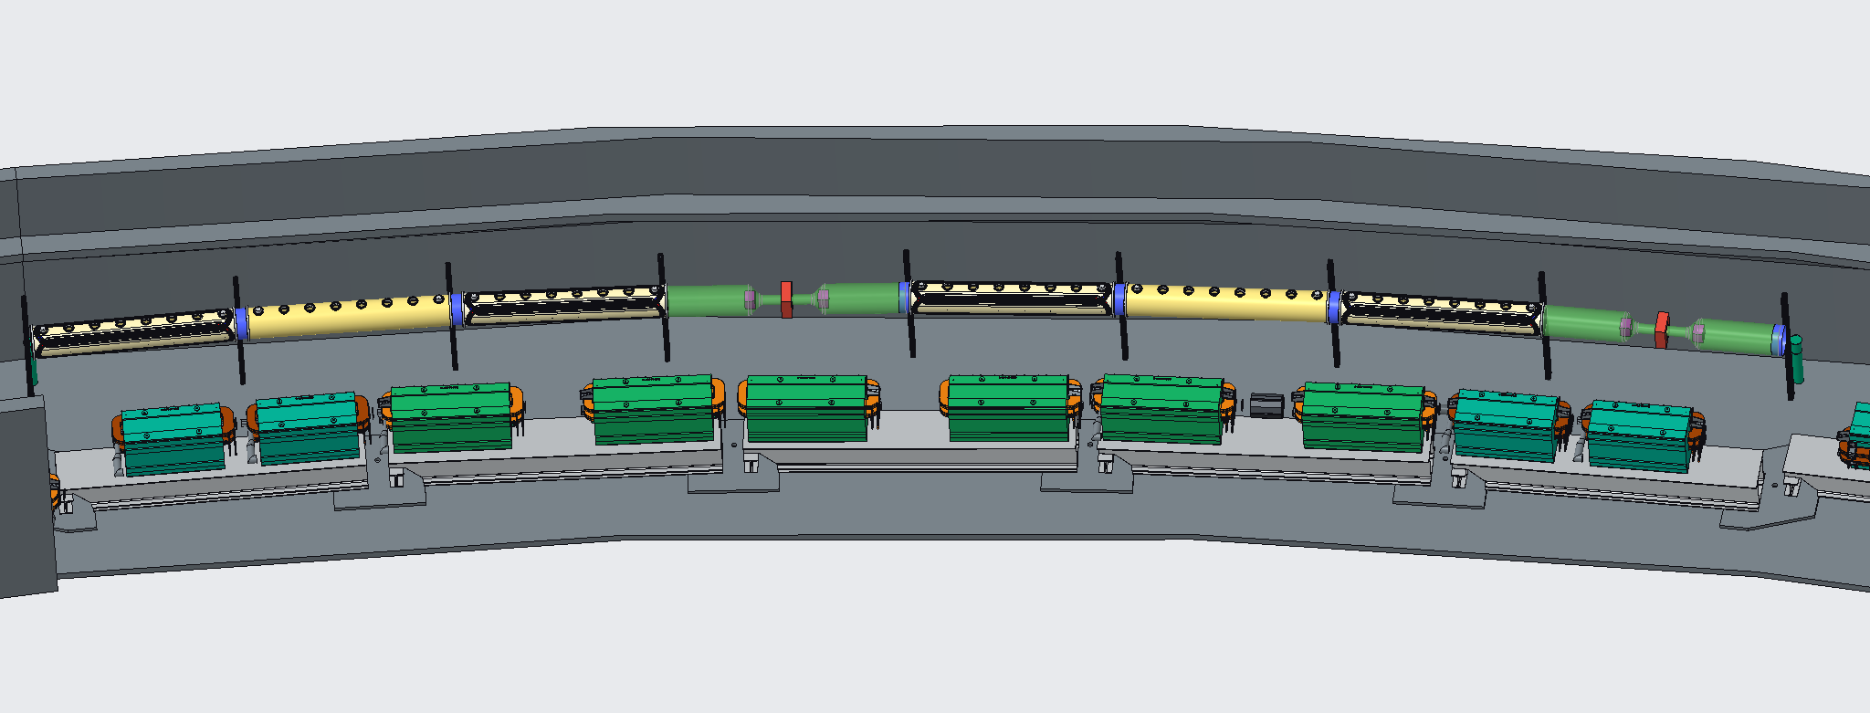
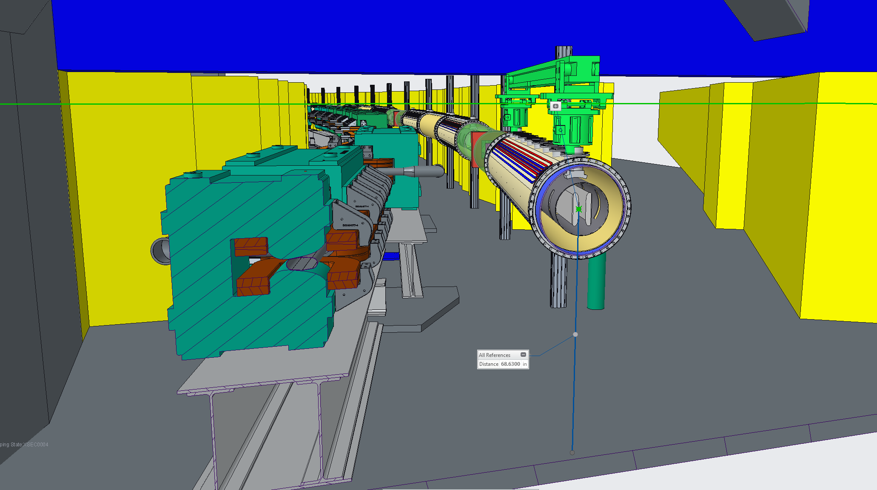
What’s next?
BNL is funding an ongoing R&D, building one unit of the symmetric lattice for a ring in the AGS tunnel.
Develop electric field plates with advanced coating (TiN) for high-voltage (HV). Need DC HV 4.5MV/m and low cathode current.
Studying stochastic cooling for even better statistics experiment with large spin coherence time (SCT).
Simulate beam/spin dynamics of thousands of protons at the same time.
1/24 of ring

Slide 45
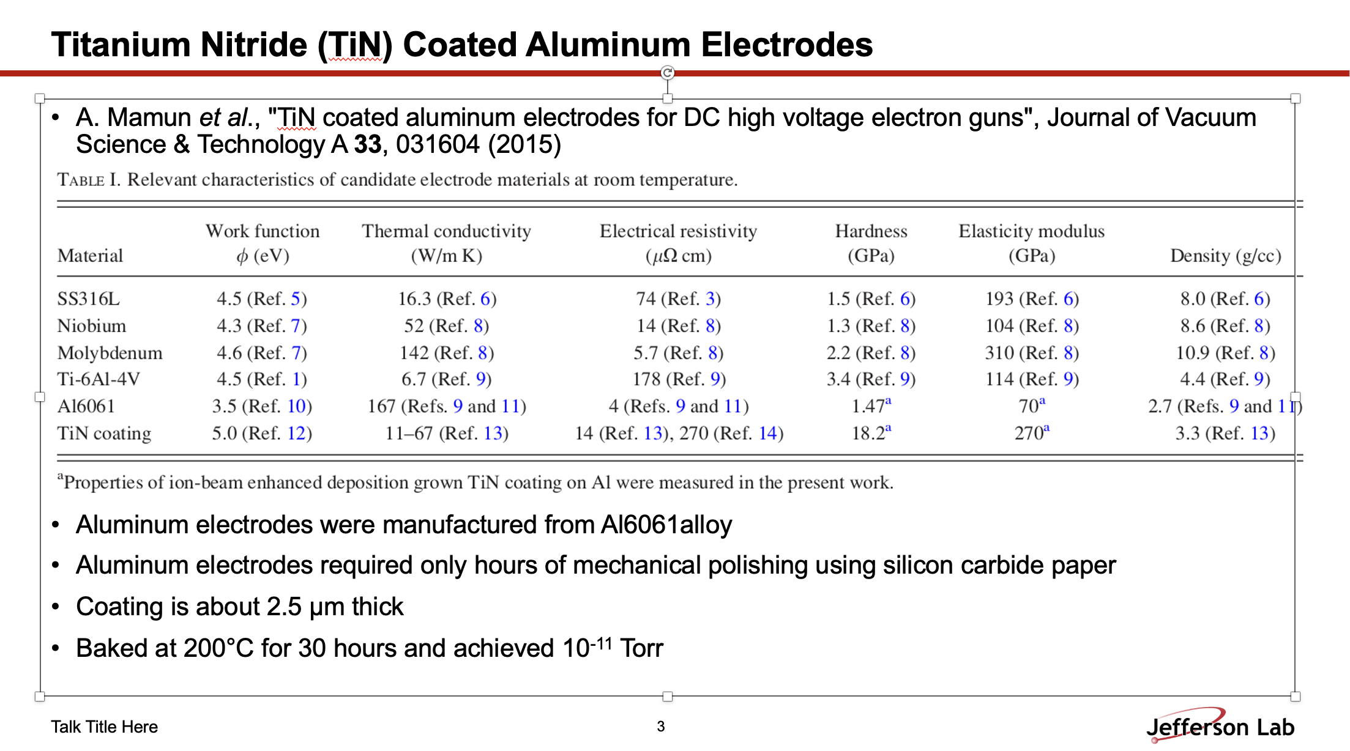
Riad Suleiman’s slide

Slide 46
LDRD work, building 1 sector out of many
HV measurements, requiring 4.5MV/m, tested at 5MV/m and measuring spark rate
Dark current, can live with <1µA, targeting <1nA for every 1m section
Vacuum requirements, 10⁻¹⁰ Torr a few hundred of seconds beam lifetime from IBS
Stochastic cooling, reduce gas-pressure requirement, ‘infinite’ SCT, prolong storage time
Control shape of fringe fields
Ability to apply fields for probing geometric phase effects (combination of two fields)
Probe and cancel electric focusing
Study lattice impedance issues
Alignment stability, make sure fields rotate locally within specs
Equipment cross-compatibility, cross-talk
Spin/beam dynamics simulation of ~10³ particles at a time by multiple teams

Slide 47
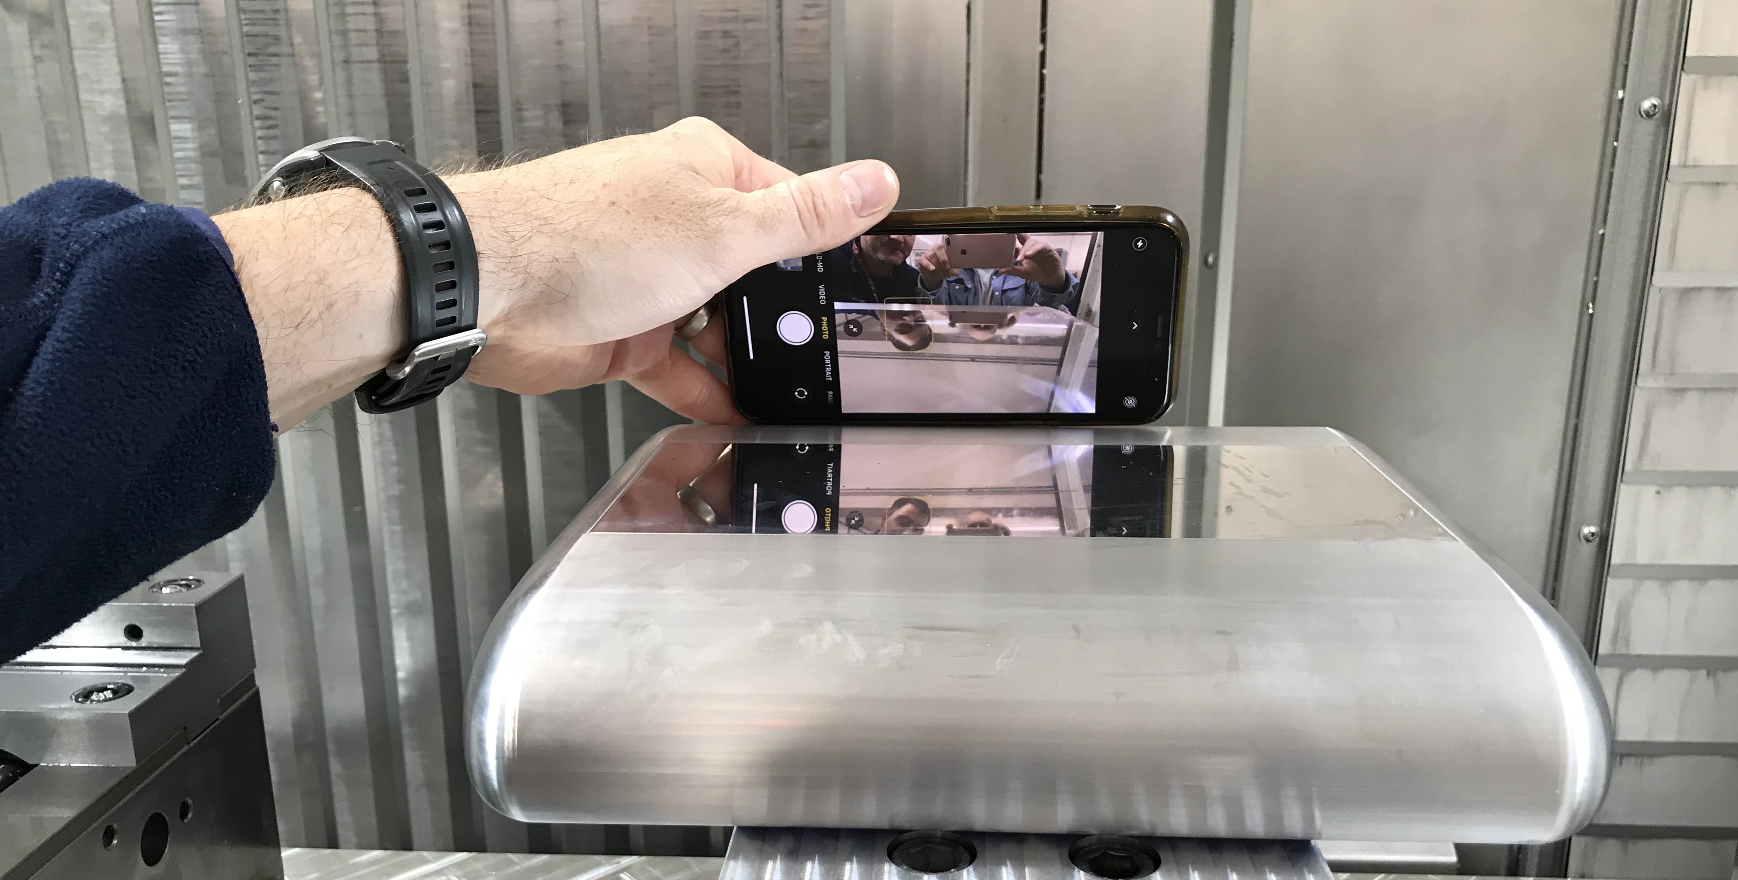
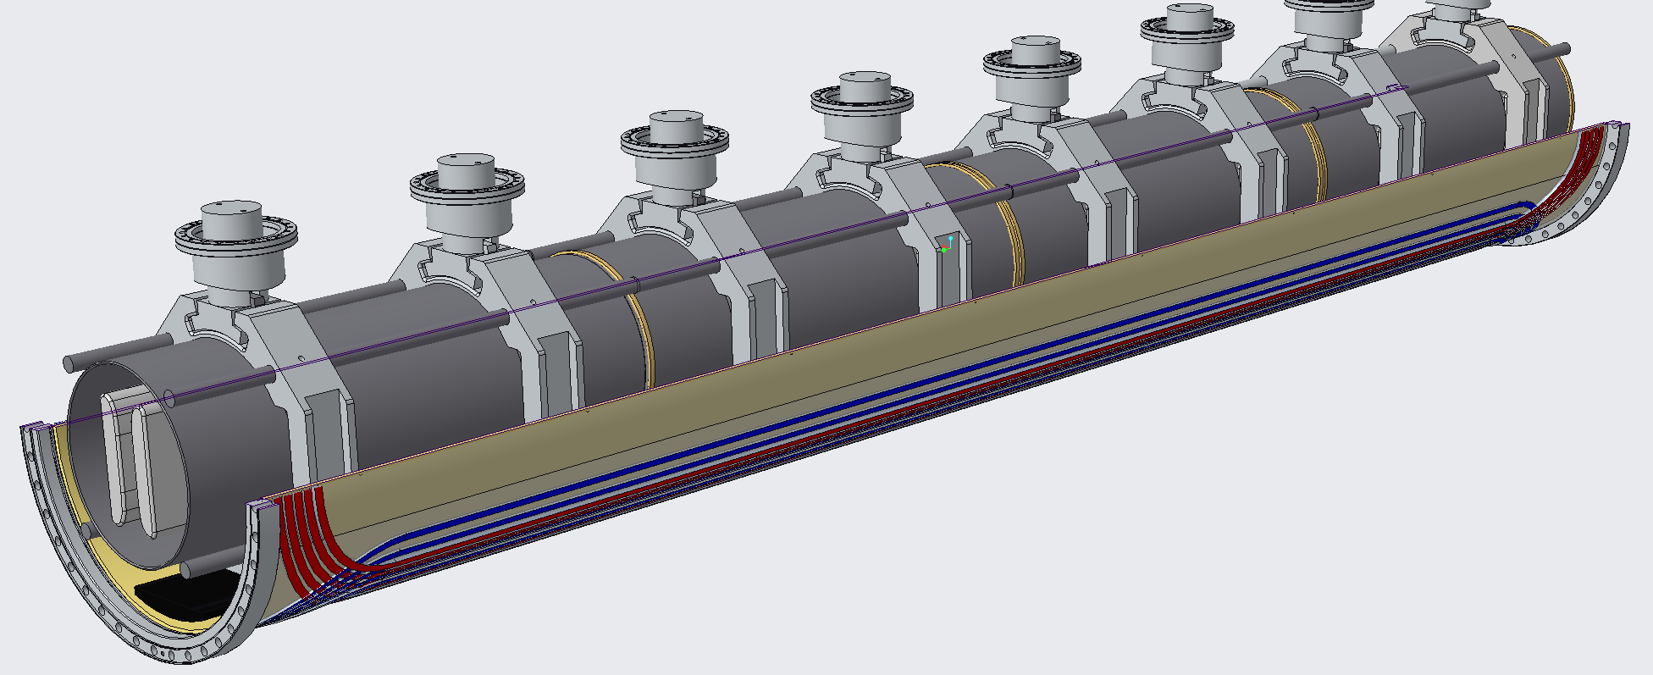
Electric field plates made with sub-micron finish, here at Liverpool Univ.
Liverpool University is designing the plates, and their support. Involved in their construction, high accuracy electric field estimations, methods to minimize high-order fields…

Slide 48
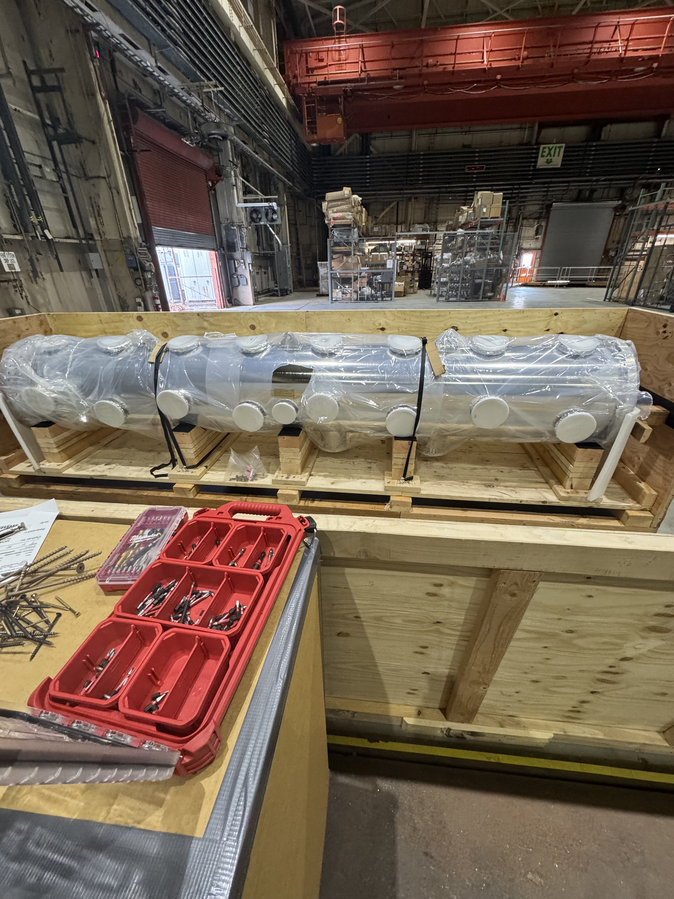
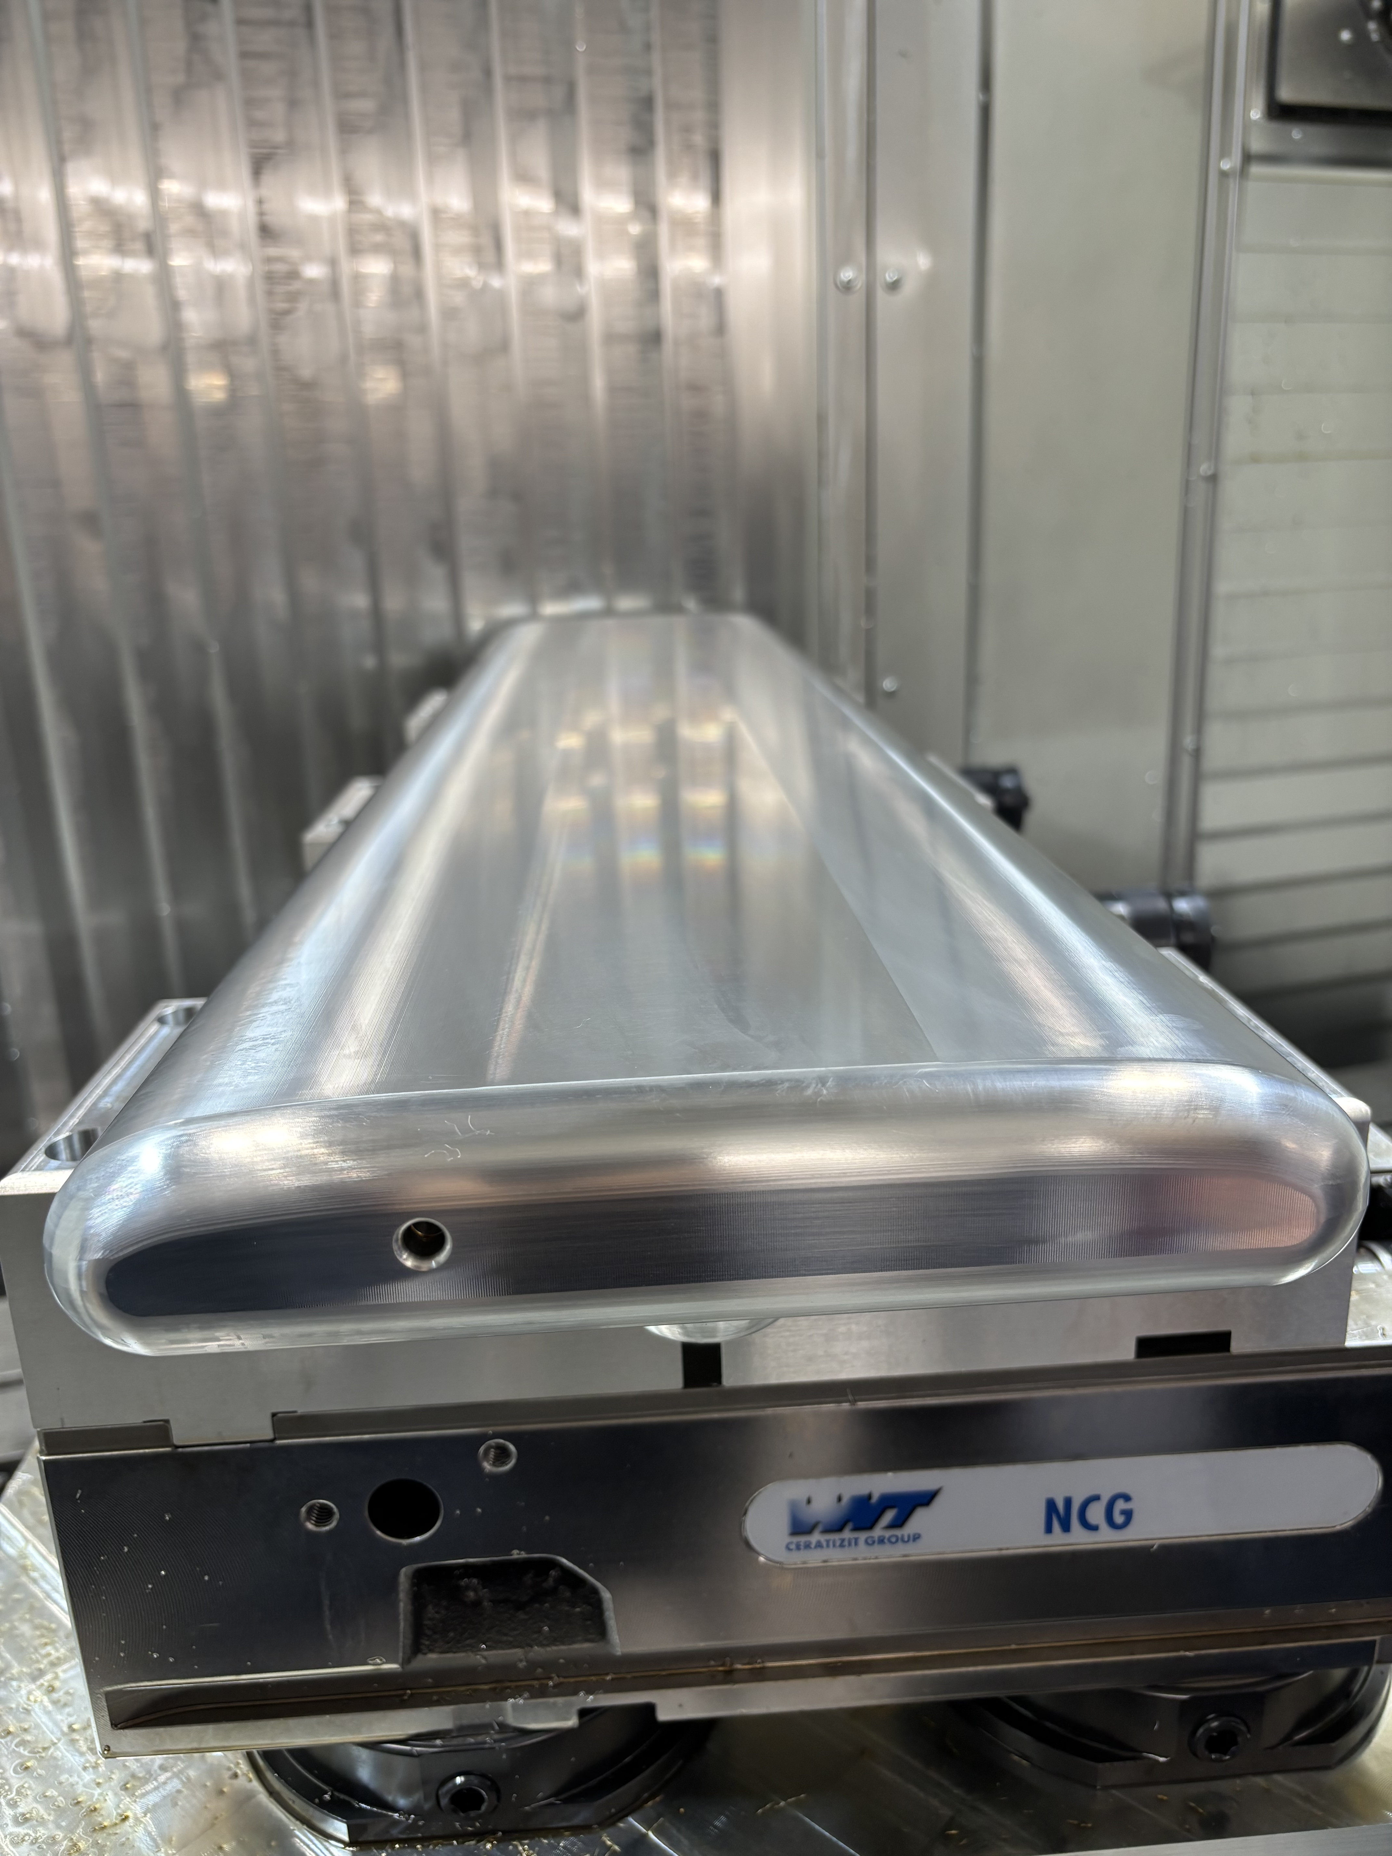
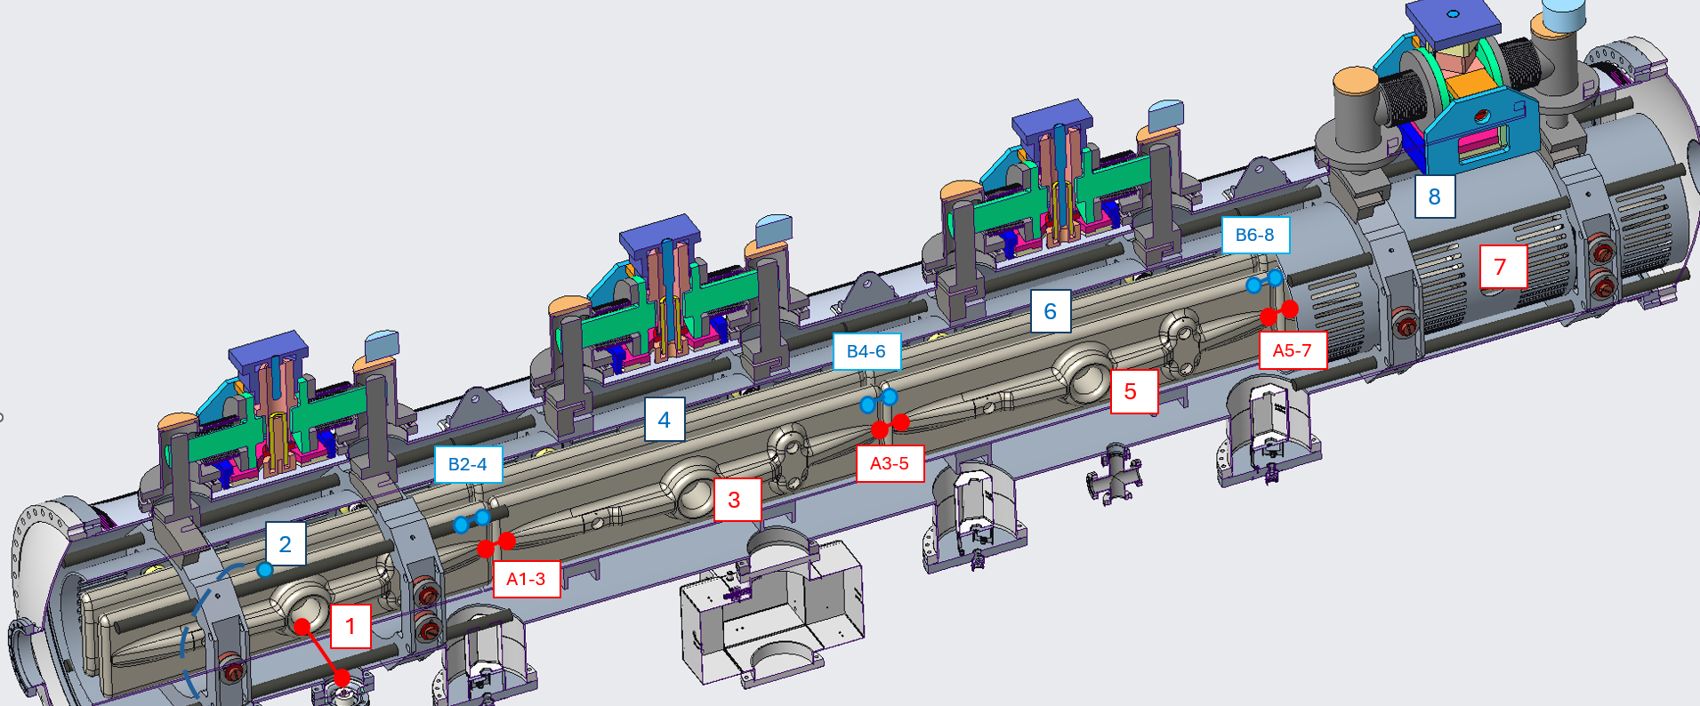
4m “Deflection” chamber, partial section, at BNL.
Liverpool University
1m long unit plate

Slide 49
Storage ring proton EDM at 10⁻²⁹ e-cm at BNL
Statistics for better than 10⁻²⁹ e-cm for pEDM, ~10³ TeV New-Physics reach
Matching systematic error levels, controlled by symmetries
Build with a facility in mind
Proton EDM, simultaneous CW and CCW storage
Deuteron EDM (while running the proton EDM ring measure level of main systematic error source, i.e., E-field direction stability)
³He EDM (neutron equivalent) and if needed pEDM with a hybrid lattice

Slide 50
Hybrid, symmetric lattice storage ring PRD105, 032001 (2021)
Low risk
Strong focusing
Sensitivity goal
10⁻²⁹e-cm

Slide 51
The storage ring pEDM exp. at 10⁻²⁹ e-cm
Required radial E-field <5 MV/m, for 40mm plate separation
Beam and spin dynamics stable for required beam intensity
Spin coherence time >10³s using sextupoles, no stochastic cooling (SC).
With SC, SCT→∞

Slide 52
The srEDM exp. at 10⁻²⁹ e-cm
Alternate magnetic focusing all but eliminates external B-field sensitivity
Symmetric lattice significantly reducing systematic error sources
Required ring planarity <0.1mm; CW & CCW beam separation <0.01mm
Geometrical phases require a combination of two unwanted fields. Enhance one to probe and reduce the other.

Slide 53
Input to hadronic EDM
Theta-QCD (part of the SM)
CP-violation sources beyond the SM
A number of alternative simple systems could provide invaluable complementary information (e.g. neutron, proton, deuteron,…).
At 10⁻²⁹e•cm pEDM is at least an order of magnitude more sensitive than the current nEDM plans

Slide 54
Bill Marciano Snowmass Workshop, September 15, 2020

Slide 55
Bill Marciano Snowmass Workshop, September 15, 2020

Slide 56
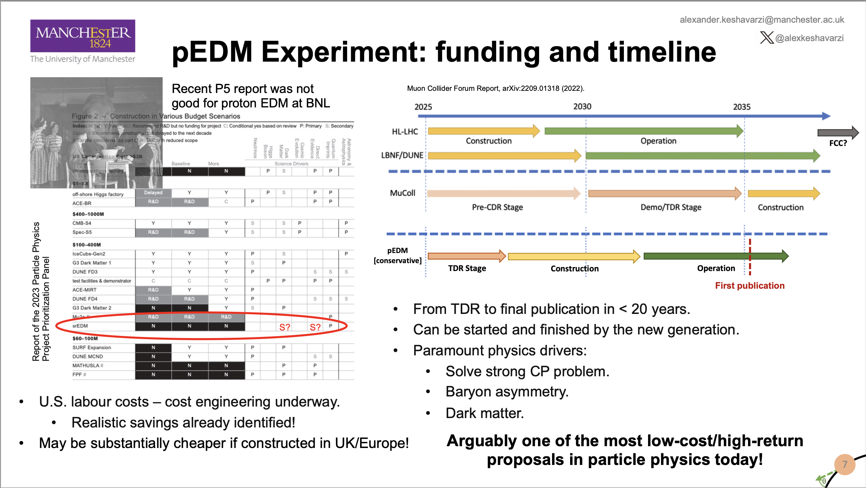
P5 didn’t rank it well despite the excellent Snowmass endorsement!
Alex Keshavarzi’s slide

Slide 57
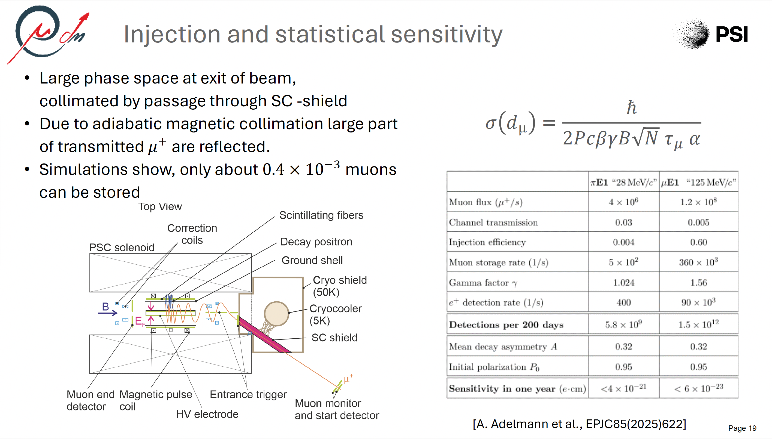
Exciting development: The very first frozen spin storage ring EDM measurement for the muon at PSI!
Slide by Philipp
Schmidt-Wellenburg.
Uses CW vs. CCW
injections plus spin flips for
systematic error suppression.

Slide 58
Summary
Lattice QCD for the hadronic correction might be able to match experimental precision in <5 years. We can do better with the muon g-2 experiment.
EDM physics is must do, exciting and timely, CP-violation, axion physics.
Hybrid, symmetric ring lattice works well. Minimized systematic error sources. Statistics and systematics to 10⁻²⁹e-cm. Recent PhD work confirmed studies by independent tools and gave insight into the symmetry workings.
pEDM lattice with “infinite” SCT and large acceptance provides the statistics
Ring planarity <0.1mm, CW & CCW beam separation <0.01mm
Great complementarity between collider and high-precision physics!
The same ring can be used for the deuteron, and ³He nuclei EDM too. Great Physics program for young people to be done in less than 20 years (Alex K.)

Slide 59
References
S. Karanth et al., First search for axionlike particles in a storage ring using polarized deuteron beam, Phys. Rev. X13, 031004 (2023)
Z. Omarov et al., Comprehensive Symm.-Hybrid ring design for pEDM experiment at below 10⁻²⁹e-cm, Phys. Rev. D 105, 032001 (2023)
P.W. Graham et al., Storage ring Probes for Dark Matter and Dark Energy, Phys. Rev. D 103 (2021) 5, 055010
S. Haciomeroglu and Y.K. Semertzidis, Hybrid ring design in the storage-ring proton EDM experiment, Phys. Rev. Accel. Beams 22 (3), 034001 (2019)
S.P. Chang et al., Axionlike dark matter search using the storage ring EDM method, Phys. Rev. D 99 (8), 083002 (2019)
S. Haciomeroglu et al., SQUID-based Beam Position Monitor, PoS ICHEP2018 (2019) 279
N. Hempelmann et al., Phase locking the spin precession in a storage ring, Phys. Rev. Lett. 119 (1), 014801 (2017)
G. Guidoboni et al., How to reach a Thousand-second in-plane Polarization Lifetime with 0.97 GeV/c Deuterons in a storage ring, Phys. Rev. Lett. 117 (5), 054801 (2016)
V. Anastassopoulos et al., A storage ring experiment to detect a proton electric dipole moment, Rev. Sci. Instrum. 87 (11), 115116 (2016)
E.M. Metodiev et al., Analytical benchmarks for precision particle tracking in electric and magnetic rings, NIM A797, 311 (2015)
E.M. Metodiev et al., Fringe electric fields of flat and cylindrical deflectors in electrostatic charged particle storage rings, Phys. Rev. Accel. Beams 17 (7), 074002 (2014)
W.M. Morse et al., rf Wien filter in an electric dipole moment storage ring: The “partially frozen spin” effect, Phys. Rev. Accel. Beams 16 (11), 114001 (2013)
N.P.M. Brantjes et al., Correction systematic errors in high-sensitivity deuteron polarization measurements, Nucl. Instrum. Meth. A664, 49 (2012)
G.W. Bennett et al., An improved limit on the muon electric dipole moment, Phys. Rev. D 80, 052008 (2009)
F.J.M. Farley et al., A new method of measuring electric dipole moments in storage rings, Phys. Rev. Lett. 93, 052001 (2004)
…

Slide 60
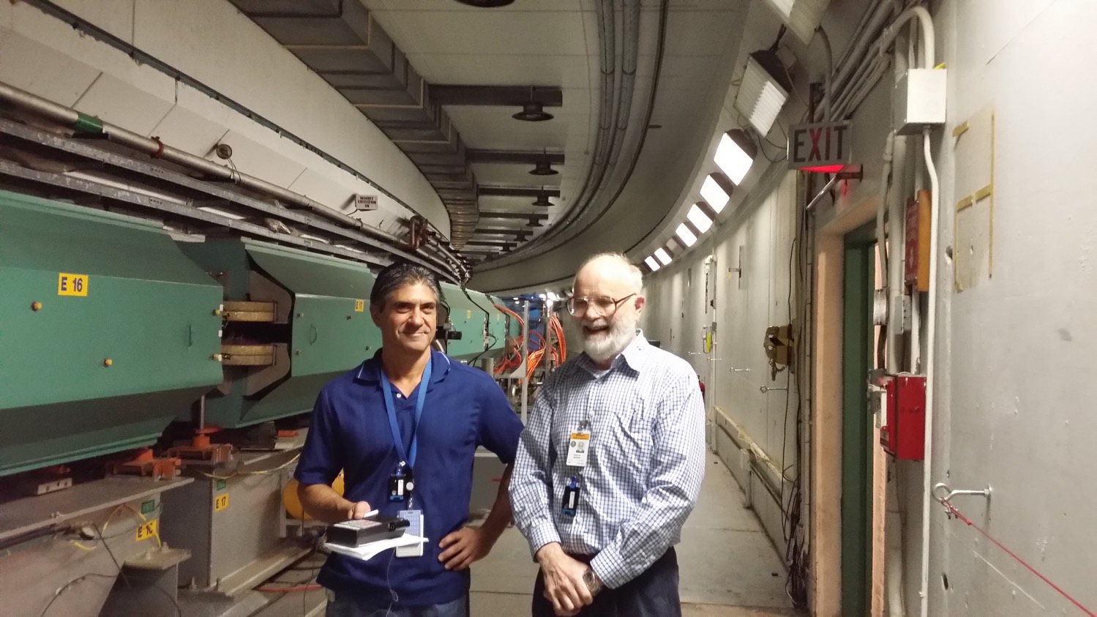
John Benante, Bill Morse in AGS tunnel of BNL, plenty of room for the EDM ring.

Slide 61
1/24 section (15°) of pEDM ring

Slide 62
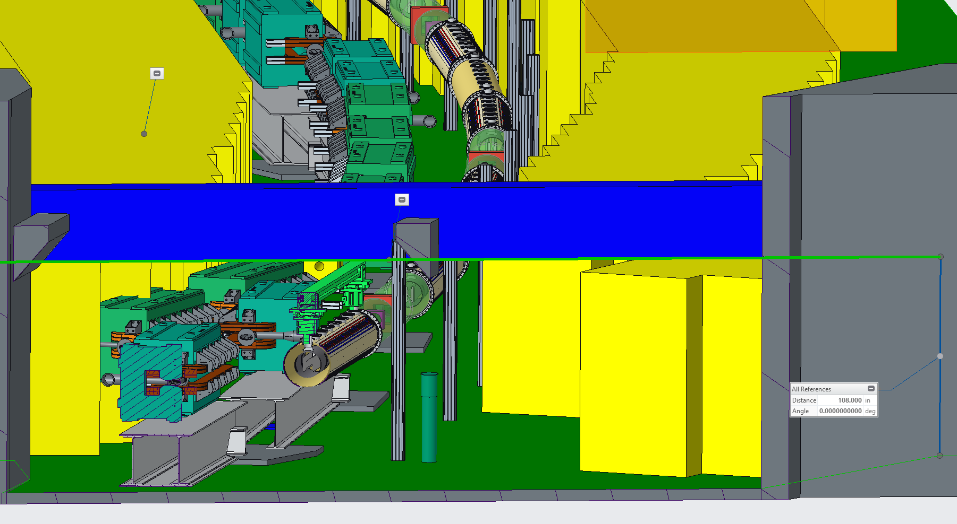
Section at F20 experimental blockhouse
Note: ceiling elevation = 108” (9’-0”)

Slide 63
Classification of systematic errors at 10⁻²⁹ e-cm
Alternate magnetic focusing allows simultaneous CW & CCW storage and shields against external B-fields. Vertical dipole E-fields eliminated (major syst. err. source), its own “co-magnetometer”; unique feature of this lattice.
Symmetric lattice significantly reduces systematic errors associated with vertical velocity (major syst. err. source). Additionally, using longitudinal, radial and vertical polarization directions, monitor potential systematic error sources.
Required ring planarity <0.1mm; CW & CCW beam separation <0.01mm, resolves issues with geometrical phases

Slide 64








Storage ring probes of DM/DE
P. Graham and S. Rajendran, PRD 88, 035023 (2013)
P. Graham et al., PRD 103, 055010 (2021)
Couplings with dark matter (DM) and dark energy (DE)
ALP DM-EDM ($g_{aNγ}a{\hat{σ}}_{N}⋅E$) $⇒$ oscillating EDM at $m_{a}$. For the QCD axion: $d_{N}^{QCD}≈{10}^{−34}\cos\left(m_{a}t\right) e⋅cm$.
ALP or vector DM wind ($g_{aNN}∇a⋅{\hat{σ}}_{N}$) $⇒$ anomalous longitudinal oscillating $B$ field.
DE wind $⇒$ anomalous longitudinal $B$ field.
Storage ring is an optimal probe for wind coupling since $β$ is large!
$$ω_{DM}∝\cos\left(m_{a}t\right)\hat{β}$$
$$ω_{DE}∝\hat{β}$$
$$p$$
DM wind

Slide 65




Storage ring probes of DM/DE
P. Graham and S. Rajendran, PRD 88, 035023 (2013)
P. Graham et al., PRD 103, 055010 (2021)
Couplings with dark matter (DM) and dark energy (DE)
ALP DM-EDM ($g_{aNγ}a{\hat{σ}}_{N}⋅E$) $⇒$ oscillating EDM at $m_{a}$. For the QCD axion: $d_{N}^{QCD}≈{10}^{−34}\cos\left(m_{a}t\right) e⋅cm$.
First experimental application at COSY 2019-2022
ALP-EDM coupling
$$ω_{axion−EDM}∝\cos\left(m_{a}t\right)\hat{x}$$
$$p$$
Storage ring probes of axion-induced oscillating EDM S. Chang et al., PRD 99, 083002 (2019).
Complementary method using an rf Wien filter On Kim and Y. Semertzidis, PRD 104, 096006 (2021)
Parasitic measurement with pEDM experiment
Low frequency: Periodogram analysis.
High frequency: Resonant rf Wien filter.

Slide 66
System | Risk factor, comments
Ring construction, beam storage, stability, IBS | Low. Strong (alternate) focusing, a ring prototype has been built (AGS analog at BNL) in 60’s. Lattice elements placement specs are ordinary. IBS OK below transition.
E-field strength | Low. Plate-units are similar to those ran at Tevatron with higher specs.
E-field plates shape | Low. Make as flat as conventionally possible. Shim out high order fields by intentionally splitting the CR-beams
Spin coherence time | Low. Ordinary sextupoles will provide ~10³s, with stochastic cooling we expect much longer, under study.
Beam position monitors (BPM), SQUID-based BPMs. | Low, medium. Ordinary BPMs and HLS (similar to FNAL’s) to level the ring to better than 0.1mm, Regular split-geometry and/or SQUID-based BPMs to check CR-beams split to 0.01mm.
High-precision, efficient simulations software | Low. We have several of them already, cross-checking our results routinely. Need to scale it up (thousands of particles)
Polarimeter | Low. Mature technology available

Slide 67

Status: what we already have done, what’s missing
Alex Keshavarzi’s slide

Slide 68
Spin Coherence Time
Not all particles have same deviation from magic momentum, or same horizontal and vertical divergence (second order effects)
They Cause a spread in the g-2 frequencies:
Correct by tuning plate shape/straight section length plus fine tuning with sextupoles (current plan) or cooling (mixing) during storage (under evaluation).

Slide 69

Is the polarimeter analyzing power good at P_{magic}? YES!
Analyzing power can be further optimized

Slide 70
E-field plate modules: The (24) FNAL Tevatron ES-separators ran for years with harder specs
Beam position
0.4 m
3 m

Slide 71

E-field plate modules: The (24) FNAL Tevatron ES-separators ran for years with harder specs
Beam position
0.4 m
3 m
Their specs were
<1spark/year at 6MV/m & 5cm plate separation

Slide 72
Large Scale Electrodes
Parameter | Tevatron pbar-p Separators | BNL K-pi Separators | pEDM (low risk)
Length | 2.6m | 4.5m | 12.5m
Gap | 5cm | 10cm | 4cm
Height | 0.2m | 0.4m | 0.2m
Number | 24 | 2 | 48
Max. HV | ±(150-180)KV | ±200KV | ±90KV

Slide 73
Ring planarity critical to control geometrical phase errors
The beam planarity requirement: <0.1mm, within existing technology
Clock-wise (CW) and counter-clock-wise (CCW) beam storage split to <0.01mm. SQUID-based BPMs (S-BPM) resolution: 10nm/sqrt(Hz)!

Slide 75
HLS measurements at Fermilab

Slide 76


Slide 77
Physics strength comparison (Marciano)
System | Current limit [e⋅cm] | Future goal | Neutron equivalent
Neutron | <1.6×10⁻²⁶ | ~10⁻²⁸ | 10⁻²⁸
¹⁹⁹Hg atom | <7×10⁻³⁰ | <10⁻³⁰ | 10⁻²⁶
¹²⁹Xe atom | <6×10⁻²⁷ | ~10⁻²⁹-10⁻³¹ | 10⁻²⁵-10⁻²⁷
Deuteron nucleus |  | ~10⁻²⁹ | 3×10⁻²⁹- 5×10⁻³¹
Proton nucleus | <2×10⁻²⁵ | ~10⁻²⁹ | 10⁻²⁹
From theta-QCD
From SUSY-like CPV
Notes:
77

Slide 78
³He Co-magnetometer
If nEDM = 10⁻²⁶ e⋅cm,
10 kV/cm → 0.1 μHz shift
≅ B field of 2 × 10 ⁻¹⁵ T.
Co-magnetometer :
Uniformly samples the B Field
faster than the relaxation time.
Data: ILL nEDM experiment with ¹⁹⁹Hg co-magnetometer
EDM of ¹⁹⁹Hg < 10⁻²⁸ e-cm (measured); atomic EDM ~ Z² → ³He EDM << 10⁻³⁰ e-cm
Under gravity, the center of mass of He-3 is higher than UCN by Δh ≈ 0.13 cm,
sets ΔB = 30 pGauss (1 nA of leakage current). ΔB/B=10⁻³.

