Slide 1
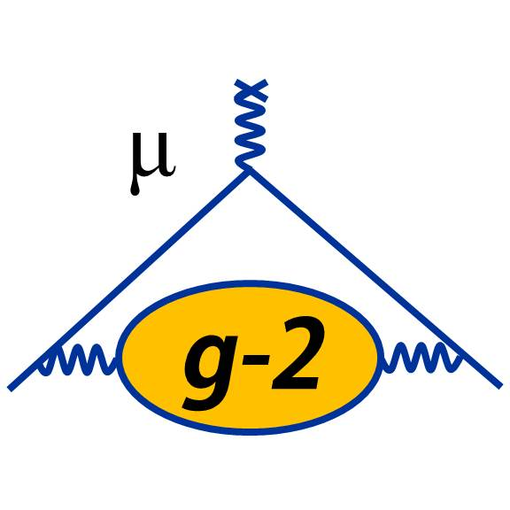



Status of the puzzles of g-2
4th Workshop on Muon Precision Physics The Spine, Liverpool, 11th Nov 2025
Thomas Teubner
Introduction & (not always so) recent history
Main changes in the a_{μ}SM prediction, WP25
  Data and data-driven dispersive HVP evaluations
  vs Lattice QCD+QED
Current & future efforts, pathways to solving the puzzles
Outlook
Disclaimer: Many more detailed/specialist talks later at this workshop

Slide 2
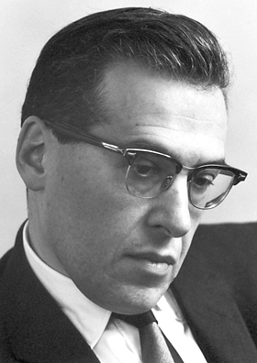
Introduction: it all started with the electron…
1947: small deviations from predictions in hydrogen and deuterium hyperfine structure; Kusch & Foley propose explanation with g = 2.00229 ± 0.00008
1948: Schwinger calculates the famous radiative correction:
➠ g = 2 (1+a), with the anomaly
This explained the discrepancy and was a crucial step
in the development of perturbative QFT and QED ``If you can’t join ‘em, beat ‘em“
In terms of an effective Lagrangian, the anomaly is from the Pauli term:
Note: This is a dimension 5 operator and NOT part of the fundamental (QED) Lagrangian,
but occurs through radiative corrections and is calculable in (Standard Model) theory:

Slide 3
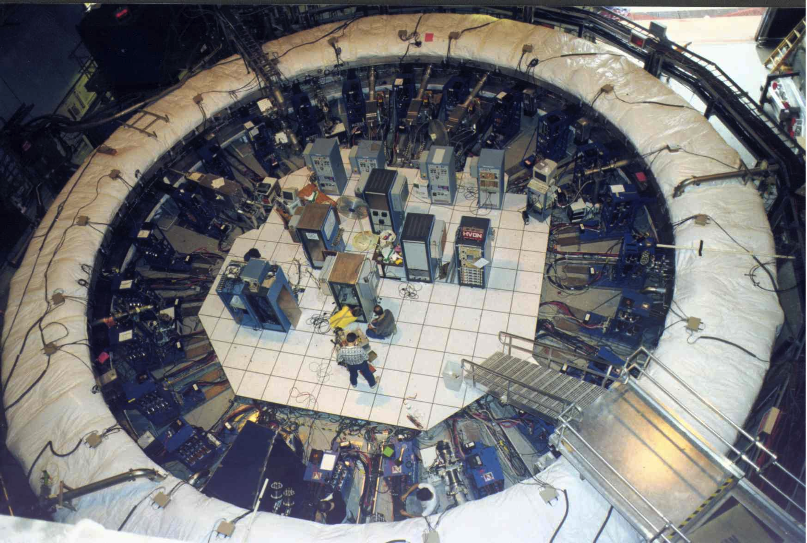
Short detour: a_{e} vs. a_{μ} and why we want to study the muon
a_{e}= 1 159 652 180.73 (0.28) 10⁻¹² [0.24ppb] a_{μ}= 116 592 089(63) 10⁻¹¹ [0.54ppm]
Hanneke et al., PRL 100(2008)120801 @ Harvard Bennet et al., PRD 73(2006)072003 @ BNL
one-electron quantum cyclotron
a_{e}^{EXP} more than 2000 times more precise than a_{μ}^{EXP}, but for e⁻ loop contributions come from very small photon virtualities, whereas muon `tests’ higher scales
dimensional analysis: sensitivity to NP (at high scale Λ_{NP}):
μ wins by for NP, a_{e} `determines’ α, tests QED & low scales
[Note: 𝜏 too short-lived for storage-rings, hard to get precision at colliders]

Slide 4
a_{e} current status (exp @ Northwestern): PRL 130 (2023) 7, 071801
[arXiv:2209.13084]
SM theory prediction depends strongly
on α, but measurements with Cs and
Rb disagree by 5.4σ :
Figures from Muon g-2 Theory Initiative WP25
[Phys. Rept. 1143 (2025) 1-158]
⟵ Translation to derived value of α

Slide 5
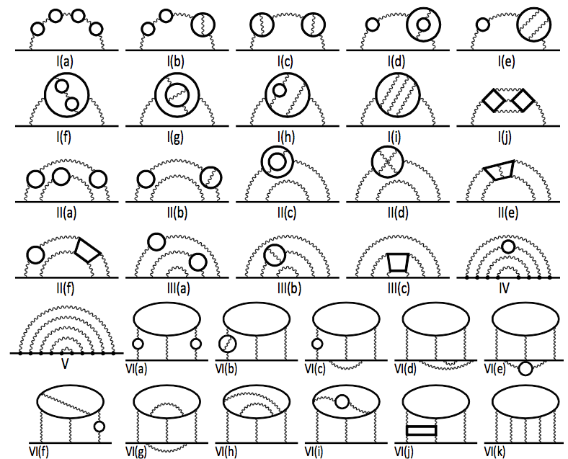
a_{μ}^{QED} & a_{μ}^{weak} : a triumph for perturbative QFT
QED: Kinoshita et al. + many tests
g-2 @ 1, 2, 3, 4 & 5 loops
Subset of 12672 5-loop diagrams:
code-generating code, incl renormalisation
multi-dim. numerical integrations
including now consolidation of numerical 5-loop (analytical: Stefano Laporta’s talk)
latest update (WP25):
a_{μ}^{QED} = 116 584 718.8 (2) × 10⁻¹¹ ✓
Weak: (several groups agree)
done to 2-loop order, 1650 diagrams
the first full 2-loop weak calculation
latest update (WP25):
a_{μ}^{weak} = 154.4 (4) × 10⁻¹¹ ✓
SM weak 1-loop diagrams

Slide 6
a_{μ}^{hadronic} : non-perturbative, the limiting factor of the SM prediction
q₁²
q₃²
q₂²
q²
Q: What’s in the hadronic (Vacuum Polarisation & Light-by-Light scattering) blobs?
A: Anything `hadronic’ the virtual photons couple to, i.e. quarks + gluons + photons
But: low q² photons dominate loop integral(s) ➠ cannot calculate blobs with perturbation theory
Two very different (model independent) strategies:
  use wealth of hadronic data, `data-driven dispersive methods’:
    data combination from many experiments, radiative corrections required
  simulate the strong interaction (+photons) w. discretised Euclidean space-time, `lattice QCD’:
    finite size, finite lattice spacing, artifacts from lattice actions, QCD + QED needed
    numerical Monte Carlo methods require large computer resources

Slide 7
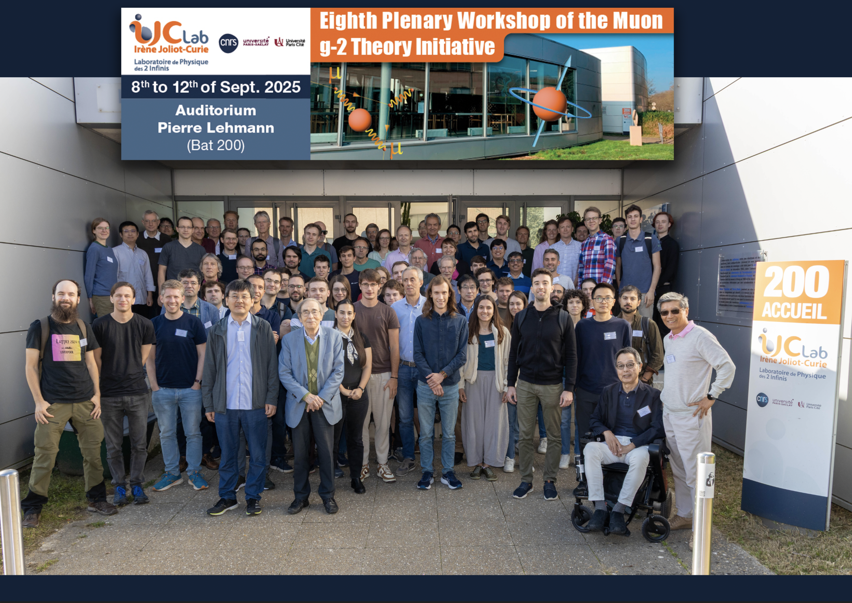
Muon g-2 Theory Initiative est. 2017 https://muon-gm2-theory.illinois.edu
Organised 13 int. workshops in 2017-2024
White Paper 2020 posted 10 June 2020 (132 authors, from 82 institutions, in 21 countries)
  ``The anomalous magnetic moment of the muon in the Standard Model’’ [Phys. Rept. 887 (2020) 1-166]
White Paper 2025 ``… : an update’’ [Phys. Rept. 1143 (2025) 1-158]
Group photo from the Orsay workshop in September 2025
Mission: ``… map out strategies for obtaining the
best theoretical predictions for these hadronic corrections
in advance of the experimental result.’’

Slide 8
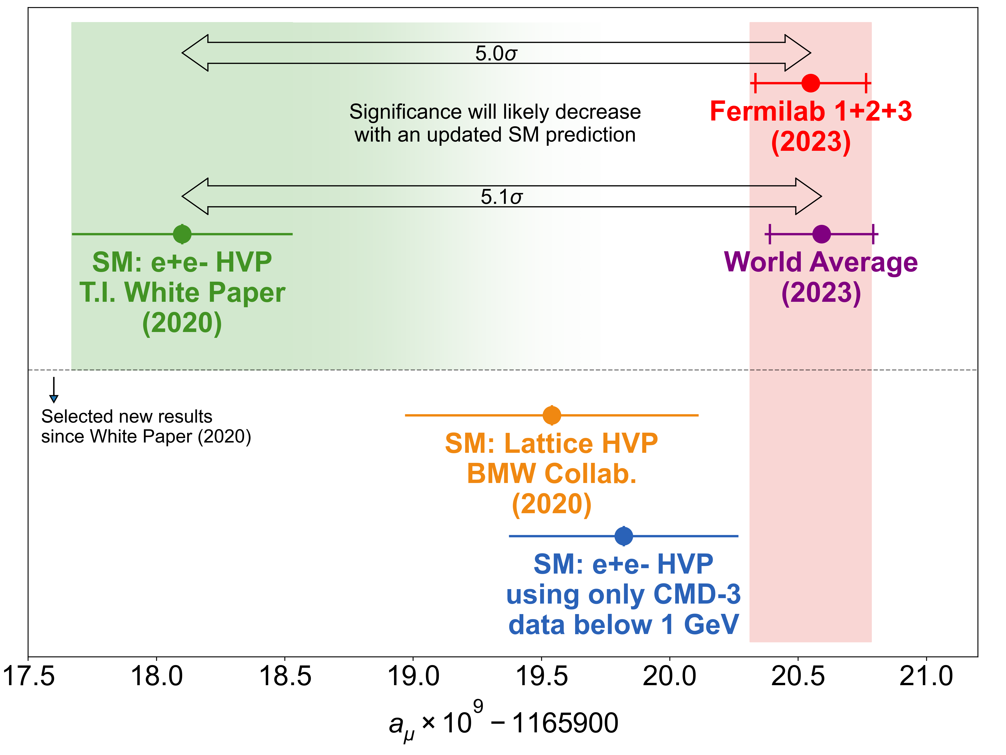
SM (WP20) vs. Experiment, after FNAL run2+3 results
Measurement of the Positive Muon
Anomalous Magnetic Moment to 0.46 ppm
[Phys. Rev. Lett. 126 (2021) 14, 141801]
… to 0.20 ppm [PRL 131 (2023) 16, 161802]
White Paper [T. Aoyama et al., Phys. Rept. 887 (2020) 1-166]
0.37 ppm
!! No official
TI predictions:
➥
➤ SM uncertainty dominated by
hadronic contributions,
now with δ HVP > δ HLbL
… seemed close to a NP discovery?!

Slide 9
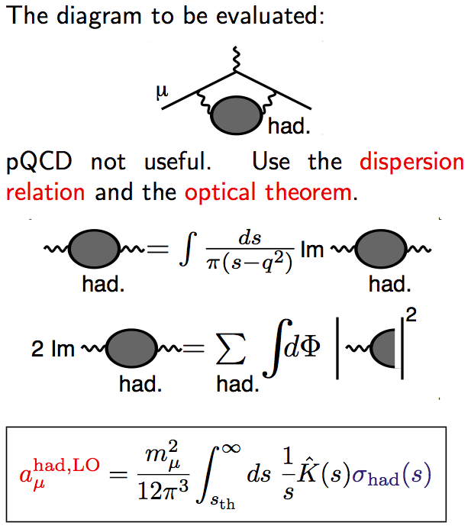
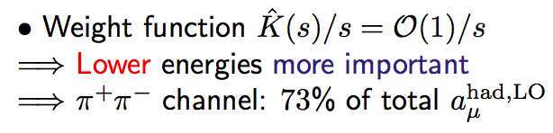
a_{μ}^{HVP} : Basic principles of dispersive data-driven method
One-loop diagram with hadronic blob =
integral over q² of virtual photon, 1 HVP insertion
Causality ➠ analyticity ➠ dispersion integral:
obtain HVP from its imaginary part only
Unitarity ➠ Optical Theorem:
imaginary part (`cut diagram’) =
sum over |cut diagram|² , i.e.
∝ sum over all total hadronic cross sections
q²
✂️
Total hadronic cross section σ_{had} from ~ 250 data sets for e⁺e⁻ ➞ hadrons in ~ 50 final states
Uncertainty of a_{μ}^{HVP} prediction from statistical & systematic uncertainties of input data
pQCD only at large s, no modelling of σ_{had}(s), direct data integration
The method is solid beyond doubt

Slide 10
a_{μ}^{HVP} : Higher orders & power counting; WP20 values in 10⁻¹¹
➤ All hadronic blobs also contain photons,
i.e. real + virtual corrections in σ_{had}(s)
LO: 6931(40)
NLO: - 98.3(7)
from three classes of graphs:
- 207.7(7) + 105.9(4) + 3.4(1) [KNT19]
(photonic, extra e-loop, 2 had-loops)
NNLO: 12.4(1) [Kurz et al, PLB 734(2014)144,
see also F Jegerlehner]
from five classes of graphs:
8.0 - 4.1 + 9.1 - 0.6 + 0.005
➥ good convergence,
iterations of hadronic blobs _very_ small
➠ `double-bubbles’ very small

Slide 11
a_{μ}^{HLbL} : Hadronic Light-by-Light: Dispersive approach
Dispersive analyses have matured in recent years and provide precise results without relying on (and not contradicting earlier) hadronic model calculations

Slide 12
a_{μ}^{HLbL} : WP25 Summary of Hadronic Light-by-Light contributions
New, precise data-driven dispersive (`phenomenology’) & lattice results are consistent
Their combination has improved the WP25 prediction of a_{μ}^{HLbL} to a precision of 8.5% ✓

Slide 13
HVP: Recent (of >30 years) experiments providing input σ_{had}(s) data
Different methods: `Direct Scan’ (tunable e⁺e⁻ beams) &
`Radiative Return’ (Initial State Radiation scan at fixed cm energy) ➚
Over last decades detailed studies of radiative corrections & Monte Carlo Generators for σ_{had}(s)
➤ RadioMonteCarLow Working Group report: Eur. Phys. J. C66 (2010) 585-686
➤ full NLO radiative corrections in ISR MC Phokhara: Campanario et al, PRD 100(2019)7,076004

Slide 14
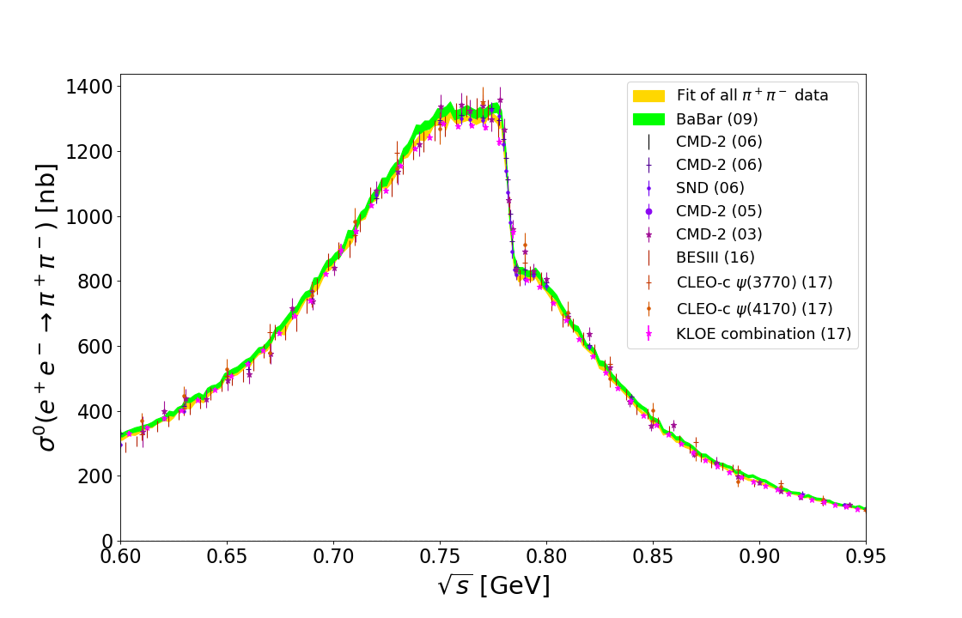
HVP disp: Landscape of σ_{had}(s) data. Most important 𝛑⁺𝛑⁻ channel
[KNT18, PRD97, 114025]
hadronic channels for energies below 2 GeV
dominance of 2𝛑
𝛑⁺𝛑⁻ :
[KNT19, PRD101, 014029]
Combination of >30 data sets, >1000 points, contributing >70% of total HVP
Precise measurements from 6 independent experiments with different systematics and different radiative corrections
Dominated by Radiative Return, tensions could be accommodated by error inflation
Until the CMD-3 result in 2023 (not in here → )

Slide 15
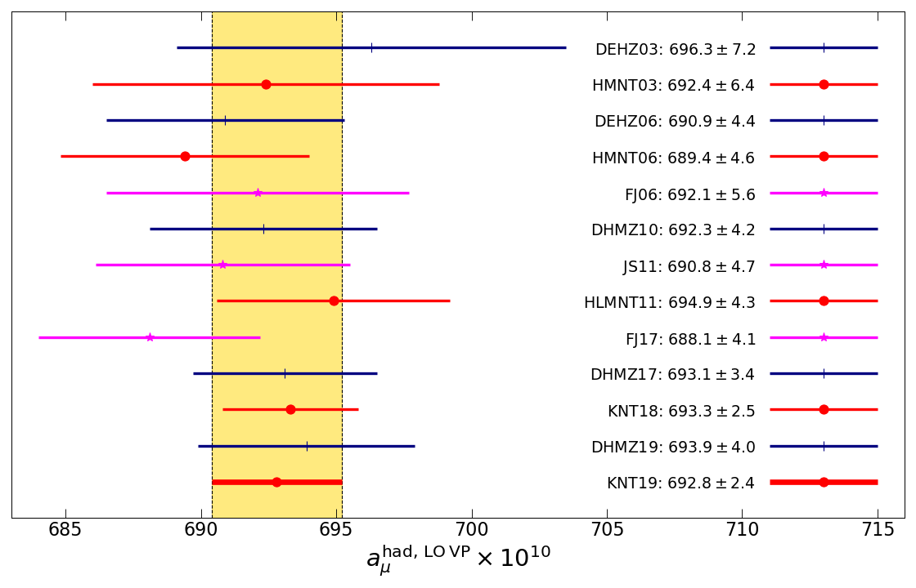
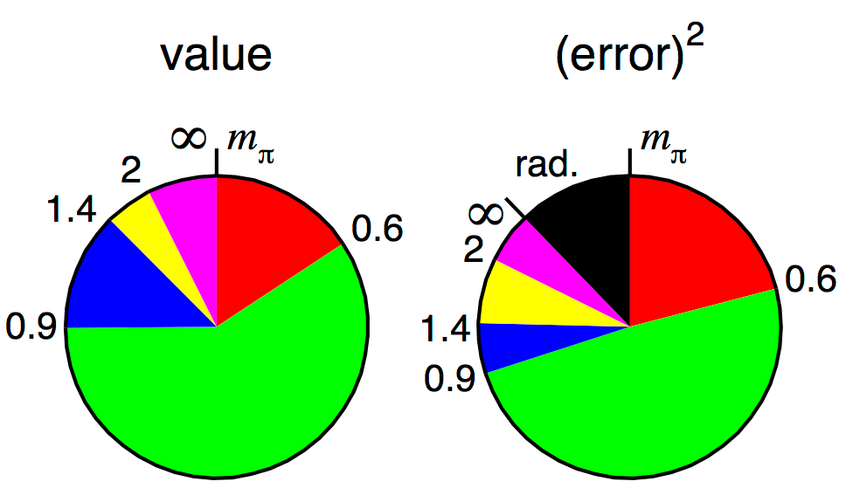
a_{μ}^{HVP} : > 20 years of data based predictions, `pies’
Stability and consolidation over two decades thanks to more and better data input and improved compilation procedures
Compare with merged DHMZ & KNT value in 2020 TI WP:
a_{μ}^{had, LO VP}(WP20) = 693.1(4.0)×10⁻¹⁰
Pie diagrams for KNT compilation:
error dominated by the two pion channel
significant contribution to error from additional uncertainty from radiative corrections
From 2023: Is all this invalidated by the CMD-3 data?

Slide 16
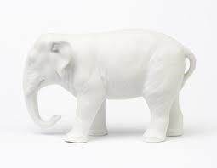
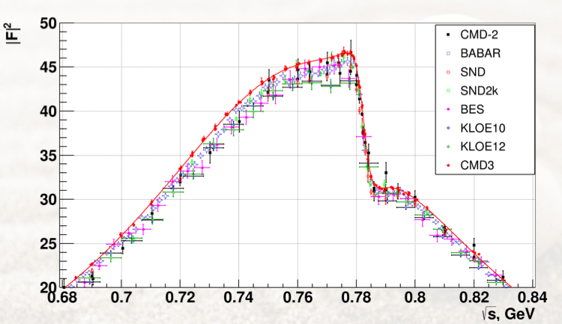
CMD-3 𝛑⁺𝛑⁻ data vs. other experiments
Figure from Fedor Ignatov’s TI talk 27.3.2023
PRD 109(2024)11,112002 PRL 132(2024)23,231903

Slide 17
Theory Initiative: Sep. 2023 workshop at Bern
Michel Davier’s summary of the `49 Questions to CMD-3’ (all answered by Fedor Ignatov):
In my opinion, these statements still stand.

Slide 18
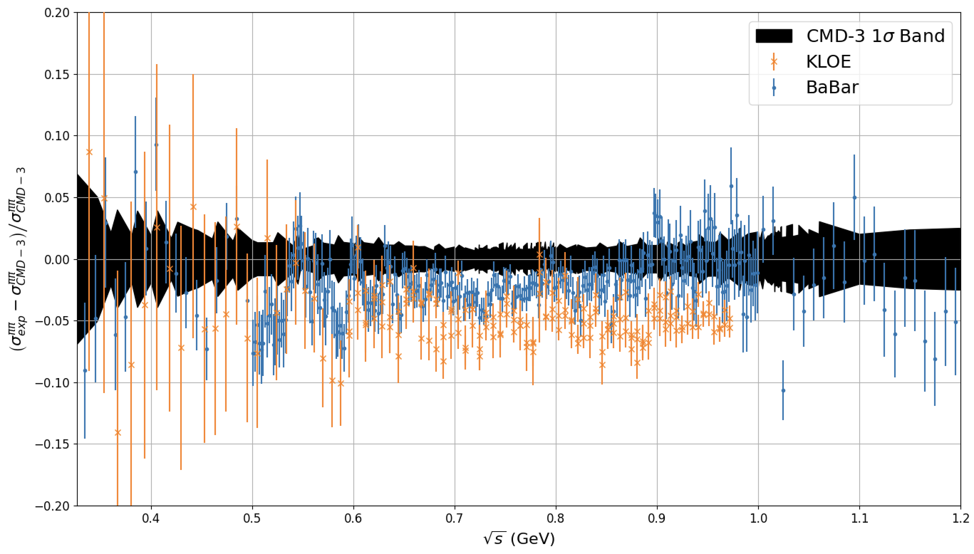
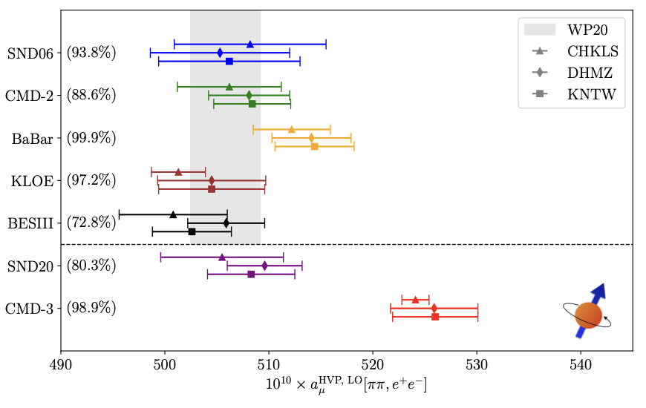
a_{μ}^{HVP} : 𝛑⁺𝛑⁻ data tensions: KLOE vs. Babar vs. CMD-3 puzzle
CMD-3 spectrum much higher than all other previous data
tensions with BaBar (~2.5σ) and KLOE (~5σ)
no errors found despite significant efforts
Theory Initiative’s WP25:
detailed discussion of data, combination methods and theory inputs, but
NO data-driven a_{μ}^{HVP} `average’
For more details on HVP dispersive see Aidan Wright’s talk tomorrow morning

Slide 19
a_{μ}^{HVP} : Lattice result from BMW [Borsanyi et al., Nature 2021]
First full lattice prediction with errors matching the data-driven approach
Current-current correlators, summed over all distances and integrated over time (TMR)
Using a L∼6fm lattice (11fm for finite size corrections)
Physical quark masses
Strong + QED isospin breaking corrections

Slide 20
a_{μ}^{HVP} : Tension between data-driven & BMW. Systematics
BMW20 [Borsanyi et al, arXiv:2002.12347, 2021 Nature]
BMW20: large systematics from continuum limit,
large taste-breaking corrections (`SRHO’)
upper right panel: limit and uncertainty estimation
lower right panel: limit for central `window’ compared
to other lattice and data-driven results (3.7σ tension)

Slide 21
a_{μ}^{HVP} : Window method for more detailed comparison

Slide 22
a_{μ}^{HVP} : Window method for more detailed comparison
Correspondence to kernels for comparison with (time-like) dispersive approach:
Windows for lattice ↔ approximate, wide regions for dispersive
Fig.: G. Colangelo, PWA12/ATHOS7 2021

Slide 23
a_{μ}^{HVP} : Window method for detailed comparisons (WP25)
Comparison of the leading connected ud quark contributions to a_{μ}^{HVP, LO}, in the three windows and for the total contribution, between data-driven and lattice results
Discrepancies are clearly established, unless CMD-3 is used as input for the data-driven evaluation
For more details on lattice HVP see Davide Giusti’s talk tomorrow morning

Slide 24
a_{μ}^{HVP} : Summary plot for HVP comparison from WP25
Comparison of predictions for the full a_{μ}^{HVP, LO} from data-driven dispersive (including tau-based*) and lattice approaches
The red band represents the current experimental uncertainty from the latest FNAL results
Agreement between different averages for the lattice-based predictions
Th error bands :-!
* See Martin Hoferichter’s talk on Thursday for latest news on tau

Slide 25
a_{μ} : Final WP25 summary table

Slide 26
a_{μ} : Final WP25 summary plot
For WP25, the pendulum has swung. Will it stay? My opinion: too early to tell!

Slide 27
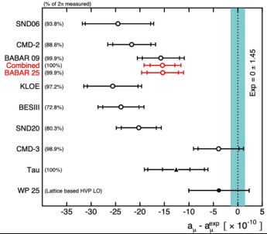
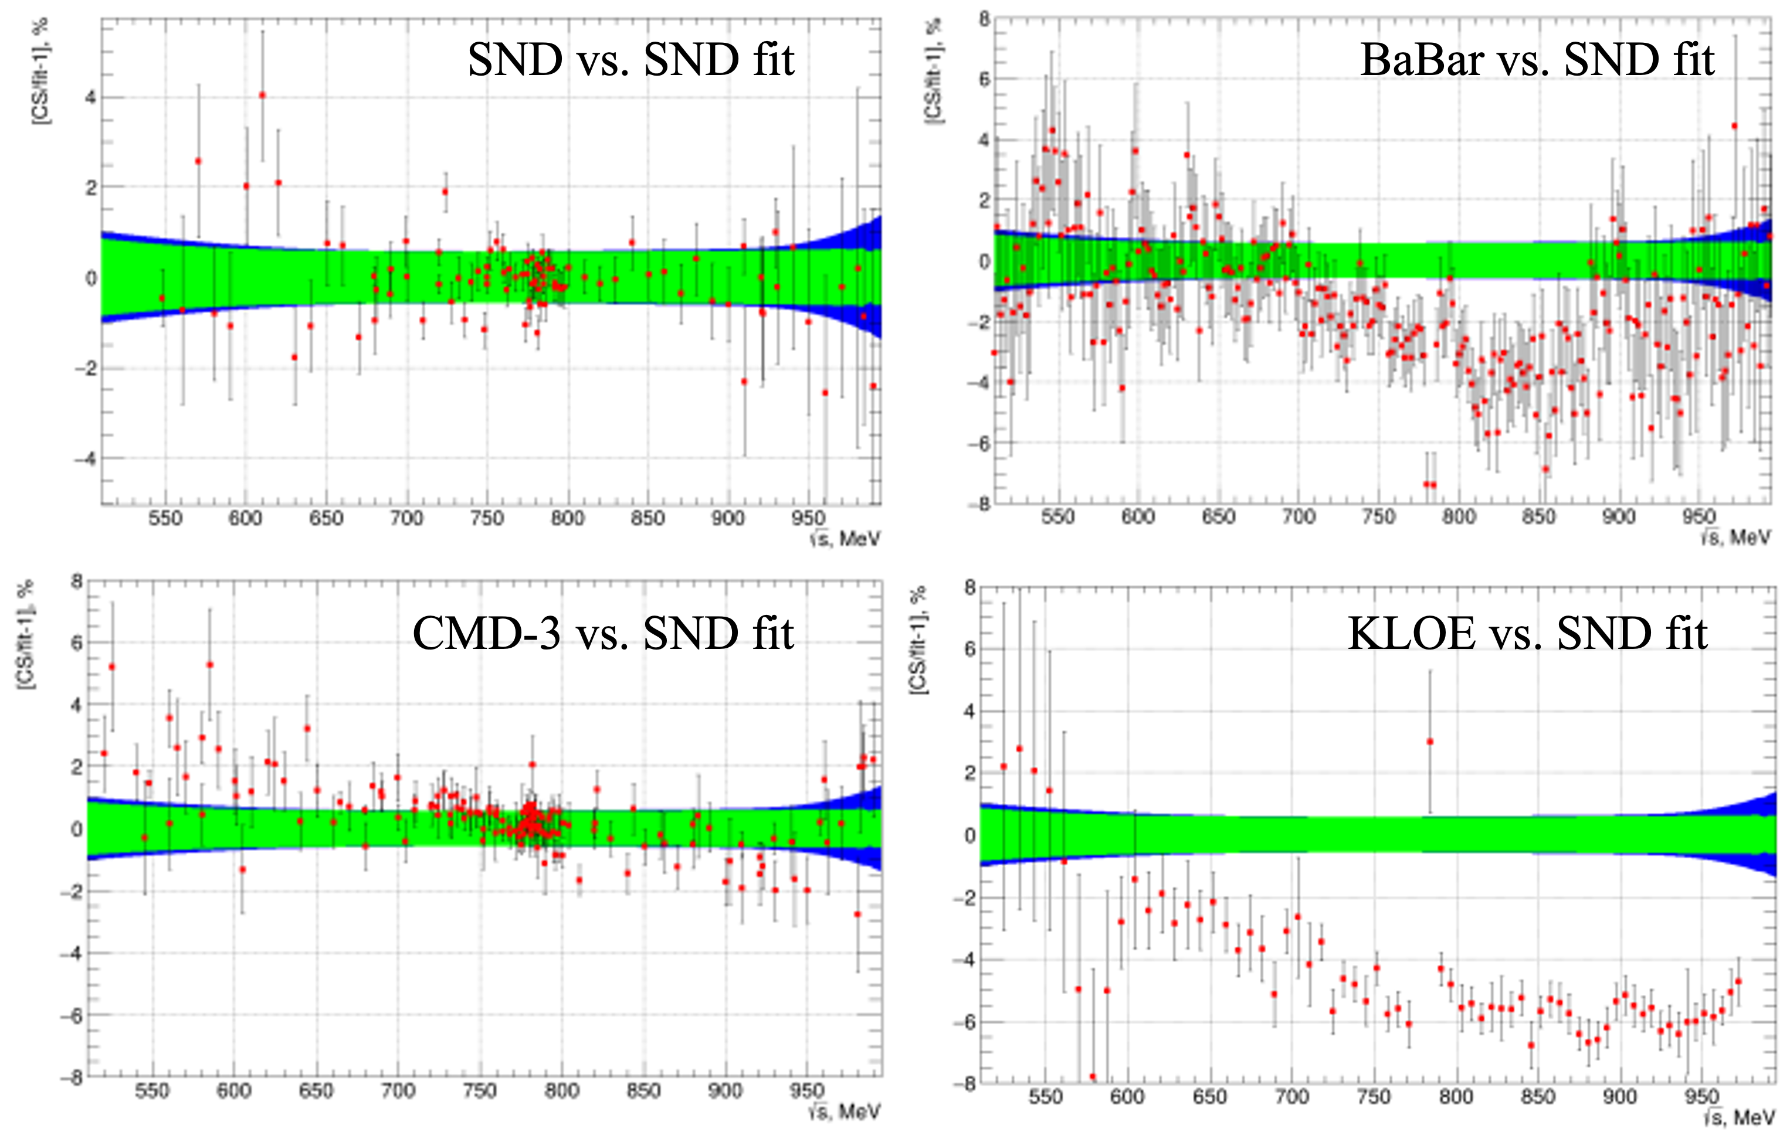
a_{μ}^{HVP} : latest news for 𝛑⁺𝛑⁻
BaBar:
Preliminary new analysis based on new method
Reduced systematics for 0.5-1.4 GeV region
Excellent agreement with previous analysis
SND:
Preliminary new, unblinded analysis leads to cross section significantly higher than previously
Results more in line with CMD-3
A. Pinto, talk at the TI plenary 2025
A. Kupich, talk at the TI plenary 2025
For more on HVP data, see Achim Denig’s talk tomorrow morning

Slide 28
Pathways to solving the puzzles
Situation complicated due to emerged puzzles in data, mainly (but not only) in the leading two pion channel
Lattice predictions may further consolidate and improve, but full agreement between the methods and higher accuracy are needed to match the experimental precision, and to have full confidence in conclusions w.r.t. BSM
More & more precise data are needed and are already coming from:
BaBar, CMD-3, SND, BES III, Belle II, and KLOE
For this, improved Radiative Corrections & Monte Carlo generators are needed, especially for Radiative Return
To avoid any possible bias, blinded analyses are now the standard, for both experiments (g-2 and σ_{had}) and lattice, also for the next KNTW compilation
The third way: MUonE scattering experiment at CERN
(see Wednesday afternoon talks by Giovanni Cantatore and Fulvio Piccinini)

Slide 29

KLOE 2𝛑, RC & MC activities
Liverpool⁺ effort to analyse the full KLOE 2𝛑 statistics (integrated L ~ 1.7 fb⁻¹)
  Graziano, with his Leverhulme grant, has brought together a team of
  exp+Th+MC in Liverpool (+ external collaborators), and the work is ongoing
Goal: sub-percent accuracy for e⁺e⁻ → 𝛑⁺𝛑⁻(𝛾) from KLOE, i.e.
aim at reduction of uncertainty in g-2 to Δaμ^{KLOE 2𝛑} ≲ 0.4%
This requires significant involvement from theoretical groups
  improvement of MC(s) to better describe ISR and FSR (Phokhara,…)
  main aim is NNLO⁺ (+resummation) for ISR and improvement/consistent FF treatment for FSR, e.g.
  other MC groups are also concentrating on e⁺e⁻ → 𝞹⁺𝞹⁻, μ⁺μ⁻, e⁺e⁻ at higher order
  International Working Group RadioMonteCarLow 2 has already published their phase 1 ➠

Slide 30
RadioMonteCarLow 2
For more on RMCL2, see talk tomorrow’s talks by Andrea Gurgone and Marco Ghilardi

Slide 31
Outlook / Conclusions
The still unresolved g-2 puzzles have triggered a lot of experimental & theory activities, including experiments, the Muon g-2 Theory Initiative & lattice
Progress in lattice methods and simulations has been impressive
The final FNAL result will define the field for years to come
… but to fully exploit it, much more effort will be needed to improve the SM prediction
There is a hard but clear pathway for this, from theory, MC, via experimental analyses and completely new approaches including MUonE
In the longer future, J-PARC can provide a completely independent measurement at low muon momentum
Together with other lepton moment measurements (including the muon EDM) and lepton flavour violation searches, g-2 continues to be a testbed for new methods, and new physics.
My view: the puzzles are very much `WIP’, and g-2 is not `RIP’
`The closer you look the more there is to see’ (Fred Jegerlehner)

