Slide 1


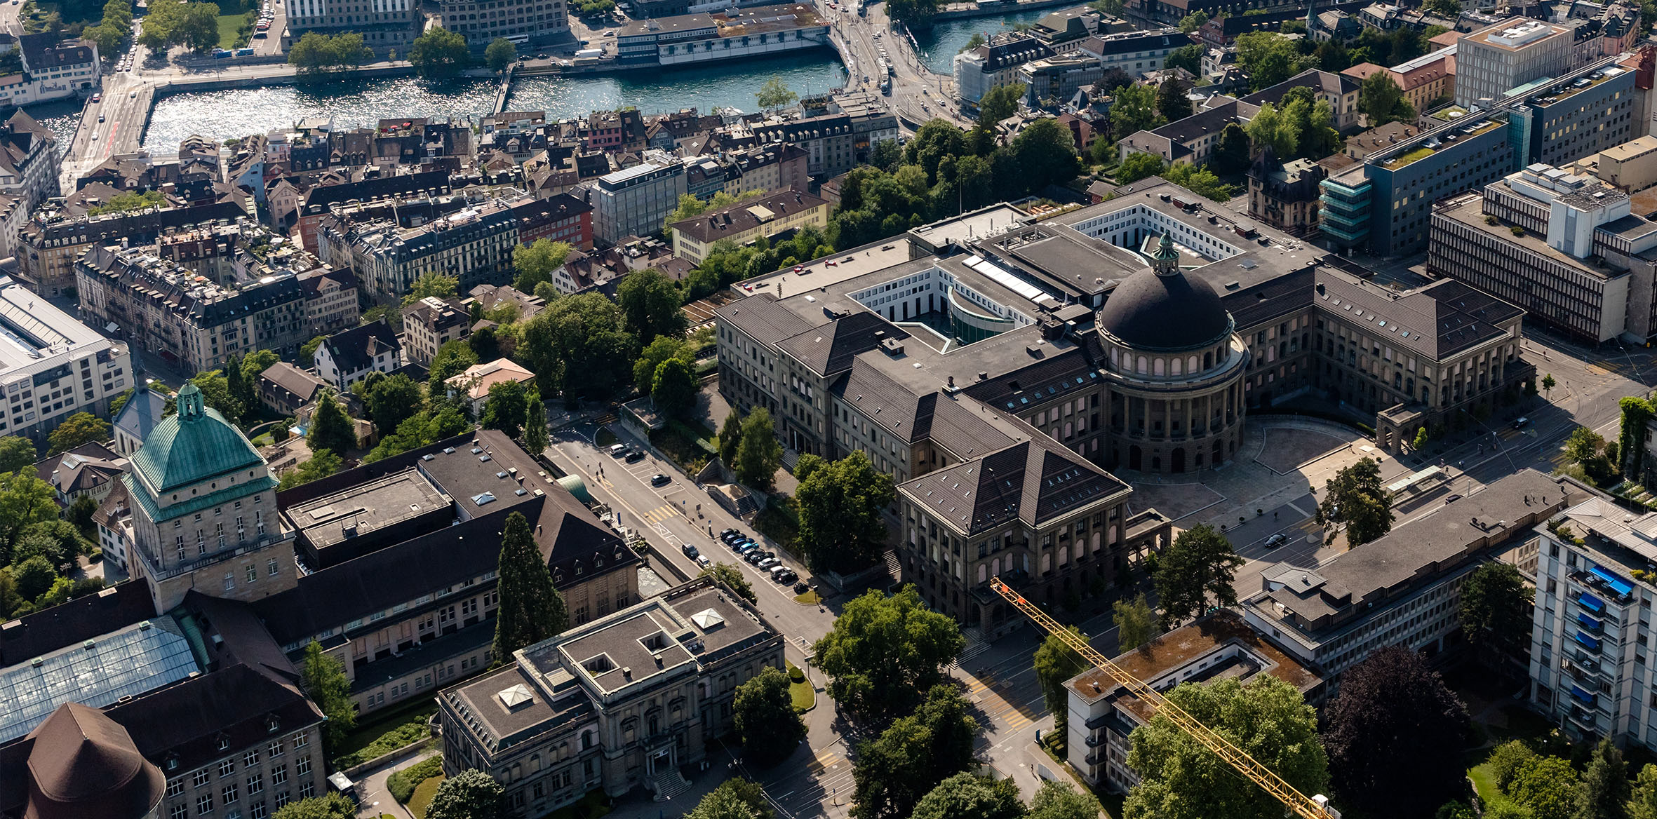
Progress on the Mu-MASS experiment
Muonium 1S-2S precision spectroscopy , Upgrades, & Hydrogen Commissioning
Ted Thorpe-Woods
on behalf of the Exotic Matter group at ETH Zurich
Ted Thorpe-Woods, Liverpool 2025
on behalf of Paolo Crivelli and the Mu-MASS collaboration

Slide 2
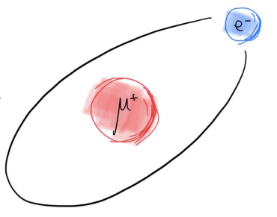

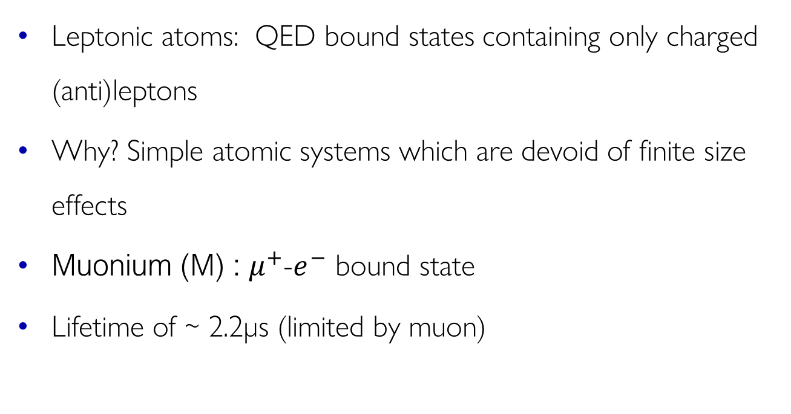
Edward Thorpe-Woods; Liverpool 2025
Leptonic atoms & Muonium
Leptonic atoms: QED bound states containing only charged (anti)leptons
Why? Simple atomic systems which are devoid of finite size effects
Muonium (M) : $μ^{+}$-$e^{−}$ bound state
Lifetime of ~ 2.2µs (limited by muon)
$$m_{M}\sim \frac{1}{9}m_{H}$$

Slide 3
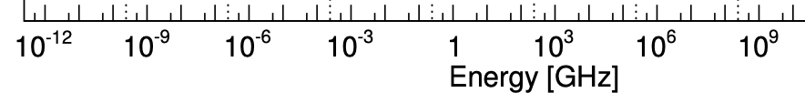
Edward Thorpe-Woods; Liverpool 2025
Current status of Theory and Experiments
Karshenboim et al. PRA 103, 022805 (2021) Eides, Phys. Lett. B 795, 113 (2019)
HFS (LAMPF 1999)
Liu et al. PRL82, 711 (1999)
Adkins et al. PRL130, 023004 (2023) I. Cortinovis et al., EPJD 77, 66 (2023)
1S-2S (RAL 1999)
Meyer et al. PRL84, 1136 (2000)
LS (PSI 2022)
B. Ohayon et al, PRL 128, 011802 (2022)
V.A. Yerokhin, et al. Ann. der Phys. 531, 1800324 (2019) M. Heides et al. PRA 105 (2022) 1, 012803 G. Janka et al. EPJ Web Conf. 262, 01001 (2022)
FS (PSI 2024)
P. Blumer et al, paper in preparation
UNCERTAINTY (LEFT EDGE)
MEASURED QUANTITY (RIGHT EDGE)
EXP.
THEORY
UNCERTAINTY DUE TO UNCALCULATED b-QED TERMS (LEFT EDGE)
UNCERTAINTY FROM KNOWLEDGE mμ/me (RIGHT EDGE)
3

Slide 4




Edward Thorpe-Woods; Liverpool 2025
Muonium Spectroscopy – expected
S. Kanda et a. PLB 815 (2021) 136154
HFS
I. Cortinovis, PC, et al., EPJD 77, 66 (2023)
1S-2S
LS
G. Janka, PC, et al. EPJ Web Conf. 262, 01001 (2022)
FS
PROJECTED UNCERTAINTY (LEFT EDGE)
MEASURED QUANTITY (RIGHT EDGE)
EXP.
THEORY
UNCERTAINTY DUE TO UNCALCULATED b-QED TERMS (LEFT EDGE)
UNCERTAINTY FROM KNOWLEDGE mμ/me (RIGHT EDGE)
4

Slide 5
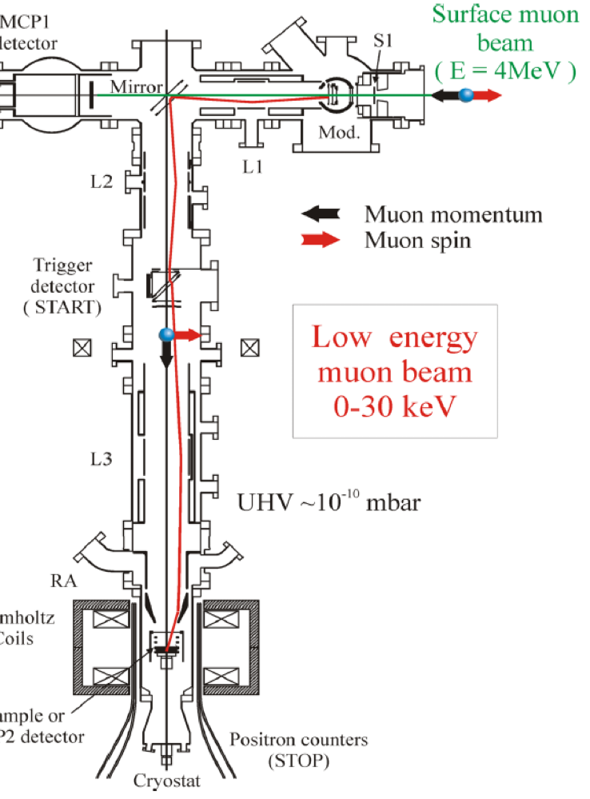
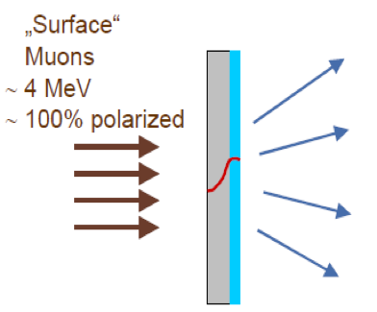

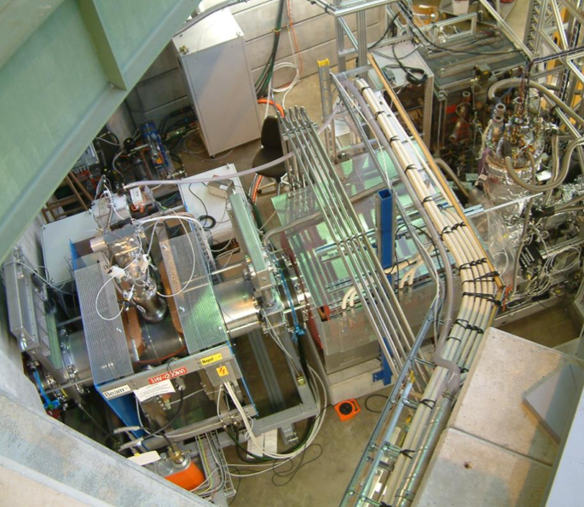
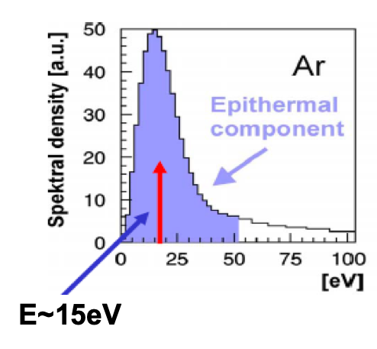
Edward Thorpe-Woods; Liverpool 2025
The PSI low energy muon beam (LEM)
Solid Ne/Ar 500 nm film
https://www.psi.ch/en/low-energy-muons
Up to 5x10³ μ⁺/s
Helmholtz coil
TARGET

Slide 6
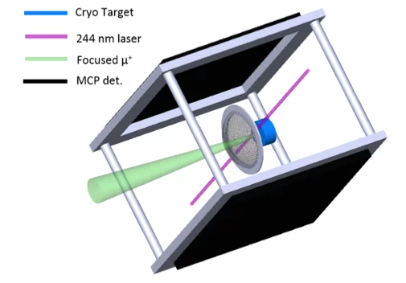
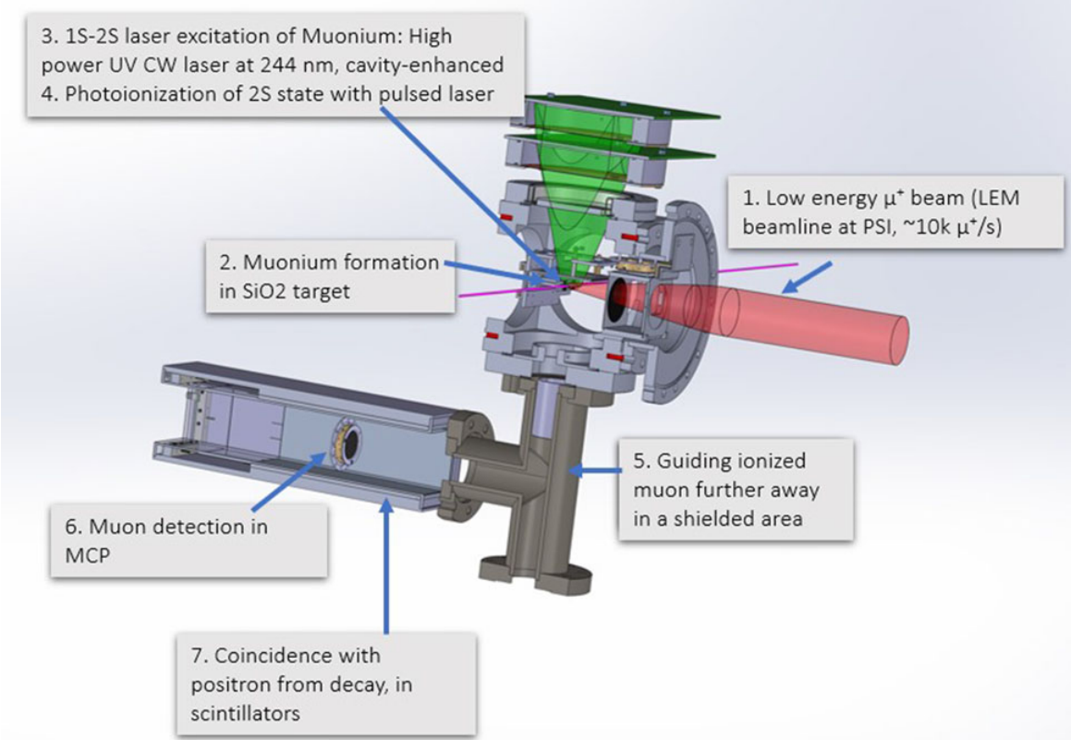
Edward Thorpe-Woods; Liverpool 2025
Mu-MASS timeline
2018
2019
2020
07/21
12/22
6/23
12/23
6/23
3/25
11/25
6/26
1.5W UV CW laser developed
Engineering runs PSI
M Lamb Shift
1S-2S attempt
Diffusion studies 2
FA
upgrades
Beamtime
Beamtime
Pulsed CW technique developed
Diffusion studies 1
M Fine structure
Hydrogen commissioning

Slide 7





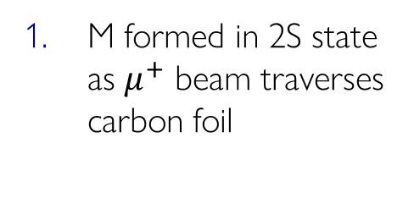


Edward Thorpe-Woods; Liverpool 2025
Muonium Microwave spectroscopy setup
y
z
Carbon foil
LyA MCP
Microwave
Lya
$$e^{−}$$
$$M\left(1S,2S\right)$$
$$M$$
$$μ^{+}$$
$$M (2S →1S)$$
StopMCP
$$μ^{+}$$
$$μ^{+}$$
Quenching electrodes
Tag MCP
LyA MCP
M formed in 2S state as $μ^{+}$ beam traverses carbon foil

Slide 8
Edward Thorpe-Woods; Liverpool 2025
Muonium Microwave spectroscopy setup
y
z
Carbon foil
LyA MCP
Microwave
Lya
$$e^{−}$$
$$M\left(1S,2S\right)$$
$$M$$
$$μ^{+}$$
$$M (2S →1S)$$
StopMCP
$$μ^{+}$$
$$μ^{+}$$
Quenching electrodes
Tag MCP
LyA MCP
M formed in 2S state as $μ^{+}$ beam traverses carbon foil
Resonant microwaves excite 2S→2P, followed by 2P→1S decay
Resonant RF
2S
2P
Undetected LyA Photon
1S

Slide 9
Edward Thorpe-Woods; Liverpool 2025
Muonium Microwave spectroscopy setup
y
z
Carbon foil
LyA MCP
Microwave
Lya
# Dectected LyA
$$e^{−}$$
$$M\left(1S,2S\right)$$
$$M$$
$$μ^{+}$$
$$M (2S →1S)$$
StopMCP
$$μ^{+}$$
$$μ^{+}$$
Quenching electrodes
f
Tag MCP
LyA MCP
Remaining 2S states quenched in detection region, 121nm photon detected
M formed in 2S state as $μ^{+}$ beam traverses carbon foil
Resonant microwaves excite 2S→2P, followed by 2P→1S decay
Stark Mixing
2S
2P
DETECTED LyA Photon
1S

Slide 10
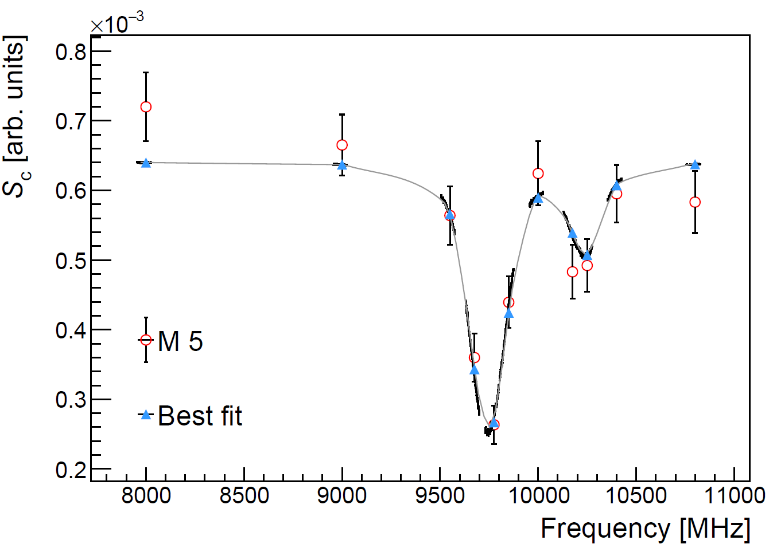
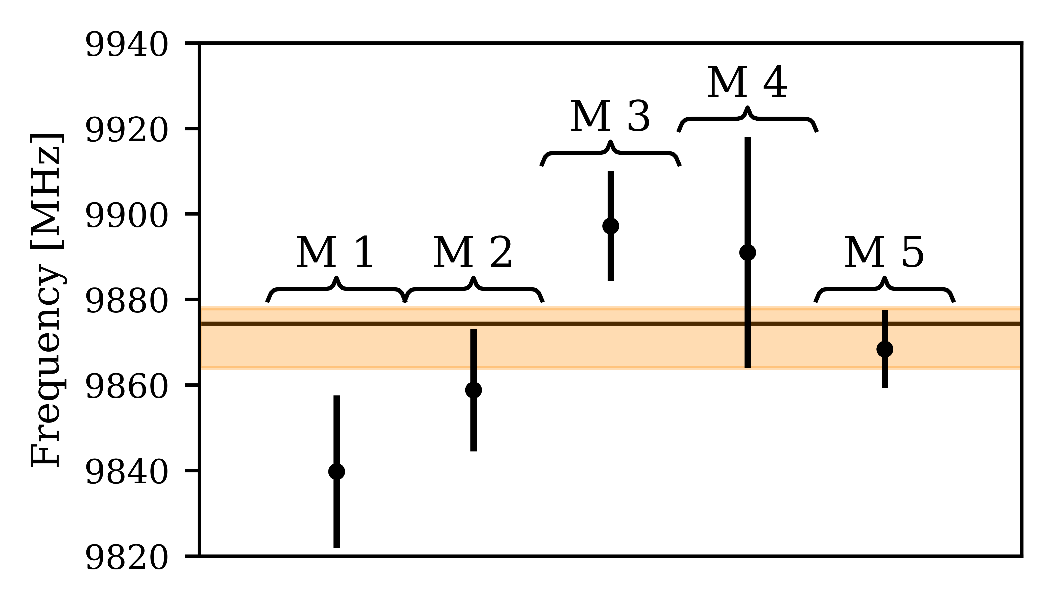
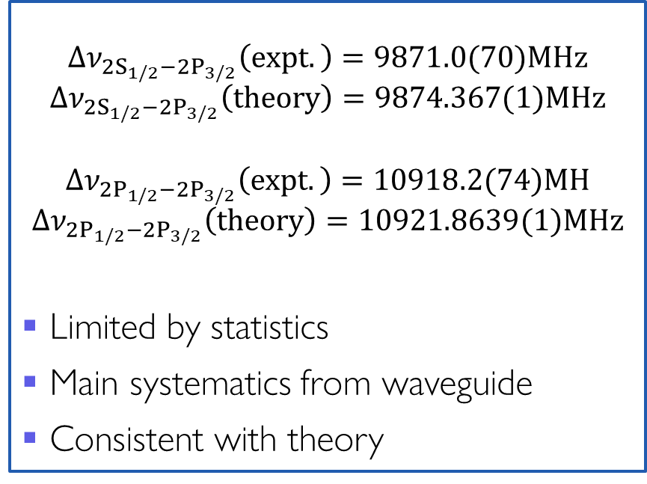

Edward Thorpe-Woods; Liverpool 2025
New ${∆ν}_{{2S}_{1/2}−{2P}_{3/2}}$ results!
$${∆ν}_{{2S}_{1/2}−{2P}_{3/2}}\left(expt.\right)=9871.0(70)MHz$$
$${∆ν}_{{2S}_{1/2}−{2P}_{3/2}}\left(theory\right)=9874.367(1)MHz$$
$${∆ν}_{{2P}_{1/2}−{2P}_{3/2}}\left(expt.\right)=10918.2(74)MH$$
$${∆ν}_{{2P}_{1/2}−{2P}_{3/2}}\left(theory\right)=10921.8639(1)MHz$$
Limited by statistics
Main systematics from waveguide
Consistent with theory
P Bulmer; arXiv:2509.04674 PrePrint

Slide 11
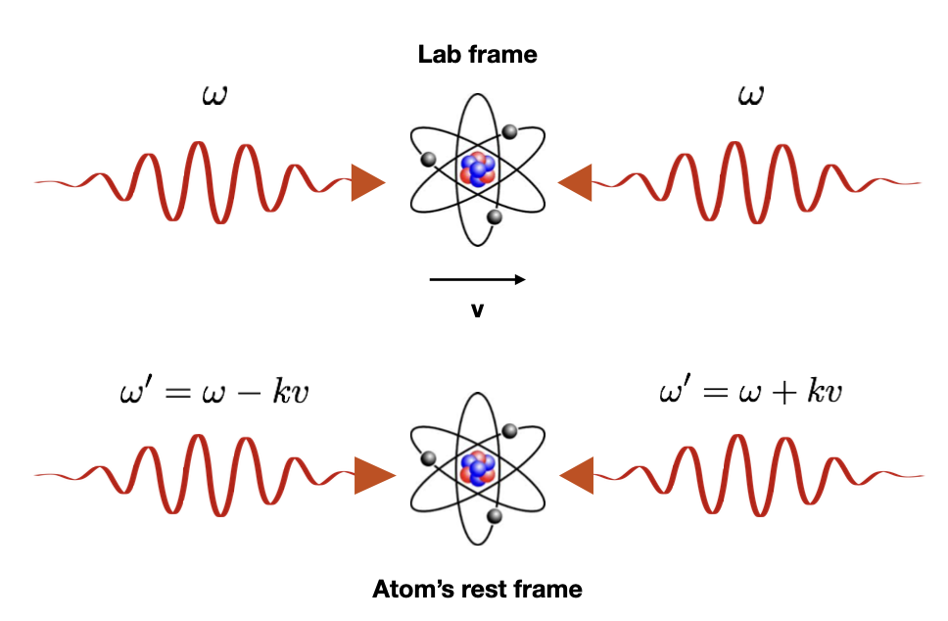
Edward Thorpe-Woods; Liverpool 2025
The 1S-2S transition
2S
To gain knowledge of atom energy structure: probe it with electromagnetic radiation
The 1S-2S transition is the provide the gold standard for precision spectroscopy
Meta-stable (long lifetime, resulting in narrow linewidth)
Doppler free to first order in cavity
A key goal of MuMASS: measure the 1S-2S of Muonium with a CW laser
This can be used to extract the muon-electron mass ratio <1pbb
244nm
244nm
1S

Slide 12
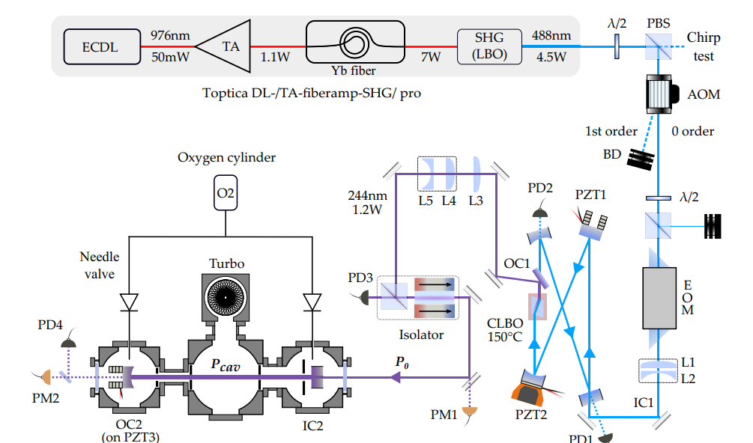
Edward Thorpe-Woods; Liverpool 2025
Upgraded 244nm laser system
976nm light amplified to 10W via sequential TA and FA
Frequency doubled to 7W of 488nm
Second frequency doubling to ~2W of 244nm within custom made cavity with CLBO
Enhanced to 30-40W within MuMASS
10W
7W
2W
N Zhadnov et al, Optics Express 31, 17(2023)

Slide 13
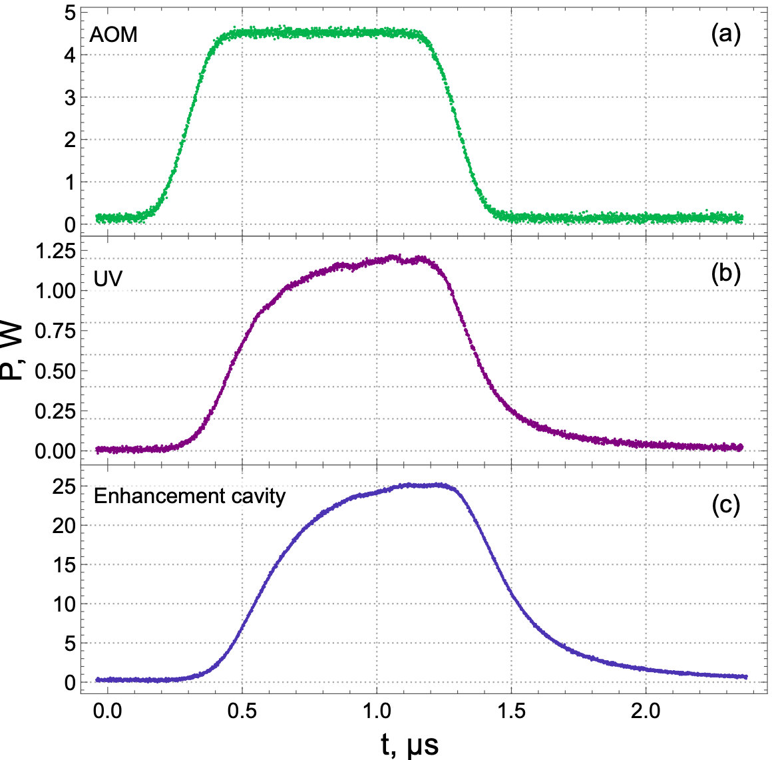
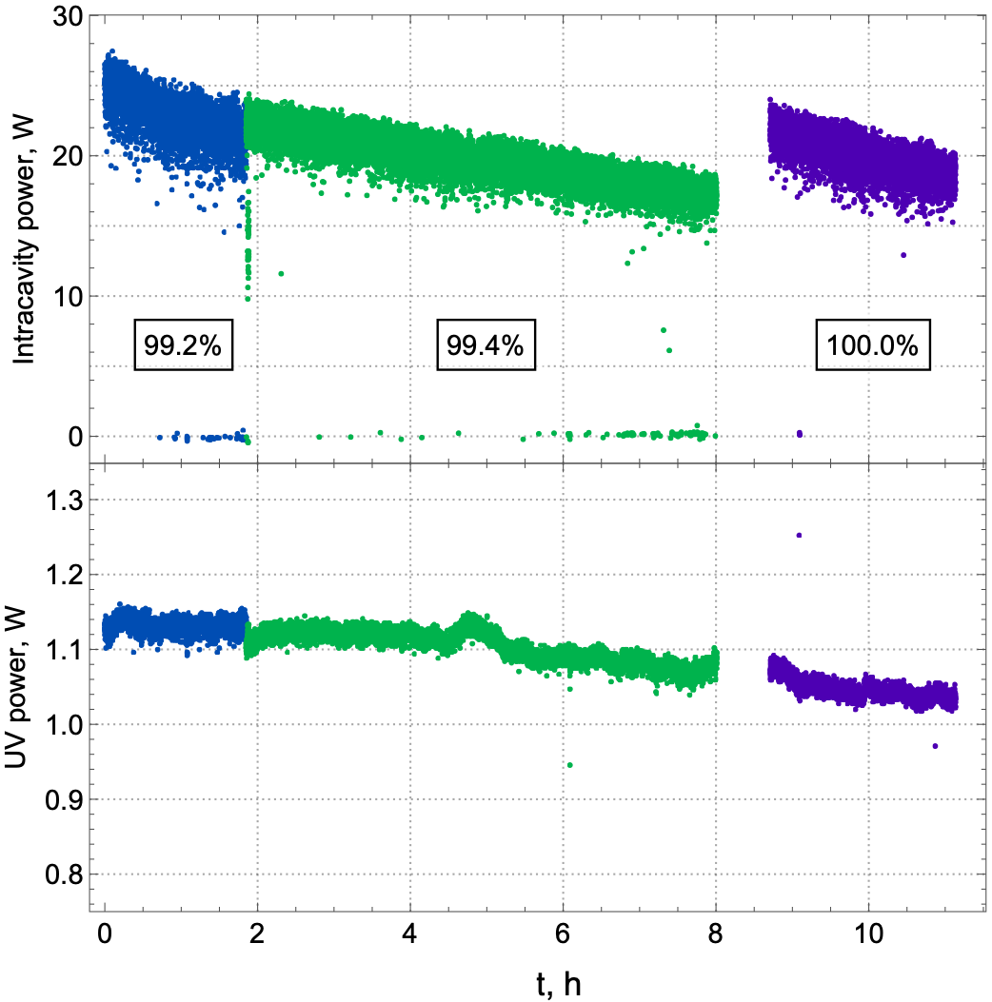
Edward Thorpe-Woods; Liverpool 2025
Pulsed CW technique
1-2W of CW 244nm light (enhanced to 30W) is an extremely harsh optical environment
Degrades optics, adds background
Solution: Pulse CW power when needed
Previously: AOM; Now: Pockles Cell + AOM
Can operate consistently for days, with occasional O2 treatment
N Zhadnov et al, Optics Express 31, 17(2023)

Slide 14
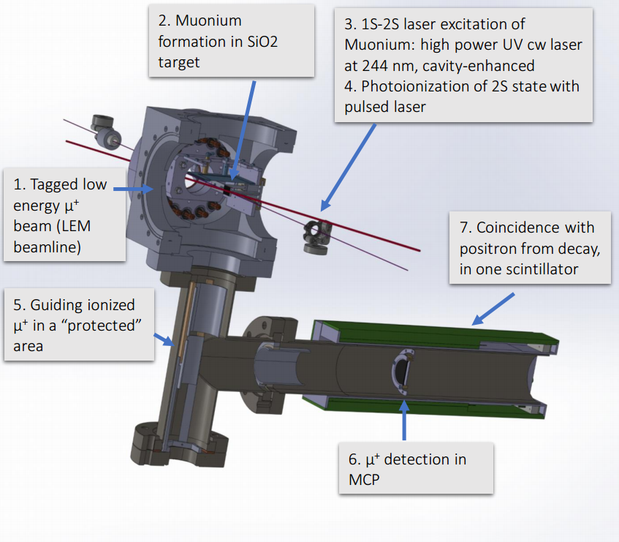
Edward Thorpe-Woods; Liverpool 2025
Mu-Mass experimental setup
Zoom on Laser & target
I. Cortinovis, PC, et al., EPJD 77 (2023)
244nm (100mW)
SiO2 target
Internal State of M
continuum
2S
1S

Slide 15

Edward Thorpe-Woods; Liverpool 2025
Mu-Mass experimental setup
Zoom on Laser & target
I. Cortinovis, PC, et al., EPJD 77 (2023)
$$μ^{+}$$
244nm (100mW)
SiO2 target
Internal State of M
continuum
2S
1S

Slide 16

Edward Thorpe-Woods; Liverpool 2025
Mu-Mass experimental setup
Zoom on Laser & target
I. Cortinovis, PC, et al., EPJD 77 (2023)
$$M$$
244nm (100mW)
SiO2 target
Internal State of M
continuum
2S
1S

Slide 17
Edward Thorpe-Woods; Liverpool 2025
Mu-Mass experimental setup
Zoom on Laser & target
I. Cortinovis, PC, et al., EPJD 77 (2023)
$$M$$
244nm (30W)
SiO2 target
Internal State of M
continuum
2S
244nm
244nm
1S

Slide 18


Edward Thorpe-Woods; Liverpool 2025
Mu-Mass experimental setup
Zoom on Laser & target
I. Cortinovis, PC, et al., EPJD 77 (2023)
$$μ^{+}$$
$$M$$
$$e^{−}$$
244nm (30W)
355nm (~1mJ)
SiO2 target
Internal State of M
continuum
355nm
2S
244nm
244nm
1S

Slide 19
Edward Thorpe-Woods; Liverpool 2025
Mu-Mass experimental setup
Zoom on Laser & target
I. Cortinovis, PC, et al., EPJD 77 (2023)
$$μ^{+}$$
$$M$$
$$e^{−}$$
244nm (100mW)
SiO2 target
Internal State of M
continuum
355nm
2S
244nm
244nm
1S

Slide 20
Edward Thorpe-Woods; Liverpool 2025
Mu-Mass experimental setup
Zoom on Laser & target
I. Cortinovis, PC, et al., EPJD 77 (2023)
$$μ^{+}$$
$$M$$
$$e^{−}$$
244nm (100mW)
SiO2 target
Internal State of M
continuum
355nm
2S
244nm
244nm
1S

Slide 21
Edward Thorpe-Woods; Liverpool 2025
Mu-Mass experimental setup
Zoom on Laser & target
I. Cortinovis, PC, et al., EPJD 77 (2023)
$$μ^{+}$$
$$M$$
$$e^{−}$$
244nm (100mW)
SiO2 target
Internal State of M
continuum
355nm
2S
244nm
244nm
1S

Slide 22
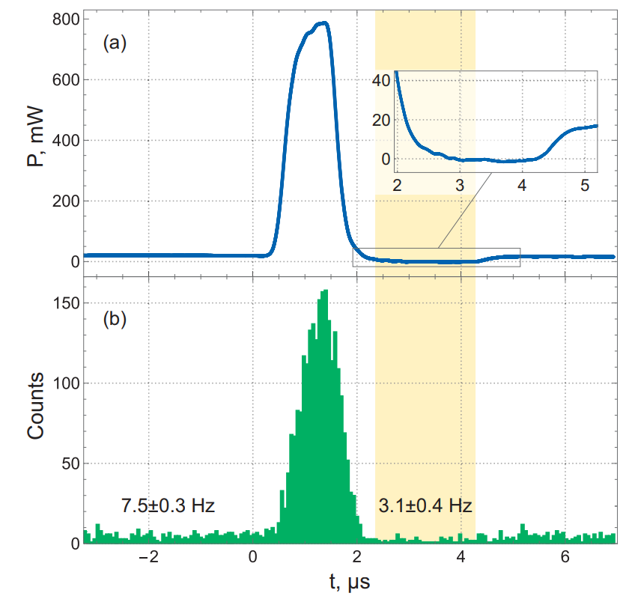
Edward Thorpe-Woods; Liverpool 2025
2022 campaign
2022 campaign (5 days of muon beam) unfortunately did not see any signal
Reduction of factor 7 in flux due to laser interaction with muon trigger
Unexpectedly short muonium formation time lead to unoptimised timing
These problems have been addressed since
Pulsing scheme allowed experiment to be operated continuously for 80 hours
Detection scheme with pulsing reduced experimental background to < 1 background count per day)

Slide 23
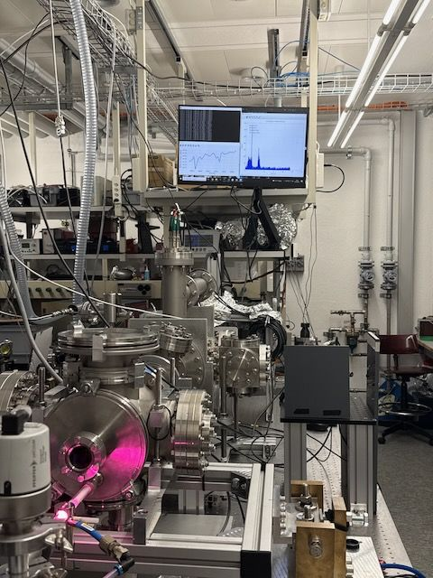
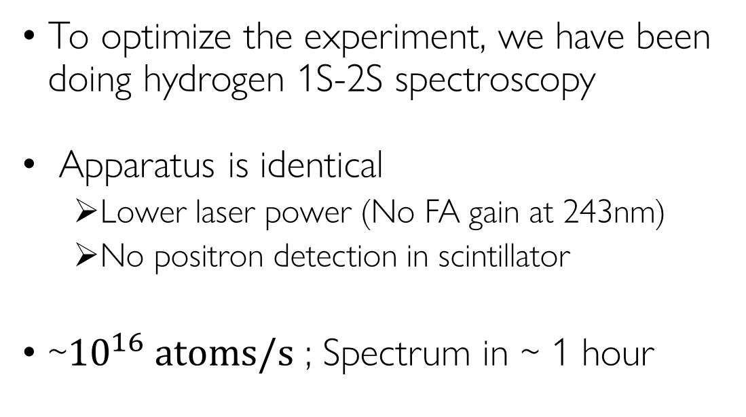
Edward Thorpe-Woods; Liverpool 2025
Commissioning with Hydrogen
To optimize the experiment, we have been doing hydrogen 1S-2S spectroscopy
Apparatus is identical
Lower laser power (No FA gain at 243nm)
No positron detection in scintillator
~$10^{16} atoms/s$ ; Spectrum in ~ 1 hour

Slide 24
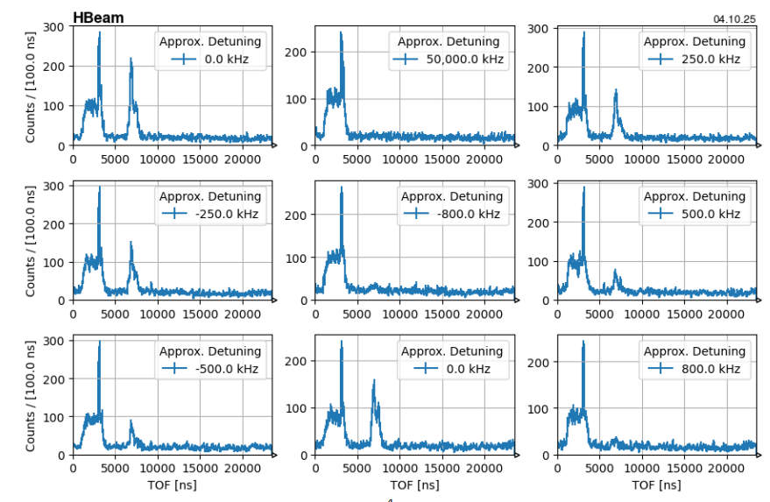
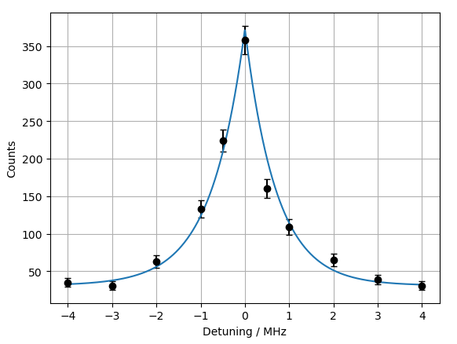
Edward Thorpe-Woods; Liverpool 2025
Detection of Hydrogen 1S-2S
We see distinctive second peak which indicates 1S-2S of hydrogen
Can measure the 1S-2S spectrum of hydrogen

Slide 25
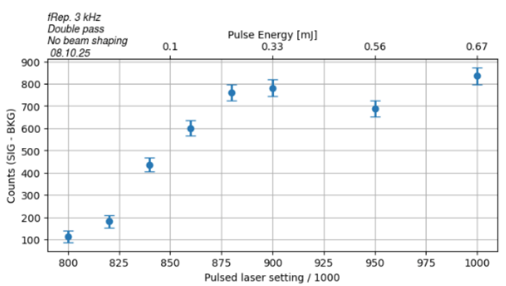
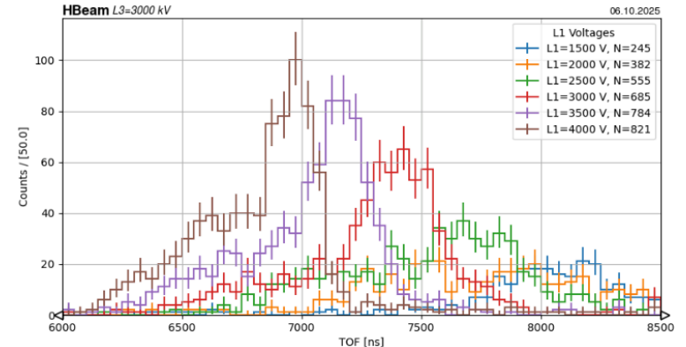
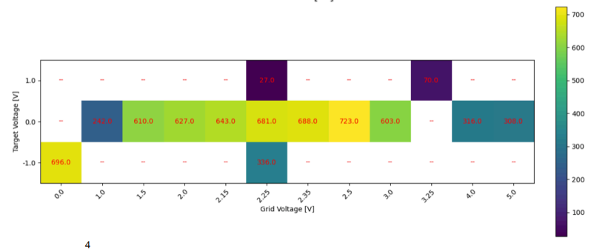
Edward Thorpe-Woods; Liverpool 2025
Use hydrogen to optimise Mu-MASS
Scan/Optimise experimental parameters
Compare to Simion Simulations
Select optimum parameters for muonium

Slide 26
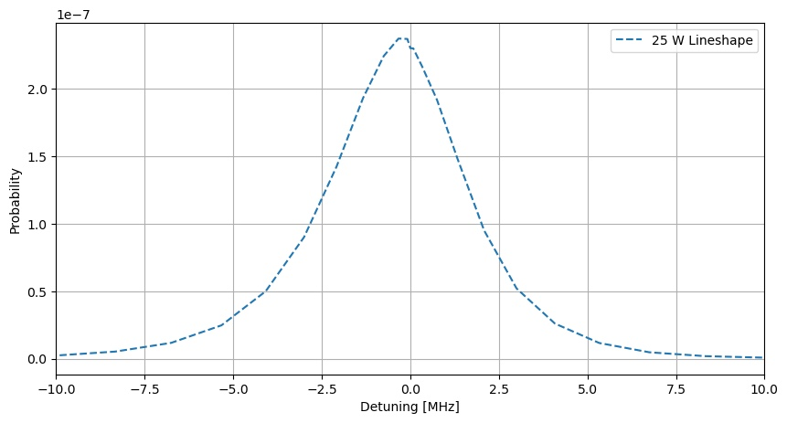
Edward Thorpe-Woods; Liverpool 2025
Beamtime Nov 2025
We return in less than a month!
Improvements since 2022:
More laser power
Faster laser pulsing
Active beam stablisation
Optimised setup via hydrogen
We only have 7 days of beam + 3 of setup
We expect ~ 10 counts per day
Goal – observe on/off resonance comparision
Ask longer beamtime 2026
Long shutdown mid 2026
~37 counts
~3counts

Slide 27
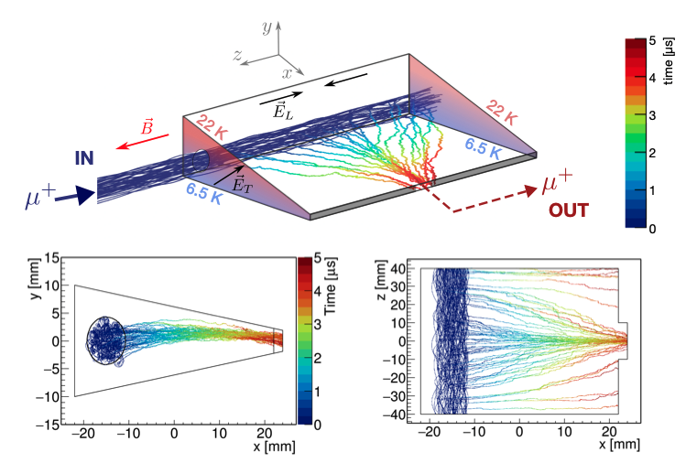
Edward Thorpe-Woods; Liverpool 2025
What next?
Beamtime in November this year,
Next year ect
Improved muon rates: HIMB
Better phase-space beams:
MuCOOL (muon beam phase-space compression)
SFHe sources (smaller initial M phase-space, Landau critical velocity: mono-energetic to the ~5% level)
Alternative spectroscopic technique: Ramsey spectroscopy
Fig 2 from “Phase space compression of a positive muon beam in two spatial dimensions”, Antognini et al. 2024
A. Soter, A. Knecht SciPost Phys. Proc. 5, 031 (2021)
A. Soter, Physics of fundamental Symmetries and Interactions (2025)

Slide 28
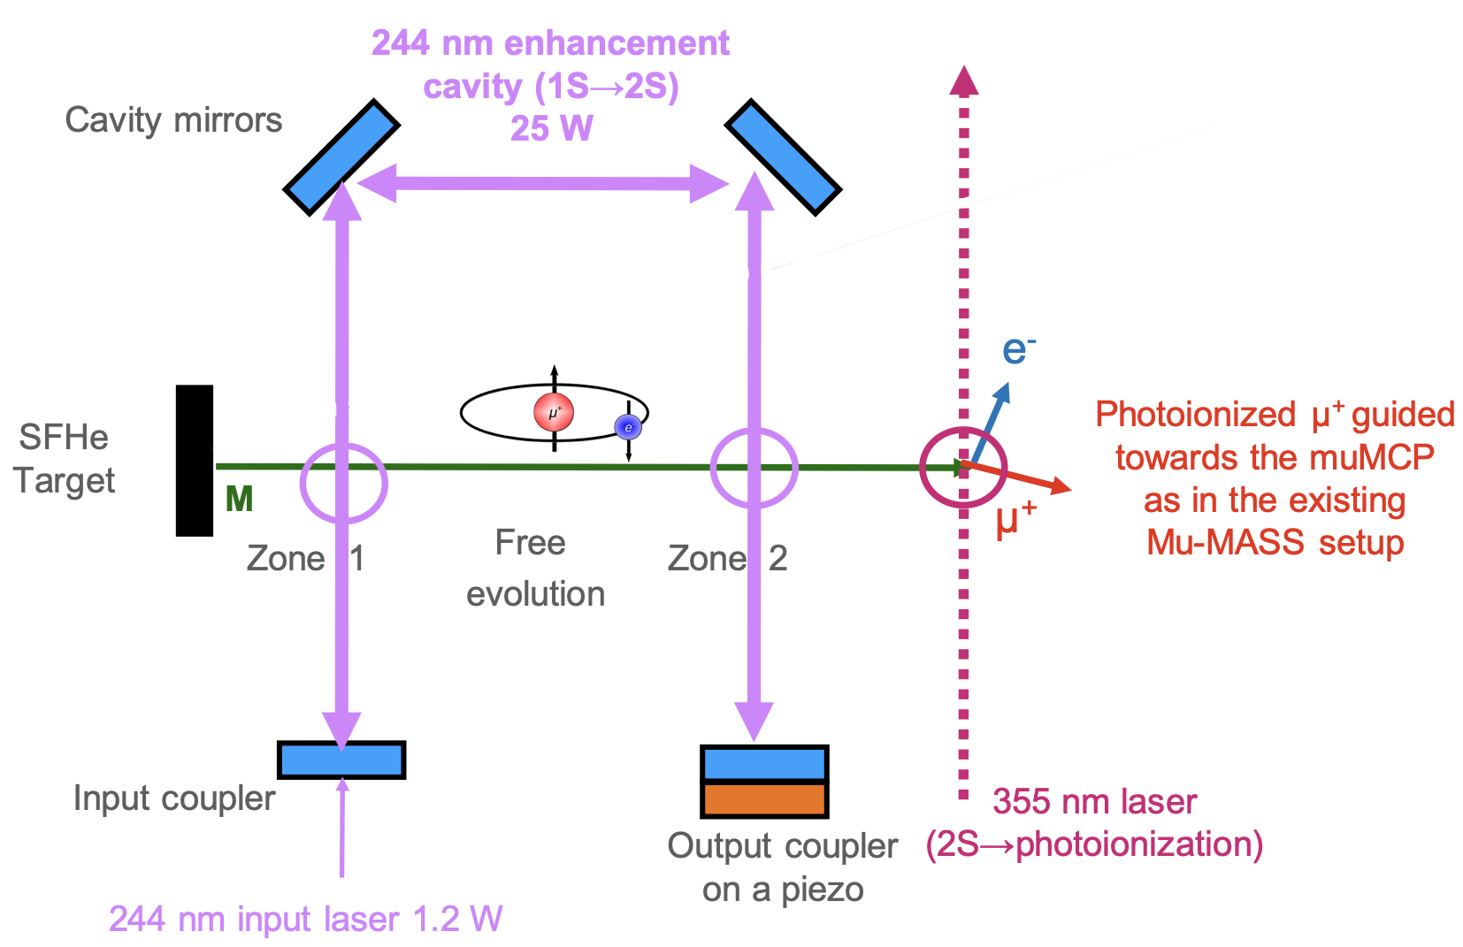
Edward Thorpe-Woods; Liverpool 2025
SFHe Targets & Ramsey Spectroscopy of M
Two interaction regions separated by longer free evolution
Has been done with hydrogen
For classical Ramsey, mono-energetic atoms, requires SFHe
Javary, E., Thorpe-Woods, E., Cortinovis, Mähring, M., de Sousa Borges, L., Crivelli, P. Eur. Phys. J. D 79, 15 (2025)
A. Huber, B. Gross, M. Weitz, and T. W. Hänsch, Phys. Rev. A 58 (1998)
Soter, A. Physics of fundamental Symmetries and Interactions (2025)

Slide 29
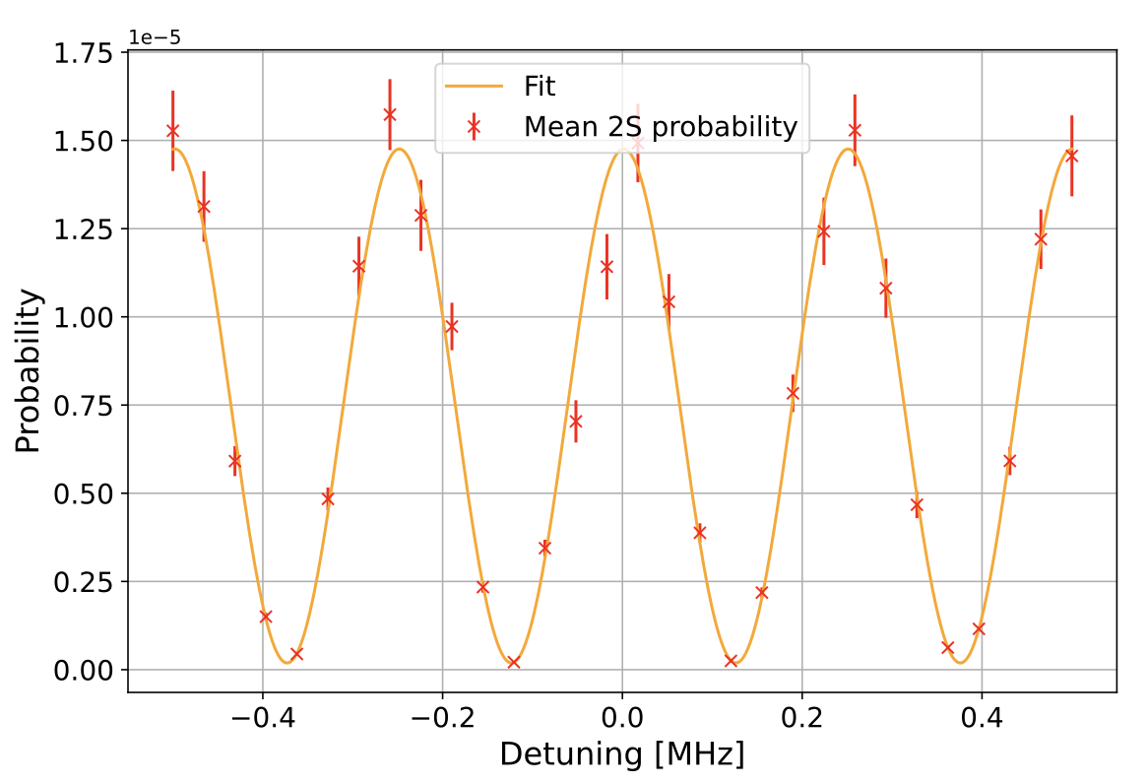
Edward Thorpe-Woods; Liverpool 2025
Simulated Ramsey Spectroscopy of M
Monte Carlo simulation using expected parameters
Result: Ramsey fringes with ~120kHz linewidths
~1kHz statistical uncertainty in 10 days of measurements
Reduced AC Stark (Ramsey)
Reduced 2nd Doppler (SFHe)
Javary, E., Thorpe-Woods, E., Cortinovis, Mähring, M., de Sousa Borges, L., Crivelli, P. Eur. Phys. J. D 79, 15 (2025)

Slide 30
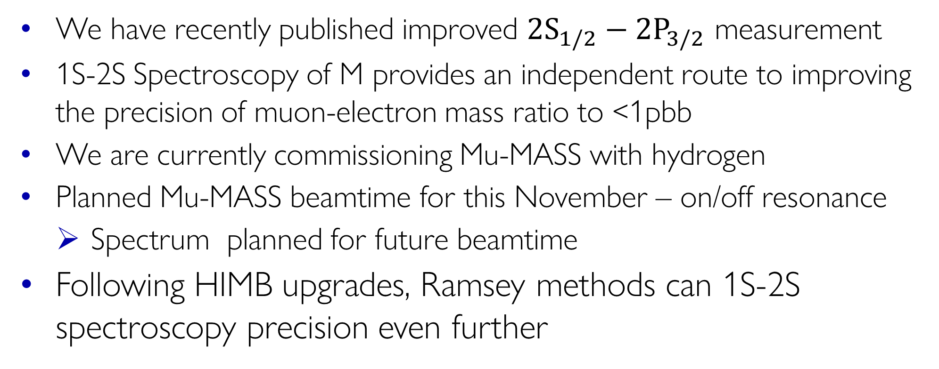
Edward Thorpe-Woods; Liverpool 2025
Summary & conclusion
We have recently published improved ${2S}_{1/2}−{2P}_{3/2}$ measurement
1S-2S Spectroscopy of M provides an independent route to improving the precision of muon-electron mass ratio to <1pbb
We are currently commissioning Mu-MASS with hydrogen
Planned Mu-MASS beamtime for this November – on/off resonance
Spectrum planned for future beamtime
Following HIMB upgrades, Ramsey methods can 1S-2S spectroscopy precision even further

Slide 31
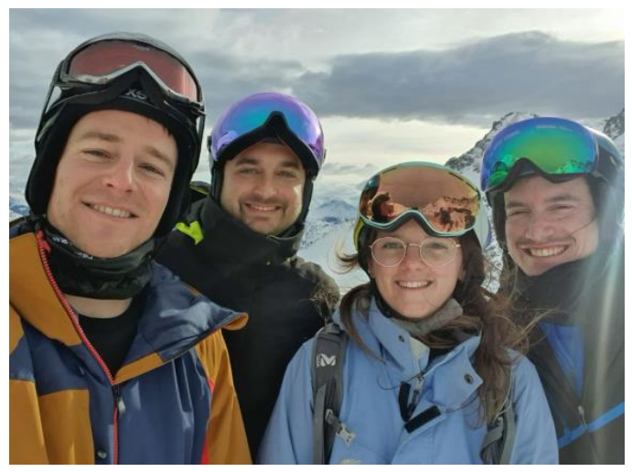

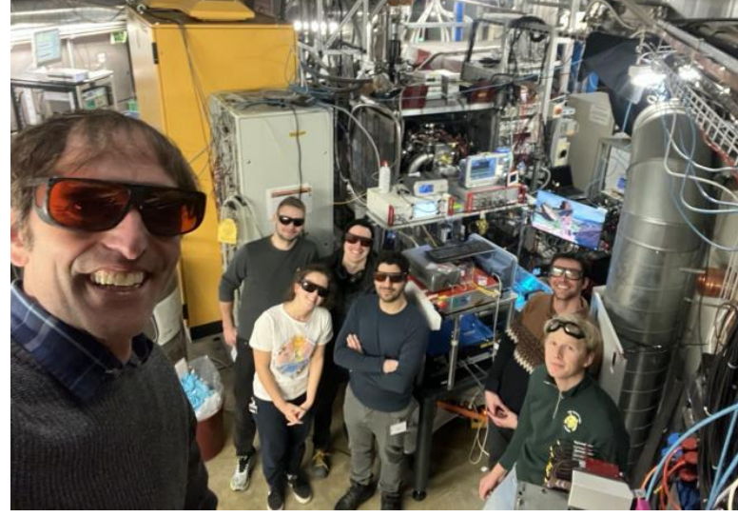
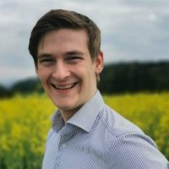
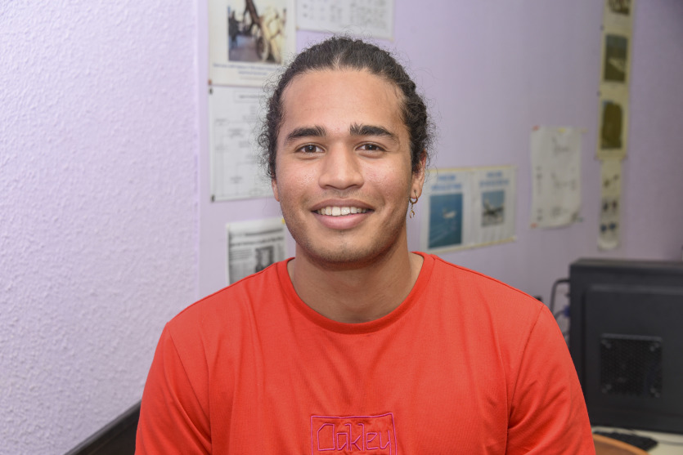


Edward Thorpe-Woods; FFK 2025
Thank you for listening!
PART OF THIS WORK IS SUPPORTED BY an ERC consolidator grant (818053 -Mu-MASS) and by the Swiss National Foundation under the grants 197346 219485.

Slide 32
Extra Slides

Slide 33

Edward Thorpe-Woods; Liverpool 2025
Muon-electron mass ratio from Muonium 1S-2S
How does the uncertainty of $r$ extracted from the 1S-2S transition frequency scale with the precision of the spectroscopy?
Again, we can use logarithmic sensitivities:
$$ν_{1S−2S}^{Mu}∝\frac{r}{1+r}R_{∞}c×\left[1+Δ_{QED}+⋯\right]$$
$$S_{r}^{\left(1S−2S\right)}≡\frac{∂\ln{{(ν}_{1S−2S})}}{∂\ln{r}}=\frac{1}{1+r}$$
Using this to map uncertainty in 1S-2S transition frequency
$$\frac{σ_{r}(r)}{r}=\left(1+r\right)\frac{σ_{υ}}{ν}≈208\frac{σ_{υ}}{ν}$$
A 10kHz uncertainty in the 1S-2S frequency translated into $\frac{σ_{r}(r)}{r} ≈$ 0.85ppb

