Slide 1


Status of the MuSEUM experiment at J-PARC
Koichiro Shimomura
Institute of Materials Structure Science (IMSS), KEK
Muon Science Section, Materials and Life Science Division, J-PARC Center
On behalf of the MuSEUM Collaboration

Slide 2



















MuSEUM Collaboration
(Muonium Spectroscopy Experiment Using Microwave)
KEK
M. Abe, M. Hiraishi, T. Ino, S. Kanda, S. Nishimura, H. Okabe,
K. Sasaki, K. Shimomura, P. Strasser
Nagoya University
K. Asai, M. Fushihara, Y. Goto, S. Kawamura, M. Kitaguchi,
T. Okudaira, M. Okuizumi, H. M. Shimizu, H. Tada
University of Tokyo
University of Calgary
H. A. Torii
A. Powell
Michigan State Univ.
S. Fukumura,
R. Azuma, K. Yamura
R. Iwai
JAEA
T. Oku
On behalf of the extended MuSEUM Collaboration

Slide 3
Outline
MuSEUM=Muon Spectroscopy Experiment Using Microwave
Present projects
Muonium Hyperfine Splinting Measurement
(K.Shimomura)
Muonic He Hyperfine Splinting Measurement
(P.Strasser)
Future projects
Positive Muon Trap
Negative Muon Trap and anti Muonium
(S. Nishimura, T.Yamazaki, Y.Nagatani)

Slide 4
Muonium
Muonium: bound state of µ⁺ and e⁻
Muonium Energy Level Diagram
Lifetime: 2.2 µs
Leptons (= point particles)
e–
µ⁺
Hydrogen-like atom: simplest bound-system
Precise theoretical calculation of energy levels possible → QED development
Klauss Jungmann, LNP 570, pp. 81–102 (2001)
Compare precise experiments with theoretical calculations
  Precision test of the Standard Model
If discrepancy found between theory & experiment
  Could be an evidence of New Physics Beyond the Standard Model

Slide 5
Muonium
Muonium: bound state of µ⁺ and e⁻
Muonium Energy Level Diagram
Lifetime: 2.2 µs
Leptons (= point particles)
e–
Muonium 1S-2S
Laser Spectroscopy
(AMuLET & MuMass)
µ⁺
Hydrogen-like atom: simplest bound-system
Precise theoretical calculation of energy levels possible → QED development
Muonium HFS
(MuSEUM)
Klauss Jungmann, LNP 570, pp. 81–102, (2001)
Compare precise experiments with theoretical calculations
  Precision test of the Standard Model
If discrepancy found between theory & experiment
  Could be an evidence of New Physics Beyond the Standard Model
Notes:
AMuLET: Advanced Muonium Laser spectroscopy Experiment at Tokai

Slide 6
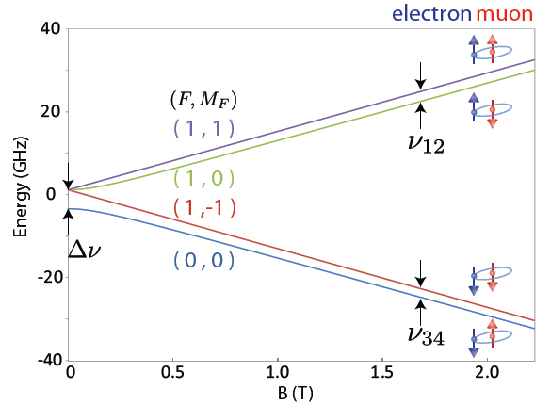

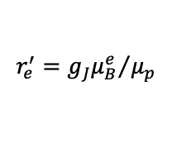


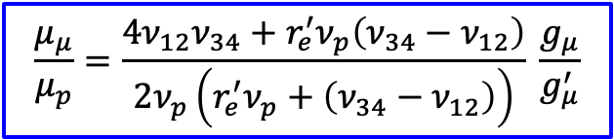

Muonium Hyperfine Structure
Muonium: bound state of µ⁺ and e⁻
Pure lepton
= point particle
Breit-Rabi Energy level diagram
Zeeman Splitting
e⁻
μ⁺
$Δν$≈ 4463 MHz
e⁻
High Field (HF)
μ⁺
$Δν$ : Muonium Hyperfine Structure
Zero Field (ZF)
ZF: 4 463 302.2(14) kHz (310 ppb)
HF: 4 463 302.765(51)(17) kHz (12 ppb)
$Δν=ν_{12}+$ $ν_{34}$
Exp. dominated by statistical uncertainty!
$$\frac{μ_{μ}}{μ_{p}}=\frac{4ν_{12}ν_{34}+r_{e}^{′}ν_{p}\left(ν_{34}−ν_{12}\right)}{2ν_{p}\left(r_{e}^{′}ν_{p}+\left(ν_{34}−ν_{12}\right)\right)} \frac{g_{μ}}{g_{μ}^{′}}$$
MuSEUM goal: ~ 2ppb
ZF: D. E. Casperson et al., Phys. Lett. B 59, 397 (1975)
HF: W. Liu et al., Phys. Rev. Lett. 82, 711 (1999)
$$r_{e}^{′}={g_{J}μ_{B}^{e}}/{μ_{p}}$$
$$hν_{p}=2μ_{p}H$$
with and

Slide 7
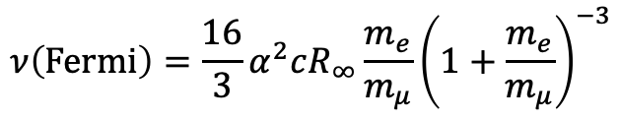
Most Precise Test of Bound-State QED
Experiment:
LAMPF Experiment (1999)
W. Liu et al., Phys. Rev. Lett. 82, 711 (1999)
ν_{HFS}(exp) 4463.302 765 (53) MHz [12 ppb]
µ_{µ}/µ_{p} = 3.18334524(37) [120ppb]
m_{µ}/m_{e} = 206.768277(24) [120ppb]
Theory:
M. I. Eides Phys. Lett. B 795, 113 (2019)
ν_{HFS}(theory) 4463.302 868 (515) MHz [120 ppb]
ν_{HFS}(QED) 4463.302 720 (511) (70) (1) MHz
(m_{μ}/m_{e}) (QED) (α)
ν_{HFS}(weak) -65 Hz
ν_{HFS}(had. v.p.) 237.7(1.5) Hz
ν_{HFS}(had. h.o.) 5 (2) Hz
m_{µ} uncertainty
120 ppb (exp)
CODATA 2022
22 ppb (theo+exp)
$$ν\left(Fermi\right)=\frac{16}{3}α^{2}cR_{∞}\frac{m_{e}}{m_{μ}}{\left(1+\frac{m_{e}}{m_{μ}}\right)}^{−3}$$
QED calculations: Effort for 10 Hz accuracy in progress (by Eides et al.)
Notes:
had. v.p. : hadronic vacuum polarization
had. h.o : hadronic higher-order correction
Alpha: Fine structure constant – precision of alpha
Theorists are confident that muonium HFS can be calculated to 10 Hz, if needed (Eides,...)
Experimental value from Liu et al.

Slide 8
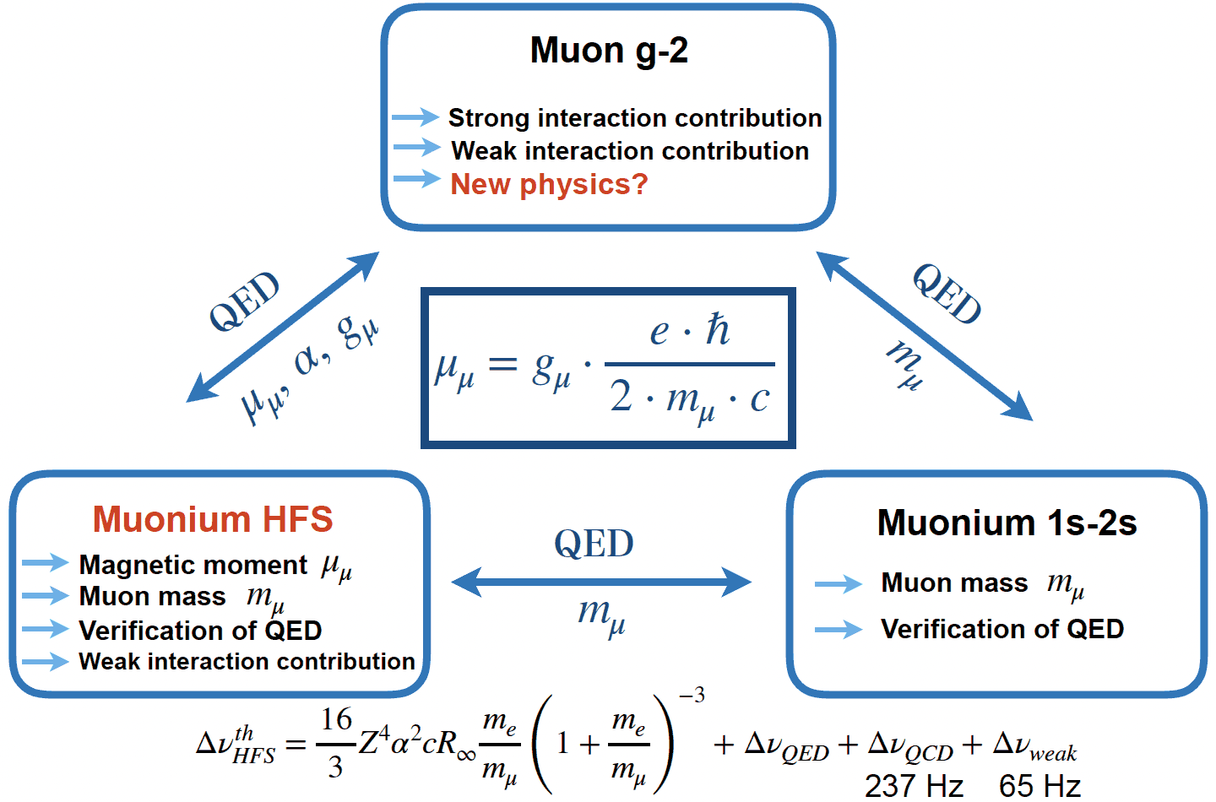
Muon Precision Measurements
Slide from Klaus Jungmann

Slide 9
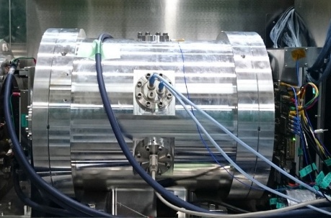

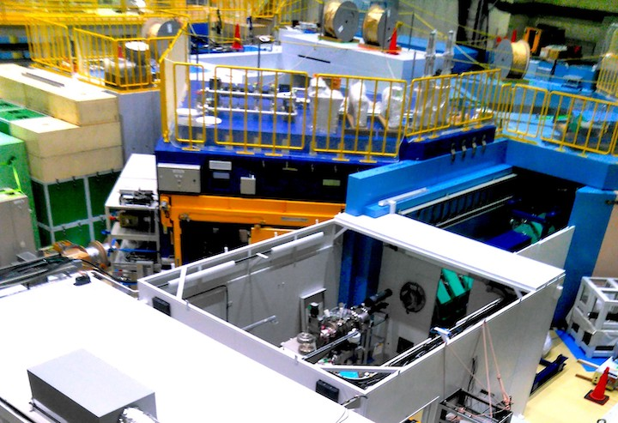
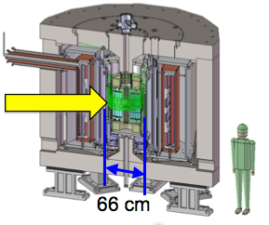
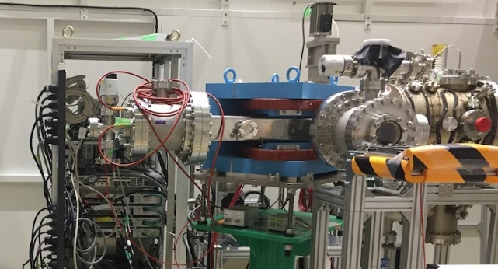
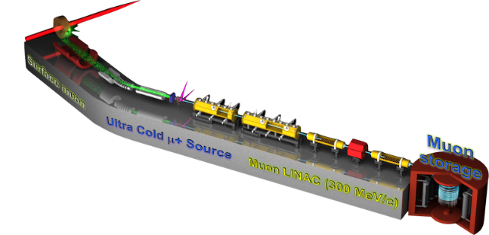
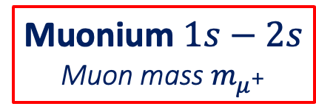
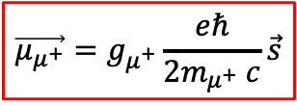

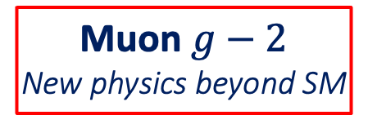
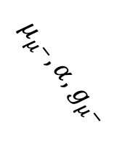
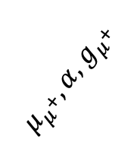

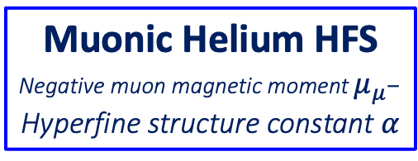

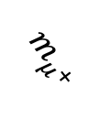
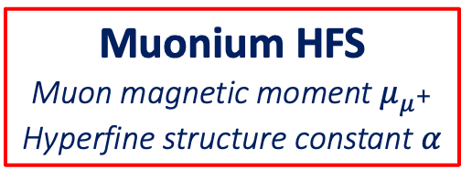
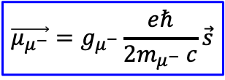



Muon Precision Measurement
MuSEUM
@ J-PARC MLF
Diagram borrowed from Klaus Jungmann
H1
Muonic Helium HFS
Negative muon magnetic moment $μ_{μ^{−}}$
Hyperfine structure constant $α$
CPT Test
Muonium HFS
Muon magnetic moment $μ_{μ^{+}}$
Hyperfine structure constant $α$
$$m_{μ^{−}}≑m_{μ^{+}}$$
$${∆ν}_{HFS, n=1}$$
NEGATIVE MUON
POSITIVE MUON
$$\vec{μ_{μ^{−}}}=g_{μ^{−}}\frac{eℏ}{2m_{μ^{−}} c}\vec{s}$$
$μ_{μ^{−}}, α,$ $g_{μ^{−}}$
$μ_{μ^{+}}, α,$ $g_{μ^{+}}$
$$\vec{μ_{μ^{+}}}=g_{μ^{+}}\frac{eℏ}{2m_{μ^{+}} c}\vec{s}$$
$$m_{μ^{+}}$$
MuMass@PSI
FNAL($μ^{+}$)
$${∆ν}_{1s–2s}$$
BNL($μ^{−}$)
Muon $g−2$
New physics beyond SM
$$m_{μ^{+}}$$
Muonium $1s−2s$
Muon mass $m_{μ^{+}}$
J-PARC MLF
H2
J-PARC Muon g-2/EDM
AMuLET (J-PARC)
H1
S2
H2
S2

Slide 10
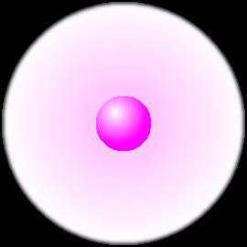


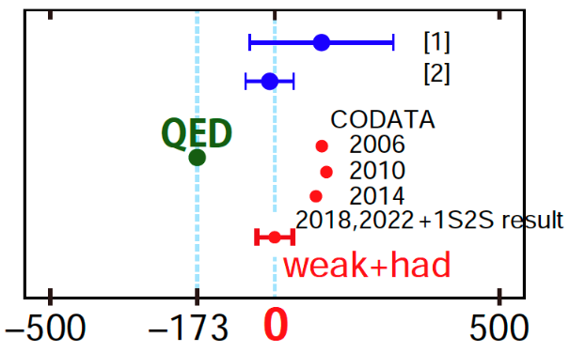
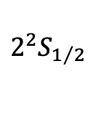


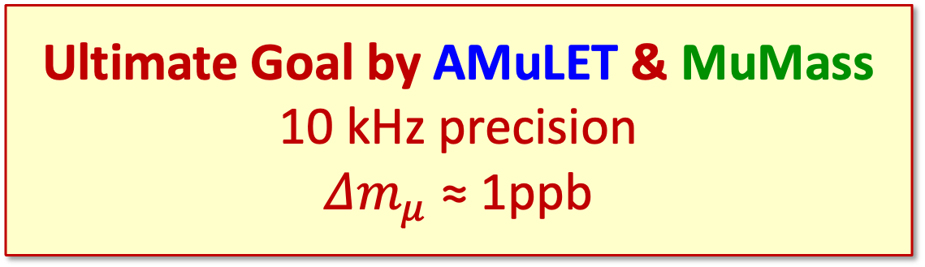

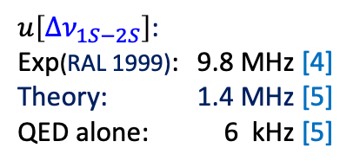

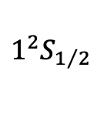
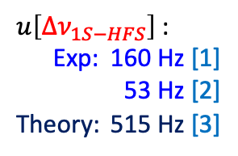
1S-2S Current Precision and Goal
From S. Uetake (Okayama Univ.)
Muonium Energy Level
1S-2S Laser Spectroscopy
$${Δν}_{1S−2S} ≃\frac{3α^{2}}{8h}m_{e}c^{2}{\left(1+\frac{m_{e}}{m_{μ}}\right)}^{−1}$$
$$2^{2}S_{1/2}$$
F
1
$u\left[{Δν}_{1S−2S}\right]$:
Exp(RAL 1999): 9.8 MHz [4]
Theory: 1.4 MHz [5]
QED alone: 6 kHz [5]
mass
0
1S-2S Goal (a): 100 kHz
Reduce mass uncertainty
120 ppb 8 ppb
Laser spectroscopy
$${Δν}_{1S−2S}$$
122 nm
Ultimate Goal by AMuLET & MuMass
10 kHz precision
${Δm}_{μ}$ ≈ 1ppb
1S-HFS Microwave
Spectroscopy
$${Δν}_{1S−HFS} ≃\frac{16}{3}α^{2}cR_{∞}\frac{m_{e}}{m_{μ}}{\left(1+\frac{m_{e}}{m_{μ}}\right)}^{−3}$$
$u\left[{Δν}_{1S−HFS}\right]$:
Exp: 160 Hz [1]
53 Hz [2]
Theory: 515 Hz [3]
mass
m_{µ}
mass uncertainty
120 ppb (Exp)
40 Hz
Muon mass uncertainty:
511 Hz (120 ppb) [2]
1
Microwave
$${Δν}_{1S−HFS}$$
Electroweak contribution: -65 Hz
Hadronic vacuum polarization: +237.7 Hz
center: 4.46 x 10⁹ Hz
$$1^{2}S_{1/2}$$
0
Electron mass uncertainty: m_{e} ≈ 0.3 ppb
[1] F. G. Mariam et al., PRL 49, 993 (1982)
[2] W. Liu et al., PRL 82, 711(1999)
[3] M. I. Eides, PLB 795, 113 (2019)
[4] V. Meyer et al., PRL 84, 1136 (2000)
[5] I. Cortinovis et al., EPJD 77, 66 (2023)
Experiment (RAL 1999): 2 455 528 941.0(9.8) MHz [4]
Bound-state QED predictions: 2 455 528 935.2(1.4) [5]
QED calculations alone known down to 6 kHz (2.4 ppt) [5]
Notes:
Experiment (RAL 1999): 2 455 528 941.0(9.8) MHz
Bound-state QED predictions: 2455528935.4(1.4) MHz [1–3].
QED calculations alone known down to 20 kHz (8 ppt) [4]
[1] K. Pachucki, et al., J. Phys. B 29, 177 (1996)
[2] S. G. Karshenboim, Z. Phys. D 39, 109 (1997)
[3] S. G. Karshenboim, Can. J. Phys. 77, 241 (1997)
[4] S. G. Karshenboim, Phys. Rep. 422, 1 (2005)

Slide 11
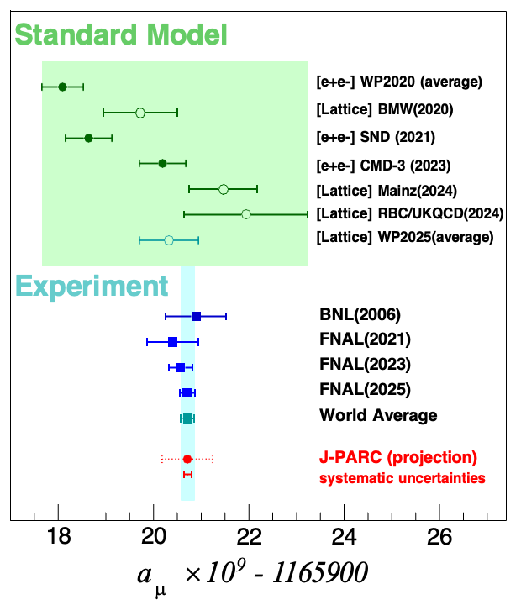

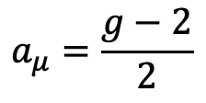

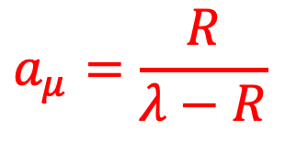
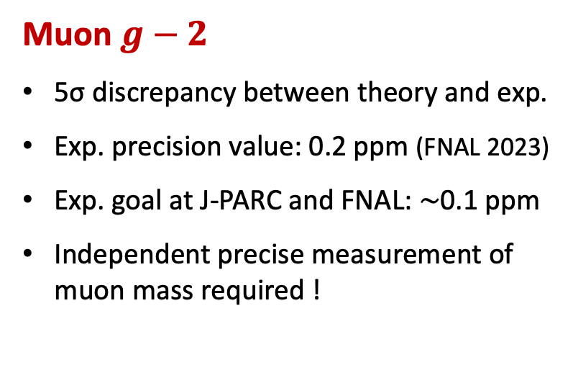

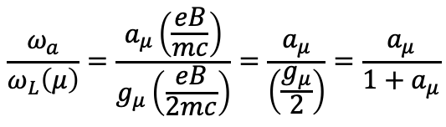

Relation between Muon g−2 & MuHFS
WP: arXiv:2505.21476
FNAL: PRL135, 101802 (2025)
$$a_{μ}=\frac{g−2}{2}$$
Muon $g−2$
  5σ discrepancy between theory and exp.
  Exp. precision value: 0.2 ppm (FNAL 2023)
  Exp. goal at J-PARC and FNAL: $\sim$0.1 ppm
  Independent precise measurement of muon mass required !
  Exp. value obtained using Muonium HFS result
From M. Kimura’s Talk at NuFACT2025
$$\frac{ω_{a}}{ω_{L}\left(μ\right)}=\frac{a_{μ}\left(\frac{eB}{mc}\right)}{g_{μ}\left(\frac{eB}{2mc}\right)}=\frac{a_{μ}}{\left(\frac{g_{μ}}{2}\right)}=\frac{a_{μ}}{1+a_{μ}}$$
$$a_{μ}=\frac{R}{λ−R}$$
$$R≡\frac{ω_{a}}{ω_{p}}$$
$$λ≡\frac{μ_{μ}}{μ_{p}}$$
$$=\frac{ω_{a}}{ω_{L}\left(p\right)}\frac{ω_{L}\left(p\right)}{ω_{L}\left(μ\right)}=\frac{ω_{a}}{ω_{p}}\frac{μ_{p}}{μ_{μ}}=\frac{R}{λ}$$
From g-2 storage ring
From Muonium HFS
μ_{μ}/μ_{p} accuracy from direct measurement: 120 ppb
W. Liu et al., Phys. Rev. Lett. 82 (1999) 711
Notes:
WP: arXiv:2505.21476
FNAL: arXiv:2506.03069 -> Phys. Rev. Lett. 135, 101802 PRL135, 101802(2025)

Slide 12
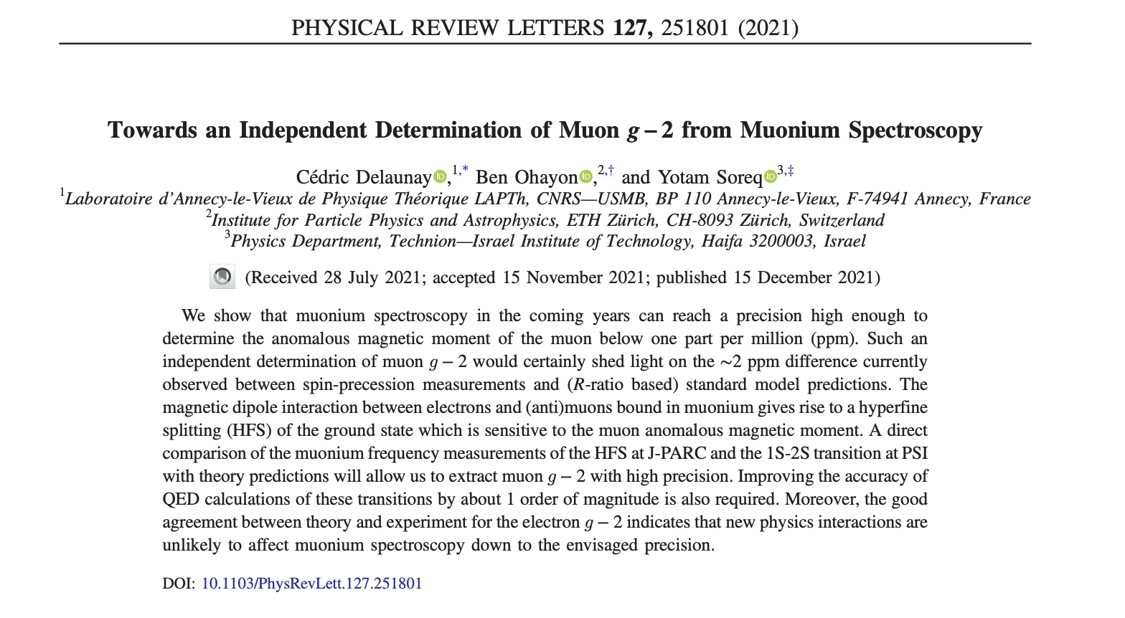
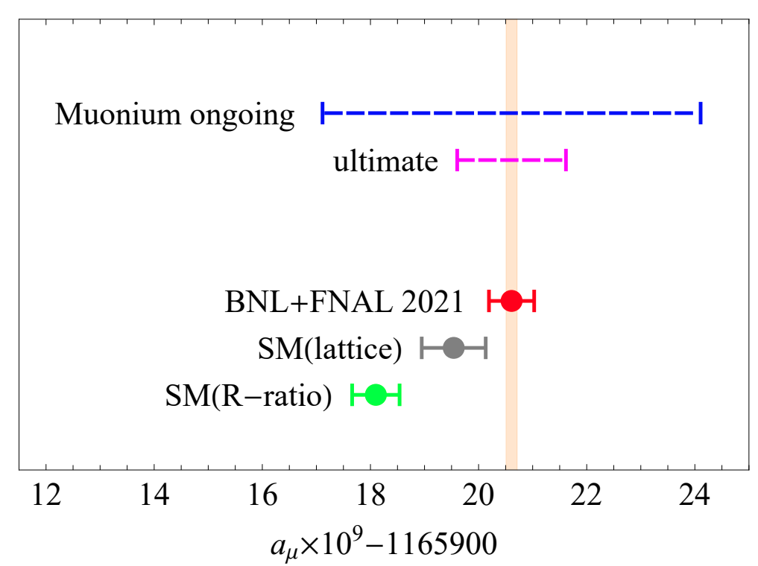
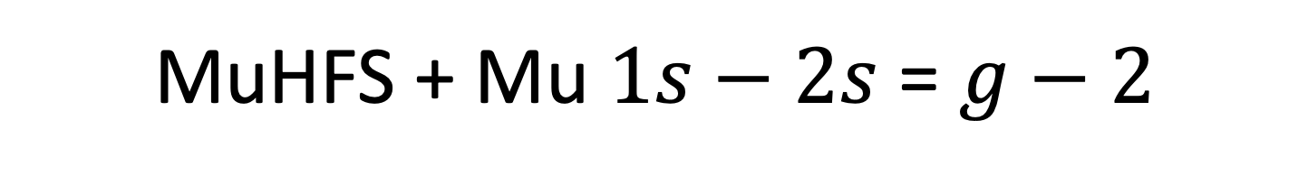
MuHFS + Mu $1s−2s$ = $g−2$

Slide 13
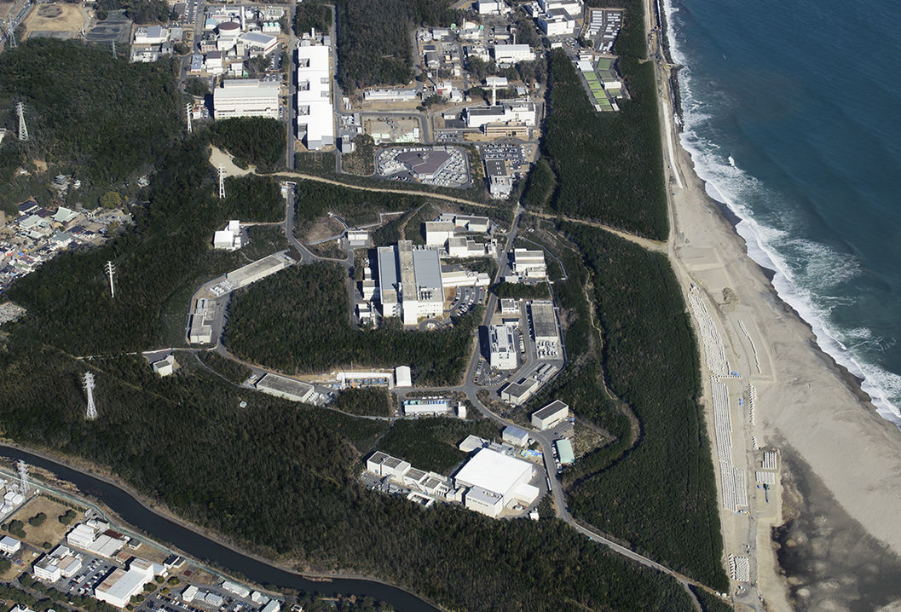
J-PARC Facility (KEK/JAEA）
Linac
400MeV
Rapid Cycle Synchrotron (RCS)
Energy: 3 GeV,
Repetition: 25 Hz
Design Power: 1MW
Neutrino Beams
(to Kamioka)
Materials and Life Experimental
Facility (MLF)
Main Ring (MR)
Top Energy: 30 GeV,
FX Design Power: 0.75 MW
SX Power Expectation: > 0.1 MW
Hadron Hall

Slide 14
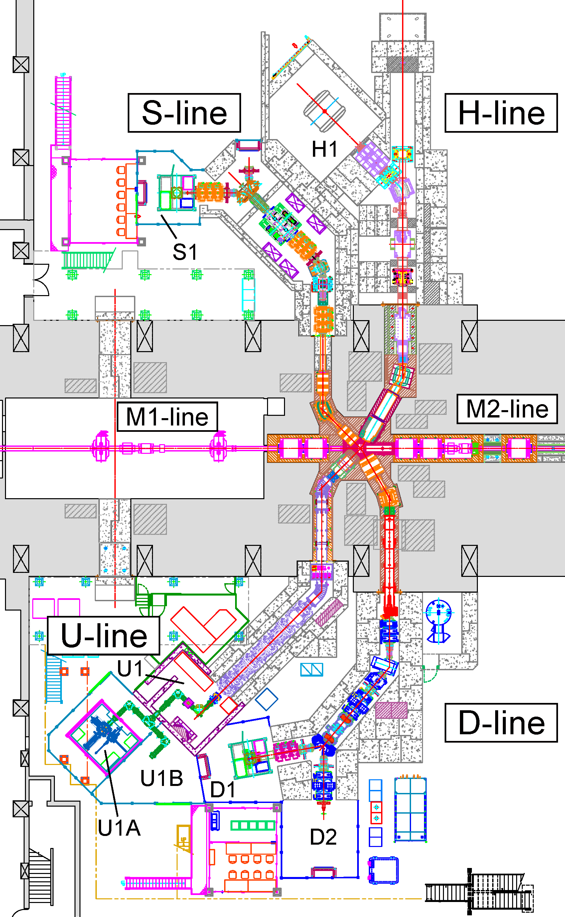
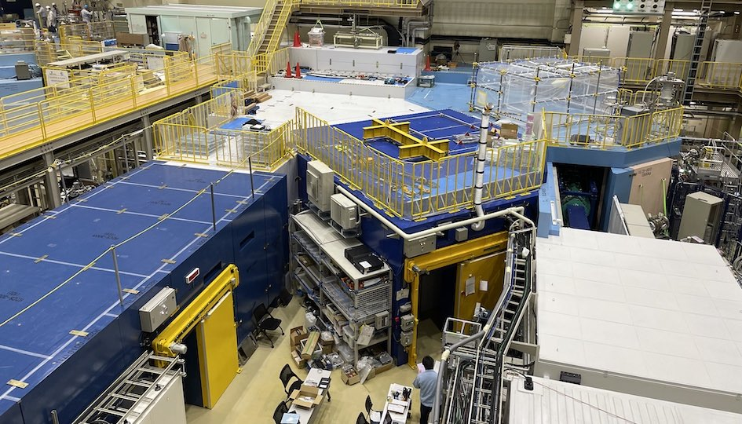
J-PARC Muon Science Facility (MUSE)
H1 Area
S2
g–2/EDM, TμS
Under Commissioning
H2
H-Line: for particle and atomic physics large scale experiments, “precision frontier”
Higher intensity tunable (4 – 50 MeV) µ⁺ & µ– beam.
(Exp.: MuSEUM, Deeme, g–2/EDM, …)
MuSEUM
DeeMe
H1 Area
3 GeV proton
H2
S2
Muon Target
MLF Experimental Hall No. 1 (May 2023)
Beamlines in Operation
S-Line: Surface muon (µ⁺)
Slow (4 MeV) beam for condensed matter physics.
D-Line: Decay muon (µ⁺ & µ–)
Slow (50 keV) – fast (50 MeV) beam, general purpose.
U-Line: Ultra-slow muon (µ⁺)
Ultra-slow (0.1 – 30 keV) beam for near-surface condensed matter physics, chemistry, etc.
D2 Area

Slide 15
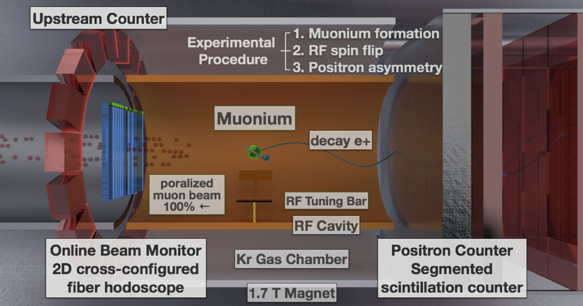
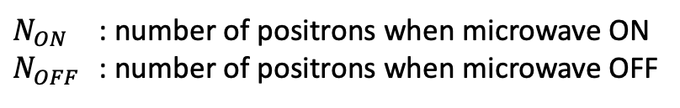
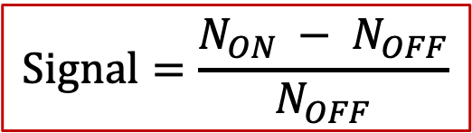
Muonium HFS Experiment Scheme
Upstream Counter
Experimental
Procedure
1. Muonium formation
2. Microwave spin flip
3. Positron asymmetry
Muonium
Decay e⁺
Polarized
Muon Beam
100% ←
MW Tuning Bar
MW Cavity
Online Beam Monitor
2D Cross-configured
Fiber Hodoscope
Positron Counter
Segmented
Scintillation Counter
Kr Gas Chamber
MRI Magnet (or)
Magnetic Shield
1.7 T Magnet
$$Signal=\frac{N_{ON} − N_{OFF}}{N_{OFF}}$$
$N_{ON}$ : number of positrons when microwave ON
$N_{OFF}$ : number of positrons when microwave OFF

Slide 16
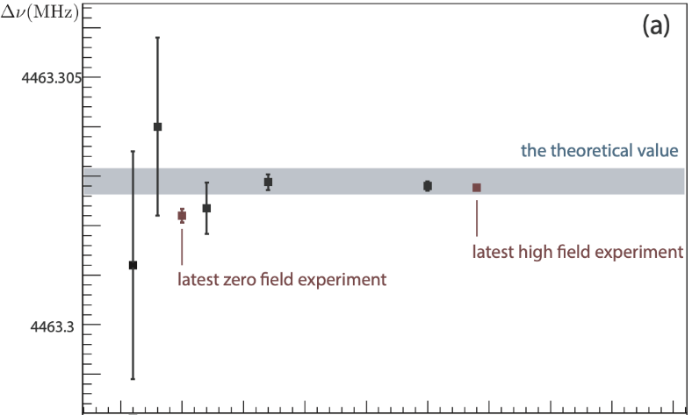
Previous Experiments
Time | Group | Δν | ppm | B field (T)
1961 | Yale-Nevis | 5500 MHz |  | 0.01-0.58
1962 | Yale-Nevis | 4 461.3(2.0) MHz | 450 | 1.1353
1964 | Yale-Nevis | 4 463.24(12) MHz | 27 | 0.5
1966 | Yale-Nevis | 4 463.18(12) MHz | 27 | 2.7 × 10⁻⁴
1969 | Yale-Nevis | 4 463.26(4) MHz | 9.0 | 3 × 10⁻⁴
1969 | Chicago | 4 463.317(21) MHz | 4.7 | 1.1353
1970 | Chicago | 4 463.302 2(89) MHz | 2.0 | 1.1353
1971 | Yales-Nevis | 4 463.308(11) MHz | 2.5 | 3 × 10⁻⁴ and 1 × 10⁻⁶
1973 | Chicago-SREL | 4 463 304.4(2.3) kHz | 0.5 | 0
1975 | LAMPF | 4 463 302.2(1.4) kHz | 0.3 | very weak
1977 | LAMPF | 4 463 302.35(52) kHz | 0.12 | 1.36
1982 | LAMPF | 4 463 302.88(16) kHz | 0.036 | 1.36
1999 | LAMPF | 4 463 302.765(53) kHz | 0.012 | 1.7
+2900
–1500
1970
1980
1990
2000
2010
Precision improved greatly in the 1970s due to the improvement of muon facilities.
Current world record is Liu (1999) at LAMPF.
→ New high-intensity muon experiments are needed!

Slide 17
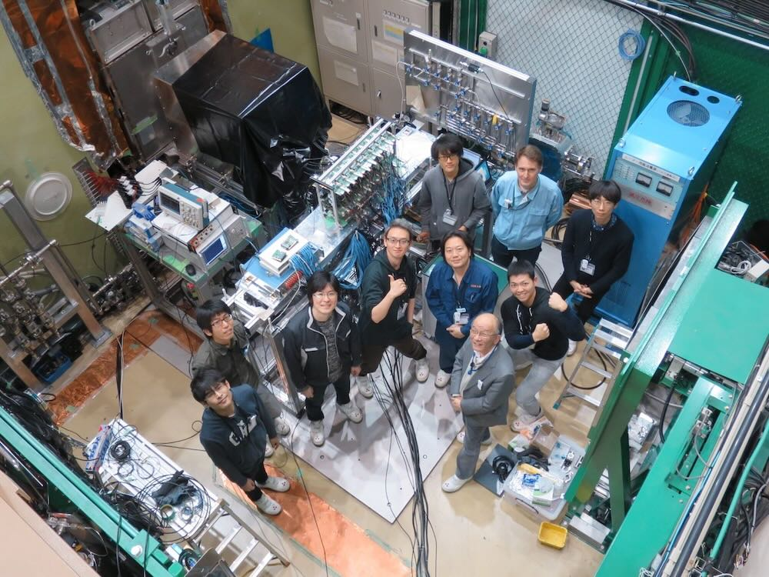
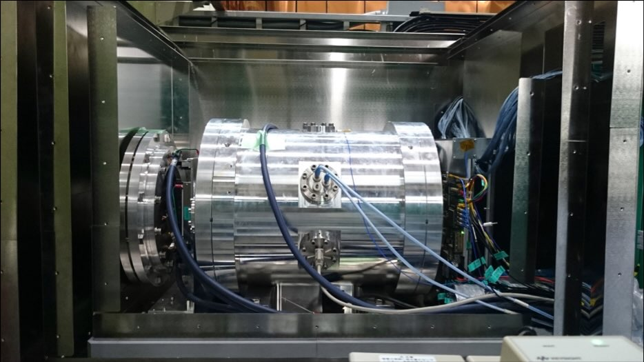
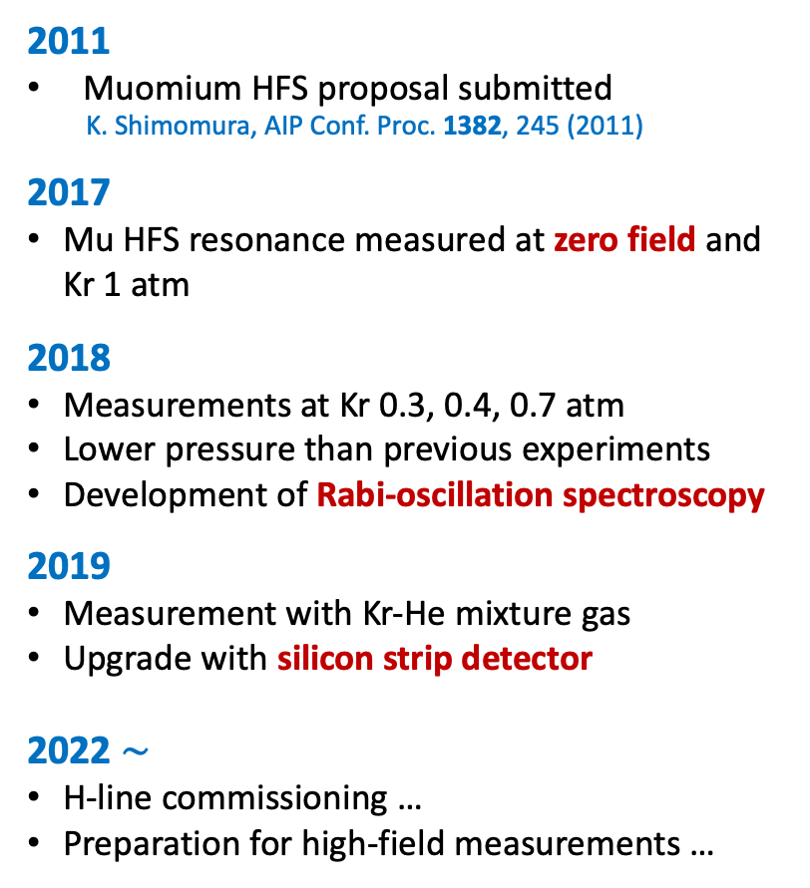
MuSEUM Experiment Timeline
2011
Muomium HFS proposal submitted
K. Shimomura, AIP Conf. Proc. 1382, 245 (2011)
2017
Mu HFS resonance measured at zero field and Kr 1 atm
2018
Measurements at Kr 0.3, 0.4, 0.7 atm
Lower pressure than previous experiments
Development of Rabi-oscillation spectroscopy
2019
Measurement with Kr-He mixture gas
Upgrade with silicon strip detector
2022 $\sim$
H-line commissioning …
Preparation for high-field measurements …
Silicon Strip Detector
Muon
Beam
Kr Gas
Chamber
Magnetic Shield
Zero-Field Experiment

Slide 18
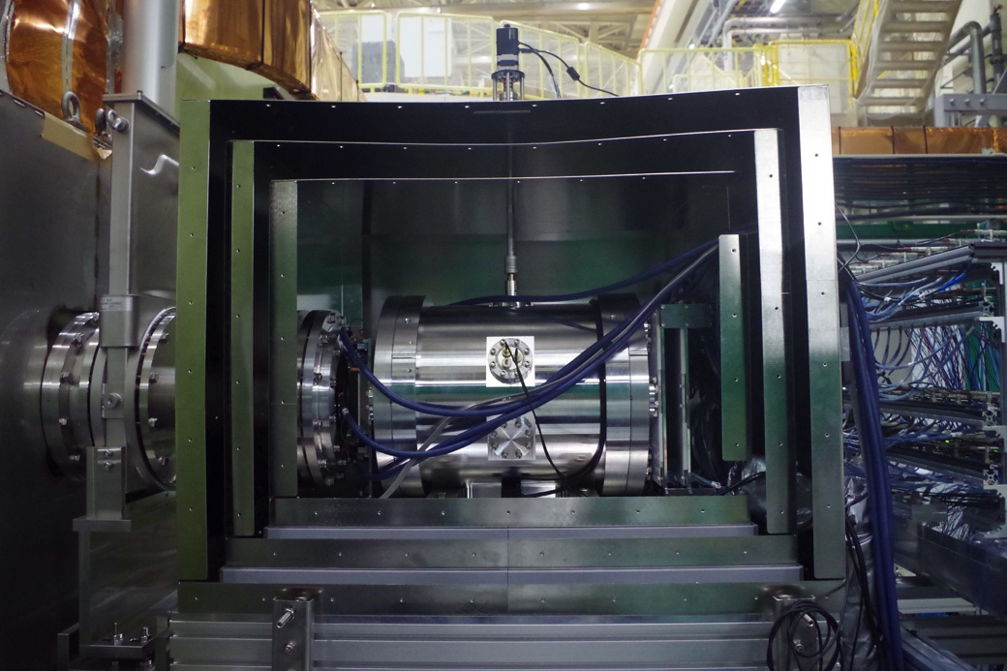
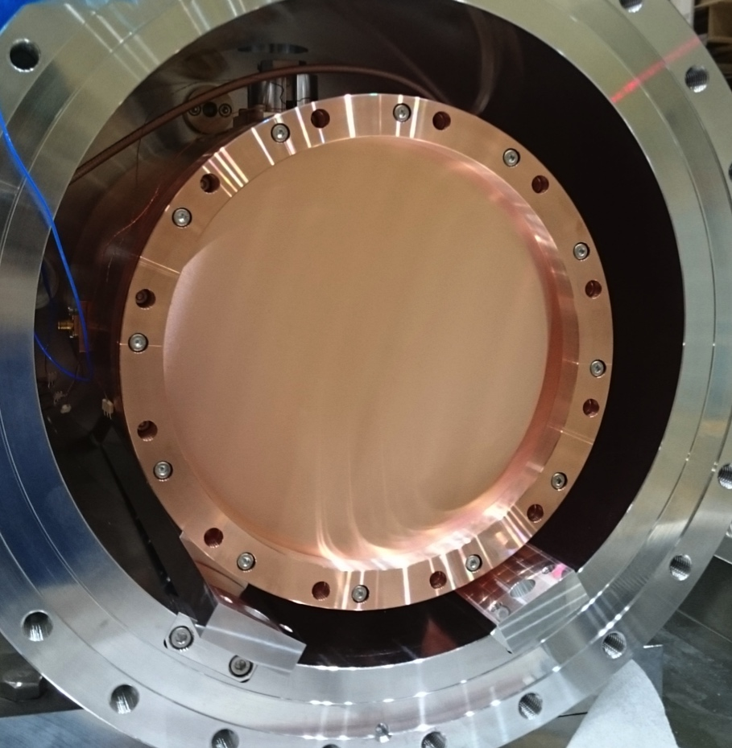
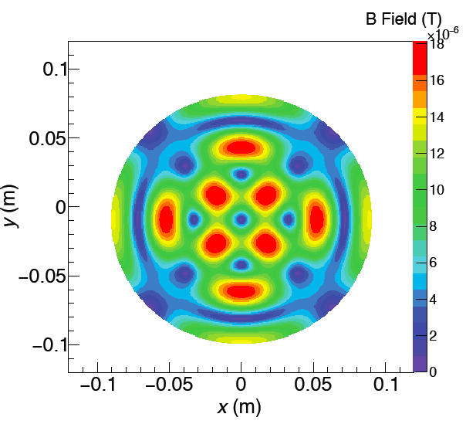
MuSEUM Zero-Field Experiment
Experimental Setup
Microwave Cavity for Zero Field
Magnetic Shield
Online Beam
Profile Monitor
Positron
Counters
Readout
Electronics
180 mm
Muon Beam
Microwave Intensity
Kr Gas
Chamber
Residual Magnetic Field
Δν = 4.463 GHz
~ 80nT
TM220 mode
Larger cavity
More muon stop
Q-Value: 20,000 (calc.)
Upstream
Window
Downstream
Window

Slide 19
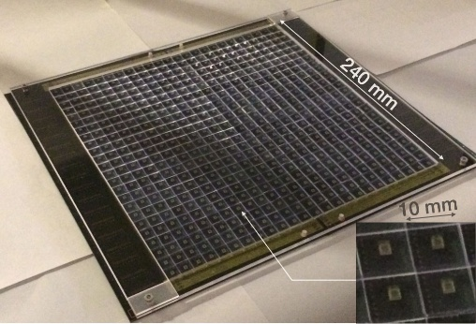







Counter Development
Positron Counter (1)
Segmented Scintillation Detector
Muon Beam Profile Monitor
32ch MPPC input
FPGA
Ethernet
Trigger input
100 mm
ASIC
PROM
+5V(A), +1.8V
Plastic scintillator + MPPC(SiPM) + Kaliope readout circuit
Unit cell: 10 mm × 10 mm × 3 mm^{t}
Area: 240 mm × 240 mm
24x24 segments x 2 layers = 1152 ch
High-rate capability
Pileup loss at 3 MHz/ch ~ 2%
100 μm
Area 100 x 100 mm²
100-µm fiber hodoscope (16 ch x 2)
3 x 3mm² active area MPPC with
15-µm pixel pitch
EASIROC readout
Positron Counter (2)
Silicon Strip Detector
New
Quarter Vane Module
4 sensors
~ 98 x 98 mm²
~200 mm
σ=26.5±2.8 mm
σ=20.8±1.5 mm
Readout chips (SliT128A, 128 ch/chip)
Developed for J-PARC g−2/EDM experiment
Highly-segmented
High-rate capability (S/N ~ 21)
Strip pitch: 0.19 mm
Strip length: 48.575 mm
No. of strips: 512 x 2 blocks
Thickness: 0.32 mm
Vertical position (mm)
Horizontal position (mm)

Slide 20



Rabi-Oscillation Spectroscopy Method
Simulation
Developed by Shoichiro Nishimura (KEK)
Δν_{HFS}(0) = 4 463 301.61(71) (160 ppb)
Experiment (2017 June)
S. Nishimura et al., Phys. Rev. A 104 (2021) L020801
Advantages:
Each detuning frequency data fitted individually
Can determine Δν_{HFS} with only one frequency data
Can improve statistical uncertainty by 3.2 times compared to the conventional method
Can reduce systematics due to microwave power variation (free fitting parameter)
Need fast detector and high-statistics data

Slide 21








MuSEUM Recent Publications
Zero-Field and High-Field Microwave Cavity
Zero-Field Experimental Setup and First Result
Rabi-Oscillation Spectroscopy
Δν = 4,463,301.61(71) (160ppm)

Slide 22






Development for
High-Field Experiment
Blind Analysis
HF Cavity
MRI Magnet
Magnetic Probes
Upstream Detector
Rectangular Cavity

Slide 23



High-Field Microwave Cavity
Cylindrical Cavity
Frequencies at 1.7 T
TM110 : 1.897 GHz
TM210 : 2.566 GHz
Two tuning bars
MWS Simulation
Cavity Test
Q Value
Modes | Q (measured) | Q (simulation)
TM110 | 11,300 | 29,700
TM210 | 8,050 | 28,900
Re-tuning
in progress !
K. S. Tanaka et al., PTEP 2021, 053C01 (2021)

Slide 24



Improvement from LAMPF
Cavity Length
MuSEUM Cavity
Muonium transition frequency in gas varies with the gas pressure due to atomic collisions between Mu and Kr
Previous experiment used fitting of 0.8 and 1.5 atm data only using old quadratic dependence parameter (LAMPF)
Data at lower pressure needed to improve uncertainty

Slide 25




MRI Magnet for High-Field Experiment
Requirements for magnetic field
0.2 ppm (peak-to-peak) uniformity
±0.1 ppm stability during measurement
Field Homogeneity (after shimming)
  Spheroid :
  r=100 mm, z=300 mm
Second-hand 2.9 T MRI magnet
(ppm)
these data: 1.4 ppm (p-p)
Iron shim plates:
341 ppm (p-p)
Long Term Stability
Nickel films:
0.27 ppm (p-p)
(achieved!)
64 Hz / 9.7 days
Magnetic putty:
0.17 ppm (p-p)
(simulation)
0.003 ppm /h

Slide 26


MRI Magnet Installation in H1 Area
Installation of the superconducting magnet in the H1 experimental area completed in November 2023
Magnet successfully energized to the target field strength of 1.7 T
Next magnetic field homogeneity through successive shimming

Slide 27




Magnetic Field Probes
Three types of probes are being developed
Standard Probe
  CW-NMR field monitoring system
  Precision of 15 ppb has been achieved
Field Camera
Ch5
Ch6
  24-channels rotating NMR probe to map magnetic fields
  Used for shimming
  10-channel prototype has been developed
Ch4
Ch7
Ch3
Ch8
Ch2
Ch9
Ch1
Ch10
Fixed Probe
  Compact probe to monitor magnetic field stability during experiment
200mm
80 mm

Slide 28






Field Camera
Developed by Hiroki Tada (Nagoya Univ.)
Scanning a sphere with a radius of 25 cm
24-channel half-circle multi-channel system
Scanning time: 3 hours (single probe) $→$ 20 minutes (multi-channel system)
24 channels
Support
Structure
25 cm
Large Field Camera
10-channel Prototype
Microwave
Cavity
Small Field
Camera

Slide 29



Magnetic Field Homogeneity Measurement
Proton NMR
by Yu Goto (Nagoya Univ.)
Ken-ichi Sasaki (KEK)
Aluminum
Cover
Field Camera
Shim Tray
80 mm
NMR Signal
Use protons
in pure water
Stability during
measurement: ±0.1 ppm
×24
By taking into account:
Effect of the cylindrical shape of pure water
Difference in resonance peaks between both paths of the modulation field
Detuning of the LC resonant circuit
Dependence on the probe direction
An absolute accuracy of 15 ppb can be achieved.
Rotate the 24-channel magnetic field camera by 24 angles and create a 576-point magnetic field measurement map
H. Tada, poster at FKK 2023
H. Tada et al., IEEE Trans. Appl. Supercond. 32 (6), 9002205 (2022)

Slide 30




Field Mapping & Adjustment (1)
Raw field data
by Mitsushi Abe (KEK)
Angles
Magnetic Field Reconstruction Method
Field reconstruction from measurements by assuming magnetic moments on the outer spherical surface
about 5000 points
Shim plates
Fe
Fe
Ni
Shimming
Calculate the number of shims required in each tray pocket
Channels
Pockets
Shim Tray
Truncated Singular Value Decomposition
Solving the inverse problem using a singular value decomposition method
Limiting the number of eigenvalues (modes) when solving the inverse matrix → Maximize the effect while minimizing the number of shim plates
Increasing the total number of shimming iterations → Minimize the thermal effect of shim plates on the magnetic field
M. Abe et al., IEEE Trans. on Appl. Supercond. 27 (7), 4400812 (2017)

Slide 31

Field Mapping & Adjustment (2)
Bare Field
After Shimming
Field Homogeneity
about 30ppm per line
After 2 coarse shimming
and 3 fine shimming
iterations
±1 ppm line
±0.1 ppm line
$$\text{Homogeneity}=\frac{\text{B}\text{(}\text{maximum}\text{)}−B(\text{minimum})}{B\text{(}\text{average})}×{10}^{6}[ppm]$$
Coarse shimming:
Large-scale shimming with magnetic field ramp-up and ramp-down
Fine shimming:
Detailed shimming without ramping up or down the magnetic field
Magnetic field | Fe Volume (cc) | Homogeneity (ppm) Ø20 x 30 cm DSS
Bare field | C1: 700.05 | 295.59
After C1 | C2: 48.77 | 8.9182
After C2 | F1: (29) | 0.5281
Before F1 | F1: 28.08 | 0.6854
After F1 | F2: 1.020 | 0.5712
After F2 | F3: 0.249 (Ni) | 0.2506
After F3 |  | 0.2033
As a result of this shimming,
a magnetic field homogeneity of 0.2ppm was achieved.
by Mitsushi Abe (KEK)

Slide 32





New Inner Field Camera
  Field measurements and adjustment with
  all components in place
Developed by Yu Goto (Nagoya Univ.)
Gas Chamber
Microwave Cavity
13 NMR Probes
x
12 angles
Raw field data:
  Preliminary measurements:

Slide 33


Experimental Preparation Status
Fixed Probe
Magnetic Field Monitoring
by Yu Goto (Nagoya Univ.)
From past studies
Temperature coefficient of magnetic field: 0.17 μT/K
Field drift during long-term operation: ≈ 0.88 ppm/10 days
→ It was confirmed that precise magnetic field measurements can be performed during the experiment
Positron
Detectors
Evacuation &
Gas Handling
Cavity inside
Gas Chamber
Microwave &
Piezo Cables
Cavity
Cooling Water
→ Installation of most of the equipment completed

Slide 34







Blind Analysis for MuSEUM
Hidden answer method
Before opening the blind
Value to be blinded: injected microwave frequency
Microwave frequency input by user: $ν_{set}$
Blinded offset: $δ$
True microwave frequency: $ν_{mw}$
$δ$ constant for all $ν_{set}$ to draw a resonance curve
If |$δ$| < 8kHz
  blind value sufficient for the target precision
  rate of change in stored microwave energy < 0.07%
Signal
$$ν_{mw}=ν_{set}+δ$$
$ν_{mw}$− 4,463,302 kHz − $δ$
= $ν_{set}$ − 4,463,302 kHz
Implemented in Python3
True frequency hidden
Blind Test (for µHe HFS)
2023/05/18
Password protected, safety/protection features to prevent mis-operation
Microwave power and gas pressure are also monitored and recorded

Slide 35




First Muonium HFS at High Field
TM110
TM210
ν₁₂
ν₃₄
Preliminary
Liu (1999)
February 2025
2 days with 100 kW proton beam
Statistical error of Δν is 1100 Hz
H1 Area
Next µHe HFS at high field!

Slide 36






Second Muonium HFS at High Field
November 2025
6 days with 800 kW proton beam
Statistical error of Δν is 300 Hz (12 h data)
To achieve an accuracy of 8 Hz (our goal):
  Rabi-oscillation spectroscopy (x2~3)
  100 days (x$\sqrt{200}$)
  S/N improvement (x3)
We also plan to measure at 1.15 T and 2.9 T

Slide 37

Preliminary Systematic Errors (High Field)*
Contributions | Accuracy | $ν_{12}$ and $ν_{34}$ | $$δ\left({Δν}_{HFS}\right)$$ | $$δ\left({μ_{μ}}/{μ_{p}}\right)$$
Magnetic Field | 15 ppb |  | 0.0 ppb | 8 ppb
RF power | < 0.1 % | < 1 Hz | 0.2 ppb | 2 ppb
Kr gas temperature | 0.2 deg. | < 2 Hz | 0.4 ppb | 4 ppb
Kr gas pressure | 1 Pa | 1 Hz | 0.2 ppb | 0 ppb
H impurity | < 50 ppm | 1 Hz | 0.5 ppb | 0 ppb
Quadratic dependence |  | 5 Hz | 1.0 ppb | 5 ppb
Muonium position (x,y) | 1 mm | 3 Hz | 0.6 ppb | 6 ppb
Muonium position (z) | 1 mm | < 1 Hz | 0.2 ppb | 2 ppb
Beamline | 10⁻⁴ | < 1 Hz | 0.2 ppb | 2 ppb
Detector pile-up | w/o absorber w/ absorber | 2.8 Hz 0.3 Hz | 0.5 ppb < 0.1 ppb | 3 ppb < 1 ppb
Total |  |  | $\sim$ 1.5 ppb | $\sim$ 13 ppb
* Should be re-estimated by the latest progress and further MC simulation (old estimation)

Slide 38
Muonic Helium Atom Ground-State HFS
Muonium
Muonic Helium

Slide 39
Muonic Helium Atom
Muonium
Muonic Helium
System composed of a helium atom with one of its two electrons replaced by a negative muon (µ–) (bound muon Bohr radius: r_{µ} ≅ 1/400 a_{o}).
A hydrogen-like atom very similar to muonium (Mu).
Ground state hyperfine structure (HFS) results from the interaction of the remaining electron and the negative muon magnetic moment (almost equal to that of muonium but inverted).
Same technique as with muonium used to measure muonic helium HFS.
Sensitive tool to test 3-body atomic system and bound-state QED theories and determine fundamental constants of the negative muon magnetic moment and mass to test CPT invariance with 2nd generation lepton.

Slide 40


Muonic Helium Atom
Hydrogen-like atom similar to muonium
Similar ground-state HFS but inverted
Same technique to measure µHe HFS
Muonium
Muonic Helium
Ground-state muonic helium
HFS structure and low-field
Zeeman splitting
Δν(Mu) = 4463.302765(53) MHz
Δν(µHe) = 4464.980(20) MHz
Mu
µHe
Sensitive tool to …
test 3-body atomic system and bound-state QED
$$ν_{12}+ν_{34}=Δν$$
determine negative muon magnetic moment and mass
$$\frac{μ_{μ^{±}}}{μ_{p}}=\frac{r_{e}^{′}ν_{p}\left(ν_{34}−ν_{12}\right)∓4ν_{12}ν_{34}}{2ν_{p}\left(r_{e}^{′}ν_{p}+\left(ν_{34}−ν_{12}\right)\right)} \frac{g_{μ}}{g_{μ}^{′}}$$
Breit-Rabi energy level diagrams
CPT test with 2nd generation lepton

Slide 41




Previous µHe HFS Experiments ('80s)
Zero Field (SIN)
High Field (LAMPF)
pressure: 20 atm
pressure: 5 & 15 atm
ZF
HF
 | Condition | Δν | µ_{µ}–/µ_{p}
⁴He | zero field [1] ZF | 4464.95(6) MHz [13 ppm]
 | high field [2] HF | 4465.004(29) MHz [6.5 ppm] | 3.18328(15) [47 ppm]
³He | zero field [3,4] | 4166.41(5) MHz [12 ppm]
[1] H. Orth et al., Phys. Rev. Lett. 45 (1980) 1483
[2] C. J. Gardner et al., Phys. Rev. Lett. 48 (1982) 1168
[3] V. W. Hughes and G. zu Putlitz, in Quantum Electro-dynamics (ed. T. Kinoshita, World Scientific, 1990) 822
[4] M. Gladish, At. Phys. 8 (1983) 197-211

Slide 42
CPT with Second Generation Lepton
The “positive muon mass” is experimentally determined by muonium ground state HFS measurement through µ_{µ}+/µ_{p} to 120 ppb [5].
The direct experimental value of the “negative muon mass” is only determined to 3.1 ppm from muonic X-ray studies using bent-crystal spectrometer [7]. µ_{µ}– obtained within the same accuracy.
  The ratio µ_{µ}+/µ_{µ}– gives a CPT invariance test at a level of 3 ppm [8].
µ_{µ}–/µ_{p} also needed to determine a_{µ}– and its g factor g_{µ}– in the existing BNL muon g–2 experiment [9].
New precise measurements will soon come out:
MuSEUM at J-PARC
Mu-MASS at PSI [6]
Muonium 1S-2S spectroscopy at J-PARC
[5] W. Liu et al., Phys. Rev. Lett. 82 (1999) 711
[6] P. Crivelli, Hyperfine Interact. 239 (2018) 49
[7] I. Beltrami et al., Nucl. Phys. A 451 (1986) 679
[8] X. Fei, Phys. Rev. A 49 (1994) 1470
[9] G. W. Bennett et al., Phys. Rev. A 92 (2004) 161802
More precise measurement of the negative muon magnetic
moment highly desirable !
Notes:
The ratio µ_{µ}–/µ_{p} is also needed to determine the anomalous magnetic moment of the negative-muon a_{µ}–
and its g factor g_{µ}– in the existing BNL muon g–2 experiment.

Slide 43
Δν_{HFS} : Experiment vs. Theory
Ground state HFS of muonic helium is very similar to muonium.
In reality, however, muonic helium is complicated because three-body interaction has to be considered, thus limiting the theoretical approach.
Calculations performed since the 1970s based on perturbation theory (PT), variational approach (VA), and Born-Oppenheimer (BO) theory.
Muonic Helium-4 HFS (⁴He²⁺µ–e–)
Experiments
PT: Amusia, Krutov, Lakdawala, …
VA: Aznabayev, Chen, Forlov, Huang, Pachucki, …
BO: Drachman, …
error from
numerical
convergence
only ???
no error
reported !
Δν = 4464.55(60) MHz (135 ppm)
D. T. Aznabayev et al.,
Phys. Part. Nucl. Lett. 15 (2018) 236
Possible theoretical improvements:
QED effects calculation in 3-body systems could be performed more precisely in higher orders of perturbation theory.
Recent calculations developed for HFS in ³He (40-fold improvement): could it be applied to muonic helium HFS ?
K. Pachucki Phys. Rev. A 63 (2001) 032508
V. Patkos et al., Phys. Rev. Lett. 131 (2023) 183001
Notes:
PT: Amusia, Krutov, Lakdawala, … (perturbation theory)
VA: Chen, Forlov, Huang, Pachucki, Aznabayev, … (variational approach)
BO: Drachman, … (Born-Oppenheimer)
NV: Krivec (4454.213±0.003), … (nonvariational calculation)

Slide 44

Muonic Atom Spectroscopy Theory Initiative
URL: https://asti.uni-mainz.de/
Aim to improve the Standard Model theory predictions for the Lamb shift and hyperfine splitting in muonic hydrogen, deuterium, and muonic helium ion.
Note: the HFS in the three-body muonic ⁴He atom is not covered at present.

Slide 45
Why so difficult compared to Mu?
Muonic helium atom residual polarization
Depolarization during muon cascade process: 100% → 2–5%
Electron donor
Helium capturing a muon forms (⁴Heµ–)⁺ ion → need an electron donor !!!
Previously 1–2% xenon (IP = 12.1 eV) was used. But Xe (Z=54) prevents efficient µ– capture by He (Z=2) due to Fermi-Teller Z-law.
Recently methane (CH₄) was found more efficient because of its reduced total charge (Z=10) and similar IP of 12.5 eV. Polarization of ∼ 5% reported.
Negative Muon Beam Intensity
Negative muon beams are generally 10 – 100 times less intense than surface (positive) muon beams
P. A. Souder et al., Phys. Rev. A 22 (1980) 33: 5.0 ± 0.7%
H. Orth, Hyperfine Interact. 19 (1984) 829: 2.3 ± 0.5%
D. J. Arseneau, et al., J. Phys. Chem. B 120 (2016) 1641

Slide 46

New µHe HFS at J-PARC MUSE
New precise HFS measurements are being planned at the Muon Science Facility (MUSE) of the Japan Proton Accelerator Research Complex (J-PARC).
Three key components for improvement:
Using high-intensity negative muon beam at J-PARC MUSE.
Applying Rabi-oscillation spectroscopy technique to HFS measurements.
Producing highly-polarized muonic helium atoms to improve the µ– residual polarization in helium by Spin Exchange Optical Pumping (SEOP).
Signal

Slide 47
Experimental Arrangement
Spin Flip
Zero-Field Measurements
High-Field Measurements

Slide 48
Expected Improvements
Previous experiments: δ(Δν) = 6.5 ppm, δ(µ_{µ}–/µ_{p}) = 47 ppm)
5 ´ 10⁴ µ–/s at 55 MeV/c (low field), 4 ´ 10⁴ µ–/s at 35 MeV/c (high field)
H-line:
∼10⁷ µ–/s at 30 MeV/c (at 1-MW proton beam power)
→ ∼10⁴ times more statistics (intensity ´ ∼10³ & runtime of 100 days)
Statistical Improvement | Δν | µ_{µ}–/µ_{p}
10⁴ statistics (´100) | 100 ppb | 1000 ppb
Rabi Spectroscopy (´3) | 40 ppb | 400 ppb
Highly-Polarized µ–He (´7) | 6 ppb | 60 ppb
Very Very Preliminary !!!
Systematic uncertainties:
MuSEUM experiment has similar systematical errors.
Present estimation: ∼2 ppb for Δν and ∼20 ppb for µ_{µ}–/µ_{p}.
D-line: (zero field)
→ ∼10² times more statistics (depending on beamtime allocation)
General User
Program
Notes:
Previous experiments: (Δν: 6.5 ppm, µ_{µ}–/µ_{p}: 47 ppm)

Slide 49


µHe HFS Measurements at Zero-Field
Experimental Setup
Microwave Cavity (zero field)
Magnetic Shield
TM220 mode
Larger cavity
More muon stop
Q-Value:
20,000 (calc.)
Online Beam
Profile Monitor
Positron
Counters
Readout
Electronics
180 mm
MW Intensity
Muon Beam
He Gas
Chamber
Kr Gas
Chamber
Δν = 4.463 GHz
Δν = 4.465 GHz
Residual Magnetic Field
Gas
Panel
~ 80nT
[2019B0318]
Preparation of MuSEUM apparatus in D2 area
(students from
Nagoya University and
the University of Tokyo)
Microwave Window
Upstream
Downstream

Slide 50



Decay Electron Time Spectra
[2020B0333]
Frequency = 4465000 + 0 kHz
“On” resonance
µCu
Signal ($N_{ON}−N_{OFF}$)
$τ=$ 162 ns
µHe
Counts
$τ=$ 2195 ns
Rabi Oscillations
Time (ns)
Frequency = 4465000 + 600 kHz
“Off” resonance
Red : $N_{ON}$
Black : $N_{OFF}$
Signal ($N_{ON}−N_{OFF}$)
Time (ns)
Time (ns)
1st Muon
Peak (-600 ns)
$Asymmetry=\frac{N_{OFF}}{N_{ON}}−1$
0
resonance
2nd Muon
Peak (0 ns)
$N_{ON}$ : Number of e– with microwave
$N_{OFF}$ : Number of e– without microwave
Asymmetry

Slide 51




µHe HFS Resonance Curve
March 2021
February 2022
May 2022
4 atm
First Resonance Observed
10.5 atm
3 atm
Blind
Analysis
Blind
Analysis
N_{ON} / N_{OFF} - 1
N_{ON} / N_{OFF} - 1
N_{ON} / N_{OFF} - 1
[2020B0333]
[2021B0169]
[2022A0159]
Frequency – 4465050 kHz
Frequency – 4465140 kHz
Frequency – 4465000 kHz
Time cut: electron data from 1.6 µs after second µ¯ pulse !
ZF: H. Orth et al., PRL 45 (1980) 1483
HF: C. J. Gardner et al., PRL 48 (1982) 1168
After 40 years
New World Record!
ZF
HF
Δν = 4464.95(6) MHz (Orth et al.) [13 ppm] zero field (ZF)
Δν = 4465.004(29) MHz (Gardner et al.) [6.5 ppm] high field (HF)
Δν = 4464.980(20) MHz (MuSEUM) [4.5ppm] zero field
P. Strasser et al., Phys. Rev. Lett. 131 (2023) 253003

Slide 52



High-Field Microwave Cavity (Mu&µHe)
Cylindrical Cavity
3D CAD
MWS Simulation
Comparison between Muonium & µHe
Cavity Test
Q Value
Modes | Q (measured) | Q (simulation)
TM110 | 1.13 x 10⁴ | 2.97 x 10⁴
TM210 | 8.05 x 10³ | 2.89 x 10⁴

Slide 53
Highly-Polarized
Muonic Helium Atom

Slide 54


Highly-Polarized Muonic He Atom
by Spin Exchange Optical Pumping (SEOP)
Glass cell target: (T ≈ 200°C)
Sphere: ~Ø2.5 cm x 100 µm^{t}
He: 8 atm
Rb: 4.4 x 10¹⁴ atoms/cm³
N₂ : 75 Torr
CH₄ : up to 250 Torr
A. S. Barton et al., Phys. Rev. Lett. 70, 758 (1993)
⁴He (no CH₄)
³He (no CH₄)
for µ⁴He: 6% → 44%
Improvement by a factor 7 achieved !
⁴He (with CH₄)
³He (with CH₄)
Maximum theoretical polarization:
⁴He = 100%, ³He = 75%
Notes:
the maximum theoretical polarization is 3/4 (1) for He3 (He4).
the spin-1/2 muon must couple to the spin-1/2 He3 nucleus.
the spin-0 singlet state in He3 (25%) cannot be polarized.

Slide 55
Polarization of Muonic He Atom
by S. Fukumura
laser
light
Rb⁺
Rb⁺
1
e⁻
e⁻
2
Rb
polarized Rb
μ⁻
μ⁻
μ⁻
μ⁻
Rb⁺
⁴He⁺⁺
Rb⁺
⁴He⁺⁺
Rb⁺
⁴He⁺⁺
Rb⁺
⁴He⁺⁺
e⁻
e⁻
e⁻
e⁻
e⁻
e⁻
polarized Rb
µHe ion
Rb ion
electron-polarized
µHe atom
polarized Rb
He atom
Rb
electron-polarized
µHe atom
Charge Exchange
Reaction
Spin Exchange
Reaction
μ⁻
μ⁻
⁴He⁺⁺
hyperfine interaction
⁴He⁺⁺
e⁻
e⁻
electron-polarized
µHe atom
muon-polarized
µHe atom

Slide 56
µHe SEOP Objectives
Demonstrate re-polarization of µHe atoms at using the SEOP technique
  Test experiment at D1 area under development
Further improvements expected with a hybrid-SEOP technique
  Use K/Rb to enhance the spin-exchange efficiency
  Rb is used as a spin-transfer agent to K, to prevent depolarization of Rb due to Rb-Rb collision.
  K-He transfers the angular momentum with much greater efficiency than directly Rb-He (nearly 10 times greater than with pure Rb pumping).
  Can achieve high polarizing rate with high polarization, which is very important for HFS measurements
Demonstrate that the SEOP technique can be applied to muonic helium HFS measurements
  Simulation (in progress)
  Test experiment

Slide 57





SEOP Experimental Setup for µHe
New MuSEUM-SEOP collaboration: MUON + NEUTRON
Kakenhi(A): FY2021-2023
KEK: T. Ino, S. Kanda, S. Nishimura, K. Shimomura
Nagoya Univ.: S. Fukumura, T. Okudaira, M. Kitaguchi, H. M. Shimizu
Tohoku Univ.: M. Fujita, Y. Ikeda (glass cell)
JAEA: T. Oku
SEOP Cell
surrounded by:
Oven heater (200°C)
Insulation Foam
Laser Diode Array
Laser
Muon Beam
Power: 〜60 W
Wavelength: 795 nm
Operating mode:CW
Glass Cell
Laser
57
MAC
2023/02/21

Slide 58



First Laser Experiment at D1 Area
Muonic helium atom polarization
[2022B0314]
Depolarization during the muon cascade ↘︎ ∼5%
Re-polarization of µHe atom by Spin-Exchange Optical Pumping (SEOP)
µHe SEOP Beamtime (Feb. 2023)
-0.03
µHe
Upstream (FWD)
µ–
S. Fukumura,
T. Okudaira
(Nagoya Univ.)
Asymmetry (F-B)/(F+B)
-0.04
Rb cell @ 180°C
-0.05
-0.06
-0.07
Laser light polarization:
Left Circ. (Rb↓)
Linear
Right Circ. (Rb↑)
Downstream (BWD)
-0.08
µ–
Preliminary
-0.09
D1 laser enclosure can also be used by other experiments.
8000
9000
10000
11000
12000
13000
14000
15000
16000
&
Time (ns)
First laser experiment at D1 area
First successful µHe SEOP Results!
Laser Diode
Array
Laser Diode
Array

Slide 59















Glass Cell Development
e ⁻
by S. Fukumura
FWD
Left-handed circular polarization
Rb⁺
μ⁻
Asymmetry:
e ⁻
μ⁻
$$A\left(t\right)=\frac{F\left(t\right)−B\left(t\right)}{F\left(t\right)+B\left(t\right)}$$
Right-handed circular polarization
Rb⁺
μ⁻
Muon Beam
e ⁻
BWD
e ⁻
Old Pyrex Cell
Glass Cells:
Blown at the Glass Workshop of Tohoku University
Filled and tested by Takashi Ino (KEK)
New GE-180 Cell
Size: Ø75 mm x 150 mm
Wall (front): 1 mm
Wall (side): 1 mm
Size: Ø50 mm x 180 mm
Wall (front) : 0.5 mm
Wall (side) : 1.0 mm
Rb cell: 180°C
Feb. 2023
Upstream
(FWD)
left-handed
[2022B0314]
Very Preliminary
Asymmetry
Asymmetry
linear
Dec. 2023
Downstream
(BWD)
[2023A0317]
right-handed
Time (ns)
Time (ns)

Slide 60

µHe SEOP vs. Hybrid-SEOP
160 °C
180 °C
200 °C
240°C
1. Polarization increases with Rb mobility
Rb Pure Cell
2. Polarization decreases due to Rb-Rb collisions
Hybrid Cell
[K]/[Rb] = 12.5 (mole)
180 °C
200 °C
1
2
Very Preliminary
Decrease in polarization efficiency due to spin relaxation
Hybrid K/Rb Cell
Increased polarization efficiency at higher temperatures due to K-μHe spin exchange
(on-line analysis only)

Slide 61



Comparison: Pure & Hybrid Cell
$$A\left(t\right)=\frac{F\left(t\right)−B\left(t\right)}{F\left(t\right)+B\left(t\right)}$$
$$A_{0}P_{SEOP}\left(t\right)=\frac{R\left(t\right)−L\left(t\right)}{\left(N_{He}^{R}+N_{He}^{L}\right)\exp\left(−λ_{He}t\right)}$$
Asymmetry:
Muons stopped in He
A₀ : Experimental asymmetry
A₀ = 1/3 (theory)
$\text{A}\text{0 } \text{=}$ 0.25 (exp. thin target)
 | P_{SEOP}
Lower Limit (A₀ = 1/3) | ≈ 70%
Upper Limit (A₀ = 0.25) | ≈ 90%
Geant4 simulations needed to determine A₀
Analysis in progress
High polarizing rate with high polarization efficiency achieved with “Hybrid” at 240°C

Slide 62



From Glass to Metal Cell
Advantages:
Less background from high-Z nuclei, shorter lifetime, …
The metal cell is the microwave cavity
Higher pressure can be achieved
Can be re-used
…
Diagram of the polarized target/drift chamber
Apparatus for SEOP µHe-HFS experiment
P.A. Souder et aI., Nucl. Instum. Meth. A 402 (1998) 311

Slide 63

Summary & Future Plans
Muonium HFS precision measurement
  Precise bound-state QED test
  Muon $g−2$ & Muonium $1s−2s$
Zero-Field Experiment
  Development of Rabi-oscillation spectroscopy
  World’s highest precision in ZF measurement: 160 ppb
High-Field Experiment (H1 area)
  Field uniformity: 0.20 ppm achieved
  Development of CW-NMR magnetic probe: 15 ppb precision achieved
  Field measurements and adjustment with all components in progress
  First test result at high field with low proton beam power (100 kW)
  Next commissioning run: October 30 ∼ November 7, 2025
  First physics run (TBD): February ∼ March 2026 period
Muonic Helium HFS Measurement
  Zero-Field experiment successful; world’s highest precision: 4.5 ppm
  Highly-polarized µHe formation by SEOP under development
  High-field experiment planned after muonium

Slide 64
Muon Precision Measurement with the Penning Trap at J-PARC
2025/05/30
Shoichiro Nishimura^{1,2}, Yukinori Nagatani^{1,2}, Takayuki Yamazaki^{1,2},
Patrick Strasser^{1,2}, Koichiro Shimomura^{1,2}, Ken-ichi Sasaki^{1,2},
Masatoshi Hiraishi^{1,2}, Amba Dat Pant^{1,2}, Hiroto Kokubo³, Hiromi Iinuma³, Taihei Adachi⁴, Makiko Nio⁴, Hirotaka Okabe^{1,2}, Takashi Higuchi⁵
¹KEK IMSS, ²J-PARC Center, ³Ibaraki Univ., ⁴RIKEN, ⁵Kyoto Univ.

Slide 65
Proposal 1 | Ultra-slow muon

Slide 66
Muon Penning Trap Experiment
Muon | Value | Precision
Mass | 105.658 375 5(23) MeV | 22 ppb
Magnetic moment | −4.490 448 30(10)×10⁻²⁶ J/T | 22 ppb
Lifetime | 2.196 9811(22)×10⁻⁶ s | 1.0 ppm
Goal |
  Mass q/m (〜1ppb)
  Magnetic moment (〜1ppb)
  Lifetime (〜1ppm)
First step｜Verification of Muon trapping in vacuum
The key of Muon Penning Trap experiment
  Measuring oscillation frequency of short-lived particle
  Generating high-intensity slow muon beam
CODATA 2022
Realized by high-intensity muon beam at J-PARC MUSE

Slide 67


Schematic of Muon Penning Trap
3T Magnet
3T Magnet
Detector
Detector
Degrader or
Muonium Production Target
Degrader or
Muonium Production Target
Electrode
Electrode
RF Cavity
RF Cavity
4 MeV Muon Beam
4 MeV Muon Beam
244nm Ionization Laser
244nm Ionization Laser

Slide 68

Schematic of Muon Penning Trap
e⁺
3T Magnet
e⁺
3T Magnet
Detector
Detector
Degrader or
Muonium Production Target
Degrader or
Muonium Production Target
RF
RF
Electrode
Electrode
244nm Ionization Laser
244nm Ionization Laser
RF Cavity
RF Cavity

Slide 69



Magnetic & Electric Fields
Magnetic Field
  3 Tesla MRI Magnet
  developed by MuSEUM Group
  Magnetic probe | 15 ppb
  Field uniformity | 0.2 ppm p-p
Quadrupole electric field
  Rectangular electrode
  design in progress
  Simple harmonic motion
J-PARC H1 area
J-PARC H1 area
3 T MRI Magnet
3 T MRI Magnet
Magnetic Probe
Magnetic Probe

Slide 70

Rectangular Trap Electrode
Features
  RF field can be stored from outside
  Muonium polarization 100%
  Ultra-slow muon directory trapped
  Small spin flip coil
  Low inductance & Low power operation

Slide 71

Detection of Decay Electron
Simulation Condition
  Magnetic Field | 2.9 T
  Initial spin | Perpendicular to B field
  Detector | 35 mm from trap region
Larmor precession
  135.53 MHz/T ×2.9 T ＝ 393.037 MHz
  Period | 2.55 ns
Fitting result
  Δγµ = 6 ppb with 10¹² µ⁺
  Goal with 100 days measurement
Initial spin
Initial spin

Slide 72


Detection of Decay Electron
Simulation Condition
  Magnetic Field | 2.9 T
  Initial spin | Perpendicular to B field
  Detector | 35 mm from trap region
Larmor precession
  135.53 MHz/T ×2.9 T ＝ 393.037 MHz
  Period | 2.55 ns
Fitting result
  Δγµ = 6 ppb with 10¹² µ⁺
  Goal with 100 days measurement
初期スピン
初期スピン
# of count
0
50
ー Up
ー Down
Time (ns)

Slide 73


Detection of Decay Electron
Simulation Condition
  Magnetic Field | 2.9 T
  Initial spin | Perpendicular to B field
  Detector | 35 mm from trap region
Larmor precession
  135.53 MHz/T ×2.9 T ＝ 393.037 MHz
  Period | 2.55 ns
Fitting result
  Δγµ = 6 ppb with 10¹² µ⁺
  Goal with 100 days measurement
初期スピン
初期スピン
0
50
Asymmetry
Time (ns)

Slide 74
Proposal 2 | Using Degrader
(Negative Muon Trap)

Slide 75

Test of Negative Muon Trap
Trap µ⁻ in vacuum
  Momentum | p〜30 MeV/c
  Degraded by Cu electrode
  Trapping voltage | 〜10 kV
  Only detecting µ⁻ decay
  at downstream electrode
  µ⁻ lifetime in Cu｜160 ns
１．７ T
Cu
Cu
µ⁻
µ⁻
〜1000 mm
〜1000 mm
Start
Time variation of trap potential
µ⁻
µ⁻
〜100 ns （Trapping）
µ⁻
µ⁻
µ⁻
µ⁻
A few µs (after trapping)
µ⁻
Untrapped muon | Disappear in short life
µ⁻
Trapped muon | Delayed signal

Slide 76


Set up of µ⁻ trap test
2023/12/23-25
2024/02/14-
@H1 area
µ⁻
µ⁻

Slide 77



Results (First Trial)
Condition
Momentum | 30 MeV/c
Trap electrode voltage | 6 kV
DC separator | 175 kV
Trap OFF
Cu & SUS
Carbon!!
Carbon target
Very Preliminary

Slide 78


Results (After Improvement)
Condition
Momentum | 17 MeV/c
Trap electrode voltage | 6 kV
DC separator | 500 kV
Trap OFF
Trapping
Very Preliminary

Slide 79



Dependence of Trap Time
Trap time | 2 µs
Trap time | 3 µs
Trap time | 4 µs
Ntrap/NCu=0.66(8)%
Ntrap/NCu=0.71(10)%
Ntrap/NCu=0.82(8)%
Very Preliminary

Slide 80


Trapping Ratio of Negative Muon
Number of injected µ⁻
  Estimated by activation of Cu
  600 µ⁻/pulse (p=17 MeV/c)
Number of trapped µ⁻
  Detection efficiency estimated
  by Geant4
  0.52 µ⁻/pulse
Activation measurement
# of trapped µ⁻ per pulse
Trapped µ⁻ / Injected µ⁻ = 0.09 %
Trap time (µs)

Slide 81











Accelerator-generated
Muon Beam
Curved-membrane
Beam Cooler
(Large Aperture)
Curved-membrane
Beam Cooler
(Precised)
Anti-Muonium Generator
Thin Foils
Coaxial Beam Transporter ～1m
Focused neg μ
5000 μ/sec
φ＜1mm focused
E <1keV
Entering even for any positions or directions
Concept of the work
Half-pipe slope
with a friction
Simulation of the beam cooling by curved membranes
Output becomes monochromatic and thin beam
(very fine emittance)

Slide 82
Strong Mag-field B ~ a few T
Wolfram moderator
N²-GAS
Kapton-window
Detectors
Ring electrodes
Vacuum
Pump
1) Positron Injection
N²-Gas 0.1Pa
Voltage
e⁺
Position
Storage positrons in the Brillouin limit as non-neutral plasma

Slide 83
Strong Mag-field B ~ a few T
Wolfram moderator
Kapton-window
Detectors
Ring electrodes
char-X ray
Vacuum
Pump
1) Positron Injection
Mu
Pair 511keV γ
Generation of
anti-Muonium
Voltage
change to
Double-well potential
e⁺
Position
μ⁻

Slide 84







Summary & Prospects
Muon Precision Measurement
Muonium & Muonic He HFS
High-Intensity Slow Muon
  Ultra-slow muon
  Degraded muon
Positive Muon Trap
Test of negative muon trap
  µ⁻ trapped in vacuum
  Trap efficiency 0.09%
What’s Next?
  Measuring µ⁻ life time in vacuum
  Anti-muonium production

Slide 85
Backup

Slide 86










Rectangular Cavity for 2.9 T Measurement
Developed by Ryoto Iwai (KEK)
Improve ${μ_{μ}}/{μ_{p}}$ determination at higher field
NMR probe has same accuracy at different magnetic field strengths
Cylindrical cavity only works where ${F_{TM110}}/{F_{TM210}}≈{ν_{12}}/{ν_{34}}$
FRIB/MSU
Frequencies
𝜈₁₂ = 1.778 GHz, 𝜈₃₄ = 2.686 GHz
$$a$$
Cavity Size
$a$ = 249.19 mm, $b$ = 114.54 mm
$$b$$
$$d$$
$c$: speed of light
$μ_{r},ε_{r}$: relative permeability and permittivity
$m,n,l$: mode numbers
$a,b,d$: cavity dimensions
µ
$$F_{mnl}=\frac{c}{2\sqrt{μ_{r}ε_{r}}}\sqrt{{\left(\frac{m}{a}\right)}^{2}+{\left(\frac{n}{b}\right)}^{2}+{\left(\frac{l}{d}\right)}^{2}}$$
Cavity design is ongoing!
Prototype constructed and tested
1.15 T
1.7 T
2.9 T
µ
R. Iwai et al., Nucl. Intrum. Meth. A 1064, 169434 (2024)

Slide 87


Electric & Magnetic Trap
Penning Trap
  Trap particle with E & B Field
  Muon trap | 1st time
Motion in the Trap
  Cyclotron motion
  Axial motion
  Magnetron motion
    E×B drift
Magnetron motion ω−
B
Magnetron motion ω−
Axial motion ωZ
Axial motion ωZ
(Modified) cyclotron motion ω+
(Modified) cyclotron motion ω+
J. Dilling, Ph.D. thesis, Rupertus Carola University of Heidelberg, Germany

