Slide 1

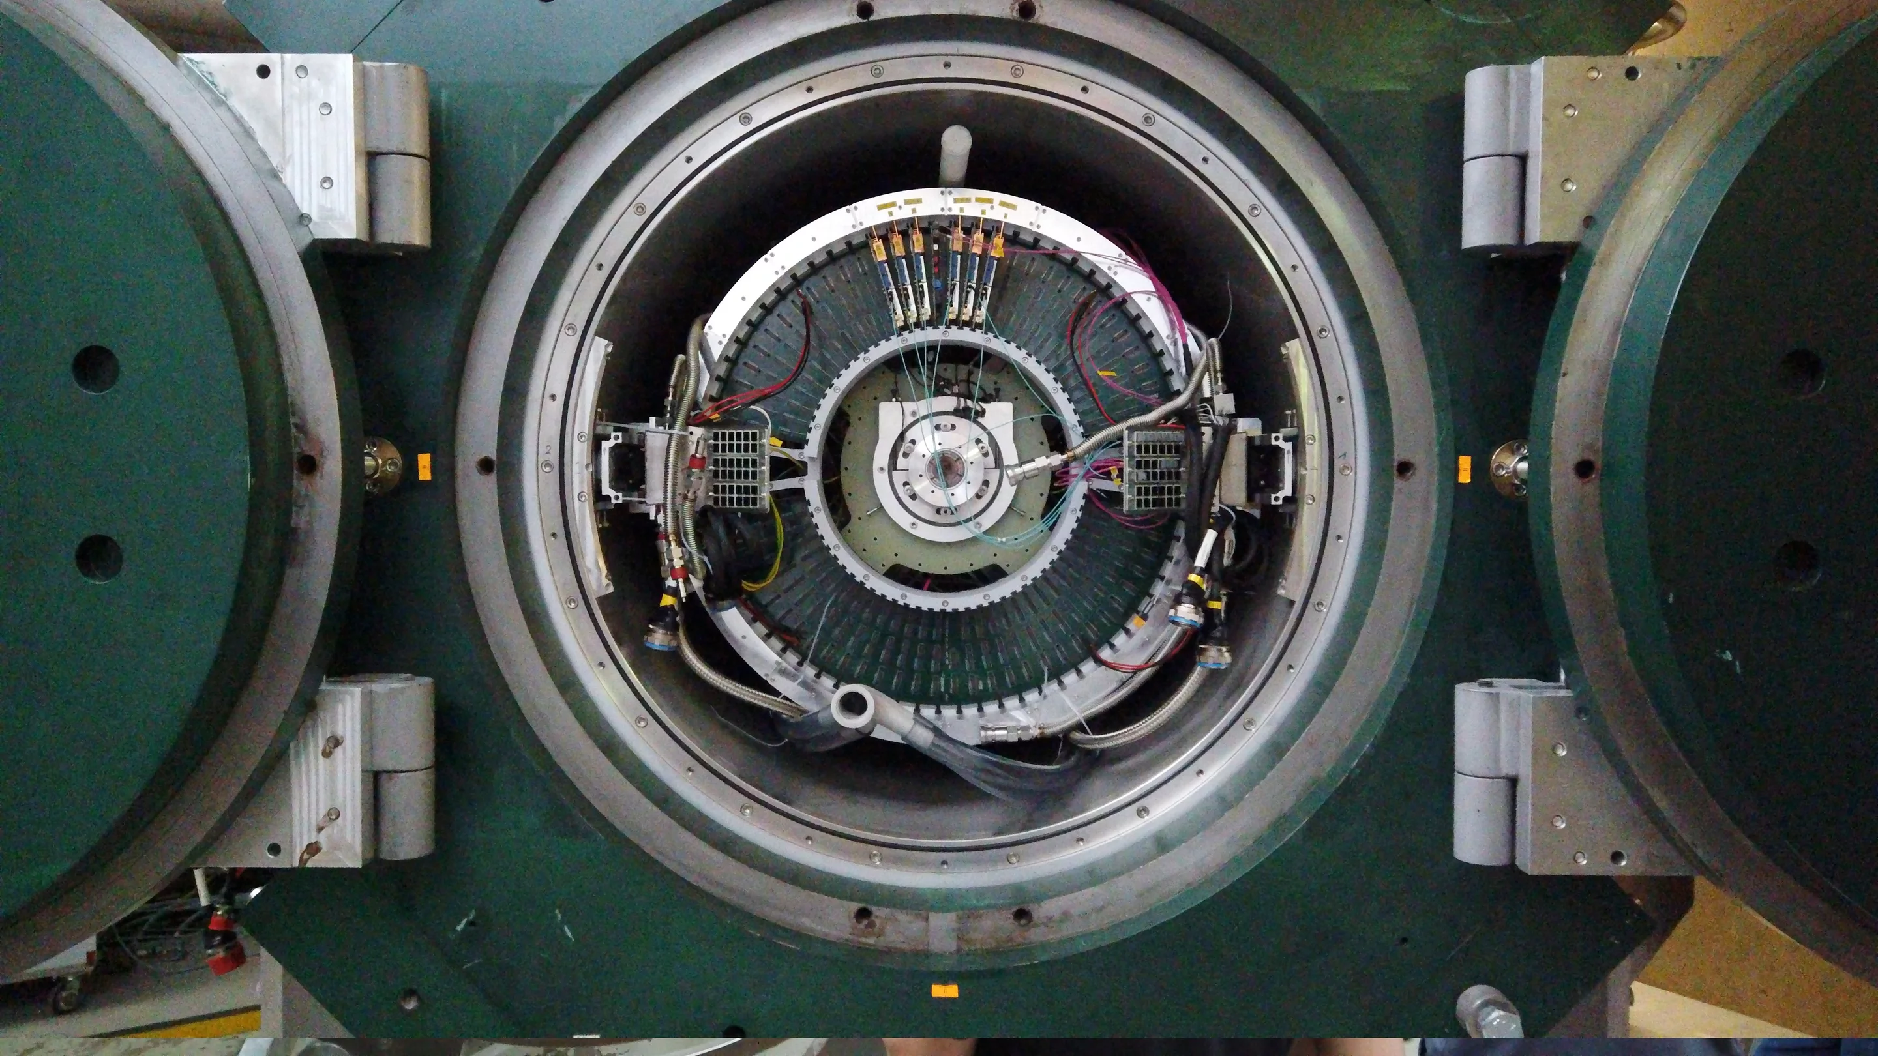

Mu3e
Thomas Christian Senger on behalf of the Mu3e collaboration

Slide 2
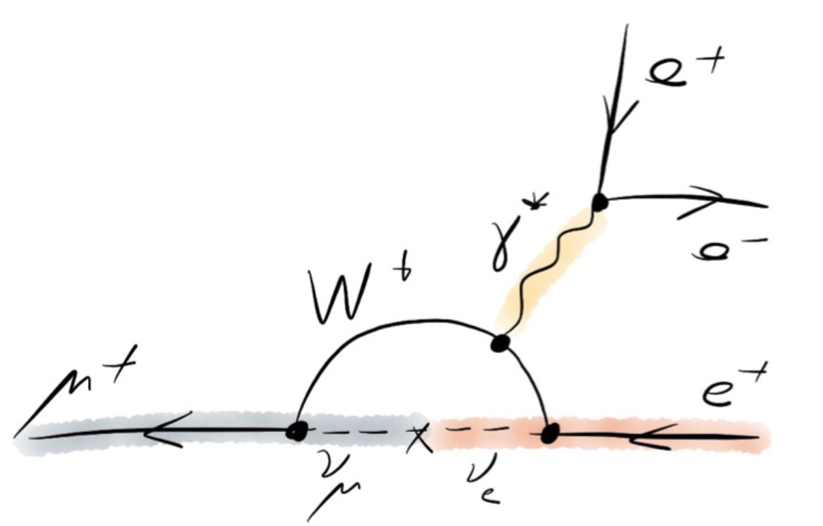
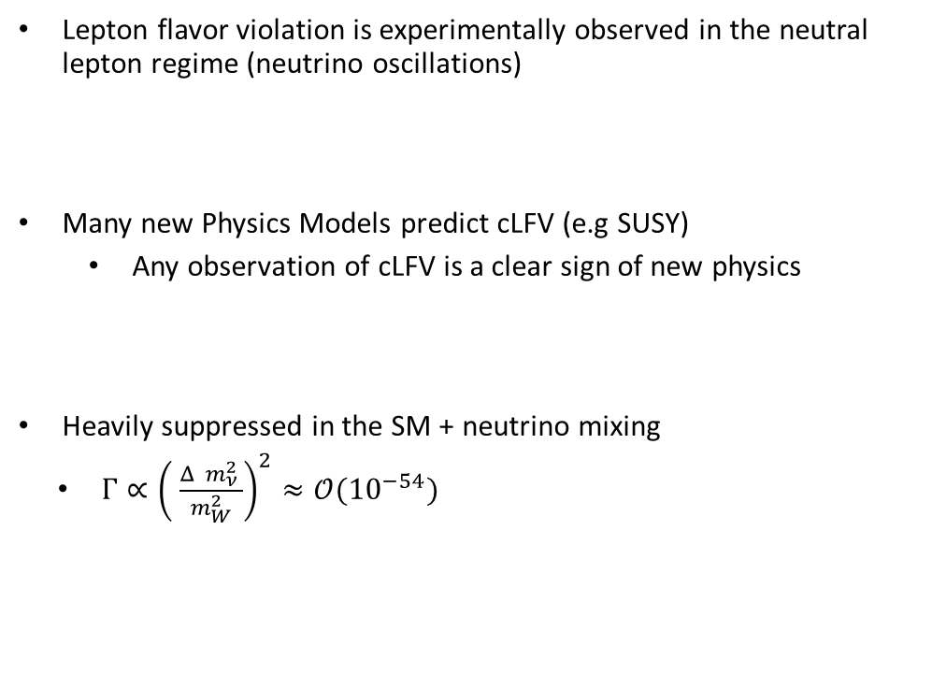
Charge Lepton Flavor Violation
Lepton flavor violation is experimentally observed in the neutral lepton regime (neutrino oscillations)
Many new Physics Models predict cLFV (e.g SUSY)
Any observation of cLFV is a clear sign of new physics
Heavily suppressed in the SM + neutrino mixing
$Γ∝{\left( \frac{Δ m_{ν}^{2 }}{m_{W}^{2}}\right)}^{2}≈𝒪{(10}^{−54})$

Slide 3
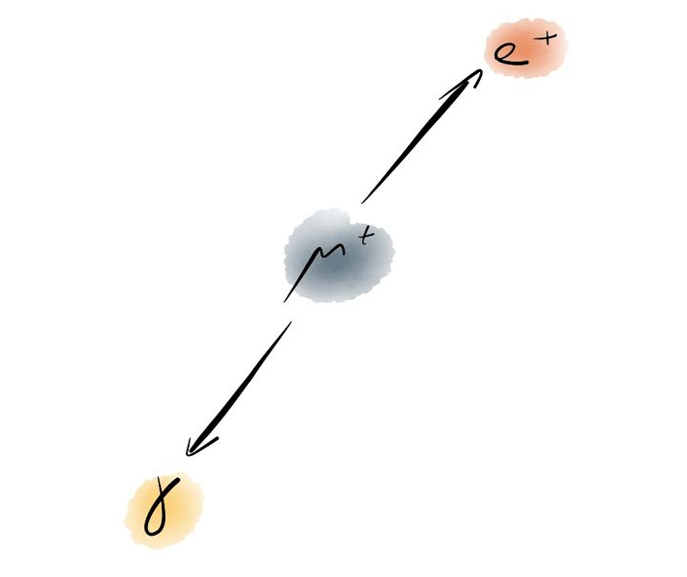
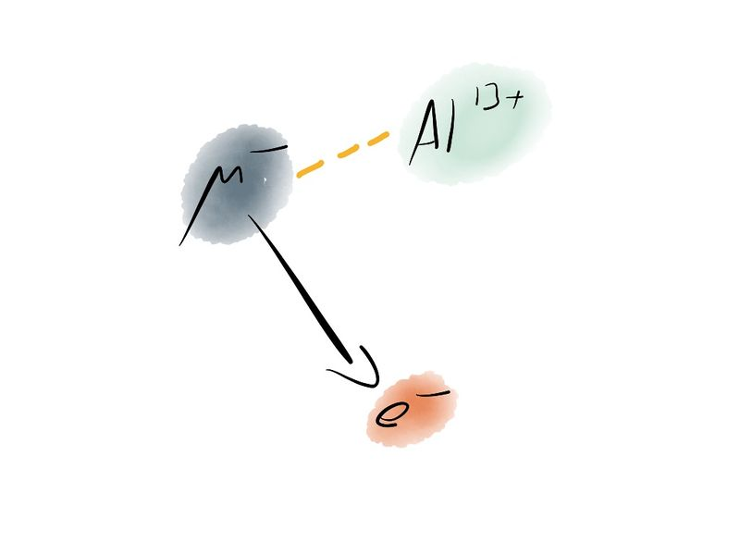
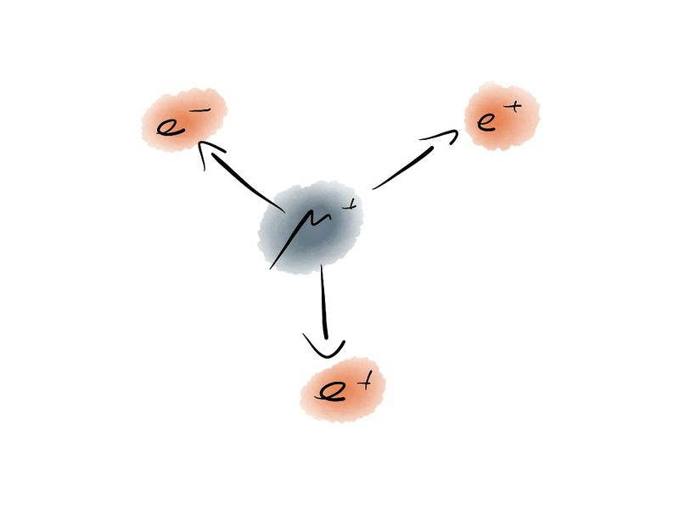
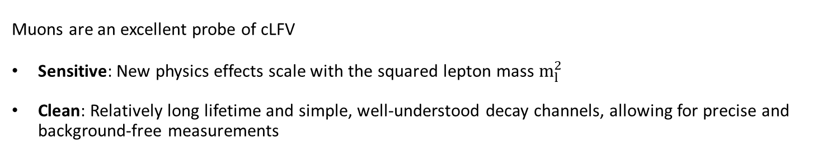
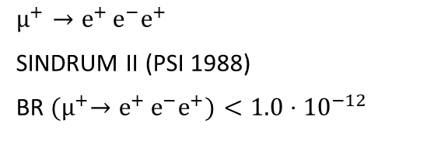
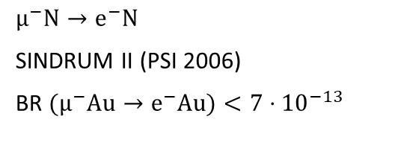
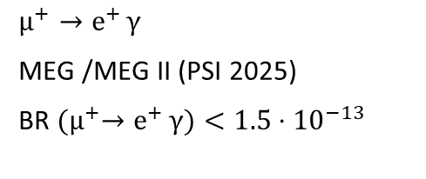
The golden muon channels
Muons are an excellent probe of cLFV
Sensitive: New physics effects scale with the squared lepton mass $m_{l}^{2}$
Clean: Relatively long lifetime and simple, well-understood decay channels, allowing for precise and background-free measurements
$$µ^{+}→e^{+ }γ$$
MEG /MEG II (PSI 2025)
BR ${(µ}^{+}→e^{+ }γ)<1.5⋅{10}^{−13}$
$$µ^{−}N→e^{−}N$$
SINDRUM II (PSI 2006)
BR ${(µ}^{−}Au→e^{−}Au)<7⋅{10}^{−13}$
$$µ^{+}→e^{+ }e^{−}e^{+}$$
SINDRUM II (PSI 1988)
BR ${(µ}^{+}→e^{+ }e^{−}e^{+})<1.0⋅{10}^{−12}$

Slide 4
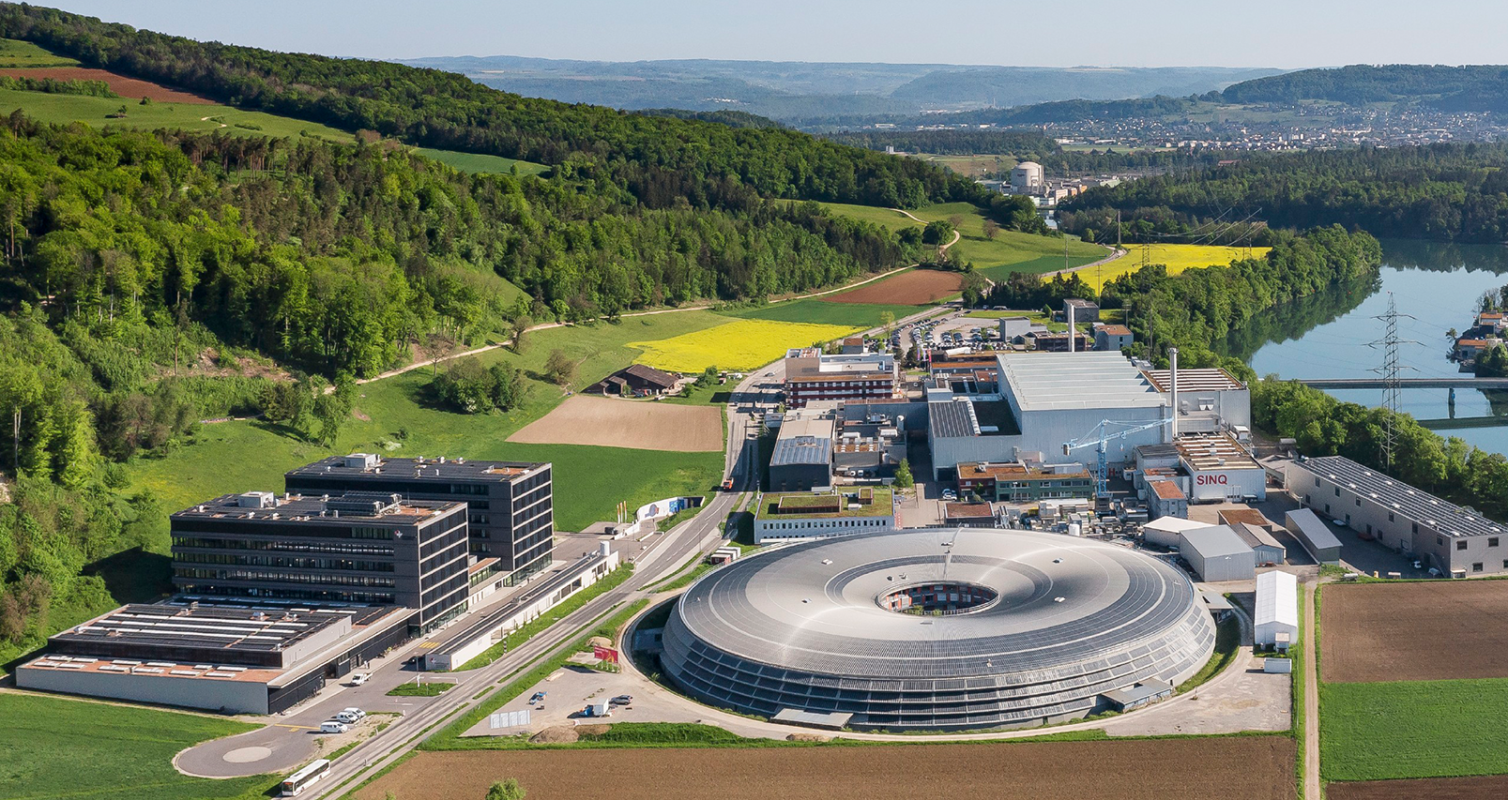
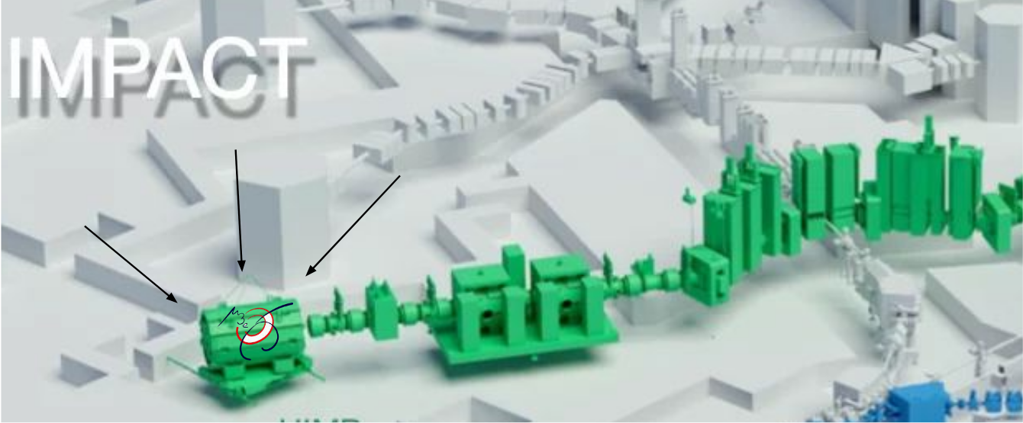
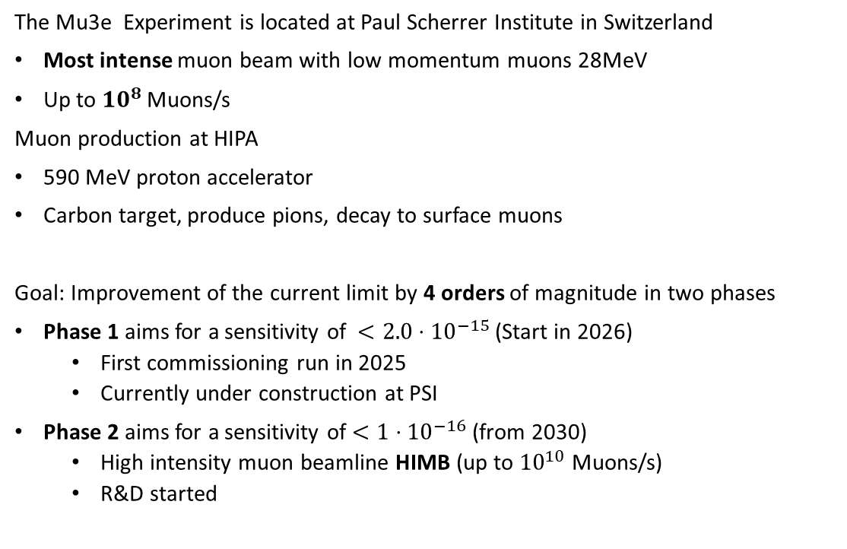
The Mu3e experiment at PSI
The Mu3e Experiment is located at Paul Scherrer Institute in Switzerland
Most intense muon beam with low momentum muons 28MeV
Up to ${10}^{8}$ Muons/s
Muon production at HIPA
590 MeV proton accelerator
Carbon target, produce pions, decay to surface muons
Goal: Improvement of the current limit by 4 orders of magnitude in two phases
Phase 1 aims for a sensitivity of $<2.0⋅{10}^{−15}$(Start in 2026)
First commissioning run in 2025
Currently under construction at PSI
Phase 2 aims for a sensitivity of $<1⋅{10}^{−16}$(from 2030)
High intensity muon beamline HIMB (up to ${10}^{10}$ Muons/s)
R&D started

Slide 5
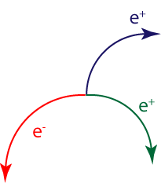
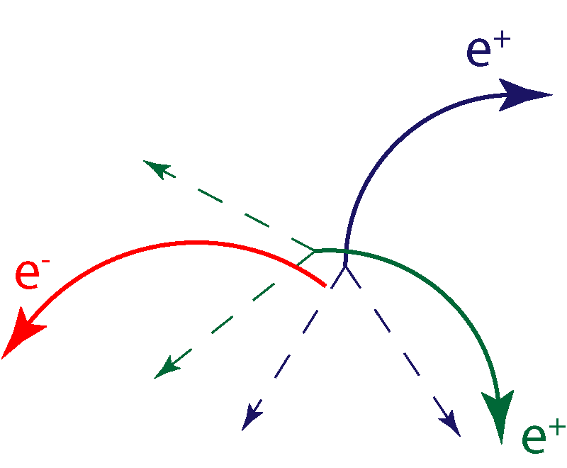
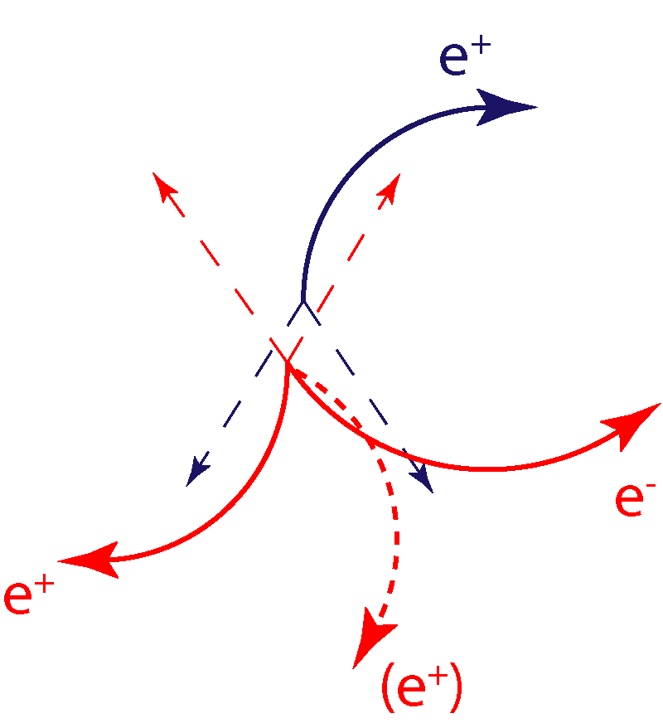
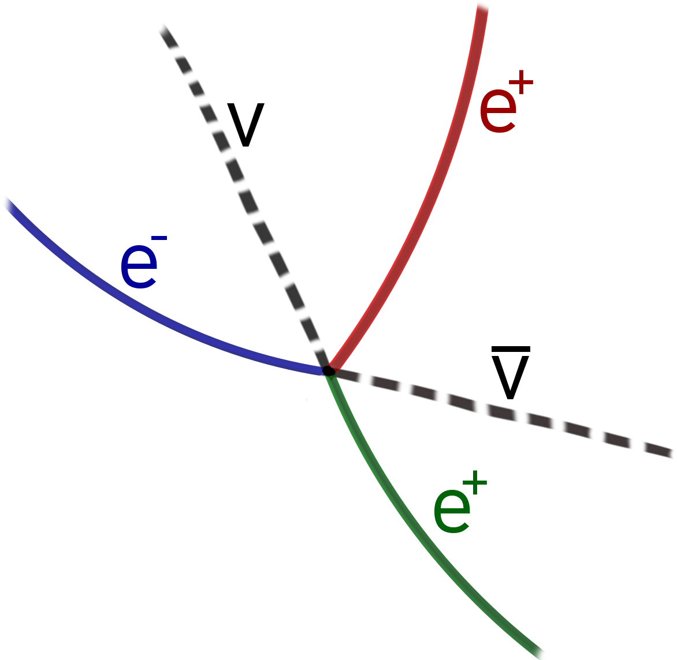
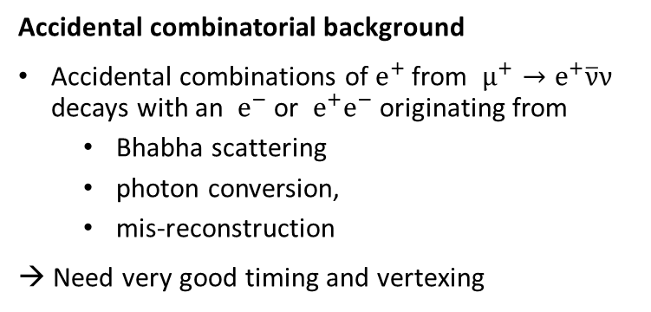
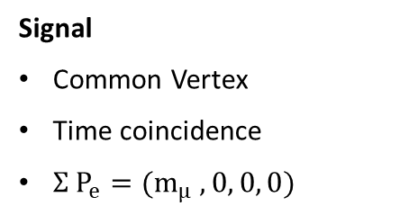
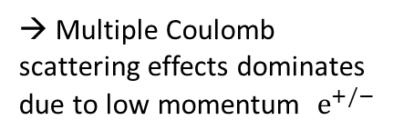
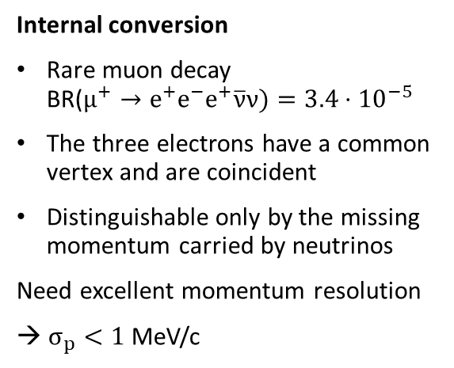
Mu3e signal and backgrounds
Two Michel decays + $e^{−}$ Michel decay + Internal Conversion
Signal
Common Vertex
Time coincidence
$Σ P_{e}=(m_{μ} ,0, 0, 0)$
Accidental combinatorial background
Accidental combinations of $e^{+}$ from $μ^{+}→e^{+}\overline{ν}ν$ decays with an $e^{−}$ or $e^{+}e^{−}$ originating from
Bhabha scattering
photon conversion,
mis-reconstruction
→ Need very good timing and vertexing
Internal conversion
Rare muon decay BR($μ^{+}→e^{+}e^{−}e^{+}\overline{ν}ν)=3.4⋅{10}^{−5}$
The three electrons have a common vertex and are coincident
Distinguishable only by the missing momentum carried by neutrinos
Need excellent momentum resolution
→ $σ_{p}<1$MeV/c
→ Multiple Coulomb scattering effects dominates due to low momentum $e^{+/−}$

Slide 6
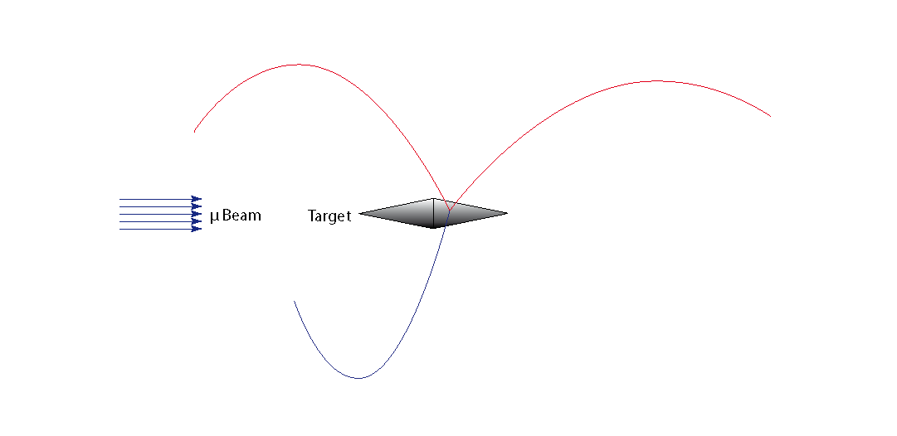
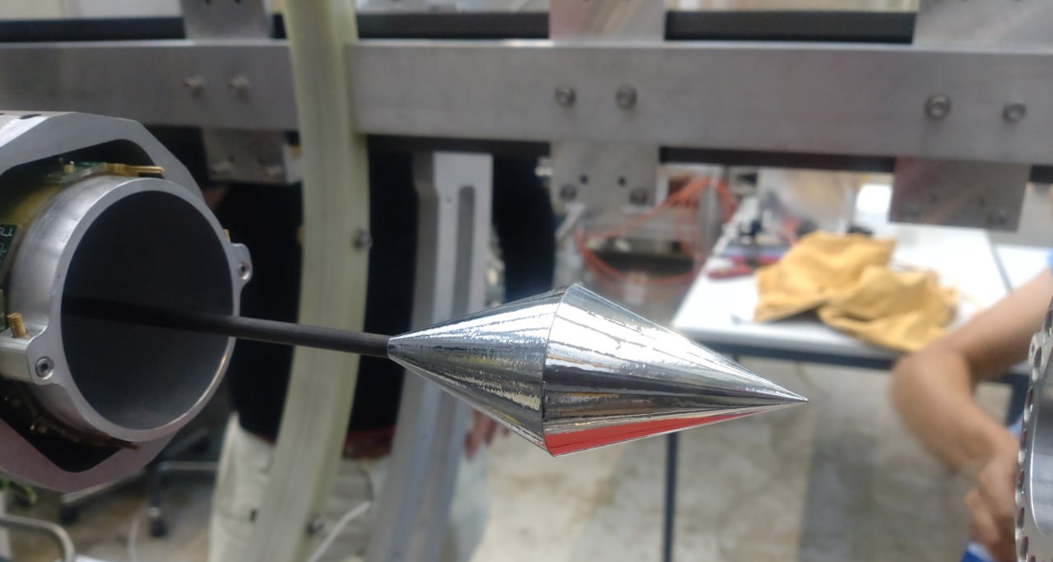
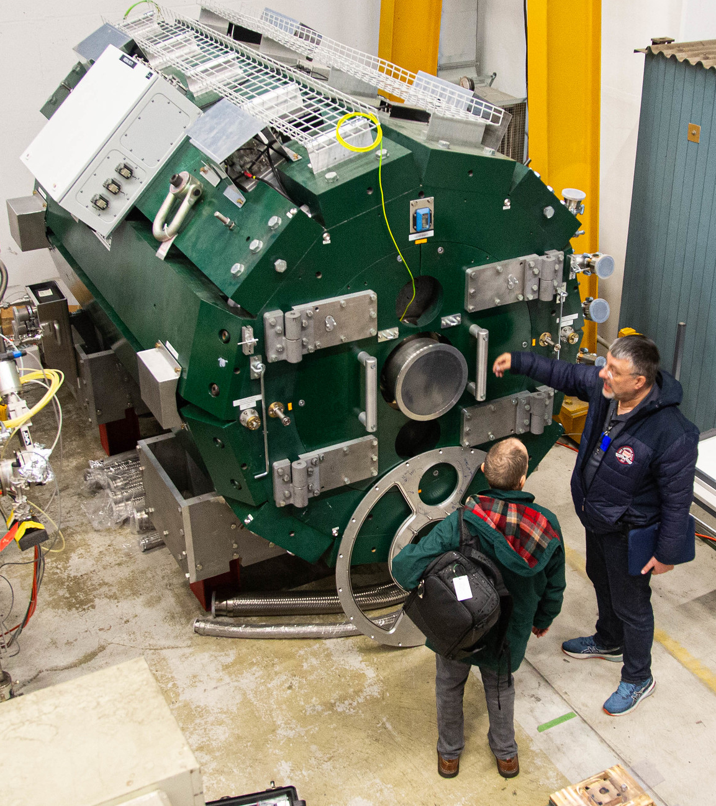
The Mu3e experiment
Mu3e magnet
Superconducting solenoid
Provides a uniform 1 T field
Enable precise momentum reconstruction
Target
Muons are stopped on aluminised mylar double hollow cone
Maximum stopping fraction 95.5%
Minimal material budget (~0.15%)

Slide 7
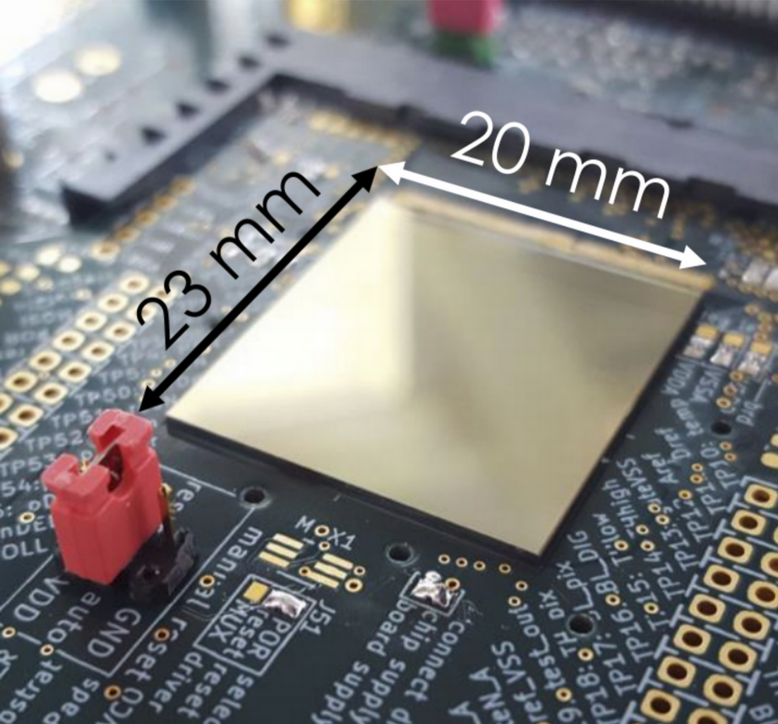
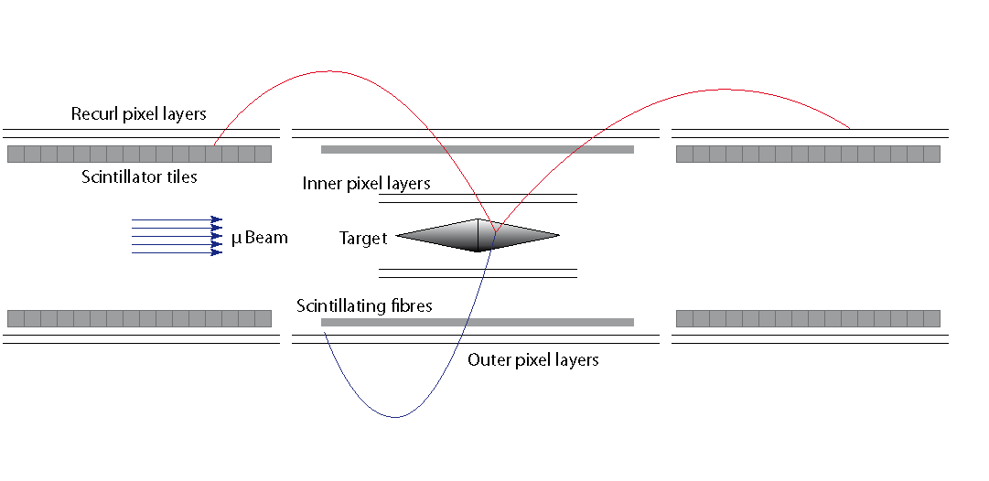
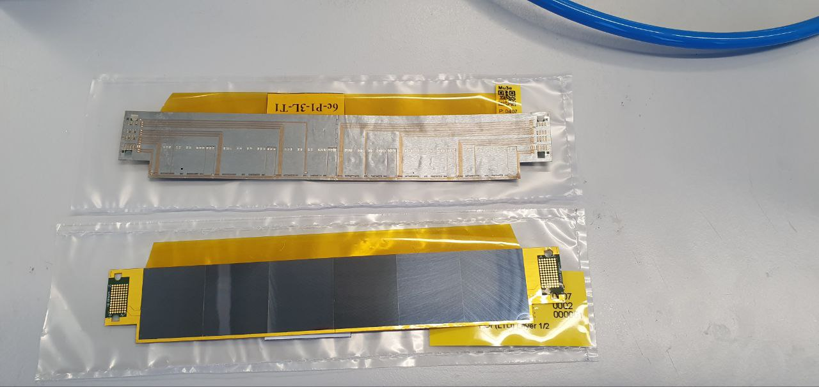
2 Outer Pixel Layers
70µm thin Mupix 11 sensors / Up to 18 sensors per ladder
For good momentum resolution and high p acceptance
→ reconstruction of recurling tracks
2 layer Vertex Detector
50µm thin Mupix 11 sensors / 6 chips per ladder
Precise vertexing (~ 200μm)

Slide 8
2 Outer Pixel Layers
70µm thin Mupix 11 sensors / Up to 18 sensors per ladder
For good momentum resolution and high p acceptance
→ reconstruction of recurling tracks
2 layer Vertex Detector
50µm thin Mupix 11 sensors / 6 chips per ladder
Precise vertexing (~ 200μm)
Cooled by low-density gaseous helium

Slide 9
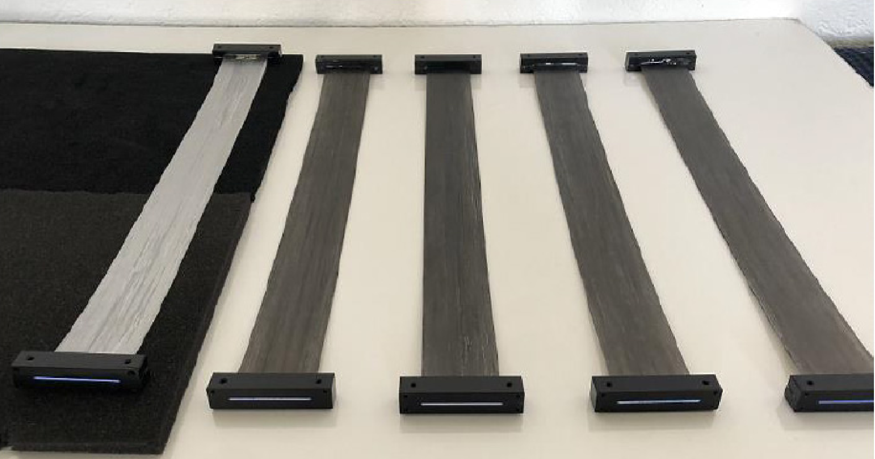
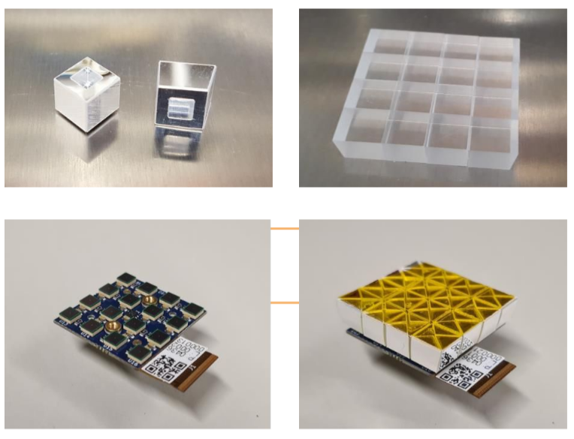
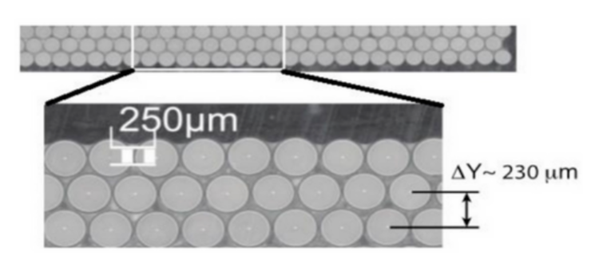
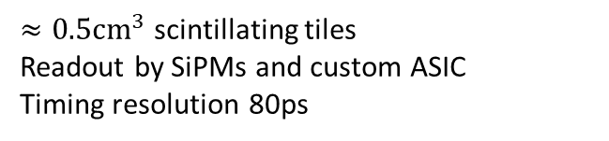
3 layers of 250µm scintillating fibres
Read-out by (SiPMs) and custom ASIC
Timing resolution < 0.5 ns
$≈0.5cm^{3}$ scintillating tiles
Readout by SiPMs and custom ASIC
Timing resolution 80ps

Slide 10
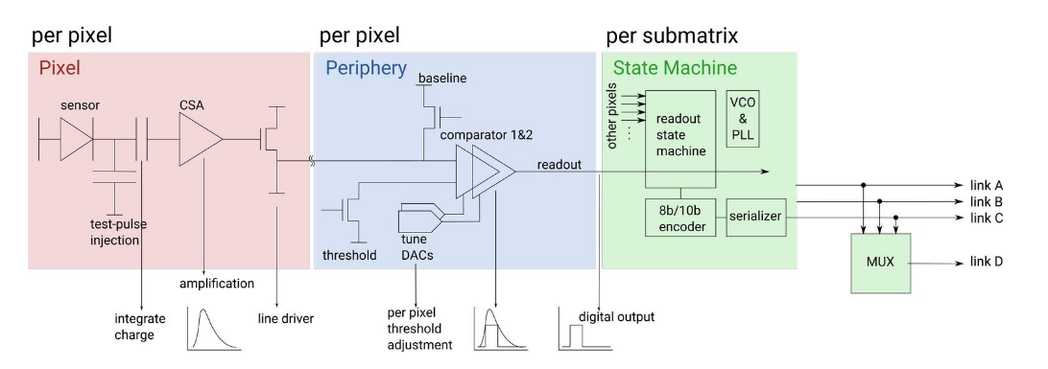

Mupix 11
High-Voltage Monolithic Active Pixel Sensor (HV-MAPS)
Detection and Readout combined in one chip
Fully digital 1.25Gbit/s LVDS output
Pixel size 80 x 80 $μm^{2}$
99% efficiency with less than 20ns time resolution
2 comparator design
Tuning/trimming and masking available
Chip sub-divided into 3 matrices → 1 data link each + 1 multiplexed link

Slide 11
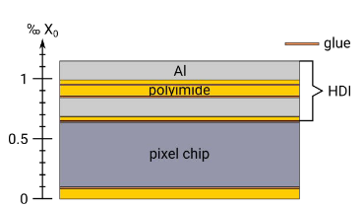
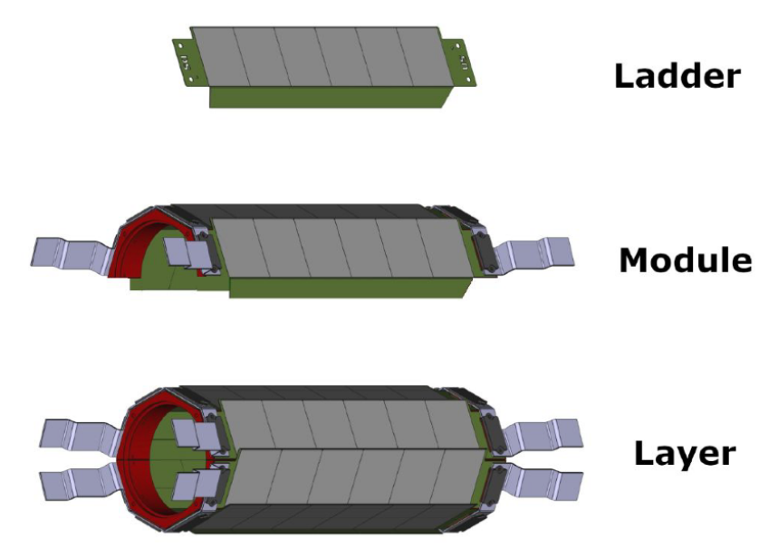
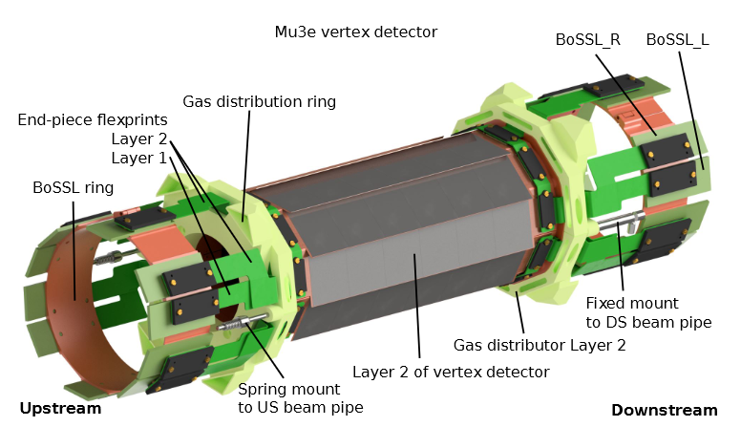
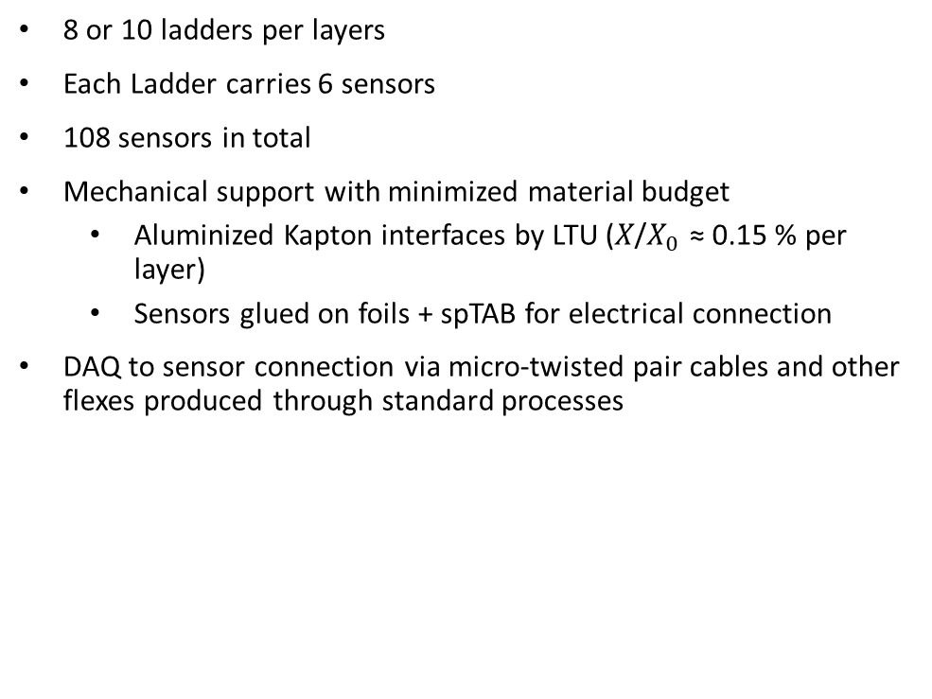
Mu3e Vertex Detector
8 or 10 ladders per layers
Each Ladder carries 6 sensors
108 sensors in total
Mechanical support with minimized material budget
Aluminized Kapton interfaces by LTU (𝑋/$X_{0}$ ≈ 0.15 % per layer)
Sensors glued on foils + spTAB for electrical connection
DAQ to sensor connection via micro-twisted pair cables and other flexes produced through standard processes

Slide 12
Challenges in the Construction and the Operation of the Mu3e Vertex Detector

Slide 13
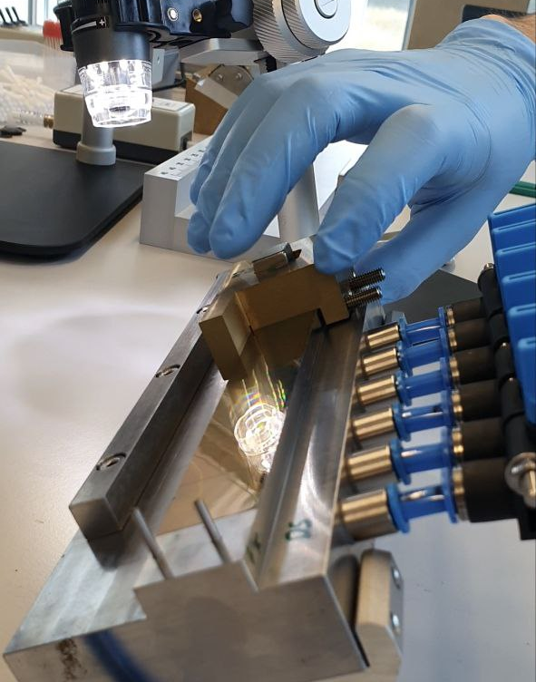
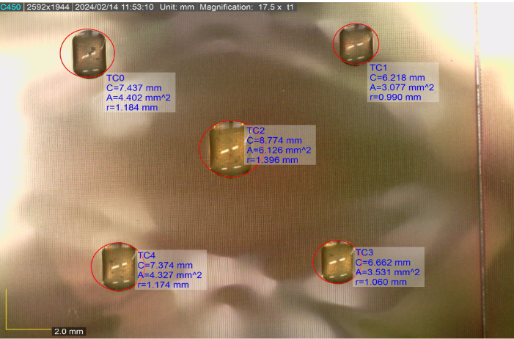
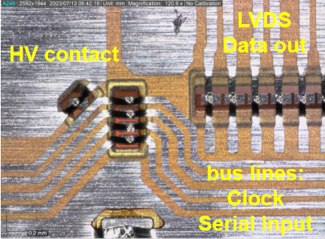
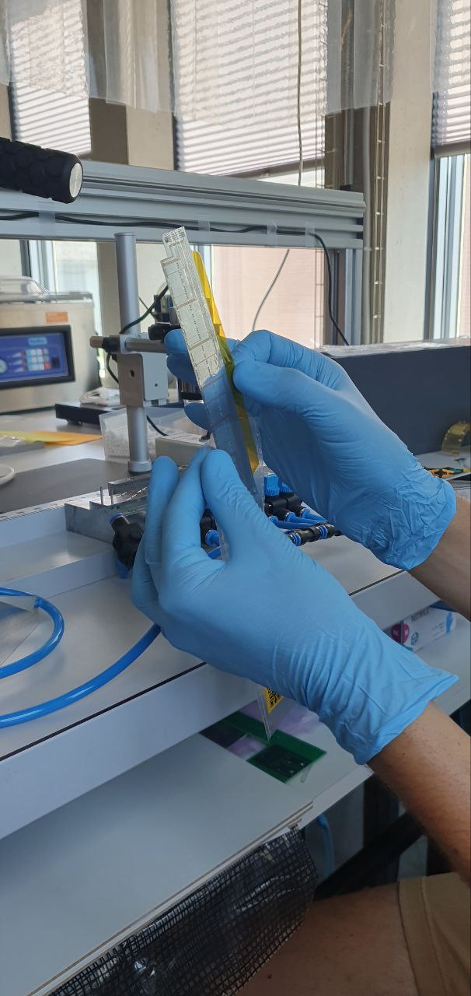
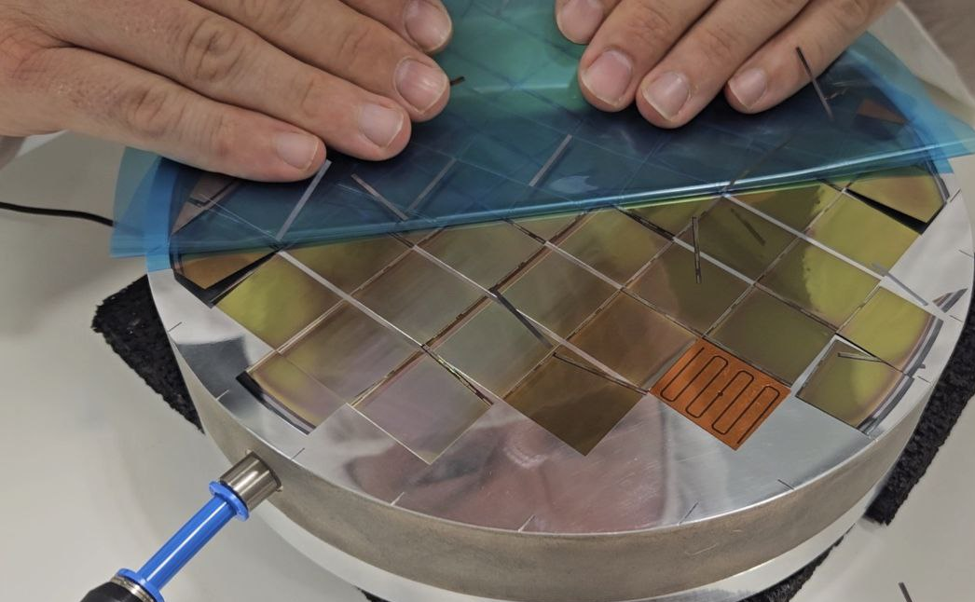
Construction and Handling
Wafer Peeling
Manual Chip Placement
Glue Distribution
spTa-Bonding
Handling

Slide 14
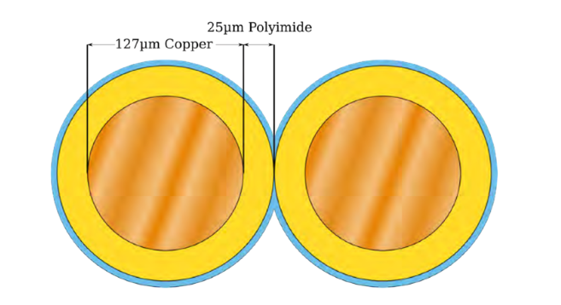
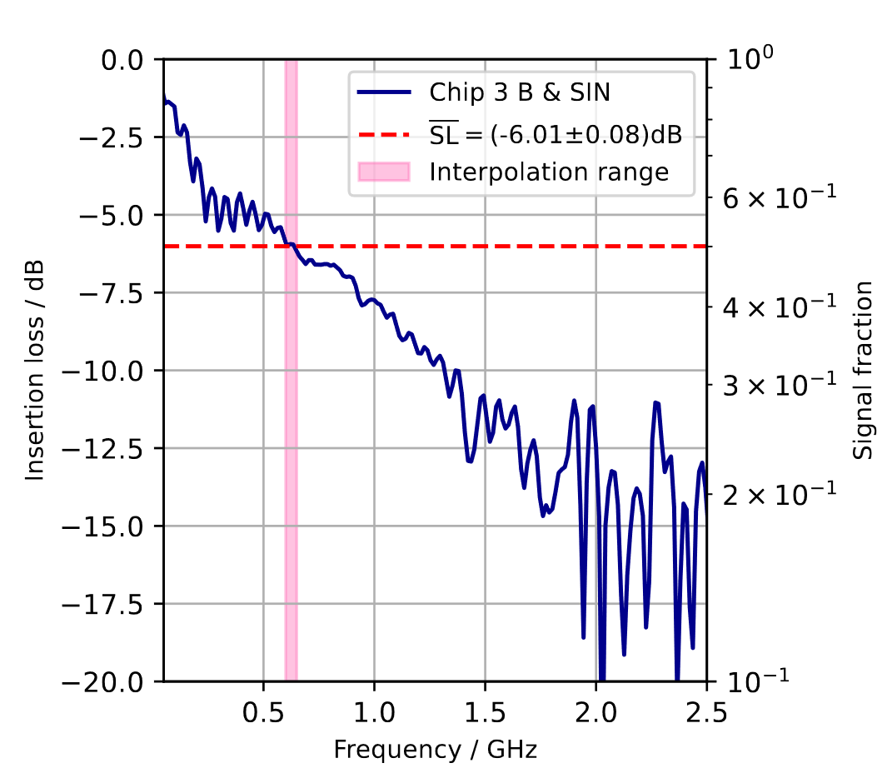
Signal transmission challenge
Need to transmit all differential LVDS data over µTP cables
Space limitations
Used in the CMS experiment at much lower data readout rate (factor 10 lower)
Huge challenge to transmit data error free
Loss of up to 70% of signal amplitude at maximum data rate (1.25 Gbit/s)
Can be partially recovered through the chip internal preemphasis (VNLVDSDel) and signal amplification (VNLVDS)
With increase of the preemphasis the eye opening factor increases and signal amplitude decreases
Signal amplitude saturates at certain DAC setting point
Higher DAC settings increase power consumption of the sensor
Have ladder qualification criteria to check each ladder for error free data transmission

Slide 15
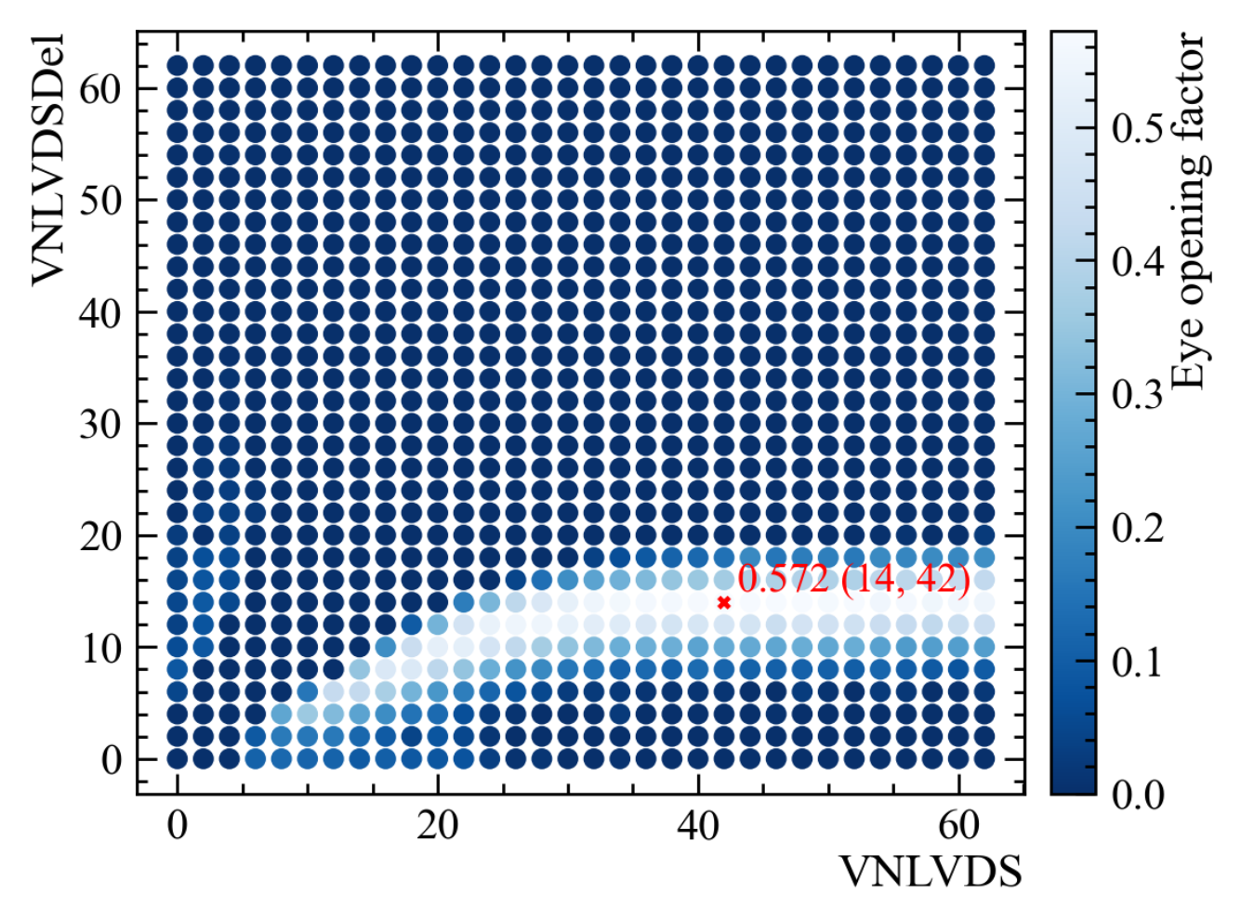
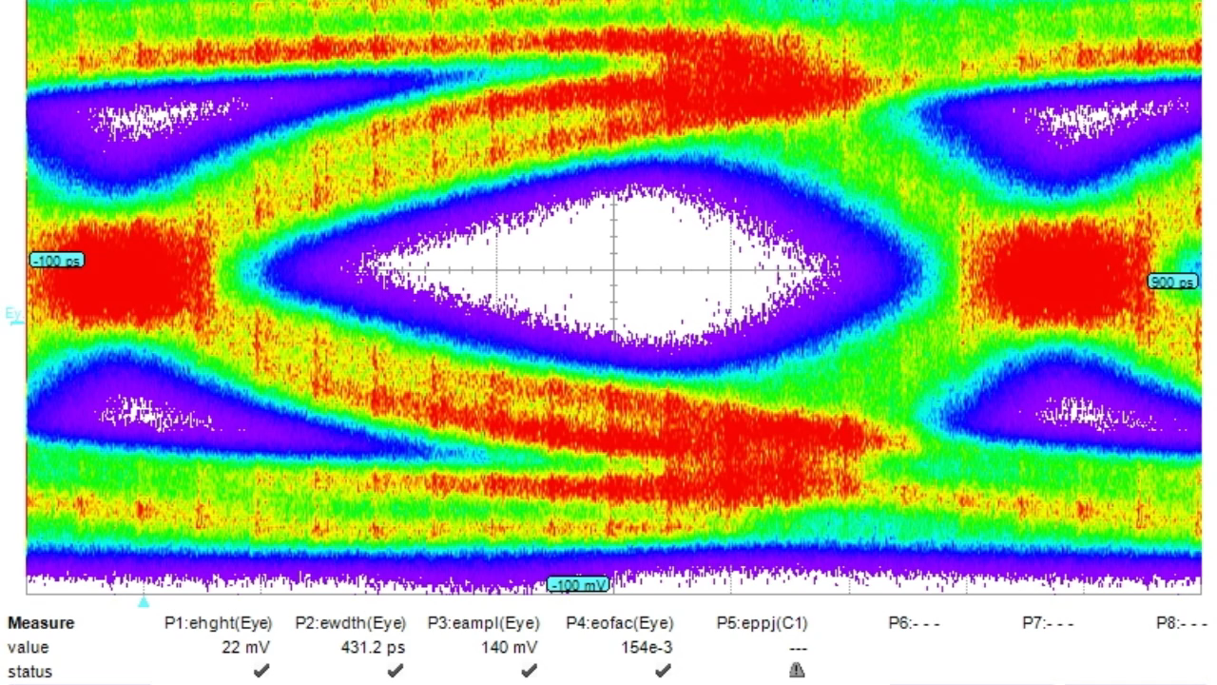
Signal transmission challenge
Need to transmit all differential LVDS data over µTP cables
Space limitations
Used in the CMS experiment at much lower data readout rate (factor 10 lower)
Huge challenge to transmit data error free
Loss of up to 70% of signal amplitude at maximum data rate (1.25 Gbit/s)
Can be partially recovered through the chip internal preemphasis (VNLVDSDel) and signal amplification (VNLVDS)
With increase of the preemphasis the eye opening factor increases and signal amplitude decreases
Signal amplitude saturates at certain DAC setting point
Higher DAC settings increase power consumption of the sensor
Have ladder qualification criteria to check each ladder for error free data transmission

Slide 16
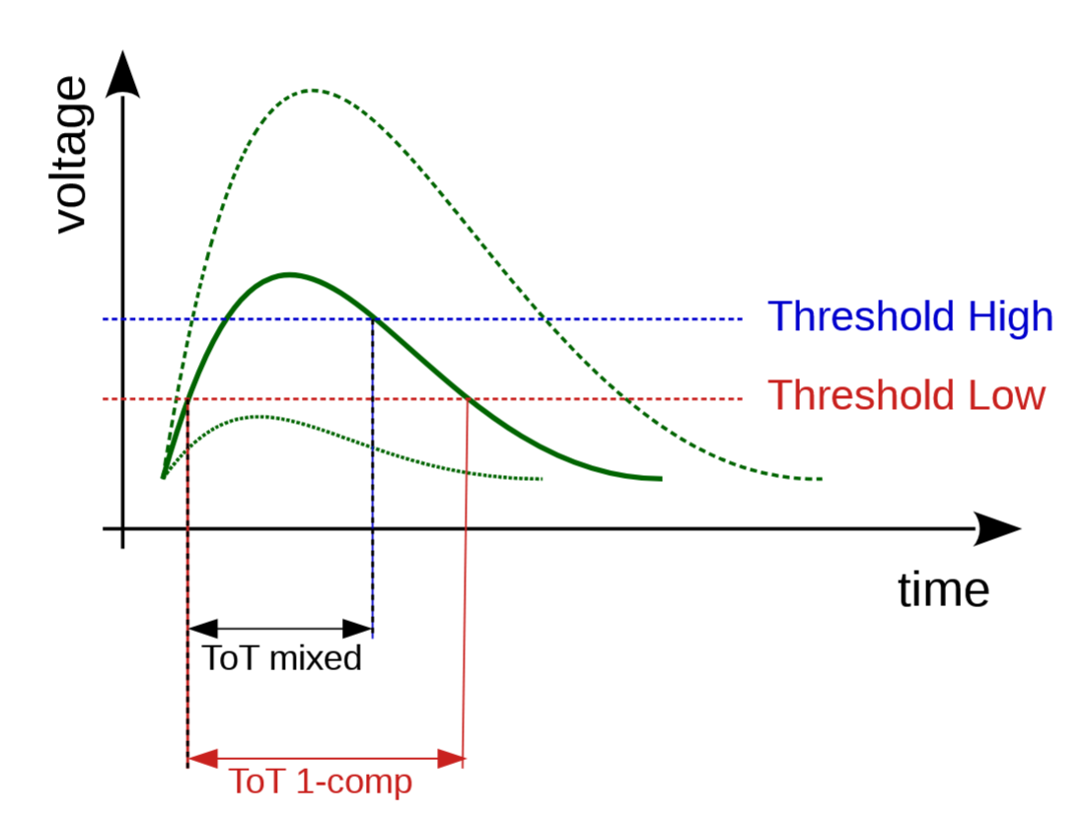
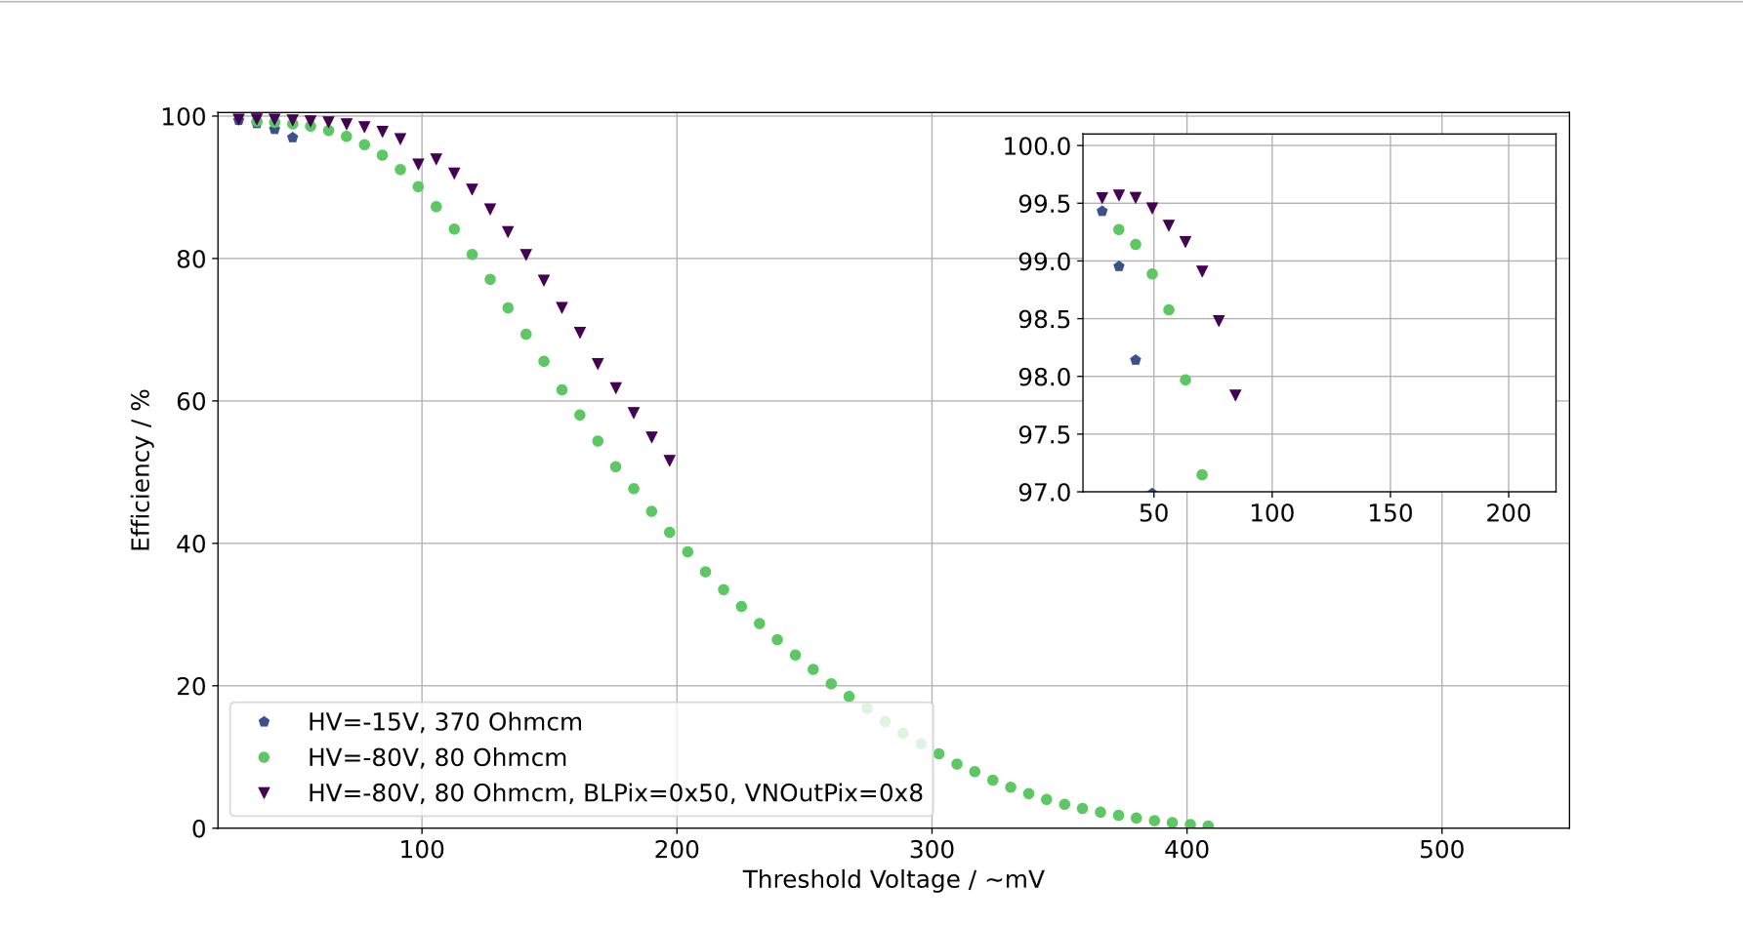
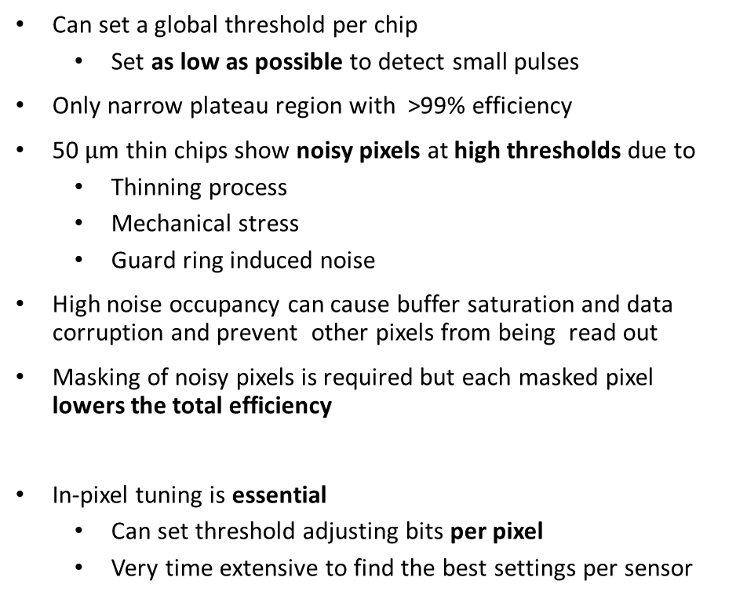
Efficient pixel operation
Can set a global threshold per chip
Set as low as possible to detect small pulses
Only narrow plateau region with >99% efficiency
50 $μ$m thin chips show noisy pixels at high thresholds due to
Thinning process
Mechanical stress
Guard ring induced noise
High noise occupancy can cause buffer saturation and data corruption and prevent other pixels from being read out
Masking of noisy pixels is required but each masked pixel lowers the total efficiency
In-pixel tuning is essential
Can set threshold adjusting bits per pixel
Very time extensive to find the best settings per sensor

Slide 17
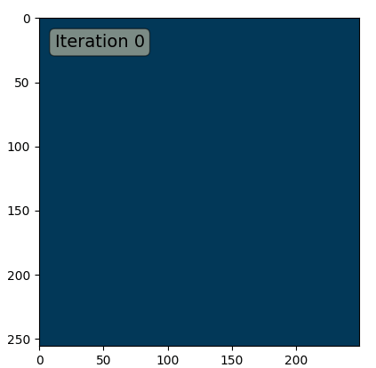

Efficient pixel operation
Can set a global threshold per chip
Set as low as possible to detect small pulses
Only narrow plateau region with >99% efficiency
50 $μ$m thin chips show noisy pixels at high thresholds due to
Thinning process
Mechanical stress
Guard ring induced noise
High noise occupancy can cause buffer saturation and data corruption and prevent other pixels from being read out
Masking of noisy pixels is required but each masked pixel lowers the total efficiency
In-pixel tuning is essential
Can set threshold adjusting bits per pixel
Very time extensive to find the best settings per sensor

Slide 18



Scintillating Fibres
3 layers of 250 μm staggered fibres
12 long fibre ribbons covering 4 𝜋
1 ribbon = 720 μm thick, 0.2 % radiation length
300 ps time resolution
Readout by SiPM arrays at both ends and custom ASIC (MuTRiG)
256 channels per ribbon
Liquid cooling (SilOil, -20°) through the Cooling Ring

Slide 19



Scintillating Tiles
Highly segmented in ~6k tiles
Very compact design
Tiles from fast Ej-228 plastic scintillator (6 x 6 x 5 mm3)
Individually wrapped in ESR foil - Minimize crosstalk
Coupled to Hamamatsu SiPMs read out by Mutrig ASIC
(S13360-3050VE @ -10°C, Silicon oil cooling)
Efficiency > 99%, single-channel time resolution ~ 40 ps
Performance validated in Demonstrator Modules
SIPM matrix Tile matrix
Tile module

Slide 20


Mu3e Data Acquisition
Custom readout board electronics inside the magnet. Front-end board
Full streaming DAQ → triggerless readout
Synchronises data from all sub-detectors
Network of FPGAs and optical links
Collect all data of a time slice on one PC
Reconstruct tracks, then vertices on a GPU
Write interesting events to disk

Slide 21

Minimal detector configuration
Three weeks of commissioning run campaign in 2025 at PSI in PiE5
Full vertex detector installed with 108 sensors
One of six SciFi modules
Three of fourteen SciTile modules
Operation with gaseous helium cooling and 1 T magnetic field
Most services independent of the sub-system have been installed and tested

Slide 22



Commissioning Run 2025
Full Vertex Detector
2 SciFi ribbons
3 SciTile modules (DS)

Slide 23





Service Installation

Slide 24


The flight of Mu3e

Slide 25



Successful Commissioning of the Mu3e Detector
Operate vertex, scintillating fibres and tile detector with beam
Showed high-rate capability with sub-detector synchronisation
Stress test at ${10}^{7}$muons / s
Demonstrated online track reconstruction with GPU filter farm
PIE5 services commissioned
First preliminary result
Measured momentum distribution for 6-,8,-10- and 12-hit long tracks
Re-weighted momentum distribution to correct for:
limited polar angle of the vertex detector
momentum dependence of a misaligned detector
Michel edge visible

Slide 26



Successful Commissioning of the Mu3e Detector
Thinnest (0.12%${ X}_{0}$/ layer) vertex detector currently operational
Demonstrated efficient data collection after successful tuning
All 108 chips installed
75 % of the submatrices were operational
4 had a mechanical damages before installation
Lost ladders during installation
A few chips were lost during operation
Many first times and unknowns
Were the first to build such a detector
We learned a lot
Improved ladder tooling and flex designs for the second version of the Mu3e Vertex Detector

Slide 27

Successful Commissioning of the Mu3e Detector
Thinnest (0.12%${ X}_{0}$/ layer) vertex detector currently operational
Demonstrated efficient data collection after successful tuning
All 108 chips installed
75 % of the submatrices were operational
4 had a mechanical damages before installation
Lost ladders during installation
A few chips were lost during operation
Many first times and unknowns
Were the first to build such a detector
We learned a lot
Improved ladder tooling and flex designs for the second version of the Mu3e Vertex Detector

Slide 28





Towards physics in 2026
Aim for a physics run in 2026
Construct Vertex V2 (70µm thin sensors)
Outer pixel production (central detector)
Use 25 μm uni-directional carbon-fibre stiffner
Robotic gantry used for placement of chip
SciFi & Tile production
Could surpass the SINDRUM limit in less than two weeks
Install the full detector in 2027
Production of recurl stations (2026)
Phase I data taking in HIMB
Need 1 year of data taking to reach the branching ratio of ${10}^{−15}$
Carbon stiffner attached to a ladder
Robotic gantry for chip placement
Detector Setup for 2026 Physics data taking campaign

Slide 29

Towards physics in 2026
Aim for a physics run in 2026
Construct Vertex V2 (70µm thin sensors)
Outer pixel production (central detector)
Use 25 μm uni-directional carbon-fibre stiffner
Robotic gantry used for placement of chip
SciFi & Tile production
Could surpass the SINDRUM limit in less than two weeks
Install the full detector in 2027
Production of recurl stations (2026)
Phase I data taking in HIMB
Need 1 year of data taking to reach the branching ratio of ${10}^{−15}$
Detector Setup for 2026 Physics data taking campaign

Slide 30


Phase II from 2030 onwards
New challenges
At least a factor 20 times higher hit rates
→ higher readout bandwidth (faster links)
Accidental BG (Bhabha & Michel) will increase by a factor of 400
Power consumption will be critical
More hit combinatorics
→ complexity of reconstruction will increase
Detector R&D
Ultra long ladders, thinner Vertex detector (30µm)
Serial powering (reduction of material)
Faster MuPix20 pixel tracker (σ ≤ 1ns)
PicoAD sensor (σ ≤ 100ps)
Radiation tolerance of SciTiles
New readout system with optical
Transceivers closer to the detector frontend
PicoAD

Slide 31












Thank you

Slide 32
Backup

Slide 33



Helium cooling
Mass flow of several g/s provided to pixel detectors
Based on novel industry technology transferred to science: Miniature turbo compressors
2 g/s circuit for Vertex Detector
16 g/s circuit for Outer Central Station

Slide 34

Outer Pixel Central station
17 (18) x MuPix11 sensors in layer 3 (4)
70µm thick sensors for Phase I
4 ladders per module
6 (7) modules in layer 3 (4)
→ 52 ladders (912 sensors)
25 μm uni-directional carbon-fibre stiffner
very stiff along length (impact on yield and Transportation)
Automate ladder building procedure as much as possible
Robotic gantry used for placement of chips
Sensors are tested manually, but semiautomatic probestation is available

Slide 35
Towards physics in 2026

