Slide 1



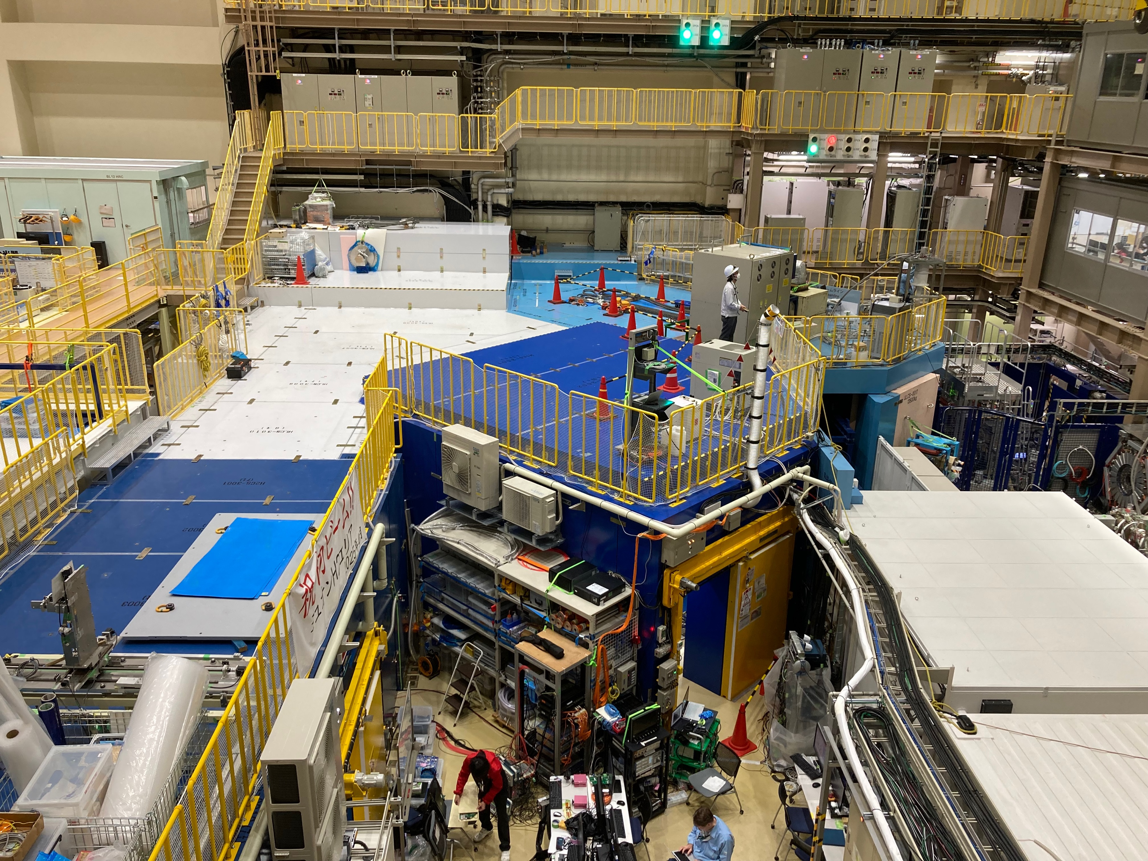
Status of J-PARC muon g-2/EDM experiment
E. Bottalico on behalf of g-2 collaboration
MPPW 2025
11th November 2025

Slide 2
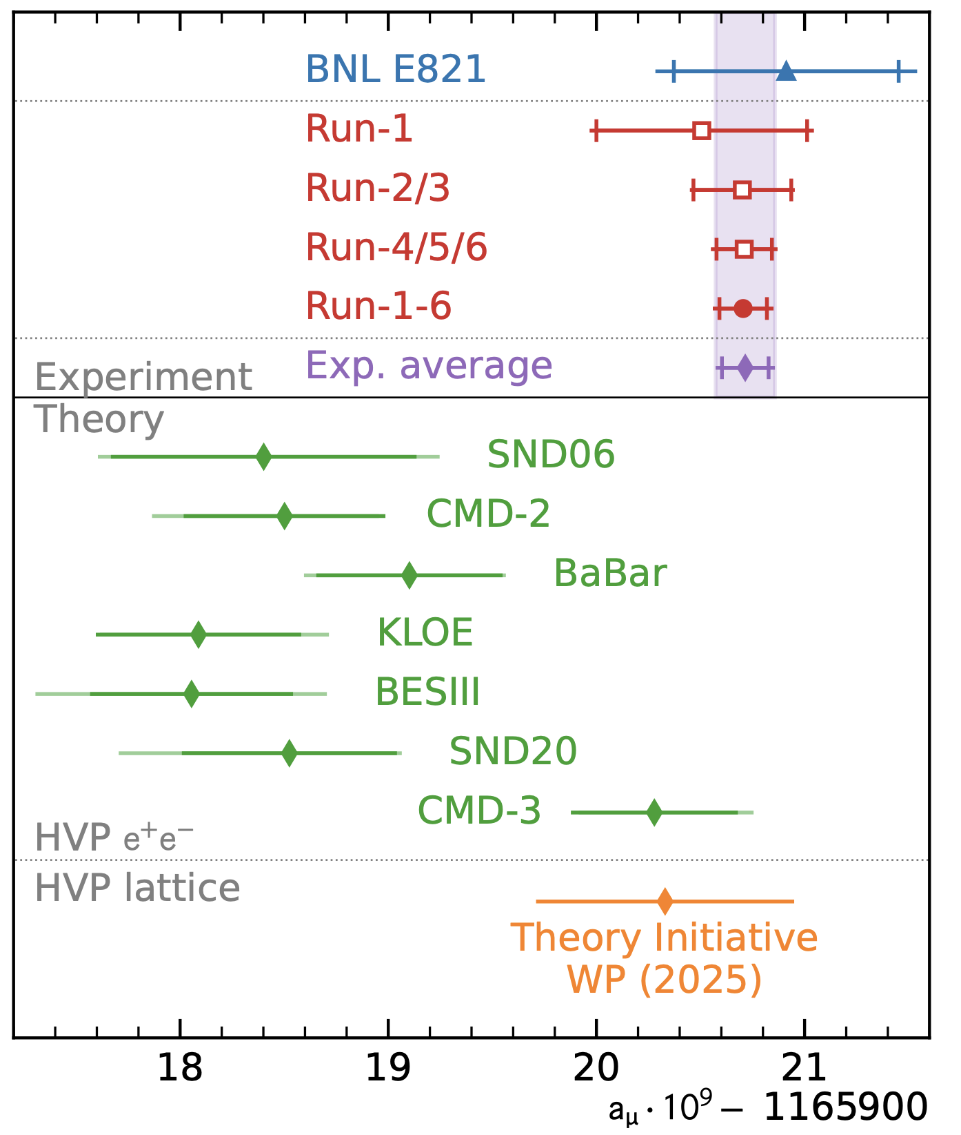
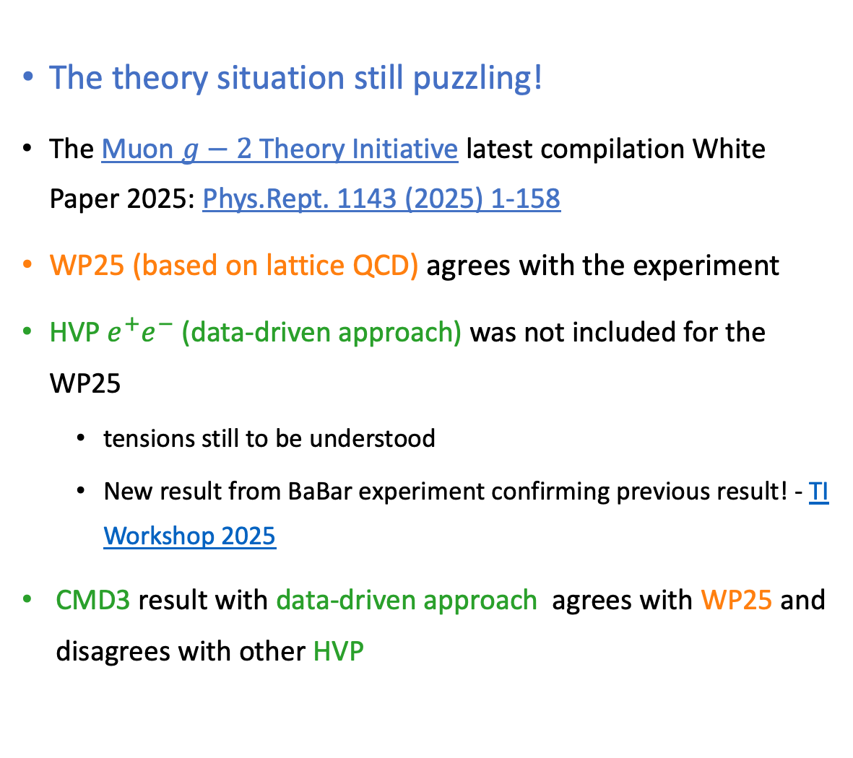
Current status
The theory situation still puzzling!
The Muon $g−2$ Theory Initiative latest compilation White Paper 2025: Phys.Rept. 1143 (2025) 1-158
WP25 (based on lattice QCD) agrees with the experiment
HVP $e^{+}e^{−}$ (data-driven approach) was not included for the WP25
tensions still to be understood
New result from BaBar experiment confirming previous result! - TI Workshop 2025
CMD3 result with data-driven approach agrees with WP25 and disagrees with other HVP

Slide 3
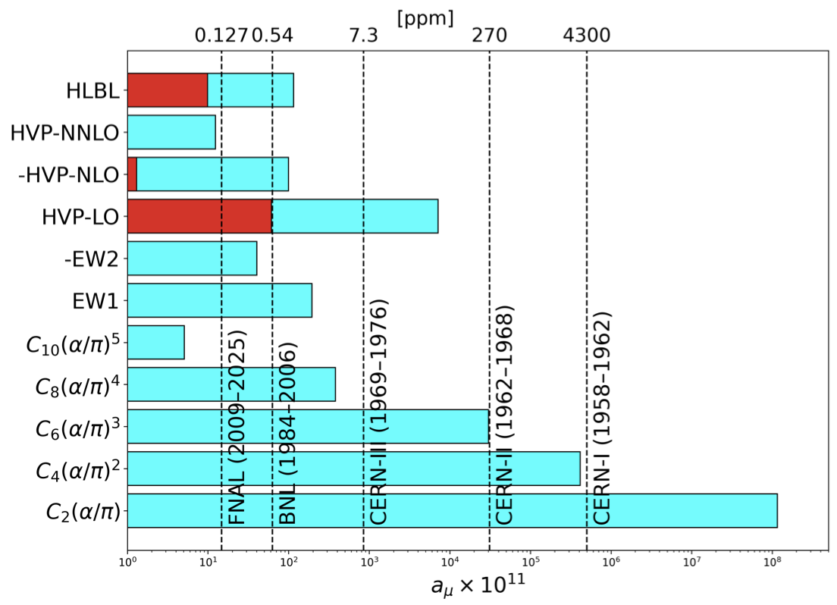
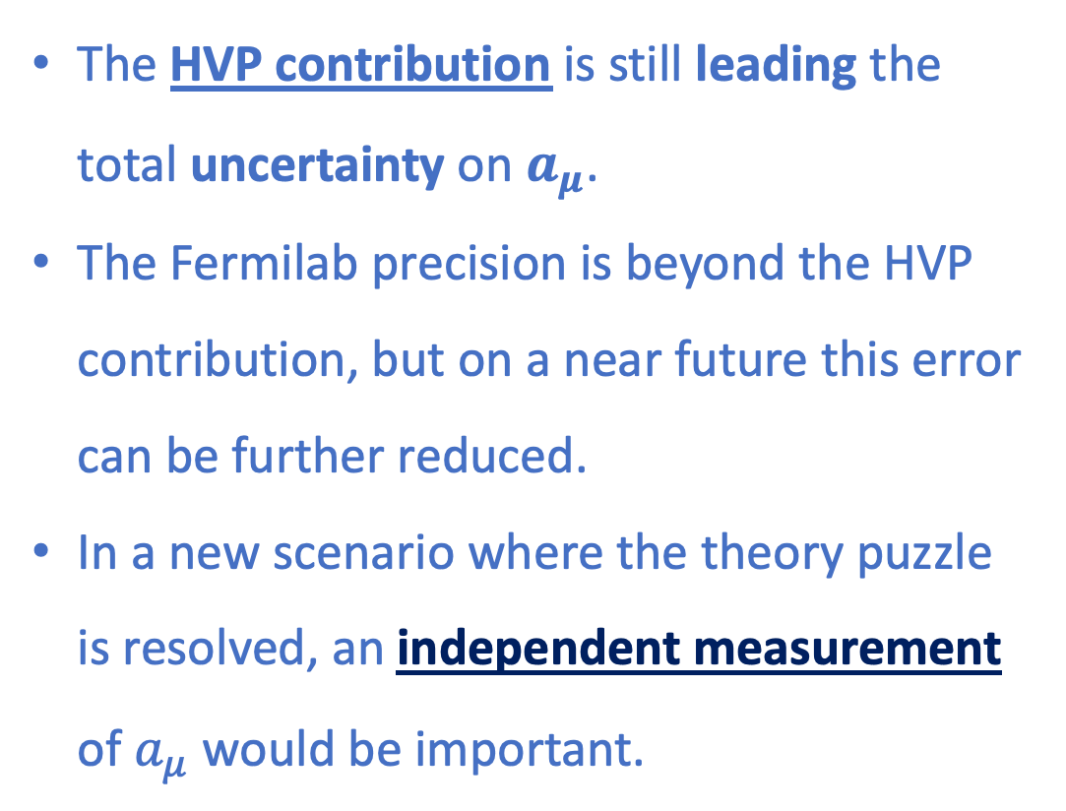
Current status
The HVP contribution is still leading the total uncertainty on $a_{μ}$.
The Fermilab precision is beyond the HVP contribution, but on a near future this error can be further reduced.
In a new scenario where the theory puzzle is resolved, an independent measurement of $a_{μ}$ would be important.
Measured Lepton Magnetic Moment – G. Gabrielse, G. Venanzoni

Slide 4
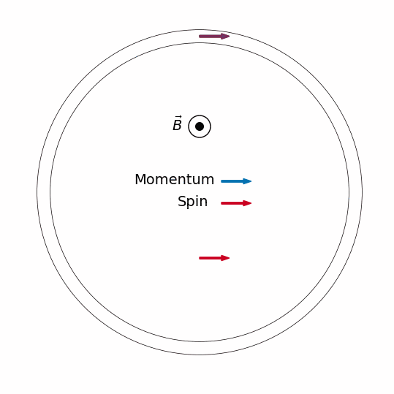
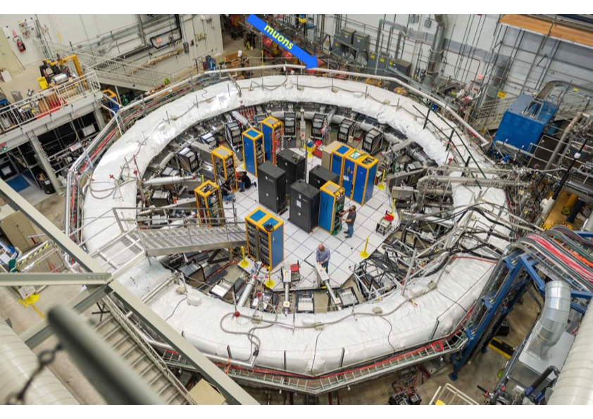
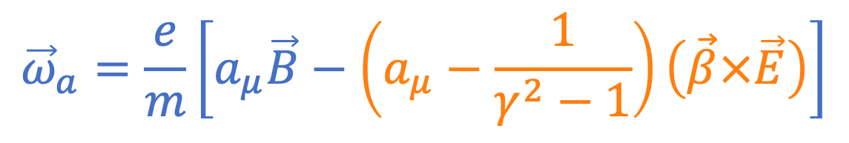
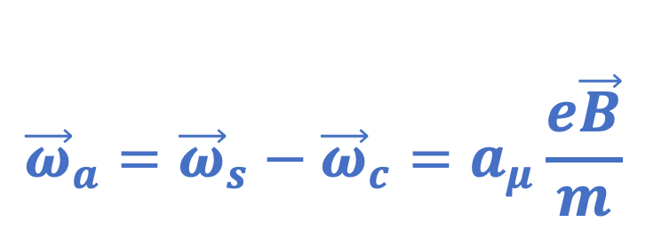
Measurement principle - Fermilab
$${\vec{ω}}_{a}=\frac{e}{m}\left[a_{μ}\vec{B}−\left(a_{μ}−\frac{1}{γ^{2}−1}\right)\left(\vec{β}×\vec{E}\right)\right]$$
Electric focusing (vertical confinement)
14 m ring diameter (B= 1. 45T)
$${\vec{ω}}_{a}={\vec{ω}}_{s}−{\vec{ω}}_{c}=a_{μ}\frac{e\vec{B}}{m}$$

Slide 5
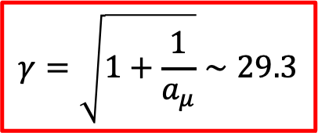
Measurement principle - Fermilab
$${\vec{ω}}_{a}=\frac{e}{m}\left[a_{μ}\vec{B}−\left(a_{μ}−\frac{1}{γ^{2}−1}\right)\left(\vec{β}×\vec{E}\right)\right]$$
$$γ=\sqrt{1+\frac{1}{a_{μ}}}∼29.3$$
Electric focusing (vertical confinement)
14 m ring diameter (B= 1. 45T)
Magic momentum γ= 29.3 (p = 3.1 GeV/c)
$${\vec{ω}}_{a}={\vec{ω}}_{s}−{\vec{ω}}_{c}=a_{μ}\frac{e\vec{B}}{m}$$

Slide 6
Measurement principle – J-PARC
$${\vec{ω}}_{a}=\frac{e}{m}\left[a_{μ}\vec{B}−\left(a_{μ}−\frac{1}{γ^{2}−1}\right)\left(\vec{β}×\vec{E}\right)\right]$$
300 MeV/c momentum
0.66 m ring diameter (B = 3 T)
$${\vec{ω}}_{a}={\vec{ω}}_{s}−{\vec{ω}}_{c}=a_{μ}\frac{e\vec{B}}{m}$$

Slide 7
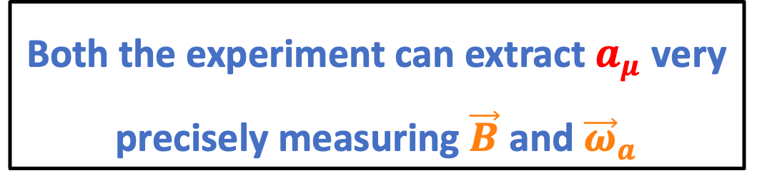
Measurement principle – J-PARC
$${\vec{ω}}_{a}=\frac{e}{m}\left[a_{μ}\vec{B}−\left(a_{μ}−\frac{1}{γ^{2}−1}\right)\left(\vec{β}×\vec{E}\right)\right]$$
300 MeV/c momentum
0.66 m ring diameter (B = 3 T)
No electric field (E=0)
$${\vec{ω}}_{a}={\vec{ω}}_{s}−{\vec{ω}}_{c}=a_{μ}\frac{e\vec{B}}{m}$$
Both the experiment can extract $a_{μ}$ very precisely measuring $\vec{B}$ and ${\vec{ω}}_{a}$

Slide 8
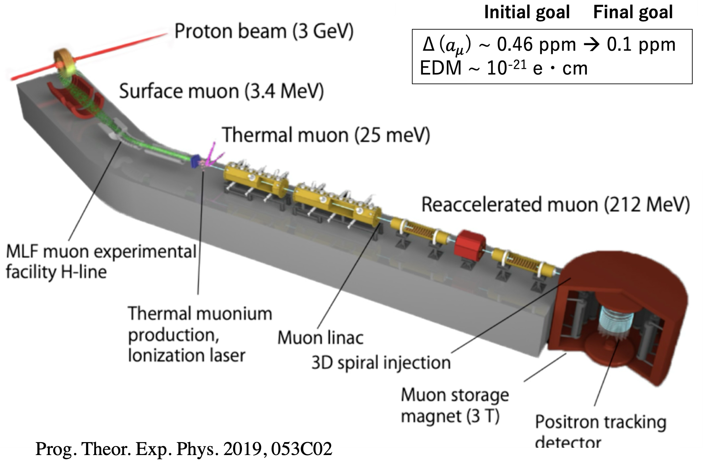
New features of E34
Low emittance muon beam (1/1000)
Muon acceleration -> 212 MeV
No strong focusing
3D spiral injection:
Large kick in few ns
Good injection efficiency (x10)
Compact storage ring (1/20)
Tracking detector
Excellent sensitivity to muon EDM about 100 times better than the previous limit

Slide 9
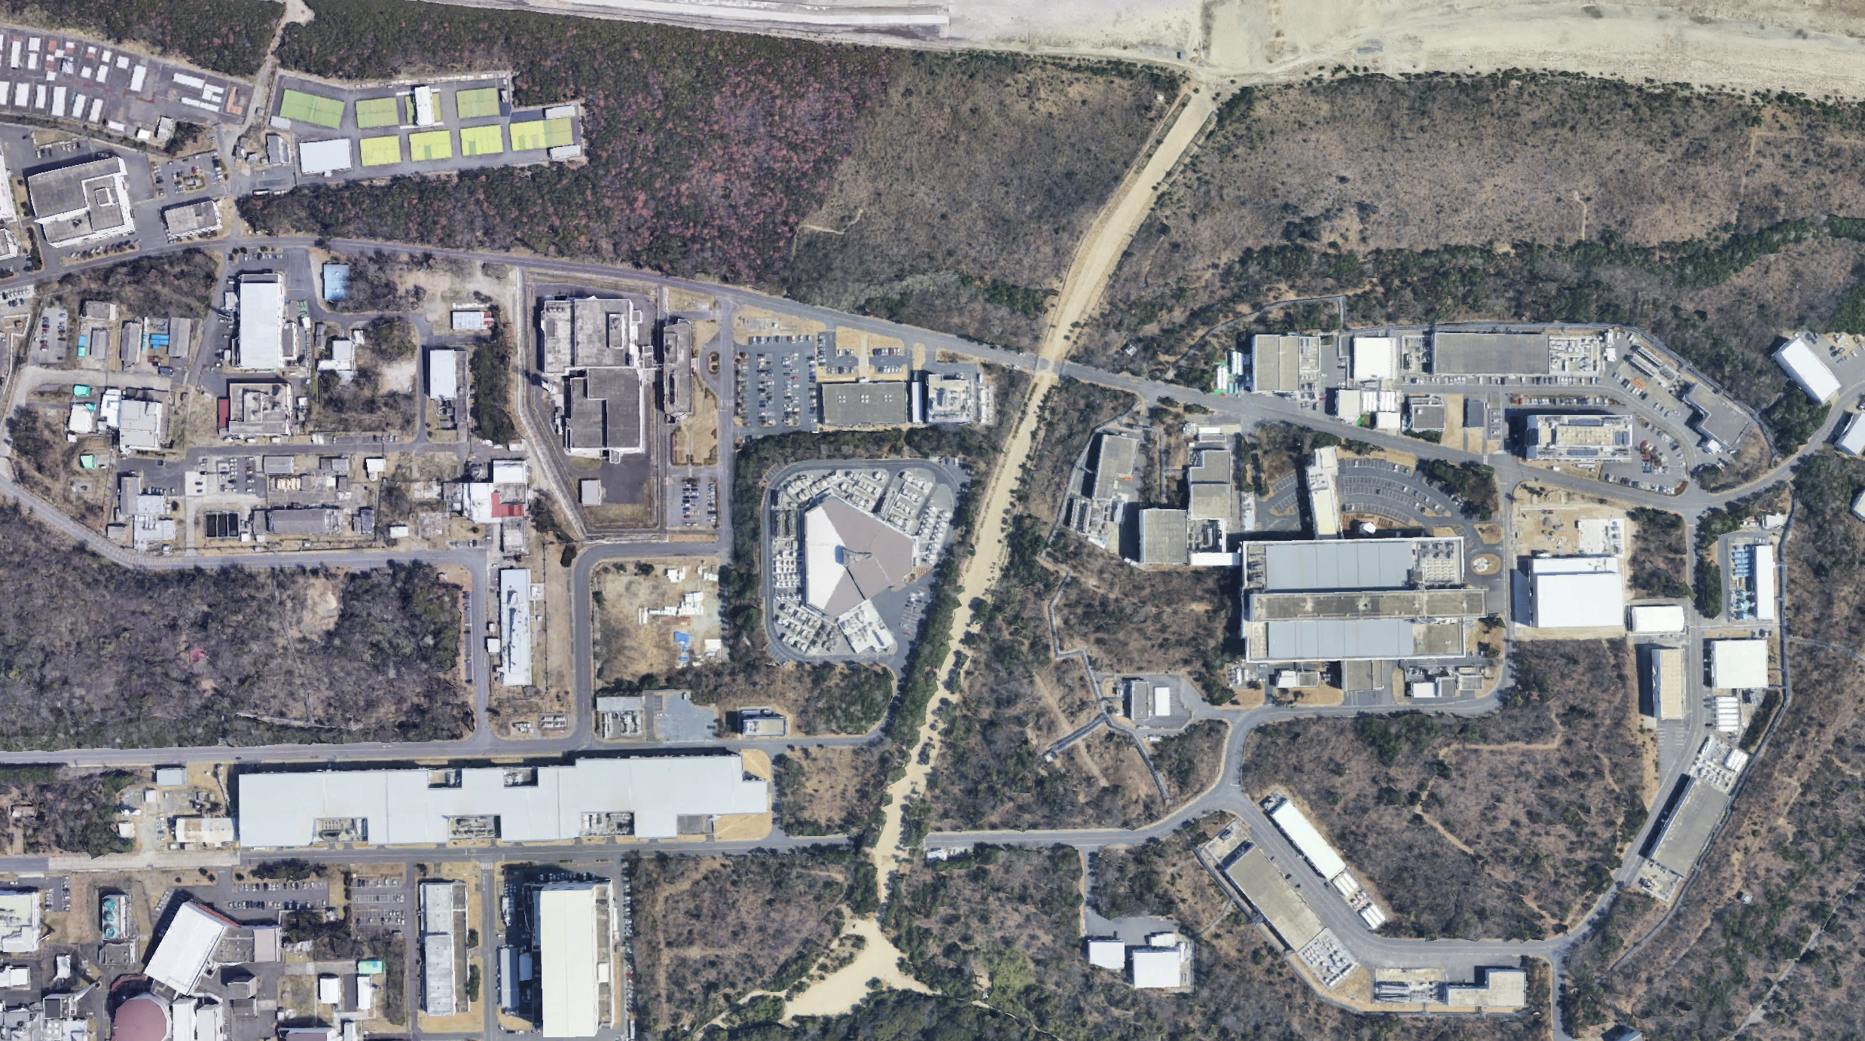

Slide 10

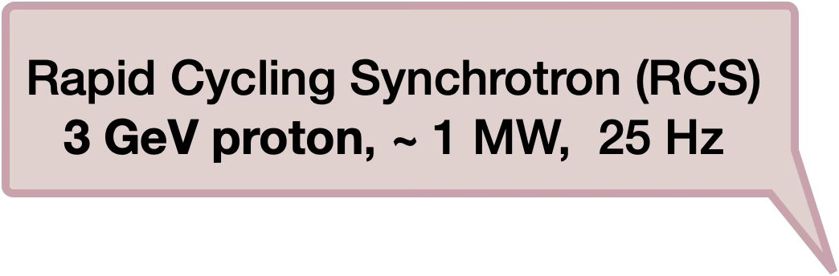


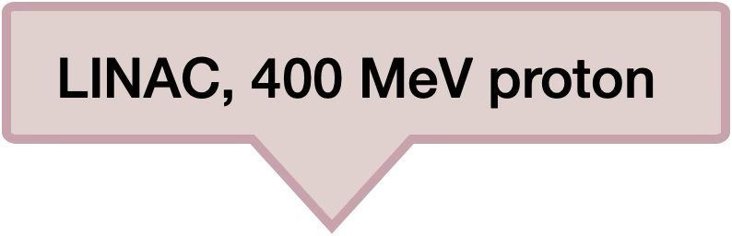
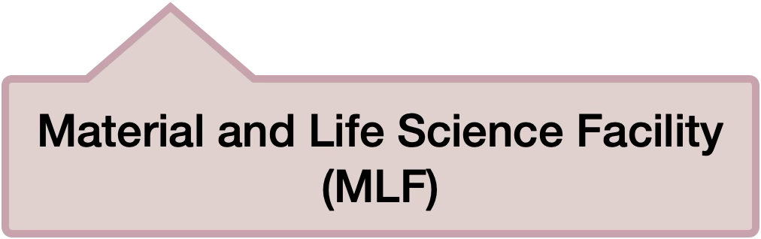
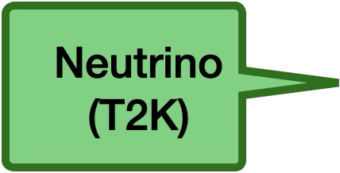

Slide 11
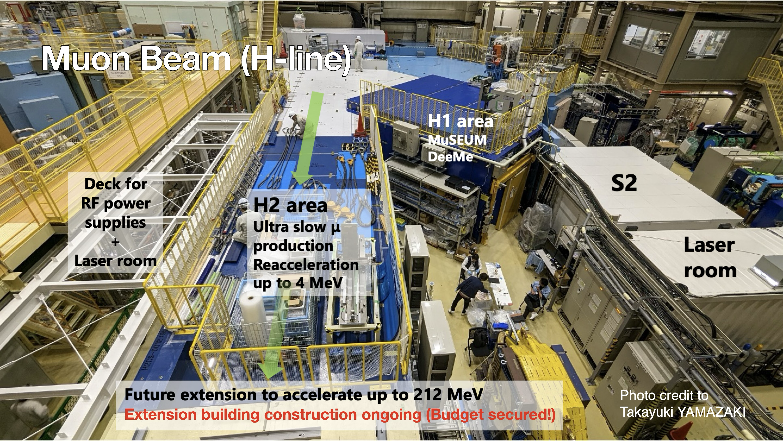
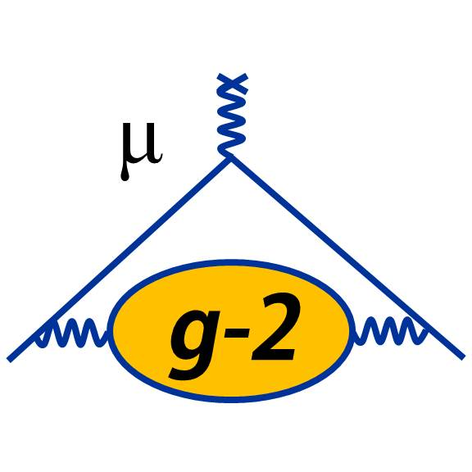

Slide 12
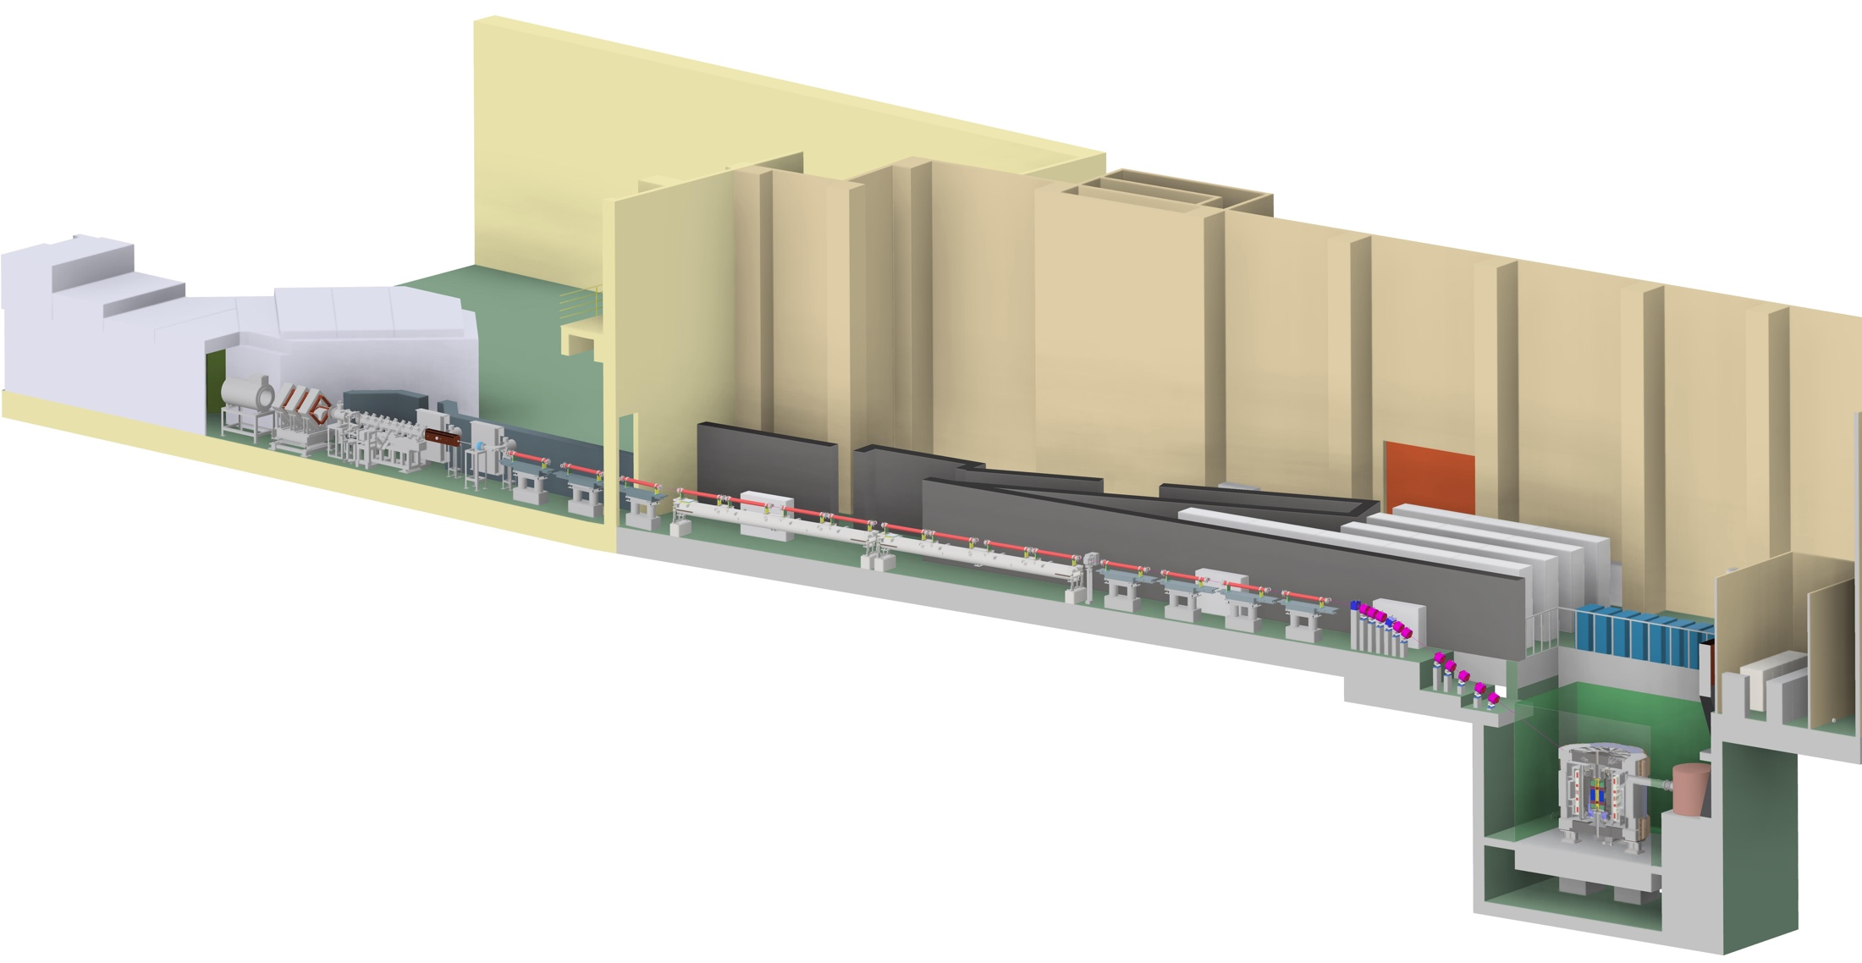
Muon g-2 at J-PARC (E34)
graphite
target
Constructed in 2021
H-line experimental bldg.
Muon beam
Transmission muon microscope
μ+(4 MeV)
cooling
25 meV
4 MeV
injection
acceleration
g-2/EDM
212 MeV
0.66 m
storage
Shields, area control (2022)
Muon storage ring
Muon storage ring

Slide 13
Muon cooling
graphite
target
Constructed in 2021
H-line experimental bldg.
Muon beam
Transmission muon microscope
μ+(4 MeV)
cooling
25 meV
4 MeV
injection
acceleration
g-2/EDM
212 MeV
0.66 m
storage
Shields, area control (2022)
Muon storage ring
Muon storage ring

Slide 14
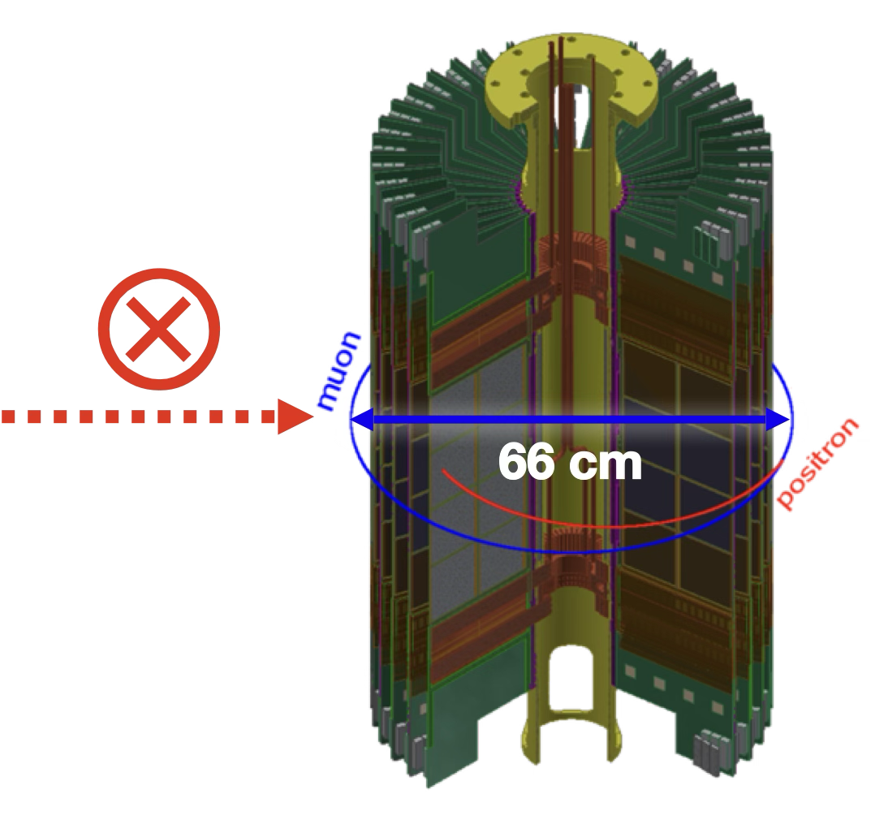
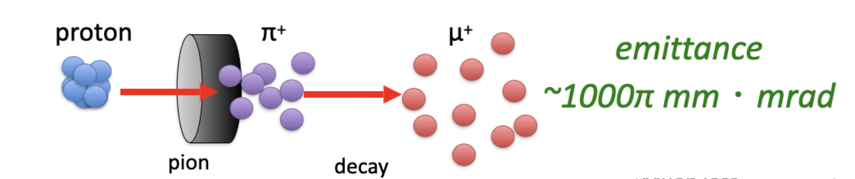

Muon cooling
A conventional muon beam:
can not be injected without a strong focusing → electric field;
This leads to muon losses and background contamination from $π$.
Desired beam:
The muon must be compact and non-divergent;
Typically with a RMS of $∼$mm → never achieved before.

Slide 15
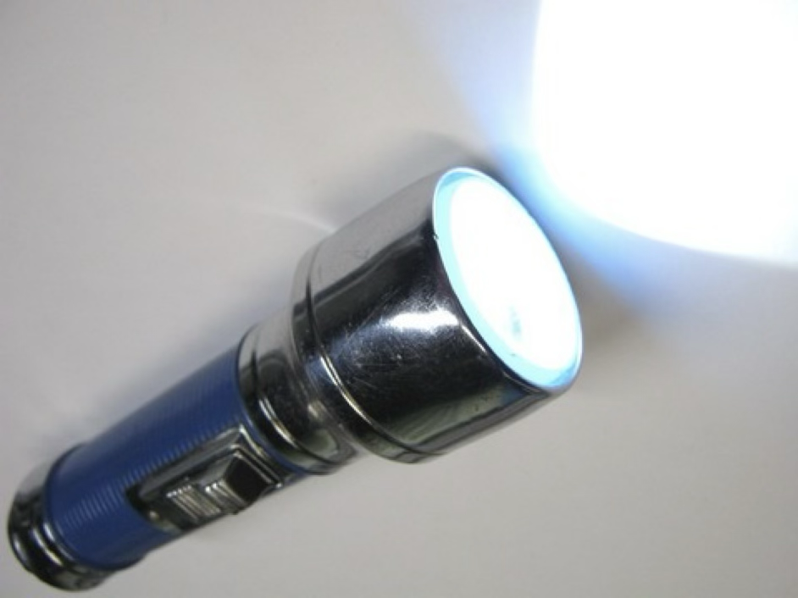
Muon cooling
Flashlight
Laser light

Slide 16
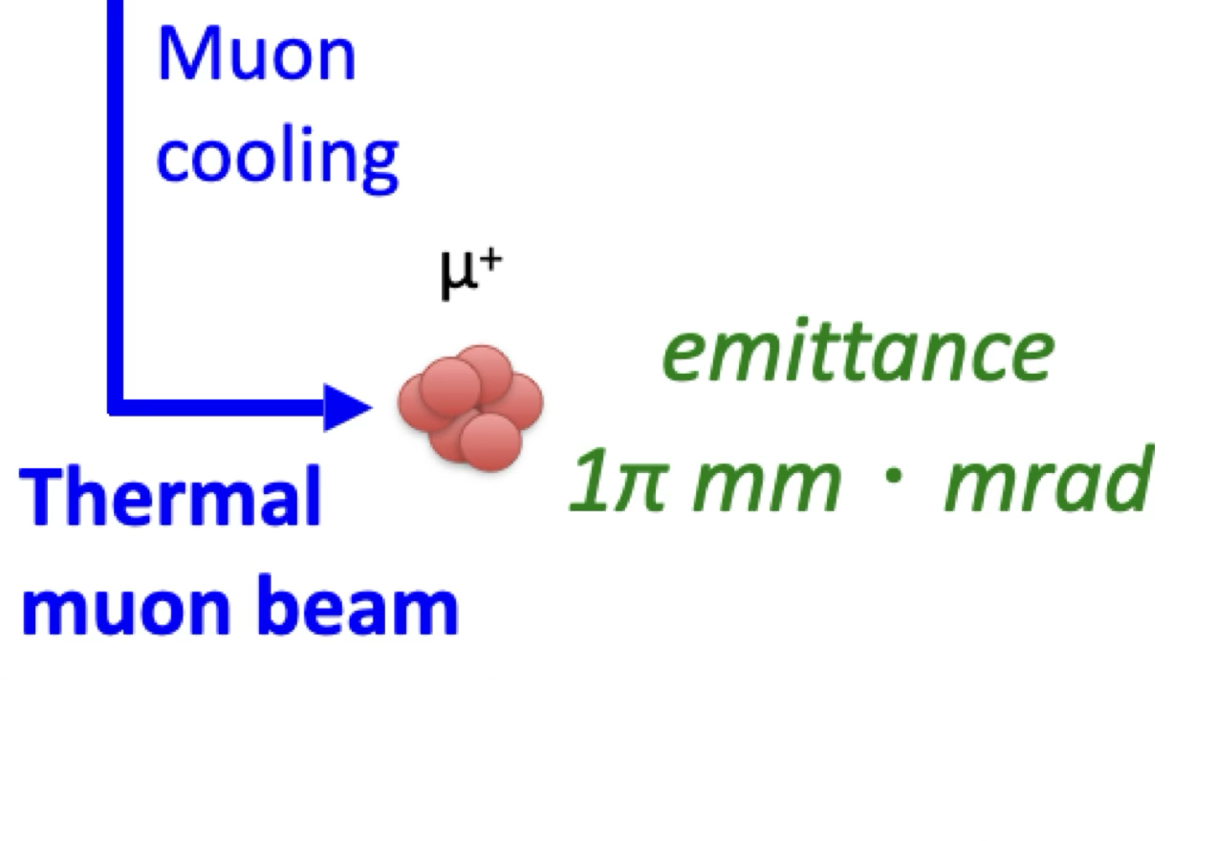
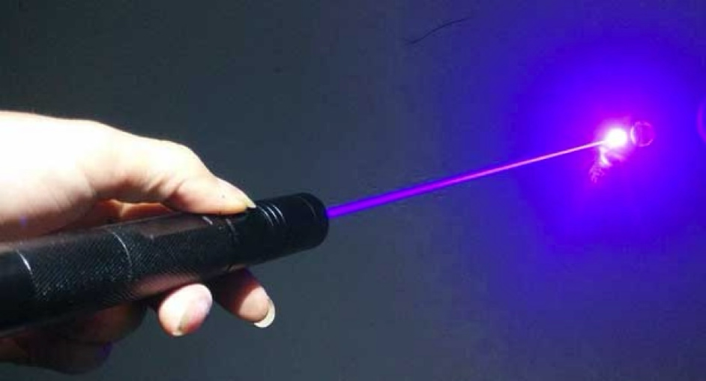
Muon cooling
Flashlight
Laser light

Slide 17
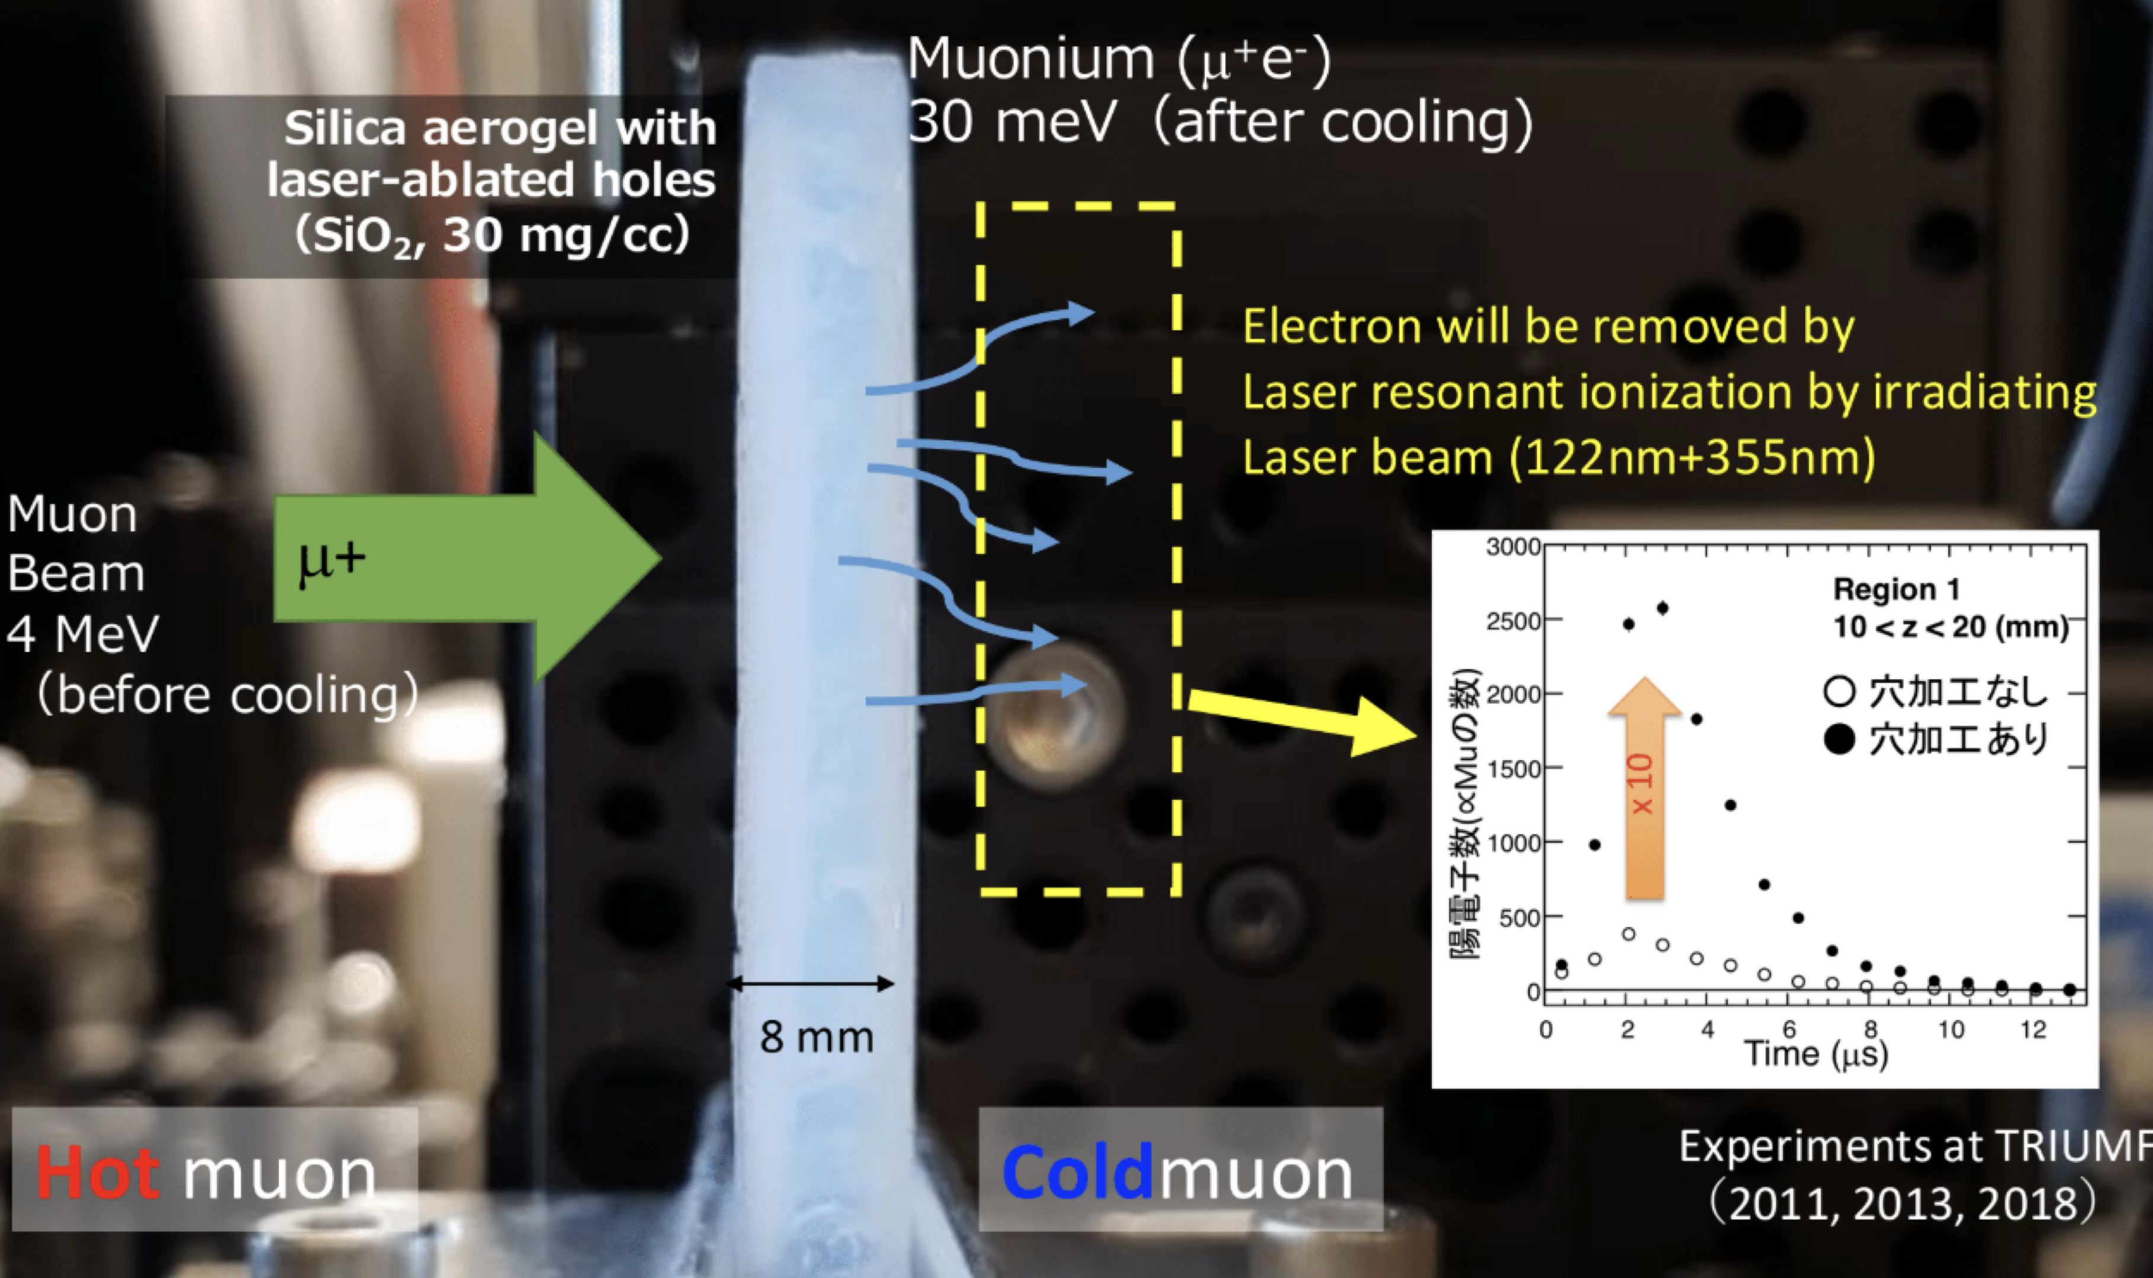
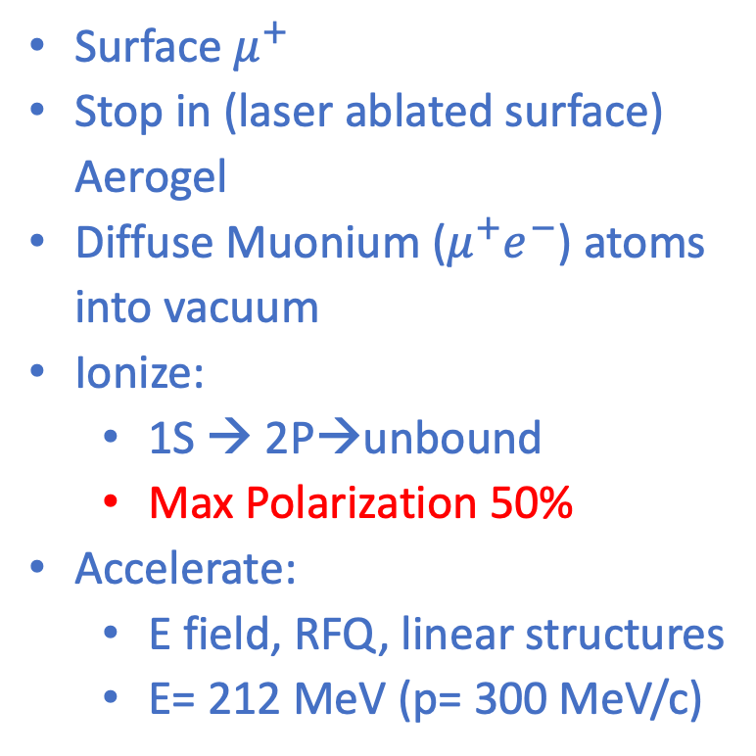
Ultra-cold muons
Surface $μ^{+}$
Stop in (laser ablated surface) Aerogel
Diffuse Muonium ($μ^{+}e^{−}$) atoms into vacuum
Ionize:
1S → 2P→unbound
Max Polarization 50%
Accelerate:
E field, RFQ, linear structures
E= 212 MeV (p= 300 MeV/c)

Slide 18
Re-accelerated thermal muon
graphite
target
Constructed in 2021
H-line experimental bldg.
Muon beam
Transmission muon microscope
μ+(4 MeV)
cooling
25 meV
4 MeV
injection
acceleration
g-2/EDM
212 MeV
0.66 m
storage
Shields, area control (2022)
Muon storage ring
Muon storage ring

Slide 19
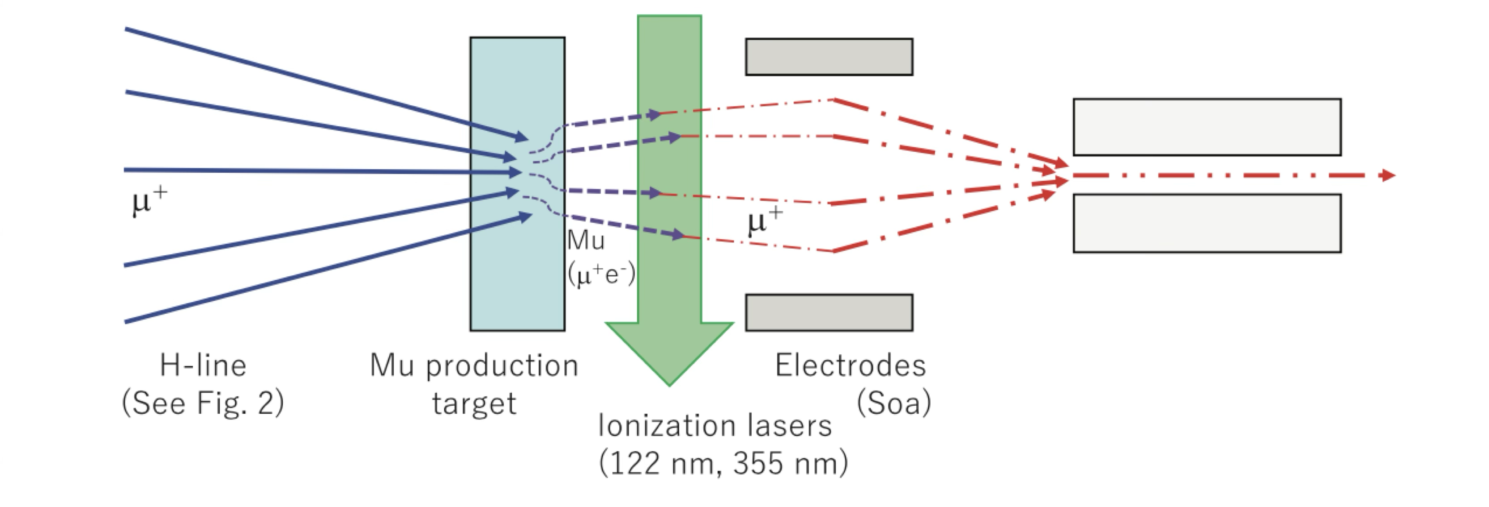
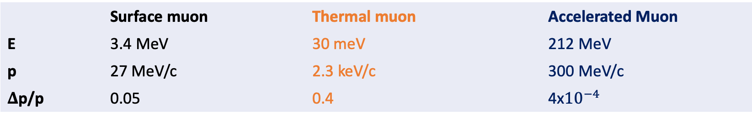
Re-accelerated thermal muon
 | Surface muon | Thermal muon | Accelerated Muon
E | 3.4 MeV | 30 meV | 212 MeV
p | 27 MeV/c | 2.3 keV/c | 300 MeV/c
$Δ$p/p | 0.05 | 0.4 | 4x${10}^{−4}$
Surface Muon
Re-accelerated muon
From silica aerogel

Slide 20
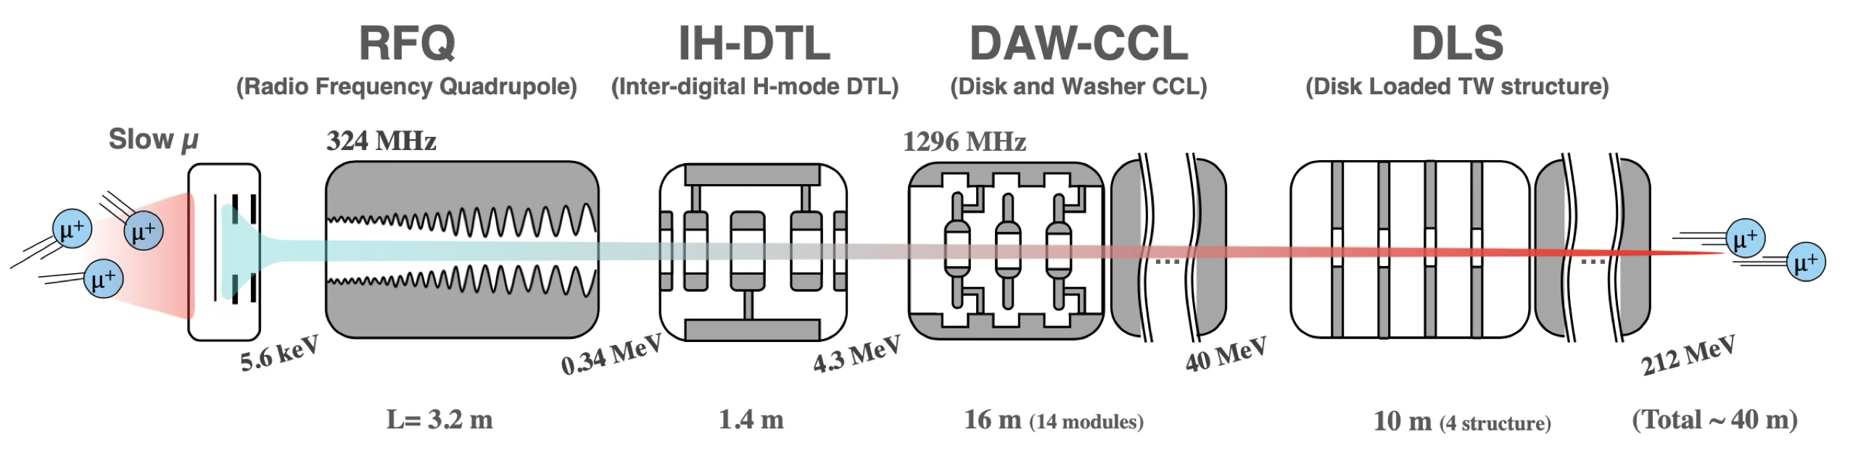
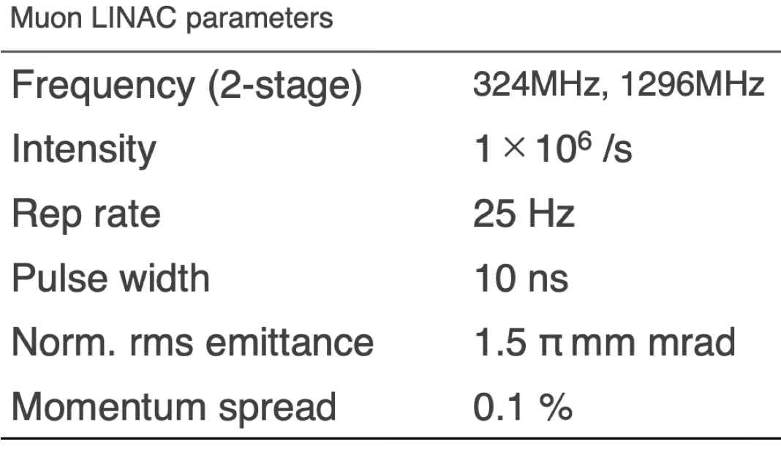
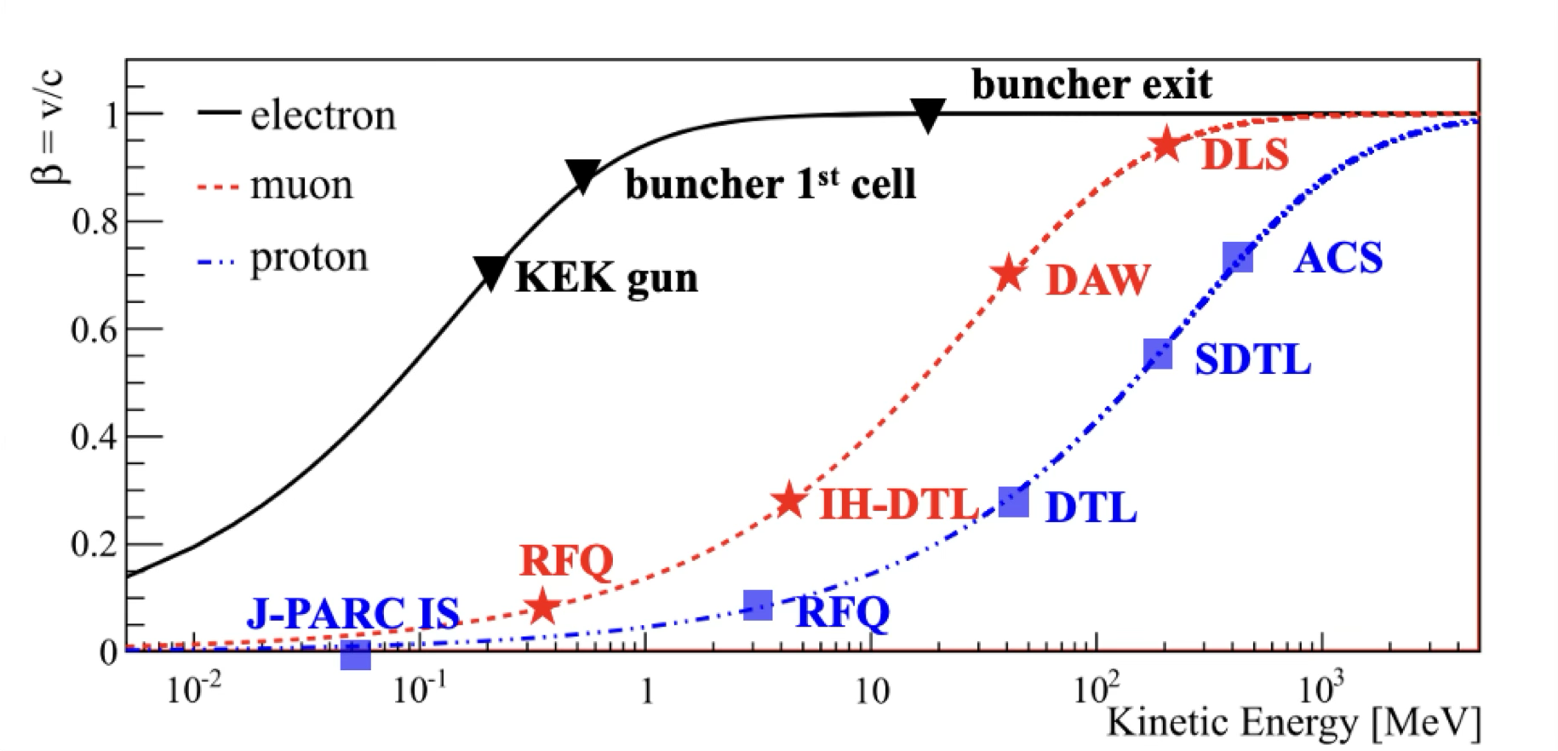

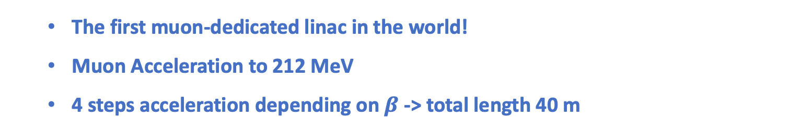


Re-accelerated thermal muon
Low $β$ (0.01 $→$ 0.3)
Middle $β$ (0.3 $→$ 0.7)
High $β$ (0.7 $→$ 0.94)
The first muon-dedicated linac in the world!
Muon Acceleration to 212 MeV
4 steps acceleration depending on $β$ -> total length 40 m

Slide 21
Re-accelerated thermal muon
Low $β$ (0.01 $→$ 0.3)
Middle $β$ (0.3 $→$ 0.7)
High $β$ (0.7 $→$ 0.94)
Acceleration test
with thermal μ planned.
Fabrication
completed.
High power
test on going
Prototype fabricated
and tested
Prototype fabricated
and tested
The first muon-dedicated linac in the world!
Muon Acceleration to 212 MeV
4 steps acceleration depending on $β$ -> total length 40 m

Slide 22
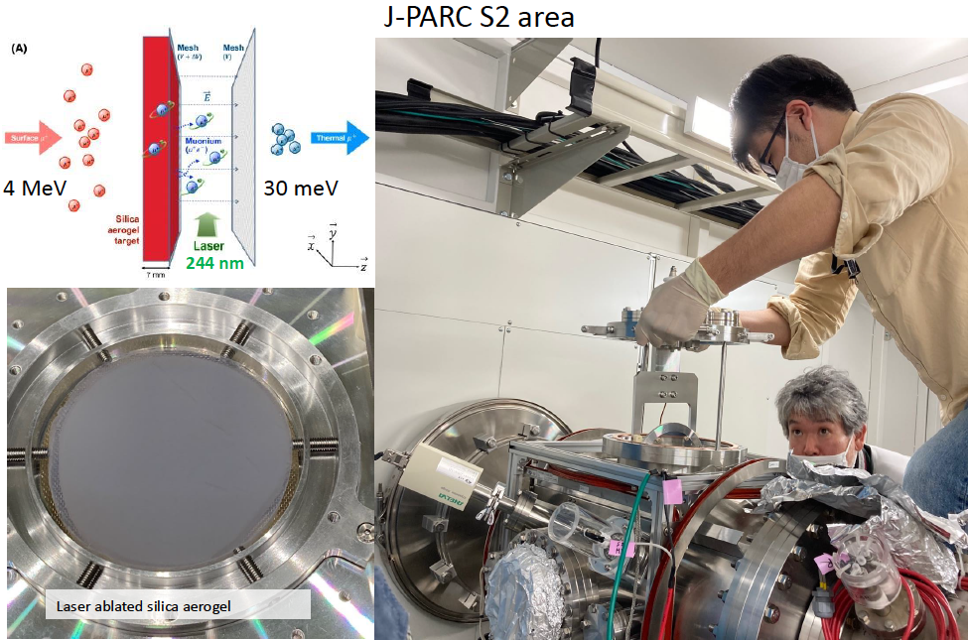
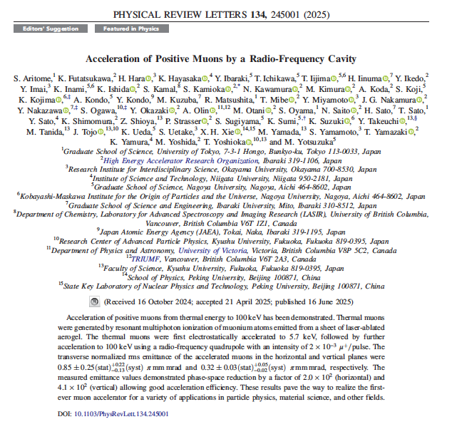
Re-accelerated thermal muon
Phys. Rev. Lett. 134, 245001
Acceleration from termal energy to 100 keV by RF system

Slide 23
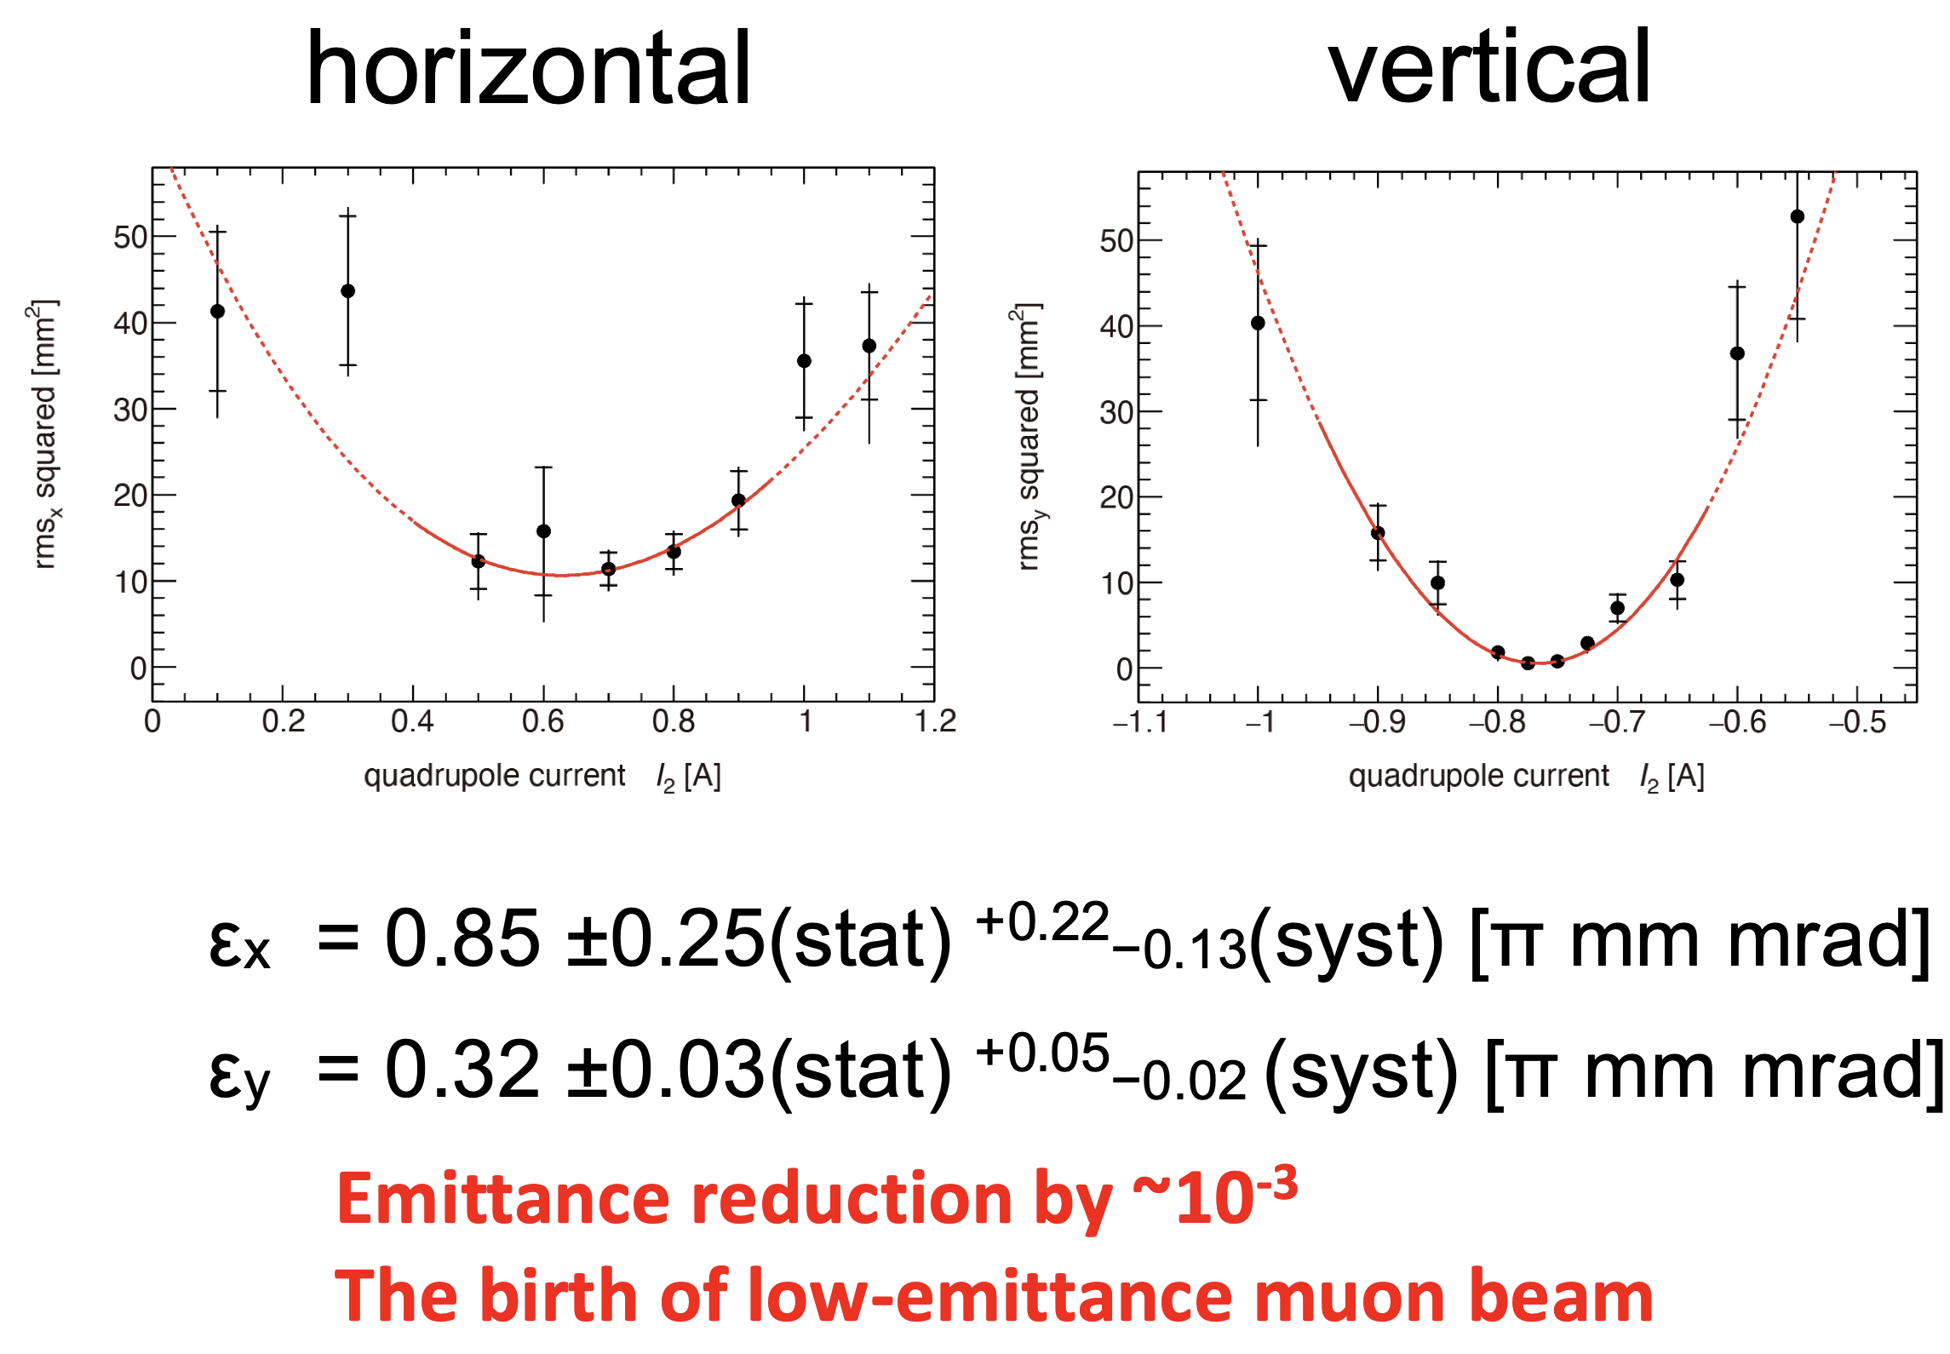
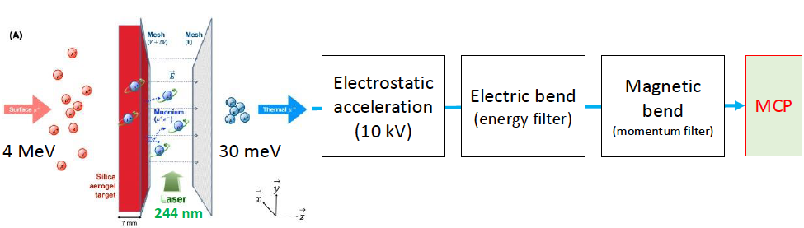
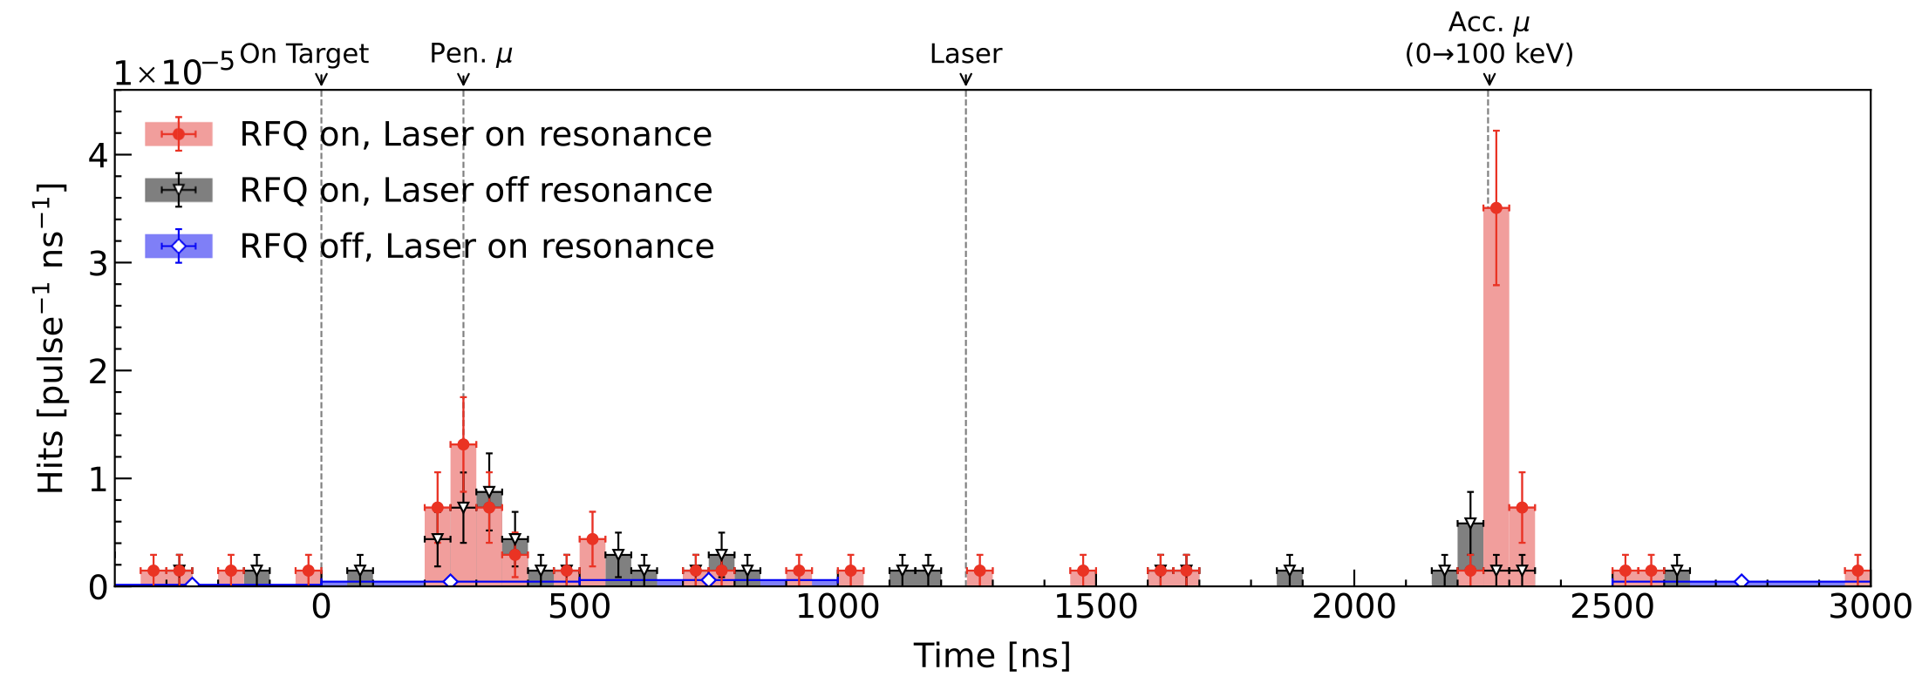
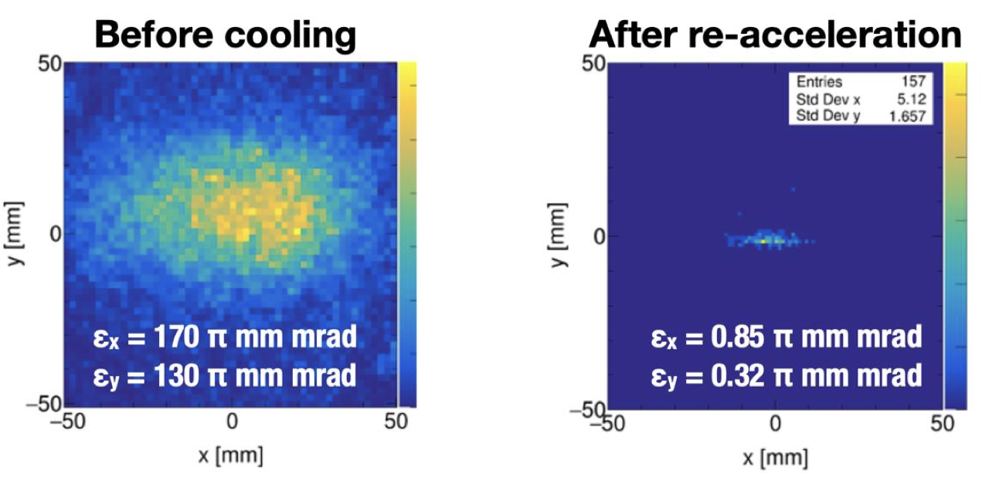
Re-accelerated thermal muon
Muon Cooling demonstration:
A single-anode microchannel plate
Phys. Rev. Lett. 134, 245001

Slide 24
3D spiral injection
graphite
target
Constructed in 2021
H-line experimental bldg.
Muon beam
Transmission muon microscope
μ+(4 MeV)
cooling
25 meV
4 MeV
injection
acceleration
g-2/EDM
212 MeV
0.66 m
storage
Shields, area control (2022)
Muon storage ring
Muon storage ring

Slide 25
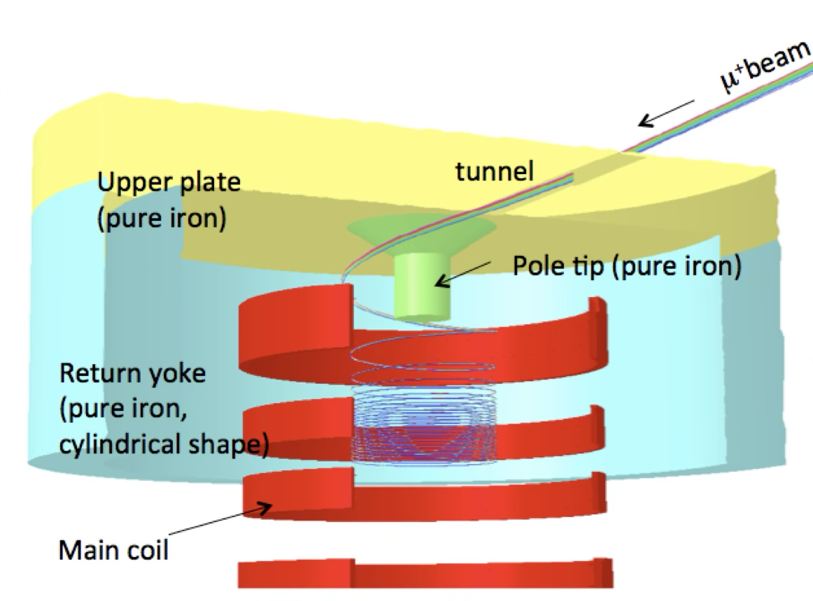
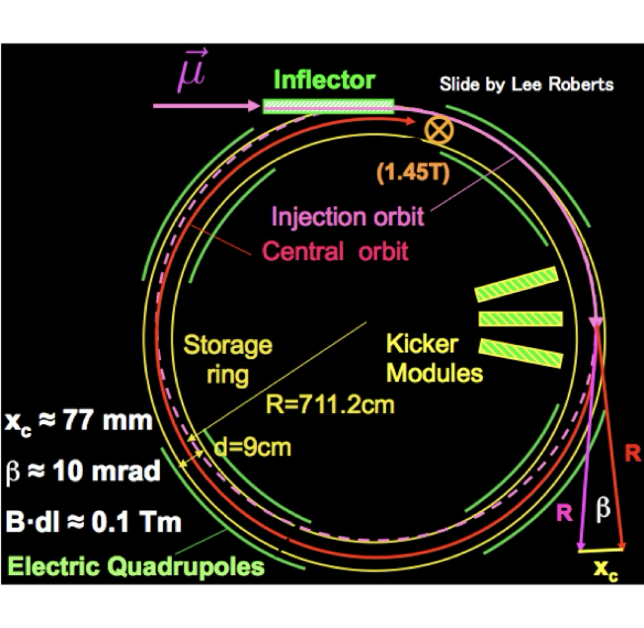
3D spiral injection
The 3D spiral injection scheme has been invented for small muon orbit
[H. Iinuma et al., NIMA 832, 51, 2016]
[PRD73, 072003, 2006 ]
Novel injection @J-PARC
3D spiral injection + vertical kicker
Efficiency > 80%
to be adopted for the EDM @ PSI too
Conventional 2D injection @BNL and FNAL
Inflector + horizontal kicker
Efficiency ~3-5%

Slide 26
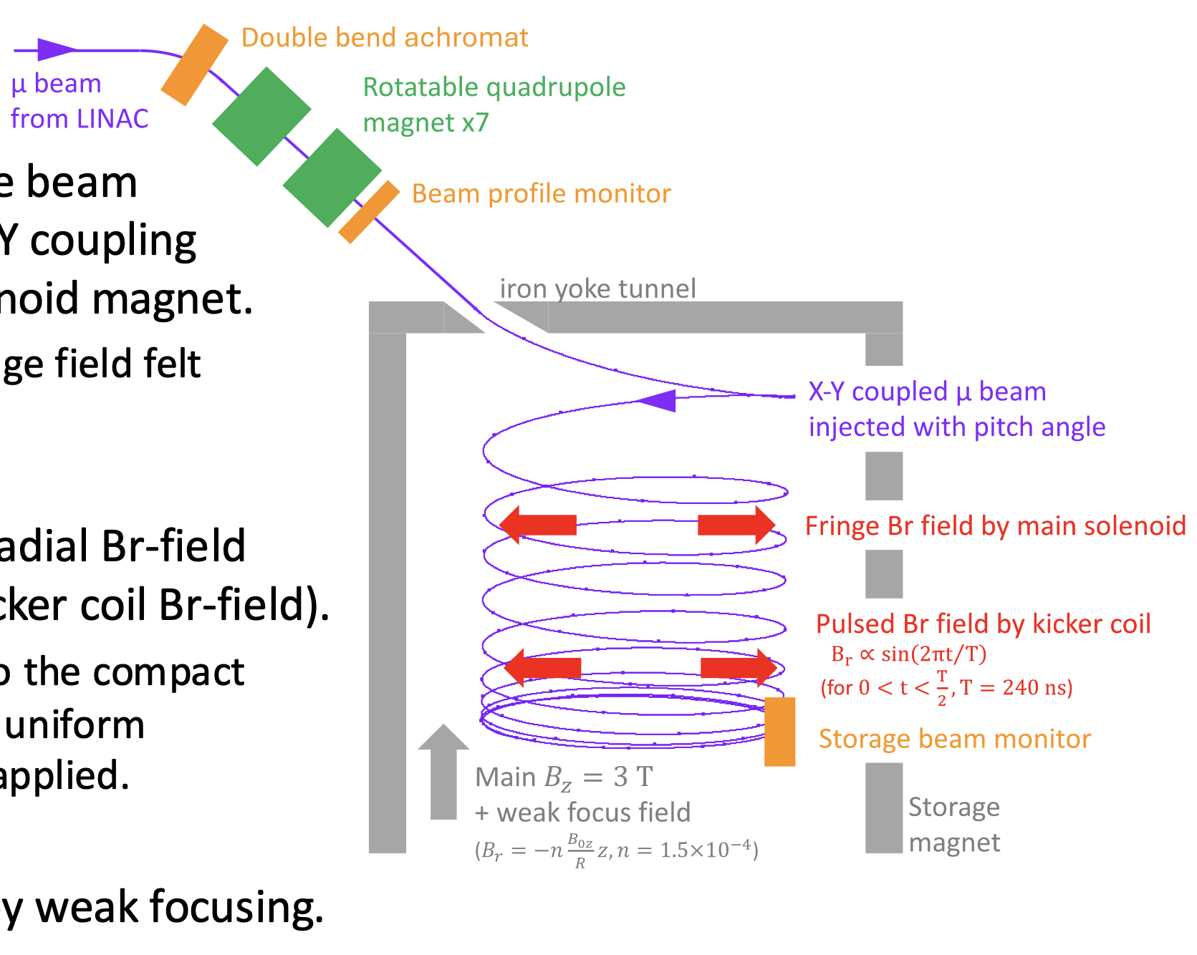
3D spiral injection
Low emittance muon beam (300MeV, 0.3π mm-mrad) will be injected into the storage orbit and stored without electric focusing with good injection efficiency.
Key points
Inject low emittance beam with appropriate X-Y coupling into solenoid magnet – to compensate fringe field felt by each muon
Apply appropriate radial Br-field (Fringe Br-field + kicker coil Br-field).
to guide muons to the uniform magnetic field region.
3. Store muon beam by weak focusing.

Slide 27
Storage Ring
graphite
target
Constructed in 2021
H-line experimental bldg.
Muon beam
Transmission muon microscope
μ+(4 MeV)
cooling
25 meV
4 MeV
injection
acceleration
g-2/EDM
212 MeV
0.66 m
storage
Shields, area control (2022)
Muon storage ring
Muon storage ring

Slide 28
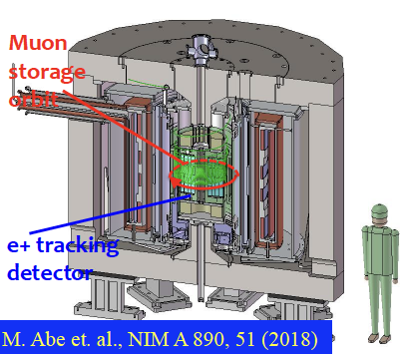
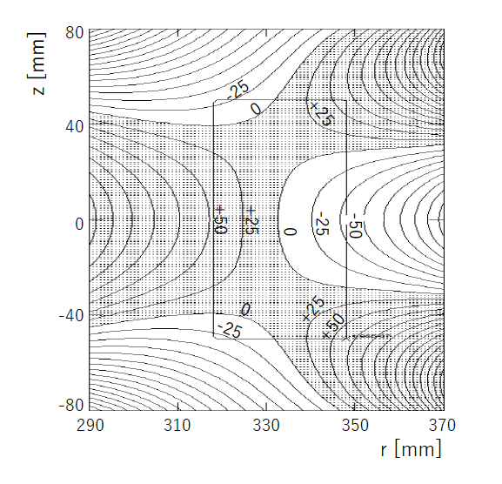

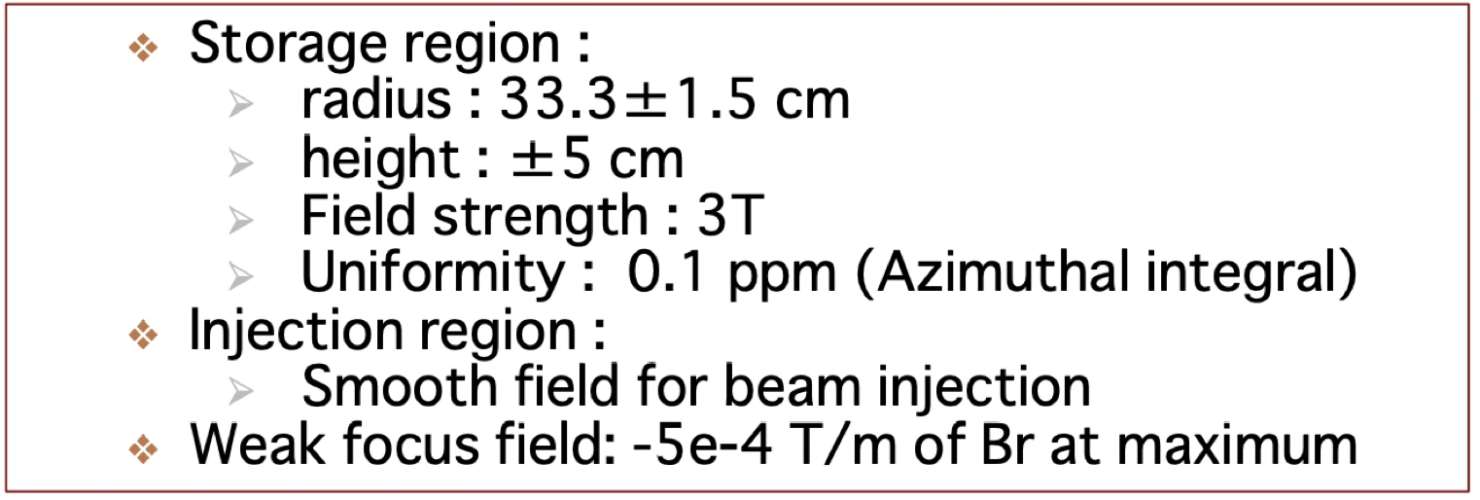
Storage Magnet
3 Tesla MRI-type superconducting solenoid magnet is under design
Average magnetic field uniformity is better than 0.1 ppm
25 ppb/line

Slide 29
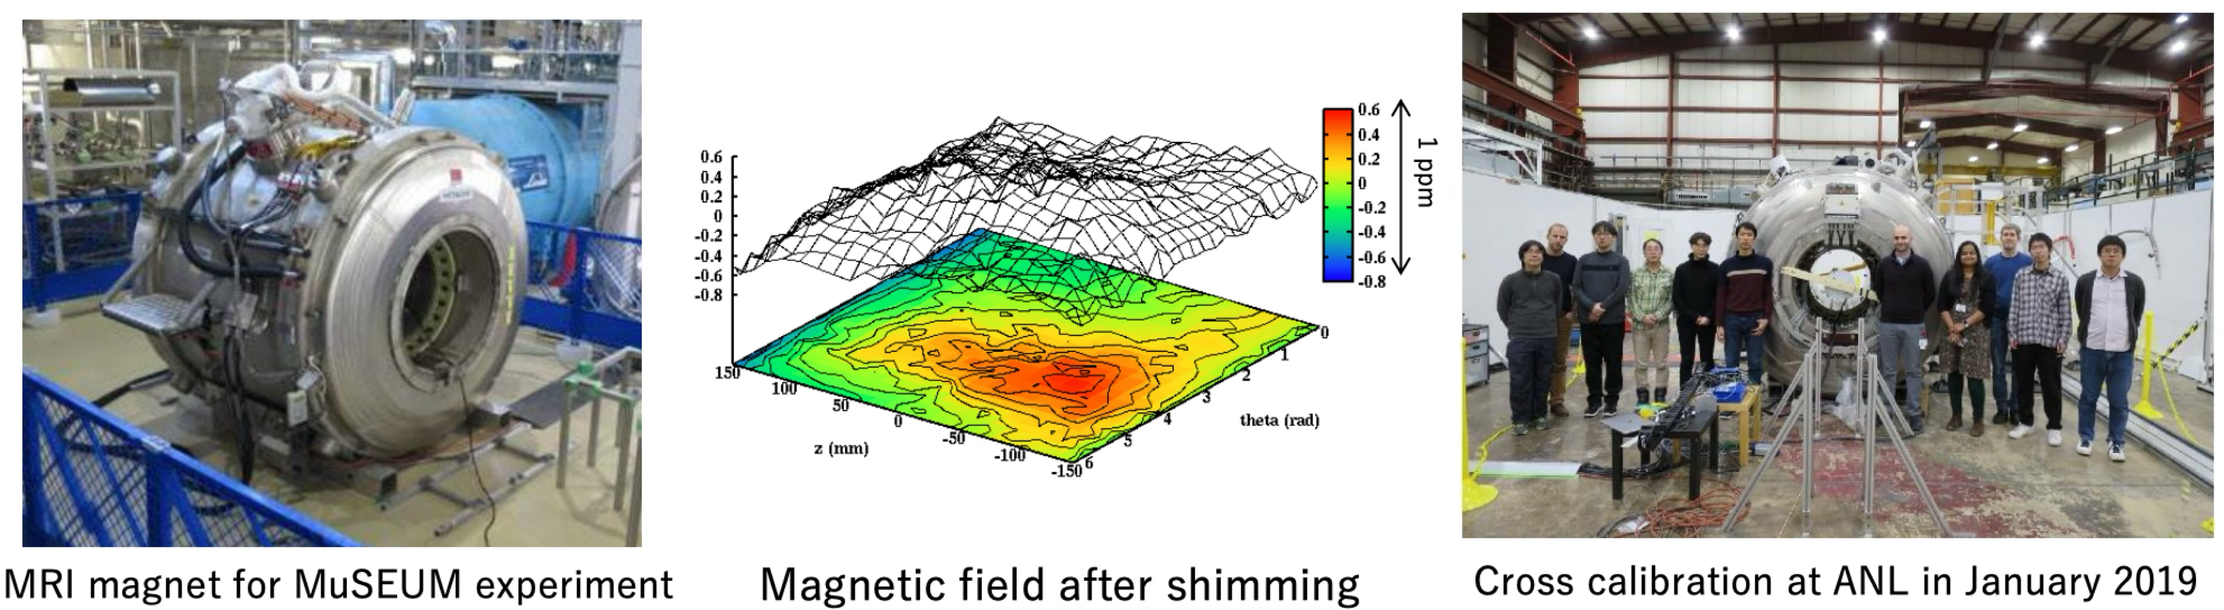
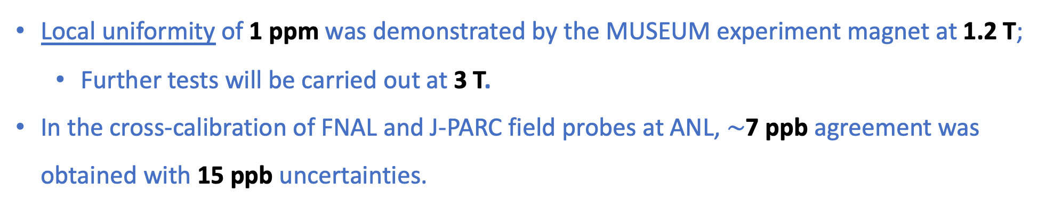
Storage Magnet
Local uniformity of 1 ppm was demonstrated by the MUSEUM experiment magnet at 1.2 T;
Further tests will be carried out at 3 T.
In the cross-calibration of FNAL and J-PARC field probes at ANL, $∼$7 ppb agreement was obtained with 15 ppb uncertainties.

Slide 30
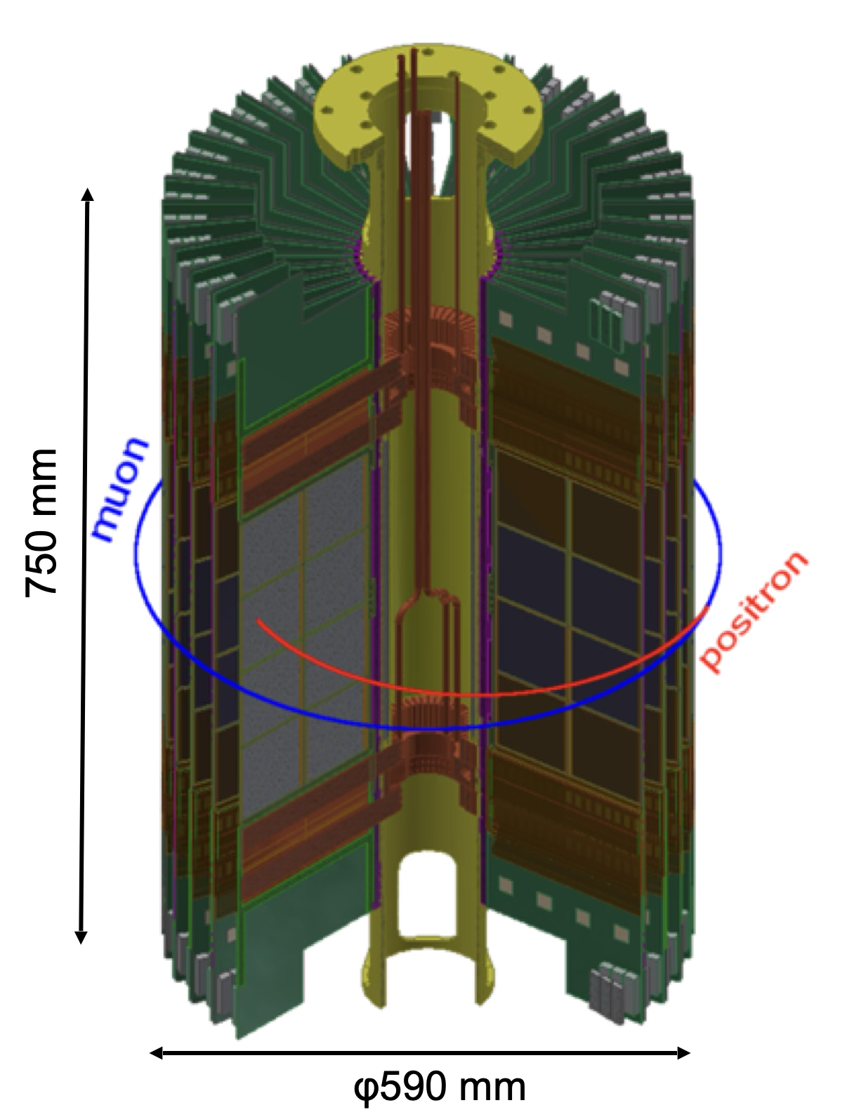
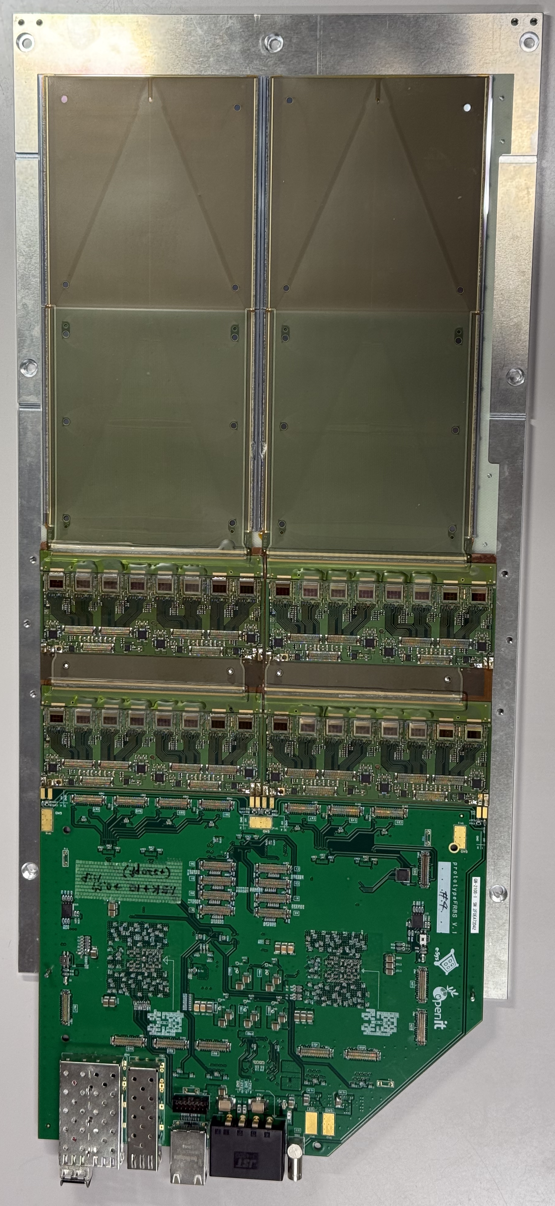




Positron Tracking Detector
“Prototype quarter-vane”
40 modules (vanes) each 200mm (radial) x 400mm (axial)
Each vane consists of 16 Si sensors (10x10 cm², 320 $μ$m thickness).
Two-dimensional hit position is reconstructed from orthogonally arranged silicon strip sensor (512 strips with 190 μm pitch)
32 Readout ASIC w/ 5nsec sampling rate.

Slide 31



Expected sensitivity - Statistics
A TDR muon rate 3.2×10⁸μ/sec at the entrance at 1 MW proton power.
The expected intensity of stored muon is 1.3×10⁵ μ/sec. Cumulative efficiency from thermal muon generation to reconstructed positron is 4.0×10⁻⁴
2-years data taking ( 2×10⁷ seconds, $∼$230 days) will give a total positron 5.7×10¹¹, achieving the BNL precision of 0.45 ppm on $a_{μ}$.

Slide 32

Expected sensitivity - Systematic
The systematic uncertainties are estimated to be less than 70 ppb – smaller than the statistical one:
$δa_{μ(syst)}∼70$ ppb $→$ this experiment is expected to be strongly statistically limited.

Slide 33



Expected sensitivity comparison with FNAL
Here is the comparison between the Run-456 FNAL result and the project error for J-PARC experiment:
FNAL – Run456
J-PARC – TDR
$δ{ω_{a}}_{syst}∼52$ ppb
$δ{ω_{p}}_{syst}∼57$ ppb

Slide 34
Expected sensitivity comparison with FNAL
Here is the comparison between the Run-456 FNAL result and the project error for J-PARC experiment:
FNAL – Run456
J-PARC – TDR
$δ{ω_{a}}_{syst}∼52$ ppb
$δ{ω_{p}}_{syst}∼57$ ppb
$δa_{μ(syst)}∼78$ ppb
$δa_{μ(syst)}∼70$ ppb

Slide 35


Towards high sensitivity
Given the strong limitation on statistics we can tweak the current set-up to increase the statistics.
The statistical precision on the anomalous precession frequency $ω_{a}$ is:
$$\frac{Δω_{a}}{ω_{a}}=\frac{1}{ω_{a}γτP}\sqrt{\frac{2}{NA^{2}}}$$

Slide 36

Towards high sensitivity
Given the strong limitation on statistics we can tweak the current set-up to increase the statistics.
The statistical precision on the anomalous precession frequency $ω_{a}$ is:
$$\frac{Δω_{a}}{ω_{a}}=\frac{1}{ω_{a}γτP}\sqrt{\frac{2}{NA^{2}}}$$
Increasing the momentum improves measurement precision linearly.

Slide 37
Towards high sensitivity
Given the strong limitation on statistics we can tweak the current set-up to increase the statistics.
The statistical precision on the anomalous precession frequency $ω_{a}$ is:
$$\frac{Δω_{a}}{ω_{a}}=\frac{1}{ω_{a}γτP}\sqrt{\frac{2}{NA^{2}}}$$
Increasing the momentum improves measurement precision linearly.
Magnetic Field Adjustment:
Higher momentum requires a proportional increase in the magnetic field to maintain experiment size.

Slide 38


Towards high sensitivity
Given the strong limitation on statistics we can tweak the current set-up to increase the statistics.
The statistical precision on the anomalous precession frequency $ω_{a}$ is:
$$\frac{Δω_{a}}{ω_{a}}=\frac{1}{ω_{a}γτP}\sqrt{\frac{2}{NA^{2}}}$$
Increasing the momentum improves measurement precision linearly.
Magnetic Field Adjustment:
Higher momentum requires a proportional increase in the magnetic field to maintain experiment size.
Effect on Anomalous Precession ($ω_{a}$):
A stronger magnetic field increases the anomalous precession frequency.

Slide 39

Towards high sensitivity
Given the strong limitation on statistics we can tweak the current set-up to increase the statistics.
The statistical precision on the anomalous precession frequency $ω_{a}$ is:
$$\frac{Δω_{a}}{ω_{a}}=\frac{1}{ω_{a}γτP}\sqrt{\frac{2}{NA^{2}}}$$
Increasing the momentum improves measurement precision linearly.
Magnetic Field Adjustment:
Higher momentum requires a proportional increase in the magnetic field to maintain experiment size.
Effect on Anomalous Precession ($ω_{a}$):
A stronger magnetic field increases the anomalous precession frequency.
→ Doubling both momentum and field ⇒ x4 improvement in $ω_{a}$ precision.

Slide 40


Towards high sensitivity
Polarization Contribution (P):
Current polarization: 50% Possible improvement: → 75% (realistically) → Adds an additional x1.5 gain in total precision.
$$\frac{Δω_{a}}{ω_{a}}=\frac{1}{ω_{a}γτP}\sqrt{\frac{2}{NA^{2}}}$$
Higher momentum beam (needs higher B-field)
Optical pumping with train of laser pulse

Slide 41


Towards high sensitivity
Polarization Contribution (P):
Current polarization: 50% Possible improvement: → 75% (realistically) → Adds an additional x1.5 gain in total precision.
Here is projected $\frac{Δω_{a}}{ω_{a}}$ as function of the momentum.
A task force has been built to check the feasibility:
Magnetic field;
Linac;
Polarization;
Other possible improvements.
$$\frac{Δω_{a}}{ω_{a}}=\frac{1}{ω_{a}γτP}\sqrt{\frac{2}{NA^{2}}}$$
Higher momentum beam (needs higher B-field)
Optical pumping with train of laser pulse

Slide 42



Running test experiments
Three experiments are currently running at J-PARC MLF since October 29.
③
①
②
②
① Surface muon beam commissioning (H2 area)
② cold muon source
(S2 area & H2 area)
③ MuSEUM (H1 area)
Positron tracking detector

Slide 43

Conclusion
J-PARC’s independent approach can provide an excellent cross check of Fermilab’s measurement;
J-PARC has achieved great progress recently -> First cold muon beam acceleration was an historical achievement.
It aims for 0.45 ppm precision ($∼$BNL level with data expected 2030+)
The high sensitivity study could bring to a turning point towards Fermilab precision.
This will be another fundamental step towards our final goal: Measuring muon g-2 with ever-increasing precision – testing the SM and probing new physics.

Slide 44

“The closer you look the more there is to see”
F. Jegerlehner
THANK YOU!
Ph. Stella Critelli

Slide 45
BACK-UP

Slide 46
Comparison with Fermilab
t_{μ}∼ 64.4 us
t_{μ}= 6.6 us
80
Completed

Slide 47






Muon g-2 at J-PARC (E34)
graphite
target
Constructed in 2021
H-line experimental bldg.
Muon beam
Transmission muon microscope
μ+(4 MeV)
cooling
25 meV
4 MeV
injection
acceleration
g-2/EDM
212 MeV
Shields, area control (2022)
RF Acc. Test at S2 area (May 2023)
storage
0.66 m
0.66 m
Shields, area control (2022)
Muon storage ring
Muon storage ring
Muon storage ring

Slide 48

Why a new g-2 experiment? – Precision
Fermilab’s result has reached and surpassed the 100 ppb level in both statistical and systematic uncertainties.
When systematics match statistics, new methods are required, not just more data!
Further gains using the same approach would be extremely difficult.
$$\frac{ω_{a}}{{\tilde{ω}}_{p}^{′}}$$ | Stat. Uncertainty (ppb) | Syst. Uncertainty (ppb) | Total Uncertainty (ppb)
Run-1 | 434 | 159* | 462
Run-2/3 | 201 | 78* | 216
Run-4/5/6 | 114 | 76 | 137
Run-1-6 | 98 | 78 | 125
TDR goal: 140ppb

Slide 49
Status of J-PARC muon g-2/EDM experiment
E. Bottalico on behalf of g-2 collaboration
MPP2025
11th November 2025

