Slide 1
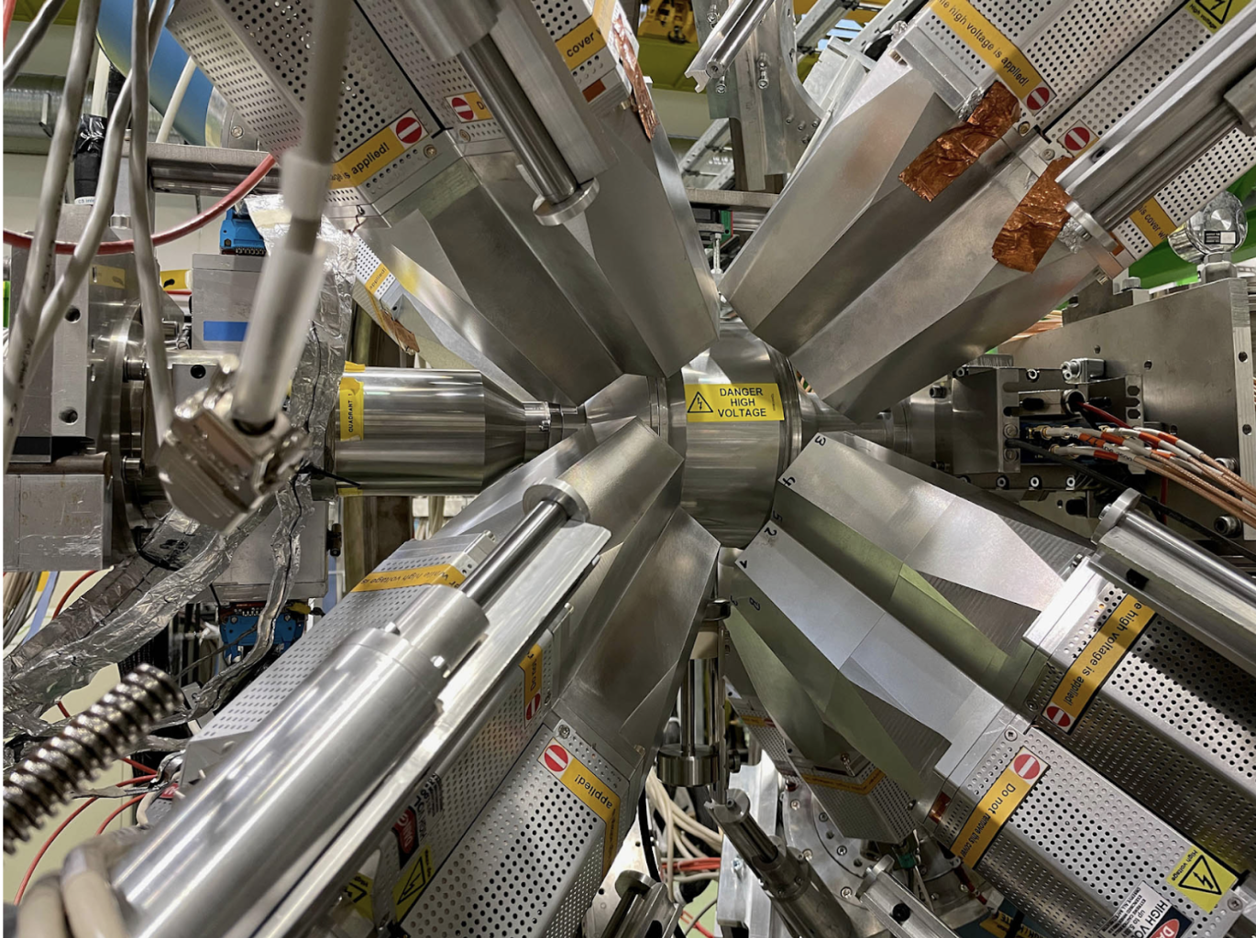





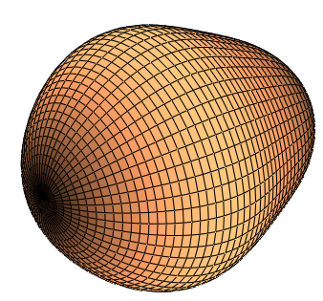

The impact of nuclear physics on electric dipole moment (EDM) searches
Liam Gaffney
University of Liverpool
4th Liverpool Workshop on Muon Precision Physics 2025
13th November 2025 – Liverpool

Slide 2
Talk outline
Content warning – this talk may contain NP (Nuclear Physics!!)
EDMs in nuclear, atomic and molecular systems
A focus on the Schiff moment and heavy, deformed nuclei
Radioactive nuclear systems and the latest atomic EDM pursuits
What are nuclear theory + experiment doing in this direction?
Aside on opportunities utilising radioactive molecules
Conclusions…

Slide 3
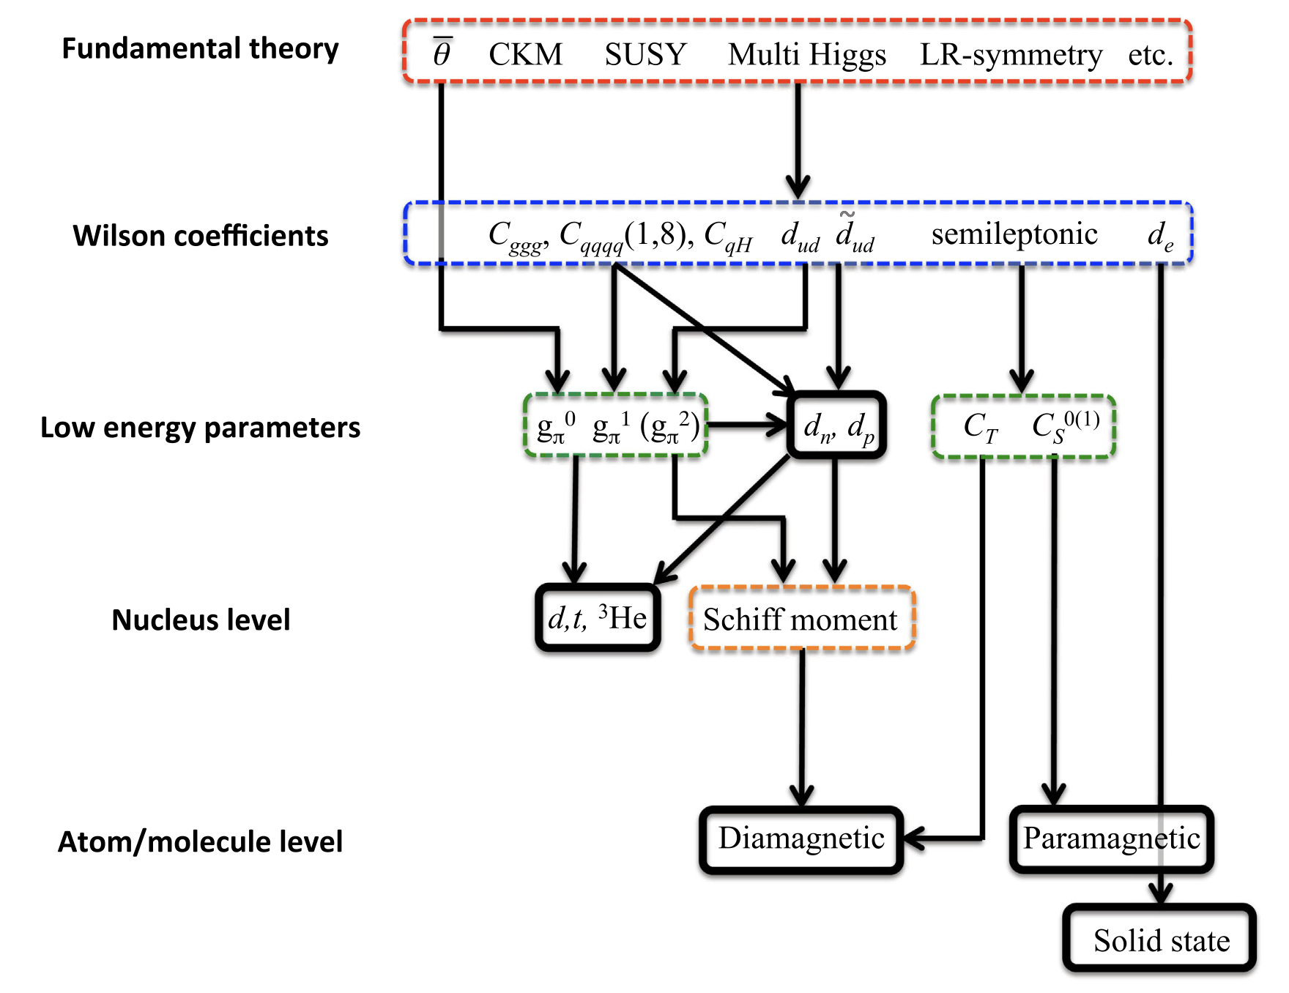
EDMs in nuclei, atoms and molecules
Sources of CP-violation
Particle Physics Theory
Effective Field Theory
Lattice QCD Theory
Nuclear Theory
+
→ Nuclear Experiment ←
Atomic Theory
+
Atomic Experiment
Molecular Theory
+
Molecular Experiment
T. E. Chupp, P. Fierlinger, M. J. Ramsey-Musolf, and J. T. Singh, Rev. Mod. Phys. 91, 015001 (2019).

Slide 4
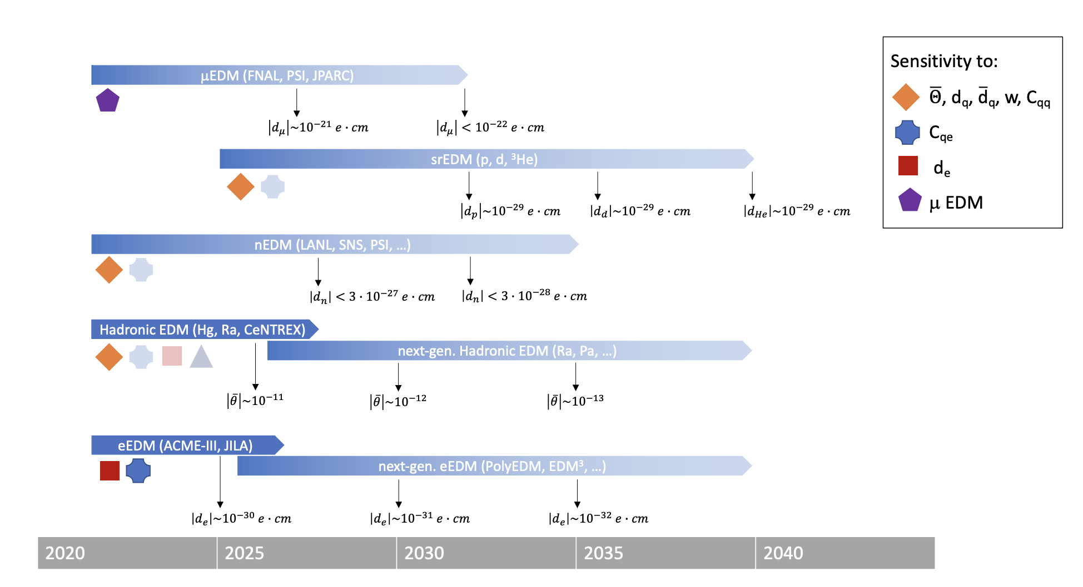
EDMs in nuclei, atoms and molecules
T. Blum, P. Winter, et al.,
“Fundamental Physics in Small Experiments”
arXiv:2209.08041v2 [hep-ex]

Slide 5
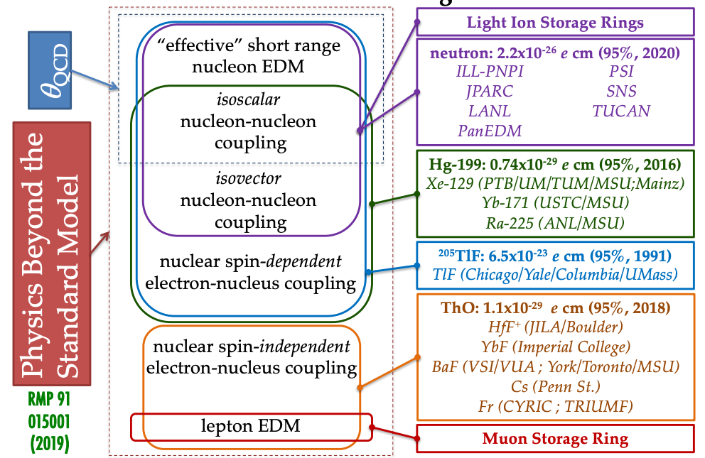
EDMs in nuclei, atoms and molecules
pEDM @ BNL
Talk Wednesday
Yannis K. Semertzidis
This talk … ish
Not discussed are other PV moments in nuclei, e.g. MQM.
Summarised already in talk on Wednesday by Antonio Masiero
Talks this morning
muEDM @ PSI
P. Schmidt-Wellenburg
muon EDM at g-2
Katie Ferraby
Unashamedly stolen from Jaideep Singh (MSU)
T. E. Chupp, P. Fierlinger, M. J. Ramsey-Musolf, and J. T. Singh, Rev. Mod. Phys. 91, 015001 (2019).

Slide 6
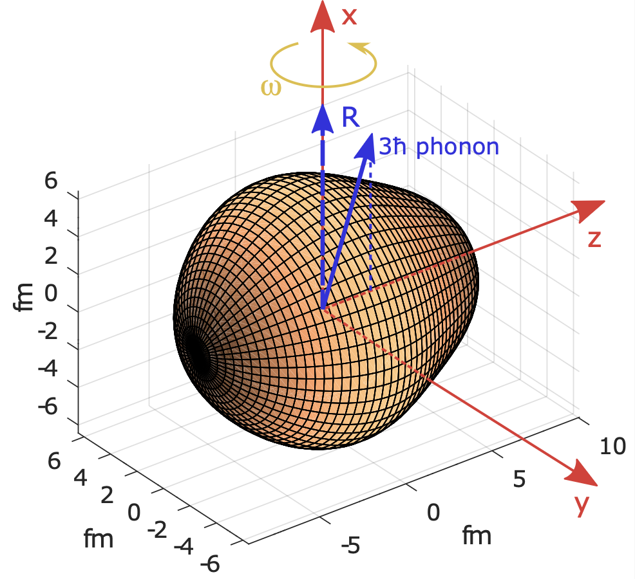
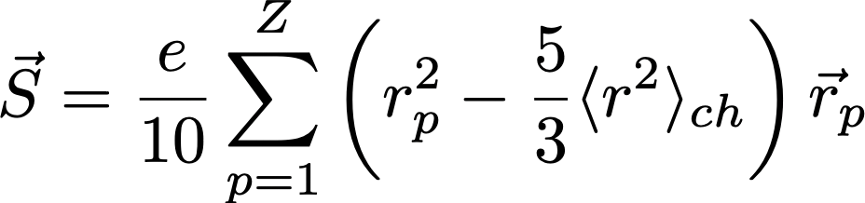



Schiff moments
Electron cloud -Q
Nucleus +Q
$$\vec{E_{ind}}$$
The nucleus can acquire an EDM from PT-violating term in the nuclear Hamiltonian or via the neutron (d_{n}) and proton (d_{p}) EDMs.
Applied electric field, $\vec{E_{lab}}$
$$\vec{E_{ind}}≅−\vec{E_{lab}}$$
Neutral atom
Atomic system screens the nuclear dipole moment according to the Schiff theorem, but finite size of the nucleus induces residual electric field in the atom.
Deformed, heavy nuclei have Schiff moments.
Asymmetric, rotating nuclei, show enhanced Schiff moments (~10³) if PT-violating term is present.
L. Schiff, Phys. Rev. 132, 2194 (1963).
J. Engel, M. J. Ramsey-Musolf, and U. van Kolck, Prog. Part. Nucl. Phys. 71, 21 (2013).
﻿V. Spevak, N. Auerbach, and V. Flambaum, Phys. Rev. C 56, 1357 (1997).

Slide 7
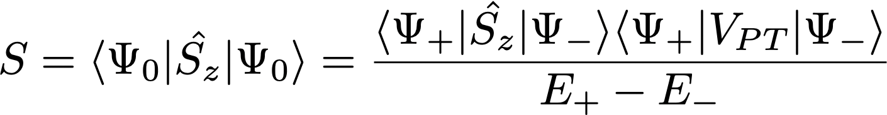
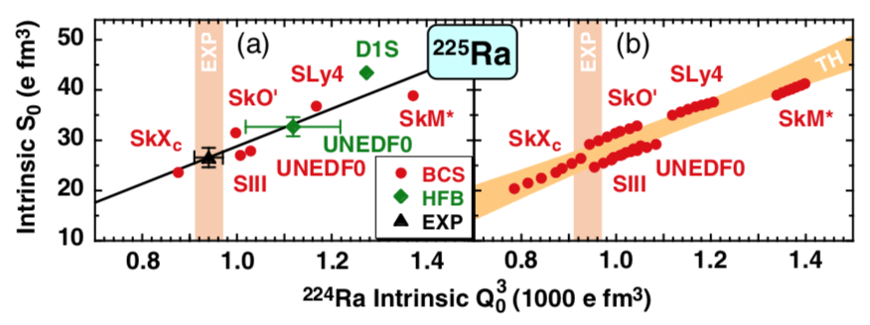



Schiff moments
PTV nucleon-nucleon interaction
`
`
Intrinsic nuclear Schiff moment, S, gives rise to atomic EDM
New physics!?
Discovery measurement?
`
````````
Schiff moment of opposite parity states
Nuclear theory + Experiment
Nuclear experiment
ΔE±: Energy splitting of nuclear states with same spin and opposite parity
²²⁵Ra
ΔE± = 55 keV
J. Dobaczewski, J. Engel, M. Kortelainen, and P. Becker, Phys. Rev. Lett. 121, 232501 (2018).
T. E. Chupp, P. Fierlinger, M. J. Ramsey-Musolf, and J. T. Singh, Rev. Mod. Phys. 91, 015001 (2019).

Slide 8
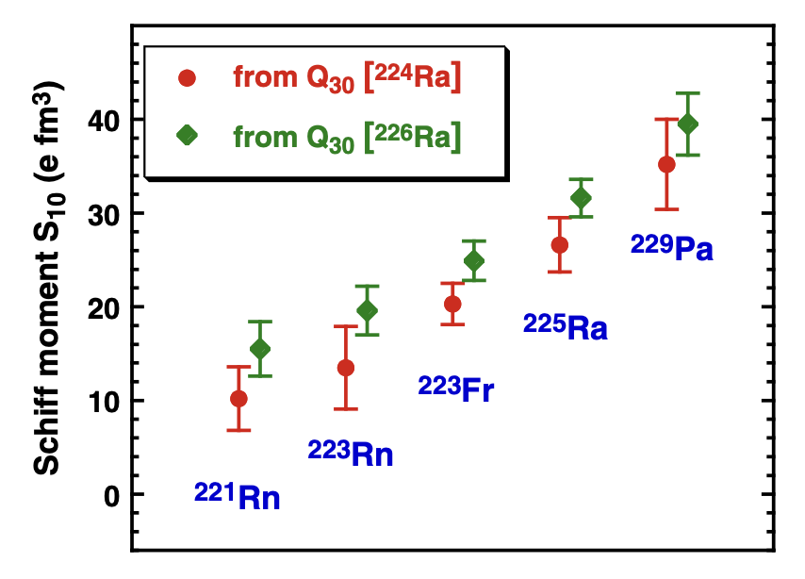


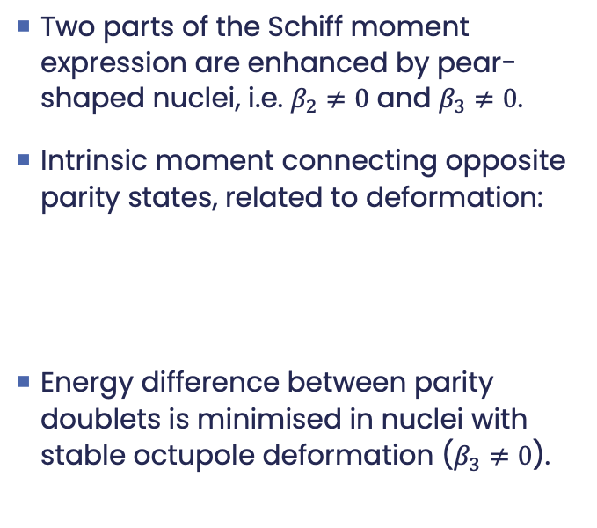
Enhancement of the Schiff moment
Two parts of the Schiff moment expression are enhanced by pear-shaped nuclei, i.e. $β_{2}≠0$ and $β_{3}≠0$.
Intrinsic moment connecting opposite parity states, related to deformation:
Energy difference between parity doublets is minimised in nuclei with stable octupole deformation ($β_{3}≠0$).

Slide 9
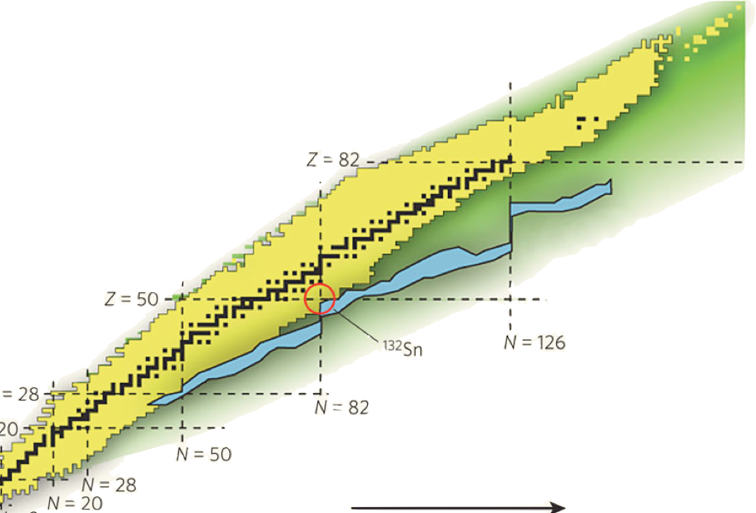
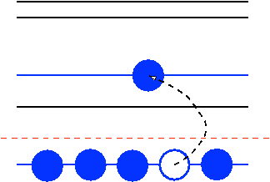
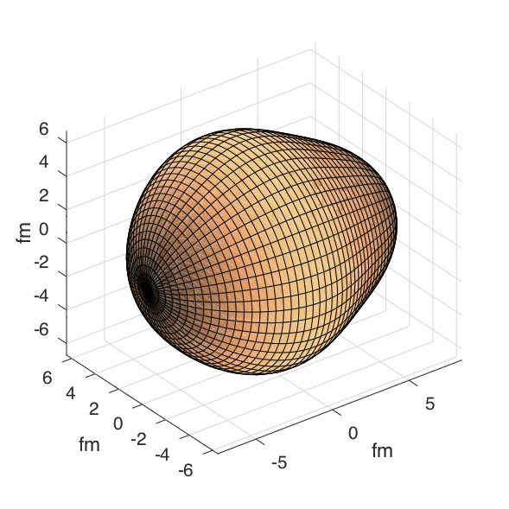

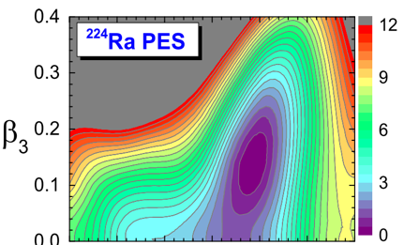

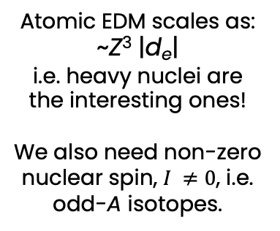
Octupole deformation in nuclei
Enhanced at octupole "magic" numbers:
34, 56, 88, 134
Z = 88
ε_{F}
Z = 56
²²⁴Ra
N = 134
Atomic EDM scales as: ~Z³ |d_{e}|
i.e. heavy nuclei are the interesting ones!
We also need non-zero nuclear spin, $I ≠0$, i.e. odd-A isotopes.
Z = 34
N = 88
¹⁴⁴Ba
N = 56
N = 34

Slide 10
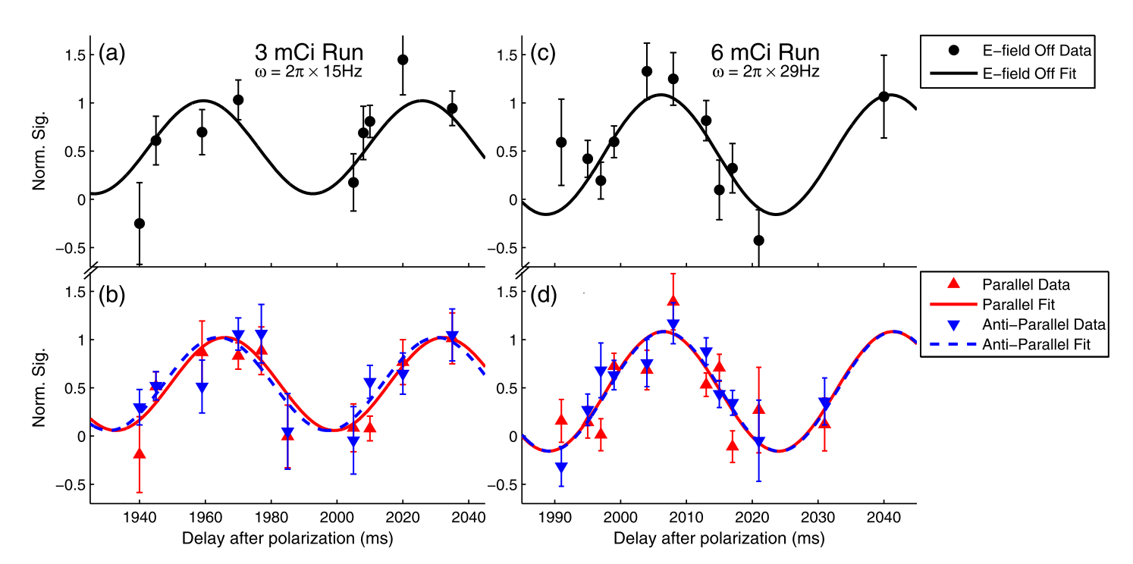

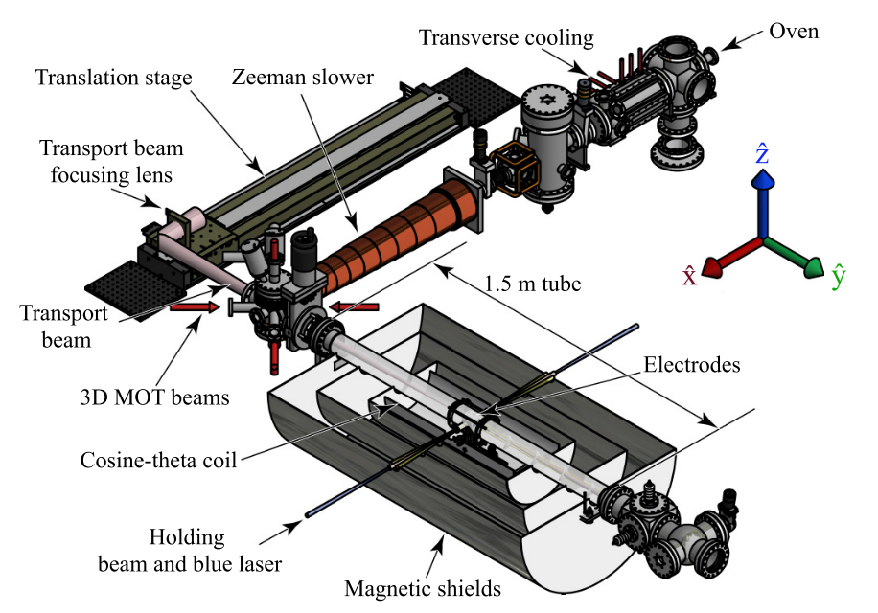
EDM measurements in atomic systems
The Argonne National Laboratory ²²⁵Ra measurement
|d(²²⁵Ra)| < 1.4 × 10⁻²³ e cm (95% CL)
Proof-of-principle with 500 ²²⁵Ra atoms trapped in optical lattice
Plans to increase E field, number of ions, spin coherence time, etc, to rival or surpass ¹⁹⁹Hg experiment.
First EDM measurement with an octupole-deformed isotope.
Compared to “gold standard”: |d(¹⁹⁹Hg)| < 7.4 × 10⁻³⁰ e cm (95% CL)
M. Bishof et al., Phys. Rev. C 94, 025501 (2016).
R.H. Parker et al., Phys. Rev. Lett. 114, 233002 (2015).
B. Graner et al., Phys. Rev. Lett 116, 161601 (2016).
T_{1/2}(²²⁵Ra) = 14 days

Slide 11
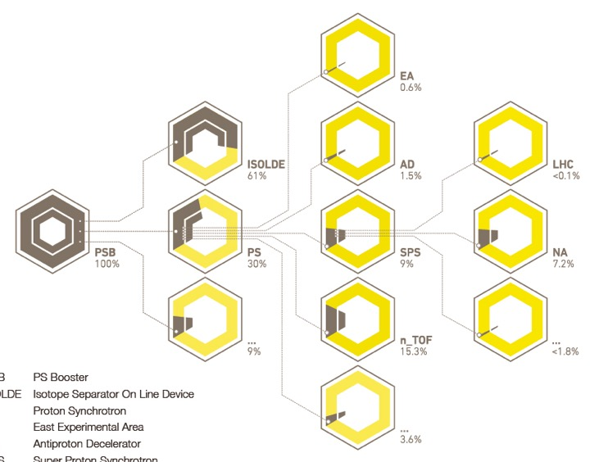
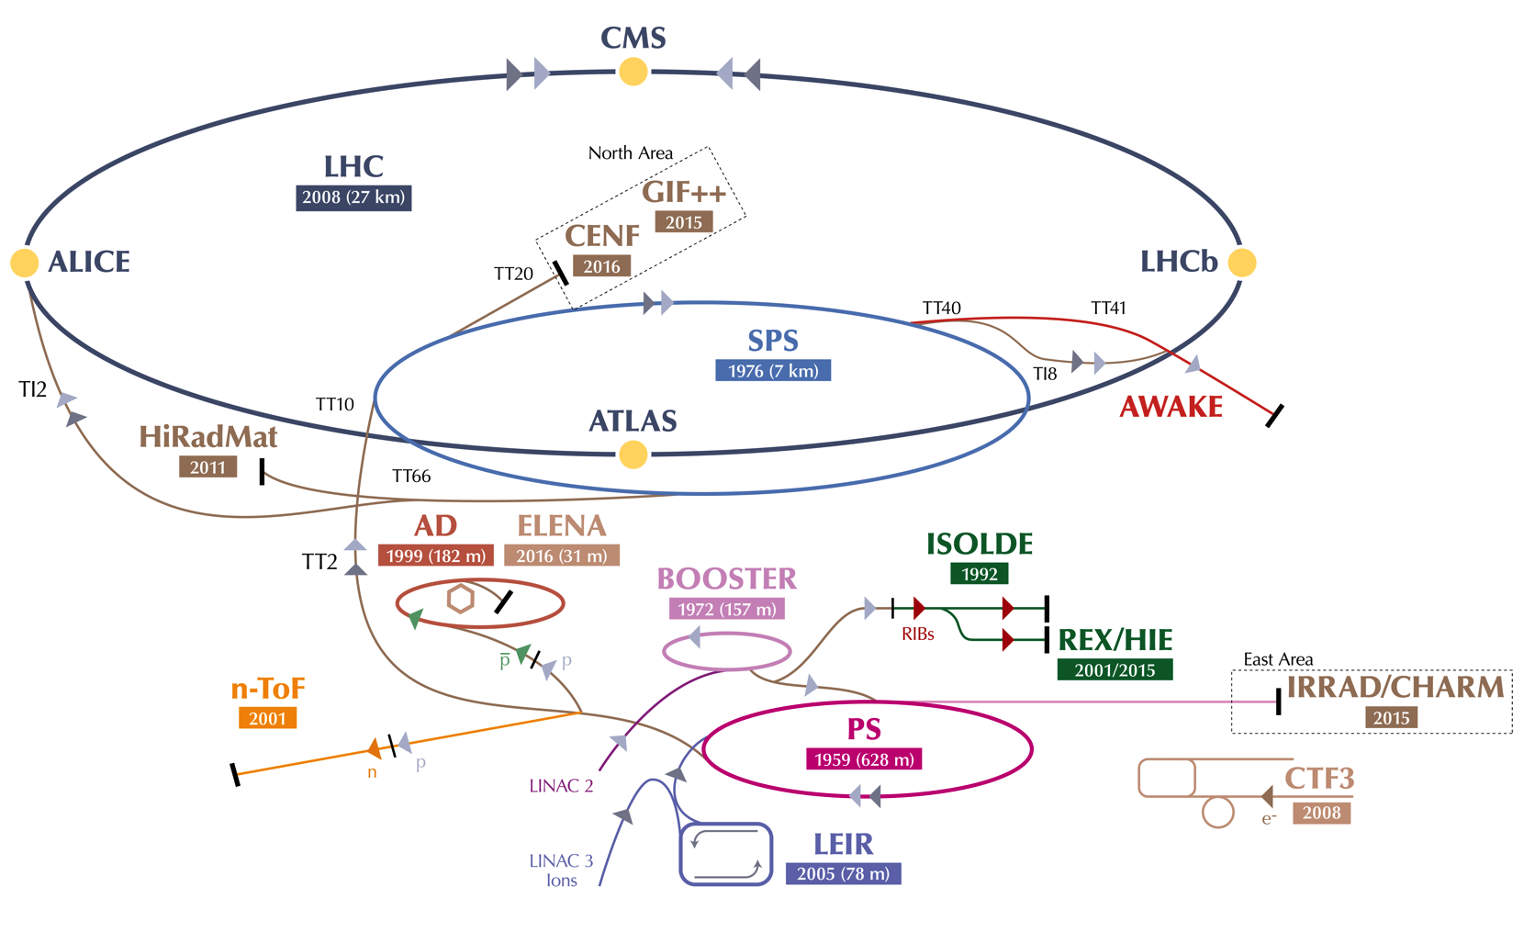
CERN accelerator complex
What about the production and study of short-lived nuclei?
Isotope Separation Online technique

Slide 12


Radioactive ion beam production
© CERN doi:10.17181/cds.2289929

Slide 13

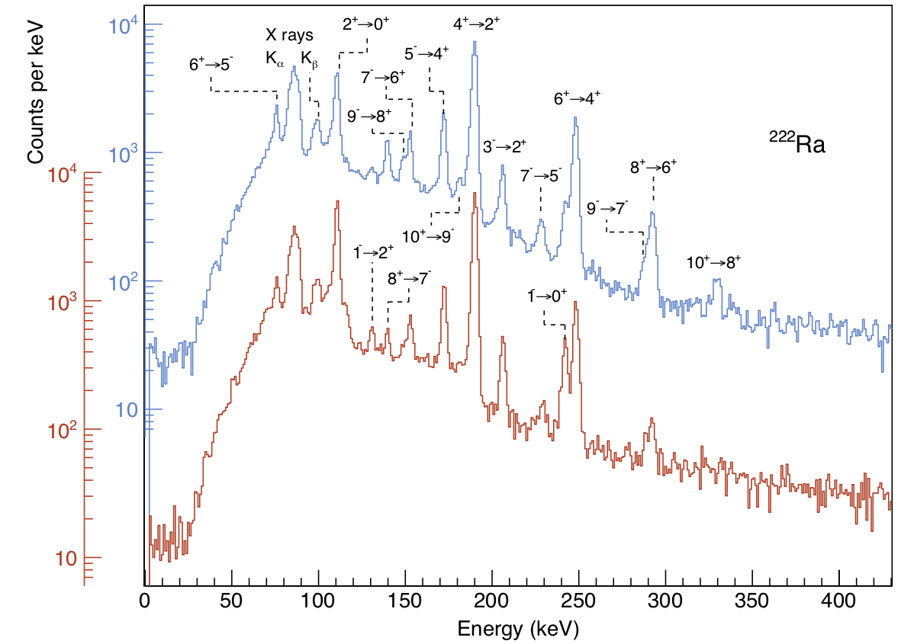
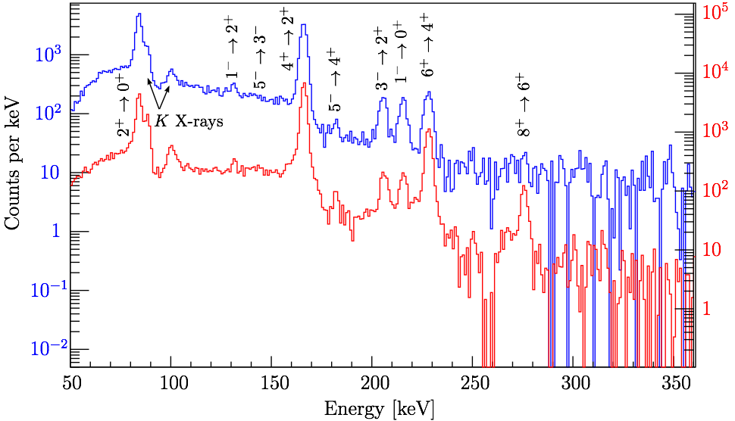
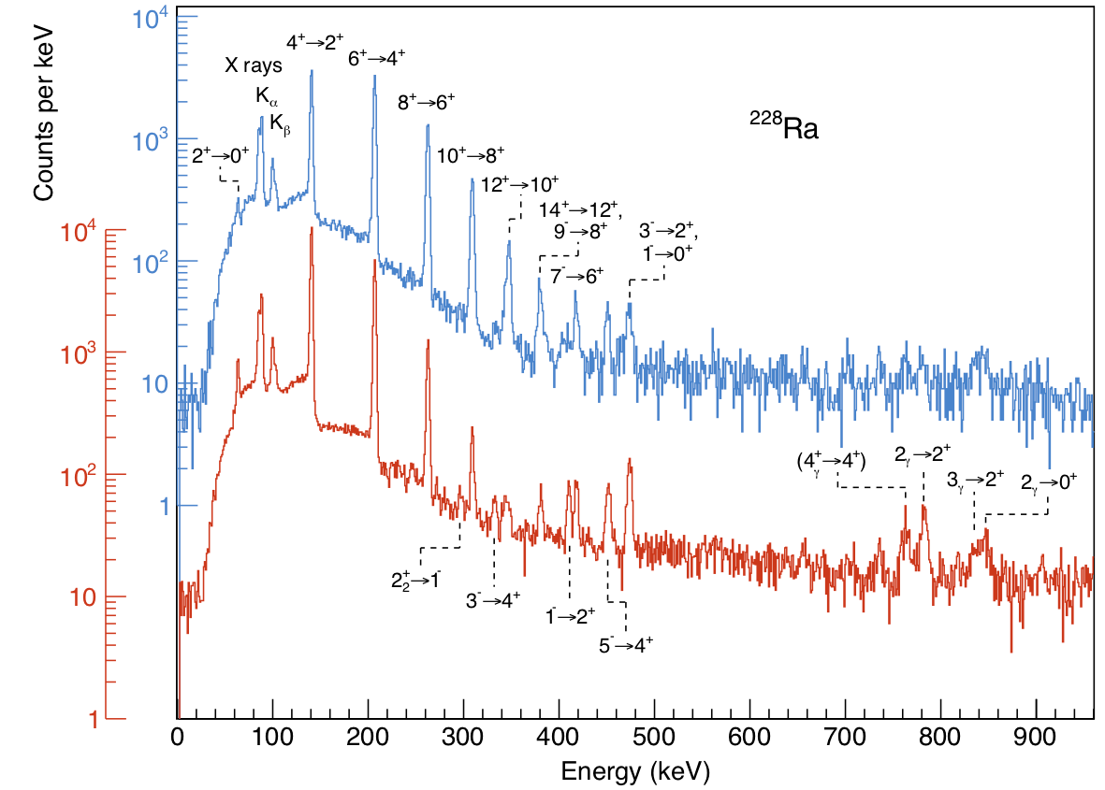
Radium (Z=88) @ ISOLDE
²²²Ra
4.3 MeV/u
L. P. Gaffney, et al.
Nature 497, 199 (2013)
P. A. Butler, LPG, et al.,
PRL 124, 042503 (2020)
¹²⁰Sn target
²²⁴Ra
2.8 MeV/u
⁵⁸Ni target
²²⁸Ra
4.3 MeV/u
¹²⁰Sn target
⁶⁰Ni target
¹²⁰Sn target
Energy (keV)
^{222,224,226}Ra: Consistent with rigid deformation
²²⁸Ra: Consistent with vibrational mode
⁵⁸Ni target

Slide 14
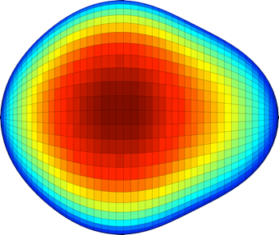
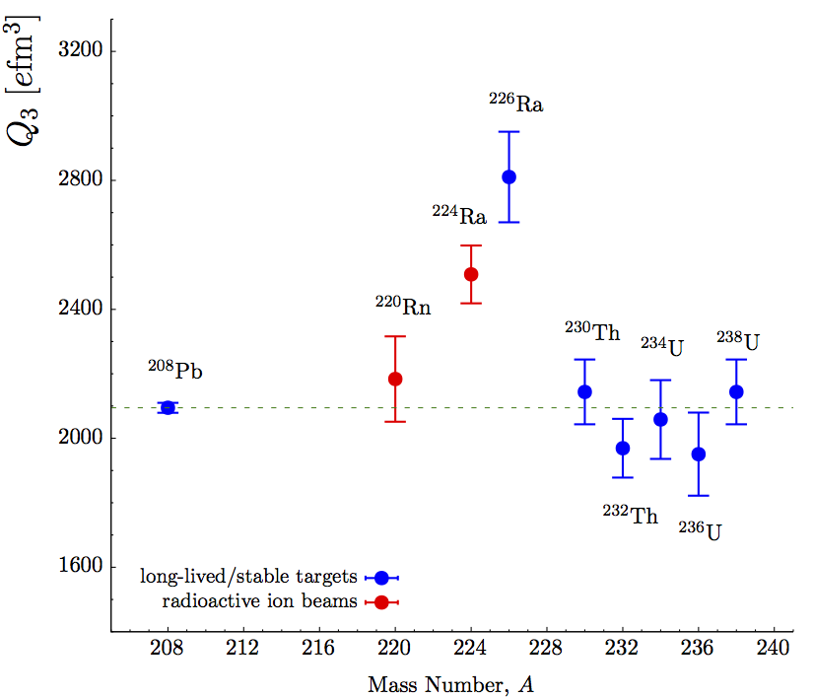
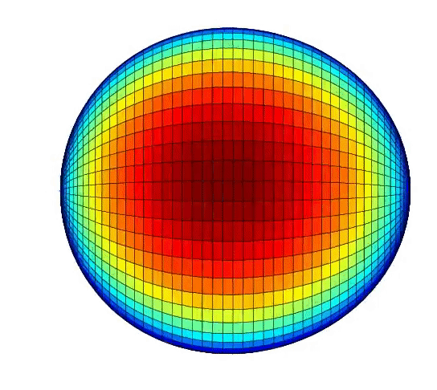
Experimental octuple moments in actinides
²²²Ra
Only three isotopes identified with enhanced octupole deformation by direct measurement.
Experimental reach for short-lived isotopes challenging above Ra (Z=88) due to production.
Octupole deformed
²²⁸Ra
Octupole moment,
Focus on even-Z, even-N isotopes due to experimental challenges direct measurements of odd-A nuclei relevant for EDM.
²²²Rn
Octupole vibrational
Notes:
What are we doing to address this?
Measurements of the octupole moment, the key indicator of the nuclear shape are severely lacking exactly in the region where it is expected to be strongest
Experimental breakthroughs in radioactive ion beams have allowed the octupole deformation to be determined in short-lived nuclei for the first time.
Work that I led on 220Rn and 224Ra showed that while the former tends to behave similarly to vibrational-like nuclei in the region, 224Ra has an enhanced octupole moment, indicating a static deformation just like 226Ra.
Quantifying this in the odd-mass nuclei is a huge challenge going forward, but is in reach with new experimental techniques that I am proposing as part of this fellowship.

Slide 15
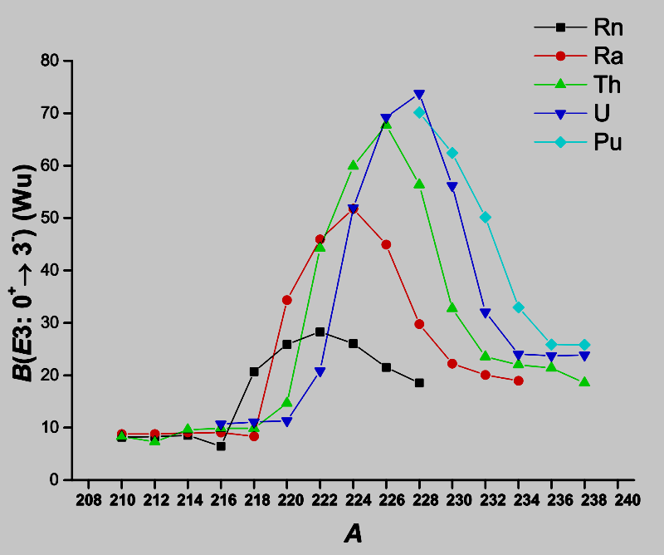
Nuclear theory predictions
Transition strength, B(E3), proportional to octupole deformation parameter, β₃, or square of intrinsic octupole moment, Q₃²
Beyond mean-field theory can give global systematics.
“World-record” octupole deformation is expected in Th, U and Pu, as well as the odd-Z chains of Pa and Np.
Nuclear data on these isotopes is almost non-existent;
  Missing parity-doublet states
  No deformation measurements
  Ground-state spins are ambiguous
Production + data is current challenge for nuclear community in this area…
﻿P.A. Butler, J. Phys. G Nucl. Part. Phys. 43, 073002 (2016).
﻿L.M. Robledo and G.F. Bertsch, Phys. Rev. C 84, 54302 (2011).

Slide 16
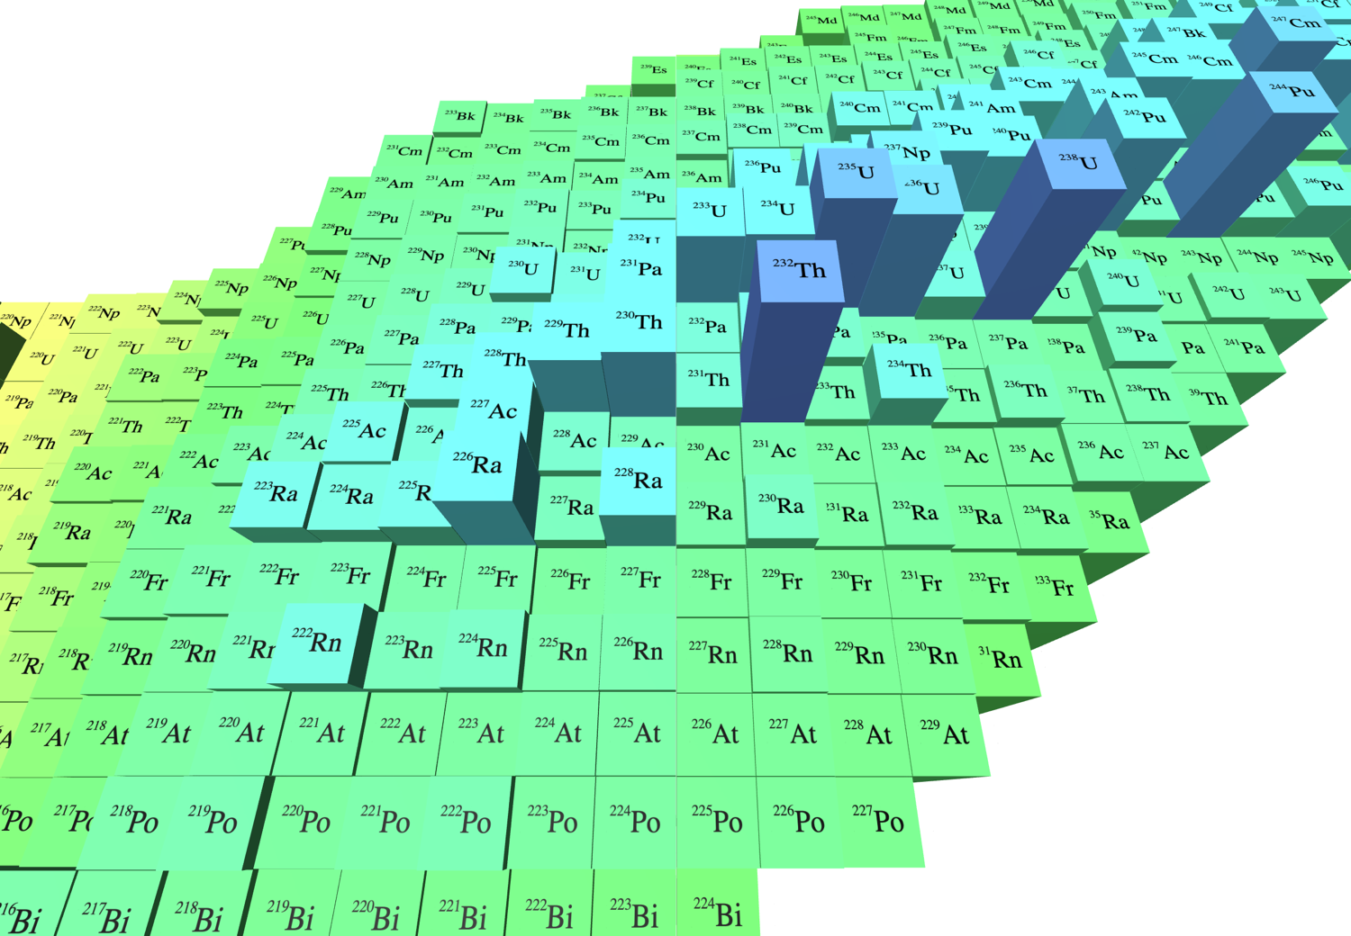
Experimental measurements in the actinides
Candidates such as ²²⁹Pa identified as case for EDM search.
  Parity doublet proposed with ∆E± = 0.15(10) keV [1]
  T_{1/2} = 1.5 days
  J^{π} = 5/2⁺
Limited information available, all short-lived actinide isotopes so far by our ISOLDE collaboration.
X
Octupole hole!
X
X
X
X
X
X
X
X
X
X
X
X – Short-lived radioactive beams
X – Long-lived radioactive targets
[1] I. Ahmad, Phys. Rev. C 92, 024313 (2015)
https://people.physics.anu.edu.au/~ecs103/chart3d/
Ed Simpson’s Nuclear Chart

Slide 17

Next steps for nuclear EDMs
²²⁹Th
Production and study of candidate isotopes in the “octupole hole”.
Direct measurements of octupole deformation in odd-A systems is required to constrain correlations to intrinsic Schiff moment in theory.
Identification of parity doublets (∆E± term) in candidate isotopes.
Recent developments on ²²⁹Th nuclear clock [1-5] demonstrates path towards determining very low-energy (few eV) nuclear transitions.
New facilities with dedicated production for next generation CPV searches.
Facility for Rare Isotope Beams (FRIB) at MSU, USA building new collaboration to identify, characterise, build and measure atomic EDM in short-lived actinides (²²⁹Pa?).
FunSy collaboration at CERN initiated this year, bringing together nuclear and AMO physicists.
[1] B. Seiferle et al., Nature 573, 243 (2019)
[2] S. Kraemer et al., Nature 617, 706 (2023)
[3] J. Tiedau et al., Phys. Rev Lett. 132, 192501 (2024)
[4] R. Elwell et al., Phys. Rev Lett. 133, 013201 (2024)
[5] C. Zhang,. et al.. Nature 633, 63 (2024)

Slide 18

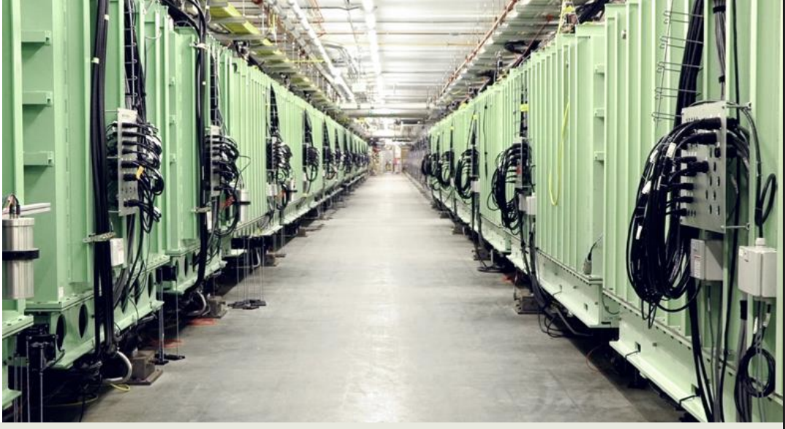
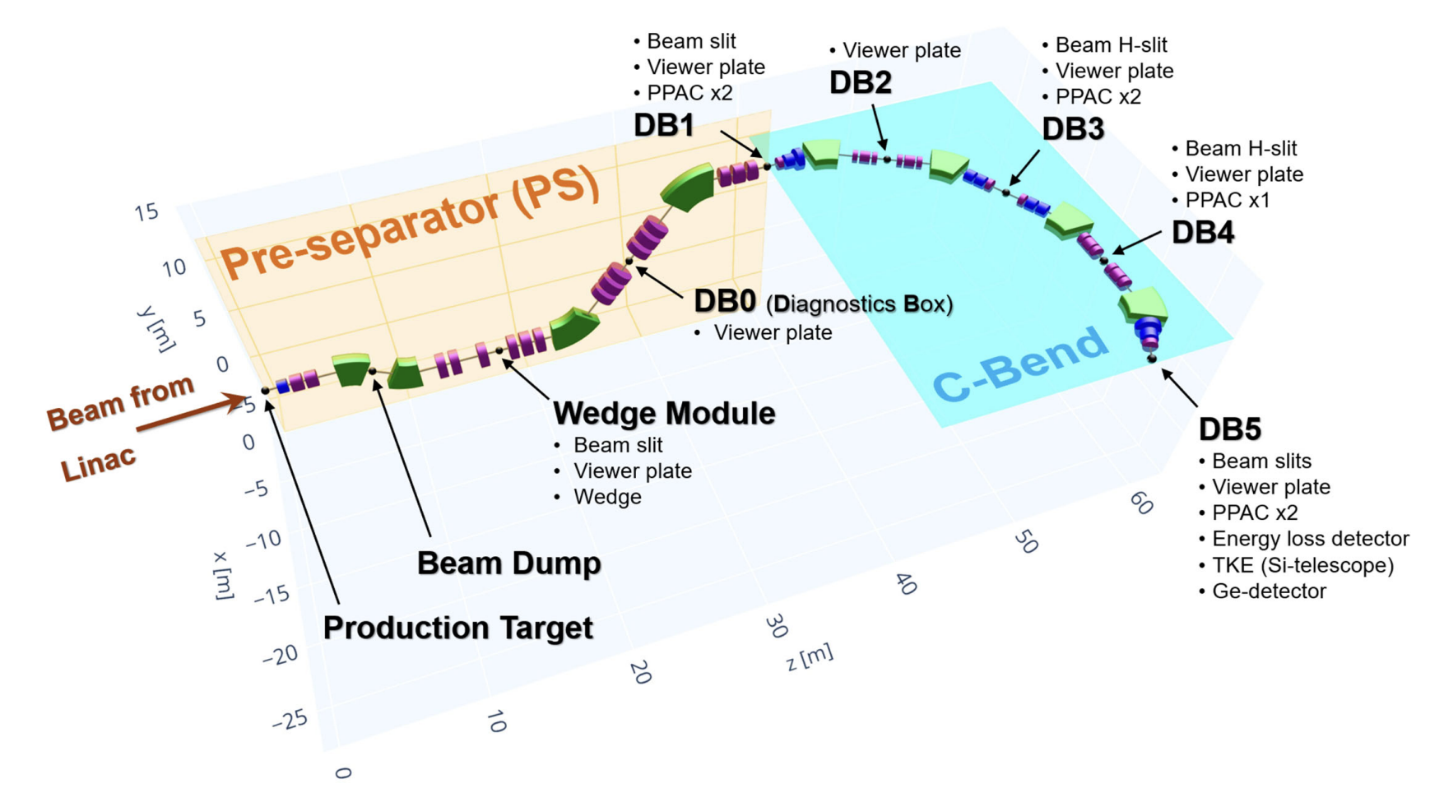
Facility for Rare Isotope Beams (FRIB)
Linear acceleration of ²³⁸U beams to 200 MeV/u with 324 SC cavities in 46 cryomodules. Commissioned in 2022.
Fragmentation on ¹²C production target and separation and identification of reaction products in-flight, delivered to end-user stations for secondary reactions or spectroscopy.
Currently operating at 10-20 kW on target, design goal of 400 kW at full power.
Advantage over ISOLDE for refractory elements, such as U, Th and Pa… No chemistry needed!
New isotope discoveries already…
O. B. Tarasov et al., Phys. Rev. Lett. 132, 072501 (2024)

Slide 19
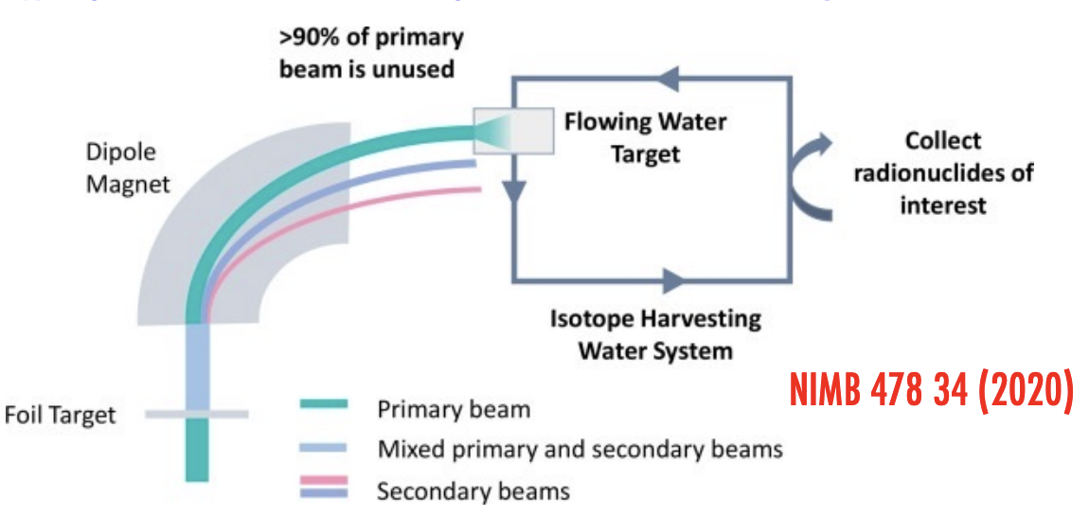
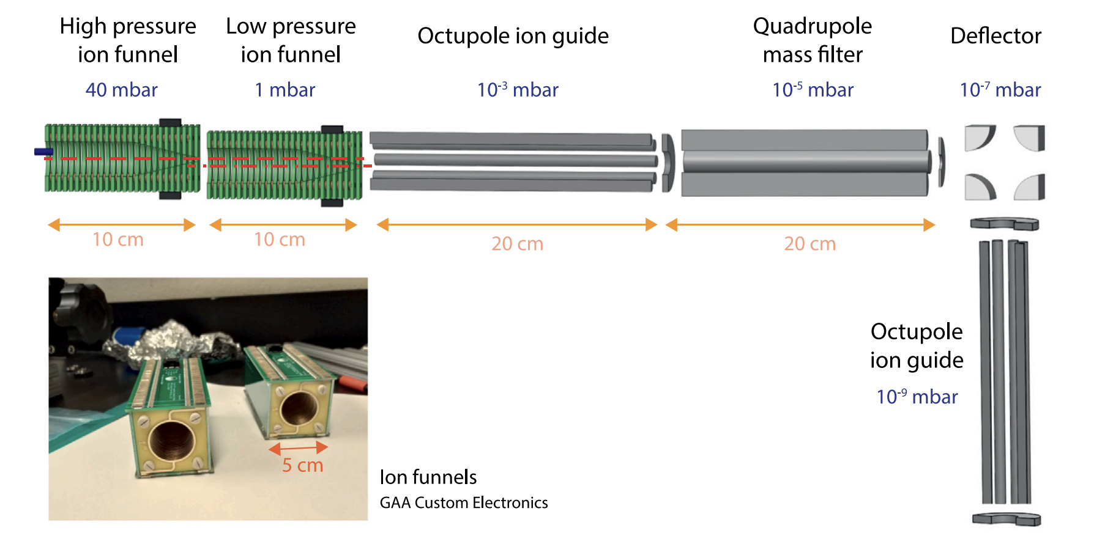
Facility for Rare Isotope Beams (FRIB)
Isotope harvesting at beam dump (water target) is key to future EDM programme.
  “The Nuclear Pear Factory”
EDMs, actinides and octupoles highlighted in theory WP motivating first experiments.
B. A. Brown et al. arXiv:2410.06144v1 [nucl-th]
Dedicated FRIB-EDM front-end for extracting actinides from solution and transporting as a beam to high vacuum.
Collaboration with ISOLDE target and ion-source team with aim of delivering atomic and molecular beams for CPV studies.
J. Ballof et al., NIMB 541, 224 (2023)

Slide 20
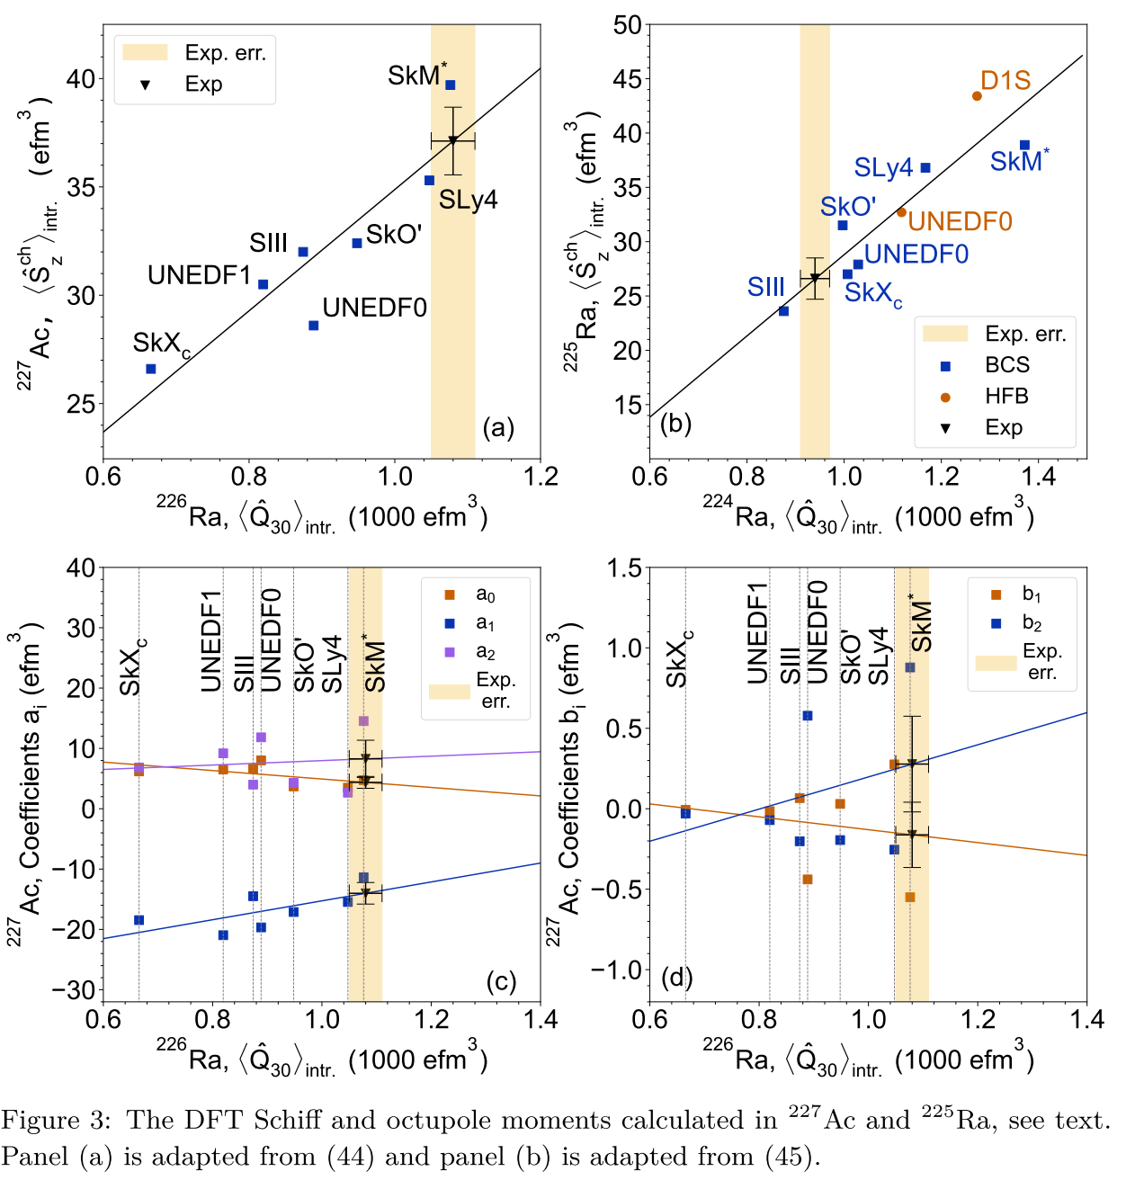
Nuclear theory for EDMs
Modern nuclear density functional theory yields a spread of Schiff moment predictions.
However, correlation with the intrinsic nuclear octupole moment is demonstrated, reduced systematics.
Requires better nuclear data, and direct measurements in isotopes of interest.
Also interest in MQM and anapole moments
New review on arXiv::2511.04632v1 [nucl-th] by Jacek Dobaczewski.
F. Dalton, V. V. Flambaum, and A. J. Mansour, Phys. Rev. C 107, (2023).

Slide 21
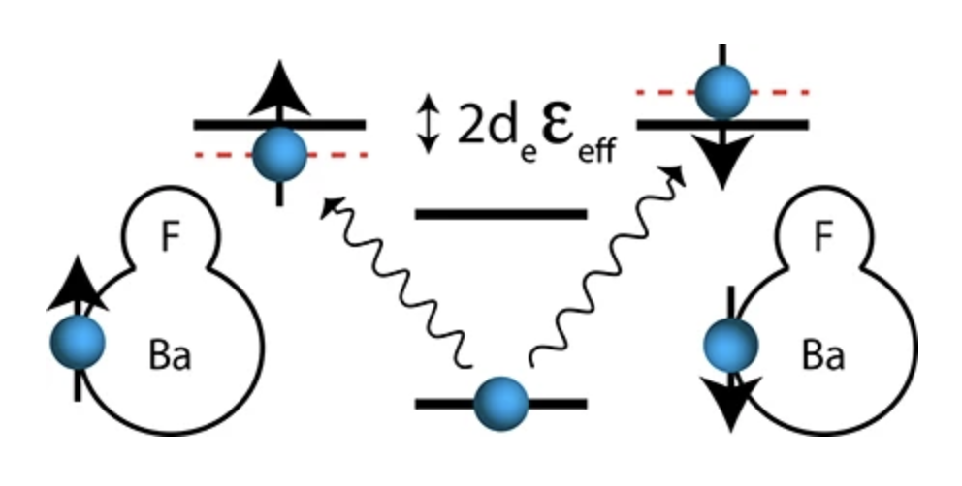
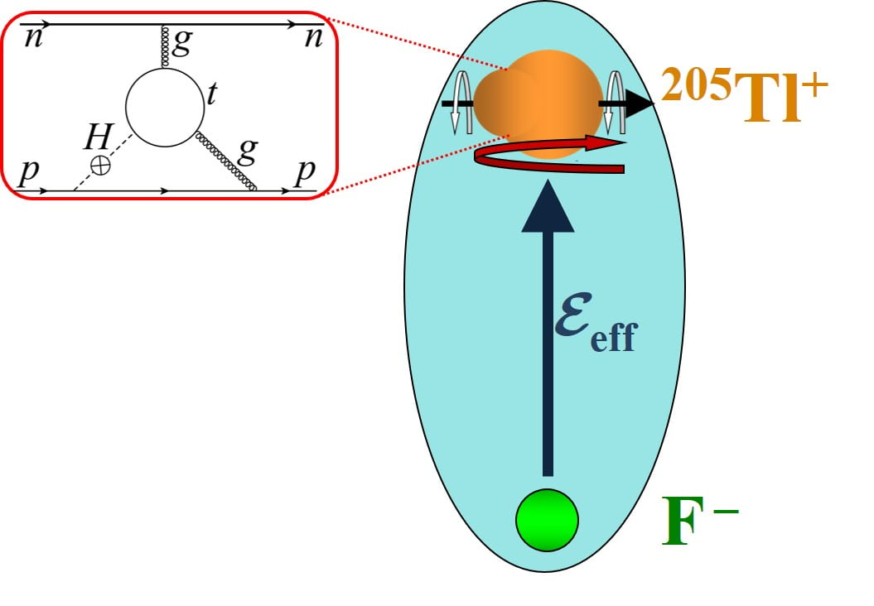
EDMs in molecules
Strong electric field in molecule enhances sensitivity to the eEDM… splitting proportional to 2d_{e} ε_{eff} .
ACME experiment pursuing ThO and set the current molecule limit of |d_{e}| < 1.1 × 10⁻²⁹ e cm (90% CL).
CeNTREX experiment using ultracold TlF for Schiff moment study to constrain (model-dependent) d_{p} and θ_{QCD}.
Both current experiments use stable/long-lived isotopes. Well studied electronic, rotational, vibrational and hyperfine levels.
“Bench-top” university experiments, no requirement for accelerators, just E and B fields! → Precision!!
NL-EDM Collaboration, EPJD 72, 197 (2018)
[CeNTREX Collaboration] O Grasdijk et al, Quantum Sci. Technol. 6 044007 (2021)
Notes:
Spectroscopy, production, cooling, transport, trapping

Slide 22


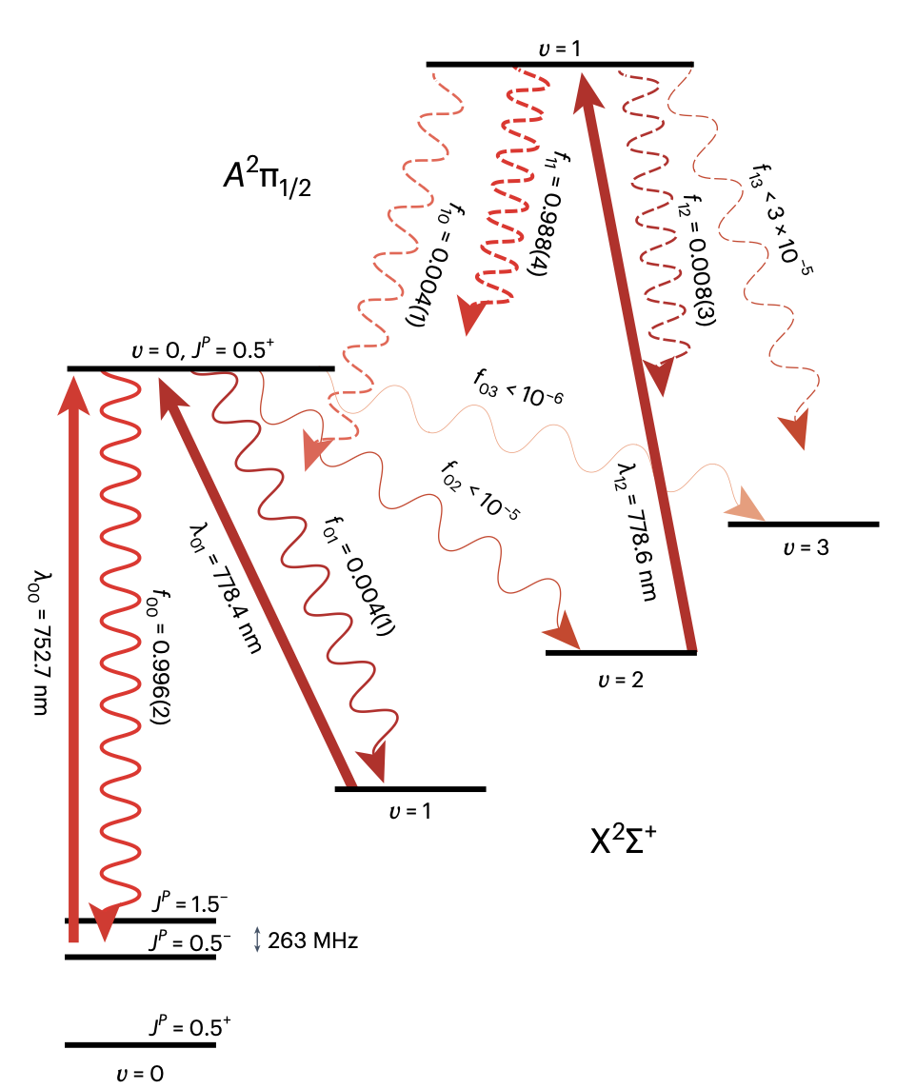
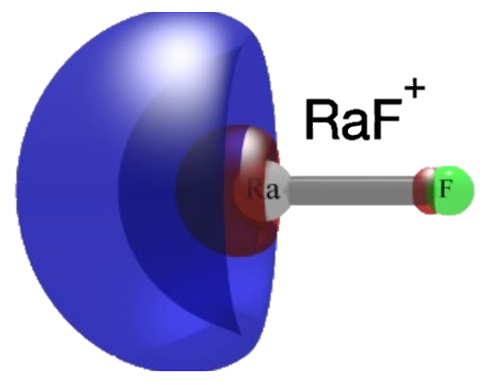
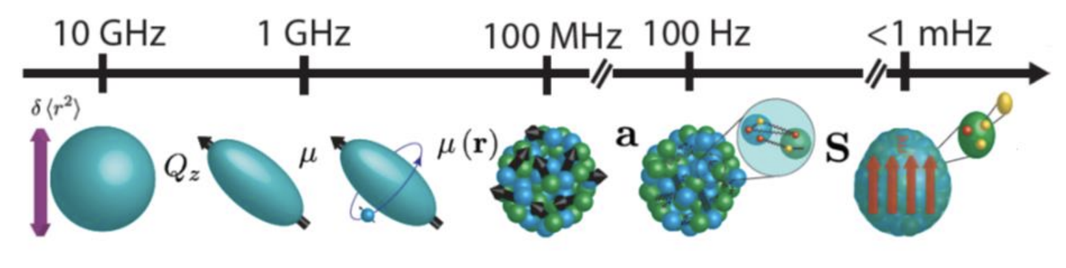
Radioactive molecules
RaX collaboration
Using species with octupole deformed nuclei at their centre enchances sensitivity, e.g. RaF, ThF, FrAg.
But they are short-lived, which brings challenges!
First spectroscopy needs to be performed “online” with radioactive molecules produced in hot source.
Progress with RaF at ISOLDE, e.g. hyperfine spectroscopy demonstration of laser cooling, efficient trapping
New experiments under construction at FRIB, taking advantage of isotope harvesting, e.g. RaX collaboration.
RaF laser cooling scheme
R. F. Garcia Ruiz, et al., Nature 581, 396 (2020)
S. M. Udrescu, et al., Nature Physics 20, 202 (2023)
Notes:
Spectroscopy, production, cooling, transport, trapping

Slide 23
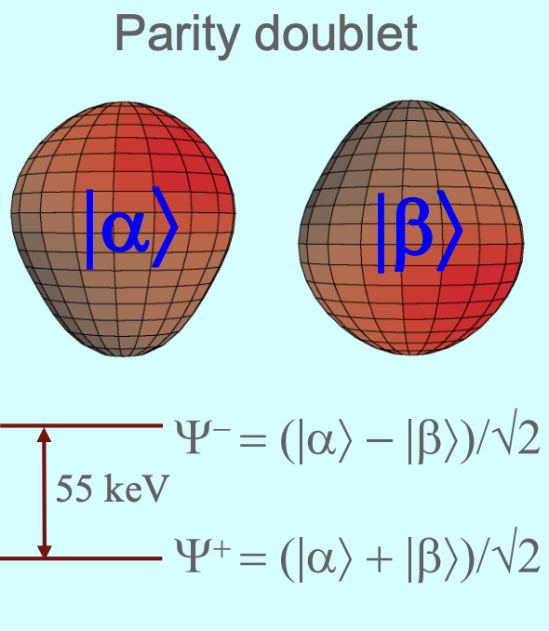
Summary and conclusions
²²⁵Ra
Heavy, octupole-deformed nuclei offer powerful laboratory for atomic and molecular EDM measurements… but they are hard to produce, short-lived and have missing nuclear data.
Interest rising in more exotic species than ²²⁵Ra, e.g. ²²⁷Th and ²²⁹Pa, with parity doublets in the eV range, versus 55 keV for ²²⁵Ra → enhancements in Schiff moment of 10³!!
Radioactive molecules offer a variety of new opportunities for CPV searches using novel methods.
A coordinated effort between AMO theory/experiment alongside nuclear theory/experiment is required to build next generation Schiff moment experiment.
Discovery potential a long time away, so particle theory can relax a little, but the possible gains in sensitivity span many orders of magnitude over the ¹⁹⁹Hg limit.

Slide 24
Backup slides

Slide 25
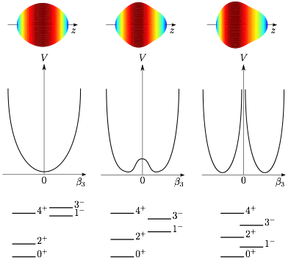
Octupole collectivity
Macroscopically, nuclei take on a “pear” shape.
Reflection asymmetric
  β3-vibration
  β3-deformation
  Rigid β3-deformation…
Signatures...
  Odd-even staggering, -ive parity
  Parity doublets in odd-A nuclei
  Collective B(E3) transitions
9/2–
9/2⁺
7/2–
9/2–
9/2⁺
9/2–
5/2–
9/2⁺
7/2–
7/2⁺
7/2⁺
5/2–
7/2⁺
7/2–
5/2⁺
5/2⁺
5/2⁺
5/2–

Slide 26




Octupole Collectivity
184
Microscopically driven
  Intruder orbitals of opposite parity and ∆𝑗, ∆ℓ = 3 close to the Fermi level.
134
126
88
82
56
50
ε_{F}
34
²²⁴Ra (actinides)
Z = 88, N = 134 region
28
¹⁴⁴Ba (lanthanides)
Z = 56, N = 88 region
20

Slide 27
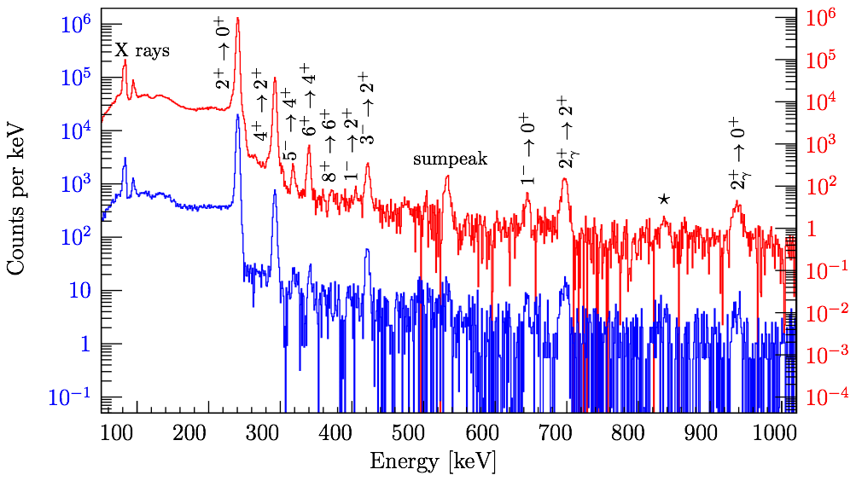
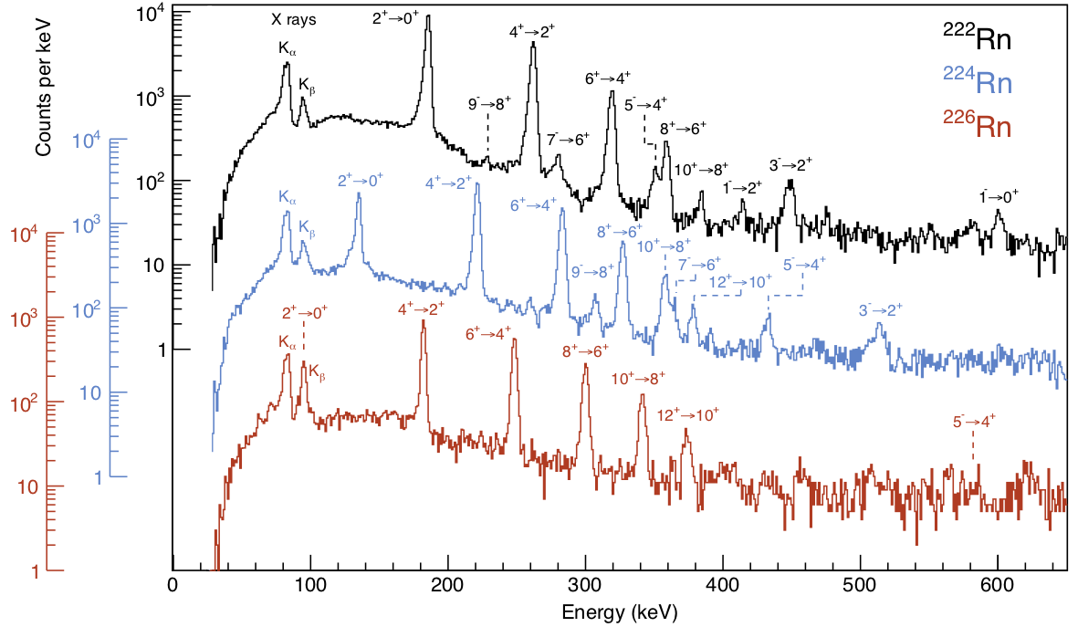
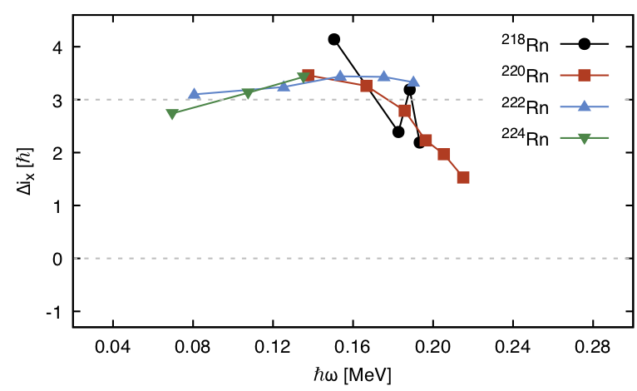
Radon (Z=86) @ ISOLDE
²²⁰Rn
2.8 MeV/u
L. P. Gaffney, et al.
Nature 497, 199 (2013)
P. A. Butler, LPG, et al.,
Nature Comms 10, 2473 (2019).
P. Spagnoletti, LPG et al.,
PRC 105, 024323 (2022)
5.1 MeV/u
Consistent with vibrational mode

Slide 28
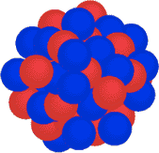
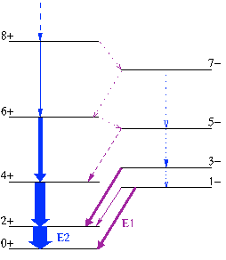
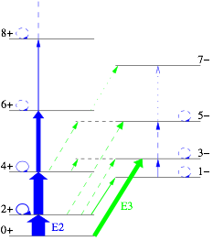

Coulomb Excitation
Projectile (Z1,A1)
θ
b
v
Target (Z2,A2)
Sommerfeld parameter:
“Safe” Coulex:
Dominated by E2 and E3 excitation near the Coulomb barrier
28

Slide 29


Quantifying octupole collectivity, B(E3)
Pros:
Insensitive to single-particle effects
Direct measure of octupole collectivity
Linked to deformation via β3 parameter
Cons:
Difficult to access E3 transitions
Excited state decay dominated by E1/E2
Solved! Use Coulomb excitation from the ground state!

Slide 30
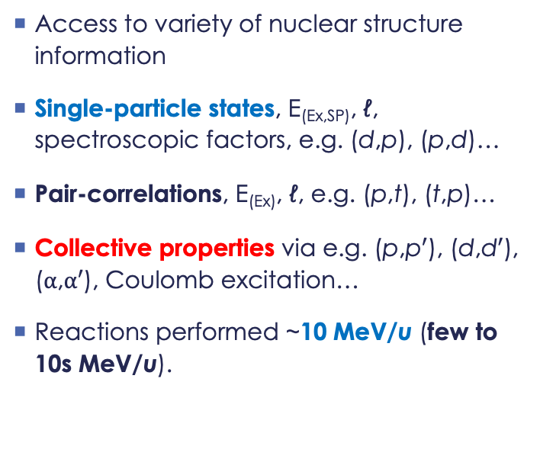
Direct reactions around the Coulomb barrier
Access to variety of nuclear structure information
Single-particle states, E_{(Ex,SP)}, ℓ, spectroscopic factors, e.g. (d,p), (p,d)…
Pair-correlations, E_{(Ex)}, ℓ, e.g. (p,t), (t,p)…
Collective properties via e.g. (p,p$′$), (d,d$′$), ($α$,$α′$), Coulomb excitation…
Reactions performed ~10 MeV/u (few to 10s MeV/u).

