Slide 1
Progress towards a digital shadow for CLARA & ISIS
Alexander Brynes, UKRI-STFC
Accelerator Science and Technology Centre
Matt King, James Jones, Valentina Malconi, Amelia Pollard, Nasiq Ziyan (ASTeC), Kathryn Baker, Raunakk Banerjee, Mateuz Leputa, Mihnea, Romanovschi (ISIS)
ML4Accelerators, Daresbury
2nd December 2025

Slide 2
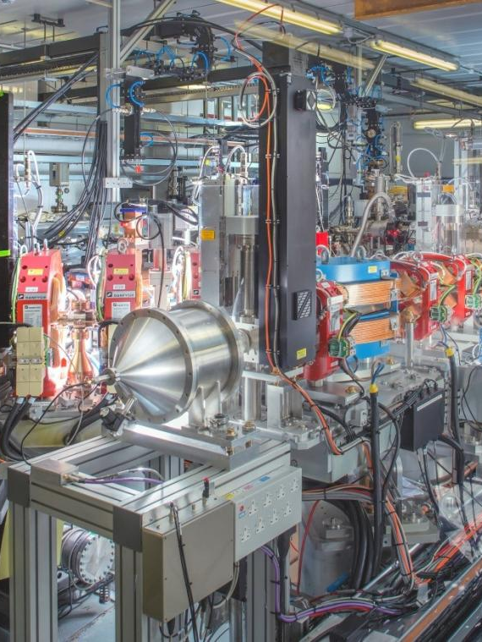

Introduction
ASTeC have developed a suite of software tools for beam physics simulations and accelerator control systems, primarily for use on the CLARA accelerator at Daresbury.
A virtual accelerator + simulation model is under development, to pave the way for a digital twin of CLARA.
Collaboration with ISIS is underway for developing their virtual injector model.
This work lays the foundations for the integration of ML models into our virtual accelerator to enable fast virtual diagnostics and optimisation routines.
Disclaimer: Much of this talk will not focus on ML methods; we aim to show instead the structure required for paving the way towards a digital twin that can make use of ML.
Notes:
An example of how these hardware components form a particle accelerator is CLARA
CLARA is a compact linear accelerator used mainly for research applications.
It is made to generate a 250 pico coloumb electron beam with a momentum of 250 mega electron volts over c
It can generate a beam at rates between 10 and 400 times a second which is then provided to university partners and industry experts for experiments
CLARA is currently undergoing an upgrade from phase 1 to phase 2 which includes a new experiment area called FEBE
After this upgrade is complete, CLARA will be composed of many more hardware components for control, including: 81 electromagnets
6 Accelerator Structures
And 86 diagnostics ranging from cameras to charge monitors.
This means that CLARA will be far more complex in terms of control parameters, but before moving onto how software can help with this. I will provide a simple overview of how operators get information from these components to a computer in the control room.

Slide 3
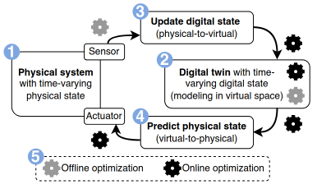
Digital Twin Structure:
How and Why
Why is a digital twin desirable for an accelerator?
A wide range of machine and environmental factors influence the properties of beams in accelerators.
A digital twin can be used for:
Predictive maintenance;
Anomaly detection;
Virtual diagnostics;
Automated tuning.
Figure from Twinac paper, arXiv.2507.24093
Definition:
A digital model of a physical product, system or process that serves as a digital counterpart for simulation, testing, integration, monitoring and maintenance
How can we realise a digital twin?
Generate a virtual copy of the physical accelerator (within reasonable limits).
Use a configurable simulation model to read in the status of the accelerator and model the evolution of the beam.
Write the simulated outputs to the virtual accelerator.
Notes:
An example of how these hardware components form a particle accelerator is CLARA
CLARA is a compact linear accelerator used mainly for research applications.
It is made to generate a 250 pico coloumb electron beam with a momentum of 250 mega electron volts over c
It can generate a beam at rates between 10 and 400 times a second which is then provided to university partners and industry experts for experiments
CLARA is currently undergoing an upgrade from phase 1 to phase 2 which includes a new experiment area called FEBE
After this upgrade is complete, CLARA will be composed of many more hardware components for control, including: 81 electromagnets
6 Accelerator Structures
And 86 diagnostics ranging from cameras to charge monitors.
This means that CLARA will be far more complex in terms of control parameters, but before moving onto how software can help with this. I will provide a simple overview of how operators get information from these components to a computer in the control room.

Slide 4

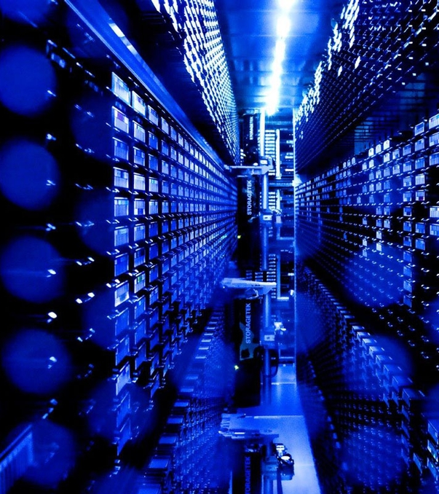
Agenda
1 Simulation Software
Seamless handshaking between codes, standard lattices and optimisation
2 Virtual Accelerator and Middle Layer
Simplified control system interfaces and virtual integration.
3 Integrated Model
Interfacing between the virtual accelerator and simulation codes
4 Applications for ML
Future plans for including ML in software framework
Image © STFC Alan Ford
Notes:
In my presentation today, I am going to talk about the following: A brief overview of how we use control systems to operate particle accelerators
How we can develop software to help operators use particle accelerators
The aims and design of the CLARA integrated model
And finally, the current state of the activity and some notes on future work

Slide 5



Simulation Software
Seamless handshaking between codes, standard lattices and optimisation
Notes:
So how do we develop software for a particle accelerator like CLARA?

Slide 6
Lattice Description
How do you describe an accelerator lattice?
It depends who you ask!
Physicist:
Components that use EM fields to direct, steer and focus beams of particles.
Description format:
Simulation code lattice files
Controls Engineer:
Elements that can be used to change or monitor the beam using setpoints, currents and voltages
Description format:
Control system configuration files (i.e. EPICS database)
RF / Magnet / Diagnostics expert:
In-depth knowledge of the physics and design of specific components.
Description format:
Simulated models of components and their fields
Mechanical Engineer:
Elements physically connected, aligned and placed on girders.
Description format:
CAD models and drawings
Can there be an all-encompassing description of a lattice that will satisfy everyone?
(Perhaps not, but for a digital twin we at least need to unify the control system and simulation descriptions.)
Notes:
Well, in the past software development on CLARA has been done in two ways: We can prototype an application without any machine interaction, using internal values to represent data from the control system
However this approach will always require some changes to the application when it is deployed on the machine
Another way is to develop an application using the machine directly when appropriate.
It is clear then that both of these approaches require some machine time to work, but unfortunately: Machine time is expensive and is often better used to commission, develop, or provide beam to experiments which means it is difficult to develop more complex procedures during these activities as it can rarely be done parasitically.
There is a third possible way however, that requires minimal physical machine time whilst incorporating interactions with a control system.
And that is to create a virtual copy of the CLARA control system that provides almost identical process variables for developers to use.

Slide 7
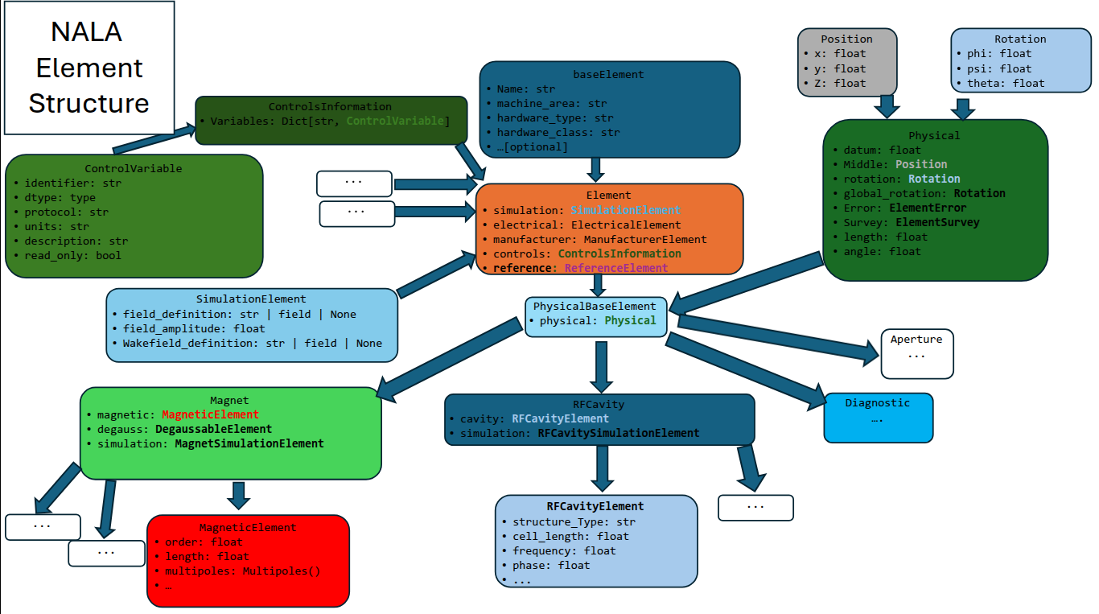
NALA (Not Another Lattice Architecture)
NALA repo (STFC gitlab required)
Notes:
Well, in the past software development on CLARA has been done in two ways: We can prototype an application without any machine interaction, using internal values to represent data from the control system
However this approach will always require some changes to the application when it is deployed on the machine
Another way is to develop an application using the machine directly when appropriate.
It is clear then that both of these approaches require some machine time to work, but unfortunately: Machine time is expensive and is often better used to commission, develop, or provide beam to experiments which means it is difficult to develop more complex procedures during these activities as it can rarely be done parasitically.
There is a third possible way however, that requires minimal physical machine time whilst incorporating interactions with a control system.
And that is to create a virtual copy of the CLARA control system that provides almost identical process variables for developers to use.

Slide 8
SIMBA repo (STFC gitlab required)
Simulation Framework
Define lattice
SIMBA is a python package to enable simulations of (linear) particle accelerators.
The lattice is derived from the NALA structure.
Abstract away the details of underlying tracking codes:
Consistent beam tracking across multiple beam physics modalities (i.e. RF gun, linac, FEL, plasma...).
Does not require expertise in multiple codes!
Specify subsections and codes to be used
Define input beam
Track:
Preprocess (generate code-specific inputs)
Write lattice file
Run tracking code
Postprocess (standardise outputs)
SIMBA
Optimise
Abstract input files away
Interact only with python methods
Code-agnostic input/output
Convert input/output data to standard formats
Learn new “abstract” code
Notes:
Well, in the past software development on CLARA has been done in two ways: We can prototype an application without any machine interaction, using internal values to represent data from the control system
However this approach will always require some changes to the application when it is deployed on the machine
Another way is to develop an application using the machine directly when appropriate.
It is clear then that both of these approaches require some machine time to work, but unfortunately: Machine time is expensive and is often better used to commission, develop, or provide beam to experiments which means it is difficult to develop more complex procedures during these activities as it can rarely be done parasitically.
There is a third possible way however, that requires minimal physical machine time whilst incorporating interactions with a control system.
And that is to create a virtual copy of the CLARA control system that provides almost identical process variables for developers to use.

Slide 9
Virtual Accelerator &
Middle Layer
Simplified control system interfaces and virtual integration.
Notes:
So how do we develop software for a particle accelerator like CLARA?

Slide 10
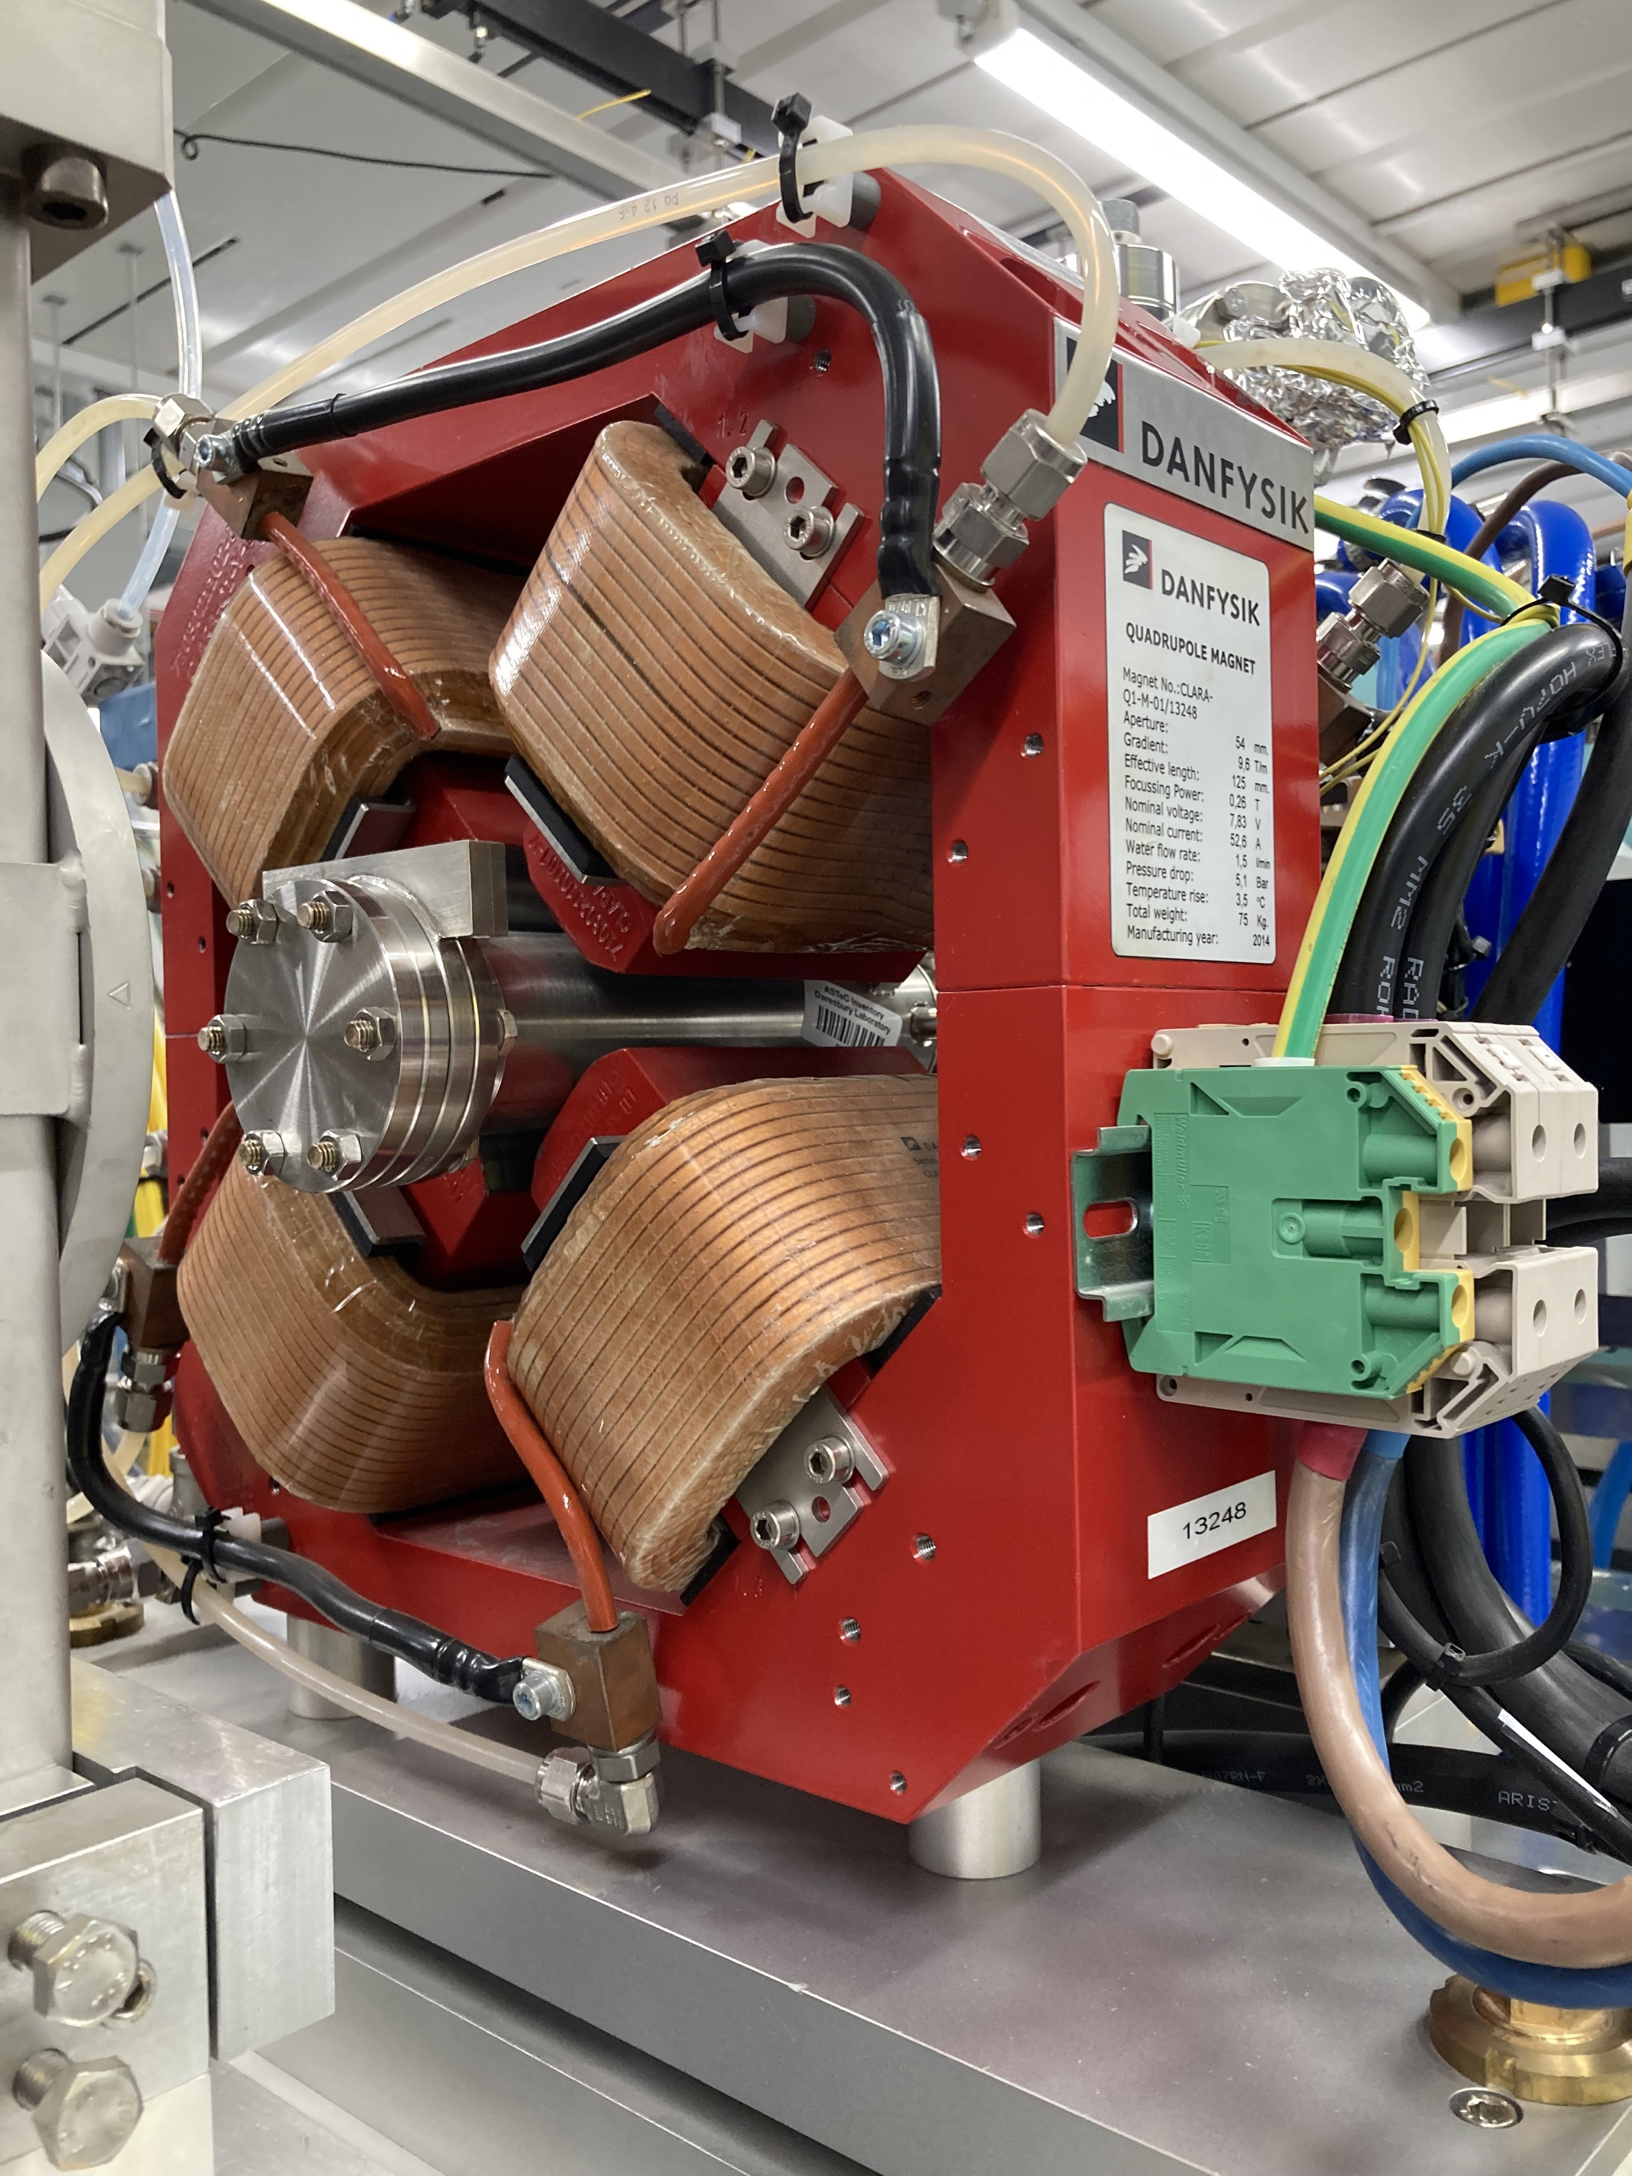
Control System
The control system for CLARA uses EPICS (Experiment Physics and Industrial Control System) as an interface to its hardware components.
EPICS provides process variables (PVs) to communicate with those components and return data from them using Channel Access protocol.
These PVs are used when developing applications and procedures for operators.
Hardware/EPICS Drivers
Input/output Controller
EPICS Server
Process Variables
CLARA Quadrupole Magnet
EPICS Channel Access
Client Computer (Application/Script)
Notes:
Well, in the past software development on CLARA has been done in two ways: We can prototype an application without any machine interaction, using internal values to represent data from the control system
However this approach will always require some changes to the application when it is deployed on the machine
Another way is to develop an application using the machine directly when appropriate.
It is clear then that both of these approaches require some machine time to work, but unfortunately: Machine time is expensive and is often better used to commission, develop, or provide beam to experiments which means it is difficult to develop more complex procedures during these activities as it can rarely be done parasitically.
There is a third possible way however, that requires minimal physical machine time whilst incorporating interactions with a control system.
And that is to create a virtual copy of the CLARA control system that provides almost identical process variables for developers to use.

Slide 11
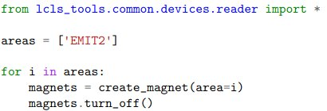
Control Room Application
Control Room Script
Middle Layer
A middle layer is an abstraction layer between the control system and the control room that simplifies the ways in which operators interact with the machine.
Since the NALA structure defines the control
system variables for an element, we can:
Create virtual accelerator elements from the same source of truth as the simulation model.
Programmatically construct an entire virtual accelerator.
CATAP Python Modules
CATAP C++ Libraries
EPICS Channel Access
Virtual CLARA Controls Network
Controlling LCLS magnets using CATAP middle layer, arXiv.2509.19794
VIOC
VIOC
VIOC
VIOC
VIOC
VIOC
Notes:
Well, in the past software development on CLARA has been done in two ways: We can prototype an application without any machine interaction, using internal values to represent data from the control system
However this approach will always require some changes to the application when it is deployed on the machine
Another way is to develop an application using the machine directly when appropriate.
It is clear then that both of these approaches require some machine time to work, but unfortunately: Machine time is expensive and is often better used to commission, develop, or provide beam to experiments which means it is difficult to develop more complex procedures during these activities as it can rarely be done parasitically.
There is a third possible way however, that requires minimal physical machine time whilst incorporating interactions with a control system.
And that is to create a virtual copy of the CLARA control system that provides almost identical process variables for developers to use.

Slide 12
Integrated Model
Interfacing between the virtual accelerator and simulation codes
Notes:
So how do we develop software for a particle accelerator like CLARA?

Slide 13
Integrated Model: Design
User/Application
Users interact with the virtual control system in the same way as on the physical machine
In the background, changes are detected, triggering a simulation to run with those settings
Simulation results (beam distributions, BPM readings, etc.) are communicated back to the virtual control system via a Simulation-to-Control conversion layer.
The conversion layer also lets physical control system settings to be passed to the simulation layer.
This can enable model matching, optimisation and virtual diagnostics.
Virtual Control System
Simulation-to-Control Conversion
Simulation Database
Particle Simulation Framework
Integrated model repo + ISIS collaboration version (to be merged)
Notes:
This flow diagram represents the fundamental design for how the integrated model works: As with the physical machine, an operator or users will interact with the control system PVs, in this case it will be the virtual control system
Any changes in these PV values by the user are detected and a trigger is sent for a simulation to be run with those values.
Once this simulation is complete, any results such as beam images are communicated back to the virtual control system via the conversion layer.
The purpose of the conversion layer is translate between simulation and control parameters such that a user could swap out the virtual control system
For the physical control system to run simulations using the physical machine settings.
This approach will be vital when we wish to match the simulation models to the physical machine during the commissioning of CLARA Phase 2 and FEBE.

Slide 14
Integrated Model: Services
HTTP
HTTP
HTTP
Comms to RESTFrame
EPICS to Comms
Channel Access (CA)
SIMBA
HTTP
ASTRA
GPT
Comms Layer
RESTFrame
Virtual CLARA Controls Network
Elegant
Cheetah
CA/PVA
HTTP
VIOC
RESTFrame to Comms
Comms to EPICS
Simulation DB
HTTP
HTTP
Now all connections are running:
A simulation is triggered by setting a virtual trigger PV
The results (BPM readings, phase spaces etc.) can be seen etc.) can be seen via the virtual control system
SQL
HTTP
Comms Layer DB

Slide 15
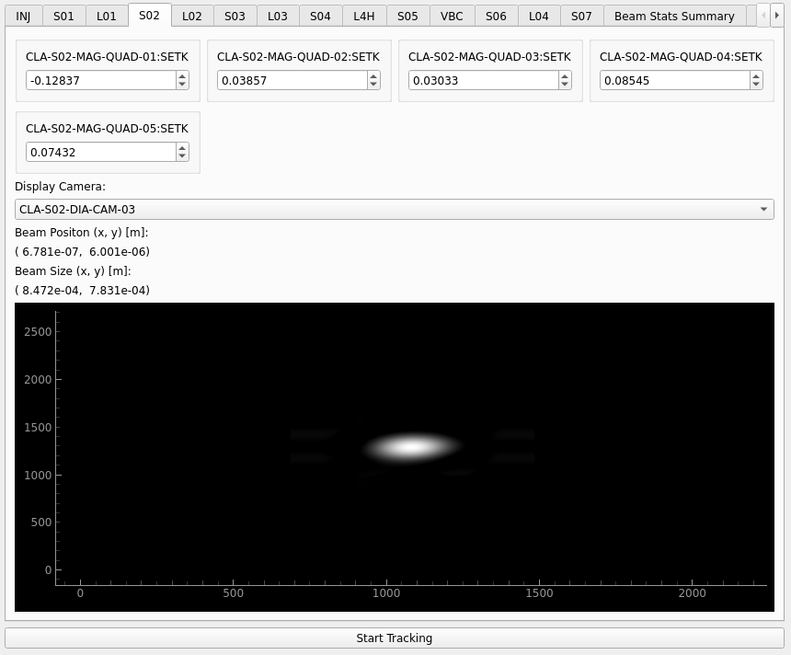
Integrated Model: Example Application (Machine Sections)
Magnet Setting can be adjusted and send to EPICS
Choice of camera to get beam image
Beam position and size from model
Beam distribution from model turned into an image using Kernel Density Estimator and sent to EPICS as waveform (Image Rotation is not correct!)

Slide 16
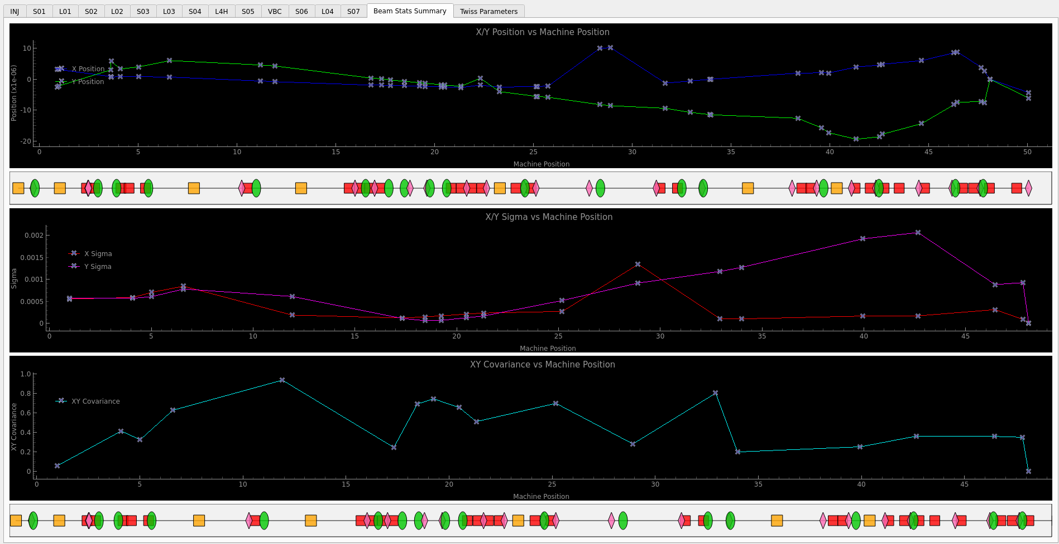
Integrated Model: Example Application (Beam Summary)
X/Y Position along the machine with measurement markers
X/Y Sigma with XY Covariance along the machine with measurement markers
Beamline schematic: Quads (Red), Cavity (Yellow), Screen (Green), BPM (Pink)

Slide 17
Applications for ML (finally!)
Future plans for including ML in software framework
Notes:
I will now present the current progress of the integrated model, and some suggestions for future work

Slide 18
Preparing for ML
Currently, we only have a "digital shadow":
The integrated model relies on using beam tracking codes which run at << machine repetition rate.
To enable the integrated model to access ML methods, we need:
An interface in SIMBA for ML models.
To train some models!
Poly-lithic
Allows deployment of models with arbitrary I/O.
Given a model trained on an accelerator lattice & range of input beams, we need to be able to predict output distributions & beam evolution.
2. Model training
Requires defining a standarised structure for data from the accelerator with a sufficiently deep representation of the beam properties at defined locations.
Could be agnostic to physical/simulated data?
Notes:
After the initial 10 weeks of development since the design of the integrated model started
Each constituent codebase has been made into a service which are all running inside docker containers on a server.
To communicate with each other, each service can report its current state such as ready for instruction, results ready, waiting for simulation to finish
And the other services can listen to these states and determine what processes need to be completed.
Users are currently able to change the strength of any magnetic field in CLARA via a PV in the virtual control system which triggers a simulation to be run.
All resulting beam images along the CLARA are sent to PVs for the virtual control system cameras which can then be viewed by the users.
If a user has previously completed a simulation with these magnetic field settings, the entire process from changing a PV to receiving an image takes around 1 second to complete. To run a simulation with new settings can take up to 40 seconds to complete before images are returned.

Slide 19
Model Training Plans / Thoughts
Simulated Data
Measured Data
Easy to generate
Inputs/outputs standardised via SIMBA & Integrated Model
Produces all required output data (phase spaces, Twiss parameters, etc.)
Not trivial to get good agreement between model and experiment.
Does not capture all relevant information.
Is real
Lots of data available (especially using archived data).
Not all relevant information may be saved.
Invasive diagnostics prevent capturing the full machine.
Difficult to measure certain parameters.
How best to bring these disparate forms of data to produce robust ML models?
Should we aim to produce separate models that are optimised for different tasks? (Which algorithms are best suited for doing different tasks such as phase space prediction, virtual diagnostics, anomaly detection, ….)
What are the low-hanging fruits?
Notes:
After the initial 10 weeks of development since the design of the integrated model started
Each constituent codebase has been made into a service which are all running inside docker containers on a server.
To communicate with each other, each service can report its current state such as ready for instruction, results ready, waiting for simulation to finish
And the other services can listen to these states and determine what processes need to be completed.
Users are currently able to change the strength of any magnetic field in CLARA via a PV in the virtual control system which triggers a simulation to be run.
All resulting beam images along the CLARA are sent to PVs for the virtual control system cameras which can then be viewed by the users.
If a user has previously completed a simulation with these magnetic field settings, the entire process from changing a PV to receiving an image takes around 1 second to complete. To run a simulation with new settings can take up to 40 seconds to complete before images are returned.

