Slide 1
Frontier aims and funding opportunities
Context: Liverpool PP Frontier ambitions & Funding situation UK
Funding opportunities
Meetings

Slide 2

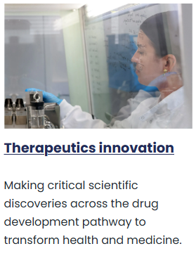
Research Frontiers
Frontier aims
Attract talent – fellowship candidates, studentships, visiting researchers / professorships (in and out)
Increase profile Liverpool PP - host conferences, workshops, collaboration meetings, outreach, publicity, ..
Increase funding – new (large) grants
We can only achieve this if all experiment groups and staff contribute.
For muon group here is the additional challenge that we have a large team funded on a grant that end in 2027.
To sustain the strength of this programme new grants are needed!

Slide 3
Funding Opportunities

Slide 4
Very generically
There are many schemes (see following slides).
It is useful to sign up to https://www.researchprofessional.com/ and to register for research/funding news from RS, Leverhulme, ERC, STFC, etc
In general it is easier to get funding for: new experiments, work across experiments, novel analyses/approaches, AI development*, R&D, applications, work with industry, travel and exchanges
Harder for: M&O existing experiments, analyses in running experiments (fellowships are an exception), detector construction and upgrades (aside from STFC/UKRI project funding)
Note: substantial funding ringfenced for AI and QT – range of funding opportunities

Slide 5
Fellowships
STFC Ernest Rutherford Fellowship 2025
Royal Society University Research Fellowships
UKRI Future Leaders Fellowships
UoL University Fellowships (2025: AI for Research Frontiers)
ERC (Starter, Consolidator, Advanced)
Other: MSCA, Leverhulme, Royal Commission for the Exhibition 1851
We internal/external candidates (up to ~10 yrs after PhD) with a strong CV, leadership and a novel/strong proposal.

Slide 6
STFC (in addition to the CG)
Large Projects - Projects Peer Review Panel (PPRP) 2025 to develop a large or complex scientific projects. You must have already discussed your ideas with one of our programme managers and have been invited to submit a full proposal.
Public Engagement Spark Awards 2025A to engage the public with Science and Technology Facilities Council (STFC) supported science, people, technology or facilities. (Public Engagement Legacy Awards: 2025A, Nucleus Public Engagement Awards 2025 )
Funding for short courses and summer schools in 2025 - Apply for funding to hold short courses, summer schools and online training resources in science or technology.
Proof of concept to support the commercialisation of research and the development of new products, processes or services.
Early stage research and development scheme 2024 Apply for funding to commercialise your technology or science developed from the STFC particle physics, astronomy and nuclear physics (PPAN) community.
Late-stage commercialisation scheme 2024 Apply for funding to commercialise your technology or science developed from the STFC particle physics, astronomy and nuclear physics (PPAN) community.

Slide 7
UKRI (cross council)
UKRI cross research council responsive mode pilot scheme: round two full stage
Apply for funding for breakthrough or disruptive interdisciplinary ideas that transcend, combine or significantly span disciplines that are not routinely funded through existing UK Research and Innovation (UKRI) responsive mode schemes.

Slide 8
Other UK councils
EPSRC research project grant : possible scope for AI and quantum related work
Strategic infrastructure for engineering and physical sciences: June 2025
Apply for funding to purchase strategic infrastructure that will improve UK scientific capability and enable cutting-edge research of high priority to EPSRC.
Other ..

Slide 9

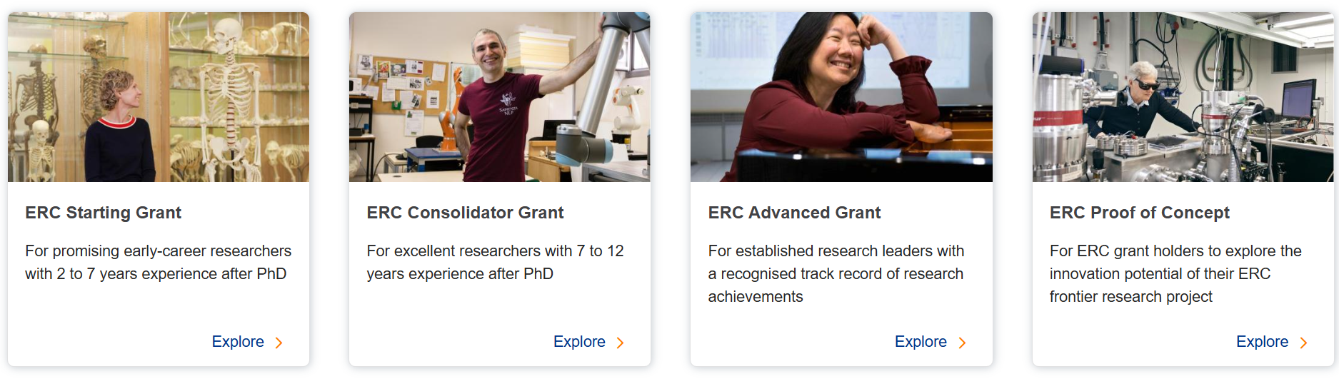

+ other grants:
Industry led project innovation grants
Public Engagement grants
Horizon Europe programme
New in 2026 programme launched ERC+

Slide 10
MSCA COFUND 2025 (24 June 2025)– needs matching funding
regional, national and international programmes for training and career development, through co-funding mechanisms
Doctoral Programmes
MSCA Doctoral Networks 2025 (25 November 2025)
doctoral programmes, by partnerships of universities, research institutions and research infrastructures, businesses including SMEs, and other socio-economic actors from different countries across Europe and beyond.
MSCA Postdoctoral Fellowships 2025 (10 September 2025)
Individual early career fellowships
MSCA Staff Exchanges 2025 (8 October 2025)
Travel awards
COST | European Cooperation in Science and Technology (21 October 2025)
Networking grants

Slide 11

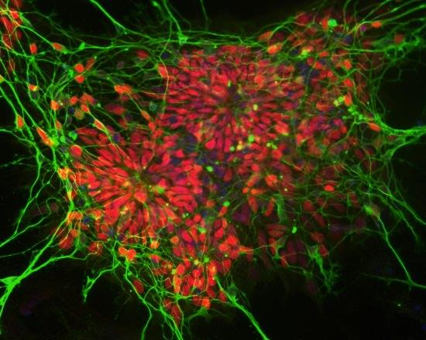
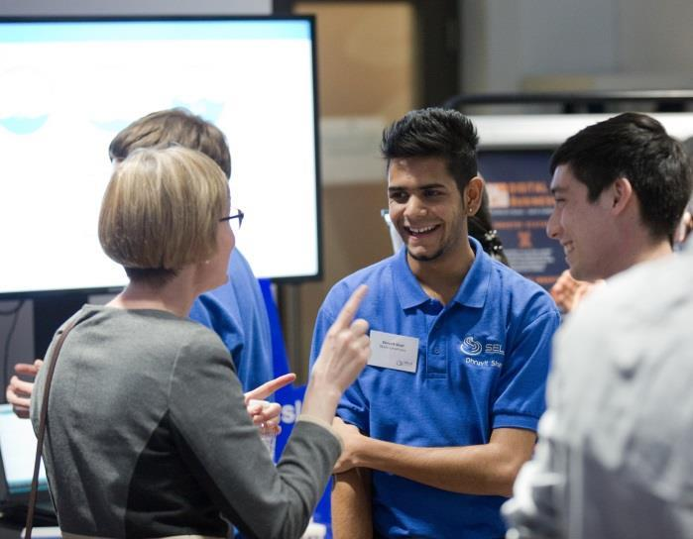

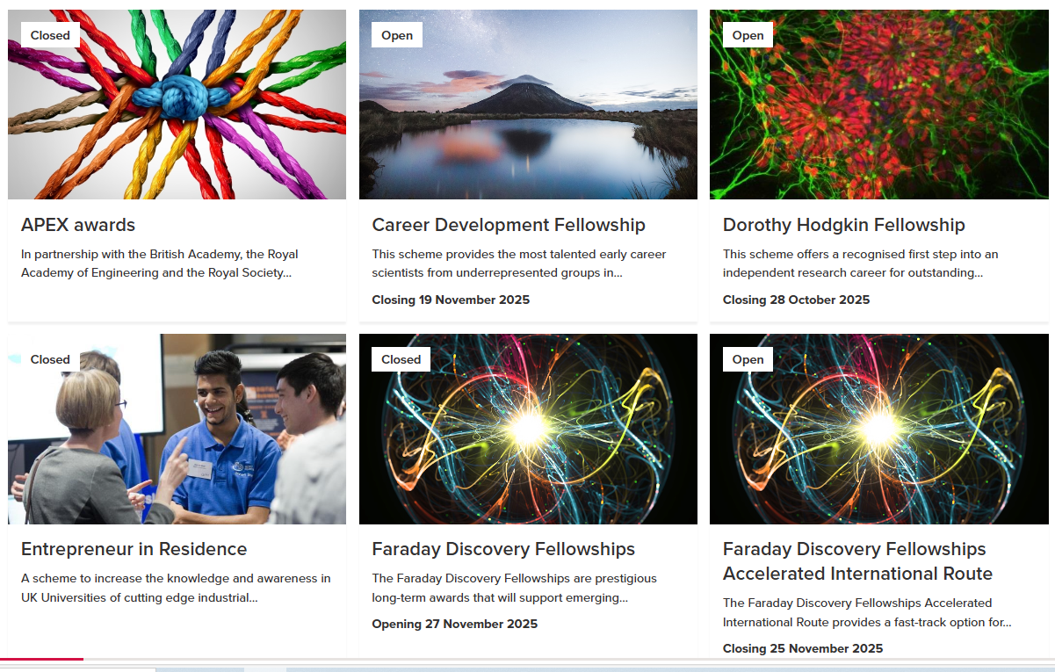
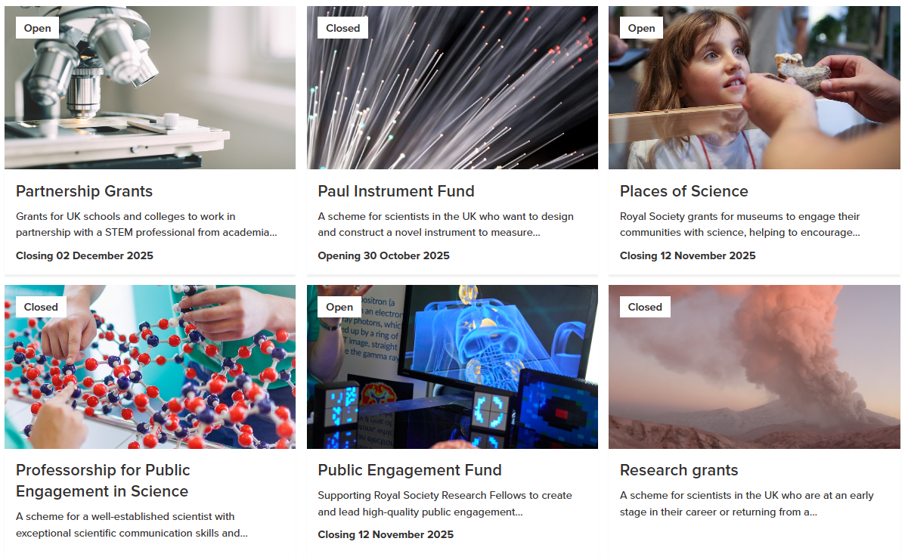
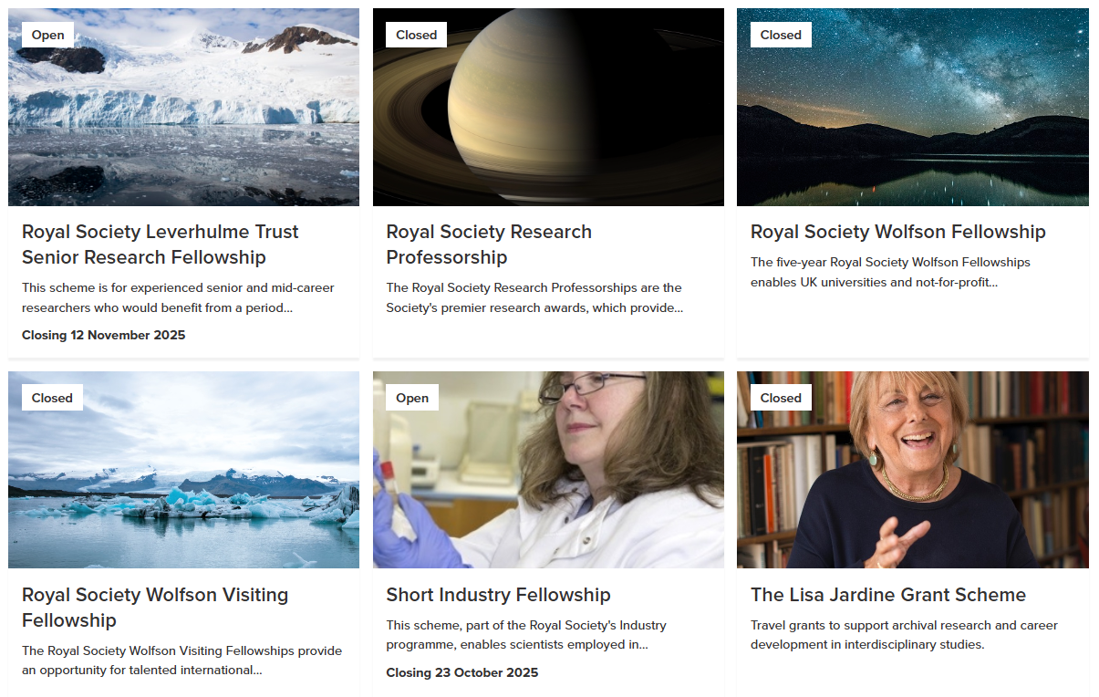
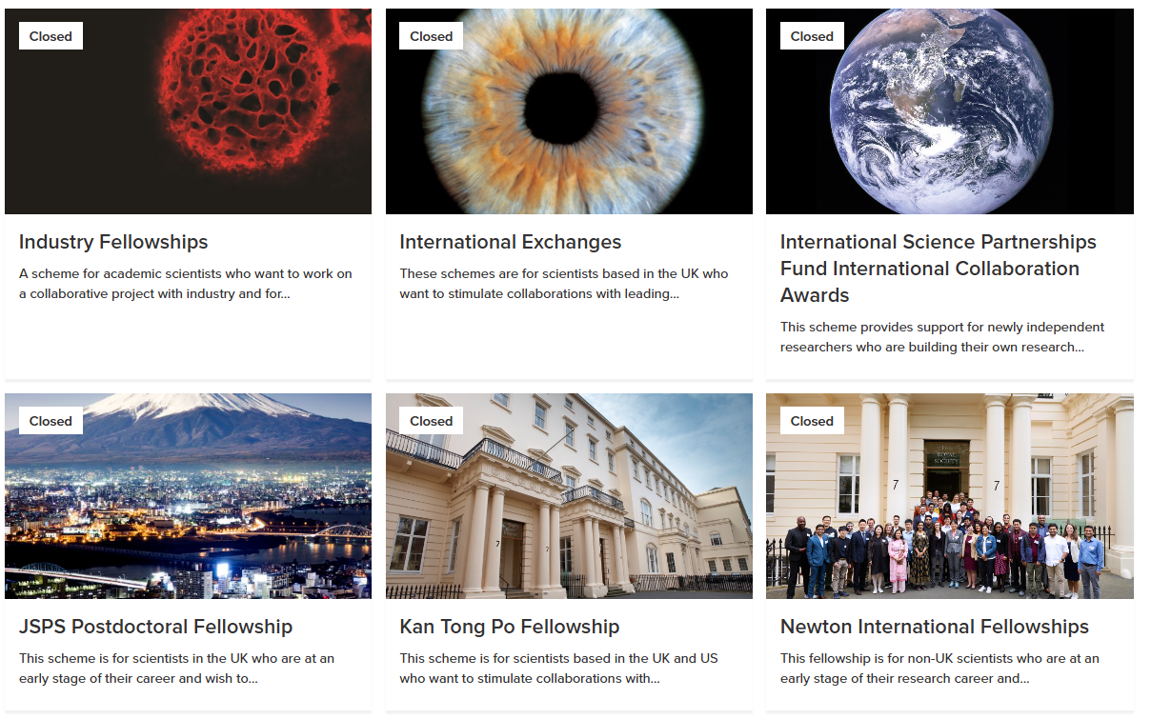


Slide 12

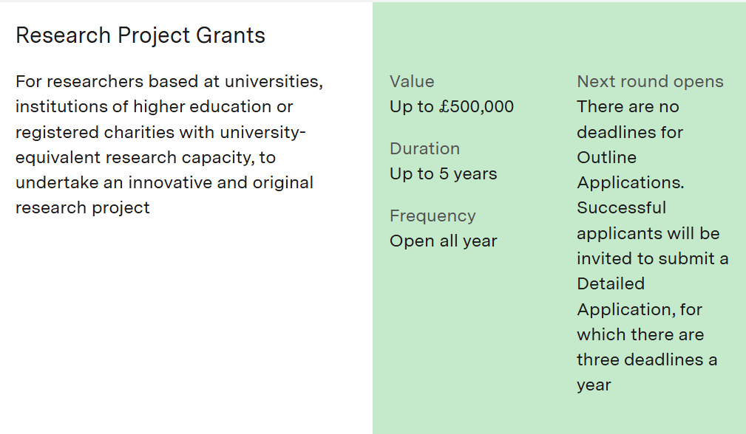
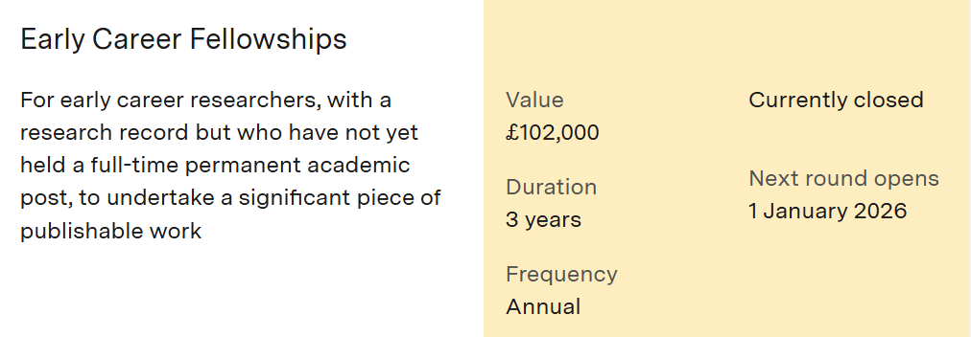
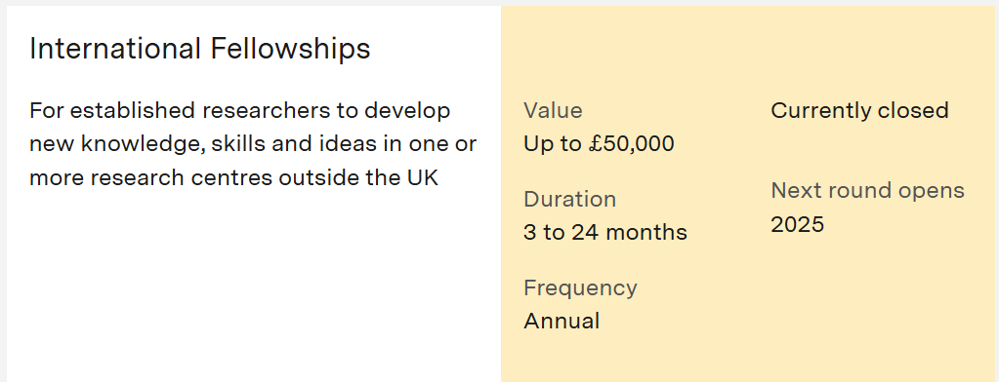
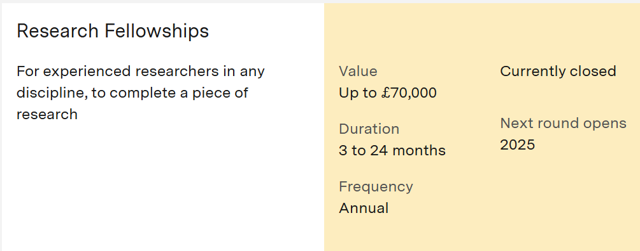
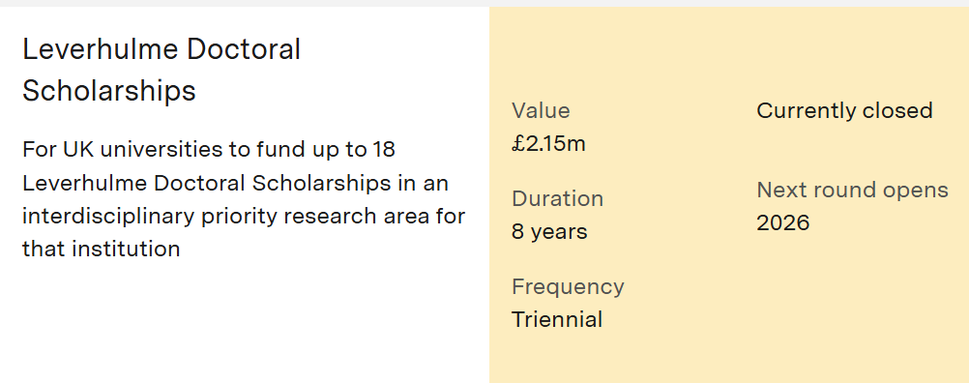

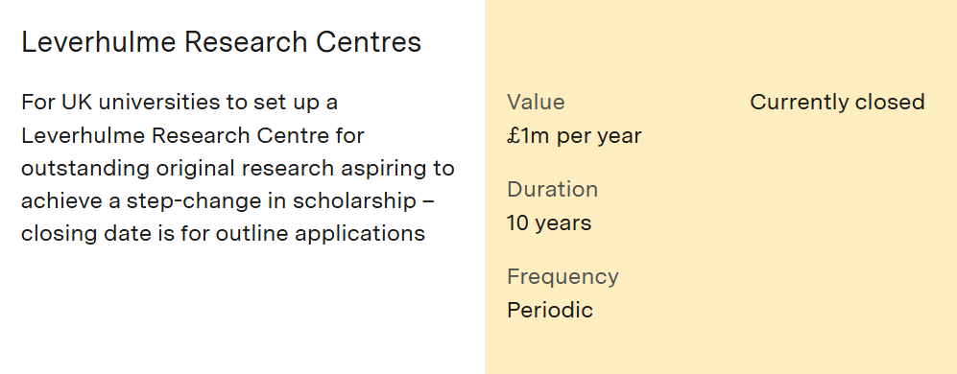
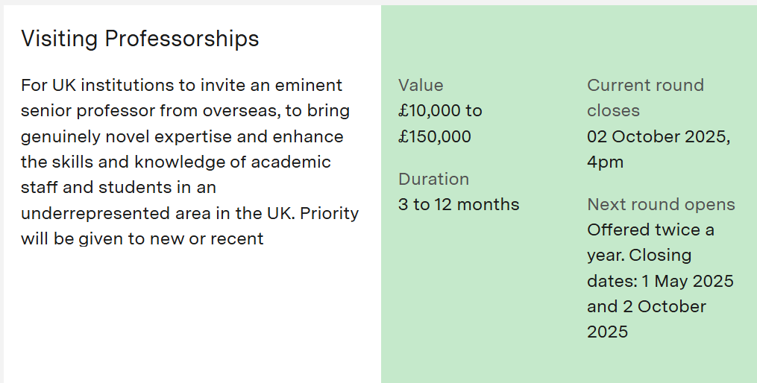

Slide 13

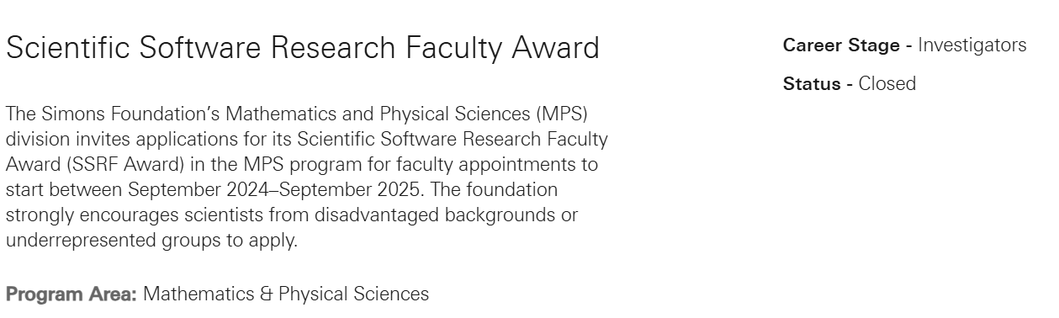


Slide 14
Other
ARIA Funding for topical research areas
AI Scientist 5-6 projects (each with up to £500K) using AI Scientists to explore and understand what role AI Scientists may take in creating and performing research.
Templeton Foundation: Science and Philosophy

Slide 15
PP meetings hosted in Liverpool
Recent meeting and workshops:
Annual Muon Precison Workshop
NUFACT 2025
Recent collaboration meetings: ATLAS ITk, LHCb UG2, g-2, MuEDM, FASER
LATTICE2024
Planned:
CERN School of Computing 2026
CHEP2027 (tbc)

Slide 16
Develop process with each experiment group
Proposal of how to organise this:
Start regular meetings with each experiment group or research area, to discuss how to achieve the aims.
Once or twice per year meeting frontier team with all experiments
Interspaced with more meetings with the individual experiments
Discuss: funding, newsworthy results and stories, scope for hosting meetings, outreach, networking activities, outreach, …
For all academics, ECR or senior research staff individually
Set out ambitions for future work, collaboration, funding opportunities and explore pathways to achieve this
Network activities: new collaborations, hosting meetings,
Establish and maintain a live list of funding opportunities and applications that are in progress or preparation.

