Slide 1

Muon Beam Energy Estimation
Tom Lenane
Liverpool Muon Group Meeting

Slide 2
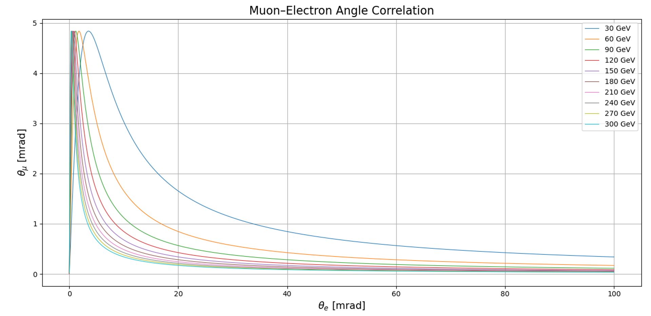
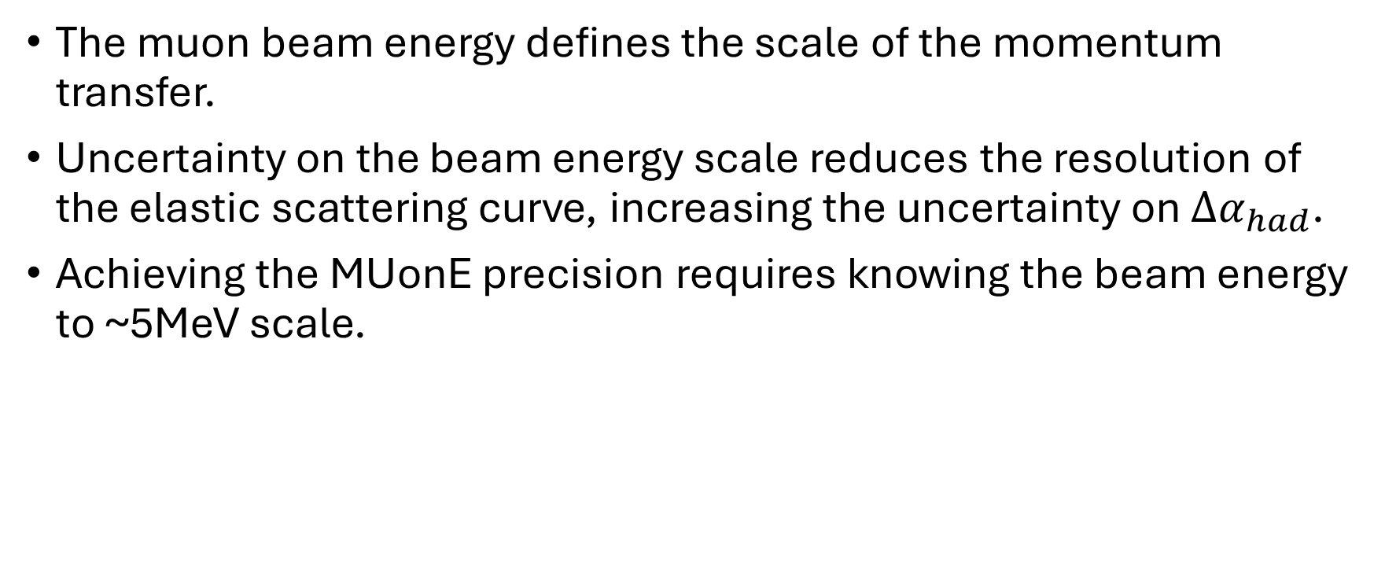
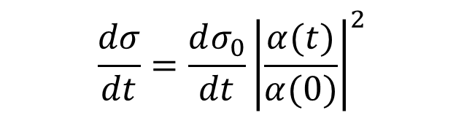
Motivation
$$\frac{dσ}{dt}=\frac{dσ_{0}}{dt}{\left|\frac{α(t)}{α(0)}\right|}^{2}$$
The muon beam energy defines the scale of the momentum transfer.
Uncertainty on the beam energy scale reduces the resolution of the elastic scattering curve, increasing the uncertainty on ${∆α}_{had}$.
Achieving the MUonE precision requires knowing the beam energy to ~5MeV scale.

Slide 3
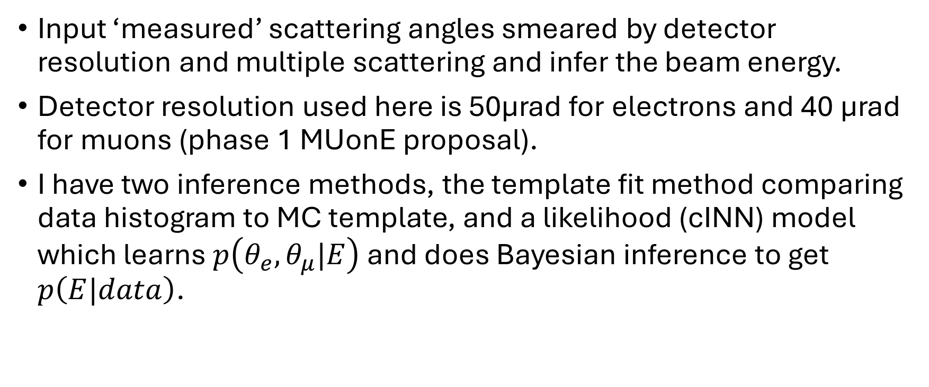
Goals
Input ‘measured’ scattering angles smeared by detector resolution and multiple scattering and infer the beam energy.
Detector resolution used here is 50μrad for electrons and 40 μrad for muons (phase 1 MUonE proposal).
I have two inference methods, the template fit method comparing data histogram to MC template, and a likelihood (cINN) model which learns $p\left(θ_{e},θ_{μ}|E\right)$ and does Bayesian inference to get $p\left(E|data\right)$.

Slide 4
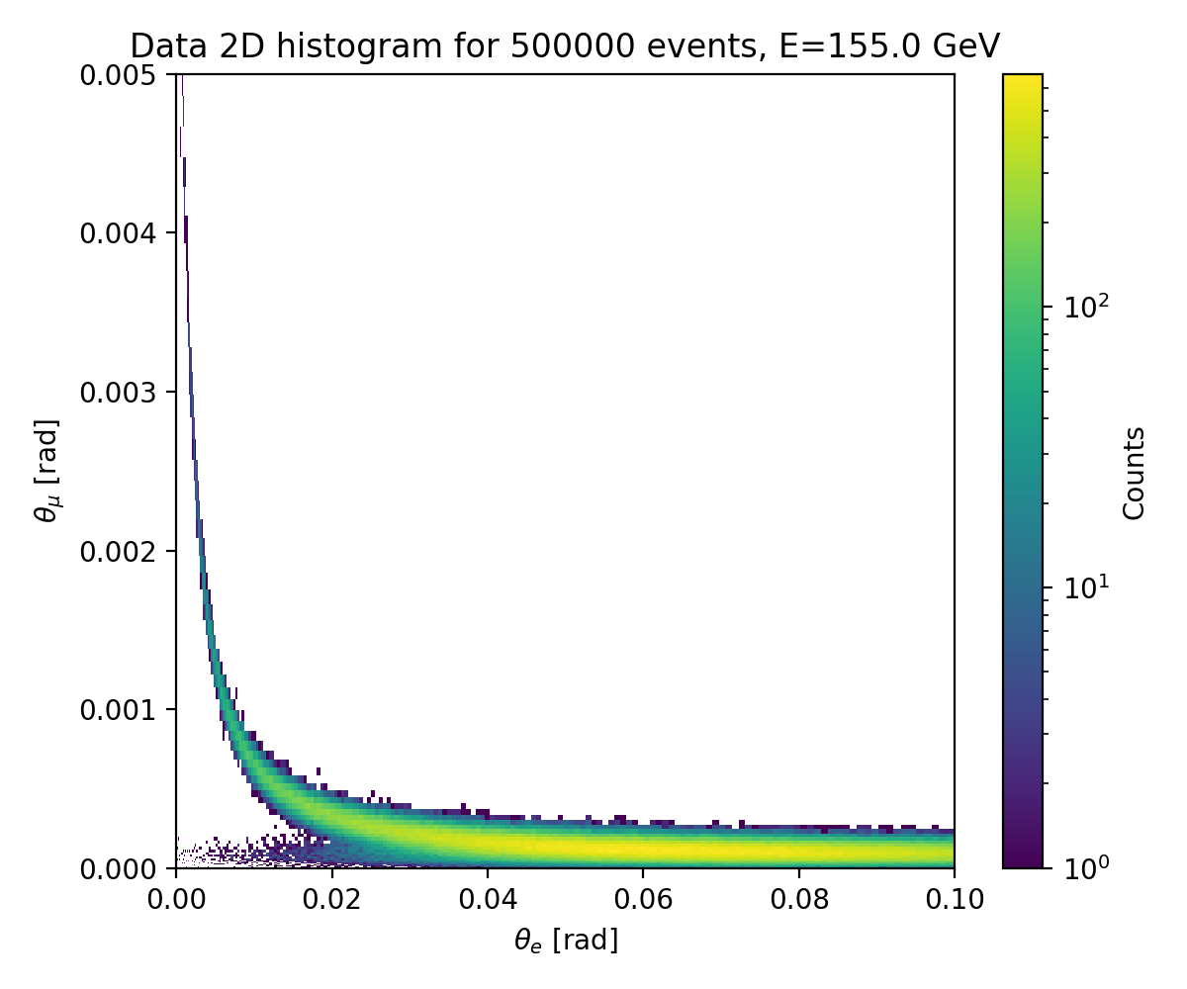
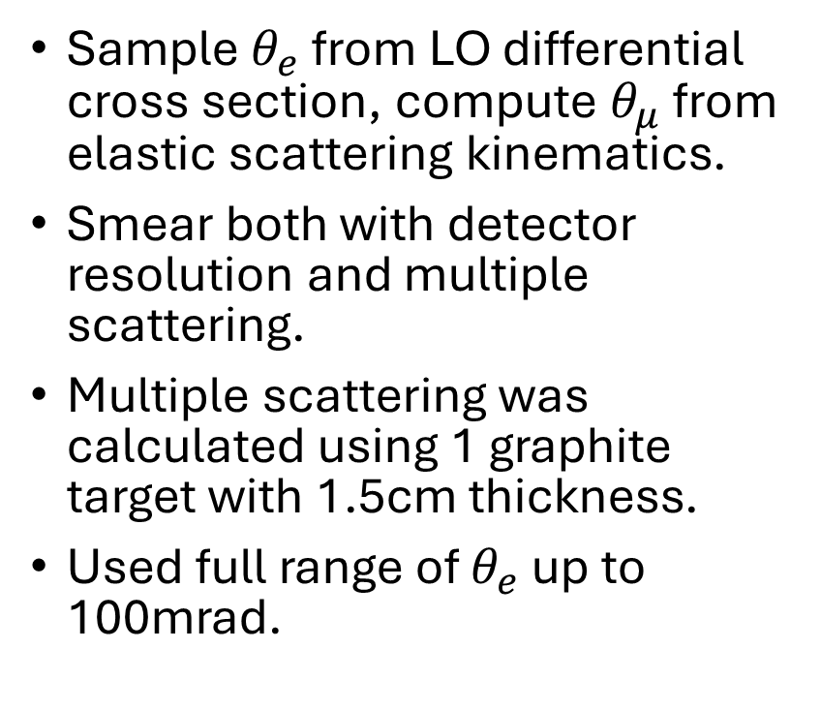
Data Generation
Sample $θ_{e}$ from LO differential cross section, compute $θ_{μ}$ from elastic scattering kinematics.
Smear both with detector resolution and multiple scattering.
Multiple scattering was calculated using 1 graphite target with 1.5cm thickness.
Used full range of $θ_{e}$ up to 100mrad.

Slide 5
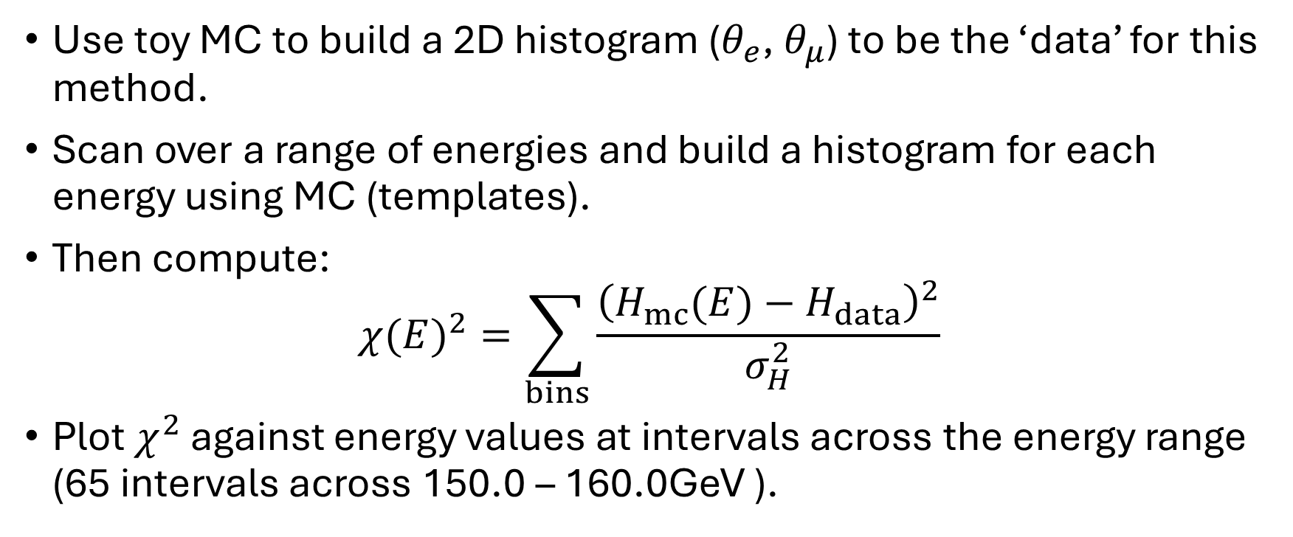
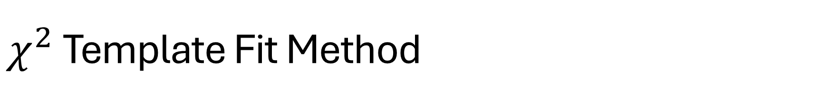
$χ^{2}$ Template Fit Method
Use toy MC to build a 2D histogram ($θ_{e}$, $θ_{μ}$) to be the ‘data’ for this method.
Scan over a range of energies and build a histogram for each energy using MC (templates).
Then compute:
$${χ(E)}^{2}=\sum_{bins}{\frac{{\left(H_{mc}(E)−H_{data}\right)}^{2}}{σ_{H}^{2}}}$$
Plot $χ^{2}$ against energy values at intervals across the energy range (65 intervals across 150.0 – 160.0GeV ).

Slide 6
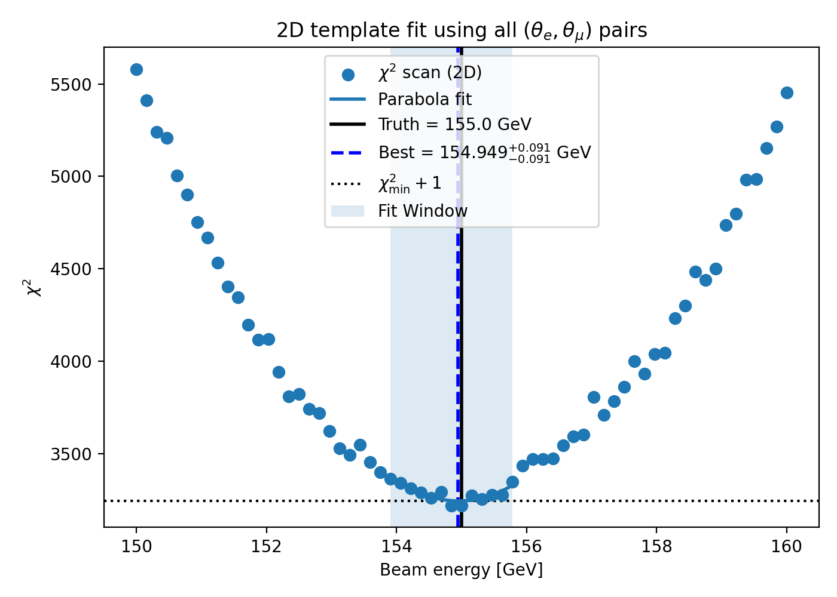
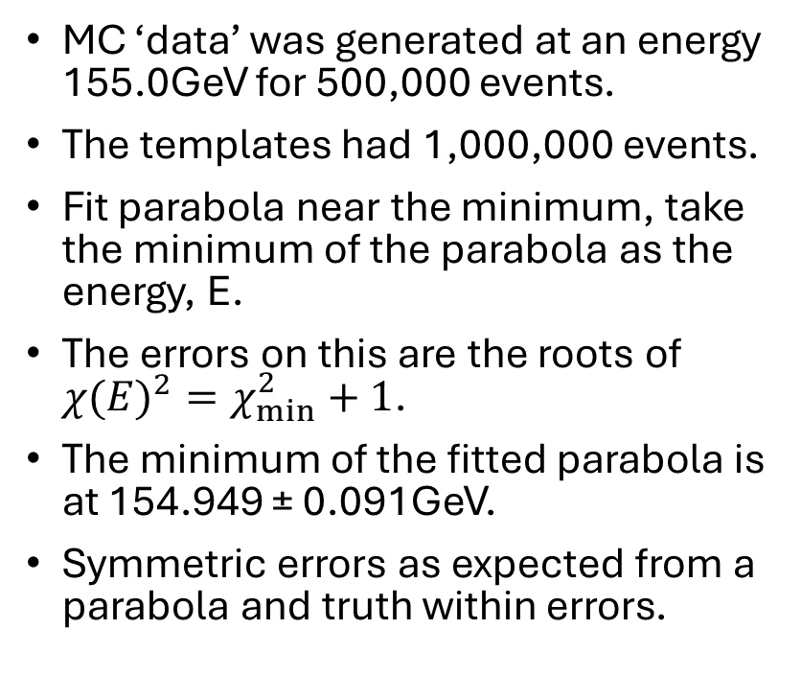
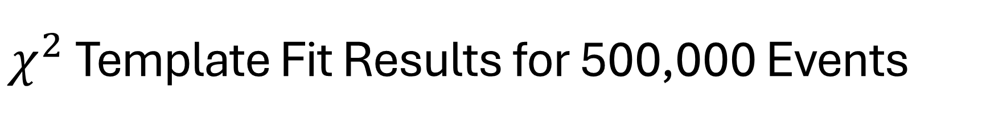
$χ^{2}$ Template Fit Results for 500,000 Events
MC ‘data’ was generated at an energy 155.0GeV for 500,000 events.
The templates had 1,000,000 events.
Fit parabola near the minimum, take the minimum of the parabola as the energy, E.
The errors on this are the roots of ${χ(E)}^{2}=χ_{min}^{2}+1$.
The minimum of the fitted parabola is at 154.949 ± 0.091GeV.
Symmetric errors as expected from a parabola and truth within errors.

Slide 7
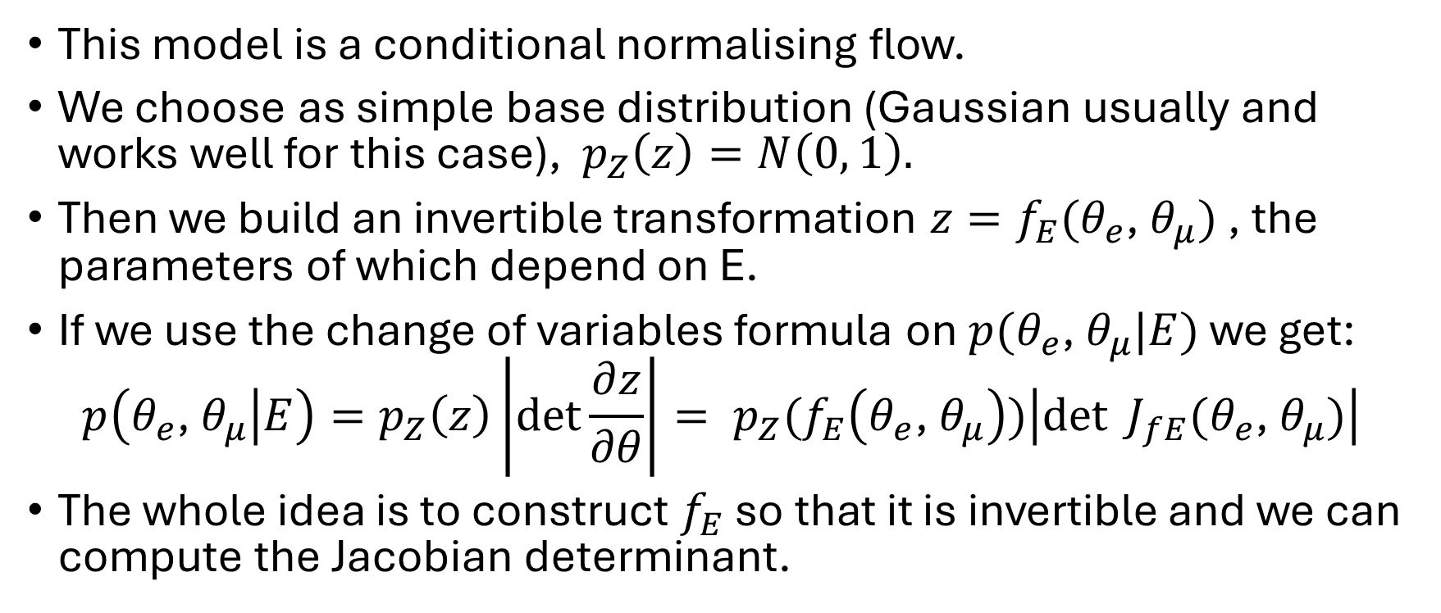
NN Method
This model is a conditional normalising flow.
We choose as simple base distribution (Gaussian usually and works well for this case), $p_{Z}\left(z\right)=N\left(0, 1\right).$
Then we build an invertible transformation $z=f_{E}(θ_{e}\text{, }θ_{μ})$ , the parameters of which depend on E.
If we use the change of variables formula on $p(θ_{e}\text{, }θ_{μ}|E)$ we get:
$$p\left(θ_{e}\text{, }θ_{μ} | E\right)=p_{Z}\left(z\right)\left|\det{\frac{∂z}{∂θ}}\right|= p_{Z}(f_{E}\left(θ_{e}\text{, }θ_{μ}\right))\left|\det{J_{fE}(θ_{e}\text{, }θ_{μ})}\right|$$
The whole idea is to construct $f_{E}$ so that it is invertible and we can compute the Jacobian determinant.

Slide 8
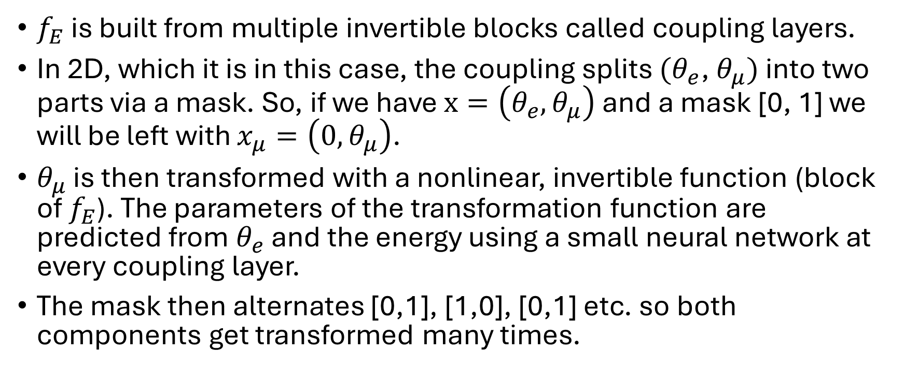
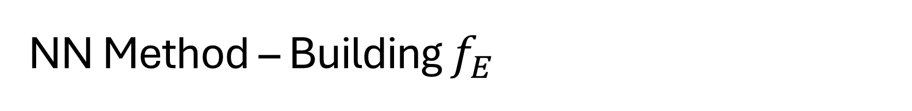
NN Method – Building $f_{E}$
$f_{E}$ is built from multiple invertible blocks called coupling layers.
In 2D, which it is in this case, the coupling splits $(θ_{e}$, $θ_{μ})$ into two parts via a mask. So, if we have $x=\left(θ_{e}, θ_{μ}\right)$ and a mask [0, 1] we will be left with $x_{μ}=\left(0, θ_{μ}\right)$.
$θ_{μ}$ is then transformed with a nonlinear, invertible function (block of $f_{E}$). The parameters of the transformation function are predicted from $θ_{e}$ and the energy using a small neural network at every coupling layer.
The mask then alternates [0,1], [1,0], [0,1] etc. so both components get transformed many times.

Slide 9
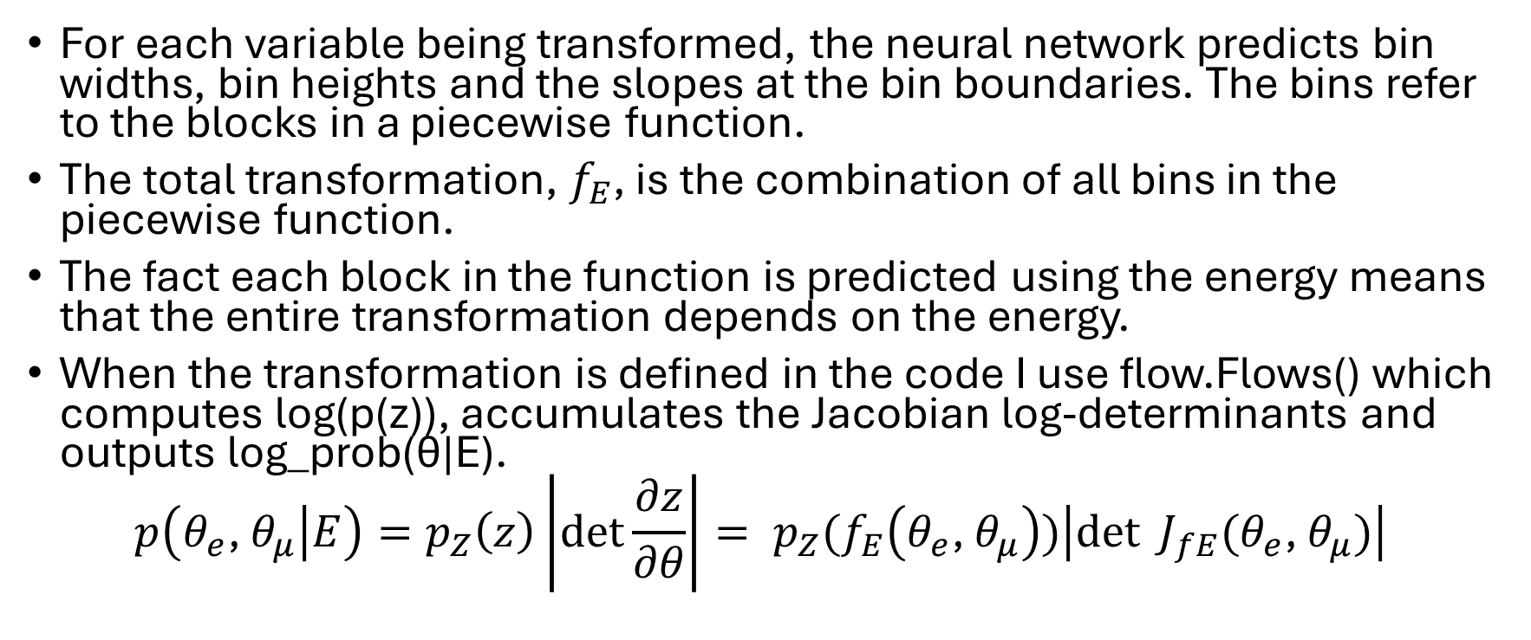
NN Method – Building $f_{E}$
For each variable being transformed, the neural network predicts bin widths, bin heights and the slopes at the bin boundaries. The bins refer to the blocks in a piecewise function.
The total transformation, $f_{E}$, is the combination of all bins in the piecewise function.
The fact each block in the function is predicted using the energy means that the entire transformation depends on the energy.
When the transformation is defined in the code I use flow.Flows() which computes log(p(z)), accumulates the Jacobian log-determinants and outputs log_prob(θ|E).
$$p\left(θ_{e}\text{, }θ_{μ} | E\right)=p_{Z}\left(z\right)\left|\det{\frac{∂z}{∂θ}}\right|= p_{Z}(f_{E}\left(θ_{e}\text{, }θ_{μ}\right))\left|\det{J_{fE}(θ_{e}\text{, }θ_{μ})}\right|$$

Slide 10
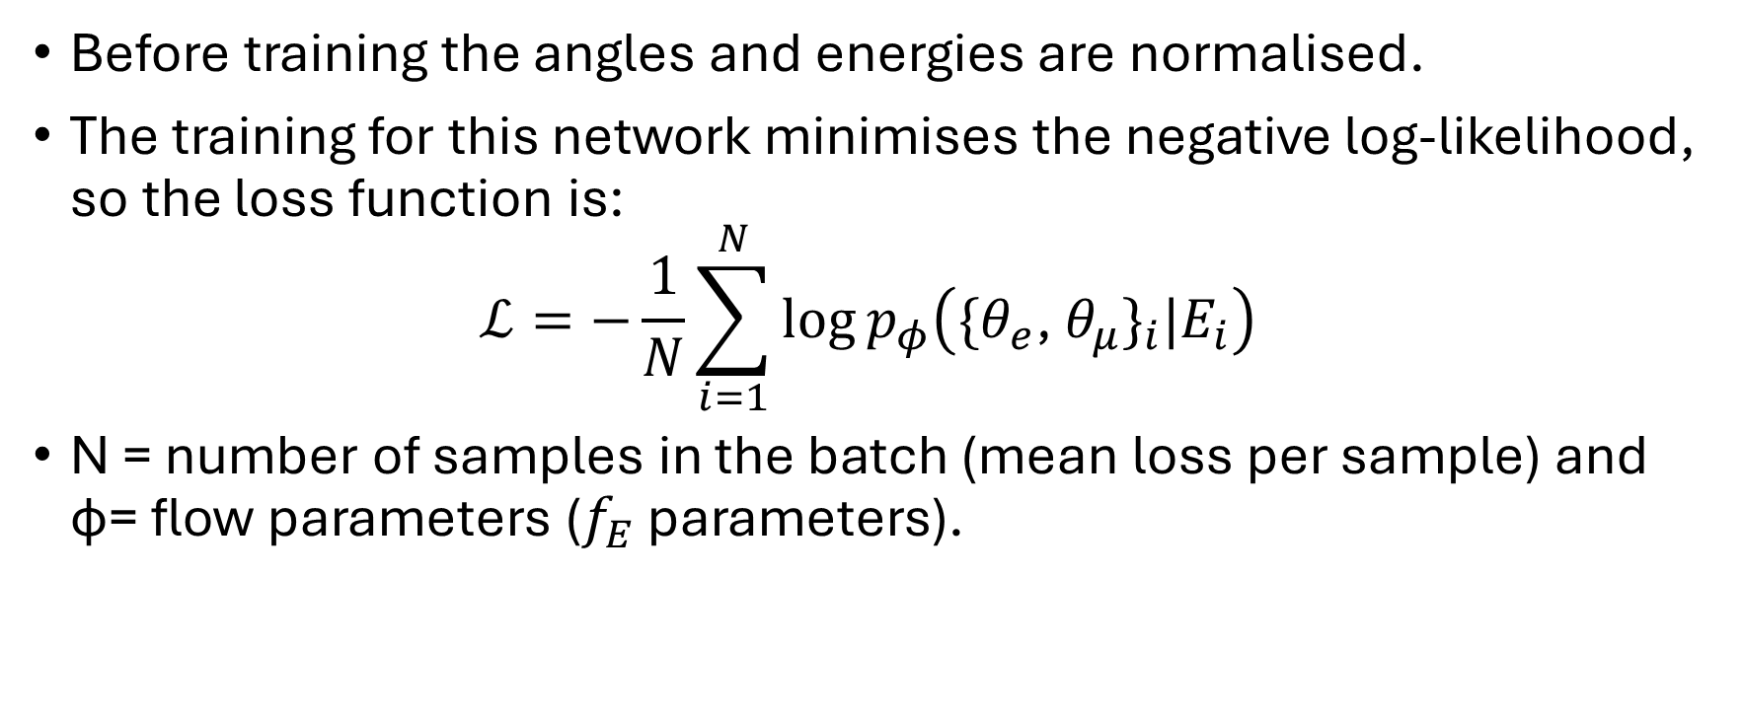
NN Method - Training
Before training the angles and energies are normalised.
The training for this network minimises the negative log-likelihood, so the loss function is:
$$ℒ=−\frac{1}{N}\sum_{i=1}^{N}{\log{p_{φ}\left({\{θ_{e}\text{, }θ_{μ}\}}_{i}|E_{i}\right)}}$$
N = number of samples in the batch (mean loss per sample) and ϕ= flow parameters ($f_{E}$ parameters).

Slide 11

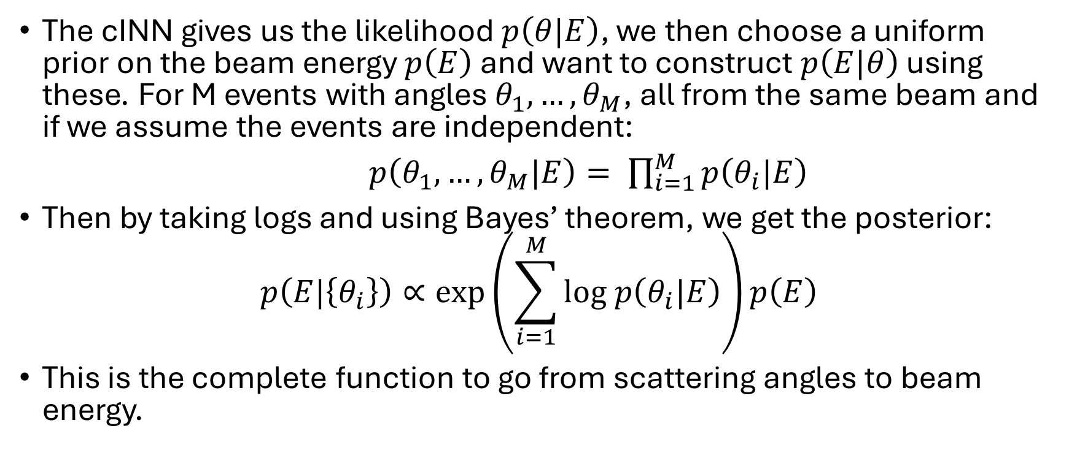
NN Method - Inference
posterior
likelihood
prior
$$p\left(E|θ\right)∝p\left(θ|E\right)p\left(E\right)$$
The cINN gives us the likelihood $p\left(θ|E\right)$, we then choose a uniform prior on the beam energy $p\left(E\right)$ and want to construct $p\left(E|θ\right)$ using these. For M events with angles $θ_{1}, …,θ_{M}$, all from the same beam and if we assume the events are independent:
$p\left(θ_{1}, …,θ_{M}|E\right)= \prod_{i=1}^{M}{p\left(θ_{i}|E\right)}$
Then by taking logs and using Bayes’ theorem, we get the posterior:
$$p\left(E|\left\{θ_{i}\right\}\right)∝\exp\left(\sum_{i=1}^{M}{log p\left(θ_{i}|E\right)}\right)p\left(E\right)$$
This is the complete function to go from scattering angles to beam energy.

Slide 12
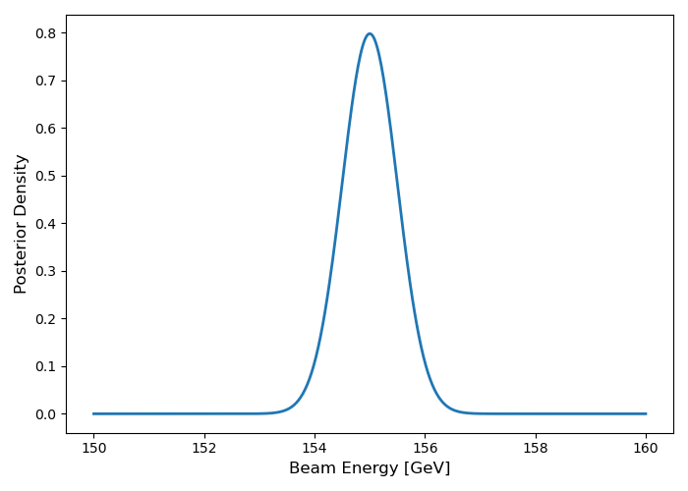
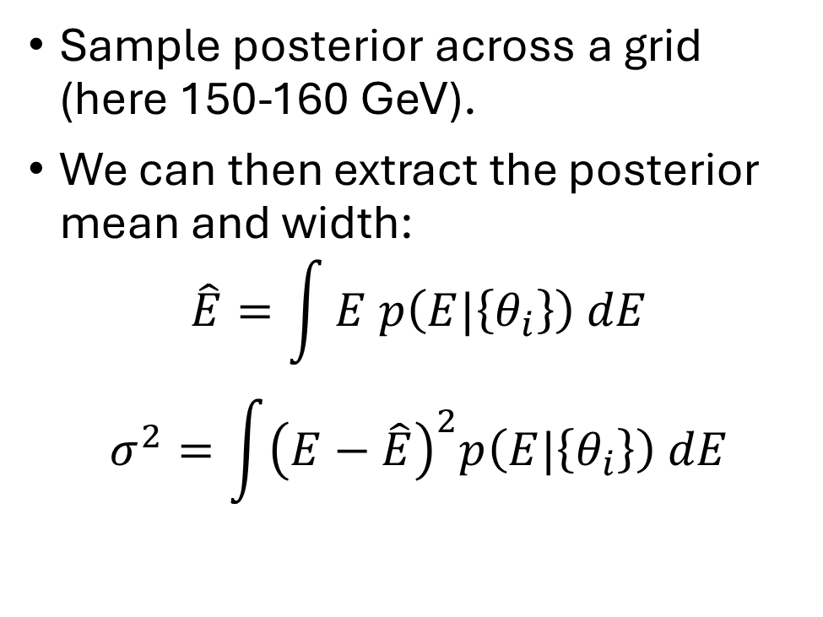
Using the NN to Measure Energy
Sample posterior across a grid (here 150-160 GeV).
We can then extract the posterior mean and width:
$$\hat{E}=\int{E p\left(E|\left\{θ_{i}\right\}\right) dE}$$
$$σ^{2}=\int{{\left(E−\hat{E}\right)}^{2}p\left(E|\left\{θ_{i}\right\}\right) dE}$$

Slide 13
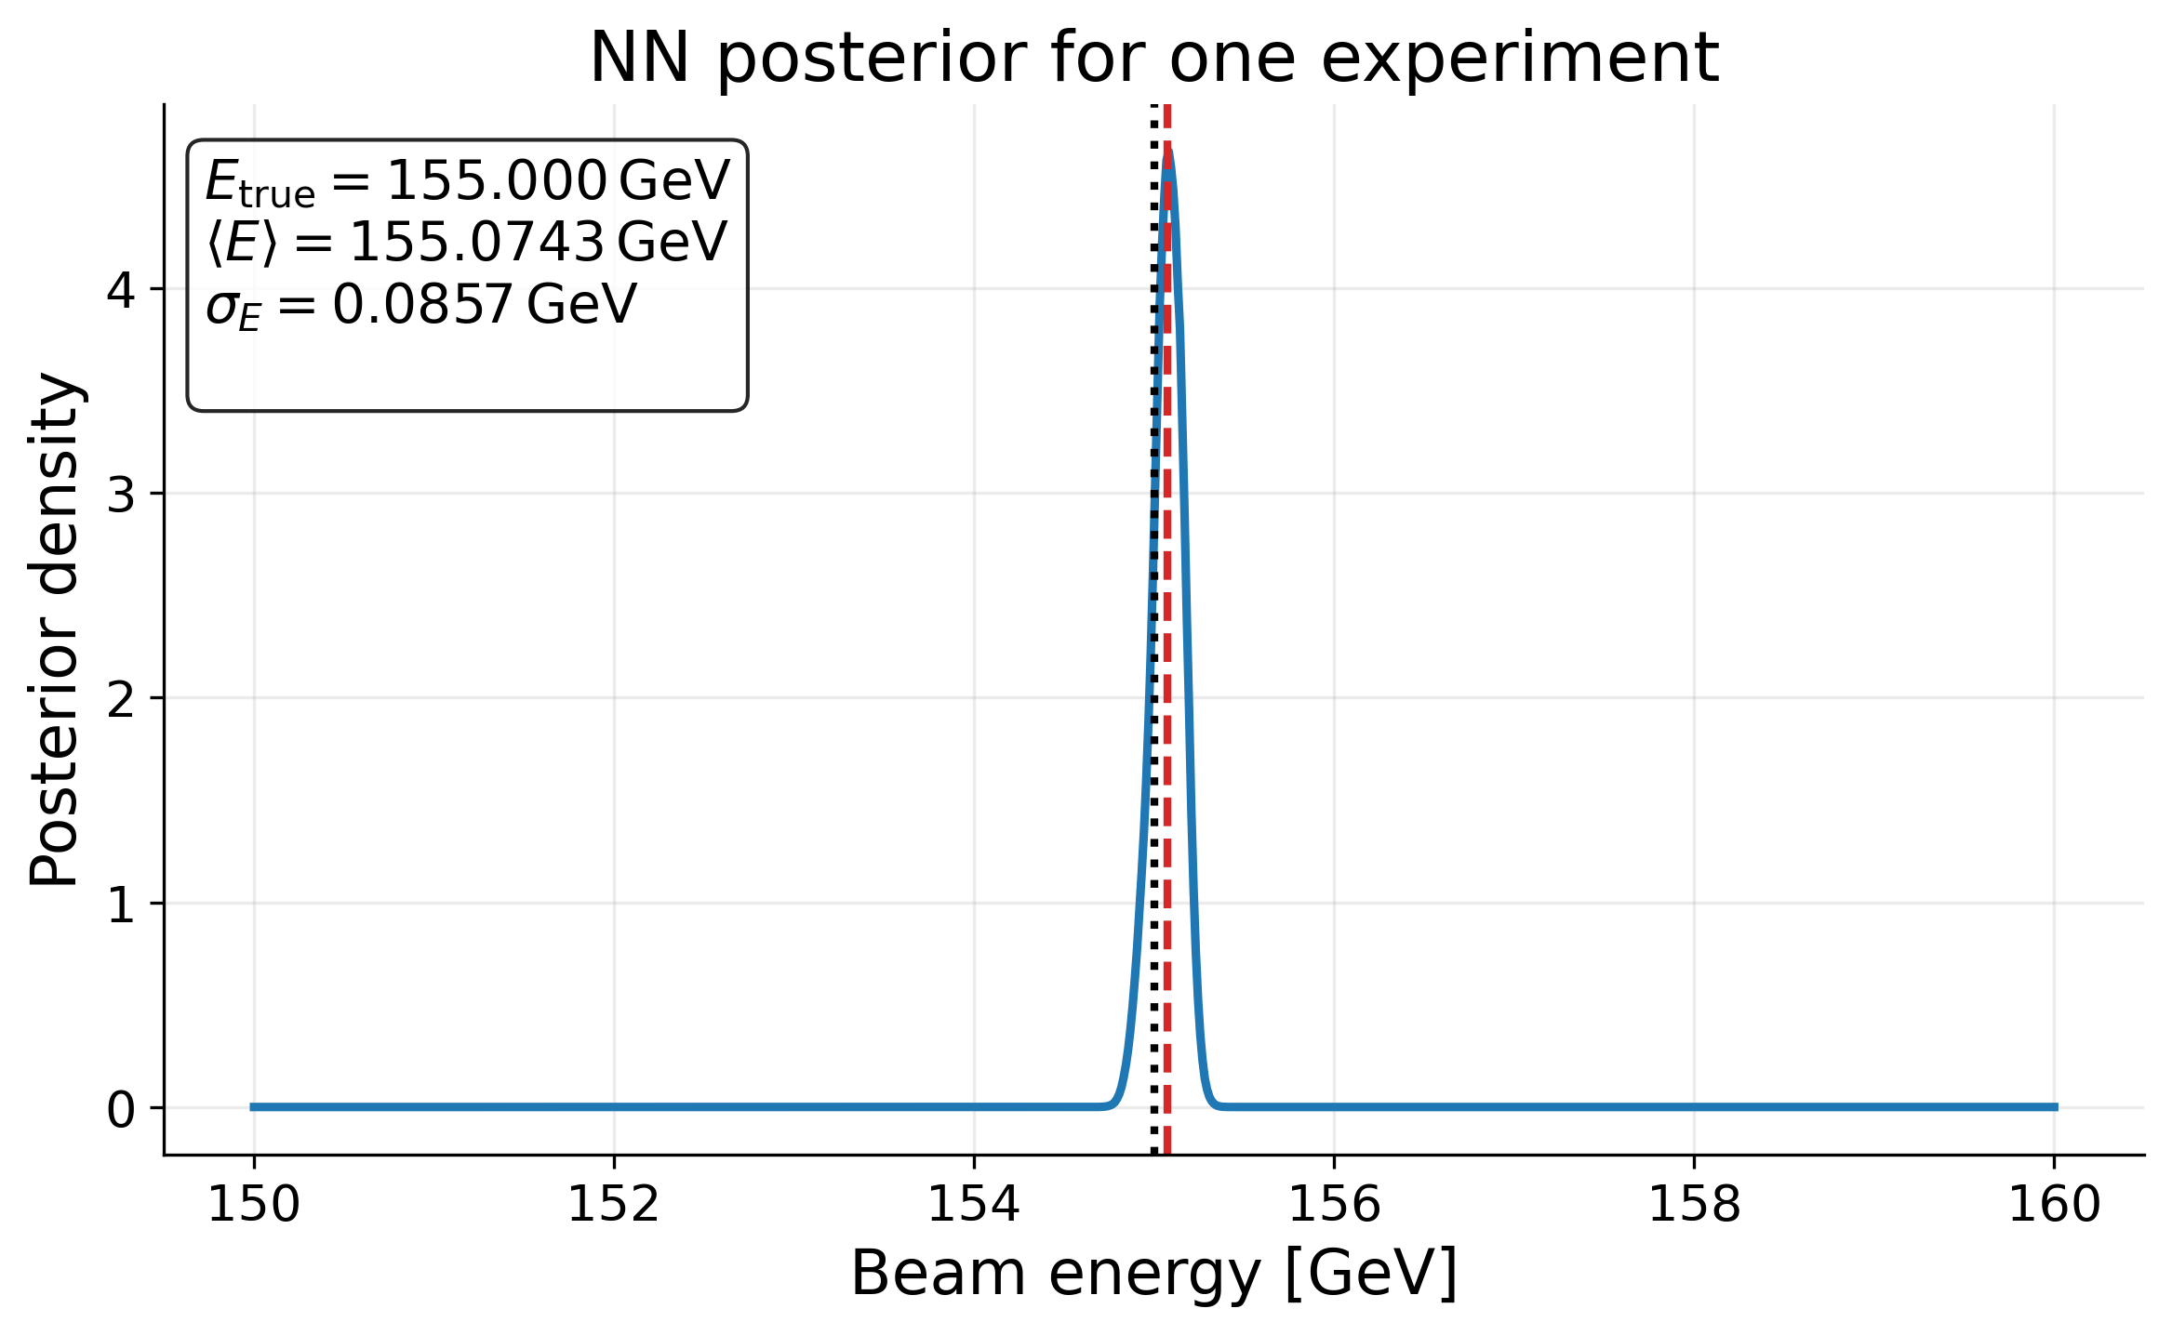
NN Method Results for 500,000 Events
Generating 500,000 events from monoenergetic beam (155.0GeV).
Same conditions as template fit.
Giving data to NN results in this posterior.
Mean energy 155.074 ± 0.086GeV.

Slide 14
Conclusion
I have built a NN that, given the muon and electron scattering angles accurately reproduces the muon beam energy.
Template fit gives a beam energy 154.949 ± 0.091GeV and the NN posterior gives 155.074 ± 0.086GeV.
These are very similar results. The next steps will be to understand the speed and precision of these methods. As well as comparisons which include the amount of statistics needed for the methods to be accurate and their robustness against systematics.
My next step is to use a Gaussian beam profile instead of a monoenergetic beam to test the NN further.
Then I will use MESMER NLO simulations to test if it can reconstruct a more realistic beam profile.

