Slide 1
Saara Chikh
The University of Liverpool
Muon Biweekly Meeting Presentation
9th March 2026
The 3D injection scheme with a 6T magnetic field at J-PARC g-2/EDM experiment

Slide 2
Overview
Introduction and motivations
Proposition of 6T field – why?
The muon trajectory and storage aims
Acceptance and adherence to constraints
Next steps…

Slide 3

3D injection scheme: an overview for the 3t case
Statistical uncertainty of g-2 experiment aimed at $<0.1$ ppm
300 MeV muon beam injected
Orbit should have r = 33.3 cm
MRI-type magnet, 1 ppm local magnetic field uniformity (!!!)
Beam guided to the storage region, weak focusing field stores it there
[1] M.A. Rehman et al. "BEAM CONTROL AND MONITORS FOR THE SPIRAL INJECTION TEST EXPERIMENT," in 10th Int. Particle Accelerator Conf.. https://inspirehep.net/files/085289a95183a4b0bae73cf356bad674

Slide 4
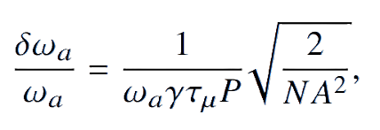

Why the 6t upgrade?
A statistical precision benefit… →
Sensitivity scales almost quadratically with momentum increase (a necessity for a field increase)
$ω_{a}∝B$
[2] G. Venanzoni “STATUS OF THE MUON G-2/EDM EXPERIMENT AT J-PARC," arXiv:2512.20335v1 23 Dec 2025

Slide 5
A small muon orbit
BNL/FNAL 2D injection sufficient: kick angle 10.8 mrad
J-PARC kick angle much greater, 233 mrad so 3D injection is required
→ Needs only B fields to hold the muon stable to |A|< 5cm
Main field keeps the muon orbit circular at a set radius
Challenge remains to keep the vertical betatron motion as limited as possible
Efficiency > 80% compared to the above experiments’ 3-5% efficiencies
Beam ultra-low emittance and much lower momentum
→ Better stats will arise

Slide 6
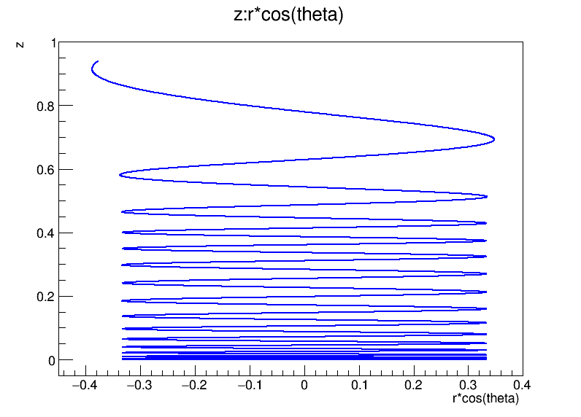
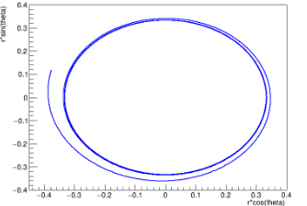
Helical orbit, visualised
Here are some plots showing the trajectory of the muon that I created ☺
These are derived from ‘tracking’ files provided by Shinji Ogawa (from the collaboration)
z vs. x (the front-on view)
x vs. y (the bird’s-eye view)

Slide 7
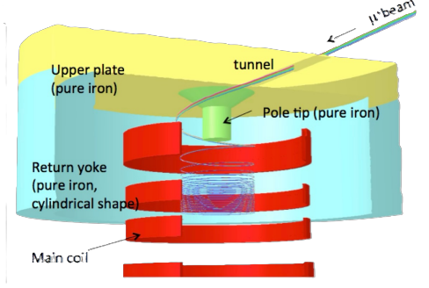

Helical orbit
Any change to ‘main’ field (z-direction) requires a change to the kicker field
The question is:
What changes need to be made to the kicker field and fringe field etc.?
[3] H. Iinuma et al.. ‘Three-dimensional spiral injection for the g-2/EDM experiment at J-PARC’, 2016
Surely we could just scale everything up by a factor of 2,
achieve the same result,
while enjoying the statistical benefits of a 6T field?

Slide 8

Why not?
  Doubling the main field affects the Lorentz force felt by the muon
  $F=q\left(v×B\right)$
  The kicker field must be adjusted in timing and magnitude such that the same orbit is achieved… its role is to reduce the z-component of momentum of the muon beam

Slide 9
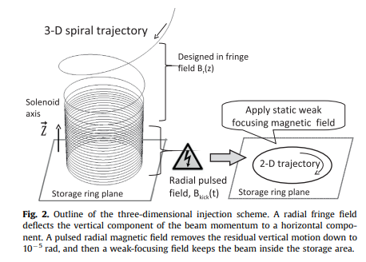
Kicker coils
The way the field within the two kicker coils looks will depend on:
  Current through coils
  Spacing of coils
  Thickness of coils
  The breakdown voltage (which may limit current)
  The timing of the extremely short pulse
  Angle of injection chosen
[3]

Slide 10
Kicker coils and fringe field effects
We have access to code that will evaluate the acceptance related to the selected kicker files
How successful will our injection be?
Acceptance
How many muons (close tie to efficiency) will follow the reference particle into a stable +/- 5 cm near-circular orbit and remain there?

Slide 11
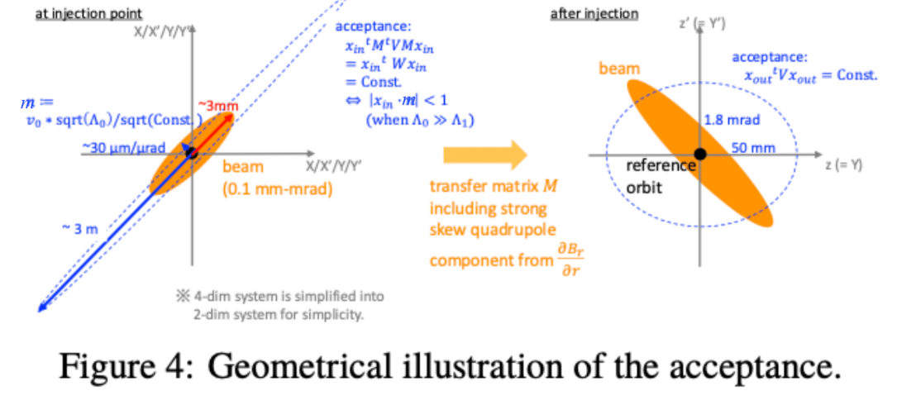
Calculating acceptance
Align principal axes with phase space
Perform an eigen decomposition process to break transport matrix down
Calculate acceptance using the code
[5] Cedric’s slides

Slide 12

Where The results come from
We normalise the physical constraint (+/- 5cm fluctuations) into a single parameter m which the code provides…
Under this simplification, the acceptance criteria becomes
$$\left|x_{in}∙m\right|<1$$
where $m=v_{0}\frac{\sqrt{Λ_{0}}}{5}$
and $v_{0}$ is the principal eigenvector of W, the transport matrix
[5] Cedric’s slides

Slide 13
Summary and next steps
KEY TAKEAWAYS:
We aim to keep the trajectories found from the 3T case constant
  We see how the kicker and fringe fields must therefore adjust to the change in main field
  We quantify this with m, a parameter tied to acceptance, the funnel in phase space that the muon beam must fit into
  A smaller m, or larger ‘funnel’, improves our injection efficiency, so this is what we iterate the matrix/acceptance process to find.
Which kicker field (and therefore which coil properties) will lead us to the optimal acceptance?

Slide 14
Thank you for listening!

