Slide 1

Mu2e Status Update – Spring 2026
Sean Isaac + Dominika Vasilkova

Slide 2
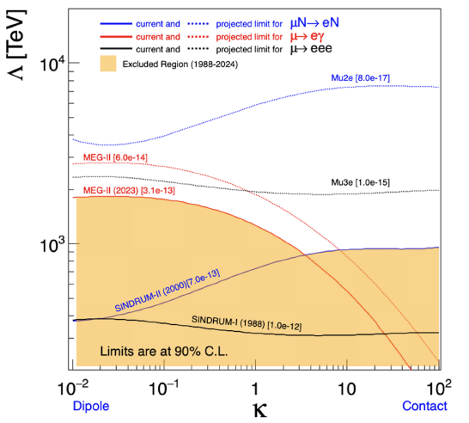
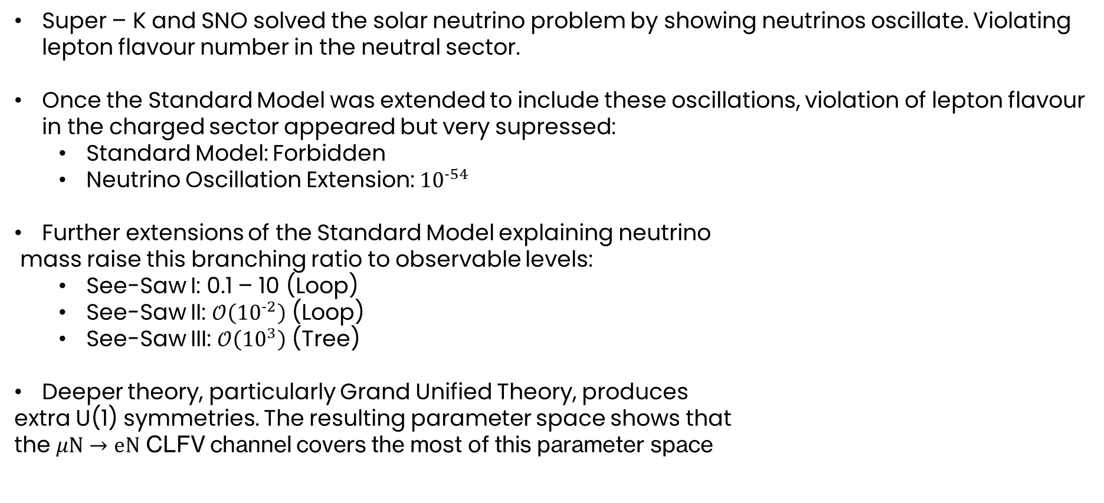
Reminder: Physics Motivation
Super – K and SNO solved the solar neutrino problem by showing neutrinos oscillate. Violating lepton flavour number in the neutral sector.
Once the Standard Model was extended to include these oscillations, violation of lepton flavour in the charged sector appeared but very supressed:
Standard Model: Forbidden
Neutrino Oscillation Extension: ${10}^{−54}$
Further extensions of the Standard Model explaining neutrino
mass raise this branching ratio to observable levels:
See-Saw I: 0.1 – 10 (Loop)
See-Saw II: $𝒪\left({10}^{−2}\right)$ (Loop)
See-Saw III: $𝒪\left({10}^{3}\right)$ (Tree)
Deeper theory, particularly Grand Unified Theory, produces
extra U(1) symmetries. The resulting parameter space shows that
the $μN→eN$ CLFV channel covers the most of this parameter space

Slide 3
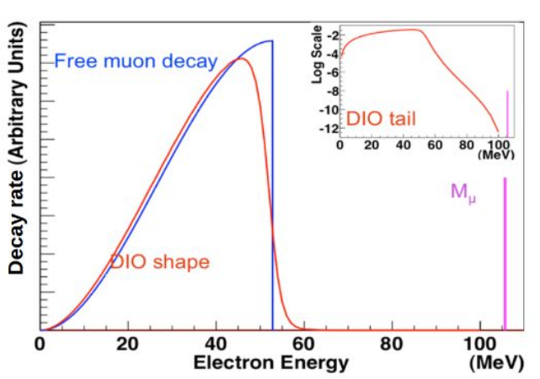
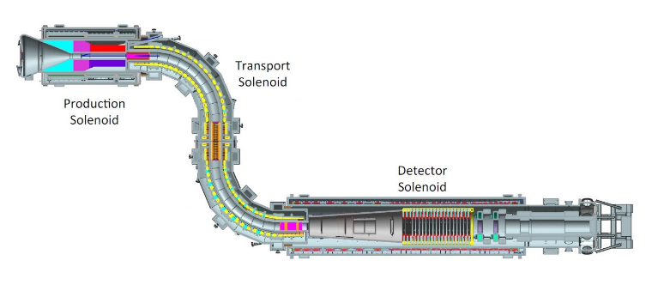
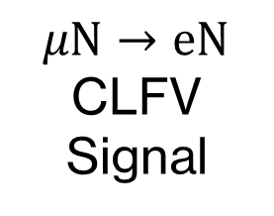
Mu2e Overview
$μN→eN$ CLFV Signal
Production Target
(Tungsten)
Protons
Stopping Target Monitor
Stopping Target
(Aluminium)
Calorimeter
(20m)
Tracker
Mu2e Image credit: https://users.hep.manchester.ac.uk/u/markl/muons/mu2e/index.shtml

Slide 4
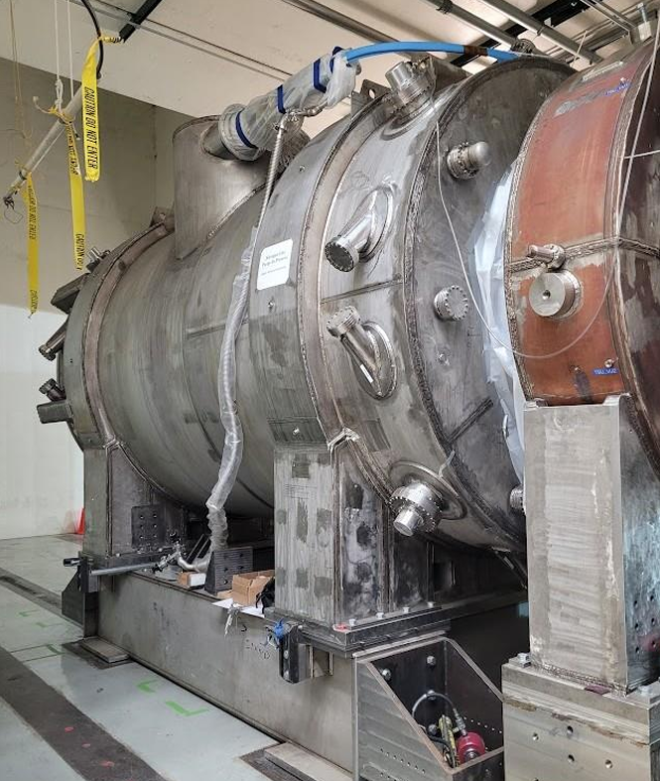
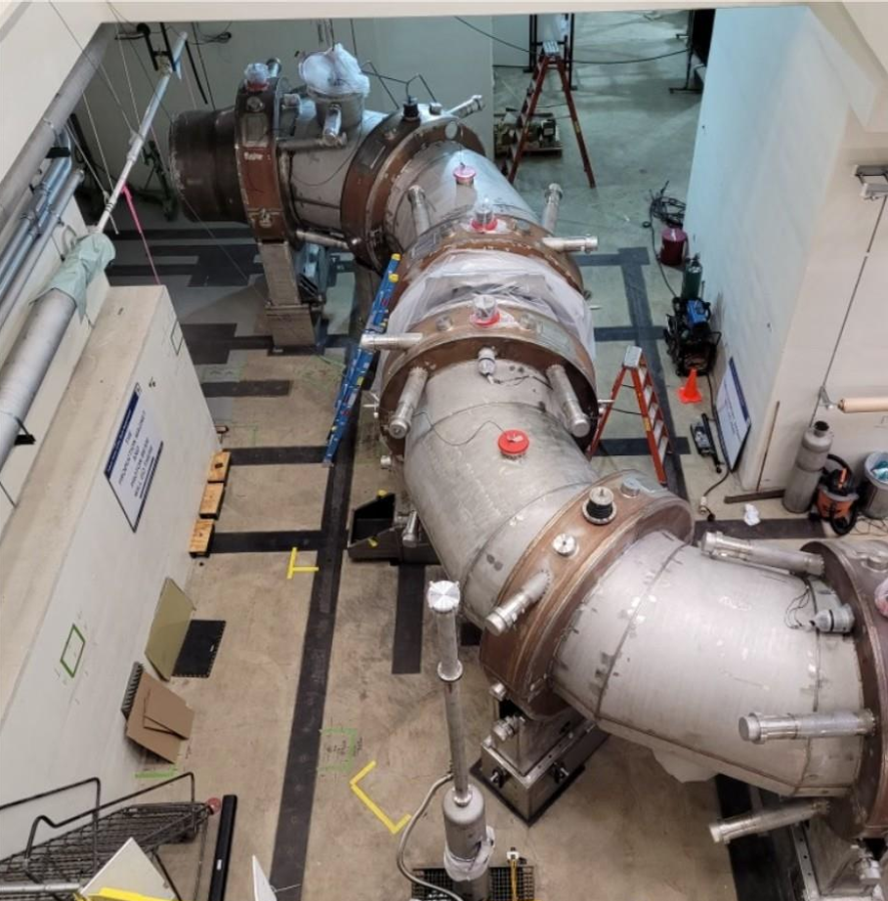
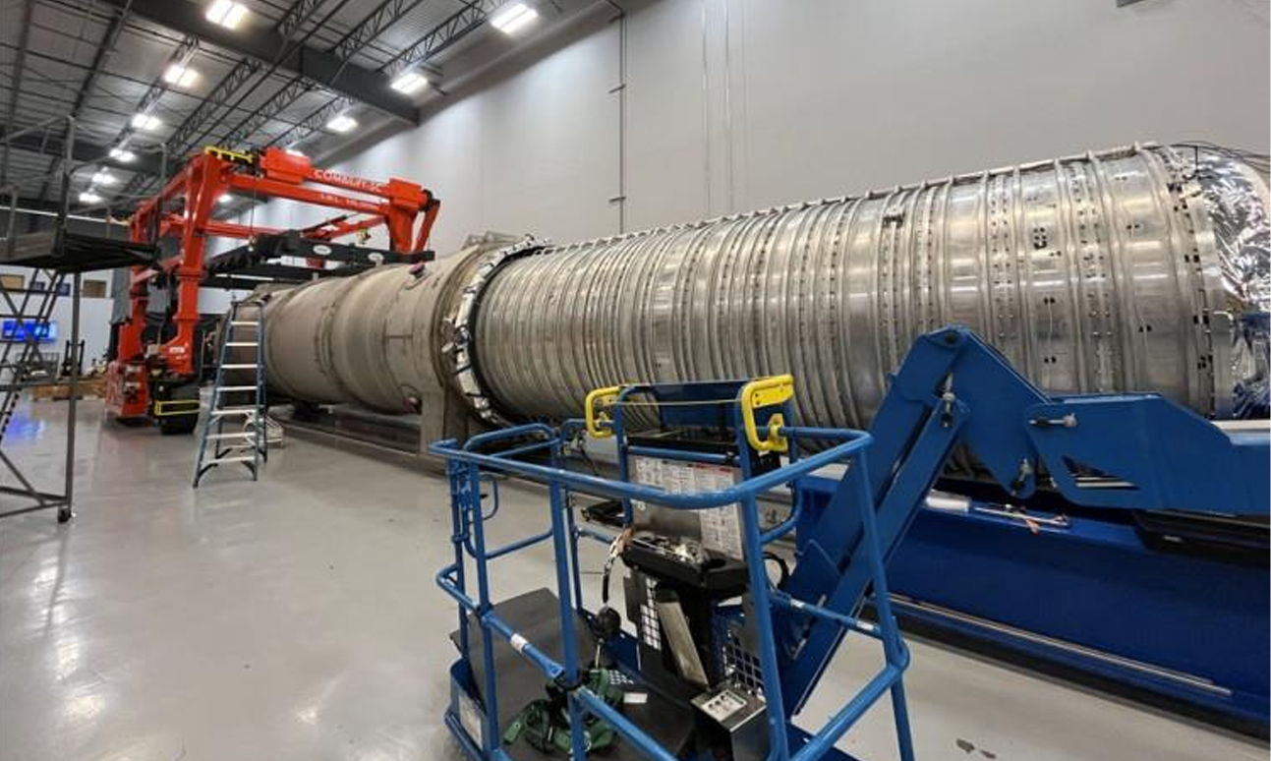
Solenoid status
PS
TS
Production solenoid (PS) and transport solenoid (TS) installed in Mu2e hall – PS cryo interconnect complete, TS had successful leak check and pump down.
Currently undergoing quench protection and power supply testing, plan to cool down and power this summer.
Detector solenoid (DS) still with manufacturer – undergoing cooling and leak tests after sealing.
DS delivery expected in July 2026, then ~ 1 year to commission.
DS

Slide 5
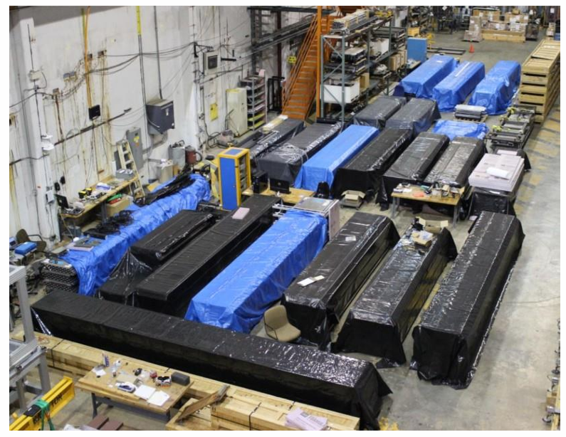
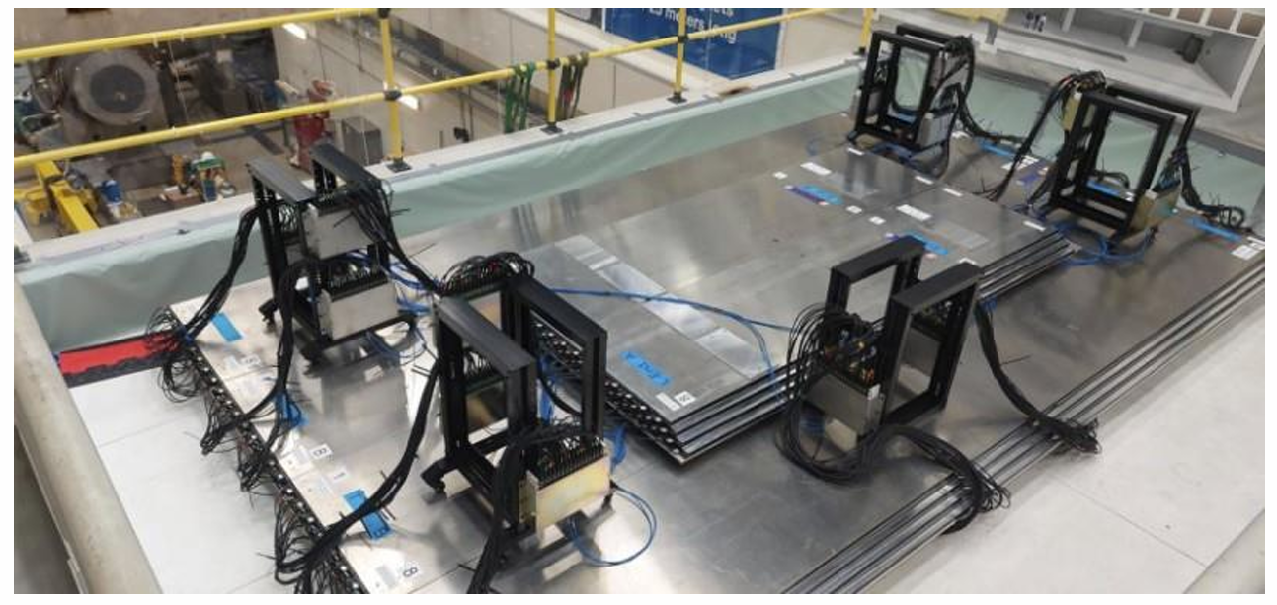
In the hall:
CRV has all modules complete and delivered to FNAL with 8 installed in the hall for cosmic ray running.
Tests with cosmics show they are meeting the ~ 99.9% efficiency requirement.
Successful DAQ runs with STM, calo and tracker paired individually.
CRV modules in storage
CRV installed above tracker and calorimeter

Slide 6
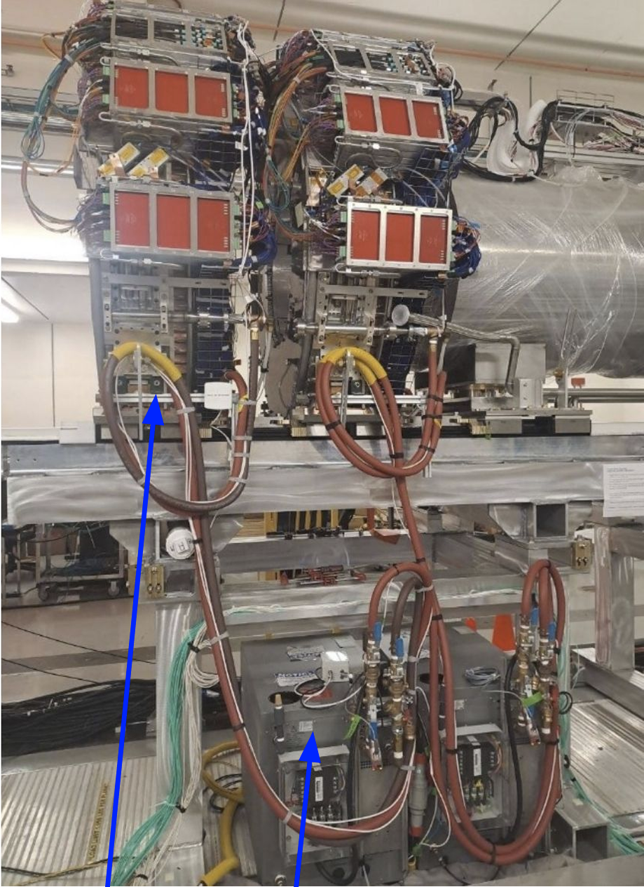
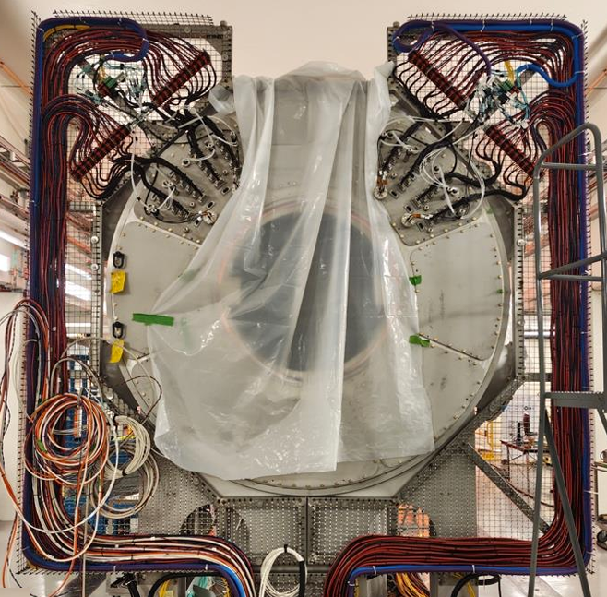
In the hall:
Calorimeter installed in the mu2e hall last September, now fully cabled up and connected to chillers (lower box in photo).
Work ongoing to finish mapping readout + integrate with Mu2e’s OTSDAQ
Successfully running with cosmics to test general functionality as well as laser/source calibration systems.
Calo side view showing chiller
Cabling for both sides is now complete.

Slide 7
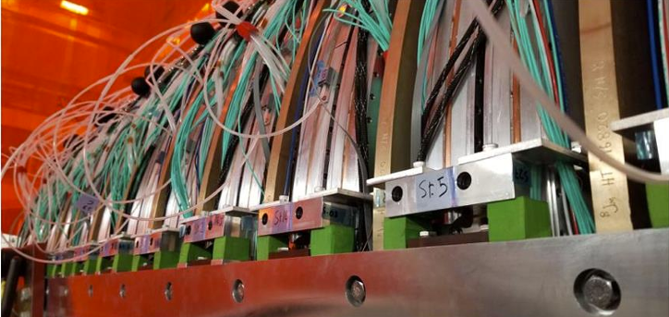
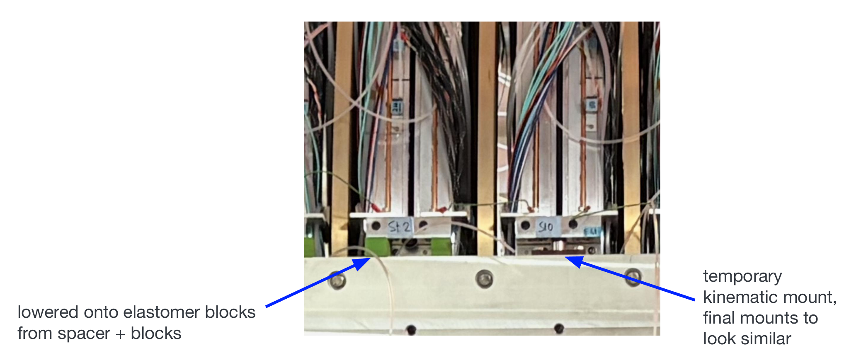
In the hall:
Tracker has all stations connected to cooling and powered in the hall with 3 of them able to take data.
Currently undergoing gas flow and leak testing in the hall, alongside alignment studies and moving the stations to their ‘final’ kinematic mounts (rather than the current temporary ones).

Slide 8
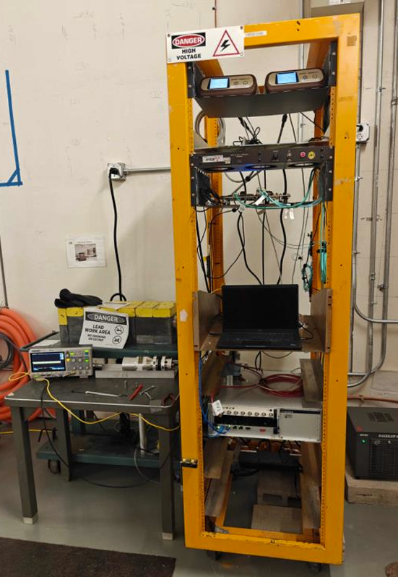
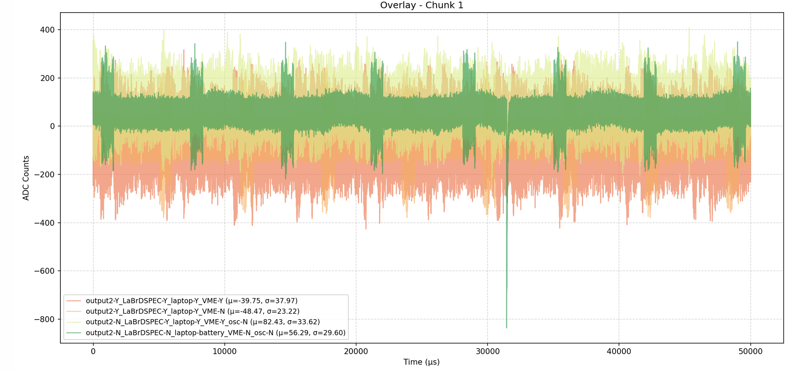
In the hall
STM set up in a ‘temporary’ position at the back of the hall (both HPGe and LaBr) one in lead shielding depending on requirements.
Past month has focussed on understanding and reducing noise seen in HPGe, and integrating DAQ with OTSDAQ and other subsystems.
STM rack with HPGe in shielding.
STM noise with different components removed.

Slide 9
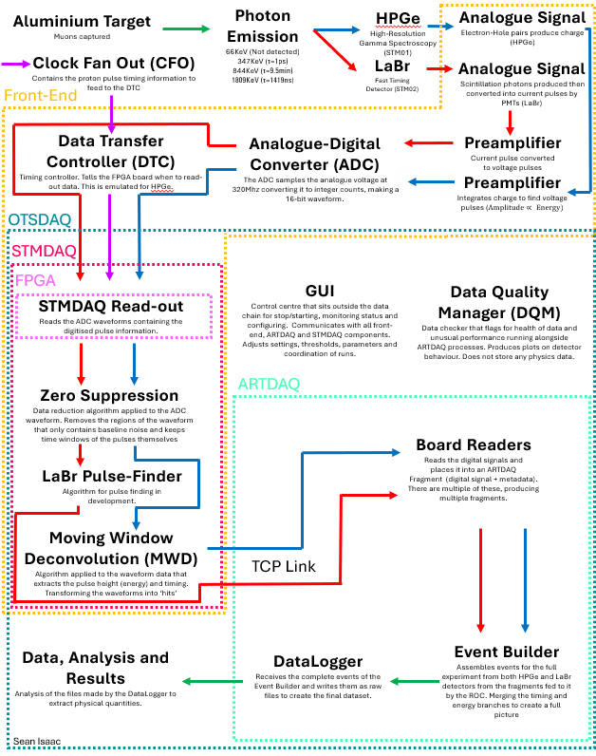
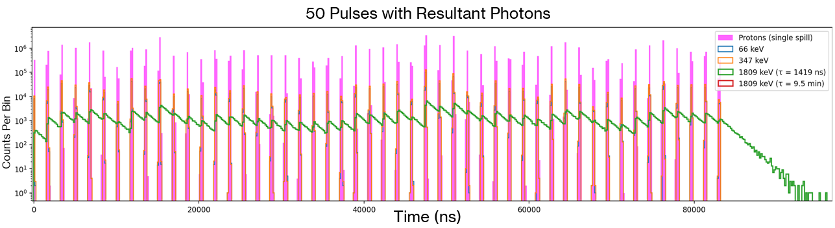
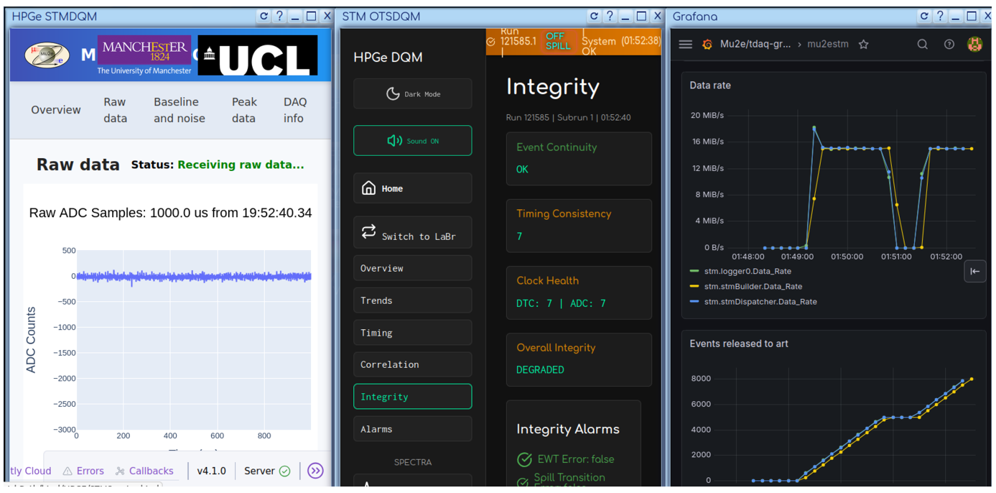
Liverpool Contributions

Slide 10
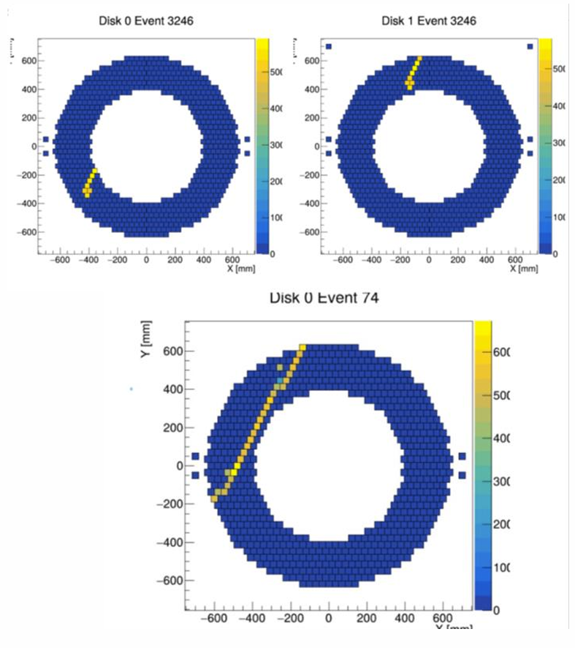
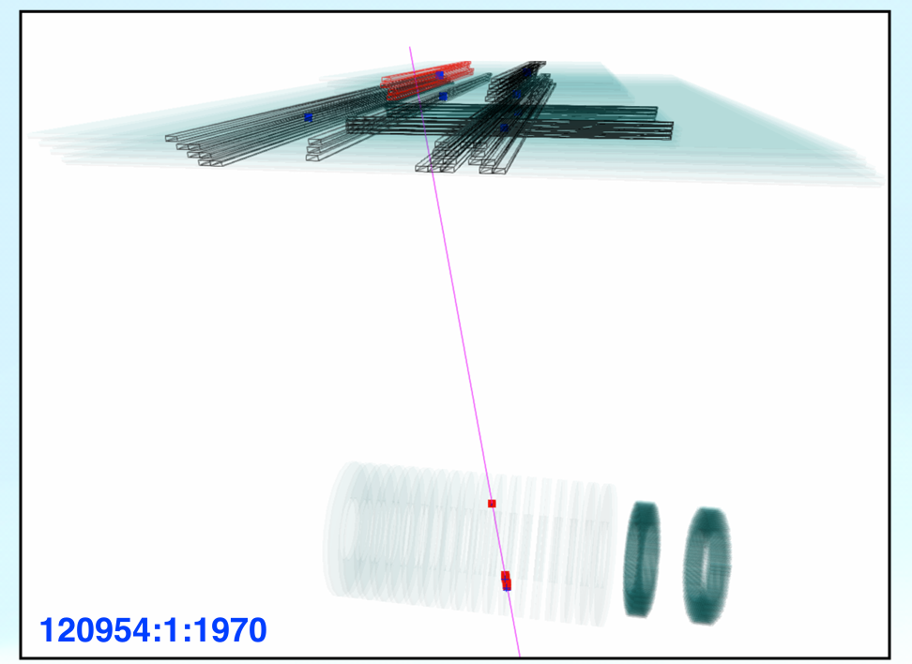
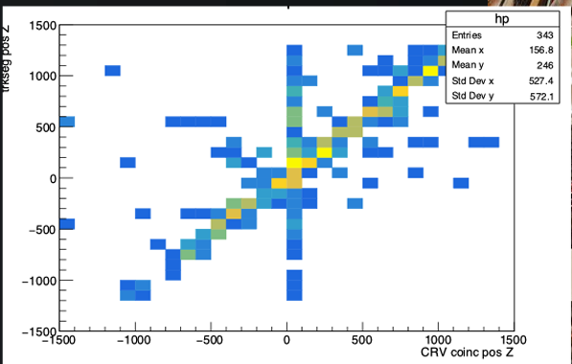
Looking towards experimental operations
Mu2e Project milestone of ‘key performance parameters’ for CRV, tracker and calorimeter:
Each subsystem needs to be fully powered and able to measure cosmics.
All 3 subsystems close to achieving full KPP – successful paired runs of CRV + other systems:
Calo half disk KPP run:
Event display and z-position coincidence plot with tracker/CRV:

Slide 11
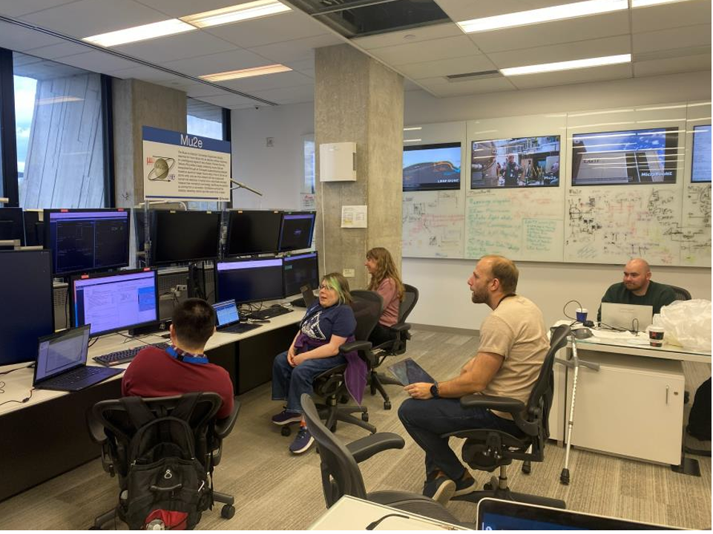
Towards experimental operations – shifter run
‘Cosmic ray run’ planned for later this year with all subsystems turned on.
Requires all subsystems fully operational + continuous data taking - so needs shifters!
Planned ‘shifter runs’ every few weeks to test (and fix issues with) stability of subsystems and their DAQs + non-expert controls.
Shifter run 1 (29th/30th Apr): joint running with STM and CRV
Complications from power outages and recovery from them.
Both subsystems able to run together for a short period of time.
Shifter controls and monitoring successful!
Shifter run 2 planned for 26th/27th May: STM + CRV + Calo
UK group will be actively participating remotely as needed.

Slide 12
Run 1A/Run 1B scenarios
DS commissioning timescale will set mode of running before FNAL long shutdown:
With DS manufacturer promising delivery in July, Run 1A is still the target!
Run 1A
Run 1B
Planned for second half of 2027 before FNAL long shutdown.
All magnets fully powered, subsystems in with partial CRV (just the top), no DS shielding
Aiming to improve on SINDRUM II’s limit by a factor of ~ 30.
Collect muons even with the DS off.
A backup plan in case of further large delays with the DS.
Still plenty of useful physics to do: backgrounds inc. RMC, muon stopping rates, beam extinction, normalization etc.
Work ongoing to design a ‘1B’ configuration target which can be quickly switched back into ‘1A’ running

Slide 13
Conclusion
Major steps forward – major subsystems approaching performance targets
Data taking WILL happen before the 2028 long shutdown
In a good position for Run 1A and improvement on SINDRUM-II limit
Pessimistic case of Run 1B still guarantees good physics insight

Slide 14
Thank you and any questions?

