Slide 1
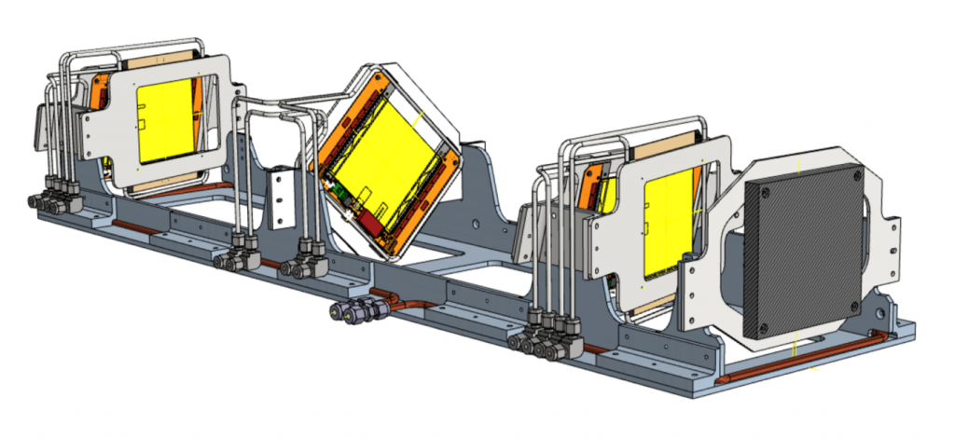

Determination of the muon beam energy at the MUonE experiment
Tom Lenane | University of Liverpool
Supervisors: Saskia Charity, Riccardo Pilato, Graziano Venanzoni

Slide 2
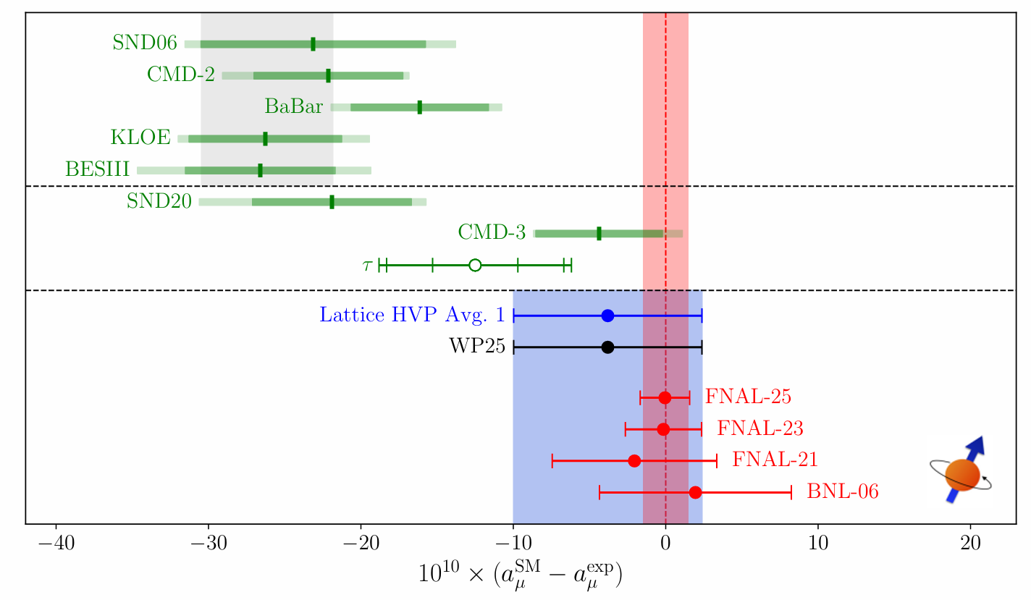
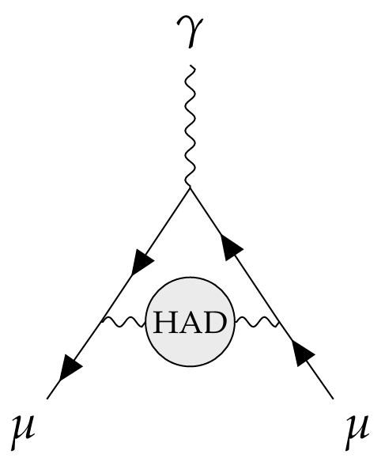
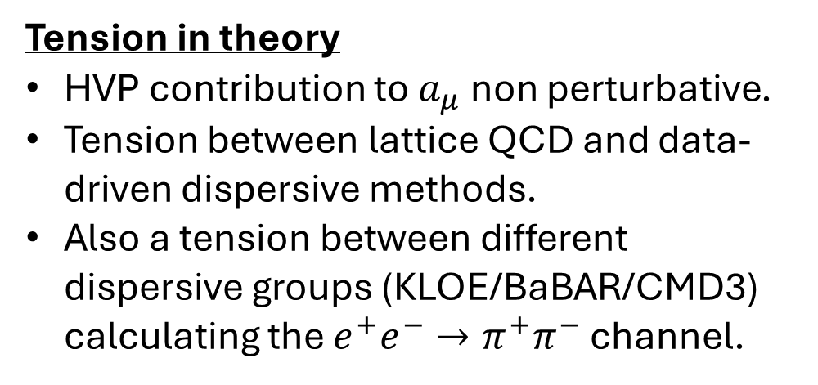
MUonE: Motivation
Tension in theory
HVP contribution to $a_{μ}$non perturbative.
Tension between lattice QCD and data-driven dispersive methods.
Also a tension between different dispersive groups (KLOE/BaBAR/CMD3) calculating the $e^{+}e^{−}→π^{+}π^{−}$ channel.

Slide 3
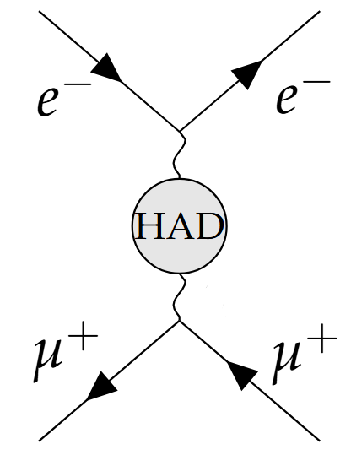
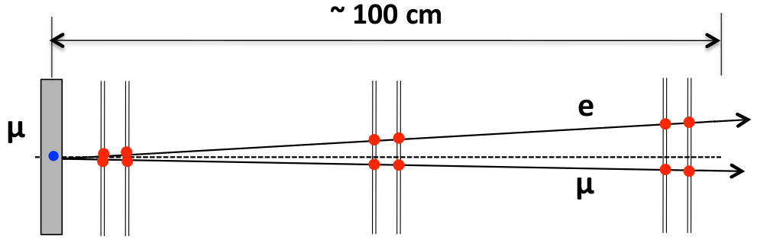
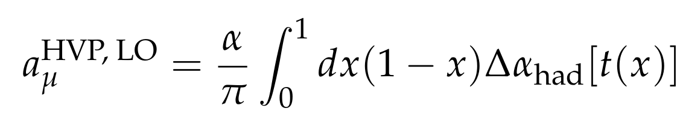
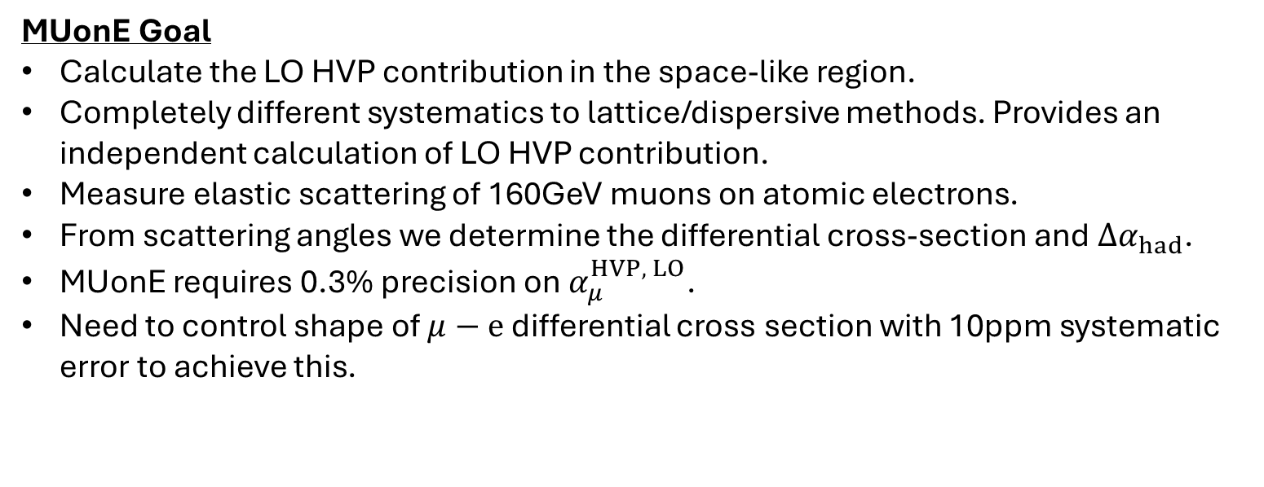
MUonE: Experimental Goal
MUonE Goal
Calculate the LO HVP contribution in the space-like region.
Completely different systematics to lattice/dispersive methods. Provides an independent calculation of LO HVP contribution.
Measure elastic scattering of 160GeV muons on atomic electrons.
From scattering angles we determine the differential cross-section and $Δα_{had}$.
MUonE requires 0.3% precision on $α_{μ}^{HVP, LO}$.
Need to control shape of $μ−e$ differential cross section with 10ppm systematic error to achieve this.

Slide 4
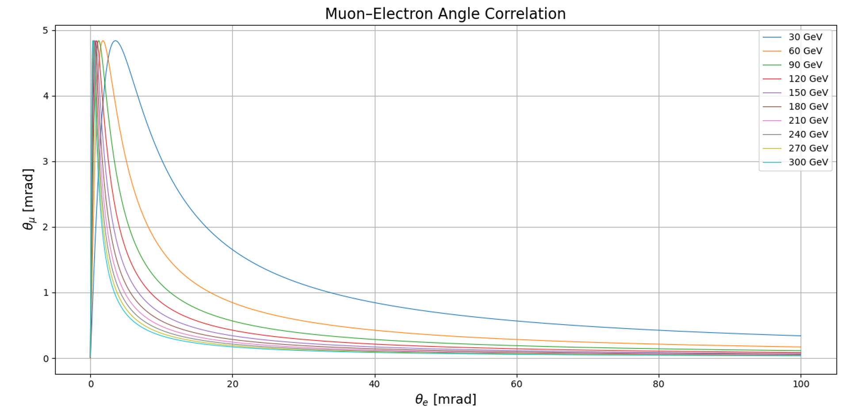
Beam Energy Requirements
Beam Energy
We need knowledge of the beam energy to ~5MeV for a 160 GeV muon beam.
The shape of the differential cross section is dependent on the shape of the elastic scattering correlation curve.
The elastic scattering curve changes with the the incoming beam energy.

Slide 5
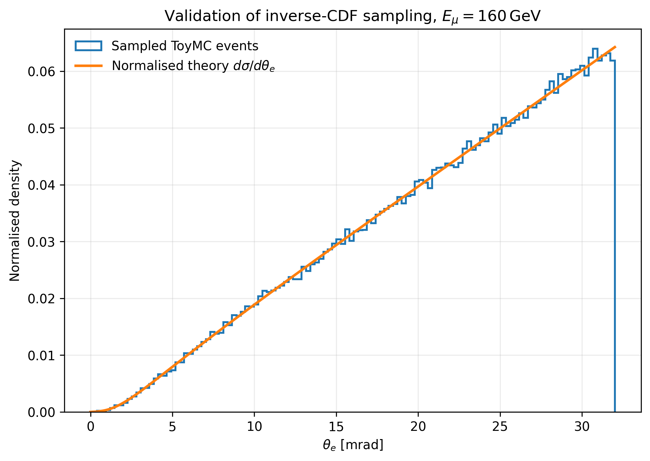
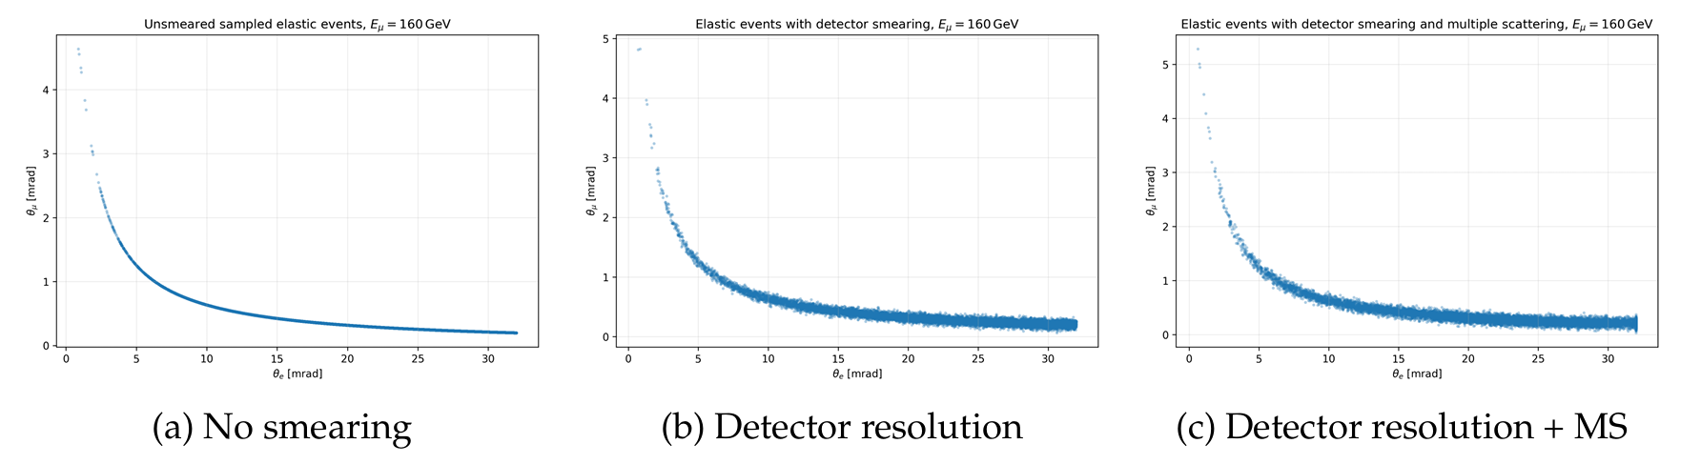
Toy MC for Investigating Beam Energy Extraction
Event Generation from toy MC
For a monoenergetic or gaussian beam energy, events are generated from the LO differential cross section.
Angles are smeared to account for detector resolution and multiple scattering in the target.
Energy Extraction
Toy MC pseudo-data used to develop methods for extracting beam energy.
Template fit, CNF, equal angle methods.

Slide 6
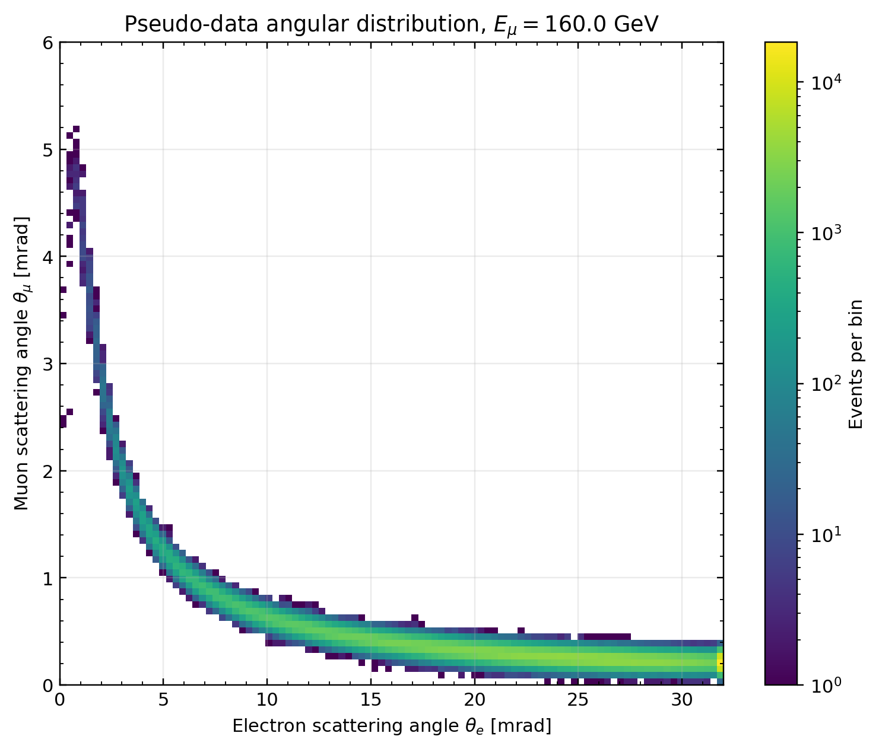
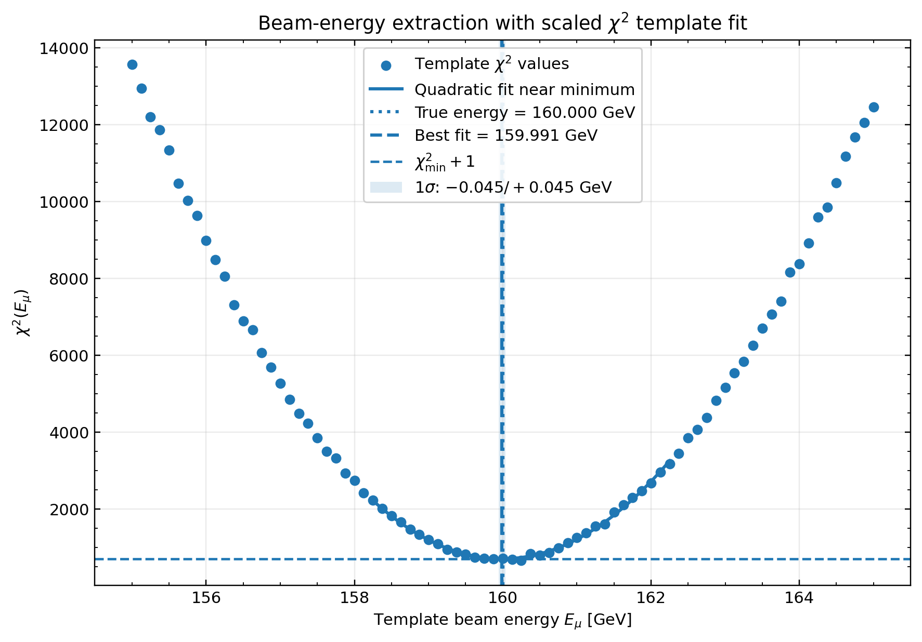
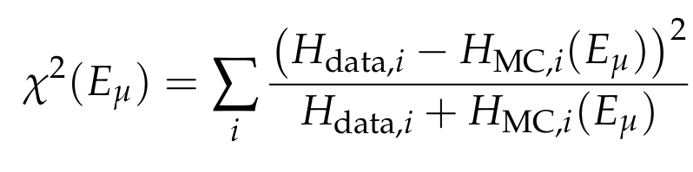
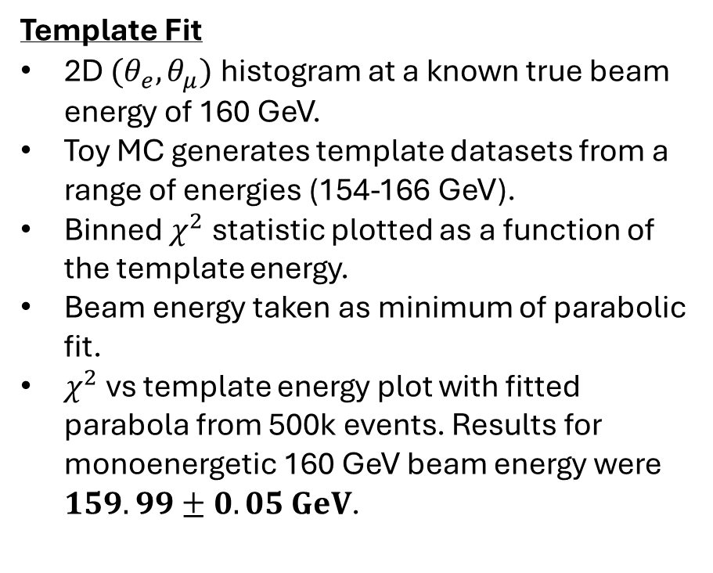
$χ^{2}$ Template Fit Method
Template Fit
2D $(θ_{e},θ_{μ})$ histogram at a known true beam energy of 160 GeV.
Toy MC generates template datasets from a range of energies (154-166 GeV).
Binned $χ^{2}$ statistic plotted as a function of the template energy.
Beam energy taken as minimum of parabolic fit.
$χ^{2}$ vs template energy plot with fitted parabola from 500k events. Results for monoenergetic 160 GeV beam energy were $159.99±0.05 GeV$.

Slide 7
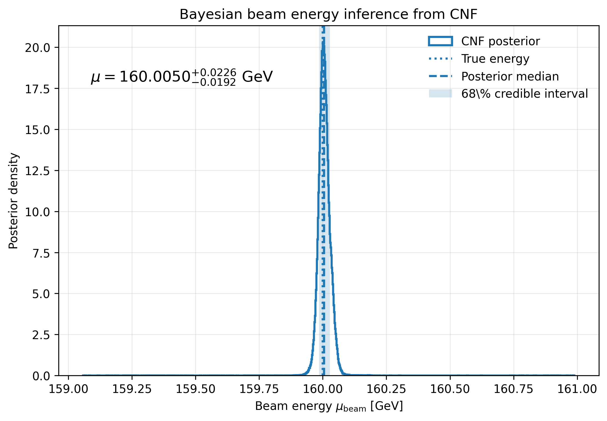
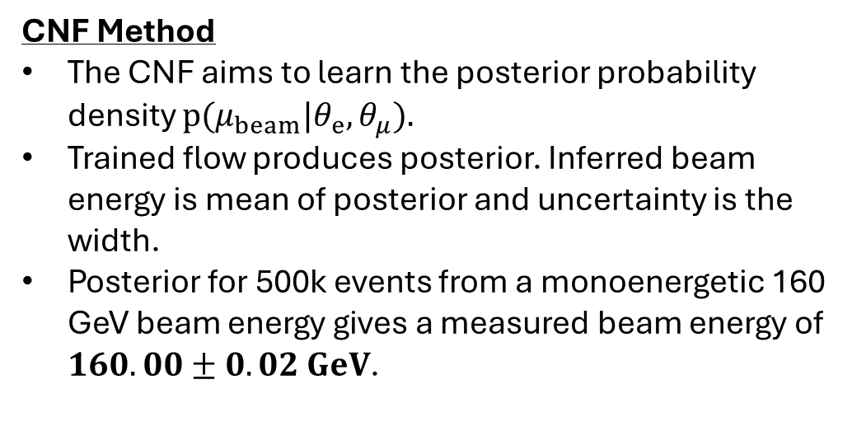
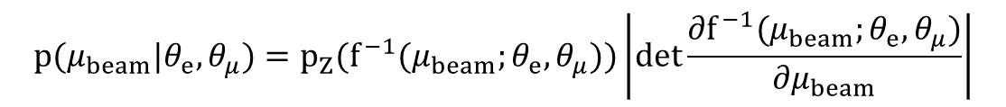
Conditional Normalising Flow (CNF) Method
CNF Method
The CNF aims to learn the posterior probability density $p(μ_{beam}|θ_{e},θ_{μ}).$
Trained flow produces posterior. Inferred beam energy is mean of posterior and uncertainty is the width.
Posterior for 500k events from a monoenergetic 160 GeV beam energy gives a measured beam energy of $160.00±0.02 GeV$.
$$p(μ_{beam}|θ_{e},θ_{μ})=p_{Z}(f^{−1}(μ_{beam};θ_{e},θ_{μ}))\left|det\frac{∂f^{−1}(μ_{beam};θ_{e},θ_{μ})}{∂μ_{beam}}\right|$$

Slide 8
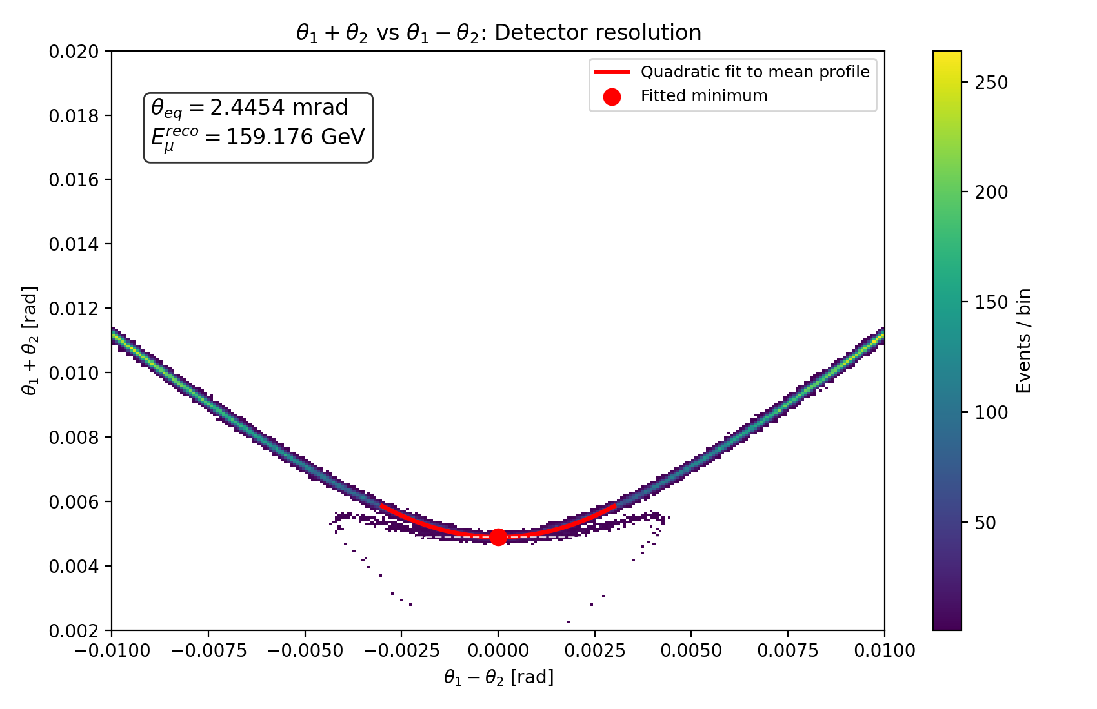
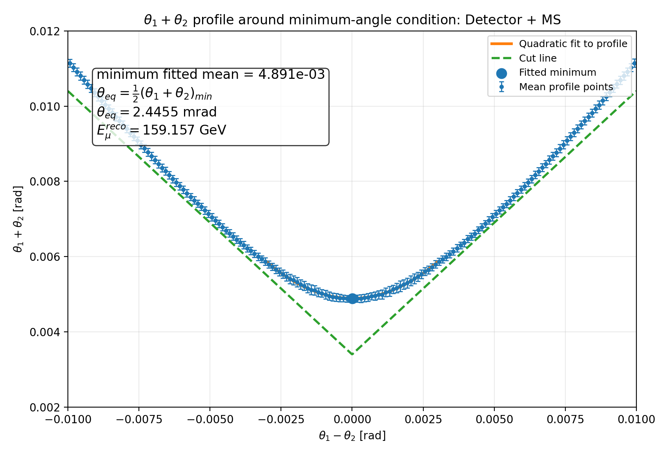
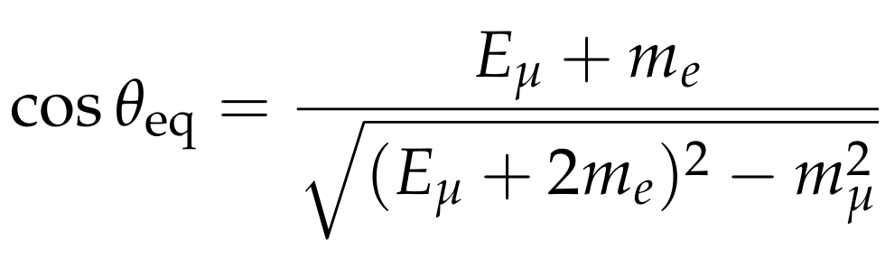
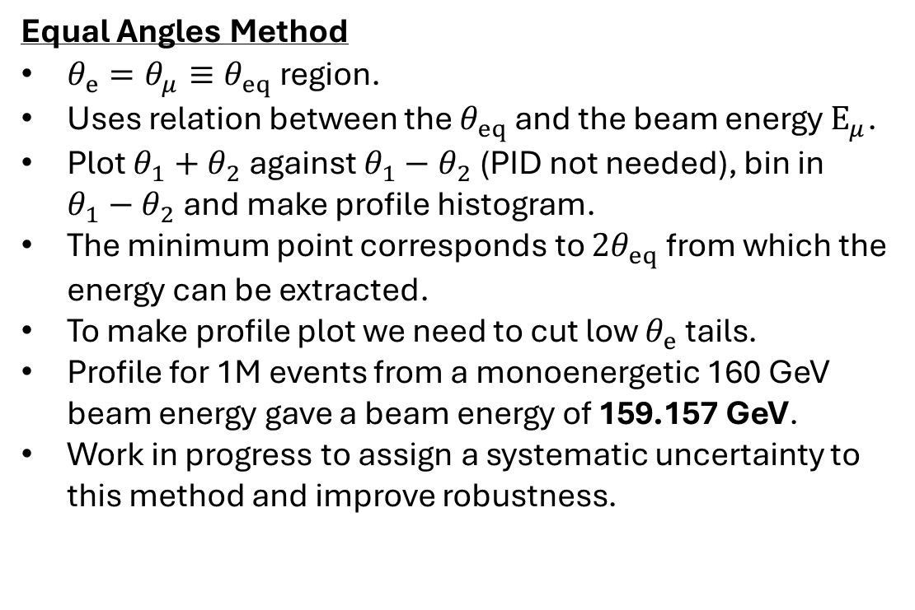
Equal Angles Method
Equal Angles Method
$θ_{e}=θ_{μ}≡θ_{eq}$ region.
Uses relation between the $θ_{eq}$ and the beam energy $E_{μ}$.
Plot $θ_{1}+θ_{2}$ against $θ_{1}−θ_{2}$ (PID not needed), bin in $θ_{1}−θ_{2}$ and make profile histogram.
The minimum point corresponds to ${2θ}_{eq}$ from which the energy can be extracted.
To make profile plot we need to cut low $θ_{e}$ tails.
Profile for 1M events from a monoenergetic 160 GeV beam energy gave a beam energy of 159.157 GeV.
Work in progress to assign a systematic uncertainty to this method and improve robustness.

Slide 9
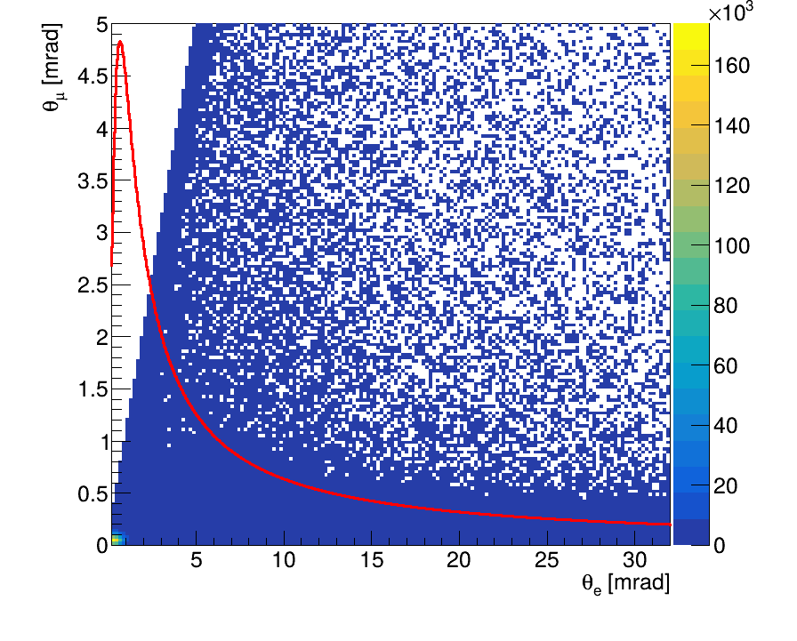
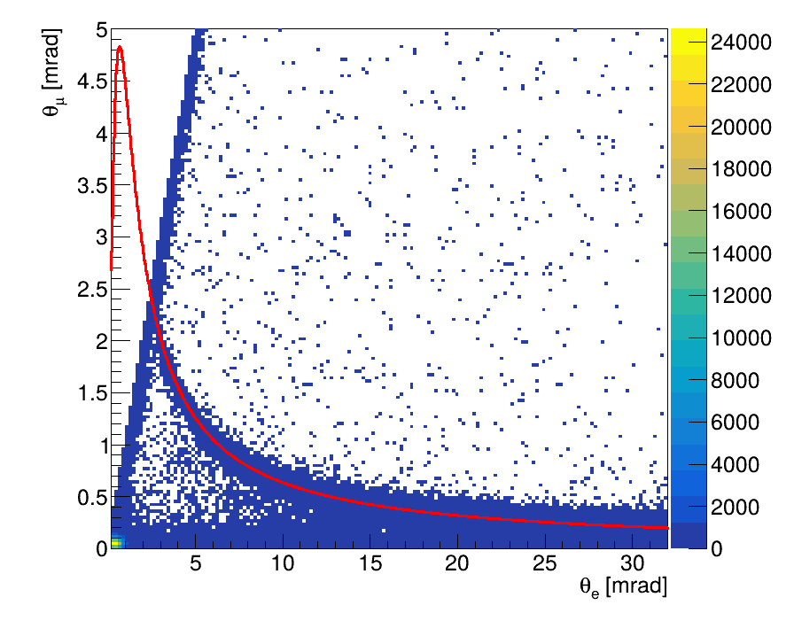
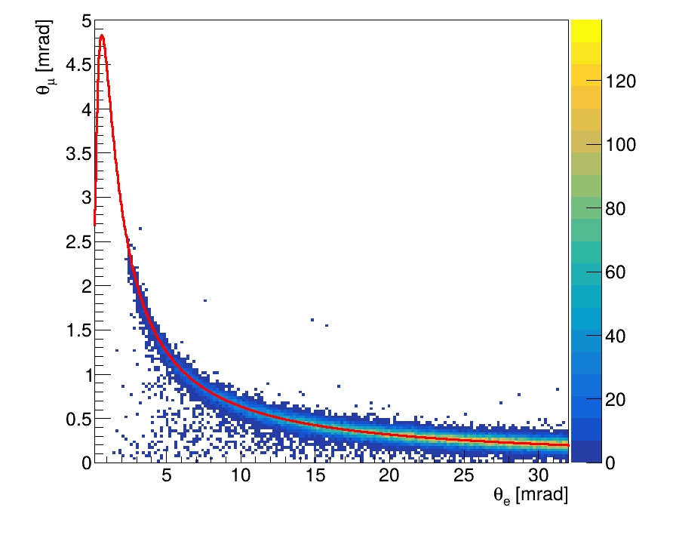
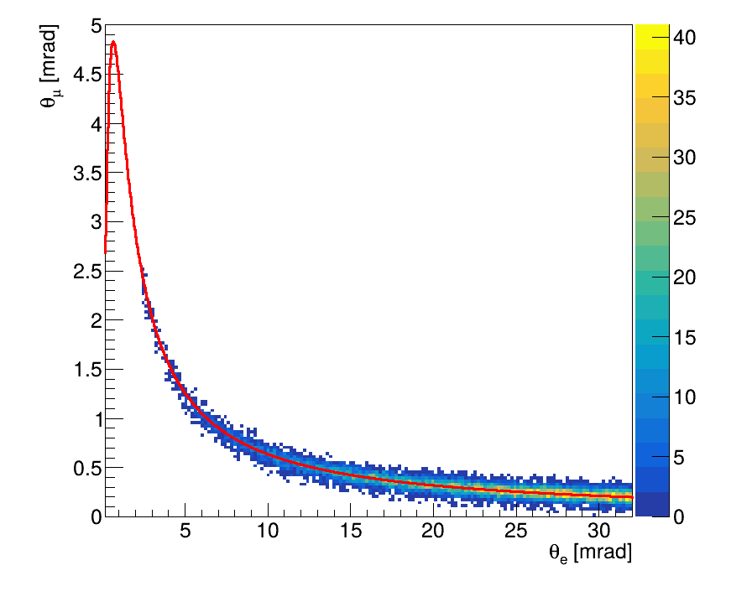
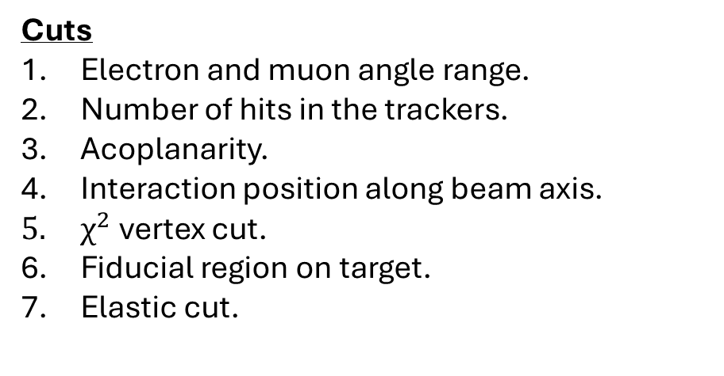
Elastic Event Selection Cuts on 2025 data
Event Selection
Beam energy extraction methods will be applied to data and full MC.
Work has been done on elastic event selection to remove backgrounds.
Cuts
Electron and muon angle range.
Number of hits in the trackers.
Acoplanarity.
Interaction position along beam axis.
$χ^{2}$ vertex cut.
Fiducial region on target.
Elastic cut.

Slide 10
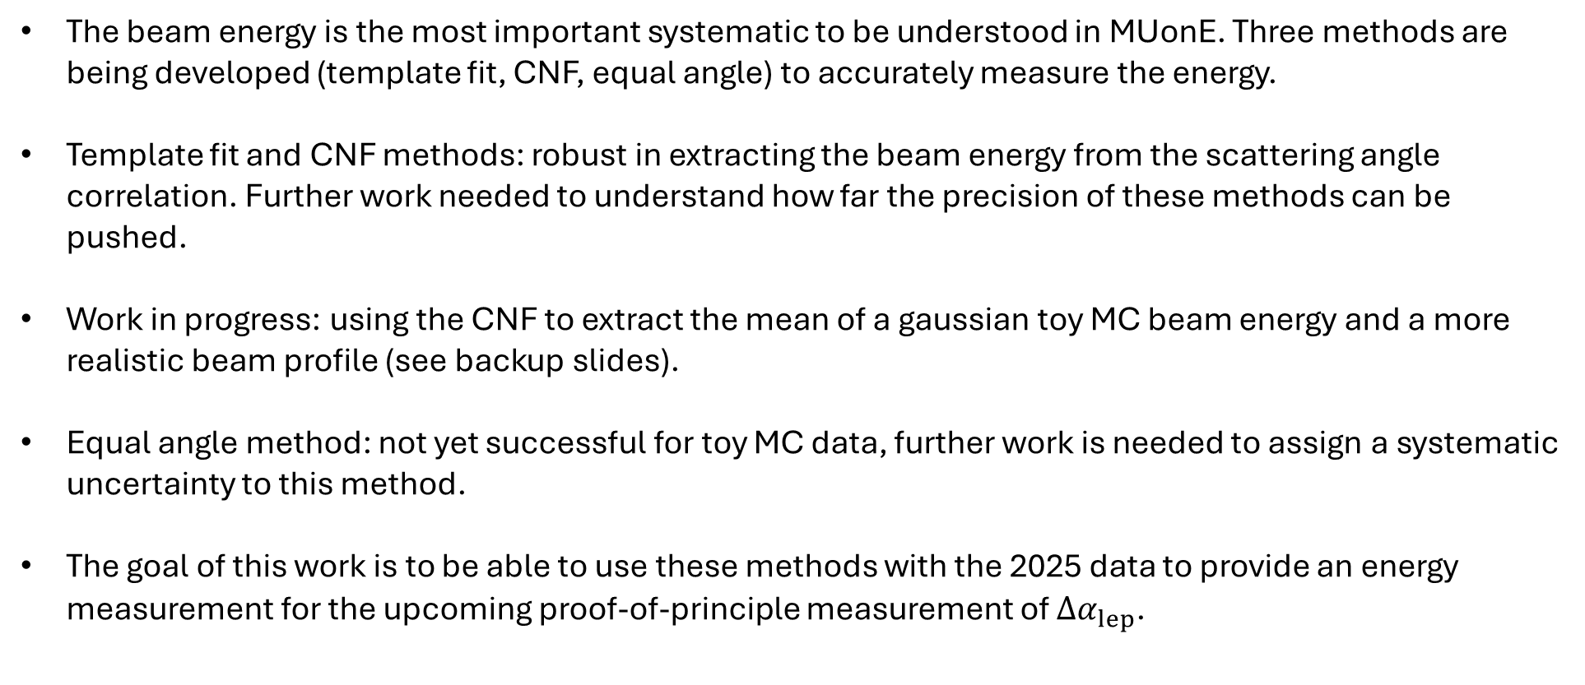
Conclusions and Future Work
The beam energy is the most important systematic to be understood in MUonE. Three methods are being developed (template fit, CNF, equal angle) to accurately measure the energy.
Template fit and CNF methods: robust in extracting the beam energy from the scattering angle correlation. Further work needed to understand how far the precision of these methods can be pushed.
Work in progress: using the CNF to extract the mean of a gaussian toy MC beam energy and a more realistic beam profile (see backup slides).
Equal angle method: not yet successful for toy MC data, further work is needed to assign a systematic uncertainty to this method.
The goal of this work is to be able to use these methods with the 2025 data to provide an energy measurement for the upcoming proof-of-principle measurement of $Δα_{lep}$.

Slide 11
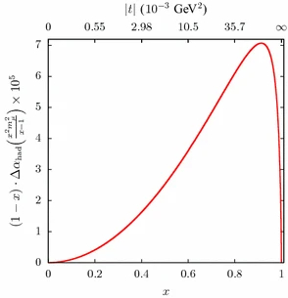
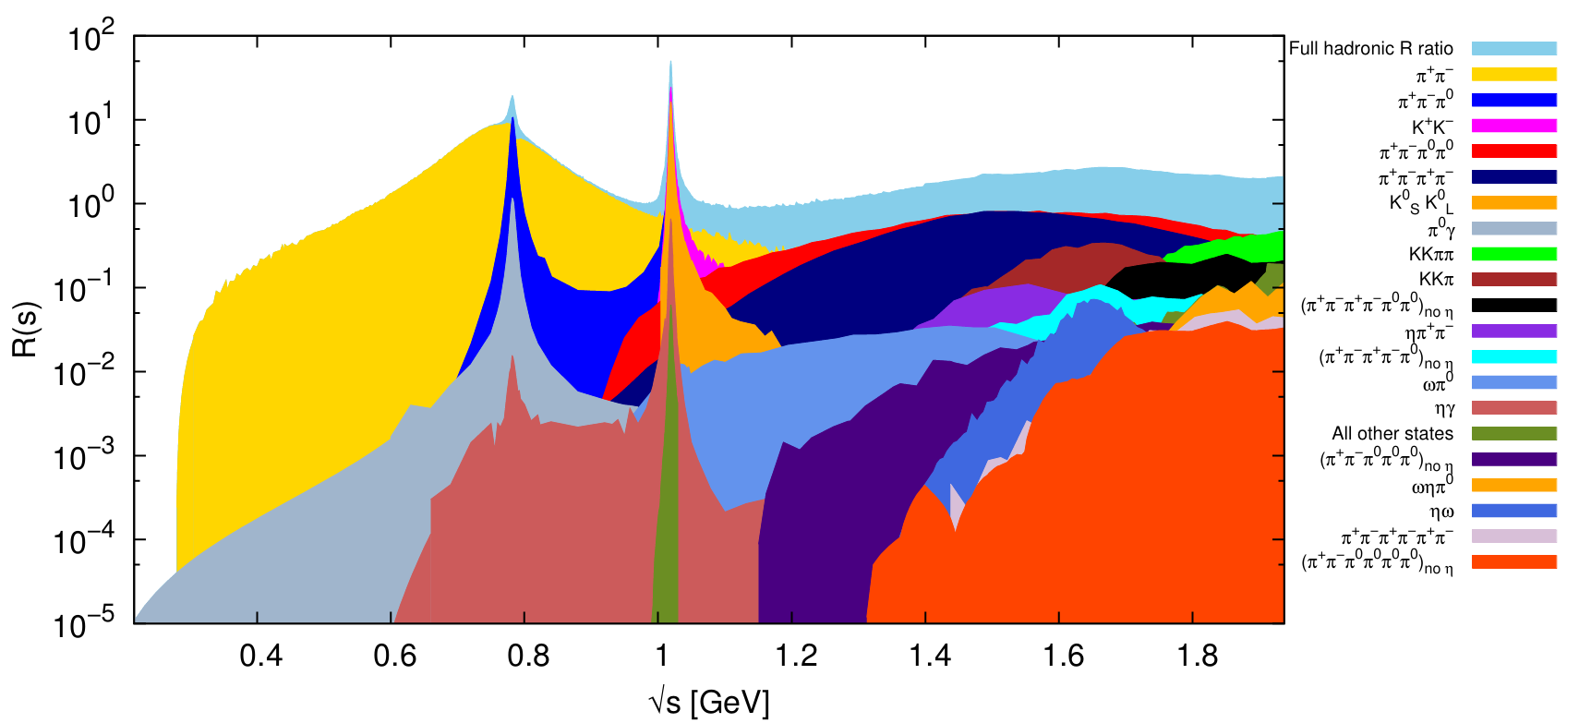
Backup: MUonE Advantage
Difficulty with theory calculations
The R-ratio plots from data-driven methods has resonant peaks.
Resonances are hard to integrate.
Systematics introduced when combining all channels.
MUonE Advantage
Space-like integrand is smooth and free of resonances meaning it is easier to compute than the time-like dispersive integrals.
One measurement.

Slide 12
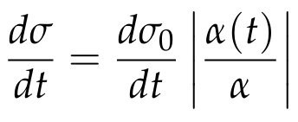
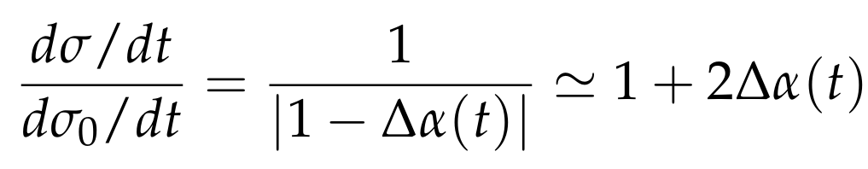
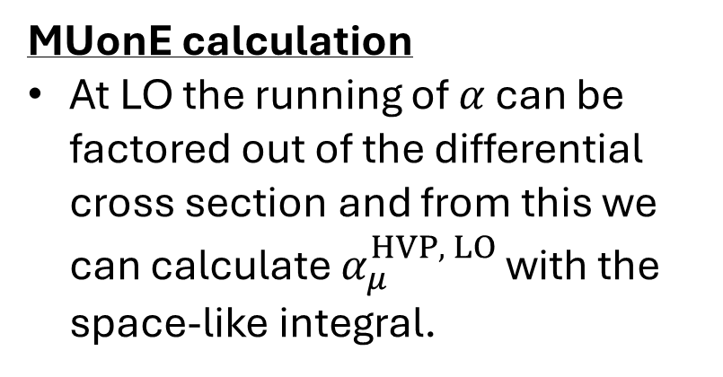
Backup: MUonE Calculation
MUonE calculation
At LO the running of $α$ can be factored out of the differential cross section and from this we can calculate $α_{μ}^{HVP, LO}$ with the space-like integral.

Slide 13
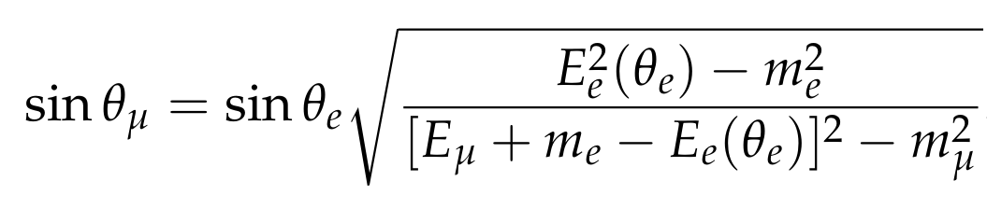
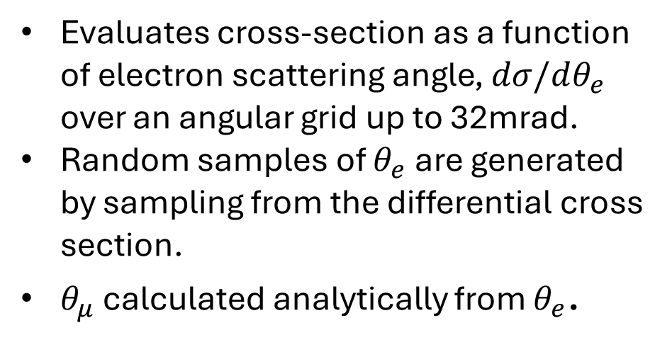
Backup: Toy MC event generation.
Evaluates cross-section as a function of electron scattering angle, $dσ/dθ_{e}$ over an angular grid up to 32mrad.
Random samples of $θ_{e}$ are generated by sampling from the differential cross section.
$θ_{μ}$ calculated analytically from $θ_{e}$.

Slide 14
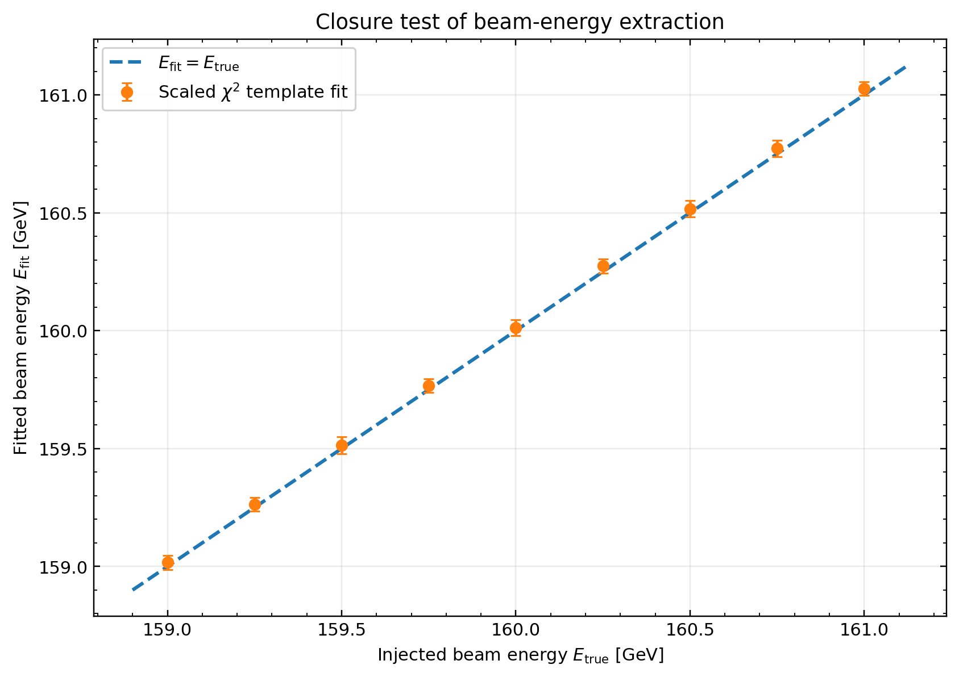
Backup: Template fit further analysis
Results for 9 datasets with true beam energy between 159-161GeV shown to lie on expected diagonal line.
Running 80 different pseudo experiments at the same beam energy resulted in a mean bias of +0.02 GeV and RMS of biases of 0.04 GeV.

Slide 15
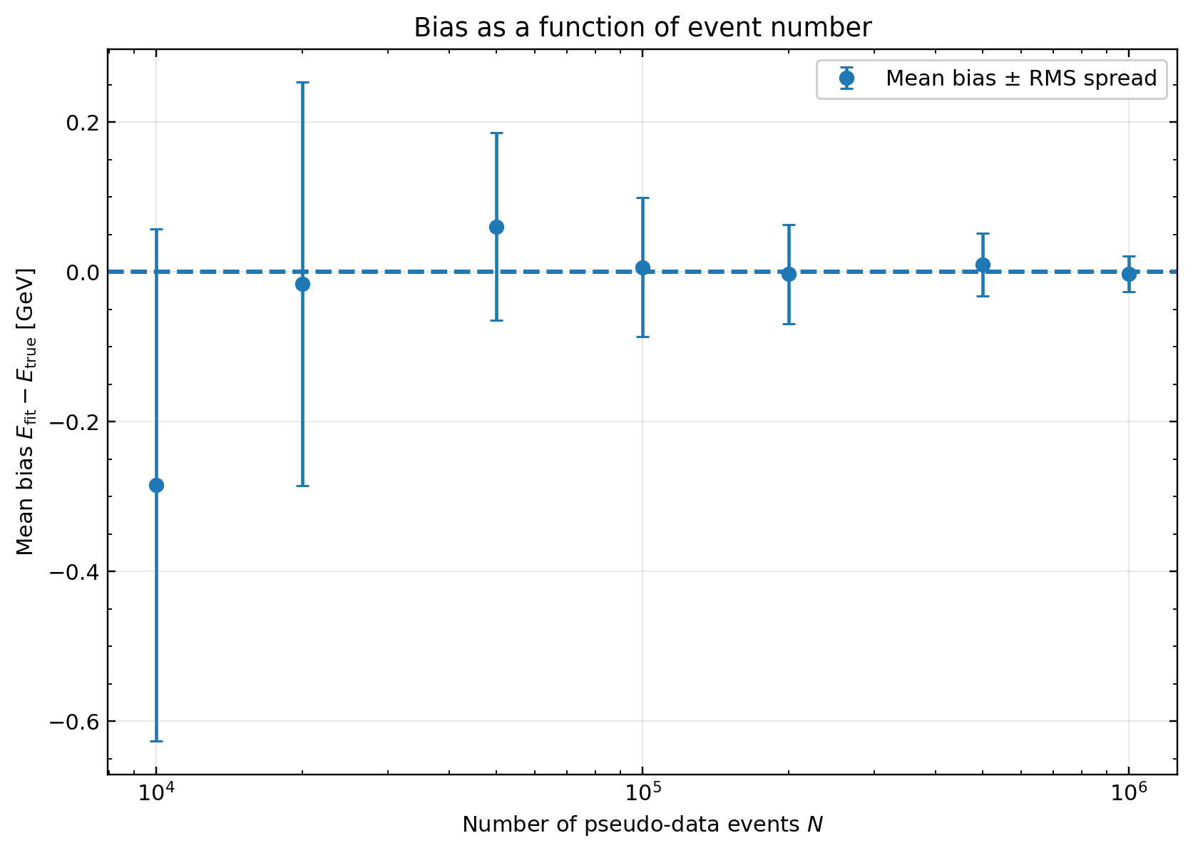
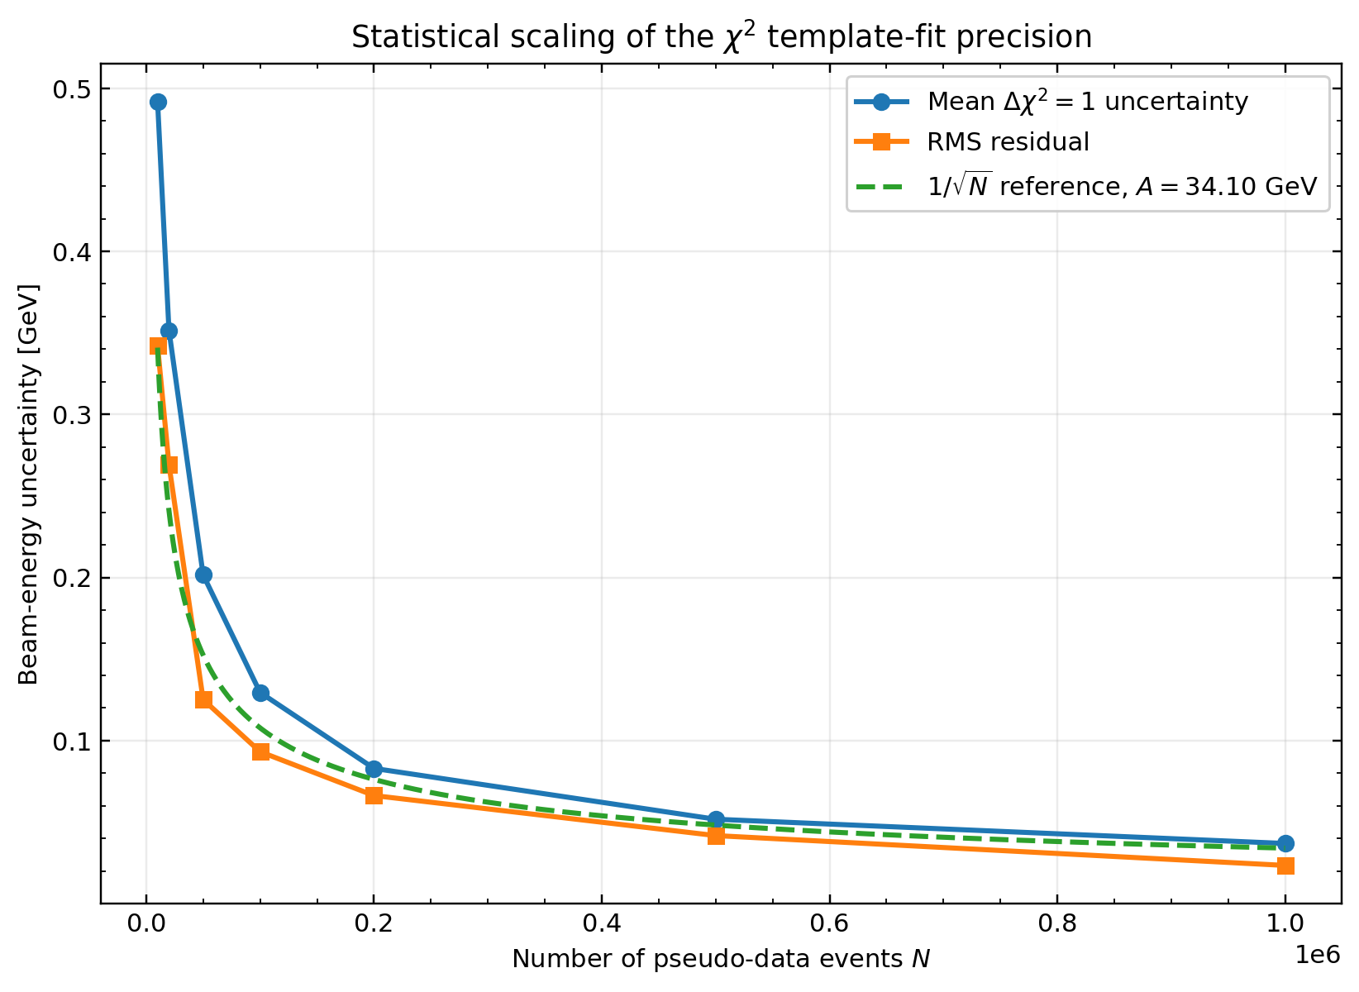
Backup: Template Fit Precision Scaling
Bias vs number of events
Uncertainties vs number of events

Slide 16
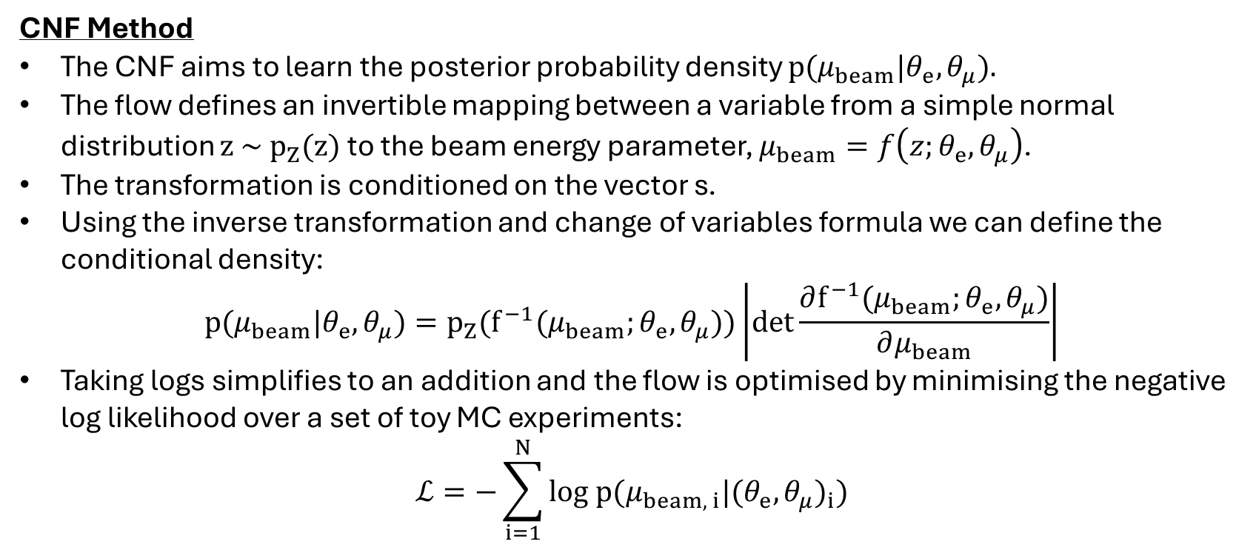
Backup: CNF Method Futher Detail
CNF Method
The CNF aims to learn the posterior probability density $p(μ_{beam}|θ_{e},θ_{μ}).$
The flow defines an invertible mapping between a variable from a simple normal distribution $z \sim p_{Z}(z)$ to the beam energy parameter, $μ_{beam}=f\left(z;θ_{e},θ_{μ}\right)$.
The transformation is conditioned on the vector s.
Using the inverse transformation and change of variables formula we can define the conditional density:
$$p(μ_{beam}|θ_{e},θ_{μ})=p_{Z}(f^{−1}(μ_{beam};θ_{e},θ_{μ}))\left|det\frac{∂f^{−1}(μ_{beam};θ_{e},θ_{μ})}{∂μ_{beam}}\right|$$
Taking logs simplifies to an addition and the flow is optimised by minimising the negative log likelihood over a set of toy MC experiments:
$$ℒ=−\sum_{i=1}^{N}{log p(μ_{beam, i}|{(θ_{e},θ_{μ})}_{i})}$$

Slide 17
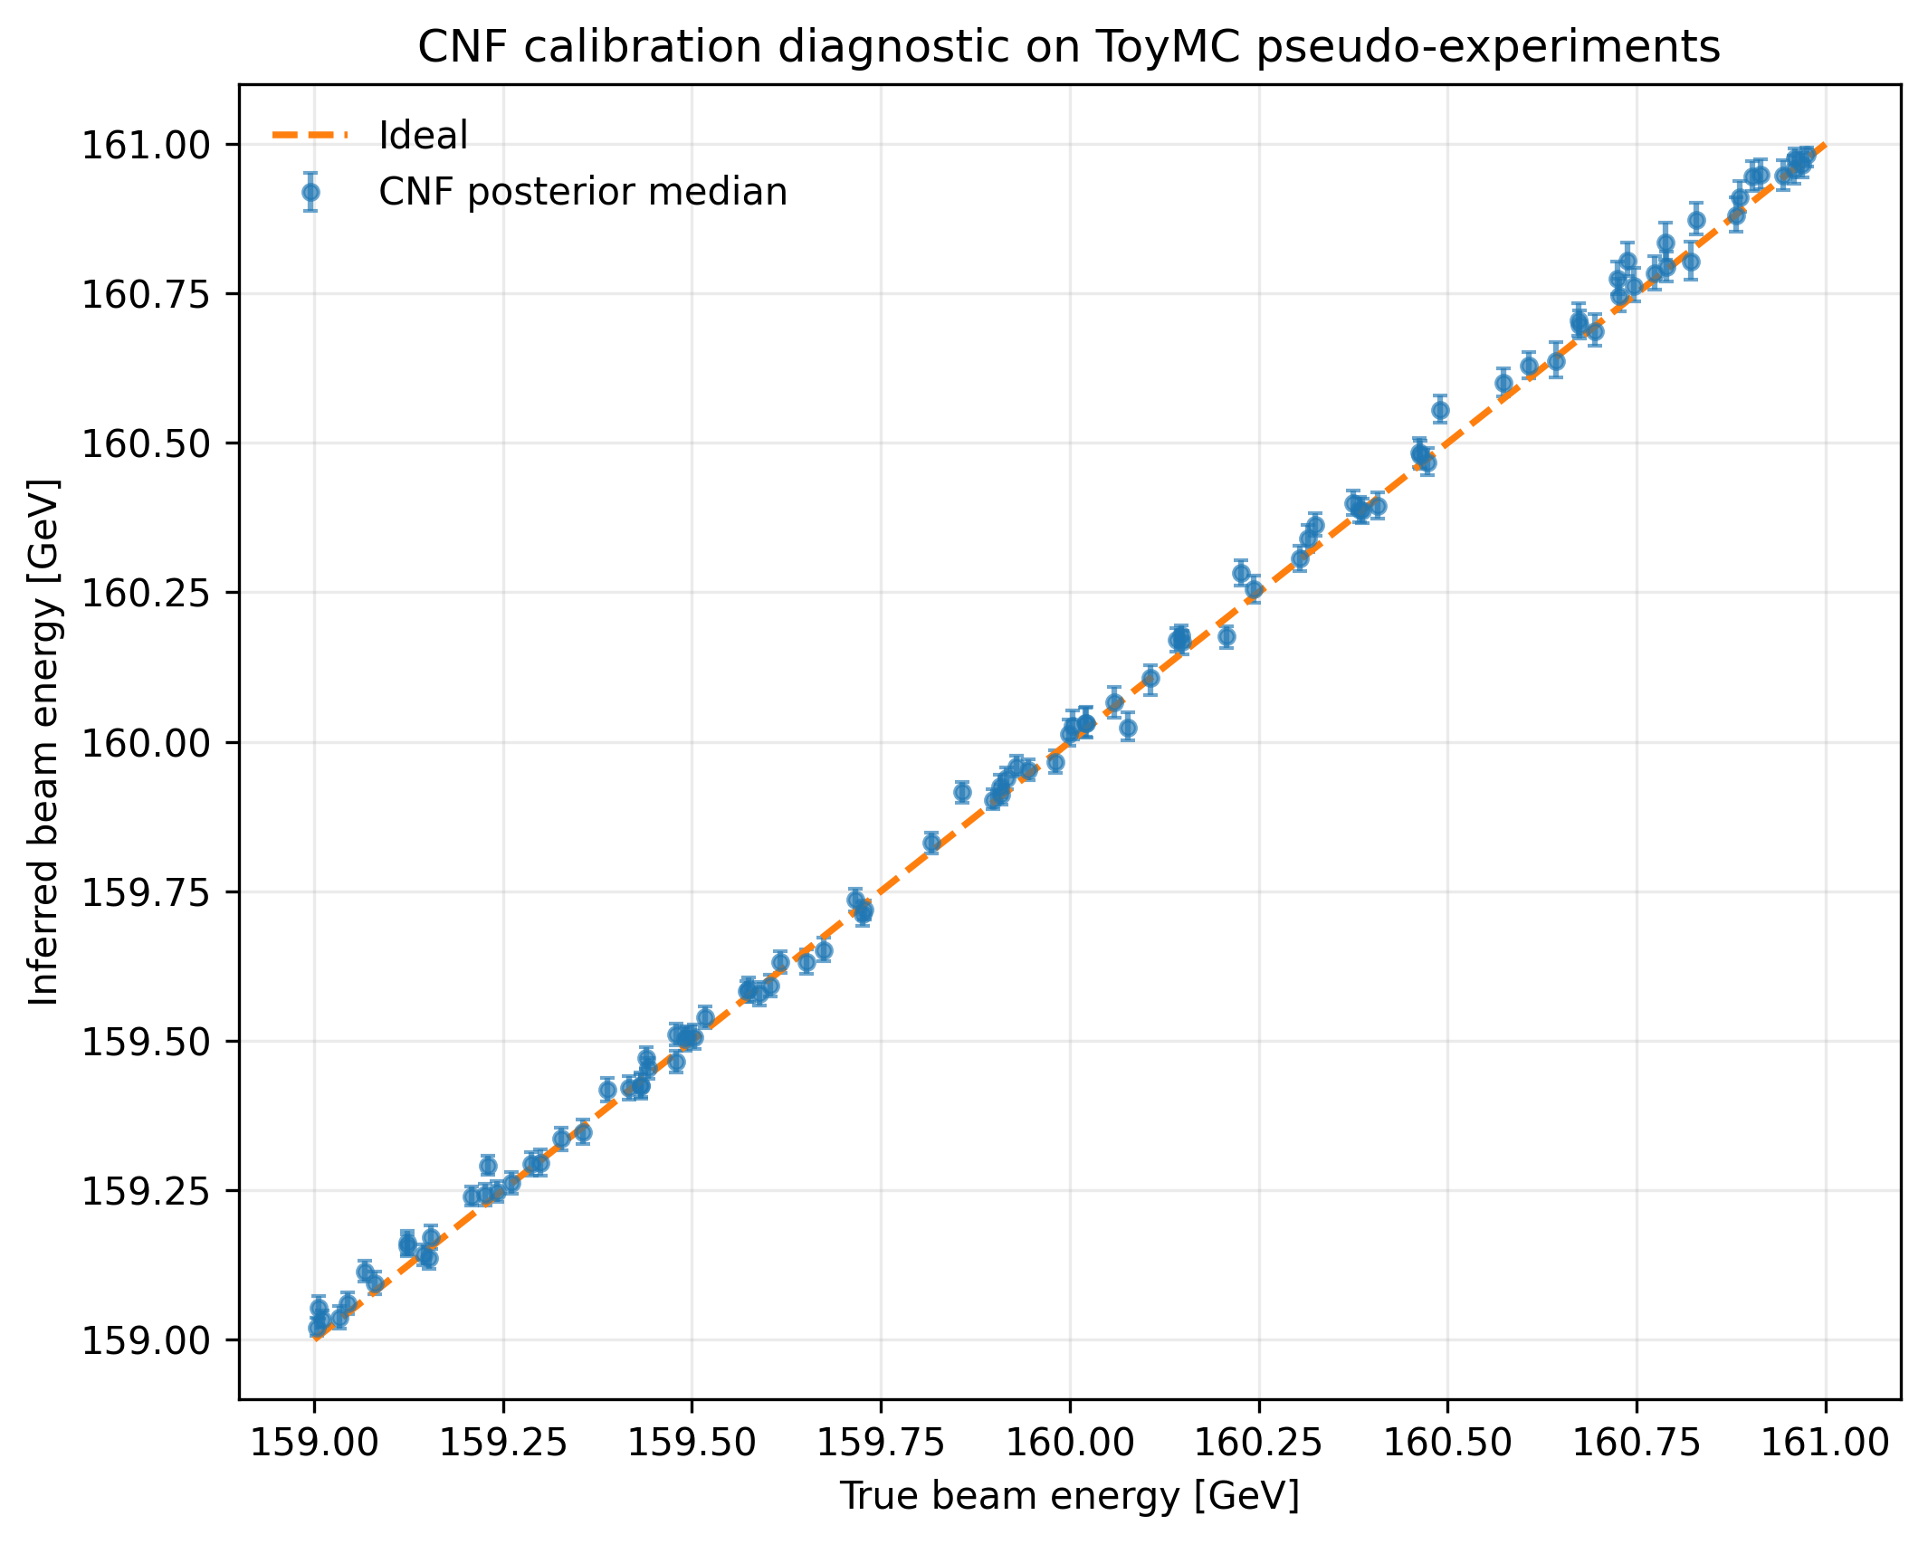
Backup: CNF Method Futher Analysis
Results for many different toy MC experiments with beam energy between 159-161 shown to lie on the expected diagonal line.
Running 100 different experiments at the same beam energy resulted in a mean bias of +3.9MeV and RMS of biases of 0.02 GeV.

Slide 18
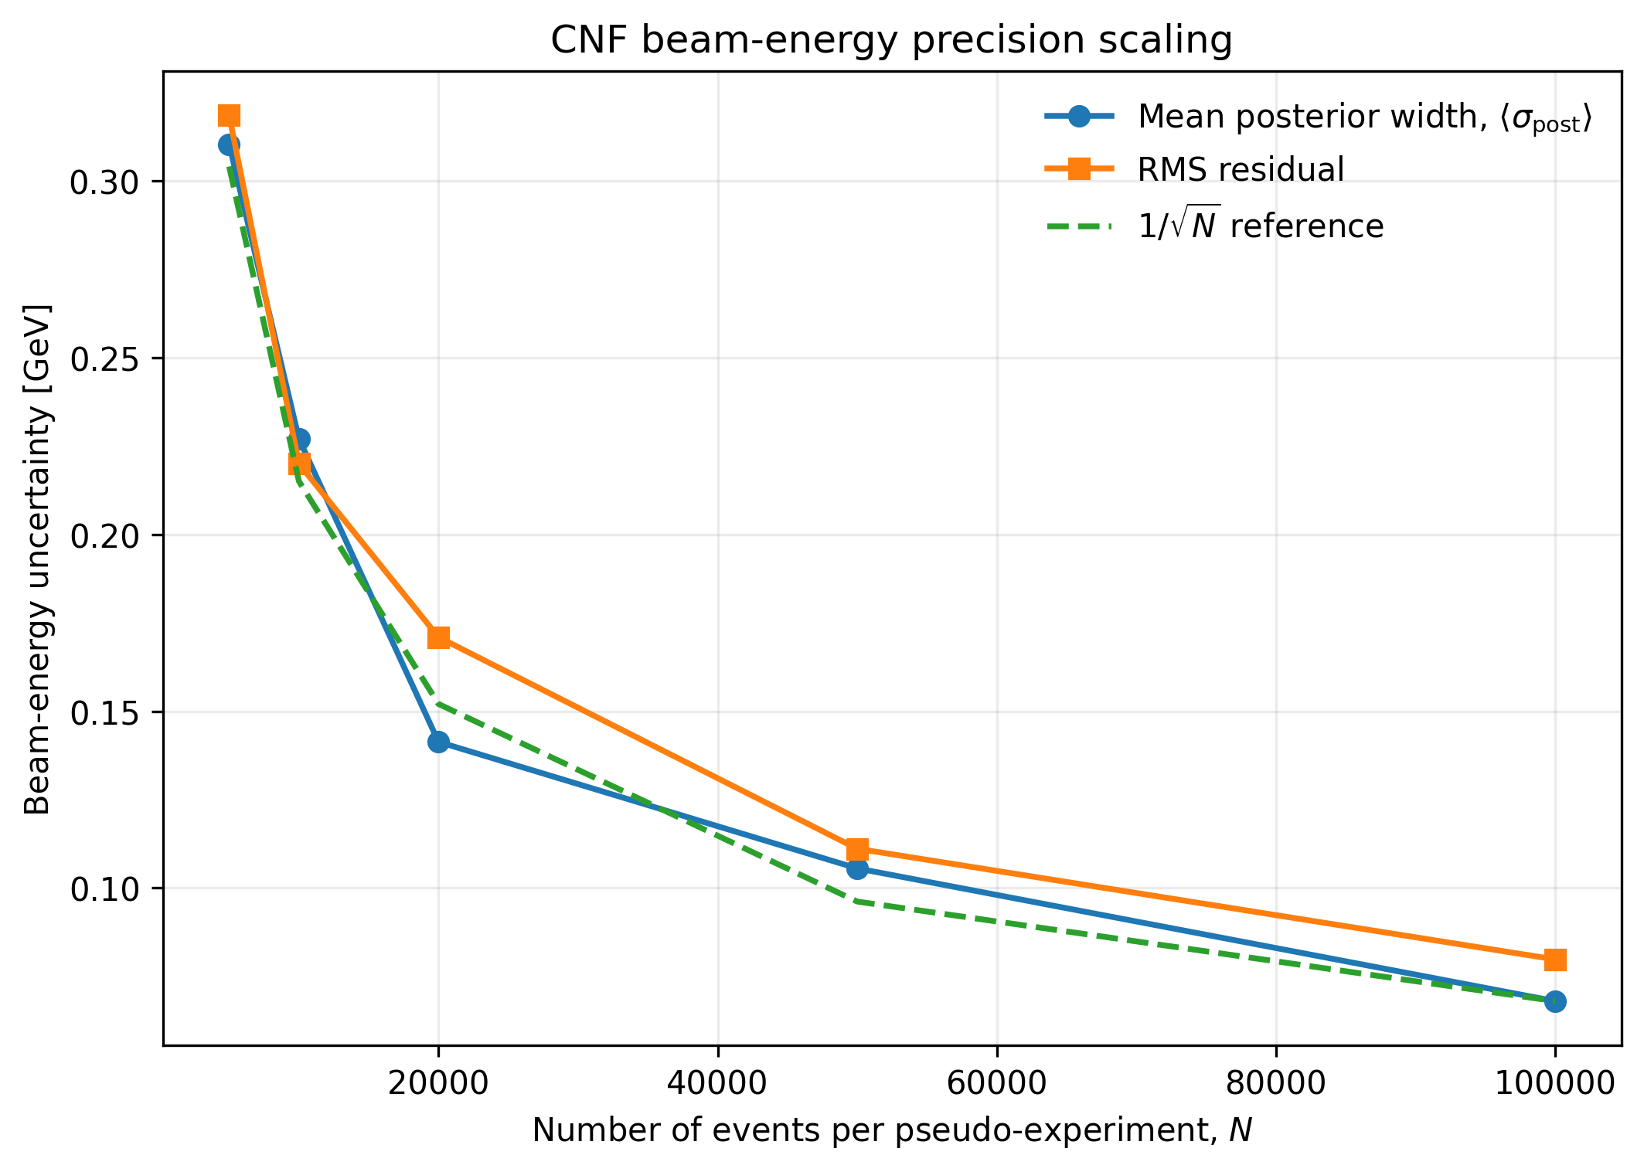
Backup: CNF Precision Scaling
Uncertainties vs number of events

Slide 19
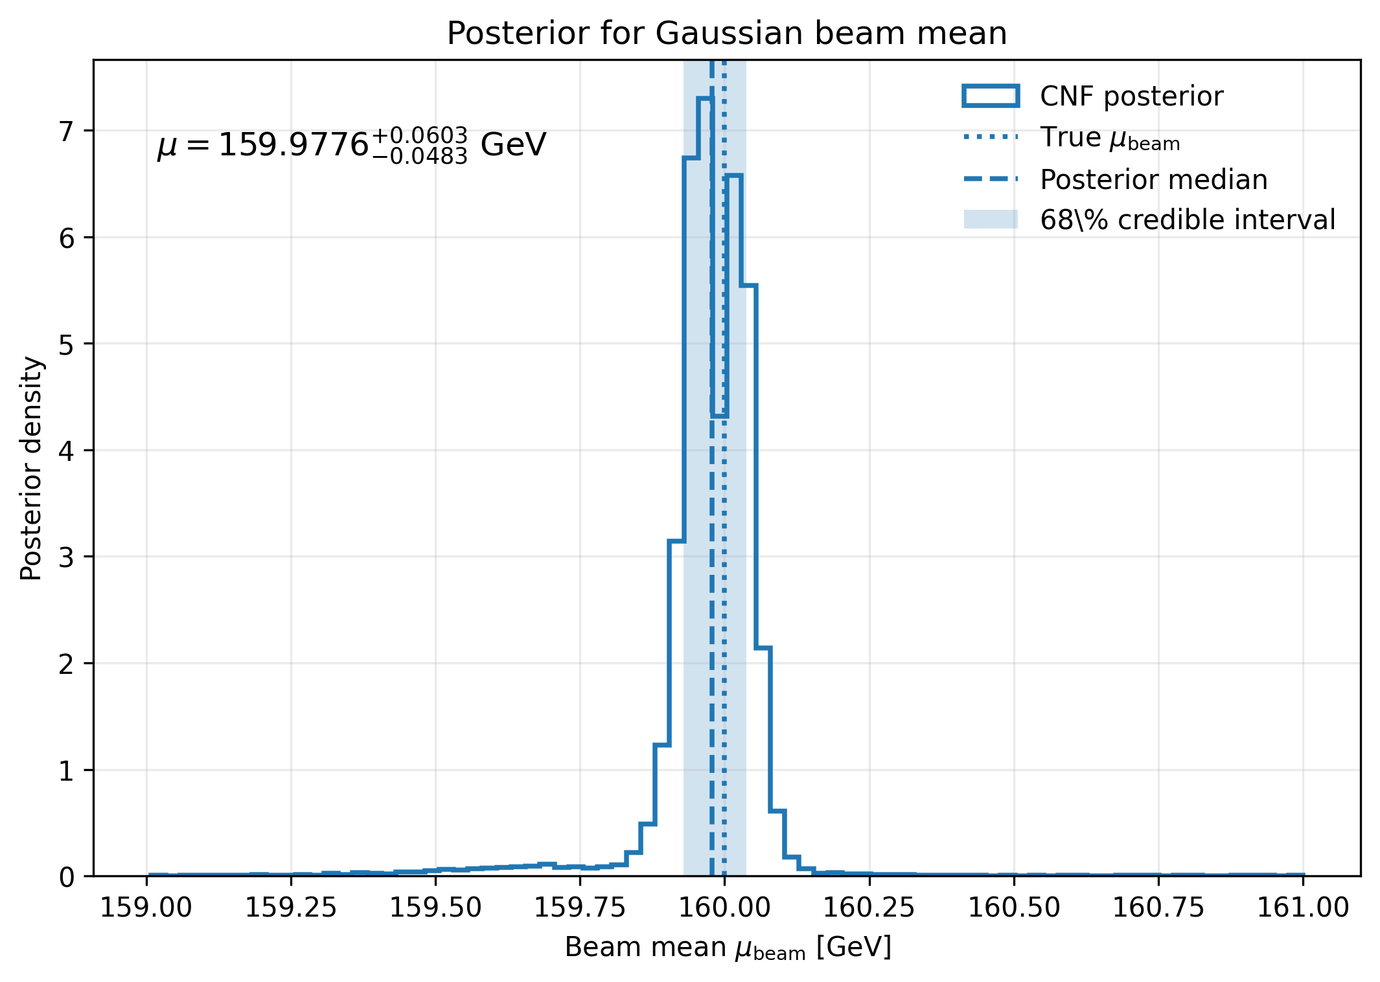
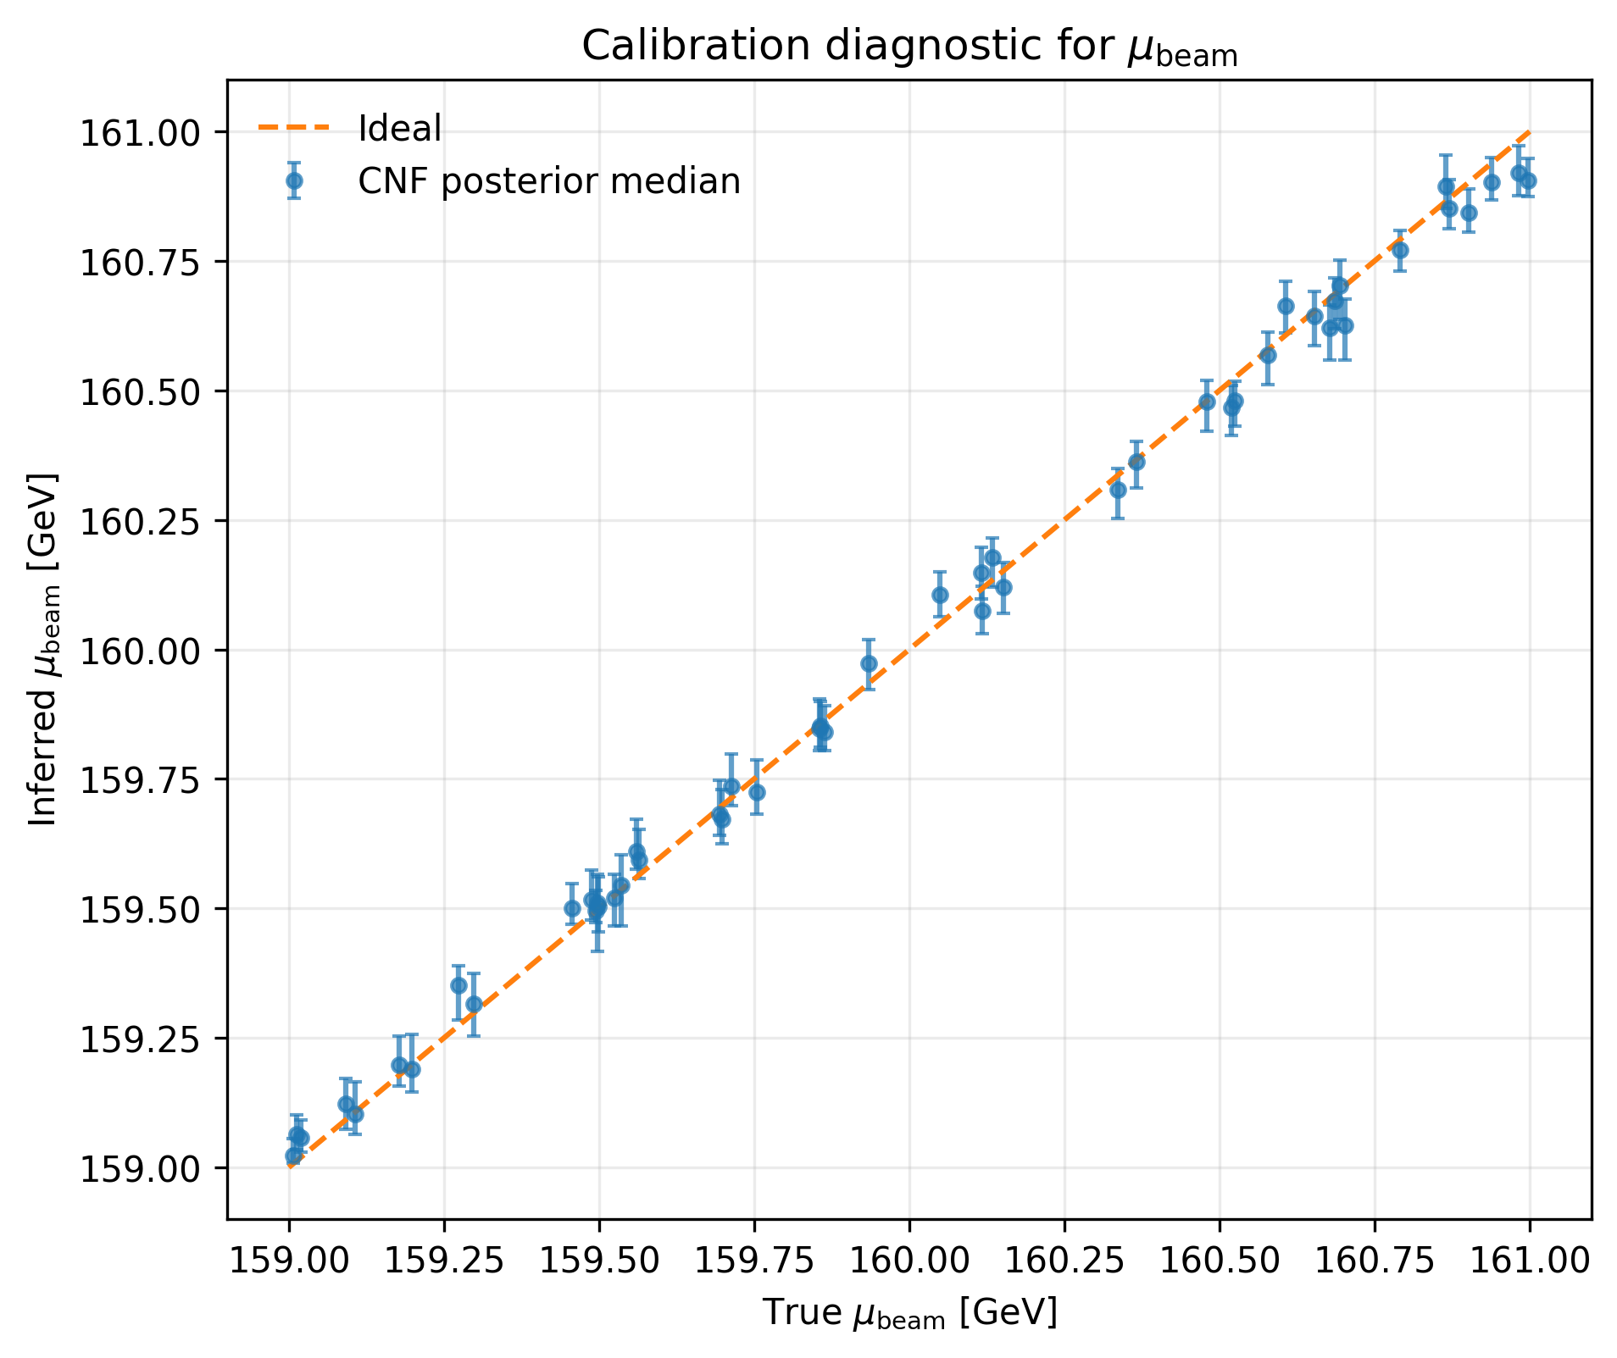
Backup: Gaussian Beam Energy
Posterior for Gaussian beam mean
Beam mean extracted for 159-161 GeV true beam means

Slide 20
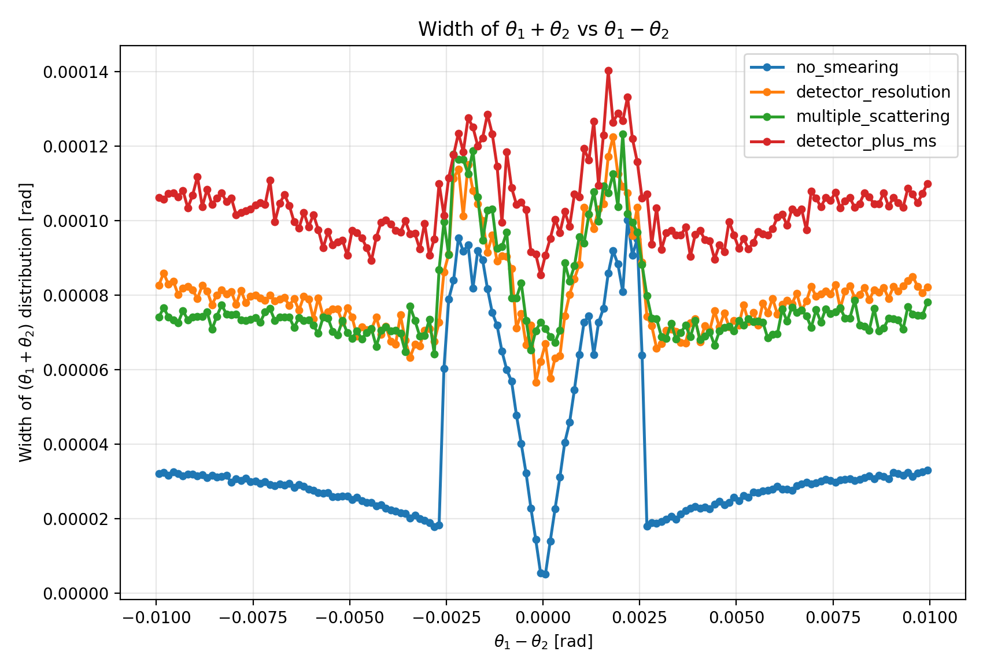
Backup: Equal angle cut inefficiency
Plotting the spread of the value in each bin shows that the tails from the low electron angles increase the spread despite the V-shaped cut.
Further work is needed to reduce the increase in spread in these areas which effects the fit and therefore the inferred beam energy.

